Slide 1
pMRI Image Upload Training
June 16, 2026
Heather Kincaid
Sean Kelly
JPL Informatics Center

Slide 2

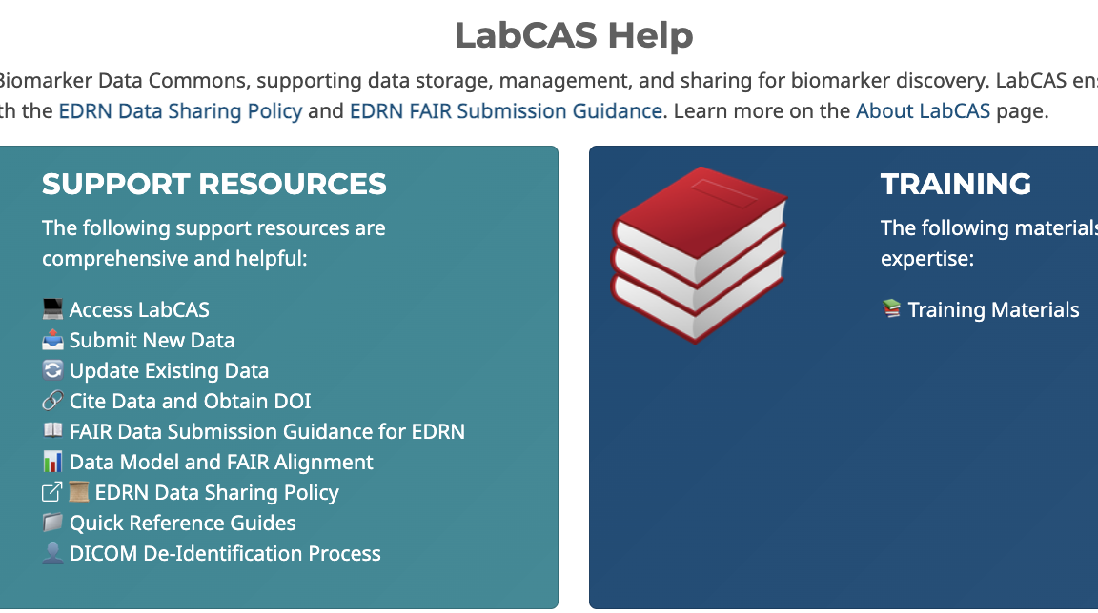
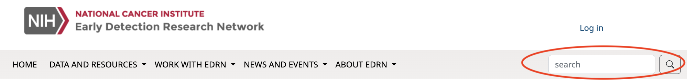
pMRI Upload Documentation: edrn.cancer.gov
description
Standard Operating Procedures
Official guidelines and protocol documentation.
privacy_tip
EDRN DICOM De-identification Process (DRAFT)
Ensure de-identification before data submission.
help_outline LabCAS Quick Reference Guide
• Install Aspera
• Upload Data
• LabCAS Users Guide
• LabCAS DICOM Viewer Guide
book Training Slides
Email JPL Informatics Center at ic-data@jpl.nasa.gov.

Slide 3


Image Uploading Process and Training Outline
Follow P-MRI_MRI Procedure and Image(s) Storage SOP section 1.5 on the EDRN Public Portal
1. Generate EventID
(In VSIMS)
2. De-identify Images
(At your site)
3. Organize Images
(By EventID)
4. Setup Aspera
(One-time setup)
8. Check Compliance
De-id & Tags OK?
7. Validate Images
(JPL Audit)
6. Notify JPL IC
(Transfer Done)
5. Upload Images
(To EDRN Aspera at JPL)
No
Yes
9. Validation Reports
(Back to Site)
10. Publish Images & Notify Site
(To LabCAS)
11. Site Verification
(Log into LabCAS)

Slide 4
Generate VSIMS EventID
Generate an anonymized Event ID in VSIMS prior to transferring data.
The Event ID is generated automatically in VSIMS
  First submission → P-MRI MRI form (Form ID 2508)
  Follow-up → P-MRI MRI Follow-up form (Form ID 2519)

Slide 5

2. EDRN DICOM De-identification Process
Study sites will transfer de-identified data to NASA Jet Propulsion Laboratory Informatics Center (JPL IC) for archiving in DICOM format.
Identifiers
Set Patient Name to "ANONYMOUS"; modify Patient ID and Institution Name to "ANONYMOUS".
Demographics
Retain sex, weight; cap age at 090Y for patients >89.
Dates
Adjust to preserve longitudinal intervals.
Metadata/Tags
Remove private tags and clean free-text fields.
Pixel Data
Mask or remove burned-in PHI.
Device Serial Number
Remove/replace Device Serial Number.
description DRAFT EDRN DICOM De-identification Process
Compliant with HIPAA Safe Harbor and NCI TCIA standards to ensure PHI-free images.

Slide 6
3. Images Organized by EventID
To prepare images for upload, you must organize files into a directory named after the corresponding Event ID.
Directory Structure
Name the root folder using the VSIMS Event ID (e.g., 1234567).
📁 1234567/
📄 Image0001.dcm
📄 Image0002.dcm
📄 Image0003.dcm
Submission Requirements
File Formats: Submit individually or as a .zip archive labeled with the Event ID. JPL will handle extraction.
CD-ROMs: Upload entire contents if placed within a parent folder labeled with the Event ID.

Slide 7
4. Setup IBM Aspera
One-time setup

Slide 8
Request an IBM Aspera Account
menu_book LabCAS Quick Reference Guide
1. Contact JPL IC
Email JPL Informatics Center at ic-data@jpl.nasa.gov.
Provide the following details:
Full Name
Institution
Email address you would like associated with your Aspera login.
Project name (e.g., "EDRN PMRI")
2. Accept Invitation
Find the email invitation from IBM and click the "Accept" button.
This will direct you to the EDRN Aspera login page:
https://edrn-labcas.ibmaspera.com/
Note: Check your spam or junk folder if you don't see the invitation.
email

Slide 9
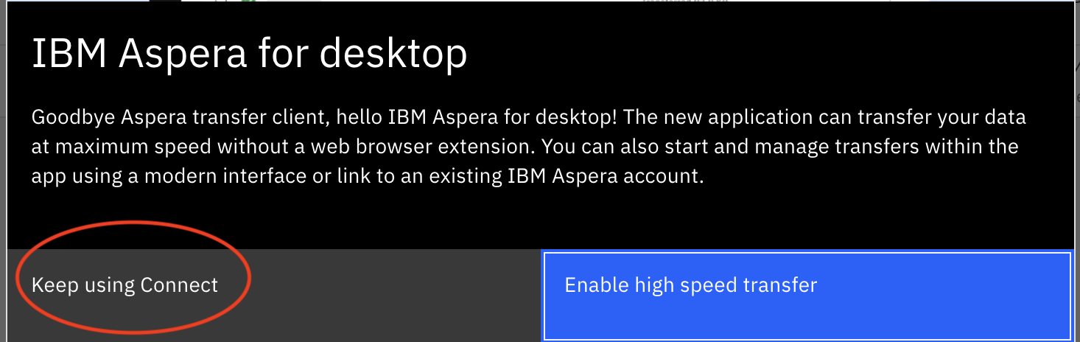
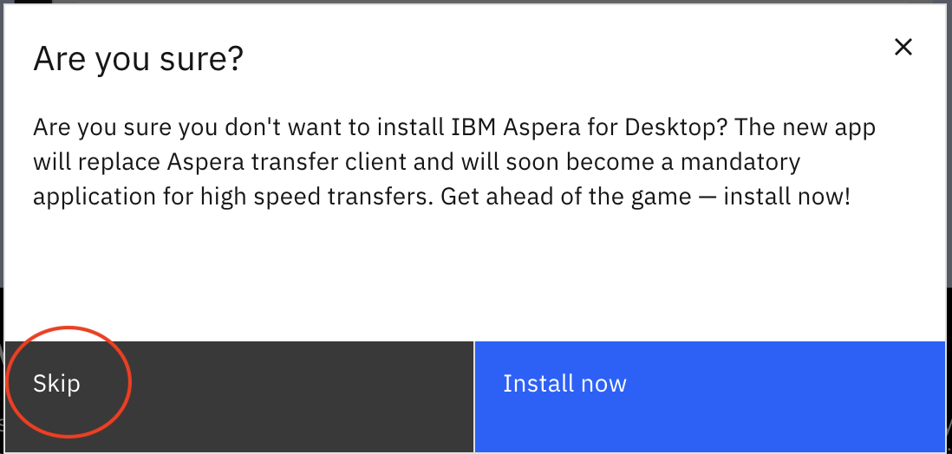
Install Aspera Connect
Steps to Install Aspera Connect
Do not install the Desktop version. If prompted to install the Desktop version, click Skip.
menu_book LabCAS Quick Reference Guide

Slide 10

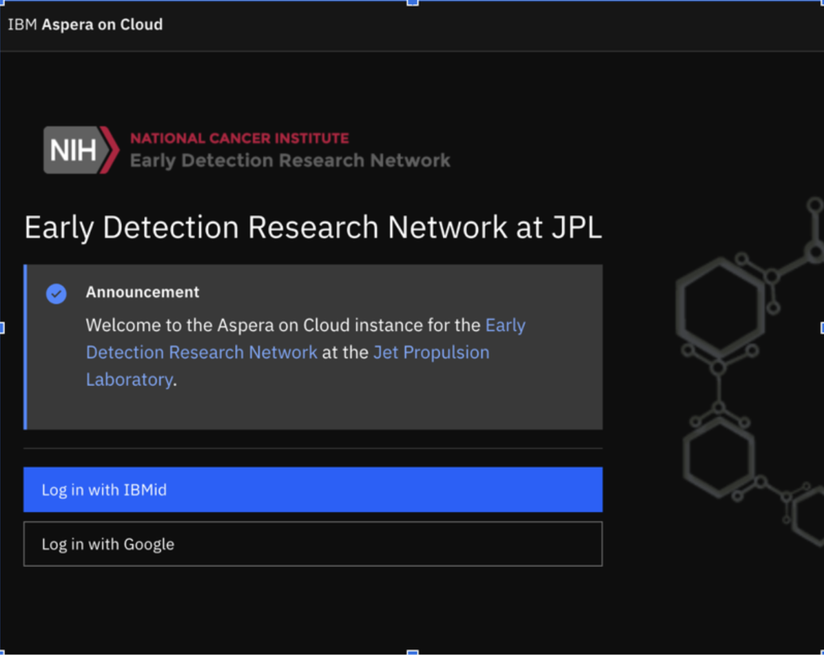
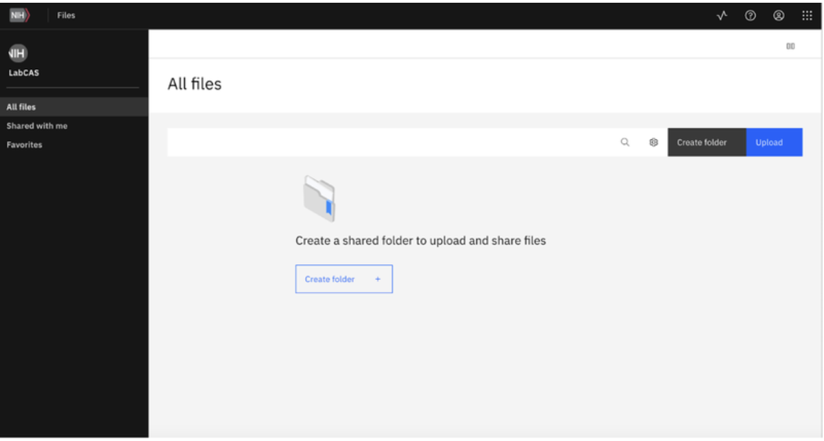
5. Upload Images & 6. Notify JPL
menu_book LabCAS Quick Reference Guide
Step 1: Login to EDRN Aspera
Sign in using your IBMid (your email address) at EDRN Aspera.
Step 2: Create Folder & Upload
Create a folder in Aspera with the Date (e.g., 2026-06-16) to track site uploads. Drag and drop your files organized by EventID.
Step 3: Notify after Completion
Data upload complete:
email Email the JPL Informatics Center that your data transfer is complete.

Slide 11




7. Validate Images and 8. Check Compliance
DRAFT
Validation criteria and workflows are currently in draft. Once reviewed by the EDRN DICOM Subgroup and approved, the SOP and EDRN Portal will be updated.
fact_check Automated Validation Check
Validation runs on existing and new uploads. Sites receive reports for any issues found or failures during upload.
Ensuring Data Accuracy & Compliance
PASS
check_circle
cloud_upload
fact_check
cancel
visibility Manual Site Review
Sites review flagged issues in reports and indicate a final status for each identified item.
Site Uploads Images
JPL Verification
NOT PASS
Review and Reconcile Issues
Local Validation Tool (In Development)
JPL is developing a local application to allow users to perform validation checks on their own hardware prior to uploading.
sync_alt Final Site Reconciliation
JPL and sites collaborate to remediate issues, delete non-compliant files, and reupload corrected images.

Slide 12
9. Validation Reports
Two possible reports from the validation process
assignmentPossible PHI/PII Report
Identifies potential PHI/PII values in the DICOM tag metadata or burned in to the image. Sites must review each flagged value and specify if it is actual PHI/PII, a false positive, or requires further action.
assignmentEDRN Core Validation Issues Report
Identifies possible technical or metadata validation issues based on the EDRN Core DICOM validation rules. This may include missing required tags, corrupted files, or other validation errors.

Slide 13
9. JPL Publish Images to LabCAS and 10. Notify Site
All validation criteria met or outstanding issues fully resolved.
cloud_done Publication to LabCAS
JPL publishes the finalized image datasets directly to LabCAS.
email Site Notification
JPL notifies the site via email to review LabCAS and verify upload completeness.

Slide 14
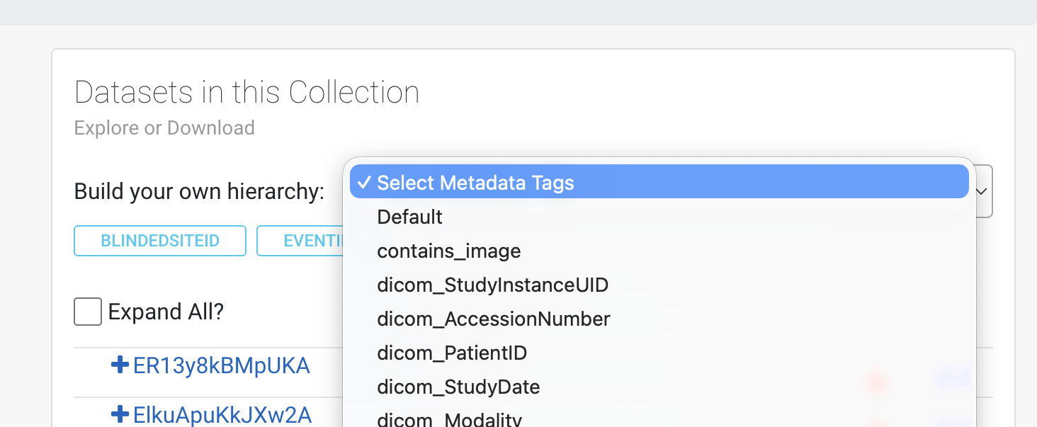
11. Site Verification in LabCAS
Review Process
Access LabCAS: Log in with VSIMS credentials. If needed, apply for an EDRN Account.
Navigate to the Prostate MRI collection.
Verify all uploaded EventIDs are present.
Confirm Images by spot-checking sample images for each EventID.
email Notify JPL IC that the images have been verified.
💡 Tip: Grouping for Easier Review
In Dataset panel, select "Build your own hierarchy."
Select metadata tags: Blinded SiteID, EventID.
LabCAS Portal: https://edrn-labcas.jpl.nasa.gov/labcas-ui/
menu_book LabCAS Quick Reference Guide

