Slide 1
EDRN Biomarker Session:
Challenges and Decision Points in Biomarker Discovery and Validation.
Guillermo Marquez, MD, PhD
Cecilia CS Yeung, MD
March 4,2026

Slide 2
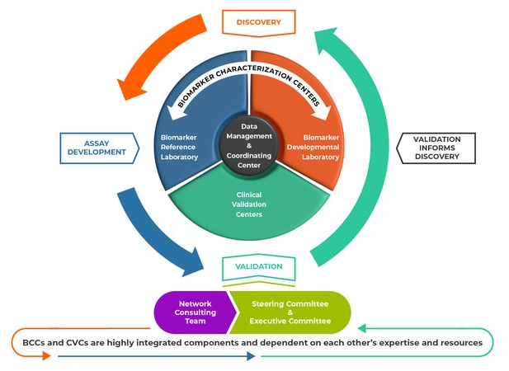
The mission of the EDRN:
1) discover, develop and validate biomarkers and imaging methods to detect early stage cancers and assess risk for developing cancer
2) translate these biomarkers and imaging methods into clinical tests.
Notes:
The mission of the Early Detection Research Network (EDRN) is to discover, develop and validate biomarkers and imaging methods to detect early stage cancers and to assess risk for developing cancer, and to translate these biomarkers and imaging methods into clinical tests. A consortium of more than 300 investigators at academic institutions and in the private sector are working collaboratively to bring biomarkers and imaging methods to clinical use.
The major components of the EDRN (Biomarker Characterization Centers, Biomarker Developmental Laboratories, Biomarker Reference Laboratories, Clinical Validation Centers, and Data Management and Coordinating Center) have distinct but complementary roles and work synergistically to facilitate the discovery, development, and validation of cancer biomarkers.
Biomarker Characterization Centers (BCCs): BCCs characterize new biomarkers or refine existing biomarkers. There are two kinds of BCCs:
Biomarker Developmental Laboratories (BDLs): BDLs discover and develop new biomarkers or refine existing biomarkers. They are the primary source of new biomarkers or panels of biomarkers on which the EDRN conducts validation trials. They also develop assays to detect candidate biomarkers and conduct pre-validation studies.
Biomarker Reference Laboratories (BRLs): The primary role of the BRLs is to conduct assays for EDRN validation trials. The assays are performed on blinded biospecimens to minimize bias in the analysis and independently verify the assay performance. BRLs also serve as the primary resource for analytical validation of biomarkers, technological development, standardization, assay refinement and quality control.
Clinical Validation Centers (CVCs): The primary role of the CVCs is to conduct validation trials on biomarkers discovered/developed by both EDRN and non-EDRN investigators. CVCs also provide high-quality, well-annotated biospecimens to the BDLs for biomarker discovery, development and pre-validation studies. The use of biospecimens collected using rigorous standard operating procedures helps minimize false discoveries.
Data Management and Coordinating Center (DMCC): One of the major roles of the DMCC is to work with the CVCs to conduct biomarker validation trials. The DMCC assists with protocol design, monitors the trial, and maintains the data and biospecimen tracking system. The DMCC is responsible for analyzing the results of the trials, thereby reducing bias as they are independent from the laboratories that discovered the biomarkers. The DMCC provides statistical advice to the BDLs, develops theoretical and applied approaches for simultaneous analysis of multiple markers, and collaborates with the EDRN Informatics Center.
EDRN Steering Committee: The EDRN Steering Committee is composed of all the EDRN Principal Investigators (PIs) and is responsible for overseeing the activities of the EDRN and setting priorities. The Steering Committee meets in person twice a year. The Executive Committee, which consists of the EDRN Chair and Co-Chair and the elected Chairs of the Collaborative Groups, have monthly conference calls.
In addition to the formal structures, the network encourages cross-collaboration through several channels:
Collaborative Groups: Within the EDRN there are four organ-specific Collaborative Groups—Breast and Gynecologic Cancers, Colorectal and Other Gastrointestinal Cancers, Lung and Upper Aerodigestive Cancers, and Prostate and Other Urologic Cancers.
All EDRN PIs, co-investigators and many Associate Members are members of one or more of these collaborative groups. They have monthly conference calls and meet twice a year in person to update each other on their progress and to develop collaborative projects that use the resources of all the investigators. These projects frequently involve comparing the performance of biomarkers from different laboratories in a common set of biospecimens and when appropriate combining these biomarkers to create a panel. These projects are supported by the grantees' set-aside funds, which are restricted for this purpose.
Interagency Agreements: The EDRN has collaborations with four other federal agencies: the National Aeronautics and Space Administration's Jet Propulsion Laboratory (JPL), which supports EDRN informatics and data science; Pacific Northwest National Laboratory (PNNL), which supports the development of proteomic-based assays; the Department of Defense Center for Prostate Disease Research (CPDR), which provides valuable biospecimens collected from subjects with prostatic diseases with high representation of African Americans; and the National Institute of Standards and Technology (NIST), which assists in the development of standards and references.

Slide 3
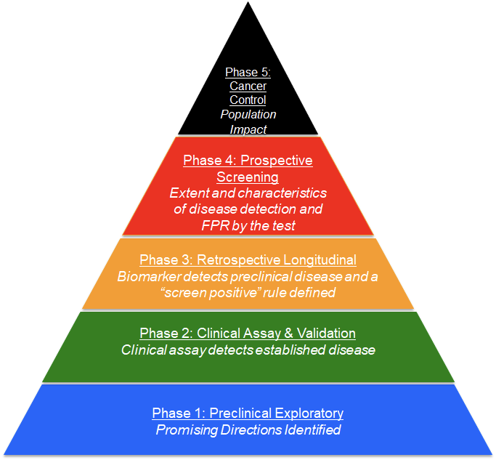
Five-Phase Approach and Prospective specimen collection, Retrospective Blinded Evaluation Study Design
A major achievement of the EDRN was the development of a five-phase approach for biomarker development. This systematic approach to discovery, development and validation is used to help identify “winners” or “losers” among biomarkers.
The phased process has been widely accepted by the biomarker research community.
Notes:
This rigorous, efficient method for biomarker discovery and validation, which is used throughout the EDRN, requires a highly collaborative organization that includes a broad range of expertise with each collaborator having an essential role. The organization has been compared by some to the mission control room of NASA, where if a single component in a pre-launch sequence is not performing at 100%, the launch is “held” until the issue is resolved. Similarly, because of the essential nature of each of the components in the process of biomarker validation, all components are regarded as equals.
The broad range of individuals involved, from biostatisticians to clinicians, scientists, and technology experts, are equally valued and respected within the organization. In this context, it has been the entire team that ensures and celebrates each success, rather than an individual.
EDRN has also developed and adopted the Prospective specimen collection, Retrospective Blinded Evaluation study design, an approach to reduce bias during all phases of biomarker discovery and validation. The Prospective specimen collection, Retrospective Blinded Evaluation study design has four key elements: clinical context and outcomes; criteria for measuring biomarker performance; the test itself; and the size of the study.
Critical features of this design are: all patients are enrolled prior to diagnosis; cases and controls are enrolled under the same conditions; and all samples are collected and processed identically. For a screening application, this design may require large numbers of study participants because the incidence of most cancers is low. For instance, as the incidence of colon cancer in a screening population is about 0.5 percent, 20,000 patients would need to be enrolled to obtain 100 cancers.

Slide 4
Regulatory Considerations in the Biomarker Development Lifecycle
Develop and Validate Assays: Phase I
Preliminary Research: “proof of concept”
Generate New Research Questions
Clinical Patient Care
& Phase 5
Sponsored Research / Clinical Trials Phase II, III, IV
FDA IDE:
Testing to be performed in a CLIA certified lab or a CLIA compliant environment
Integral Biomarkers:
Required for Trial
Informs management decisions including eligibility, risk stratification, or treatment assignment
Must be performed in a CLIA licensed laboratory
Reimbursement/Medicare coverage
Research Only
CLIA Certification required
Notes:
Medicare coverage of the new tests once they have been approved and shown to be clinically effective

Slide 5
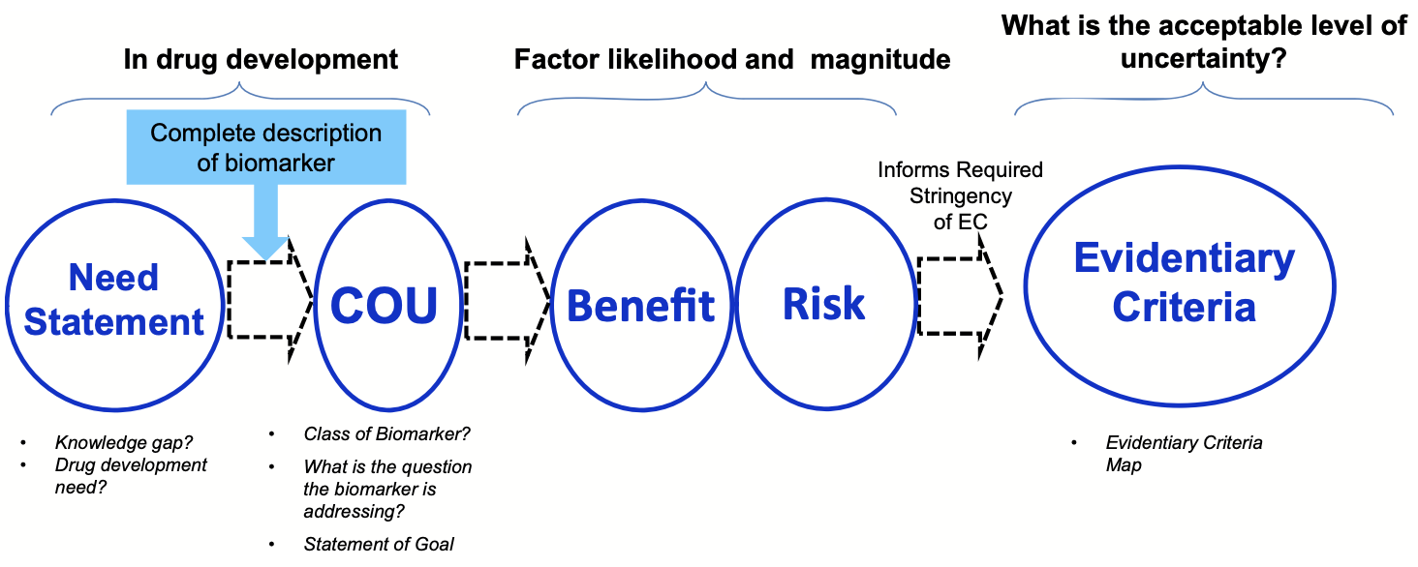
Evidentiary criteria framework for safety biomarkers qualification.
Information from 2 FNIH BC/FDA co-sponsored workshops in 2016 and 2018
https://fnih.org/wp-content/uploads/2023/06/Evidentiary-Criteria-Framework-Final-Version-Oct-20-2016.pdf
Notes:
FNIH Biomarker Consortium and the FDA

Slide 6
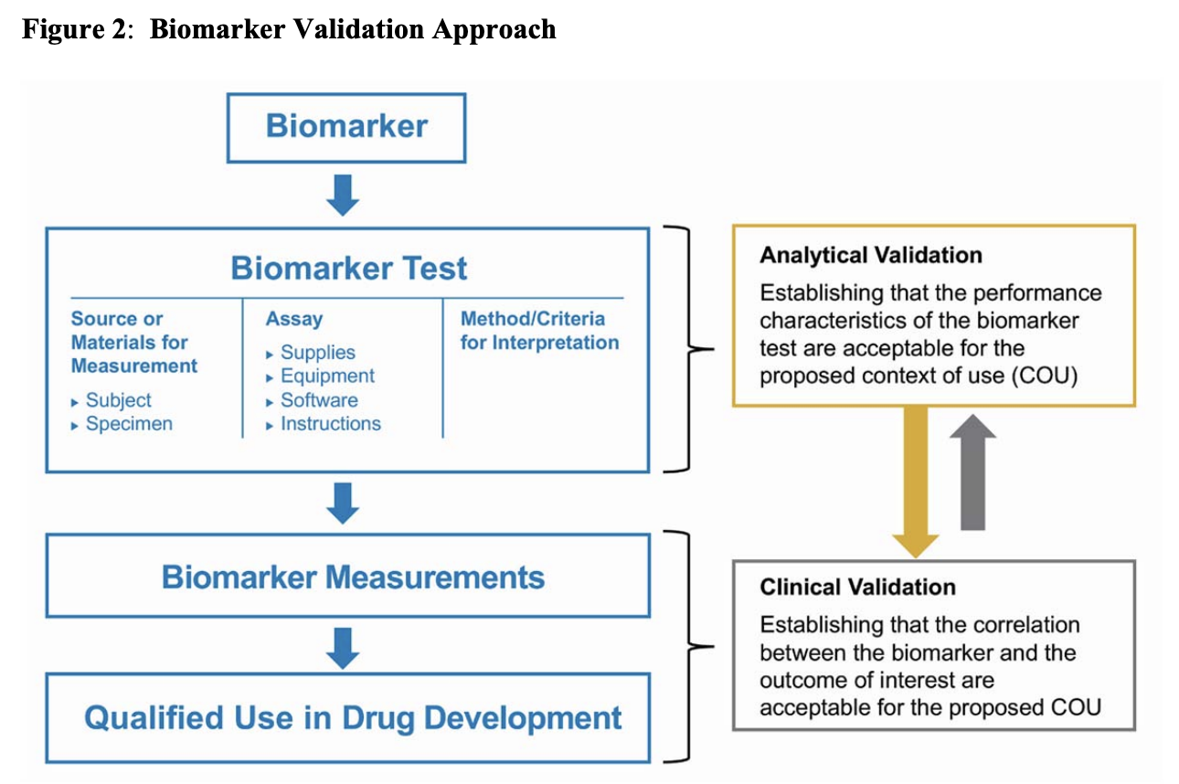
Biomarkers Validation recommendations from the FDA
https://www.fda.gov/media/119271/download

Slide 7
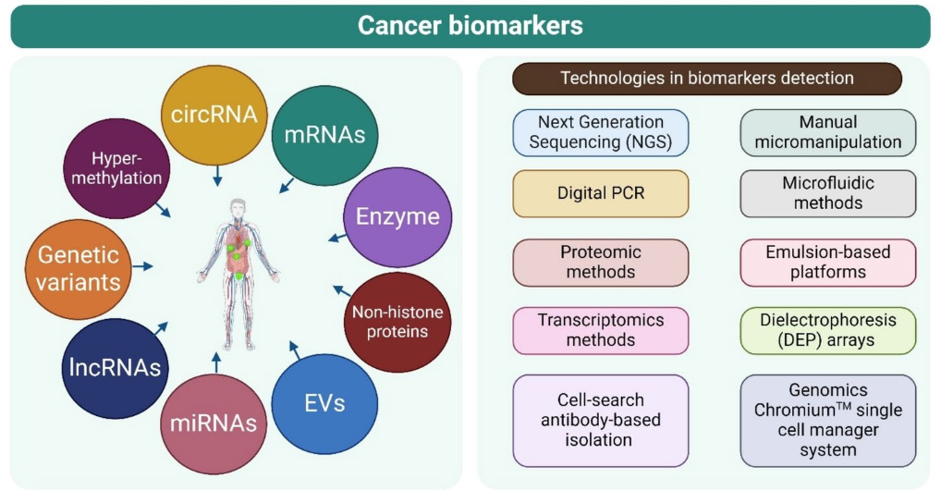
Cancer biomarkers and their advanced technologies for detection
RNA in urine.
Zafar, S., Hafeez, A., Shah, H. et al. Emerging biomarkers for early cancer detection and diagnosis: challenges, innovations, and clinical perspectives. Eur J Med Res 30, 760 (2025). https://doi.org/10.1186/s40001-025-03003-6

Slide 8
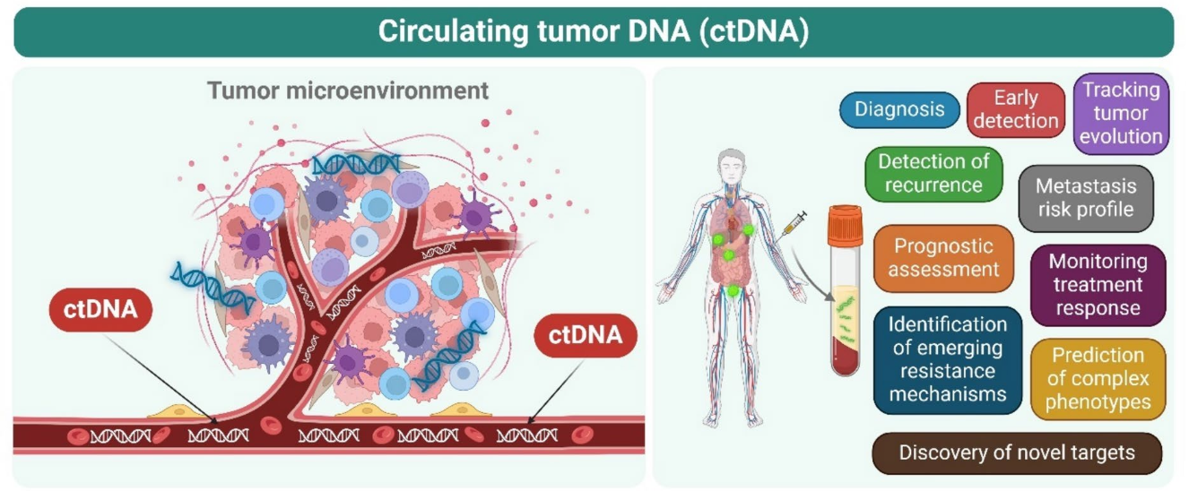
Application of circulating tumor DNA in cancer.
Zafar, S., Hafeez, A., Shah, H. et al. Emerging biomarkers for early cancer detection and diagnosis: challenges, innovations, and clinical perspectives. Eur J Med Res 30, 760 (2025). https://doi.org/10.1186/s40001-025-03003-6
Notes:
In the tumor microenvironment, cells undergo necrosis, apoptosis, pyroptosis,
and phagocytosis, releasing their DNA as soluble debris known as circulating tumor DNA (ctDNA) (left). This ctDNA is present in liquid biopsies
and has clinical applications in cancer diagnosis, prognosis, and monitoring treatment response (right)

Slide 9
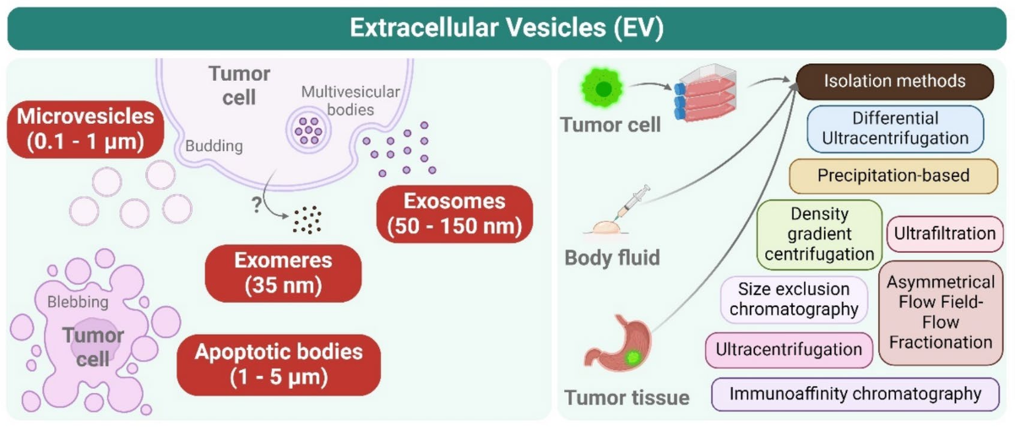
Application of extracellular vesicles in cancer.
Zafar, S., Hafeez, A., Shah, H. et al. Emerging biomarkers for early cancer detection and diagnosis: challenges, innovations, and clinical perspectives. Eur J Med Res 30, 760 (2025). https://doi.org/10.1186/s40001-025-03003-6
Notes:
Exosomes are derived not only from intraluminal vesicles within multivesicular bodies (MVBs)
but also from the budding of the plasma membrane. Early endosomes mature into late endosomes or multivesicular bodies (MVBs), which can then
be directed to either the secretory or degradative pathways. In contrast, microvesicles are produced by direct budding from the cell membrane,
while apoptotic bodies form during programmed cell death. Exosomes are spherical structures enclosed by a lipid bilayer and contain a variety
of complex molecules, including proteins, mRNA, miRNA, ncRNA, and DNA (left). The initial biofluid sample contains extracellular vesicles (EVs),
suspended proteins, and debris. Subsequently, ultracentrifugation results in a pellet of EVs mixed with proteins, which can be further purified using
discontinuous ultracentrifugation or density gradient ultracentrifugation. These methods separate proteins and EVs based on their density. Other
techniques include ultrafiltration, size exclusion chromatography, and asymmetrical flow field-flow fractionation for separate molecules based
on size or hydrodynamic radius. Precipitation-based isolation utilizes compounds such as polyethylene glycol (PEG) to concentrate particles. In
contrast, immunoaffinity isolation employs antibodies to capture specific EV populations, though it does not isolate all EV types (right)

Slide 10
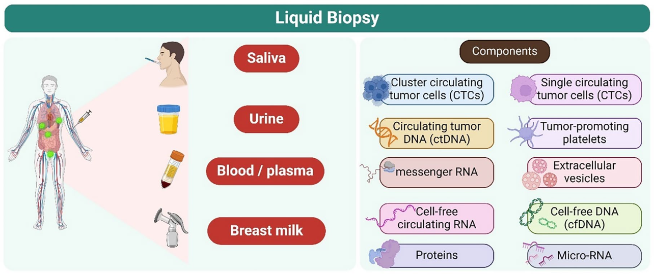
Application of Liquid biopsy in cancer.
Zafar, S., Hafeez, A., Shah, H. et al. Emerging biomarkers for early cancer detection and diagnosis: challenges, innovations, and clinical perspectives. Eur J Med Res 30, 760 (2025). https://doi.org/10.1186/s40001-025-03003-6
Notes:
Liquid biopsies, such as those obtained from saliva, urine, blood, plasma, and breast milk, have potential clinical
value in managing tumors (left). These non-invasive or minimally invasive techniques are primarily being developed to identify biomarkers for early
diagnosis, prognosis prediction, and targeted treatments (right)

Slide 11
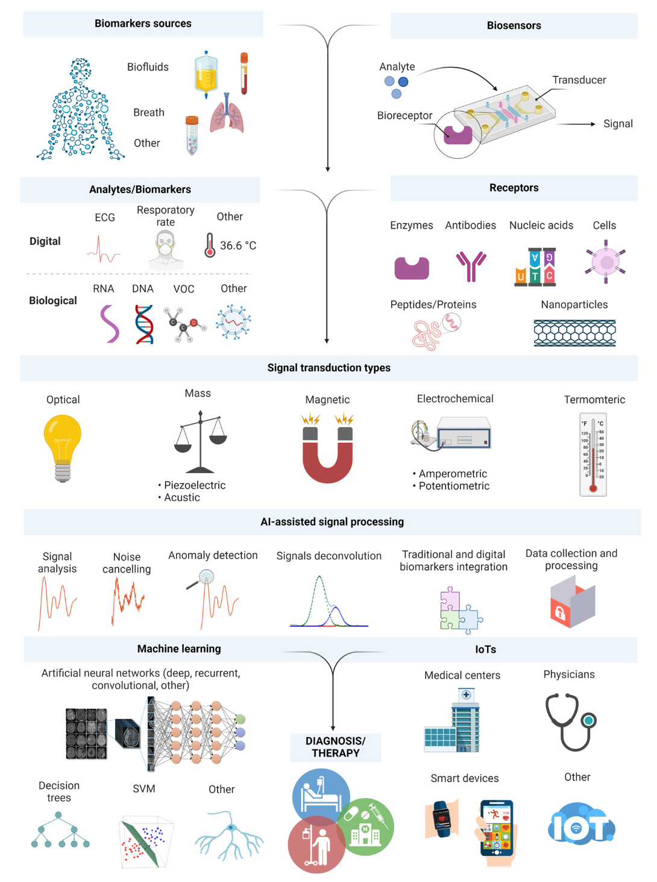
Future
Biomarkers

Slide 12
Future Biomarkers

Slide 13
Biomarker Assay | Purpose | EDRN PI— CLIA Laboratory
MyProstateScore 2.0 | Detection of prostate cancer | Arul Chinnaiyan, M.D., Ph.D. — Lynx Dx
APOA2-iTQ® (analysis of two APOA2 isoforms, APOA2-AT and APOA2-TQ) | Detection of pancreatic diseases associated with exocrine function disorder | Giman Jung, Ph.D. — Toray International America, Inc.
LungLB | Blood test validated to detect lung cancer from indeterminate lung nodules | Paul Pagano, Ph.D. — LungLife AI
MiCheck (Glypican-1 protein and related signaling molecules) | Differentiate aggressive prostate cancer from non-aggressive cancer and no cancer | Daniel Chan, Ph.D. — Minomic, Inc
Videssa (a multi-protein biomarker blood test) | Distinguish benign from malignant breast lesions | Joshua LaBaer, M.D., and Karen Anderson, M.D. — Provista
DetermaVu | Liquid biopsy test intended to facilitate clinical decision making in lung cancer | Louise Showe, Ph.D. — OncoCyte
Percepta | (23-gene expression panel) Detection of lung cancer | Avrum Spira, M.D. — Veracyte Inc.
Esoguard (methylated vimentin & cyclin A1) | Detection of Barrett’s esophagus | Sandford Markowitz, M.D. — PAVmed
Decipher Prostate Cancer Classifier Test (SChLAP1 and other lncRNAs) | Determination of prostate cancer aggressiveness | Arul Chinnaiyan, M.D., Ph.D. — GenomeDx
Protein panel (TIMP1, LRG1, and CA19-9) | Detection of pancreatic cancer | Samir Hanash M.D., Ph.D. — Cosmos Wisdom
Mucin panel (MUC4, MUC5AC, MUC16 and MUC17) | Detection of pancreatic cancer | Surinder Batra, Ph.D. — Sanguine Diagnostic and Therapeutics
MiPS (Mi Prostate Score Urine test), Multiplex analysis of TMPRSS2:ERG gene fusion, PCA3, and serum PSA | Detection of prostate cancer | Arul Chinnaiyan, M.D., Ph.D. — Gen-Probe
IHC and FISH for TMPRSS2:ERG fusion | Detection of prostate cancer | Arul Chinnaiyan, M.D., Ph.D. — Roche
GSTP1 methylation | Decision making regarding repeat biopsies in prostate cancer | David Sidransky, M.D. — OncoMethylome
Mitochondrial deletion | Detection of prostate cancer | National Institute of Standards and Technology (NIST) — Mitomics
Proteomic panel | Detection of lung cancer | William Rom, M.D., M.P.H. — Celera
Aptamer-based markers | Detection of lung cancer | William Rom, M.D., M.P.H. — Somalogic
Vimentin methylation in stool | Detection of colon cancer | Sanford Markowitz, M.D., Ph.D. — LabCorp
Galectin-3 ligand | Detection of advanced adenomas and CRC | Robert Bresalier, M.D. — BG Medicine
GP73 | Risk of hepatocellular carcinoma | Timothy Block, Ph.D. — Beckman Coulter
8-gene Panel for Barrett’s Esophagus (BE) | Progression prediction of BE | Stephen Meltzer, M.D. — Diagnovus
EDRN CLIA-Approved Markers
18 EDRN developed biomarker tests are available in Clinical Laboratory Improvement Amendments (CLIA) approved laboratories.

Slide 14
EDRN FDA-Approved Tests
Diagnostic tests or devices supported by the EDRN have been approved by the U.S. Food and Drug Administration for clinical use
Biomarker Assay | Purpose | EDRN PI— CLIA Laboratory
EsoCheck™ | Non-invasive five-minute office-based procedure to detect Barrett's Esophagus. | Sanford Markowitz, M.D., PAVmed.
CancerSEEK | Detection of genetic mutations associated with pancreatic and ovarian cancer. | Ken Kinzler, Ph.D., Robert Schoen, M.D., Randall Brand, M.D., Peter Allen, M.D., and Samir Hanash, M.D., Thrive Detection Corp.
Overa | 5 analytesfor prediction of ovarian cancer risk in women with adnexal mass. | Zhen Zhang, Ph.D. and Daniel Chan, Ph.D., Vermillion.
%[-2]proPSA | Reduce the number of unnecessary initial biopsies during prostate cancer screening. | Daniel Chan, Ph.D., Beckman Coulter.
PCA3 (Prostate Cancer Antigen 3) | Use of RNA in urine to determination of need for biopsy/repeat-biopsy in patients at risk for prostate cancer. | John Wei, M.D., Gen-Probe.
Risk of Ovarian Malignancy Algorithm (ROMA) | Prediction of ovarian cancer risk in women with pelvic mass. | Steve Skates, Ph.D., Fujirebio Diagnostics.
DCP and AFP-L3 | Risk assessment for development of hepatocellular carcinoma. | Jorge Marrero, M.D. Wako Diagnostics.
OVA1™ | (5 analytes: CA 125, prealbumin, apolipoprotein A-1, beta2 microglobulin, transferrin). Prediction of ovarian cancer risk in women with adnexal mass. | Daniel Chan, Ph.D. and Zhen Zhang, Ph.D., Vermillion.
APOA2-itQ® (also approved in Japan) | Diagnostic aid for pancreatic cancer from analysis of two APOA2 isoforms, APOA2-AT and APOA2-TQ | Kazufumi Honda, D.D.S., Ph.D., and Giman Jung, Ph.D /Toray Industries, Inc.

Slide 15
Ruth Etzioni, Roman Gulati, Christos Patriotis, Carolyn Rutter, Yingye Zheng, Sudhir Srivastava, Ziding Feng
Revisiting the standard blueprint for biomarker development to address emerging cancer early detection technologies
JNCI: Journal of the National Cancer Institute, Volume 116, Issue 2, February 2024, Pages 189–193, https://doi.org/10.1093/jnci/djad227
According to EDRN PBD and USPSTF: A biomarker-based test for population screening should
  1) test sensitivity in a prospective screening setting must be adequate,
  2) the shift to early curable stages must be meaningful
  3) any stage shift must translate into clinically significant mortality benefit.
Problems:
  Phase 5 = randomized screening trials - lengthy, costly, and complex, particularly in the average-risk population.
  Given their expense and duration, randomized trials can generally evaluate only 1 or 2 screening strategies.
  Further, because diagnostic and treatment practices often continue to evolve, the trial results may be less relevant to contemporary practice when they finally become available.
Notes:
To reduce cost – use of surrogate markers like reduction in the incidence of late-stage disease, which has been proposed as a surrogate or provisional endpoint for mortality benefit.

Slide 16
Speakers for the session
9:50-10:10 | Dr. Yingye Zheng | Statiscian - statistical considerations, sample size, manging overfitting and optimism bias
10:10-10:40 | Dr. Eric Grogan, Dr. Steve Skates, Dr. Joseph Willis, Dr. Josh LaBaer Dr. William Grady | Panel: Successes and failures of biomarker development
10:40-10:50 | Break
10:50-11:10 | Sam Hanash | Risk Assessment Early Onset Cancers
11:10-11:30 | Ruth Etzioni | Ca Biomarker RCTs
11:30-12:00 | Victoria Raymond Guardant Health | Closing - going the final mile to patient testing, billing and insurance consideration

