Slide 1
Data Science, Digital Infrastructure, and Biomarkers
March 4, 2026
Moderators:
Jennifer Beane, Boston University
Nicholas Hodges, NIH

Slide 2
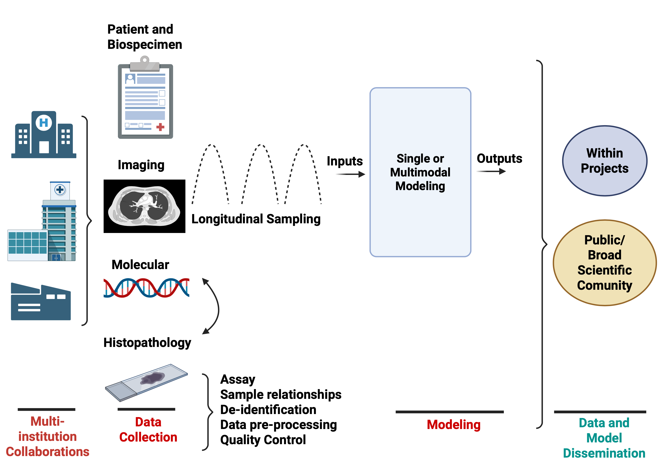
Data is Complex

Slide 3
FAIR and AI-ready Data
FAIR Data Principles – maximize the value of research data
  Findable – data must have unique identifiers that can be retrieved in searchable resources
  Accessible – data is easily retrievable with effective and secure authentication/authorization procedures
  Interoperable – data uses and speaks the same language (e.g., common data elements/vocabularies)
  Reusable – data is adequately described to new users and has clear data usage licenses and data provenance.
AI-ready
  High-quality, structured, and organized data that can be immediately use for machine learning and AI models
  Researchers spend a lot of time to collecting, curating, cleaning, and processing data from different repositories/studies

Slide 4
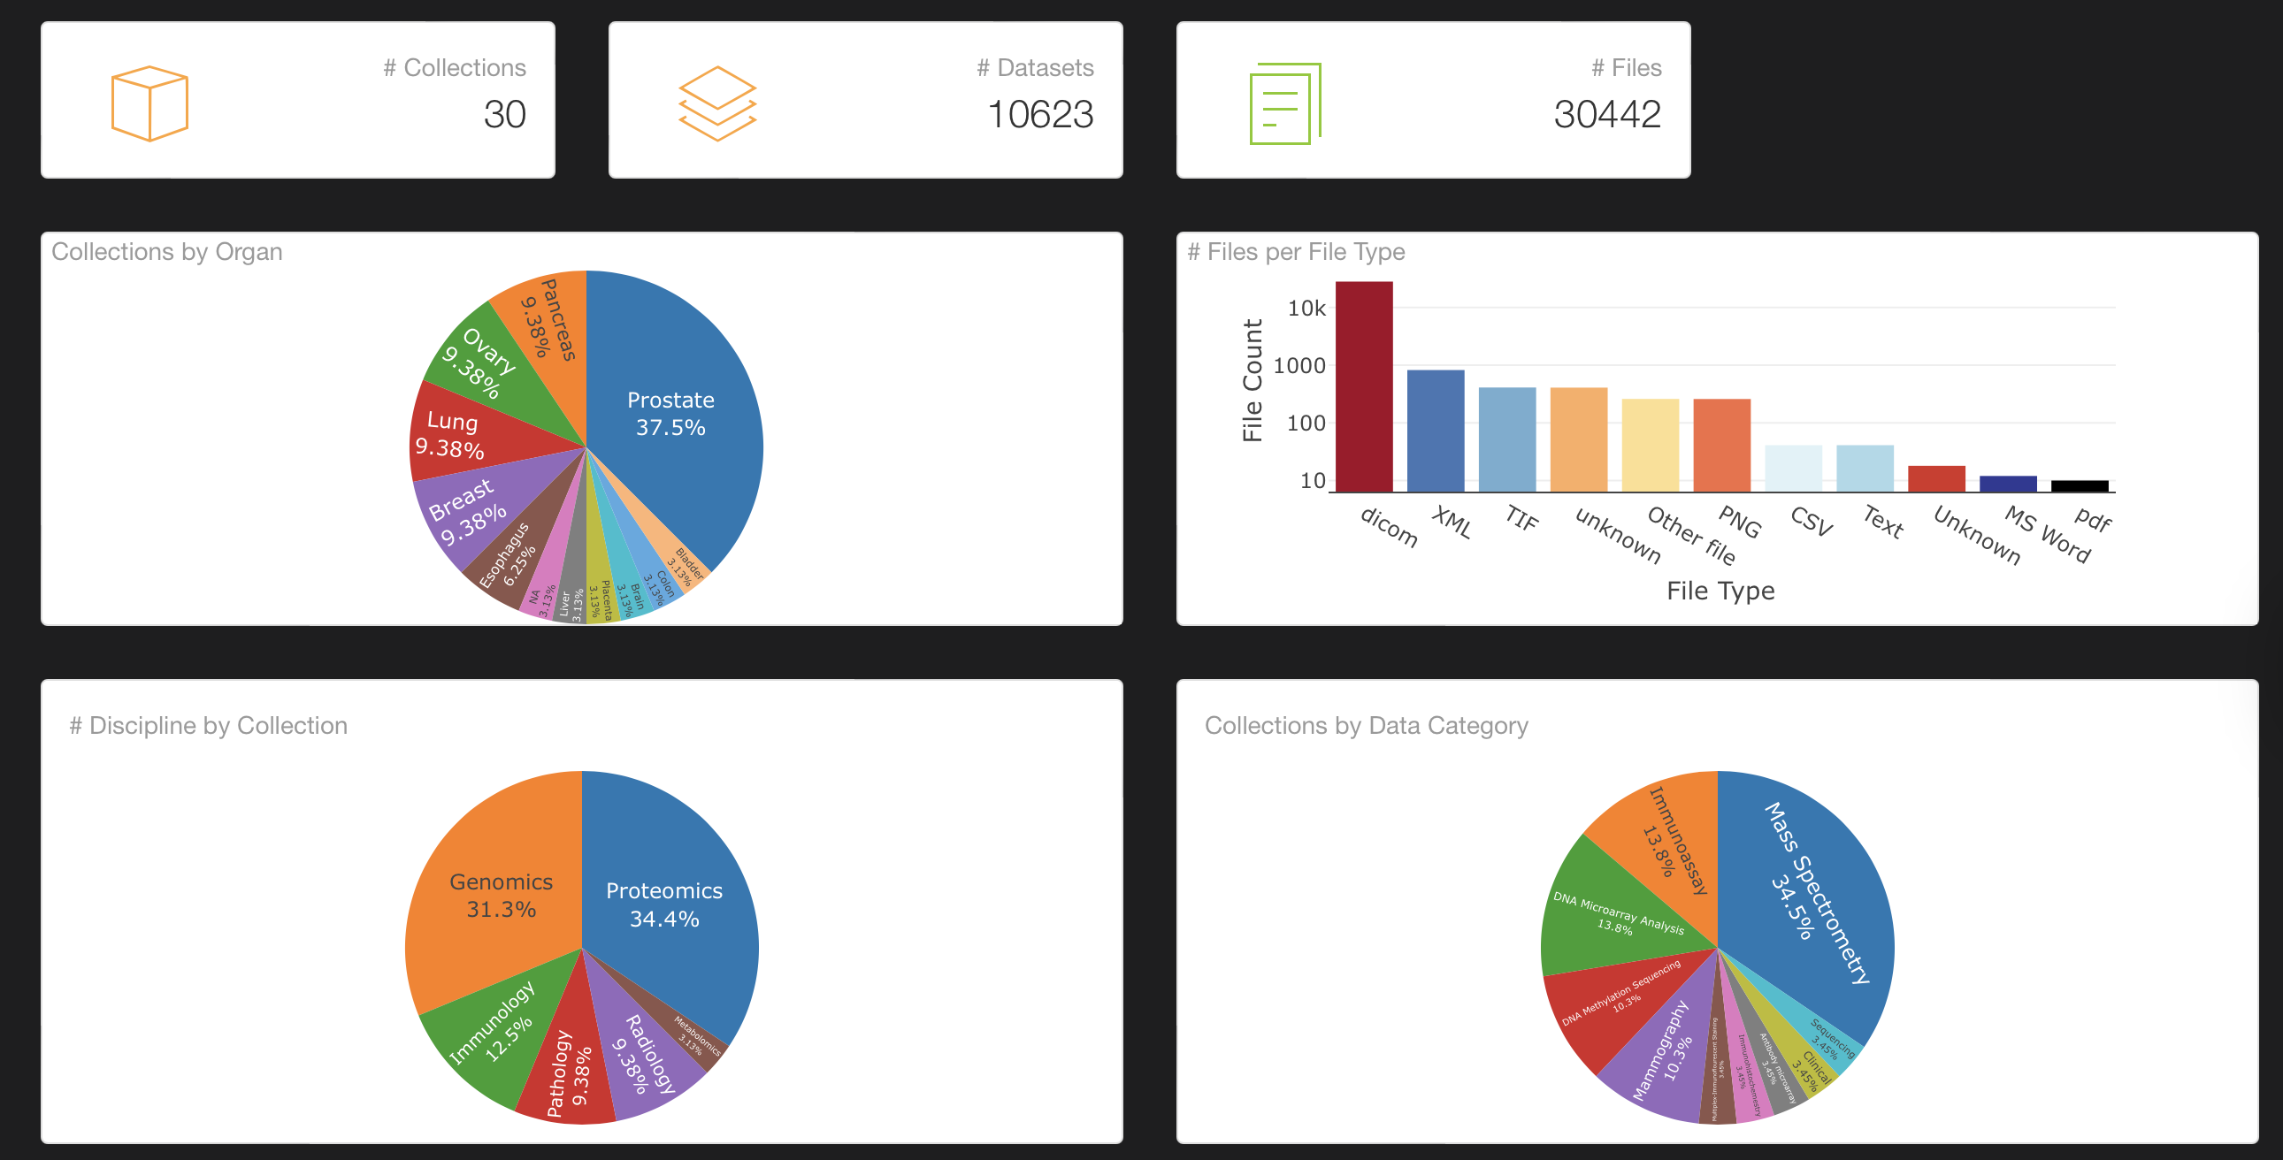
Digital Dashboards
EDRN LabCAS

Slide 5
Data Science, Digital Infrastructure, and Biomarkers
Scientific Intent: Discuss how to ensure that EDRN data assets are FAIR AND decision-relevant for biomarker discovery/validation.
Desired Outputs: Prioritized roadmap for improving data standards, AI capabilities, and dashboards for biomarker discovery and validation.
  What are the must-do items?

Slide 6
Data Science, Digital Infrastructure, and Biomarkers
Panelists:
Dr. William Hsu, University of California Los Angeles
Dr. Savannah Partridge, University of Washington School of Medicine
Dr. Pei Wang, Icahn School of Medicine at Mount Sinai
Dr. Yingye Zheng, Fred Hutch Cancer Center
Dr. Daniel Crichton, Jet Propulsion Laboratory California Institute of Technology

Slide 7
Panel Questions
A. Data sharing that is usable
For the most common EDRN data types (clinical, imaging pathology, genomics, proteomics), what are the challenges/pain-points in making data shareable and scientifically useful? What gets lost during de-identification?
What were the lessons learned from pMRI and LTP2 -- What can we do to make data collection, curation, and release more streamlined and usable?
What are the top barriers preventing EDRN datasets from being reused by researchers outside the originating site(s)?
B. Data harmonization across sites/institutions
Based on your experience, what approaches work best to harmonize data generated across institutions? What should be standardized versus ‘mapped’ later?
Is there a minimum set of fields/standards we must require so datasets can be combined across sites?
What QC metrics should be included in datasets so that users can judge whether to use the data?

Slide 8
Panel Questions
C. AI for EDRN
Where would AI deliver the most near-term value for EDRN?
What does AI-ready mean here? If we want EDRN data to support AI/machine learning, what is needed in terms of data labels, metadata, provenance, documentation to make sure model results are reproducible?
Should we prioritize data infrastructure that allows research to run algorithms on the data versus distributing datasets? Which approach is most feasible to the most researchers?
D. Dashboards and digital infrastructure
The EDRN currently has a basic dashboard that broadly shows its data assets. Who is the dashboard for and what decisions should it help make and what questions should it answer?
What are the top dashboard features that you would actually use?
E. Workflow
What are some ideas for improving the communication/workflow between data scientists, researchers involved in sample collection and data generation, and statistical/bioinformatic scientists? What are barriers for using current infrastructure (e.g., LabCAS)?
F. Prioritization/Summary
How do we prioritize what challenges to work on? Can we pick 1 or 2 top priorities in data sharing, harmonization, AI, and dashboards/infrastructure?

