Slide 1
Breast / Gyn Collaborative Group Updates
45th EDRN Steering Committee Meeting
March 5, 2026
Co-Chairs: Savannah Partridge (UW) and Abhijit Patel (Yale)

Slide 2
MGH/Yale - Ovary BCC
Steven Skates, Abhijit Patel

Slide 3
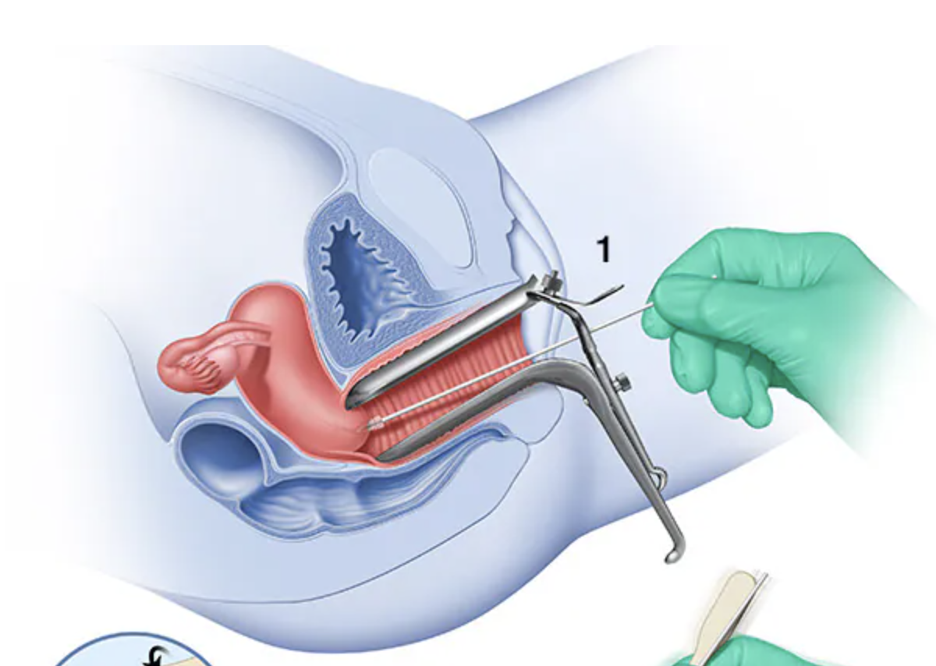
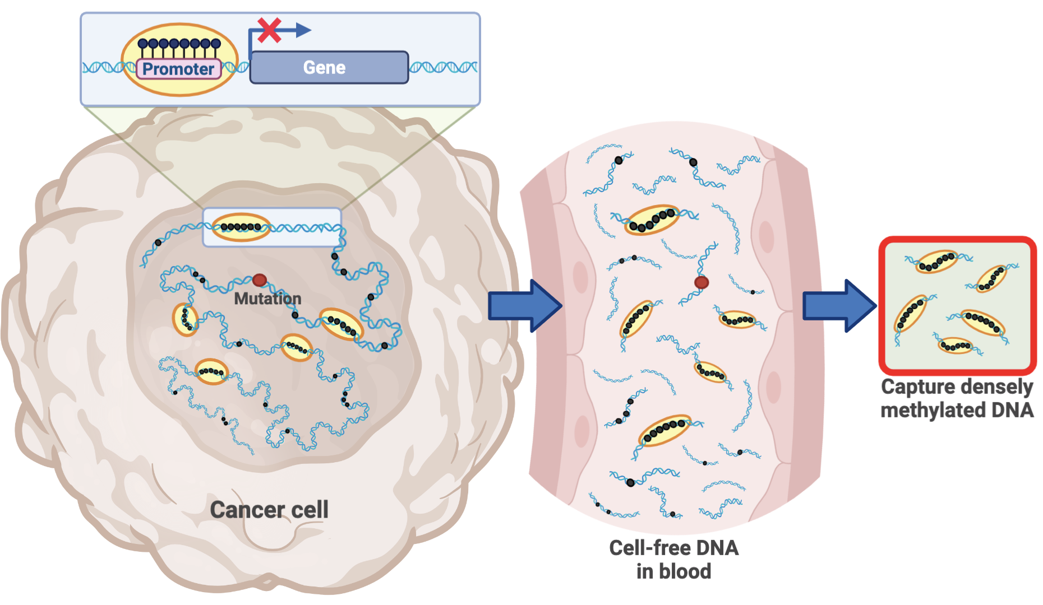
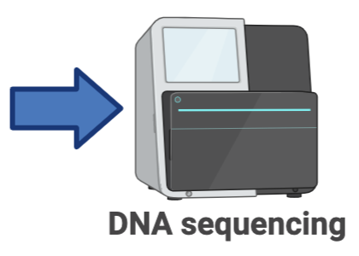
Genome-wide methylation of proximal biospecimens for early detection of ovarian cancer
Hypothesis: Earlier signal compared to peripheral circulation
Proximal Biospecimens
Gene silencing via promoter methylation is a fundamental mechanism of carcinogenesis
Uterine Lavage
Cervical Swab
Ultimate Goal
Triple & single channel catheters
BEDOCA Cases, Controls, and Endpoint – Rabin Medical Center
Uterine Lavage samples with single channel catheter
25 women with benign disease (controls)
18 women with late stage ovarian cancer
5 women with early stage ovarian cancer
Endpoint: Count of hypermethylated DNA fragment mapping to a CpG island

Slide 4
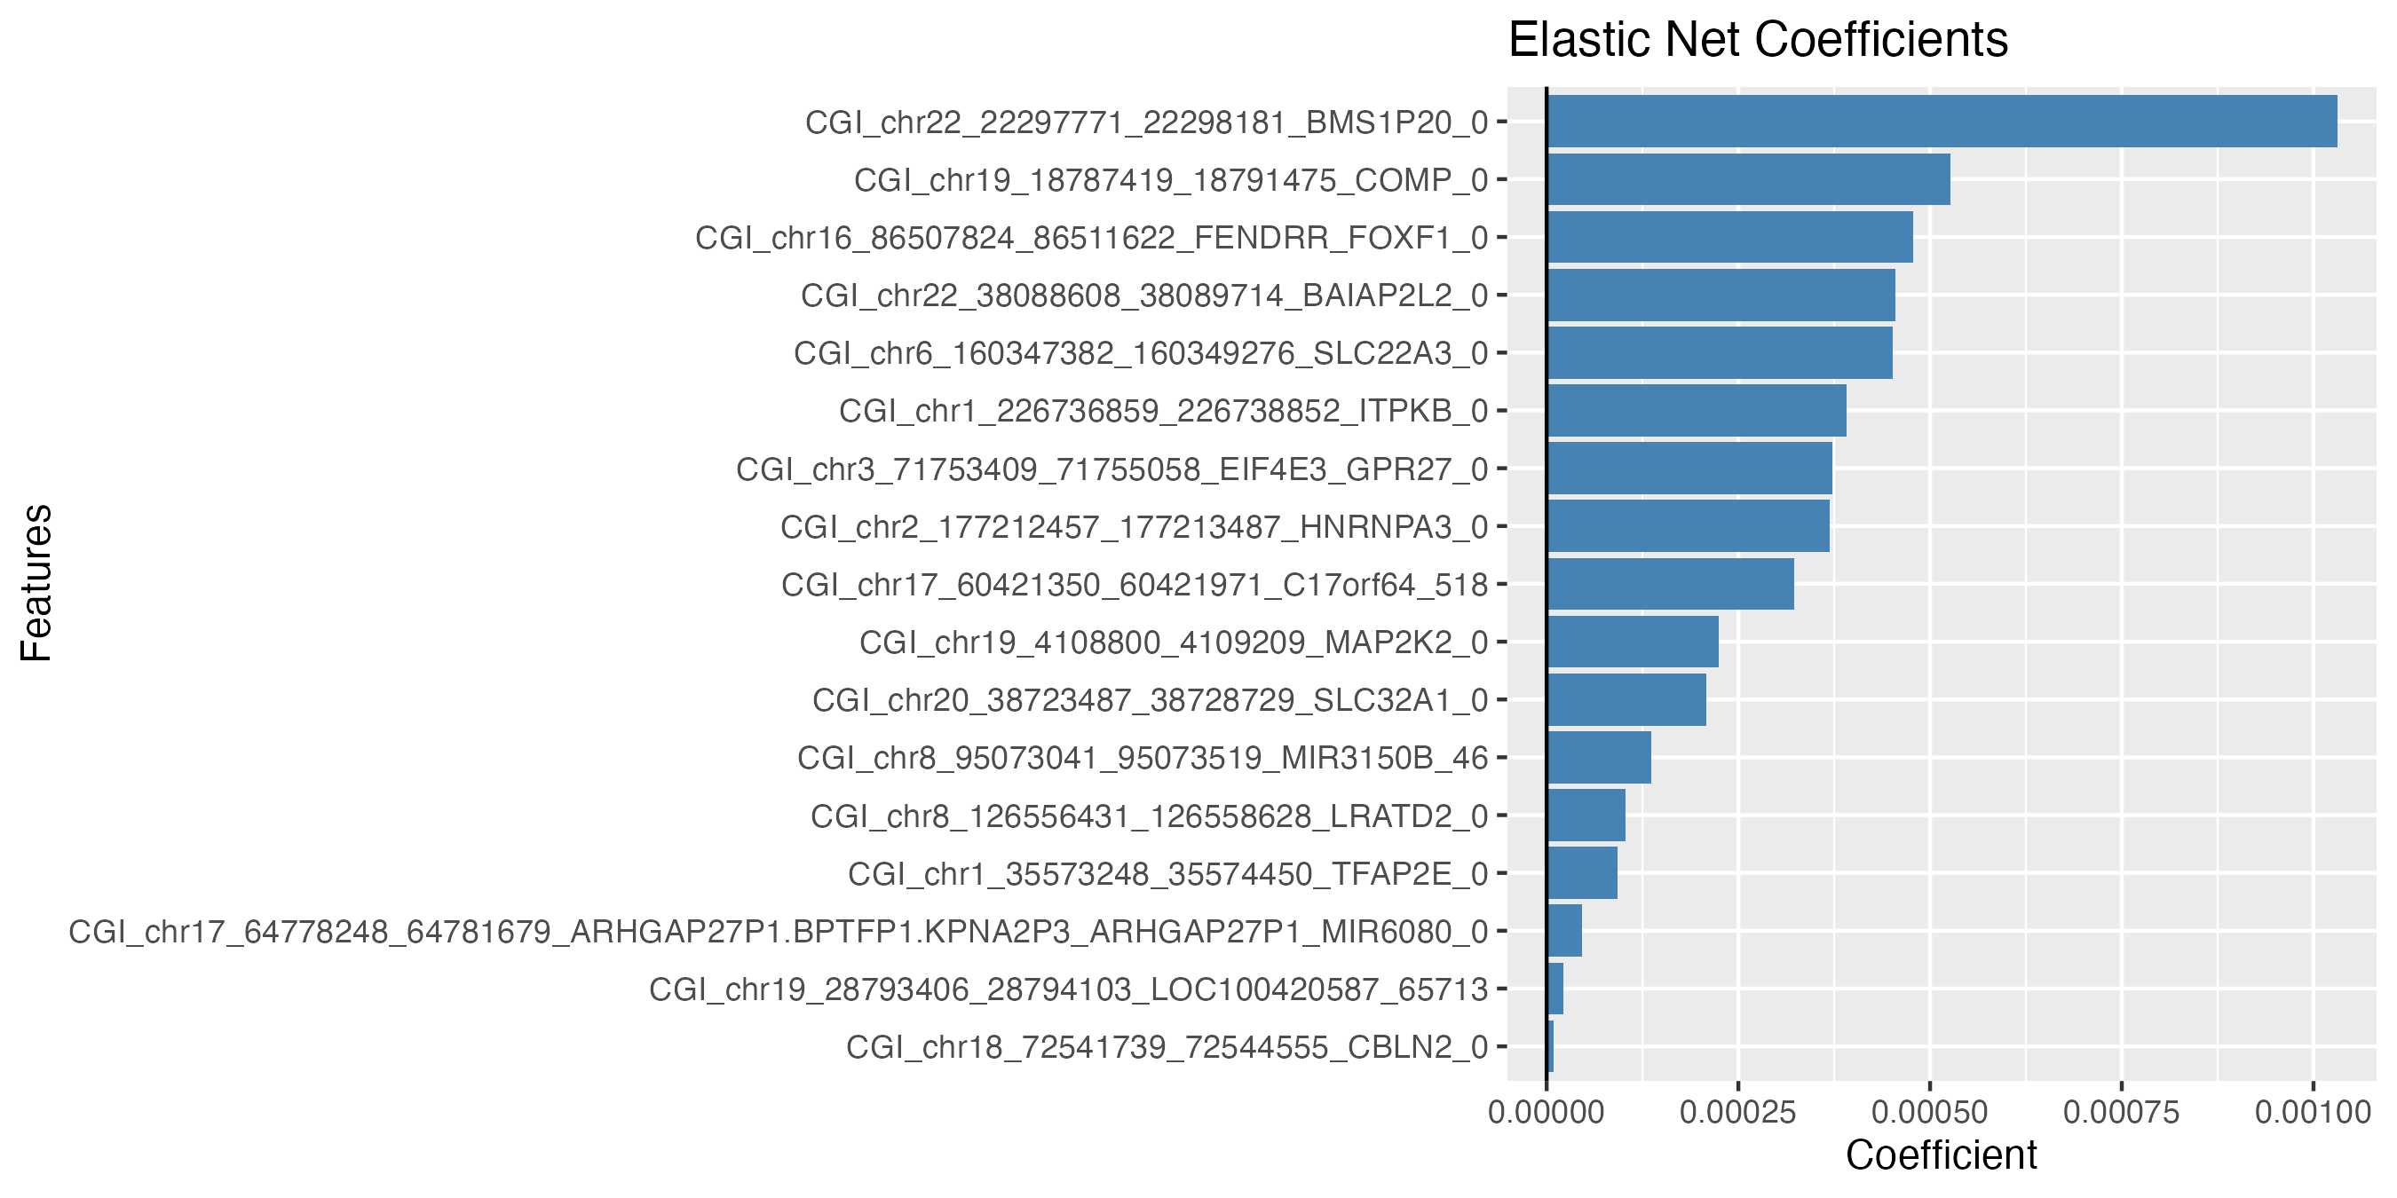
Genome-wide methylation of proximal biospecimens for early detection of ovarian cancer
C_{p}G Islands
Two methods for combining information over CpG Islands across the genome
1. Additive Models
Performance metric: sensitivity at 95% specificity (in BEDOCA training data)
Logistic regression to singles, pairs, and triples of C_{p}G islands
26%, 52%, 65% sensitivity at 95% specificity
Ridge regression: 551 CGI’s with individual sensitivity >5% at 95% specificity
83% sensitivity at 95% specificity
Elastic net regression: feature selection reduced predictors to 17 CGI’s
  83% sensitivity at 95% specificity (weights in figure)
2. Bayes Factor using fraction of CpG’s methylated in each C_{p}G Island (CGI)
cfDNA a mixture of DNA from healthy tissue and from cancer tissue
Apply mixture model to each CGI – log odds is log(ratio of densities)
Add log odds over all CGI’s across genome to give Bayes factor
Apply to EDRN Uterine Lavage Study
Accrual N = 218
Split 50:50 training : validation sets
Identify best model on training set
Validate on validation set

Slide 5
Johns Hopkins – Ovary BCC
Ie Ming Shih, Zhen Zhang

Slide 6
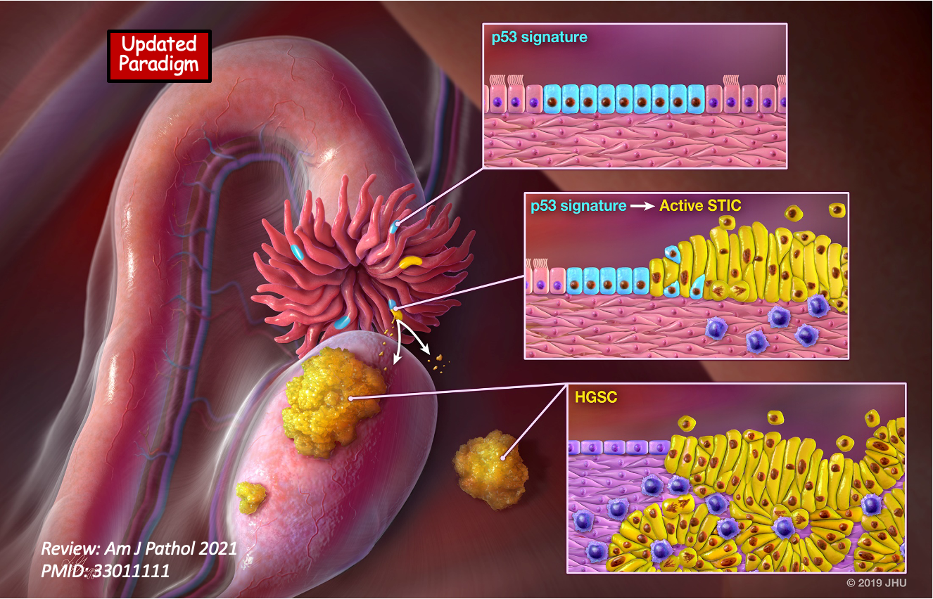
A multidisciplinary BCC for ovarian cancer early detection: translating discoveries to clinical use with a by-design approach (JHU)

Slide 7
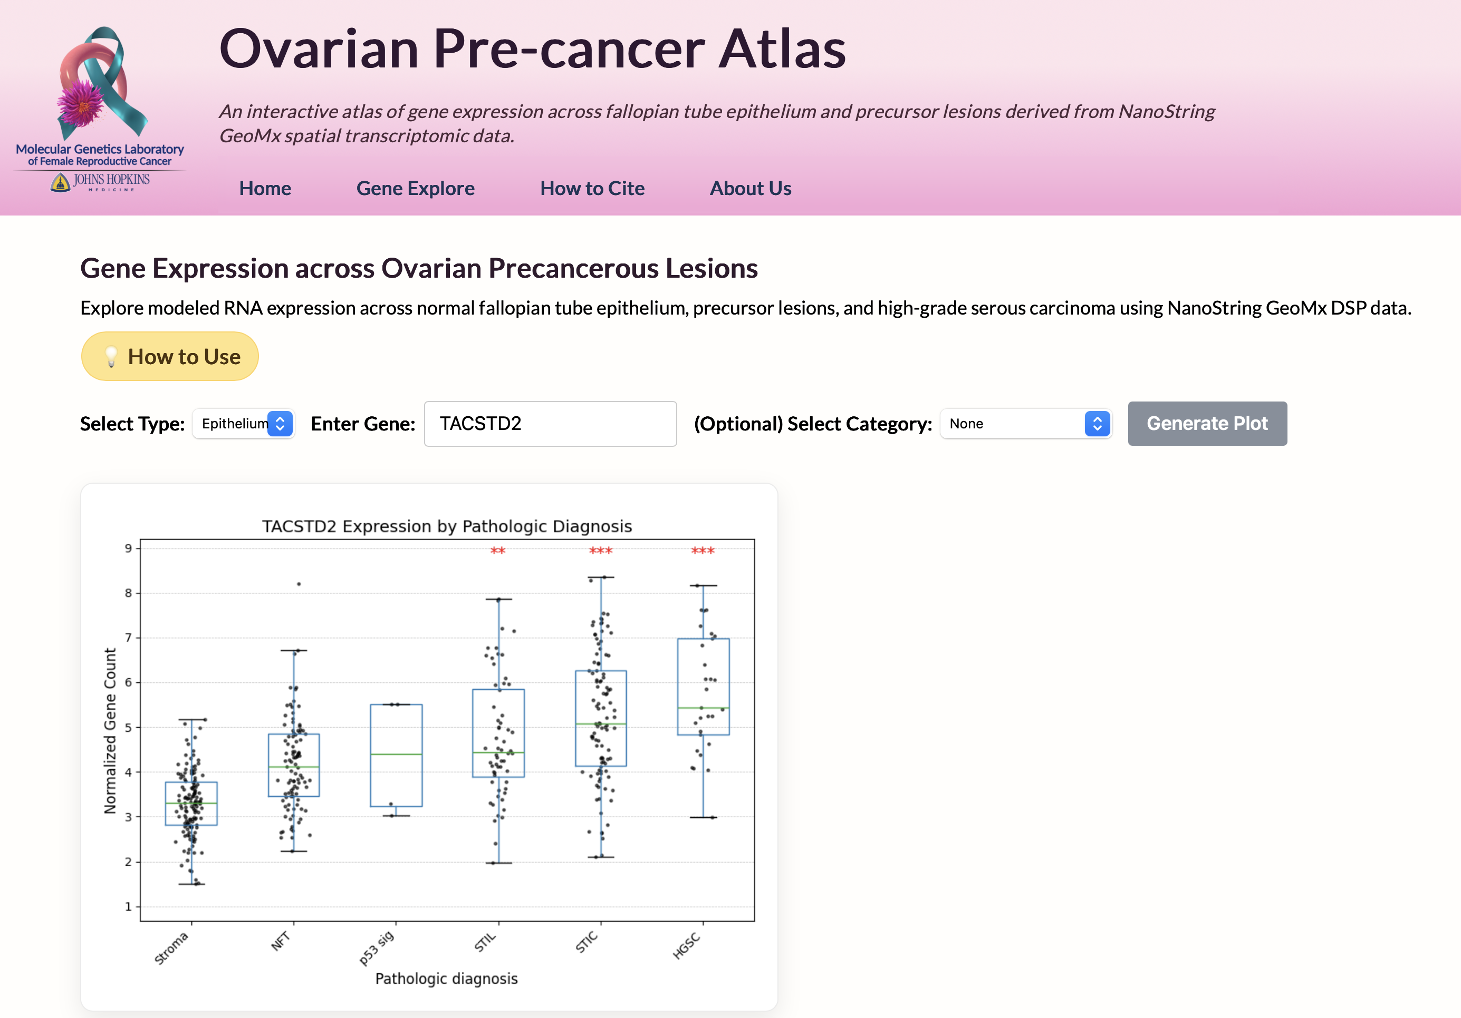
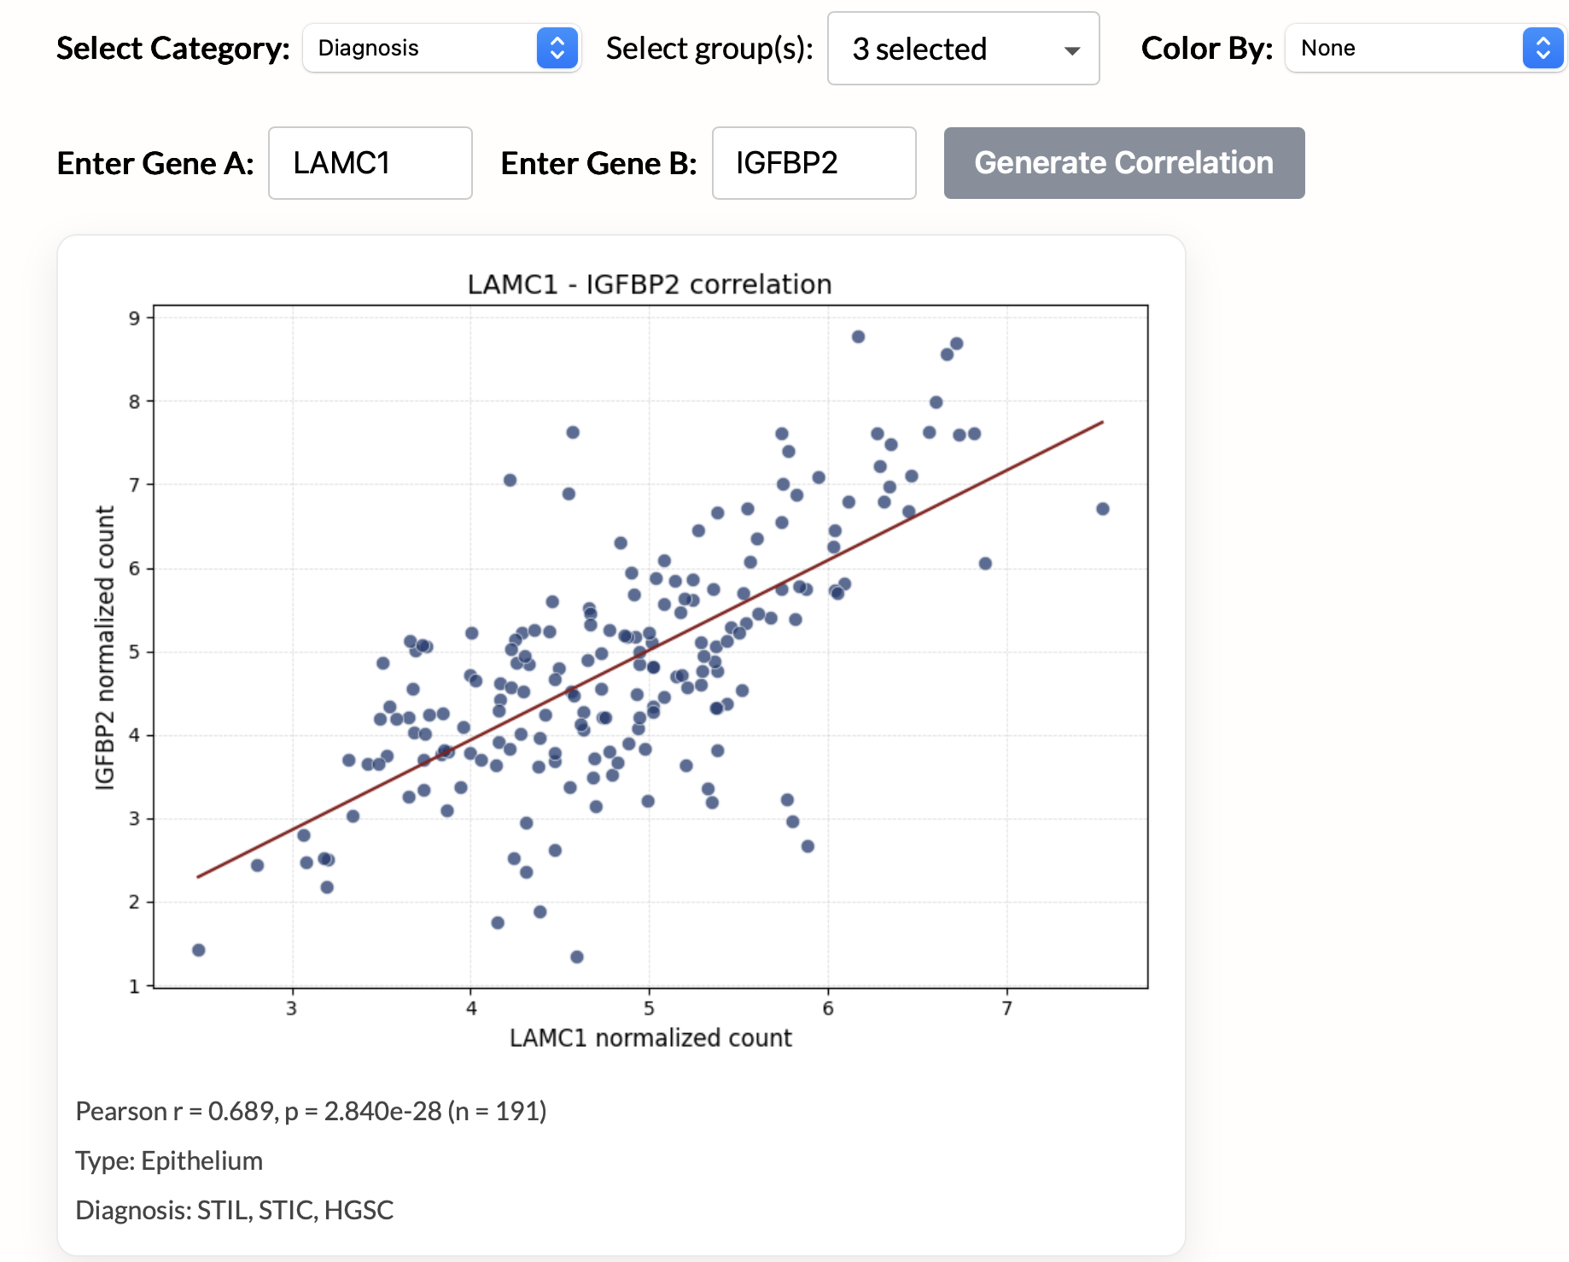
https://ovarian-precancer-atlas.gynecologycancer.org
Publicly accessible interactive Ovarian Pre-Cancer Atlas generated by Nanostring GeoMx
In > 150 precursor lesions
SCT2
SCT2

Slide 8
MD Anderson – Ovary CBC
Robert Bast

Slide 9
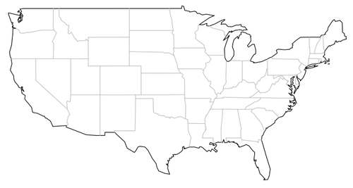
Normal Risk Ovarian Screening Study 2 using 4 Biomarkers
(CA125, HE4, HE4 Ag-AAb complexes, Osteopontin)
Minneapolis
Rochester
Des Moines
Providence
Morristown
Oklahoma City
Dallas
San Antonio
Houston (2)
Miami
Over the last 17 months we have recruited 2,982 participants at 9 sites
A screening site is just opening at the University of Minnesota
Another screening site will open at UT Southwestern
The ROCA2 algorithm that combines 4 biomarkers needs revision
Notes:
The MD Anderson CVC is conducting a second-generation Normal Risk Ovarian Screening Study (NROSS2) in postmenopausal women at average risk for ovarian cancer combining 4 biomarkers including CA125, HE4, HE4 antigen-autoantibody complexes and osteopontin using the Risk of Ovarian Cancer Algorithm – 2 (ROCA2).
Over the last 17 months they have recruited nearly 3,000 participants at 9 sites
A screening site is just opening at the University of Minnesota
Another screening site will open at UT Southwestern
They have found that the ROCA2 algorithm that combines 4 biomarkers needs revision.

Slide 10
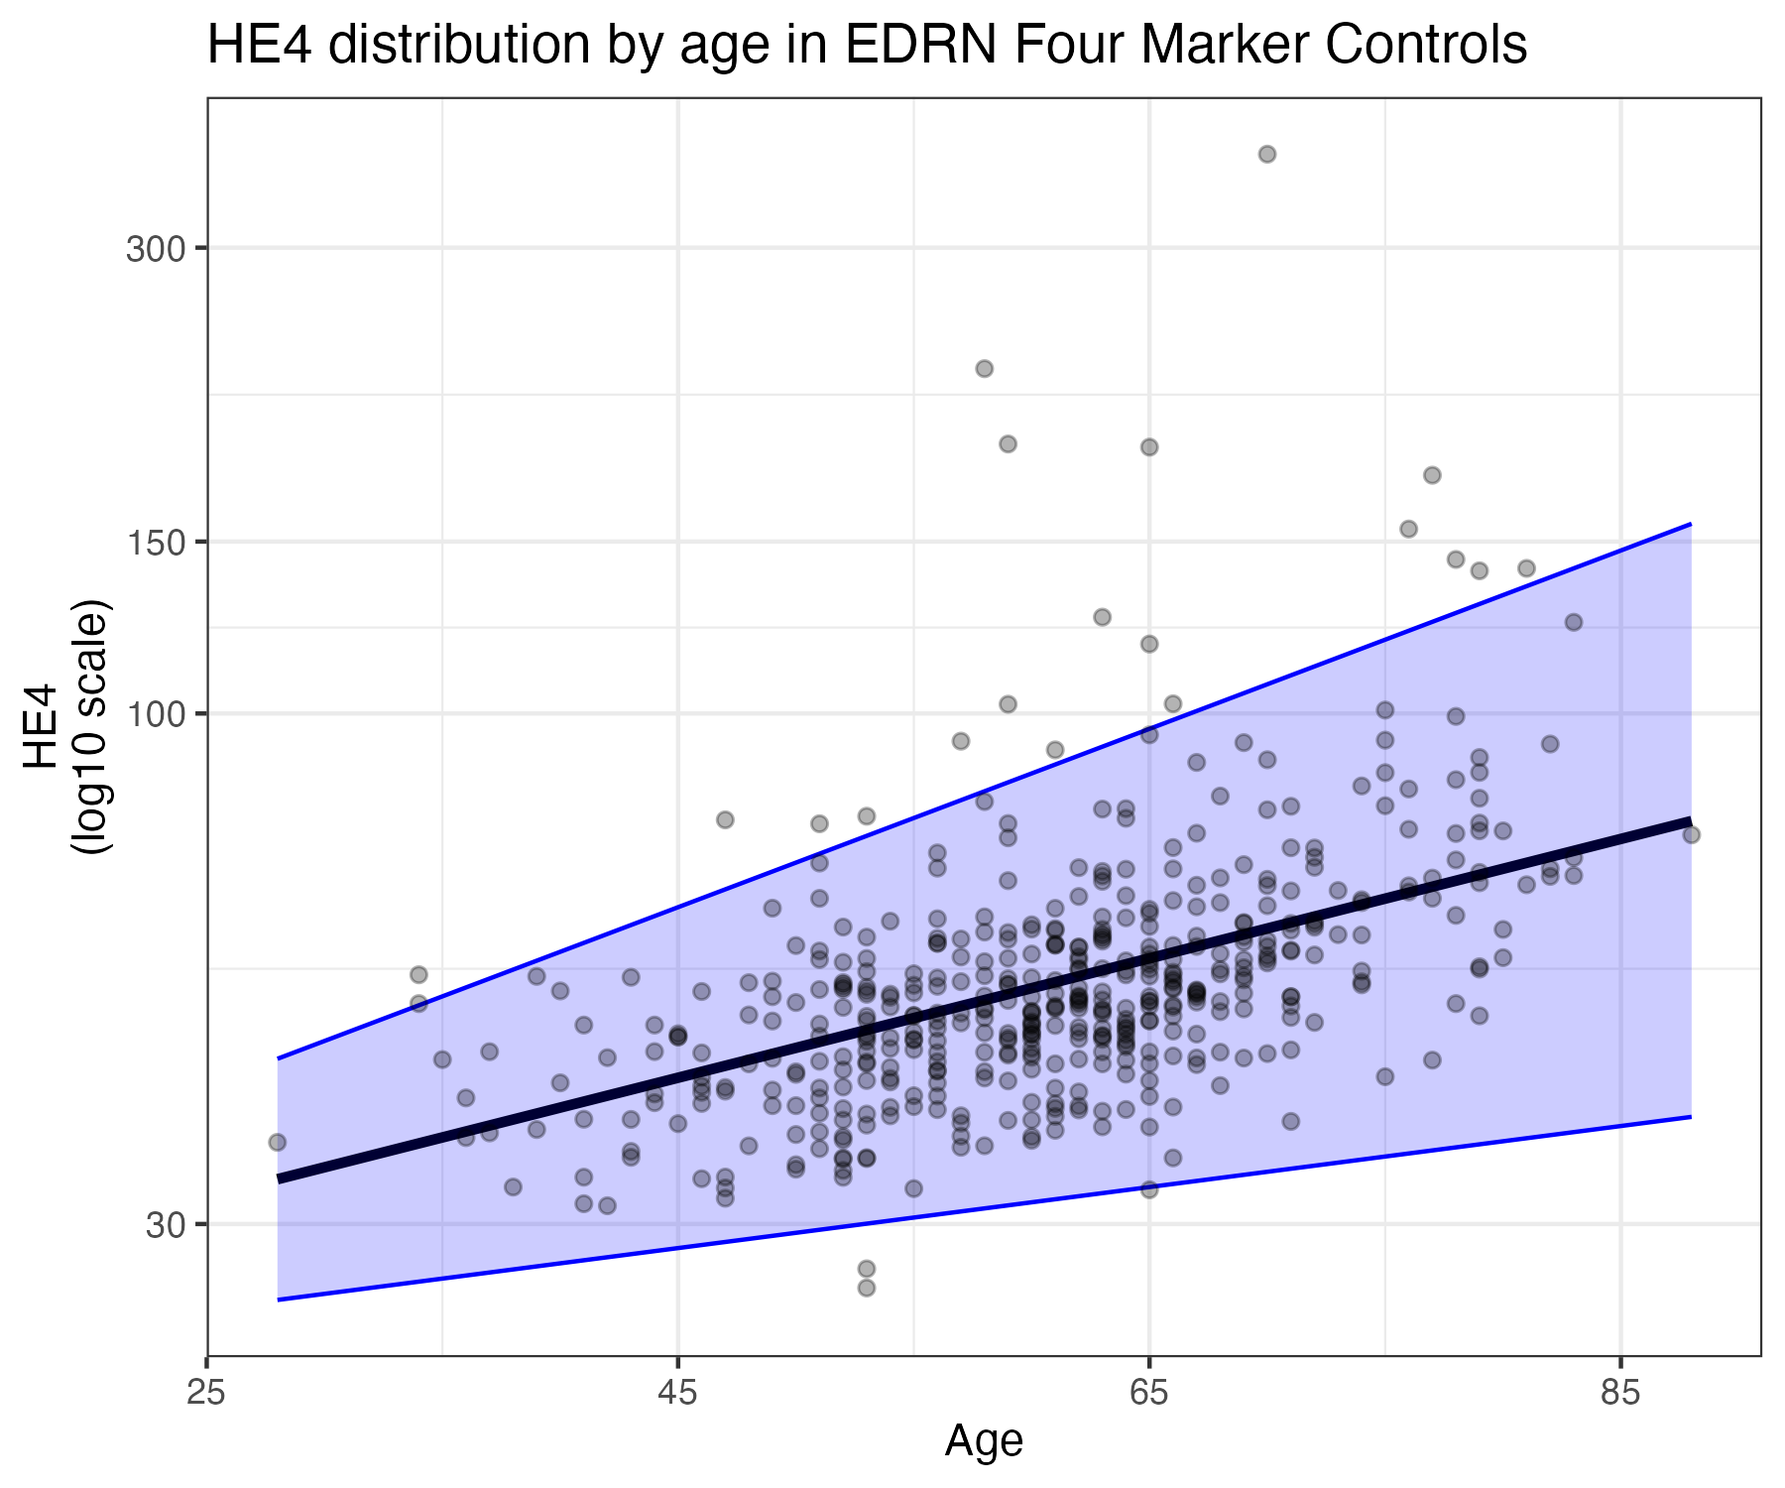
HE4 age-adjustment in ROCA2
HE4 levels increase with age prompting inappropriate referral of older NROSS2 participants to ultrasound
Normalized HE4 values to 65 y/o:
  95th perc. of 85 y/o HE4 dist —>
  95th perc. of 65 y/o HE4 dist
Allowed the ROCA2 to be used with older
AND younger populations
Retrained ROCA2 with age-adjusted HE4,
same risk cutoff (0.2%) for TVUS referral
  NROSS Specificity in 250 controls:
  97.5% (95.6% - 99.4%)
NROSS2 Specificity in participants during 2025:
current = 96.7% (96.0% - 97.5%)
age-adjusted = 98.8% (98.3% - 99.2%)
Notes:
HE4 levels increase with age prompting inappropriate referral of older NROSS2 participants to ultrasound
Daniel Schwartz and Steve Skates have correlated HE4 values with age and examined the 95% confidence limits.
HE4 levels not only rise with age, but also show greater variation
To allow the ROCA2 to be used with older AND younger patients they retrained ROCA2 with age-adjusted HE4, using the same risk cutoff (0.2%) for ultrasound referral.
When run against 5 serial samples from 250 healthy controls form the original NROSS, specificity was 97.5%.
When NROSS2 samples gathered during 2025 were re-run with the age correction, specificity rose from 96.7% to 98.8%.
Currently we are running more samples to determine whether specificity actually exceeds 98%.

Slide 11
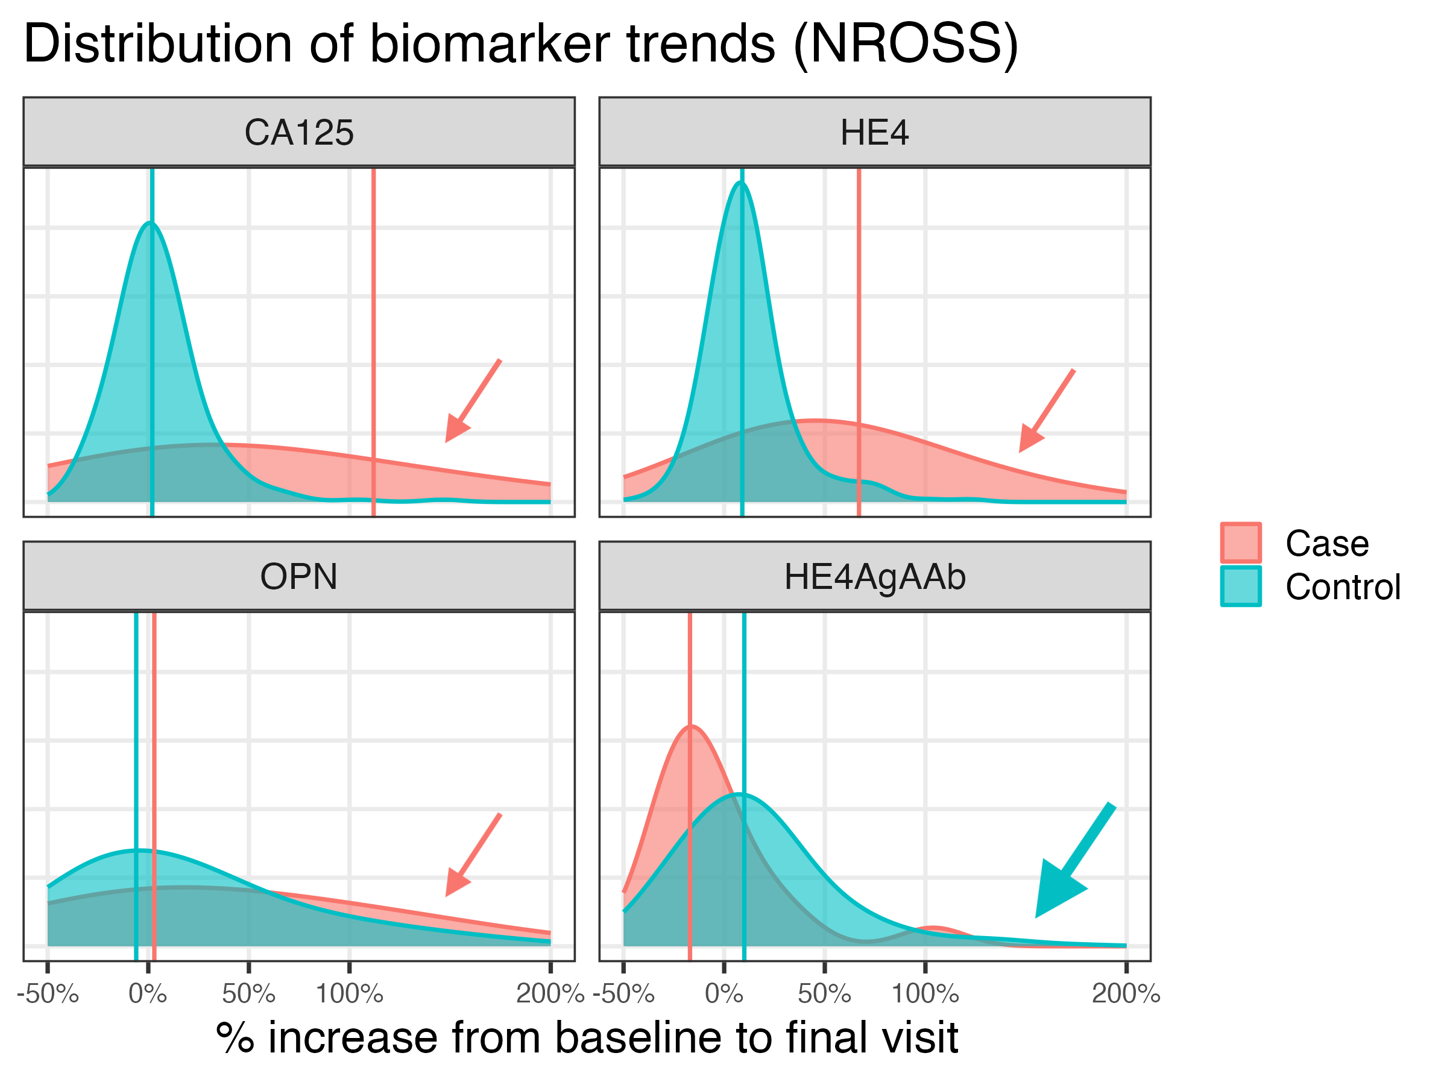
No benefit of adding HE4AgAAb to CA125 + HE4 + OPN
Search for HE4AgAAb signal:
  Included in ROCA2 model
  —> no change in risk scores
  increases sensitivity by 0.0% (98% specificity)
  Measured signal:noise ratio
  —> HE4AgAAB ratio is 106x smaller than CA125, 47x smaller than HE4, and 5x smaller than OPN
  Statistical comparisons of cases vs. controls
  —> HE4AgAAb increases are more common in controls…
Remove HE4AgAAb from ROCA2, providing
a 3-marker algorithm
Median % increase from baseline to final visit
 | CA125 | HE4 | OPN | HE4AgAAb
MDA-Control | 2% | 9% | -6% | 10%
MDA-Case | 112% | 67% | 3% | -17%
Notes:
They have also re-examined the contribution of HE4 antigen-autoantibody complexes to the ROCA2
They observed that the other 3 biomarkers increased with advancing stage, whereas Ag-Aab complexes did not, consistent with the immunobiology of antigen-autoantibody complexes with increasing tumor burden producing more antigen and suppressing antibody production.
When the new HE4 Ag-AAb complex data were Included in the ROCA2 model, there was no change in risk scores increasing sensitivity by 0.0% at 98% specificity
When they measured signal:noise ratio —> the HE4 AgAAB ratio is 106x smaller than CA125, 47x smaller than HE4, and 5x smaller than OPN
When changes from the baseline to final values for the 4 biomarkers from cases and controls were compared in the original NROSS study, —> HE4AgAAb increases were more common in controls…
The investigators are planning to remove Ag-Aab complexes and proceed with a 3-biomarker algorithm

Slide 12
Fred Hutch / UW – Breast CVC
Christopher Li, Savannah Partridge

Slide 13
Validated Biomarkers in Preclinical Sets
Goal: Validation of blood-based and radiomics biomarkers for risk prediction and early detection of breast cancer
Protein Markers
 | WHI 1 (n=121/121) |  |  | WHI2 (n=90/90) |  |  | CHS (n=65/296)
Protein Name | Sens @ 80% spec | p-value | AUC | Sens @ 80% spec | p-value | AUC | Sens @ 80% spec | p-value | AUC
REG4 | 40% | 0.001 | 0.63 | 33% | 0.040 | 0.58 | 42% | 0.010 | 0.66
JAK2 | 34% | 0.017 | 0.64 | 40% | 0.001 | 0.57 | 34% | 0.024 | 0.62
Autoantibody Markers
 |  | WHI 2 |  | WHI 1 |  | CHS |  | WHI CT Phase 3
Protein Name | Marker Type | Sens @80% spec | p-value | Sens @80% spec | p-value | Sens @80% spec | p-value | Sens @80% spec | p-value
TLR2 | IgM | 38% | 0.04 | 31% | 0.04 | 46% | 0.0004 | 21% | 0.19
MSLN | IgG | 32% | 0.10 | 30% | 0.05 | 38% | 0.02 | 22% | 0.37
CUX1 | IgG/IgM | 33% | 0.09 | 30% | 0.06 | 33% | 0.049 | 29% | 0.017
MSD assay development underway
  REG4, JAK2, Autoantibody markers

Slide 14
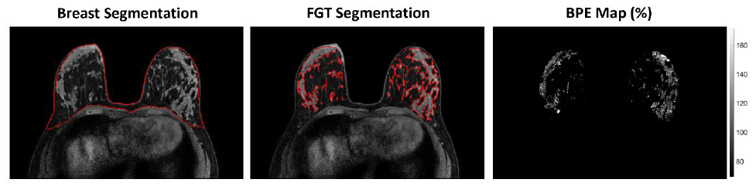
Imaging Biomarkers Under Investigation
Dataset: UW MRI screening cohort (2005 – 2022): 2786 women, 115+, median f/u 9.5 yrs
Background Parenchymal Enhancement (BPE) on MRI
  Qualitative per BI-RADS
  Quantitative 3D BPE metrics
Deep learning MRI-based models
Multi-modality Radiomics (MRI + mammography) - set-aside collab with Moffitt Team (Heine, PI)

Slide 15
Planned next steps:
Evaluate MSD assays on new WHI set (n=228 cases/455 controls) to refine a combination marker decision rule.
Explore multiparametric modeling of BPE plus clinical risk factors to further improve risk prediction performance.
Test MSD decision rule and radiomics markers in the MD Anderson MERIT cohort (~250 incident breast cancers to date), explore integration of blood-based and radiomics markers.

Slide 16
Fred Hutch / UW / Mount Sinai
– Breast BCC
Pei Wang, Amanda Paulovich, Andy Hoofnagle

Slide 17
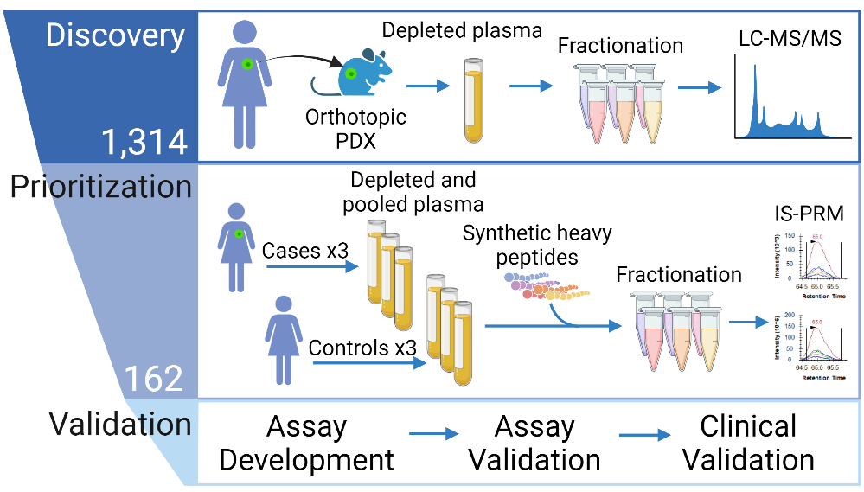
FHCRC/UW/Mt. Sinai
The Main Project aims to build and validate a blood-based biomarker panel for breast cancer that could be used in conjunction with screening mammography to improve sensitivity and specificity:
  Successfully developed immuno-MRM assays for 72 potential protein markers from a list of 162 candidate blood-based biomarkers identified in the previous study phase.
  Expected to establish a multiplex immuno-MRM assay panel of 92 proteins once finalizing all the assay development.
  On the track to obtain the blood specimen from three study cohorts (750 cases and 750 control in total) to evaluate/validate the multiplex immuno-MRM assay panel.

Slide 18
FHCRC/UW/Mt. Sinai
Set-aside project 1, a successful BRL collaboration between Dr. Hoofnagle’s lab at UW and and Dr. Semme’s lab at VHS, aims to construct transferrable assays that distinguish aggressive and non-aggressive prostate cancer.
  Set-up a cross-lab collaboration pipeline for transferrable assay development.
  In the process of developing immuno-MRM assays for 18 candidate peptides from previous candidate list.
Set-aside project 2 aims to leveraging the UK Biobank Pharma Proteomics Project (UKB-PPP) data to screen and validate early-detection biomarker candidates for breast cancer and other cancer types.
  Current UKB-PPP data: N=54,219, marker number=3071 (Olink).
  Next phase UKB-PPP data: N=500,000, marker numbers=5400 (Olink).
    Data will be released in batches over the coming few years.

Slide 19
Moffitt – Breast CVC
John Heine, Matthew Schabath

Slide 20


Moffitt: Clinical Validation Center(CVC) : Breast Projects
Moffitt Cancer Center: John Heine*, PhD; Matthew Schabath*, PhD; Yoga Balagurunathan, PhD; Erin Fowler, MPH; Megan Bullard; Jared Weinfurtner, MD
*Multiple Principal Investigator
NASA Jet Propulsion Laboratory, NCI's Early Detection Research Network (EDRN) and DMCC
Two Ongoing Projects and EDRN Resources
Project 1: Serial mammographic screening study including Phase 3 validation of risk prediction measures validated with three matched-case control studies previously (EDRN resources)
Project 2: BI-RADS 4 prospective diagnostic study (continued study from a set-aside project started last cycle (EDRN resource)

Slide 21

Image Biomarkers & Data Resources
All data was/is collected as EDRN resources and can be shared easily
Original Aims: validated multiple breast cancer risk prediction measures from mammograms
In Phase 2 validation studies using matched case control studies: breast density, Fourier, bilateral asymmetry and correlation measures
EDRN Resource: Three matched case-control studies spanning 2007-2022 are available
Project 1: (1) Phase 3 validation study of risk prediction measures, referenced above, included in absolute risk prediction models (prediction over time) using data collected longitudinally; and (2) make comparisons with AI methods
Current goal n = 8000 women (Current accrual: ~4000 with multiple screening exams)
Shared:
EDRN Data (LabCAS)
Project 2: Prospective diagnostic mammography study of women designated as BI-RADS 4 that seeks to combine blood biomarkers, image markers, and clinical data to reduce negative biopsies (originally a Moffitt and Duke Collaboration)
Current Moffitt accrual goals: prospective n = 1025 and retrospective n = 2525
Blood collection 20ml for serum and plasma for prospective patients only
Current accrual:
Moffitt: prospective n = 622 and retrospective n = 1538
Duke BDL (prior set-aside collaborator) prospective n = 633
Total blood specimens to date: n = 1255 (about 20% breast cancer positive)

