Slide 1








Prostate/GU Collaborative Group
Jeffrey Tosoian, MD, MPH
John Semmes, PhD
Co-Chairs

Slide 2
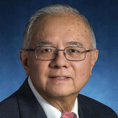




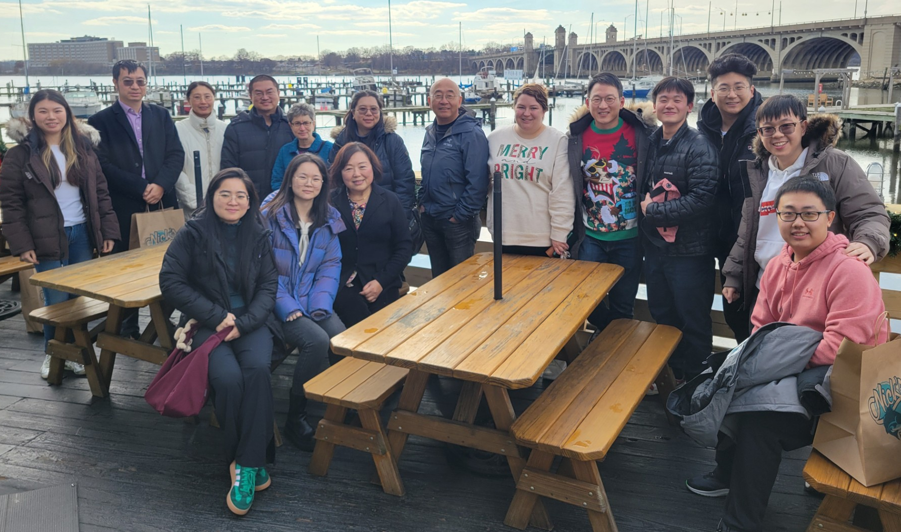

BCC for Prostate Cancer:
Discovery and Translation of Biomarkers for Clinical Unmet Needs
Daniel W. Chan Hui Zhang Zhen Zhang Lori Sokoll Christian Pavlovich
Principal Investigators Co-Investigators
The goal of the JHU BCC is to develop and validate in vitro diagnostic multivariate index assays (IVDMIA) that combine a panel of biomarkers into a single-valued numerical index with the intended use for the clinical unmet needs in prostate cancer.
External Collaborations with Industry
Major Accomplishments
Collaborations with Clinical Diagnostics Companies
  Beckman Coulter, Inc.
  Abbott Laboratories
  Minomic International
Licensing
  Biomarker panels licensed to Alluz Dx for clinical development and commercialization
Biomarker tests with assigned CPT codes and/or FDA approved
  Prostate Health Index (phi)
  Prostate Cancer Antigen 3 (PCA3)
  MiCheck Prostate

Slide 3
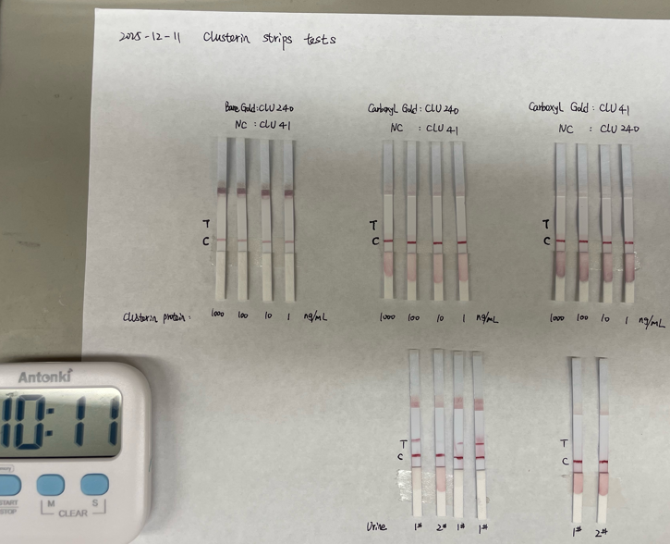
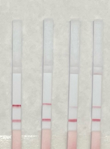
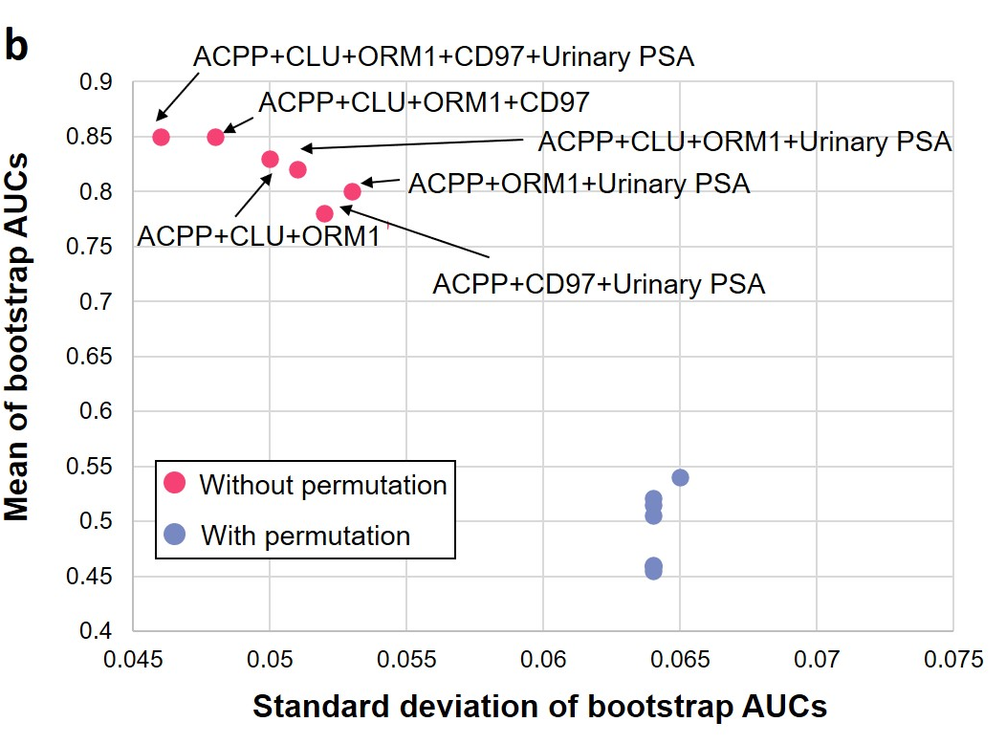
BDL: Recent Accomplishments
Assay development and clinical performance
Lateral flow assays
1. Identified and validated several urinary glycoproteins associated with aggressive PCa
Developed targeted assays and validated candidates
- MS-based targeted assays
- Lateral flow assays
- ELISA
CLU
PSA
T
C
T
C
PRM assays
ELISA
Notes:
Parallel reaction monitoring: mass spec technique for precise quantification of proteins/peptides in complex samples

Slide 4
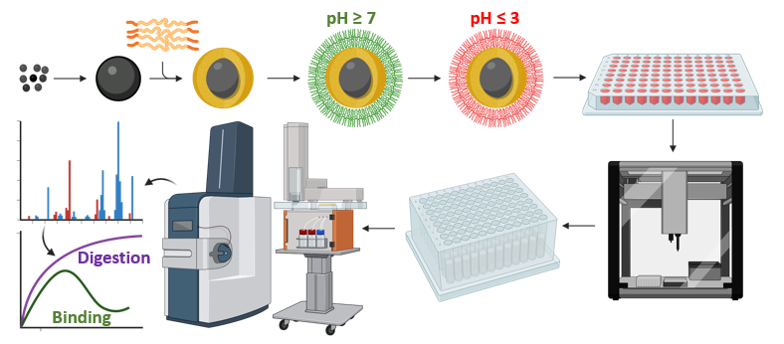
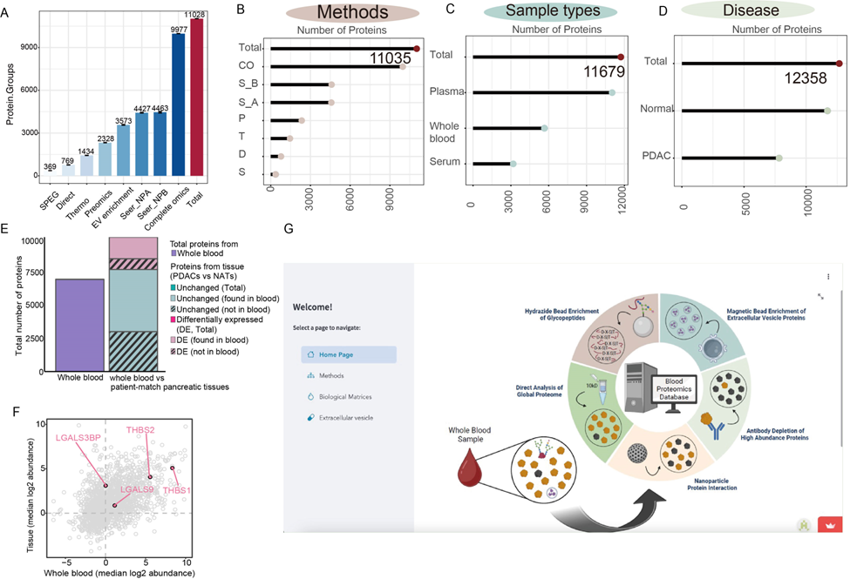
BDL: Ongoing Project
Blood Proteomics by Automated Nanoparticles and Mass Spectrometry
Sample cohorts under analysis
EDRN Reference set
598 total plasma: 255 malignancy present
JHU AS cohort
400 total blood specimens
150 x2 stayed as non-aggressive prostate cancer with two time points
50 x 2 upgraded tested in two time points

Slide 5
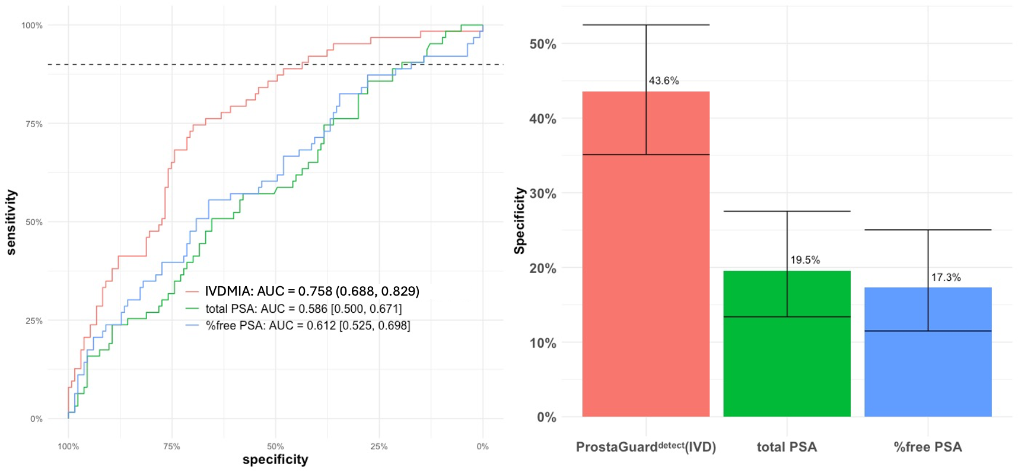
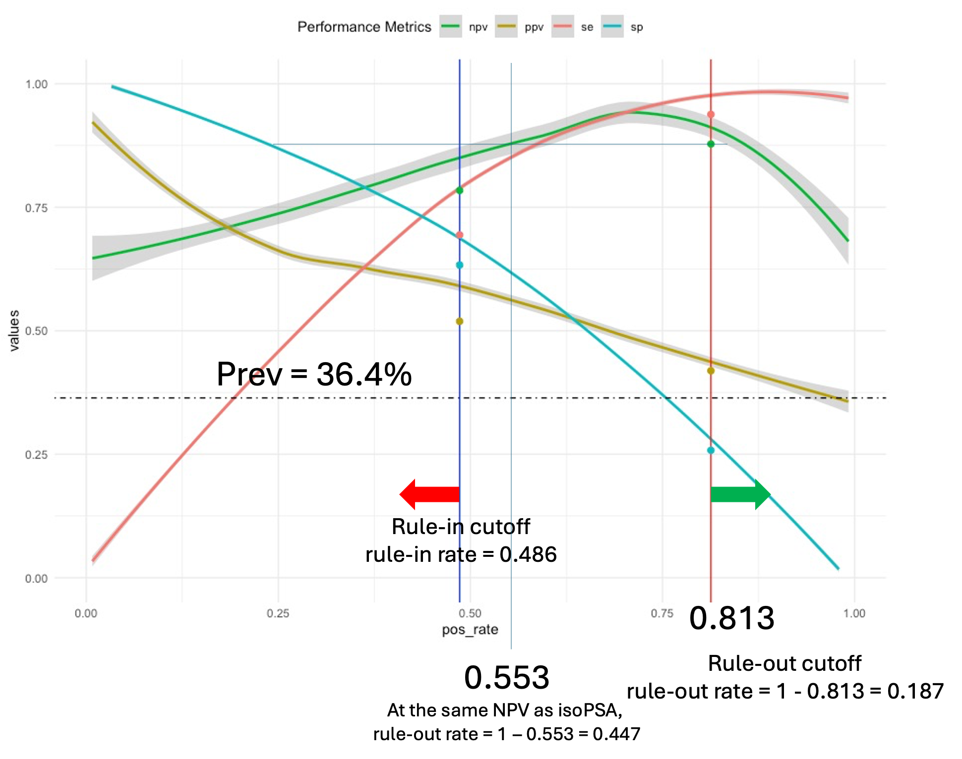
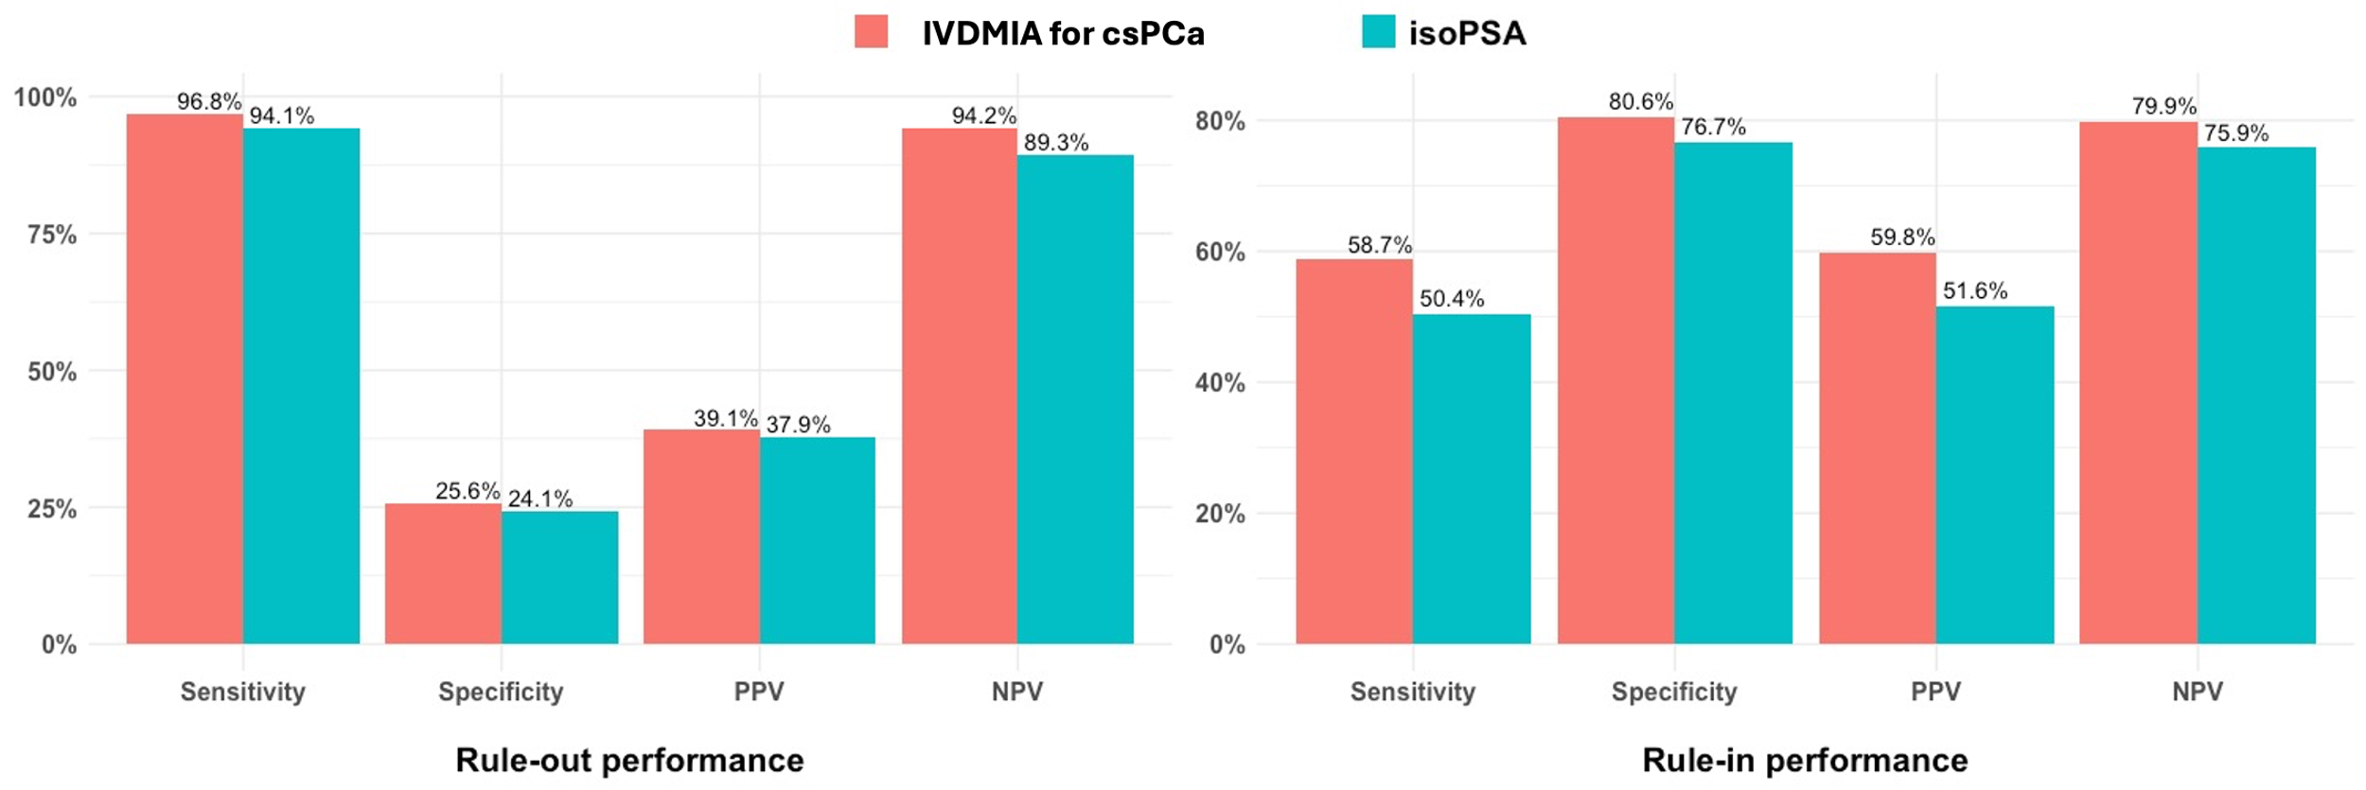
IVDMIA of multiplexed protein markers for detection of high-grade PCa: comparison to newly FDA approved isoPSA test
BRL: Translating discoveries to LDT/IVD
Differentiating ≥GG2 from GG1/GG0
Using our test data to simulate subgroup prevalence as isoPSA PMA study, the IVDMIA would have improved NPV (95.7% vs 87.8%) at the same rule-out rate as isoPSA; or at the same NPV with 44.7% rule-out compared to isoPSA 18.7%.
Comparison to isoPSA
Notes:
In Vitro Diagnostic Multivariate Index Assay (IVDMIA)

Slide 6
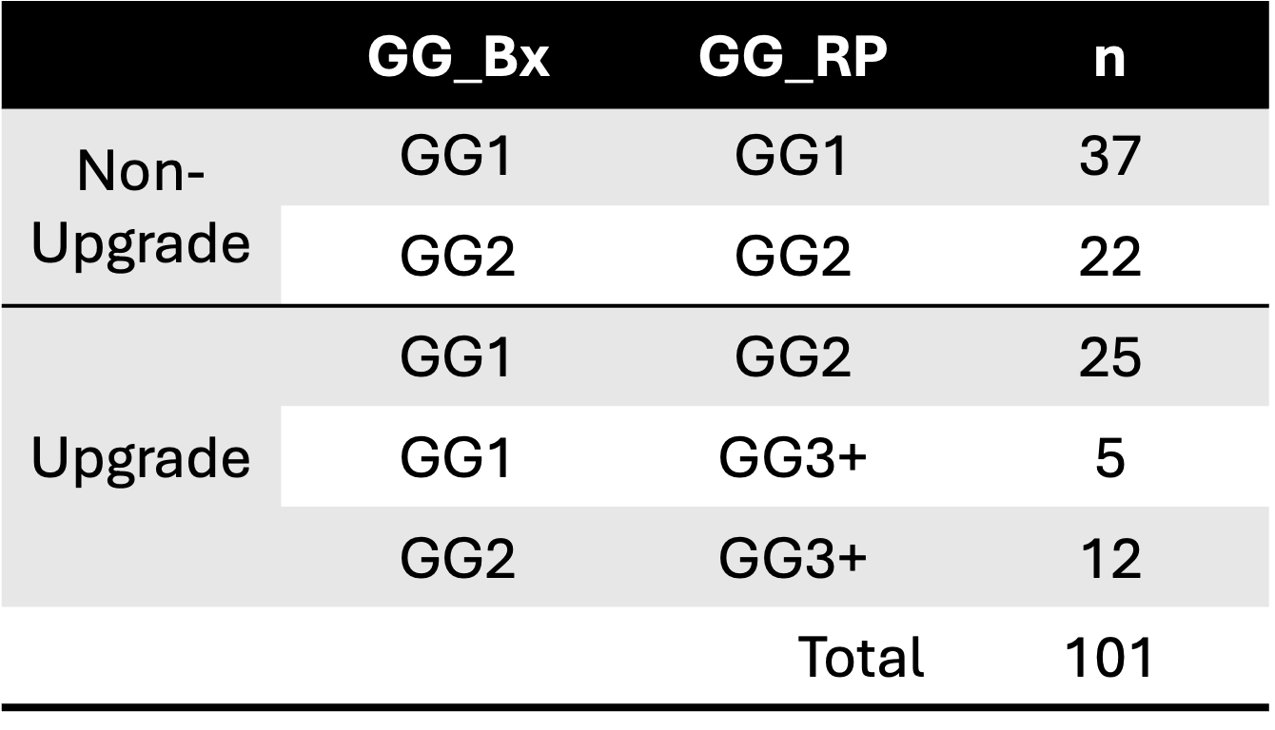
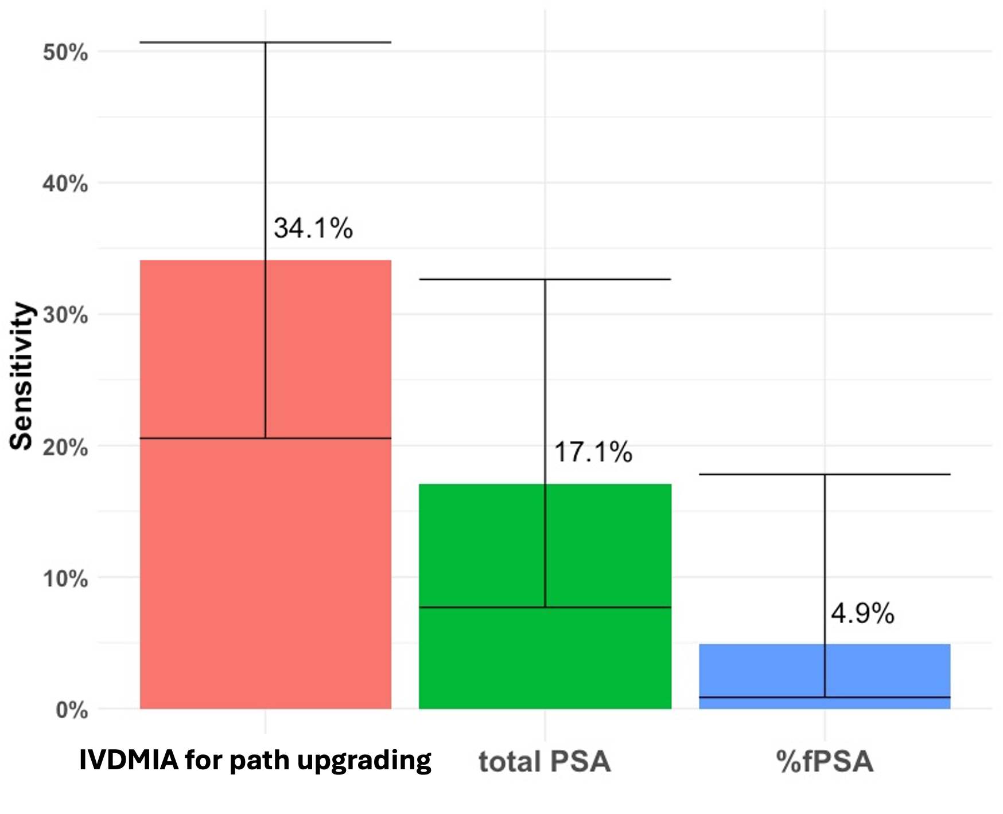
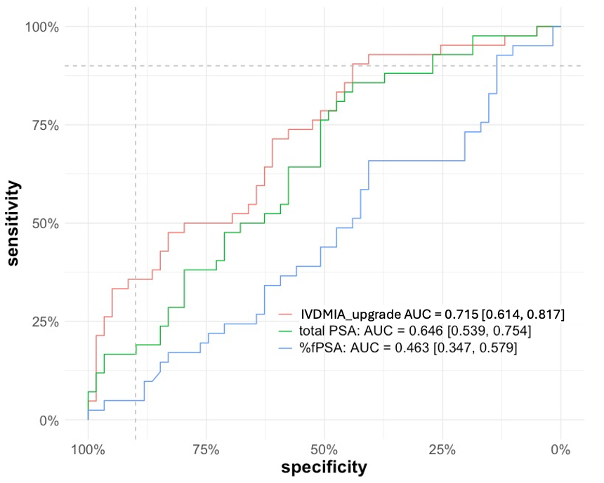
Prediction of pathologic upgrading
Sensitivity at 90% specificity

Slide 7
Translation to clinical test and next steps
Licensed to Alluz Dx.
Working to better define intended clinical use.
Further evaluation with EDRN ref sets and other high-quality clinical sets to generate clinical evidence to support commercialization.
Objective is to develop into LDT first and work with IVD/Ref labs for further platform specific assay analytical development and eventual pivotal clinical study.

Slide 8
Virginia UCLA Toronto* BCC
Paul P. Boutros, PhD
Thomas Kislinger*
John Semmes, PhD
MPI

Slide 9
Accomplishments
Identification of Urine Peptides as Candidate Biomarkers to Discriminate between Low- and High Risk Disease.
Our BCC team has completed biomarker discovery efforts toward early detection of significant prostate cancer through the application of mass spectrometry. Our data derives from the in-depth proteomic profiling of 929 patients, representing several risk stratification strategies including ISUP grade group, and clinical/pathological upgrading. Nature Comm. 2024,Nature Review Urology 2021, Nature Comm. 2016.
Development of PRM-MS CLIA-Compliant Assays for Detection of High-Risk Disease.
From the above discovery efforts we have selected 132 peptides associated with 76 proteins to build PRM-MS assays under CLIA compliant process. This assay development is underway in our BRL team. This project is a collaboration with Emory CVC and Fred Hutch/WU BRL.
Development of Crowd-sourced Benchmarking for Optimization of Algorithm Performance.
In the context of bringing biomarkers to the clinic, it is critical to integrate performance benchmarking into this workflow. Nature Biotechnology 2025b.
Development of Novel Approaches to Identify Previously Inaccessible Proteome.
We developed moPepGen as novel computational tool that combines proteogenomic data to identify unobservable noncanonical peptides arising from genomic variants, noncoding open reading frames, RNA fusions and RNA circularization (i.e., so called peptidoforms).Nature Biotechnology 2025a

Slide 10
Highlighted Accomplishment: moPepGen Resource for Identification of Unobservable Non-canonical Peptidoforms
Notes:
novel computational tool that combines proteogenomic data to identify unobservable noncanonical peptides arising from genomic variants, noncoding open reading frames, RNA fusions and RNA circularization (i.e., so called peptidoforms).

Slide 11
Ongoing High-Value Projects Advancing Phase 3 Validation
Development of targeted protein-based assay for early detection of aggressive prostate cancer in urine.
  Protein-based biomarker panel for the early detection of significant prostate cancer in Active Surveillance.
  We are conducting concurrent validation in both post-DRE or non-DRE. BRL-BRL collaboration with FHCRC/UW.
  The assay will be suitable for planned Phase II/III studies.

Slide 12
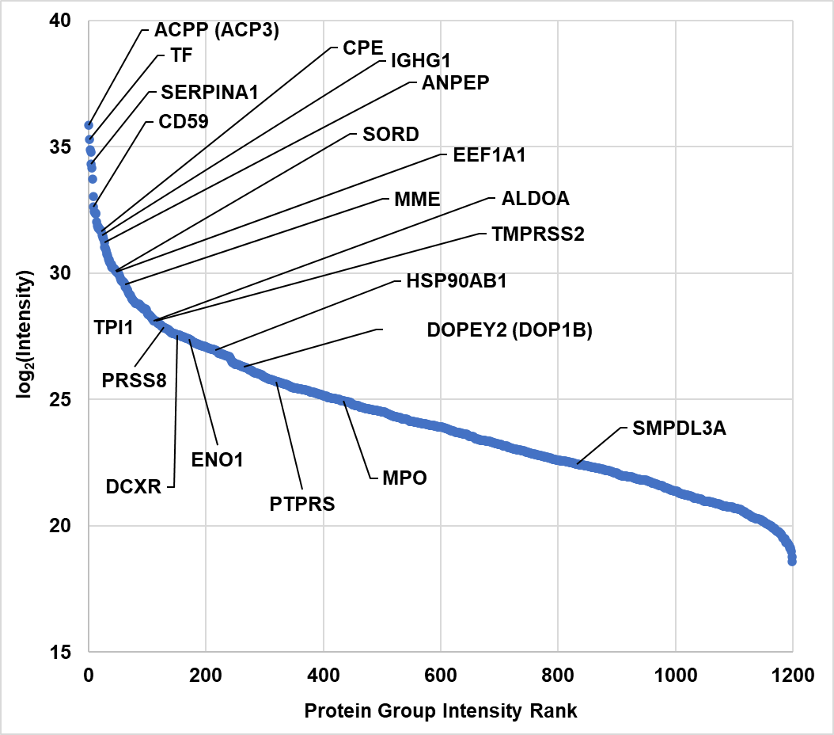
Ongoing High-Value Projects Advancing Phase 3 Validation: Building CLIA-Compliant Assays for Detection in Urine
Discovery Cohort
Selection Criteria
Relative Peptide Abundance in Post-DRE Urine
Co-development of anti-peptide immunoenrichment and antibody-free CLIA-compliant Targeted Assay
Notes:
5822

Slide 13
Michigan-Vanderbilt (VUMC) BCC
MPArul Chinnaiyan, MD, PhD, University of Michigan
Jeffrey Tosoian, MD, MPH, Vanderbilt University Medical Center

Slide 14
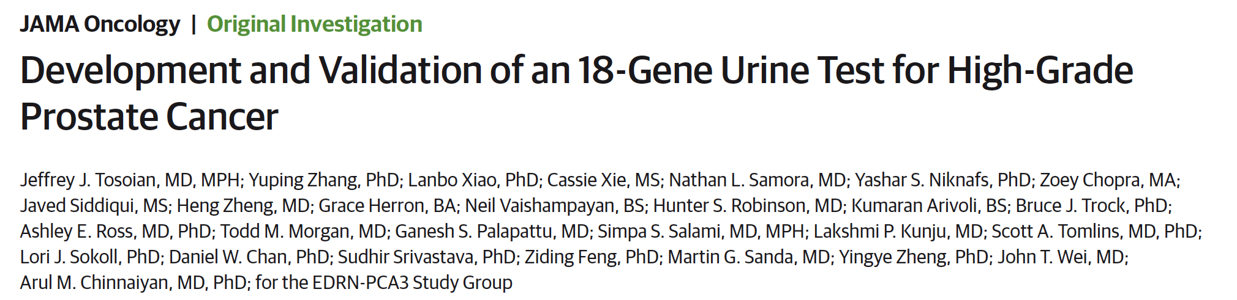

Major Accomplishments
2024: Development and validation of novel urine test (MPS2) for early detection of high-grade PCa
1. Discovery
-Measure ~60K markers in benign, GG1, GG2-5 tissue with RNAseq
-Identify candidate markers overexpressed in cancer (vs. benign) and GG2-5 (vs. GG1)
2. Development
3. Validation
-Blinded performance assessment in appropriate external study population
-Head-to-head comparison with existing biomarkers
-Measurable in post-DRE urine by PCR
-Optimal testing approach for detection of GG≥2 cancer: 18 markers

Slide 15
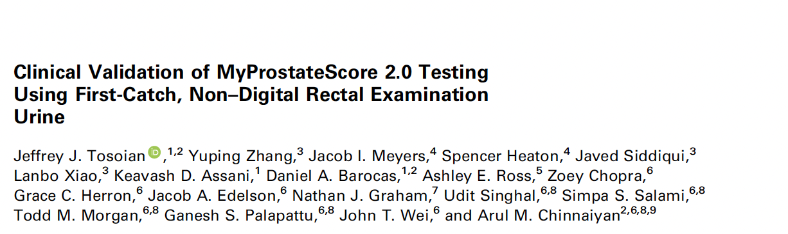

Major Accomplishments
2025:
MPS2 re-validation in non-DRE urine
Addition to NCCN clinical guidelines
Reimbursement approved by CMS

Slide 16
Ongoing high-value projects
Development and validation of a novel MPS2-based test for monitoring on active surveillance
External validation
  Patients on AS for GG1 PCa
  Spanning 11 community and academic urology practices
  Patients underwent prostate MRI followed by biopsy
  MPS2-AS performance compared to MRI and PSA-based testing
  Recruitment ongoing
Notes:
Please include in this slide where your biomarkers are in the Phase and what is needed to get them to the next phase.

Slide 17
Ongoing high-value projects
Clinical consequences of testing – initial data (N~300)
Model | GG≥3 Upgrades Detected (Sensitivity) | Unnecessary Bx Avoided (Specificity) | NPV | PPV
MPS2-AS | 97% | 64% | 99% | 22%
PSA | 97% | 17% | 98% | 11%
PCPTrc | 97% | 17% | 98% | 11%
PSAD | 97% | 23% | 99% | 12%
MRI: PR≥3 | 81% | 51% | 96% | 15%
MRI: PR≥4 | 78% | 66% | 96% | 20%
Use of MPS2-AS prior to required AS biopsies would avoid approximately 2/3 of those biopsies while maintaining immediate detection of 97% of significant upgrades (GG≥3)
Under Review
Notes:
Please include in this slide where your biomarkers are in the Phase and what is needed to get them to the next phase.

Slide 18

Emory, UAB & UTSW Prostate Cancer CVC Collaborations
EDRN-BCC or NCI Project # | Biomarker (Biospecimen) | Study Design (Clinical Target) | Target N
U Michigan EDRN Set-aside | 18-gene MPS-2 (Non-DRE Whole Urine) | Blinded Phase II (Diagnostic Biopsy) | 282
Johns Hopkins EDRN Set-aside | Glycoproteome by Targeted LC-MS (Post-DRE Urine) | Case-Control Phase I (Diagnostic Biopsy) | 100
Eastern Virginia Med School EDRN Set-aside | Proteome by Targeted PRM-MS (Non-DRE vs Post-DRE) | Case-Control Phase I (GG1 vs GG3+ in Active Surveillance) | 200
Vanderbilt LynxDx EDRN Core Fund | Validation of the MPS2 Test for Non-Invasive Monitoring of PCa on Active Surveillance | Blinded Multi-site Phase II | 100
Dana Farber U01-CA296432 (S Baca, PI) | Predicting PCa risk via multi-ancestry epigenome profiling and chromatin QTL discovery | Case-Control Phase I | 100

Slide 19

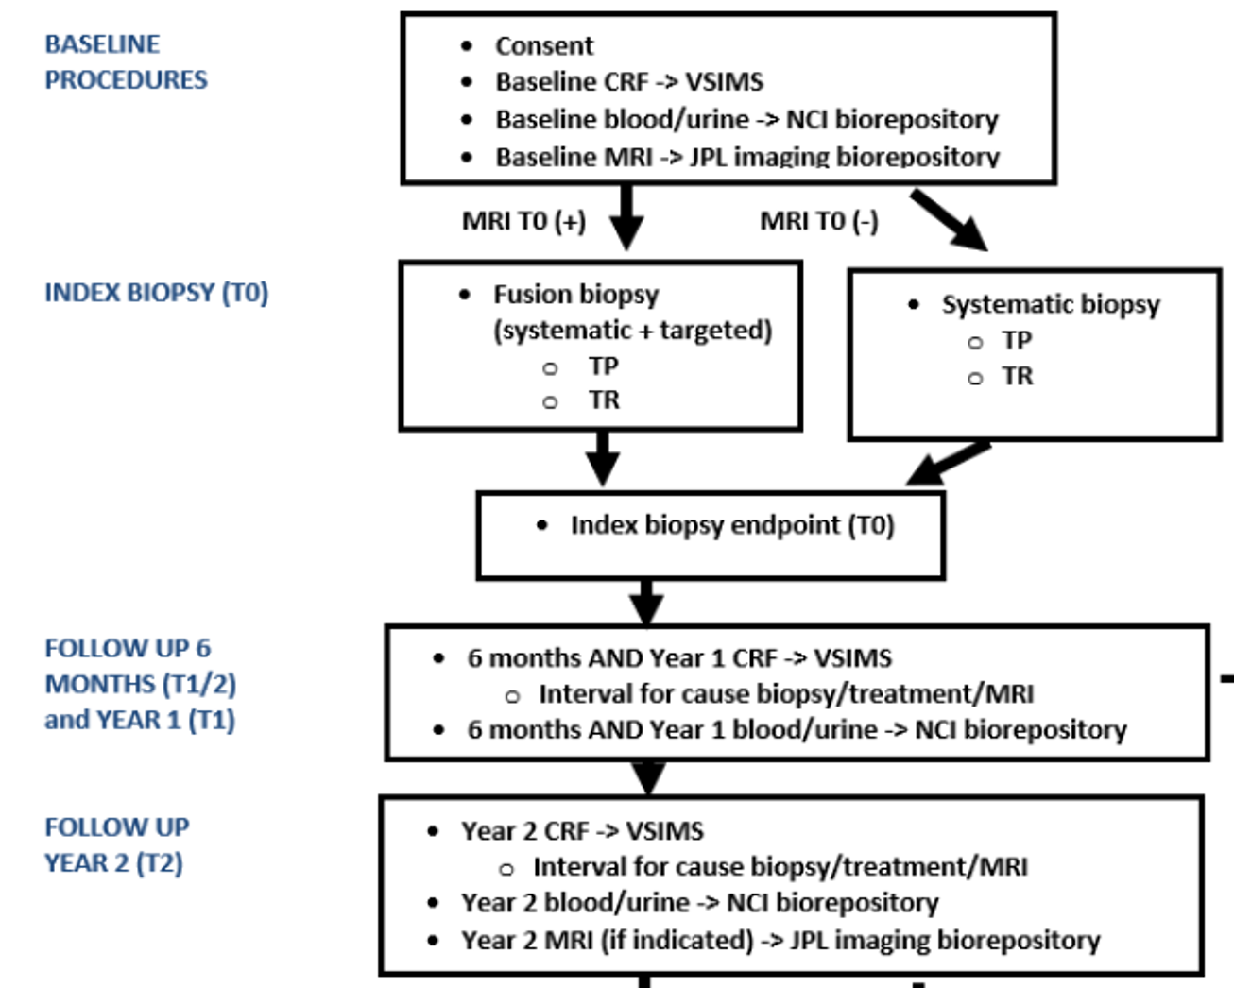
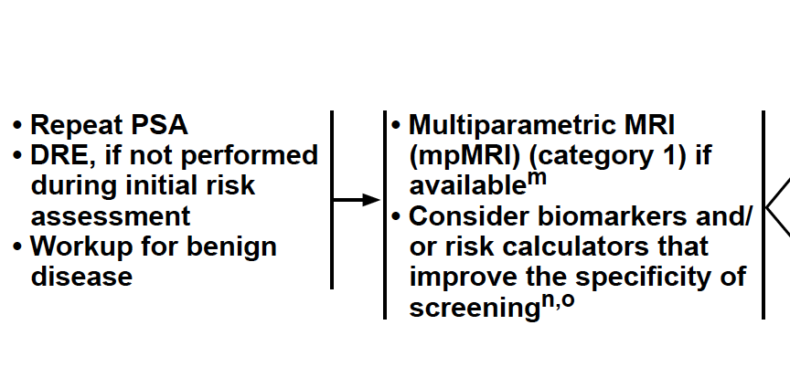
PMRI: PHASE 2
Central question in the field:
When and how to use each of MRI and biomarkers?

Slide 20

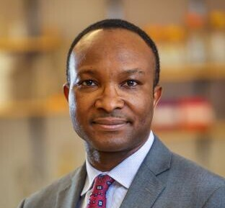
PMRI: PHASE 2
John Wei, MD, MS
Simpa Salami, MD, MPH

Slide 21
GU Vision & Strategic Direction
Thematic goals:
Continue to foster inter-site collaboration that drives the EDRN’s unique productivity
Use thoughtful, adaptive study design to accelerate validation and translation to clinical use
Leverage industrial partnerships for seamless commercialization of newly validated assays
Specific goals:
Combine EDRN-supported guideline-endorsed tests and imaging to validate the standard-of-care diagnostic approach to clinically-significant prostate cancer
Validate and disseminate clinically the first standard-of-care non-invasive test to replace periodic biopsies in men on active surveillance
Demonstrate clinical utility and cost-effectiveness of validated testing approaches

Slide 22
THANK YOU

