Slide 1
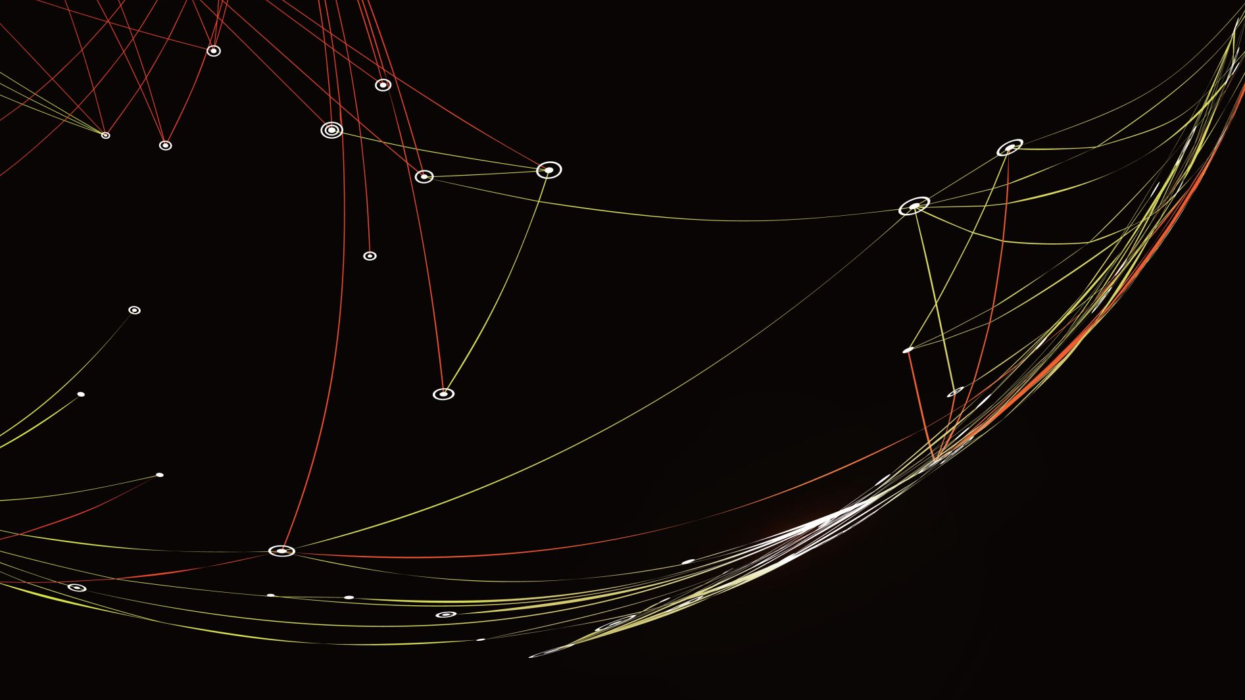
EDRN Lung / H&N collaboative group update
March 5th 2026
45th EDRN steering committee
Houston, TX

Slide 2
Recent & Upcoming deliverables
ASU Head & Neck CVC
  Completed development of lateral-flow assay for anti-HPV-16 antibody testing, screening of 4000 individuals. At home sample collection protocol development and testing.
  NEXT: Launching Southwest Screening Study. 2500 participant population study with in-depth clinical screening in individuals postivie for HPV-16 Ab or DNA .
Moffitt Radiology CVC
  New deep learning models for lung cancer risk assessment that incorporate longitudinal imaging outperform models like Sybil
  New deep learning models of tumor recurrence that segment nodules into a mixture of habitats outperform and combine with more homogenous intratumor models
  NEXT: Validation and implementing federated approaches to model development and testing

Slide 3
Recent & Upcoming deliverables
BU-UCLA Lung Cancer BCC
  Veracyte completed enrollment of 2400-person clinical utility trial for Percepta Nasal Swab (PNS). Patients will be followed for 2-years to determine change in patient outcome
  NEXT: Develop and test deep learning models combining CT imaging and nasal gene expression to potentially augment PNS
NYU Lung Cancer BCC
  Completed blood multi-omic data generation for diagnostic biomarker development focusing on metagenome, metabolome and extracellular vesicles
  Completed tissue multi-omic data generation for prognostic biomarker development focusing on metagenome, metabolome, and host transcriptome
  NEXT: Work on orthogonal targeted approaches and spatial approaches

Slide 4
Recent & Upcoming deliverables
MDACC Lung Cancer CVC
  Developed multi-cancer risk stratification test (MCaST) based on previous panels developed for lung cancer
  NEXT: establishing frameworks for clinical utility trials of MCaST (and 4MP)
JHU Lung Cancer CVC
  With DELFI, completed Phase III validation studies of cfDNA fragmentome assay for lung cancer early detection (n=12,000)
  NEXT: Results of validation study expected Q4 2026. Evaluation of multiple analytes and features for higher-performance early detection tests

Slide 5
Recent & Upcoming deliverables
Vanderbilt Lung Cancer CVC
  Validated four protein biomarker (and 4MP + Fungal) for cancer diagnosis. Additional work on stage, treatment response, and risk
  NEXT: Work with Roche to expand indication of 4 MP components for lung cancer. Complete SPOT-IT trial of radiomic clinical utility trial.
Pittsburgh Lung Cancer BCC
  Developed new technology based on hairpin probes with different melt temperatures to increase multiplexing for cfDNA-methylation detection by up to 12-fold. Necessary for MCED testing
  NEXT: Work to translate this technology to clinical testing

Slide 6
Recent & Upcoming deliverables
ASU Lung Cancer BCC
  Identified 44 auto-antibodies and 3 serum proteins that individually have > 15% sensitivity at 90 or 95% specificity for discriminating benign and malignant IPN
  NEXT: Validate these analytes and move high performing markers to MSD platform for further validation.

Slide 7
Focusing on deliverables and milestones
Had quick updates from each center to identify progress so far and deliverables for the rest of each center’s funding cycle
Some initial work on developing milestones toward achieving these goals
Going forward, will transform our monthly meeting: quarterly updates on progress toward milestones that will help us track progress toward larger deliverables
Collectively we can help troubleshoot any challenges as well as identify additional opportunities.
Frequent discussion of each center’s progress will also help us anticipate future biospecimen needs that the group can then work to provide
Our centers are involved in a diverse portfolio of biomarker projects at all phases of development. The exercise around current and future deliverables helps us catalog those that are moving to Phase III and Phase IV validation

Slide 8
Image Analysis in LTP2
LTP2 is a PRoBE-compliant blinded biomarker comparison study for testing biomarkers that distinguish between benign and malignant indeterminate pulmonary nodules, multi-center mix of prospectively collected and retrospective cases (n=300)
Biospecimens have been distributed to molecular labs, testing completed, and results returned to DMCC
To begin biomarker comparison and look at biomarker combinations, we need assessment of imaging-based biomarkers to be completed.
Have encountered real challenges with CT deidentification between clinical sites
Have convened a DICOM-headers working group which is working diligently to resolve issues. JPL team has been very helpful in identifying deidentification best practices
We renewed our commitment at this meeting to get this done

Slide 9
New opportunities for EDRN collaboration with AHEAD
AHEAD group has initiated many exciting intra-AHEAD collaborations (which you’ll hear about shortly)
We identified an opportunity for AHEAD to publish a description of their success in developing these initiatives over a relatively short time frame and what lessons they learned from EDRN.
Also identified several exciting areas for AHEAD-EDRN collaboration
  Relationship between H&N premalignancy and lung squamous premalignancy
  Relationship between biomarkers that predict premalignant progression in H&N vs. lung cacner
  Relationship between diagnostic biomarkers in H&N vs. lung cancer
Plan to meet further and build concrete plans around these ideas

