Slide 1


AHEAD Collaborative Group Update
Co-Chairs:
Sara Pai, MD, PhD, Yale University
Yu Leo Lei, DDS, PhD, MD Anderson Cancer Center
NIH:
Zhong Chen, MD, PhD, NIDCR
Jason Wan, PhD, NIDCR
Wendy Wang, PhD, MSc, NCI

Slide 2

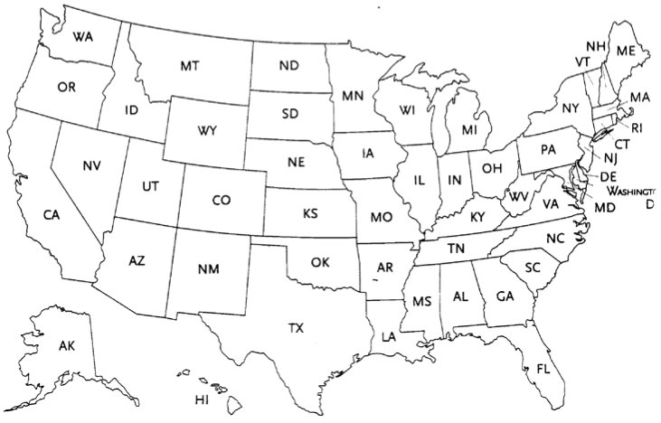
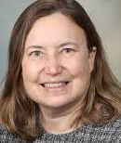

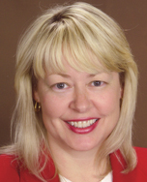

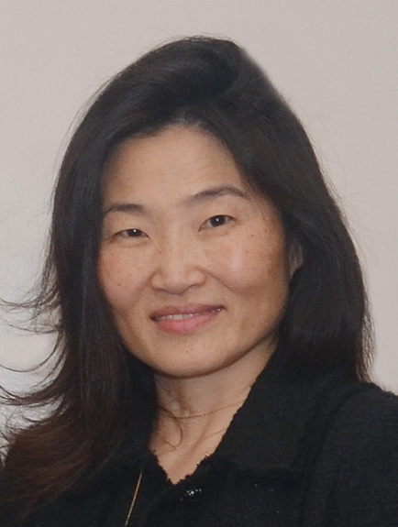

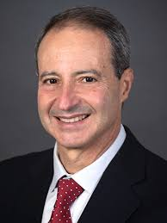
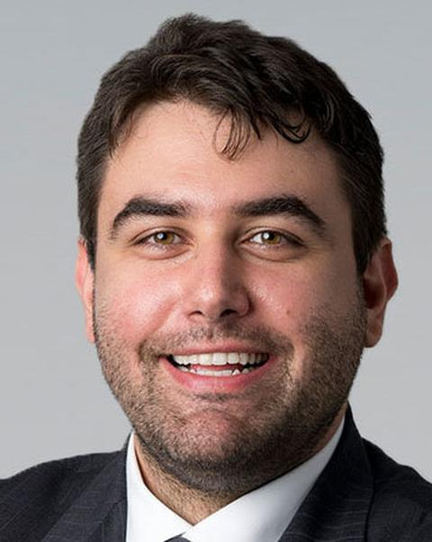
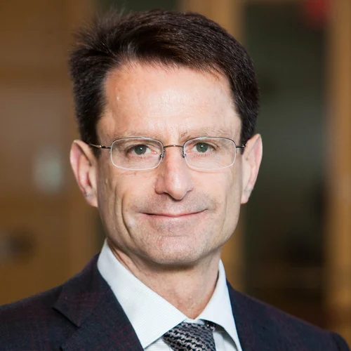
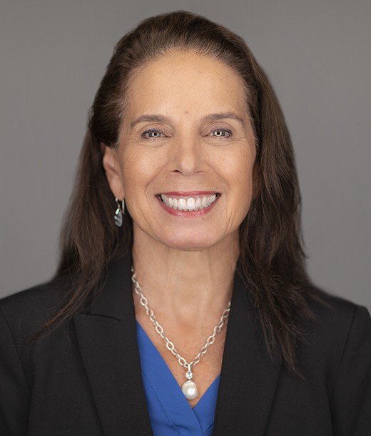
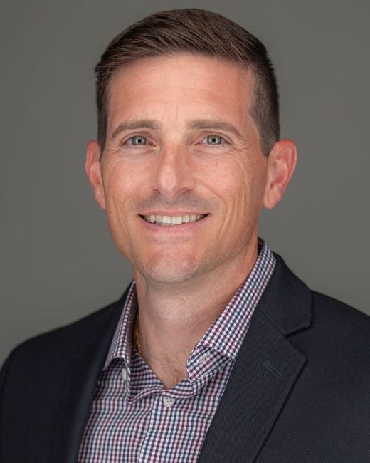

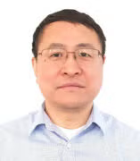
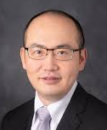


ADVANCING HEAD & NECK CANCER EARLY DETECTION RESEARCH (AHEAD)
16 PIs; 11 Institutions
Southwest EDRN Clinical
Validation Center for Head
and Neck Cancer
Karen Anderson (C, ASU);
Erich Sturgis (Baylor);
Ann Spolarich (ATSU)
Immune and Transcriptomic Biomarkers of Progressive Oral Premalignant Lesions
Fatemeh Momen Heravi (UCSF)
Early Detection and Risk of Head and Neck Cancer through Immune Based Spatial Omics
Sara Pai (Yale)
Mapping Immuno-Genomic Drivers of the Head and Neck Precancer Invasive-Disease Transition
Ludmil Alexandrov (C); J Silvio Gutkind; Scott Lippman (UCSD)
Oral Dysplasias to Carcinomas: Multi-Omics Study of Progression
Laura Rozek (Georgetown)
Advancing On-Slide and Optical Biopsy Tools to Detect High-Risk Oral Premalignancy
Y Leo Lei (C, MD Anderson); Steven Chinn; Thomas Wang (Univ Michigan)
Combined Imaging and RNA Analyses to Predict Head and Neck Cancer Recurrence
Hua Li (C, Wash U); Xiaowei Wang (UIC)
Biomarker Approach to Screening for the Early Detection of HPV-Related Oropharyngeal Cancer (BASH OPC)
Anna Giuliano (C); Antonio Amelio (Moffitt)
Notes:
AHEAD is an exciting new early detection program that was created under the visionary leadership of NIDCR. This program allows us to closely work with dentists to discover and validate biomarkers for pre-cancerous lesions with true high risks. Similar to the SPORE and Moonshot programs, AHEAD also has noted geographic diversity and connects a broad scientific community in collaboration with the NCI’s Early Detection Research Network, or EDRN.

Slide 3
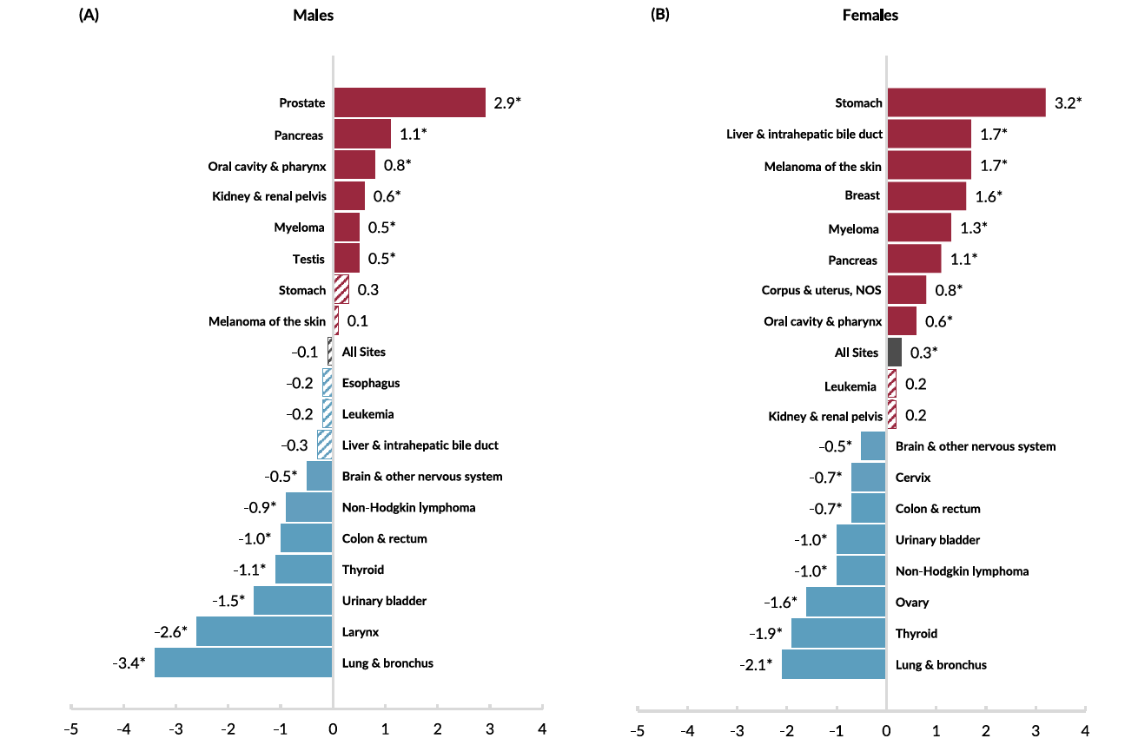
Oral Cavity & Pharynx Cancers Are Increasing in Incidence Among Both Male and Female
2025 Annual Report to the Nation on the Status of Cancer

Slide 4
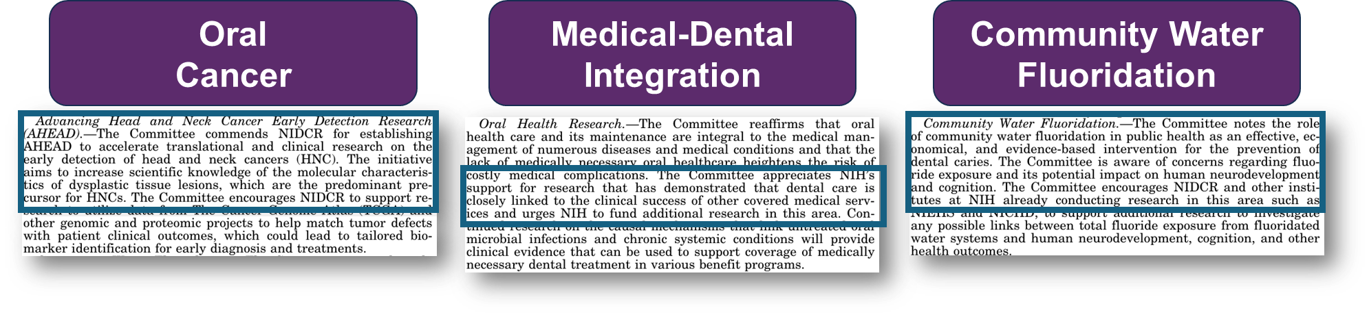
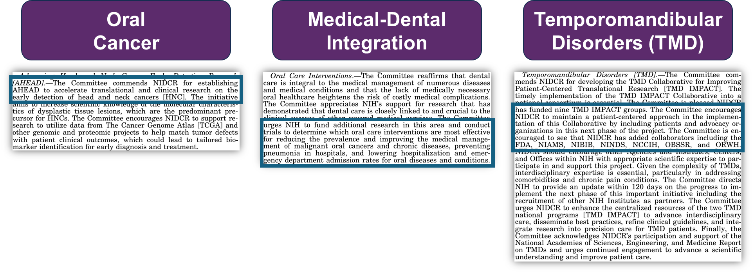
Fiscal Year 2026 Appropriations – House Report Highlights
Fiscal Year 2026 Appropriations – Senate Report Highlights

Slide 5
Project Number Contact PI | Goal | Cohort type Unique aspects | Biomarker platform | Biomarker type
U01CA290479 Alexandrov, Ludmil | Identify transition from an OL into OSCC | 300 OL from two existing and one prospective cohorts | Deep whole-exome sequencing; total RNA sequencing Spatial multiplex immune profiling Single cell genome, transcriptome, and immune landscape (mouse model) | Genomics, Transcriptomics & Immune
U01DE033351 Momen Heravi, Fatemeh | Identify progressive OL with a high risk of OSCC conversion | 820 OL from 3 existing cohorts; high racial and gender diversity | RNA sequencing and spatial transcriptomics Multiplex immune fluorescence | Transcriptomics & Immune
U01DE033330 Lei, Yu Leo | Discover features to capture high-risk OED at the earliest phase | 100 OED and HNC from existing cohorts | Immunometabolic markers (genetically engineered mouse models) Confocal laser endomicroscopy On-slide ancillary studies, multiplexed single-cell FISH | Immune & Metabolomics
U01DE033348 Rozek, Laura | Identify those hallmarks of OED lesions that lead to OSCC | 833 OED from existing cohorts; followed since 2009 (Greek population) | Histology RNA-seq; exome sequencing DNA methylation | Genomics, Transcriptomics & Epigenetics
U01DE033324 Pai, Sara | Improve risk assessment for malignant progression of oral lesions | 270 pre and cancer samples from existing & prospective collections | Single-cell profiling; RNA sequencing Spatial omics technology using SAFE (scission-accelerated fluorophore exchange) Immune-based biomarkers | Immune & Transcriptomics
U01DE033329 Giuliano, Anna | Distinguish HPV+ early OPC cases from late-stage cancer and controls | 497 early and late staged OPC from existing & ongoing prospective collections | Non-invasive HPV16 DNA test Host gene methylation oral biomarker panel | Epigenetics & Viral genetics
R56DE033344 Li, Hua | Computational model for early prediction of HNSCC treatment responses and tumor recurrence | 200 HPV+ and 200 HPV- HNSCC from two existing cohorts | Radiologic (PET, CT, MRI), histologic and digital pathology imaging Host and HPV RNA biomarkers Network-based deep learning and belief function theory methods | Imaging, Digital pathology, & Transcriptomics
U01CA281660 Anderson, Karen | Southwest EDRN Clinical Validation Center for Head and Neck Cancer | 2,500 Normal individuals for screening of HPV+ HNSCC | Salivary (HPV16 qPCR) and serum (HPV16 E1, E2, E6, E7 and L1 antibodies) Biomarkers | Genomics & Immune
OL = oral leukoplakia; OSCC = oral squamous cell carcinoma; OED = oral epithelial dysplasia; HNC = Head and neck cancer;
OPC = oropharyngeal cancer; HNSCC = Head and neck squamous cell carcinoma; HPV = human papilloma virus

Slide 6
Project Aims
3 Broad Primary Aims:
  Newly Diagnosed Cancer Patients:
    HPV (-): Identify at-risk tissue-based biomarkers for progression of dysplasia to oral cancer (Georgetown, MD Anderson/Univ of Michigan, UCSD, UCSF, Yale)
    HPV (+): Identify liquid biomarkers (serum and saliva/oral gargle-based) for high-risk individuals for developing HNSCC (Moffitt, ASU/Baylor)
  Recurrent/Metastatic Patients:
    HPV (+) and HPV (-): Early prediction of treatment response and recurrence (Wash U/UIC)
Species studied:
  Human Samples (ASU/Baylor, Georgetown, Moffitt, UCSD, UCSF, Wash U/UIC, Yale)
  Murine Models (MD Anderson/Univ of Mich; UCSD)
Notes:
Include your aims for your grant.

Slide 7
Accomplishments
Infrastructure Created
  Oral pre-malignant disorders clinics created
  New multi-disciplinary teams and tumor boards formed (dentists, OMFS, HN surgeons, oral pathologists, HN pathologists, radiation oncologists)
  New GEMM preclinical models
  New collaborations formed
UCSF
UCSF
Loma
Linda
UPMC
MD
Anderson
UCSF
UCSF
MD
Anderson
Univ
Penn
UCSD
UCSF
Moffitt
Yale
UCSF
UCSF
Rutgers
TruDiagnostics

Slide 8

Highlights of Major Achievements of AHEAD Group
• High-impact publications:
Ludmil Alexandrov, J. Silvio Gutkind, and Scott Lippman, UCSD: Nature, Nature Communications (2), Nature Genetics.
Leo Lei, MD Anderson: Nature Communications.
Hua Li, Wash U/Xiaowei Wang, UIC: Cancer Research, Communications Biology, Medical Physics, Engineering Applications of Artificial Intelligence, Journal of Medical Imaging, and Nucleic Acids Research.
• Presentation at major national and international meetings:
IADR/AADOCR/CADR Annual Meeting “Move AHEAD for Early Detection and Diagnosis of Pre- and Malignant Oral Lesions” San Diego, CA March 25, 2026
International AHNS Meeting, Instructional Course, “ Advancing Head and Neck cancer Early Detection Research” Boston, MA July 18, 2026
Ludmil Alexandrov, Plenary Lecture, AACR 2026
J. Silvio Gutkind, Distinguished Lecture Series Speaker, IADR/AADOCR/CADR 2026

Slide 9
Highlights of Major Achievements of AHEAD Group
• Biomarker discovery and validation:
* Uncovered a new class of tumor suppressors whose function is suppressed by unique metabolic cues in the initiation of oral cancers, a major conceptual advance in understanding how high-risk oral pre-cancers progress (LL).
*Developed a suite of deep learning methods that extract predictive PET imaging and histopathological features to forecast HNC recurrence (HL/XW).
Major collaborations, innovation pipeline, and created resources:
* Filed a United States Patent Application entitled “A biomarker for high-risk epithelial dysplasia”, and generated data repositories at NCBI SRA and the NCBI GEO (LL).

Slide 10
Ongoing high-value projects advancing toward Phase 3 validation
Ongoing Phase 2 study of oral gargle-based biomarker (HPV16 DNA and host gene methylation panel)
  Concordance between oral gargle and saliva being tested in parallel in preparation for expansion to Phase 3
Ongoing mini-Phase 4 study of blood-based biomarkers (HPV serologic, methylation, and ctHPV DNA) in normal individuals
Retrospective and prospective collection of human biological samples:
  2,751 HPV (-) patients (pre-cancerous tissue, radiographic images)
  497 HPV+ HNC patients (saliva/oral gargle, radiographic images)
  2,500 normal individuals (saliva/oral gargle and serum)
Notes:
Please include in this slide where your biomarkers are in the Phase and what is needed to get them to the next phase.

Slide 11
Resources for the Public
WUSTL/
UIC
UCSF
ASU/
Baylor
UCSD
AHEAD
Georgetown
Yale
Moffitt
NCI/
NIDCR
MD Anderson/
Univ of Mich

Slide 12
Resources for the Public
Establish a Pathology Working Group to review and classify the oral pre-malignant cases being utilized across the AHEAD sites
  H&E image repository which are classified in various pre-stages of cancer
Dr. Li (Wash Univ St Louis) to apply Deep Learning AI modeling on these H&E slides
  Develop AI algorithms to diagnose various stages of pre-cancer based on H&E slides
Establish a spatial transcriptomics Working Group to harmonize methods and biomarkers explored across various sites
  Spatial transcriptomics database to be publicly accessible
Dr. Wang (Univ of Chicago, IL) to analyze matched scRNASequencing and spatial transcriptomics datasets
  Directly compare scRNASeq, Visium HD and Xenium platforms across matched human samples

Slide 13
Resources for the Public
GEMM models developed at MD Anderson and UCSD. Compare H&E AI algorithms developed in human tissue to pre-cancer histologic stages in GEMMs
  Validate relevance of these mouse models to the human setting
Establish a Common Data Elements (CDE) Working Group
  Develop uniform synoptic reporting for oral pre-cancers
  Develop uniform clinical reporting of oral pre-cancers
Establish Human Biospecimen Protocols Working Group
  Develop uniform protocols for the collection of serum, oral gargles, and saliva for non-invasive biomarker assays to share biological resources

Slide 14
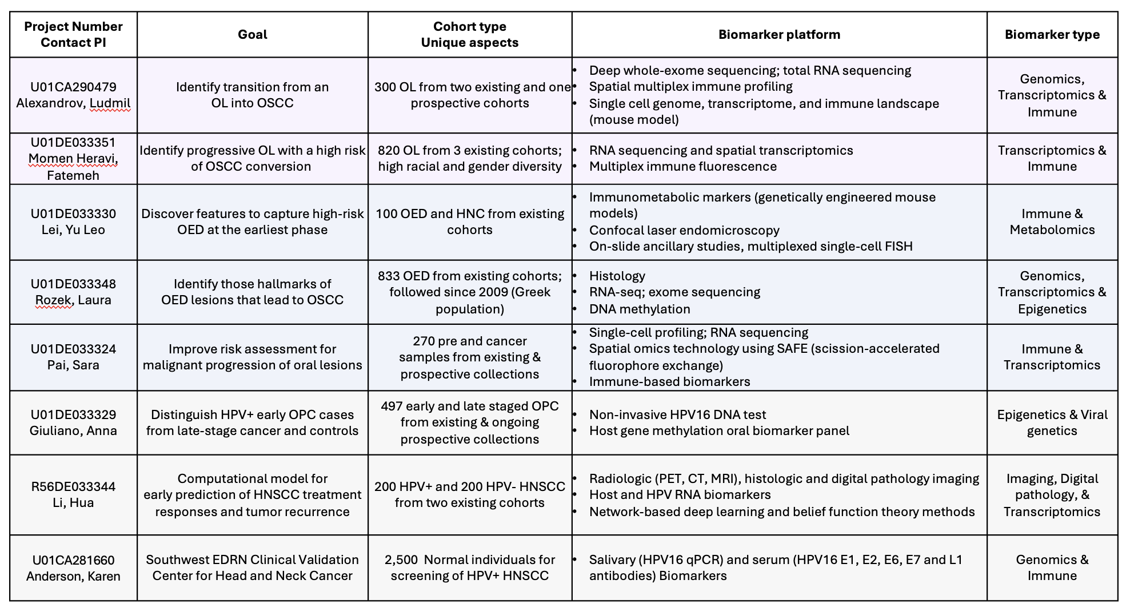
Resources for the Public
WUSTL/
UIC
UCSF
ASU/
Baylor
UCSD
AHEAD
Georgetown
Yale
Moffitt
NCI/
NIDCR
MD Anderson/
Univ of Mich

