Slide 1

Multi-Cancer Early Detection and Risk Assessment: Challenges and Paths Forward
Johannes F. Fahrmann, Ph.D.
Department of Clinical Cancer Prevention
The University of Texas MD Anderson Cancer Center

Slide 2
Disclosures
IP on a 4-protein biomarker panel and multi-cancer risk stratification test (MCaST)
Recent new agreement with Quest Diagnostics (research support for developing cancer early detection blood tests)

Slide 3
EDRN Involvement
EDRN Young Career Investigator
Clinical Validation Center for Pancreatic Cancer (PI: Maitra; Site PI-Fahrmann)
Clinical Validation Center for Lung Cancer (PI: Hanash)
Clinical Validation Center for Breast Cancer (PI: Li)
Clinical Validation Center for Ovarian Cancer (PI: Bast)

Slide 4
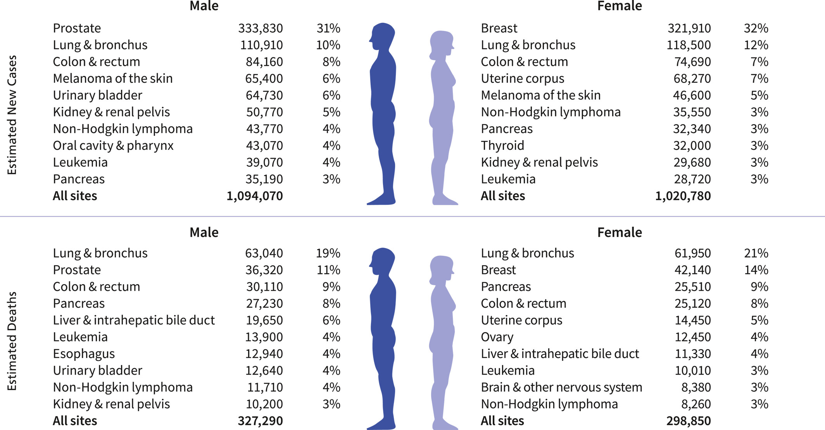
Cancer Statistics- 2026

Slide 5
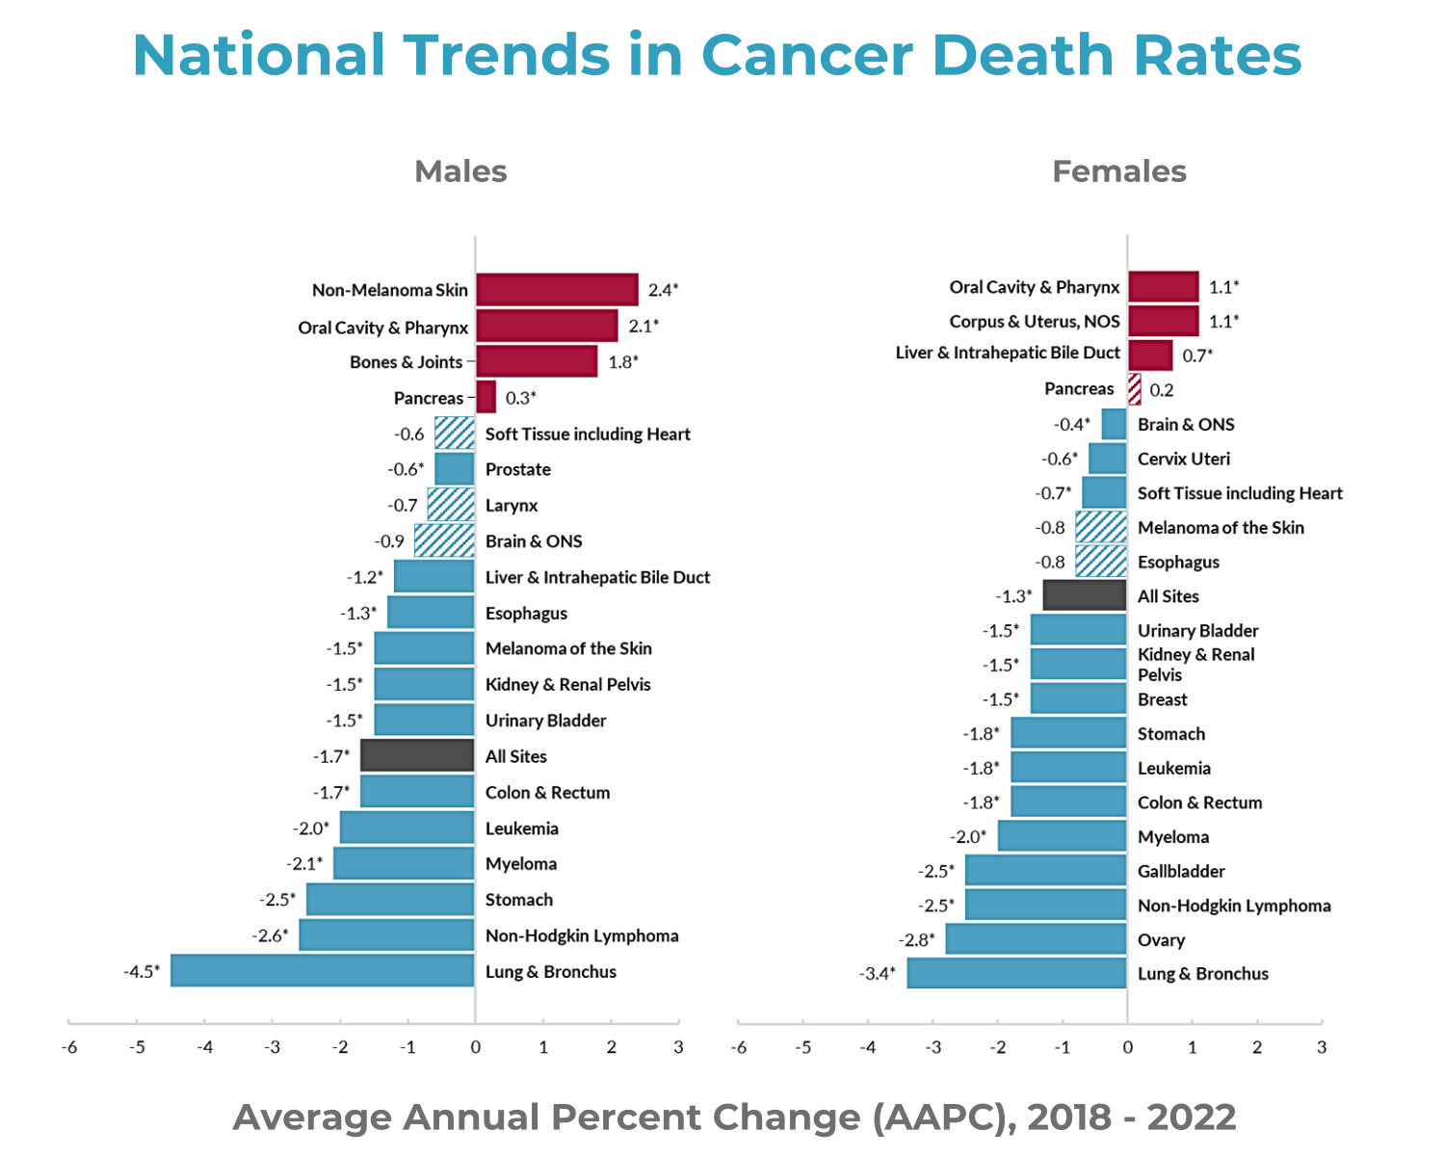
SEER Annual Report to the Nation 2025: National Trends in Cancer Death Rates

Slide 6
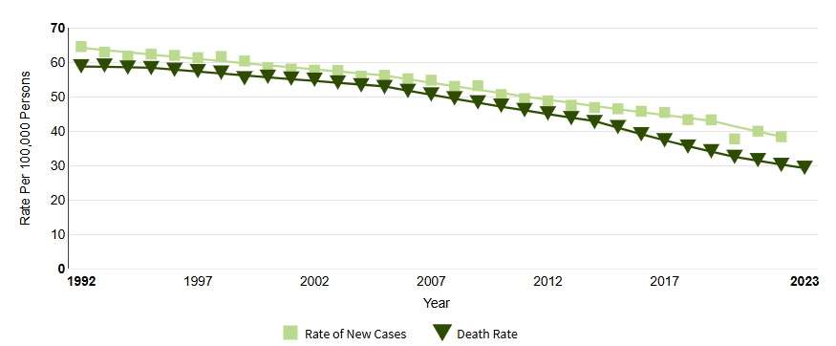

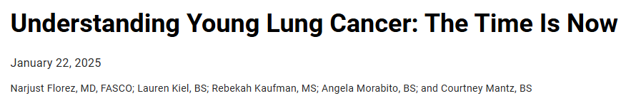
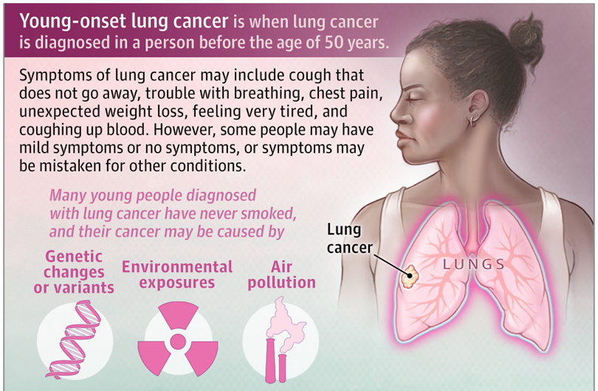
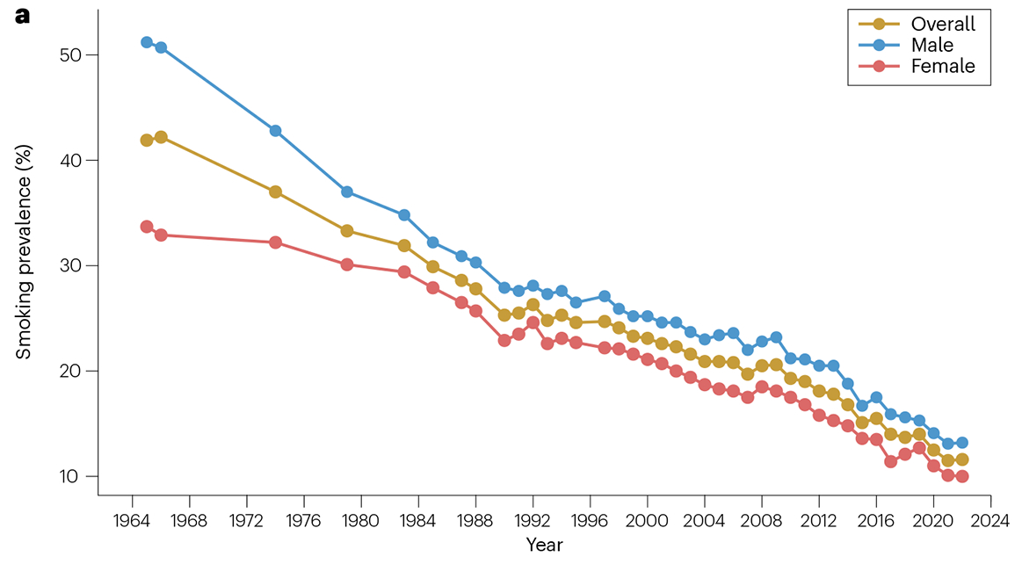
Trends in lung cancer incidence and mortality
Rate of New Cases
Death Rate
https://seer.cancer.gov/statfacts/html/lungb.html
LoPiccolo et al. Nat Rev Clin Onco. (2024)
Antonoff, et al. JAMA Network (2025)

Slide 7
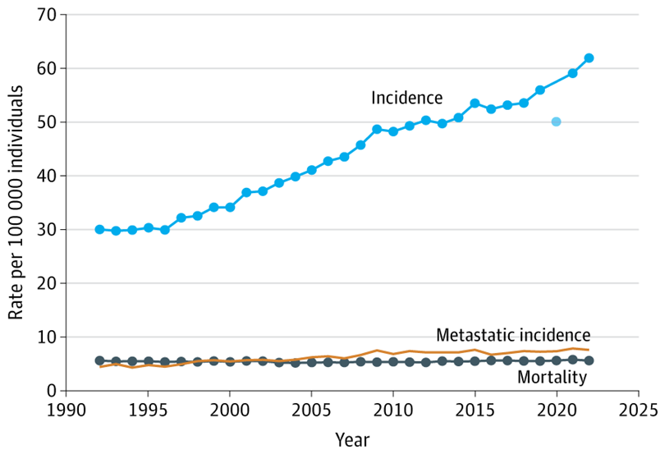
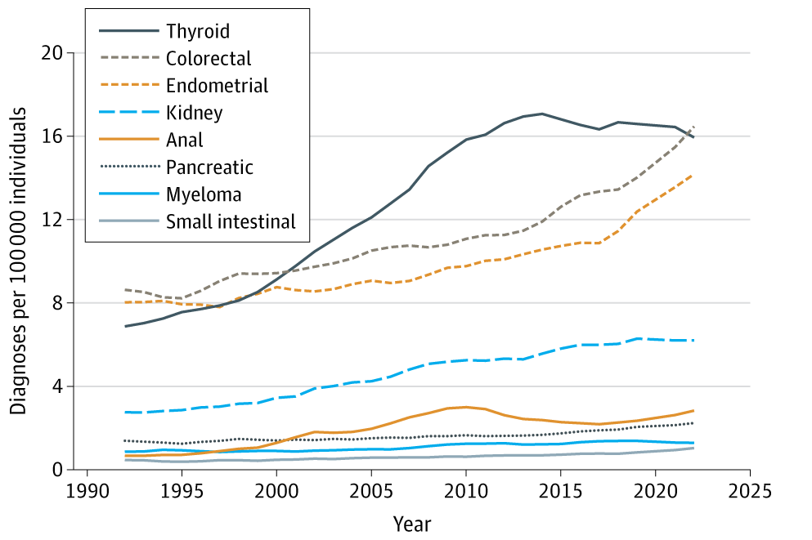
Red Flag: The Rise in Early-Onset Cancer in the US Population
Patel, et al. JAMA Network (2025)

Slide 8

The Good, the Bad, and the Ugly…
Overall trends in cancer-associated mortality have largely decreased
Mortality has increased for a subset of cancers
(e.g. Pancreas)
There is an alarming rise in cancer among younger individuals

Slide 9

The holy grail… development of minimally invasive biomarker tests for risk assessment and early detection of cancer
Focused efforts towards a single cancer or multiple cancers

Slide 10
Types of Biomarkers
- Nucleic acids:
- Mutated DNA
- Methylated DNA
- Non-coding RNA
- Fragmented DNA
Proteins
Metabolites
Immune related:
  - Cytokines/chemokines
  - Autoantibodies
Circulating microparticles/exosomes
Circulating tumor cells

Slide 11
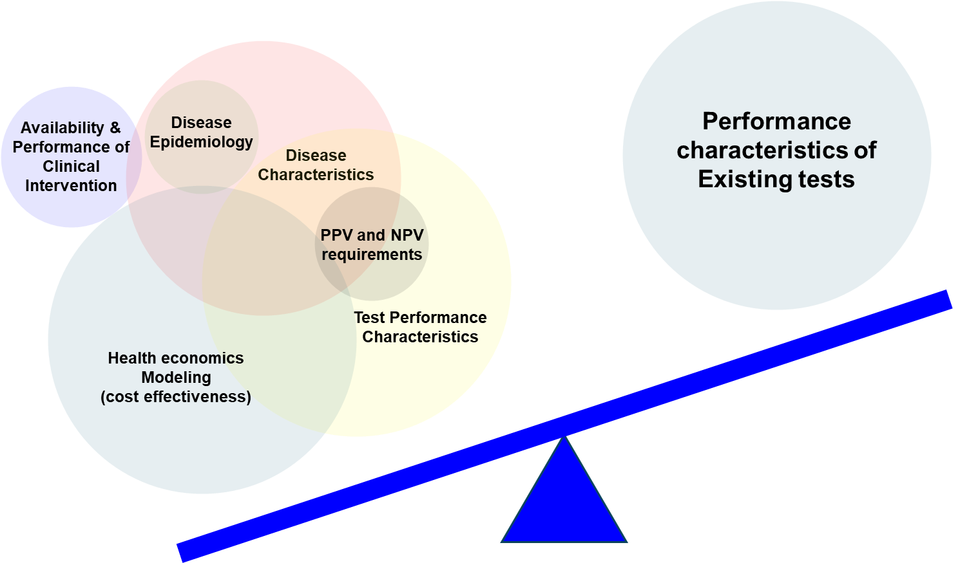
Feasibility of a biomarker test
End-Goal:
Mortality benefit
(Potential Surrogate:
Stage-shift)

Slide 12
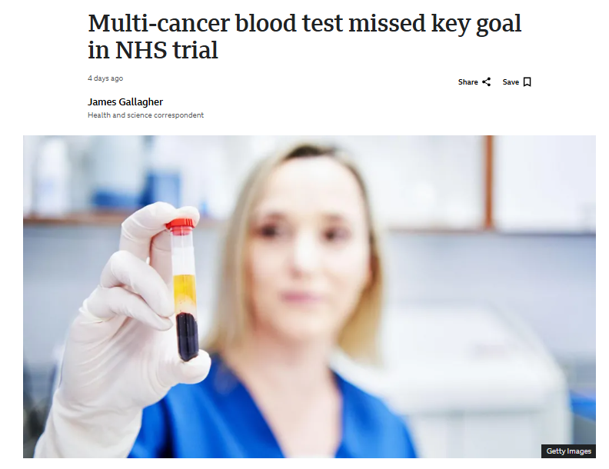
Challenges with MCD: Insights from the GALLERI MCD Test
“The primary endpoint of statistically significant Stage III-IV reduction was not observed. However, there was a favorable trend toward fewer Stage III-IV cancers in a pre-specified group of 12 deadly cancers* in the intervention arm after the prevalent screening round. ”
Opinion: These findings are not a criticism of GRAIL, but rather a reinforcement of the challenges that we face in the context of MCDs

Slide 13
Limitations of a one size fits all approach:
Does not consider incidence of disease in the intent to test population
Cancer Type | Age adjusted incidence (per 100,000)
Lung | 135.4
Breast | 329.6
Colorectal | 74
Prostate | 374.4
Pancreatic | 34.8
Ovarian | 24.4
Liver | 14.5
Upper GI (Esophagus + Stomach) | 17.2
Based on SEER data

Slide 14





Limitations of a one size fits all approach:
Does not consider existing clinical frameworks
Modality
Frequency
Age
Eligibility
Compliance
Low-Dose CT
Annual
50-80
12%
(Liu 2025)
15%
(Zhang 2024)
Lung
Prostate-specific antigen
Shared-decision
55-69
All Males
59%
Prostate
Colonoscopy, Stool tests
Modality-based
45-75
All
40%
CRC
Pap smear
3 years
21-69
All Females
79%
Cervical
Mammogram
Biennial
40-74
All Females
80%
Breast

Slide 15
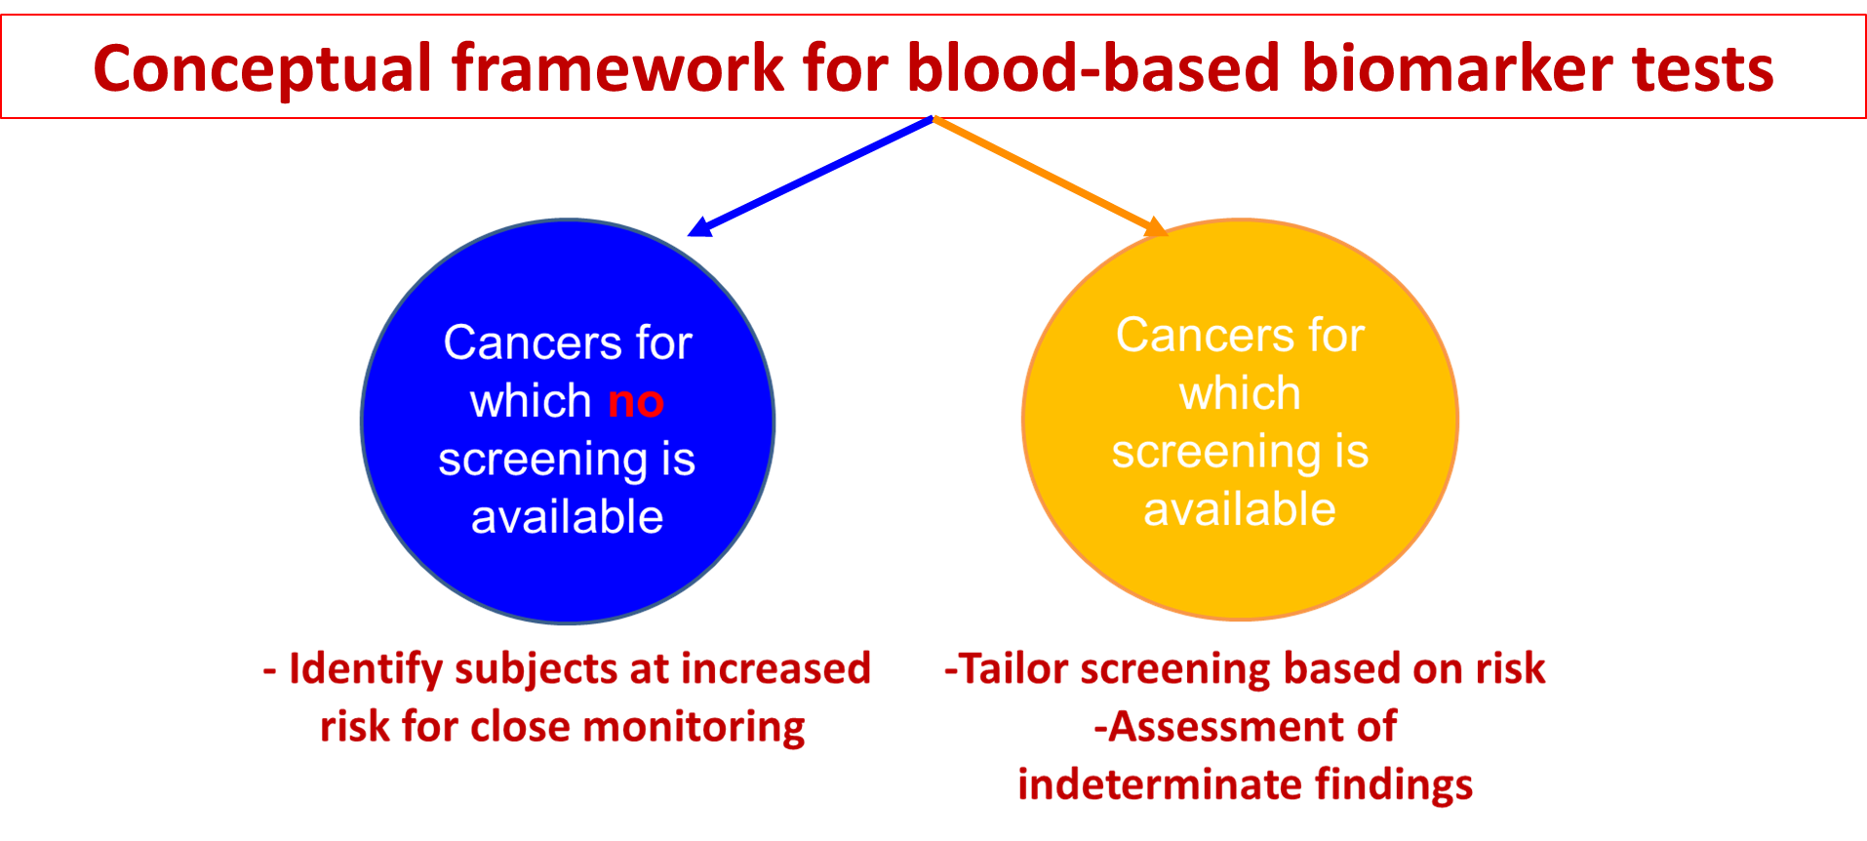
e.g. pancreatic cancer
e.g. lung cancer

Slide 16
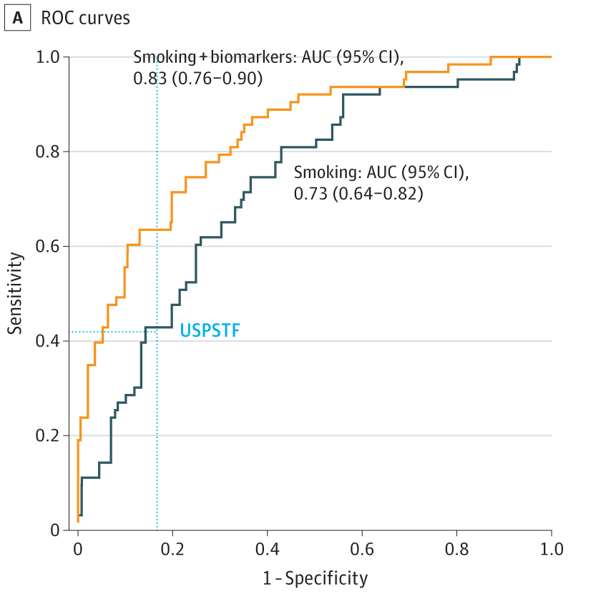
4-marker protein panel for risk assessment of lung cancer
Journey through time
Guida et al.
JAMA Onc, 2018
4MP developed in CARET
Validated in EPIC/UMEA Cohort

Slide 17
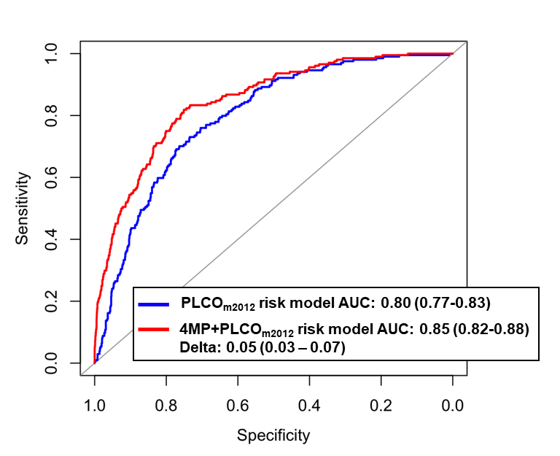
4-marker protein panel for risk assessment of lung cancer
Journey through time
Guida et al.
JAMA Onc, 2018
4MP developed in CARET
Validated in EPIC/UMEA Cohort
Fahrmann et al.
JCO, 2022
Validation of 4MP for lung cancer risk assessment in PLCO
Take-away: Among subjects with 10+ smoking pack-years, the model would have identified for annual screening 9.2% more lung cancer cases and would have reduced referral by 13.7% among non-cases compared with current USPSTF criteria

Slide 18
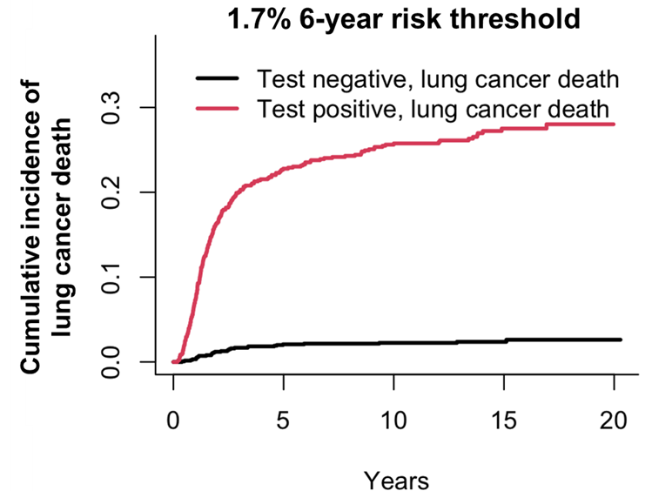
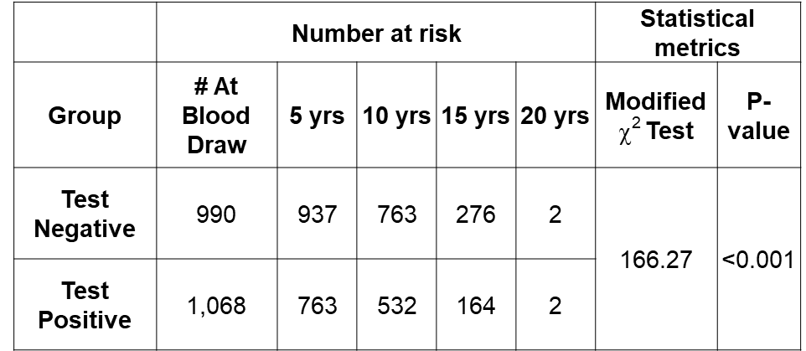
4-marker protein panel for risk assessment of lung cancer
Journey through time
Guida et al.
JAMA Onc, 2018
4MP developed in CARET
Validated in EPIC/UMEA Cohort
Fahrmann et al.
JCO, 2022
Validation of 4MP for lung cancer risk assessment in PLCO
Irajizad et al.
JCO, 2023
Mortality benefit of 4MP

Slide 19
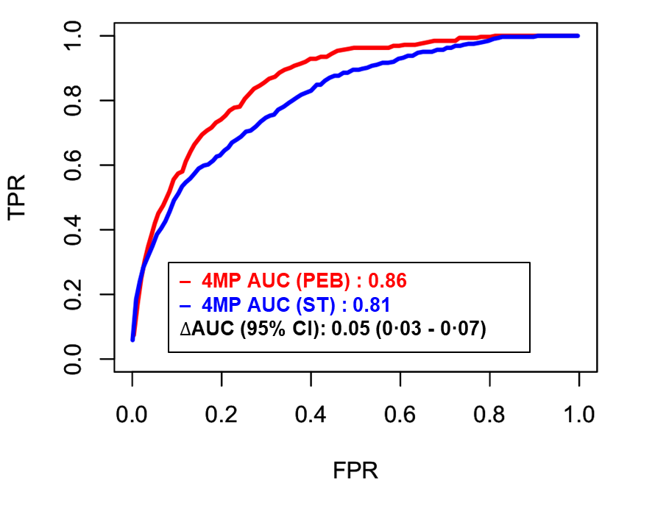
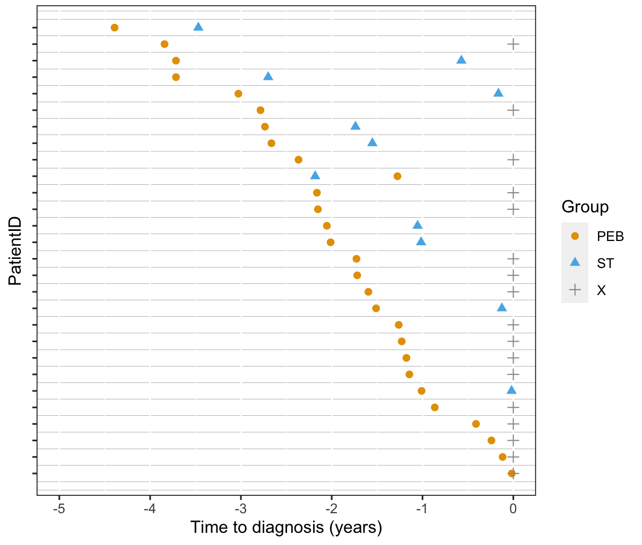
4-marker protein panel for risk assessment of lung cancer
Journey through time
Guida et al.
JAMA Onc, 2018
4MP developed in CARET
Validated in EPIC/UMEA Cohort
Fahrmann et al.
JCO, 2022
Validation of 4MP for lung cancer risk assessment in PLCO
Irajizad et al.
JCO, 2023
Mortality benefit of 4MP
Irajizad et al.
EbioMed, 2024
Longitudinal trajectory of 4MP for risk of lung cancer
Fahrmann et al. pending
Validation of 4MP in the LEAP cohort
Take-away: The PEB algorithm identified 17 of the 35 cases that remained ST negative, at an average of 1.26 years before diagnosis.
Ten case individuals who were positive based on ST at an average of 1.03 years prior to diagnosis were identified earlier by PEB, at an average of 2.70 years.

Slide 20
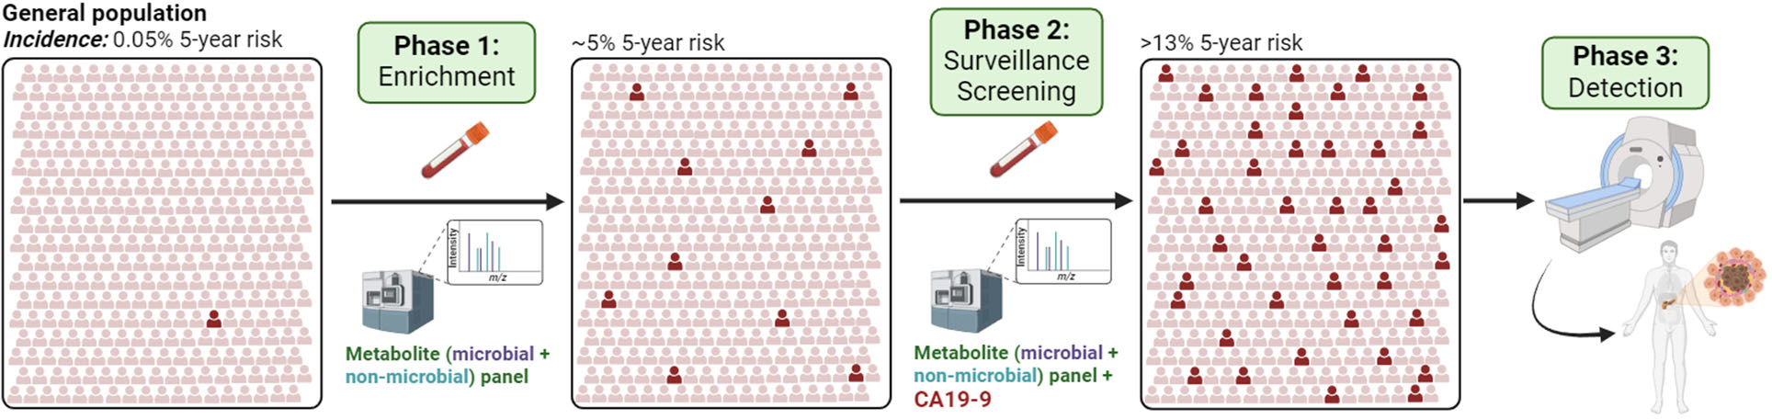
Two-Tier Strategy for earlier detection of PDAC
Biomarker Tests that identify individuals at risk of developing PDAC (Enrichment)
Biomarker Tests that identify individuals at high risk of harboring PDAC (Surveillance/Screening)
Reference: Ricardo A León-Letelier, J Cancer Immunol. (2025)

Slide 21
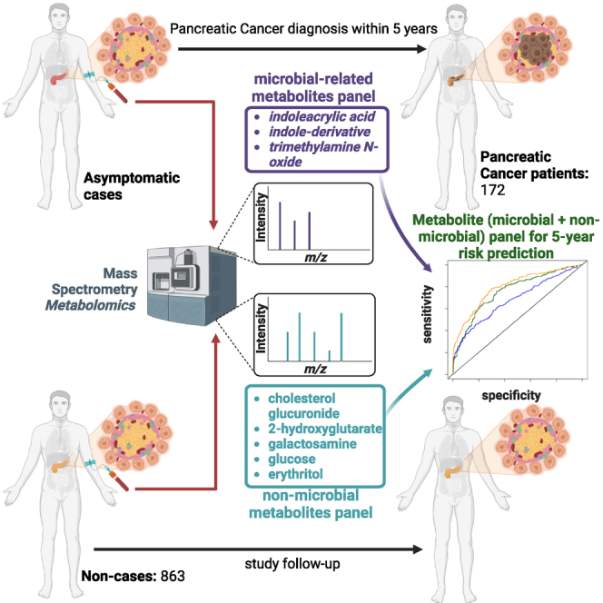
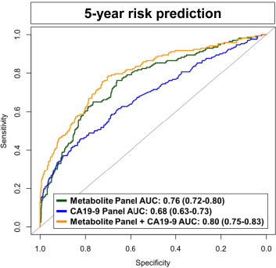
A blood-based metabolomic signature predictive of risk for pancreatic cancer
Fahrmann et al. Cell Reports Medicine (2024)

Slide 22
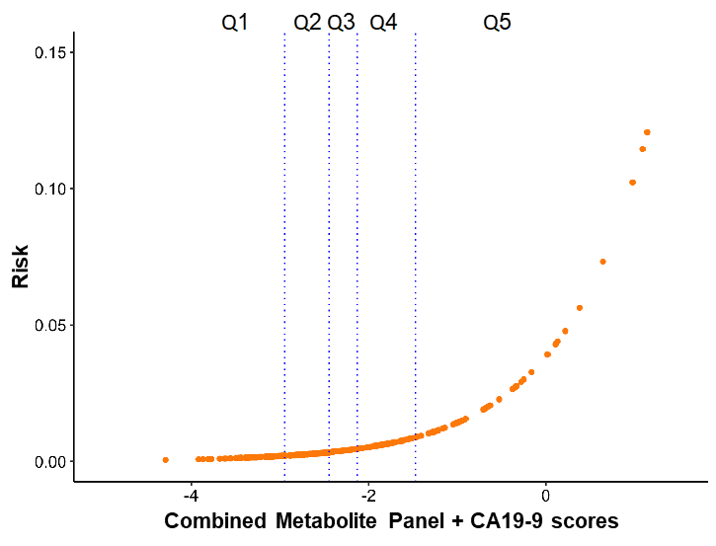
Estimated absolute 5-year risks based on model scores
        Estimated absolute 5-year risks based on model scores
 | 5-year absolute risk
Percentiles | Combined Metabolite Panel | Combined Metabolite Panel + CA19-9
20.0% | 0.26 | 0.23
40.0% | 0.43 | 0.35
60.0% | 0.65 | 0.53
80.0% | 1.25 | 1.07
90.0% | 1.89 | 2.05
95.0% | 2.88 | 4.52
97.5% | 4.74 | 13.33
Irajizad E. et al. Cell Reports Medicine (2024)

Slide 23
PLCO PDAC longitudinal cohort
Serially collected pre-diagnostic plasma from 242 PDAC cases and 242 age- and sex-matched non-case control participants in the PLCO cohort
Number of Tests | Case Participants | Non-case Participants | Total Participants
3 | 103 | 103 | 206
2 | 65 | 65 | 130
1 | 74 | 74 | 148
Total | 242 | 242 | 484

Slide 24
Longitudinal Trajectory of the Microbiome+Host Metabolite Panel for Risk Prediction of PDAC in the PLCO Cohort
N= 242 PDAC cases and 242 age- and sex-matched non-case control participants
Includes serial samples (3-5 per subject)
Unpublished; confidential

Slide 25
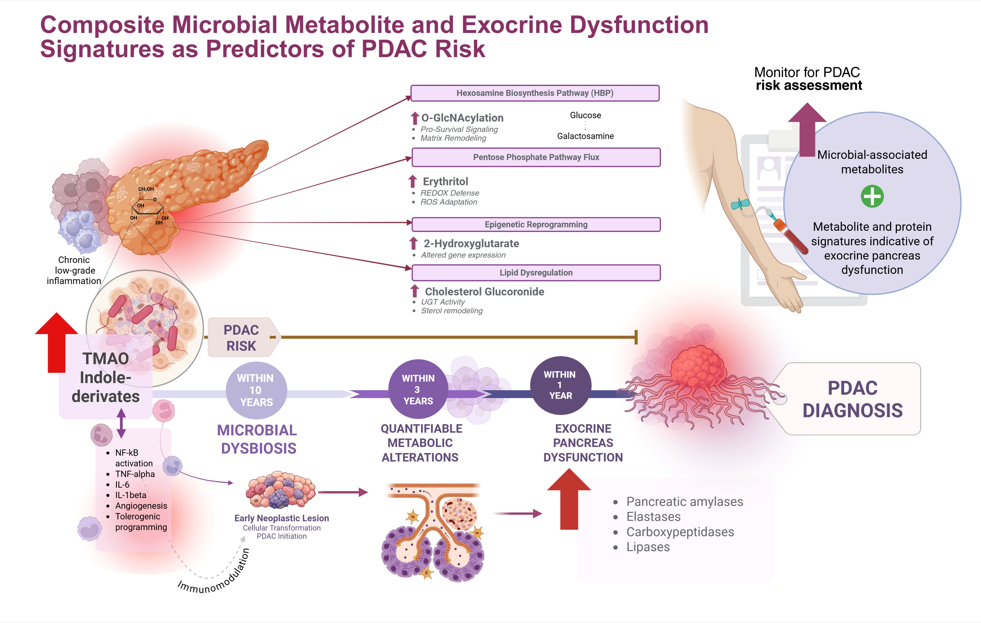

Slide 26
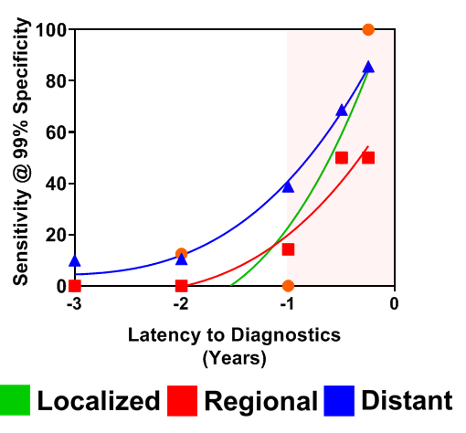
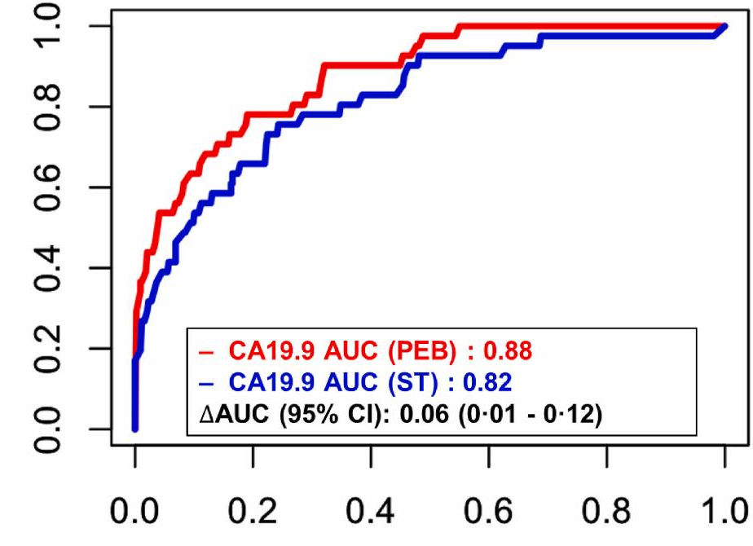
Longitudinal trajectory of CA19-9 for risk of PDAC in the PLCO Cohort
TPR
FPR
PEB signaled ‘positive’ on average 1.09 years before clinical diagnosis
ST signaled ‘positive’ on average 0.48 years prior to clinical diagnosis
For those individuals low for CA19-9; TIMP1 improved sensitivity by 14%
Inclusion of LRG1 and TIMP1 increases sensitivity by 13.2% without loss of specificity among participants ‘Negative’ for CA19-9
Fahrmann et al. Gastroenterology (2020)
Fahrmann et al. Cancer Letters (2025)

Slide 27
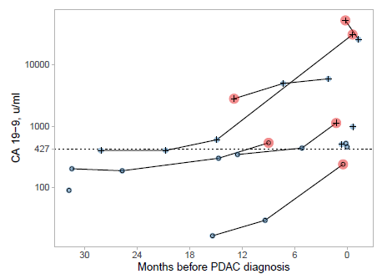
Lead-time of CA19-9 for risk prediction of PDAC among 2,121 NOD patients
CA19-9 Positive
CA19-9 PEB Positive
CA19-9 Negative
1% 1-year risk Cutoff
Of the 2 cases missed, 1 (50%) was picked up by an algorithm that considers repeat CA19-9 testing
Irajizad et al. in revision

Slide 28
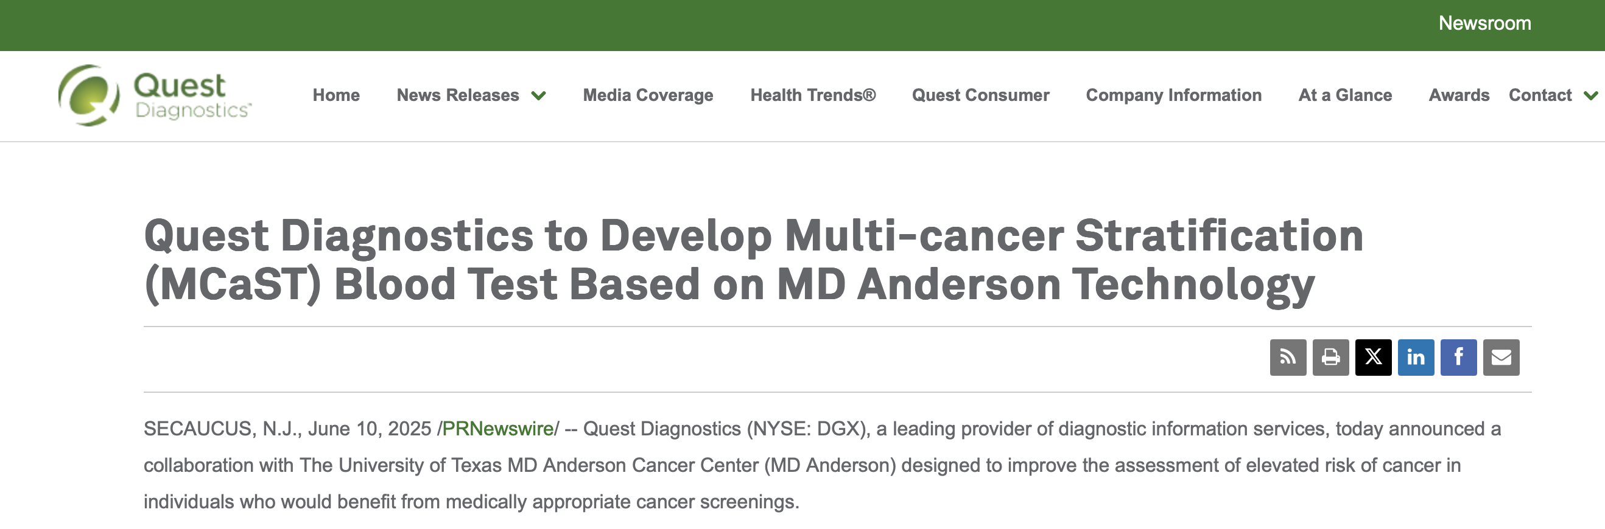
Multi-Cancer risk Stratification Test (MCaST)
Conceptual basis originates from work in lung and pancreatic cancer
Quantifies levels of 10 cancer-associated biomarkers for assessing the risk of developing or harboring any of nine cancer types: lung, prostate, colorectal, breast, ovarian, pancreatic, esophageal, and stomach cancers.

Slide 29
Multi-Cancer risk Stratification Test (MCaST)
Proprietary individualized combination rules based on a broader panel of 10 protein biomarkers for each of the nine specified cancer types
  e.g. 4MP for lung cancer
Proprietary longitudinal algorithms that consider repeat MCaST measurements
  Lung, Breast, Prostate, Pancreas, Colorectal
The MCaST model was calibrated for the general population and cancer-specific risk thresholds for elevated risk were predefined based on established clinical guidelines.

Slide 30
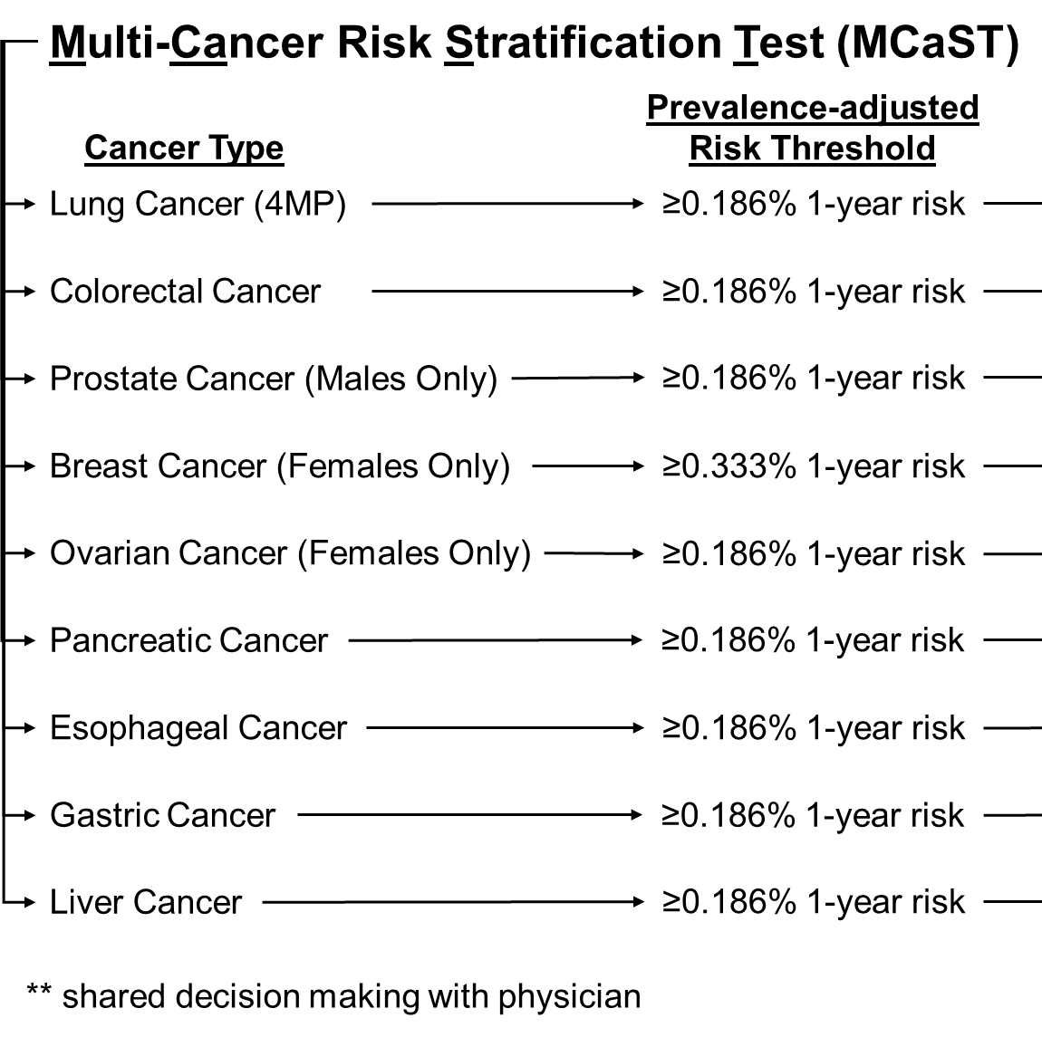

Slide 31
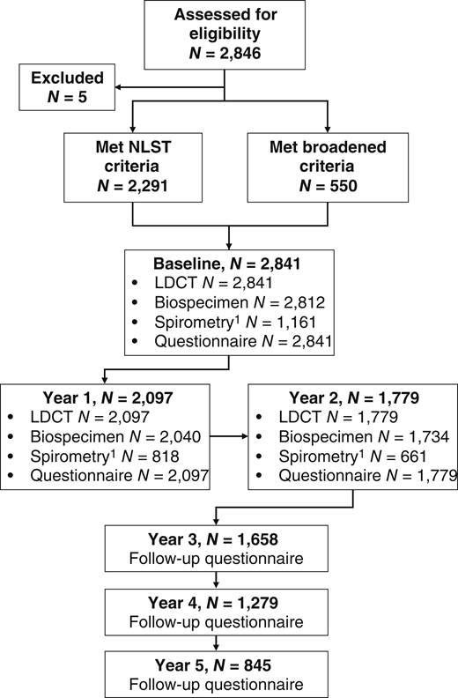
The LEAP Study: A Multicenter Biospecimen and Imaging Resource for Lung Cancer Screening
International, prospective, multicenter, longitudinal cohort study launched in 2014 to address needs related to lung cancer screening
  United States, France, and Spain
The study design included a 2-year active screening phase with annual low-dose chest CT scans
Blood specimens were collected by each center at baseline and at each subsequent annual follow-up visit up until the time of clinical diagnosis of lung cancer or end of study follow-up
Dennison et al. CEBP (2026)

Slide 32
Patient characteristics and cancer diagnoses in the LEAP Cohort
LEAP US + Europe Sites | Cases, N | Case Samples, N | Non-Cases, N | Non-Case samples
All | 170 | 319 | 336 | 506
Anal Cancer | 2 | 4 | - | -
Bladder Cancer | 13 | 30 | - | -
Breast Cancer | 11 | 20 | - | -
Colon and Rectal Cancer | 7 | 2 | - | -
Endocrine Cancer | 2 | 2 | - | -
Upper GI | 3 | 4 | - | -
Ovarian Cancer | 4 | 10 | - | -
Vaginal Cancer | 1 | 3
Head and Neck Cancer | 5 | 9 | - | -
Kidney Cancer | 4 | 4 | - | -
Leukemia | 3 | 6 | - | -
Lung Cancer | 73 | 134 | - | -
Lymphoma | 10 | 24 | - | -
Neuroendocrine tumors | 5 | 12 | - | -
Other | 4 | 8 | - | -
Pancreatic Cancer | 2 | 4 | - | -
Prostate Cancer | 18 | 37 | - | -
Throat Cancer | 1 | 2 | - | -
Thyroid Cancer | 2 | 4 | - | -
Age (IQR) | 63 [59-68] |  | 60 [56-65]
Sex | Male: 105, Female: 65 |  | Male: 297, Female: 229
Smoking Status | Current Smoker: 113 |  | Current Smoker: 359
 | Former Smoker: 57 |  | Former Smoker: 167
Pack Years (IQR) | 45.5 [36.0-61.1] |  | 42.0 [33.0-52.5]

Slide 33
Results – Lung Cancer
On a subject level, 65 out of 73 lung cancer cases had a positive MCaST (i.e met or exceeded the 0.167% 1-year risk threshold)
  Including 45 out of 51 stage I-II cases
Rate of MCaST positivity increase the closer samples were collected prior to a clinical diagnosis of lung cancer
90% of lung cancer cases had a positive MCaST within 3 months of a lung cancer diagnosis
Fahrmann et al, 2026, submitted (preprint available)

Slide 34
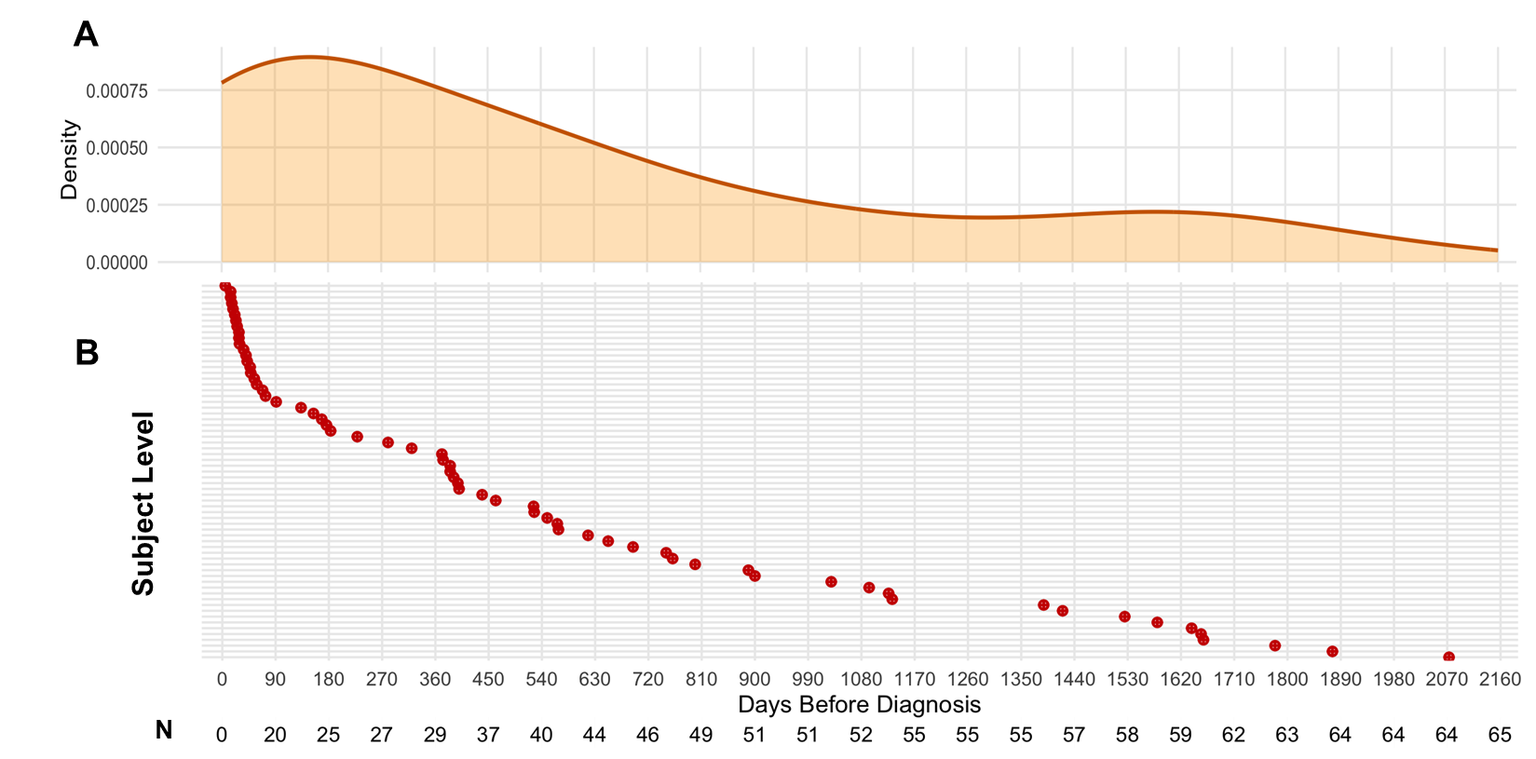
Time of the first positive MCaST for individuals who were later diagnosed with lung cancer in the LEAP Cohort
Median (interquartile range) : 12.7 (1.7-27.8) months
Fahrmann et al, 2026, submitted (preprint available)

Slide 35
Example: MCaST Positivity in subset of Lung Cancer Cases
Fahrmann et al, 2026, submitted (preprint available)

Slide 36
Example: MCaST Positivity in subset of Lung Cancer Cases
Fahrmann et al, 2026, submitted (preprint available)

Slide 37
Results – Other common and lethal solid cancers
On a subject level, 62 of 84 non-lung cancer cases were identified at elevated risk by MCaST
  16 of 18 prostate cancer cases
  5 of 8 invasive breast cancer cases
  6 of 7 colorectal cancer cases
  2 of 4 ovarian cancer cases
  1 of 2 pancreatic cancer cases
  2 of 3 upper GI cases
Median (interquartile range) time from the first positive MCaST to a clinical diagnosis was 20.7 months (10.2-42.8 months)
High risk population: 346/526 non-case controls also positive
  285 of the 346 non-case controls were identified to at elevated risk of lung cancer by MCaST
Fahrmann et al, 2026, submitted (preprint available)

Slide 38
What comes next?
Prospective clinical utility trials of MCaST
Can a biomarker convince those opting out of screening to participate?
Can a biomarker identify high-risk individuals among those currently ineligible for screening?
Decision making algorithms
Impact of comorbidities, cost effectiveness

Slide 39



Acknowledgements
RODEO TEAM:
Samir Hanash, M.D., Ph.D.
Jennifer D. Dennison, Ph.D.
Edwin Ostrin, MD. Ph.D.
Ehsan Irajizad, Ph.D.
Jody Vykoukal, Ph.D.
Clinical Validation Center for Pancreas:
Anirban Maitra, M.D.
Eugene Koay, M.D., Ph.D.
Ziding Feng, Ph.D.
Cameron Lopez, M.S.
Internal/External Collaborators:
Florencia McAllister, M.D.
Michael Kim, M.D.
Brian Wolpin, M.D.
Randy Brand, M.D.
Brian Haab, Ph.D.
Max C. Schmidt, M.D.
Funding:
U01CA194733
U01CA213285
U24CA086368
U01CA295902
CPRIT RP250269
NCI U54CA274371
U01CA239522
Dr. Rashmi Gopal-Srivastava

