Slide 1
Early Detection Research Network
15th Scientific Workshop
Scientific Theme: Reimagining Early Detection in the Era of Multimodal Science
Sudhir Srivastava, Ph.D., MPH
Chief, Cancer Biomarkers Research Branch
Division of Cancer Prevention

Slide 2
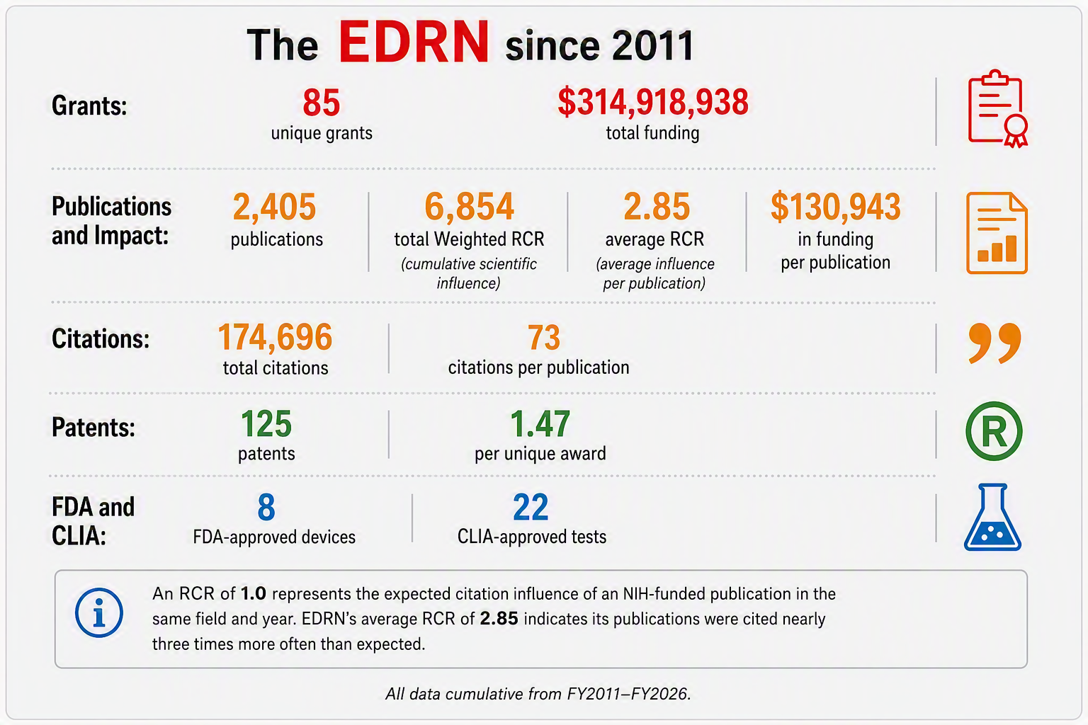
EDRN Milestones Since 2011
Scientific, translational, and regulatory impact
Notes:
Source infographic retained and enlarged. All data are cumulative from FY2011–FY2026, as shown in the graphic.

Slide 3
Why Reimagine EDRN?
The landscape has shifted—and EDRN’s distinctive role should shift with it.
2000
TODAY
NEXT
EDRN begins
Industry expands
EDRN’s next phase
The biomarker discovery landscape at launch.
Participation grows in liquid biopsy, multicancer early detection, and related technologies.
Complement, not compete with commercial development by closing scientific and evidence gaps unlikely to be solved by the private sector alone.
Distinctive public role: independent, rigorous evidence generation
Notes:
Original content:
• The biomarker discovery landscape has changed substantially since EDRN began in 2000.
• Industry participation in liquid biopsy, multi-cancer early detection, and related technologies has expanded.
• The next phase should therefore complement—not compete with—commercial development by addressing scientific and evidence gaps that are unlikely to be solved by the private sector alone.

Slide 4
The Evidence Gap
Promising performance in case–control studies does not guarantee performance before diagnosis or in practice.
PROMISE
IMPACT
Case–control
biomarker performance
Prediagnostic
specimens
Longitudinal
sampling
Blinded
validation
Real-world
populations
Demonstrated
clinical utility
Discovery signals may look compelling in controlled comparisons.
Evidence that a biomarker improves meaningful clinical outcomes.
THE EVIDENCE GAP
The unmet need has shifted from finding more signals to proving that biomarkers work before diagnosis and in practice.
Notes:
Original content:
The major unmet need is increasingly not the discovery of additional biomarkers, but rigorous validation and demonstration of clinical utility. Biomarkers that appear promising in case-control studies may perform differently when evaluated with prediagnostic specimens, longitudinal sampling, blinded validation, and real-world populations.

Slide 5
Where Public Research Adds Distinctive Value
Four domains where shared infrastructure, independent evaluation, and long time horizons matter most.
1
Build longitudinal evidence
2
Prove benefit and quantify harm
Prediagnostic cohorts with serial biospecimens, imaging, symptoms, and EHR data.
Priority cancers: those without proven screening tests.
Clinical utility, mortality, late-stage diagnosis, time to diagnosis, procedures, and cost.
False positives/negatives, anxiety, overdiagnosis, overtreatment, and false reassurance.
3
Ensure validity and comparability
4
Expand access and specimen diversity
Address biological confounders such as clonal hematopoiesis, germline variants, inflammation, infection, trauma, and tissue injury.
Create reference materials, blinded specimens, SOPs, reproducibility studies, and cross-platform benchmarks.
Advance non-blood and low-cost biomarkers using urine, saliva, breath, stool, cervicovaginal samples, menstrual blood, and sputum.
Notes:
Original content:
• Prediagnostic longitudinal validation: build or expand cohorts with serial blood, urine, saliva, imaging, symptoms, and EHR data collected before diagnosis.
• Cancers without proven screening tests: develop evidence for pancreatic, ovarian, liver, stomach, esophageal, kidney, bladder, brain, and selected hematologic or rare cancers.
• Clinical utility and mortality impact: determine whether biomarkers reduce late-stage diagnosis, mortality, time to diagnosis, unnecessary procedures, or cost.
• Harms and overdiagnosis: quantify false positives, false negatives, unnecessary imaging and biopsy, anxiety, overdiagnosis, overtreatment, and false reassurance.
• Biological confounders: address clonal hematopoiesis, germline variants, inflammation, age-related methylation, infection, trauma, and tissue injury.
• Open standards and benchmarking: develop reference materials, shared blinded specimens, pre-analytical SOPs, reproducibility studies, and cross-platform benchmarks.
• Non-blood and low-cost biomarkers: expand research on urine, saliva, breath, stool, cervicovaginal samples, menstrual blood, sputum, and low-cost testing formats.

Slide 6
Broader Biomarker Opportunities
Opportunity expands when EDRN broadens the signal, sharpens the clinical question, and focuses the population.
1
EXPAND THE SIGNAL
2
SHARPEN THE QUESTION
3
FOCUS THE POPULATION
Non-cfDNA classes
Disease behavior
High-risk cohorts
Proteins • metabolites • autoantibodies • extracellular vesicles • microbiome • integrated multi-omics
Distinguish aggressive or lethal disease from indolent lesions
New-onset diabetes • hereditary-risk families • chronic pancreatitis
New discovery modes
Symptomatic diagnosis
Dynamic risk signals
Synthetic biomarkers • AI-generated in silico biomarkers
Evaluate nonspecific presentations such as anemia, weight loss, pain, bloating, hematuria, new-onset diabetes, dyspepsia, thrombosis, or fatigue
Metabolic and weight changes (e.g., GLP-1 use and implications for cancer prevention)
Notes:
Original content:
• Non-cfDNA biomarkers including proteins, metabolites, autoantibodies, extracellular vesicles, microbiome signals, and integrated multi-omic panels.
• Biomarkers that distinguish aggressive or lethal disease from indolent lesions to reduce overdiagnosis and overtreatment.
• Synthetic biomarkers.
• AI-generated in silico biomarker discovery.
• Symptomatic early-diagnosis biomarkers for patients presenting with nonspecific symptoms such as anemia, weight loss, abdominal pain, bloating, hematuria, new-onset diabetes, dyspepsia, thrombosis, or unexplained fatigue.
• Focused high-risk cohorts, including new-onset diabetes, hereditary-risk families, chronic pancreatitis, and suspicious metabolic or weight changes.

Slide 7
Emerging Frontiers in Early Detection
Extend EDRN’s validation framework into technologies and biological questions that could reshape detection and interception.
Liquid biopsy
AI & machine learning
ctDNA/RNA • extracellular vesicles • tumor-derived proteins
Integrate multi-omics, pathology, imaging, and longitudinal clinical data
VALIDATION
SCIENCE
Precancer biology
Analytical validation • harmonized protocols • quality assurance • longitudinal studies
Single-cell & spatial
Early molecular and cellular changes • immune and stromal interactions
Cellular diversity • tumor evolution • early malignant transformation
Digital twins
Biomimetics
Predict disease trajectories and support individualized screening
Organoids • lab-on-a-chip • microfluidics • tissue-mimetic systems
Notes:
Original content:
A reimagined EDRN would extend EDRN’s validation framework into emerging technologies and biological questions that could reshape early detection and interception:
• Liquid biopsy: circulating tumor DNA and RNA, extracellular vesicles, tumor-derived proteins, and other minimally invasive signals.
• Artificial intelligence and machine learning: integration of multi-omics, digital pathology, imaging, and longitudinal clinical information.
• Tumor microenvironment and precancer biology: early molecular and cellular changes, immune responses, and stromal interactions.
• Single-cell and spatial technologies: cellular diversity, tumor evolution, and early malignant transformation.
• Validation science: analytical validation, harmonized protocols, quality assurance, and large longitudinal studies.
• Digital twins: predictive models that integrate biology, technology, and clinical medicine to simulate disease trajectories and support individualized screening.
• Biomimetics: three-dimensional tumor models, organoids, lab-on-a-chip systems, microfluidics, and tissue-mimetic systems, including collaboration with translational science programs.

Slide 8
EDRN’s Role in a Changing MCED Landscape
A platform-neutral public role spanning failure analysis, independent verification, evidence assets, and method development.
INTERROGATE
VERIFY
BUILD
ADVANCE
Independent assay analysis
Blinded MCED verification
Longitudinal PRoBE sets
MCED multimodal development
False negatives • interval cancers • stage III–IV disease • tissue-of-origin errors • diagnostic pathways
Limit of detection • stability • reproducibility • interference • failure rates • tissue-of-origin accuracy
Serial prediagnostic specimens • early-stage and interval cancers • benign, inflammatory, and hematologic controls
Methylation • fragmentomics • mutations • proteins • autoantibodies • metabolites • imaging • clinical risk
Failure-focused review
Platform-neutral challenges
Open benchmarks & data commons
Longitudinal algorithms
Use available specimens where access can be negotiated
Identical blinded specimens • comparable specificity • stratified by cancer type, stage, and lead time
Common data elements • assay-version tracking • preserved code • controlled sharing
Evaluate within-person change rather than treating each annual test independently
FOUNDATION: Equity & generalizability across diverse populations, comorbidities, smoking history, socioeconomic settings, and health systems
Notes:
Original content:
• Independent MCED assay analysis – Examine false negatives, interval cancers, stage III–IV cancers, tissue-of-origin errors, and diagnostic pathways using available specimens where access can be negotiated.
• Blinded MCED verification – Evaluate limit of detection, preanalytical stability, reproducibility, interference, failure rates, and tissue-of-origin accuracy using locked algorithms.
• Longitudinal PRoBE reference sets – Establish serial specimens collected years before diagnosis, including early-stage cancers, interval cancers, and appropriate benign, inflammatory, and hematologic controls.
• Platform-neutral MCED challenge studies – Compare multiple commercial and academic assays using identical blinded specimens at comparable specificity, stratified by cancer type, stage, and time before diagnosis.
• MCED multimodal development – Combine molecular signals such as methylation, fragmentomics, mutations, proteins, autoantibodies, metabolites, imaging, and clinical-risk factors to improve early-stage sensitivity without sacrificing specificity.
• Longitudinal and personalized algorithms – Evaluate within-person biomarker changes rather than treating each annual test independently.
• Equity and generalizability – Evaluate performance across diverse populations, comorbidities, smoking history, socioeconomic settings, and health systems.
• Open benchmarks and data commons – Establish common data elements, assay-version tracking, preserved analysis code, and controlled data sharing to enable independent replication.

Slide 9
REIMAGINING EDRN
Complement industry.
Close the evidence gap.
Demonstrate clinical utility.
Thank you
Sudhir Srivastava, Ph.D., MPH | Chief, Cancer Biomarkers Research Branch
Notes:
Closing summary derived from the presentation: complement commercial development, close the evidence gap through rigorous validation, and demonstrate clinical utility.

