Slide 1
Genome-wide Cell-free DNA Fragmentation for Early Detection of Cancer
Victor Velculescu, MD, PhD
15th EDRN Scientific Workshop Agenda
Gaithersburg, MD, September 23, 2026

Slide 2
Disclosure Information
  Founder of Delfi Diagnostics
  Founder of Artemyx
  Founder of Personal Genome Diagnostics (acquired by LabCorp in 2022)
  Scientific Advisory Board of Epitope and Viron Therapeutics.
  Dr. Velculescu is an inventor on patent applications submitted by Johns Hopkins University related to cancer genomic and cell-free DNA analyses that have been licensed to one or more entities, including Delfi Diagnostics, Artemyx, LabCorp, Qiagen, Sysmex, Agios, Genzyme, Esoterix, Ventana and ManaT Bio. Under the terms of these license agreements, the University and inventors are entitled to fees and royalty distributions. These arrangements have been reviewed and approved by the Johns Hopkins University in accordance with its conflict-of-interest policies.

Slide 3
EDRN Aims
Aim 1: Characterize genomic and epigenomic changes in nucleosomal DNA from neoplastic, preneoplastic, and normal tissues in patients with the earliest stages of adenocarcinoma, screen-detected lesions, and interval cancers
Milestone 1A) Assess chromatin accessibility, methylation, and gene expression in lesions and WBCs
Milestone 1B) Integrate multi-omics data from analyses of lesions and WBCs to identify biomarkers of cancer:
Aim 2: Model the contribution of early lesions, tumors, and WBCs to cfDNA fragmentation (Phase II)
Milestone 2A) Identify cfDNA fragmentation patterns in matched liquid biopsies from individuals with early lesions, tumors, and non-cancer controls using whole genome sequencing (WGS)
Milestone 2B) Correlate genomic and epigenomic features from analyses of lesions and WBCs (M1B) to cfDNA fragmentation:
Milestone 2C) Deconvolute cfDNA fragmentation patterns to identify contributing tissues:
Aim 3: Optimize a highly sensitive machine learning model for early detection of lung cancer using features from integrated genomic and epigenomic data (Phase III)
Milestone 3A) Identify cfDNA fragmentation patterns in liquid biopsies from 300 individuals with lung cancer, 500 individuals with other cancer, and 1500 without cancer
Milestone 3B) Apply machine-learning to identify the combination of cfDNA features that provide the highest accuracy for cancer classification
Aim 4: Apply the optimized DELFI approach for early detection of lung cancer in a prospectively collected cohort of 1000 high-risk individuals undergoing screening for lung cancer (Phase 4 Futility Study)
Milestone 4A) Identify cfDNA fragmentation patterns in liquid biopsies from 1000 individuals
Milestone 4B) Apply the DELFI approach for early detection of lung cancer and assess performance
Milestone 4C) Assess the feasibility of combining the DELFI approach in tandem with LDCT

Slide 4


JHU EDRN Team
Mariana Brait
Otis Brawley
Zack Foda
Jill Phallen
Rob Scharpf
David Sidransky
Victor Velculescu

Slide 5
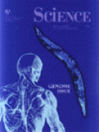



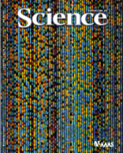


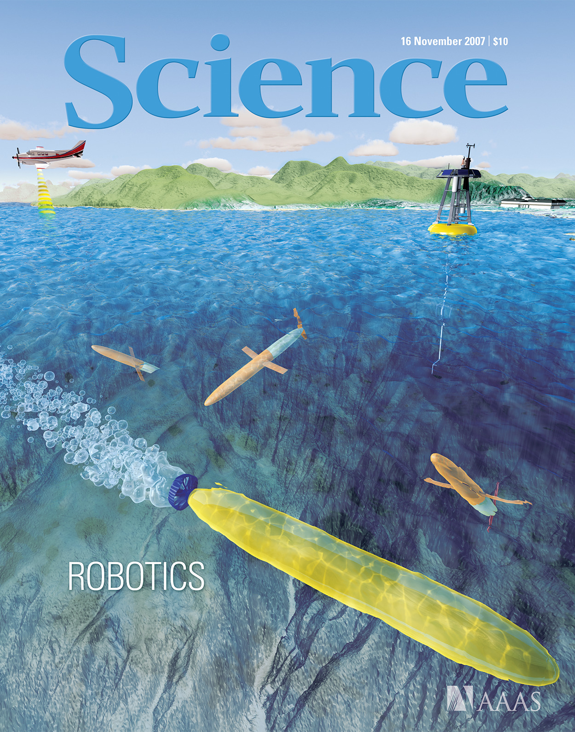
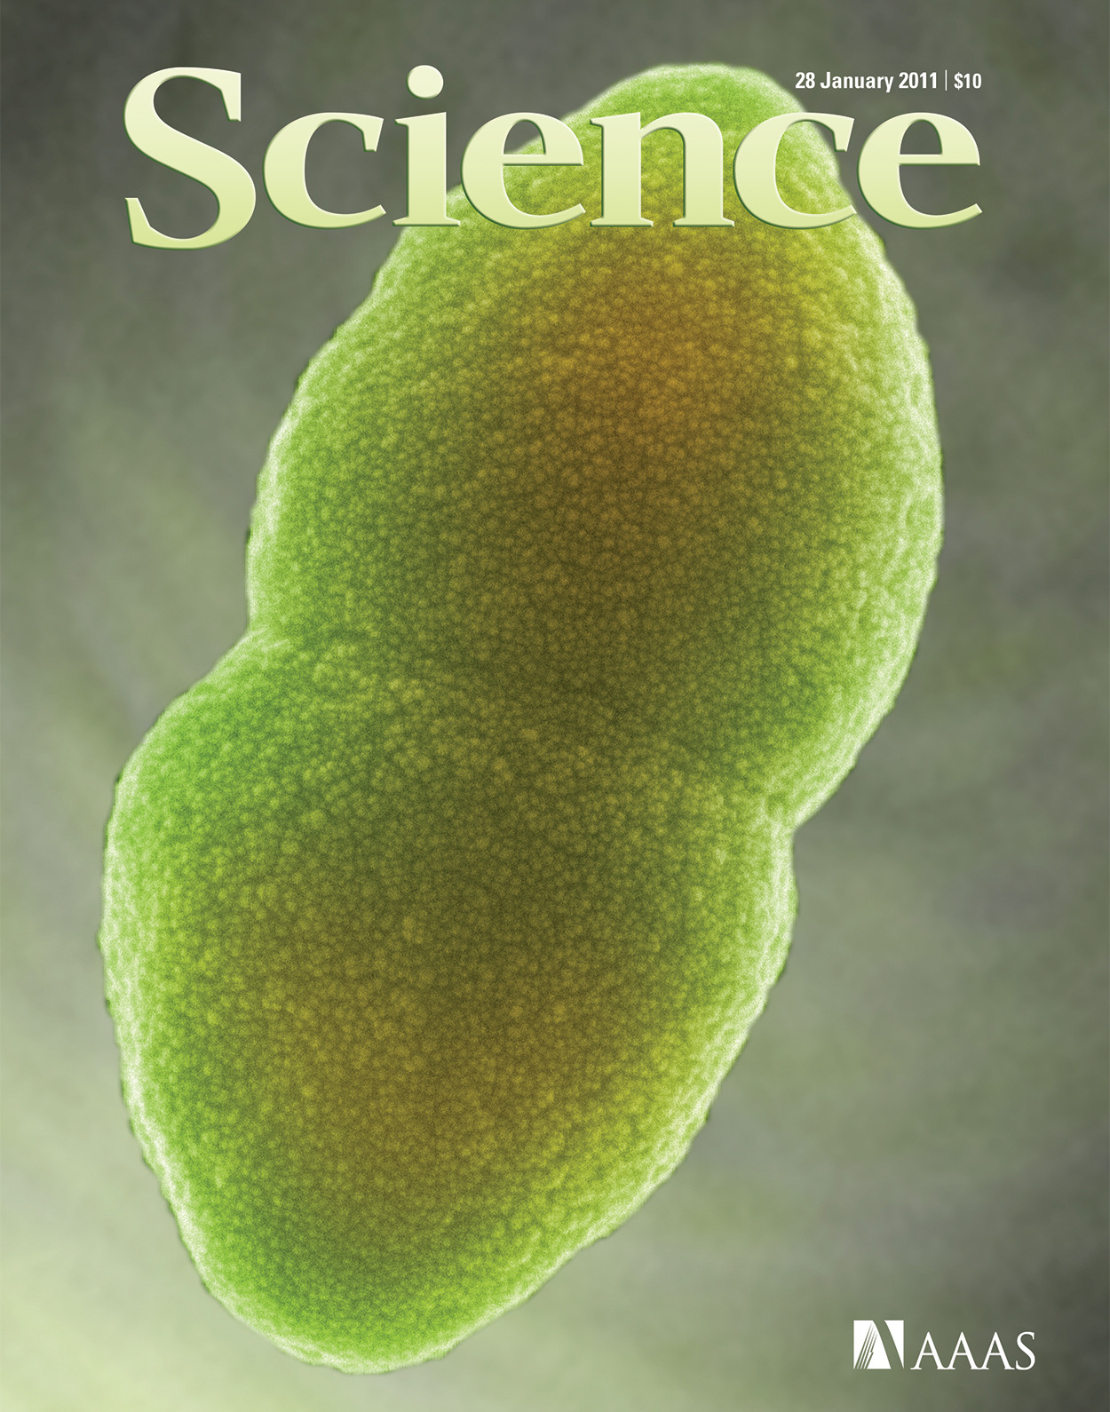






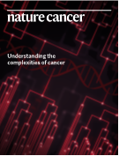

Sequence Analysis of the First 100 Cancer Genomes and Beyond
Cancers analyzed: colon, breast, pancreatic, GBM, medulloblastoma, ovarian clear cell, H&N (refs 1-10)
Technologies developed: SAGE (transcriptome) (11), Digital Karyotyping (CNVs) (12), PARE (rearrangements) (13), automated mutation calling (1)
Examples of new driver genes/pathways: PIK3CA in colorectal, breast and other cancers; IDH1/IDH2 in gliomas; chromatin modifying genes in medulloblastoma, ovarian clear cell (OCC), and others; tyrosine kinases and phosphatases in colorectal and other cancers
Genomic landscape of human cancers opened new avenues for understanding and targeting cancer:
1) Personalized therapies for new driver genes / pathways
2) Tumor evolution and resistance for targeted and immune therapies
3) New approaches for diagnosis and screening of cancer using noninvasive liquid biopsies
References: (1) Nature. 418(6901):934, 2002; (2) Science. 300(5621):949, 2003; (3) Science. 304(5674):1164-6, 2004: (4) Science 314(5797):268-74, 2006; (5) Science 318(5853):1108-13, 2007; (6) Science 321(5897):1801-6, 2008; (7) Science 321(5897):1807-12, 2008; (8) Science 331: 435-9, 2010; (9) Science, 330(6001):228-31, 2010; (10) Science 333: 1154-7, 2011; (11) Science 270:484-7, 1995; (12) PNAS 99:16156-161, 2002; (13) Science TM, 2: 20ra14, 2010
Notes:
Our work in this area began in the early 2000’s with the first elucidation of the coding genes of a cancer genome in a variety of human cancers, and with that the discovery of the great complexity of this disease and the need for personalized intervention, new gene alterations that led to new avenues for therapeutic intervention, and ultimately new ways to think about diagnosis or screening of these disease

Slide 6
Early Cancer Detection has Great Public Health Potential
Cancer rates continue to rise world-wide
Largest potential strides against cancer are in early detection
For screening to work it must find early-stage disease as this has greatest impact on mortality
Screening has to be a public health effort that is widely accessible at population scale
1. Global Cancer Observatory. https://gco.iarc.fr/tomorrow/en/dataviz/isotype. 2. NCI SEER Cancer Stat Facts. https://seer.cancer.gov/statfacts/.
Notes:
As background, I wanted to highlight that despite our best efforts to treat cancer, cancer rates continue to rise world-wide. By 2035, the estimates are that there will be 25 million new cases world-wide and nearly 15 million will succumb to this disease. Many lines of evidence now indicate that the largest potential strides against cancer are in early detection. For screening to work we must find early-stage disease as this has the greatest impact on mortality, and screening has to be a public health effort that is widely accessible at a population scale.

Slide 7
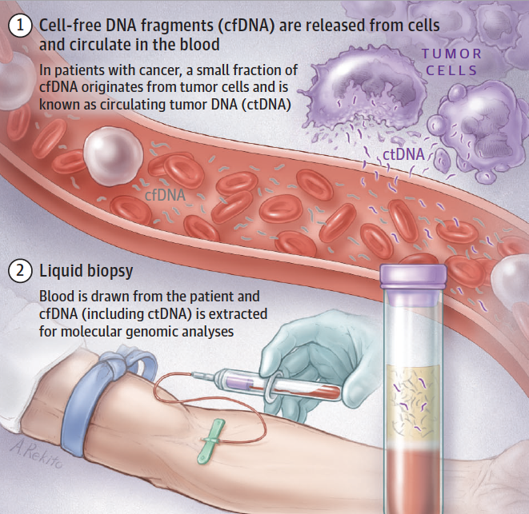
Liquid Biopsy Approaches for Detection of Cancer
Husain and Velculescu, JAMA, 2017
Notes:
Now many of us have been working in liquid biopsies, hoping these would offer a way to achieve these goals. And of course this work rests on observations of French researchers more than 50 years ago who discovered cell-free DNA in the circulation. Subsequently, researchers in the US found that such cell-free DNA could arise from cancer cells and could be analyzed through a simple blood draw. The challenge here though has been to identify the small number of cancer derived molecules from the vast sea of normal cell free DNA.

Slide 8
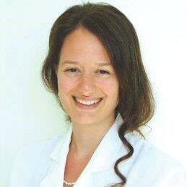

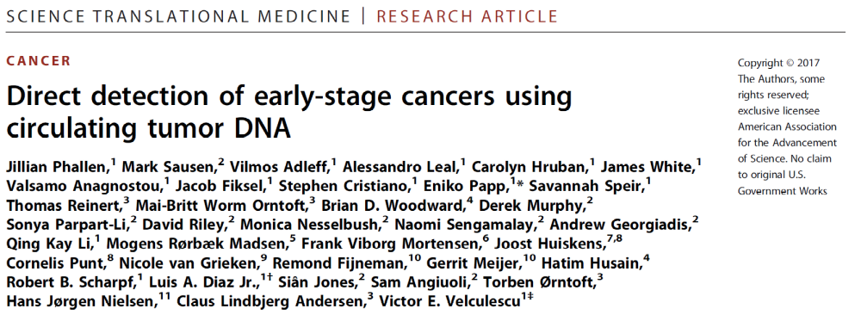
Mutations in cfDNA Provide an Avenue for Noninvasive Cancer Detection
First systematic analysis of sequence alterations in cfDNA for direct detection of early-stage cancers

Slide 9
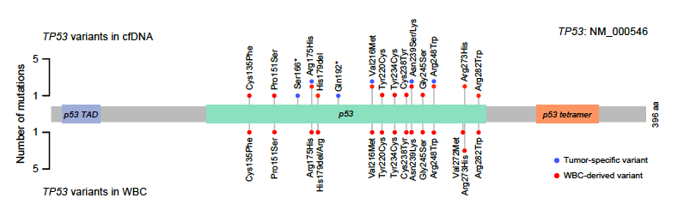
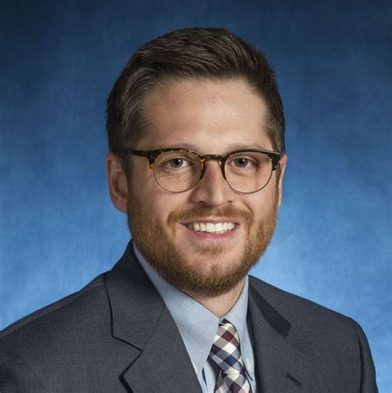
But First-Gen Liquid Biopsies Have Limitations
cfDNA from cancer patient
6x10¹⁰
Only detected a tiny fraction of ctDNA, missing ctDNA without mutations or other changes
Missed many cancers, especially early stage
cfDNA mutations occur in normal blood cells, confounding analyses
Too expensive for broad screening
ctDNA without mutations
6x10⁸
ctDNA with
mutations
6x10⁵
Estimated number of 150bp
fragments in 10ng cfDNA
Leal, van Grieken, Meijer, et al, Nature Communications, 2020

Slide 10
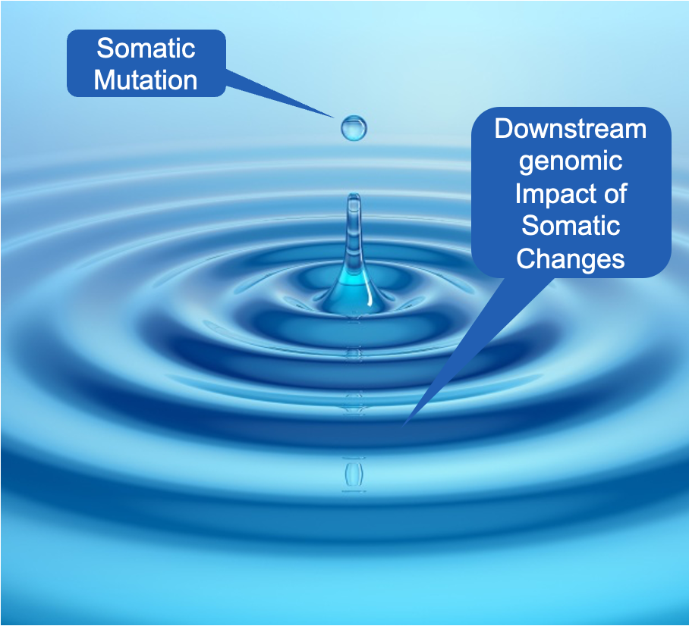
Moving Beyond Mutations or Methylation in cfDNA

Slide 11
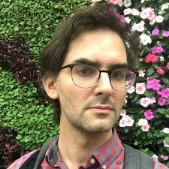
  DELFI Approach for Detection of ctDNA
Cristiano, Leal, Phallen, Fiksel, Scharpf et al., Nature, 2019
DELFI: DNA Evaluation of Fragments for early Interception
Notes:
With this goal in mind, we have developed a next-generation blood-based screening approach called DEFLI which stands for DNA evaluation of fragments for early interception. This method uses artificial intelligence and whole genome analyses of fragments of DNA in the blood to generate what we call a “fragmentome” profile of cell free DNA. The profiles of individuals with cancer are different from those without cancer due to the packaging and genomic changes of the genomes of cancer cells compared to blood cells as they are released in the circulation. We use AI / machine learning to distinguish these profiles and to identify their tissue of origin. Importantly, the DELFI lab portion is simple and inexpensive, and designed to be accessible to all, regardless of socioeconomic or geographic backgrounds.

Slide 12
  From First Gen to Next-Gen Liquid Biopsies
Orders of magnitude more data at lower cost
Known differences in DNA methylation
10³
10⁶
Genome-wide
fragmentation differences
Differences between cancer and normal cells:
Known
mutations
10²
Sequencing
depth:
>30,000x
>130x
<4x
Legacy approaches look for few mutations or methylation changes, in a priori targeted panels, representing an incomplete picture of cancer
More genomic differences even at lower sequencing depths results in high performance
Machine learning to continuously improve classifiers
Low COGS; scalable for population health
Assay Cost:
>$1000’s
<$100’s

Slide 13
cfDNA Fragmentome
The genome-wide compendium of cfDNA fragments in the circulation, providing an integrated view of the chromatin, genome, epigenome, and transcriptome states of normal and cancer cells of an individual
Notes:
This led to the definition a new ome – the cfDNA fragmentome which is the genome-wide compendium of cfDNA fragments in the circulation, which we can use to provide an integrated view of the chromatin, genome, and transcriptome of normal and neoplastic cells of an individual

Slide 14
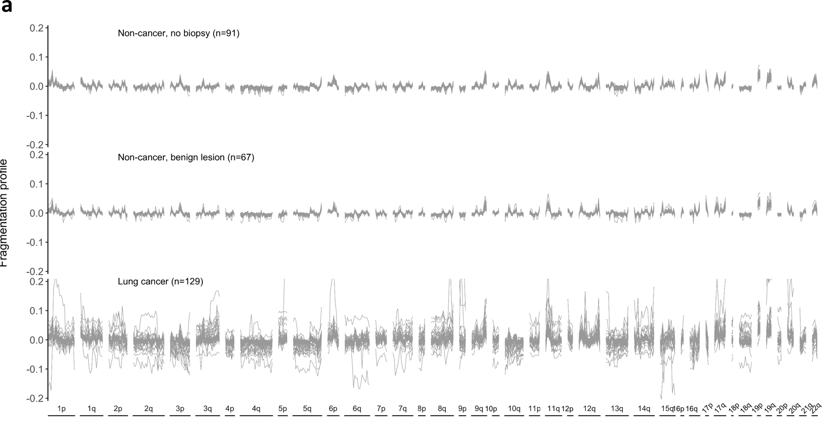
cfDNA Fragmentomes are Altered in Cancer Patients
Non-cancer; no biopsy (n=91)
Non-cancer; benign lesions (n=67)
Fragmentation Profile
Lung cancer (n=129)
Mathios D, et al. Nature Communications, 2021
Notes:
So what does a fragmentome profile look like? We can see that individuals without cancer have highly consistent fragmentome profiles across the genome, even when they have benign lesions, but these profiles are highly disordered both within and among individuals who have cancer (in this case, of the lung)

Slide 15

The Fragmentome Captures Many Features of the cfDNA Universe
Tumor DNA
entering circulation
Cell-free DNA isolated from plasma
cfDNA contains a multitude of tumor-specific changes comprising genomic, epigenomic, and other alterations
Genome-wide massively parallel sequencing
No
alteration
TF binding sites
Mutation signatures
Translocation
Amplification
Deletion
Chromosome arm loss
Chromosome arm gain
Epigenetic
Marks
Fragment size changes
Mitochondrial representation
Cell-free DNA sequence motifs
Cell-free DNA repeat landscapes
Genome-wide cfDNA fragmentation
Leary et al., Science TM, 2010
Leary et al., Science TM, 2012
Phallen et al., Science TM, 2017
Cristiano, et al., Nature, 2019
Leal et al., Nature Comm, 2021
Mathios et al., Nature Comm, 2021
Foda et al., Cancer Discovery, 2022
Bruhm et al., Nature Genetics, 2023
Annapragada et al., Science TM, 2024
Noe et al., Nature Comm, 2024
Medina et al., Cancer Discovery, 2025
Bruhm et al., Nature Reviews Cancer, 2025
Notes:
In the process of obtaining fragmentation information through the low coverage genome-wide cfDNA, we capture essentially all of the features in the cfDNA universe, not only cfDNA fragmentation but chr gains and losses, amplifications, deletions, rearrangements, mutational signatures, sequence motifs, transcription factor binding sites, mitochondrial DNA, and even the repeat landscape ..…. And all these can be incorporated into our analyses without the need for additional labwork

Slide 16
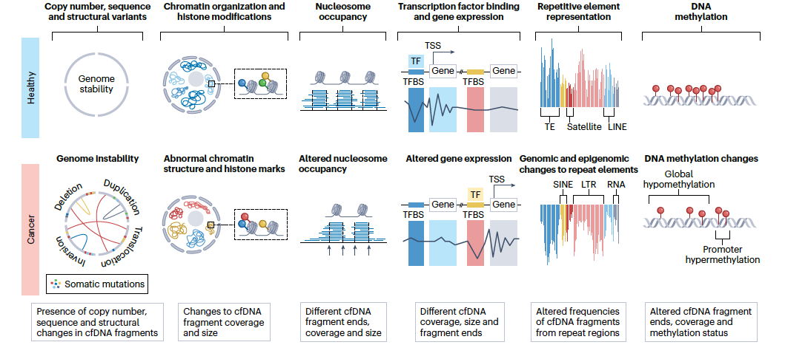
Cancer Biology Exposed Through Fragmentomic Landscapes of cfDNA
Bruhm et al., Nature Reviews Cancer, 2025
Notes:
And the more we learn about molecular changes in cancer, at the genomic, chromatin, nucleosomal, gene expression, repeat and methylation landscapes, and how these are different from healthy cells, we begin to realize that all of these have an impact on the fragments of DNA in the circulation.

Slide 17
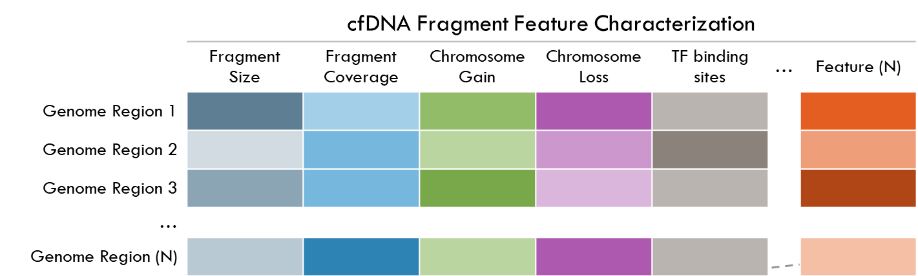
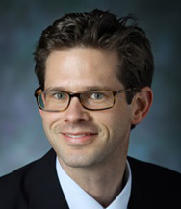
Machine Learning to Incorporate Genome-wide cfDNA Fragmentation Features for Non-invasive Cancer Detection
Classifier for cancer detection
Cristiano, Leal, Phallen, Fiksel, Scharpf et al., Nature, 2019
Notes:
Ultimately these fragmentome features are incorporated into artificial intelligence approaches that can be used to identify the best algorithm for cancer detection

Slide 18
Genome-wide Methodologies for Liquid Biopsy Analyses
Structural Changes | Global Fragmentation | Local Fragmentation | Mutational Signatures | Repeat Landscapes | Epigenetic Changes
Digital Karyotyping, Plasma Aneuploidy Score, Personalized Analyses of Rearranged Ends | DNA Evaluation of Fragments for Early Interception | DNA Evaluation of Fragments for Early Interception | GEnome-wide Mutational Incidence for Non-Invasive detection of cancer | Analysis of RepeaT EleMents in dISease | Analysis of RepeaT EleMents in dISease, preferred fragment end site frequencies
DK, PAS, PARE | DELFI | DELFI | GEMINI | ARTEMIS | ARTEMIS, others
Wang, PNAS, 2002 Leary, Science TM, 2010 Leary, Science TM, 2012 | Cristiano, Nature, 2019 | Mathios, Nat Comm, 2021 Foda, Annapragada Cancer Disc, 2023 | Bruhm, Nat Genetics, 2023 | Annapragada, Science TM, 2024 | Annapragada, Science TM, 2024 Noe, Nat Comm, 2024
Single chromosome or focal gains and losses, top arm changes, rearrangements | Chromatin and chromosomal changes - multi-feature; machine learning | Transcription factor biding sites; multi-feature, machine learning | Regional genome-wide changes in mutation profiles - multi-feature, machine learning | Repeat element representation - multi-feature, machine learning | Sites of DNA methylation, histone modification, gene expression - multi-feature, machine learning
Notes:
And the list of genome-wide features continues to grow, starting with our early work in detection of chromosomal gains and losses, rearrangements, both global and local genome-wide fragmentation profiles captured through DELFI, GEMINI which we just discussed, and most recently, changes in representation of the complex repeat elements that make up nearly half of the genome, but which to date have only been poorly evaluated due to technical limitations. We look forward to the incorporation of these genomic characteristics in combined algorithms to apply these approaches in a variety of disease detection settings.

Slide 19
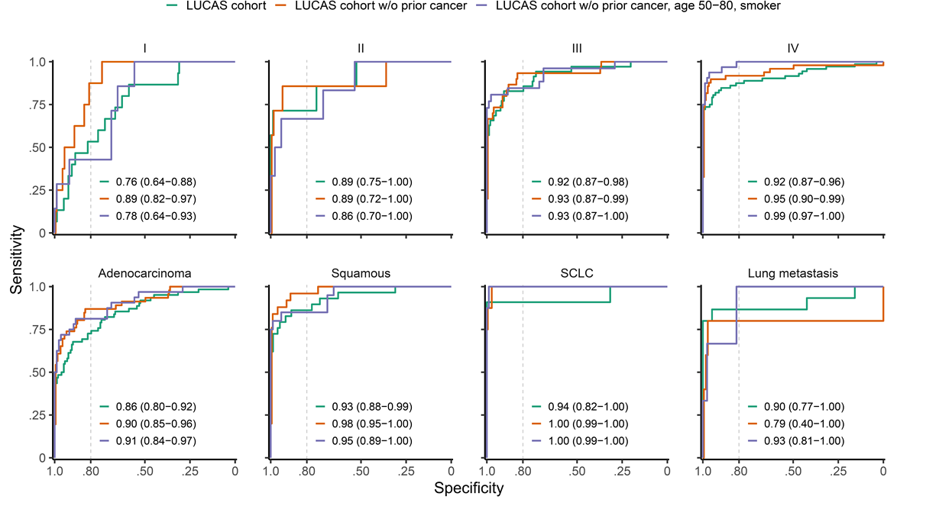
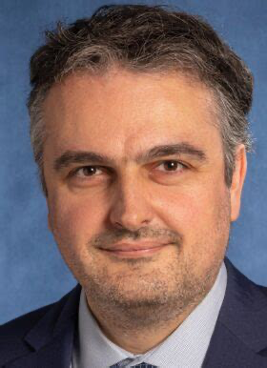
Detection of Lung Cancer: Historic Prospective Cohort
▬ Full cohort ▬ Without prior cancer ▬ Without prior cancer, 50-80 years, smoker
Mathios D, Johansen J, et al. Nature Communications, 2021
Notes:
As lung cancer is largest cancer killer world-wide, we initially applied this DELFI approach for early detection of lung cancer in a lung cancer diagnostic study of over 300 individuals in collaboration with colleagues at the University of Copenhagen. We observed high performance of the DELFI method as can be seen in these sensitivity/specificity graphs across all stages and subtypes of lung cancer in this initial study which was published in 2021.

Slide 20
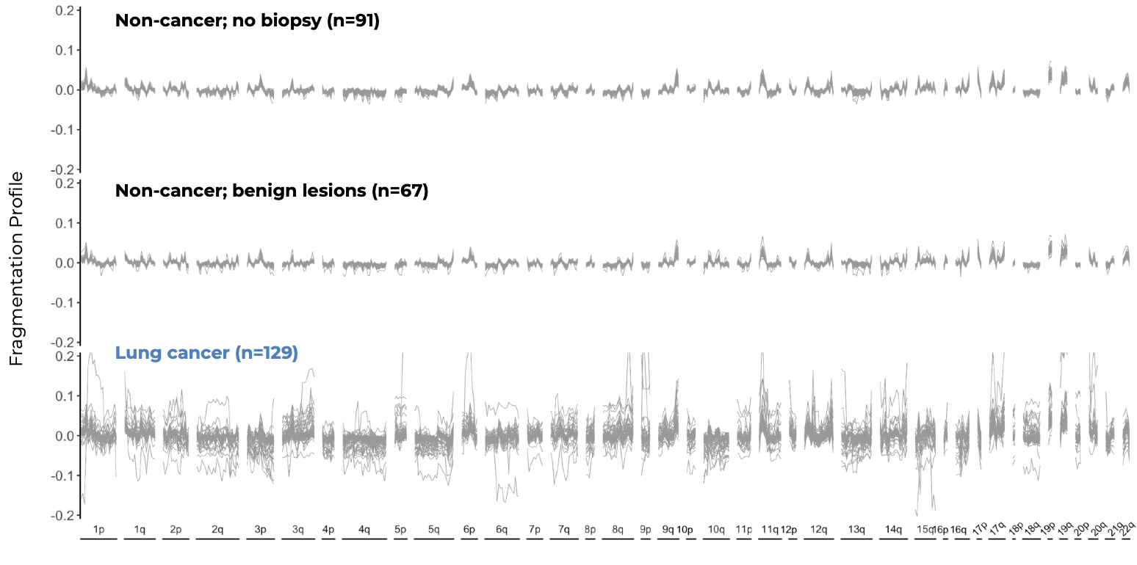
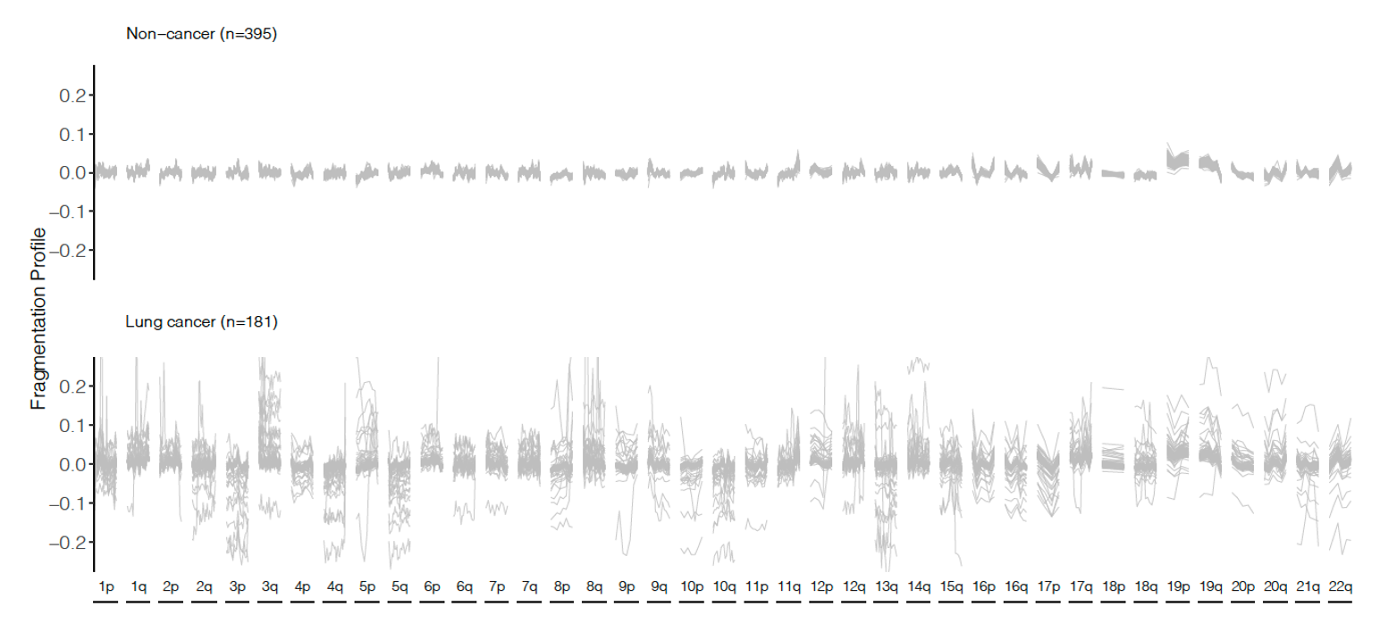
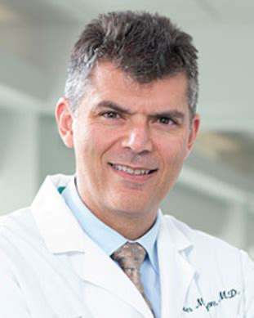
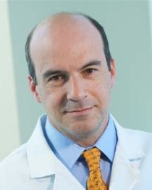
Clinical Validation of Lung Cancer cfDNA Fragmentome Assay in Prospective Cohort
Historic Prospective Cohort
Prospective Clinical Validation
Mathios D, et al. Nature Communications, 2021
Mazzone, Bach et al., Cancer Discovery, 2024
Notes:
As lung cancer is largest cancer killer world-wide, we initially applied this DELFI approach for early detection of lung cancer in a lung cancer diagnostic study of over 300 individuals in collaboration with colleagues at the University of Copenhagen. We observed high performance of the DELFI method as can be seen in these sensitivity/specificity graphs across all stages and subtypes of lung cancer in this initial study which was published in 2021.
I am pleased to say that this work has now been validated in a prospective multi-center case-control study of nearly 1000 individuals in a screening population either with or without cancer, and we can see the same dramatic profiles in individuals with cancer and consistent profiles in those without cancer that you saw earlier.

Slide 21
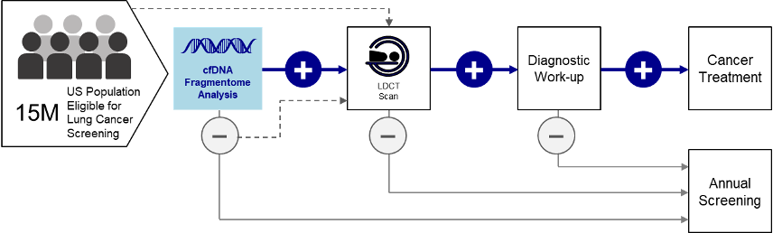
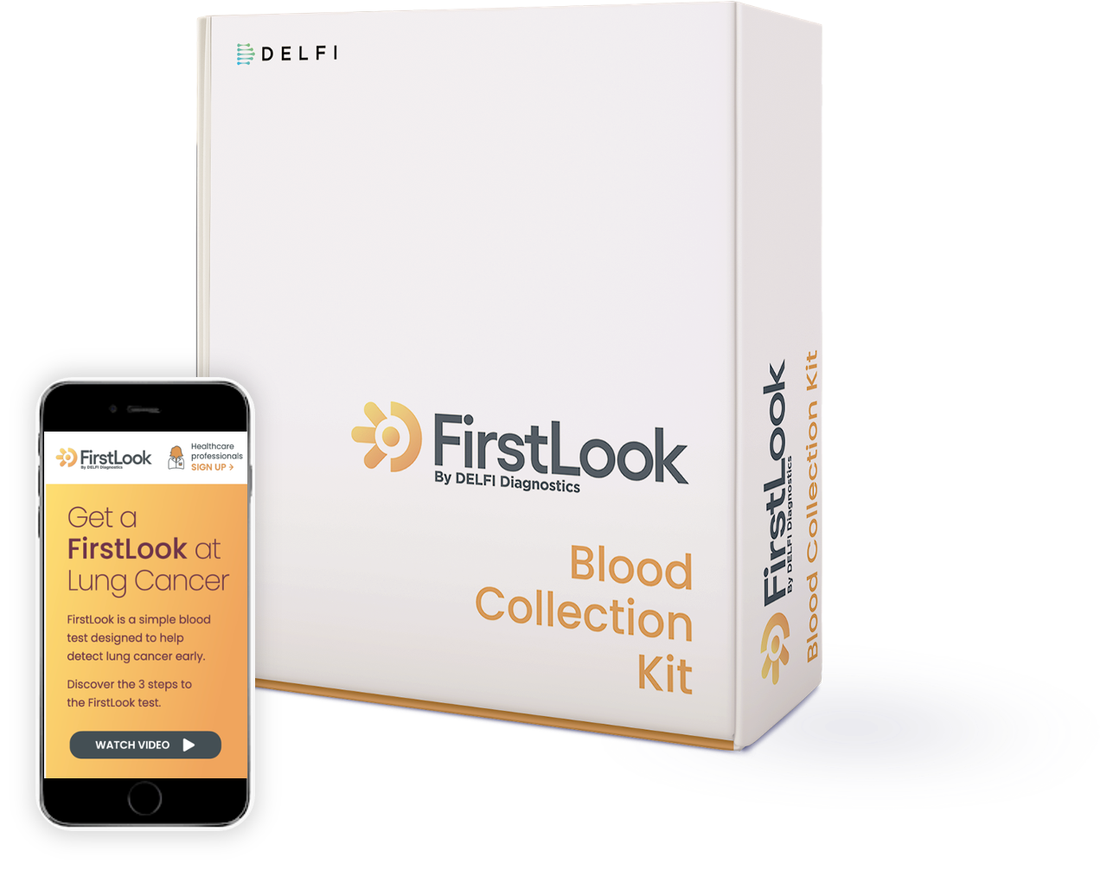

cfDNA Fragmentome Assay for Augmentation of Lung Cancer Early Detection
FirstLook Lung clinical test launched Oct 9, 2023
Notes:
This validation has now led to the launch of the first validated liquid biopsy test for lung cancer screening, FirstLook Lung, where individuals with a smoking history and above age 50 (15 M such individuals in the US) would be eligible to receive this test. Positive tests would proceed in the usual screening and diagnostic pathway for lung cancer screening today, while negative results would lead to an annual follow-up screening.
The key in such a screening population is high negative predictive value (or NPV), which is the measure of individuals who are called negative that truly do not have disease and can be safely removed from the usual screening pathway and evaluated again next year. The clinically validated NPV of this test is 99.8%. This is an exciting step for lung cancer screening and we are looking forward to this being used in the clinic. Population health estimates with a modest uptake of this test in the clinic suggest the potential to save thousands of lung cancer deaths in the US over a five-year period.
Extra information:
When the test is positive, the number needed to screen by LDCT to detect one lung cancer is 76, considerably higher than in the general population where this is 143, and much higher than when the test negative, where the NNS is 414.
PPV = 1.3%
NNS = 76 for positive, 414 for negative

Slide 22
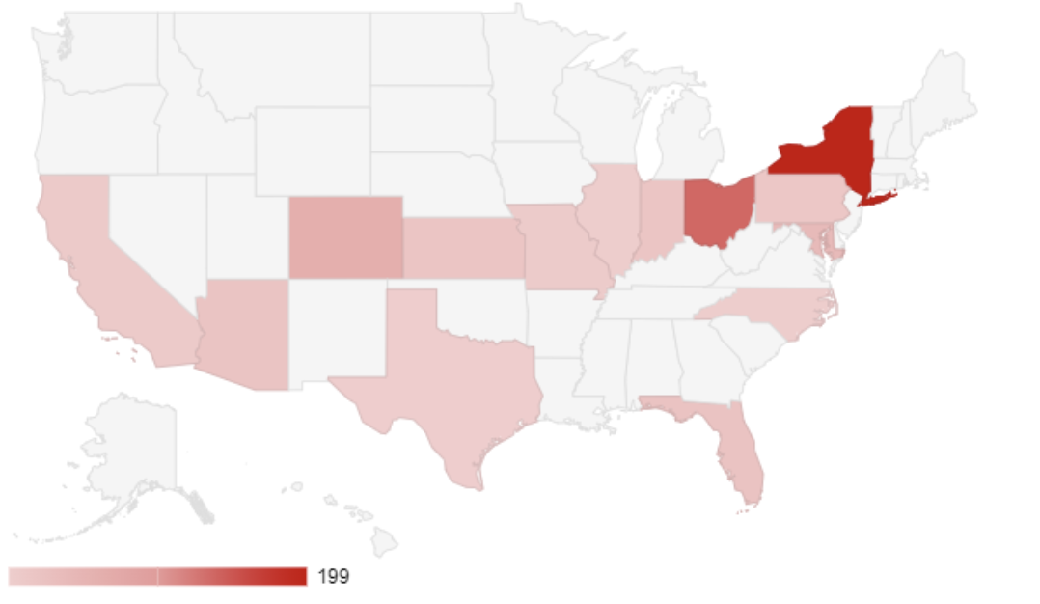




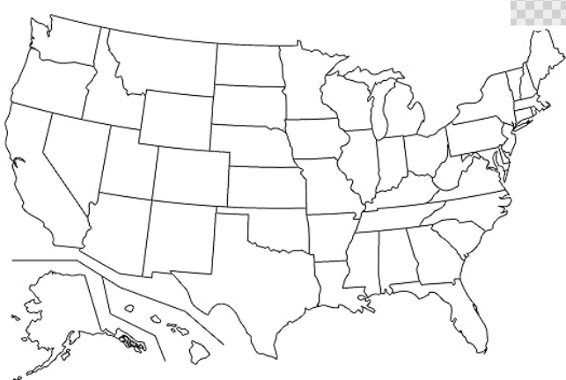
Clinical Trials for Validation of cfDNA Fragmentome Test
Study | Description | Purpose | Locations | Population | Inclusion Criteria
L101 | Prospective, observational case-control | Train and validate classifier for LDT lung cancer detection and multi-cancer detection | 20+ sites | N=2,500 participants with lung cancer, non-lung cancers*, and no cancer | ≥50 years of age; current or former smoker ≥20 pack-years
CASCADE - LUNG | Prospective, observational cohort | Validate clinical performance of the DELFI lung cancer screening test and other high-risk cancer detection | 90 sites | N≈12,000 participants, (70 with cancer) undergoing LDCT screening | ≥50 years of age; current or former smoker ≥20 pack-years
4-ITLR | Prospective observational analysis of randomized trial of annual v. biennial LDCT screening | Validate clinical performance of the DELFI lung cancer screening test and other high-risk cancer detection | PI is Harry de Koning (PI on NELSON Trial) | N≈9,000 participants undergoing LDCT screening | 60-79 years of age; current or former smoker ≥40 pack-years
Clinical Utility | Cluster randomized trial (cluster = primary care practice) of First Look ordering availability | Demonstrate that availability to order First Look cancer screening test improves LDCT screening uptake | 60-70 practices | Primary care practices with patients eligible (per USPSTF) for screening but not receiving (15+ months out of compliance) | Practices: Have eligible patients, have access to phlebotomy, can order LDCT’s Patients: USPSTF eligible
US
US
EU
US

Slide 23
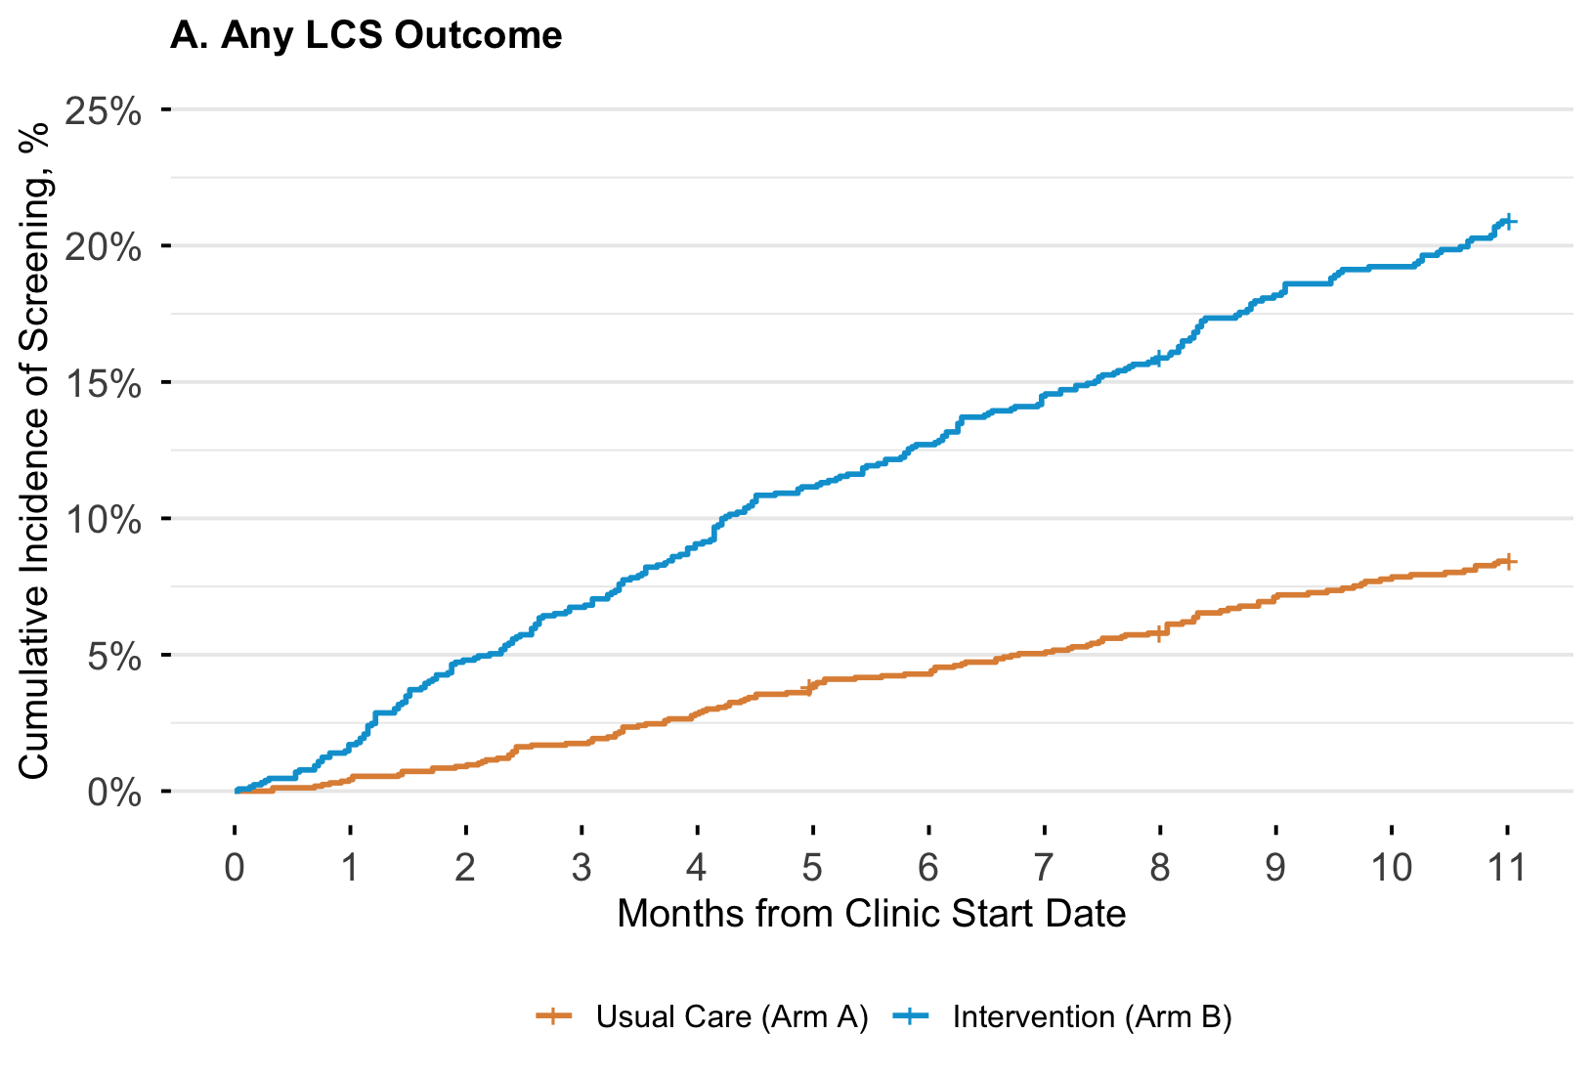

Access to FirstLook Lung Blood Test
Increases Lung Cancer Screening
Adjusted HR 2.73
[95% CI=1.91–3.89]
P < 0.001
20.9%
8.4%
Cumulative incidence of study outcomes over time. Point Estimate shown at 11 months.
The P values refer to the strength of the association in the pre-specified multivariable test.
DO NOT POST
Davis, Bach et al., ATS Meeting 2026
Notes:
Please note here that we also saw 40.2% LDCT clinical follow-up post-positive blood-testing - consistent with early Cologuard experience for colonoscopy follow-up in CRC
An additional 5% LDCT clinical follow-up post-negative blood testing.
(we don’t have time to include a slide on the data here but will be important for the room to hear)

Slide 24
Population Health Benefits of cfDNA Fragmentome Test in Lung Cancer Screening
2.7X
Screening Rate Increase
LCS: 20.9% (intervention)
vs. 8.4% (usual care)
Adjusted HR 2.73; P < 0.001
~3178
Lung Cancer Deaths Preventable
Projected over 5 years with 3% annual uptake increase across 15 million (2,975 - 5,489)
Primary Outcome: Lung Cancer Screening
Projected Population Health Impact
Potential to prevent ~3,178 more deaths than LDCT Only*
DO NOT POST
Davis, Bach et al., ATS Meeting 2026
Notes:
LDCT only is modeled to prevent an average 5980 deaths
By making the blood test available, a further 3178 deaths could be prevented.

Slide 25
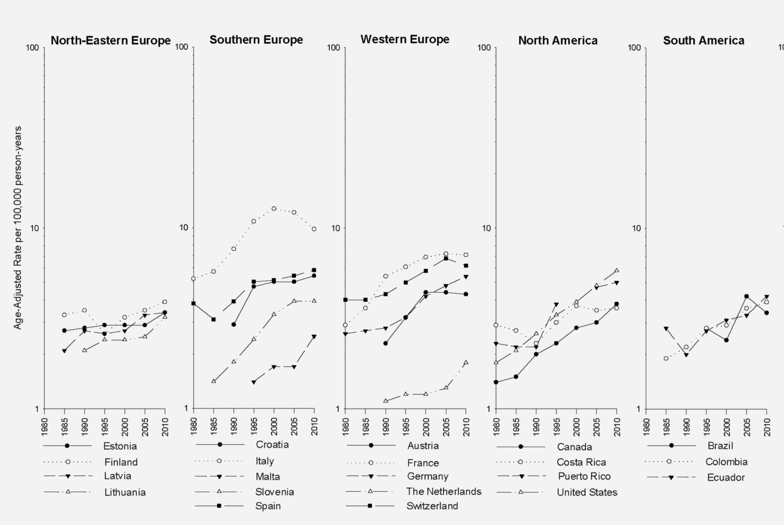
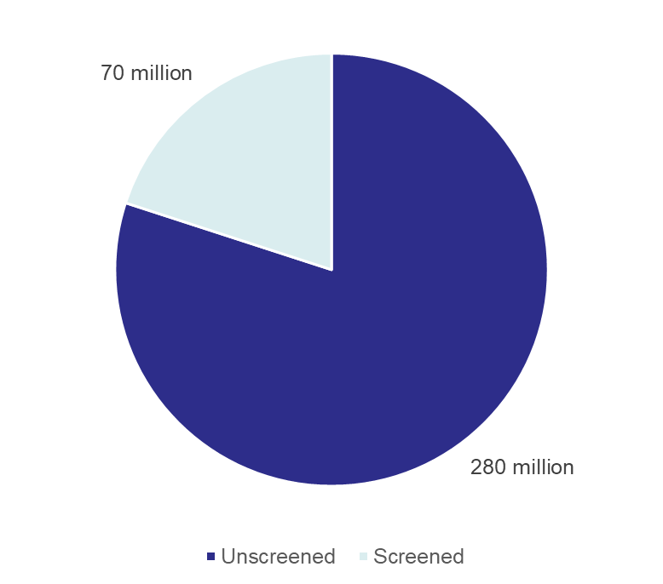
  Hepatocellular Carcinoma (HCC) is a Major Cause of Cancer Mortality Worldwide

Slide 26
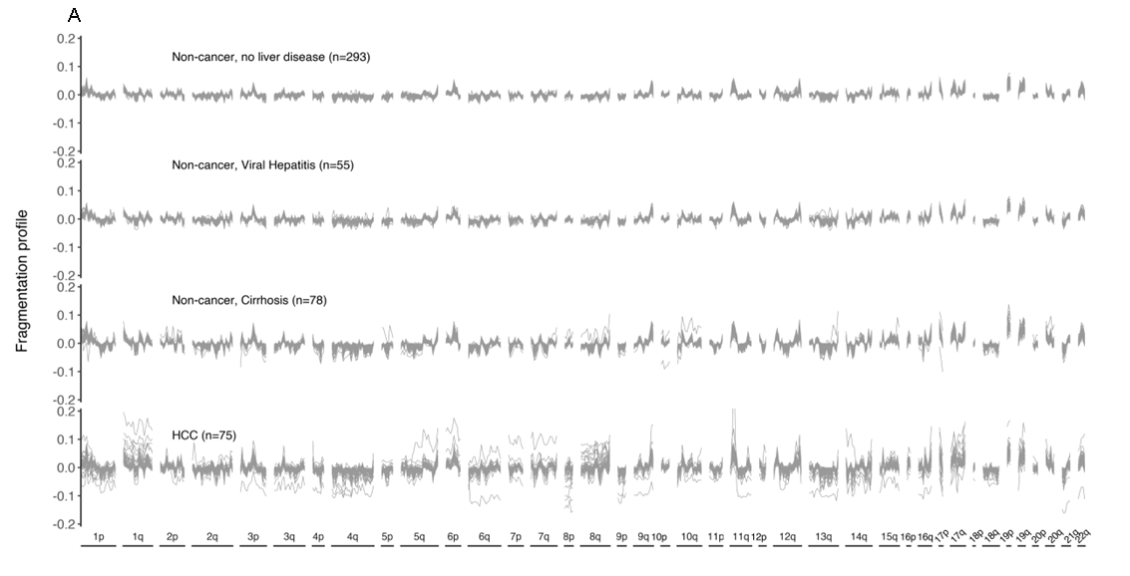
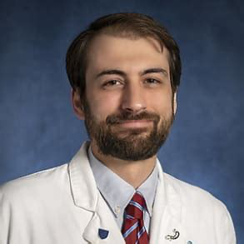
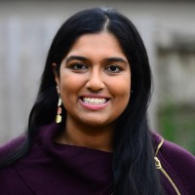
cfDNA Fragmentomes are Altered in Patients with Liver Cancer (HCC)
No cancer, no liver disease (n=293)
No cancer, viral hepatitis (n=55)
No cancer, cirrhosis (n=78)
HCC (n=75)
Foda, Annapragada, Kim, et al., Cancer Discovery, 2023
Notes:
This approach can be used in other cancer detection settings. One that we have recently explored is the early detection of liver cancer, where there is a high risk population of 400M individuals world-wide. In this study of over 700 individuals from the US, EU and Asia led by Zack Foda, Akshaya Annapragada and Amy Kim, we see again that those without cancer have consistent profiles, and those with cancer have disorganized fragmentomes genome-wide.

Slide 27
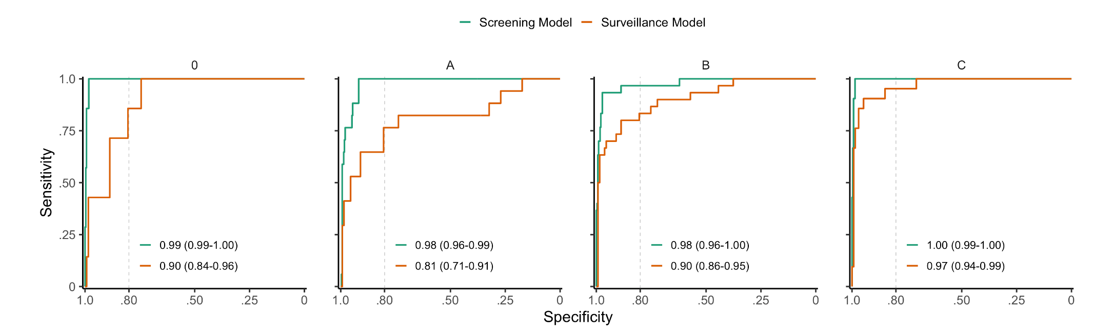
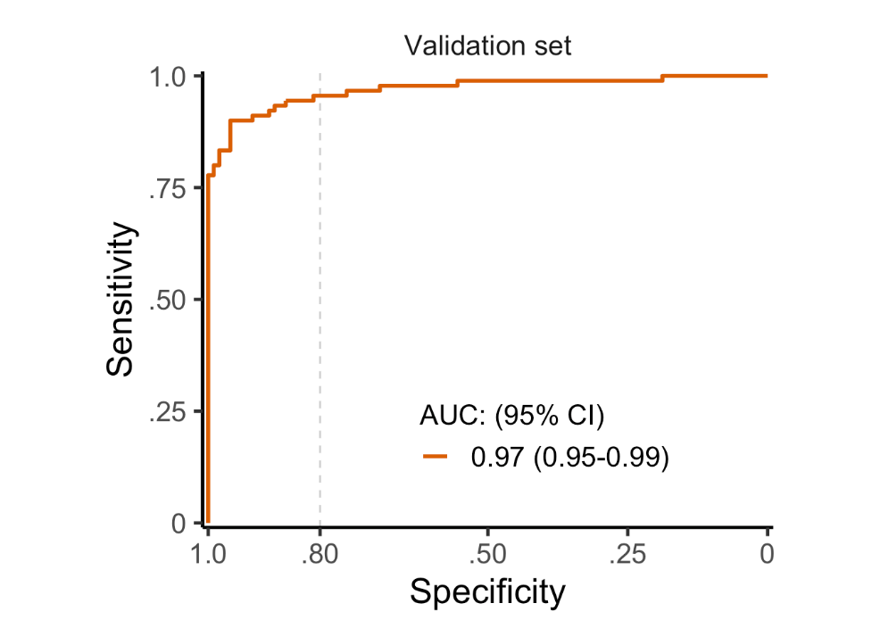
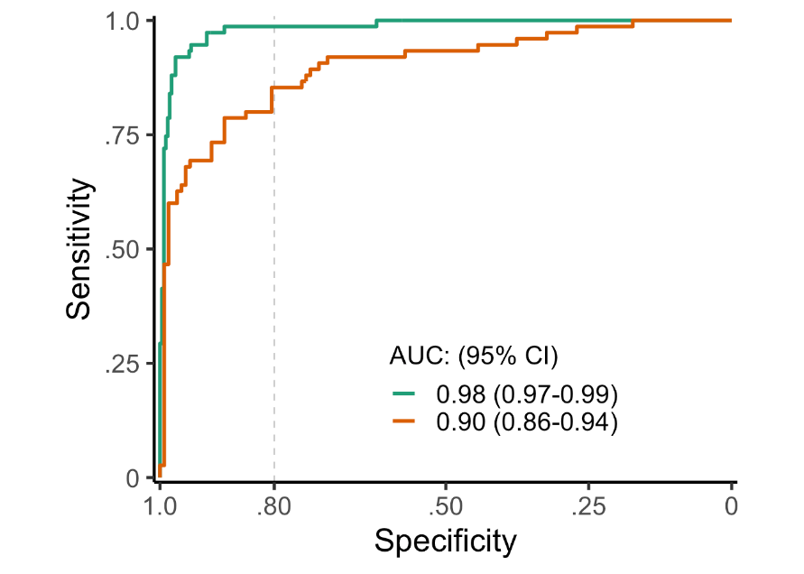
Detection of Liver Cancer: Screening and Surveillance Contexts and External Validation
BCLC Stage 0 A B C
AUC (95% CI)
0.99 (0.99-1.00)
0.90 (0.84-0.96)
AUC (95% CI)
0.98 (0.96-0.99)
0.81 (0.71-0.96)
AUC (95% CI)
0.98 (0.96-1.00)
0.90 (0.86-0.95)
AUC (95% CI)
1.00 (0.99-1.00)
0.97 (0.94-0.99)
CROSS VALIDATED COHORT
VALIDATION COHORT
AUC (95% CI)
0.98 (0.97-0.99)
0.90 (0.86-0.94)
AUC (95% CI)
0.97 (0.95-0.99)
Foda, Annapragada, Kim, et al., Cancer Discovery, 2023
Notes:
The DELFI approach highly sensitive for detection of liver cancer. You can see the high performance here across different Barcelona Clinic Liver Cancer stages, including stages 0 and A where early detection and intervention is most successful. High performance can be observed in the screening as well as surveillance settings in a cross validated analysis. The locked model was evaluated in a population from Hong Kong ad we observed high performance in a surveillance model in these individuals.

Slide 28
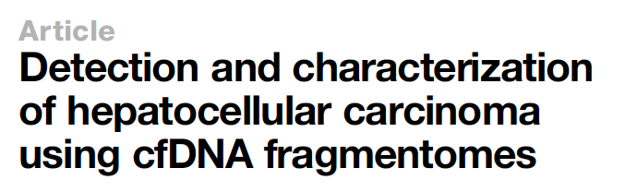

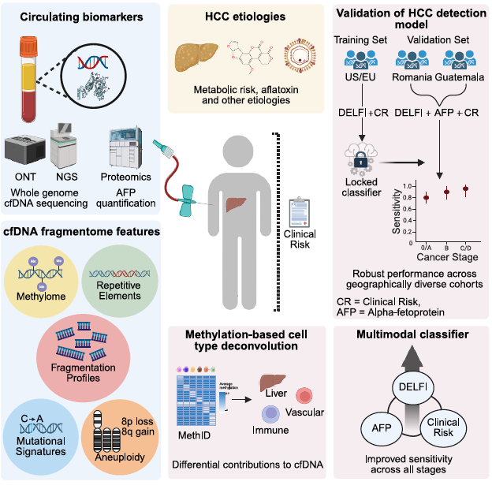
Orjuela, Norton, Foda, et al., Cell Press Blue, 2026

Slide 29
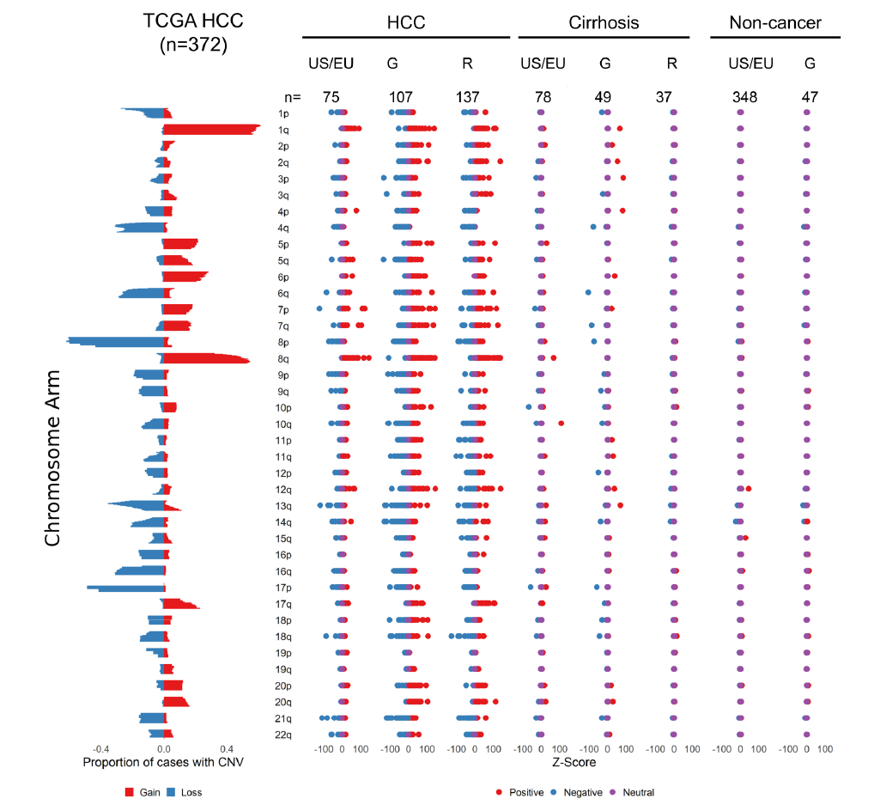
Chromosomal Changes are Biologically Consistent
Orjuela, Norton, Foda, et al., Cell Press Blue, 2026

Slide 30
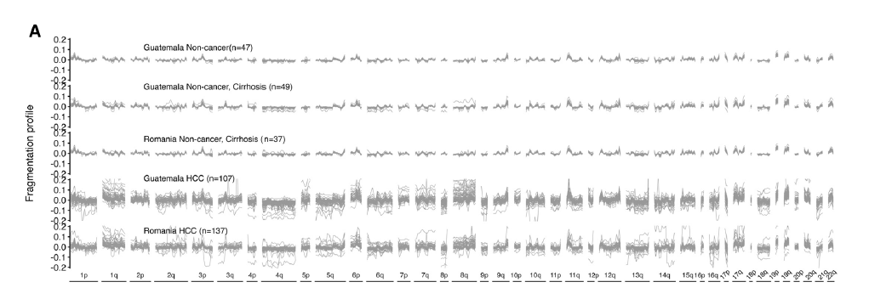
cfDNA Fragmentomes are Altered in HCC Patients from Diverse Worldwide Regions
Orjuela, Norton, Foda, et al., Cell Press Blue, 2026

Slide 31
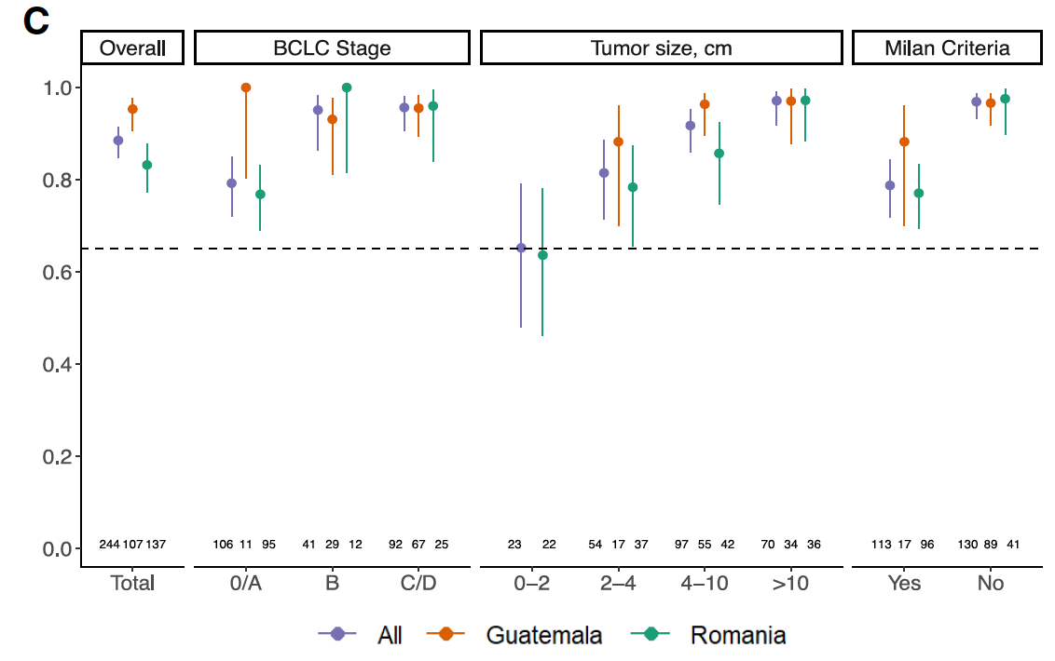
cfDNA Fragmentome Assay has High Performance for Detection of HCC in External Validation Cohorts
Orjuela, Norton, Foda, et al., Cell Press Blue, 2026
Notes:
Combining clinical risk with the DELFI+AFP classifier improved sensitivities to 95% and 83% in the two studies (89% combined), including 79% in early stage, with a slight decrease in specificity (Figure. 4, Table 2S5).

Slide 32
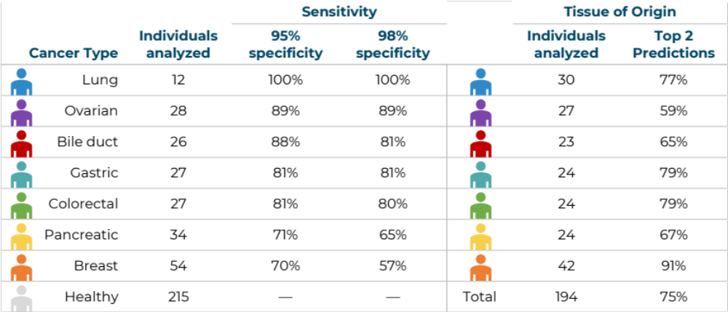
After Key Single Cancer Screening Tests, Potential for Multi-Cancer Early Detection
Cristiano, Leal, Phallen, Fiksel, Scharpf et al., Nature, 2019
Notes:
We have been able to use this approach not only for single cancer early detection, but for multi-cancer as well. In the original study published in 2019 we showed high sensitivity across 7 different cancer types and high specificity, and could identify the tumors’ tissue of origin.
This leads to the exciting possibility of using the DELFI approach initially in high risk populations but ultimately in a muli-cancer early detection setting for individuals at general risk of cancer.

Slide 33
Conclusions and Opportunities
First gen liquid biopsies have limitations that may prevent their broad use in cancer screening.
Machine learning cfDNA fragmentome classifiers detect cancer with high sensitivity, including in early-stage disease.
The clinically validated DELFI test for lung cancer screening has high performance and increases lung screening rates in primary care setting.
The cfDNA fragmentome approach shows promise for early detection of liver, ovarian, brain, and other cancers.
Accessible cfDNA analyses provide a path for disease detection that could be implemented worldwide.
Notes:
The work that we have described today allows us to see that…
… and I look forward to the steps ahead that will make this a reality

Slide 34
JHU EDRN Team
Mariana Brait
Otis Brawley
Zack Foda
Jill Phallen
Rob Scharpf
David Sidransky
Victor Velculescu

Slide 35

Acknowledgements
Johns Hopkins
Cancer Genomics Lab
Akshaya Annapragada
Adrianna Bartolomucci
Saoirse Bodnar
Daniel Bruhm
Chris Cherry
Anissa Dallmann
Dan Du
Alice Eastman
Vish Girish
Janvi Huria
Kaui Lebarbenchon
Shashi Koul
Noushin Niknafs
Carter Norton
Hope Orjuela
Sarah Short
Nick Vulpescu
James White
Jason Zavras
Zach Foda
Jill Phallen
Rob Scharpf
Recent Alumni
Valsamo Anagnostou
Stephen Cristiano
Carlie Hruban
Alessandro Leal
Johns Hopkins Kimmel
Cancer Center
Valsamo Anagnostou
Steve Baylin
Julie Brahmer
Mariana Brait
Hari Easwaran
John Groopman
Ralph Hruban
Elizabeth Jaffee
Rachel Karchin
Amy Kim
David Sidransky
Kala Visvanathan
NCI, INCAP
Katherine A. McGlynn
Manuel Ramírez-Zea
MSKCC
Luis Diaz
Allegheny Health Network
Ali Zaidi
Recent Alumni
Dimitris Mathios
Jamie Medina
Michael Noe
Mark Sausen
UCLA
Dennis Slamon
Gottfried Konecny
Beth Karlan
University of Pennsylvania
Ronny Drapkin
Susan Domchek
Ehay Jung
USC
Michael Press
Aarhus University
Claus Lindbjerg Andersen
Hvidovre Hospital
University of Copenhagen
Inna Chen
Astrid Johansen
Jakob Johansen
Julia Johansen
University of Bucharest,
Fundeni Institute, ICDG
Simona Dima
Liana Gheorghe
Razvan Iacob
Speranta Iacob
Andrei Sorop
Octavian Bucur
NKI, AMC,
MUMC and VUMC
Beatriz Carvalho
Remond Fijneman
Miriam Koopman
Kim Monkhorst
Pien Lof
Christianne Lok
Gerrit Meijer
Cornelis Punt
Suzanna Schraa
Daan van den Broek
Iris van ‘t Erve
Geraldine Vink
Meike de Wit
Delfi Diagnostics
Peter Bach
Nic Dracopoli
Laurel Keefer
Sian Jones
Keith Lumbard
Lorenzo Rinaldi
Funders: AMRF, NCI, EDRN, SU2C/AACR, Gray Foundation, Commonwealth Foundation, Delfi Diagnostics
Notes:
I would like to acknowledge again the individuals who made this work possible in addition to Jamie Medina and Akshaya Annapragada, including members of our group, colleagues at Johns Hopkins, other institutions, Delfi Diagnostics, our funders, including the Adelson Medical research foundation and the Gray Foundation, and…

Slide 36
Acknowledgements
L101 Study Investigators and Researchers
Peter J Mazzone¹, Peter B. Bach², Jacob Carey², Caitlin A. Schonewolf², Katalin Bognar³, Marcia Cruz-Correa⁴, David Gierada⁵, Sonali Kotagiri², Kathryn Lloyd⁶, Fabien Maldonado⁷, Jesse D. Ortendahl⁸, Lecia Sequist⁹, Gerard Silvestri¹⁰, Nichole Tanner¹¹, Jeffrey C. Thompson¹², Anil Vachani¹², Kwok-Kin Wong¹³, Ali Zaidi¹⁴, Joseph Catallini², Ariel Gershman², Keith Lumbard², Laurel Millberg², Jeff Nawrocki², Carter Portwood², Aakanksha Rangnekar², Carolina Campos Sheridan², Niti Trivedi², Tony Wu², Sara Zong², Lindsey Cotton², Allison Ryan², Christopher Cisar², Alessandro Leal², Nicholas Dracopoli², Robert B. Scharpf^{2,15}, Victor E. Velculescu^{2,15*}, Luke Pike¹⁶
L301 FIRSTLUNG Study Investigators and Researchers
James M. Davis, Pradeep Khanna, Niti U. Trivedi, David Morgenstern, Carolina Sheridan, Kendall R. Kirsch, Sarah L. Moseley, Chris Cisar, Peter B Bach, Clinics, Staff and Physician Participants
Thank you to the generous participants in our studies
Notes:
And our L101 study investigators and patients who generously participated in these efforts.
Thank you and glad to take any questions.

Slide 37

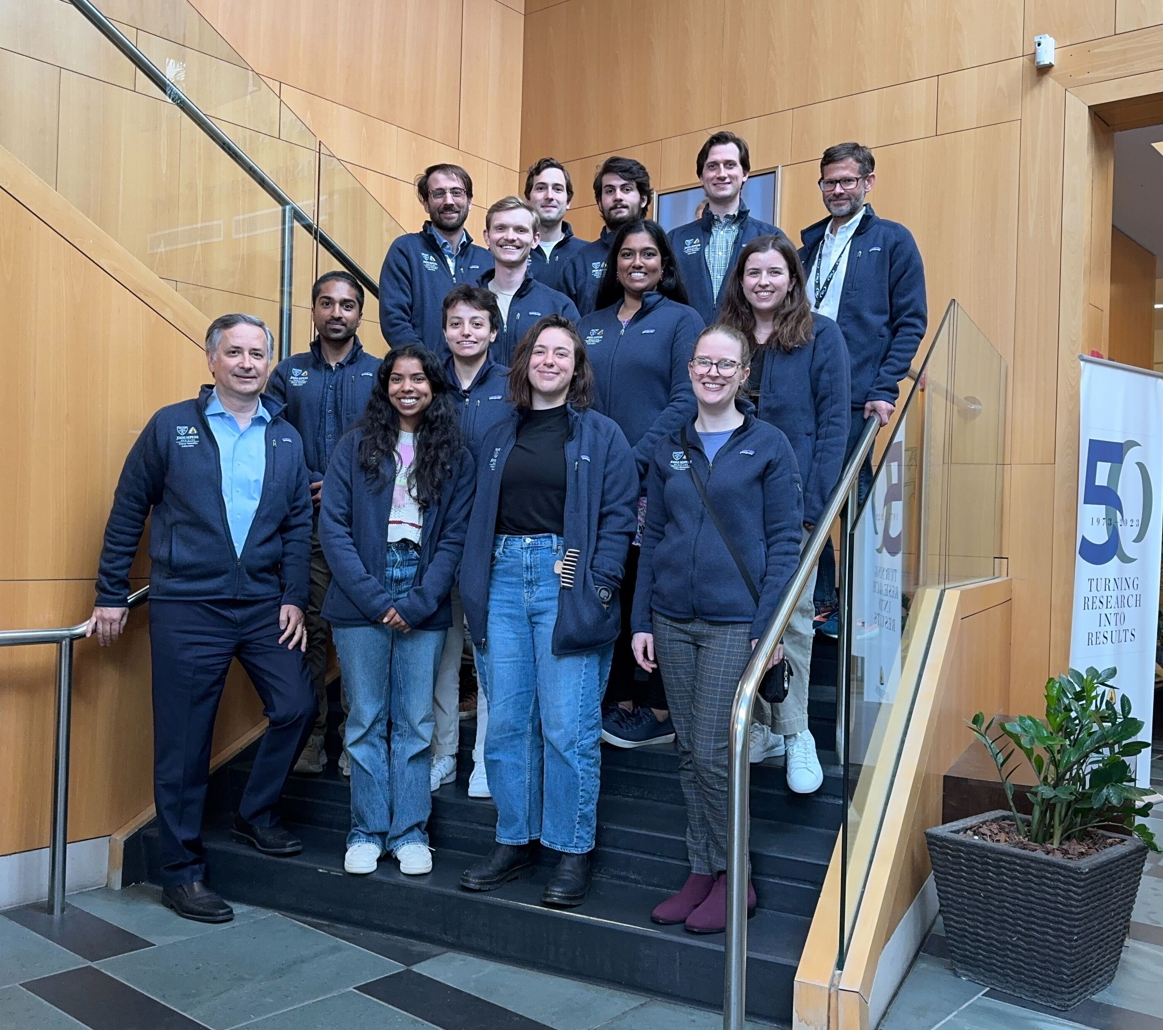
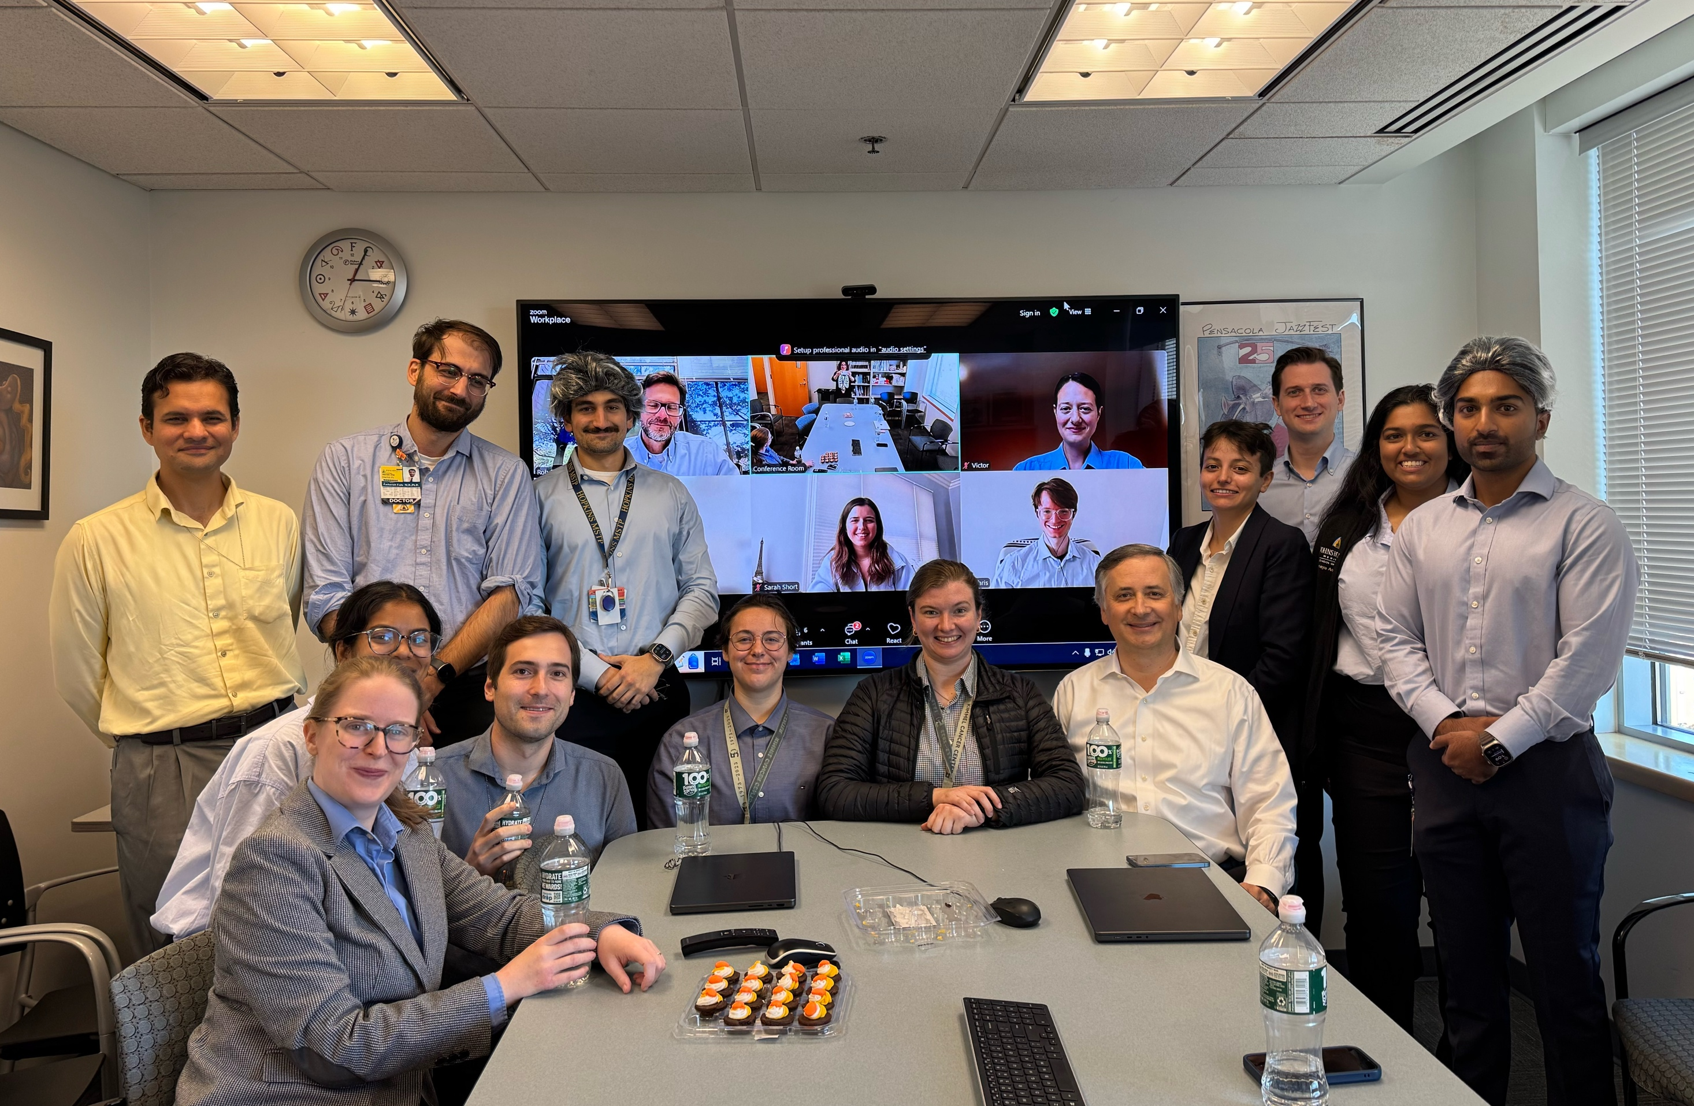


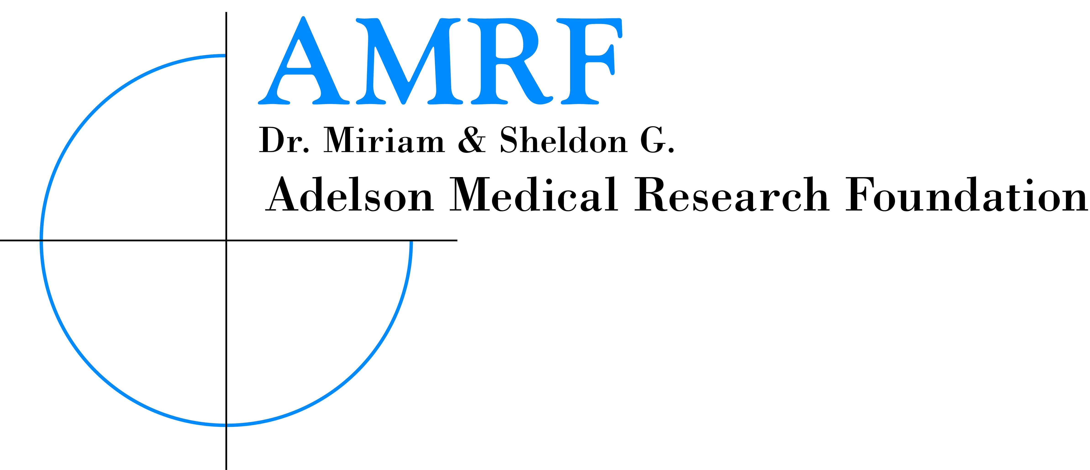


Johns Hopkins Cancer Genomics Laboratory
www.cancergenomicslab.org

