Slide 1

High-throughput immunoproteomics for cancer biomarker discovery
ASU BCC
Joshua LaBaer
Karen Anderson
Ji Qiu
Lusheng Song
Martin Stengelin
Anu Matthew

Slide 2
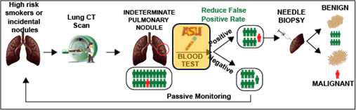
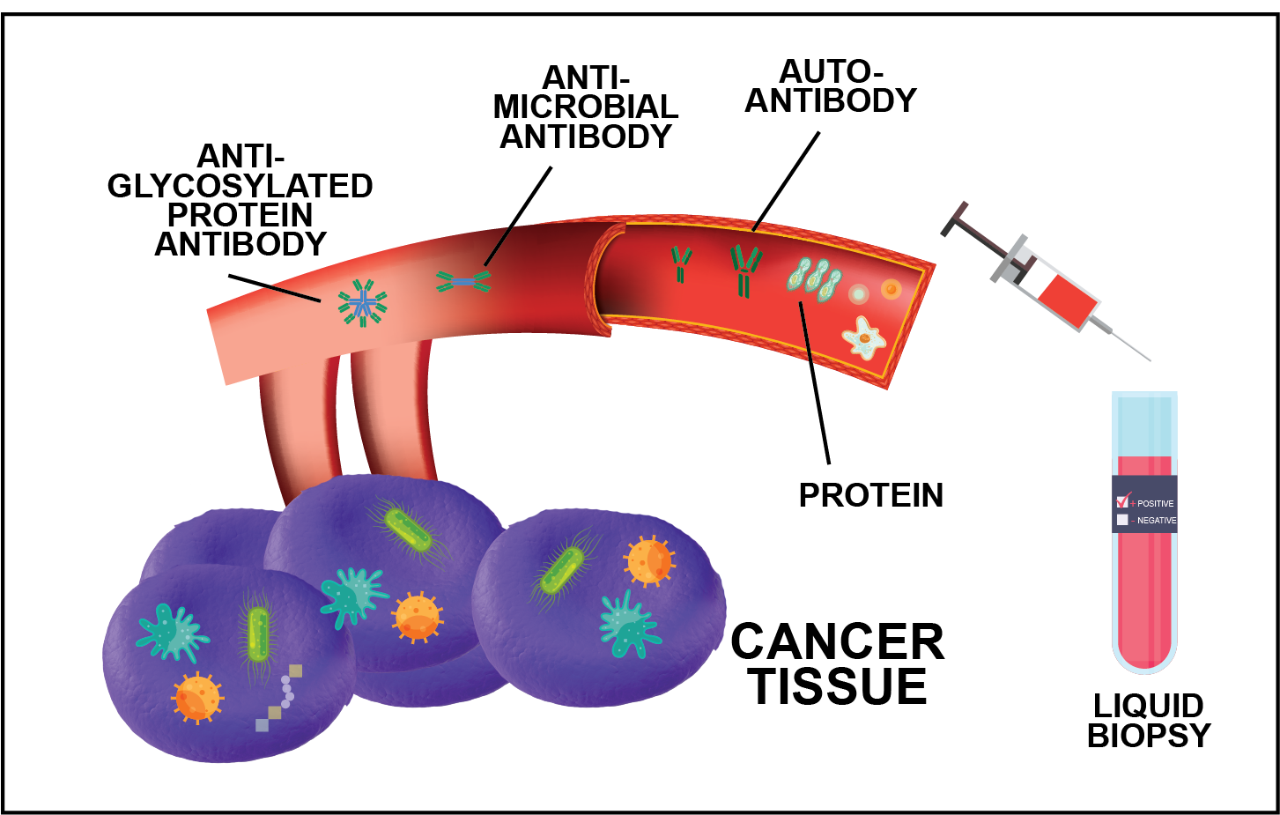
A systems immunology approach to identify biomarkers that can improve lung cancer screening
Notes:
3 types of markers
Autoantibody
Microbial antibodies
Protein markers

Slide 3
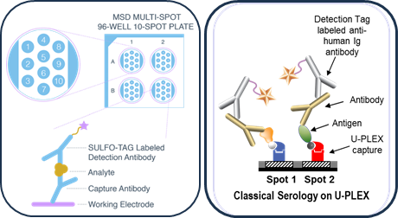
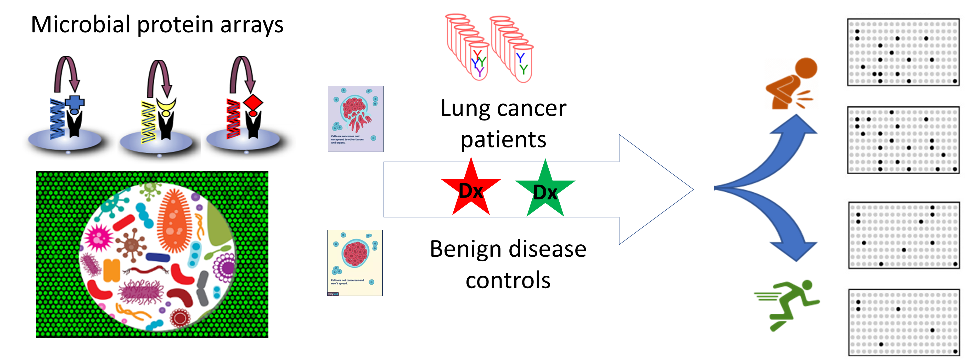
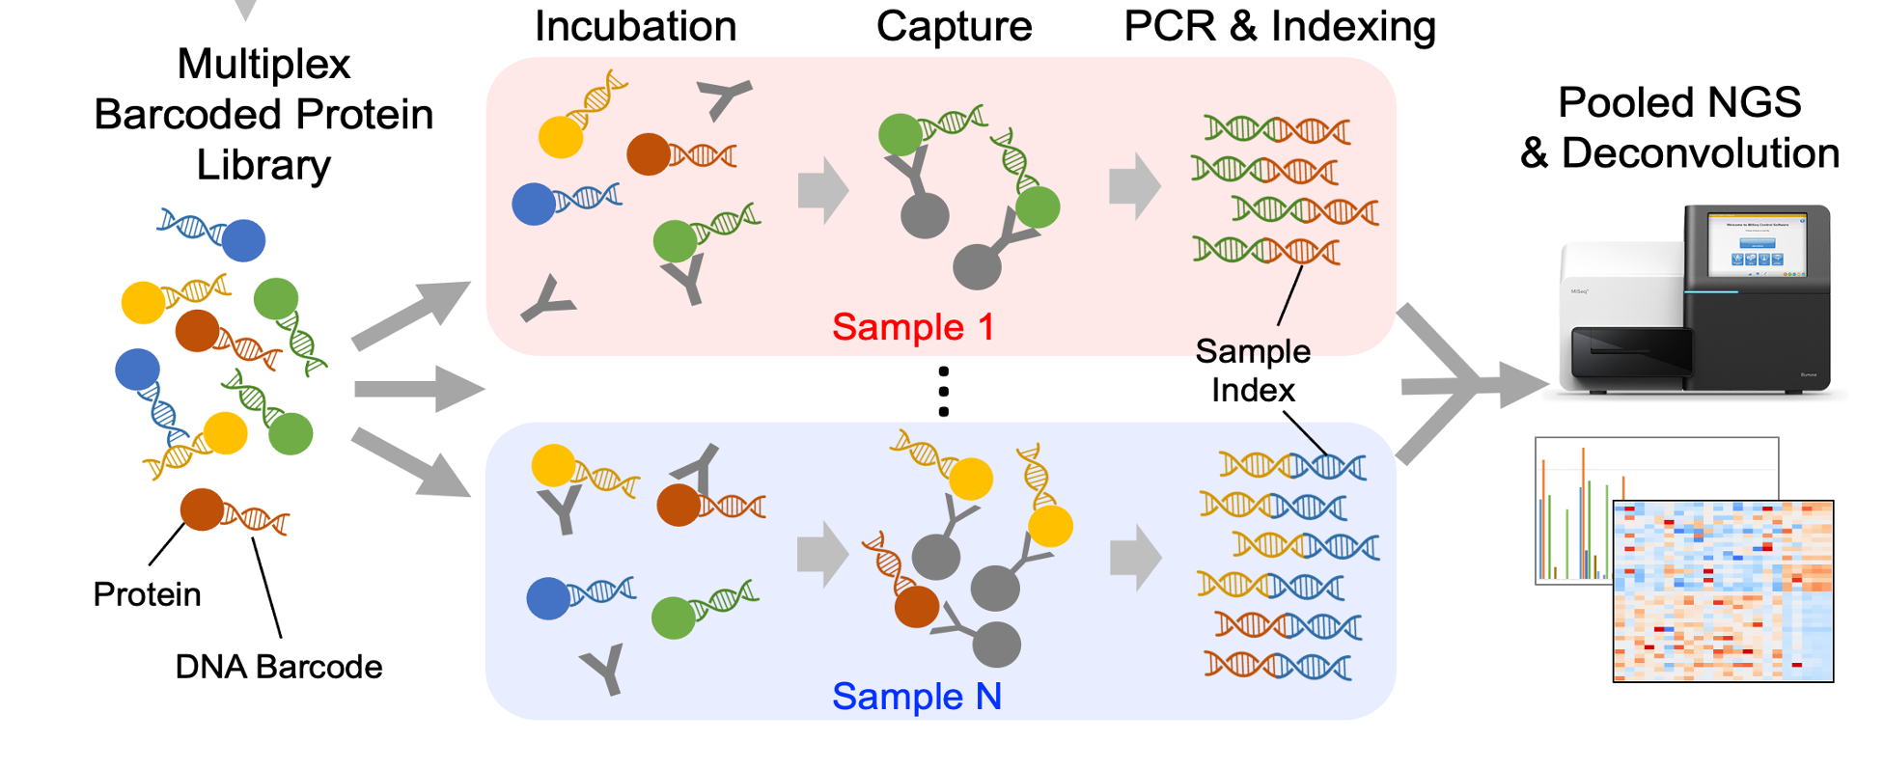
Experimental approach
Biomarker Discovery Laboratory
Biomarker Discovery Laboratory
Biomarker Reference Laboratory
PRESCREENING
20,411 antigens
(11,868 autoantigens;
8,543 microbial antigens)
DISCOVERY VALIDATION
2204 antigens
Vanderbilt University Medical Center (VUMC)
(144 + 143)
Detection of Early Lung Cancer Among Military Personnel 1 (DECAMP-1)
(215 +114)
ASSAY DEVELOPMENT
VALIDATION II
German Lung Cancer Screening Intervention trial (LUSI)
(46+230)
Lung Team Project 2
(LTP2)
(554)
Meso Scale Diagnostics
Nucleic Acid Programmable Protein Array (NAPPA)
Multiplex In-Solution Protein Array (MISPA)
Serum protein markers
Serum antibody markers
Notes:
During the monthly meetings, we discussed the low use of EDRN reference samples. We can mention how we can have access to those samples.
B.1. Detection of Early Lung Cancer Among Military Personnel 1 (DECAMP-1)
DECAMP-1 is a multicenter prospective study with the goals of developing an integrated panel of both airway and blood-based molecular biomarkers that discriminate benign and malignant indeterminate nodules detected on CT scan (10). To achieve these goals, DECAMP is compiling an extensive array of biospecimens including nasal brushings, serum, plasma and intrathoracic airway samples (bronchial brushings and bronchial biopsies) from normal-appearing airway epithelium. Inclusion criteria: 45 years of age or older, current or former cigarette smoker with ≥20 pack-year exposure, radiologic diagnosis of indeterminate pulmonary nodule (IPN; 0.7 to 3.0 cm). Exclusion criteria: previous diagnosis of LC, diagnosis of pure ground glass nodules for the target lesion on chest CT. Subjects with IPN were followed per routine standard of care for their IPN until they achieve a final diagnosis of cancer or no cancer (up to 2 years). Dr. Billatos is the PI for the DECAMP study and will serve as a Co-I on our study (see letter of support).
There are several on-going studies using DECAMP-1 samples to discover novel and validate existing molecular and imaging biomarkers, such as urinary metabolomic biomarker, circulating miRNA and circulating tumor DNA markers. Our proposed study will add a new dimension to these efforts. DECAMP will provide the opportunity for integration of multiple biomarkers across multiple biospecimens, to achieve high sensitivity and specificity. Of particular relevance to our anti-microbial antibody (AMAb) study, metagenomics analysis of the cancerous and benign tissue samples will be made available to us to facilitate the selection of relevant microorganisms and the display their antigens on our arrays. This will be help tune our array content towards our research goal to distinguish benign and malignant IPNs.
B.2. Vanderbilt University Medical Center (VUMC)
Dr. Grogan at VUMC directs a clinical validation center for the Early Detection Research Network (EDRN) and has developed a large cohort of individuals with lung nodules. We used the same inclusion and exclusion criteria as those used for the DECAMP-1 study to select samples from the VUMC cohort.
B.3.German Lung Cancer Screening Intervention trial (LUSI)
Participants of LUSI (11, 12) were current or former smokers with ≥ 15 pack-year exposure. We will work with screen-detected LC cases with available blood samples taken at the time of the LDCT scan that led to further diagnostic work-up (n=46). The benign nodule controls (BNC) will be randomly selected from participants returning for follow-up scans of suspicious nodules found during the screening period but in the following were not diagnosed with LC (n=230).

Slide 4
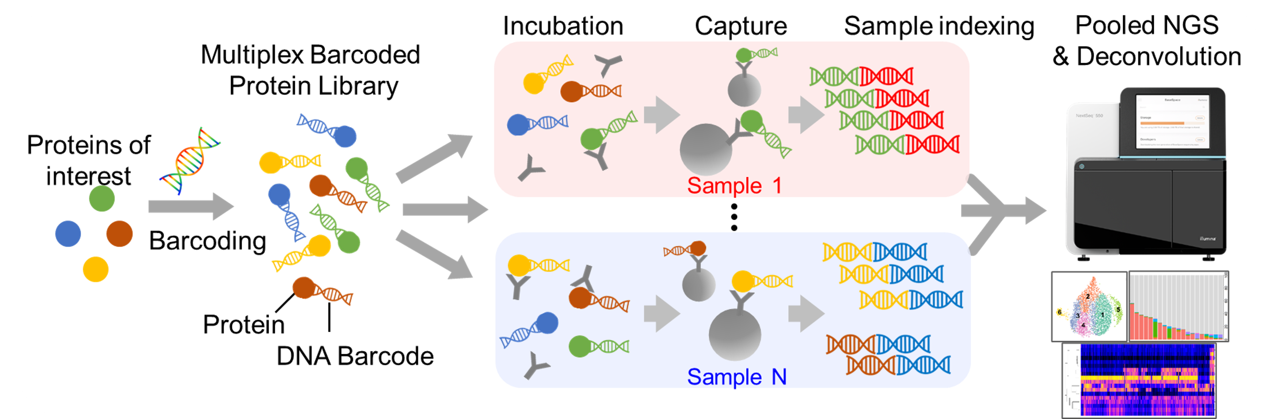
MISPA (Multiplexed In-Solution Protein Array)
Throughput: 2K-10K samples/assay
Multiplexity: 10-1,000 antigens/assay
Precision: 5-20% CV
Agreement: >95% with commercial assay
Five issued US Patents:
9,938,523
10,717,977
11,739,314
12,030,909
12,180,467
Dynamic range: 3-6 logs
Full-length protein
In-solution binding
Easy to customize

Slide 5
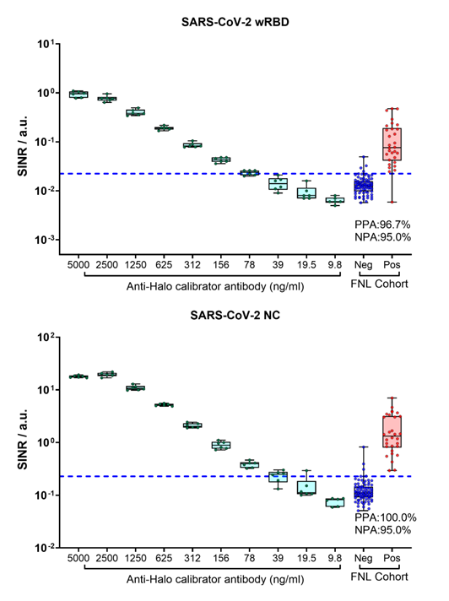
Clinical agreement (SARS-CoV-2)
Reproducible quantification (6 replicates/condition)
Wide dynamic range
Agreement with FDA cleared assays in Frederick National Lab cohort

Slide 6
Patient and nodule characteristics by Cohort and Diagnosis
(discovery: VUMC; validation: DECAMP1)
Characteristic | VUMC Case (n = 144) | VUMC Control (n = 143) | DECAMP1 Case (n = 216) | DECAMP1 Control (n = 114)
Age, years
Mean +/- SD | 67.6 ± 8.3 | 61.1 ± 9.0 | 68.4 ± 8.0 | 66.2 ± 7.8
Sex, n (%)
Male | 86 (59.7) | 90 (62.9) | 177 (81.9) | 87 (76.3)
Female | 58 (40.3) | 53 (37.1) | 39 (18.1) | 27 (23.7)
Race, n (%)
White | 130 (90.3) | 133 (93.0) | 169 (78.2) | 77 (67.5)
Black or African American | 12 (8.3) | 6 (4.2) | 38 (17.6) | 23 (20.2)
Asian | 1 (0.7) | 2 (1.4) | 2 (0.9) | 3 (2.6)
Native Hawaiian/Pacific Islander | 0 (0.0) | 0 (0.0) | 2 (0.9) | 3 (2.6)
Native American | 0 (0.0) | 1 (0.7) | 0 (0.0) | 0 (0.0)
Not reported / unknown | 1 (0.7) | 1 (0.7) | 5 (2.3) | 8 (7.0)
Nodule size, mm
Mean +/- SD | 19.2 ± 6.5 | 13.4 ± 5.8 | 16.9 ± 5.9 | 12.3 ± 4.9
Median (range) | 20.0 (6 to 30) | 12.0 (6 to 28) | 16.0 (7 to 33) | 11.0 (7 to 26)
Pathology, n (%), cases only
NSCLC | 135 (93.8) | n/a | 196 (90.7) | n/a
SCLC | 3 (2.1) | n/a | 18 (8.3) | n/a
Other (carcinoid / unknown) | 6 (4.2) | n/a | 2 (0.9) | n/a
AJCC stage, n (%), cases only
I | 69 (47.9) | n/a | 112 (51.9) | n/a
II | 30 (20.8) | n/a | 16 (7.4) | n/a
III | 32 (22.2) | n/a | 55 (25.5) | n/a
IV | 13 (9.0) | n/a | 17 (7.9) | n/a
Not reported | 0 (0.0) | n/a | 16 (7.4) | n/a
Notes:
Detection of Early Lung Cancer Among Military Personnel (DECAMP) Study 1
Vanderbilt Steve and Eric

Slide 7
Antibodies with Higher Reactivity in Controls Are Enriched for Microbial Antibodies
>10% Sens. & 95%spec. |  | VUMC | DECAMP1 | Both
Higher in cases | Autoantibody | 354 | 589 | 107
 | Microbial antibody | 267 | 458 | 37
Higher in controls | Autoantibody | 84 | 16 | 3
 | Microbial antibody | 187 | 49 | 5
VUMC
Higher in case
VUMC
Higher in control
DECAMP1
Higher in case
DECAMP1
Higher in control
Notes:
We set our marker cutoff at 10% sens at 95% spec
In both cohorts, there are more antibodies higher in cases but there are similar numbers of autoantibodies and microbial antibodies
For higher in controls, more microbial and autoantibody

Slide 8
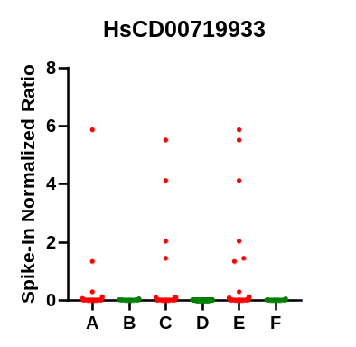
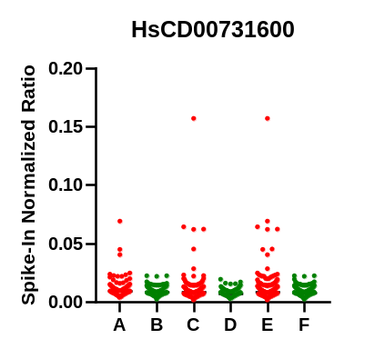
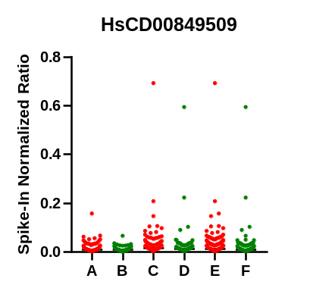
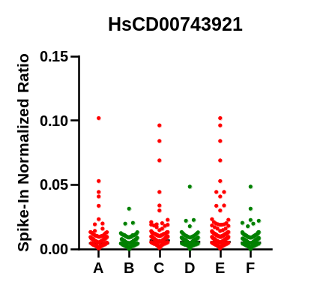
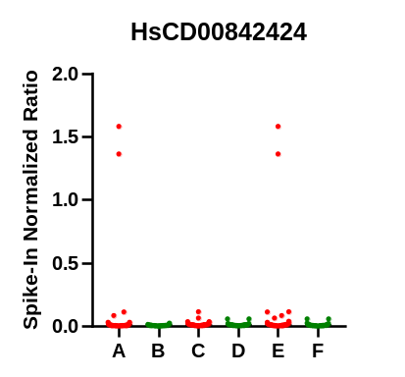
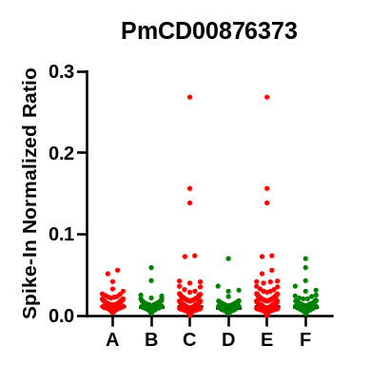
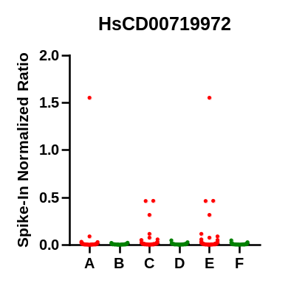
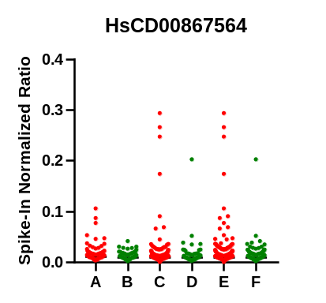
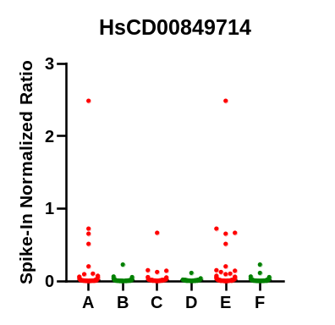
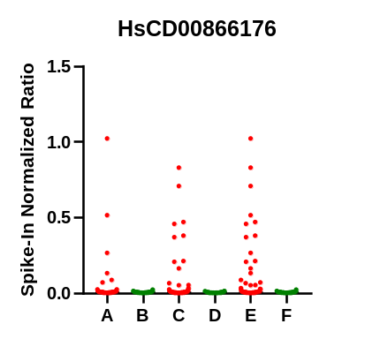
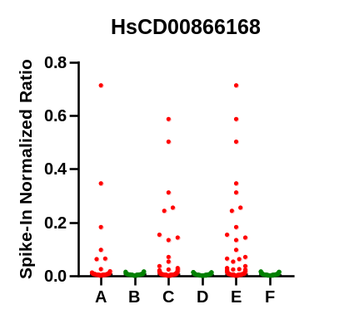
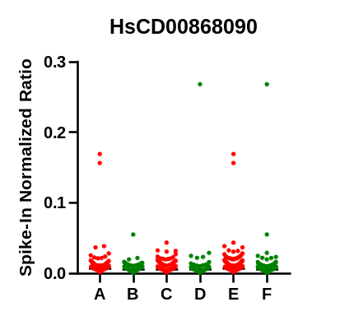
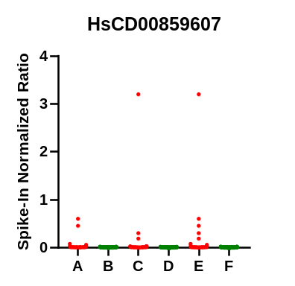
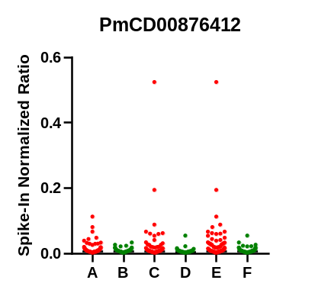
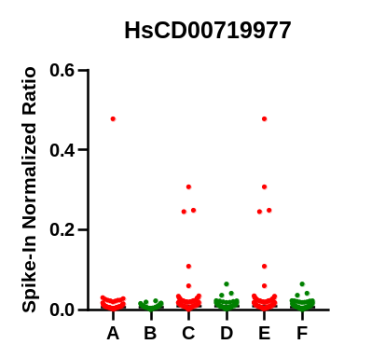
Example antibodies with higher reactivity in cases relative to controls
Discovery case;
Discovery control;
Validation case;
Validation control;
All case;
All control

Slide 9
Serum Protein markers had better performance in VUMC than in DECAMP1
 | Sens@95%Spec
Marker | VUMC | DECAMP1
Flt-3L | 10.5% | 5.7%
CEACAM5 | 15.4% | 20.4%
Flt-1 | 11.9% | 5.2%
OPN | 9.8% | 6.6%
Ca19.9 | 9.8% | 5.7%
HE-4 | 13.3% | 9.5%
MMP-2 | 10.5% | 8.1%
IGFBP-2 | 17.5% | 18.5%
Ca15-3 | 8.4% | 8.5%
CA125 | 17.5% | 7.1%
EGFR | 3.5% | 1.9%
MMP-3 | 5.6% | 4.3%
ErbB2 | 1.4% | 5.2%
MIF | 10.5% | 5.2%
MMP-9 | 7.7% | 2.8%
REG-4 | 13.3% | 4.3%
S100A6 | 9.8% | 5.2%
SCFR/Kit | 6.3% | 4.7%
TNFR1 | 15.4% | 8.1%
Cyfra-21 | 15.4% | 11.8%
HGF | 10.5% | 5.2%
NSE | 5.6% | 3.8%
Sn 15.4%
Sn 20.4%
Sn 17.5%
Sn 18.5%
Sn 15.4%
Sn 11.8%
Case Ctl Case Ctl
VUMC DECAMP1
Case Ctl Case Ctl
VUMC DECAMP1
Case Ctl Case Ctl
VUMC DECAMP1
Notes:
Confirmation literature reported lung cancer or cancer in general protein markers

Slide 10
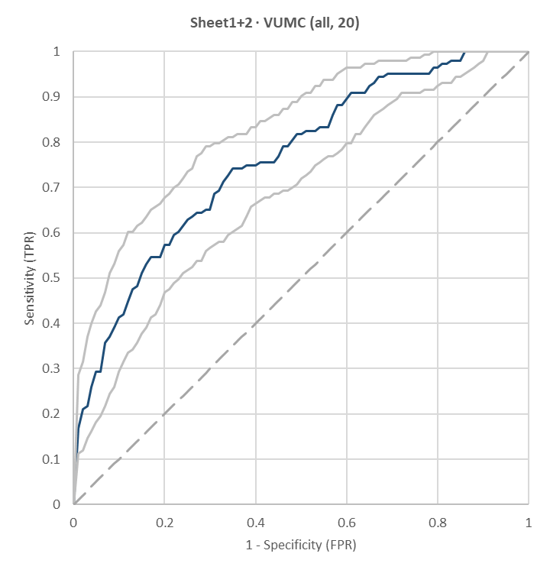
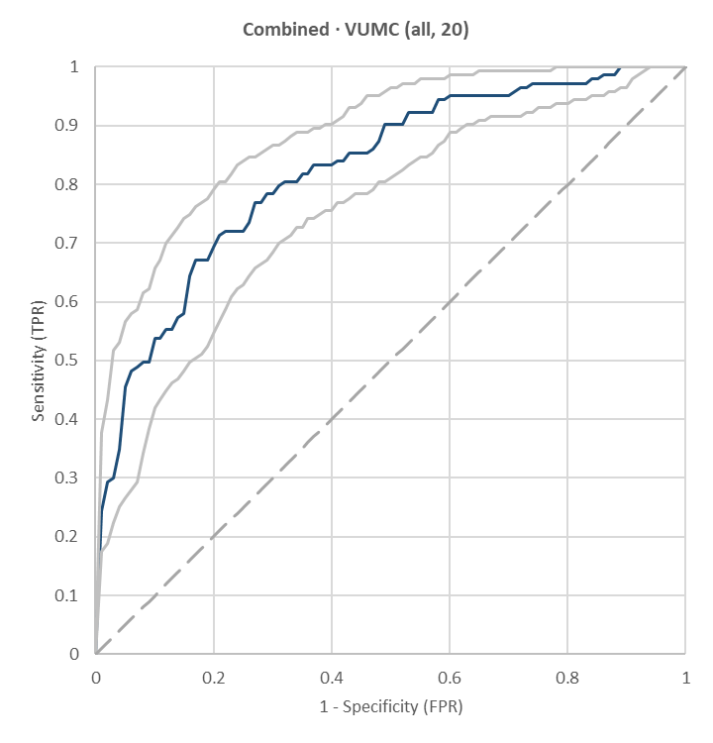
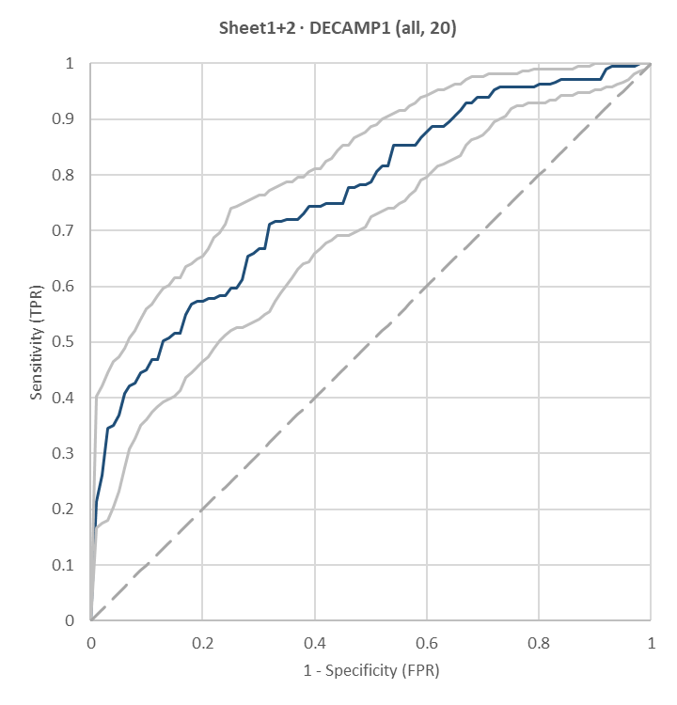
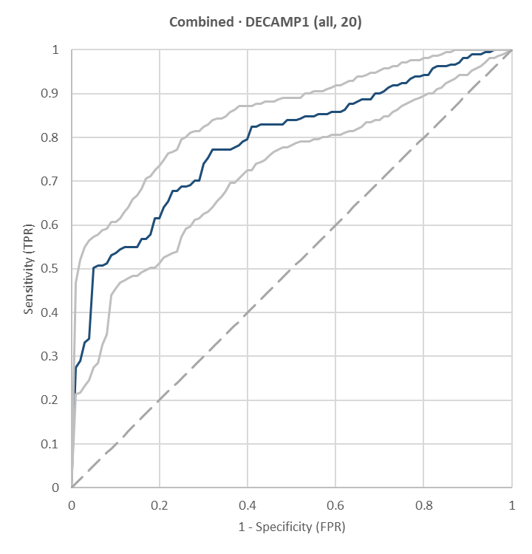
Integration of Autoantibody, Microbial Antibody, and Protein Signatures Improves Diagnostic Performance Across Independent Cohorts
VUMC
Autoantibody +
Microbial Antibody
VUMC
Autoantibody +
Microbial Antibody +
Protein
DECAMP1
Autoantibody +
Microbial Antibody
DECAMP1
Autoantibody +
Microbial Antibody +
Protein
AUC 0.76(95%CI: 0.70-0.81)
29%Sens @95%Spec
AUC 0.82 (95%CI: 0.78-0.87)
46%Sens @95%Spec
AUC 0.76(95%CI: 0.71-0.81)
37%Sens @95%Spec
AUC 0.79 (95%CI: 0.74-0.83)
50%Sens @95%Spec
Notes:
Fitted curves with 20 shared markers

Slide 11

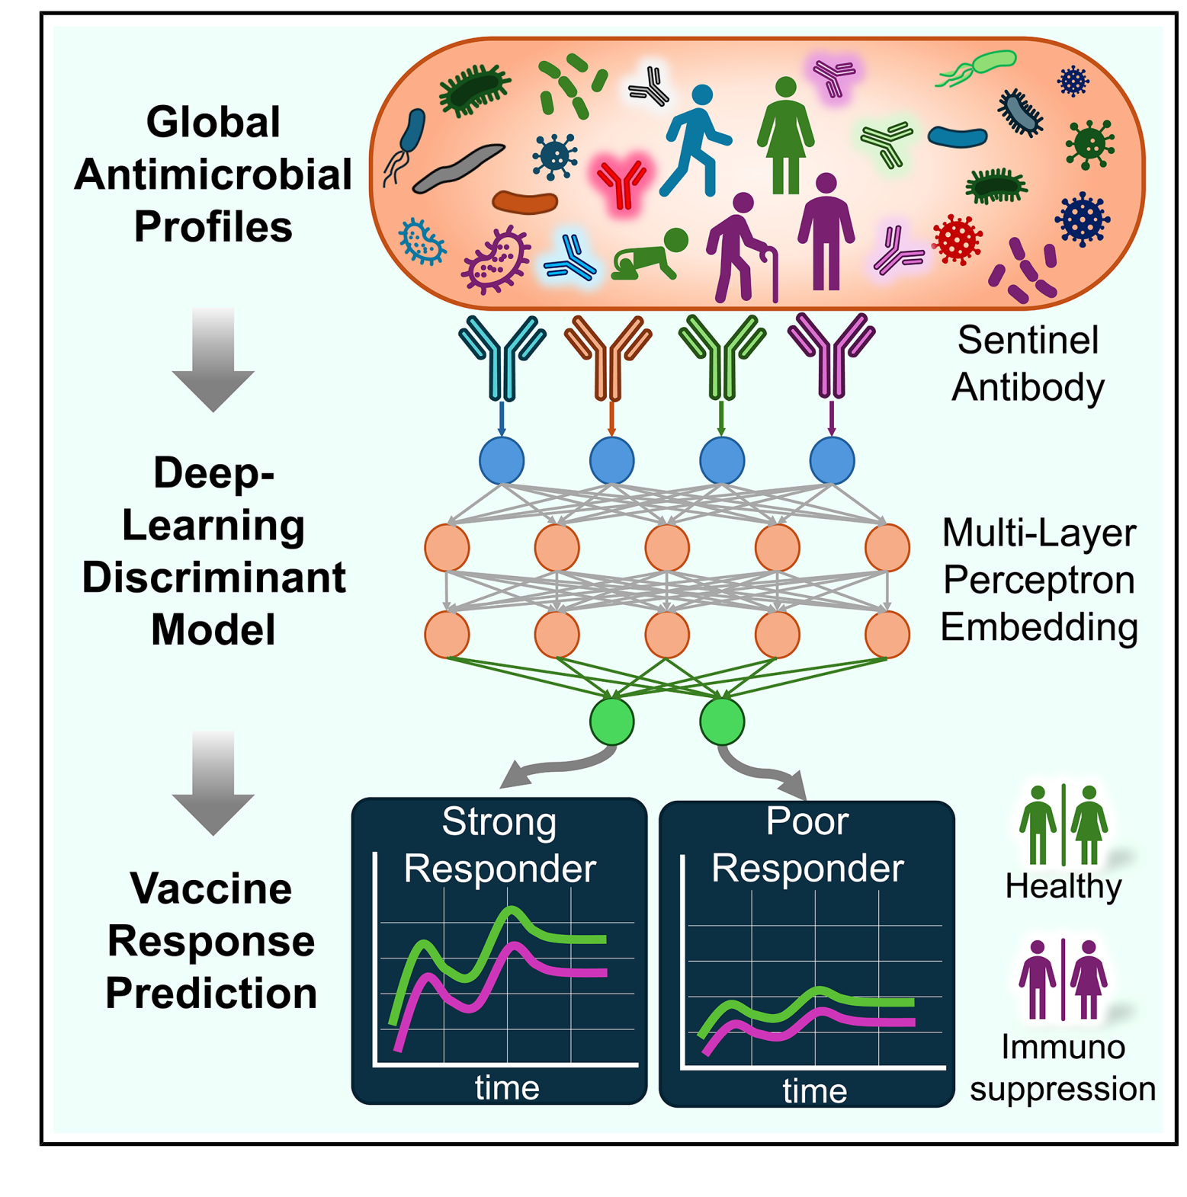
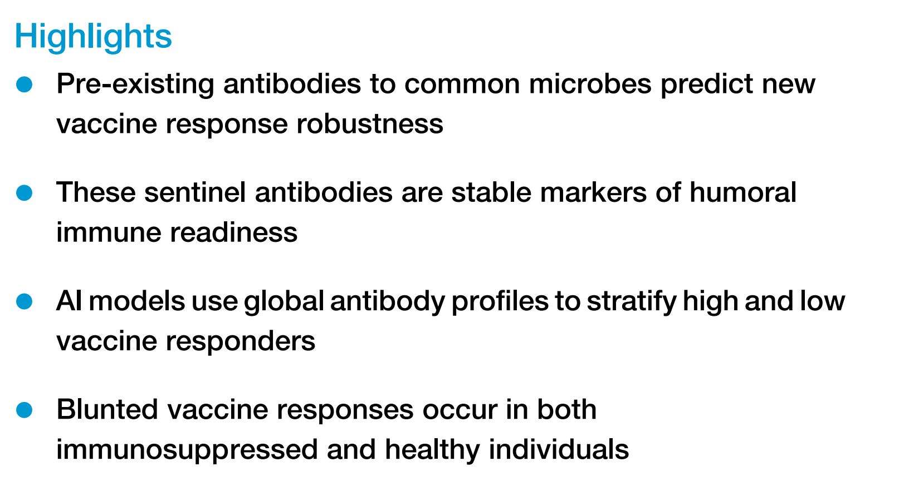

Slide 12
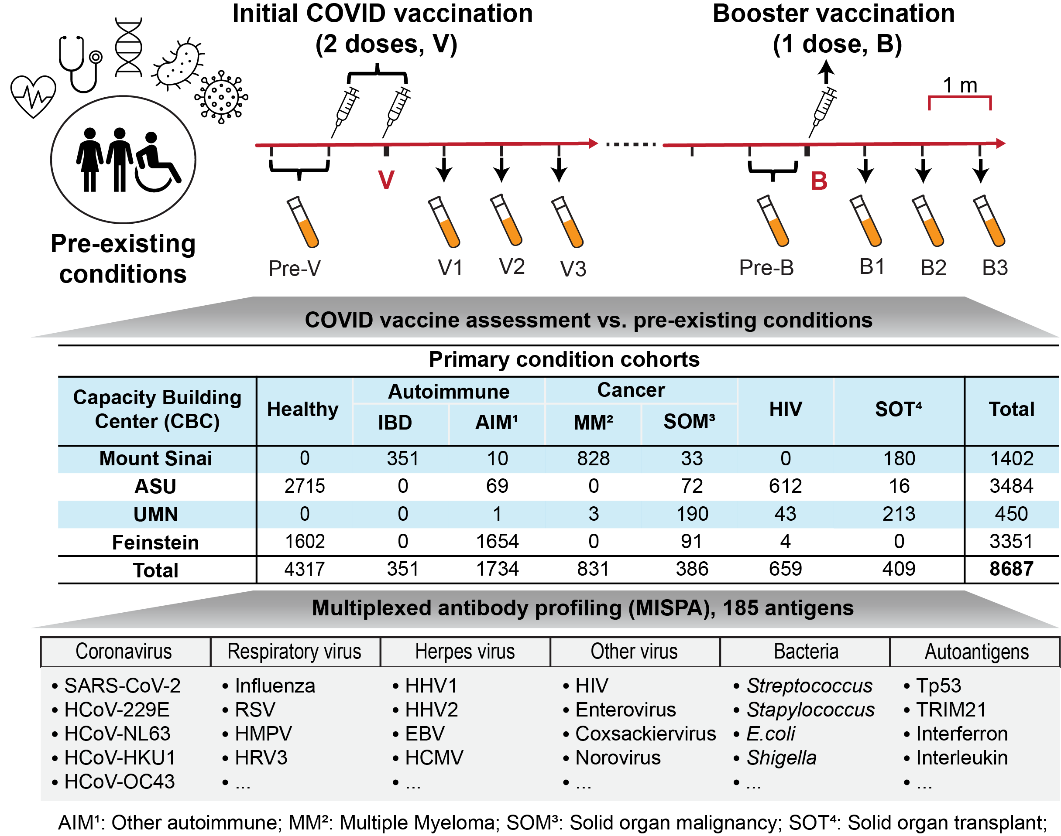

High-throughput, comprehensive antibody profiling using MISPA
SeroNet Nationwide Capacity Building Centers
Samples taken pre- and post-vaccine
Samples taken pre- and post-booster
IBD – Inflammatory bowel disease
AIM – Autoimmune, unspecified
MM – Multiple myeloma
SOM – Solid organ malignancy
HIV – Human insufficiency virus SOT – Solid organ transplant
40 sp. Bacteria
99 sp. Virus
27 autoimmune proteins
Cell Press Blue (2026), https://doi.org/10.1016/j.cpblue.2026.100088

Slide 13
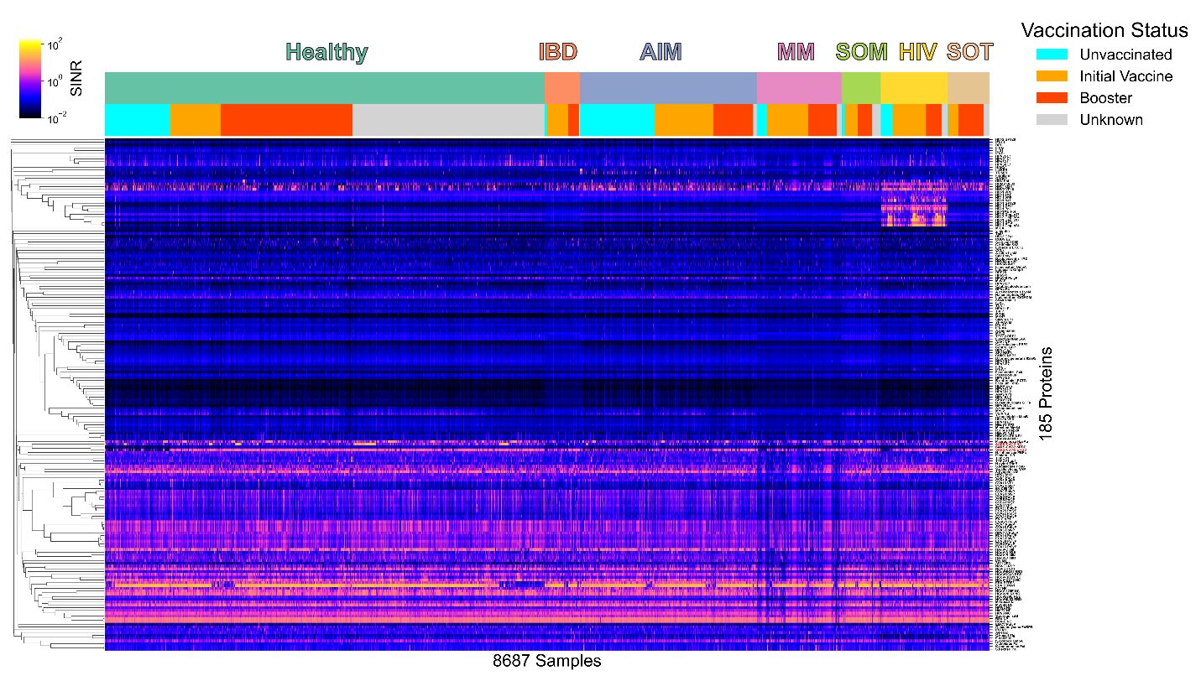
Multiplexed immune profiling of 8,687 individual samples for seven clinical cohorts
IBD – Inflammatory Bowel Disease
AIM – Autoimmune, unspecified
MM – Multiple myeloma
SOM – Solid organ malignancy
HIV – Human insufficiency virus SOT – Solid organ transplant
Cell Press Blue (2026), https://doi.org/10.1016/j.cpblue.2026.100088

Slide 14
Multiplexed immune profiling of 8,687 individual samples for seven clinical cohorts
IBD – Inflammatory Bowel Disease
AIM – Autoimmune, unspecified
MM – Multiple myeloma
SOM – Solid organ malignancy
HIV – Human insufficiency virus SOT – Solid organ transplant
Cell Press Blue (2026), https://doi.org/10.1016/j.cpblue.2026.100088

Slide 15
Multiplexed immune profiling of 8,687 individual samples for seven clinical cohorts
IBD – Inflammatory Bowel Disease
AIM – Autoimmune, unspecified
MM – Multiple myeloma
SOM – Solid organ malignancy
HIV – Human insufficiency virus SOT – Solid organ transplant
Cell Press Blue (2026), https://doi.org/10.1016/j.cpblue.2026.100088

Slide 16
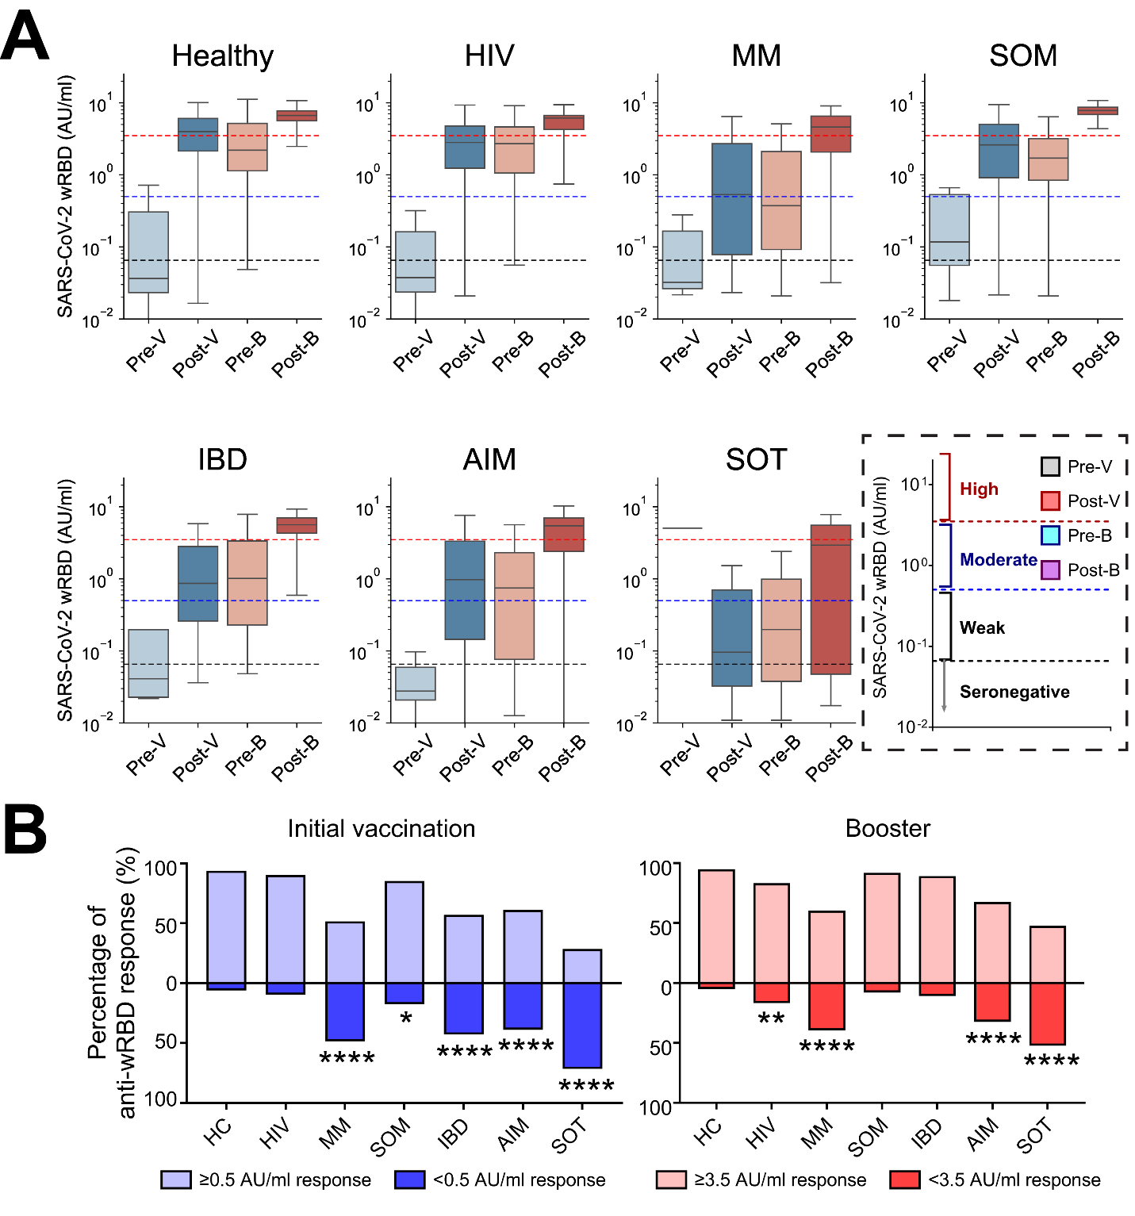
Immunosuppression blunts vaccine response
Immunosuppressed cohorts had blunted vaccine responses
Responses were very heterogenous
Some immunosuppressed individuals had excellent vaccine responses
5% of Healthy cohort showed weak vaccine responses
IBD – Inflammatory Bowel Disease
AIM – Autoimmune, unspecified
MM – Multiple myeloma
SOM – Solid organ malignancy
HIV – Human insufficiency virus SOT – Solid organ transplant
Cell Press Blue (2026), https://doi.org/10.1016/j.cpblue.2026.100088

Slide 17
Immunosuppression blunts vaccine response
IBD – Inflammatory Bowel Disease
AIM – Autoimmune, unspecified
MM – Multiple myeloma
SOM – Solid organ malignancy
HIV – Human insufficiency virus SOT – Solid organ transplant
Cell Press Blue (2026), https://doi.org/10.1016/j.cpblue.2026.100088

Slide 18
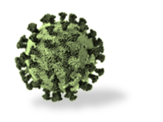
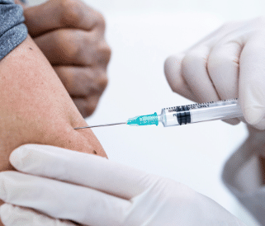
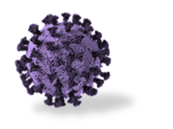
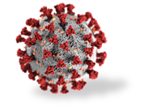

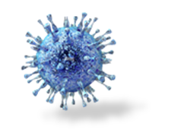
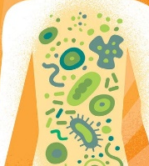
Microbial and Auto-antigens in MISPA (184 antigens)
Human Microbiome MISPA
Seasonal Coronavirus
  HCoVNL63
  HCoV229E
  HCoVOC43
  HCoVHKU
Viruses of interest
  HHVs
  HAdVs
  HPVs
  Coxsackievirus
  Echovirus
  Enterovirus
SARS-CoV-2
Seasonal Coronavirus
Respiratory virus
Virus of interest
Bacteria of interest
Age, Gender etc.
Vaccination
Other respiratory viruses
  Influenza A, B, C
  RSV
  HPIV
  Rhinovirus
  Bocavirus
Bacteria of interest
  Streptococcus
  Staphylococcus
  E. coli

Slide 19
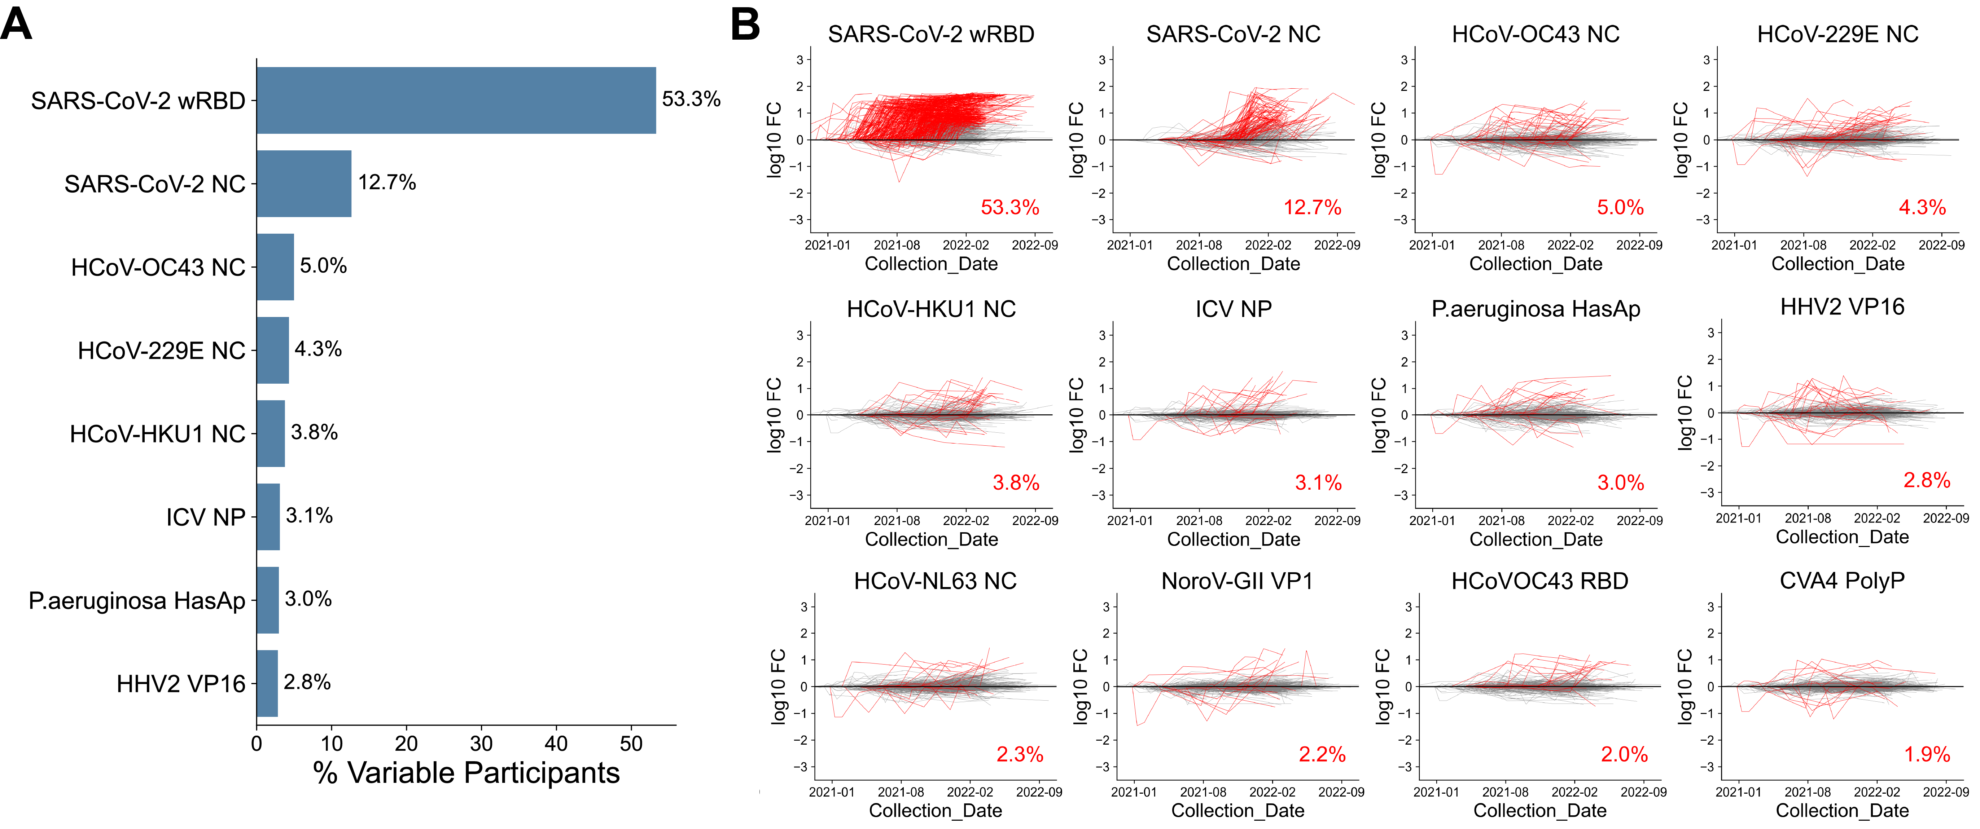
Most antibody titers were stable over 18 months
Responses that changed >4-fold in at least 2% of study population:
Responses that changed over time - % of population with > 4-fold change
Omicron
Cell Press Blue (2026), https://doi.org/10.1016/j.cpblue.2026.100088

Slide 20
Most antibody titers were stable over 18 months
Responses that changed >4-fold in at least 2% of study population:
Responses that changed over time - % of population with > 4-fold change
Omicron

Slide 21
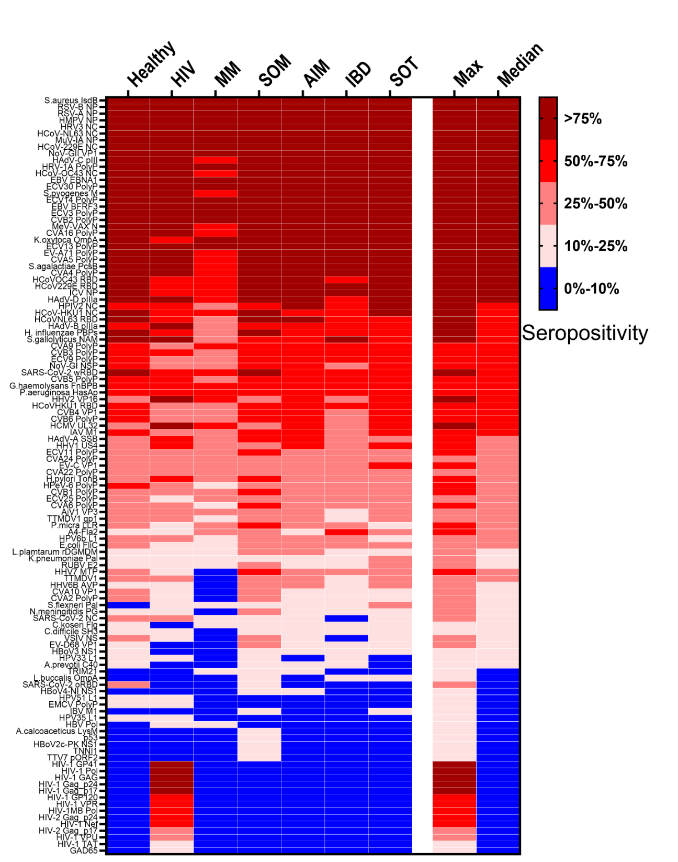
Some antibodies are especially prevalent
Overall reduced antibodies in
  multiple myeloma
  HIV
  inflammatory bowel disease
Overall higher seroprevalence in healthy controls
Strong evidence – not shown here – of protein-specific responses in the cohorts.
Cell Press Blue (2026), https://doi.org/10.1016/j.cpblue.2026.100088

Slide 22
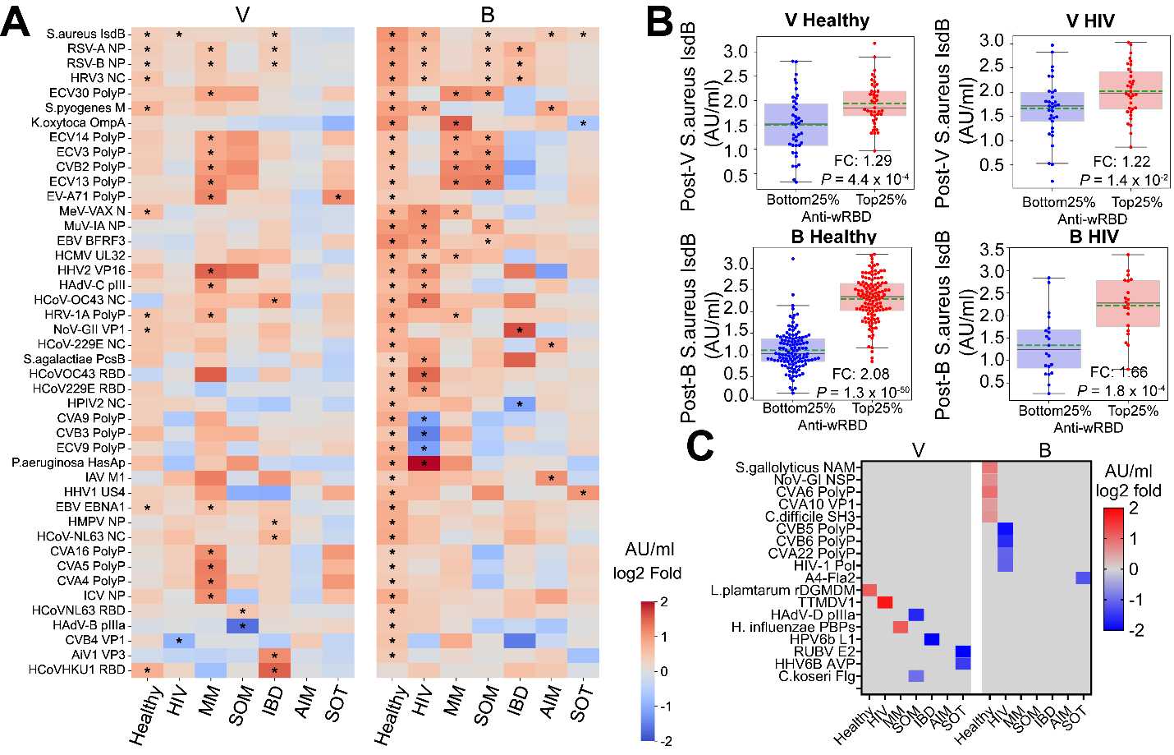
Sentinel antibodies stratify vaccine responders
1° Vaccination
Booster
Top 25% vs Bottom 25% of vaccine responders
Many antibodies revealed a significant difference in response for these two groups
Many were significantly different (* = p<0.05)
These sentinel antibodies predict vaccine response
Sentinel antibodies work in different cohorts

Slide 23
Sentinel antibodies especially predict booster vaccine response
Sentinel antibodies unique to cohorts
Cell Press Blue (2026), https://doi.org/10.1016/j.cpblue.2026.100088

Slide 24
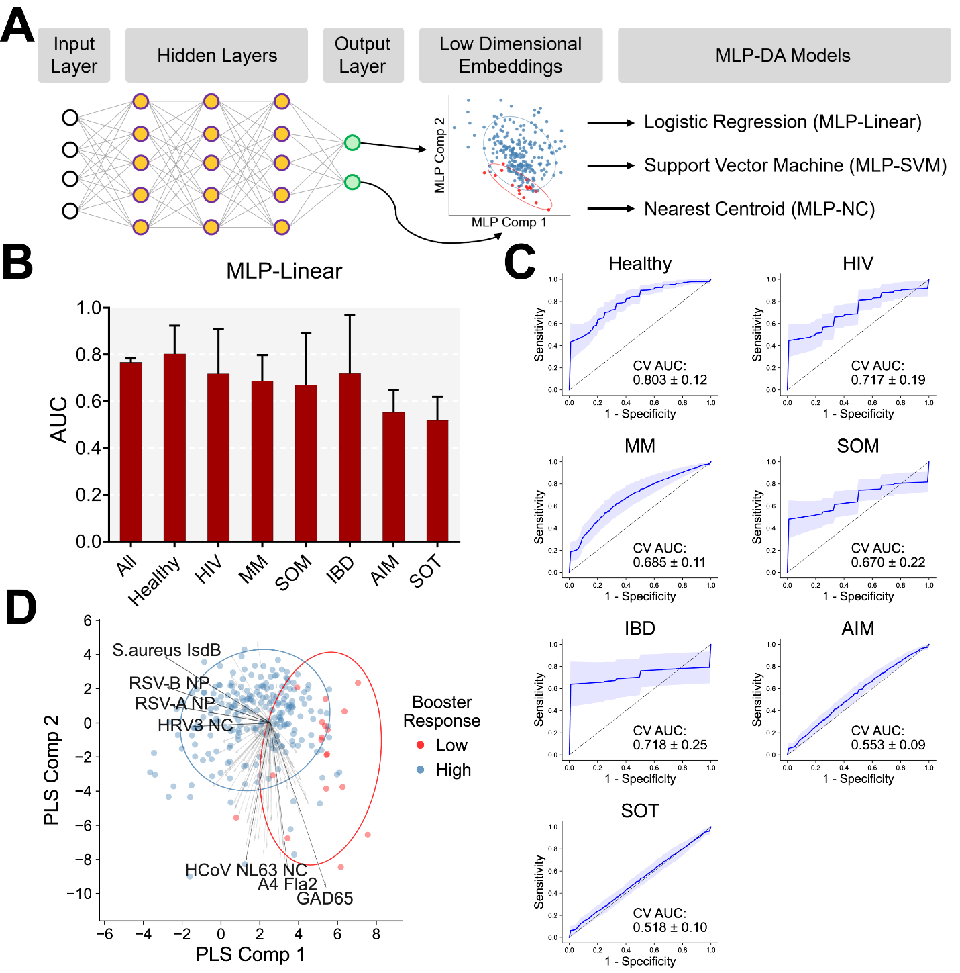
We trained AI models to predict poor responders
>2,000,000 data points
Separated data into training and testing
Used all training data to build model
5 fold cross validation with testing data
Repeated the process with 100 random seeds
Cell Press Blue (2026), https://doi.org/10.1016/j.cpblue.2026.100088

Slide 25
Universally trained MLP models predict for many cohorts
Multi-Layer Perceptron Model gave best fits
AUCs were stronger in some cohorts, especially if the N was large
For most models, prediction of poor responders was >70%
Autoimmune disease and solid organ transplant cohorts were not well predicted
Cell Press Blue (2026), https://doi.org/10.1016/j.cpblue.2026.100088

Slide 27

Thank you

