Slide 1
Machine Perception Liquid Biopsy Enabled by Tumor Ecosystem Signatures
Daniel Heller, PhD
Head, Cancer Nanomedicine Laboratory
Member, Molecular Pharmacology Program, Sloan Kettering Institute
Co-Director, The Pat and Ian Cook Doctoral Program in Cancer Engineering
Memorial Sloan Kettering Cancer Center
EDRN Workshop
September 23, 2026

Slide 2
COI Disclosure Information
I have the following financial relationships to disclose:
Co-founder/Equity Interest/Advisor/Intellectual Property Interest: Selectin Therapeutics, Inc.
Co-founder/Equity Interest/Advisor/Officer/Board of Directors: Nine Diagnostics, Inc.
Co-founder/Equity Interest/Advisor: Lime Therapeutics, Inc.
Intellectual Property Interest/Equity Interest/Advisor: Block Code Protected Ltd.
Scientific Advisor/Equity Interest: Concarlo Therapeutics, Inc., Nanorobotics, Inc., Mediphage Bioceuticals, Inc., Celine Therapeutics, Inc.
Consulting: Metis Therapeutics, Inc.

Slide 3
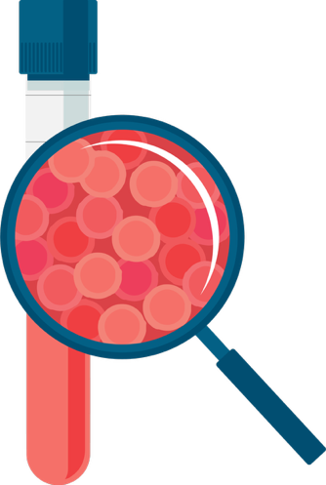
Which Blood Analytes Can Give Us the Best Liquid Biopsy for All of Our Questions?
To detect cancers early, when they are more treatable?
To predict which therapies will work best on a given patient?
To predict whether a patient is at high risk of a disease that can respond to risk-reducing treatments, like vaccines?

Slide 4
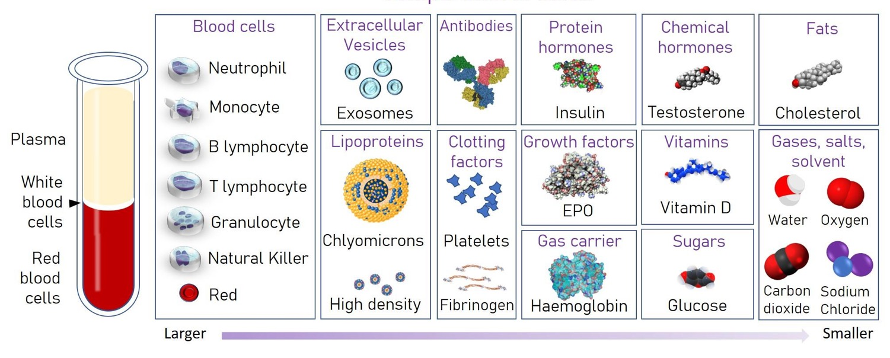
Which Blood Analytes Can Give Us the Best Liquid Biopsy for All of Our Questions?
https://www.cellgs.com/blog/what-is-in-blood-and-where-is-it-made.html

Slide 5
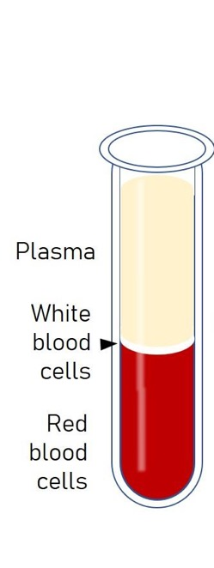
Altered Blood Plasma Proteins Present a Detection Problem
Blood Plasma Proteins:
10,000 distinct proteins
                Up to 40,000 different protein variants
22 high-abundance proteins account for 99% of the total protein mass
Albumin alone ~50% of total mass
https://www.cellgs.com/blog/what-is-in-blood-and-where-is-it-made.html

Slide 6
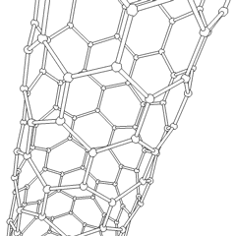
Machine Perception Liquid Biopsy
Enabled by a “Universal Sensor”

Slide 7
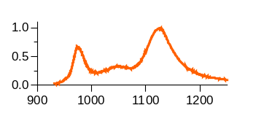
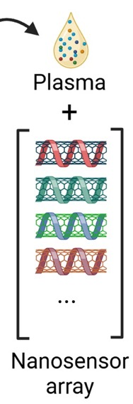
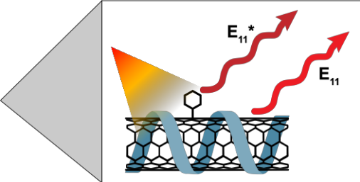
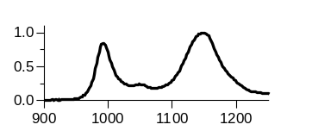

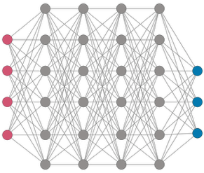
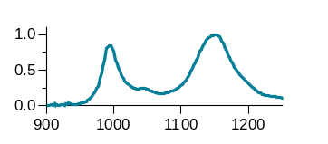
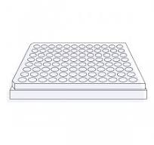
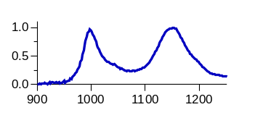
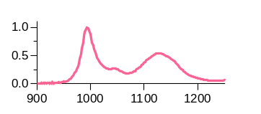
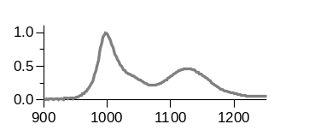
Machine Perception Liquid Biopsy (MPLB)
E₁₁
E₁₁-
-
Sensory Data
Detection of Disease Fingerprint
Tumor
No tumor
Intensity
Diagnosis
Training & Validation of ML Models
Wavelength (nm)
Notes:
Machine Perception Liquid Biopsy (MPLB)

Slide 8
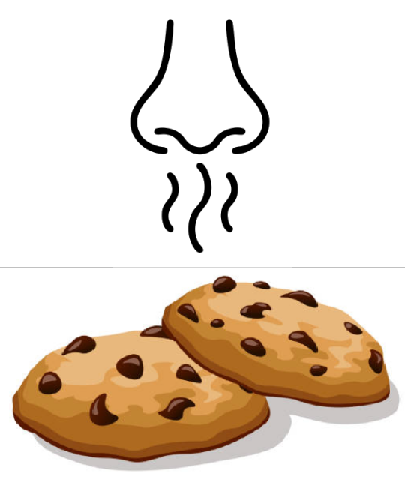
Perception: Sensing a Complex Signal “Fingerprint”
There is no single molecule that indicates “cookie”
Instead, many different signals from sensory neurons are parsed by our brain to give a single outcome
Our sensor data trains the model to perceive patterns to classify disease
Graphic by Jaina Wollowitz

Slide 9
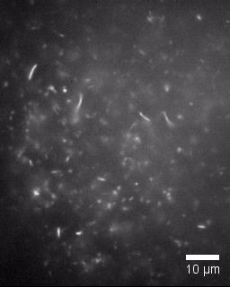


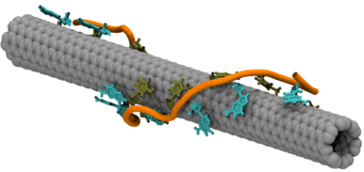
Quantum Nanosensors
Composed of Modified Carbon Nanotubes
Near-IR Emission
Excitation:
Visible Near-IR
DNA/Polymer-Encapsulated Carbon Nanotube

Slide 10


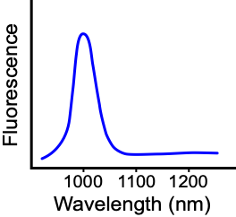
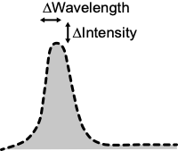
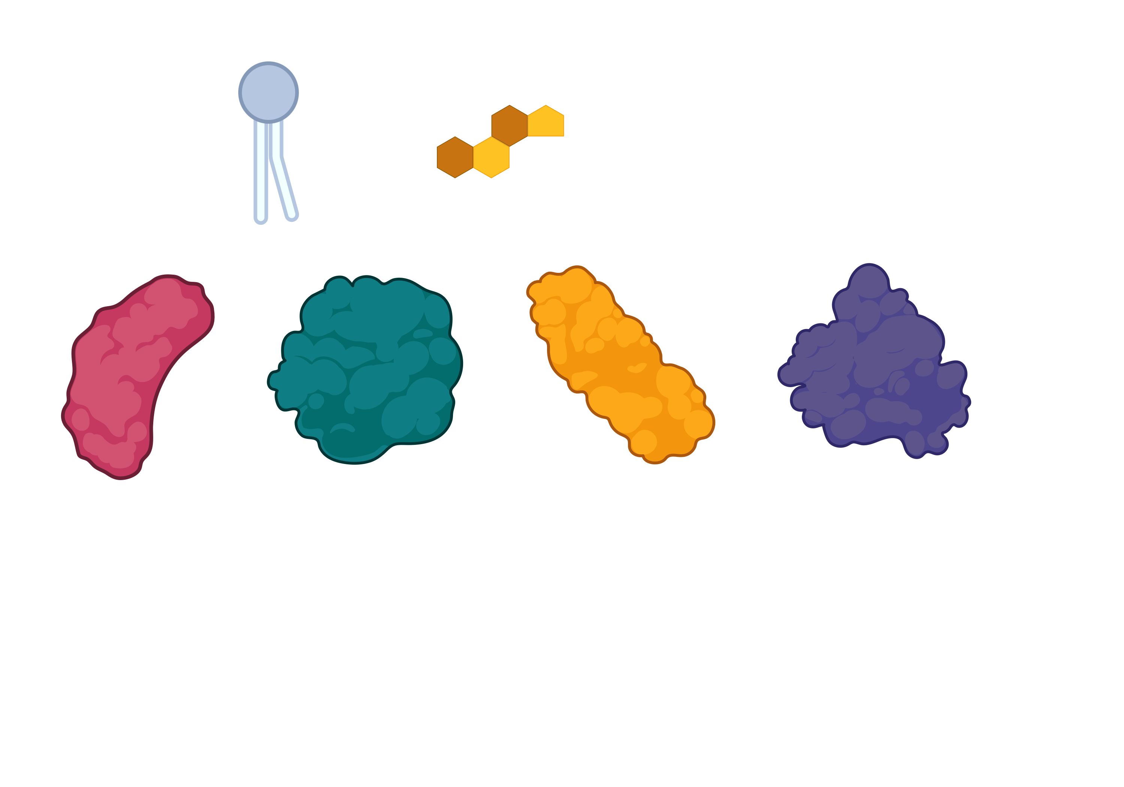
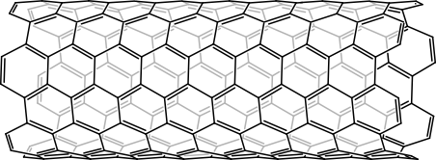
Carbon Nanotube Emission is
Environmentally-Sensitive
Excitation
Single-Walled Carbon Nanotubes:
A cylindrical arrangement of sp² hybridized carbon atoms
Notes:
Carbon nanotubes are essentially a sheet of sp2 hybridized carbons rolled into a cylinder
this long conjugated system gives CNTs interesting optical and electronic properties
they exhibit near infrared fluorescence, and most importantly for our work this fluorescence is environmentally sensitive
when the local environment around the nanotube changes, such as when exposed to a different solvent or proteins in a biological, this alters the energy levels excited electrons can exist in, thus changing the resulting fluorescence
and this make single wall carbon nanotubes excellent sensors for detecting biological changes in disease
< 1nm in diameter, ~1 μm in length

Slide 11
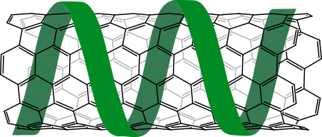
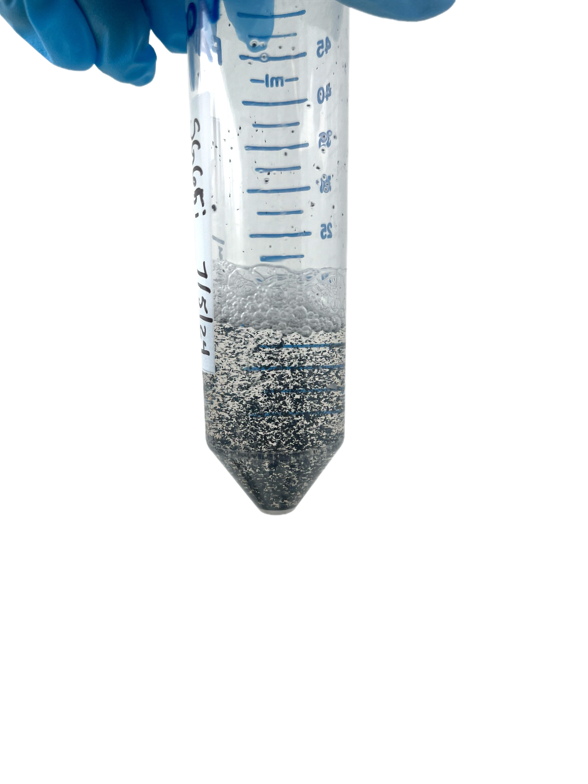
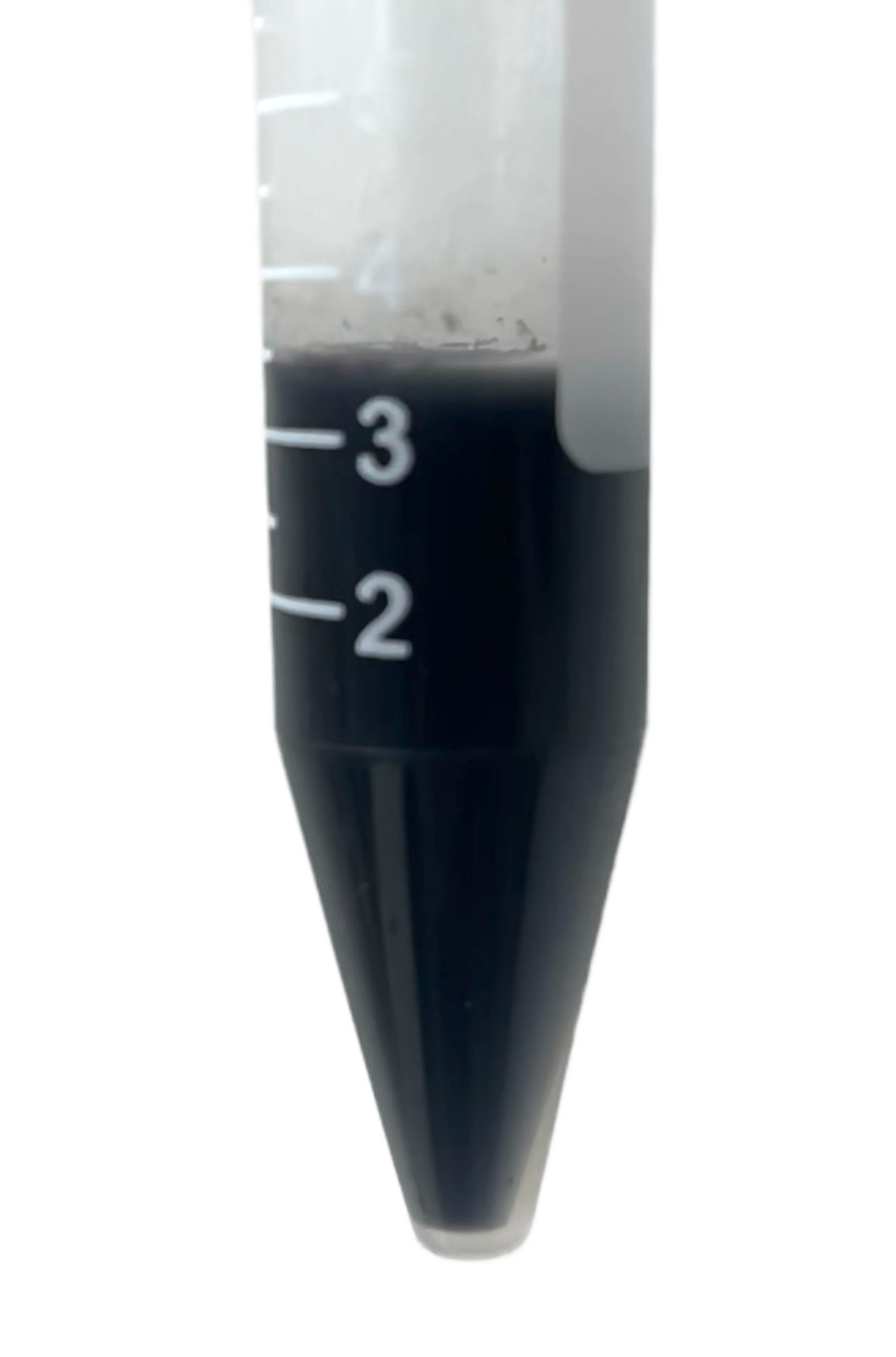
We Can Diversify the Biochemical Space our Sensors Detect Through Non-Covalent Modifications
Single-stranded DNA (ssDNA)
Probe Sonication
Non-covalent polymer wrappings alters nanotube surface accessibility and allows for them to be suspended in an aqueous solution.
Notes:
we also can also non-covalently wrap the nanotubes in polymers, such as single stranded DNA
This has two key outcomes:
It changes the surface accessibility of the nanotube and influences what biomolecules interact
It also allows for the nanotubes to be suspended in an aqueous solution
Otherwise, being very large aromatic molecules, the nanotubes clump together, and can’t interact with biomolecules in samples
the wrapping allows the nanotubes to be suspended in a homogenous solution, which is key for them to interact with and report on the biomolecules in a patient sample
using different combinations of polymer wrappings and covalent modifications allow us to create chemically distinct nanosensors, and build nanosensor arrays

Slide 12
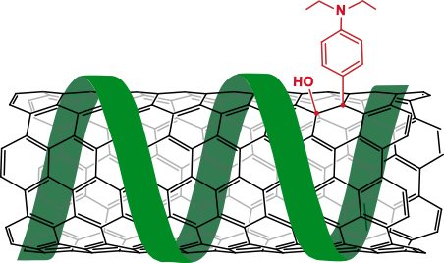
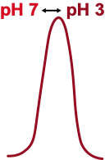
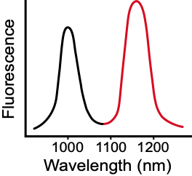
We Can Diversify the Biochemical Space our Sensors Detect Through Covalent Modifications, Yielding
Quantum Nanosensors
Quantum Well Defects
New functional groups introduce additional emission peaks and can give the nanotubes sensitivity to specific environmental changes, such as pH.
Notes:
we also can also non-covalently wrap the nanotubes in polymers, such as single stranded DNA
This has two key outcomes:
It changes the surface accessibility of the nanotube and influences what biomolecules interact
It also allows for the nanotubes to be suspended in an aqueous solution
Otherwise, being very large aromatic molecules, the nanotubes clump together, and can’t interact with biomolecules in samples
the wrapping allows the nanotubes to be suspended in a homogenous solution, which is key for them to interact with and report on the biomolecules in a patient sample
using different combinations of polymer wrappings and covalent modifications allow us to create chemically distinct nanosensors, and build nanosensor arrays

Slide 13
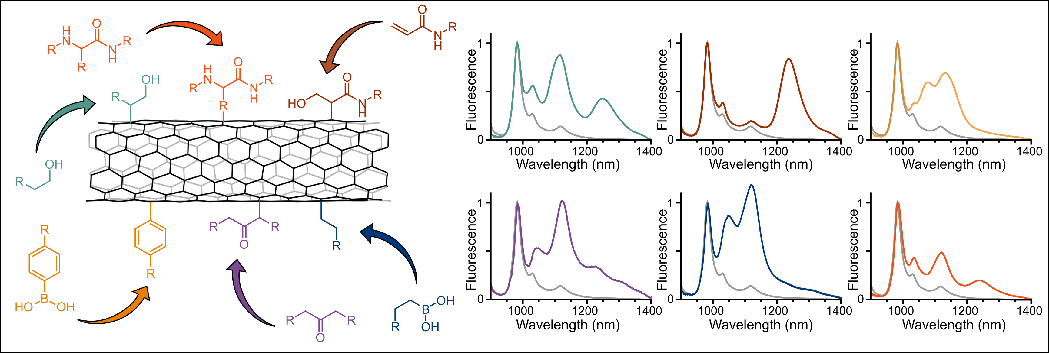
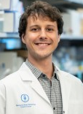
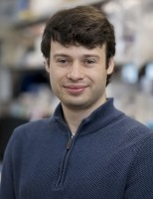
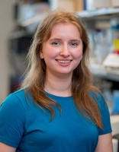
Quantum Nanosensor Sensitivity is Modulated by
Diverse Quantum Well Defects
Piletsky, S. S., et al., Nature Synthesis (2026)
Goffin, A. R, et. al., (2026) https://doi.org/10.26434/CHEMRXIV.15003612/V1
Keblish, E. E., et al. (2026) https://doi.org/10.26434/CHEMRXIV.15003628/V1
Stas Piletsky
Alec Goffin
Erin Keblish

Slide 14
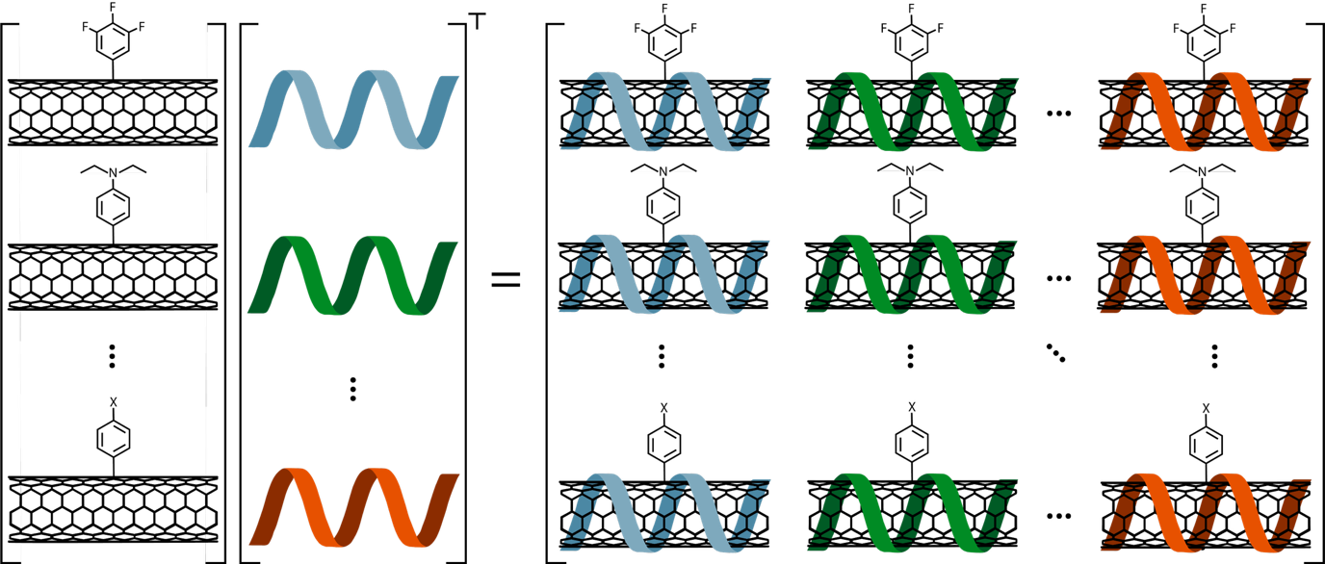
Nanosensor Array
Quantum Defect
Wrapping
Nanosensor Array

Slide 15
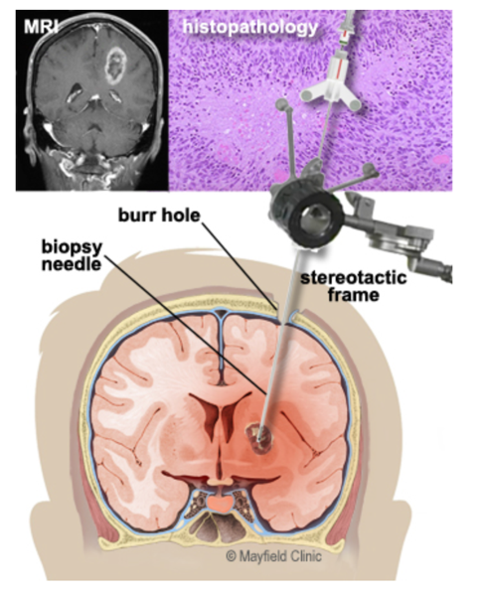
Can We Non-Invasively Identify and Stratify
Brain Tumors by Tumor Class and Subtype?
Approximately 19,000 deaths from primary cancerous brain and CNS tumors occur in the United States.
Imaging tests such as MRI/CT may show an abnormal area that is likely to be a brain or spinal cord tumor
Recent liquid biopsy methods (ctDNA) have failed to detect brain tumors
Invasive and dangerous biopsies are needed to confirm tumor and identify the class of tumor.
www.cancer.net
Notes:
A brain tumor is an abnormal growth of cells inside the brain or skull; some are benign, others malignant. Tumors can grow from the brain tissue itself (primary), or cancer from elsewhere in the body can spread to the brain (metastasis). Treatment options vary depending on the tumor type, size and location. Treatment goals may be curative or focus on relieving symptoms.
Figure 1. Brain tumors may grow from nerves (neuroma/Schwannoma), dura (meningioma), or pituitary gland (craniopharyngioma or pituitary adenoma). They may also grow from the brain tissue itself (glioma). As they grow they may compress normal tissue and cause symptoms.
The World Health Organization (WHO) developed a classification and grading system to standardize communication, treatment planning, and predict outcomes for brain tumors. Tumors are classified by their cell type and grade by viewing the cells, usually taken during a biopsy, under a microscope.
Imaging tests such as MRI/CT may show an abnormal area that is likely to be a brain or spinal cord tumor, but these scans can’t always tell exactly what type of tumor it is. Often this can only be done by biopsy.
Figure 4. During a needle biopsy, a hollow cannula is inserted into the tumor. Small biting instruments remove bits of tumor for the pathologist to examine and determine the exact tumor cell type.
https://mayfieldclinic.com/pe-braintumor.htm
Non-invasive methods to detect brain tumours by tumour class, subtype, and grade would provide significant clinical benefit by facilitating the triage of patient treatment

Slide 16
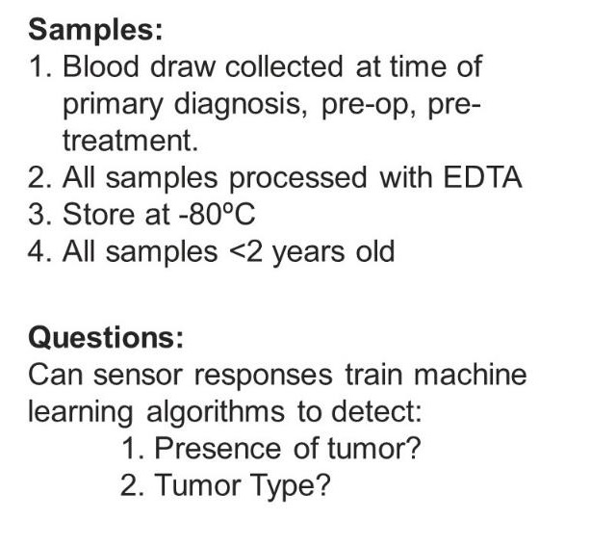
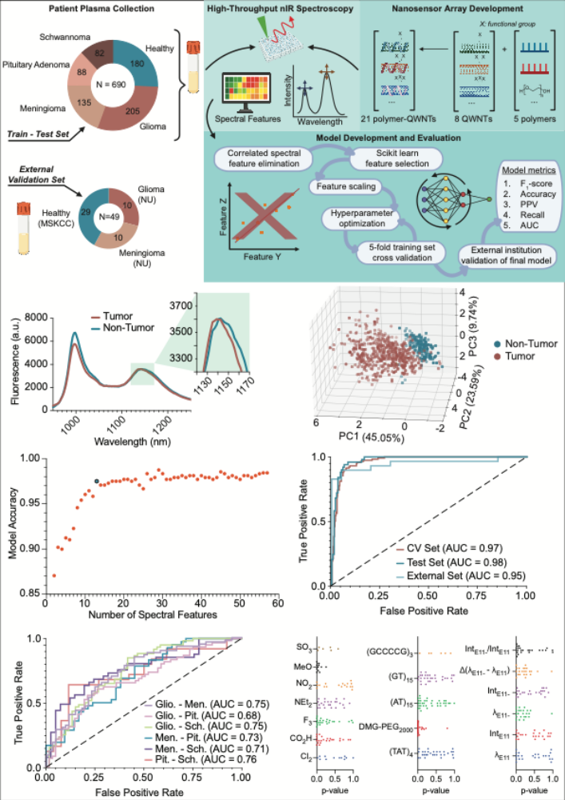
A Blood Test for Brain Tumors

Slide 17
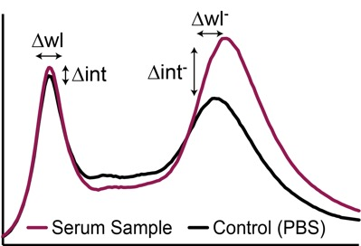
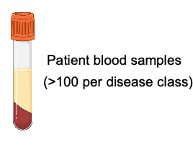
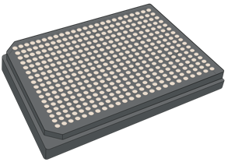
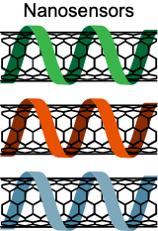
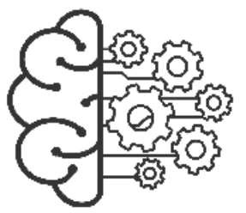
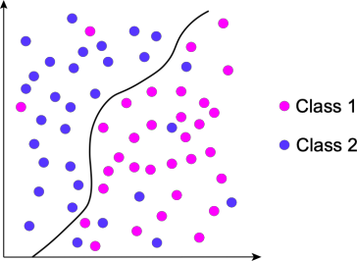
Machine Perception Liquid Biopsy Interrogation of Brain Tumor Samples
Data processing & analysis
Laser Excitation
Chemically diversified nanosensor array
Machine Learning Model Development
Measure nanosensor fluorescence
Machine perception!
Machine learning models trained on the changes in nanotube fluorescence in response to patient samples can be used to detect disease

Slide 18
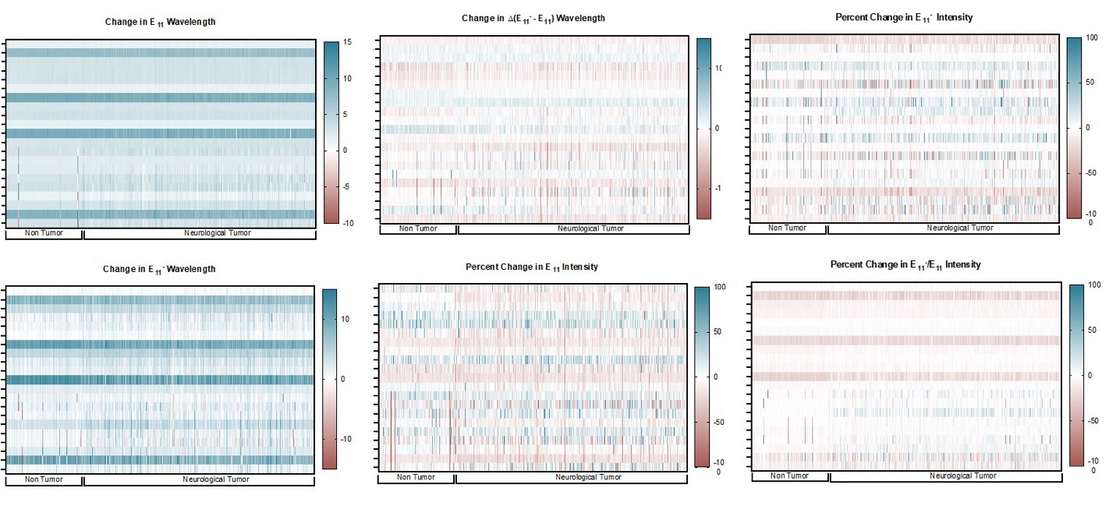
Sensor Responses from 690 Patients are Diverse
Goerzen, et al., Nat Nanotechnol, 2026

Slide 19
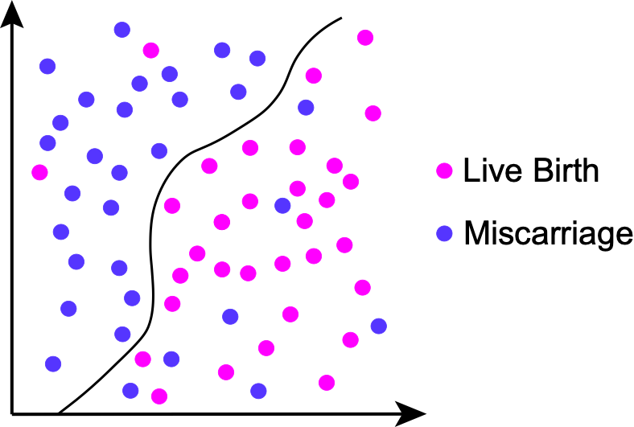
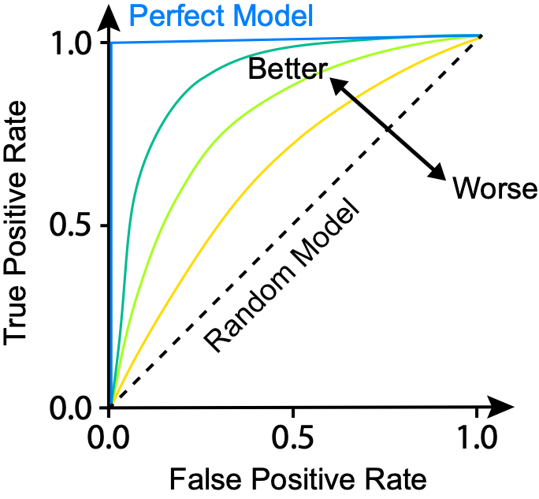
Supervised Machine Learning Models for Brain Tumor Detection
What the models are aiming to do:
How we evaluate model performance:
Binary Classification
Receiver Operating Characteristic (ROC) Curves

Slide 20
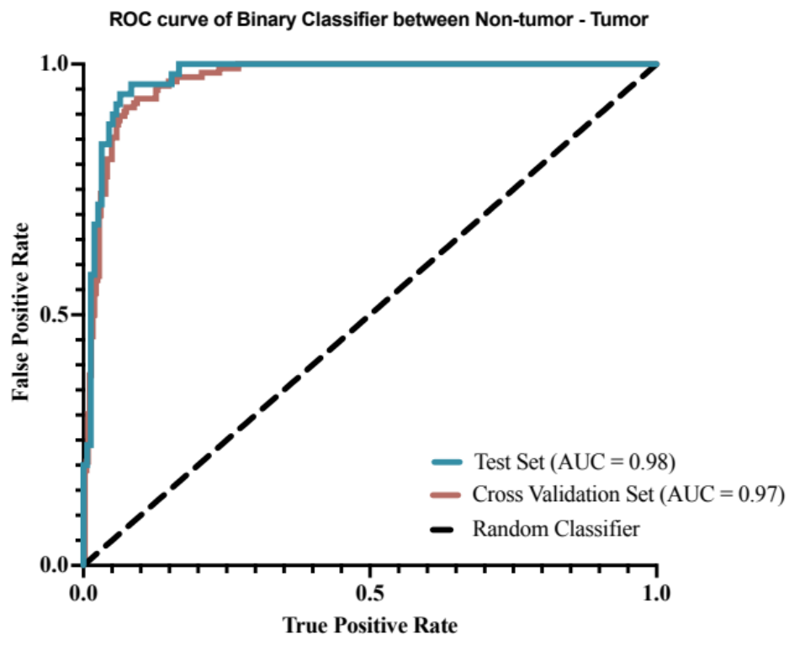
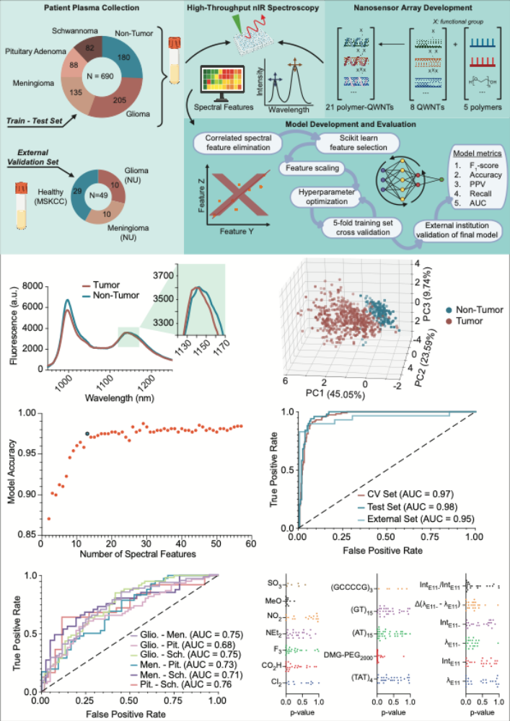
Sensor Array Responses + 12-Feature Gradient Boosting Prediction Model Differentiates Between
Healthy and Brain Tumor Patient Plasma

Slide 21
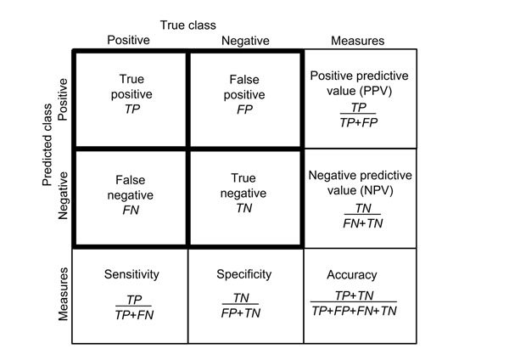
Sensor Array Responses + 12-Feature Gradient Boosting Prediction Model Differentiates Between
Healthy and Brain Tumor Patient Plasma
Class | Accuracy | Sensitivity | At specificity of | PPV
Healthy | 98% | 88% | 95% | 0.97
Tumor |  | 0.98 | 0.99

Slide 22
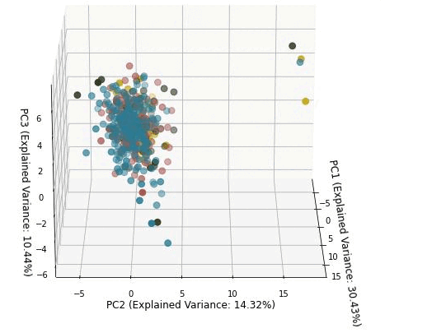
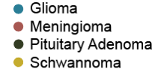
MPLB Differentiates Between CNS Cancers
Goerzen, et al., Nat Nanotechnol, 2026

Slide 23
- Can We Determine the Mechanism of Detection?
- Which Biomarkers Enable the Detection?

Slide 24
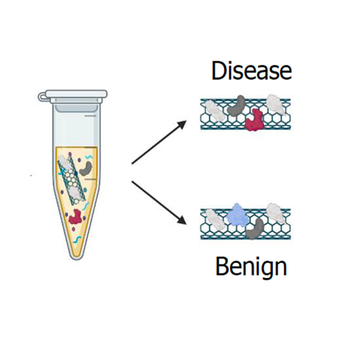
Can We Determine the Mechanism by Eluting
the Protein Corona?

Slide 25



Identifying Biomolecules Causing Nanosensor Responses
Feature importance analysis can reveal which sensors are most crucial for the success of the machine learning model (i.e. the top-performing sensors).
Top nanosensor incubated with serum samples
Mass Spectrometry
Differential Enrichment Analysis
Cohort 1
Cohort 2
Mass spectroscopy data collected in collaboration with Jacob Geri & Charlie Warren (Weill Cornell Medicine)

Slide 26


Protein Corona Extraction Facilitates
Low-Abundance Protein Analysis
10 most abundant plasma proteins are (mostly) depleted on nanotube surface
Depletion of high abundance proteins enables deep proteome detection
TMT analysis of 18 matched protein corona and bulk plasma samples
26

Slide 27
MS Reveals Differentially Enriched Proteins Between Tumor and Healthy Protein Corona of 3,4,5-trifluoro (6,5) DMG-PEG₂₀₀₀
N_{samples}=18
  6 healthy
  6 glioblastoma
  6 meningioma
Healthy
Tumor
Goerzen, et al., Nat Nanotechnol, 2026

Slide 28

Analysis of Biomarkers Finds Both Known and
Heretofore Unknown CNS Cancer Biomarkers
MMP3, APOA4, RPL4, RPL7, RPL18, RPS9, RPL6 are known glioblastoma biomarkers.
ECM remodeling
Stress response
Immune-related pathways
➔ The tumor ecosystem
Goerzen, et al., Nat Nanotechnol, 2026

Slide 29


Nanosensor Responds Preferentially to Nanotube-Enriched Proteins
Goerzen, et al., Nat Nanotechnol, 2026

Slide 30


Biomarker Validation: Independent Analysis of Patient Plasma Corroborates Proteomic Biomarker Identification
Combined Tumor
Combined Tumor
Combined Tumor
Combined Tumor
Combined Tumor
Combined Tumor
Data collected from 40 independent patient plasma samples.
All data points included were in linear range of ELISA standard curve.

Slide 31








Machine Perception Liquid Biopsy:
Detection, Prediction and Discovery
Ovarian Cancer Detection
Pregnancy Loss Prediction in IVF Patients
MPLB
Serum Biomarkers
● Platelet Activation Proteins
● Pregnancy Associated Proteins
● Possible Cell Death/Damage Markers
Kim, M. et al. (2022) Nat. Biomed. Eng.

Slide 32







Summary – Machine Perception Liquid Biopsy
Machine perception liquid biopsy uses an array of quantum nanosensors + AI/ML to identify and predict indication from blood, without a priori knowledge of biomarkers.
Eluting proteins from nanosensors found enrichment of proteins that drove the sensor response, including new potential biomarkers.
MPLB is disease/indication-agnostic.
Can be combined with other LB methods.
Jaina Wollowitz
Dana Goerzen
Mijin Kim
Matija Snuderl
Kara Long
Kim, et al., Nat Biomed Eng, 2022
Goerzen, et al., Nat Nanotechnol, 2026

Slide 33











Philip Asamani
Olivia Barr
Mark Burgess
Rebecca Callas
Alec Goffin
Logan Hillger
Atena Farahpour
Annie Ikemoto
Erin Keblish
Rami Khoury
Dohyeon Kim
Quincey LaPlant
Sengju Lee
Cyril Maliakal
Magdalini Panagiotakopoulou
Ana Marie Perea
Stanislav Piletsky
Raashed Raziuddin
Boglarka Racz
Isabella Richter
Leon Wagner
Laura Wilson
Jaina Wollowitz
Eric Yuan
Acknowledgements
Cancer Nanomedicine Lab
Alumni:
Elana Apfelbaum
Merav Antman-Passig
Hanan Baker
Januka Budhathoki
Chen Chen
Dana Goerzen
Jackson Harvey
Rune Fredericksen
Thomas Galassi
Emma Grabarnik
Declan Gwynne
Hiro Kiguchi
Mijin Kim
Takeshi Irie
Arianna Izawa-Ishiguro
Rachel Langenbacher
Mandana Manzari
Ewelina Randall
Stephen Ruiz
Daniel Roxbury
Yosi Shamay
Ramya Sridharan
Daniel Tylawsky
Kristen Vogt
Zvi Yaari
  Cancer Nanomedicine Laboratory
Collaborators
Matija Snuderl
Kara Long
Douglas Levine
Alban Ordureau
Ronny Drapkin
Jacob Geri
Tiffany Sia
Lakshmi Ramanathan
Adrianna Herskovitz
Pietro Bortoletto
Markita Landry
Svetlana Kilina
Dimitri Kilin
August Amb
Yunlun Han
Brian Davidson
Anand Jagota
Daylon James
YuHuang Wang
Ming Zheng
Xiaojia Jin
Jeff Fagan
Ronit Satchi-Fainaro
Praveen Raju
Jian Jin
Yoko Irie
Matt Greenblatt
Scott Lowe
Matteo Pasquali
Center for Mol. Imaging and Nanotechnology, MSKCC
Experimental Therapeutics Center, MSKCC

Slide 34








Cancer Nanomedicine Laboratory
at Memorial Sloan Kettering Cancer Center
Brain Tumor Detection Paper
Nature
Nanotechnology
Ovarian Cancer Detection Paper
Nature Biomedical
Engineering
Quantum Nanosensor Chemistry Paper Nature Synthesis
Cancer Nanomedicine Lab at MSKCC

