Slide 1

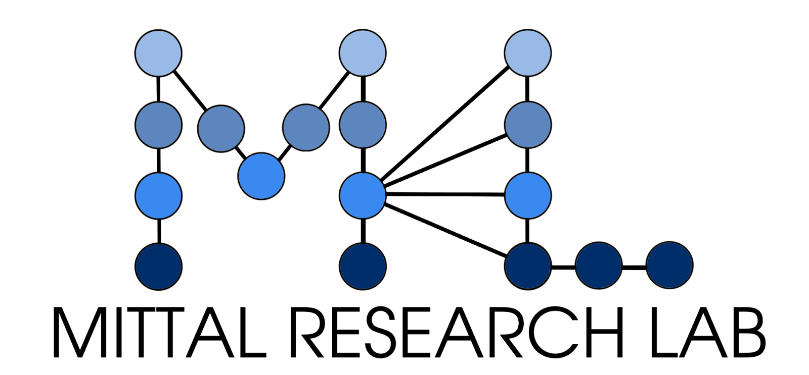

15th EDRN Scientific Workshop • Sept 23–25, 2026 • Gaithersburg, MD
AI-Assisted Cancer Risk Stratification
From tissue imaging to immune microenvironments across organ sites
Shachi Mittal, Ph.D.
Assistant Professor, Department of Chemical Engineering, University of Washington
Adjunct Assistant Professor, Department of Pathology, School of Medicine, University of Washington
Affiliate, Fred Hutch Cancer Center
Notes:
Introduce the talk around a simple question: how can AI combine tissue imaging, spatial biology, and clinical context to make early detection and risk stratification more actionable?

Slide 2
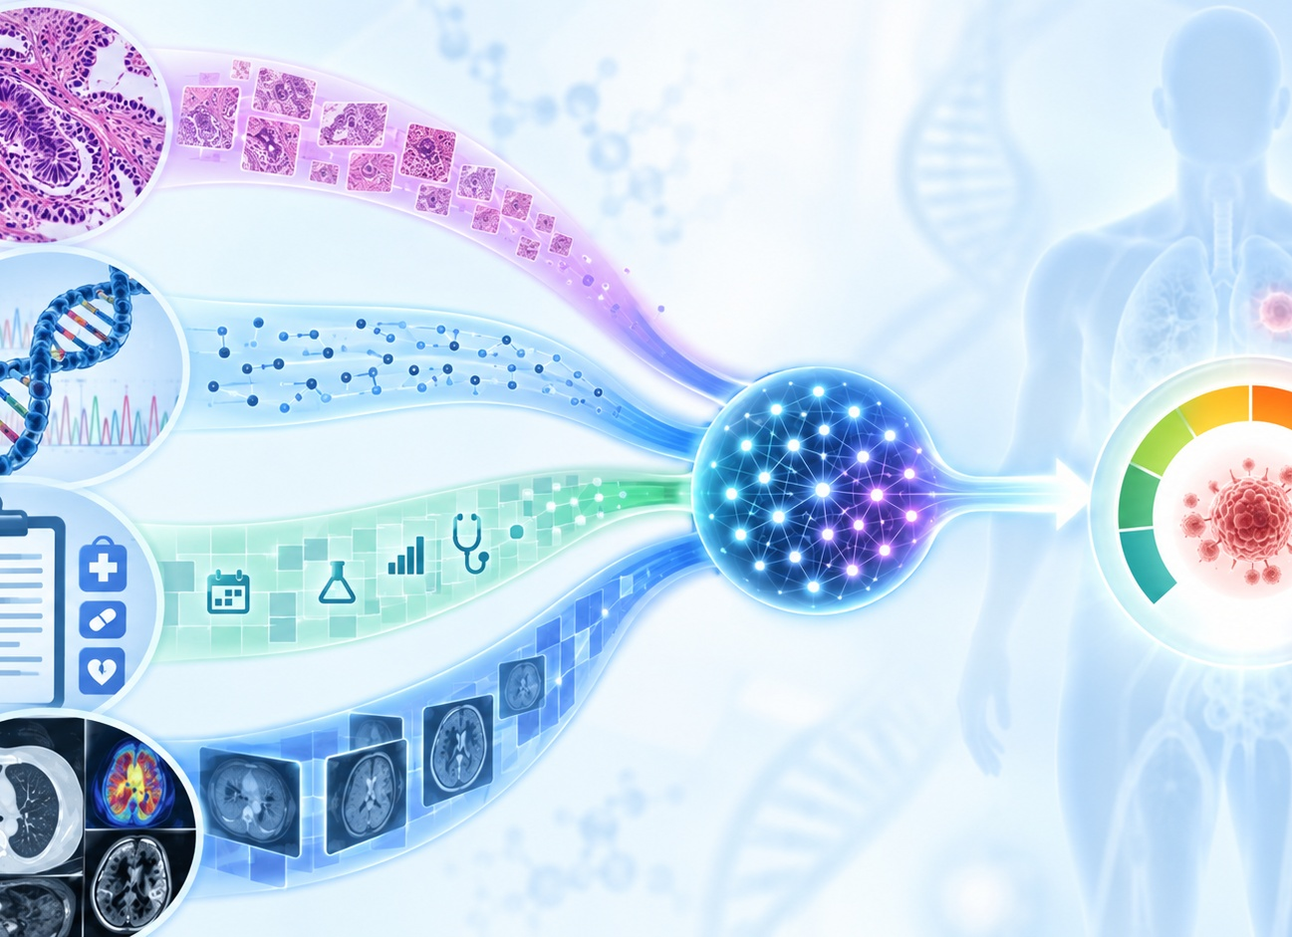




15th EDRN Scientific Workshop • Sept 23–25, 2026
Why multimodal now?
A field-wide shift from isolated measurements to integrated, predictive risk models.
Biomarkers for Prognostication, Early detection, and accurate risk stratification are the strongest drivers of improving cancer outcomes.
Multimodal Data Layers
Tissue Imaging
H&E, multiplex IF
Spatial Multi-Omics
Genome, epigenome
Clinical
Outcomes
AI / Deep Learning
Integration & inference
The opportunity: models that see biology at multiple scales and connect it to outcomes.
2
Notes:
EDRN’s 2026 theme emphasizes multimodal science. Position the lab’s work at the intersection of tissue imaging, spatial multi-omics, clinical data, and AI.

Slide 3




15th EDRN Scientific Workshop • Sept 23–25, 2026
Missing Gaps
Why current tools fall short of the multimodal, cross-organ integration
Poor reproducibility
Single-modality blind spots
Manual assessment (e.g., TIL scoring, immune profiling) suffers from low inter-observer agreement and does not scale to large cohorts.
Imaging-only or genomics-only tools miss complementary signals that jointly predict risk of malignant progression.
Limited cross-organ validation
Imprecise risk stratification
Few computational tools have been validated and translated across multiple cancer types and clinical settings.
As a result, patients are frequently over- or under-treated because existing tools lack precision and scalability.

Slide 4
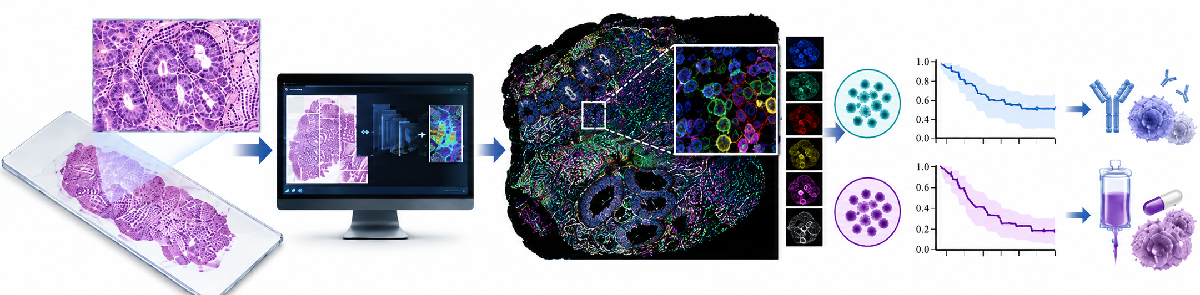
15th EDRN Scientific Workshop • Sept 23–25, 2026
Our Solution: Three Pillars, One Mission
Multimodal AI applied across organ systems and the tumor-immune continuum
Early Detection Platform and Spatial Immune Profiling
Multi-omics Progression Mapping
Therapy-Guiding Biomarkers
Single-cell spatial profiling of Barrett’s esophagus progression to adenocarcinoma
H&E-based image analysis to identify patients likely to benefit from selected therapies.
Scalable detection of early-stage cancer and immune microenvironment from routine H&E images.
BREAST CANCER
ESOPHAGEAL CANCER
COLORECTAL CANCER

Slide 5
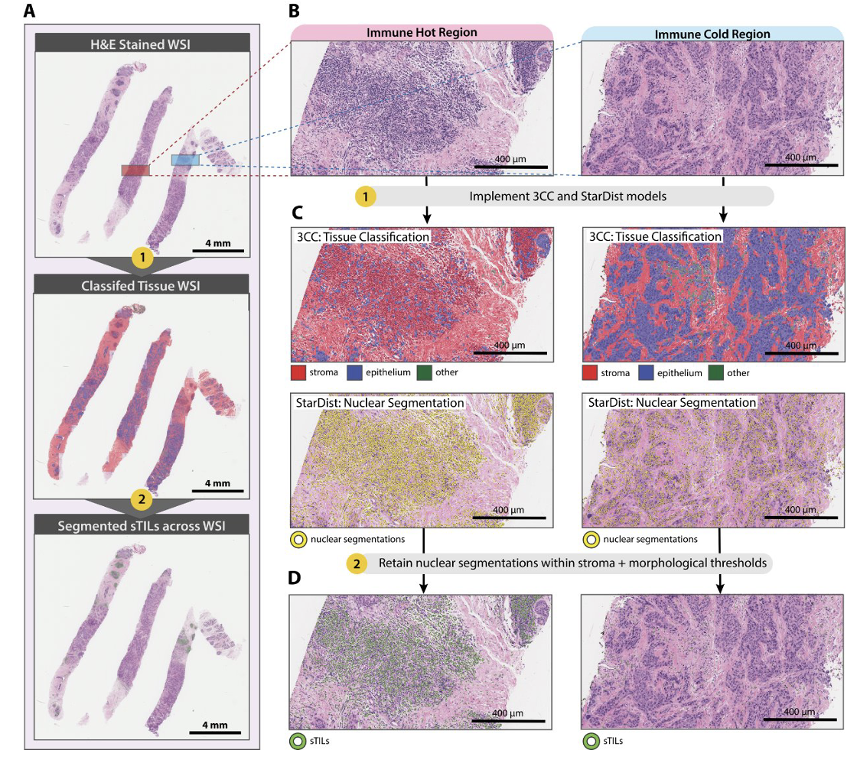
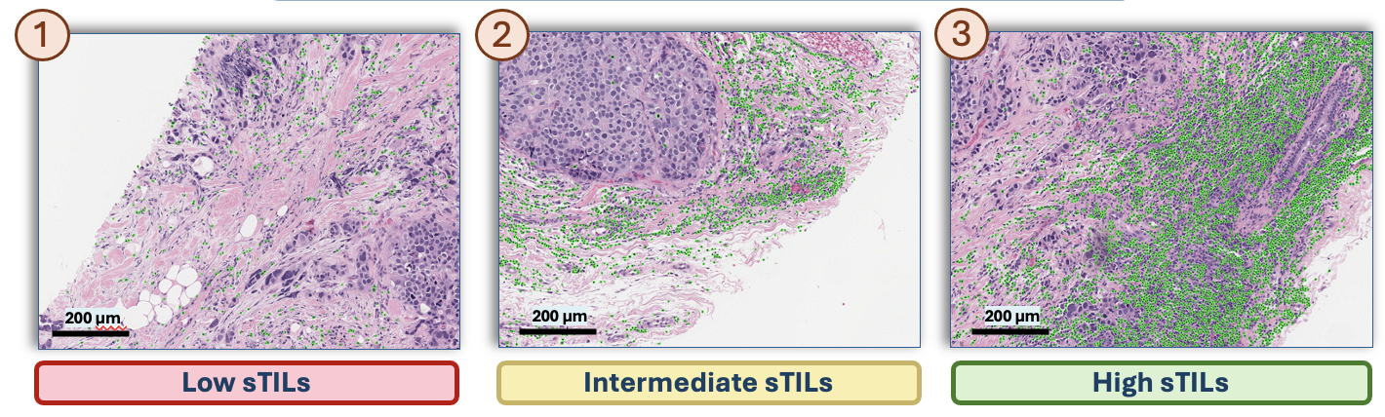
15th EDRN Scientific Workshop • Sept 23–25, 2026
Spatial Immune Markers : Breast Cancer Risk Profiling
Carr, Lisa L., et al. medRxiv (2026) : Accepted Cancer Immunology Research (In press)

Slide 6
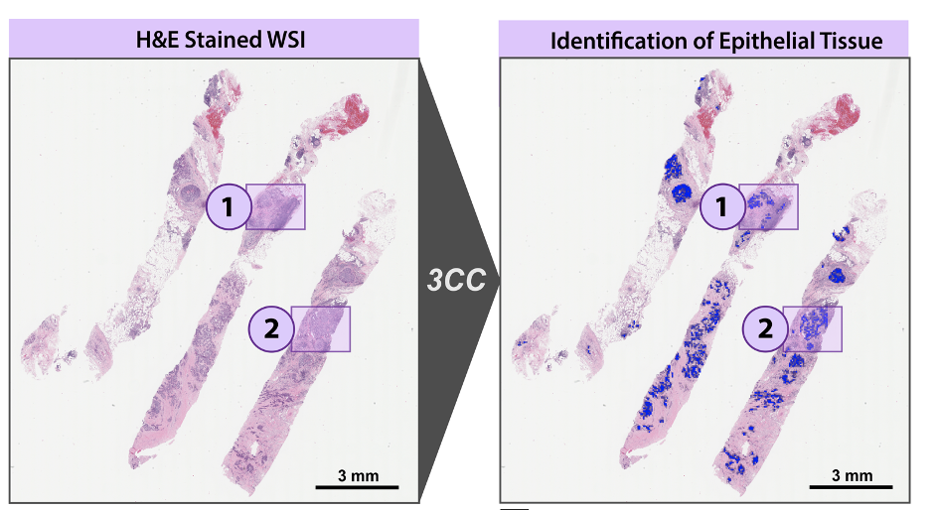
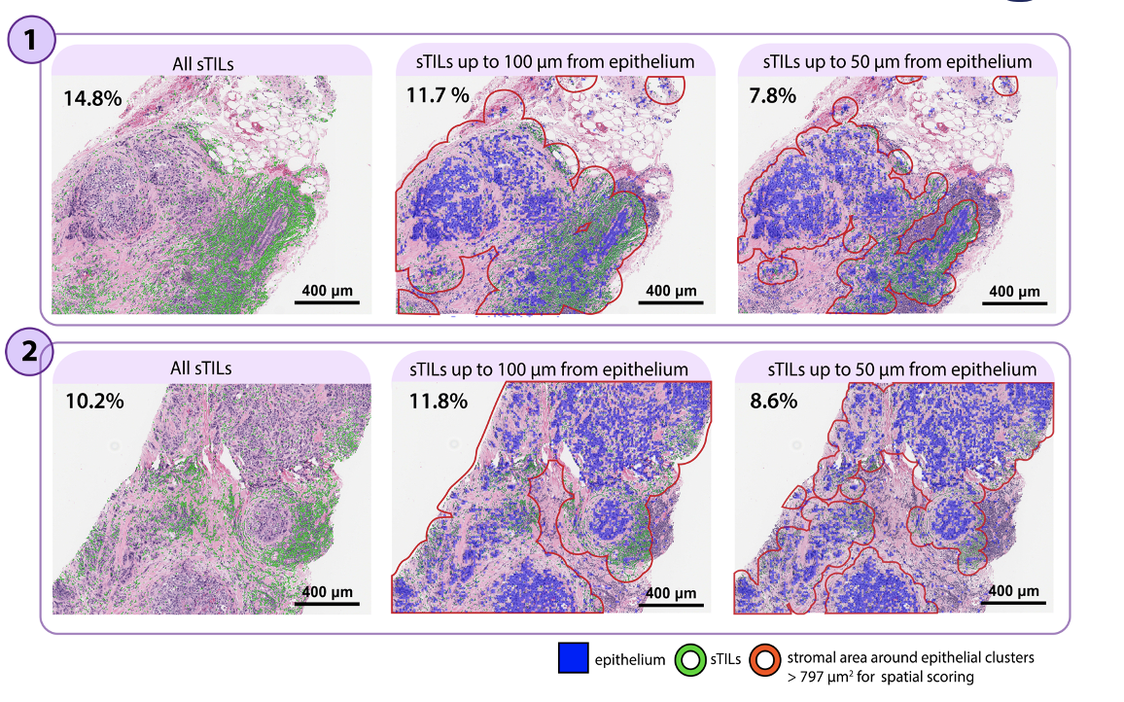
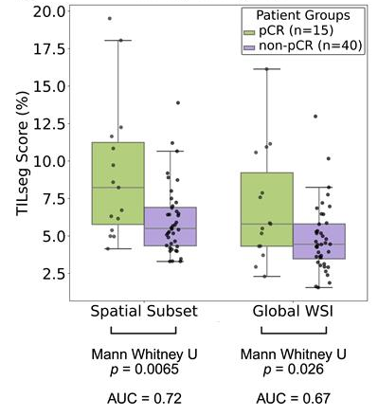
15th EDRN Scientific Workshop • Sept 23–25, 2026
Spatial Immune Markers : Breast Cancer Risk Profiling
Carr, Lisa L., et al. medRxiv (2026) : Accepted Cancer Immunology Research (In press)

Slide 7
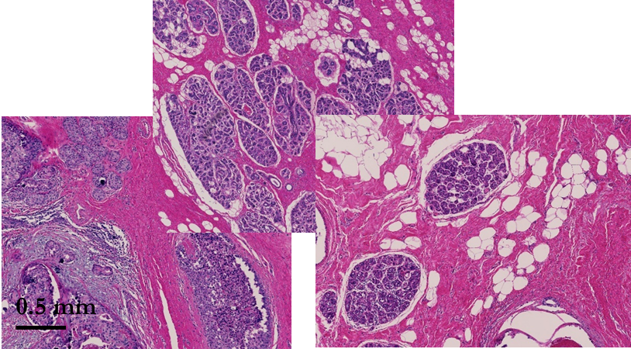
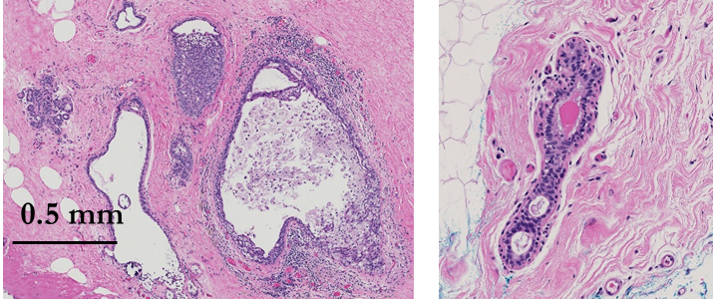
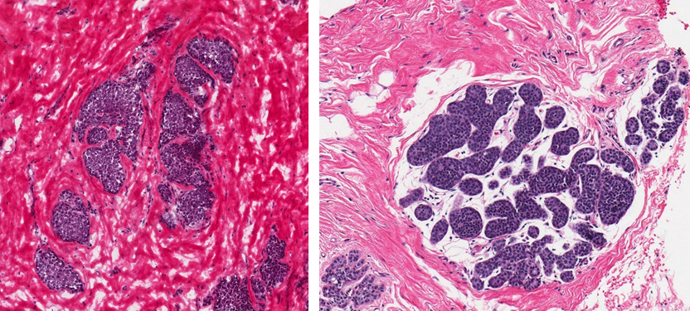
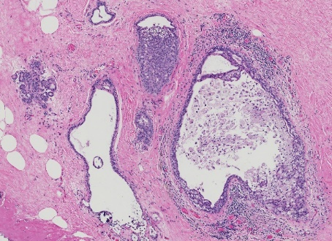
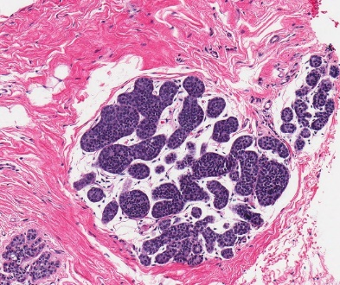
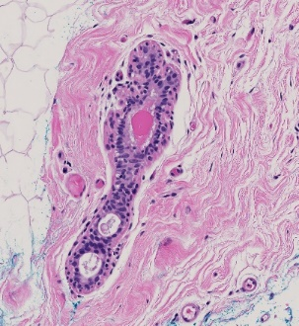
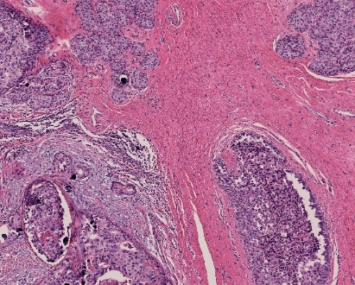
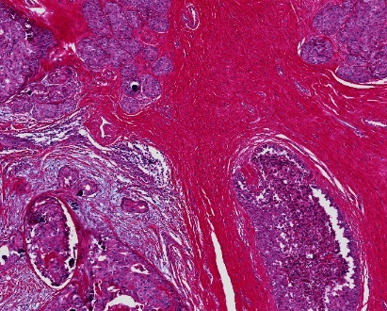
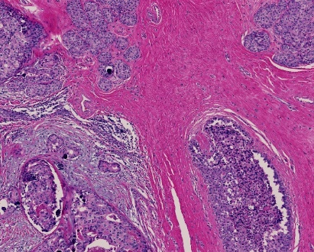
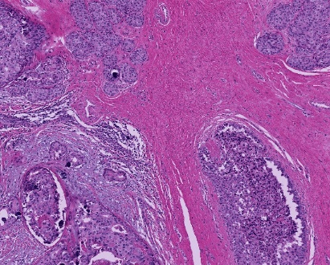
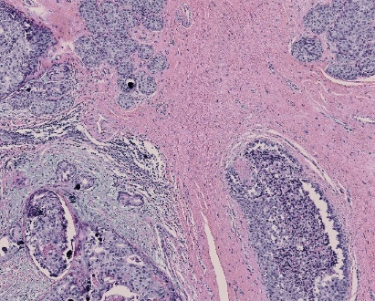
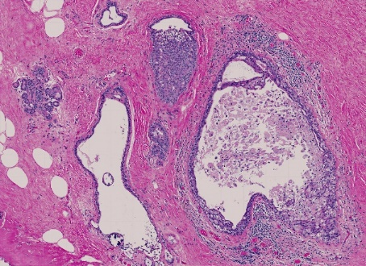
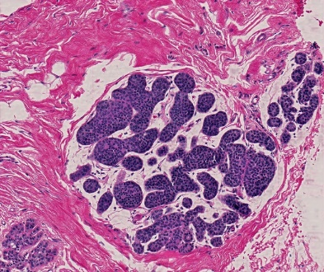
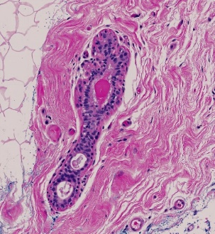
15th EDRN Scientific Workshop • Sept 23–25, 2026
Early Detection and Risk Profiling: Breast Cancer
Clinic 1
Clinic 2
Clinic 3
0.1 mm
Inter-clinical variations in clinical images
Input images
Synthetically altered images
Target Image
0.5 mm
0.1 mm
0.1 mm
NormNet
Normalized images
0.5 mm
0.5 mm
Bhargava, R., & Mittal, S. (2025). U.S. Patent No. 12,346,410.

Slide 8
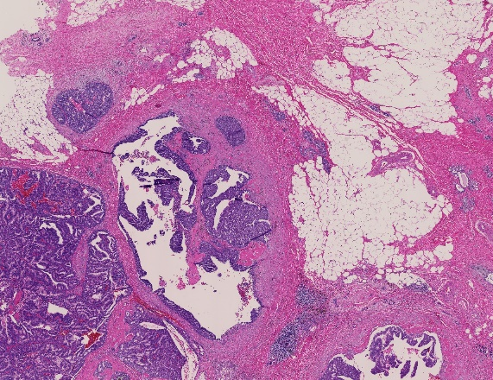
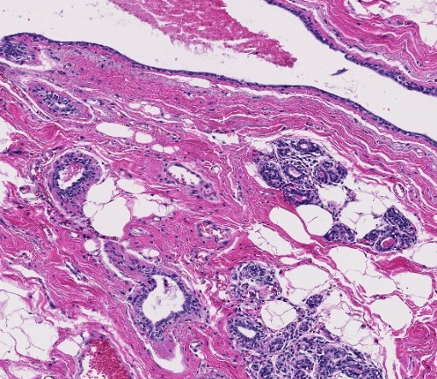
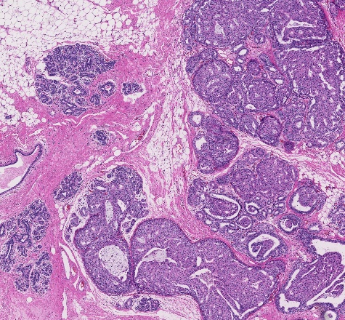
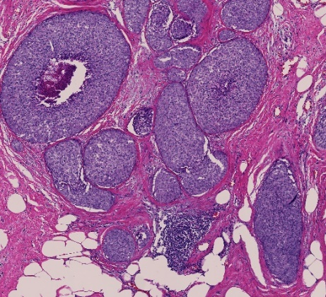
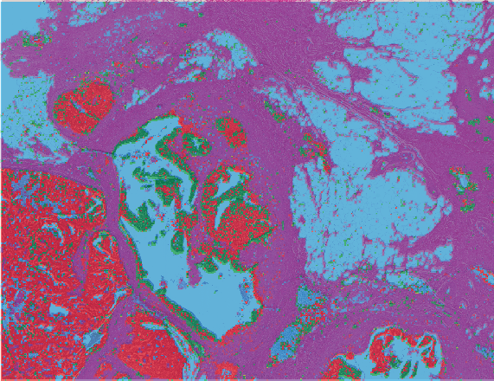
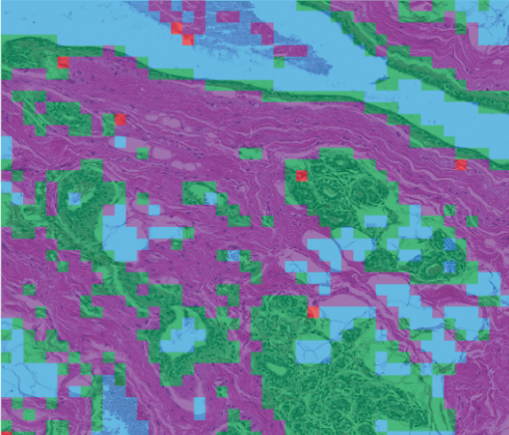
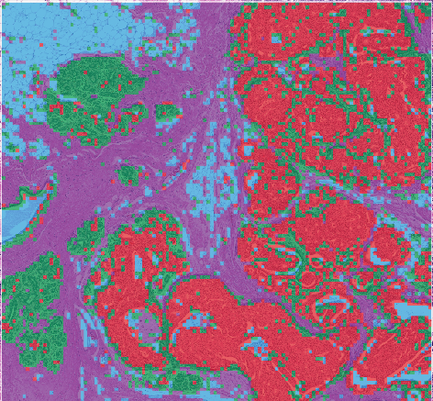
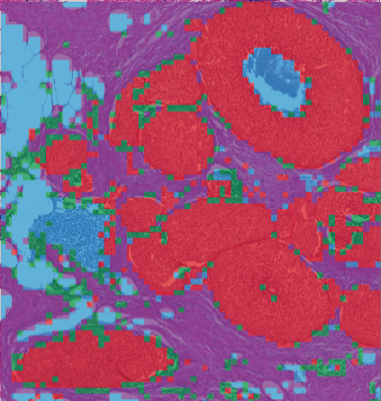
15th EDRN Scientific Workshop • Sept 23–25, 2026
Early Detection and Risk Profiling: Breast Cancer
Stroma
DCIS
Benign
Others
1 mm
0.2 mm
1 mm
0.5 mm
Early-stage cancer and benign cells can be digitally identified on stained slides with ~ 85% accuracy.
Bhargava, R., & Mittal, S. (2025). U.S. Patent No. 12,346,410.

Slide 9
15th EDRN Scientific Workshop • Sept 23–25, 2026
Early Detection and Risk Profiling: Breast Cancer
PUBLICLY ANNOTATED H&E DATASETS
PILOT STUDY: n = 56 (n = 14 progressed to invasive cancer)
BEETLE
Clinical Data
Images
(n = 151 WSIs
WSI-level histologic grade of DCIS
H&E surgical resections
Pathology result at surgery
Ki67 + scored
TIGER
Oncotype DX score + risk
p53 + scored
n = 370 WSIs
Molecular subtype
p16 + scored
ER, PR, HER2 + scored
BCSS
n = 547 WSIs
Preliminary Clinical & Biological Insights
INSTITUTIONAL STUDY: n = 600

Slide 10
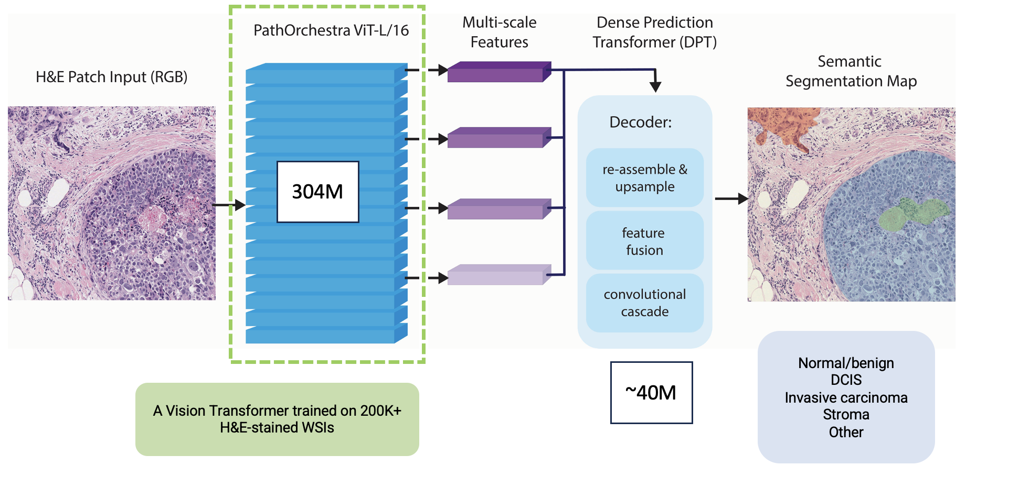
15th EDRN Scientific Workshop • Sept 23–25, 2026
Early Detection and Risk Profiling: Breast Cancer

Slide 11
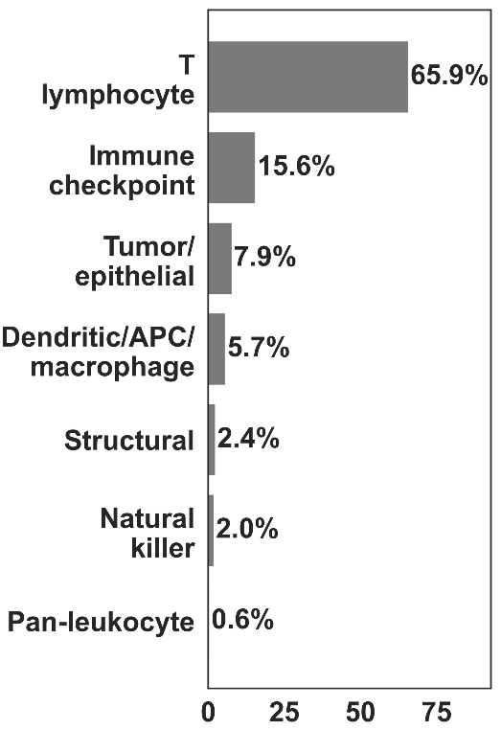
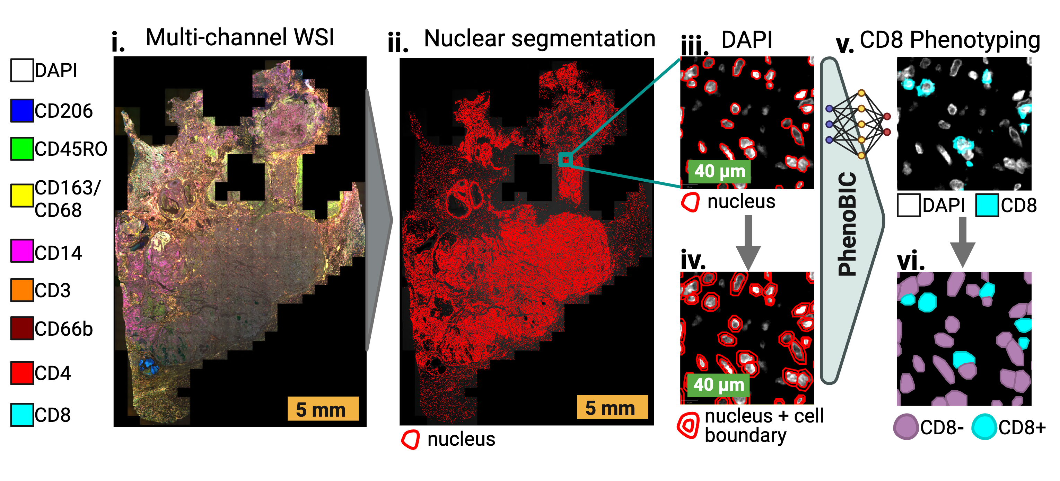
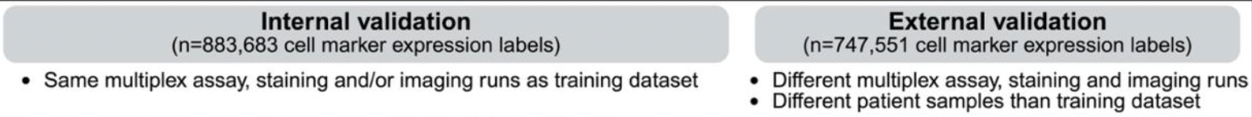
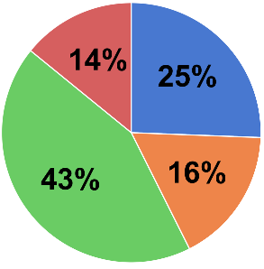
15th EDRN Scientific Workshop • Sept 23–25, 2026
Spatial Immune Markers : Breast Cancer Risk Profiling
Marker Cell Type
% of
Training Annotations
n=233,576 cell marker expression labels for training
Imaging platform, tissue type
& data source
MIBI
Decidua
Vectra
Colon
Curated and released the largest manually annotated, quality-controlled cell expression dataset, consisting of approximately 1.4 million gold-standard cell marker expression labels.
Vectra
Pancreas
Sankaranarayanan, Abishek, et al. bioRxiv (2026). Manuscript in review.
Vectra
Breast

Slide 12
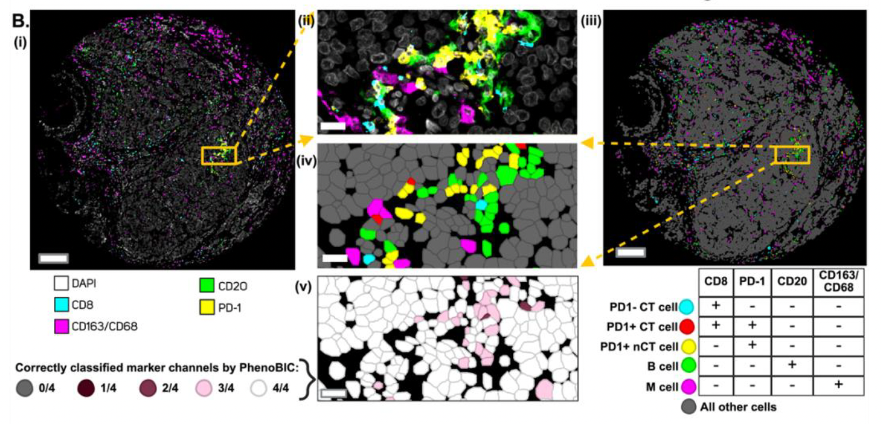
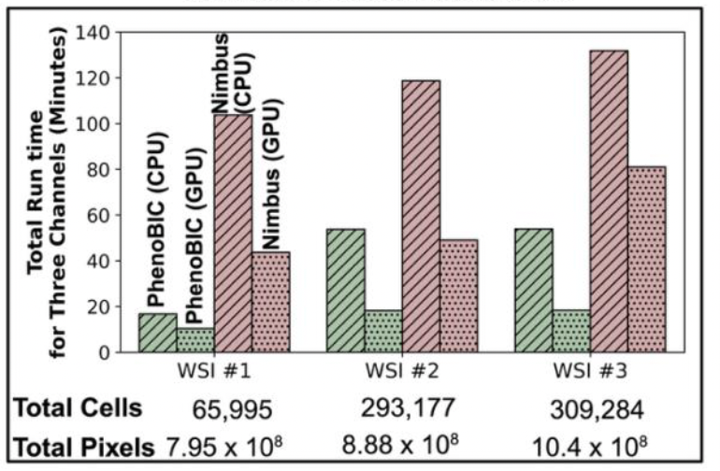



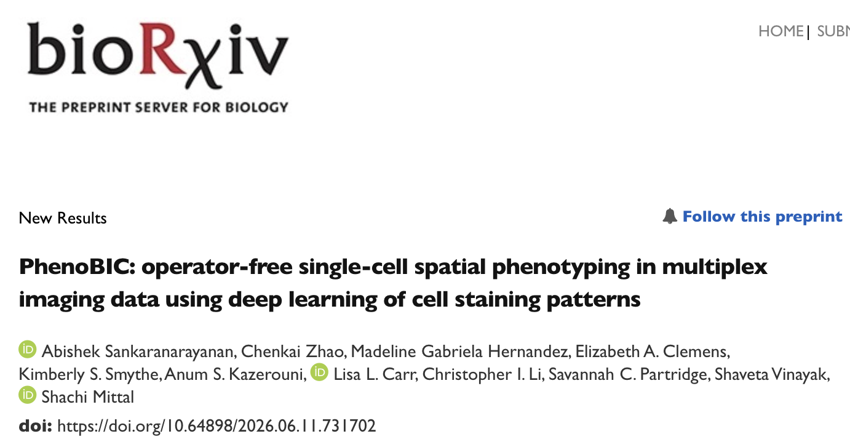
15th EDRN Scientific Workshop • Sept 23–25, 2026
Spatial Immune Markers : Breast Cancer Risk Profiling
F1 – score of 0.88 across the entire dataset
Pre-print published (Manuscript in review)
QuPath extension
Datasets released
Model released
GitHub
Hugging Face
Hugging Face

Slide 13
15th EDRN Scientific Workshop • Sept 23–25, 2026
PhenoBIC-derived Spatial Immune Metrics Correlate with Clinical Outcomes
Median NND
Avg. Proximal (r < 25 µm) Abundance
Patient Groups:
Low Risk: RFS < 3 years
High Risk: RFS > 3 years
N → T
N → CT
MCT → T
N → T
Cell Phenotype Key:
N: CD66b+ neutrophils
T: CD3+ T cells
CT: CD3+CD8+ Cytotoxic T cells
MCT: CD3+CD45RO+CD8+ Memory Cytotoxic T cells
Average number of cells (r < 25 µm)
Mann-Whitney U test
p = 0.015
AUC = 0.74
p = 0.104
AUC = 0.66
p = 0.022
AUC = 0.73
p = 0.031
AUC = 0.71
Univariate Cox Model (n=42)
p = 0.007
p = 0.047
p = 0.065
p = 0.085

Slide 14
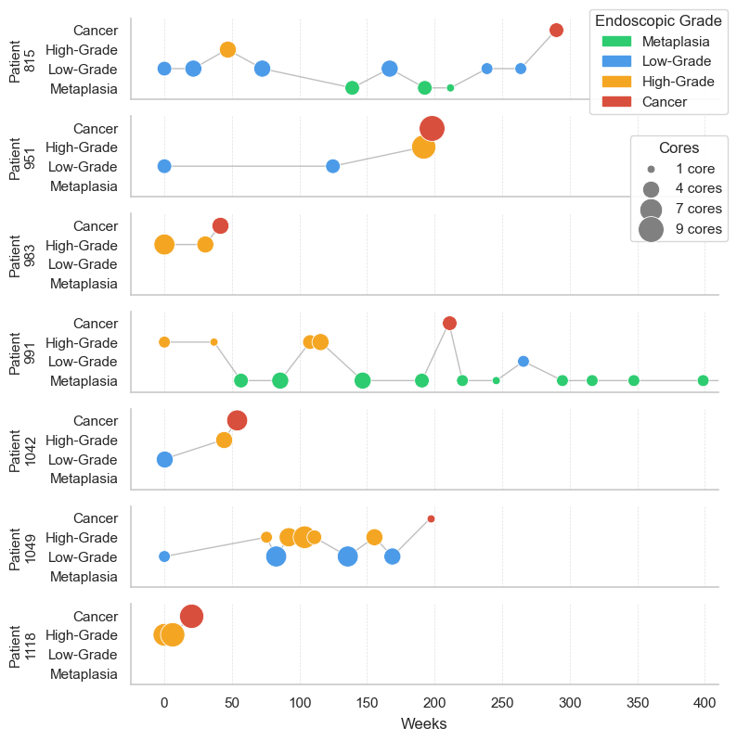
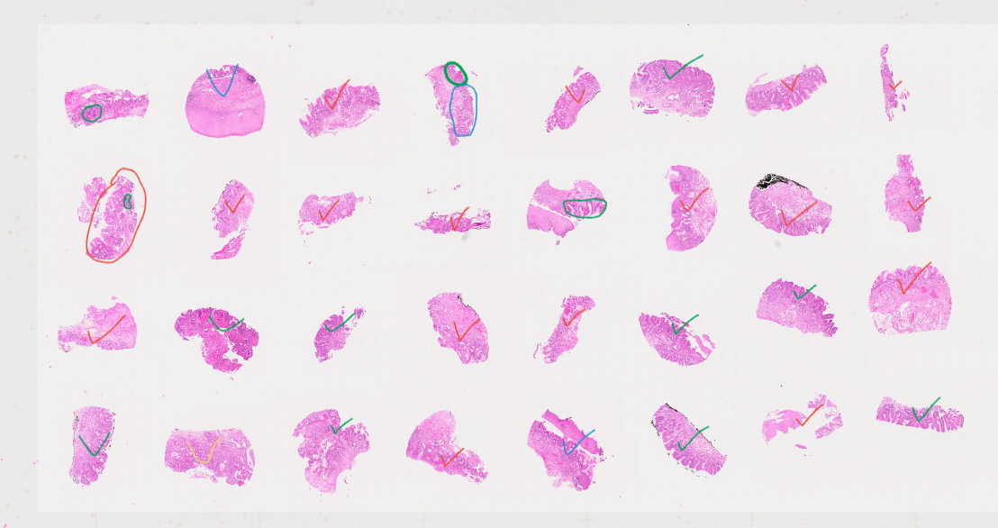
15th EDRN Scientific Workshop • Sept 23–25, 2026
Multi-omics Disease Mapping: Esophageal Cancer
n = 367 patients
n = 79 progressed to high-grade dysplasia (HGD) or EAC
H&E + CODEX + Xenium
Overall patient grade
Core-level grade
Distance of biopsy from incisors
Time point since diagnosis (weeks)
Histologic progression of BE to EAC is well established, but the underlying cellular interactions and molecular signaling remain largely undefined.

Slide 15
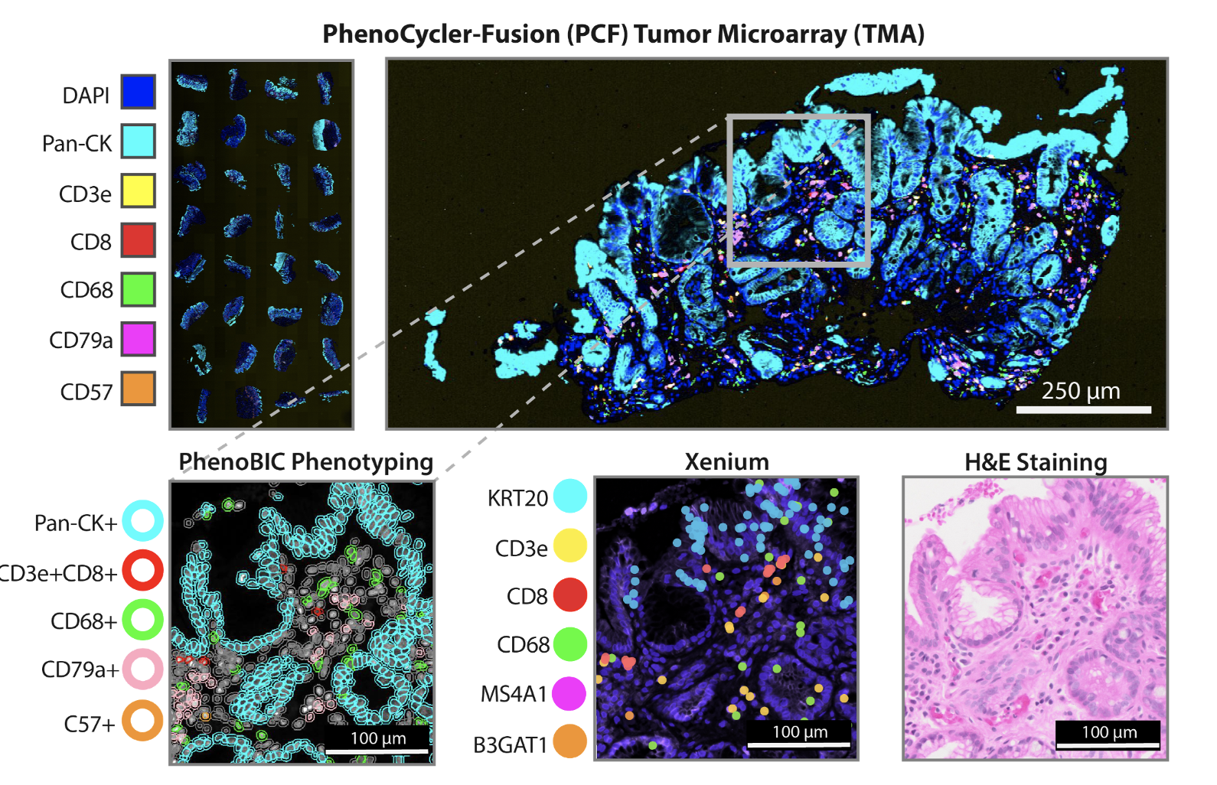
15th EDRN Scientific Workshop • Sept 23–25, 2026
Multi-omics Disease Mapping: Esophageal Cancer

Slide 16
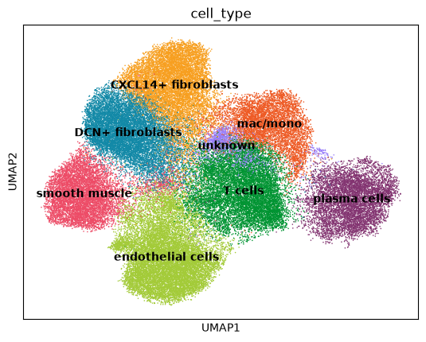
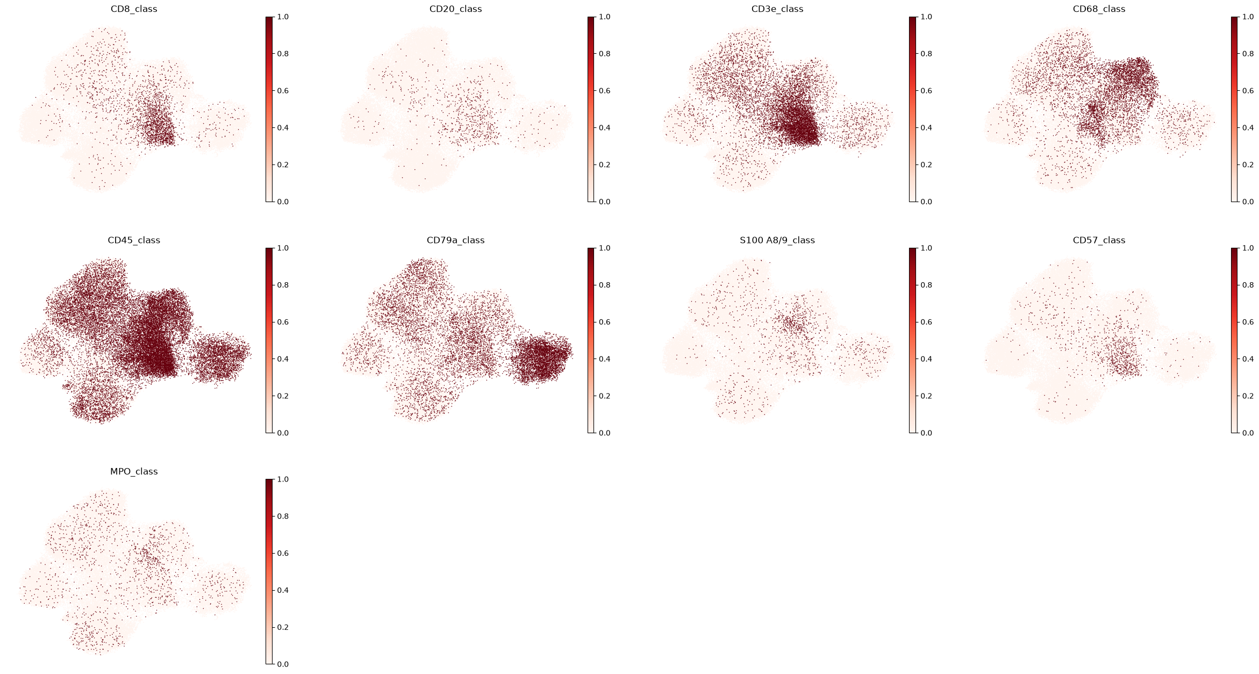
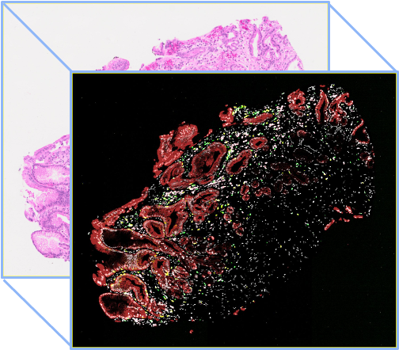
15th EDRN Scientific Workshop • Sept 23–25, 2026
Multi-omics disease Mapping: Esophageal Cancer
Xenium Cell Type Annotation
PhenoBIC classifications on Xenium UMAP:
PCF to H&E

Slide 17
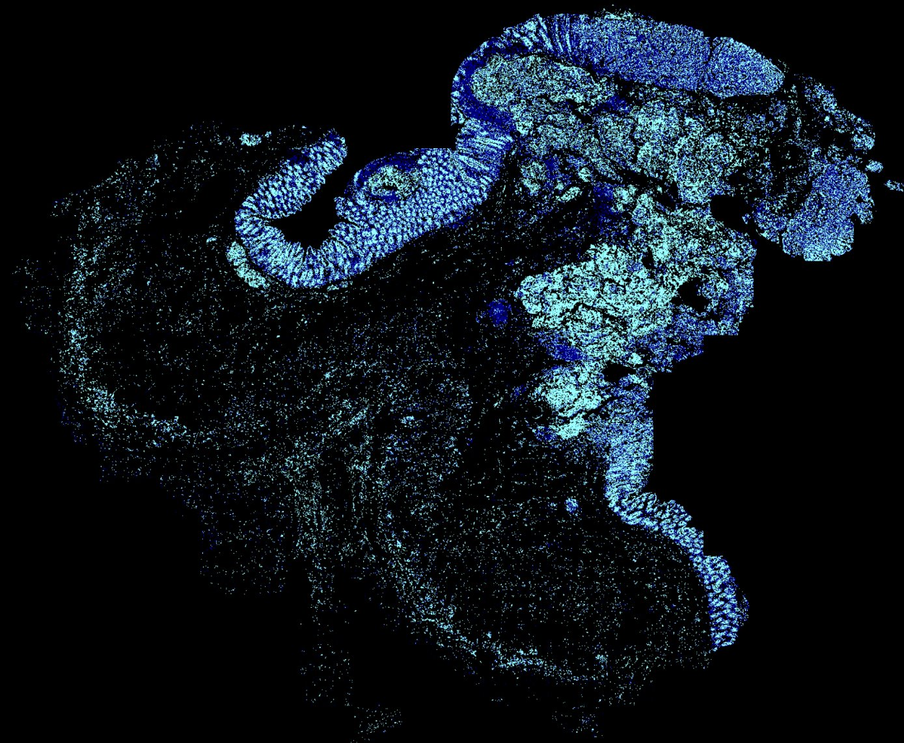



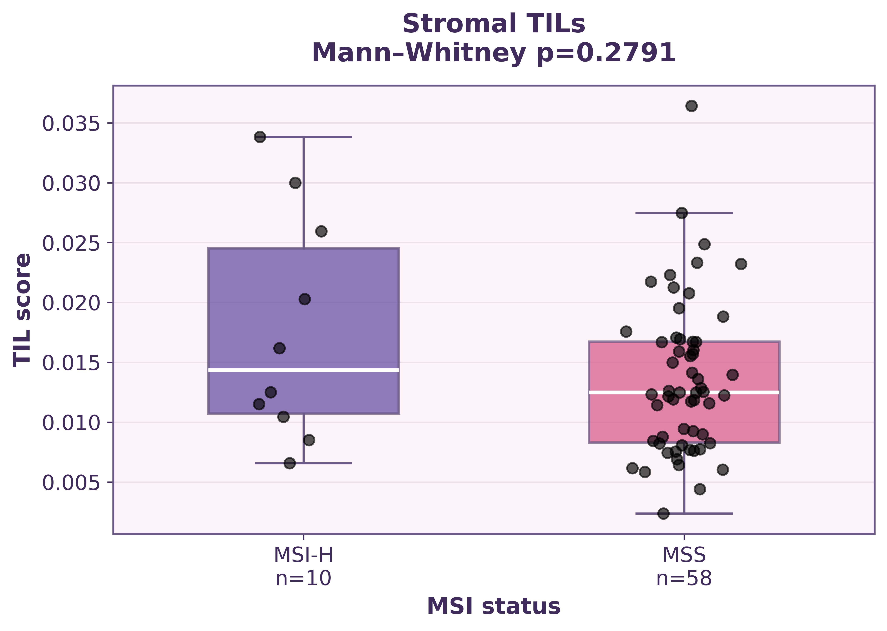
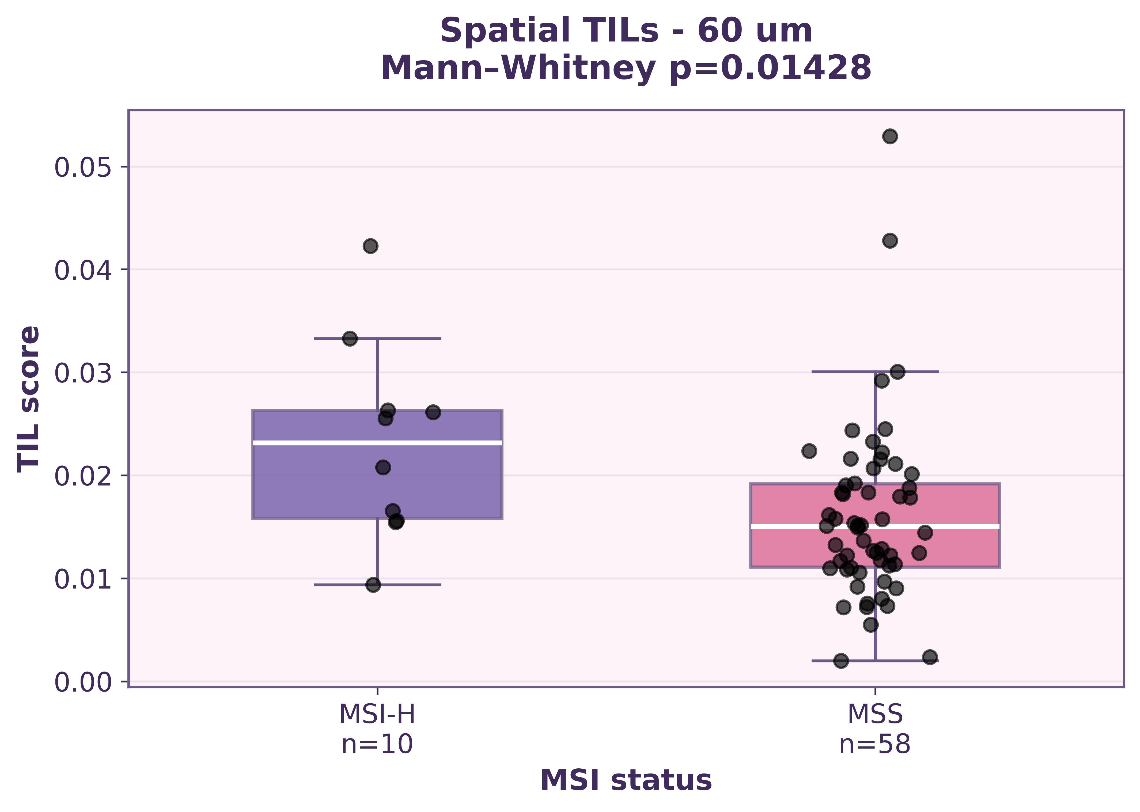
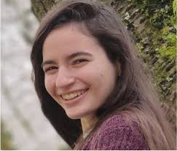

15th EDRN Scientific Workshop • Sept 23–25, 2026
Impact and Conclusion
Reproducible, scalable AI tools spanning tissue imaging, spatial multi-omics, and clinical data.
AI-assisted immune scoring and spatial analysis validated across breast, esophageal, and colorectal cancer
Precise Risk Stratification and triaging for efficient treatment planning and managing clinician workloads
ASSOCIATION OF TIL SCORES WITH MSI STATUS
Lisa Carr
Abishek Sankaranarayanan
Sergio Mayta
Stop by his poster (#20), Thursday 11:50 – 2:00 pm
Rachel Ware
Lena, Allen

Slide 18










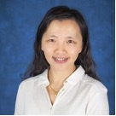

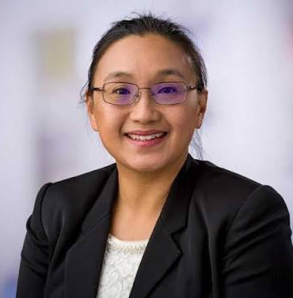







Thank you for listening!
Email: shmittal@uw.edu
Mittal Lab: shachimittal.com
Twitter: @ShachiMittal2
Dr. Chris Li, PhD, Fred Hutch
Dr. Ming Yu, PhD, Fred Hutch
Dr. William Grady, PhD, Fred Hutch
Dr. Cecilia Yeung, PhD, Fred Hutch
Prof. Savannah Partridge
PhD, Radiology
Dr. Anum Kazerouni, PhD, UW Medicine
Jennifer Specht, MD, Fred Hutch
Dan Hippe, MD, Fred Hutch
Dr. Lynn Symonds, MD, Fred Hutch
Dr. Mark Kilgore, MD
UW Medicine
Dr. Daniel Reiter, MD,
UW Medicine

