Slide 1


Single cell spatial transcriptomic profiling of progression from oral epithelial dysplasia to oral squamous cell carcinoma
Emily Hoskins, Ph.D
T32 Postdoctoral Scholar
Georgetown University
PIs: Laura Rozek, Ph.D, Eleni Gagari, D.D.S., DMSc, Maureen Sartor, Ph.D, Nisha D’Silva, BDS, MSD, Ph.D
NIH Grant #: 1U01DE033348-01
Grant title: Oral Dysplasias to Carcinomas: Multi-omics Study of Progression
09/23/2026

Slide 2
Project objective
Identify biomarkers that indicate whether an oral epithelial dysplasia will progress to oral squamous cell carcinoma (OSCC)
2
Notes:
Aligned with the AHEAD mission

Slide 3

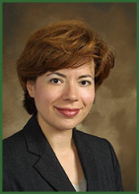
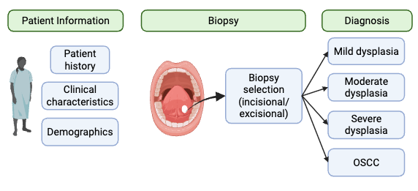
Oral Epithelial Dysplasia Cohort
Cohort: 668 individuals from University of Athens
Frequent follow-ups for precise timing of disease progression
Patients either progressed to OSCC or remained with oral epithelial dysplasia
Dr. Eleni Gagari
18 samples from 10 patients selected for CosMx WTX
3
Notes:
Talk about how our study is different from other studies (talk with Elham about details)

Slide 4

Ongoing high-value projects advancing toward Phase 3 validation
AHEAD
Annotated Discovery, Test and Validation Sets
Oral Dysplasia
Epigenetic and Genetic Studies
Spatial Transcriptomics
Biomarker Discovery
Testing
Test Set: Longitudinal Cohort
Validation Set: Retrospective Cohorts
Histomorphometric Studies (FFPE) in annotated samples
Phase 2 Validation Studies of Biomarker Performance
Notes:
Please include in this slide where your biomarkers are in the Phase and what is needed to get them to the next phase.

Slide 5
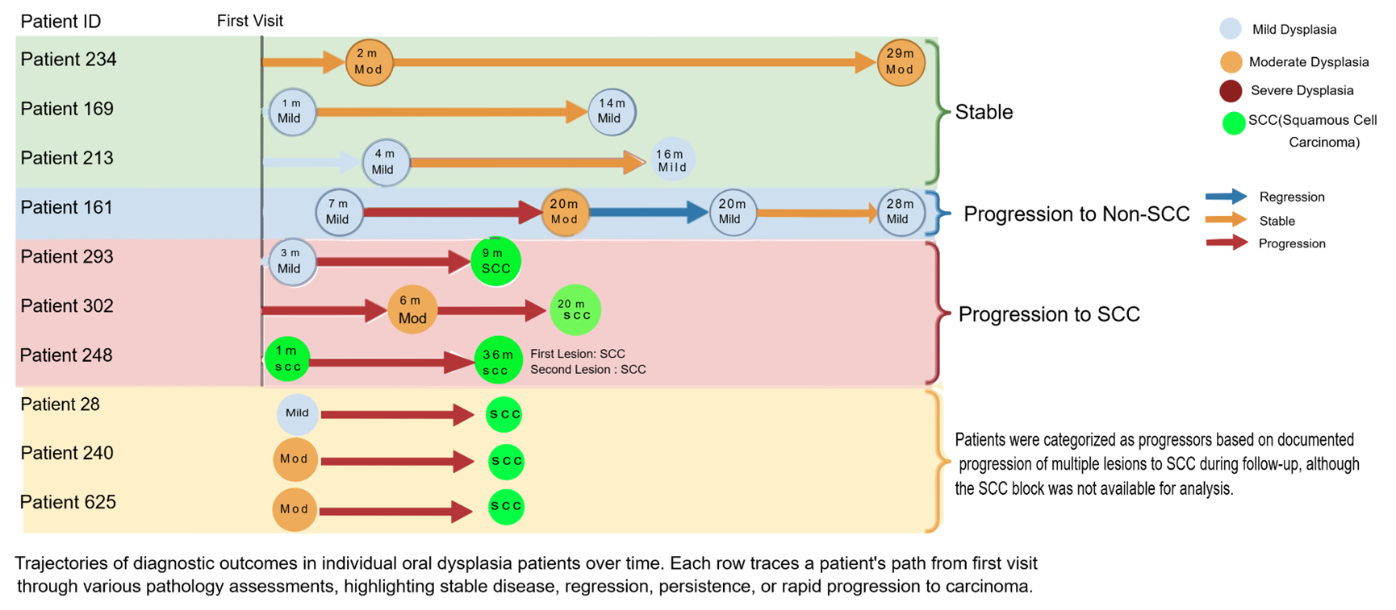
CosMx WTX Cohort Trajectories of Oral Dysplasia Patients Over Time
Notes:
Explain the slide (**practice)

Slide 6
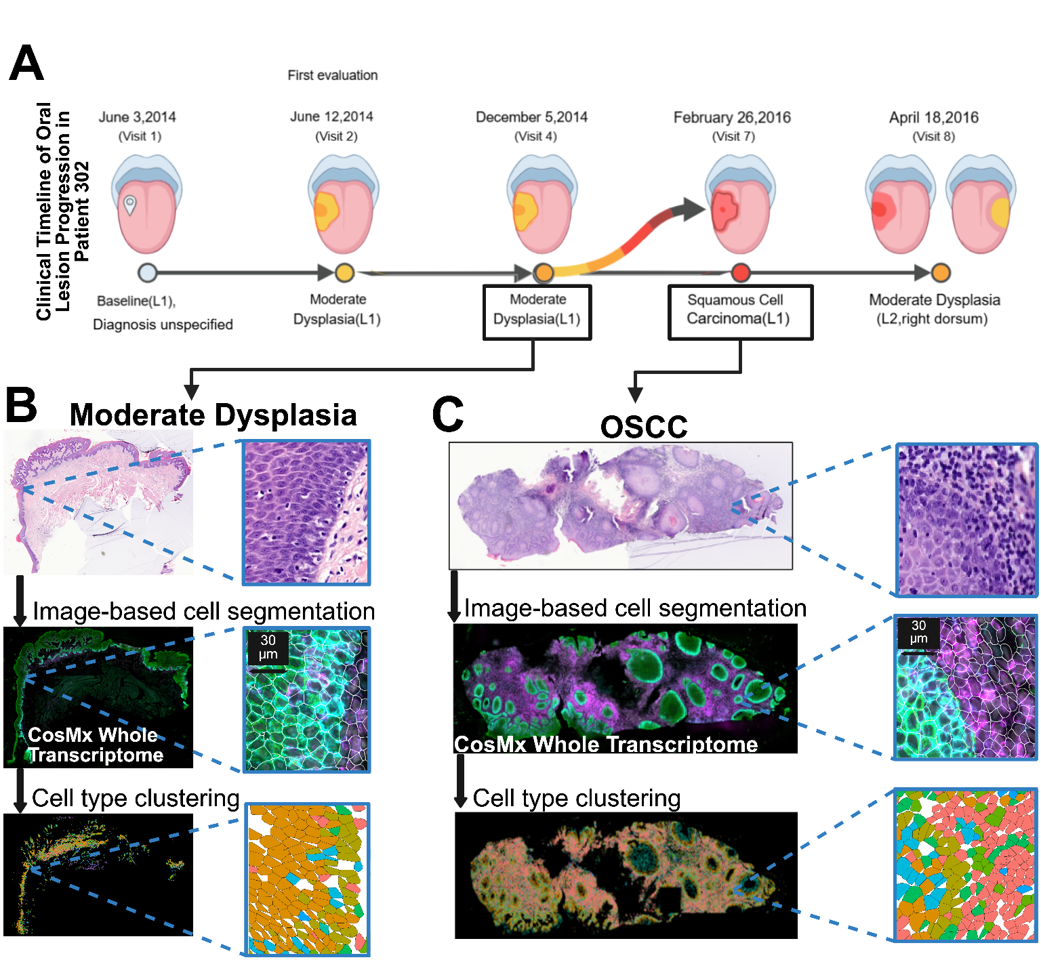

Patient timeline and biopsy sample selection for CosMx assay
H&E
CosMx Imaging
Cell typing
Notes:
make sure arrows point to correct location

Slide 7
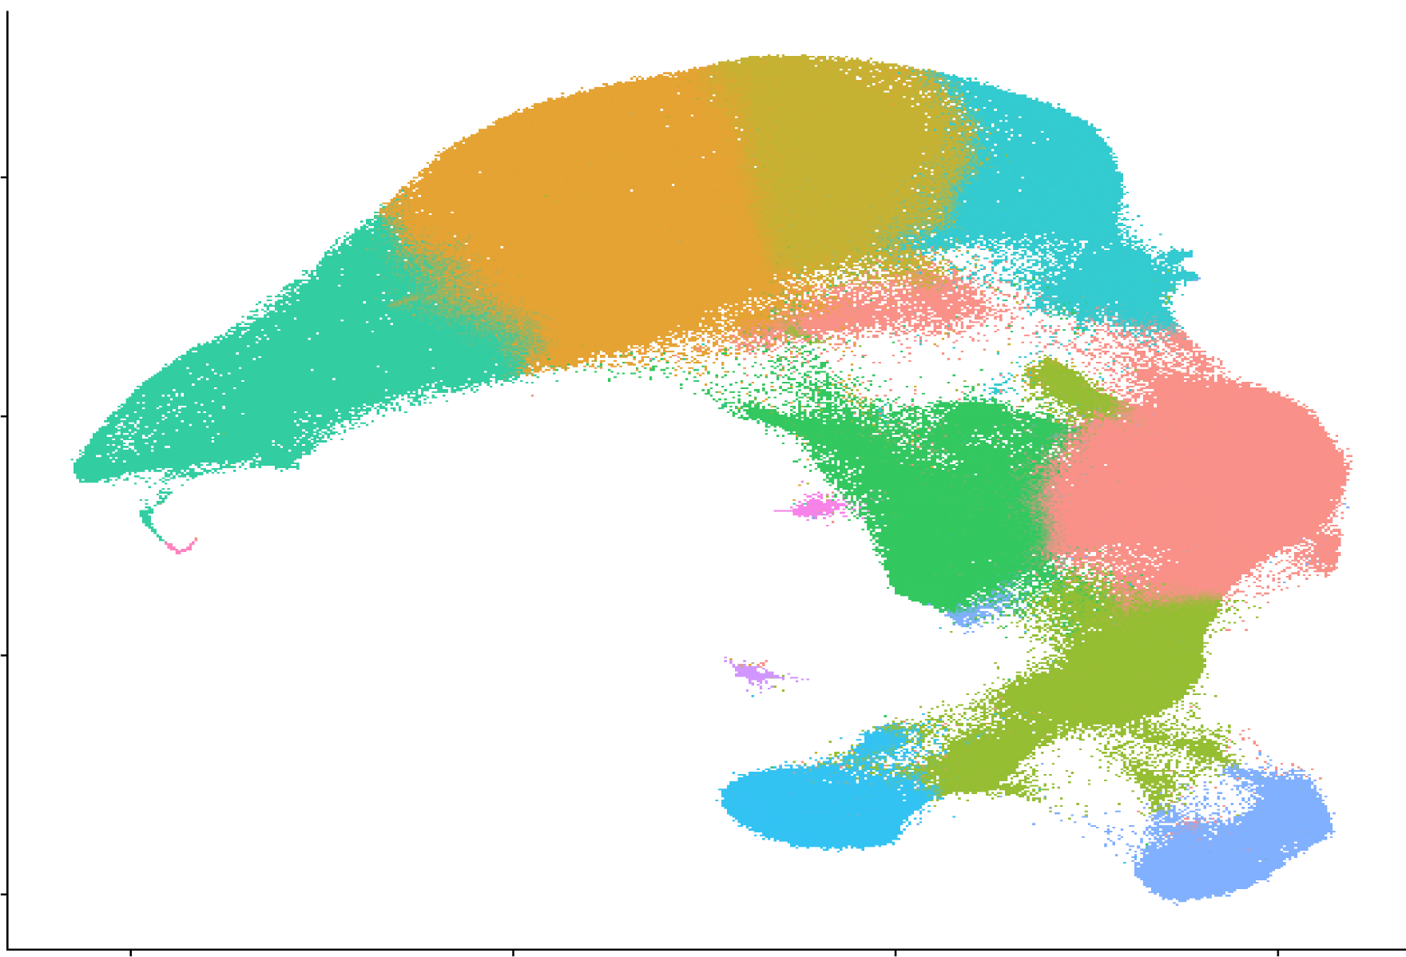
UMAP of 554,859 filtered cells for cell typing and analysis
Basal epithelial
Suprabasal epithelial
Basal proliferative
5
Differentiated epithelial
0
Macrophages
UMAP 2
T cells
Inflammatory myeloid
-5
Terminally differentiated epithelial
Skeletal muscle
Fibroblasts
Endothelial cells
B cells
-10
-10
-5
0
5
UMAP 1

Slide 8
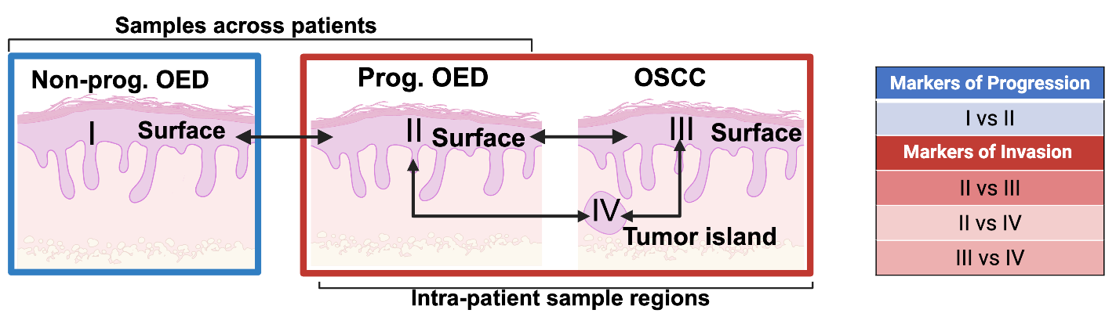
Workflow analysis to uncover transcriptomic biomarkers of malignant transformation

Slide 9
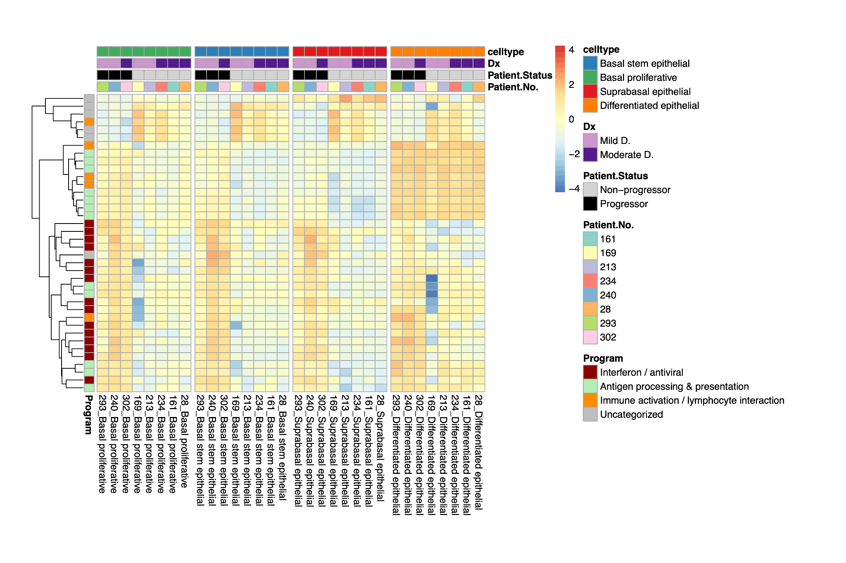
OED that underwent malignant transformation shows upregulated expression of interferon-induced inflammation and MHC processing
log2 fold change
Basal proliferative
Basal
Suprabasal
Differentiated
No malignant transformation
Malignant transformation
Model:
design = ~ Patient.No. + Patient.Status + Epithelial.Celltype
GO classification for each gene assigned using Gene Ontology Analysis (gProfiler)
Notes:
Short quick sentences
Innate immune:
Interferon / cytokine response:
MHC I antigen presentation:
Chemokine signaling:

Slide 10
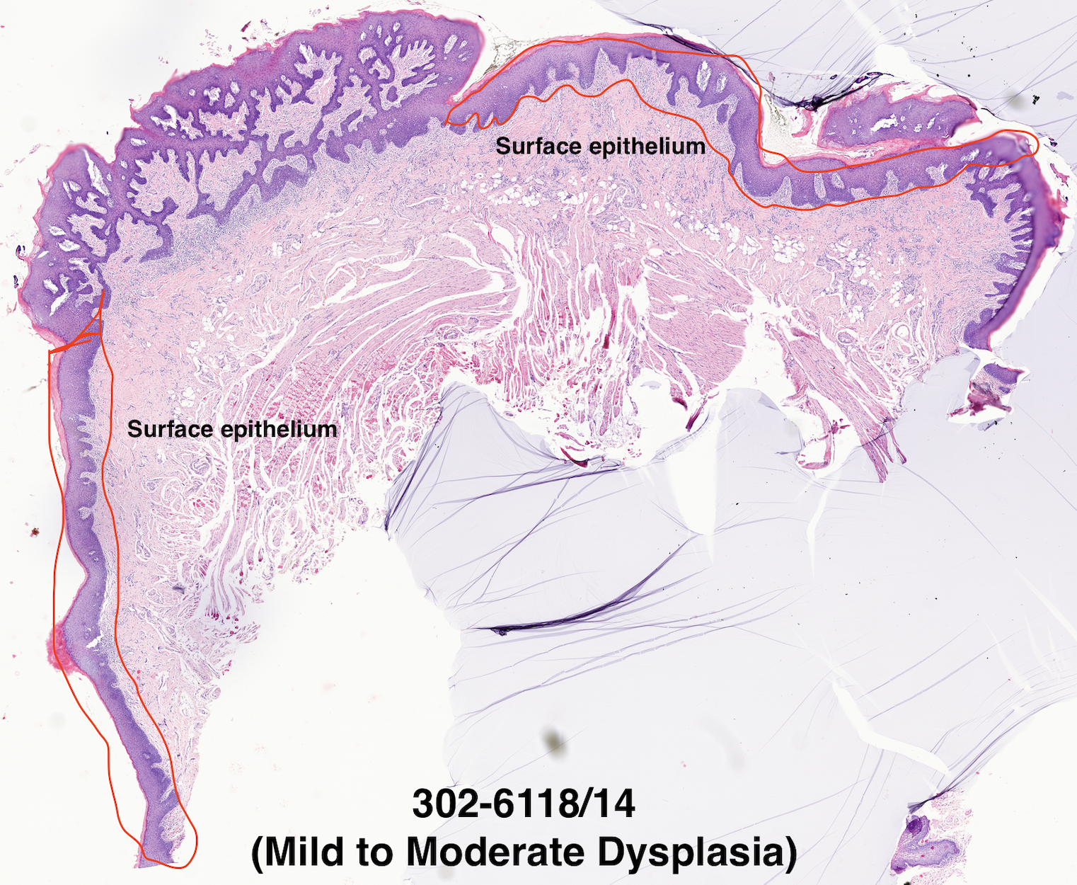
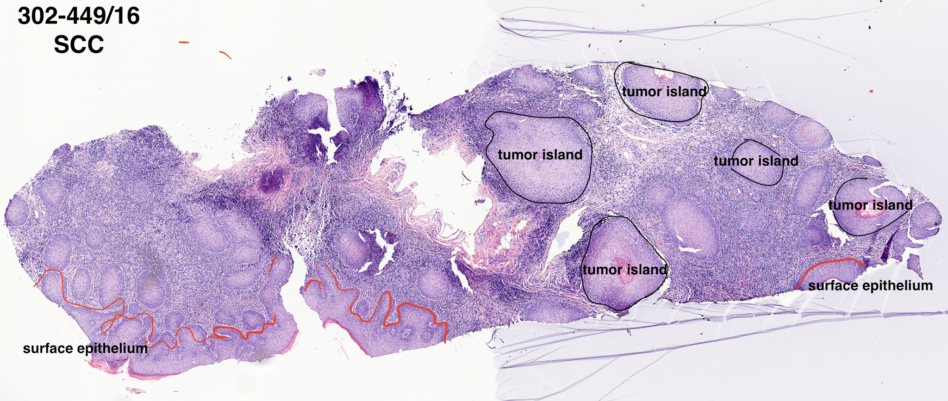
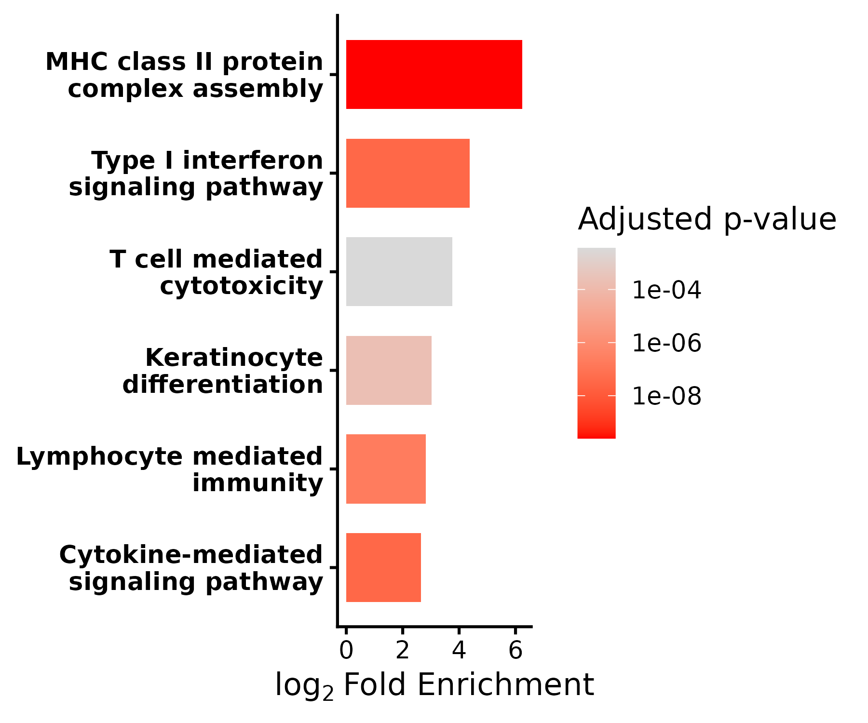
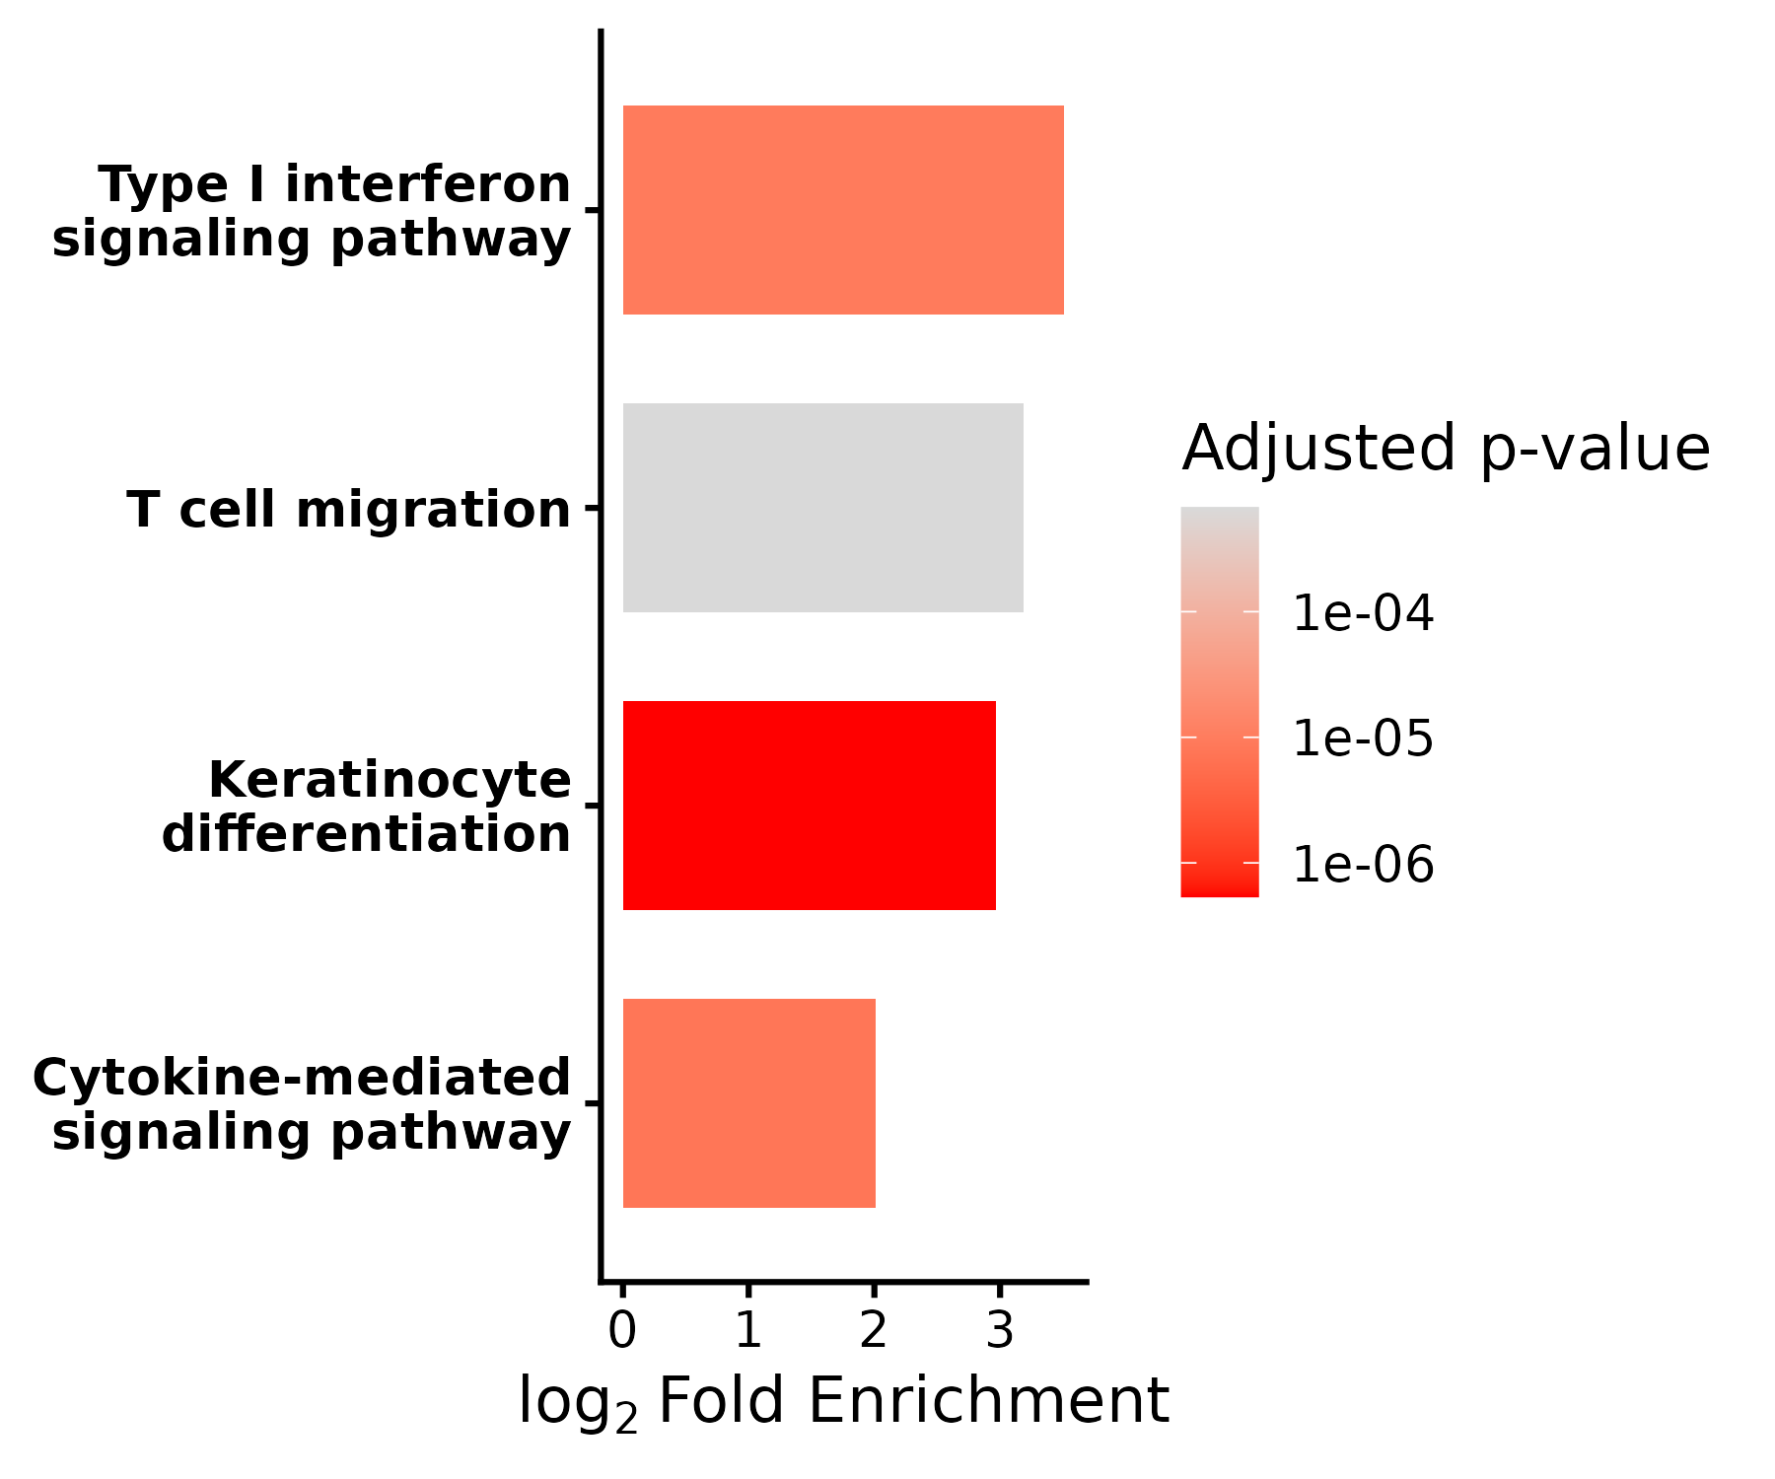
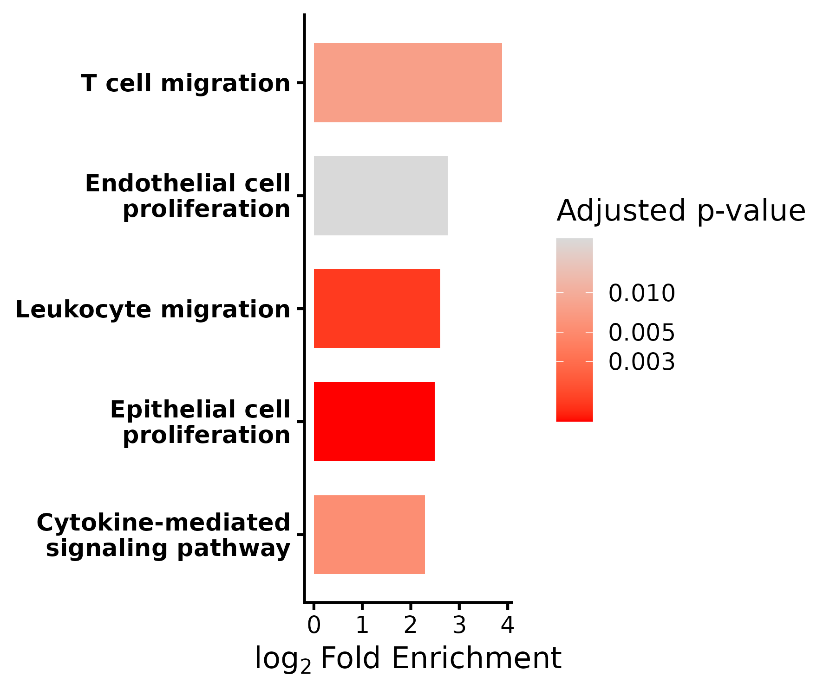
Genes associated with interferon signaling and epithelial differentiation are enriched in OSCC surface and tumor islands (Patient 302)
Moderate Dysplasia
OSCC
3
Key | Region
1 | OED surface epithelium
2 | OSCC surface epithelium
3 | Tumor Islands
1
2
2
1 vs 2
1 vs 3
2 vs 3
Upregulated in 2
Upregulated in 3
Upregulated in 3

Slide 11
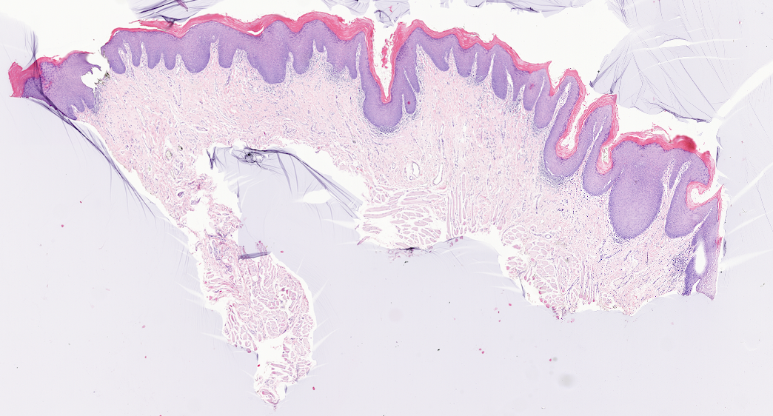
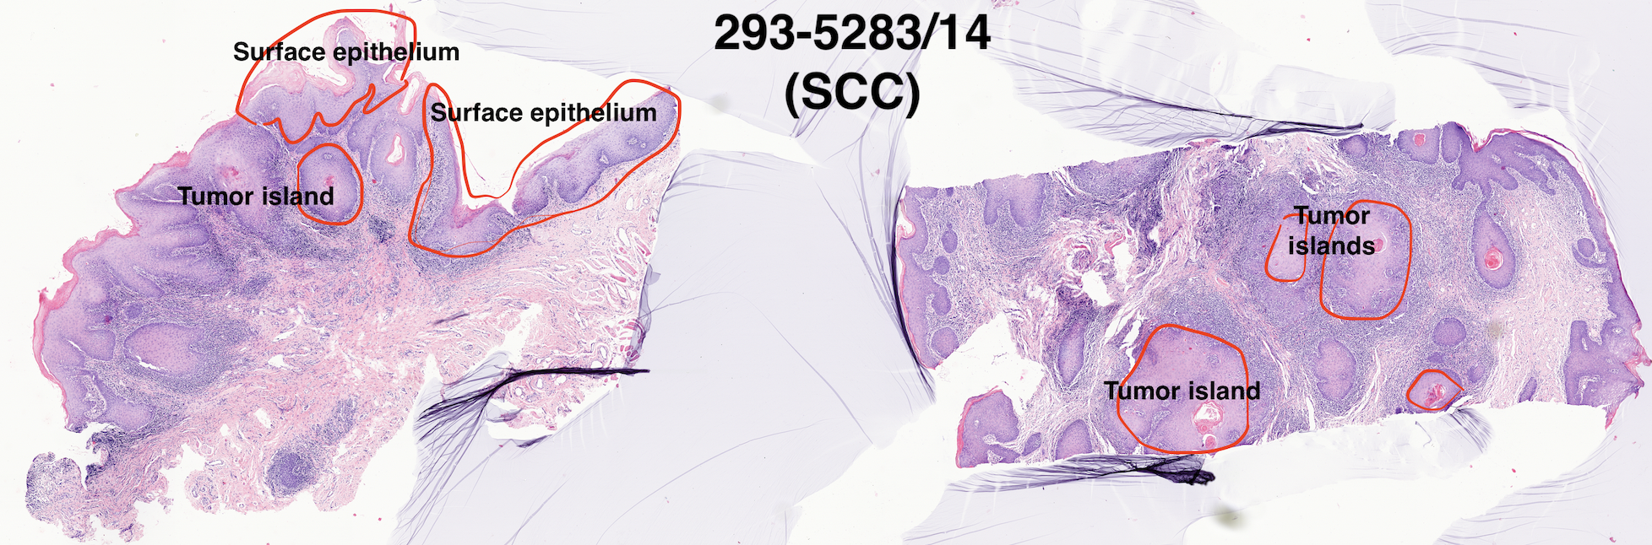
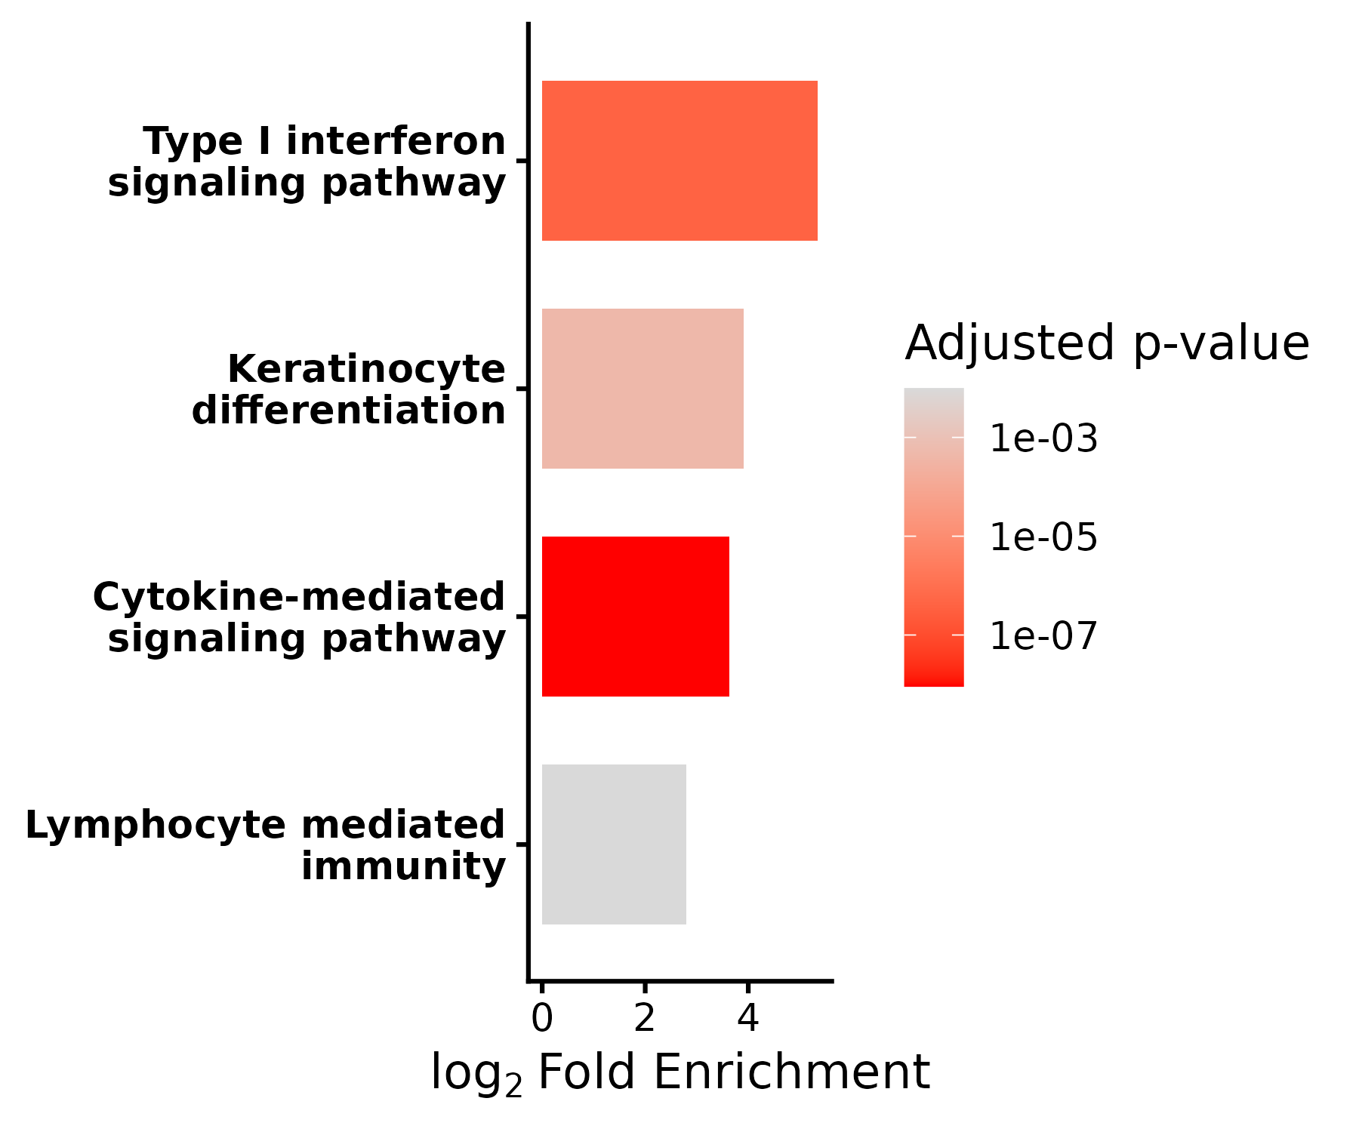
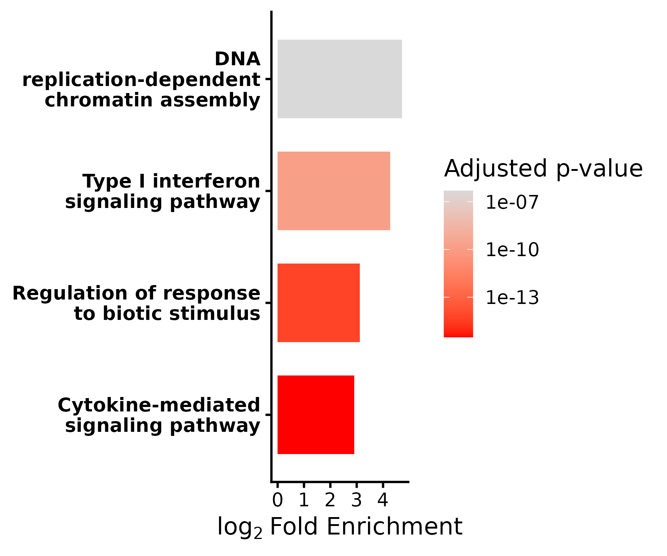
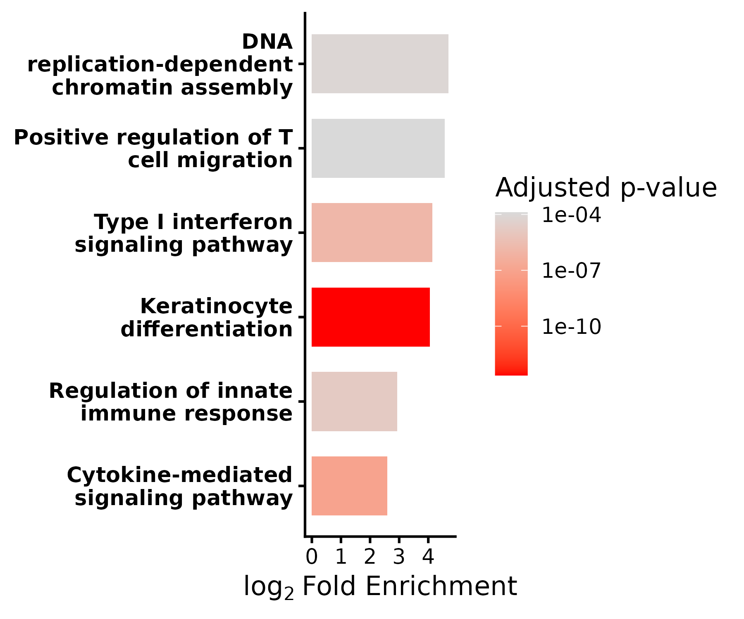
Genes associated with interferon signaling and epithelial differentiation are enriched in OSCC surface and tumor islands (Patient 293)
Mild Dysplasia
2
Key | Region
1 | OED surface epithelium
2 | OSCC surface epithelium
3 | Tumor Islands
OSCC
3
1
3
1 vs 2
1 vs 3
2 vs 3
Upregulated in 2
Upregulated in 3
Upregulated in 3

Slide 12
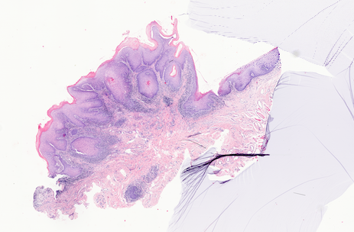
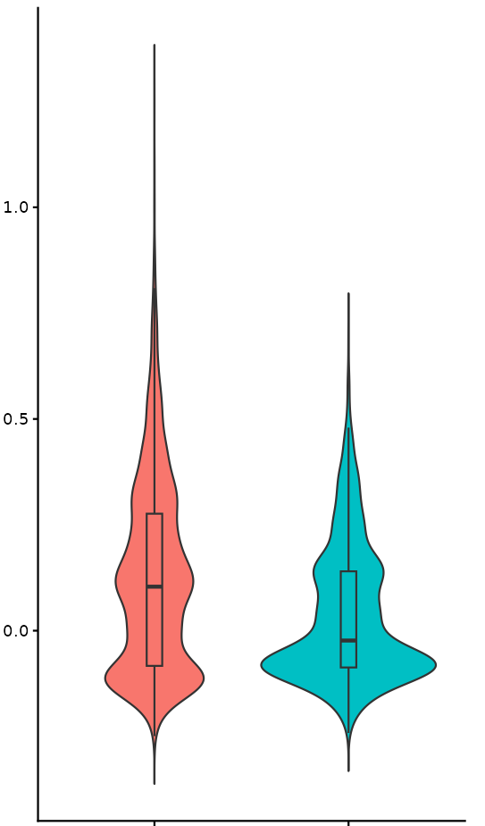
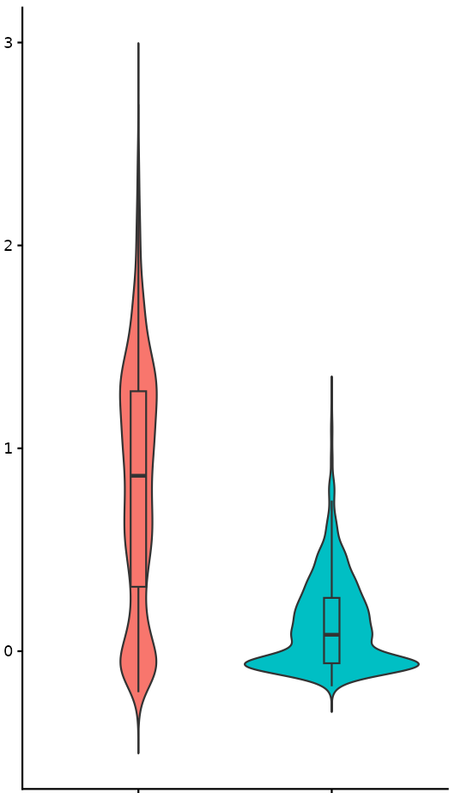
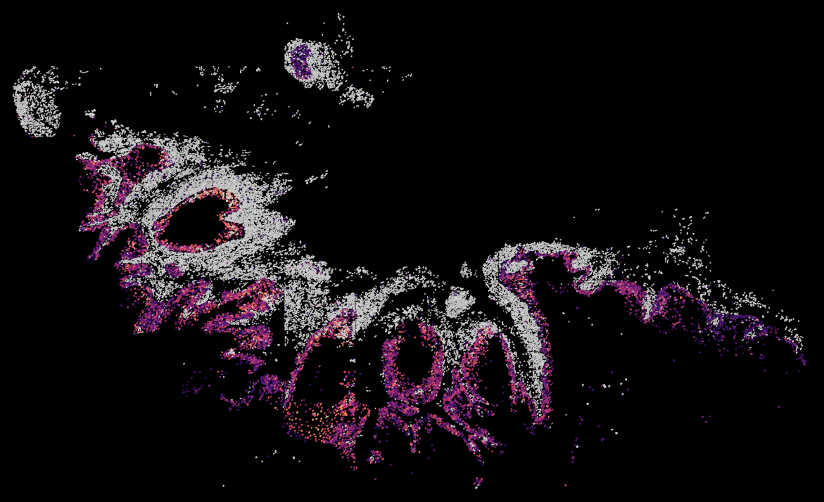
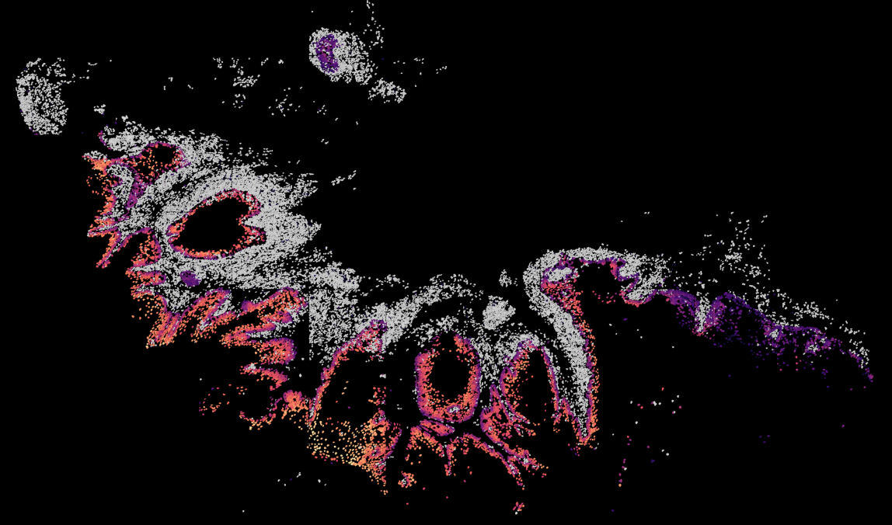
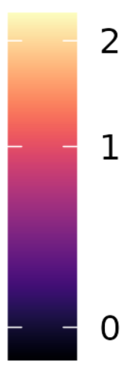
Tumor surface above invasion shows a stressed, interferon-enriched epithelial program compared to tumor surface adjacent to invasion
Surface epithelium above invasion
Surface epithelium adjacent invasion
***
***
Module scores were calculated using AddModuleScore developed by Tirosh et al. (Science, 2016). Gene lists for module were selected from significant differentially expressed genes
Interferon Module Score
Activated/Stressed Epithelial Module Score
*** p< 0.01
Above invasion
Adjacent invasion
Above invasion
Adjacent invasion
Interferon Module
Activated/Stressed Epithelial Module
Module score
Module score
Notes:
Advantage– regions are from same location (same sample)
The modules were generated using genes significantly upregulated in surface above invasion vs surface adjacent to invasion.
Activated/Stressed Epithelial Module: "KRT17", "KRT6B", "KRT16", "KRT14", "PI3", "S100A7", "DEFB4B", "SPRR2G", "KRT75"
Interferon Module: "IFI6", "IFITM3", "IFI44", "ISG15", "GBP5"

Slide 13
Ongoing high-value projects advancing toward Phase 3 validation
AHEAD
Annotated Discovery, Test and Validation Sets
Oral Dysplasia
Epigenetic and Genetic Studies
Spatial Transcriptomics
Biomarker Discovery
Testing
Test Set: Longitudinal Cohort
Validation Set: Retrospective Cohorts
Histomorphometric Studies (FFPE) in annotated samples
Phase 2 Validation Studies of Biomarker Performance
Notes:
Please include in this slide where your biomarkers are in the Phase and what is needed to get them to the next phase.

Slide 14
Acknowledgements
Georgetown University
Laura Rozek, Ph.D.
Siddhi Patil, M.P.H.
Elham Mohebbi, Ph.D.
Emily Hoskins, Ph.D.
Matthew Witek, M.D.
Peter Ahn, M.D.
Jonathan Giurintano, M.D.
Candy Promprasert
N.K. University of Athens
Eleni Gagari, DMD, DMSc
Vasiliki Lasithiotaki, D.D.S.
Eleni Tsekeri, DMD
Patients
University of Michigan
Nisha D'Silva BDS, MSD, PhD
Maureen Sartor, Ph.D
Tingting Qin, Ph.D
Min Liu, MD
Garett Maag
Western University
Dr. Mark Darling, DDS, Ph.D
Miami Baptist University
Alessandro Villa, DDS, Ph.D
Notes:
NIDCR
longitudinal samples
verified diagnoses; rigor
carefully designed comparisons

Slide 15
Questions?
eh1102@georgetown.edu

