Slide 1


Combining Noninvasive Biomarkers for Lung Cancer Diagnosis
Hudson M. Holmes, MD
EDRN Annual Symposium – September 2026
MASLAB Team – Vanderbilt University Medical Center
PIs: Eric Grogan & Stephen Deppen
Notes:
Hello everyone, thank you to the program committee for the opportunity to present some of the work from the lung team at Vanderbilt

Slide 2
Disclosures
This work is supported by the following grants:
  R01CA252964, U01CA152662 (Drs. Grogan & Deppen)
  5T32CA106183-20 (Dr. Goldenring)
  AATS Foundations David J. Sugarbaker Resident Surgical Investigator Award (Holmes)
No conflicts of interest
Notes:
I have no financial conflicts of interest; this work was funded through these sources

Slide 3
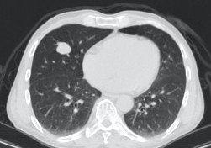
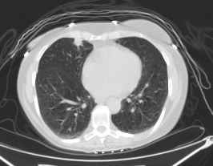
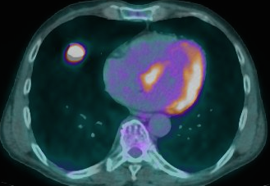
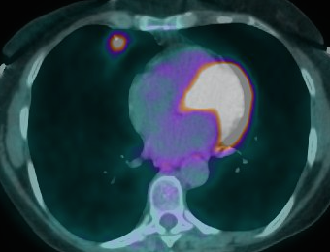
The Problem
Images courtesy of Dr. Kim Sandler
Benign sampling
Missing cancer
Ms. Jones
Ms. Smith
Squamous Cell Carcinoma
Benign Granuloma
Notes:
Our lab has long been committed to improving the early detection of lung cancer. More specifically, after a nodule has been identified on imaging – we aim to improve the way in which a nodule is diagnosed as cancerous or benign. Take Ms. Jones (left) and Ms. Smith (right). Both presented with pulmonary nodules that were suspicious enough to require invasive tissue sampling to receive a final diagnosis. Ms. Jones was ultimately diagnosed with squamous cell carcinoma and Ms. Smith with a benign granuloma. It can be extremely difficult to differentiate IPNs with clinical history and imaging data alone. And yet, clinicians are faced with this balancing act daily: how do we determine which patients to biopsy and/or resect with a cost effective and safe approach?

Slide 4
Current Practice
American College of Chest Physicians Guidelines: Algorithm for suspicious lung nodules
Notes:
Current nodule management recommendations from the American college of chest physicians are shown. When a nodule is observed on CT scan, the physician makes an “assessment” of the nodule’s probability of cancer. Management hinges on categorical risk thresholds, where those less than 5% are recommended for CT surveillance, those between 5-65% are considered intermediate risk and should undergo further testing with either PET or biopsy, and those greater than 65% are considered high risk and referred to thoracic surgery.

Slide 5
Current Practice
Clinician estimate
Prediction models
Mayo Model
Age, smoking, cancer history
Size, spiculation, location
~ AUC: 0.65 – 0.75
American College of Chest Physicians Guidelines: Algorithm for suspicious lung nodules
Notes:
this assessment comes in one of two ways: either through physician expertise or use of a validated prediction model. The most widely used and validated is the Mayo clinic model – a simple logistic regression model that consists of the clinical and radiographical features shown. It has an AUC of around 0.7 in the general population.

Slide 6
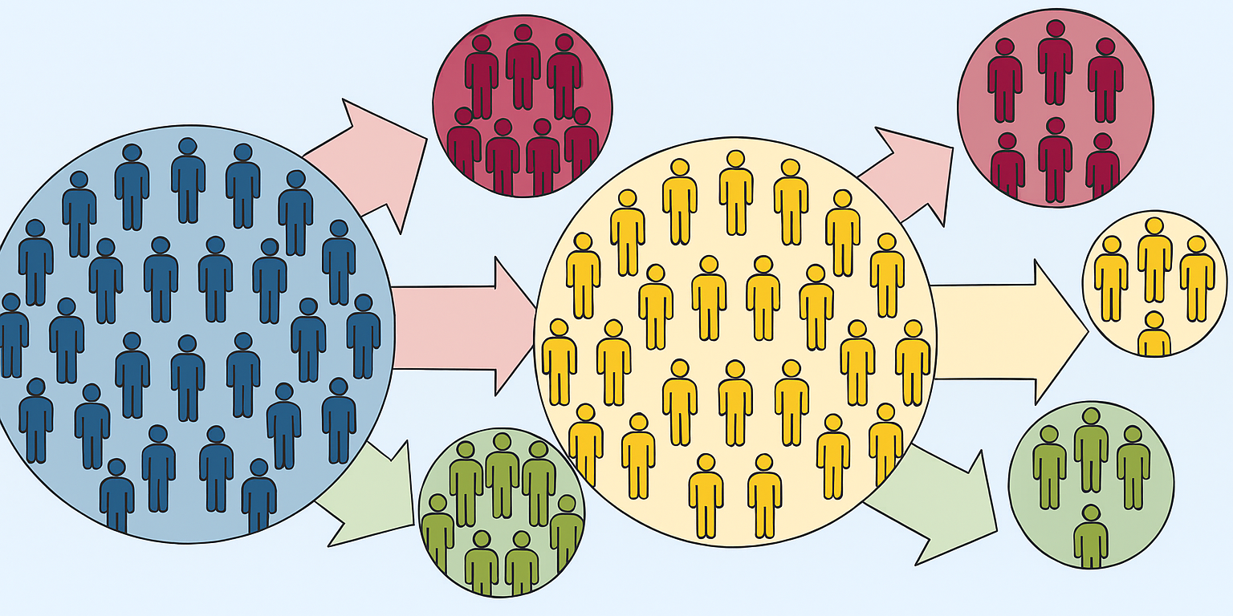
Where are Biomarkers Useful?
Notes:
current risk assessment leaves most individuals in the intermediate risk category – so when thinking about where biomarkers could be useful in lung cancer diagnosis…

Slide 7
EXPEDITED DEFINITIVE MANAGEMENT
REDUCED UNCERTAINTY
BIOMARKER APPLICATION
LESS INVASIVE WORKUP FOR BENIGN DISEASE
Early Detection is the key to improving survival in NSCLC
Notes:
it is precisely there – to help accurately refine risk estimation; driving people out of the intermediate category and into high and low risk, appropriately.

Slide 8
Biomarkers described for lung cancer
Proteins
Radiomics
Fungal (Benign) Biomarkers
CTCs
DNA-based, fragmentomics
miRNA
Metabolomics / Breathomics
…and more
Notes:
But, to date, no noninvasive biomarkers are used routinely for the detection of lung cancer, although many have been described and are actively being studied

Slide 9
Biomarkers described for lung cancer
Proteins
Radiomics
Fungal (Benign) Biomarkers
CTCs
DNA-based, fragmentomics
miRNA
Metabolomics / Breathomics
…and more
Notes:
Our lab currently focuses primarily on protein, fungal and radiomic biomarkers

Slide 10

Protein (Cancer) Biomarkers¹
Ms. Jones
CYFRA 21-1
Lung Cancer
Disease progression
CEA
Colorectal Cancer
Disease surveillance and treatment response
CA-125
Ovarian Cancer
Disease surveillance and treatment response
HE-4
Ovarian Cancer
Disease surveillance
Indication
Validated in LTP2
¹McGann, Holmes….Grogan. CEBP. 2026
Notes:
Specifically - these are four commercially available cancer proteins for other cancer indications (CYFRA, CEA, CA125 and HE4). In a study published in Cancer Epidemiology, Biomarkers & Prevention earlier this year, our lab applied these four markers to a lung nodule population and demonstrated their elevation in early-stage lung cancer as well, utilizing the multicenter LTP-2 cohort created by the EDRN as a validation set. The FDA clearance of these proteins uniquely positions them for immediate clinical impact. Perhaps by applying noninvasive biomarkers such as these, we can more quickly identify Ms. Jones’ squamous cell carcinoma.

Slide 11
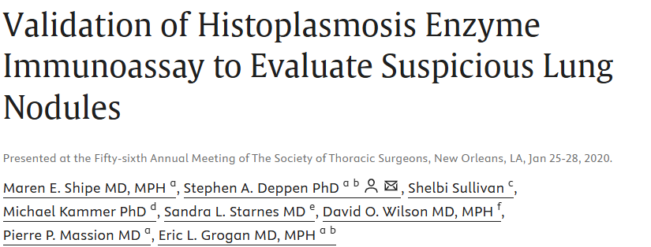
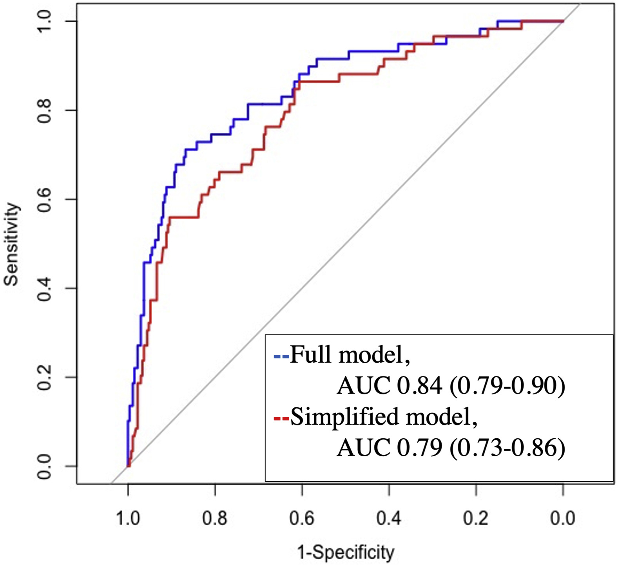
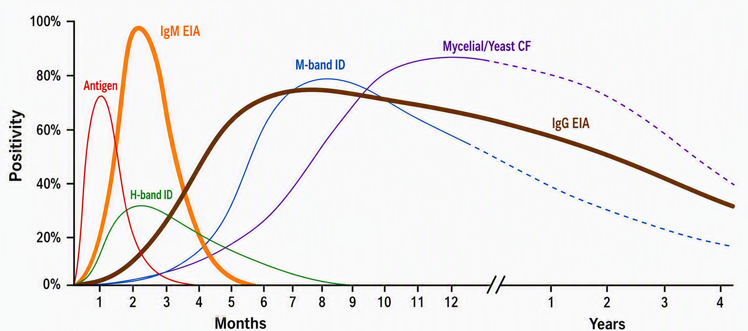
Fungal (Benign) Biomarkers
Ms. Smith
IgM EIA
IgG EIA
Histoplasma infectious markers
Notes:
Fungal granulomas are also a notorious diagnostic challenge. As I showed, they often appear PET avid and are a significant source of invasive sampling for benign disease. We’ve shown that applying Histoplasma IgM and IgG antibody measurements, which represent important acute and chronic markers of fungal infection

Slide 12
Fungal (Benign) Biomarkers
Ms. Smith
IgM EIA
IgG EIA
Histoplasma infectious markers
Notes:
in combination with clinical variables, we improve diagnostic performance for benign nodules.

Slide 13
THE GOAL: a combination biomarker approach
Notes:
Our goal, ultimately, is to develop a combination biomarker approach to improve the detection of lung cancer.

Slide 14
Notes:
We aim to identify meaningful data from multimodal inputs: including clinical data, blood-based cancer biomarker testing, benign fungal markers, and imaging features
Take that data and apply various modeling techniques
To provide accurate, individualized risk estimations for patients.
And get the information in the hands of clinicians for real patient impact.
I’ll spend my remaining time highlighting a project from the past year where we attempted to further this vision.

Slide 15
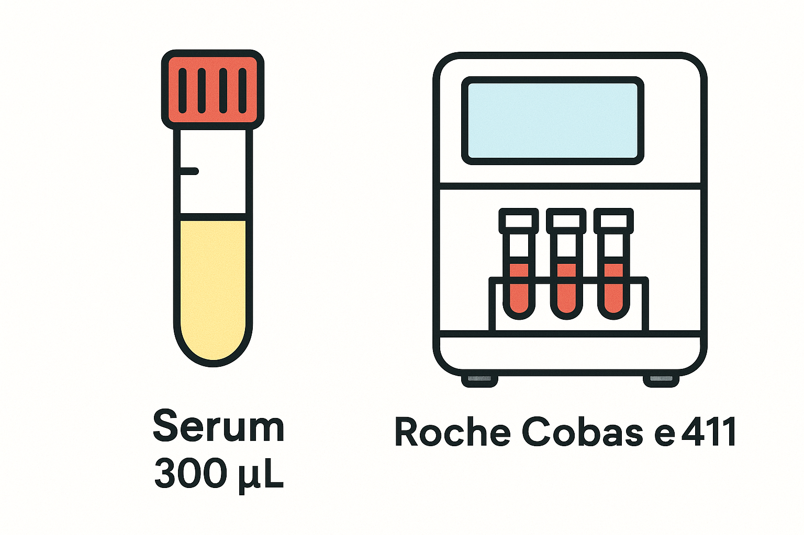
Hypothesis:
Blood-based biomarkers and machine learning methods will improve IPN risk estimation
**Abstract accepted for oral presentation at 2026 AATS International Thoracic Surgical Oncology Summit
***Manuscript in preparation for JTCVS
Notes:
In this study, we wanted develop and test models that incorporated blood data and commonly used clinical variables. We hypothesized that by both applying blood-based biomarkers and machine learning methods, we could create a model to improve IPN risk estimation.

Slide 16

Methods
Patients with IPNs from three institutions
Vanderbilt (TN)
N=359
Colorado (CO)
N=84
WashU (MO)
N=86
Notes:
Recruitment occurred from 3 institutions: Vanderbilt, Colorado, and Washington University St. Louis

Slide 17
Methods – Variable Collection
Clinical data and blood samples collected prospectively prior to treatment
Notes:
Clinical data and blood samples were collected prospectively prior to treatment at the time of nodule identification

Slide 18
Methods – Variable Collection
Clinical data and blood samples collected prospectively
Patients followed for final outcome adjudication
Notes:
Then patients were followed for final outcome adjudication of benign or malignant nodule.

Slide 19
Methods – Variable Collection
Clinical data and blood samples collected prospectively
Patients followed for final outcome adjudication
Benign:
Tissue diagnosis of benign disease
OR
2 years documented radiologic follow-up
Malignant:
Tissue diagnosis of cancer
Notes:
Benign diagnosis was defined as either tissue diagnosis of benign disease or 2 years of nodule stability on radiology. Malignancy was defined as a tissue diagnosis of cancer.

Slide 20
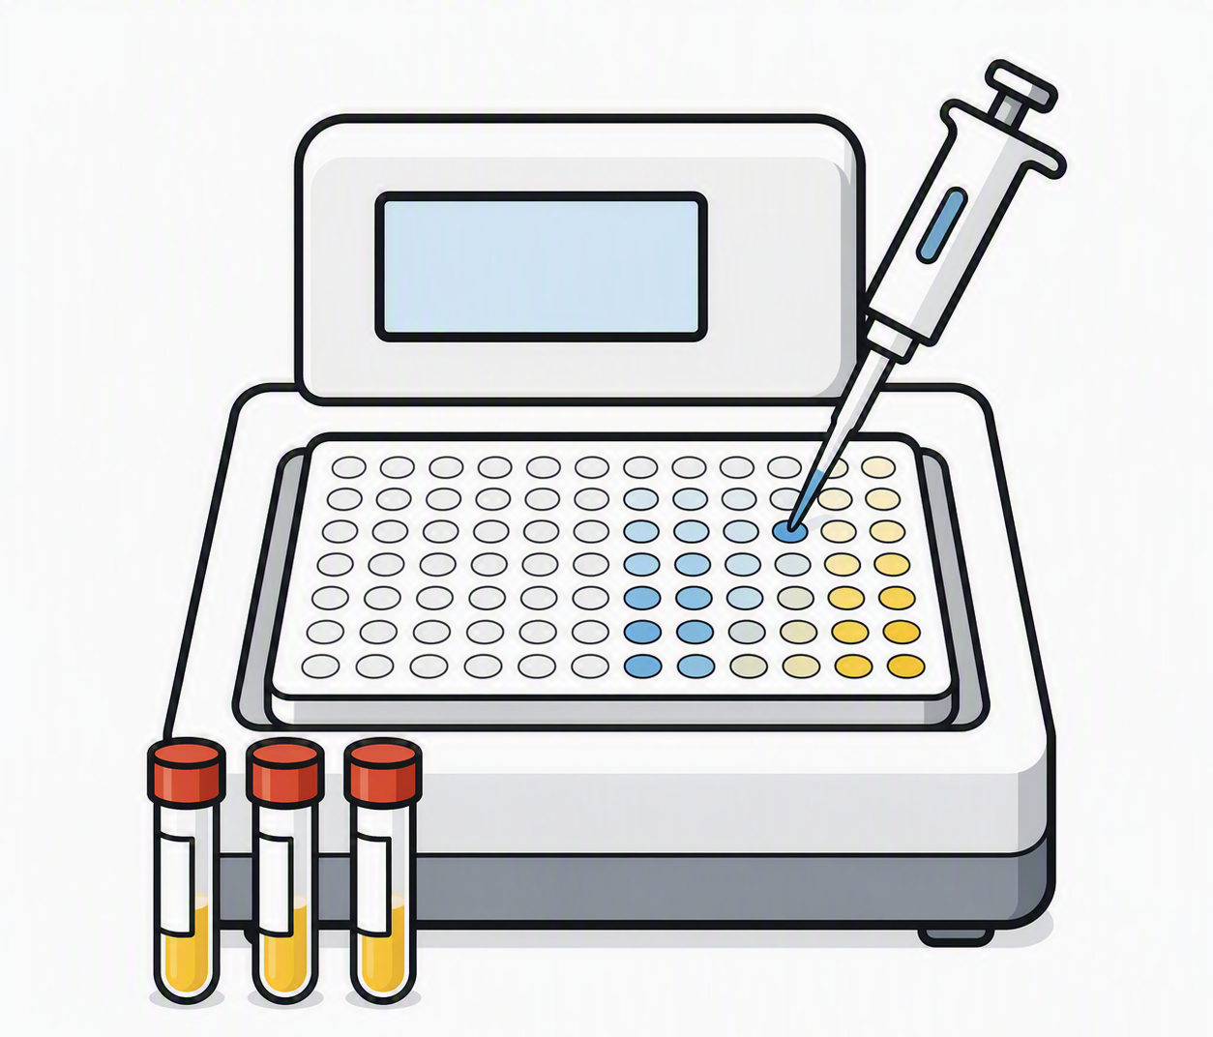
Methods – Variable Collection
Clinical data and blood samples collected prospectively
Patients followed for final outcome adjudication
Blood-biomarker levels were measured
CYFRA 21-1
CEA
CA-125
HE-4
Histoplasma IgG
Histoplasma IgM
Blood protein assay measurements in CAP-certified clinical lab
Fungal Antibody measurements in commercial lab
Notes:
Blood samples were then sent for assay measurements of the 4 protein panel and fungal antibodies in CAP certified labs.

Slide 21
Methods – Variable Collection
Clinical data and blood samples collected prospectively
Patients followed for final outcome adjudication
Blood-biomarker levels were measured
Mayo Model risk scores were generated for each patient
Mayo Model
Age, smoking, cancer history
Size, spiculation, location
~ AUC: 0.65 – 0.75
Notes:
Mayo risk scores were also calculated for each patient.

Slide 22
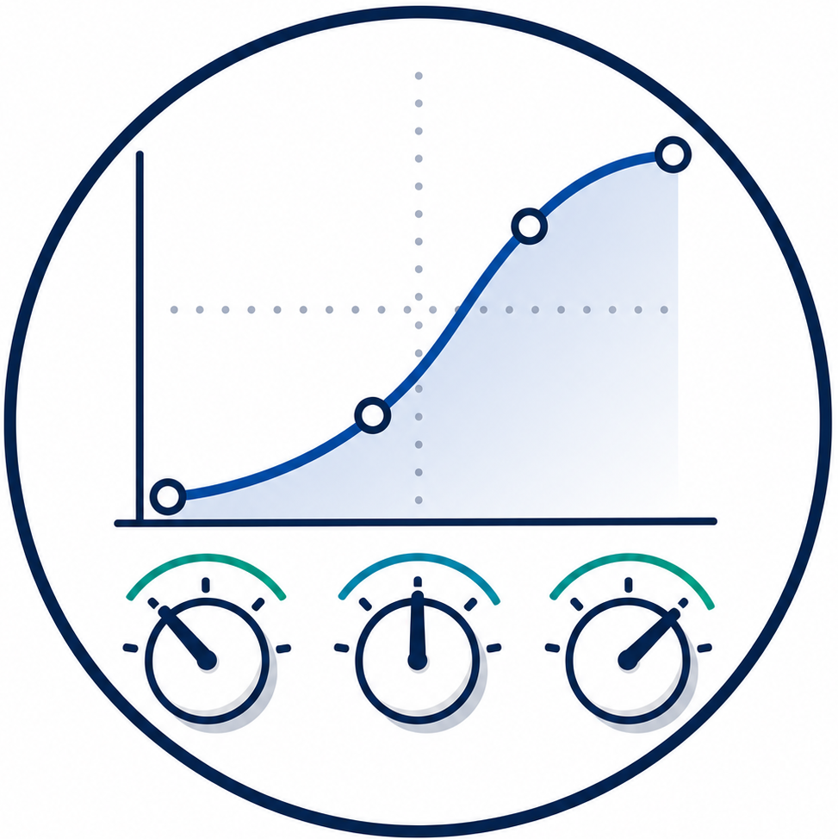
Methods – Model Development
Cohorts split into TRAIN and TEST
TN + CO
N=443
MO
N=86
Notes:
Cohorts were split into TRAIN and TEST, with individuals from Vanderbilt and Colorado comprising the TRAIN and internal validation set and patients from WashU comprising the external test set.

Slide 23
Methods – Model Development
Cohorts split into TRAIN and TEST
Three models were developed:
Notes:
Three machine learning models were then developed

Slide 24
Methods – Model Development
Cohorts split into TRAIN and TEST
Three models were developed:
  ‘Refit Mayo’ – Mayo variables re-estimated on TRAIN
Age, smoking, cancer history
Size, spiculation, location
Notes:
-’Refit Mayo’ was a logistic regression model using only the original mayo model variables but re-estimated on our training data

Slide 25
Methods – Model Development
Cohorts split into TRAIN and TEST
Three models were developed:
  ‘Refit Mayo’ – Mayo variables re-estimated on TRAIN
  ‘Regress-bio’ – Penalized LR using Mayo variables plus blood biomarkers
Age, smoking, cancer history
Size, spiculation, location
CEA, CYFRA, HE4, CA125
Histoplasma IgG & IgM
Notes:
-’Regress-bio’ was a penalized logistic regression model that included the mayo variables as well as our blood protein and fungal biomarkers

Slide 26
Methods – Model Development
Cohorts split into TRAIN and TEST
Three models were developed:
  ‘Refit Mayo’ – Mayo variables re-estimated on TRAIN
  ‘Regress-bio’ – Regression; includes blood biomarkers
  ‘RF-bio’ – Random Forest model, with same variables as Regress-Bio
Age, smoking, cancer history
Size, spiculation, location
CEA, CYFRA, HE4, CA125
Histoplasma IgG & IgM
Notes:
And lastly:
-’RF-bio’ was a random forest classifier model that used the same expanded variable set as Regress-bio.

Slide 27
Methods – Model Development
Cohorts split into TRAIN and TEST
Three models were developed:
  ‘Refit Mayo’ – Mayo variables re-estimated on TRAIN
  ‘Regress-bio’ – Regression; includes blood biomarkers
  ‘RF-bio’ – Random Forest; includes blood biomarkers
Model training & internal testing via nested cross-validation
Notes:
Model training and internal testing occurred via nested cross validation

Slide 28
Methods – Model Development
TN + CO
MO
Cohorts split into TRAIN and TEST
Three models were developed:
  ‘Refit Mayo’ – Mayo variables re-estimated on TRAIN
  ‘Regress-bio’ – Regression; includes blood biomarkers
  ‘RF-bio’ – Random Forest; includes blood biomarkers
Model Training and Internal Testing via nested cross-validation
Models were locked on TRAIN data and applied to TEST
Notes:
And after internal testing, models were re-trained on the entire training data, locked, and applied to the external test cohort

Slide 29
Methods – Model Comparisons
Models were compared against next simplest model
RF-bio
Regress-bio
Complexity
Refit Mayo
Mayo Model
Notes:
Model comparisons are shown against the next simplest model as a reference. The unadjusted mayo score was the least complex > followed by refit mayo > then the regress-bio model > and lastly RF-bio representing the most complex model.

Slide 30
Methods – Model Comparisons
Performance was assessed using AUC and log loss
RF-bio
Regress-bio
Complexity
Refit Mayo
Mayo Model
Notes:
AUC was calculated to assess model discrimination. And overall performance was assessed using log loss. Log loss may not be familiar to all in the room, but it is a metric used in machine learning that we favored here for a few reasons.

Slide 31
Methods – Model Comparisons
Performance was assessed using AUC and log loss
RF-bio
Regress-bio
Complexity
Refit Mayo
Mayo Model
Incorporates discrimination, calibration, and confidence
Notes:
#1 - It incorporates discrimination, calibration, and confidence in its score.

Slide 32
Methods – Model Comparisons
Performance was assessed using AUC and log loss
RF-bio
Regress-bio
Complexity
Refit Mayo
Mayo Model
Incorporates discrimination, calibration, and confidence
Emphasizes accurate probability estimation
Notes:
#2 – it emphasizes accurate probability estimation

Slide 33
Methods – Model Comparisons
Performance was assessed using AUC and log loss
RF-bio
Regress-bio
Complexity
Refit Mayo
Mayo Model
Incorporates discrimination, calibration, and confidence
Emphasizes accurate probability estimation
Heavily penalizes confident but incorrect predictions
Notes:
and #3 – it heavily penalizes confident but incorrect predictions.

Slide 34
Results
 | TRAIN | TEST
Number of Subjects | 443 | 86
Cancer Prevalence (%) | 224 (51%) | 28 (33%)
Median age in years (Q1, Q3) | 65 (60, 70) | 64 (58, 70)
Smoking history (%) | 375 (85%) | 68 (79%)
Pack years (Q1, Q3) | 43 (22, 62) | 29 (5, 45)
Personal Cancer History (%) | 169 (38%) | 20 (24%)
Male Sex (%) | 253 (57%) | 38 (44%)
Nodule size, mm (Q1, Q3) Benign Malignant
 | 11 (7, 16) | 9 (7, 12)
 | 18 (14, 23) | 15 (10, 18)
Spiculated (%) | 105 (24%) | 16 (19%)
Upper lobe location (%) | 232 (52%) | 44 (51%)
Mayo Score (Q1, Q3) Benign Malignant
 | 0.20 (0.09, 0.40) | 0.13 (0.07, 0.24)
 | 0.55 (0.31, 0.83) | 0.32 (0.15, 0.66)
Notes:
This table shows the basic cohort demographics. The salient points are:
Cancer prevalence was higher in train (51%) versus test (33%)
Nodule size tended to be similar between the two cohorts and
Mayo scores were unsurprisingly higher in TRAIN than TEST

Slide 35
Results
Biomarker | TRAIN (n = 443) |  | TEST (n = 86)
 | Benign | Malignant | Benign | Malignant
Histoplasma IgG+ | 96* | 66 | 18* | 1
Histoplasma IgM+ | 14 | 6 | 1 | 0
CYFRA21-1 | 2.0 | 2.3* | 1.7 | 2.0
CEA | 2.5 | 3.6* | 3.0 | 3.4
CA-125 | 10.8 | 14.4* | 11.2 | 10.5
HE-4 | 75.2 | 99.0* | 79.5 | 96.2
* denotes statistical significance (p < 0.05)
Notes:
And this table shows the biomarker distributions in each cohort. Anything with a green arrow denotes elevation in benign nodules, and anything with a red arrow denotes elevation in cancerous nodules. As expected, we can see that the fungal antibody positivity was higher in benign disease and the cancer protein markers were elevated in cancerous nodules – aside from CA125 in the test cohort.

Slide 36
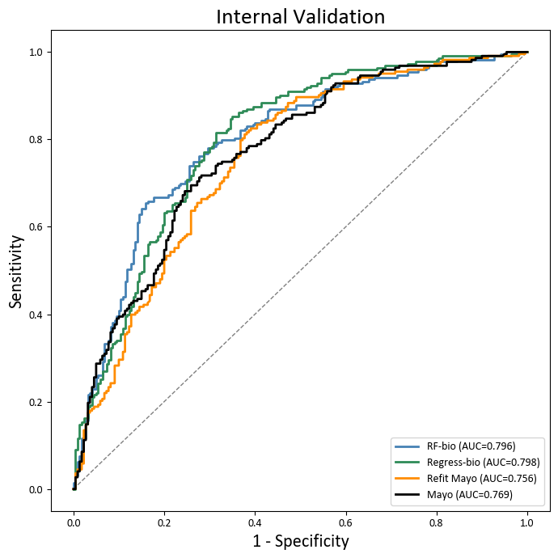
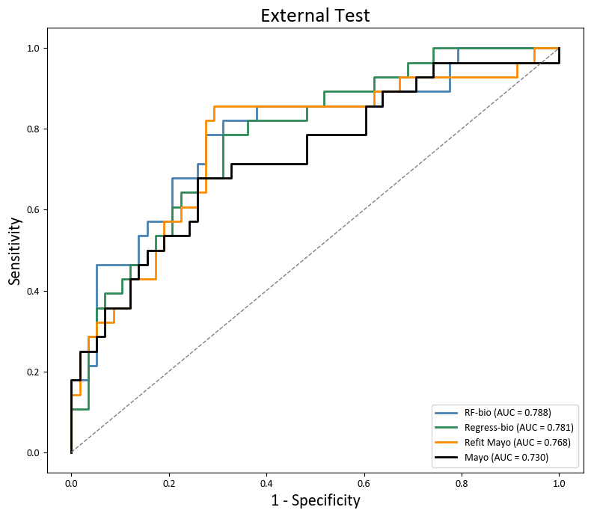
Results – Discrimination
Internal Validation (N = 443)
External Test
True Positive Rate
True Positive Rate
RF-bio (AUC=0.80)
Regress-bio (AUC=0.80)
RF-bio (AUC=0.796)
Regress-bio (AUC=0.798)
Refit Mayo (AUC=0.76)
Refit Mayo (AUC=0.756)
Mayo (AUC=0.769)
Mayo (AUC=0.77)
False Positive Rate
False Positive Rate
Notes:
In the internal validation set, unadjusted mayo had AUC of 0.77, Refit Mayo had an AUC of 0.76, Regress-bio and RF-bio both had AUCs of 0.8. What we see is that the models that included blood biomarkers in general had better discrimination than those that only used the clinical and radiographic variables from the Mayo model.

Slide 37
Results – Discrimination
Internal Validation (N = 443)
External Test
True Positive Rate
True Positive Rate
RF-bio (AUC=0.80)
Regress-bio (AUC=0.80)
RF-bio (AUC=0.796)
Regress-bio (AUC=0.798)
Refit Mayo (AUC=0.76)
Refit Mayo (AUC=0.756)
Mayo (AUC=0.769)
Mayo (AUC=0.77)
False Positive Rate
False Positive Rate
Notes:
Comparing between models, Regress-bio exhibited a statistically significantly better AUC than Refit Mayo. No other statistically significant differences were observed in between model comparisons. Importantly, use of a random forest classifier did not demonstrate better discrimination than a logistic regression model when the same variables were included.

Slide 38
Results – Discrimination
Internal Validation (N = 443)
External Test (N = 86)
True Positive Rate
True Positive Rate
RF-bio (AUC=0.796)
RF-bio (AUC=0.788)
Regress-bio (AUC=0.798)
Regress-bio (AUC=0.781)
Refit Mayo (AUC=0.756)
Refit Mayo (AUC=0.768)
Mayo (AUC=0.769)
Mayo (AUC=0.730)
False Positive Rate
False Positive Rate
Notes:
In the External Test set – we see an analogous pattern. While results were statistically inconclusive because of the small sample size, discrimination generally favored models that included blood biomarkers.

Slide 39
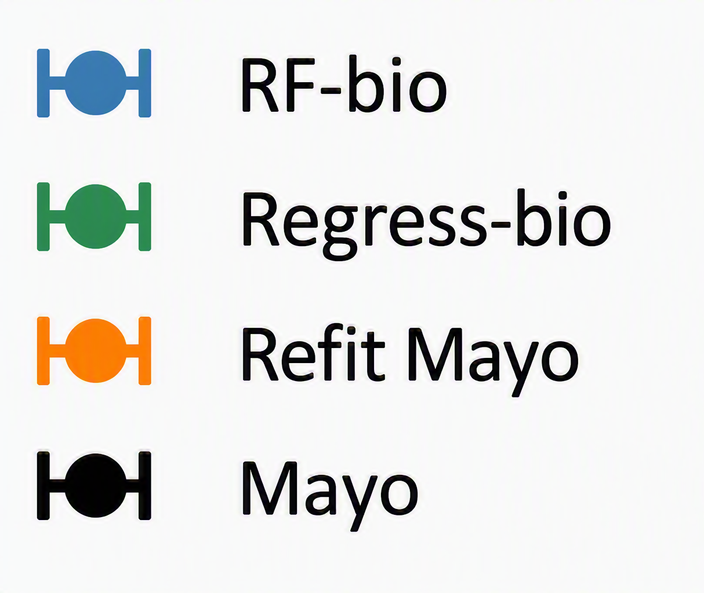
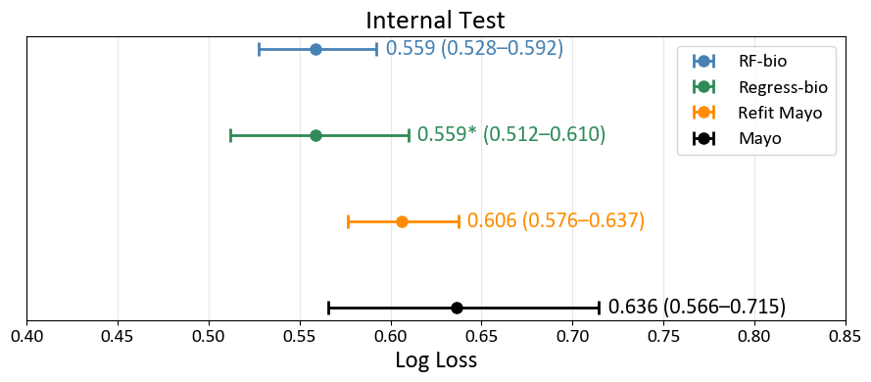
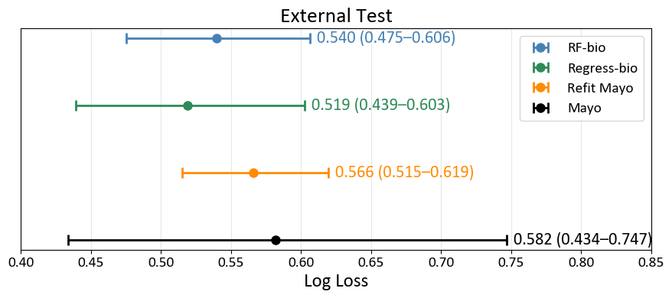
Results – log loss
RF-bio
Regress-bio
Complexity
Refit Mayo
Mayo Model
Internal Validation
External Test
0.56 (0.53-0.59)
0.56* (0.51-0.61)
0.61 (0.58-0.64)
0.64 (0.57-0.72)
Log Loss
Log Loss
Notes:
Then for our assessment of overall performance. This forest plot here shows the log loss for each model in the internal validation set.

Slide 40
Results – log loss
RF-bio
Regress-bio
Complexity
Refit Mayo
Mayo Model
Internal Validation
External Test
0.56 (0.53-0.59)
0.56* (0.51-0.61)
0.61 (0.58-0.64)
0.64 (0.57-0.72)
Log Loss
Better
Worse
Lower value indicates better performance.
Notes:
Like golf, lower log loss indicates better performance. The original Mayo model had the highest log loss at 0.64. Performance improved to 0.61 after refitting mayo and improved further to 0.56 when blood-based biomarkers were added. Interestingly, RF-bio did not outperform Regress-bio according to this metric, either.

Slide 41
Results – log loss
RF-bio
Regress-bio
Complexity
Refit Mayo
Mayo Model
Internal Validation
External Test
0.56 (0.53-0.59)
0.56* (0.51-0.61)
0.61 (0.58-0.64)
0.64 (0.57-0.72)
Log Loss
Better
Worse
Lower value indicates better performance. * denotes statistically significant improvement
Notes:
And, when we formally compared models against one another, the only statistically significant improvement observed was between Regress-bio and Refit Mayo.

Slide 42
Results – log loss
RF-bio
Regress-bio
Complexity
Refit Mayo
Mayo Model
Internal Validation
External Test
0.56 (0.53-0.59)
0.54 (0.48-0.61)
0.56* (0.51-0.61)
0.52 (0.44-0.60)
0.61 (0.58-0.64)
0.57 (0.52-0.62)
0.64 (0.57-0.72)
0.58 (0.43-0.75)
Log Loss
Log Loss
Lower value indicates better performance. * denotes statistically significant improvement
Notes:
Looking at the external test cohort on the right, we see the same pattern. Performance improves as we move from the Mayo model to Refit Mayo and then to Regress-bio, and then there is no apparent benefit from the more complex random forest classifier. Again, because of the sample size, none of these differences were statistically significant, so these results should be interpreted cautiously.

Slide 43
Conclusions
Incorporating blood biomarkers improved lung cancer prediction models
RF-bio
Regress-bio
Complexity
Refit Mayo
Mayo Model
Notes:
This study suggests that blood data improved lung cancer prediction models

Slide 44
Conclusions
Incorporating blood biomarkers improved lung cancer prediction models
  More than fine-tuning existing models (Refit Mayo)
RF-bio
Regress-bio
Complexity
Refit Mayo
Mayo Model
Notes:
more than fine-tuning existing models by adjusting for population prevalence

Slide 45
Conclusions
Incorporating blood biomarkers improved lung cancer prediction models
  More than fine-tuning existing models (Refit Mayo)
  More than using more sophisticated algorithms (RF-bio)
RF-bio
Regress-bio
Complexity
Refit Mayo
Mayo Model
Notes:
more than employing sophisticated algorithms

Slide 46
Conclusions
Model performance may be limited more by available biological information than algorithm selection
RF-bio
Regress-bio
Complexity
Refit Mayo
Mayo Model
* Come check out our poster for more details!
Notes:
Ultimately that current model performance may be limited more by available biological information than algorithm selection

Slide 47
Takeaways
Ms. Jones
Ms. Smith
Current models have reached the limits of existing data
Clinical adoption likely requires performance approaching AUC ~0.9
Radiomics and blood-based biomarkers will drive future improvement
Notes:
What have we taken away from all this? With our current markers, we see performance gains beyond existing models, but likely not enough to change clinical standard of practice. If we want to make the next leap forward, this will likely be driven by additional blood based and radiomic biomarkers

Slide 48
Next steps…
Notes:
To that end, we have a few active, ongoing projects looking at

Slide 49


Next steps
Expanded protein assays
Combining molecular markers
Notes:
Expanded protein assays in collaboration with MD Anderson.
Combining molecular markers such as addition of ctDNA in collaboration with Dr. Hermann at UPMC
MDACC
-Pro-surfactant B
Carcinoid specific
-ProGRP
-NSE

Slide 50


Next steps
LTP2 Validation
CA-125 and HE-4 adjustments*
* Come check out our poster for more details!
Notes:
We’re also working with Dr. Skates and Dr. Schwartz from the Harvard team to look at biologic factors that drive derangements in some of our current markers.

Slide 51

Next steps
* Come check out our poster for more details!
Fungal impact on radiomic scores*
Piloting AI-based radiomic tools
Notes:
Lastly, regarding radiomics, this is another frontier we’re very excited about.
-we’re piloting multiple open source and commercially available AI radiomic models, actually finishing up a pragmatic clinical trial with one commercially available tool called Optellum. Hopefully those results will be out in 2027.
-we’re also working with Dr. Schabath at Moffitt to look at a federated learning model
-And, we’re investigating interesting performance variations of a radiomic model when fungal granulomas are present.

Slide 52











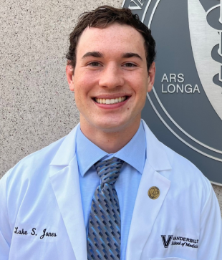




Thank you!
Notes:
With that, I’ll conclude by saying thank you to my mentors, Dr. Grogan and Dr. Deppen, and to the rest of the MASLAB team.
And of course, thank you to the EDRN for this platform and to all of our phenomenal collaborators.
I’d be happy to take any questions.

Slide 53
Supplemental
Notes:
CYFRA21-1, ng/mL (Q1, Q3)
CEA, ng/mL (Q1, Q3)
CA-125, U/mL (Q1, Q3)
HE-4, pmol/L (Q1, Q3)

Slide 54
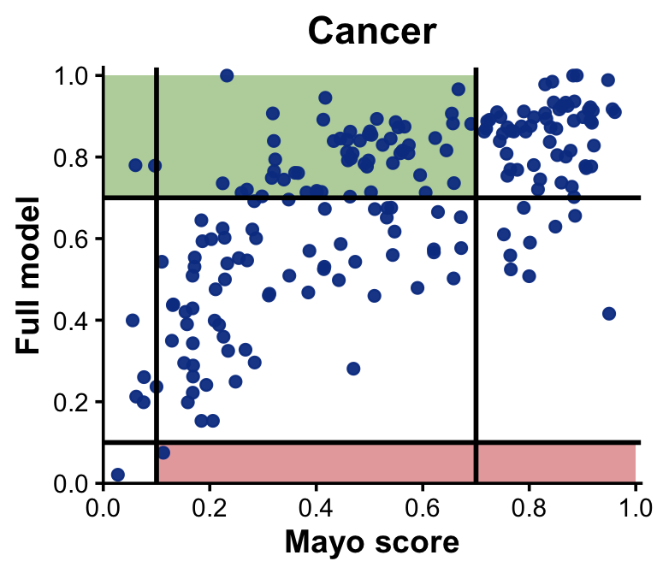
Fungal and Protein Biomarkers in IPNs
Notes:
Next, we went a step beyond discrimination and assess clinical utility. Because nodule management is threshold based, we built reclassification plots to see how many nodules would be correctly reclassified if a “full model” estimation was applied versus Mayo model estimations. To orient ourselves, this plot is showing all individuals from both cohorts with a final diagnosis of cancer. The x-axis represents the cancer probability by mayo, and the y-axis represents the cancer probability by the full model. The black lines represent the categorical thresholds that separates nodules into low-, intermediate-, and high risk.

Slide 55
Fungal and Protein Biomarkers in IPNs
LOW
INTERMEDIATE
HIGH
Notes:
So, for example, anything to the left of the first vertical black line would be low risk by Mayo score. Anything between the vertical black lines would be intermediate risk by mayo score. Finally anything to the right of the second vertical black line would be high risk by Mayo. The horizontal black lines do the same thing for the full model.

Slide 56
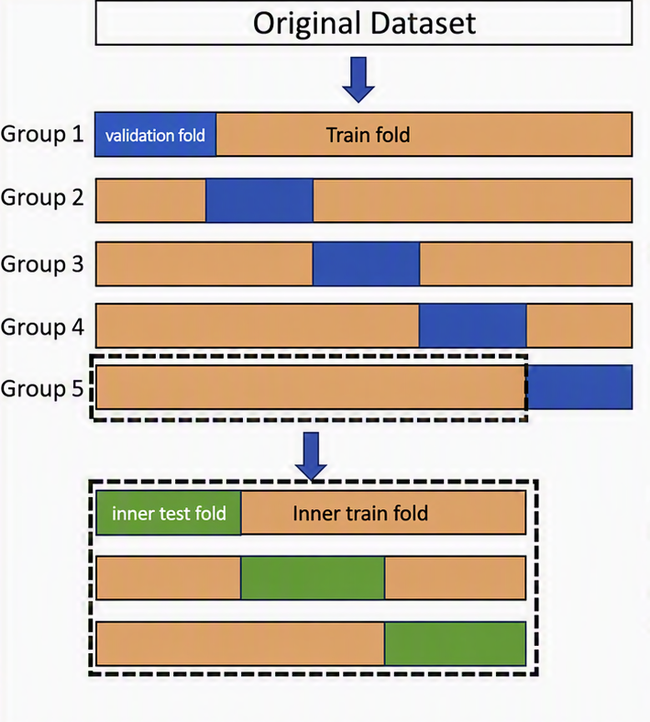
Nested Cross-Validation

Slide 57
Methods – Variable Collection
Clinical data and blood samples collected prospectively
Mayo Model risk scores were generated for each patient
Patients followed for final outcome adjudication
Benign:
Tissue diagnosis of benign disease
OR
2 years documented radiologic follow-up
Malignant:
Tissue diagnosis of cancer

Slide 58
Methods – Variable Collection
Clinical data and blood samples collected prospectively
CYFRA 21-1
CEA
CA-125
HE-4
Histoplasma IgG
Histoplasma IgM
Blood protein assay measurements in CAP-certified clinical lab
Fungal Antibody measurements in commercial lab

Slide 59
Methods – Variable Collection
Clinical data and blood samples collected prospectively
Mayo Model risk scores were generated for each patient
Mayo Model
Age, smoking, cancer history
Size, spiculation, location
~ AUC: 0.65 – 0.75

Slide 60
Methods – Variable Collection
Clinical data and blood samples collected prospectively
Mayo Model risk scores were generated for each patient
Patients followed for final outcome adjudication

