Slide 1

Multimodal Risk Stratification for Early Lung Cancer Detection
William Hsu, PhD
Professor of Radiological Sciences and Bioengineering

Slide 2
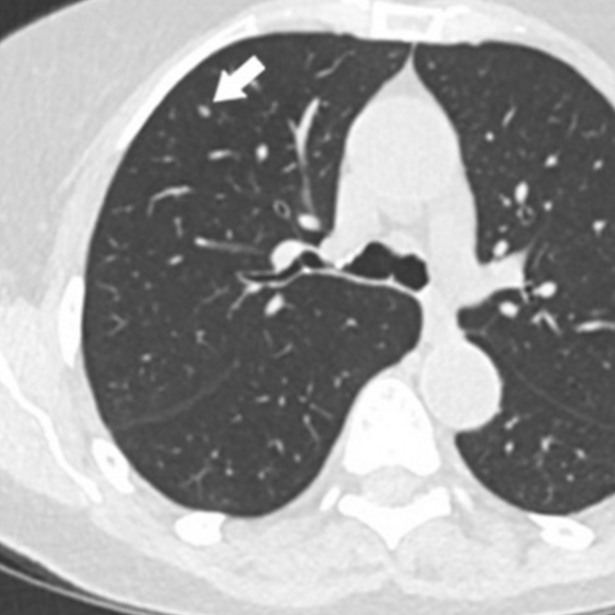
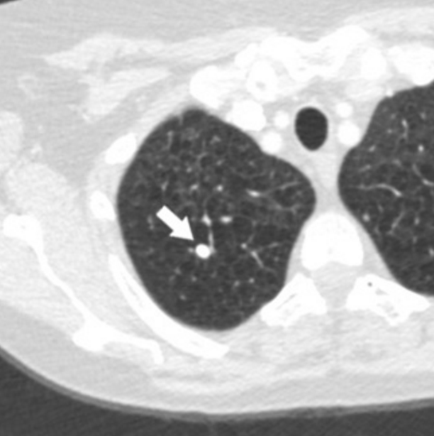
Survival depends on Early identification and characterization of nodules
Share of cases at diagnosis
5-year survival rate
Localized
29%
Localized
66%
Regional
22%
Regional
38%
Distant
44%
Distant
10%
(American Lung Association/SEER)
Today
Low risk
(Imaging
follow-up)
Intermediate risk
(PET/biopsy)
High risk
(Biopsy)
Future
Low risk
(Imaging follow-up)
Intermediate risk
(PET/biopsy)
High risk
(Biopsy)
Notes:
ALA reports a national 5-year survival of 29.7%.

Slide 3
Uncertainty in the diagnostic pathway
Screening
CT finding
Nodule management
Tissue
Diagnosis
Incidental
Notes:
The diagnostic pathway carries uncertainty at every step, from the general population through screening eligibility, CT findings, nodule management, tissue sampling, and diagnosis. I'll organize the talk around three questions. Who should be screened? About half of lung cancers occur in people who aren't screening-eligible. Is it cancer? Indeterminate nodules remain highly uncertain. And will it progress? We need to identify premalignant lesions before they become invasive.

Slide 4
Uncertainty in the diagnostic pathway
Who should be screened?
Is it cancer?
Address the >50% of lung cancers that are diagnosed outside of lung cancer screening-eligible individuals
Identify which lesions are normal/low-grade versus dysplasia or worse
General population
Screening eligibility
CT finding
Nodule management
Tissue
Diagnosis
Improve risk stratification of indeterminate pulmonary nodules with high uncertainty
Should we biopsy?
Notes:
The diagnostic pathway carries uncertainty at every step, from the general population through screening eligibility, CT findings, nodule management, tissue sampling, and diagnosis. I'll organize the talk around three questions. Who should be screened? About half of lung cancers occur in people who aren't screening-eligible. Is it cancer? Indeterminate nodules remain highly uncertain. And will it progress? We need to identify premalignant lesions before they become invasive.

Slide 5
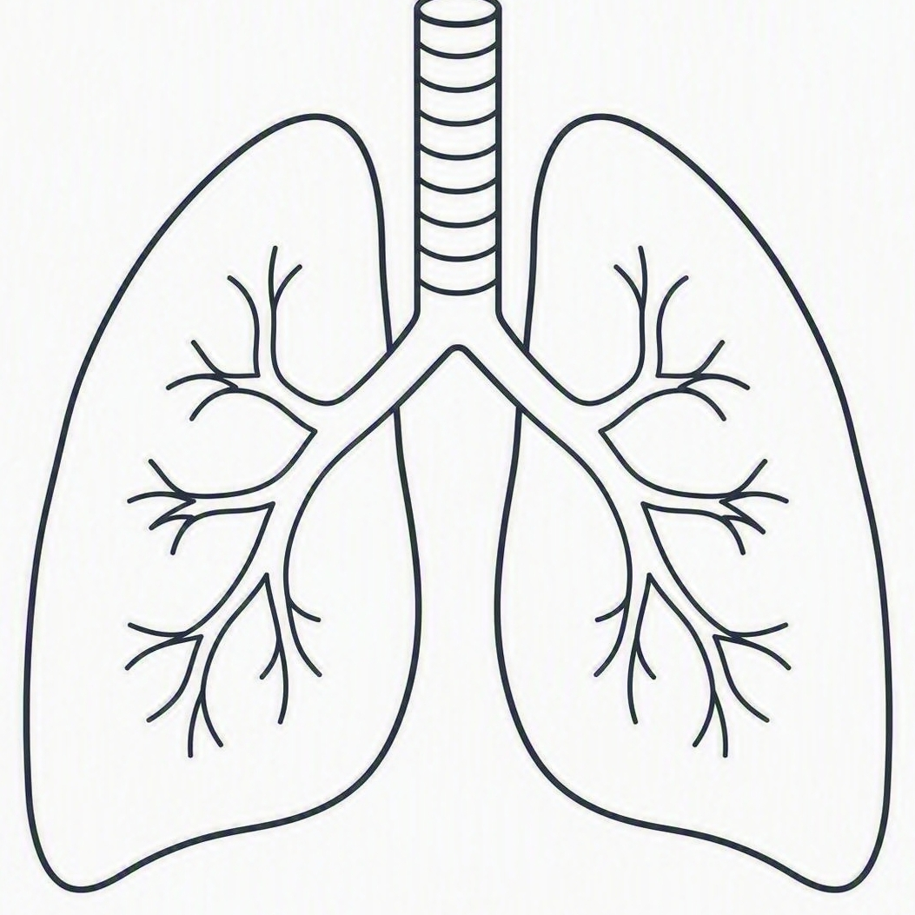

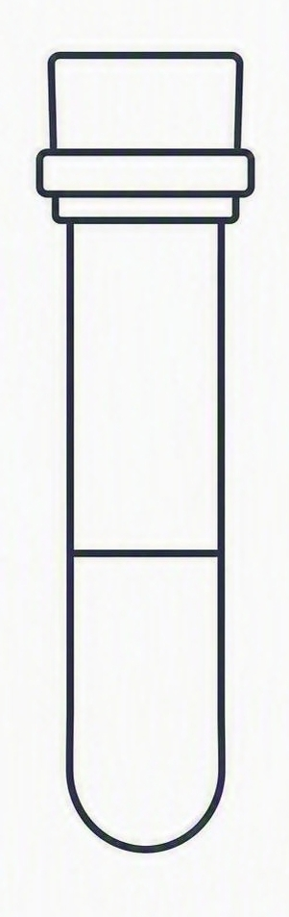
multimodal data fusion in a nutshell
Feature
Extraction
Imaging
Fusion
(joint learned weights)
Malignancy risk prediction
(0 to 100%)
Feature
Extraction
Clinical
Feature
Extraction
Blood-based
Notes:
Take imaging, clinical, and blood-based as inputs, extract features from each stream, fuse them with jointly learned weights, and output a single calibrated malignancy risk score. Importance lies in how you fuse.

Slide 6

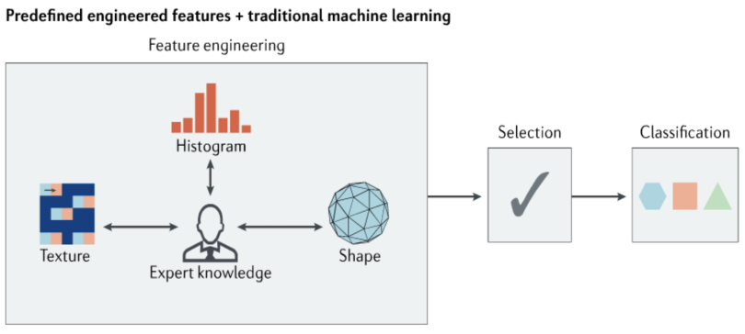
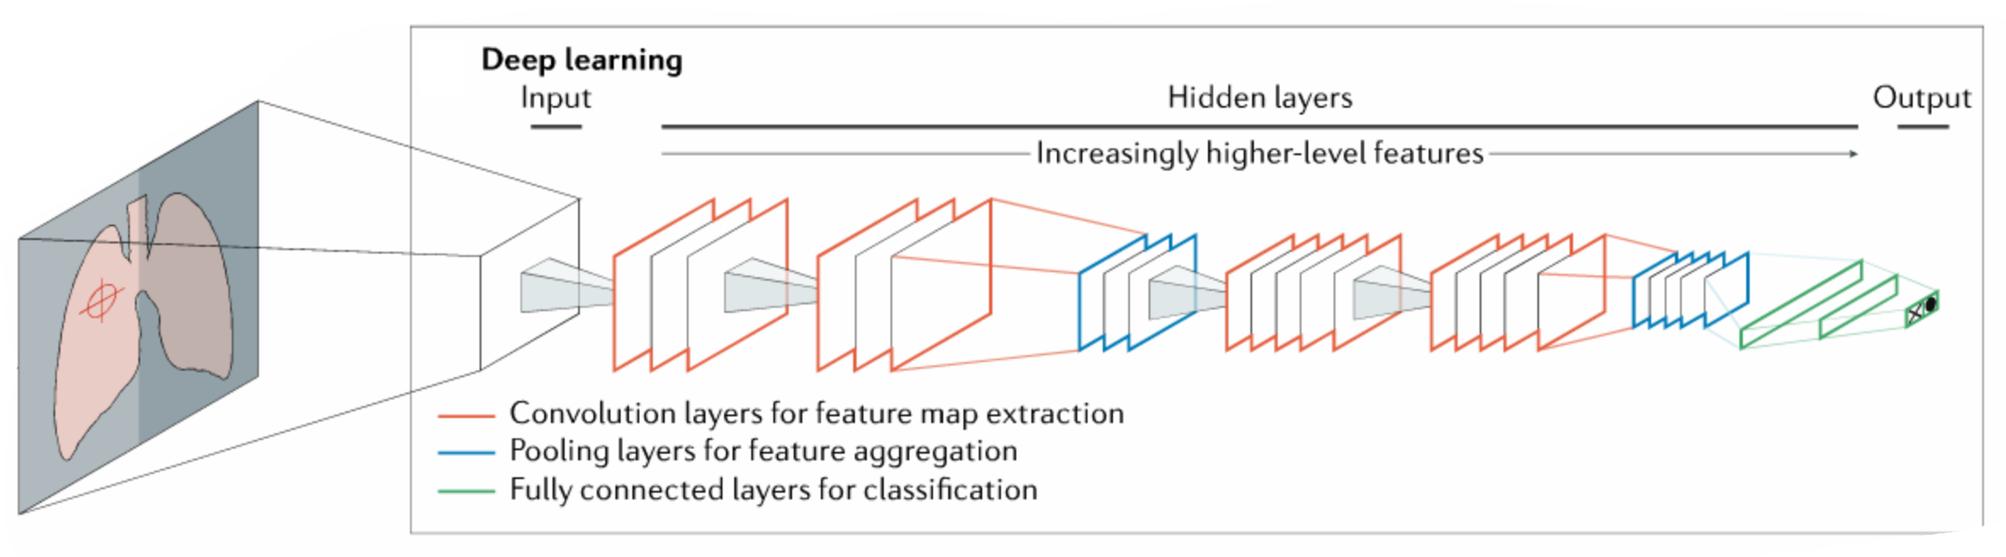
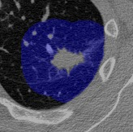
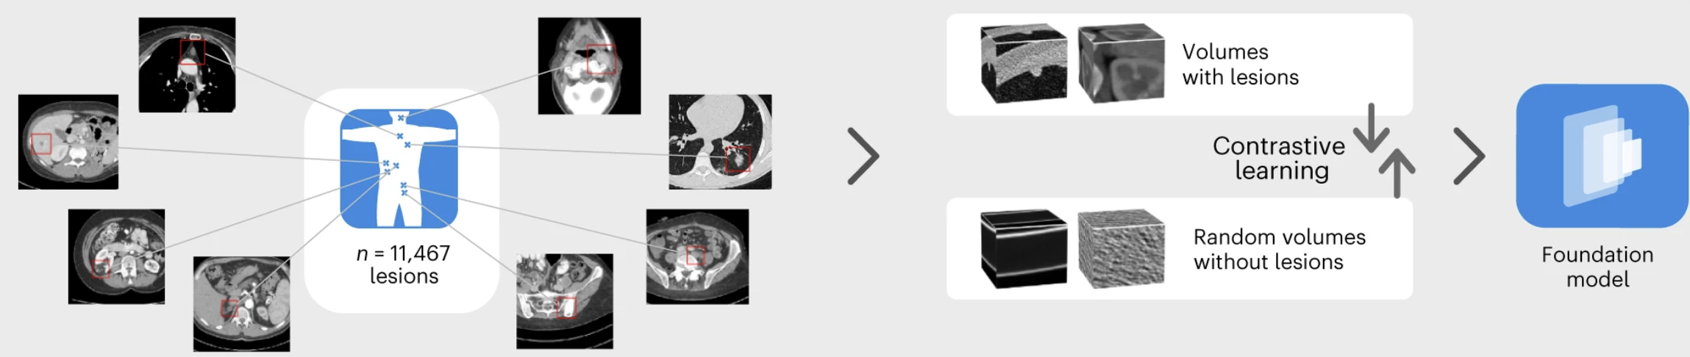
imaging as a quantitative measure
Radiomic features
Neural network-derived features
Adapted from Hosny A et al, Nat Rev Cancer, 2018. https://pubmed.ncbi.nlm.nih.gov/29777175/
Foundation model-derived features
Pai S et al, Nat Mach Intell, 2024. https://pubmed.ncbi.nlm.nih.gov/38523679/
Notes:
First, a word on imaging as a quantitative measurement. Beyond what the eye sees, we can extract handcrafted radiomic features, features learned by neural networks trained for a task, and increasingly features from foundation models trained on large unlabeled datasets. Each captures different aspects of the lesion, and each has different generalization behavior.

Slide 7


Different approaches to fusion
Early fusion
Intermediate fusion
Late fusion
Imaging
Imaging
Encoder
Imaging
Model
score
Clinical
Combined
features
Model
Risk
Clinical
Encoder
Fusion
layers
Risk
Clinical
Model
score
Combine
Risk
Blood
Blood
Encoder
Blood
Model
score
Each modality carries unique information
Imaging carries
Blood-based assay carries
Unique to
imaging
Redundant
(shared)
Synergistic
(only in combination)
Unique to
blood-based assay
Zhuang L, …, Hsu W. IEEE Rev Biomed Eng, 2026. https://pubmed.ncbi.nlm.nih.gov/40608875/
Notes:
Three canonical fusion strategies:
Early fusion concatenates raw features before a single model
Intermediate fusion encodes each modality and fuses in learned layers
Late fusion trains separate models and combine their scores.
Bottom: each modality carries unique information, some is redundant or shared, and some is synergistic, available only in combination. Intermediate fusion is usually best positioned to capture that synergy.

Slide 8
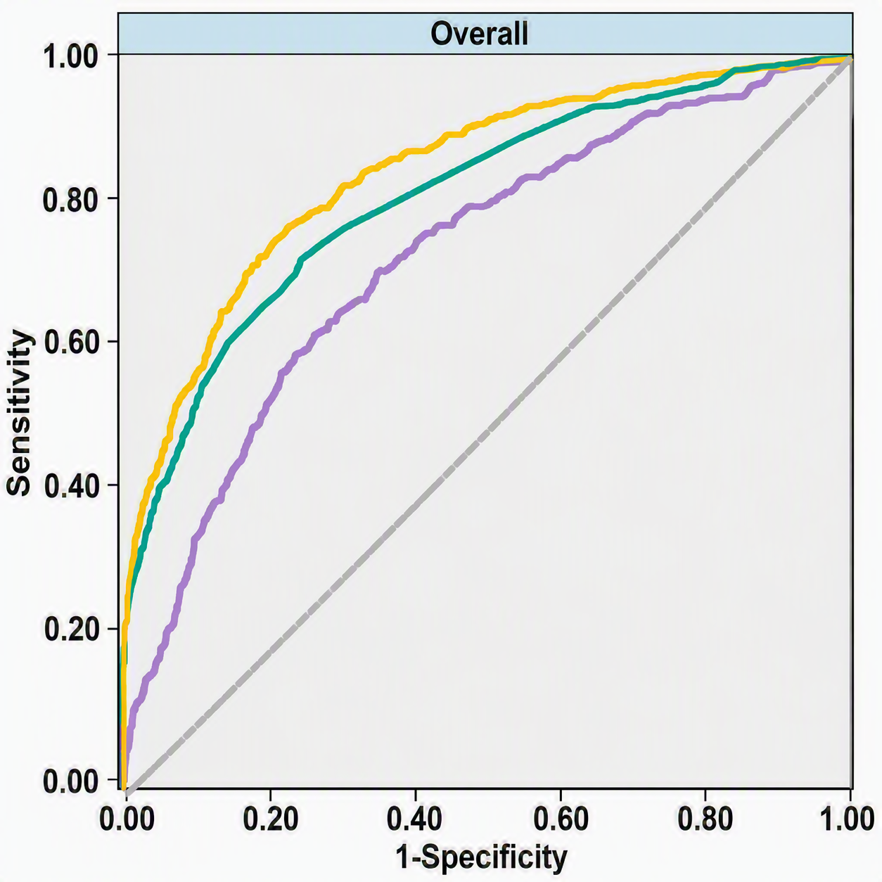
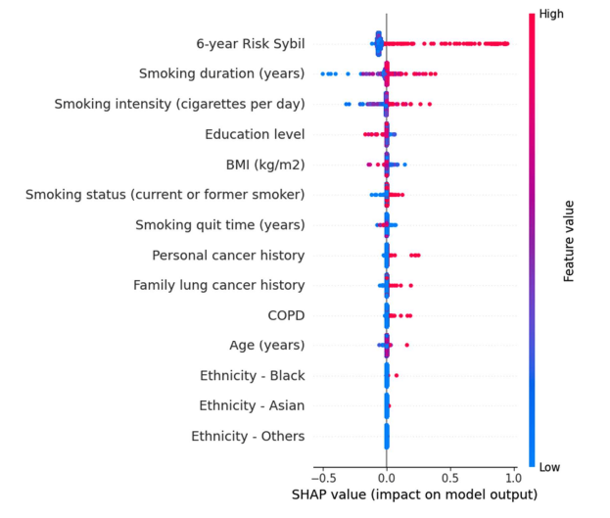
Sybil-epi: clinical + imaging results in incremental improvement
Factor | Category | Coefficient / Intercept | P-value
Intercept |  | -6.222315732 | -
6-year risk Sybil |  | 7.190352058 | <0.0001
Age (years) |  | 0.003629011 | 0.7524
BMI (kg/m²) |  | -0.016191380 | 0.0121
Education level |  | -0.042306059 | 0.0293
Ethnicity | White | Reference | 0.1112
 | Black | 0.100167458 | 0.4670
 | Asian | 0.268467320 | 0.4323
 | Others | 0.103735080 | 0.9679
COPD |  | 0.185926112 | 0.0848
Personal cancer history |  | 0.265794380 | 0.0291
Family lung cancer history |  | 0.107331266 | 0.1112
Smoking duration (yrs) |  | 0.057091822 | <0.0001
Smoking intensity (cigarettes per day) |  | 0.019851650 | <0.0001
Smoking quit time (years) |  | -0.062310461 | 0.6845
Smoking status (current or former smoker) |  | 0.124616617 | 0.1185
Aro et al. Chest, 2026. https://pubmed.ncbi.nlm.nih.gov/41833807/
Notes:
A concrete example: Sybil-epi. Integrates Sybil, a deep-learning model that predicts six-year risk from a single low-dose CT, with epidemiologic covariates like age, bmi, smoking history. Sybil's risk score dominates the model. Smoking duration and intensity add significant independent signal, along with BMI, education, and personal cancer history. The improvement is incremental, which tells us imaging already encodes much of what clinical variables capture.

Slide 9

SHOULD WE BIOPSY? INDETERMINATE NODULES HAVE HIGH DIAGNOSTIC UNCERTAINTY
Stable for
> 2 years?
Low
< 5%
Repeat CT
Low
-
Imaging + clinical + molecular marker
Risk?
Intermediate
5-65%
Risk?
PET-CT
Med
High
+
High > 65%
Invasive testing
Diagnosis
malignant vs benign
Notes:
Starting off with: is it cancer? This is the indeterminate nodule problem. Low-risk nodules under 5% get surveillance imaging; high-risk nodules above 65% go to invasive testing. The intermediate band, 5 to 65%, is where management is genuinely ambiguous and where combining imaging, clinical, and molecular markers can change decisions.

Slide 10

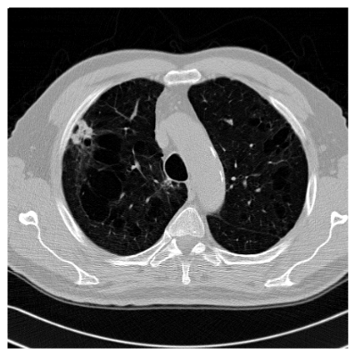
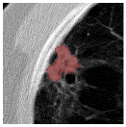
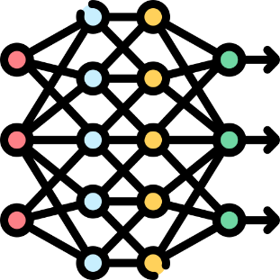
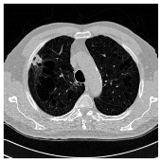
COMBINING IMAGING AND RADIOLOGIST-INTERPRETABLE semantic FEATURES
General feature: Nodule size/shape/margin
Internal feature: cyst-like spaces, necrosis
External feature: vascular convergence, pleural attachment
Semantic
Features
Goal: Utilize semantic features to guide deep-learning models to learn
clinically relevant features that are more explainable and can better generalize in predicting lung nodule malignancy risk
Low-dose CT scan
Deep Features
Zhuang L, …, Hsu W. J Biomed Inform, 2025. https://pubmed.ncbi.nlm.nih.gov/41161557/
Notes:
Our approach here is to combine deep features with radiologist-interpretable semantic features: general characteristics like size, shape, and margin; internal features like cyst-like spaces and necrosis; and external features like vascular convergence and pleural attachment. The goal is to use semantic features as guidance so the network learns clinically meaningful representations that are more explainable and generalize better.

Slide 11
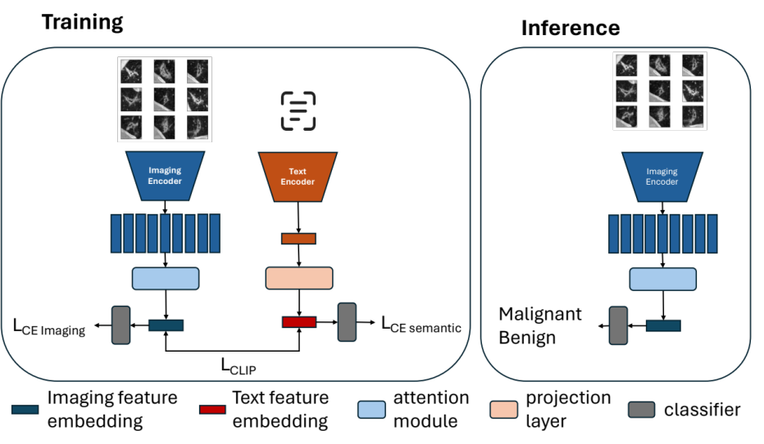
model cohorts and architecture
Dataset | Role | Patients (% cancer) | Nodules | CT scan type | Setting
NLST | Train + held-out test | 938 (23%) | 1,261 | LDCT | Screening
LIDC | Train | 1,018 (9%) | 2,625 | LDCT + diagnostic | Screening or incidental
LUNGx | External test | 70 (50%) | 83 | Diagnostic + contrast CT | Incidental
DLCS | External test | 856 (11%) | 1,388 | LDCT | Screening
UCLA | External test | 51 (55%) | 52 | Diagnostic | Biopsied, never-smokers
Zhuang L, …, Hsu W. J Biomed Inform, 2025. https://pubmed.ncbi.nlm.nih.gov/41161557/
Notes:
We trained on NLST and LIDC and held out external test sets spanning very different settings: LUNGx with diagnostic contrast CT, DLCS or the Duke Lung Cancer Screening cohort of LDCTs, and a UCLA cohort of biopsied never-smokers. Testing across acquisition types and populations was a deliberate aspect of our design.
During training, the nodule CT patch and its radiologist-annotated semantic description are encoded in parallel and aligned with a contrastive loss, so the imaging encoder is pushed to learn features that correspond to interpretable descriptors rather than dataset-specific artifacts. In inference, only the CT is needed — the semantic branch is dropped, and malignancy is predicted from imaging alone.

Slide 12
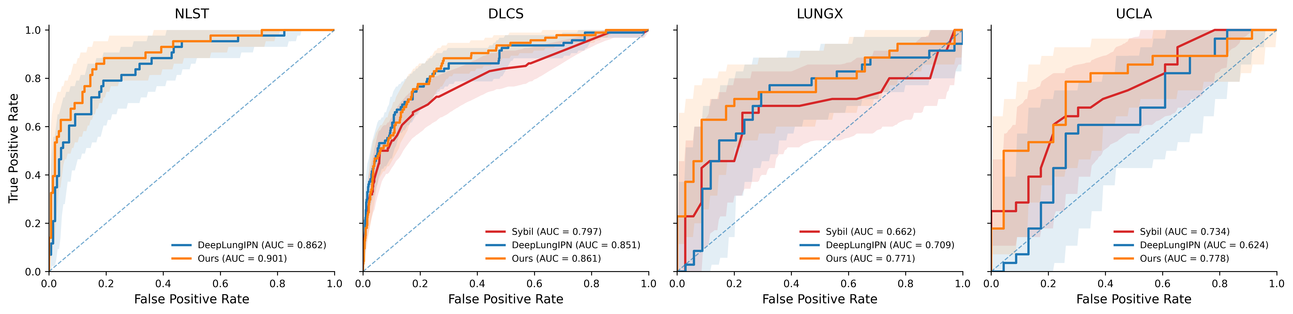
Comparison of model performance
Zhuang L, …, Hsu W. J Biomed Inform, 2025. https://pubmed.ncbi.nlm.nih.gov/41161557/
Notes:
Performance comparison across models and test sets. Our model achieved the highest AUC across imaging models but also achieved more consistent performance across cohorts.

Slide 13
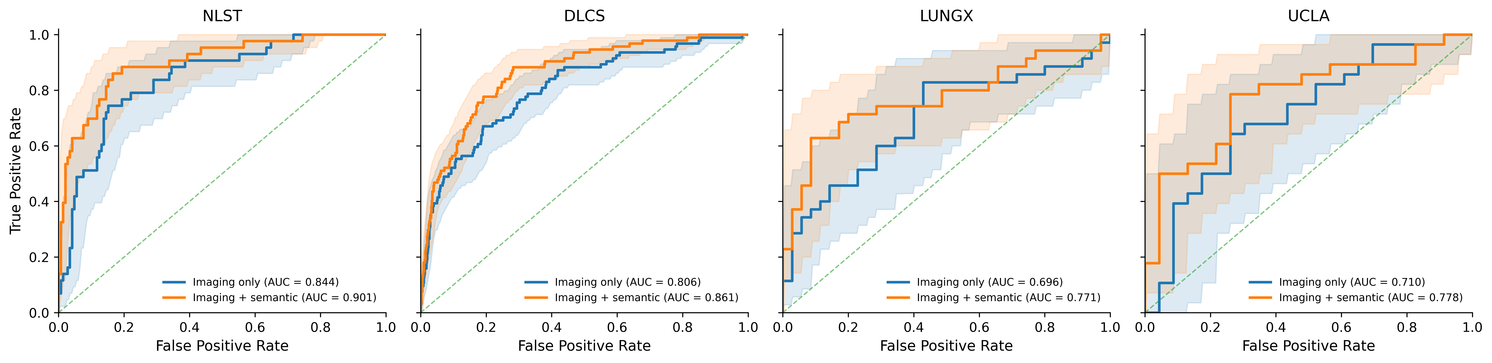
value of adding semantic guidance
Zhuang L, …, Hsu W. J Biomed Inform, 2025. https://pubmed.ncbi.nlm.nih.gov/41161557/
Notes:
This slide isolates the value of semantic guidance specifically. Adding semantic supervision improves performance, and importantly the gains are largest on the external datasets, consistent with our hypothesis that it reduces reliance on dataset-specific shortcuts.

Slide 14
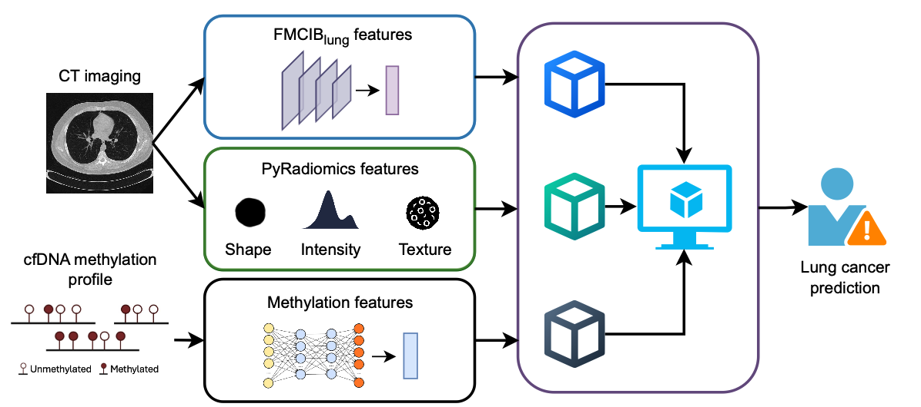
Combining imaging + blood markers
In collaboration with Xianghong Jasmine Zhou (UCLA)
Notes:
We are also examining how imaging can be combined with blood-based cell-free methylation markers to assess nodule malignancy, work in conjunction with Jasmine Zhou's group.

Slide 15
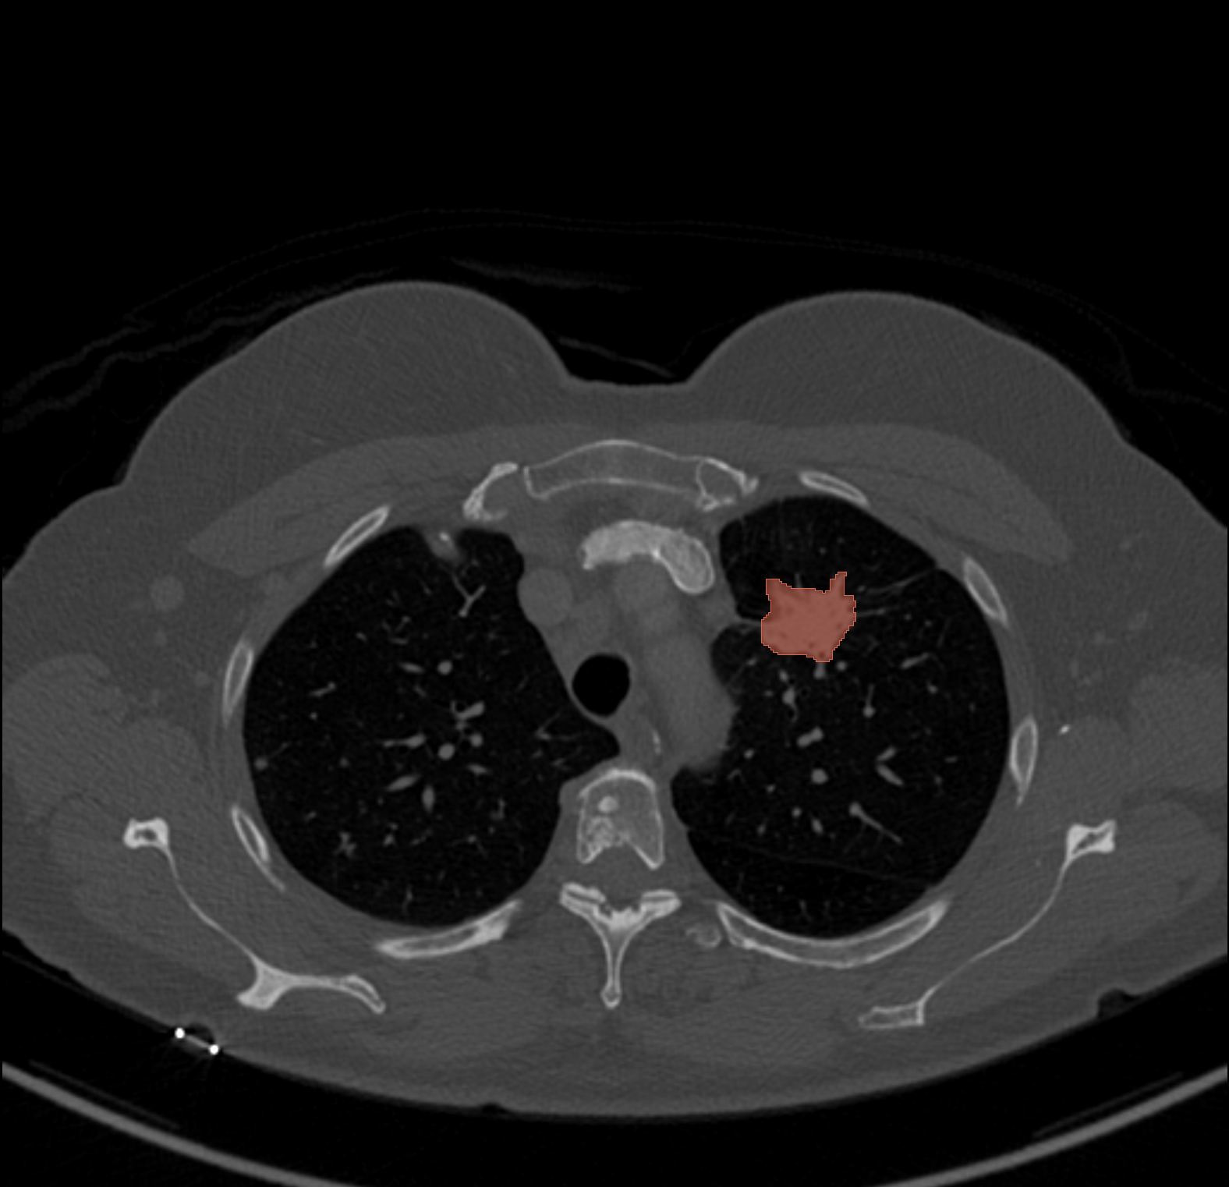
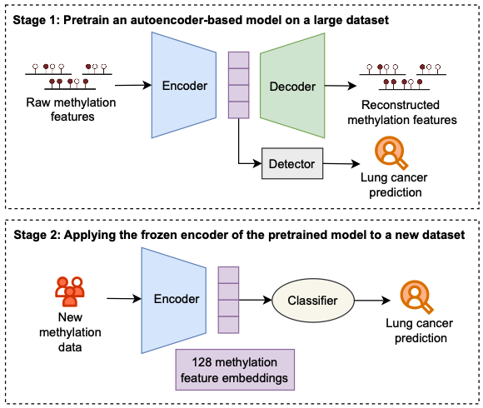
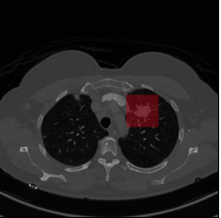
Combining imaging + blood markers
Radiomic features (PyRadiomics)
“Handcrafted” features representing shape, intensity, and texture values
Used pyRadiomics to extract 18 intensity, 14 shape, and 74 texture features (total 106) from nodule region, with default settings
Methylation features
Foundation model-based features (FMCIB_{lung})
Trained on 11,467 lesions (DeepLesion) with self-supervised contrastive learning
Encoder: 3D ResNet50
Input: CT scan & lesion location (50x50x50 mm volume)
Output: 4,096 task-agnostic features
In collaboration with Xianghong Jasmine Zhou (UCLA)
Notes:
On the imaging side, we compared handcrafted PyRadiomics features, 106 shape, intensity, and texture descriptors, against foundation-model features from FMCIB-lung, a 3D ResNet-50 trained with self-supervised contrastive learning on over 11,000 lesions, producing 4,096 task-agnostic features. These are then fused with methylation features from blood that are generated using an autoencoder pretrained on Cancer Genome Atlas data.

Slide 16
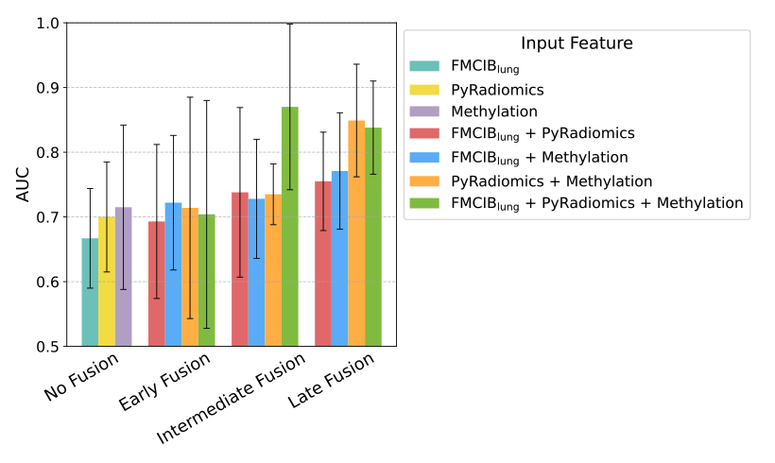
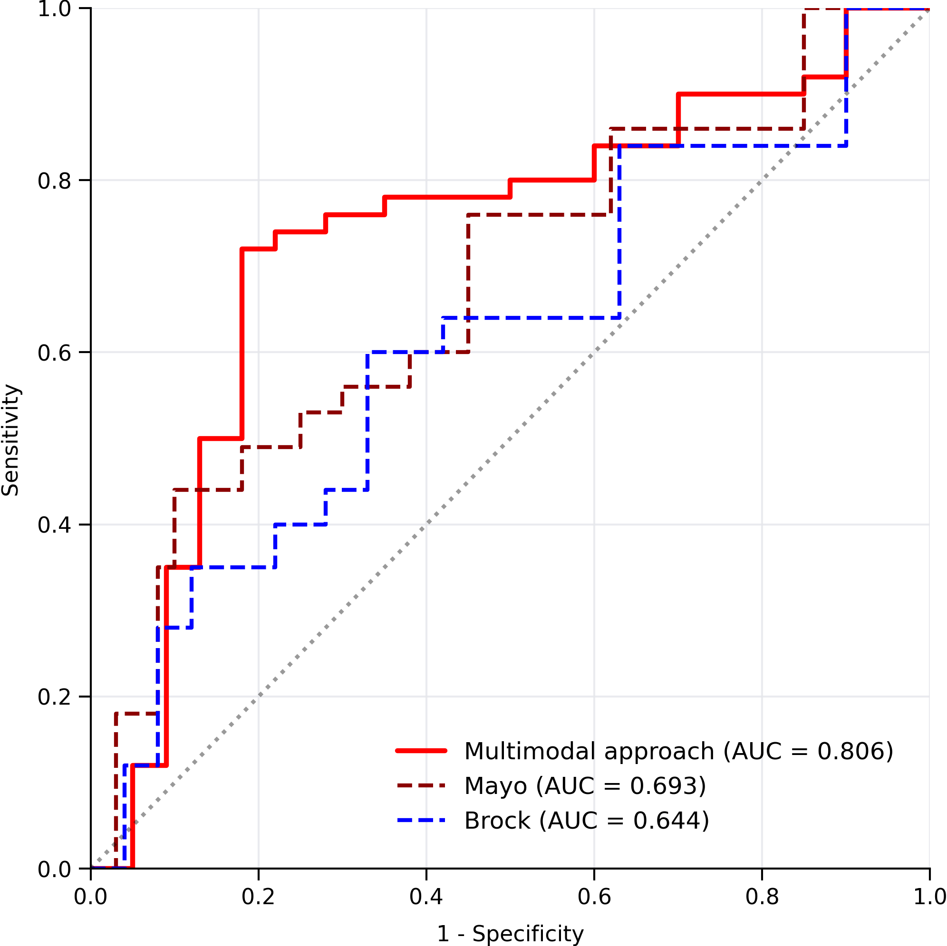
shows PROMISING PERFORMANCE in identifying early-stage cancers
AUROC for classifying Stage I
In collaboration with Xianghong Jasmine Zhou (UCLA)
Notes:
The combined model shows promising performance, particularly in identifying early-stage cancers, which is exactly the subgroup where imaging alone is weakest and where detection matters most clinically.

Slide 17
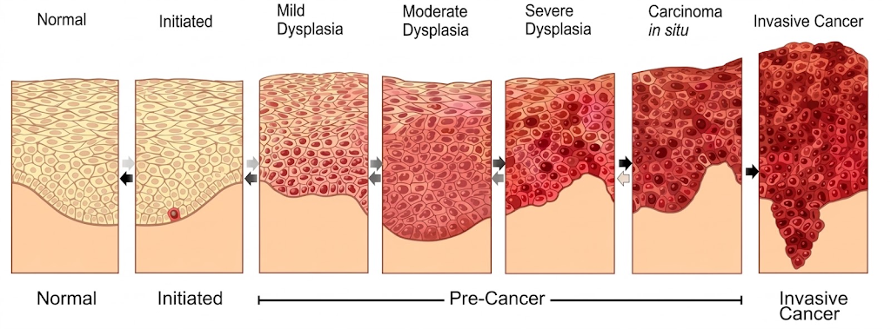
IS IT CANCER? CHARACTERIZATION of premalignant lesions
Dunn and Akpa, Semin Oncol Nurs, 2012. https://pubmed.ncbi.nlm.nih.gov/22542317/
Notes:
Now the second question: what if we find ground glass nodules

Slide 18
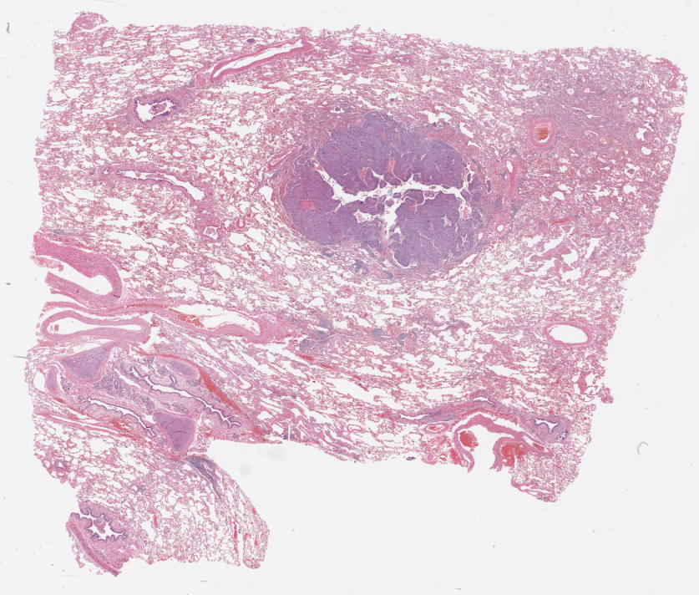
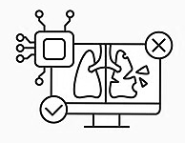
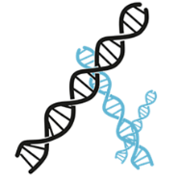

Combining gene expression and whole slide imaging
Develop a multi-modal framework that can:
leverage both WSIs and gene expression data,
stratify PML histology (e.g., normal, hyperplasia, metaplasia versus bronchial dysplasia, CIS, SCC).
z
Dysplasia or higher?
Multi-modal framework
+
yes
Whole slide images
-
no
Histology stratification
Gene expressions
(Campbell 2016, Billatos 2019, Merrick 2018, Mascaux 2019, Pennycuick 2020)
Xu L, …, Beane JE, Genome Med, 2026. https://pubmed.ncbi.nlm.nih.gov/41952176/
Notes:
They built a multimodal framework that uses both whole slide images and bulk gene expression to stratify premalignant lesion histology, separating normal, hyperplasia, and metaplasia from bronchial dysplasia, carcinoma in situ, and squamous cell carcinoma

Slide 19
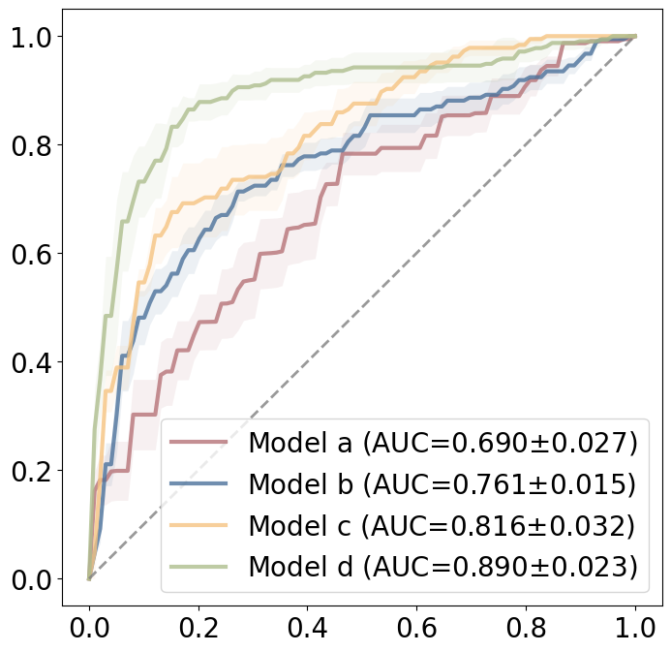
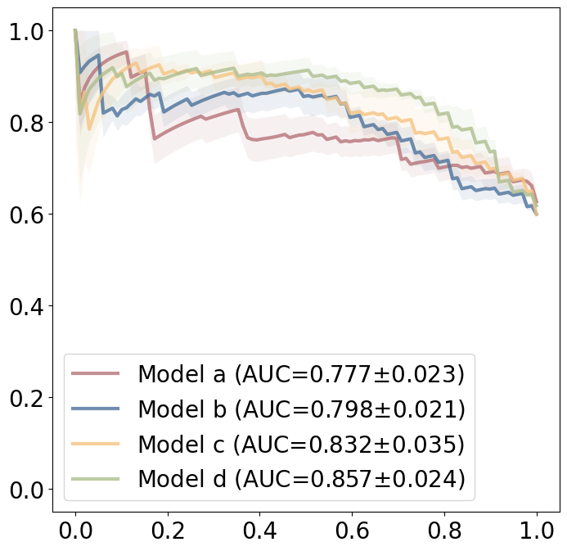
two modalities outperforms single modality
ROC curve
PR curve
True positive rate |  | Precision
 | False positive rate |  | Recall
Data Model | Training |  | Testing
 | WSI | GE | WSI | GE
Model a
Model b
Model c
Data Model | Training |  | Testing
 | WSI | GE | WSI | GE
Flexible fusion model
(on WSI)
(on WSI)
(on GE)
(on GE)
1. Utilizing two data modalities over one single modality improved model performance.
Combining GE with WSI increased AUROC by 0.071. (p<0.001)
Combining WSI with GE increased AUROC of 0.074. (p<0.001)
Xu L, …, Beane JE, Genome Med, 2026. https://pubmed.ncbi.nlm.nih.gov/41952176/
Notes:
First result: two modalities beat one. Adding gene expression to whole slide imaging raised AUROC by 0.071, and adding imaging to gene expression raised it by 0.074, both highly significant. The ROC and precision-recall curves show the gain holds across operating points.

Slide 20
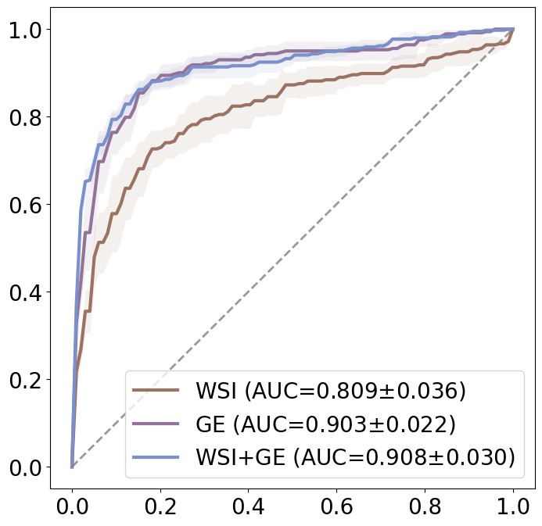
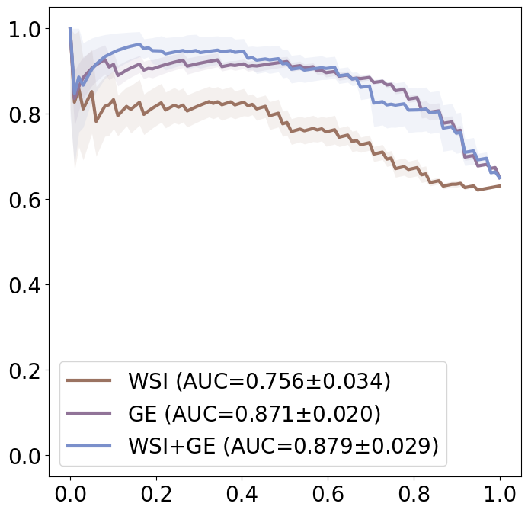
Flexible fusion model performance
ROC curve
PR curve
True positive rate |  | Precision
 | False positive rate |  | Recall
Data Model | Training |  | Testing
 | WSI | GE | WSI | GE
Model a
Model b
Model c
Data Model | Training |  | Testing
 | WSI | GE | WSI | GE
Flexible fusion model
1. Utilizing two data modalities over one single modality improved model performance.
Combining GE with WSI increased AUROC by 0.071. (p<0.001)
Combining WSI with GE increased AUROC of 0.074. (p<0.001)
2. Allowing inputs with both or one of GE and WSI further enhanced model performance.
AUROC increased by 0.048 when tested on WSI samples. (p<0.05)
AUROC increased by 0.013 when tested on GE samples. (p<0.01)
Xu L, …, Beane JE, Genome Med, 2026. https://pubmed.ncbi.nlm.nih.gov/41952176/
Notes:
Second result: the flexible fusion model, which accepts either or both modalities at inference, does better still, improving AUROC by 0.048 on WSI-only samples and 0.013 on GE-only samples. That's practically important because it means you can train on the full cohort and deploy wherever only one assay is available.

Slide 21



Who should be screened? Current eligibility misses lung cancer patients
Study cohort | Patients (N = 997)
Screening Eligible
 | Age 50-80, years (y)
 | ≥20 pack-year (PY) and quit <15 y |  | 350 (35.1%)
Screening Ineligible |  |  | 647 (64.9%)
 | 1 Criterion
 |  | Not in age range | 41 (4.1)
 |  | Quit >15 y | 134 (13.4)
 |  | <20 PY | 65 (6.5)
 | 2 Criteria
 |  | Not in age range and quit >15 y | 32 (3.2)
 |  | Not in age range and <20 PY | 15 (1.5)
 |  | <20 PY and quit >15 y (smoker) | 89 (8.9)
 |  | Age-eligible never-smokers | 195 (20)
 | All criteria |  | 76 (7.6)
50-80 years old
≥ 20 pack-year history
Quit within 15 years
Yang HC et al, JAMA Netw Open, 2025. https://pubmed.ncbi.nlm.nih.gov/41264266/
Notes:
Finally, a note about who should be screened. Current USPSTF criteria require age 50 to 80, at least 20 pack-years, and quitting within 15 years.
A recent study at Northwestern showed in a retrospective chart review of 997 patients with diagnosed lung cancer, 65% were screening-ineligible.
The largest single group is age-eligible never-smokers at 20%, followed by those who quit more than 15 years ago. Criteria based on smoking history alone leave most of the burden uncovered.

Slide 22
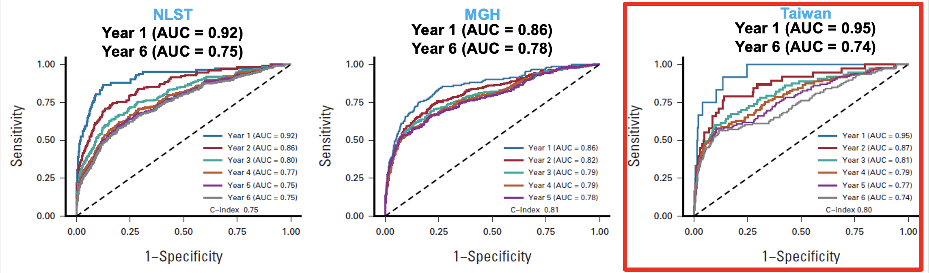
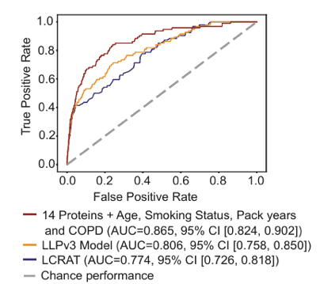
Signatures in imaging and plasma
Similar performance in a non-screening population
Mikhael et al, J Clin Oncol, 2023. https://pubmed.ncbi.nlm.nih.gov/36634294/
Pandya T et al, Cell, 2026. https://pubmed.ncbi.nlm.nih.gov/42242224/
Notes:
So we look for signatures in imaging and plasma that work in non-screened populations. Sybil demonstrated imaging-based risk prediction generalizes across cohorts, and recent plasma-based work shows that a 14-protein marker assay with clinical risk factors can accurately predict lung cancer. The opportunity is to combine them for population-level triage.

Slide 23

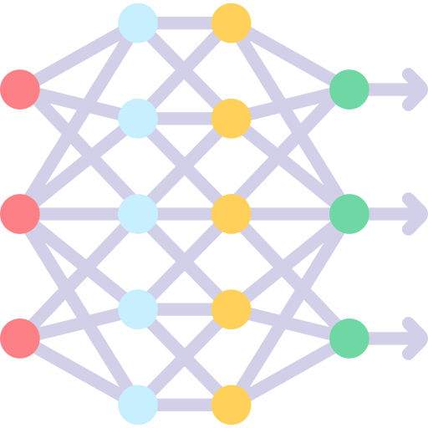

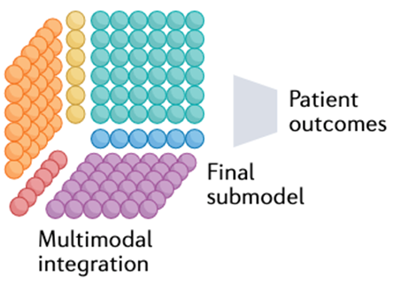
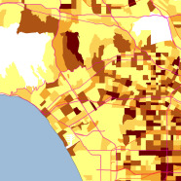
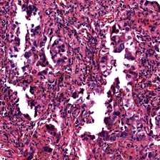
Towards A comprehensive representation of risk
Electronic health record data
Data elements: demographics, smoking history, comorbidities, clinical outcomes
Automated structuring of phenotypes using large language models
Medical imaging data
Data types: Computed tomography, semantic and quantitative features
Extraction of deep features using language-vision models, transformer models
Environmental/SES data
Data types: Satellite imagery, Block Group level exposure/SES data
Integrated modeling of environmental dynamics
Multimodal lung cancer risk model
Molecular data
Data types: Germline risk, tumor (gene expression), and circulating markers (methylation, protein assays)
Linkage of imaging features to biological markers
Notes:
Our longer-term vision is a comprehensive representation of risk: EHR data for demographics, smoking, comorbidities, and outcomes; imaging with semantic and quantitative features; environmental and neighborhood-level exposure data including satellite imagery; and molecular data. Large language and vision-language models help structure and extract these at scale, feeding a single multimodal risk model.

Slide 24
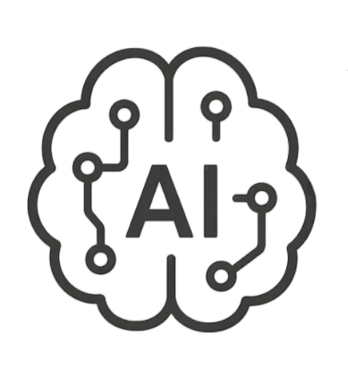

CHALLENGES + opportunities
Overcoming limited multimodal data
Need scalable infrastructure for cohort discovery, retrieval, curation, and mining of large clinical + imaging + molecular datasets
Avoid shortcut learning
Need effective methods for learning from multimodal datasets to extract biologically-informed features
finishing the
“LAST MILE”
Need strategies and solutions for delivering validated multimodal AI at the point of care in a way that is efficient and trustworthy
Notes:
Three challenges stand between us and impact. First, limited multimodal data: we need scalable infrastructure for cohort discovery, retrieval, curation, and mining. Second, shortcut learning: we need methods that extract biologically informed rather than site-specific features. Third, the last mile: delivering validated multimodal AI at the point of care efficiently and in a way clinicians trust.

Slide 25




UCLA’s integrated lung cancer research biobank
Blood
Nasal
…
…
Self-reported surveys
Screening & diagnostic CT scans
Biopsy CT scan
Banked biopsy tissue
Blood
Nasal
Diagnosis
Treatment
Outcomes
7,800 screening patients tracked
1,600 CT-guided biopsy patients
1,100+ tissue, 300+ blood, 130+ nasal
10,000+ CT scans banked
Notes:
On data infrastructure, UCLA's integrated lung cancer research biobank tracks 7,800 screening patients and 1,600 CT-guided biopsy patients, with over 1,100 tissue, 300 blood, and 130 nasal specimens, and more than 10,000 banked CT scans linked longitudinally to diagnosis, treatment, and outcomes. The infrastructure exists and is ready to expand.

Slide 26

Demographics
Gap in care
Most recent CT scan
Unknown family history of cancer
Most recent vitals
Missed screening CT scans
Missing smoking history
No indoor exposure data
Last clinical encounter
Outdoor exposure data
Notes:
Real-world data is incomplete in structured ways. A typical patient record has demographics, a recent CT, and vitals, but unknown family cancer history, missing smoking history, missed screening scans, and no indoor exposure data. Models have to be robust to missingness that is itself informative about gaps in care.

Slide 27
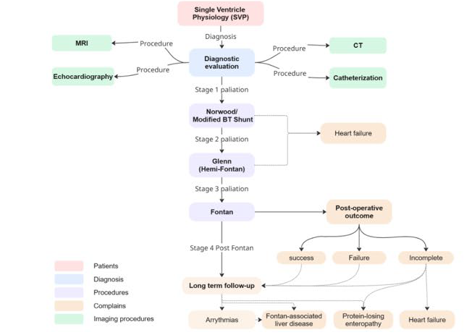
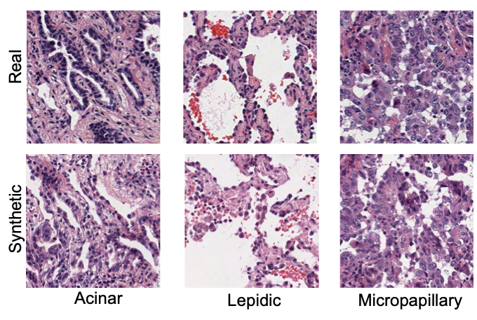
Using knowledge graphs to encode context (Xu et al, JACC Advances, in press)
Using diffusion-based synthetic data augmentation for domain adaptation
(Zhang et al, IEEE J Biomed
Health Inform, in press)
Notes:
Two methodological directions we're pursuing: knowledge graphs to encode clinical context and relationships beyond flat feature vectors, and diffusion-based synthetic data augmentation for domain adaptation across scanners and sites. Both papers are in press.

Slide 28
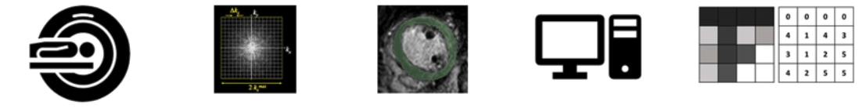
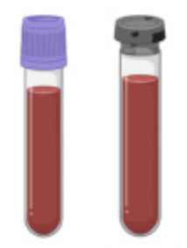
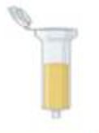
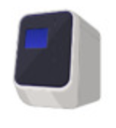
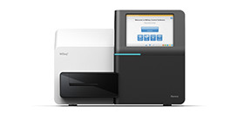
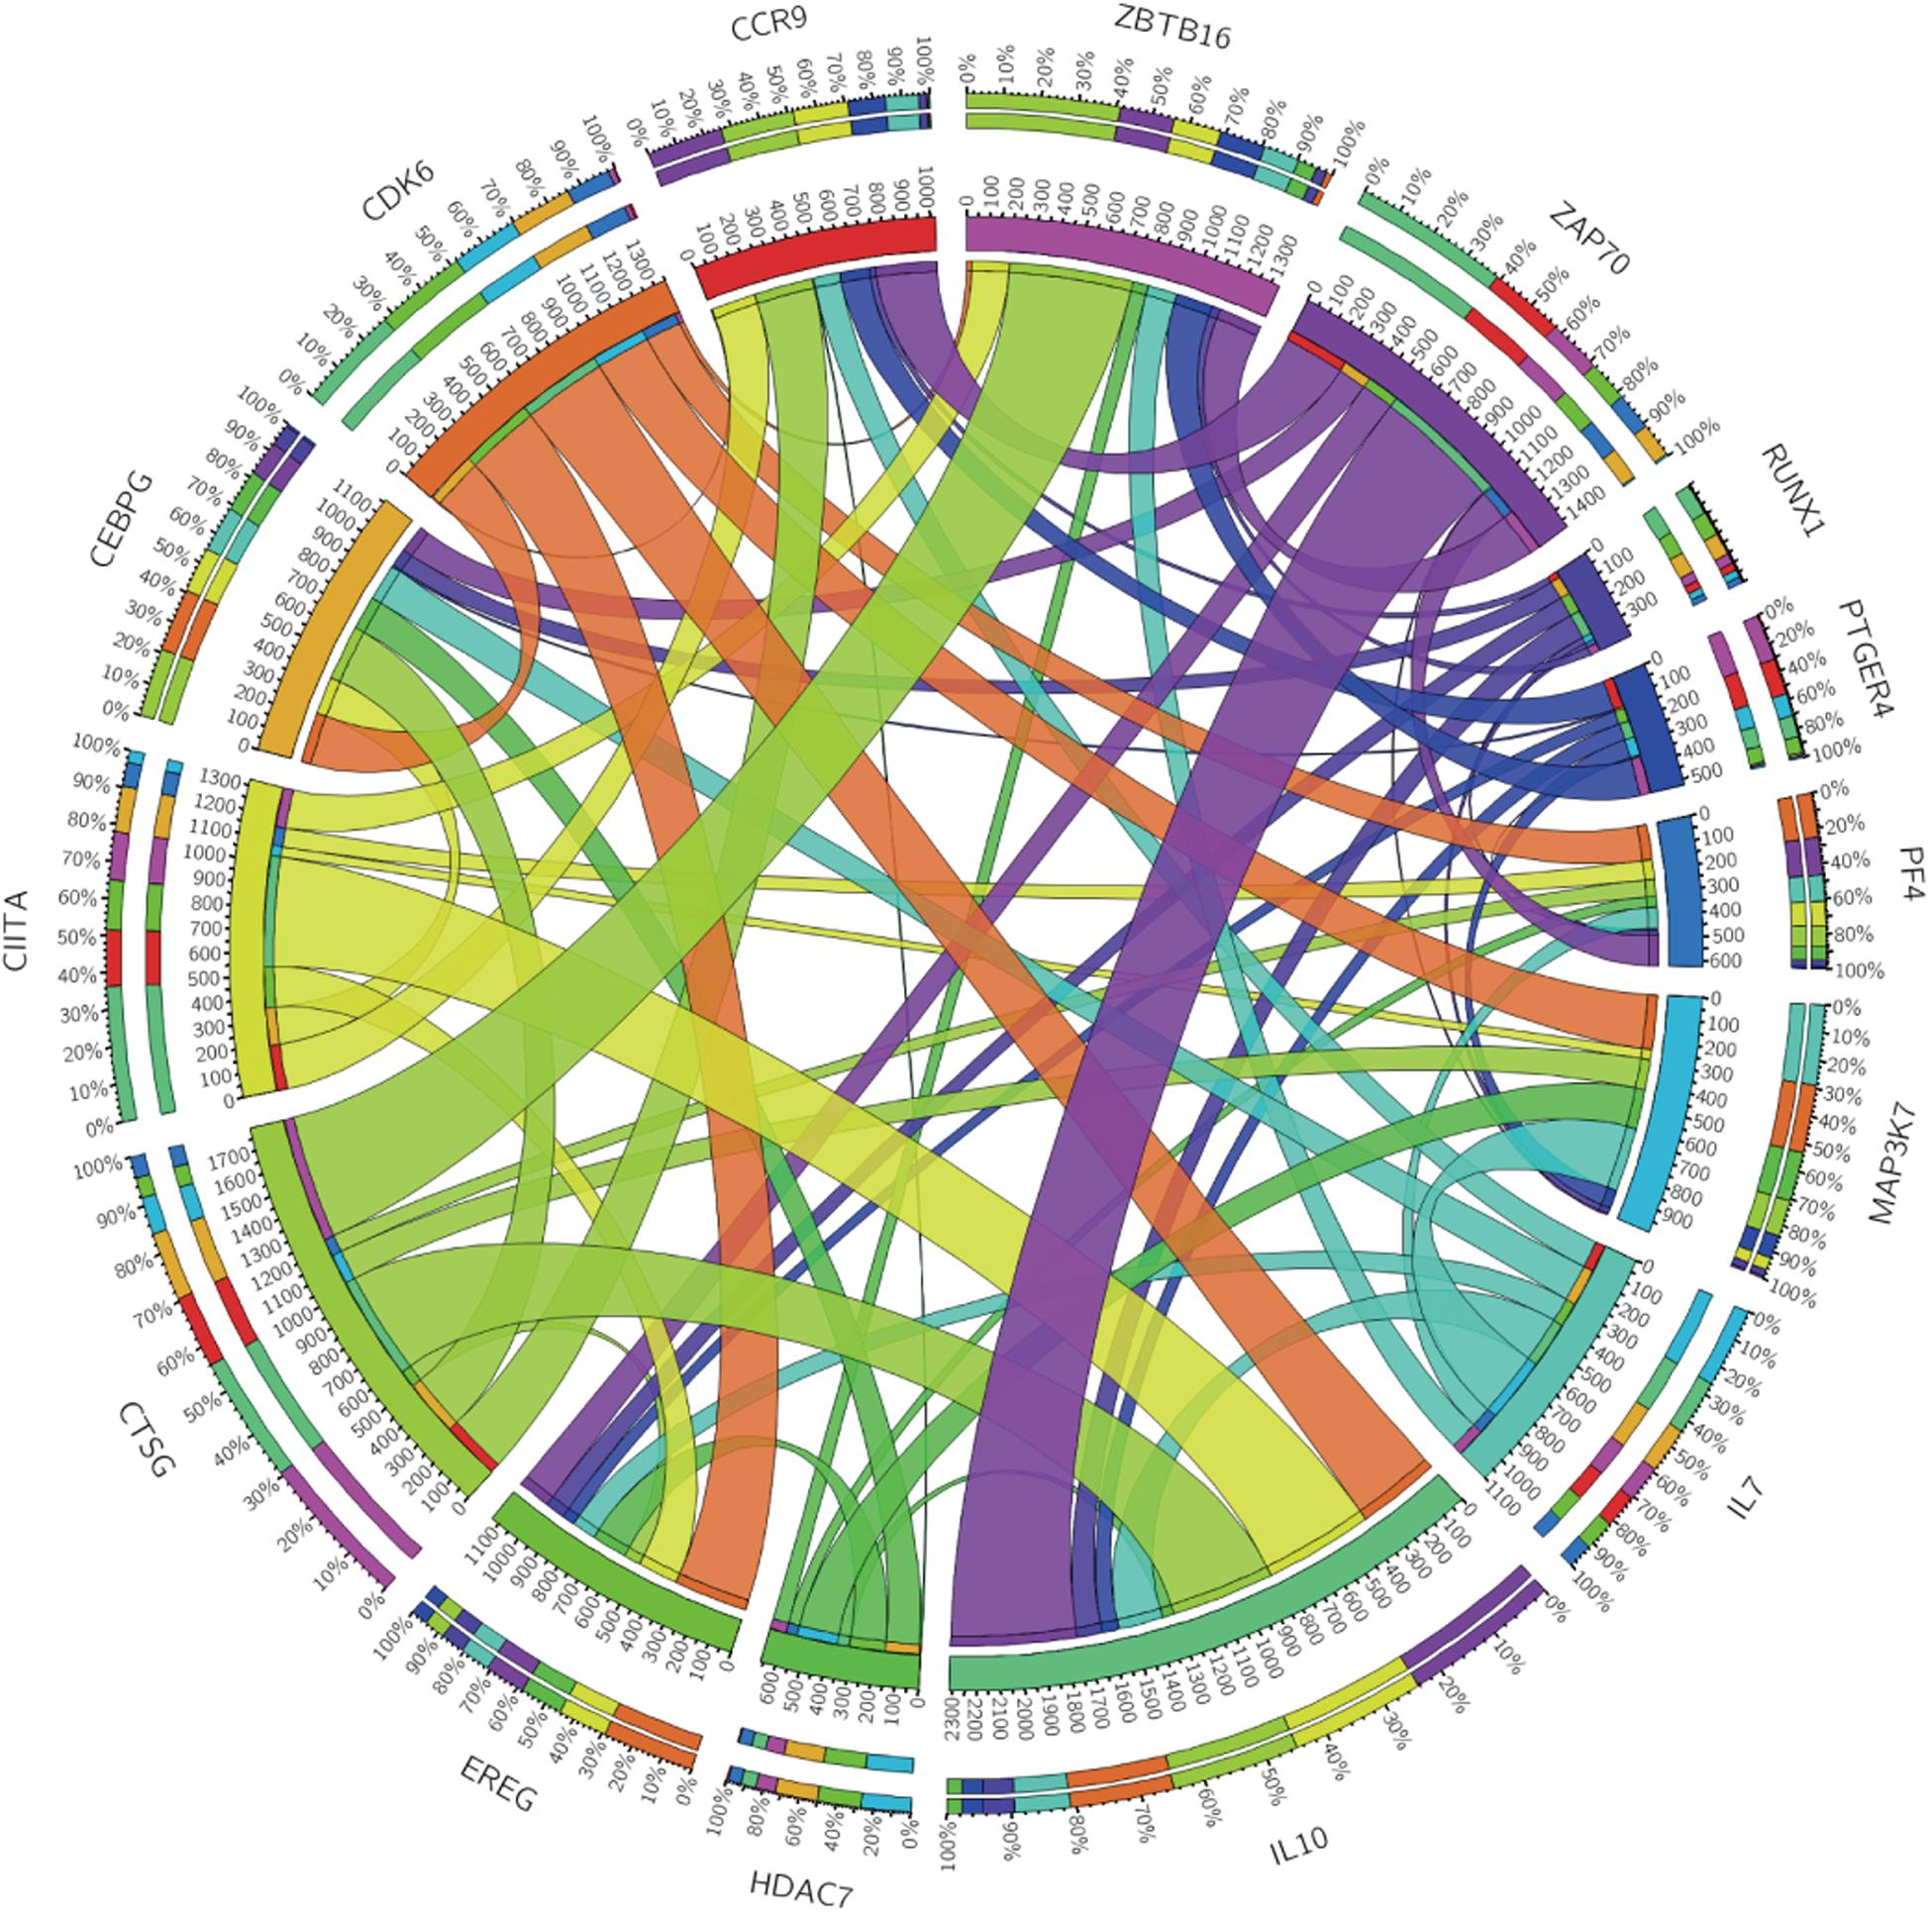
factors that influence learned features
Image acquisition
Reconstruction
Segmentation
Post-processing
Feature extraction
Learned features
Sample acquisition and handling
Isolation and qualification
Sequencing technology
Alignment and analysis
Notes:
It's worth being explicit about what shapes learned features. On the molecular side: sample acquisition and handling, isolation and qualification, alignment, and sequencing technology. On the imaging side: acquisition parameters, reconstruction kernel, segmentation, post-processing, and extraction. Most apparent biological signal can be confounded by any of these.

Slide 29

Is multimodal biomarker ready to deploy?
Discrimination
Calibration
Retrospective validation
Prospective validation
Cancer burden reduction
Cost
Algorithmic bias and fairness
Workflow integration and clinician workload
Actionability
Model drift
Notes:
Is multimodal AI ready to deploy? Discrimination and calibration are necessary but far from sufficient. We also need to address EDRN phase validation, cost, workload, algorithmic bias and fairness, accessibility, health IT integration, clinical actionability, and model drift after deployment. My answer is: promising, not yet ready, and the remaining work is mostly not modeling work.

Slide 30
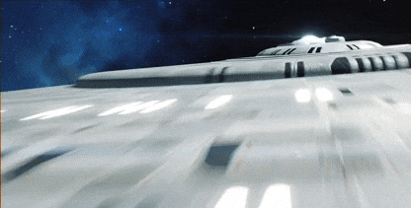
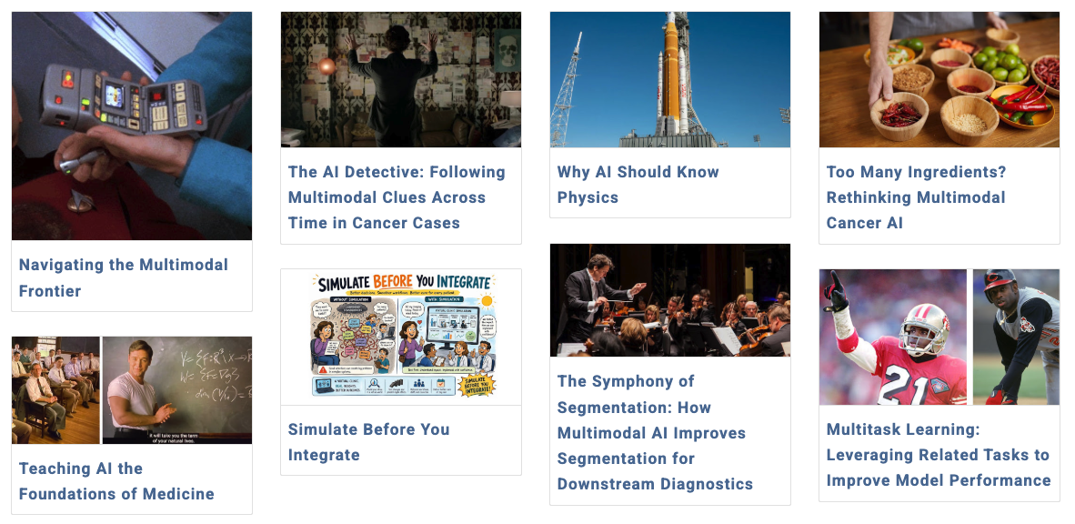

Navigating the Multimodal Frontier
http://hsulab.substack.com
Notes:
If you want to follow this thread, I write about multimodal AI in medicine at hsulab.substack.com. Happy to continue the conversation there.

Slide 31

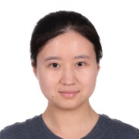
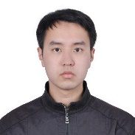















William Hsu, PhD
whsu@mednet.ucla.edu
http://hsu-lab.com
The Hsu Lab gratefully acknowledges support from the National Institutes of Health (R01 EB031993; U2C CA271898; U01 CA233370), the Agency for Healthcare Research and Quality (R33 HS029257), the V Foundation, EarlyDiagnostics Inc, the National Science Foundation, Jonsson Comprehensive Cancer Center, and the Department of Radiological Sciences.
Research team (Hsu Lab)
Funding support
Yannan Lin
Yunzheng Zhu
Luoting Zhuang
Stephen Park
Tengyue Zhang
Connor Morris
Micah Vinet
Rohil Ahuja
Bing Zhu
Soledad Lujan
Navigating the Multimodal Frontier
http://hsulab.substack.com
Notes:
Thank you. This work is the product of a terrific team, and we gratefully acknowledge support from the NIH, AHRQ, the V Foundation, EarlyDiagnostics, NSF, the Jonsson Comprehensive Cancer Center, and our department. My contact information is here, and I'm glad to take questions.

