Slide 1
AI Image-Based Breast Cancer Risk Assessment: New Opportunities for Early Detection and Cancer Prevention
Connie Lehman MD PHD
Professor of Radiology
Harvard Medical School
Founder and CEO, Clairity, Inc.

Slide 2
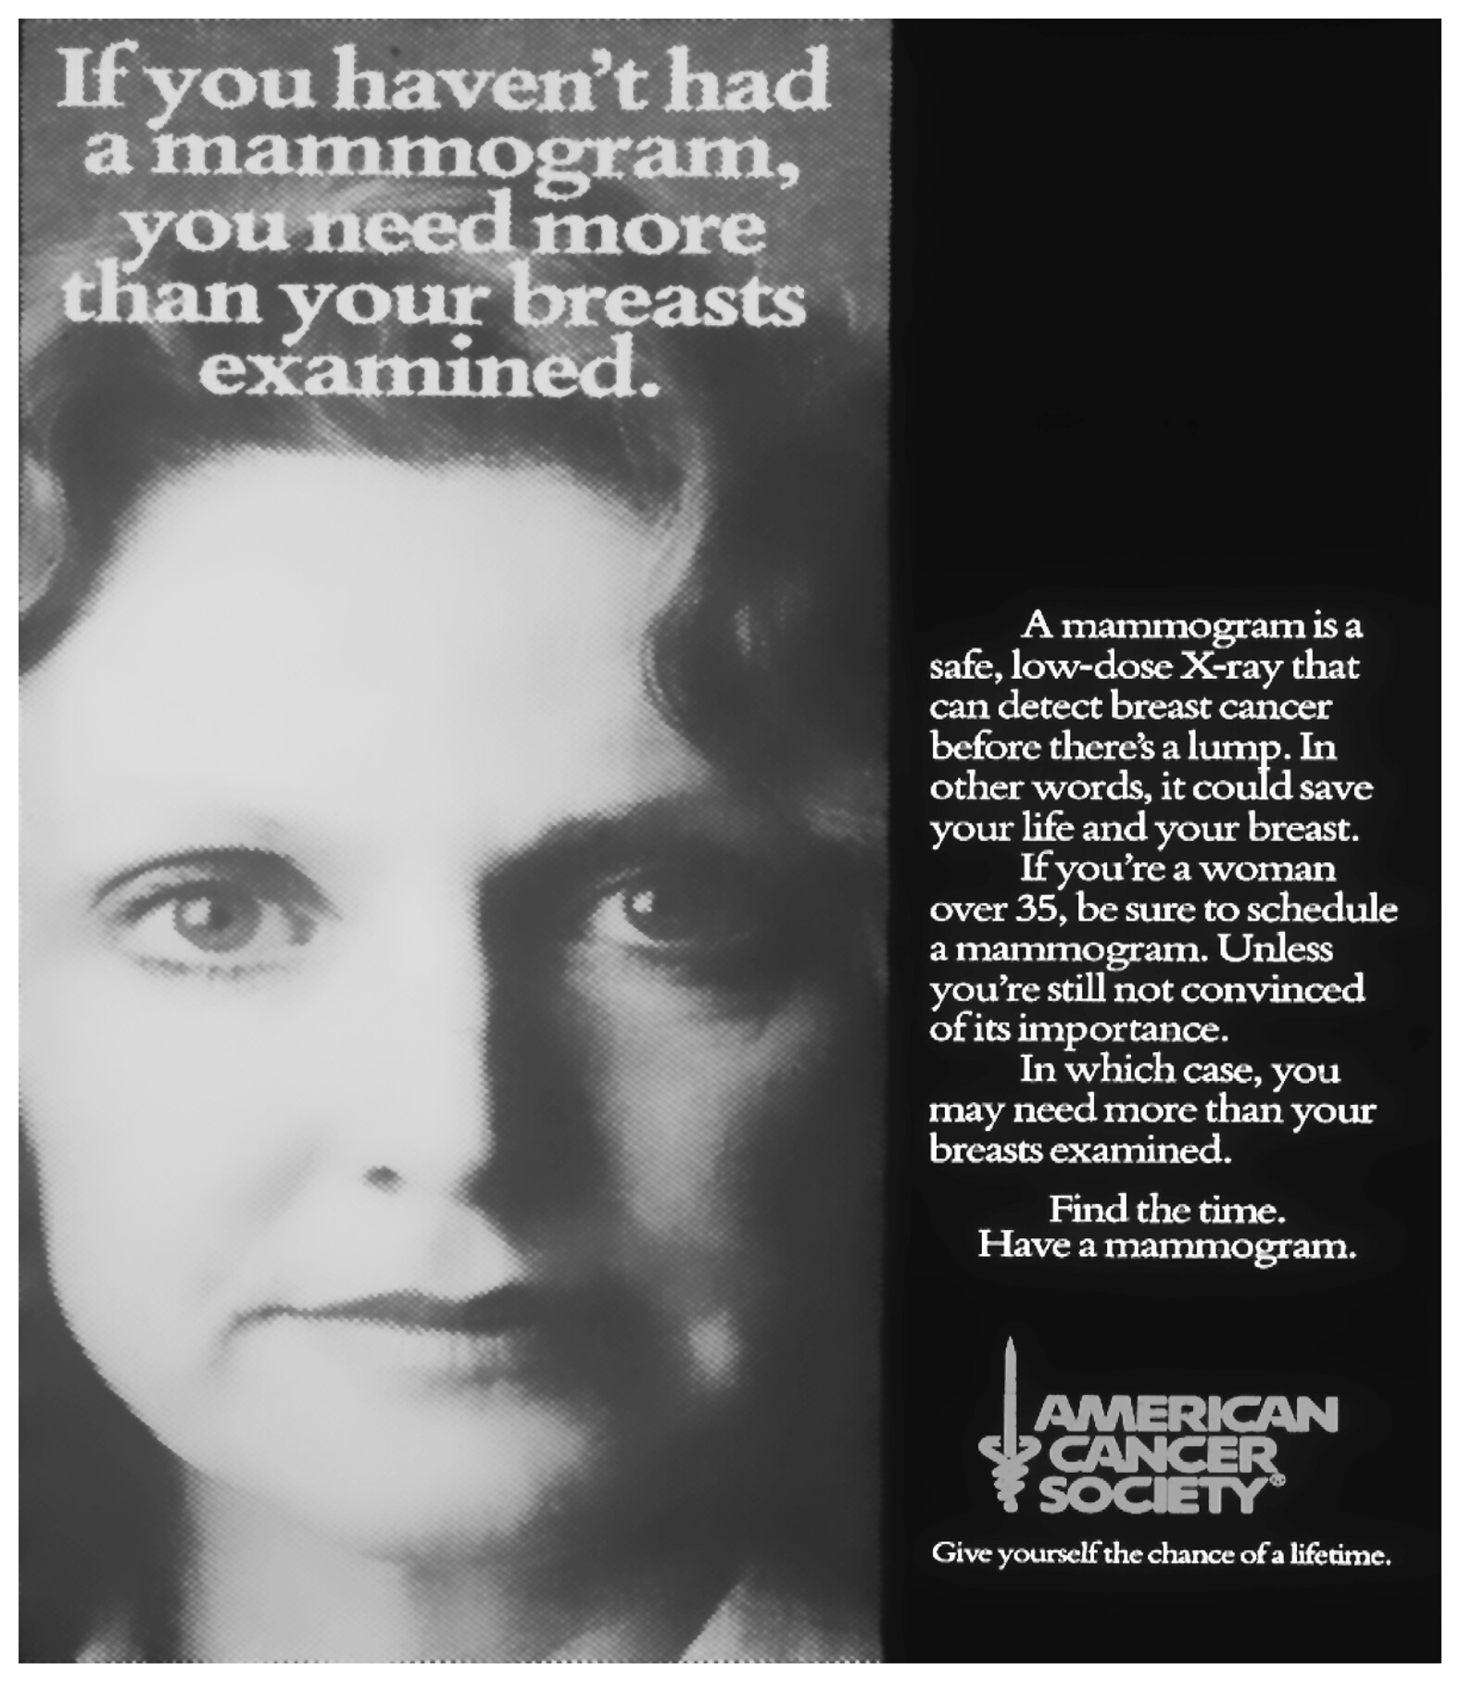
Change is long overdue
ACS Advertisement 1970s (Left):
If you are a woman over 35…
1995:
Over 40…
2015:
Over 50---and talk to your doctor if you are interested in screening in your 40s
2023:
Over 40---but every year or every other year?
And when do we stop? 69? 74? Never?
Notes:
This change is long overdue. Because age alone is such a crude way of estimating a woman’s risk of breast cancer, we have intense arguments by smart people of what ages should be screened…. In the 1970s….
Should we be screening for 50 years of a woman’s life? 24 years of her life? 15?

Slide 3
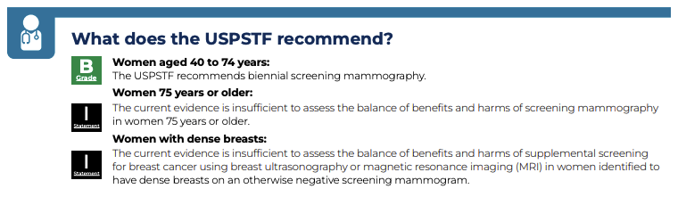




Breast Cancer Screening in the U.S. Is Largely Age-Based
Most women receive routine mammography every 1–2 years based primarily on age rather than individual risk.
USPSTF Screening Framework
Clinical Guidelines Drive
Screening Practice
Women aged 40 to 74 years
The USPSTF recommends biennial screening mammography
Coverage Policy
Affordable Care Act (2010)
Private plans must cover USPSTF A/B services
Screening mammography covered with $0 patient cost
Coverage policy therefore follows USPSTF
USPSTF: United States Preventative Task Force
Confidential — For Internal Use Only — June 2026

Slide 4

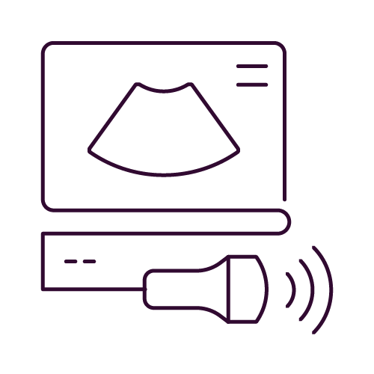

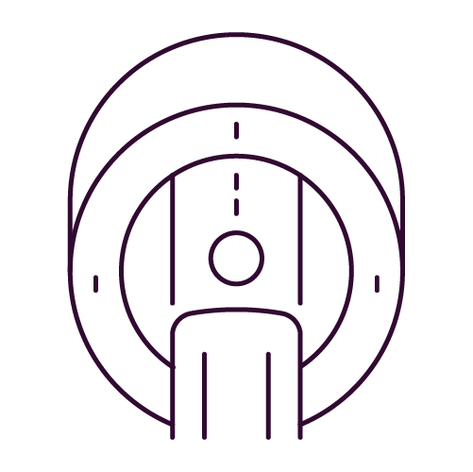
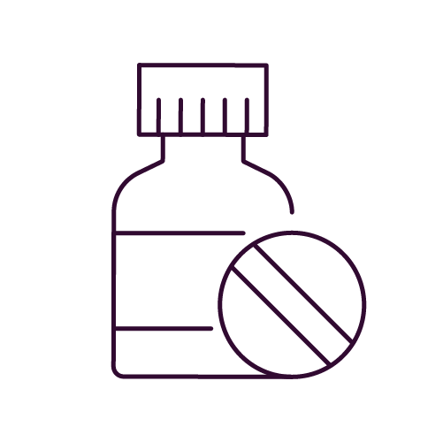

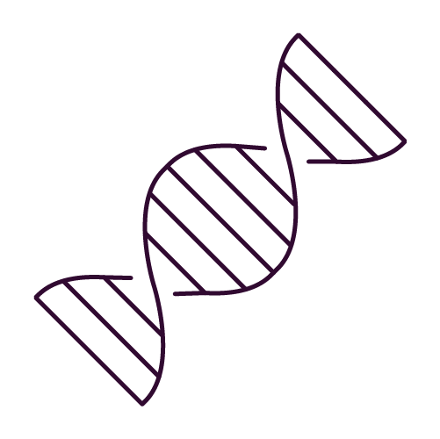

Because Age-Based Screening Is Limited, Risk Assessment Guides Additional Care - Yet Current Tools Miss Most Women Diagnosed
Additional Care for Women at Increased Risk
Early Detection
Prevention
Traditional Risk Determination
Family history of cancer
Genetic mutation
Other subjective patient inputs
Breast Ultrasound
Lifestyle Changes
Increased Risk
10-15% of Women
Breast MRI
Chemoprevention Drugs
Genetic Testing
Prophylactic Mastectomy
Average Risk
85-90% of Women
Routine Screening Only
Most breast cancers will occur in the avg. risk group
Confidential — For Internal Use Only — June 2026

Slide 5

70 years of screening mammography as primary method for early detection and 60 years of risk assessment that misses majority of women who will be diagnosed with breast cancer
The Scale of the Problem
“No one in my family had ever had breast cancer. Why me?”
-Katie Couric, on learning of her breast cancer diagnosis.
>375K
Diagnosed in the U.S. Annually
85%
have no signficant family history of breast cancer
43K
Deaths annually
= 1 woman every 12 minutes
Confidential — For Internal Use Only — June 2026
Notes:
Connie

Slide 6
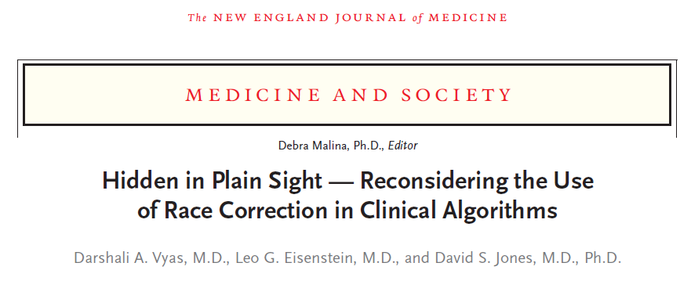





Risk-Based Screening: Current (traditional) models “favor” white women engagement
Racial and ethnic bias in traditional models
“
Though the model is intended to help conceptualize risk and guide screening decisions, it may inappropriately discourage more aggressive screening among some groups of nonwhite women².
% labeled as “Increased Risk >1.67%”
(TC-8 – 5Y)¹
White | Asian | Black | Hispanic
50% | 31% | 32% | 21%
“
Race and Ethnicity-Based Variability in Breast Cancer Risk Assessment by Traditional Models, RSNA, Leslie R. Lamb, Sarah Mercaldo, Gary X. Wang, Randy C. Miles, Constance D. Lehman
Vyas DA, Eisenstein LG, Jones DS. (2020) Hidden in Plain Sight — Reconsidering the Use of Race Correction in Clinical Algorithms. The New England Journal of Medicine.
Confidential — For Internal Use Only — June 2026

Slide 7


Family history finds only 4 of 100 future cancers in women under 50
Of 100 women under 50 who develop breast cancer within 10 years
WHY THE CRITERIA FAIL
73% of women at above-population risk had no family history of breast cancer to report
4
met family history criteria, so they would be flagged as higher risk and referred for enhanced screening and prevention
The pathway cannot reach women who have nothing to report, no matter how well it is applied.
THE ALTERNATIVE CARRIES A COST
96
35 of 100 found by the full multifactorial model, but it refers 26.5% of all women and needs questionnaires, verified pedigrees, and a polygenic score from a blood draw
never flagged before diagnosis: no referral, no enhanced screening, no prevention offer
Flagged: met NICE family history criteria for referral from primary care to specialist risk services (4.4% of 10-year cancer cases)
Independent Cambridge and ICR analysis of 1,258 women in the UK Generations Study, assessed at ages 20 to 50 (mean 35; women who developed cancer, mean 41), 392 cancers, weighted to the UK population.
17
Frost R, Ficorella L, Berrington de Gonzalez A, et al. Comparison of NICE criteria with the BOADICEA multifactorial risk model to guide breast cancer risk assessment and referral amongst women under age 50 within primary care. British Journal of Cancer, 2026. NICE criteria: 4.4% of 10-year cancer cases identified, 1.4% referred. Full BOADICEA with polygenic score: 34.8% identified, 26.5% referred.
Confidential — For Internal Use Only — June 2026

Slide 8
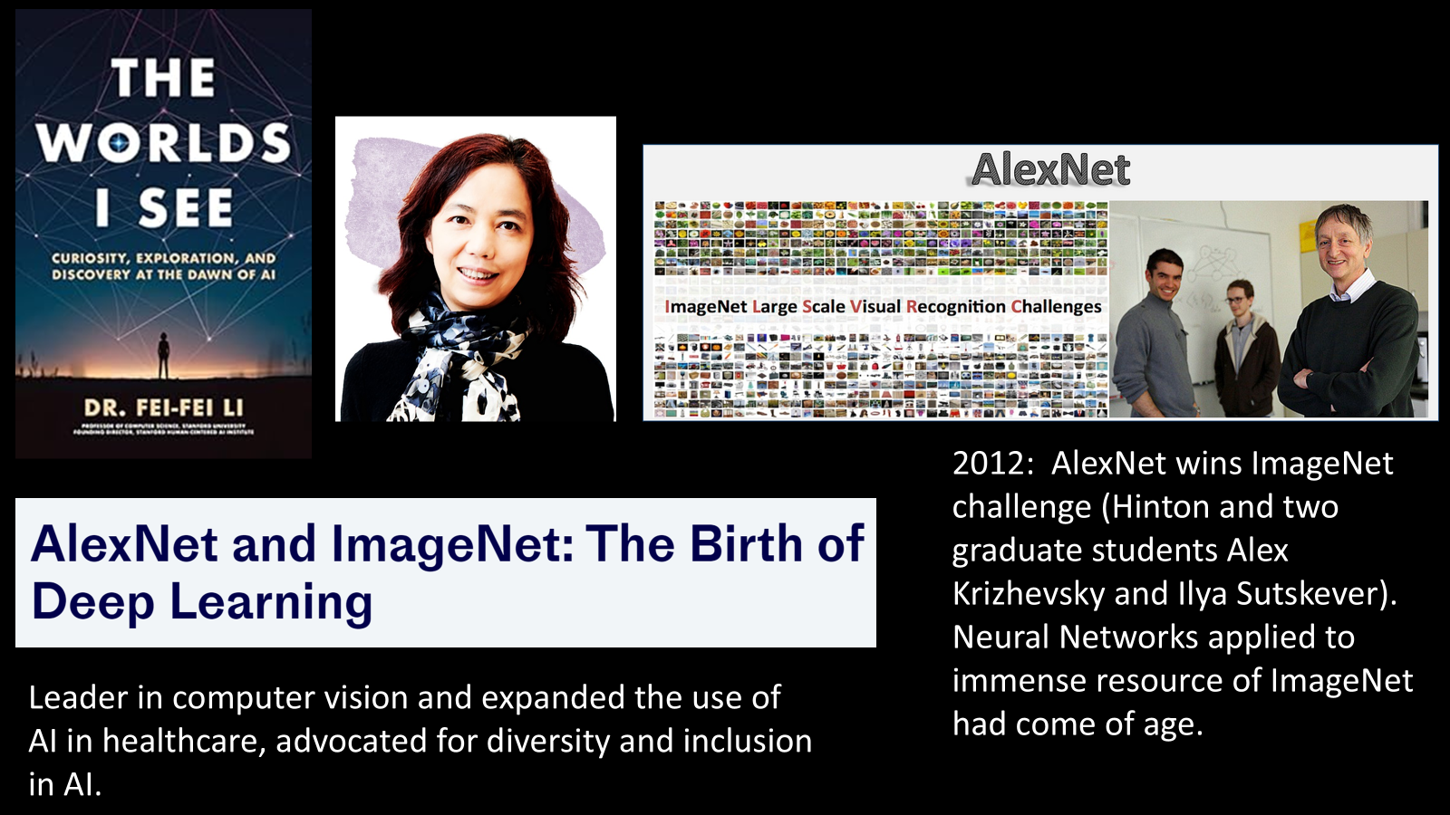

Slide 9
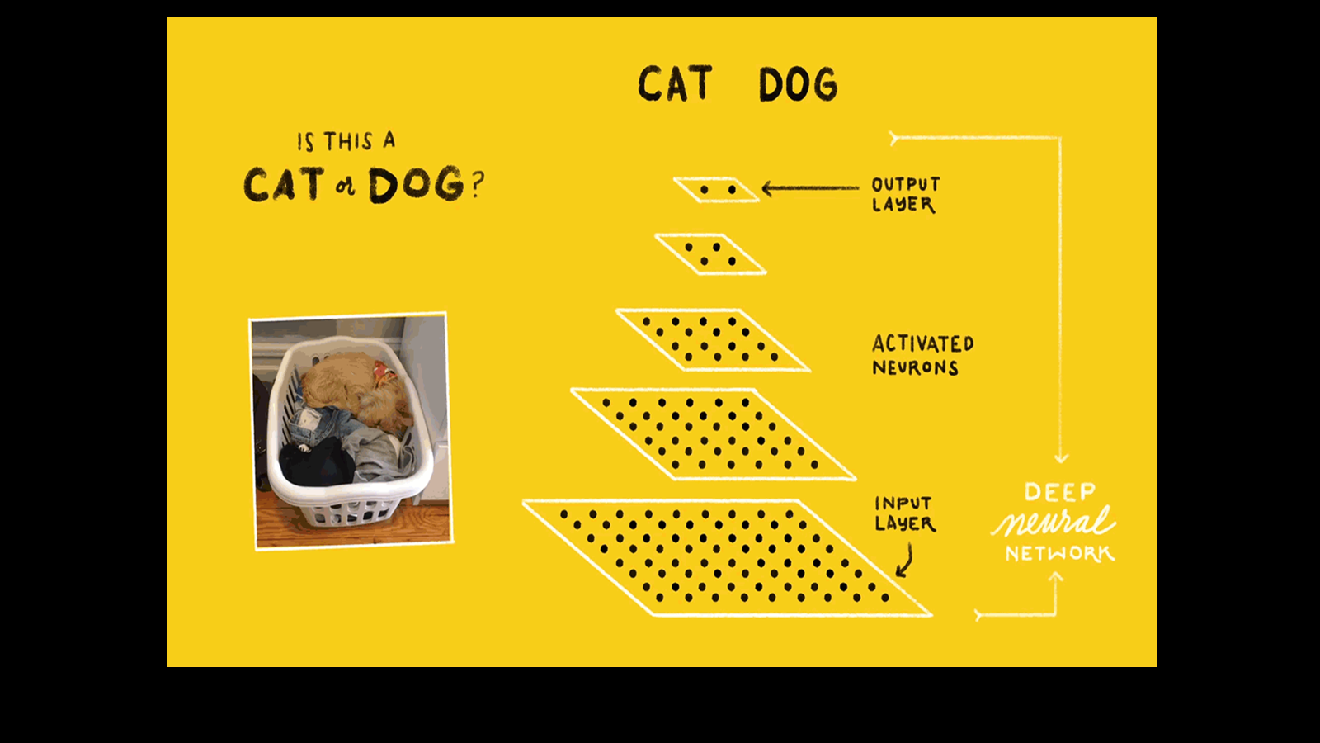

Slide 10
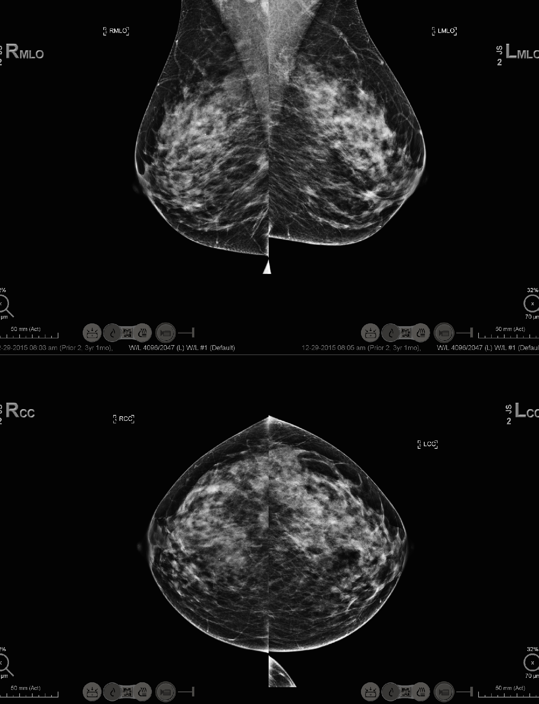
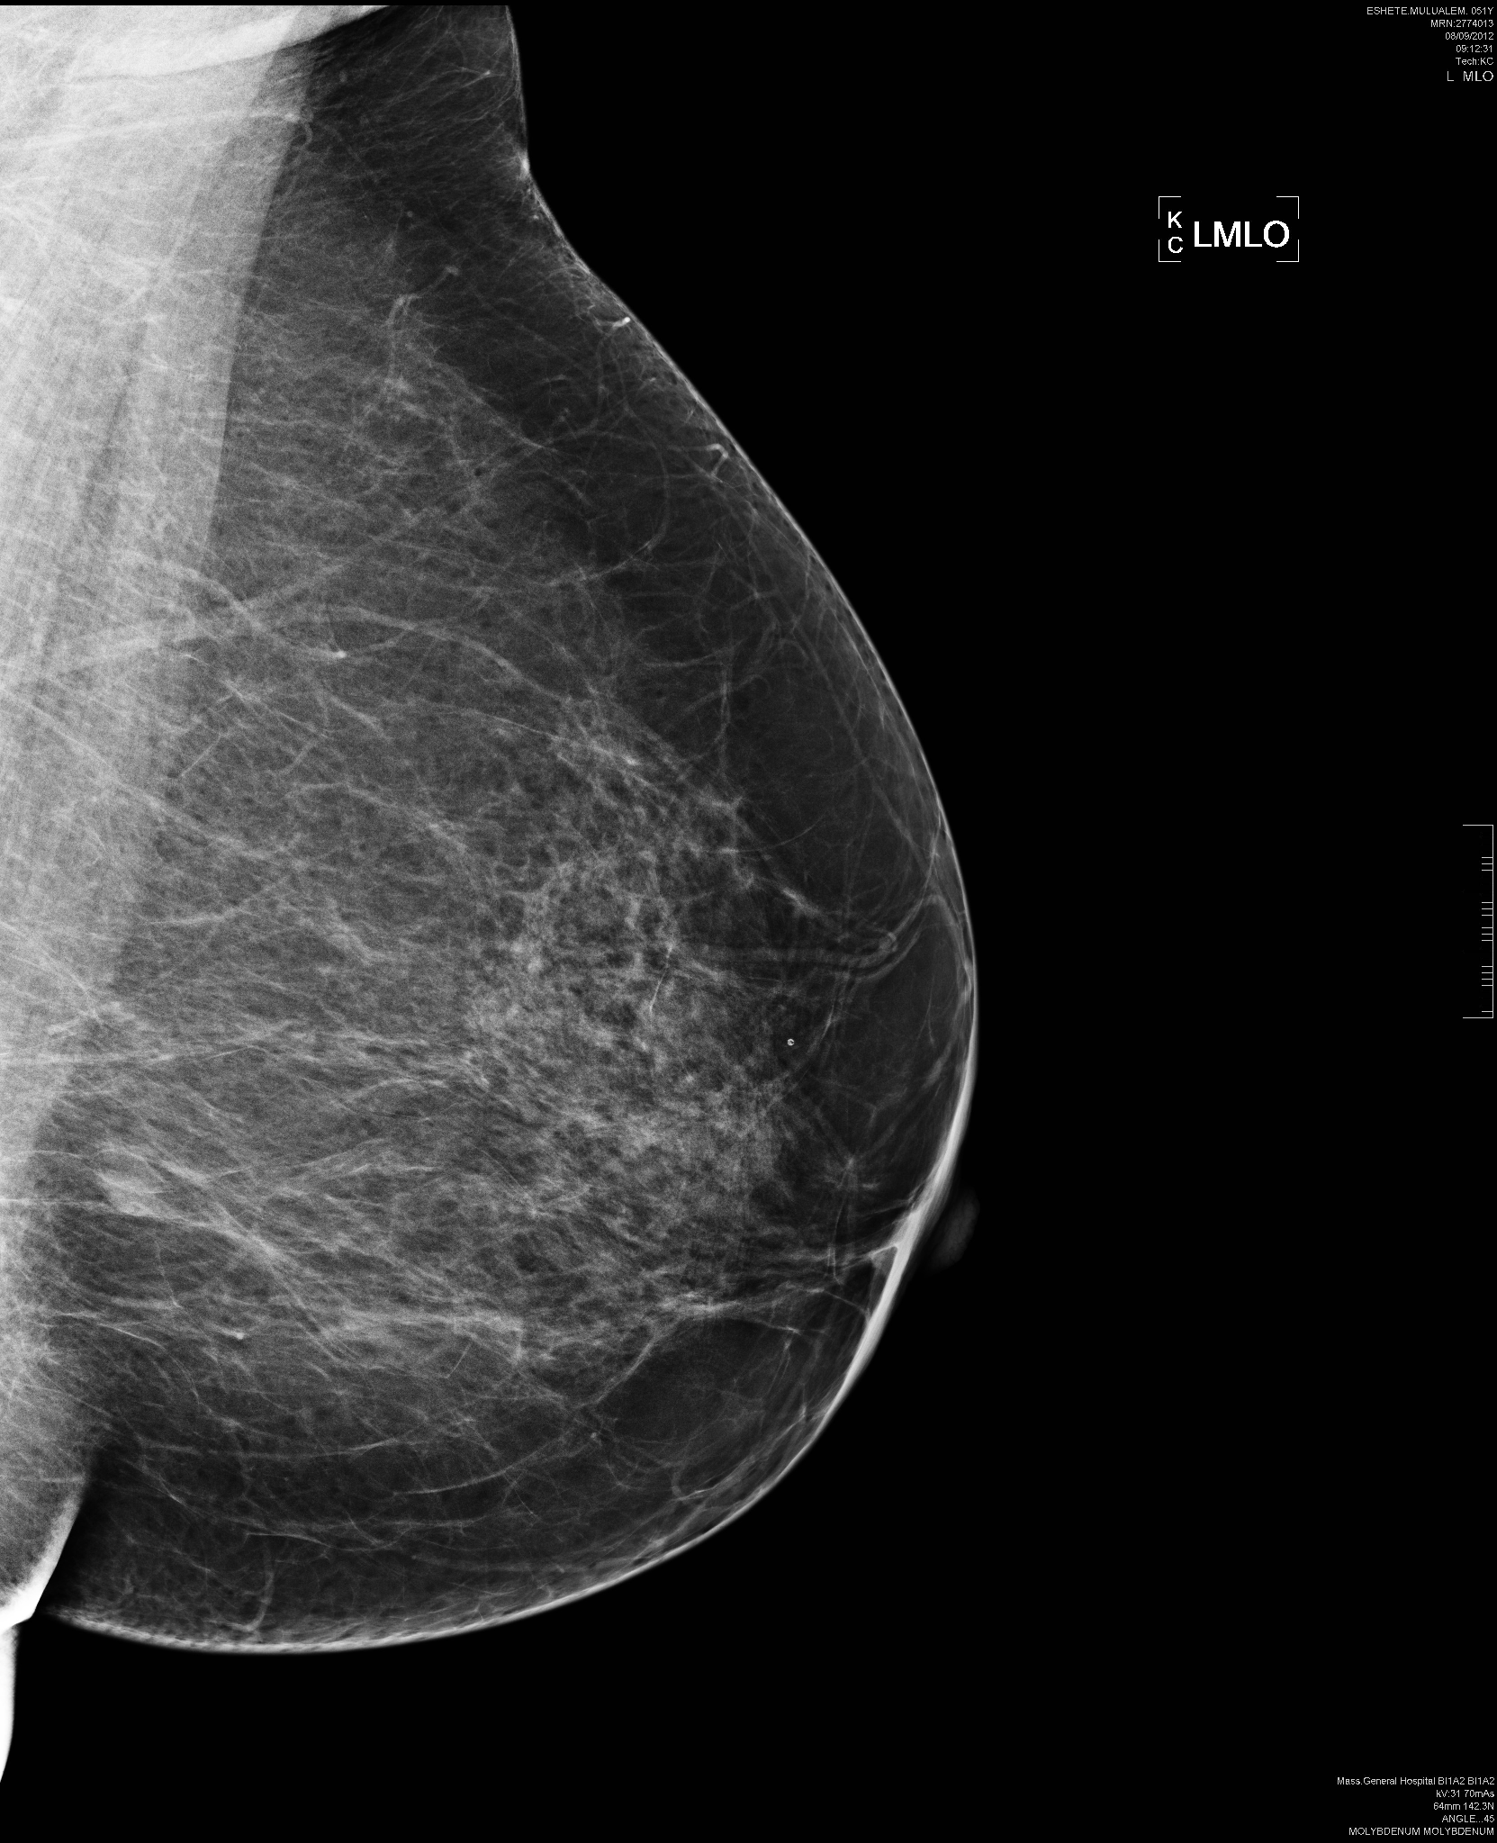
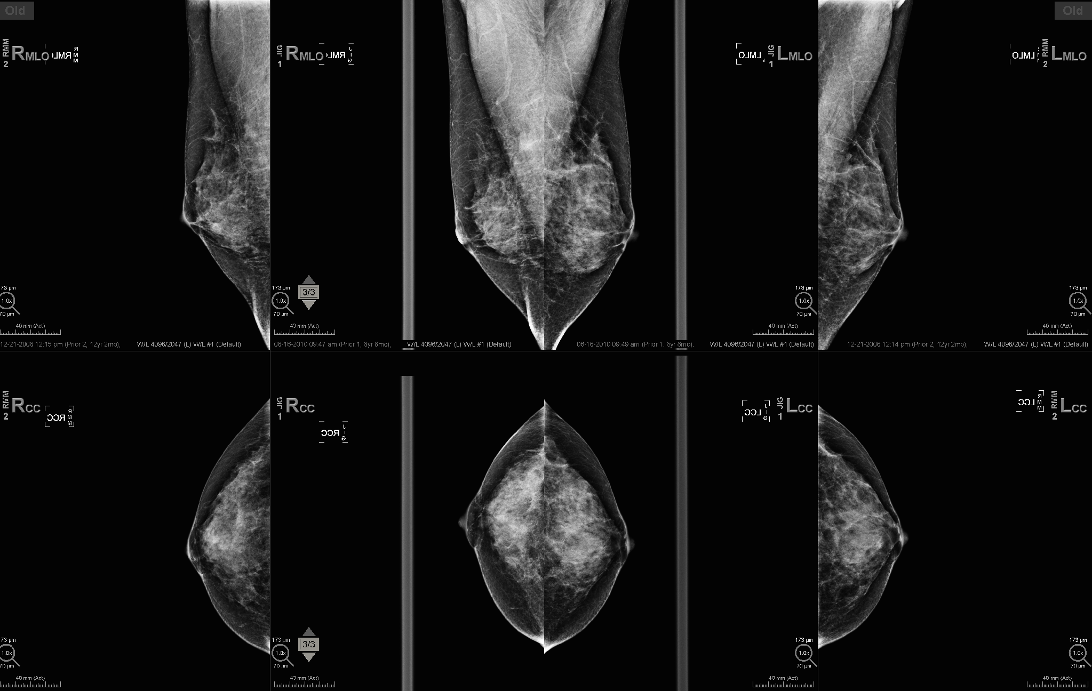
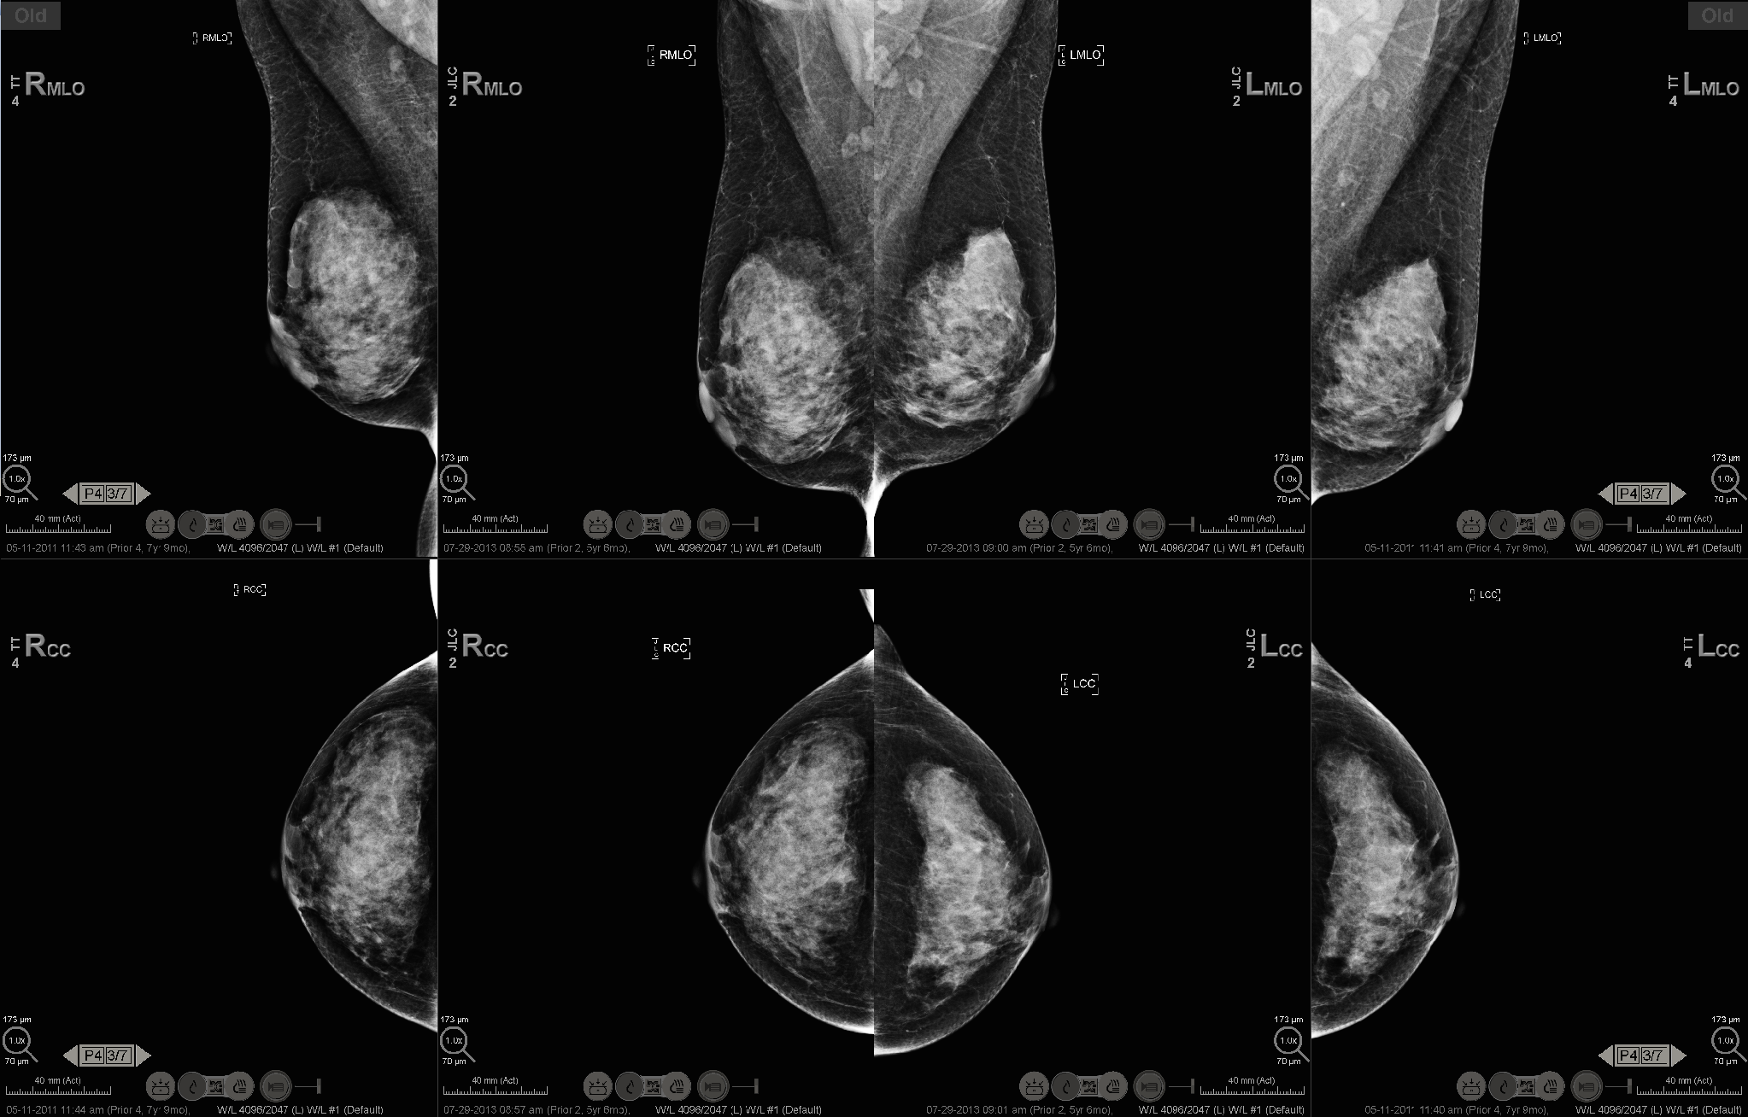
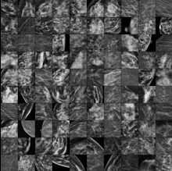
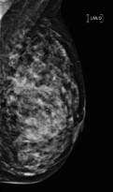
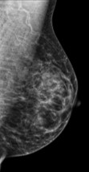
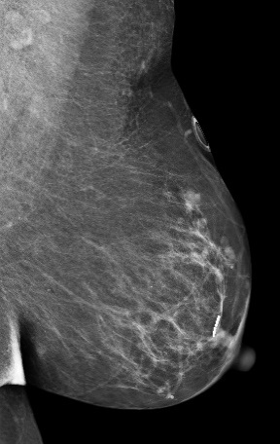
Performance
Leverage computer vision, power of AI, to extract more information than breast density or lesion (calcs, mass, distortion) presence
Notes:
So let’s do that with mammogram.s Let’s use the same techniques with images not of cats or dogs but of mammograms accurately labelled…in this case cancer now (interpret) or cancer out in the future –say 5 years in the future—assessing future risk. Current breast cancer risk models incorporate only a small fraction of patient data available ---family history, prior biopsies, binary density assessment from the mammogram…. …..

Slide 11
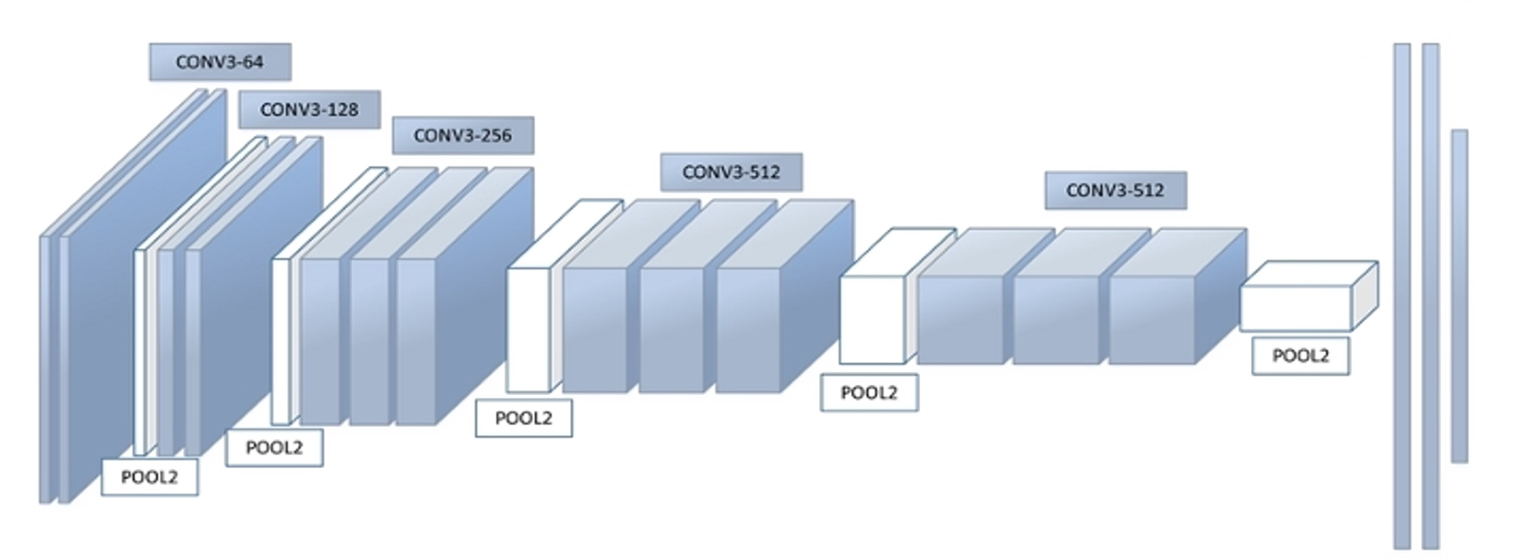
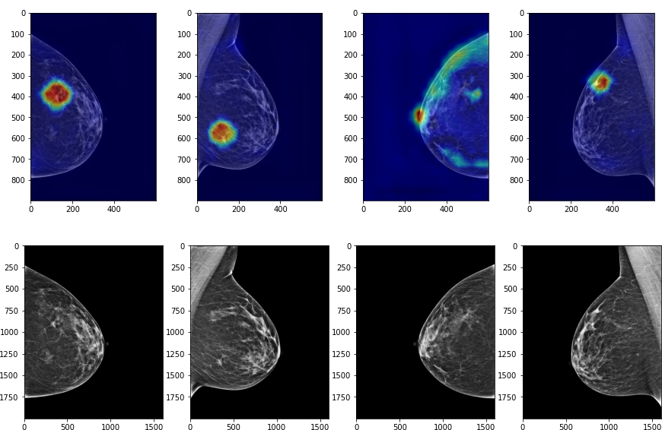
AI Unlocks Predictive Data at the individual patient level far beyond breast density
Input:
Mammogram
Radiomics
Output:
Clairity Risk Score
5-Year Breast Cancer Risk
Average Risk
Increased Risk
1.7%
3.2%
Patient: Jane Doe
Patient ID: 123953
Patient DOB: 9/5/1978
Accession #: D35395
Study Date: 4/4/2022
Increased Risk
Confidential — For Internal Use Only — June 2026

Slide 12




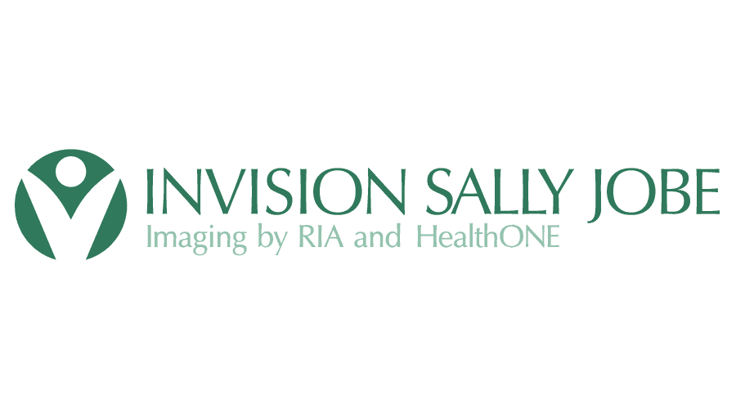


Model Development: Built and tested to support population health and full spectrum of women at risk for breast cancer.
421,499 screening mammograms from international clinical partners used for model development
122,993 independent U.S. screening exams not seen during model training
Exam Splits
for Modeling
Image and Clinical
Data Collection
Outcomes
Labeling
421,499
Model Training &
Validation
Computer
Vision AI
Calibration
122,993
External Validation
Cohort
Performance
Evaluation
Confidential — For Internal Use Only — June 2026
Notes:
421

Slide 13

Published in final edited form as: J Am Coll Radiol. 2024 February; 21(2): 319 to 328. doi: 10.1016/j.jacr.2023.10.018
AI image-based risk models consistently outperform traditional clinical risk models in multiple peer-reviewed scientific publications
Artificial Intelligence-Driven Mammography-Based Future Breast Cancer Risk Prediction: A Systematic Review
Schopf CM, Ramwala OA, Lowry KP, Hofvind S, Marinovich ML, Houssami N, Elmore JG, Dontchos BN, Lee JM, Lee CI. University of Washington School of Medicine and collaborators.
Median max AUC
Max AUC range
Risk factors only (non-AI)
0.61
0.54 to 0.69 (n = 10)
Imaging only (AI)
0.72
0.62 to 0.90 (n = 14)
+0.01
from adding clinical risk factors to the image
Imaging + risk factors (AI)
0.73
0.66 to 0.84 (n = 7)
• Image-only AI models consistently outperform traditional clinical models, identifying women at increased risk for breast cancer with greater precision and accuracy
14
Schopf CM, et al. Journal of the American College of Radiology, 2024;21(2):319-328.
Confidential — For Internal Use Only — June 2026

Slide 14
AI Image-Based Risk predicts invasive cancer and DCIS from the mammogram alone: Attention to impact of methodology on estimates
THE VALIDATION
THE RESULT, 5-YEAR AUC(t)
163,262
U.S. sites (154,316 exams)
Invasive
0.71
bilateral 2D screening exams, five U.S. sites and one European site, 2011 to 2016
DCIS
0.68
3,234
European site (8,946 exams)
cancers diagnosed within 5 years of the index exam (2.0%)
Invasive
0.78
Invasive 2,260
DCIS
0.78
70%
30%
Axis begins at 0.50, the level of chance
DCIS 974
16
Lehman CD, Kuhl C, et al. AI risk model for prediction of invasive and DCIS breast cancers in U.S. and European screening populations. RSNA 2025, Abstract S3A-SPBR-1. Overall AUC(t) 0.71 (95% CI 0.70 to 0.72); invasive 0.72; DCIS 0.68; p < 0.001.
Confidential — For Internal Use Only — June 2026

Slide 15
7
AI-predicted risk group
Precision screening by risk, not age
Average risk (below 1.7%)
Intermediate risk (1.7% to below 3.0%)
6.1
6
High risk (3.0% and above)
• Six U.S. sites and one European site
5
4.9
• 255,000+ screening mammograms, 2011 to 2016, with 5-year follow-up
4.2
4
3.7
Observed 5-year cancer incidence (%)
• Turnbull estimator for time-to-event data with interval censoring; log-rank tests for group comparisons
3.0
3
2.7
2.2
2
1.6
1.7
1.8
Mammography-based risk assessment, not age, is key to value-based, precision mammography screening.
1.1
1.3
1
0
Scientific presentation, Radiological Society of North America, Chicago, 2025.
Under 40
40 to 49
50 to 69
70 and over
Age at screening
Bar heights show the percentage of women in each age group and AI-predicted risk category diagnosed with breast cancer within five years of screening. Differences by risk group were statistically significant in every age group (log-rank p < 0.001).
13
Confidential — For Internal Use Only — June 2026

Slide 16
AI Image-based breast cancer risk far exceeds breast density in identifying women who may benefit from supplemental testing
Unadjusted
Adjusted
5
AI based risk assessment
4.5
4.5
245,000+
screening mammograms, 2011 to 2016, with 5-year follow-up
4
3
Mammography-based AI risk, not density, is key to value-based, precision breast cancer screening.
2.1
2.0
2
Density based risk assessment
1.2
1.1
1
0
Dense breast tissue
Intermediate AI risk
High AI risk
19
Scientific presentation, Radiological Society of North America, Chicago, 2025. Adjusted and unadjusted estimates as presented.
Confidential — For Internal Use Only — June 2026

Slide 17
SUPPLEMENTAL MRI ROUTING | DENSITY C/D VS CLAIRITY IMAGE BASED RISK
AI Image-Based risk routing halves the cost of every additional cancer found
44%
$32M
2.0x
fewer women routed
to supplemental MRI
saved per 100,000
women screened
cancers detected
per 1,000 MRIs
Density C/D
58,351
Density C/D
$70.2M
Density C/D
2.4
Clairity risk
32,416
Clairity risk
$38.6M
Clairity risk
4.8
1. Cohort: 120,215 screening mammograms across six practices, 1,121 cancers within two years. Clairity high risk = 32,579 women (27.1%) and 786 cancers (70.1%); density C/D = 58,644 women (48.8%) and 578 cancers (51.6%).
2. Rates: MRI eligible N = 58,351 (density C/D) vs 32,416 (Clairity). MRI cost $84.4M vs $46.4M across 120,215 women screened, a $38.0M difference, which is $316 per woman screened or $31.6M per 100,000. Total program cost $147.5M vs $109.5M.
3. Model: total program cost includes the mammography program ($63.1M with no supplemental MRI); commercial rates under age 65, Medicare at 65 and over. Incremental cancers measured against the 896 baseline; BCSC mammography sensitivity by density, MRI sensitivity from meta analysis; full adherence assumed. Dollars reflect this population and fee schedule.
Source: capstone analysis, “Seeing Past Density: Economic and Clinical Utility of Clairity Risk Based Breast Cancer Screening” (Hou, Rajagopalan, Yao, O’Rourke, Harrington; faculty advisor Y. Shieh).
Confidential — For Internal Use Only — June 2026
Notes:
Rate math, for questions on extrapolation. The $38.01M difference in MRI spend is spread across the full screened population of 120,215 women, which is $316 per woman screened, or $31.6M per 100,000 women screened (shown as $32M on the slide). Scale it to plan size: a plan screening 250,000 women a year would save roughly $79M, and a million lives screened saves roughly $316M. If asked why the slide does not say $38M, that figure belongs to this study cohort of 120,215; restating it per 100,000 is what makes it portable. The same divisor applies to total program cost, since the underlying mammography spend of $63.06M is common to both strategies.
Per 100,000 women screened, MRI spend is $70.2M under density C/D versus $38.6M under Clairity risk routing, equivalent to $702 versus $386 per woman.
Underlying figures. Density C/D: 58,351 eligible, $84.42M MRI cost, $147.48M total program cost, 1,038 cancers (142 incremental), 2.4 incremental cancers per 1,000 MRIs, $0.60M per additional cancer. Clairity high risk: 32,416 eligible, $46.41M MRI cost, $109.47M total program cost, 1,050 cancers (154 incremental), 4.8 incremental cancers per 1,000 MRIs, $0.30M per additional cancer. Common baseline with no supplemental MRI: 896 cancers at $63.06M.
Points to make verbally, now that they are off the slide. Clairity routing spares 25,935 women an MRI they do not need while total cancers detected still rises from 1,038 to 1,050. Total program cost falls 26%. Cost per additional cancer detected is halved, $0.30M versus $0.60M.
Mechanism: density is a weak triage variable because risk is heterogeneous inside every density category. Within density C alone, MRI yield runs 0.66 per 1,000 for average risk women versus 6.14 per 1,000 for high risk women, roughly a ninefold spread that density cannot see.
Limits to raise proactively: absolute dollars are specific to this population and fee schedule, the model assumes full MRI adherence, and downstream costs (biopsy, stage shift, treatment, QALYs) are not captured. Next step is a cost effectiveness extension with Markov modeling and breakpoint pricing for the Clairity test.

Slide 18
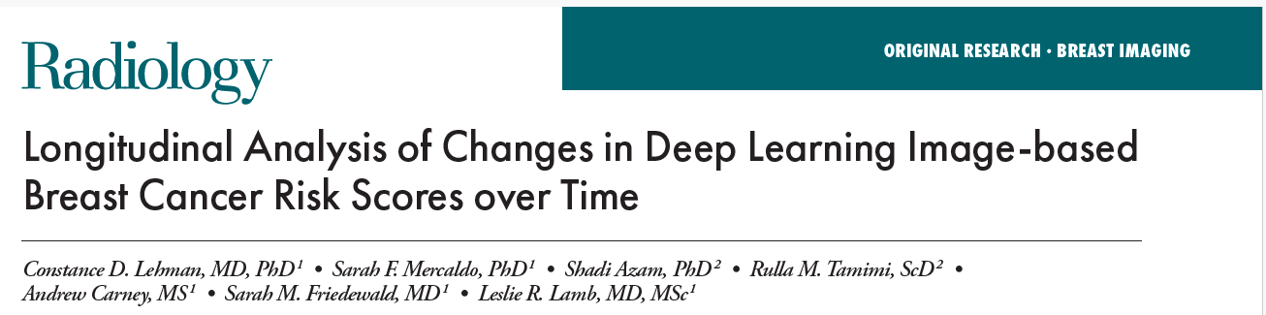

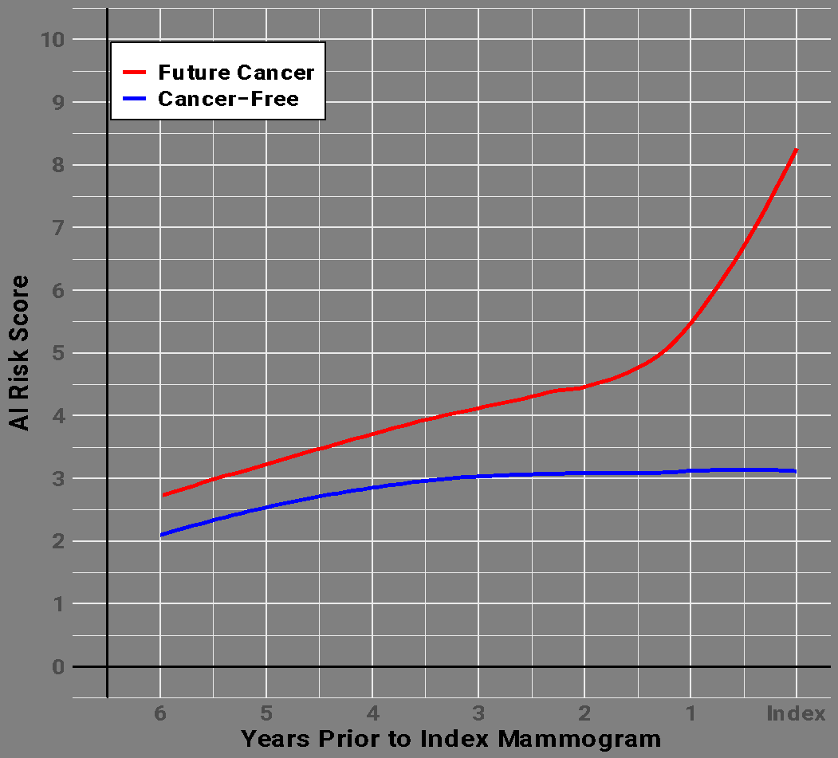
AI image-based risk is a DYNAMIC risk score: increases in a patient’s risk score evident 4-5 years before cancer is diagnosed
This provides an opportunity to develop more effective treatments to prevent cancer, tailored to the individual woman’s response
Serves as an intermediate marker of cancer risk to support more rapid and more effective drug development in the domain of chemoprevention of breast cancer
Confidential — For Internal Use Only — June 2026
Notes:
NOTE THIS WAS NOT SHARED at 5 2025 presentation…I am only including here for our internal reference and I will send abstract that goes with this….from our MGH study supported by the BCRF

Slide 19
NCCN v1.2026 national guidelines now incorporate
image-derived risk as a formal determinant of increased-risk classification
NEW v1.2026
NCCN SCREENING PATHWAY
WHAT THIS SIGNALS
Clinical Encounter + General Risk Assessment (from age 25)
Medical & family history · CBE · Breast density from prior mammogram
For the first time, image-derived risk is a formal NCCN determinant of increased-risk classification. FDA authorization is required in the US for image-based breast cancer risk model use outside of research studies. Clairity Breast is the only model with FDA authorization (June 2026).
Apply risk assessment inputs (one or more may apply):
Genetic predisposition / pedigree
Lifetime risk model ≥20% (family hx)
Prior chest radiation (ages 10–30)
ADH / lobular neoplasia (LCIS/ALH)
1
Risk is directly linked to clinical action
AI Image-Based RIsk (NEW · BSCR-4)
≥1.7% 5-year invasive
breast cancer risk
Crossing the ≥1.7% threshold triggers a mandatory protocol change — more frequent encounters, supplemental MRI consideration, and active risk-reduction referral.
For individuals ≥35 · imaging-based 5-yr risk · no additional visit
Risk classification result:
2
Reassessment is built into the pathway
NCCN explicitly mandates periodic reassessment as risk factors change. This moves breast cancer screening from a one-time classification to a continuous, longitudinal model.
AVERAGE RISK
INCREASED RISK
Annual mammo ≥40
Enhanced protocol
3
Actionable identification starts at age 35
NCCN-Mandated Clinical Actions (BSCR-4)
The imaging-based pathway creates a clinical entry point five years earlier than standard mammography eligibility — identifying high-risk individuals who would otherwise be missed until age 40.
→ Clinical encounter every 6–12 mo · Annual mammogram with tomosynthesis
→ Consider annual breast MRI w/ contrast · CEM or MBI if unavailable
→ Risk reduction strategies · Periodic reassessment as risk factors change
Source: NCCN Guidelines for Breast Cancer Screening and Diagnosis, Version 1.2026, March 5, 2026. BSCR-1, BSCR-4.
Confidential — For Internal Use Only — June 2026

Slide 20
The Clinical Case for AI Image-Based Risk Assessment
01
02
03
04
05
Population-Based Breast Cancer Screening Is Proven—
But Not Perfect
Risk Assessment Helps Close Gaps —
When Women Are
Correctly Identified
But Existing Tools
Miss Most of the
Women Who Need It
AI Solves It—
No Subjectivity.
No Extra Data.
NCCN Included AI Risk in guidelines. Coding & Payment Now Follow
Applying the same screening protocol to all woman regardless of risk means low-risk women are over-screened and high-risk women - including younger women - are missed.
When high-risk women are identified and routed to enhanced screening, outcomes improve dramatically—more cancers caught earlier, and mortality falls.
Existing risk methods — from Gail / TC to density-based - rely on inputs that are incomplete, inaccurate, or poorly predictive of who actually develops cancer.
No family history. No patient data. No “blunt tool” density classification. Pure image signal — bringing objective precision to risk identification.
For the first time, imaging based risk assessment is a formal NCCN determinant. Guideline inclusion is a predicate for coding, and now ACR has sponsored a CPT Category III request.
1 in 2
14%
85%
4.5x
2026
women get a false positives over 10 years. ~50% sensitivity in dense breasts (40% of the U.S.). High cost. High-risk women still missed.
directional mortality
reduction from
risk-stratified screening
of breast cancer patients have no family history. Also, density legislation well intended is routing millions to supplemental MRI that isn't finding cancer and missing women who would benefit
higher cancer incidence in AI high-risk vs. average-risk women. Outperforms Gail / Tyrer-Cuzick on predictive accuracy (AUC 0.72 vs. 0.61).
NCCN V.1.2026 confirmed. ACR sponsored CPT Cat III under AMA panel review, September 2026.
USPSTF meta-analysis
RCT data
Dense breasts = independent risk factor
Yen et al.
JAMA Oncology
n=1,429,890 women
American Cancer Society
Breastcancer.org
Lehman et al. RSNA 2025 | n=245,344 | NCCN-cited systematic review
Independent Consensus-based
Proven clinical utility | Independent NCCN guideline inclusion | No incremental utilization | Downstream care already reimbursed | The evidence pathway is complete.
Proven clinical utility | Independent NCCN guideline inclusion | No incremental utilization | Downstream care already reimbursed | The evidence pathway is complete.
Sources: NCCN V.1.2026 | Yen et al. JAMA Oncology (n=1,429,890) | Lehman et al. RSNA 2025 (n=245,344) | USPSTF Mammography Systematic Review | American Cancer Society
Confidential — For Internal Use Only — June 2026

Slide 21
