Slide 1

From EHR-Based Cancer Risk Prediction to Clinical Impact
Jiheum Park
Assistant Professor
Weill Cornell Medicine
Department of Population Health Sciences
Division of Health Informatics and Artificial Intelligence
2026.09.23 NCI 15th EDRN Scientific Workshop
Notes:
Wednesday Sept 23, from 1:45- 4:30 and your talk is tentatively scheduled from 3:00-3:25 (20 min presentation 5 min Q&A) followed by a panel discussion that includes all the speakers (3:50-4:20 PM).

Slide 2
From Single-Cancer Prediction to Scalable EHR Modeling
NCI, R21 (2021 – 2023)
Title: Domain-Knowledge Informed Deep Learning for Early Detection of Pancreatic Cancer
NCI, K25 (2023 – 2028)
Title: Early Detection of Pancreatic Cancer with Human-in-the-Loop Deep Learning
Department of Defense, TRPA (2025 – 2028)
Title: Enhancing Early Detection of Pancreatic Cancer Using GPT-Embedded EHR Models: A Novel Approach for Improved Predictive Performance and Interpretability
NIBIB, R01 (2026 – 2030)
Title: Scalable Multi-Cancer Early Detection Using EHR Foundation Model with Interactive Clinical Explanations

Slide 3
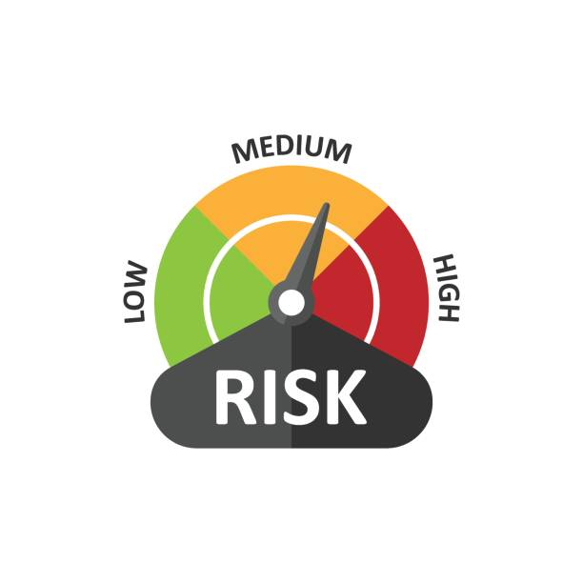






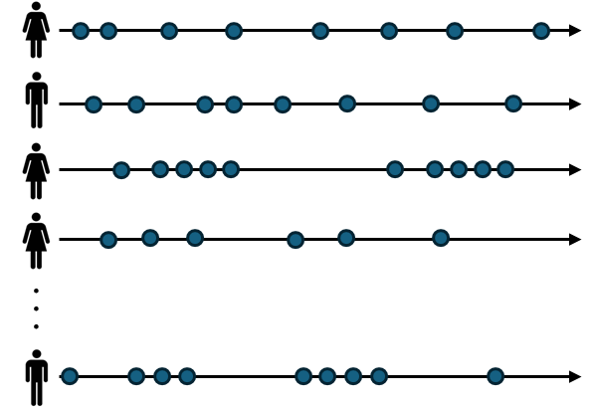



Multi-Cancer Prediction with Clinician Interaction
Patient Medical History
Patient Representation
Breast cancer cohort
0.1, 0.5, 0.4, 0.8, 0.1,…,0.1
0.7, 0.3, 0.5, 0.1, 0.1,…,0.5
0.5, 0.5, 0.1, 0.5, 0.8,…,0.1
0.2, 0.7, 0.1, 0.4, 0.4,…,0.4
0.6, 0.7, 0.7, 0.8, 0.3,…,0.7
0.1, 0.1, 0.9, 0.8, 0.6,…,0.4
0.4, 0.2, 0.1, 0.4, 0.3,…,0.1
0.4, 0.4, 0.3, 0.1, 0.6,…,0.7
0.2, 0.5, 0.4, 0.1, 0.4,…,0.4
0.8, 0.5, 0.6, 0.6, 0.6,…,0.1
Linear probing
Aim 1: Generalizable model
Lung cancer cohort
EHR
Foundation Model
Linear probing
…
Control group
…
Stomach cancer cohort
Linear probing
Aim 2: Multicancer prediction pipeline
Model information
EHR-to-text conversion and clinical notes
SOAP Note
S: 75-year-old male with history of hypertension, diabetes, and obesity presents with 1-month painless jaundice and weight loss.
O: Noted family history of pancreatic cancer and new-onset diabetes.
A: Likely pancreatic cancer; biliary obstruction less likely given subacute presentation.
P:MRI abdomen with and without contrast. If positive, proceed with endoscopic ultrasound
Aim 3: Interactive platform
for model interpretability
5% Weight Loss
How much weight has the patient lost and over what period?
Over 6 months

Slide 4
Outline
How can EHR data support early cancer detection?
Do EHR-based prediction models offer clinical utility?
How can we make the model interpretable and clinically actionable

Slide 5
How can EHR data support early cancer detection?

Slide 6

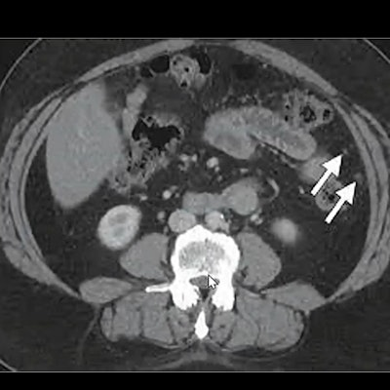

Leveraging EHR Data To Enrich High-Risk Cohorts For Early Detection
c
Electronic Health Record
General population
Age 50
Family history of cancer
Gene mutation
Diagnostic level
Treatment level
(t-1)-th Visit
EHR predictive model
Patient history
Physical exam
Lab tests
Imaging tests
Interventions
Prescription
. . .
Liquid biopsy
High-risk
Targeted screening
Cancer
Fatigue
Cough
Fever
Allergies
Past surgeries
Family history
Smoke
Drink alcohol
Exercise
Blood pressure
Breathing rate
Pulse rate
Temperature
Height
Weight
Blood count
Glucose
Sodium
Calcium
Cholesterol
Hemoglobin
Urinalysis
X-ray
MRI
CT scan
Ultrasound
Mammogram
Fluoroscopy
PET scans
Medicines
Physical therapies
Radiation therapies
Surgeries
Atrovastatin
Lisinopril
Albuterol
levothyroxine
High-risk
False positive
True positive
t-th Visit
(t+1)-th Visit

Slide 7
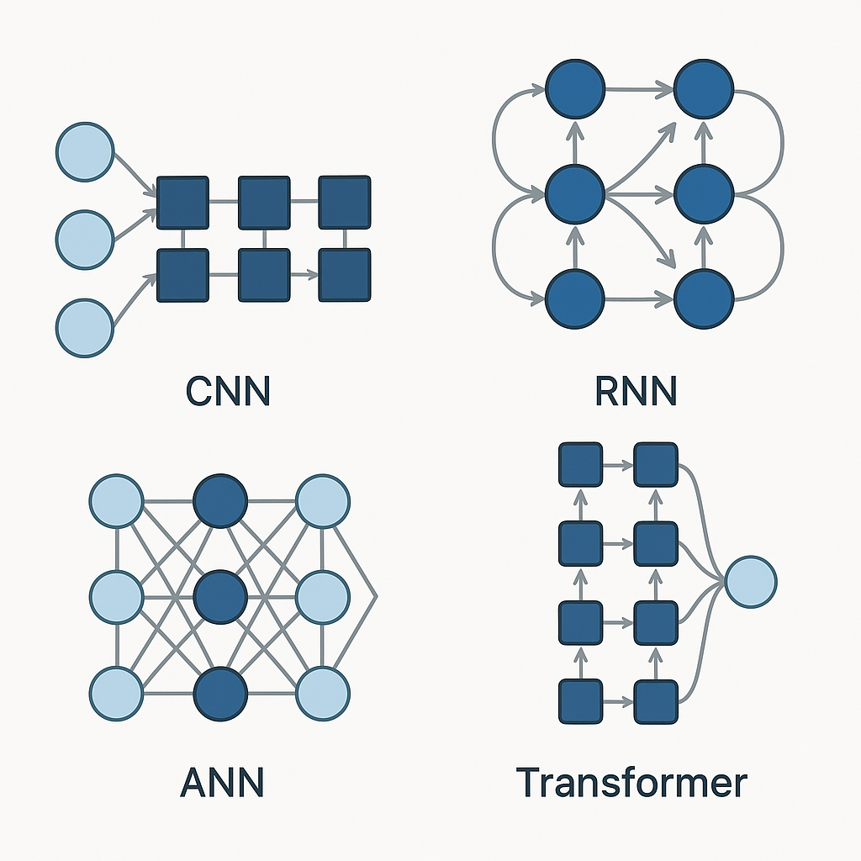

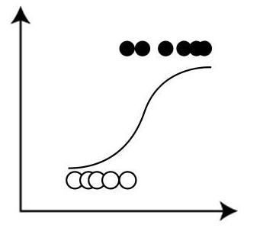
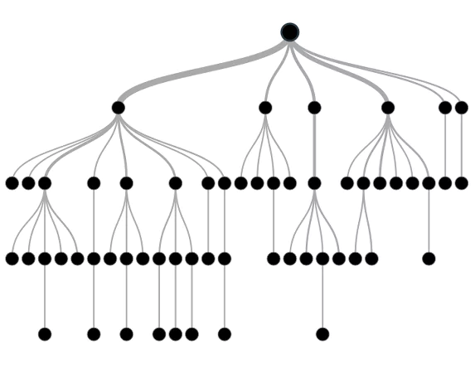
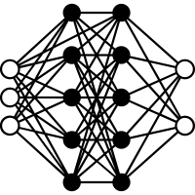
Approaches to building EHR predictive models
Logistic regression
Machine learning
Deep learning

Slide 8
Do EHR-based prediction models offer clinical utility?

Slide 9


Lift – Metrics to Compare EHR Model and Known Risk Factors
Lift measures the enrichment of true positives in the selected/classified group relative to their prevalence in the overall population.
$$Lift= \frac{PPV}{Prevalence}$$
where
$$PPV= \frac{TP}{TP+FP}$$
Park et al., 2025, npj Precision Oncology

Slide 10

Comparing EHR Models to Established Genetic and Familial Risk Factors
Cancer of the Pancreas Screening Study (CAPS)
Eligible participants
Inherited mutation in the following genes: ATM, BRCA1, BRCA2, FAMMM, PALB2, Lynch syndrome (EPCAM, MLH1, MSH2, MSH6, PMS2), hereditary pancreatitis (PRSS1/2, or CTRC), STK11 (Peutz-Jeghers)
Family history of PC: With two or more close relatives, on one side of their family tree, diagnosed with pancreas cancer
Survey
ATM | 707
BRCA1 | 947
BRCA2 | 1575
FAMMM | 0
PALB2 | 376
EPCAM | 28
MLH1 | 104
MSH2 | 92
MSH6 | 333
PMS2 | 436
PRSS1 | 45
PRSS2 | 0
CTRC | 128
STK11 | 0
Total 4738 carriers
 | Case | Control
Pancreas | 358 | 173386
Physical measurement
Wearable
Prediction time index
Case: 12 months before cancer diagnosis
Control: 2 years before the last medical condition
867,000+
Training
Split data
Test
80%
20%
EHR model
Hypothetical general population
Test
Genomics
EHR
611,000+
472,000+
Park et al., 2025, npj Precision Oncology

Slide 11
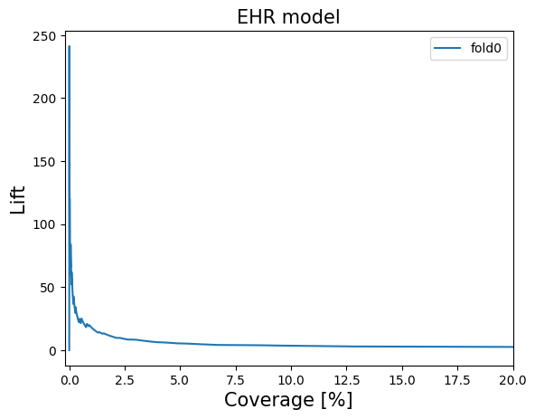
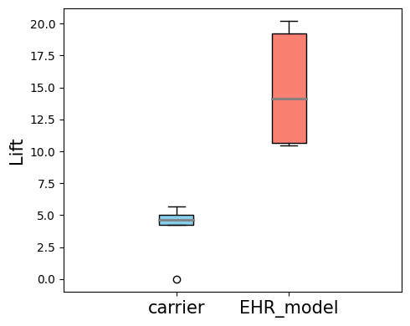
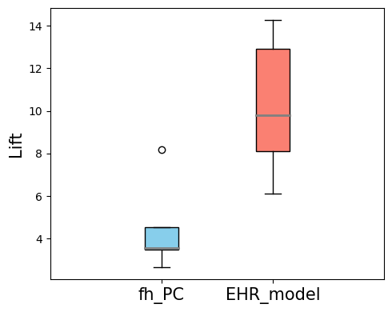
EHR Models Substantially Enrich High-Risk Group
 | coverage | HR group | PC in HR group | Prevalence (per 100,000) | Lift
baseline | 100% | 34749 | 72 | 207 | 1.00
carrier^{ⴕ} | 0.8% | 292 | 3 | 1027 | 4.96
FH_any_cancer | 18.7% | 6514 | 12 | 184 | 0.89
FH_PC | 1.6% | 559 | 4 | 715 | 3.45
Hypothetical general population
^{ⴕ}Carrier: ATM, BRCA1, BRCA2, FAMMM, PALB2, Lynch syndrome (EPCAM, MLH1, MSH2, MSH6, PMS2), hereditary pancreatitis (PRSS1/2, or CTRC), STK11 (Peutz-Jeghers)
~0.8% coverage
~1.6% coverage
Lift = 20.2
Lift = 12.9
Substantial added value beyond traditional risk factors
0.8
1.6
Park et al., 2025, npj Precision Oncology

Slide 12
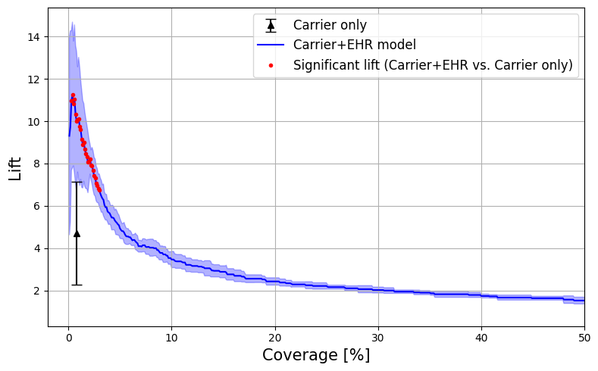
EHR Models Complement Traditional Risk Factors
Pancreatic cancer
RF: individuals with gene mutations (i.e., carrier)
Lift 6.74 [95% CI: 5.67-7.81]
RF alone
3%
Combining EHR model with RF
RF alone: 4.71 at 1% coverage
At 1% coverage: EHR model alone (15.3)→ EHR model + RF (6.74 [5.92-13.7]) @ 3% coverage
Park et al., 2025, npj Precision Oncology

Slide 13
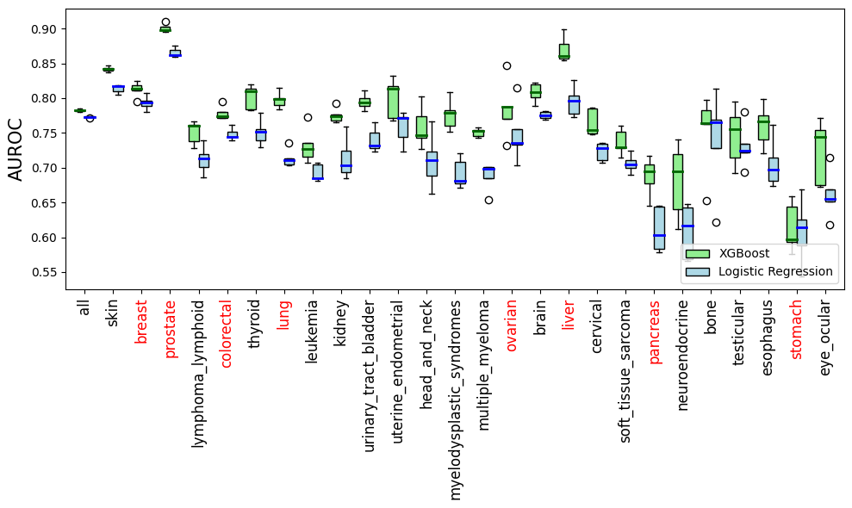
Extending EHR Prediction Across 26 Cancer Types
EHR model performance for predictions made 12 months prior to diagnosis.
All of Us
Total: 49 cancer types
Cancer cases>100: 26 cancer types
+
Park et al., 2025, npj Precision Oncology

Slide 14
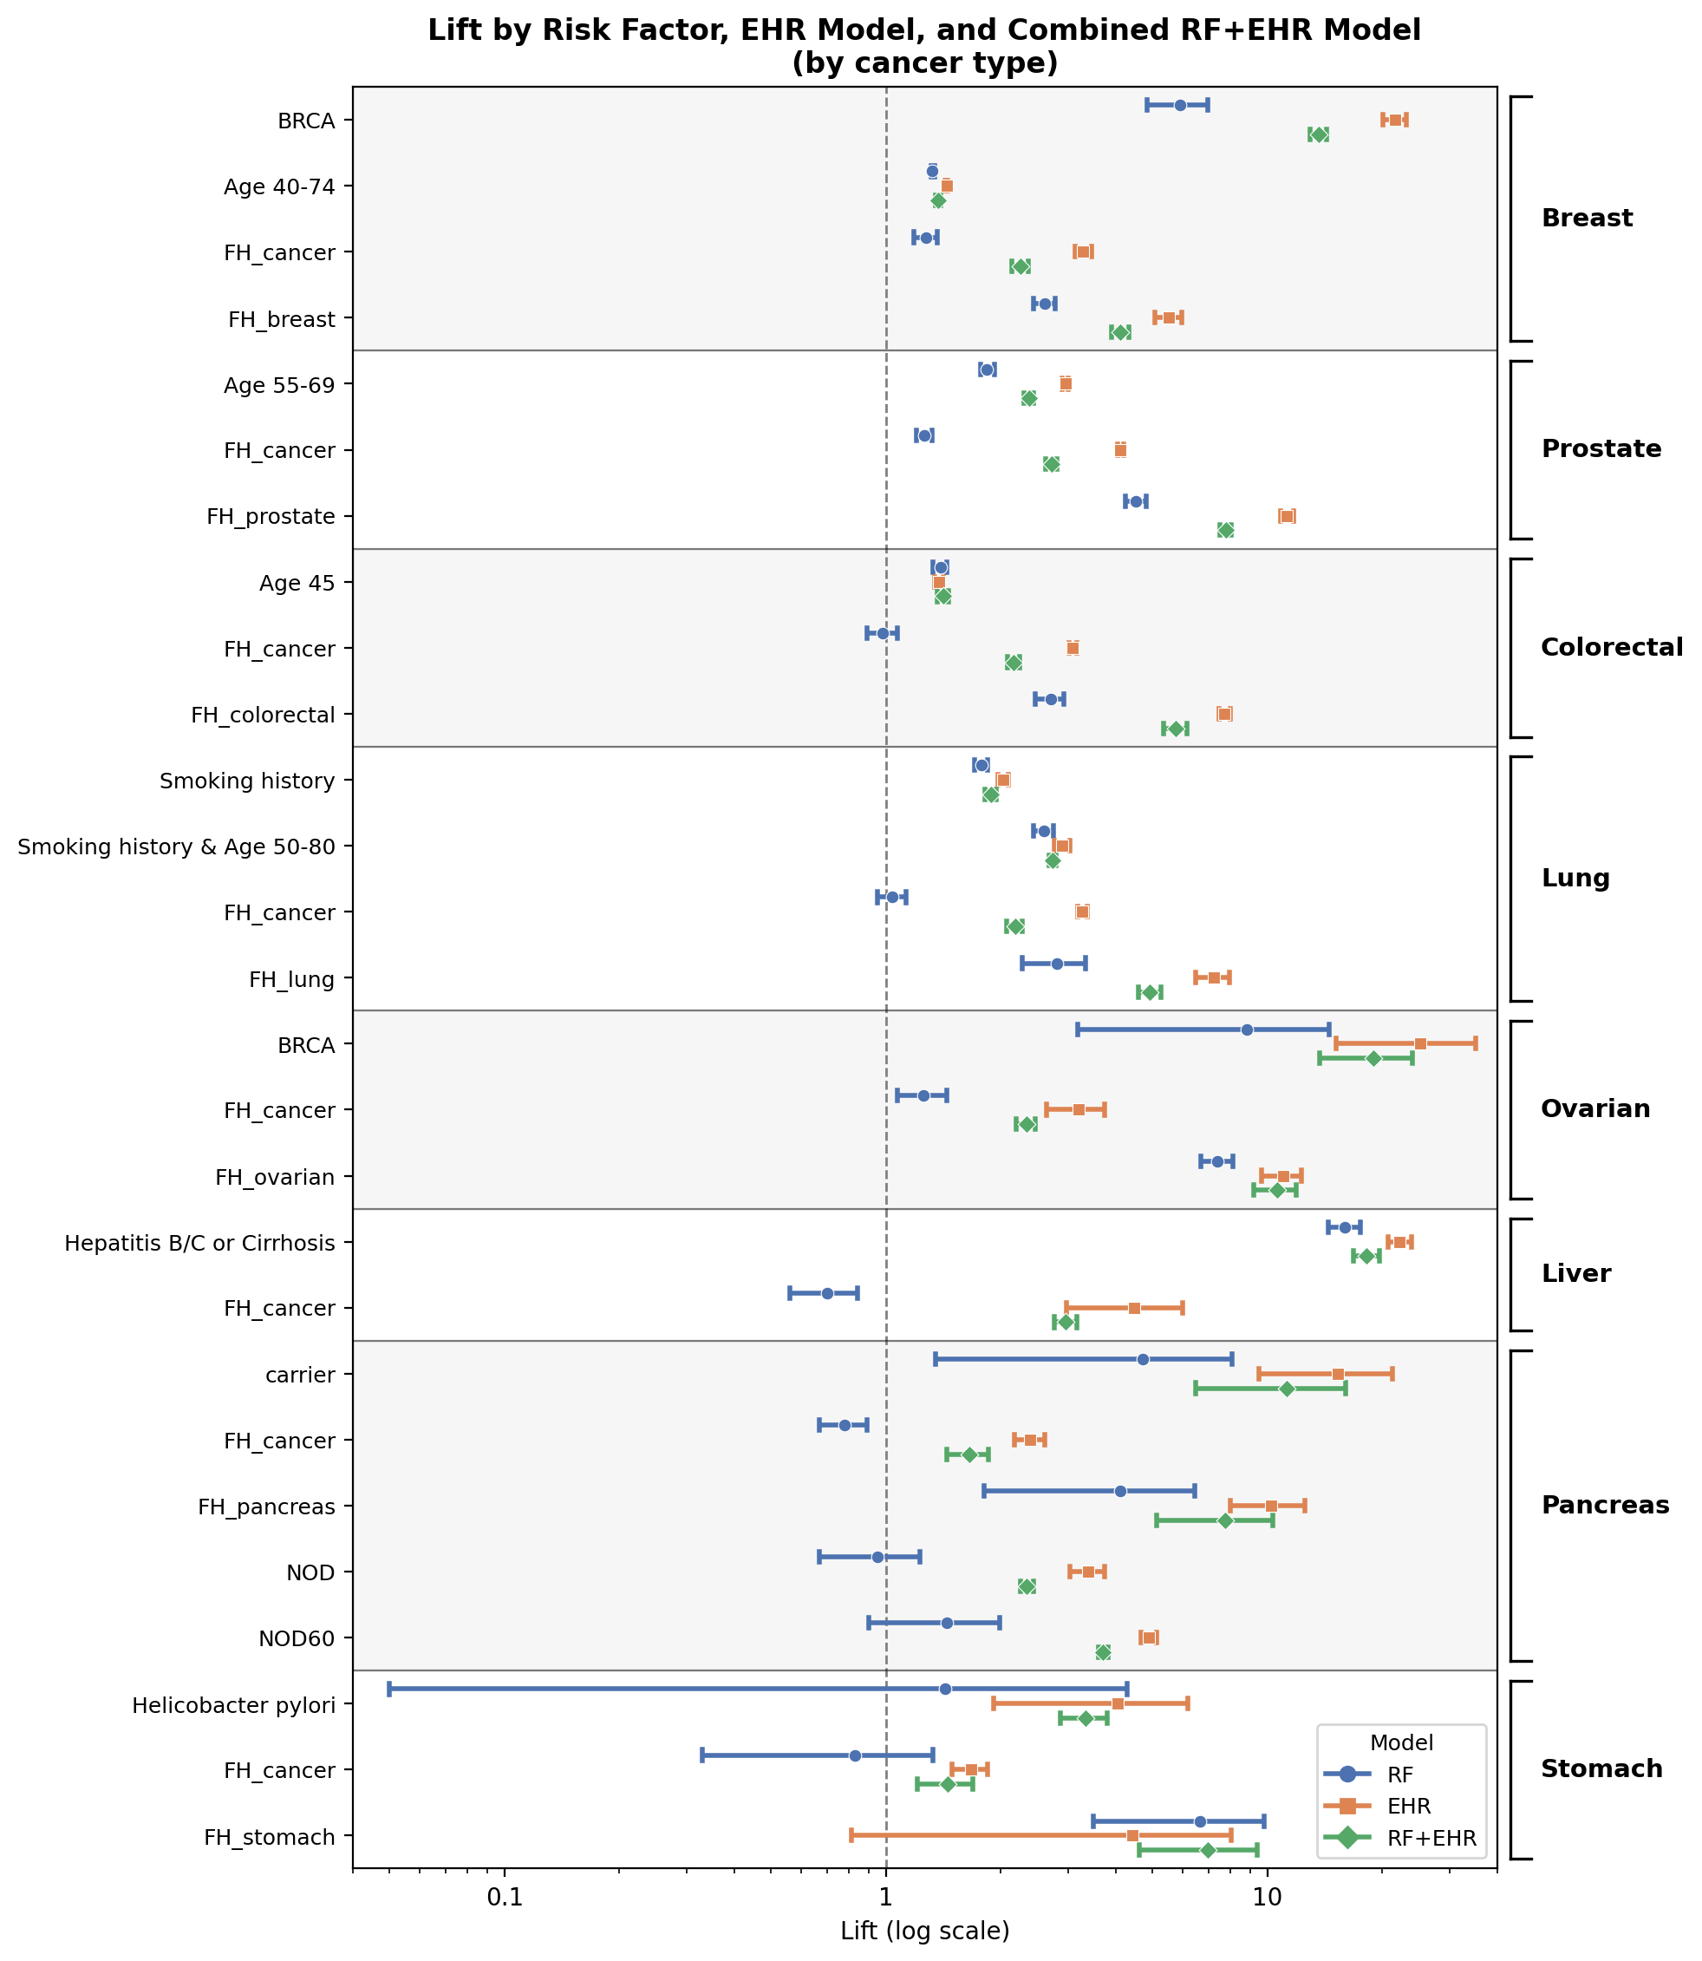
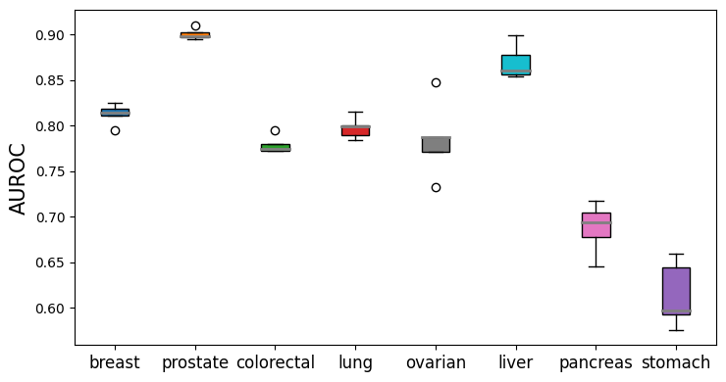
EHR Models Enrich and Broaden Detection of High-Risk Patients
Lift comparison
(Risk Factor vs EHR Model vs Combined RF+EHR model)
RF
BRCA
EHR
Age 40-74
Breast
RF+EHR
FH_cancer
FH_breast
Age 55-69
FH_cancer
Prostate
FH_prostate
Age 45
v
FH_cancer
Colorectal
FH_colorectal
Smoking history
Smoking history & Age 50-80
Lung
FH_cancer
FH_colorectal
BRCA
FH_cancer
Ovarian
FH_ovarian
Hepatitis B/C or Cirrhosis
Liver
FH_cancer
carrier
FH_cancer
FH_pancreas
Pancreas
New onset diabetes
New onset diabetes
New onset diabetes & Age 60
v
FH_cancer
Stomach
FH_stomach
Park et al., 2025, npj Precision Oncology
Lift (log scale)

Slide 15
From Baseline Models to Foundation Models
AI era
Logistic regression
Machine learning
Deep learning

Slide 16



Train Once, Predict Many: EHR Foundation Models
Traditional models
Breast
Training
Risk prediction
Lung
Pancreas
EHR Foundation Model
Colorectal
Linear regression
Stomach
Entire EHR data
Liver
Prostate
Amount of available labels

Slide 17
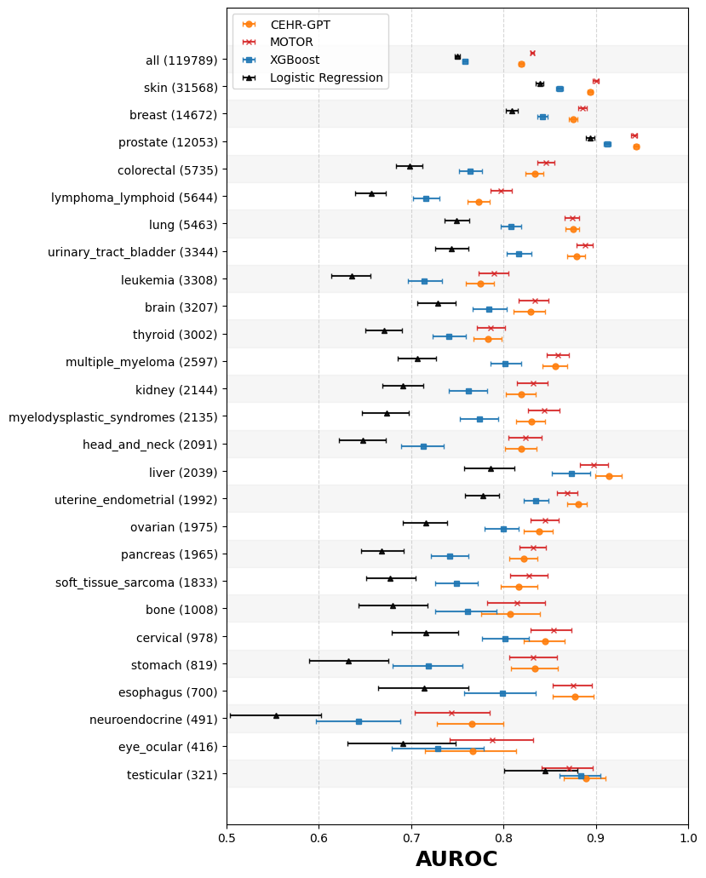
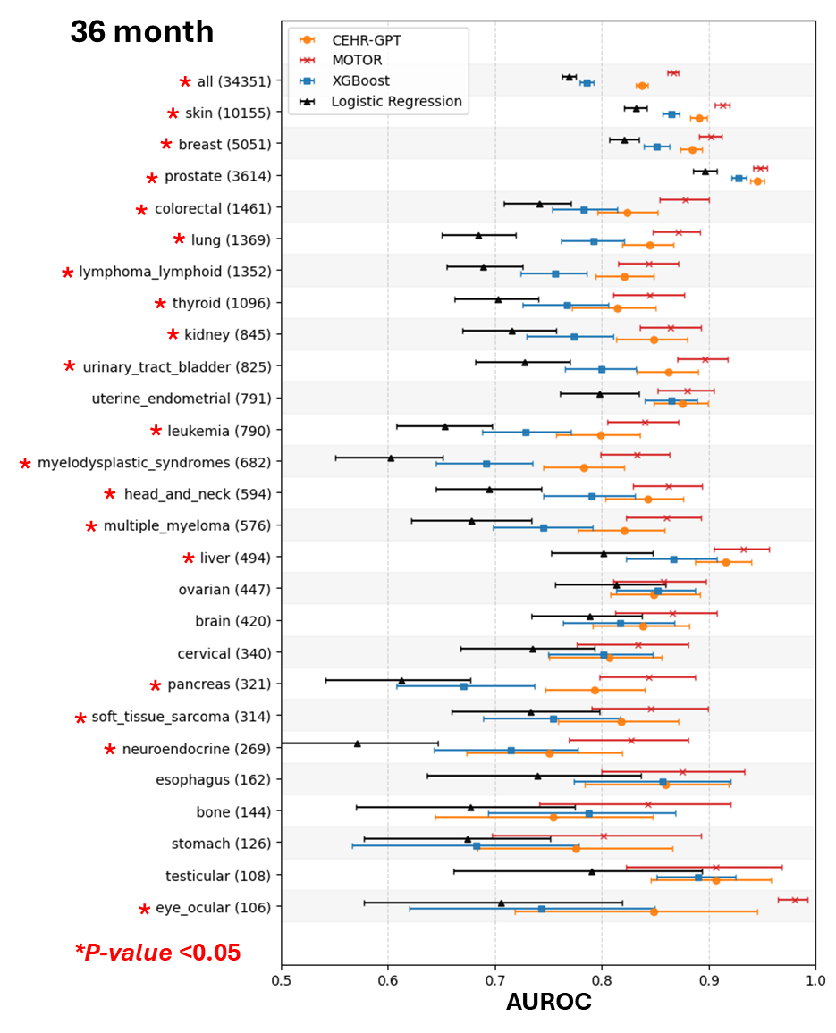
EHR Foundation Models Improve Predictions Across 26 Cancer Types
CUIMC, 36 month
AoU, 36 month
*
*
*
*
*
*
*
*
*
*
*
*
*
*
*
*
*
*
*
*
*
*
*
*
*
*
*P-value <0.05
AUROC
AUROC

Slide 18
How can we make the model clinically useful?

Slide 19

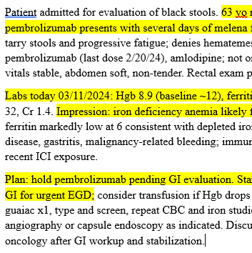

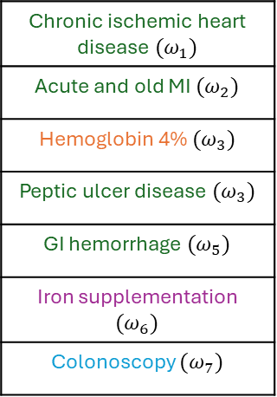
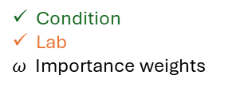
Generative AI May Improve Model Interpretability
Features contributing to the model’s prediction
Highlight key features
Chronic ischemic heart disease ${(ω}_{1})$
Acute and old MI ${(ω}_{2})$
Hemoglobin 4% ${(ω}_{3})$
Peptic ulcer disease ${(ω}_{3})$
GI hemorrhage ${(ω}_{5})$
Iron supplementation ${(ω}_{6})$
Colonoscopy ${(ω}_{7})$
LLM generated structured explanations
Grounding on patient timeline
Recent gastrointestinal bleeding supports elevated colorectal cancer risk.
☐ Agree ☐ Unsure ☐ Disagree
Severe iron-deficiency anemia supports elevated colorectal cancer risk.
☐ Agree ☐ Unsure ☐ Disagree
A recent colonoscopy without a colorectal cancer diagnosis reduces near-term colorectal cancer risk.
☐ Agree ☐ Unsure ☐ Disagree
Synthesize grounded evidence across features
Grounding on notes
Explanation
Feedback
…
Drug
Condition
Lab
$ω$ Importance weights
Procedure
Clinicians

Slide 20

Leverage Complementary Strengths Of Two Distinct AI Paradigms
EHR foundation model
Large Language Model
Temporal pattern recognition
Semantic reasoning and information synthesis
Rationale
Clinical risk prediction is fundamentally a longitudinal modeling problem.
- Sensitivity to event timing
- Repeated numeric trends
- Missingness patterns
Not naturally preserved by text-optimized LLM objectives
- Subtle pre-diagnostic abnormalities
Prior studies
“GPT-4 exhibited significant deficiencies in identifying positive cases”
“LLMs face challenges in accurate diagnosis and interpreting complex clinical data.”
“GPT-4o-mini, DeepSeek v3, and Google Gemini, all models struggles with predicting patient risk scores”
Rezk et al., LLMs for clinical risk prediction. arXiv. 2024
Kara et al., Clinical Risk Computation by Large Language Models Using Validated Risk Scores. Journal of Medical Systems. 2025

Slide 21
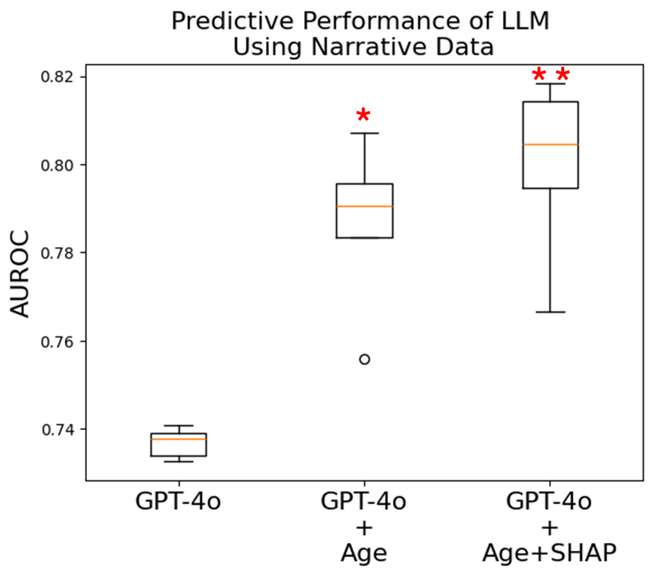
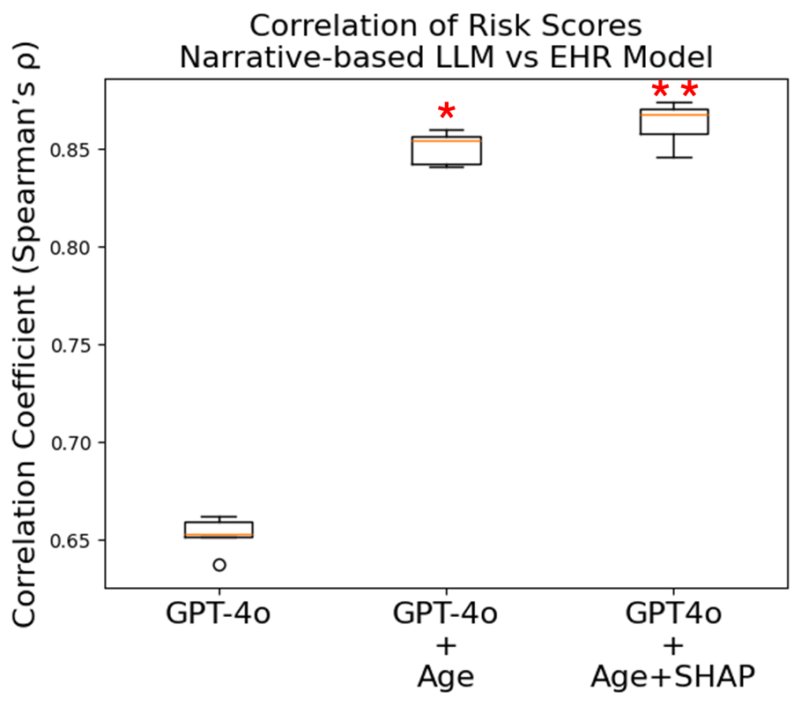
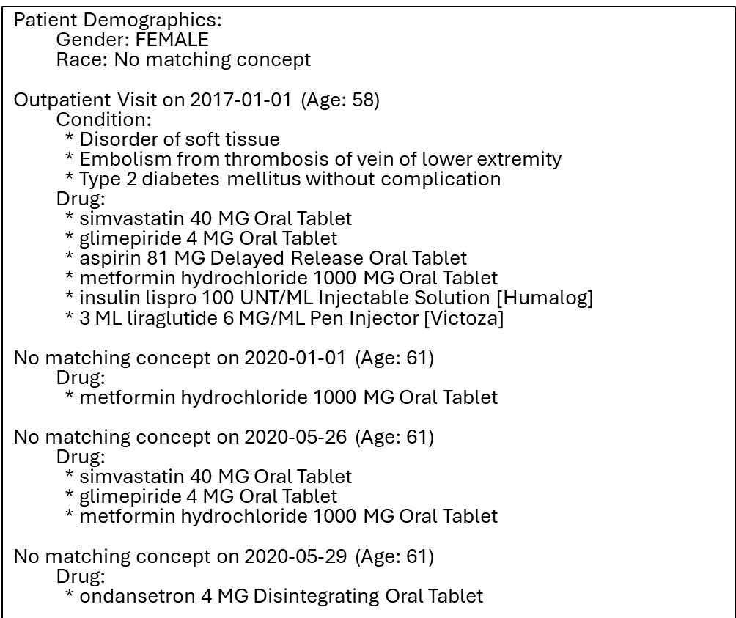
LLMs Struggle with Complex Longitudinal Histories
Patient timelines
EHR model
*
EHR-to-text conversion
LLM
Ask to estimate pancreatic cancer risk
Simply converting structured EHR data into text and prompting an LLM does not yield faithful risk predictions.

Slide 22
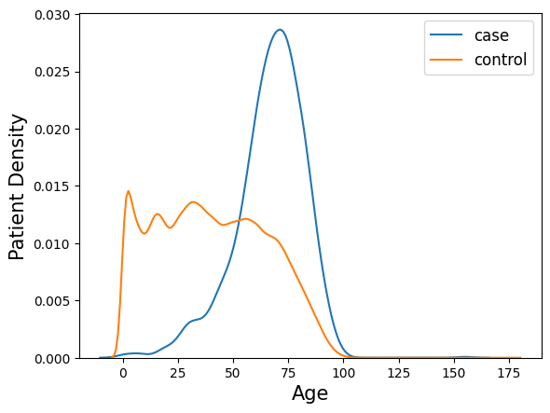
EHR Model Attribution-Guided LLM Improves Alignment
Patient timelines
EHR model
*
EHR-to-text conversion
LLM
Ask to estimate pancreatic cancer risk
SHAP values (feature, value) indicate each feature’s contribution to risk: positive = higher risk, negative = lower risk.
(diabetes, 0.87)
(pancreatitis, 0.9)
(orthopedic injuries, -0.18)
High risk: concentrated in older adults (late 60s–80s).
Low risk: broader, younger-skewed distribution tapering after ~60.
Patient timeline alone prompting → unreliable and misaligned predictions
Attribution-guided prompting → improved accuracy and alignment
. . .

Slide 23
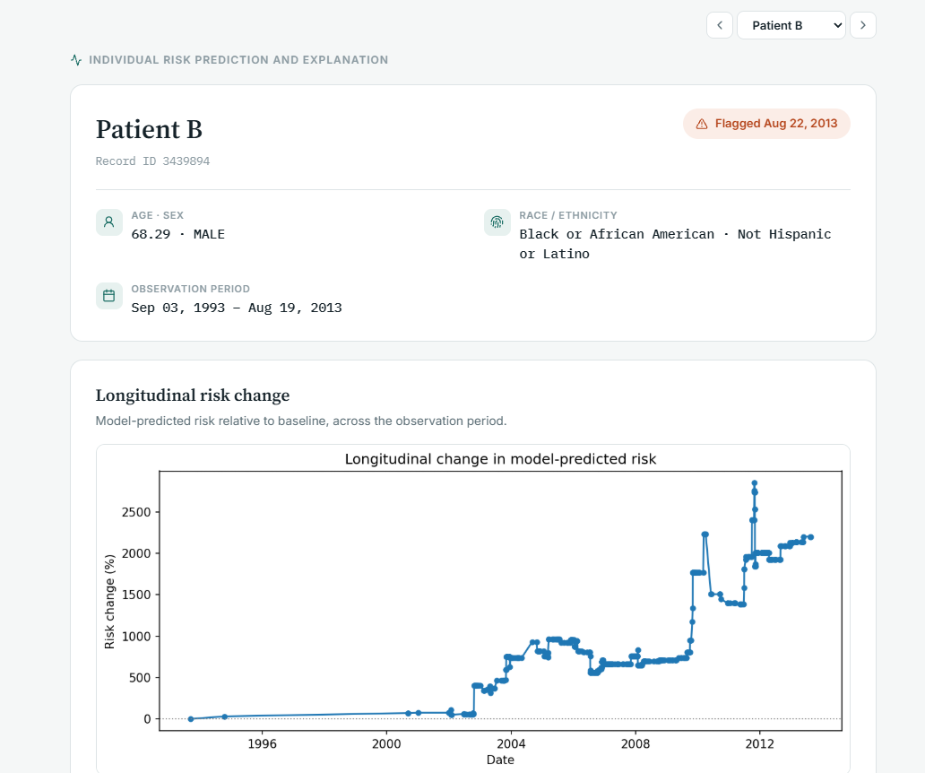
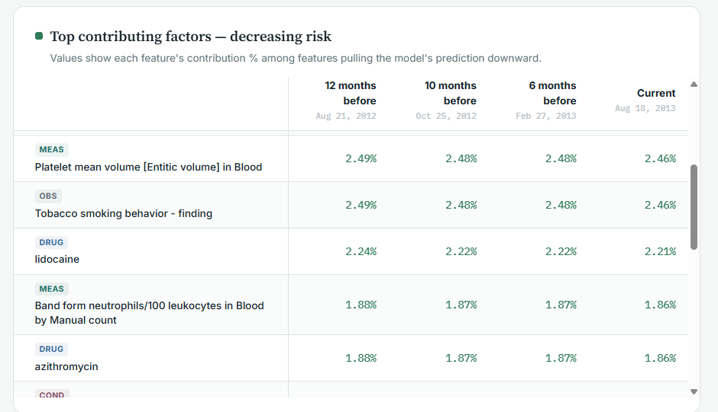
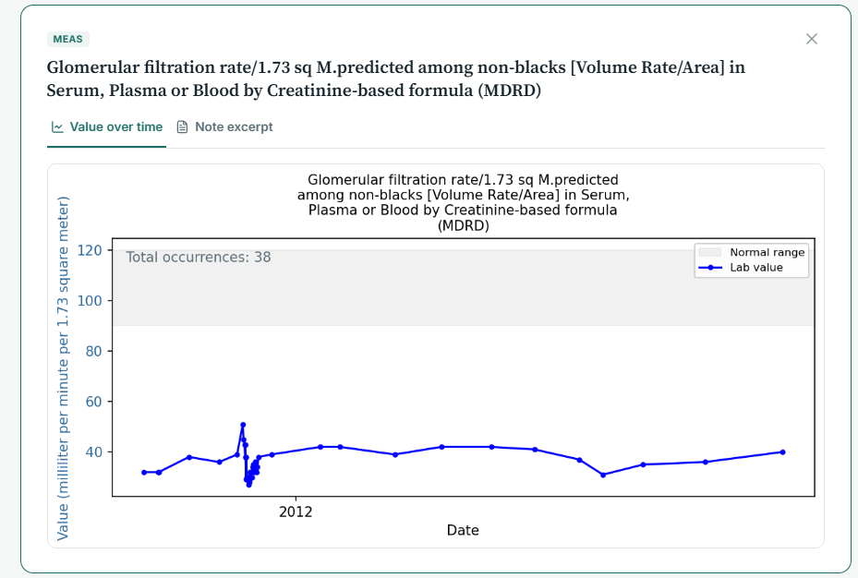
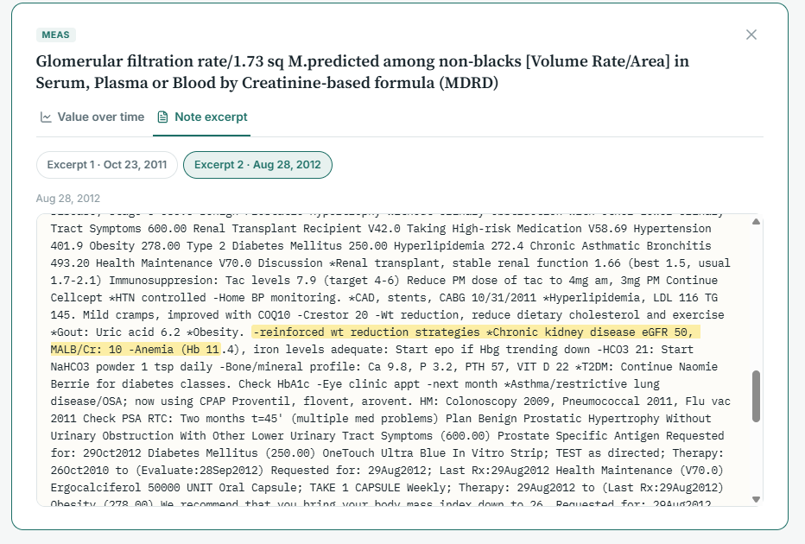
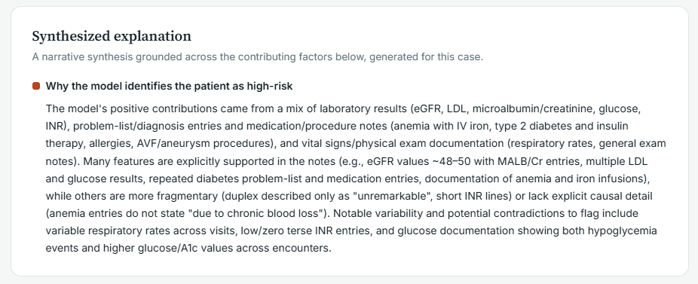
Clinician-Facing Interface Prototype Reveals Fundamental Challenges
Longitudinal risk change
Top features with longitudinal contributions
Supporting information from structured data
Note excerpt
Synthesized explanation
Non-validated features
Interpretability ≠ clinical actionability

Slide 24
From Prediction to Clinical Impact
1. Opportunity
Rich longitudinal EHR data can provide clinically meaningful insights
Routinely collected at scale
Captures patient trajectories beyond traditional risk factors
2. Validation
Robust validation is essential
Missingness, reporting bias, and data quality remain challenges
Multi-institutional validation is critical for generalizability
3. Clinical Impact
Prediction alone is not enough
Interpretability and clinical actionability
Overdiagnosis and lead-time bias
Quality of life and cost-effectiveness
The goal is not simply better prediction, but better clinical decisions and patient outcomes.

Slide 25
Thank you!
jip7012@med.cornell.edu

