Slide 1

RAS inhibitors: An Emerging Therapeutic Frontier in Pancreatic Cancer
15th EDRN Scientific Workshop
Brian M. Wolpin, MD, MPH
Robert T. & Judith B. Hale Chair in Pancreatic Cancer
Professor of Medicine
Dana-Farber Cancer Institute | Harvard Medical School
September 23, 2026
LF-DFCI Pancreatic Cancer Dedicated Lab

Slide 2
Disclosures
Research funding to institution: Amgen, AstraZeneca, Break Through Cancer, Eli Lilly, Harbinger Health, Lustgarten Foundation, Mark Foundation, NIH/NCI, Novartis, Pancreatic Cancer Action Network, Revolution Medicines, Stand Up to Cancer, Stephenson Foundation
Advisory boards/consulting: Agenus, BeiGene, BMS/Mirati, Cancer Panels, EcoR1 Capital, GRAIL, Harbinger Health, Immuneering, Ipsen, Lustgarten Foundation, Revolution Medicines, SystImmune, Takeda, Tango Therapeutics, Third Rock Ventures
I will discuss medications not approved by U.S. FDA for treatment of pancreatic cancer

Slide 3


in the
??
RAS inhibitor

Slide 4
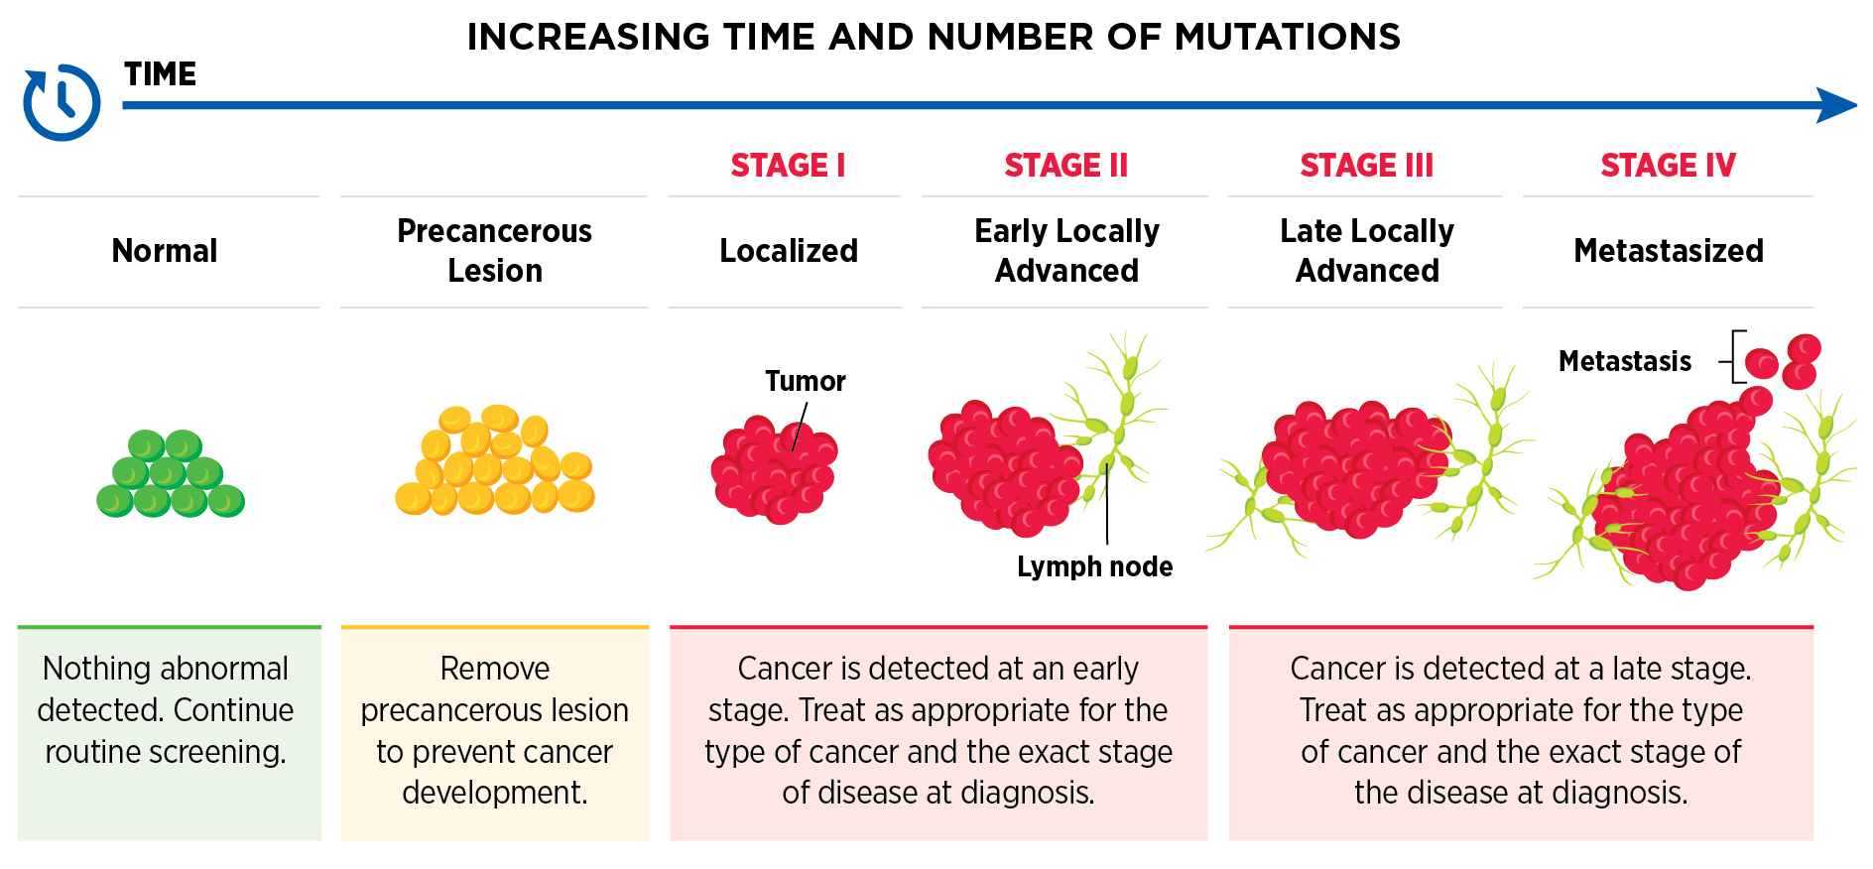
Cancer Interception
Can we treat a patient before a pancreatic tumor is detectable by imaging… without harming non-malignant tissues?
AACR Cancer Progress Report 2025
Notes:
Cancer interception involves intervening at the earliest stages of cancer formation, when the very first abnormal cells develop. By removing these early cells before they have a chance to grow, it may be possible to stop cancer from ever developing.

Slide 5
Pancreatic Cancer (PDAC) Survival by Stage
1
Localized
Locally Advanced
Metastatic
100
5%
15%
25%
55%
75
60%
Will earlier detection be enough to improve cure rates from pancreatic cancer?
5-Year Survival (%)
50
25
15%
<5%
<1%
AJCC Stage
1
2
3
4
(T1/2N0)

Slide 6
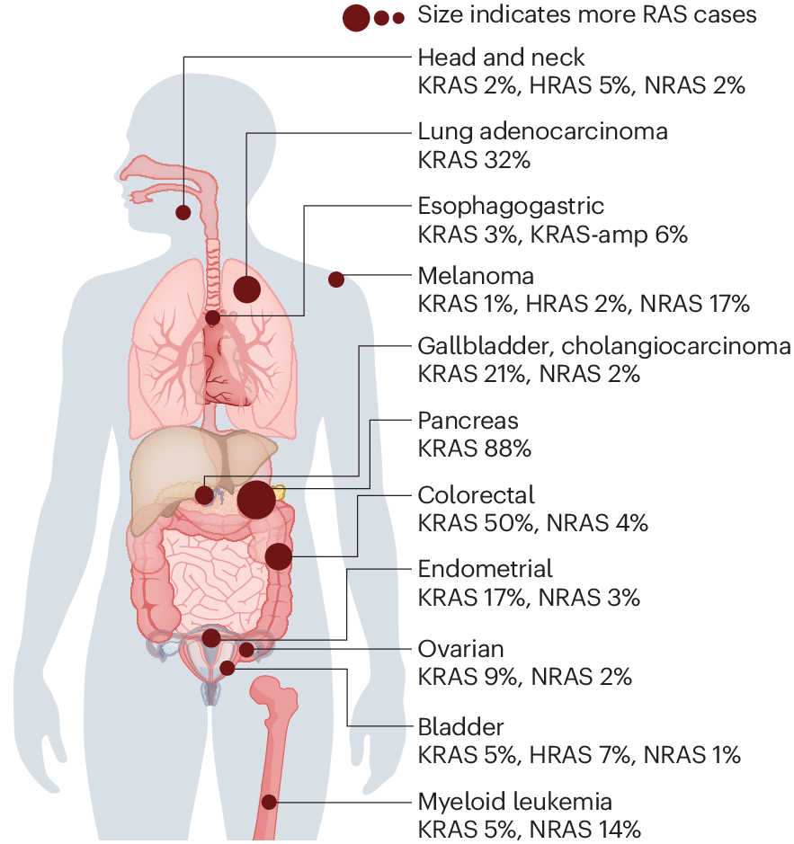
RAS mutations are common in many cancer types
2
RAS gene family = HRAS, KRAS, and NRAS
RAS family proteins are cellular ‘on-off’ switches: Primary function is to integrate signals from growth factor receptors and transmit them to effector pathways to drive cellular growth and proliferation
RAS mutations present in ~20% of all cancers
Singhal et al. Nat Med. 2024;30(4):969-983.

Slide 7
KRAS mutant alleles in 3 leading causes of cancer death in U.S.
KRAS mutations are most common in the three leading causes of cancer death in US:
32% of NSCLC
92% of PDAC
40% of CRC
G12
G12
G12
NSCLC
PDAC
CRC
G12
G12
G12
Haigis, Trends in Cancer 2017.
Notes:
Diversity of RAS mutant alleles, with large percentage at codon 12, which has been focus of RMC-6236-001 so far. Notably, KRAS G12C accounts for very small percentages of RAS mutations in PDAC and CRC.

Slide 8
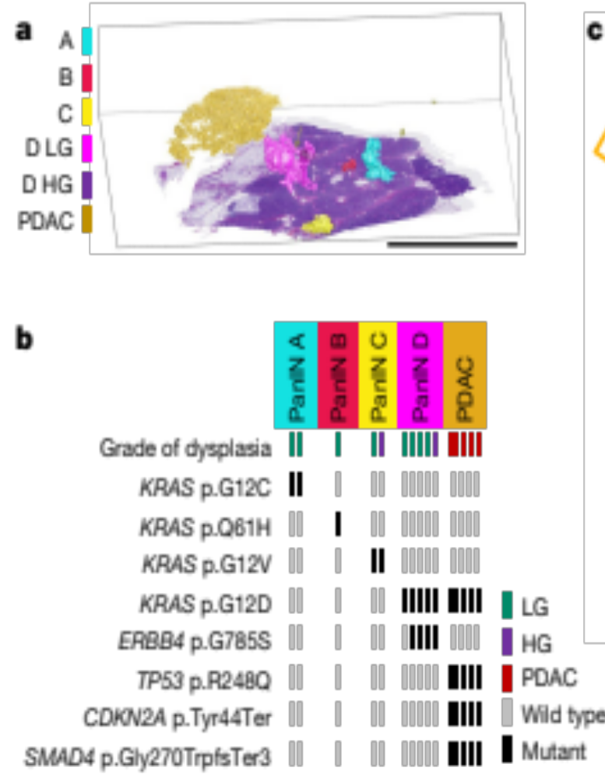
Most preneoplasia in the pancreas have KRAS mutations
3
Pancreatic Intraepithelial Neoplasia (PanIN): Many PanINs and vast majority have KRAS mutations
Braxton, Kiemen… Wood. Nature. 2024;629:679.
Others: Carpenter… Pasca di Magliano. Cancer Disc. 2023;13:1324
Min… Maitra. Cancer Disc. 2026;16(7):1323-1340.
Notes:
Wood lab paper:
Fig. 3 | 3D model and NGS results for slab 104. Each PanIN is represented by the same colour throughout this figure. a, CODA-rendered 3D model of grossly normal pancreatic tissue with multiple spatially distinct PanINs. Scale bar, 1 cm. b, Mutation chart with targeted sequencing results. Each row represents a distinct somatic mutation. Columns represent spatially distinct PanINs and bars represent vertical regions within a PanIN. c, Chow–Ruskey plot of WES results. Shapes represent groups of mutations, with overlaps indicating shared somatic mutations. Numbers refer to the number of mutations in each group.
Kalluri lab paper:
To evaluate the impact of KRAS* targeting in the context of tumor initiation and pancreatic intraepithelial neoplasia (PanIN) emergence, genetically engineered mouse models (GEMMs) driven by KrasG12D expression in the pancreas (KC mice; see STAR Methods) were employed. KC mice were treated with MRTX1133 starting at 7 weeks of age, when on average 5% of the pancreas histology involves PanIN lesions (Figures 3A–3C). KRAS* inhibition marginally decreased pancreas weight (Fig- ure S4A) and reduced the percentage of tissue with PanIN from 5% to 0.05% upon 13 weeks of treatment, whereas 35% pan- creata of vehicle-treated mice exhibited PanIN lesions after 13 weeks (Figures 3B–3D). CK19 staining confirmed regressed PanIN lesions in MRTX1133-treated mice (Figures 3B and 3D). In addition, no specific differences in bodyweight or urine protein levels were observed between vehicle and MRTX1133 treated mice over the course of 13 weeks of treatment (Figures S4B and S4C). Blood biochemistry and histological analyses revealed minimal changes upon 13 weeks of treatment with MRTX1133 compared to controls (Figures S4D and S4E).

Slide 9
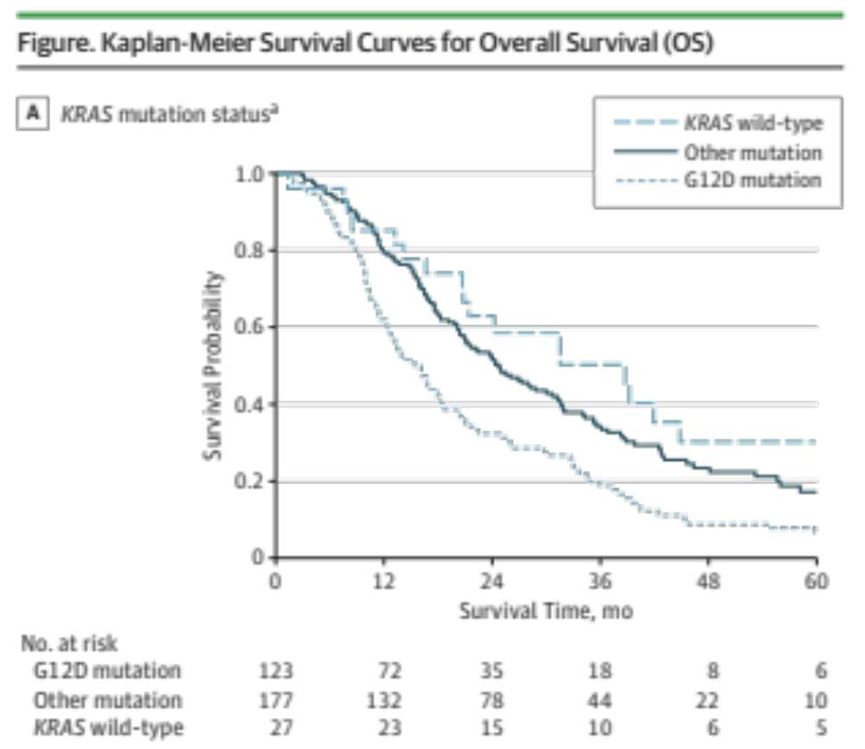



KRAS mutation status associated with patient survival
KRAS Status | Median OS (mo.)
Wild-type | 38.6
KRAS^{non-G12D} | 24.6
KRAS^{G12D} | 15.3
N=338 pts with up-front resected PDAC
Qian et al. JAMA Oncol. 2018;4:173420

Slide 10
Many RAS inhibitors in clinical development
4
G12C inhibitors
G12D inhibitors
panRAS/RAS-multi inhibitors
Sotorasib (Amgen)
Adagrasib (Mirati/BMS)
Divarasib (Genentech/Roche)
Olomorasib (Lilly)
Fulzerasib/GFH925 (GenFleet)
Glecirasib (Jacobio)
MK-1084 (Merck)
Garsorasib/D-1553 (InventisBio)
Elironrasib/RMC-6291 (RevMed)
D3S-001 (D3Bio)
HRS-7058 (Hengrui)
BBO-8520 (BBOT)
FMC-376 (Frontier Medicines)
KQB365 (Kumquat), also G12S
>10 other G12Ci
Zoldonrasib/RMC-9805 (RevMed)
HRS-4642 (Hengrui)
QTX3046 (Quanta)
QTX3034 (Quanta)
GDC-7035 (Genentech)
AZD0022 (AstraZeneca)
INCB161734 (Incyte)
INCB186748 (Incyte)
VS-7375/GFH375 (Genfleet/Verastem)
D3S-003 (D3Bio)
LY3962673 (Lilly)
KQB548 (Kumquat)
TSN1611 (Tyligand Pharma)
RNK-08954 (Ranok Therapeutics)
QLC1101 (Qilu)
ASP3082 (Astellas)
ASP4396 (Astellas)
PT0253 (PAQ Therapeutics)
Daraxonrasib (RevMed)
AN9025 (Adlai Nortye)
ERAS-0015 (Erasca)
RO7673396/RG6505 (Roche)
YL-17231 (280Bio)
ERAS-4001 (Erasca)
BI-3706674 (Boehringer Ingelheim)
QTX3034 (Quanta)
BGB-53038 (Beigene)
ALTA-3263 (Alterome)
LY4066434 (Lilly)
JAB-23425 (Jacobio)
KST-6051 (Kestrel)
ABREV001 (Agastiya)
AUBE00 (Chugai)
TRN-372 (Treeline)
AMG410 (Amgen)
BBO-11818 (BBOT)
RSC-1255 (RasCal Therapeutics)
panKRAS inhibitors
G12V inhibitors
G12D degraders
RMC-5127 (Revolution Medicines)
QTX3544 (Quanta)
Catalytic RAS(ON) inhibitor
*FDA approved agents
RMC-055 (Revolution Medicines)
panKRAS degraders
ASP5834 (Astellas)

Slide 11
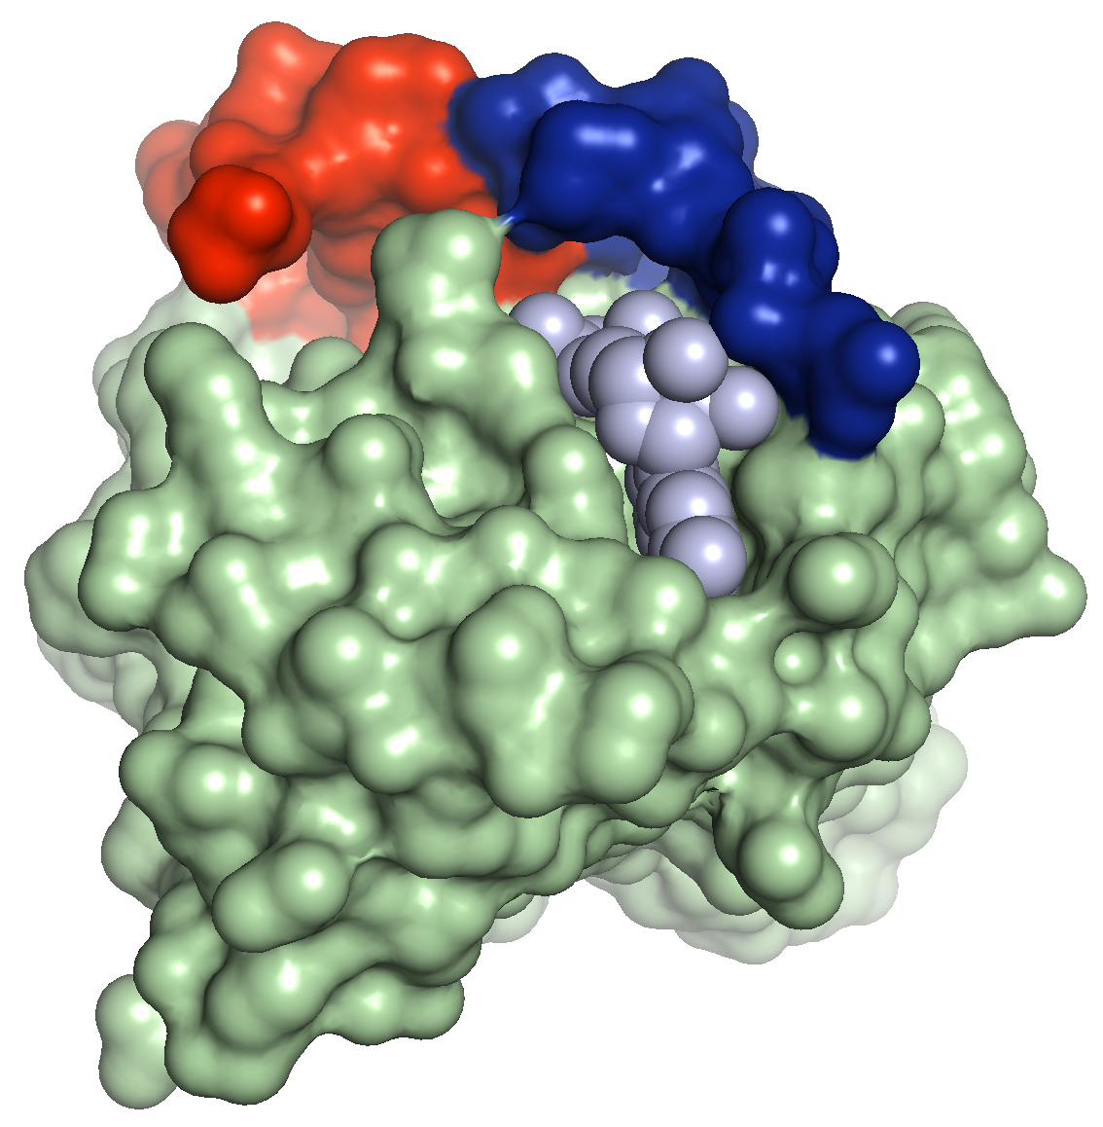
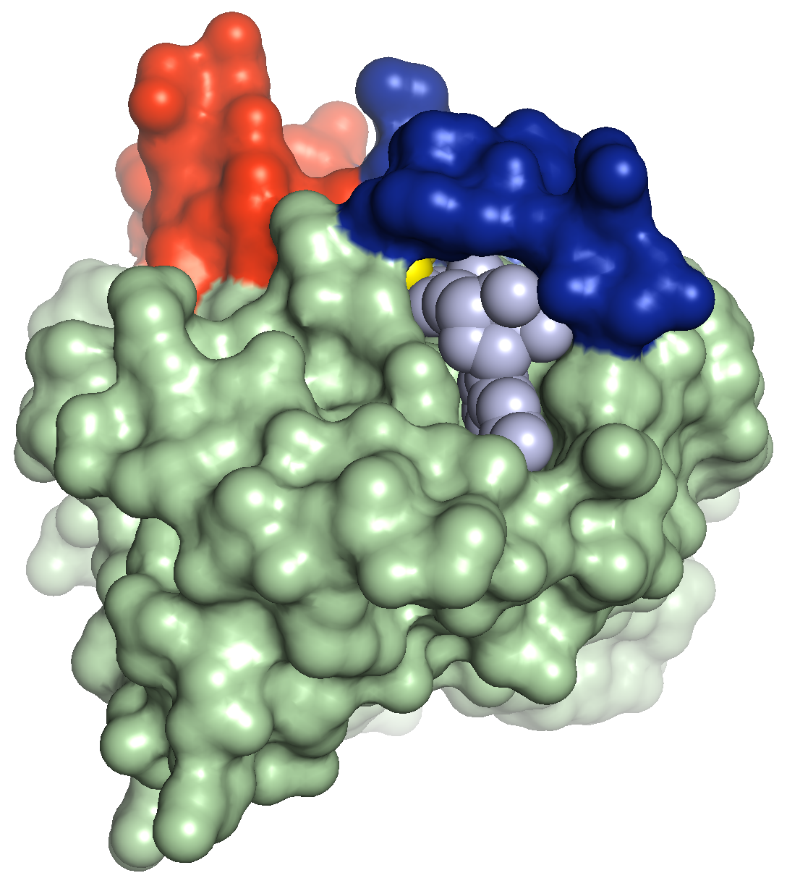
Targeting RAS
Extracellular stimuli
Cancer-associated amino acid substitutions (e.g., G12, G13, Q61) reduce GAP activity and/or enhance GEF activity –>
KRAS GTP>>GDP-bound with activity independent of extracellular stimuli
RAS(OFF)
GEFs
(e.g. SOS1)
RAS(ON)
GDP-loaded
GTP-loaded
Covalent KRAS^{G12C}
(OFF) inhibitors
Non-covalent
RAS(ON) inhibitor
GAPs
(e.g. NF1)
Sotorasib
Adagrasib
Daraxonrasib
Cell growth and survival effectors
Cell growth and survival effectors
GEFs: Guanine nucleotide exchange factors
GAPs: GTPase activating proteins
Notes:
Recent approved G12Ci are RAS-OFF (GDP-bound) inhibitors and there may be advantaged for RAS-ON (GTP bound) inhibitors.
GEFs: Guanine nucleotide exchange factors
GAPs: GTPase activating proteins

Slide 12
Many different features of RAS inhibitors
Characteristic | Features
RAS target protein | HRAS | KRAS | NRAS | Pan-(K)RAS
RAS target activation state | OFF (GDP) | ON (GTP) | ON/OFF
Wild-type binding | More | Less
Mutant allele specificity | Multi | G12C | G12D | Others
Mode of administration | Oral | IV | SC/IM?
Compound class | Direct | Tricomplex | Degrader | Others
Phase of testing | Preclinical | 1 | 2 | 3
Disease | NSCLC | CRC | PDAC | Others
NSCLC, non-small cell lung cancer; CRC, colorectal cancer; PDAC, pancreatic ductal adenocarcinoma

Slide 13
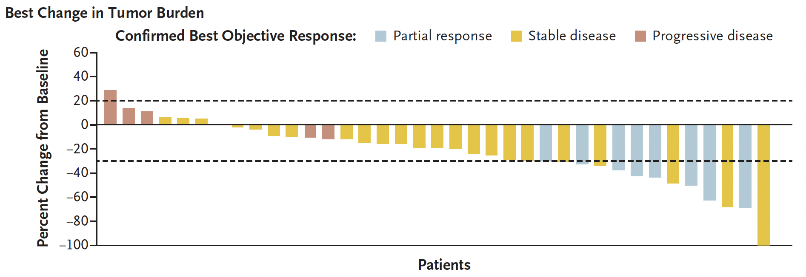
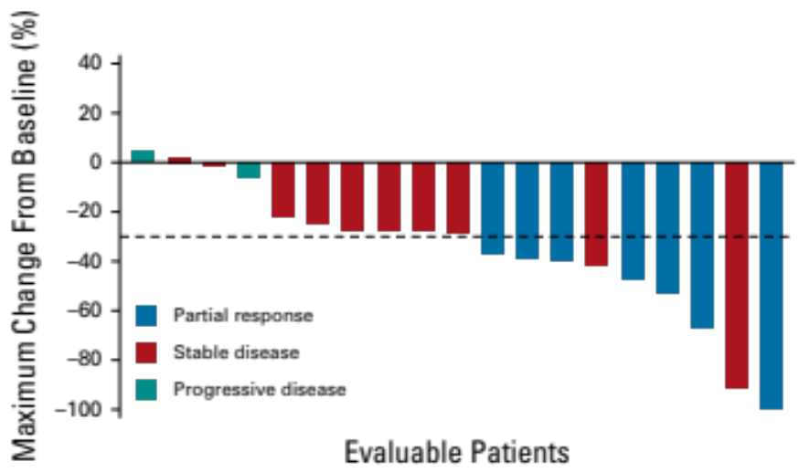
Proof of concept: KRAS^{G12C} inhibitors in PDAC
Sotorasib in advanced, previously-treated PDAC
Adagrasib in advanced, previously-treated PDAC
N=38 patients
N=21 patients
Evaluable Patients
ORR: 21% (8/38)
DCR: 84% (32/38)
mPFS: 4.0 mos
mOS: 6.9 mos
Strickler et al. NEJM 2023
ORR: 33% (7/21)
DCR: 81% (17/21)
mPFS: 5.4 mos
mOS: 8.0 mos
Bekaii-Saab et al. JCO 2023
Divarasib (Genentech): ORR 43% (N=7); Sacher et al. NEJM 2023
Glecirasib (Jacobio): ORR 42% (N=31); ASCO GI 2024
Olomorasib (Lilly): ORR 33% (n = 24); ASCO 2024
2nd Line Chemotherapy: ORR 5-10%, mPFS 2-3.5 mo., mOS 6-7 mo.
(FOLFOX, FOLFIRI, GnP)

Slide 14
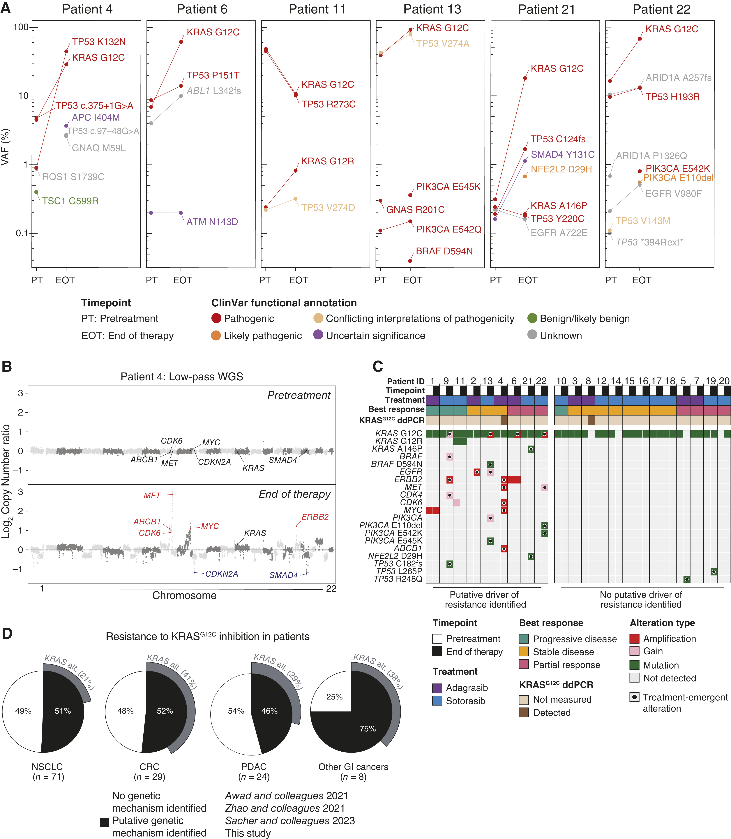
Resistance mechanisms to KRAS^{G12C} inhibitors in PDAC
Dilly et al. Cancer Discov. 2024;14:2135.
Notes:
Figure Legend:
Genetic alterations associated with acquired resistance to KRAS<sup>G12C</sup> inhibition in patients with PDAC. A, Variant allele frequencies (VAF) for the indicated genomic variants in pretreatment (PT) and end of therapy (EOT) ctDNA samples across patients with PDAC treated with adagrasib monotherapy on the KRYSTAL-1 trial (patients 4, 6) or sotorasib monotherapy on the CodeBreaK100 trial (patients 11, 13, 21, 22). B, Paired genome-wide copy number profiles from low-pass whole genome sequencing (organized by chromosome and genomic coordinates) from PT and EOT ctDNA samples for patient 4 treated with adagrasib. Gene labels indicate amplified putative drivers of acquired resistance or tumor suppressor genes. C, Co-mutation plot displaying pathogenic and likely pathogenic treatment-emergent variants and genomic amplification of putative drivers of resistance detected in ctDNA samples from PDAC patients with acquired resistance to adagrasib (patients 1–8) or sotorasib (patients 9–22). The best radiographic treatment response is indicated as measured by RECIST criteria. D, Aggregated classification of mechanisms of resistance to KRAS<sup>G12C</sup> inhibition across cancer types. Data include patients from this study and previously published studies (Supplementary Table S2; Supplementary Fig. S1G).

Slide 15
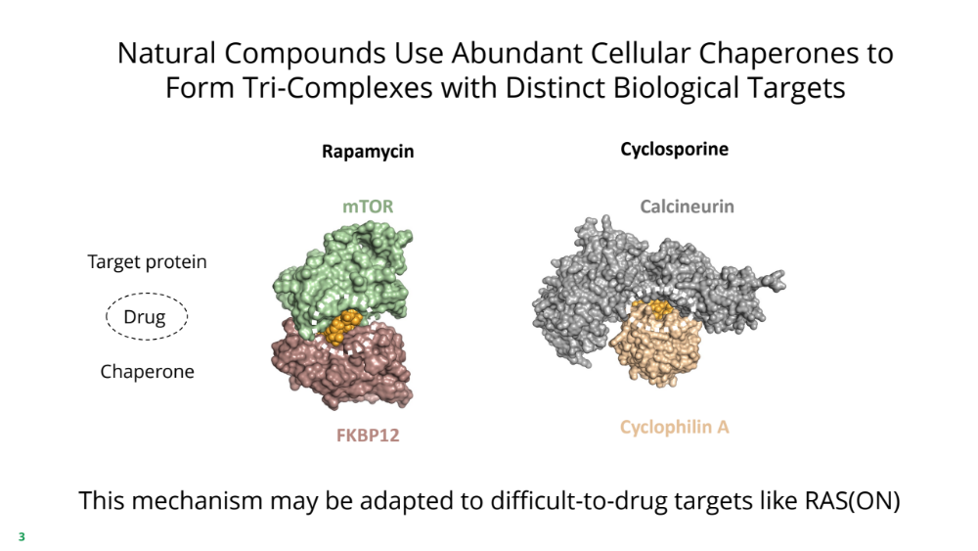
Natural compounds use cellular chaperones to form
tri-complexes with specific biologic targets
“Molecular Glue"

Slide 16
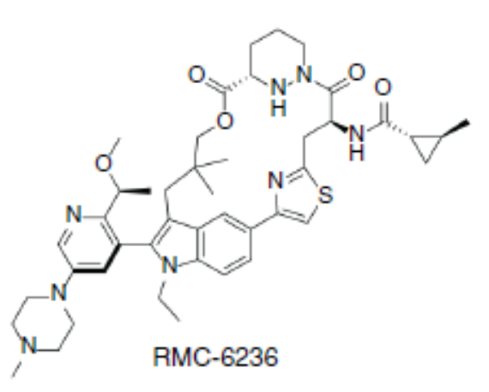
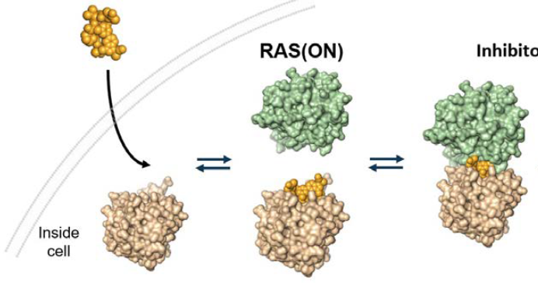
Daraxonrasib: Non-covalent RAS(ON)^{MULTI} inhibitor
Daraxonrasib (RMC-6236, Revolution Medicines) = Oral multi-selective tricomplex RAS(ON) inhibitor
→ Inhibits GTP-bound RAS with mutant alleles (G12, G13, Q61) and wild-type RAS
Daraxonrasib
RAS(ON)
RAS(ON)
Daraxonrasib
RMC-6236
Cyclophilin A
Daraxonrasib
Cyclophilin A
(CYPA)
Jiang et al. Cancer Disc. 2024;14:994

Slide 17
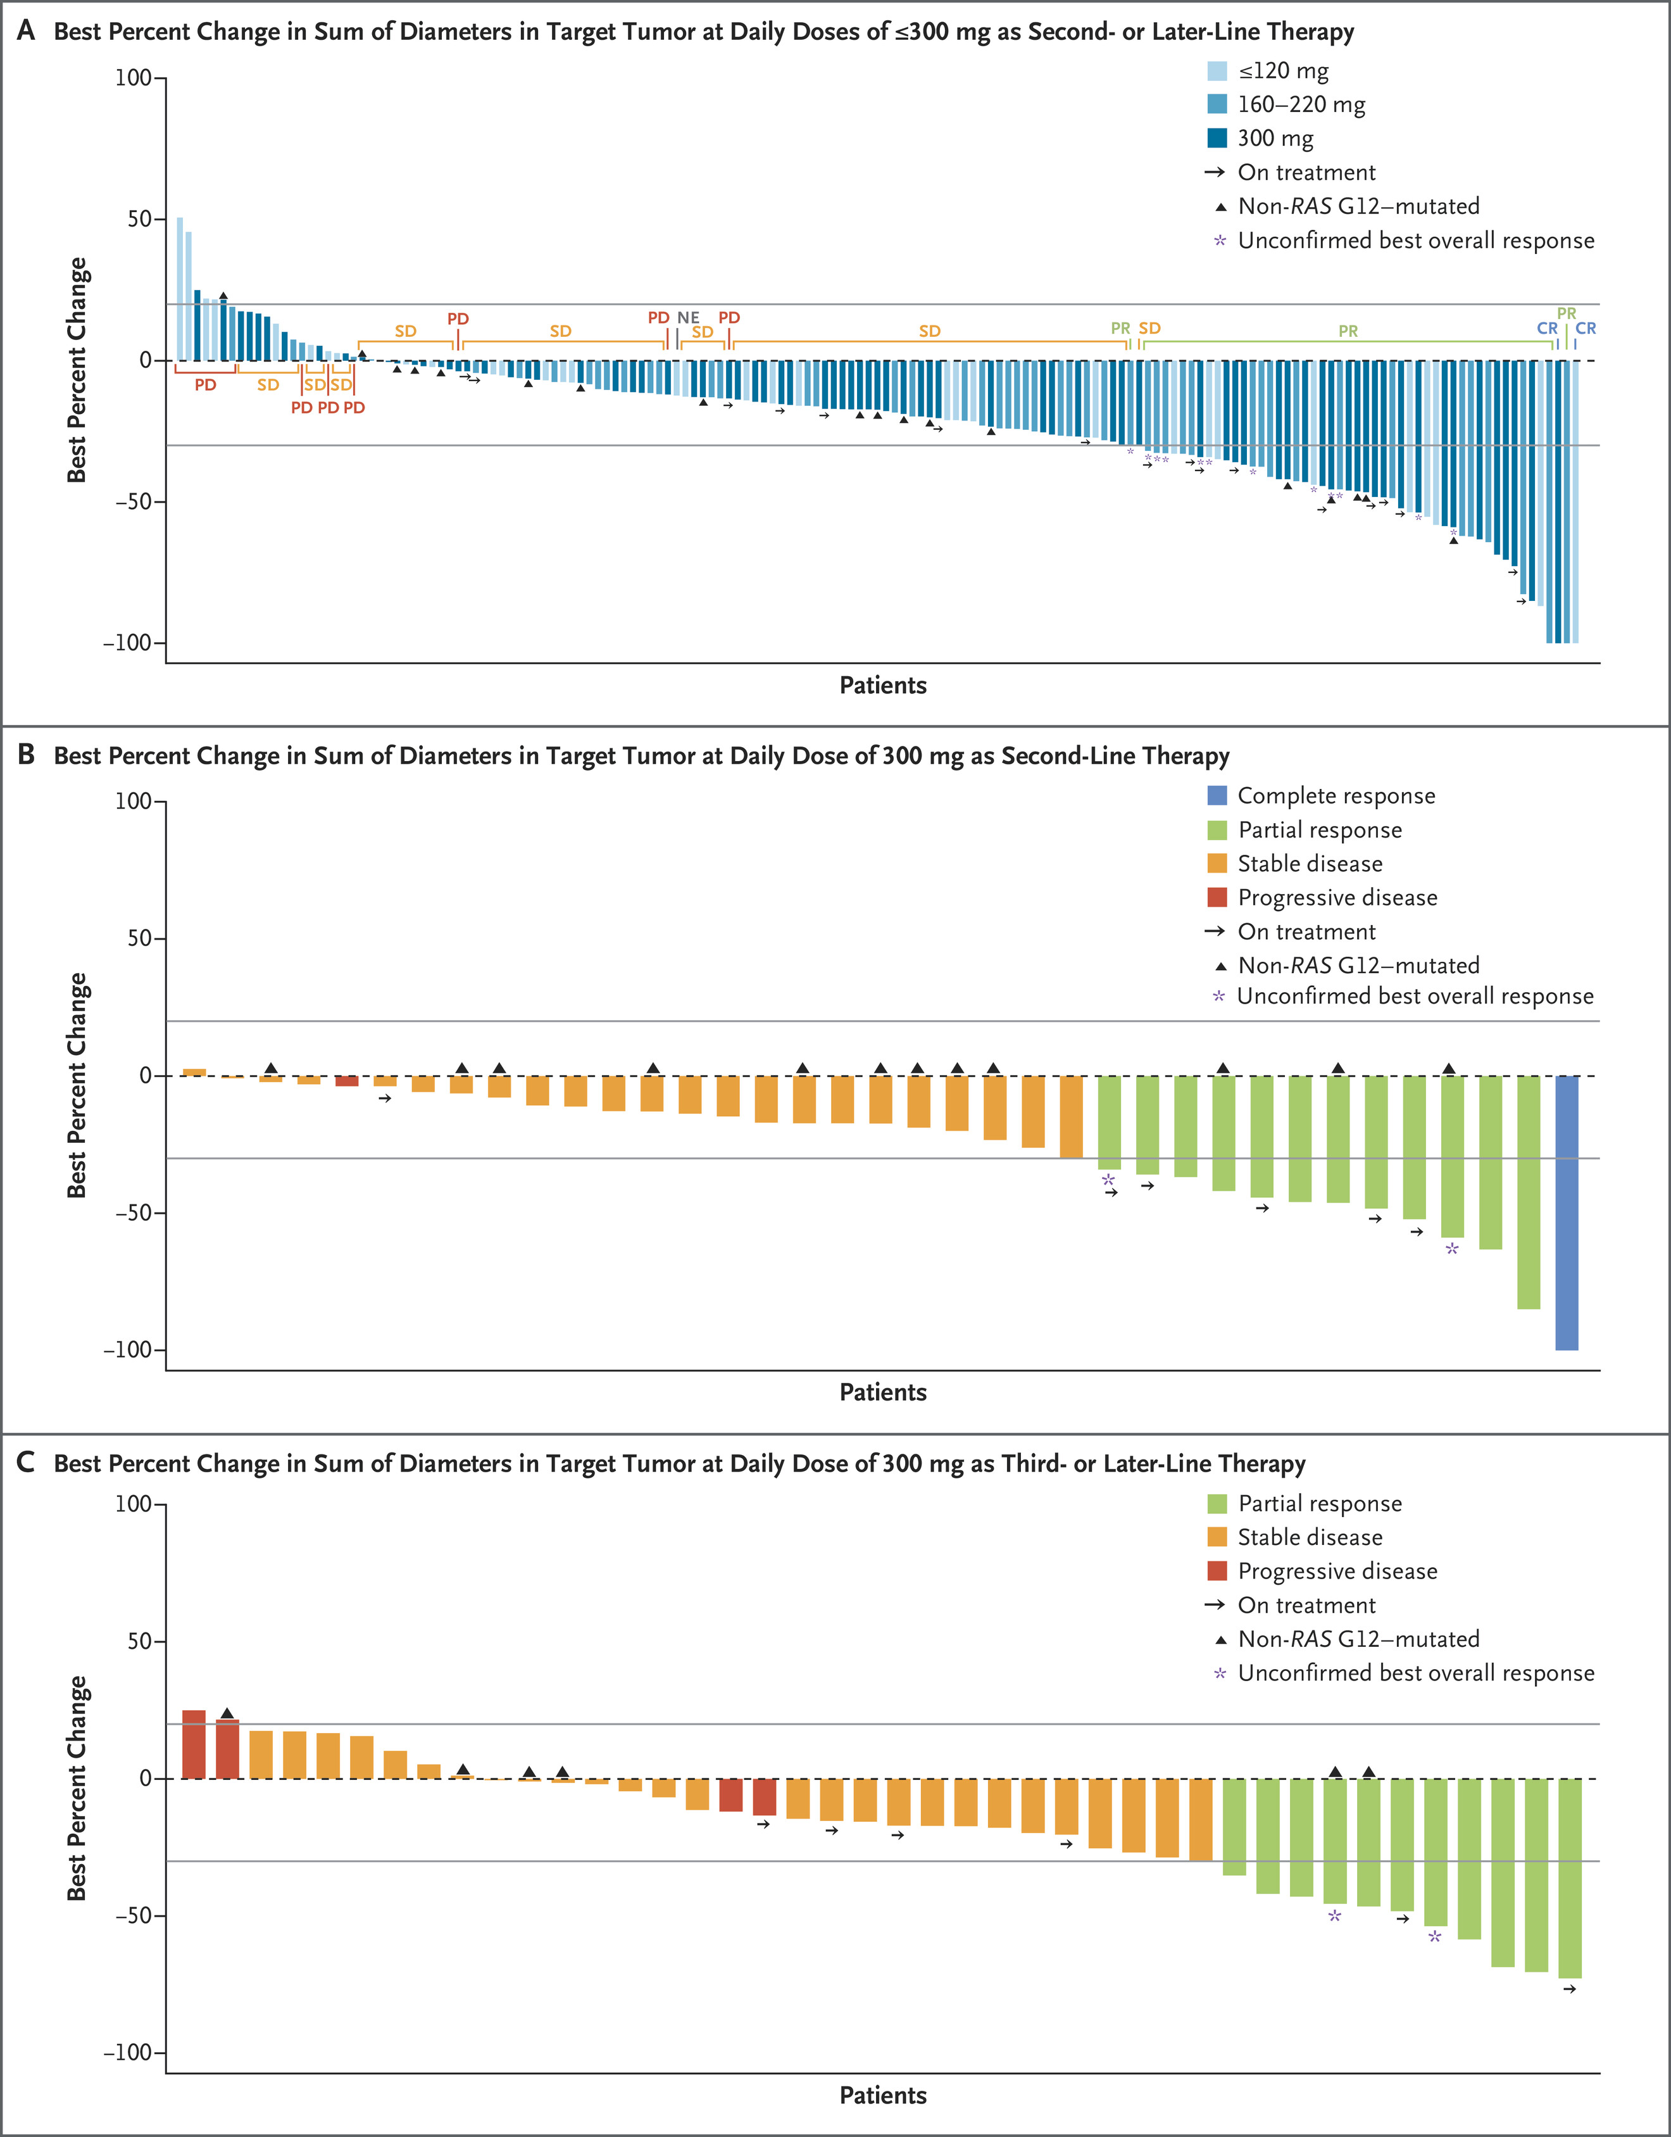
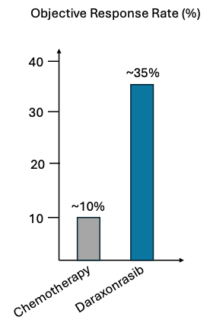
RMC-6236-001 Trial: Daraxonrasib Waterfall Plot
RECIST v1.1 Objective Response Rate (%), 2nd Line Therapy
KRAS G12D | 65 (39%)
KRAS G12V | 52 (31%)
KRAS G12R | 28 (17%)
Other RAS G12 | 4 (2%)
Non-RAS G12 | 19 (11%)
Patients with Previously-treated Metastatic Pancreatic Cancer (N=168 patients)
Wolpin et al. N Engl J Med. 2026;394(18):1790-1802.
Notes:
** Other RAS G12 mutations included KRAS G12A, KRAS G12L, KRAS G12S, and NRAS G12D (1 patient each).
†† Non–RAS G12 mutations included KRAS G13D (1 patient), KRAS Q61H (14 patients), KRAS Q61R (2 patients), and KRAS Q61K (2 patients).

Slide 18
RASolute 302 Study Design
18
Key eligibility criteria:
Adults with mPDAC
One prior fluoropyrimidine- or gemcitabine-based regimen
in the metastatic setting
ECOG PS 0-1
Documented tumor RAS mutational statusª by local testing
Daraxonrasib
300 mg, PO QD
Dual primary endpoints
OS and PFS^{b} (RAS G12 population)
R 1:1
Key secondary endpoints
Investigator’s choice chemotherapy (1 of 4)
GnP, mFOLFIRINOX,
Nal-IRI + 5-FU/LV, FOLFOX
OS and PFS^{b} (overall population^{c})
ORR^{b} (RAS G12 and overall populations)
TTD in PROs^{d} (RAS G12 and overall populations)
Stratification factors
ECOG PS (0 vs 1)
Metastatic disease at diagnosis (yes vs no)
Liver metastases at baseline (yes vs no)
Tumor RAS mutational status (RAS G12D/V vs other RAS G12
vs RAS G13 or Q61 mutation or no RAS mutation identified)
Global enrollment: 59 sites across 6 countries in North America, Europe and Asia
NCT06625320. 5-FU, 5-fluorouracil; BICR, blinded independent central review; ECOG Eastern Cooperative Oncology Group; FOLFOX, leucovorin, 5-FU, and oxaliplatin; GnP, gemcitabine and nab-paclitaxel; LV, leucovorin; mFOLFIRINOX, modified 5-FU, irinotecan, leucovorin, and oxaliplatin; mPDAC, metastatic pancreatic adenocarcinoma; Nal-IRI, nanoliposomal irinotecan; ORR, objective response rate; OS, overall survival; PFS, progression-free survival; PO, oral administration; PRO, patient-reported outcome; PS, performance status; QD, once daily; RECIST, Response Evaluation Criteria in Solid Tumors; TTD, time to deterioration.
ªEither mutant, defined as nonsynonymous mutations in KRAS, NRAS, or HRAS at codons 12, 13, or 61 (G12, G13, or Q61), or no RAS mutation identified. ^{b}By BICR per RECIST 1.1. ^{c}Including patients whose tumors harbor RAS G12, G13, or Q61 mutations, or had no RAS mutation identified. ^{d}TTD in symptom of pain and in global health status/quality of life.
Wolpin et al. 2026: LBA5 ASCO Annual Meeting.

Slide 19
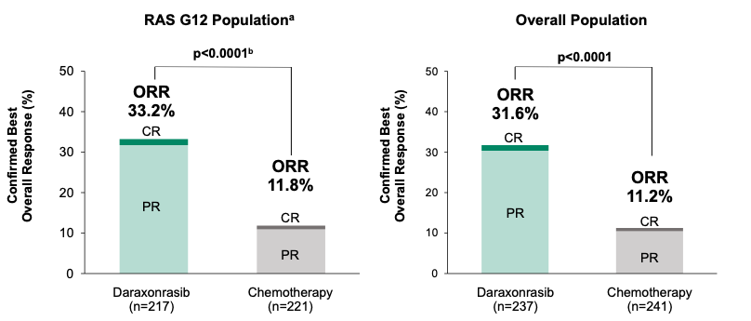
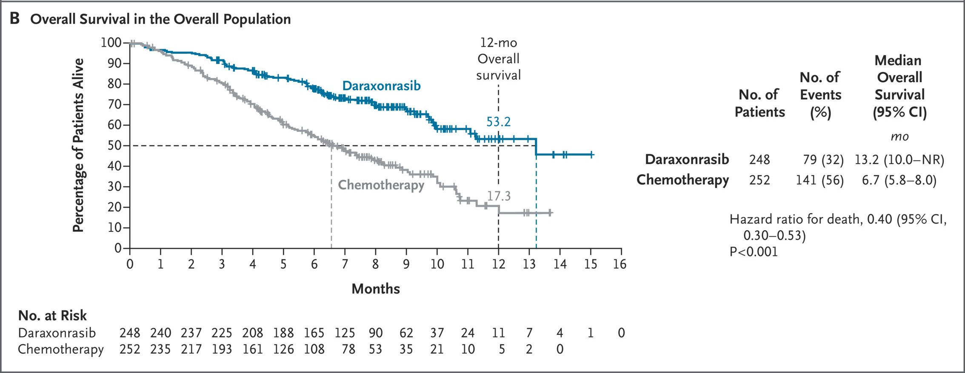
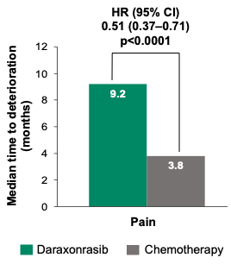
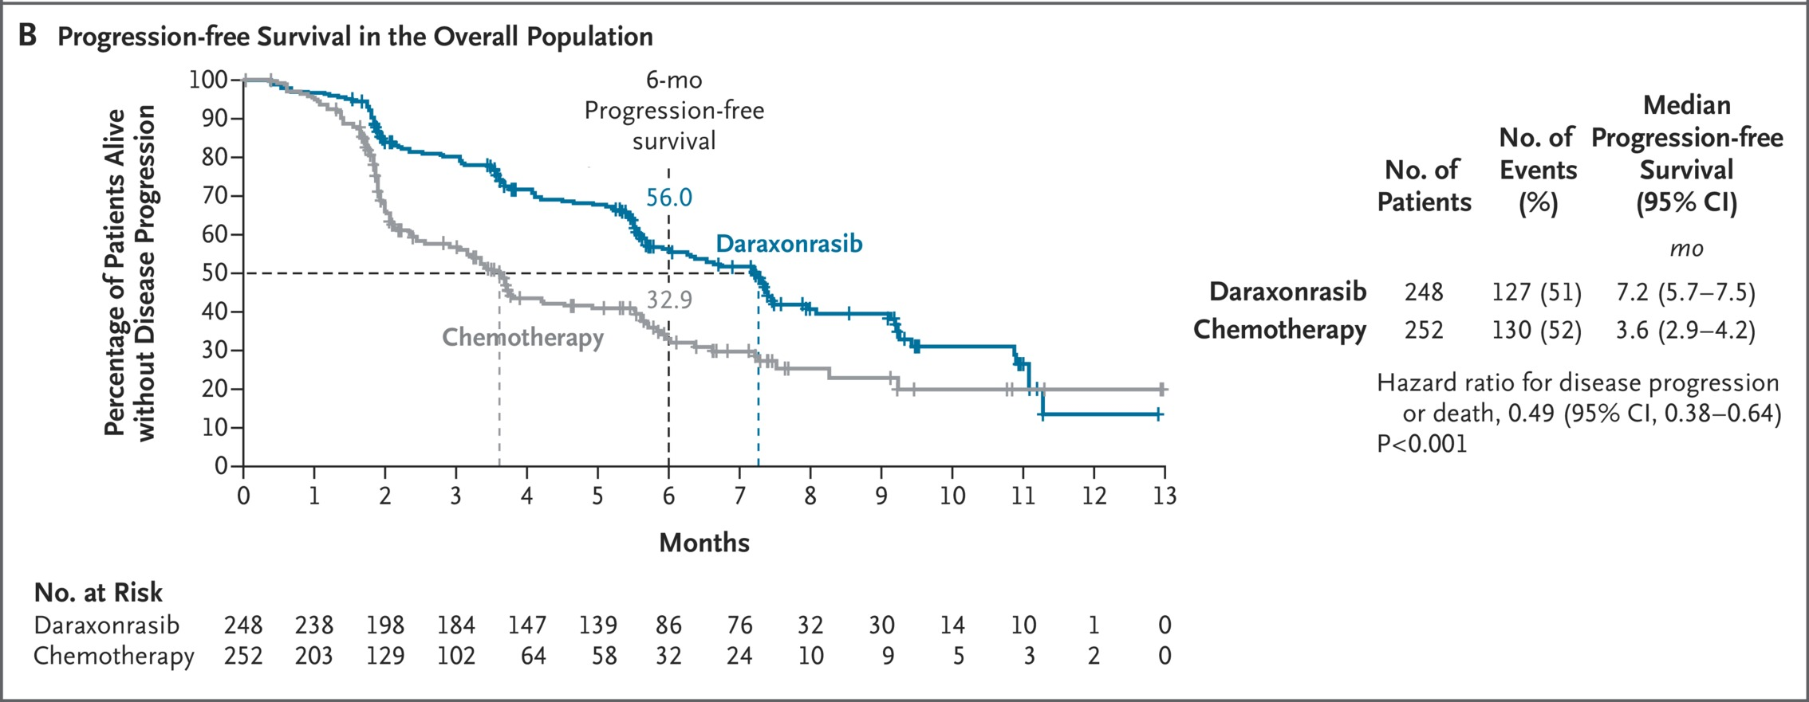
RASolute 302 Efficacy Results
Data cutoff: 10 Feb 2026. Median (range) follow-up time: 8.5 (3.2−15.9) months.
O’Reilly et al. N Engl J Med. 2026;395:325-337
Wolpin et al. 2026: LBA5 ASCO Annual Meeting.

Slide 20
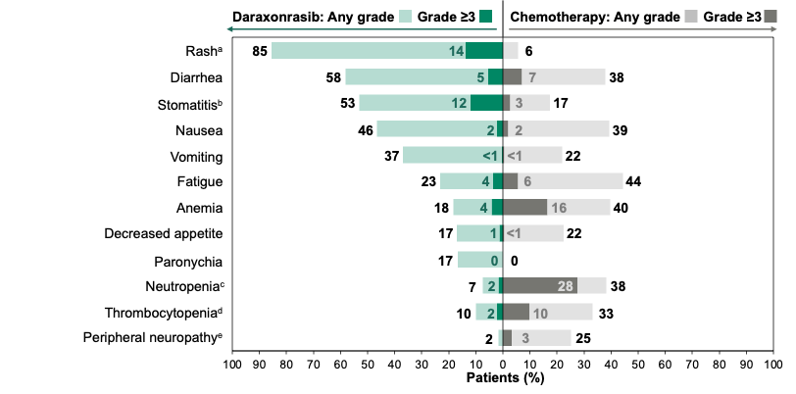
RASolute 302 Toxicities
Median dose intensity
  Daraxonrasib: 93%
  Chemotherapy: 65-95% across regimens
Treatment-related adverse events (TRAEs) leading to dose reduction
  Daraxonrasib (36%): rash (17%) and stomatitis (7%)
  Chemotherapy (58%): neutropenia (17%), thrombocytopenia (14%), fatigue (13%),
  diarrhea (10%), and peripheral neuropathy (8%)
TRAEs leading to treatment discontinuation
  Daraxonrasib: 3 (1.2%)
  Chemotherapy: 24 (11.2%)
Wolpin et al. 2026: LBA5 ASCO Annual Meeting.

Slide 21
Daraxonrasib FDA Approval
FDA News Release
FDA Approves First in Class Targeted Therapy for Metastatic Pancreatic Cancer
For Immediate Release:
August 26, 2026
The U.S. Food and Drug Administration today approved Rasonque (daraxonrasib), a RAS inhibitor for the most common form of pancreatic cancer—delivering a new treatment option to patients with advanced pancreatic cancer months ahead of schedule.
The approval is for the treatment of adults with metastatic pancreatic adenocarcinoma who have received at least one prior systemic therapy or are not candidates for multiagent systemic therapy.

Slide 22
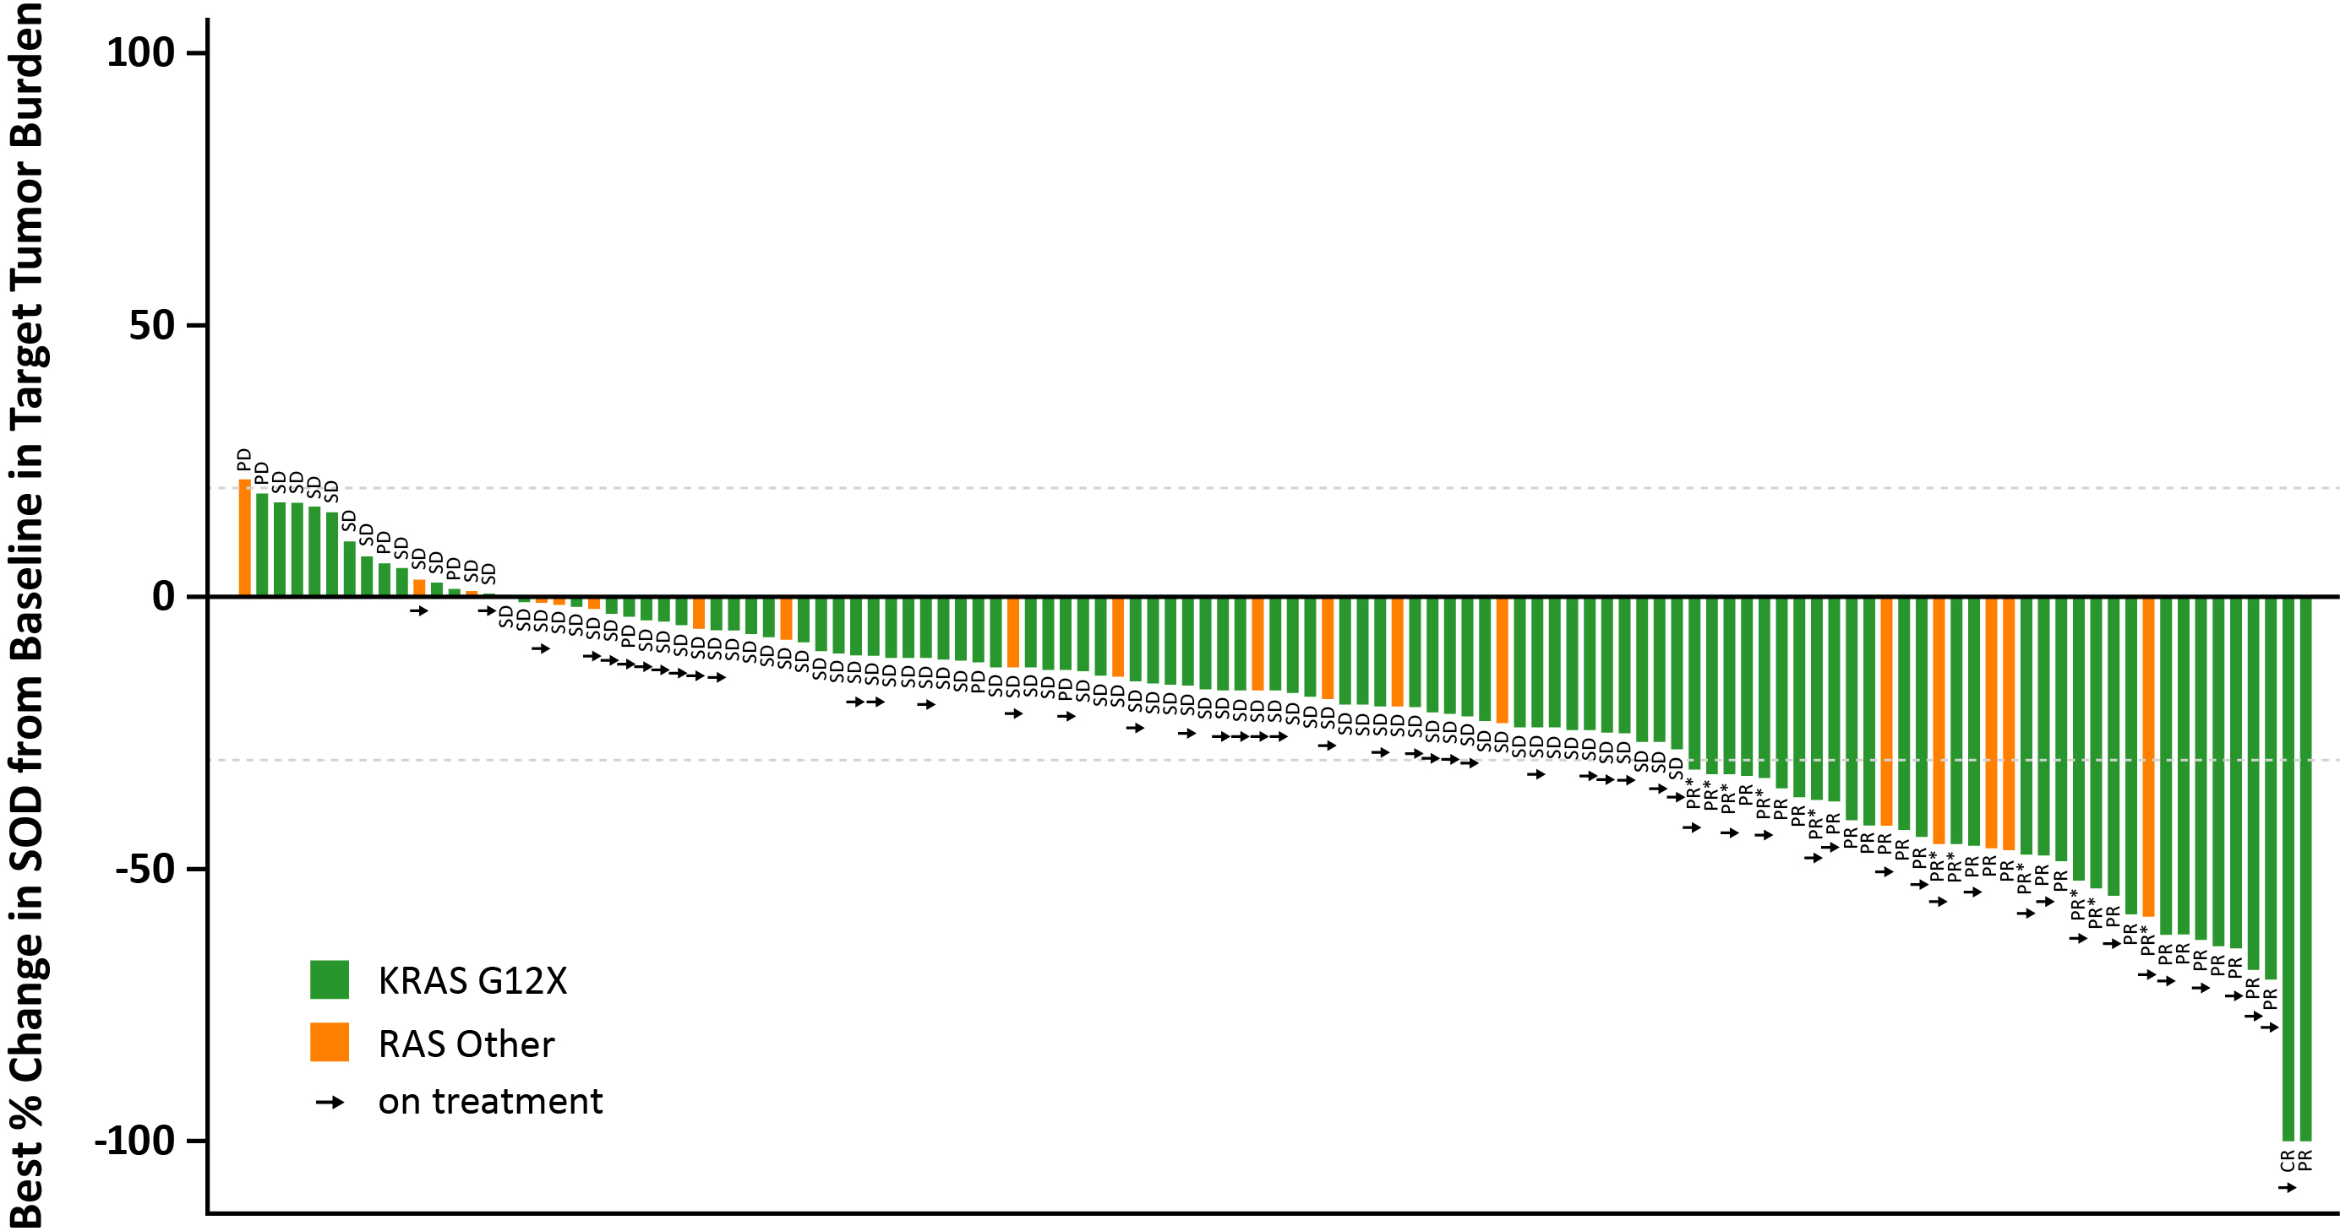
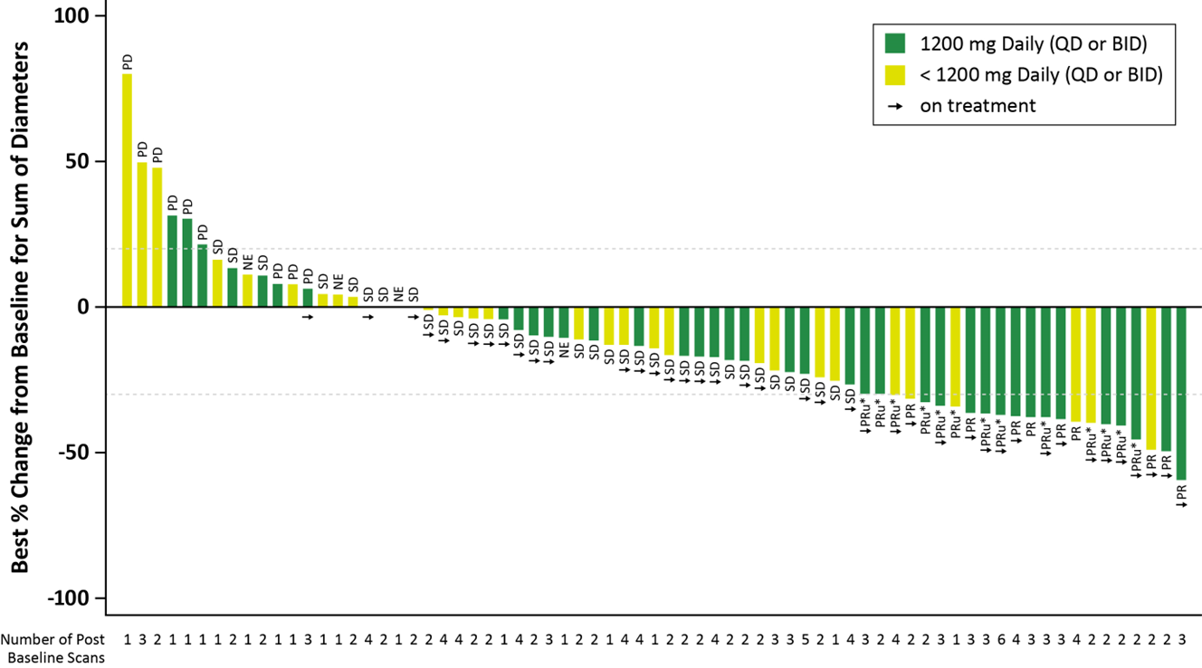
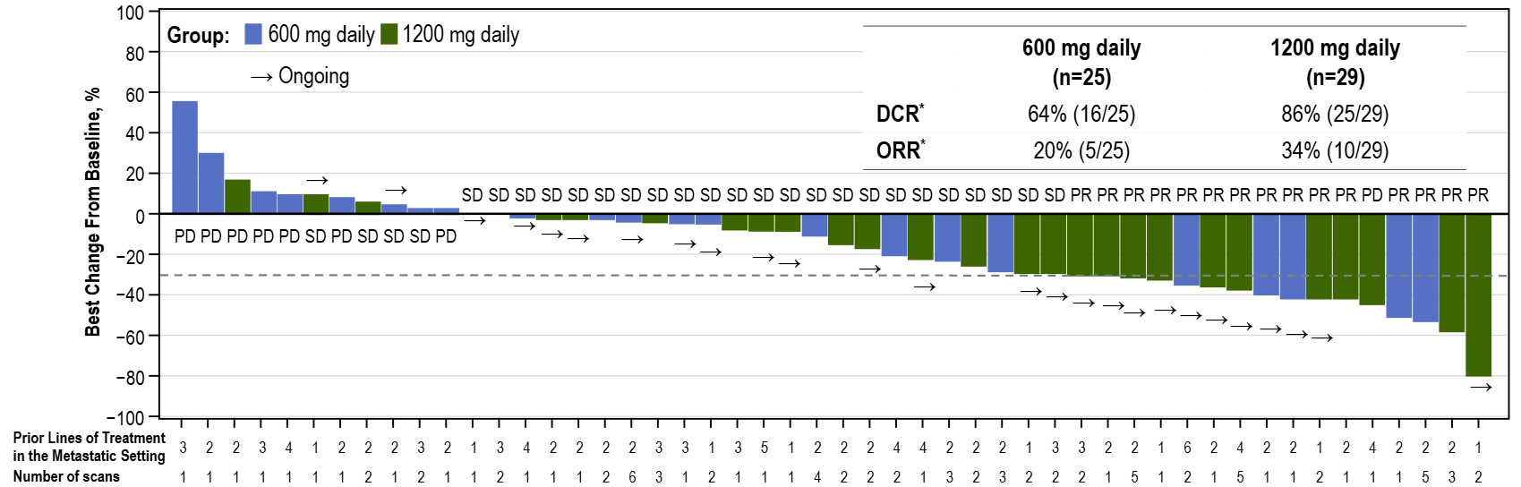
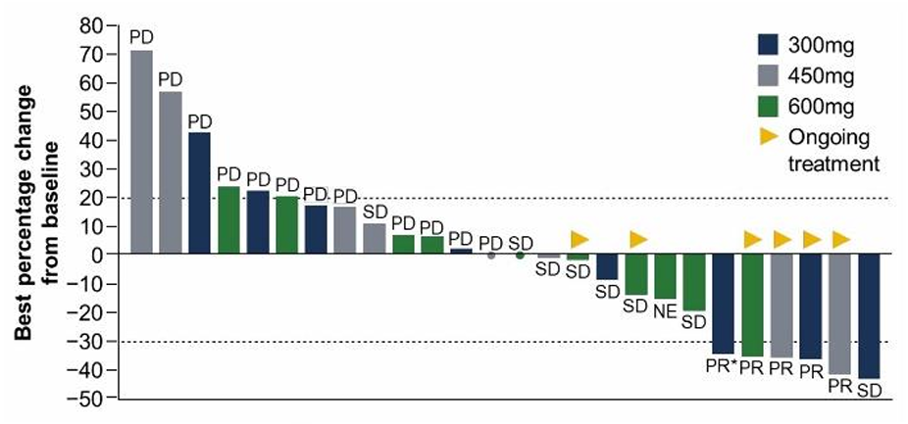
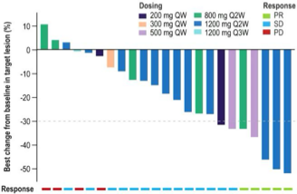
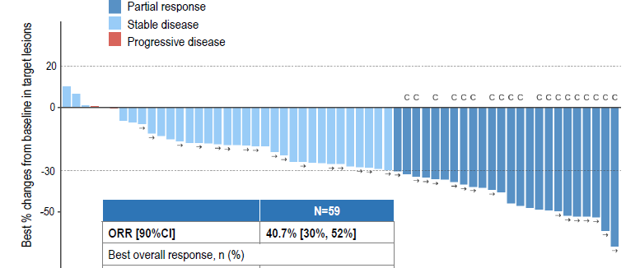
RAS inhibitors in patients with 2L+ metastatic pancreatic cancer
Daraxonrasib (Multi, ON, Non-covalent)
Zoldonrasib (G12D, ON, Covalent)
INCB161734 (G12D, ON/OFF, Non-covalent)
(CYPA Tricomplex, Oral)
(CYPA Tricomplex, Oral)
(Switch-II pocket, Oral)
Best % change from baseline in target lesions
160-300 mg PO QD
N=54 patients
N=105 patients
N=71 patients
KRAS G12X mutations are mutations in KRAS codon 12 (G12).
RAS Other are mutations in KRAS G13X or KRAS Q61X.
HRS-4642 (G12D, ON/OFF, Non-covalent)
GFH375/VS-7375 (G12D, ON/OFF, Non-covalent)
ASP3082 (G12D, OFF, Non-covalent)
(Switch-II pocket, IV)
(Switch-II pocket, Oral)
(Degrader, IV)
N=59 patients
N=27 patients
N=24 patients
Notes:
HRS-4642 from ESMO 2025

Slide 23
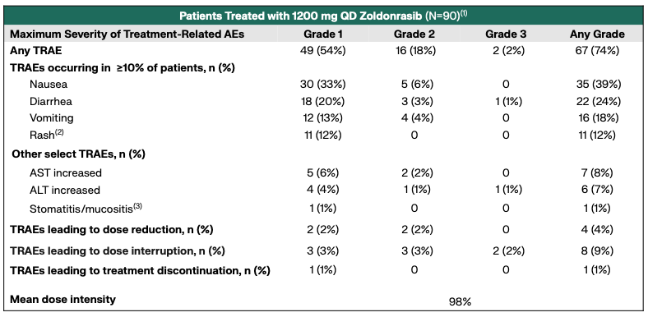
RMC-9805-001 Trial: Zoldonrasib Toxicities
Zoldonrasib = oral, covalent, tricomplex, RAS^{G12D}-specific inhibitor
N=90 patients with previously treated, metastatic PDAC, NSCLC, and CRC
Treatment-related adverse events (TRAEs)
Revolution Medicines, Corporate slide deck, May 2026

Slide 24

Will tumor response increase with early stage PDAC and preneoplasia?
100%
RAS inhibitor
(e.g., daraxonrasib)
??%
??%
??%
RECISTv1.1 Objective Response Rate
47%
Objective Response Rate
35%
21%
Objective Response Rate
0%
Chemotherapy refractory metastatic
2nd line treated metastatic
1st line UN-treated metastatic
Locally advanced
Localized
Preneoplasia
(PanIN/IPMN)

Slide 25
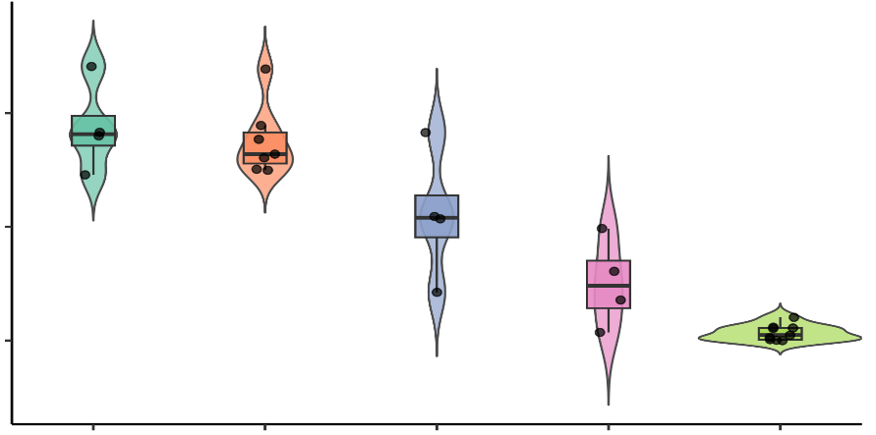




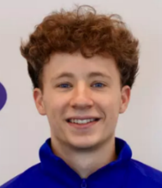
RAS inhibitors substantially reduce PanIN in mouse models
KC Mouse Model: LSL-Kras^{G12D/+}; p48-Cre
Fraction of non-cancer area of pancreas containing PanIN (%)
Non-cancer areas classified as PanIN, ADM, and normal acinar regions using machine-learning-based image analysis
56%
53%
33%
60
15%
Collaboration with Andy Aguirre Lab
PanIN (%)
30
2%
0
Julien Dilly Brendan Parent Seema Chugh
Vehicle
KRAS^{G12D}inh
3 days
Endpoint
3 days
7 days
Endpoint
Hiep Nguyen Tate Weltzin
AACR Pancreas Meeting, 2025
Notes:
Note:
Vehicle – 3 days: 4 cases
Vehicle endpoint: 7 cases
MRTX1133 – 3 days: 4 cases
MRTX1133 – 7 days: 4 cases
MRTX1133 endpoint: 9 cases

Slide 26
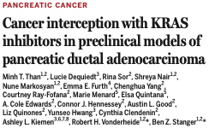
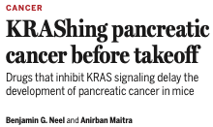
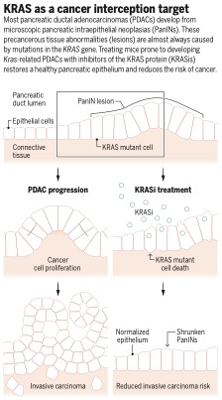
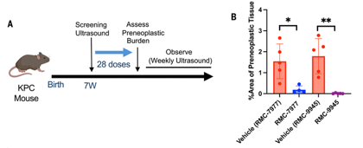
RAS inhibitors substantially reduce PanIN in mouse models

Slide 27
















Pancreatic Cancer Interception Trial
Brian Wolpin
Andrew Aguirre
Julie Sutcliffe
Mallika Singh
Elena Koltun
Clay Gustafson
Jonathan Nowak
Laura Wood
Ashley Kiemen
Brandon Huffman
Leny Gocheva

Slide 28
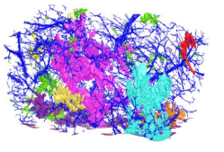
Clinical Trial to Evaluate PanIN Ablation by RAS Inhibitor
Neoadjuvant Daraxonrasib
CODA
PhenoCycler fusion (CODEX) high-plex protein assay
Resectable Pancreatic Cancer by NCCN guidelines
Surgery
CosMx spatial imaging high-plex RNA assay
No Neoadjuvant Therapy
Pancreas
Tissue

Slide 29
in the
??
RAS inhibitor

Slide 30



Acknowledgements
Wolpin-Nowak Lab
Jonathan Nowak
Anders Ohman
Xinran Qi
Carla Rujana
Mina Stanikic
Len Taing
Yas Takashima
Tate Weltzin
Shihong Wu
Melody Xiong
Leny Gocheva
Lauren Brais
Ben Mackinnon
Vidya Madineedi
Steve Smith
Emma Coleman
Precious Cramer
Andressa Dias Costa
Dalia Elganainy
Sloane Furniss
Jifan Gao
Jacob Geisberg
Elsa Joseph
Cibelle Lima
Micaela Morgado
Hiep Nguyen
Catherine O’Connor
Saraswathy Vaidyanathan
Aguirre Lab
Andrew Aguirre
Julien Dilly
Brendan Parent Seema Chugh
DFCI – Hale Center
Michael Rosenthal
Brandon Huffman
Stephanie Dougan
Kim Perez
James Cleary
Johns Hopkins Univ
Laura Wood
Ashley Kiemen
UC Davis
Julie Sutcliffe
Revolution Medicines
Clay Gustafson
Mallika Singh
Zeena Salman
Brandon Kent
Elena Koltun
Peter Lam
MDACC-NYU
Anirban Maitra
Johannes Fahrmann
Eugene Koay
Pancreatic Cancer Detection Consortium

Slide 31
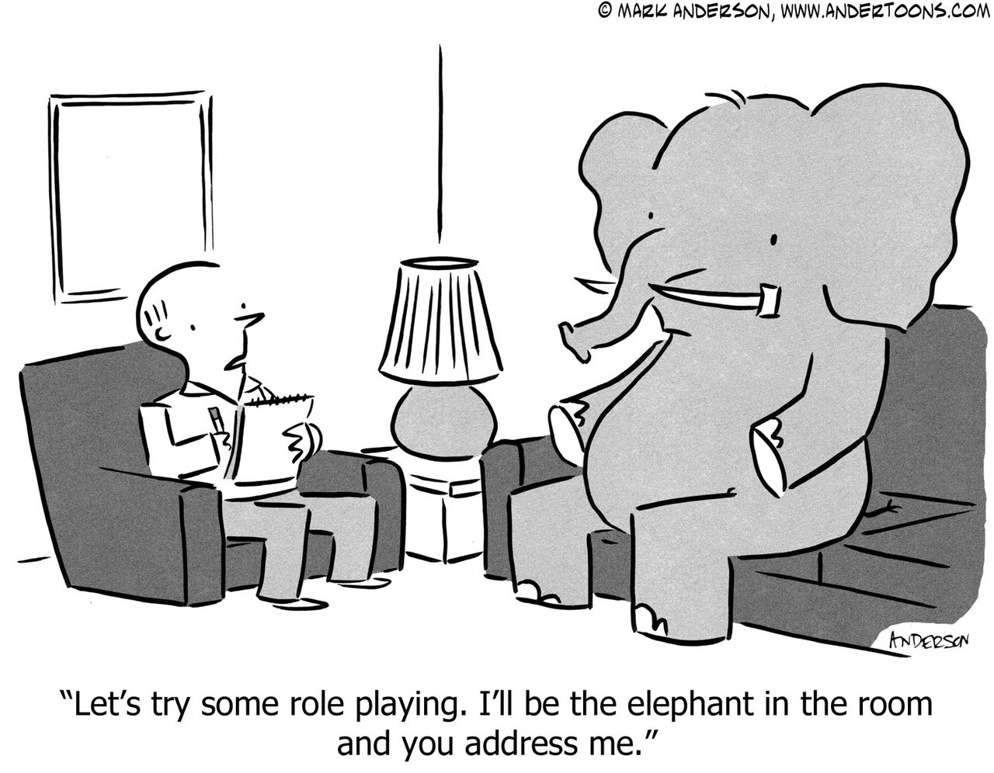
Thank you.
Mutant KRAS =

Slide 32
Thank you.

