Slide 1
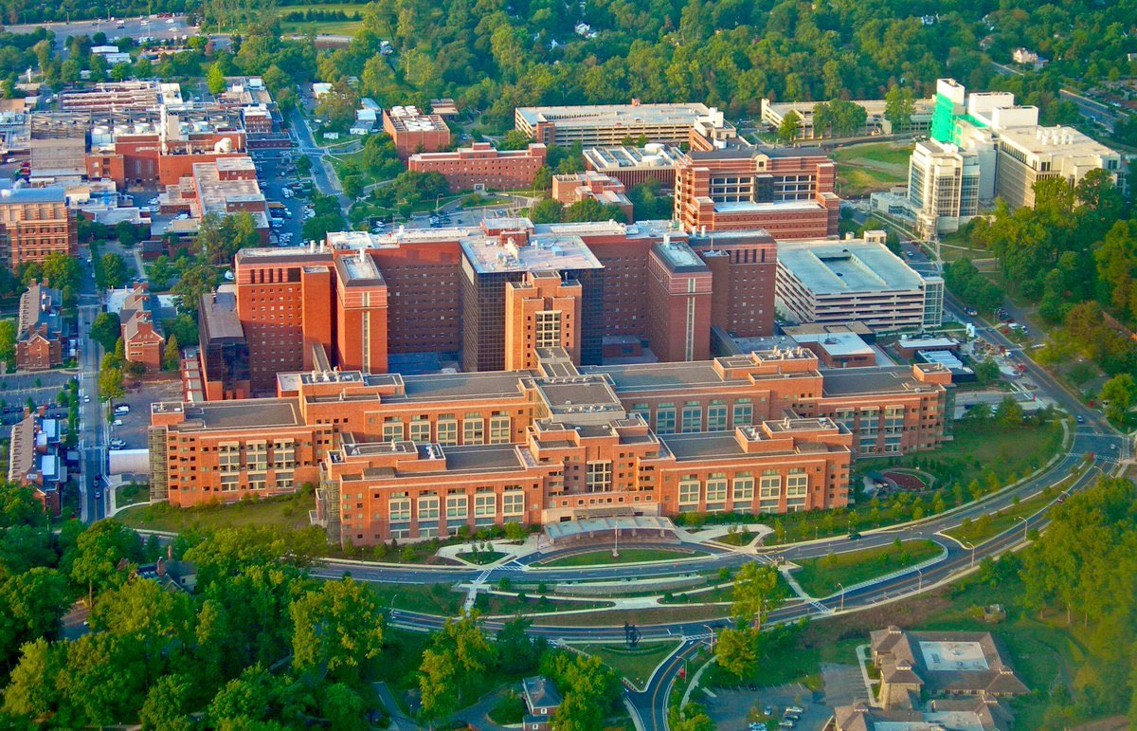
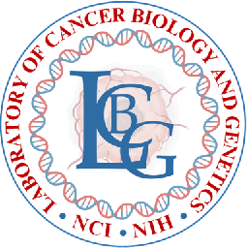
Tumor Organoids, Exosomes, and Biomarkers
Senthil K Muthuswamy, Ph.D.
Director
Center for Cancer Research,
National Cancer Institute, NIH

Slide 2

Our Research Program
Translational
Cancer Models
(Tumor organoid models)
Therapy Resistance
(Cell polarity regulated pathways )
Mechanistic

Slide 3




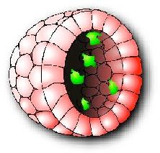

A 3D Culture Model to Investigate Epithelial Morphogenesis and Oncogenesis
Matrigel (Collagen/Laminin)
MCF-10A, human breast epithelial cells
Epithelial cell grown as
acini-like structures
Days 2-4
Days 4-6
Days 6-8
Days 12-28
Muthuswamy et al., (2001) Nat. Cell Biol.

Slide 4
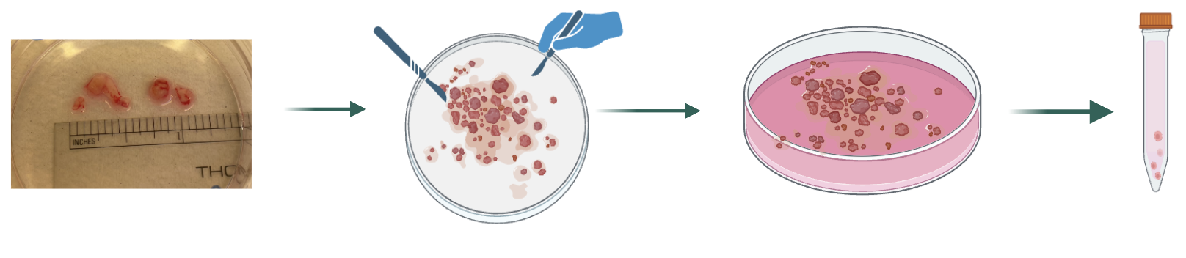
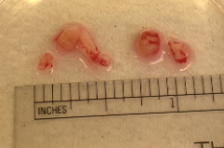
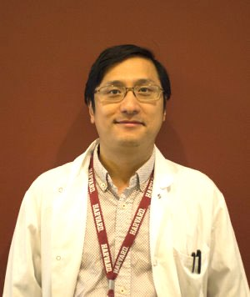
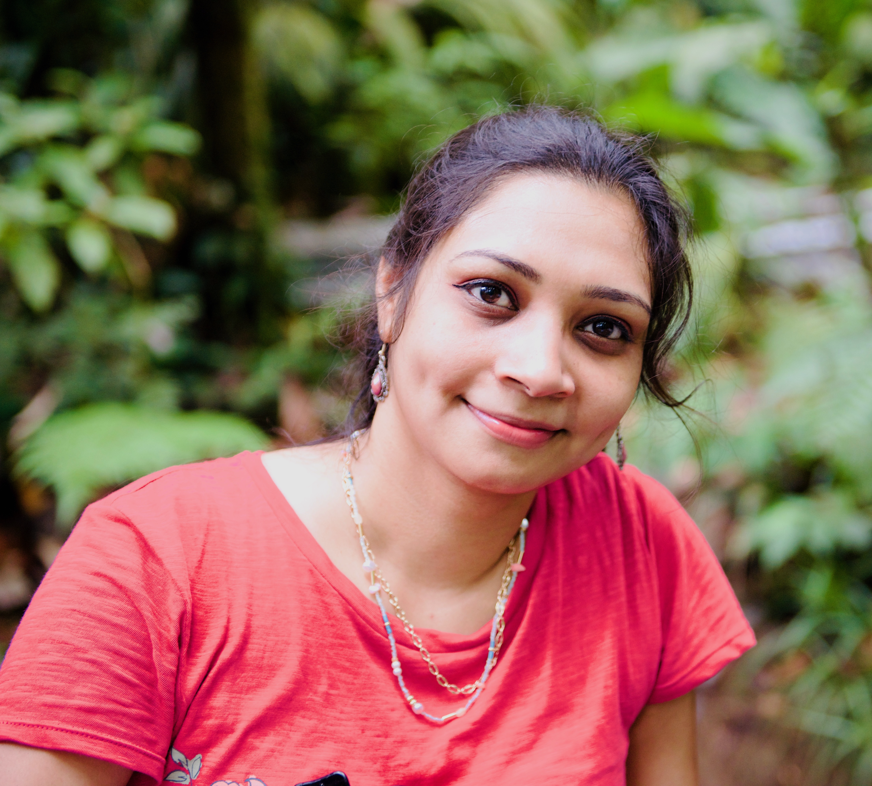
Patient Tumor-Derived Organoids (PDO)
Resected
Tumor or Biopsy
Mince
Digest
Organ-specific media
Media:
Free of stem cell factors
Organ-specific growth factors to maintain differentiation and histology
Ling Huang
Organ systems: GI organs, Breast, Head&Neck
Dipikaa Akshinthala
Li et al., (2025) Sci Rep 15:24221
Oliphant et al., (2024) Breast Cancer Res. 26:56
Huang et al., (2021) Cell Stem Cell. 28:1090
Huang et al., (2020) JCI Insight. 5:e135544
Huang et al., (2015) Nat Med. 21:1364

Slide 5
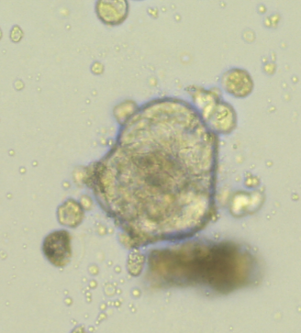
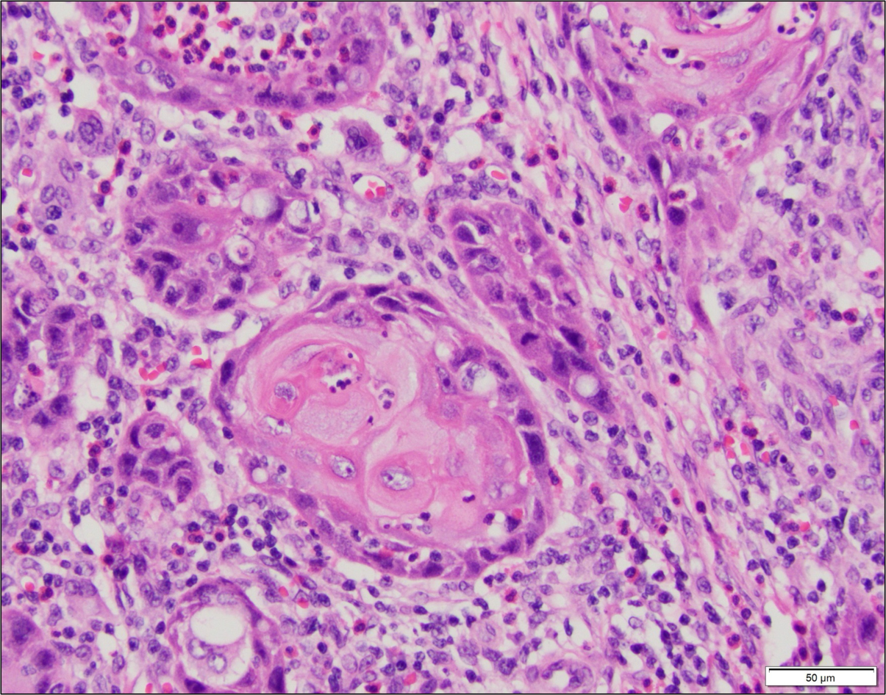
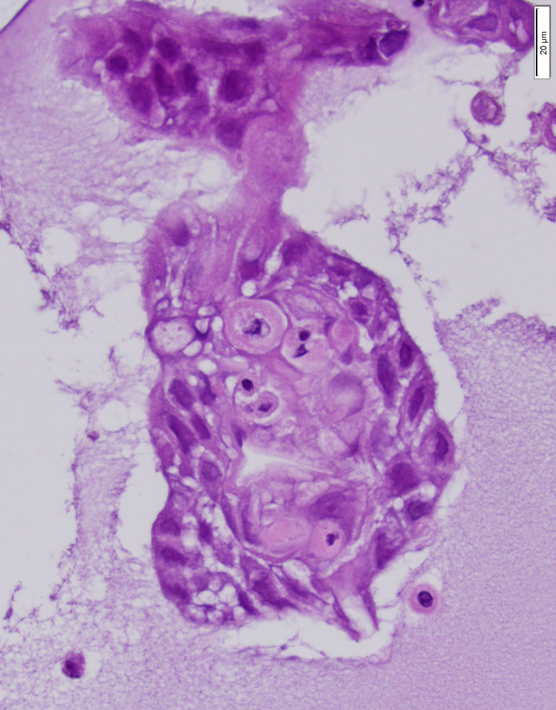
Tumor Organoids Mimic Histopathology of Patient’s Tumor
Breast
Patient’s tumor
Organoids
H&N

Slide 6
Tumor Organoids Are A Powerful Pre/Co-clinical Platform
Target identification, validation, and drug resistance
Personalizing cancer treatment
Changes in cell surface glycans
Secretome analysis for the discovery of blood-based biomarkers
Co-culture with T cells for the discovery of tumor-targeting TCRs
Cell state plasticity during metastasis and drug resistance
Li et al., (2025) Sci Rep 15:24221
Orr et al., (2023) Cancer Immune Immunother. 72:301
Gil Del Alcazar et al., (2022) Cancer Immune Res. 10:680
Kahraman et al., (2022) Nat. Metab. 4(1):76-89
Grossman et al., (2022) Clin. Can. Res. 28(4):708-718
Chafe et al., (2021) Sci. Adv. 7(35):eabj0364.
Koikawa et al., (2021) Cell 184:4753
Dedali et al., (2021) Sci Rep. 11:579
Huang et al., (2020) JCI Insight. 5:e135544
Dimitrov-Markov., (2020) Mol Cancer Ther. 19:1751
Park et al., (2019) Cell. Rep. 29:2672
Giles et al., (2018) Clin Cancer Res. 24:1734
Dai et al., (2017) Nat. Med. 23:1063

Slide 7
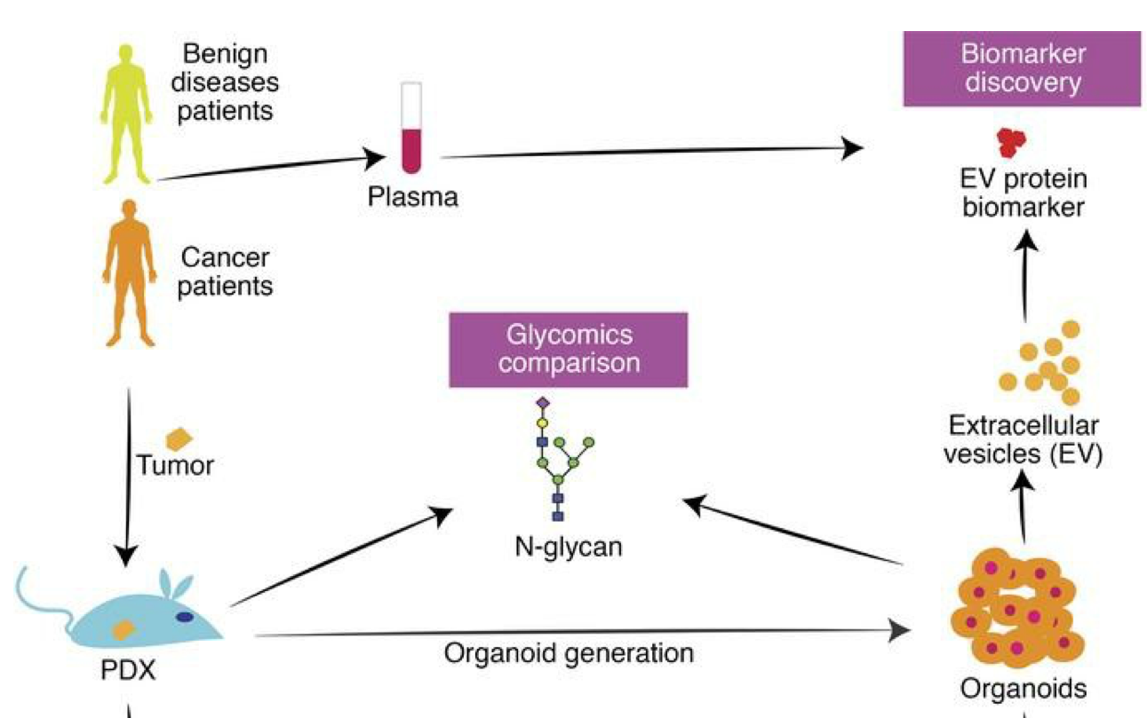
Tumor Organoids Are a Source for Discovery of EV-Based Biomarkers
Huang et al., (2020) JCI Insight. 5:e135544

Slide 8
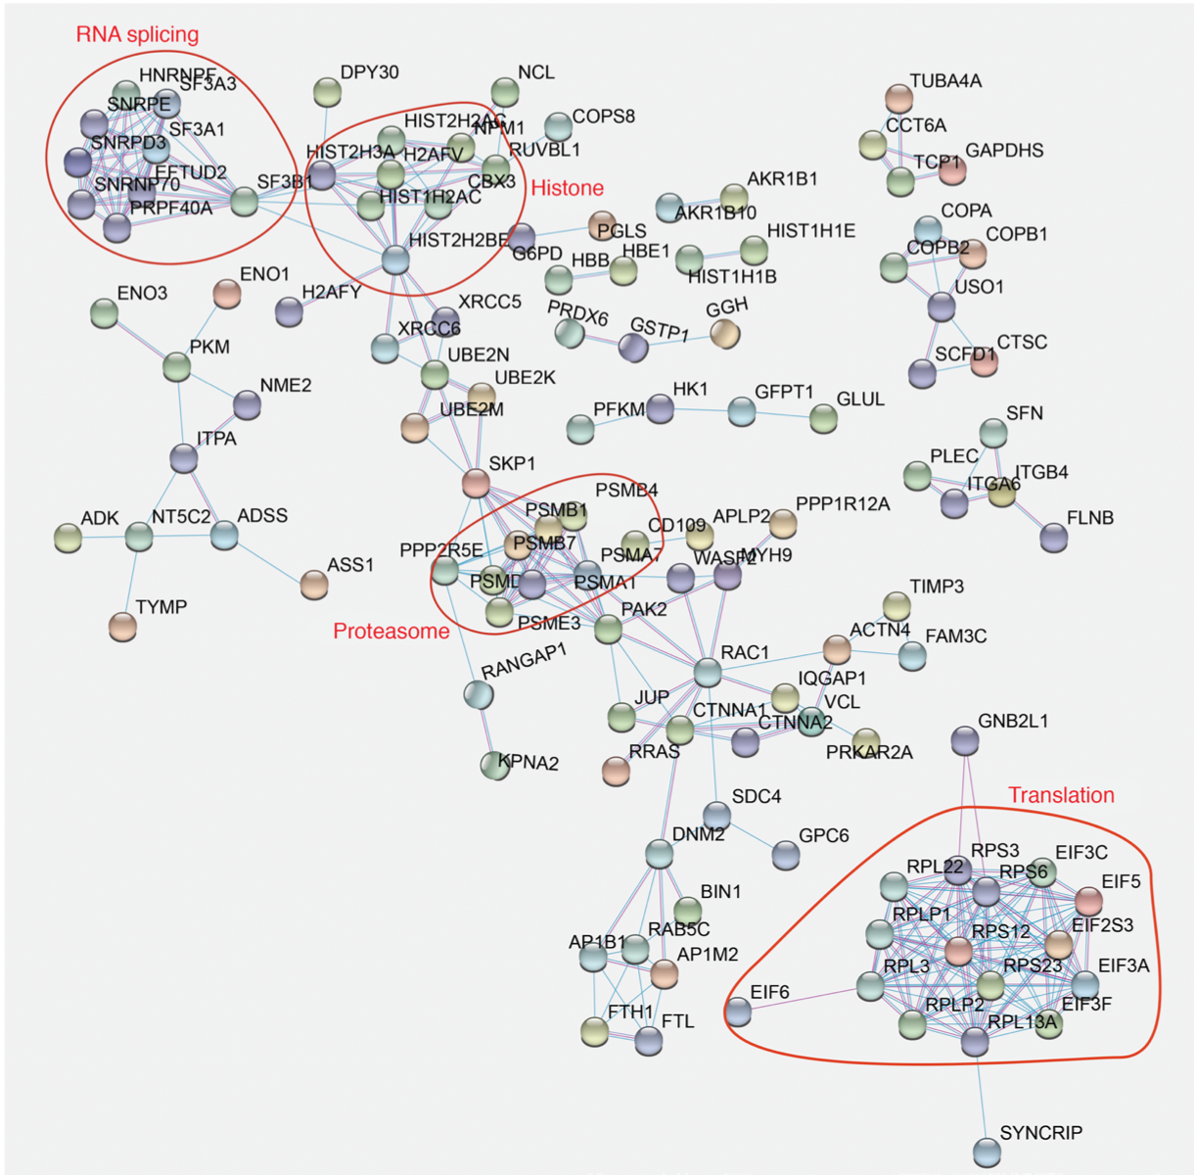
Organoid-Derived EVs Have Proteins of Multiple Functional Groups
Huang et al., (2020) JCI Insight. 5:e135544

Slide 9
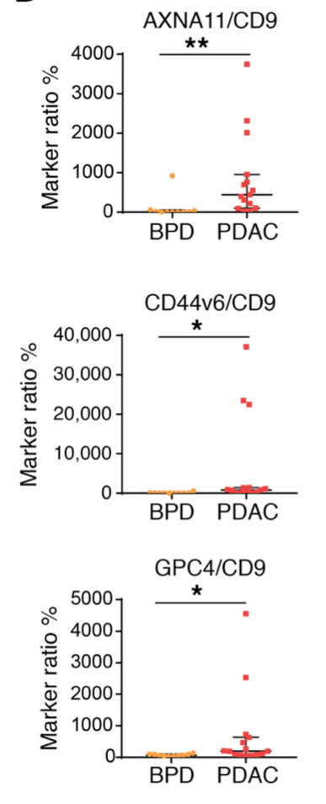
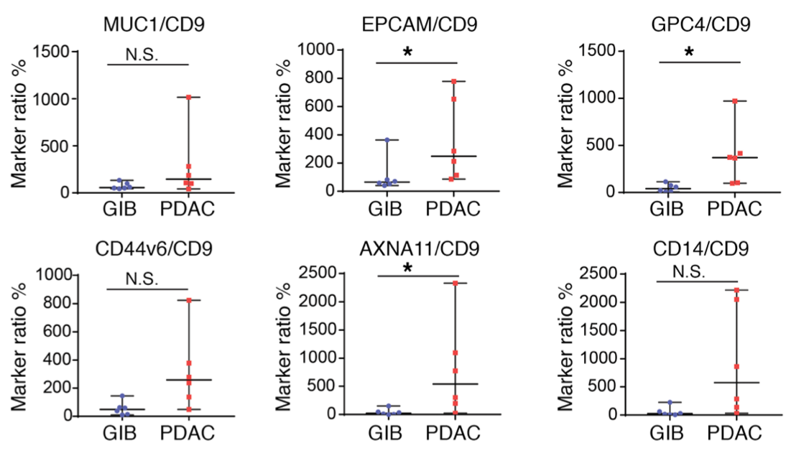
Proteins Present in Organoid-Derived EVs Detected in Serum of PDAC Patients
PDAC and Cholangiocarcinoma Vs benign GI Disease
PDAC Vs Benign pancreatic diseases
Huang et al., (2020) JCI Insight. 5:e135544

Slide 10
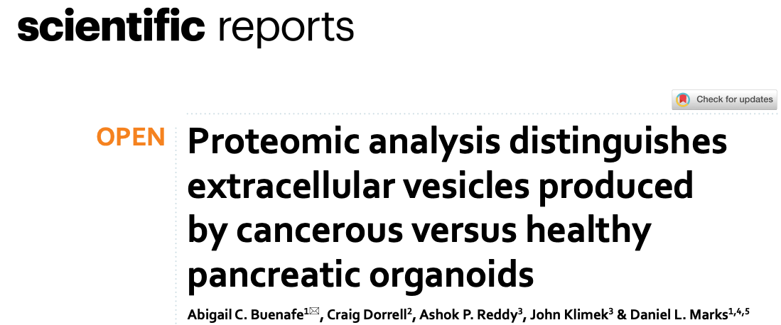
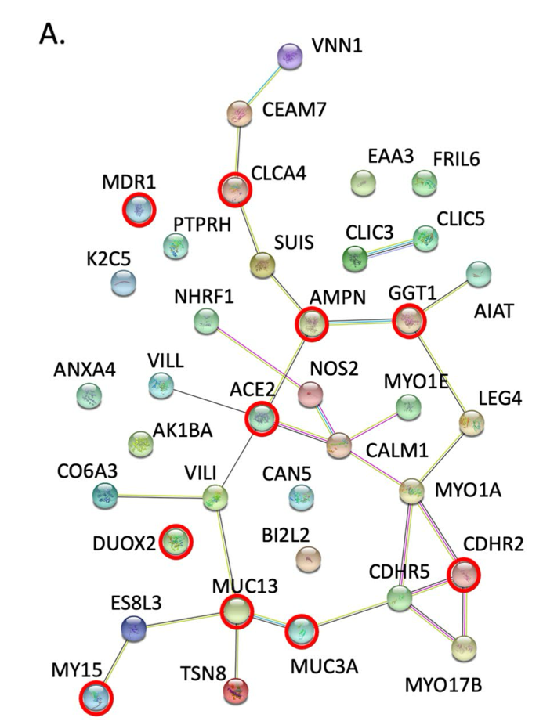
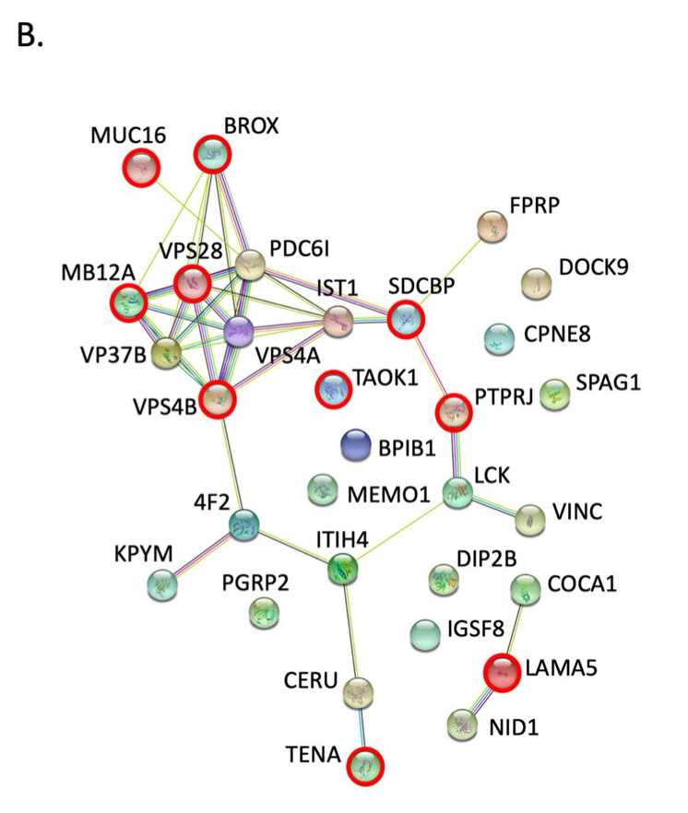
PDAC Vs Healthy organoids
51 candidates differentially regulated
Healthy
PDAC

Slide 11
EV from plasma: Identification and validation

Slide 12
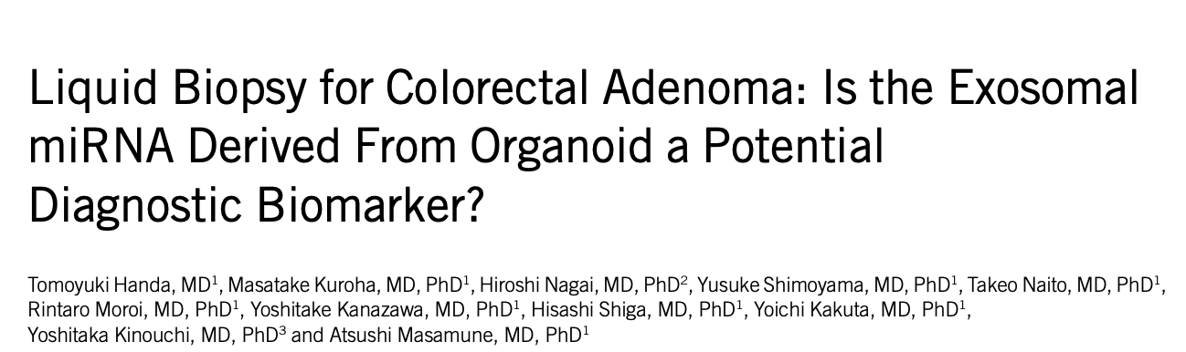
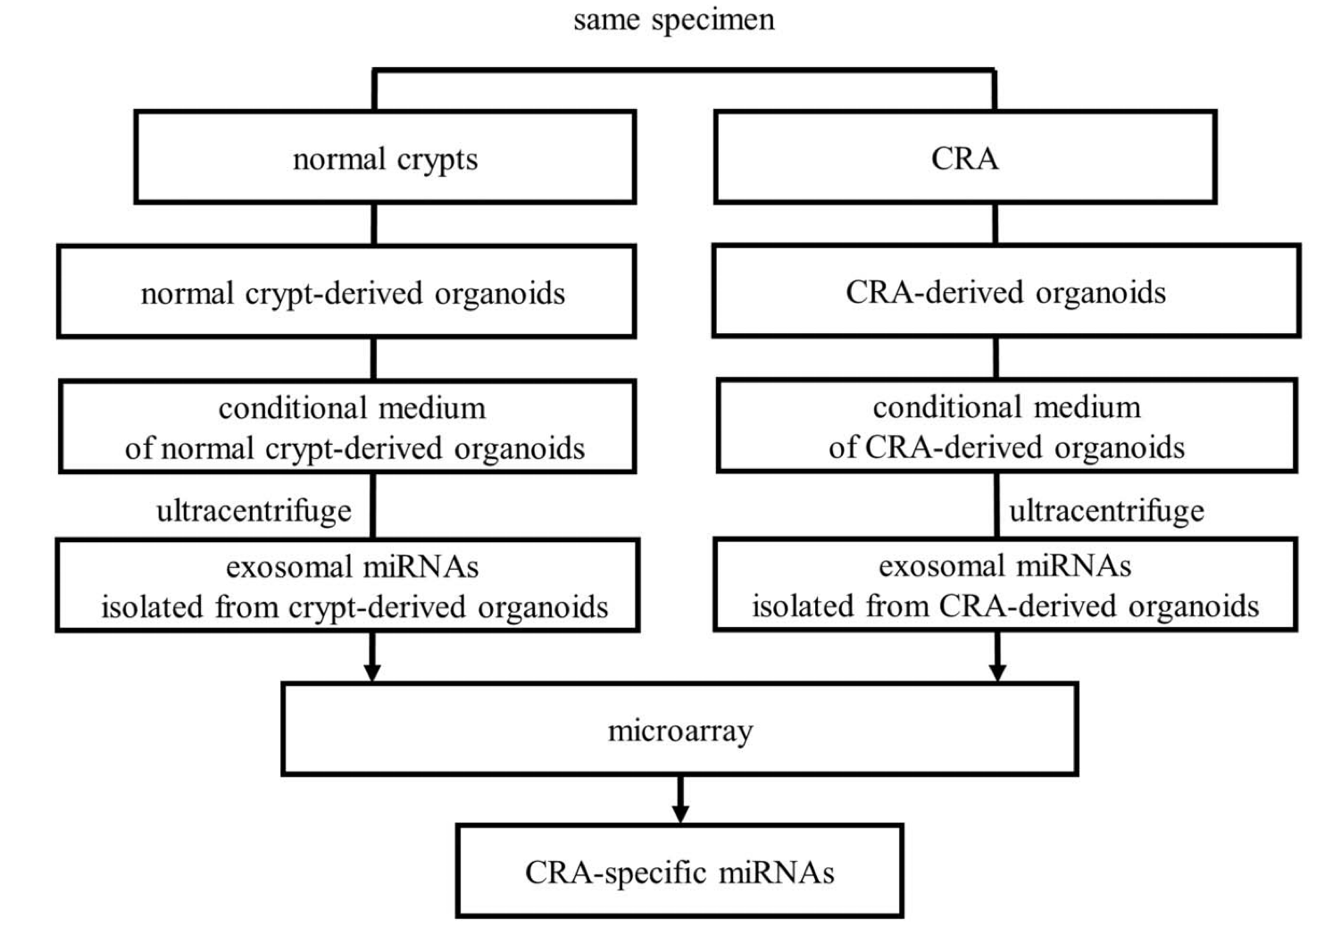
Handa T, et al. Clinical and Translational Gastroenterology. 2021;12:e00356.

Slide 13
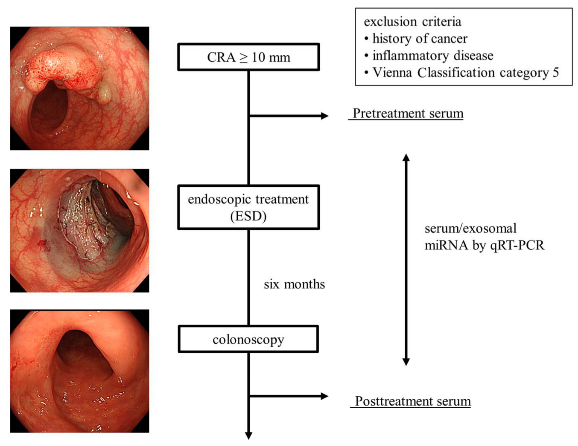
Handa T, et al. Clinical and Translational Gastroenterology. 2021;12:e00356.

Slide 14
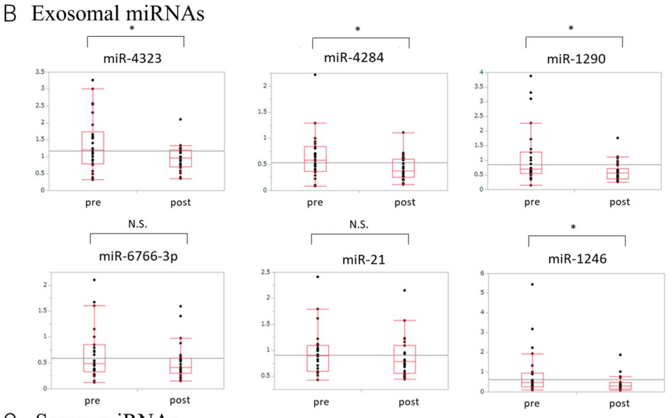
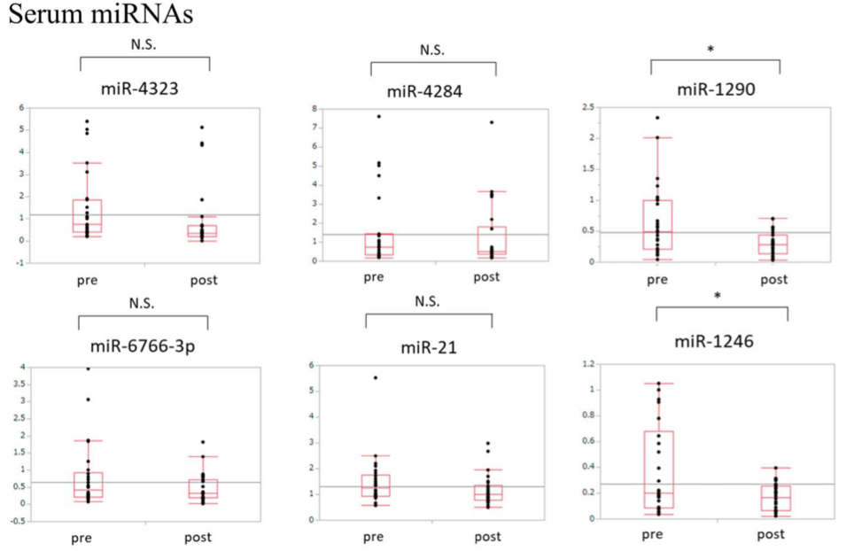
Organoid-Derived miRNA A Source For Serum Biomakers
Changes in miRNA - pre and post endoscopic resection
Handa T, et al. Clinical and Translational Gastroenterology. 2021;12:e00356.

Slide 15
EV trap: Method to Enrich For Exosomes in Serum
EV trap: Extracellular vesicle total recovery and purification.
Magnetic beads modified with aromatic and hydrophilic groups that bind to EVs.
Achieve 95% purification efficiency
Validated by EM
912 proteins on average/sample
Notes:
207 proteins - 50% of PDAC samples and 2x more than control

Slide 16
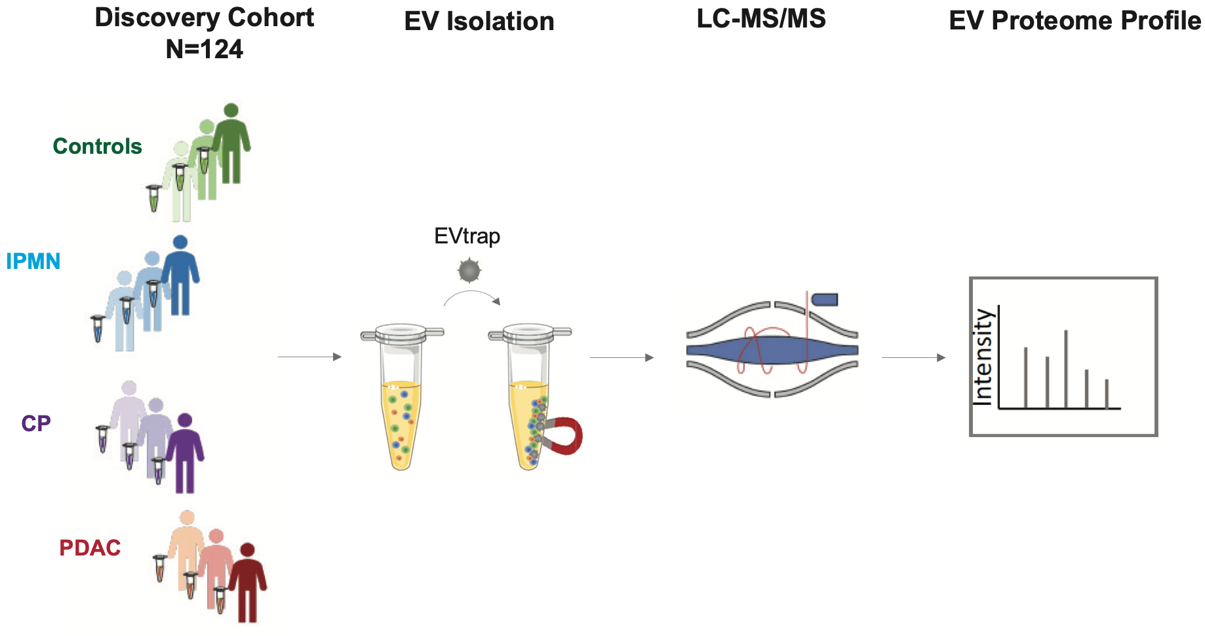
A Comprehensive Controlled Study For EV Biomarkers in PDAC
N=11
N=8
N=12
Early (N=30)
Adv (N=63)
Bockorny et al., eLIFE 2023; 12:RP87369

Slide 17
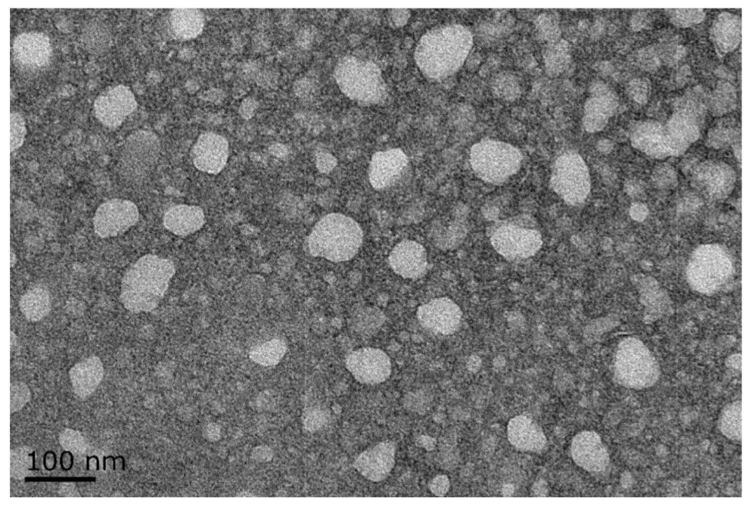
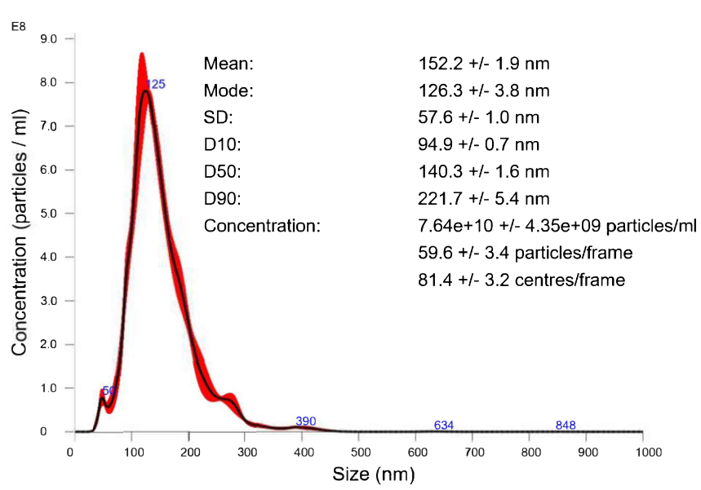
Validation of Exosomes Isolated By EV trap
Bockorny et al., eLIFE 2023; 12:RP87369

Slide 18
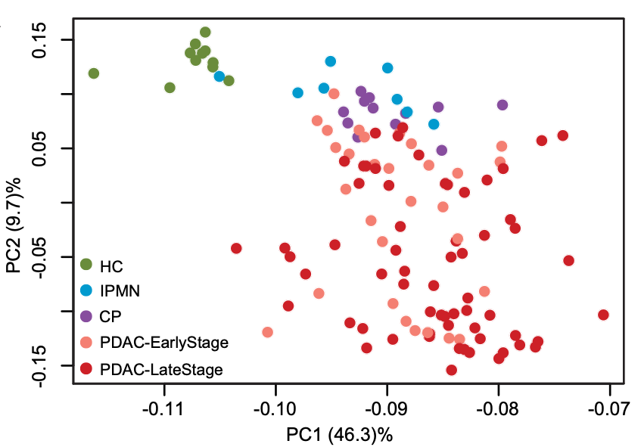
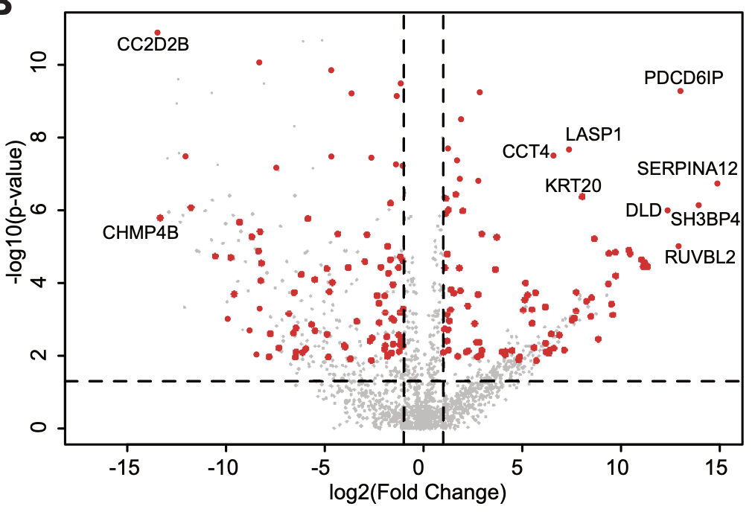
Differential Association of EVs In PDAC vs Healthy or IPMN
Bockorny et al., eLIFE 2023; 12:RP87369

Slide 19
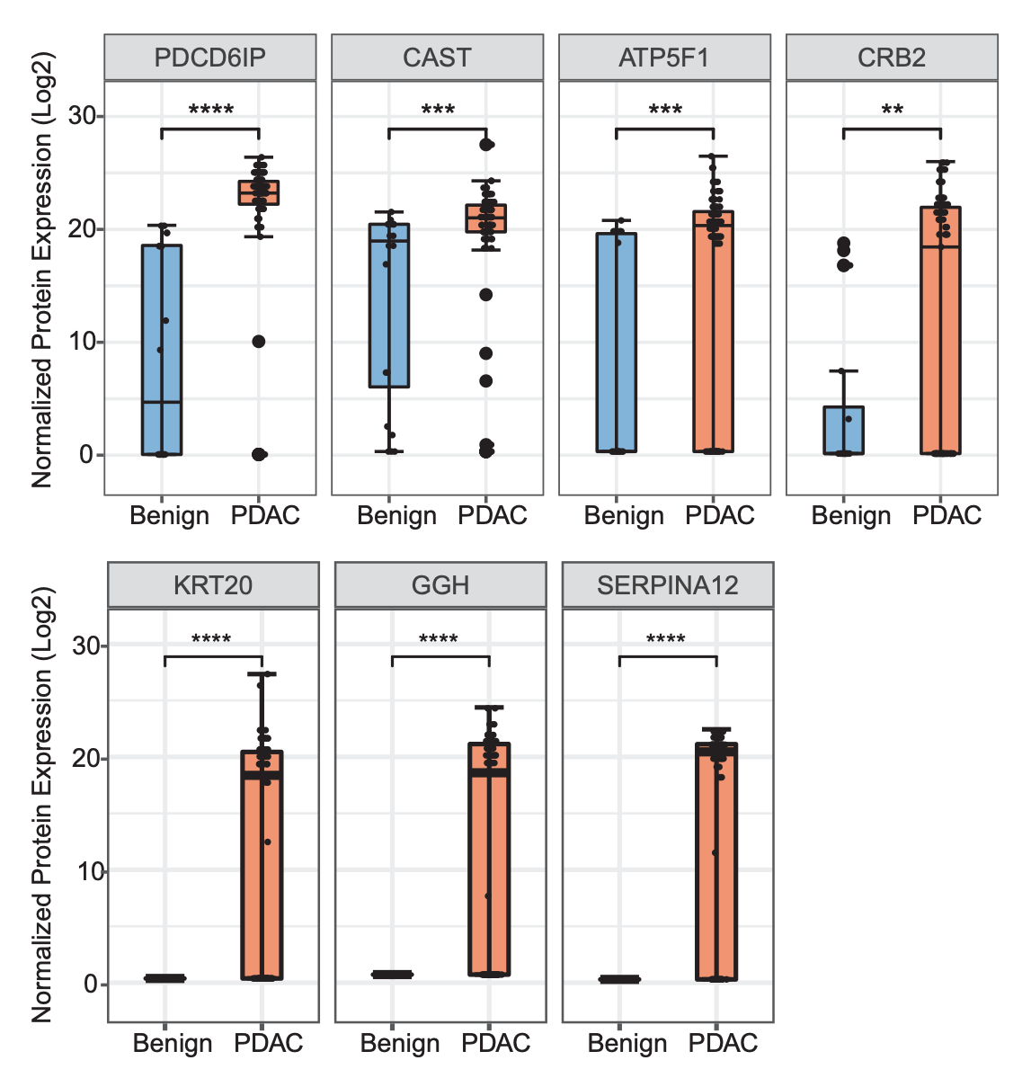
Seven Proteins Significantly Higher in PDAC Vs Benign

Slide 20
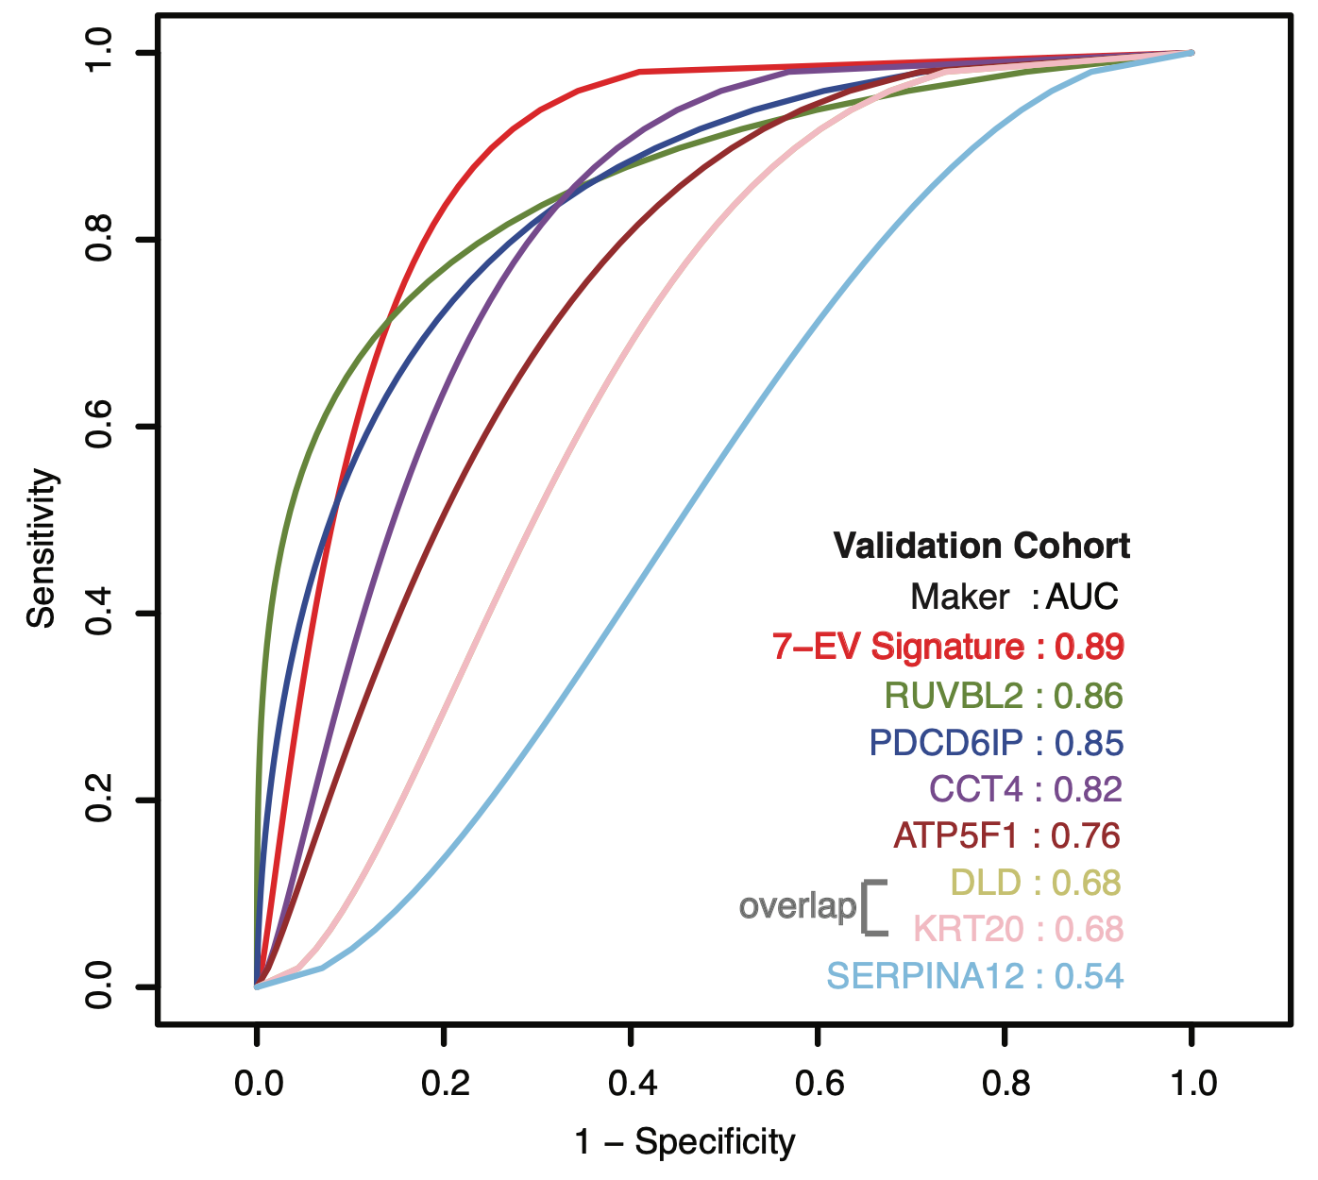

7-EV Signature Has 89% Predictive Value For Detecting PDAC
Bockorny et al., eLIFE 2023; 12:RP87369

Slide 21
A Collaborative Effort
Bruno Bockorny, MD
Joe Grossman, MD
Ling Huang, Ph.D
Dipikaa Akshinthala, MSc
Manuel Hidalgo, MD, Ph.D.

Slide 22
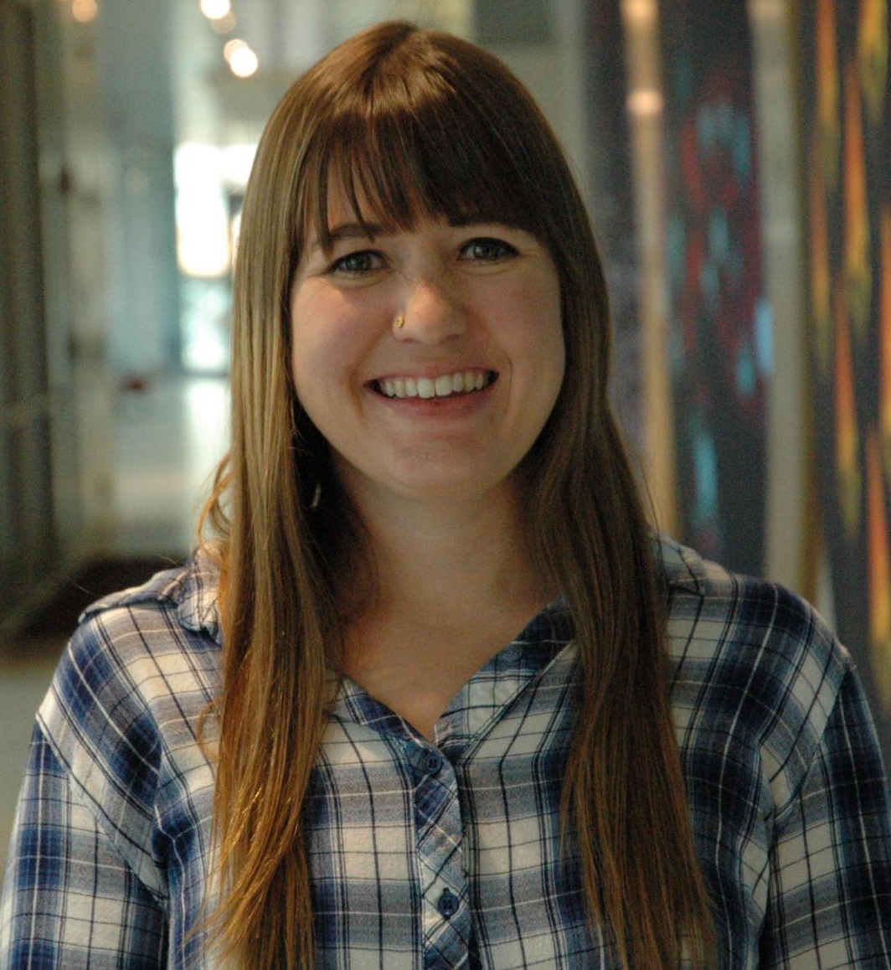
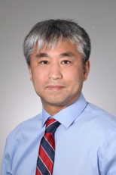
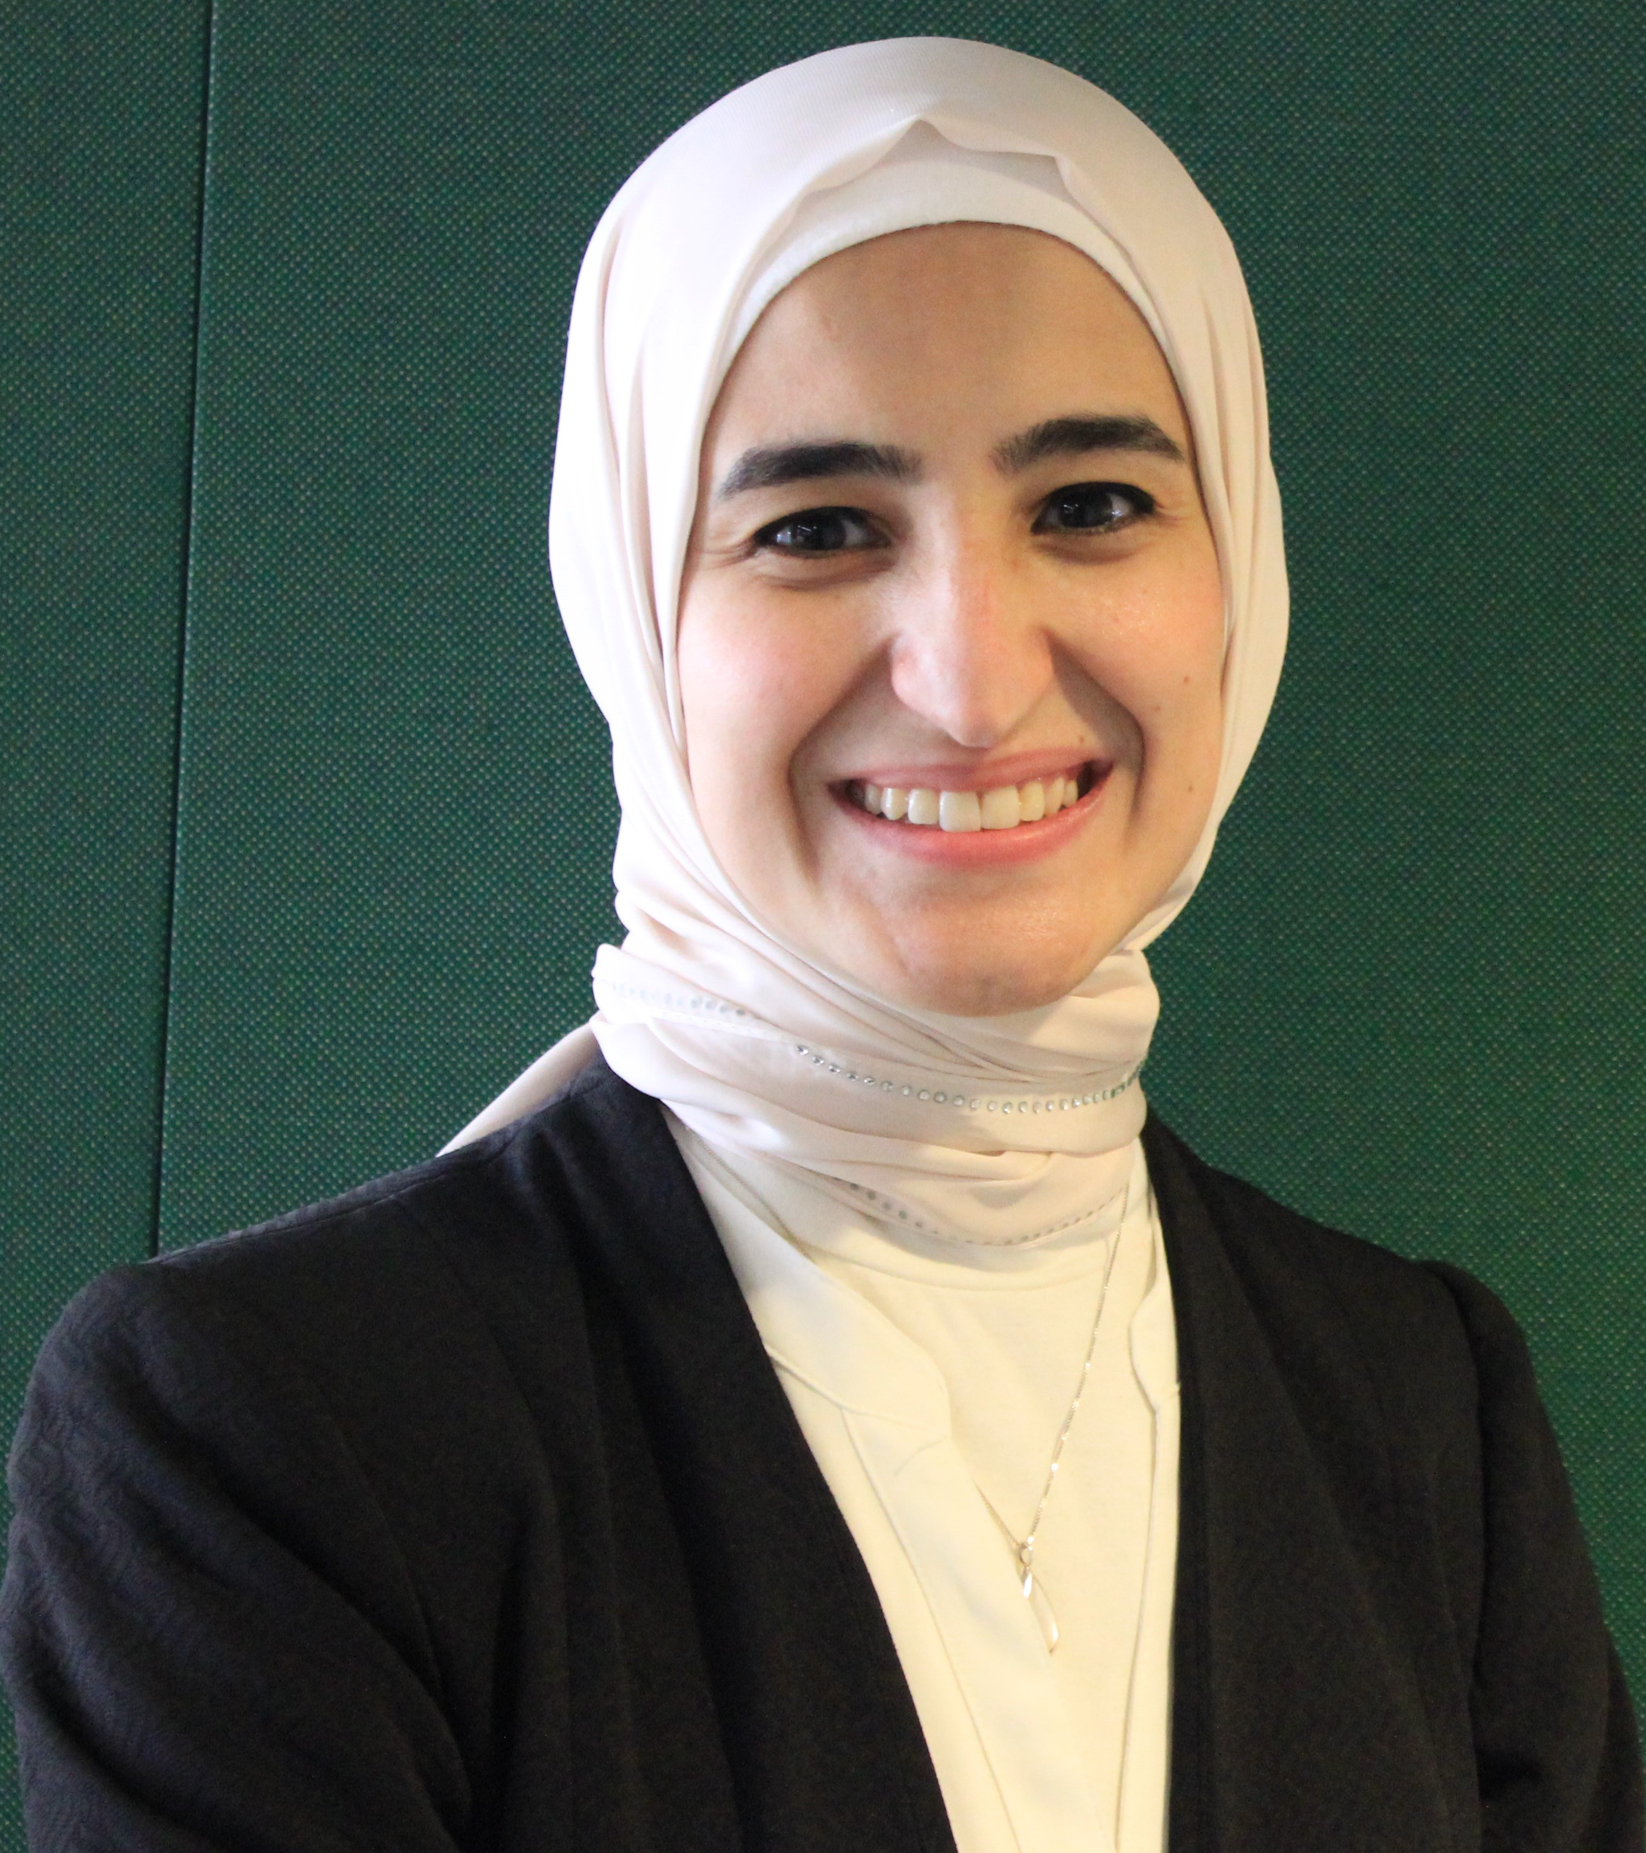
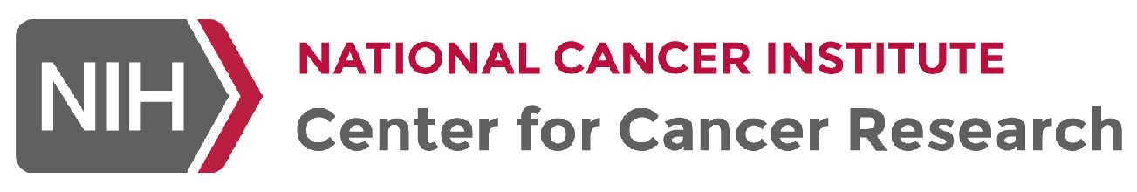
The Team @ NCI/NIH
Weilin Li
Tatiana Netterfield
Masashi Watanabe
Manar Elnaggar
Past members (related to this talk):
Ling Huang (Ass. Prof, Ford Health & Michigan State University)
Mike Oliphant (Asst. Prof, Univ of Colorado)
Yasu Saito (Asst. Prof, Keio Univ, Japan)
Mike Feigin (Associate Prof. Roswell Park)
Lixing Zhan (Prof. Chinese Academy of Sciences, Shanghai)
Victoria Aranda (Senior Editor, Nature)
Bin Xue (Director of Research, Cypre Inc.)
Marissa Nolan (Director Communications, Novartis)
Collaborators
Clint T. Allen, M.D.
Jonathan Hernandez M.D.
Andrew Blakely, M.D.
Maxwell Lee, Ph.D.
Nick Wagle, M.D. (DFCI)
Myles Brown (DFCI)

Slide 23
Opportunities at the Center for Cancer Research (CCR), NCI

Slide 24
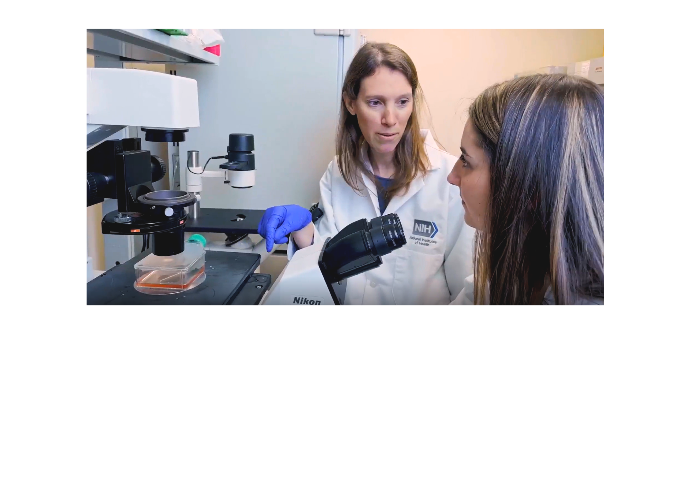

Physician-Scientist Early Investigator Program
Physician Early Investigator Program (PEIP)
At NCI’s Center for Cancer Research (CCR)
Launch your independent career
220+ leading cancer clinicians & scientists
World-class technologies & the NIH Clinical Center
3–5 years of support
Dedicated funding
Lab space
Postdoctoral support
Research independence
Mentorship
For MD or equivalent clinicians
Learn more
https://go.nih.gov/aboutpeip
Applications accepted on a rolling basis

Slide 25
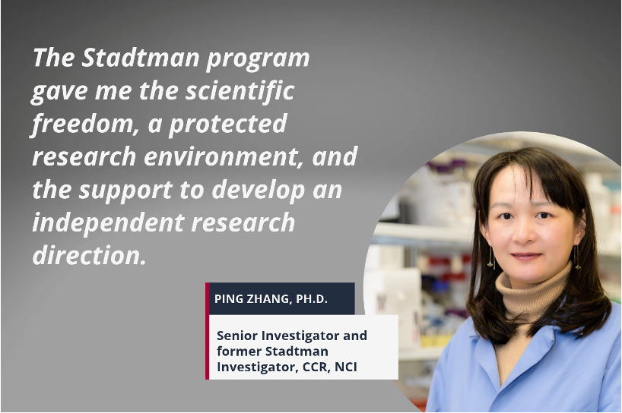

Physician-Scientist Early Investigator Program
NIH Stadtman Tenure-Track Investigator
At NCI’s Center for Cancer Research (CCR)
Why NIH?
Stable research funding
Shared resources
World’s largest research hospital
Eligility
Ph.D. or MD or MD/Ph.D.
Addressing challenging questions in cancer
Strong record of high-impact publications
Eligible for federal employment.

