Slide 1
Single-Cell Spatial Transcriptomic Signatures of Early Stage Ovarian Pre-Cancer
Alex Xu
EDRN Scientific Workshop

Slide 2
A Simple Analogy for Spatial
Do I want to eat this fruit?

Slide 3
A Simple Analogy for Spatial
Smoothie-salad-fruit cake analogy
Bulk mixed fruits
Single mixed fruits
Spatial mixed fruits
Do I want to eat this fruit?

Slide 4

A Simple Analogy for Spatial
Smoothie-salad-fruit cake analogy
Gooey cake analogy
Bulk mixed fruits
Single mixed fruits
Spatial mixed fruits
Do I want to eat this fruit?
Pineapple-y cherries?
Cake-y cherries?
How does spatial change
the flavor of fruit?

Slide 5

A Simple Analogy for Spatial
Smoothie-salad-fruit cake analogy
Gooey cake analogy
Bulk mixed fruits
Single mixed fruits
Spatial mixed fruits
Do I want to eat this fruit?
Unpublished data
Pineapple-y cherries?
Cake-y cherries?
How does spatial change
the flavor of fruit?

Slide 6
A Simple Analogy for Spatial
What is it about the fruit?
Taste?
Balance?
Too pixelated?
Spatial Omics

Slide 7
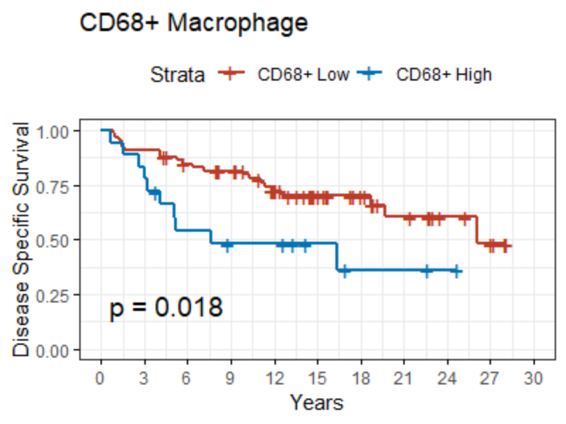
Applied Spatial Data
Correlative vs intervention
Correlative
Measurement/biomarker
Outcome
Survival
Response
Strata

Slide 8
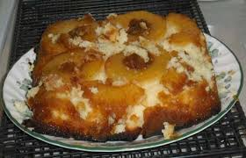
Applied Spatial Data
Correlative vs intervention
Correlative
Measurement/biomarker
Outcome
Survival
Response
Strata

Slide 9
Applied Spatial Data
Correlative vs intervention
Correlative
Efficacy
Off-target
Measurement/biomarker
Toxicity
Strata
Outcome
Survival
Response

Slide 10
Applied Spatial Data
Correlative vs intervention
Correlative
Efficacy
Off-target
Measurement/biomarker
Toxicity
Strata
Outcome
Survival
Response

Slide 11
Applied Spatial Data – Early Cancer
Early correlative vs intervention
Correlative
Measurement/biomarker
Outcome
Survival
Response
Strata

Slide 12
Applied Spatial Data – Early Cancer
Early correlative vs intervention
Correlative
Measurement/biomarker
Outcome
Survival
Response
Strata

Slide 13
Applied Spatial Data – Early Cancer
Early correlative vs intervention
Correlative
Measurement/biomarker
Outcome
Survival
Response
Strata
Incidental findings
Conjecture

Slide 14
Applied Spatial Data – Early Cancer
Early correlative vs intervention
Correlative
Measurement/biomarker
Outcome
Survival
Response
Strata
Noisy observations
Long horizons
More conjecture
Incidental findings
Conjecture

Slide 15
Applied Spatial Data – Early Cancer
Early correlative vs intervention
Mechanistic
Hypotheses
Correlative
Measurement/biomarker
Outcome
Survival
Response
Strata
Noisy observations
Long horizons
More conjecture
Incidental findings
Conjecture

Slide 16
Applied Spatial Data – Early Cancer
Early correlative vs intervention
Mechanistic
Hypotheses
Detectable
Features
Correlative
Measurement/biomarker
Outcome
Survival
Response
Strata
Noisy observations
Long horizons
More conjecture
Incidental findings
Conjecture

Slide 17
Applied Spatial Data – Early Cancer
Early correlative vs intervention
Mechanistic
Hypotheses
Detectable
Features
Correlative
Measurement/biomarker
Outcome
Survival
Response
Strata
Upstream
Validation
Noisy observations
Long horizons
More conjecture
Incidental findings
Conjecture

Slide 18
Applied Spatial Data – Early Cancer
Early correlative vs intervention
Mechanistic
Hypotheses
Detectable
Features
Correlative
Measurement/biomarker
Outcome
Survival
Response
Strata
Economical
Assays
Upstream
Validation
Noisy observations
Long horizons
More conjecture
Incidental findings
Conjecture

Slide 19
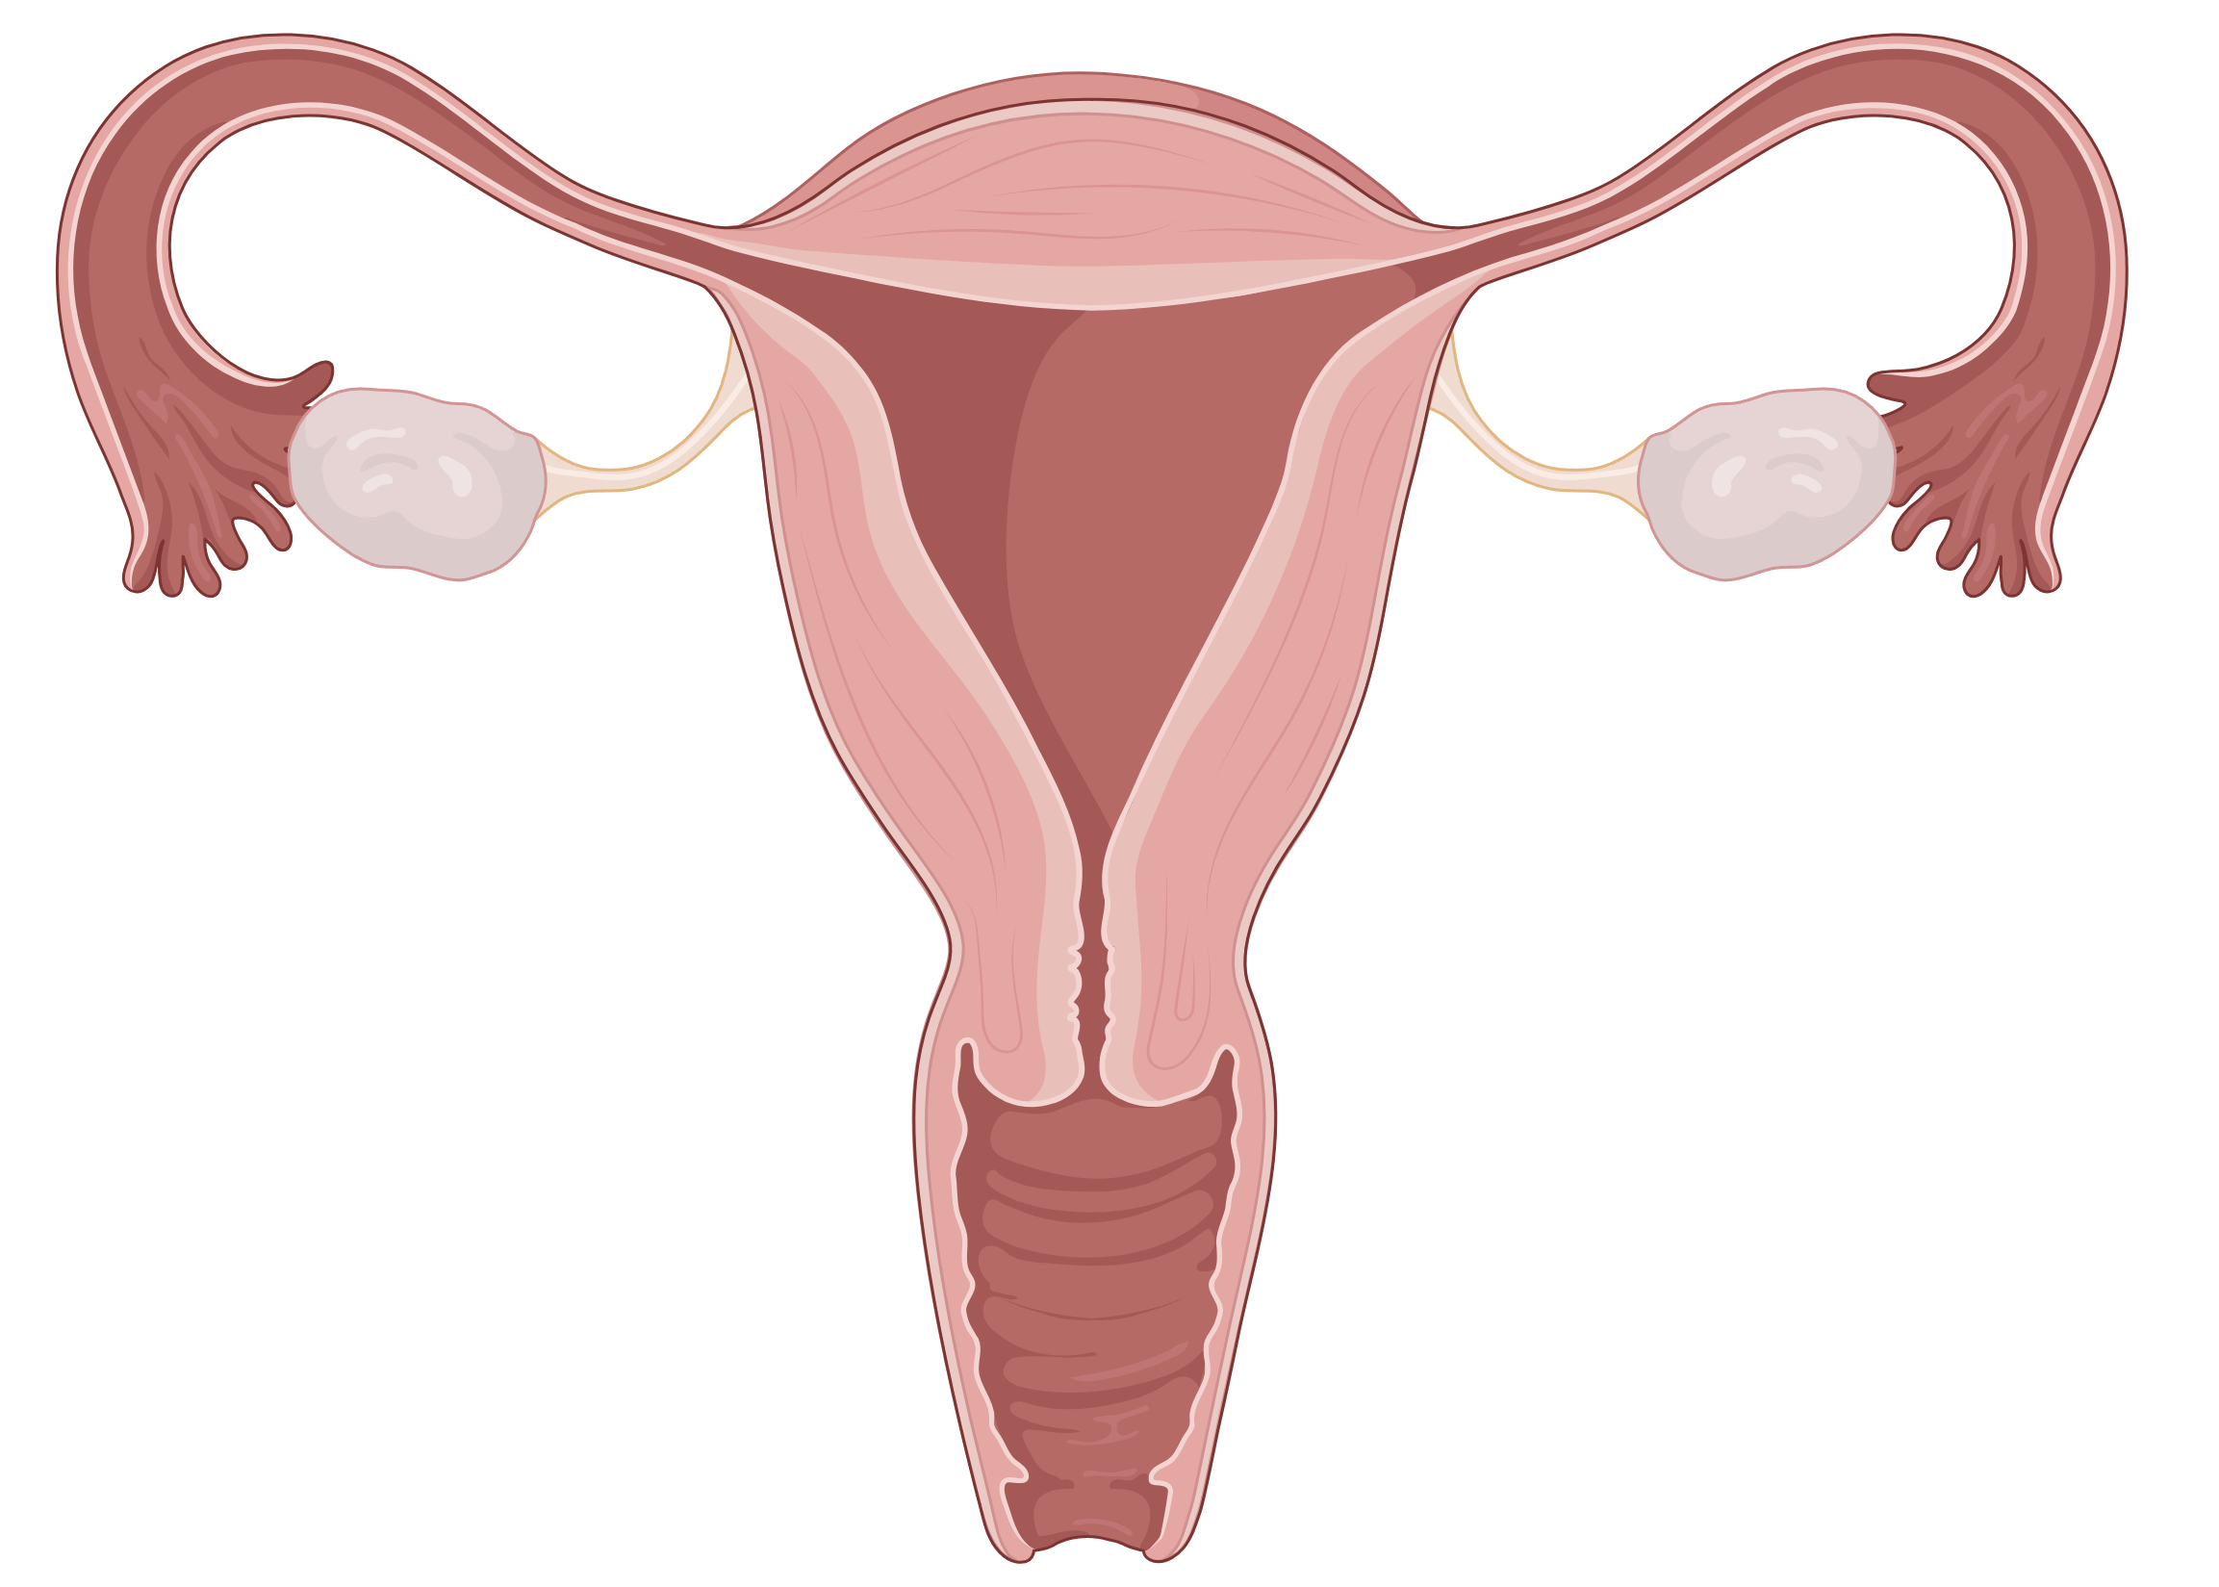


Ovarian Pre-Cancer
High Grade Serous Ovarian Carcinoma (HGSC)
5-year Survival ~ 50%
Late detection, limited strategies
Ovary
Xu et al., Science Advances, 2024
HGSC

Slide 20

Ovarian Pre-Cancer
Fallopian Tube
Serous Tubal Intraepithelial Carcinoma (STIC)
Originating in Fallopian Tube Epithelium
Exceedingly rare diagnosis (Incidental)
When Concurrent with HGSC, possible conflation with local metastases
STIC
Ovary
HGSC
Fimbriated End

Slide 21
Ovarian Pre-Cancer
Fallopian Tube
Serous Tubal Intraepithelial Carcinoma (STIC)
Originating in Fallopian Tube Epithelium
Exceedingly rare diagnosis (Incidental)
When Concurrent with HGSC, possible conflation with local metastases
Drivers of STIC progression?
Temporal tumorigenesis
Immunosuppression
STIC
Ovary
HGSC
Fimbriated End

Slide 22
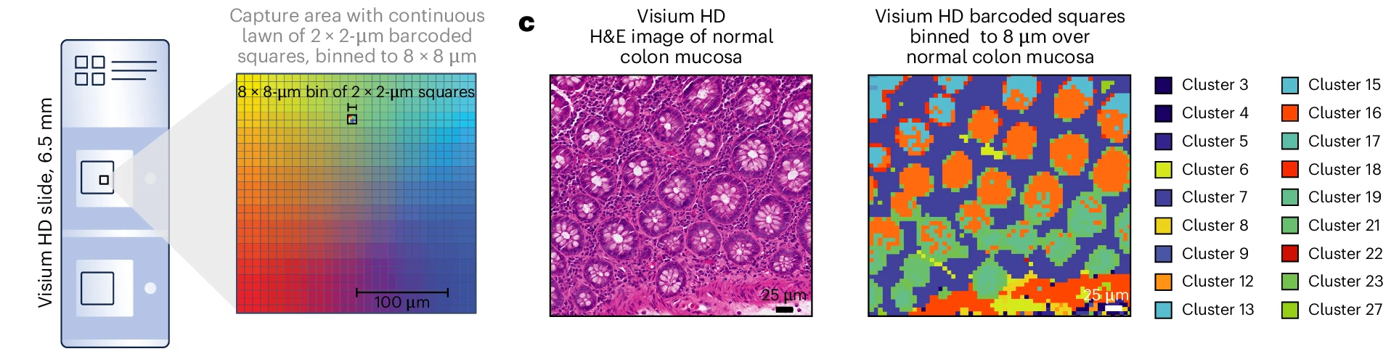
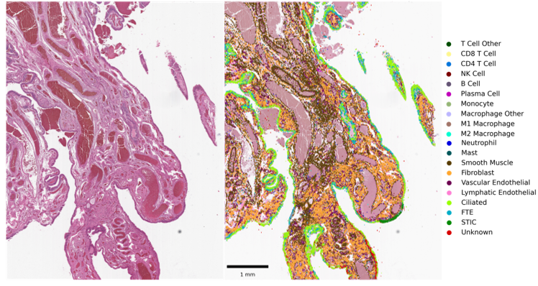
Visium HD STIC
2 µm spatial resolution
Full transcriptome
Cell segmentation

Slide 23
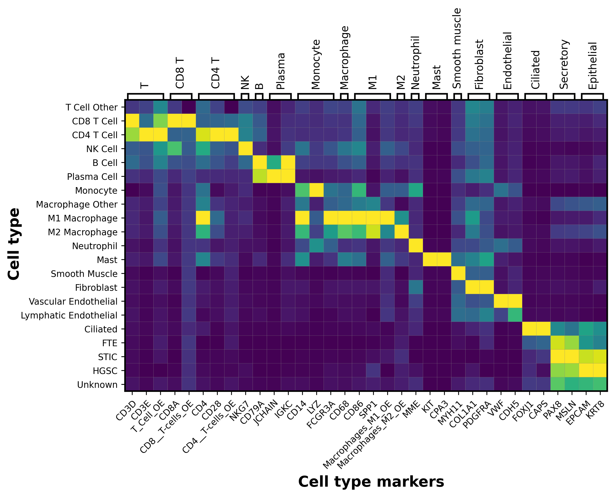
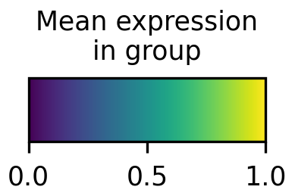
Visium HD STIC – Phenotyping
~20 cell types
Harmony batch correction
Pathologist-in-the-loop annotation
Targeted subclustering
Immune subtype signature
via Gaussian mixed modeling

Slide 24
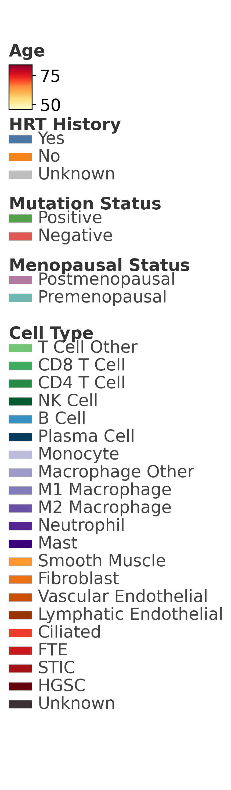
Visium HD STIC – Sample Composition
Patient characteristics
Incidental vs Concurrent STICs
Pre vs Post menopausal

Slide 25
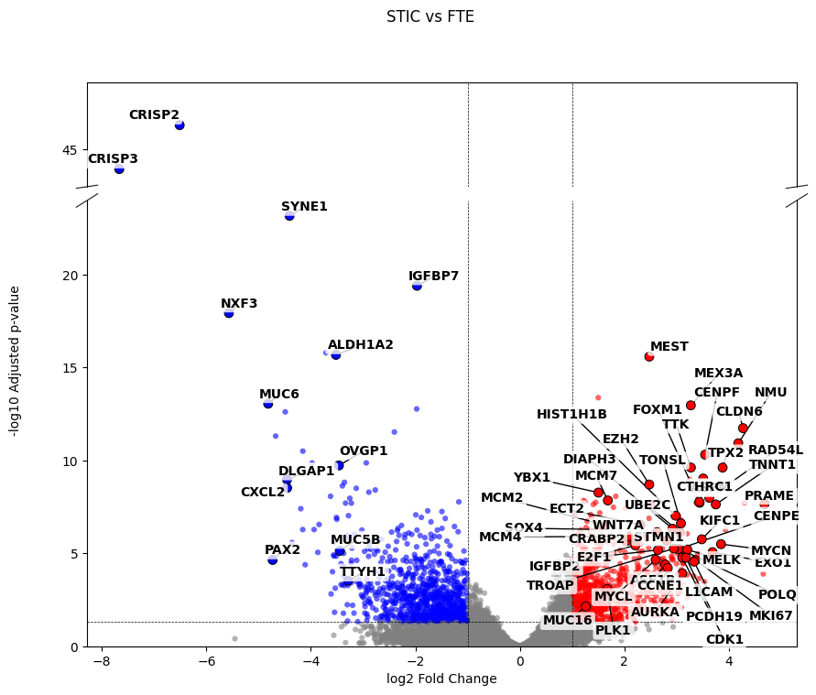
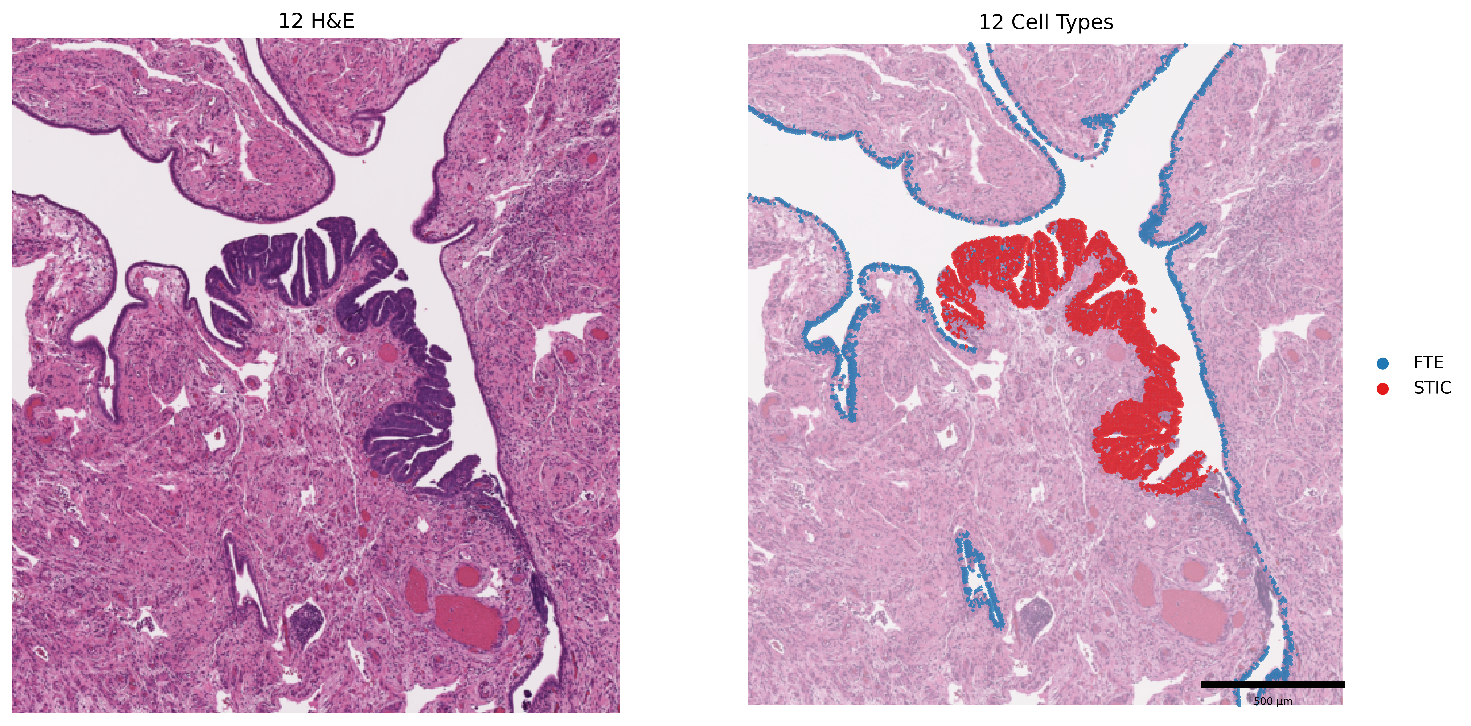
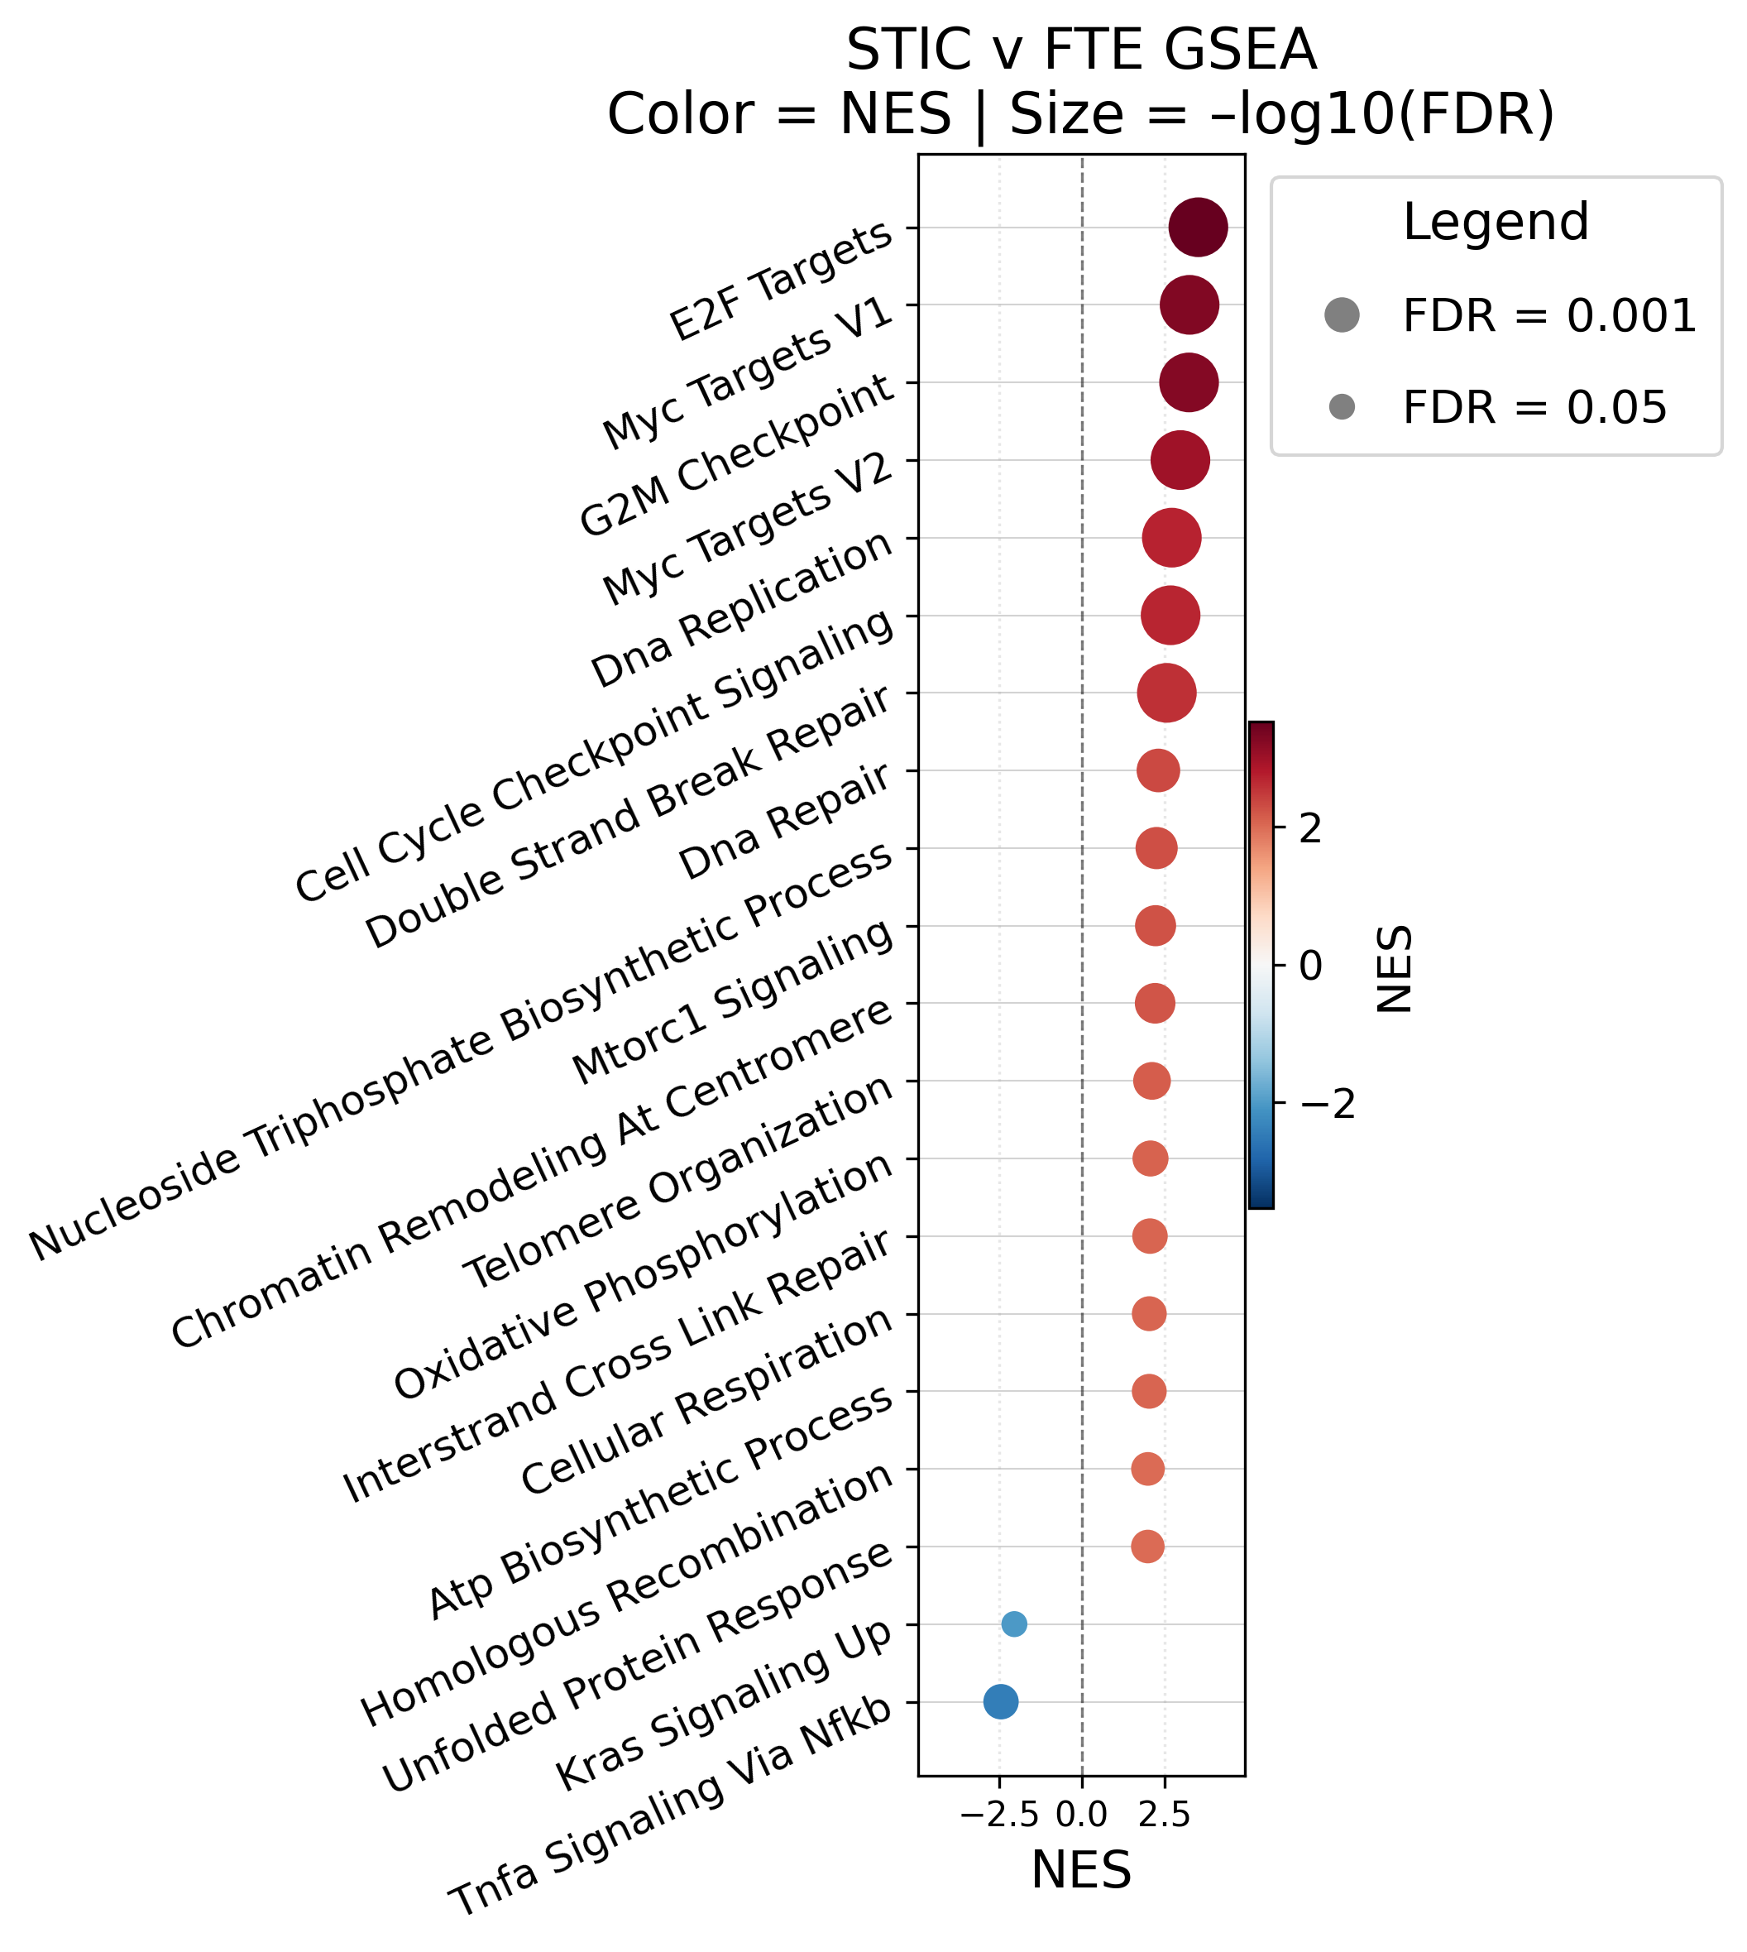
STIC Transcriptional Changes
Biomarker:
RNA
Confirmatory (Kaden et al, Garcia et al)

Slide 26
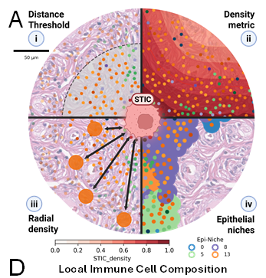
STIC Microenvironmental Changes
Rigorously defining the microenvironment
Nearest neighbor distance
Density

Slide 27
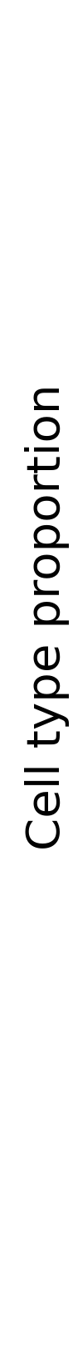
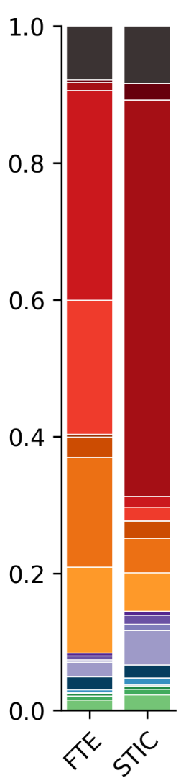
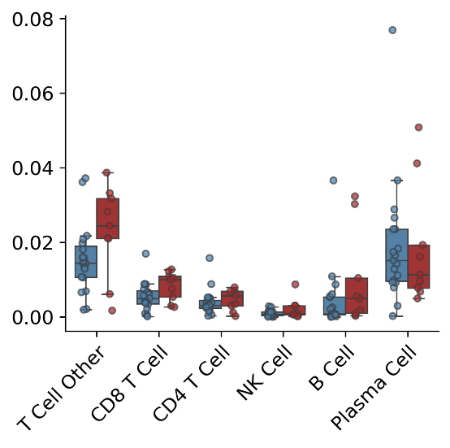
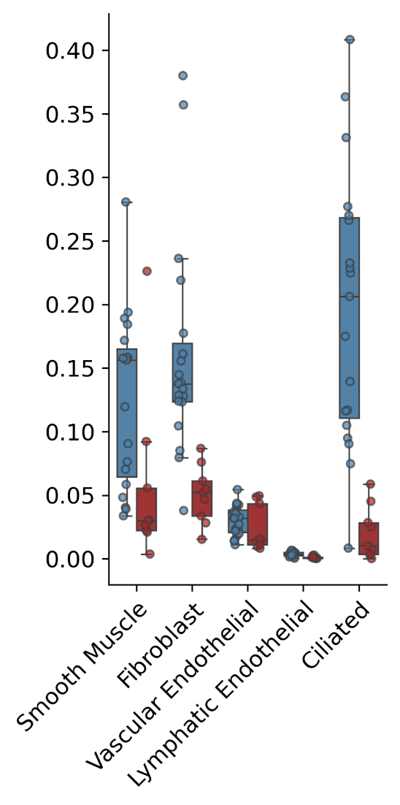
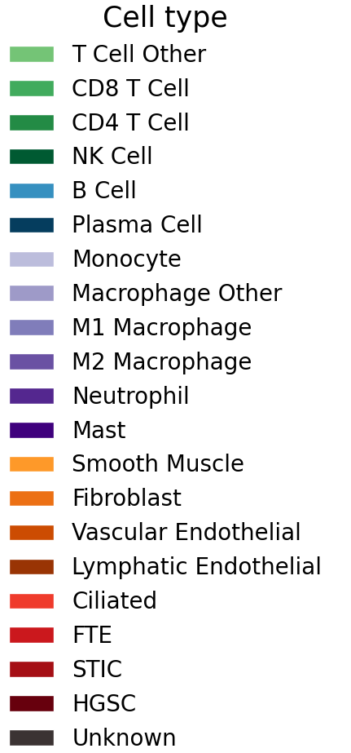
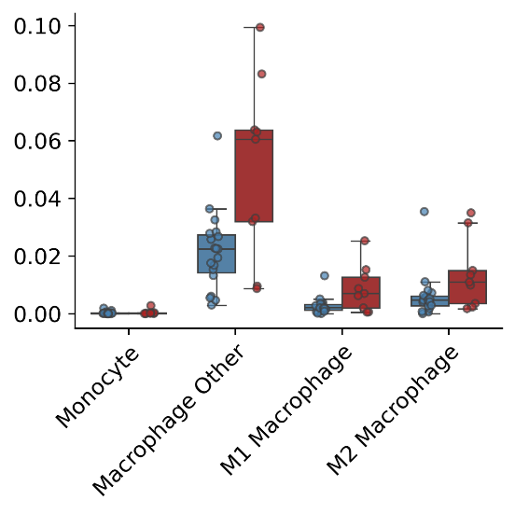
STIC Microenvironmental Changes
Biomarker:
Cell #
Local Cell Composition
Confirmatory
Quantitative cell counts
FTE
*
**
**
***
STIC
*

Slide 28
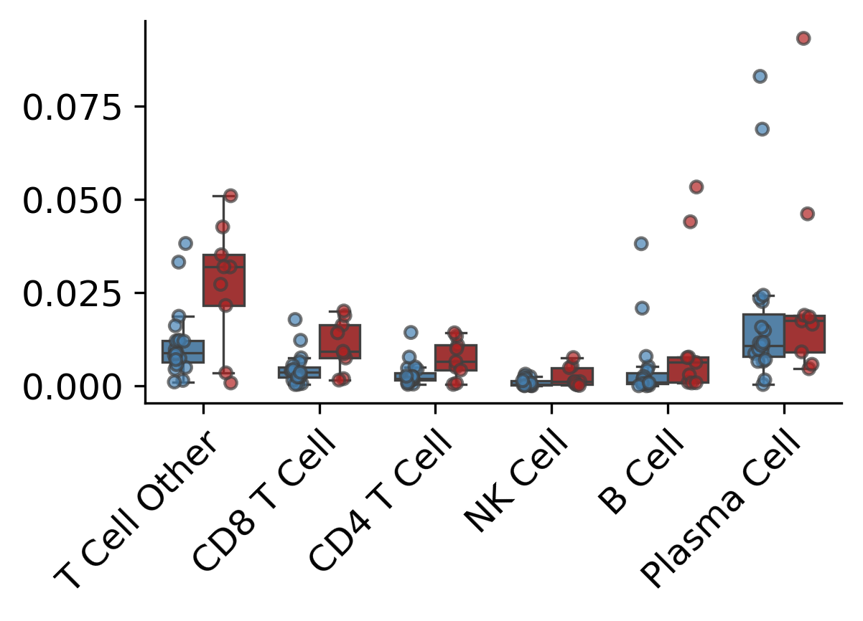
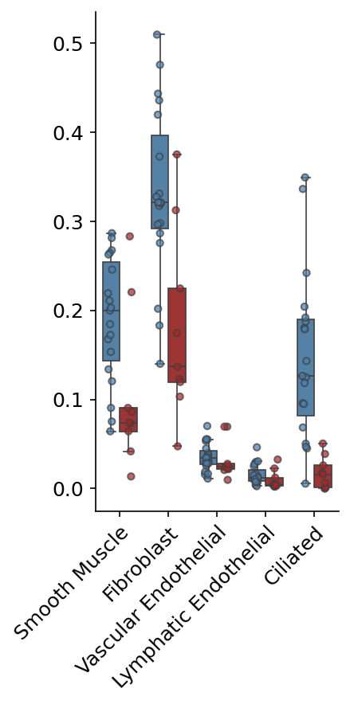
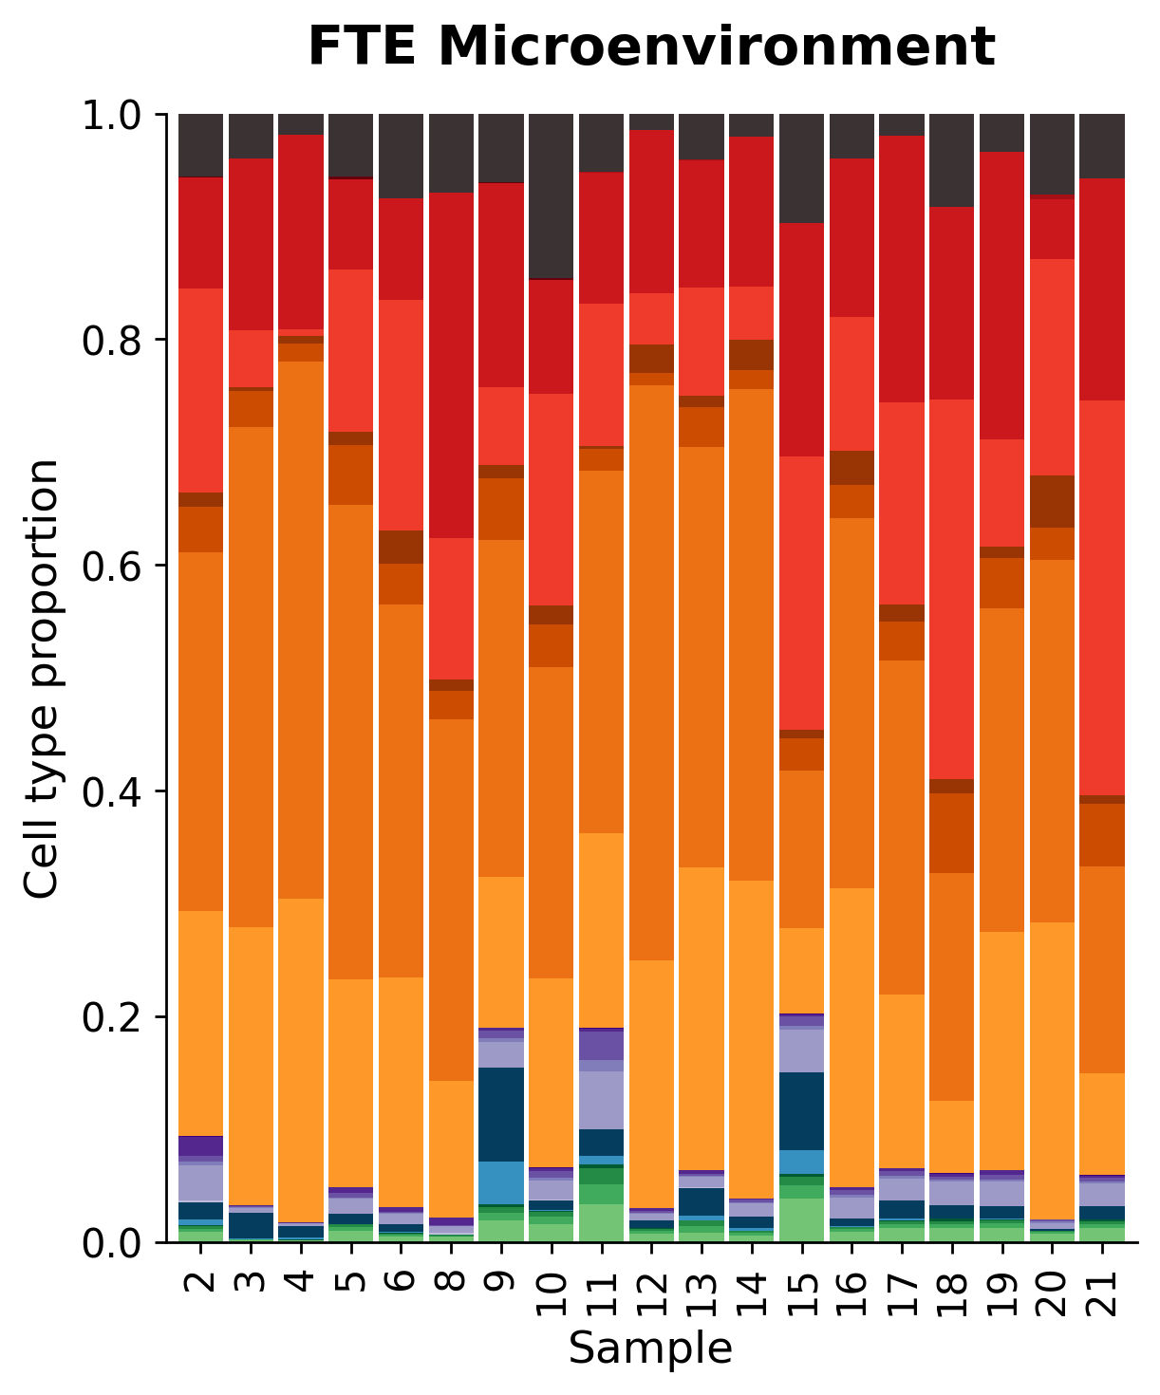
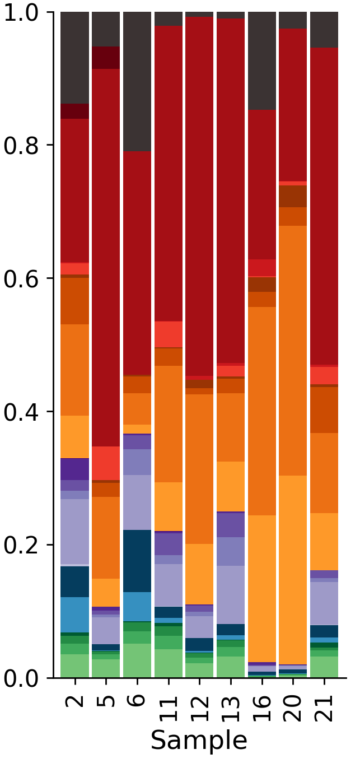
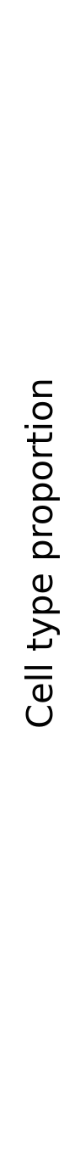
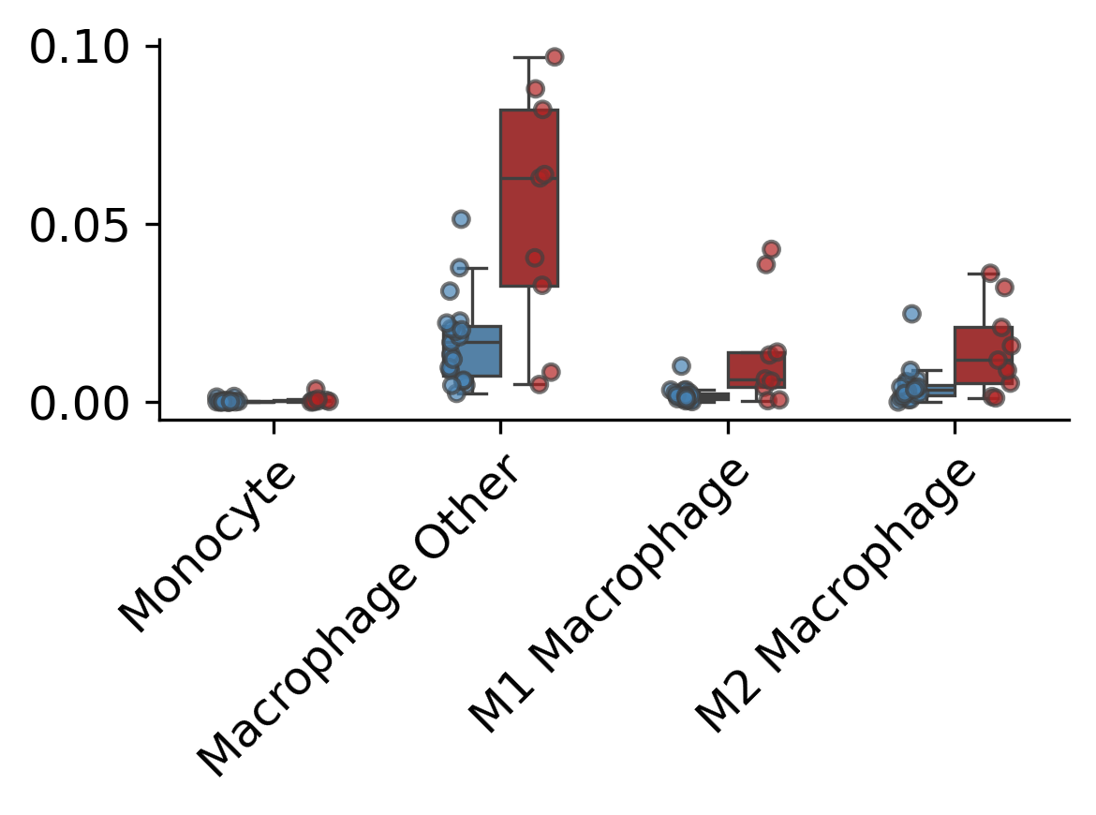
STIC Microenvironmental Changes
Biomarker:
Cell #
Pseudobulk reconstruction
Broad Cell Composition
p = 0.055
FTE
STIC
FTE
*
**
STIC
p = 0.055
p = 0.055
*
*

Slide 29
STIC Microenvironmental Changes
Rigorously defining the microenvironment
Single cell distributions

Slide 30
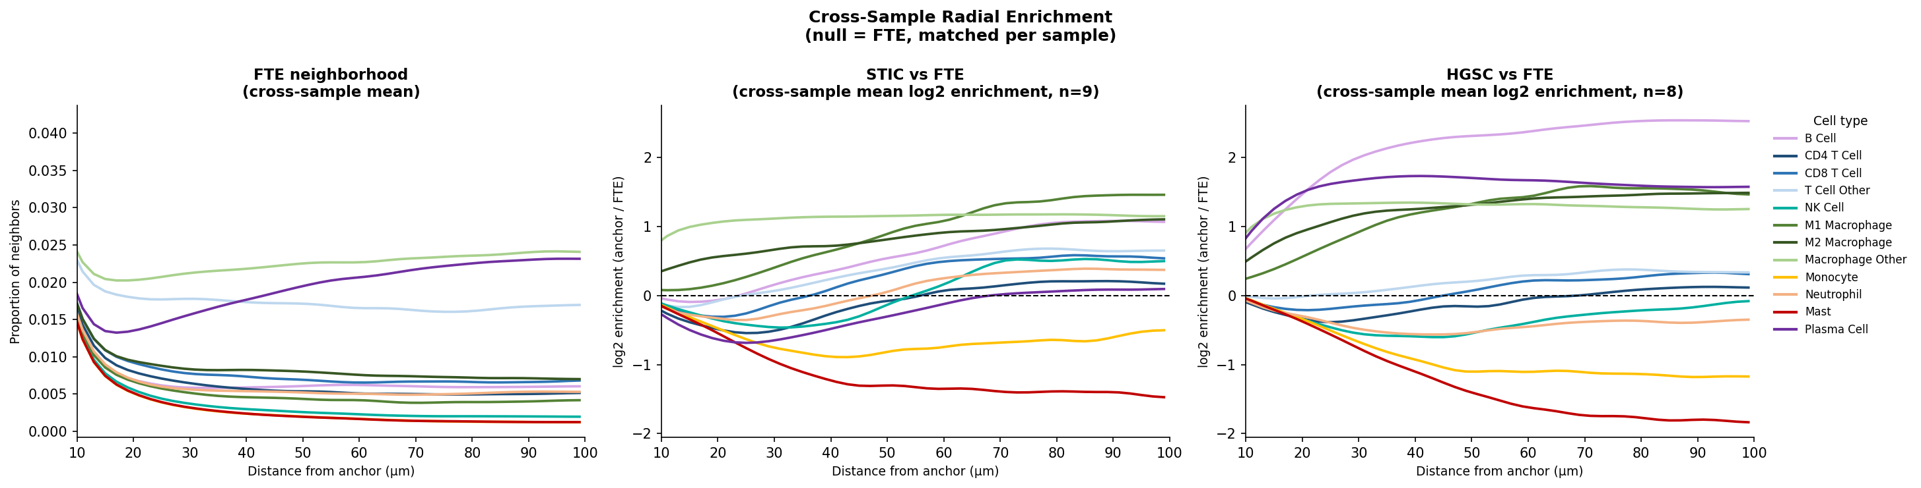
STIC Microenvironmental Changes
Biomarker:
Distance
Local distance relationships from epithelium
NK cells
CD8 T cells
Monocytes
STIC vs FTE
Radial inversion pattern
(local depletion, distal increased abundance)

Slide 31
STIC Microenvironmental Changes
Biomarker:
Distance
Local distance relationships from epithelium
NK cells
CD8 T cells
Monocytes
STIC vs FTE
HGSC vs FTE
Radial inversion pattern
(local depletion, distal increased abundance)
Radial depletion pattern

Slide 32
STIC Microenvironmental Changes
Rigorously defining the microenvironment
Multi-cellular clustering

Slide 33
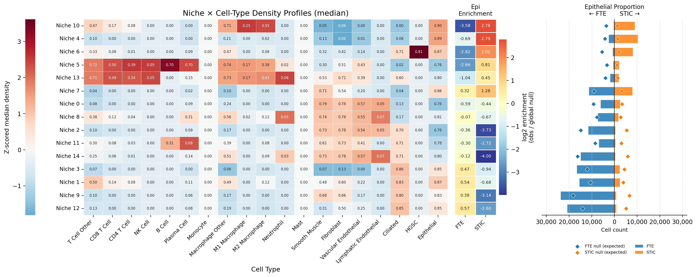
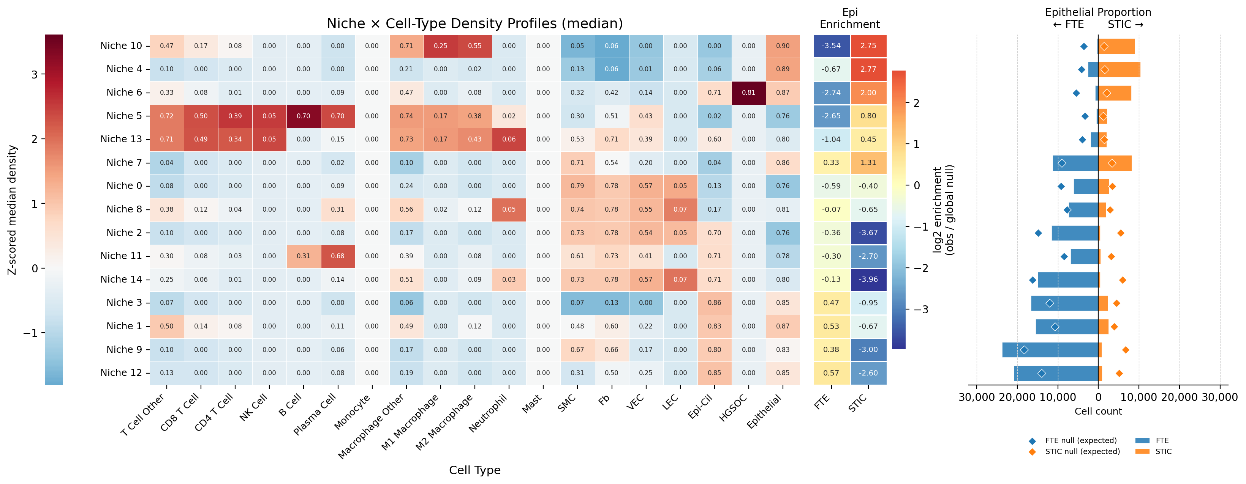
STIC Microenvironmental Niches
Biomarker:
Multi-cell
Consistent local microenvironment composition
STIC-enriched niche
Shared niche
FTE-enriched niche

Slide 34
STIC Microenvironmental Niches
Biomarker:
Multi-cell
Relative concentration of STIC vs FTE microenvironments
STIC-enriched niche
Shared niche
FTE-enriched niche

Slide 35
STIC Microenvironmental Niches
Biomarker:
Multi-cell
Relative concentration of STIC vs FTE microenvironments
As the epithelium transforms (FTE-STIC-HGSC)
Does the microenvironment transform in response?
drive transformation?
STIC-enriched niche
Shared niche
FTE-enriched niche

Slide 36
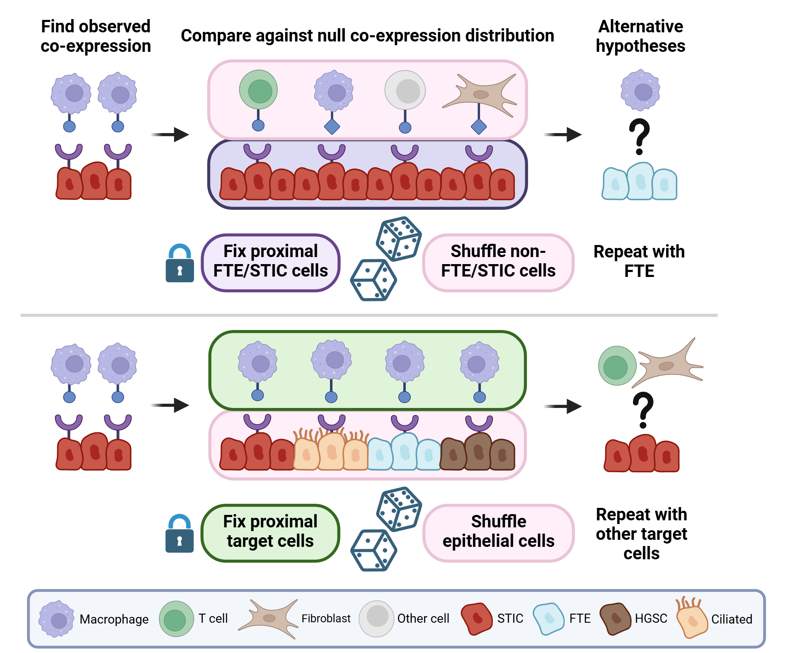
STIC Cell-to-Cell Communication
Biomarker:
Cell-cell
Are STICs receiving signal from specific elements of the STIC microenvironment?
What about the FTE and its microenvironment?

Slide 37
STIC Cell-to-Cell Communication
Biomarker:
Cell-cell
Are STICs receiving signal from specific elements of the STIC microenvironment?
What about the FTE and its microenvironment?
Are the signals exchanged between microenvironment cells and epithelium unique to STIC?
FTE?
HGSC?

Slide 38
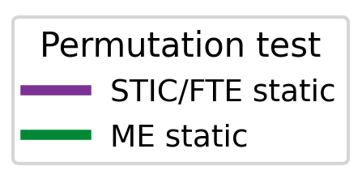
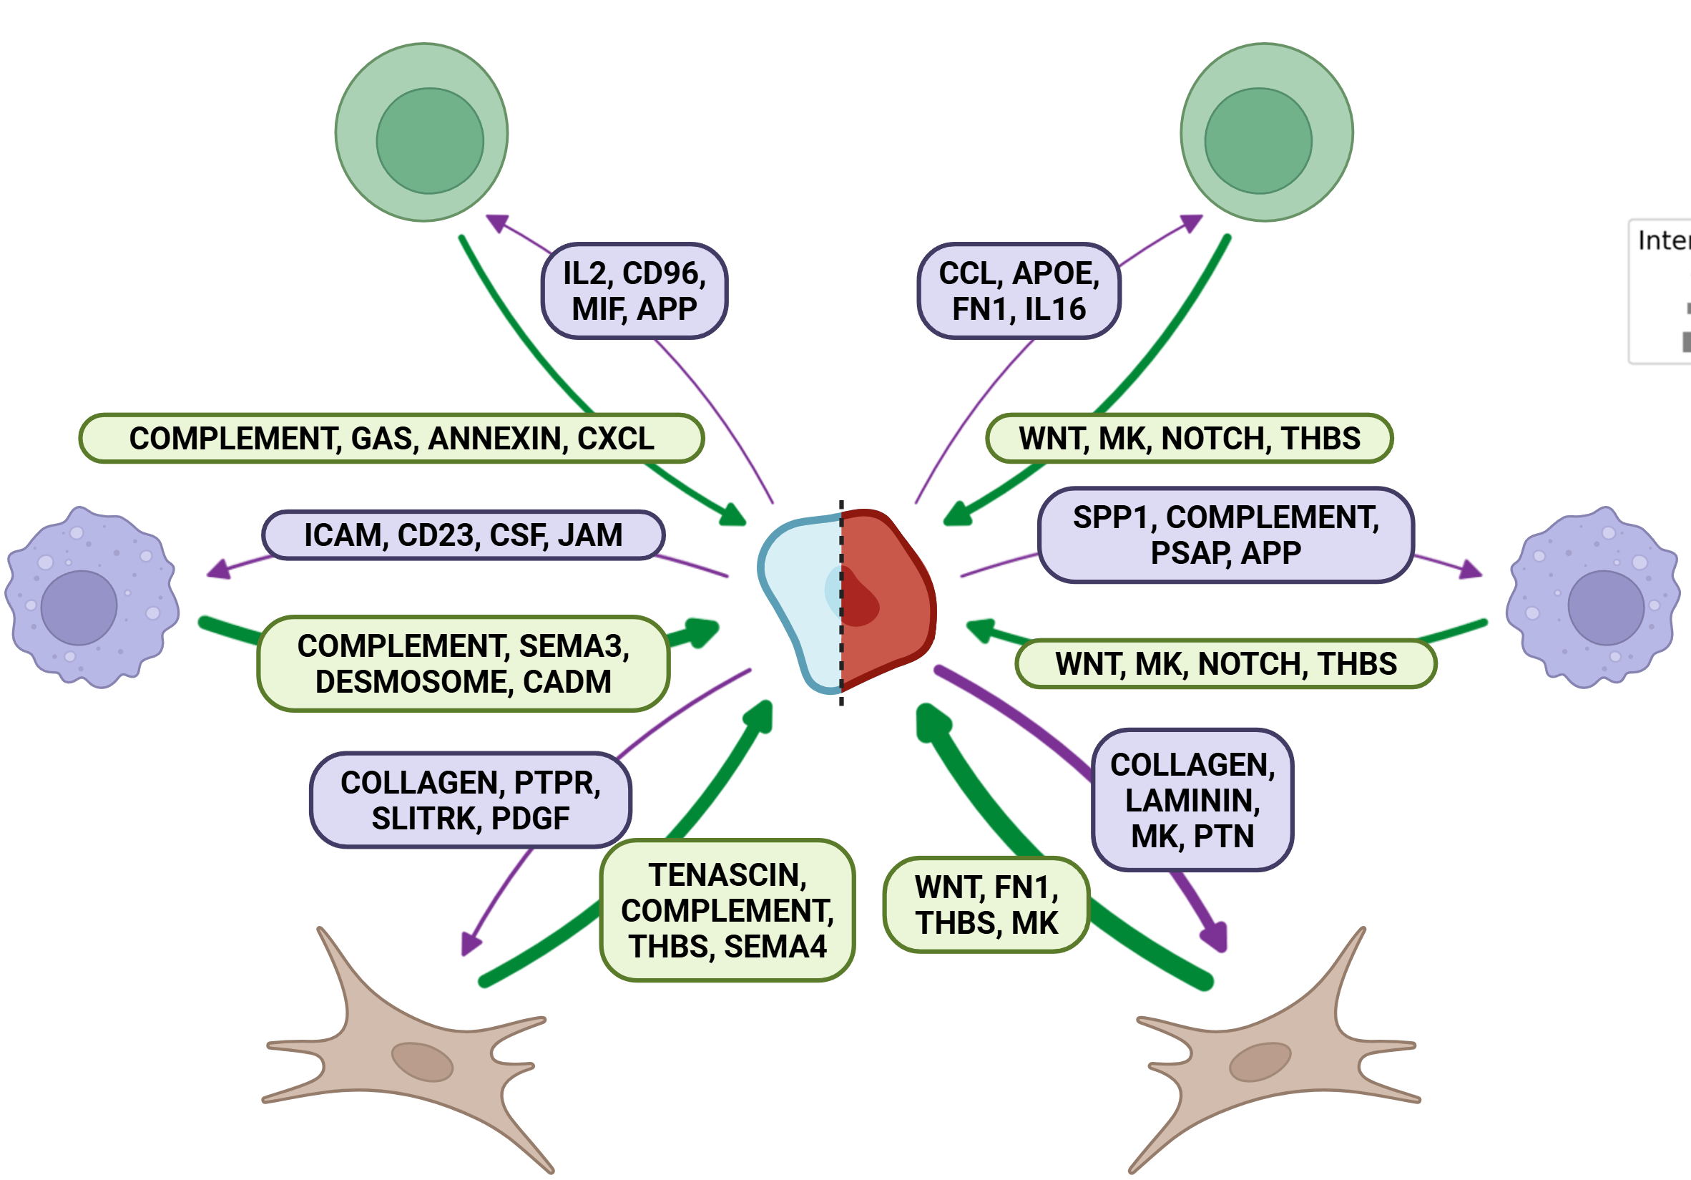
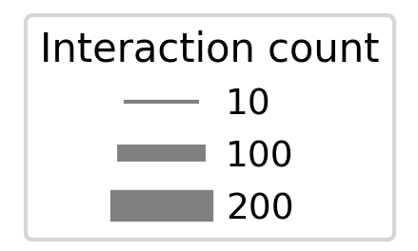
STIC Cell-to-Cell Communication
Biomarker:
Cell-cell
CCL5
SPP1

Slide 39
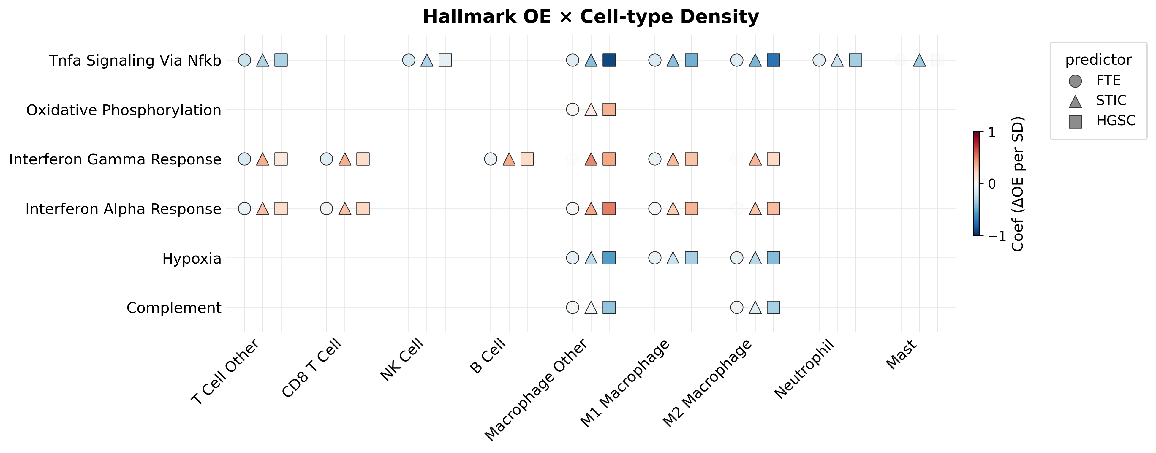
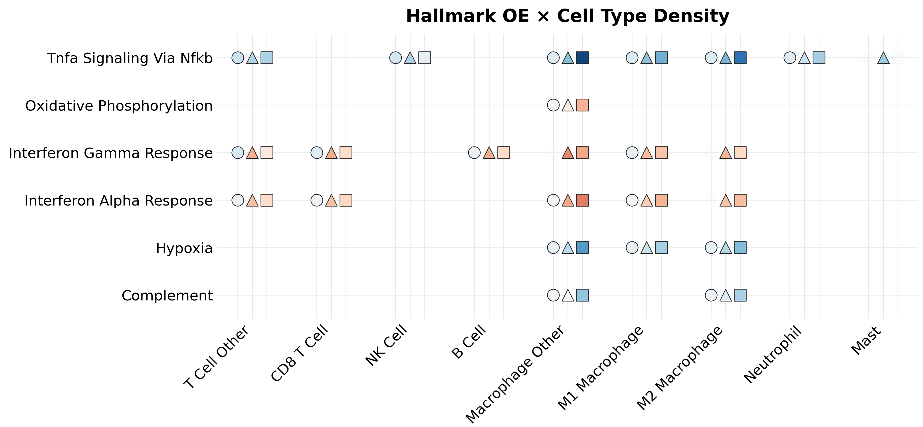
STIC Cell-to-Cell Communication
Biomarker:
Gradient
Spatial dependence of cell-type-specific transcriptional programs relative to epithelium

Slide 40
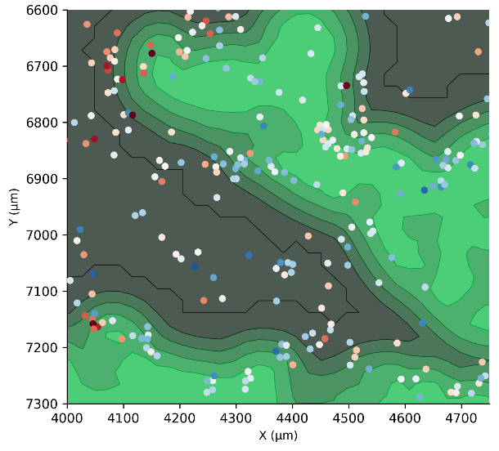
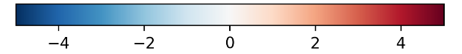

STIC Cell-to-Cell Communication
Biomarker:
Gradient
Quantitative basis
OE score
STIC density

Slide 41

Conclusions
Concerted epithelial and microenvironmental changes during STIC transformation
Insights may be relevant for deeper mechanistic understanding or early detection strategy
Spatial contributes in key ways:
Distance as a universal metric
Single cell context
Sources and sinks for secreted signals
Recouvreaux, Trang,… Xu, Orsulic, Biorxiv 2026

Slide 42
Acknowledgements
Career Development Award Funding
NCATS UCLA KL2
Tower Cancer Research Foundation
Kathleen Trang
Daniel Pintard
Ryan Mika
Jun Han Kim
Sandra Orsulic Lab
Sol Recouvreux
Shinya Kusumoto
Elana Fertig Lab
Dmitrijs Lvovs

Slide 43
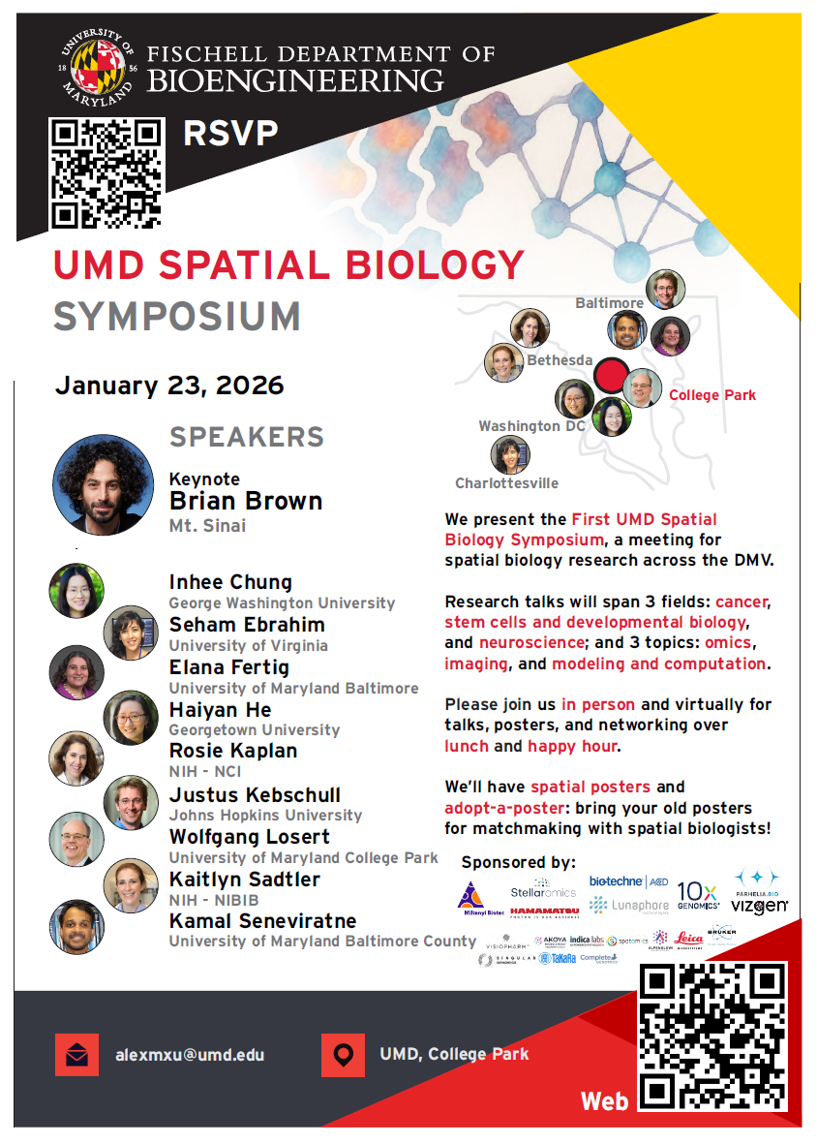

UMD Spatial Biology Symposium
Winter 2027

Slide 44

Contact
alexmxu@umd.edu

