Slide 1
Disaggregating contributions to lung-cancer mortality reductions from stage-shift and “intrastage-shift” in the NLST
Hormuzd Katki
Scientific VP, Center for Early Cancer Detection, ACS
Jointly with: Philip Castle, Anil Chaturvedi, Li Cheung, Fangya Mao (NCI) & Rebecca Landy, Robert Smith (ACS)

Slide 2
Peter Bach’s question: “Do any screening modalities satisfy the assumptions of stage-shift mathematical models?”
Bedrock mechanism for how early-detection screening saves lives:
    Screening saves lives (solely) by detecting cancer at an earlier stage
    Screen-detected cancers have the same mortality experience as symptom-detected cancers, for each stage
Why might this might not be true
    Stages are heterogeneous conglomerations of cancers with different mortality experiences
      There is a distribution of survival experience within stage
        Screen-detected cancers are not representative of the mortality experience of symptom-detected cancers, within each stage
        Screen-detected cancers may lean towards the “better” or “worse” end of the distribution in symptom-detected cancers
        Ex: stage-4 screen-detected cancer can only have been detected earlier than symptom-detected stage-4 cancer
    How appropriate is stage is for predicting mortality from screen-detected cancers?
      ”Born to be bad”: stage doesn’t matter because tumor markers entirely determine your mortality experience
“Intrastage-shift”
    Intrastage-shift: within stage, screen-detected cancers might be shifted toward the “better” or “worse” end of the distribution of mortality experience within that stage
    To be clear, I will try to refer to the usual “stage-shift” using the term “interstage-shift”

Slide 3
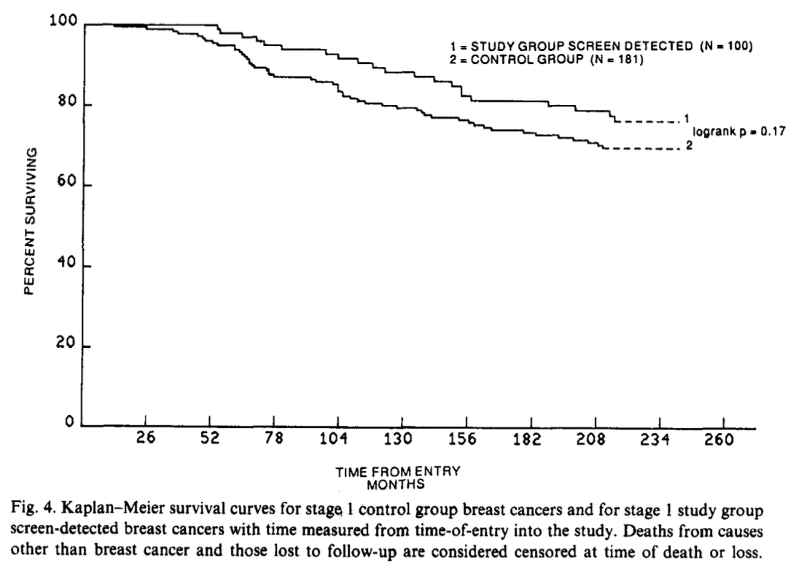
Evidence for intrastage effects: Connor et al J Clin Epi 1989
First detailed mathematical treatment I am aware of for separating (inter)stage-shift (“external shift”) vs intrastage-shift (“internal shift”)
    Calculated bounds on shifts of cancers between stages, assuming only 1-stage shifts are possible
      Despite restrictive assumption, bounds are large
    No explicit link to mortality derived
Applied to Health Insurance Plan of Greater New York (HIP) Study of mammography
    22% breast-cancer mortality reduction over 16 years
    Figure shows that screen-detected stage-1 breast cancers may have had superior survival (since date of randomization) to control stage-1 breast cancers

Slide 4
How to quantify the effect of intrastage-shift on mortality
Within each stage, we compare the mortality experiences of screen-arm vs. control-arm cancers
    Mathematical (inter)stage-shift model: the mortality experiences are exactly the same for each stage
      We reduce mortality only because screening (inter)stage-shifts cancer to earlier stages where mortality “should” be reduced
    We calculate relative and absolute reductions in cancer mortality rates, by each stage, for screen-arm vs. control-arm
      To avoid lead-time biases from using time since diagnosis, we instead use time since randomization
        “Time from randomization to death from stage-X cancer”
We calculate what the mortality reduction would have been if there had been only interstage-shift effects
    We calculate, for each stage, the excess (or deficit) of cancer deaths in the screen arm necessary so that the mortality rates in the screen-arm would each equal that in the control-arm
    We sum these # of deaths across stage: These are the total extra (or fewer) deaths due to intrastage-shift effects
      This should equal 0 if there are only interstage-shift effects
Partition the overall mortality reduction into components from interstage-shift and intrastage-shift
    Number of deaths minus the number due to intrastage-shift provides the mortality reduction if only interstage-shift effects exist
    Calculate the fraction of total mortality reduction that is due to intrastage-shift

Slide 5
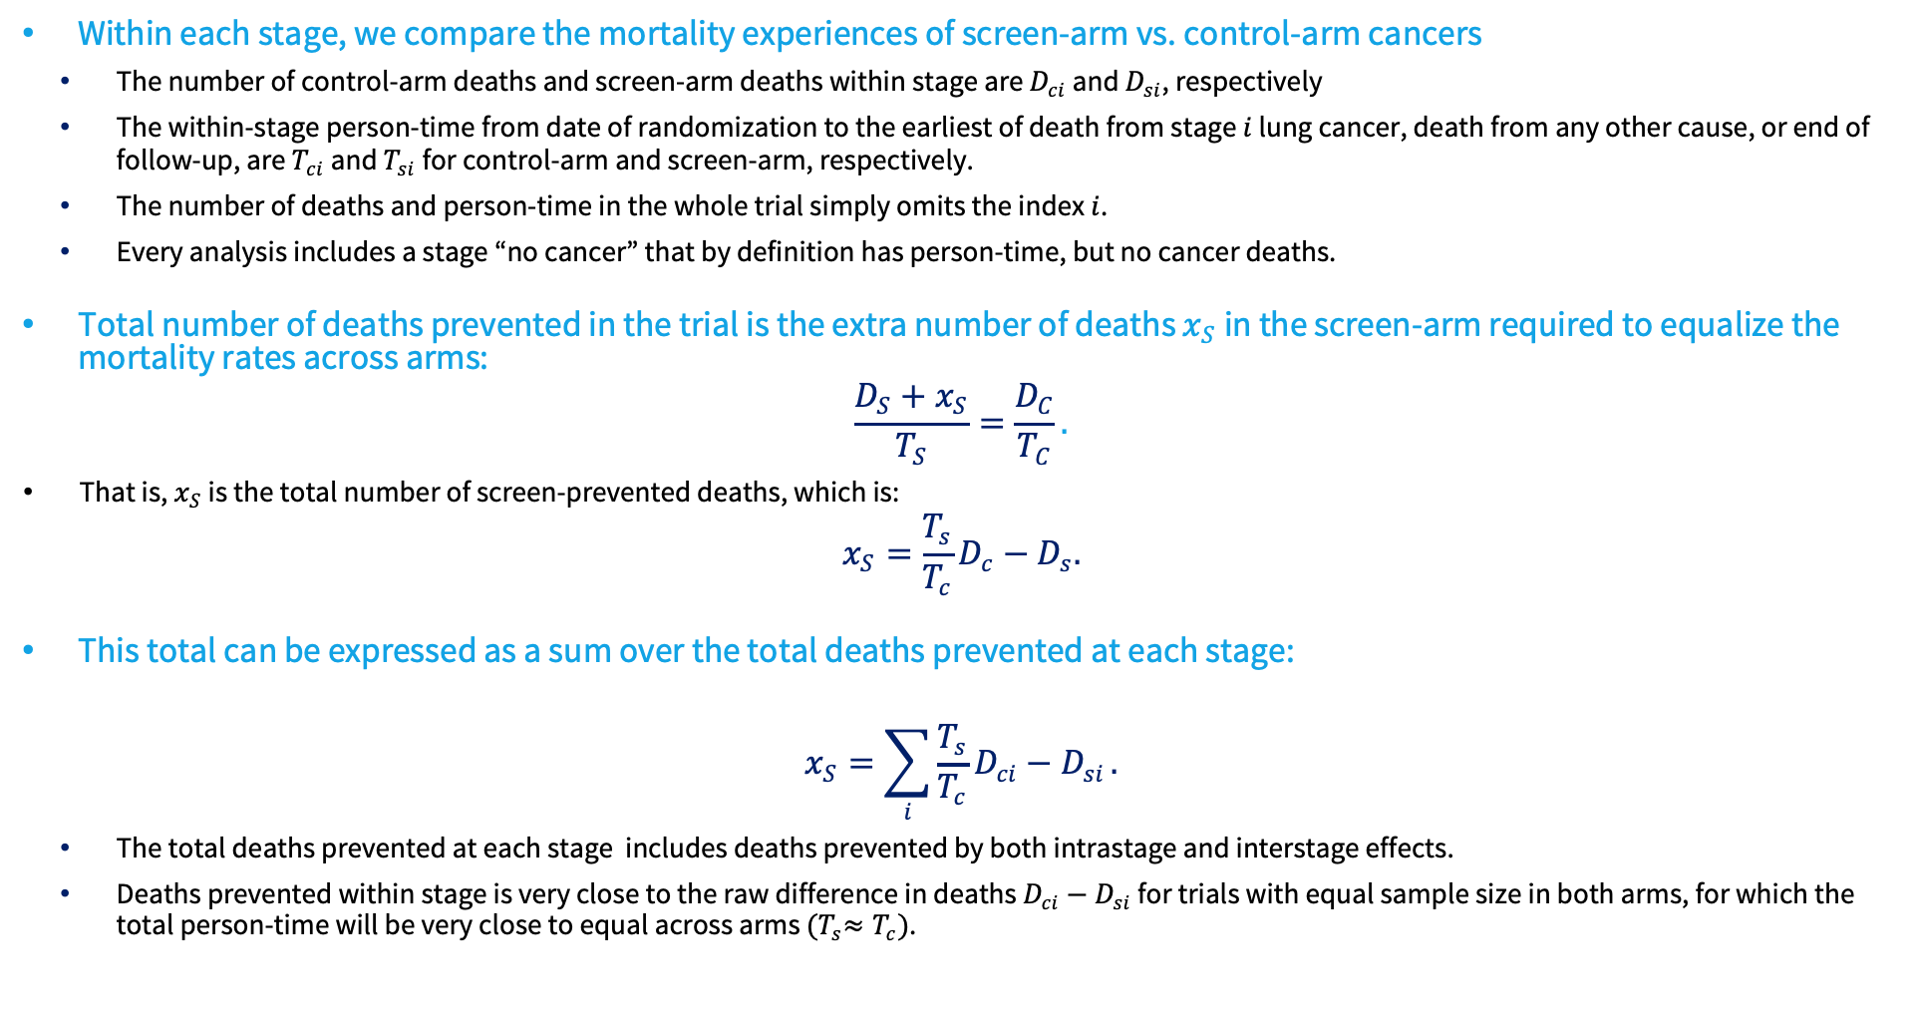
Total number of deaths prevented at each stage
Within each stage, we compare the mortality experiences of screen-arm vs. control-arm cancers
    The number of control-arm deaths and screen-arm deaths within stage are $D_{ci}$ and $D_{si}$, respectively
    The within-stage person-time from date of randomization to the earliest of death from stage $i$ lung cancer, death from any other cause, or end of follow-up, are $T_{ci}$ and $T_{si}$ for control-arm and screen-arm, respectively.
    The number of deaths and person-time in the whole trial simply omits the index $i$.
    Every analysis includes a stage “no cancer” that by definition has person-time, but no cancer deaths.
Total number of deaths prevented in the trial is the extra number of deaths $x_{S}$ in the screen-arm required to equalize the mortality rates across arms:
$$\frac{D_{S}+x_{S}}{T_{S}}=\frac{D_{C}}{T_{C}}.$$
  That is, $x_{S}$ is the total number of screen-prevented deaths, which is:
$$x_{S}=\frac{T_{s}}{T_{c}}D_{c}−D_{s}.$$
This total can be expressed as a sum over the total deaths prevented at each stage:
$$x_{S}=\sum_{i}{\frac{T_{s}}{T_{c}}D_{ci}−D_{si}}.$$
    The total deaths prevented at each stage includes deaths prevented by both intrastage and interstage effects.
    Deaths prevented within stage is very close to the raw difference in deaths $D_{ci}−D_{si}$ for trials with equal sample size in both arms, for which the total person-time will be very close to equal across arms ${(T}_{s}≈T_{c})$.

Slide 6
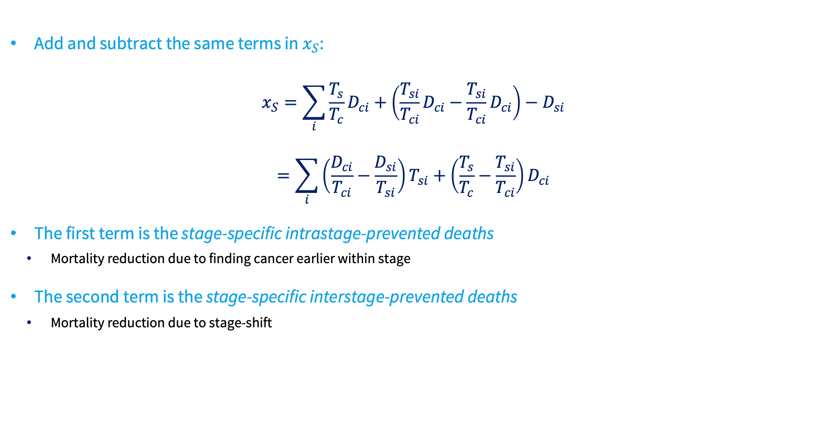
Disaggregating total number of prevented deaths $x_{S}$into components from interstage-shift and intrastage-shift
Add and subtract the same terms in $x_{S}$:
$$x_{S}=\sum_{i}{\frac{T_{s}}{T_{c}}D_{ci}+\left(\frac{T_{si}}{T_{ci}}D_{ci}−\frac{T_{si}}{T_{ci}}D_{ci}\right)−D_{si}}$$
$$=\sum_{i}{\left(\frac{D_{ci}}{T_{ci}}−\frac{D_{si}}{T_{si}}\right)T_{si}+\left(\frac{T_{s}}{T_{c}}−\frac{T_{si}}{T_{ci}}\right)D_{ci}}$$
The first term is the stage-specific intrastage-prevented deaths
    Mortality reduction due to finding cancer earlier within stage
The second term is the stage-specific interstage-prevented deaths
    Mortality reduction due to stage-shift

Slide 7
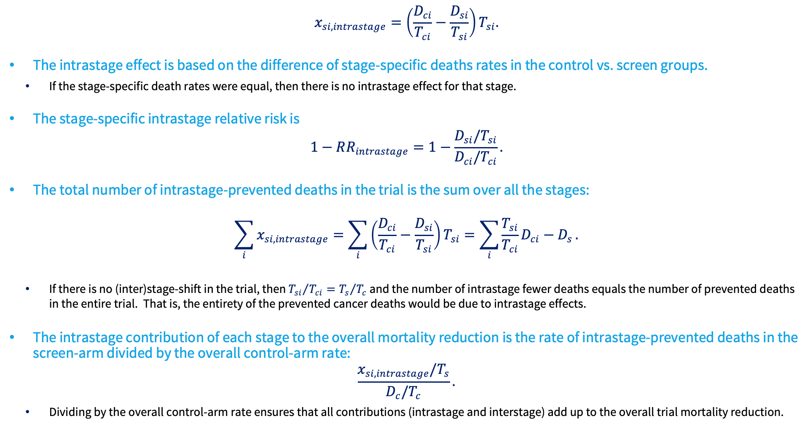
Number of intrastage-prevented deaths within stage
$$x_{si,intrastage}=\left(\frac{D_{ci}}{T_{ci}}−\frac{D_{si}}{T_{si}}\right)T_{si}.$$
The intrastage effect is based on the difference of stage-specific deaths rates in the control vs. screen groups.
    If the stage-specific death rates were equal, then there is no intrastage effect for that stage.
The stage-specific intrastage relative risk is
$$1−RR_{intrastage}=1−\frac{D_{si}/T_{si}}{D_{ci}/T_{ci}}.$$
The total number of intrastage-prevented deaths in the trial is the sum over all the stages:
$$\sum_{i}{x_{si,intrastage}}=\sum_{i}{\left(\frac{D_{ci}}{T_{ci}}−\frac{D_{si}}{T_{si}}\right)T_{si}}=\sum_{i}{\frac{T_{si}}{T_{ci}}D_{ci}−D_{s}}.$$
    If there is no (inter)stage-shift in the trial, then ${T_{si}}/{T_{ci}}={T_{s}}/{T_{c}}$ and the number of intrastage fewer deaths equals the number of prevented deaths in the entire trial. That is, the entirety of the prevented cancer deaths would be due to intrastage effects.
The intrastage contribution of each stage to the overall mortality reduction is the rate of intrastage-prevented deaths in the screen-arm divided by the overall control-arm rate:
$$\frac{x_{si,intrastage}/T_{s}}{D_{c}/T_{c}}.$$
    Dividing by the overall control-arm rate ensures that all contributions (intrastage and interstage) add up to the overall trial mortality reduction.

Slide 8
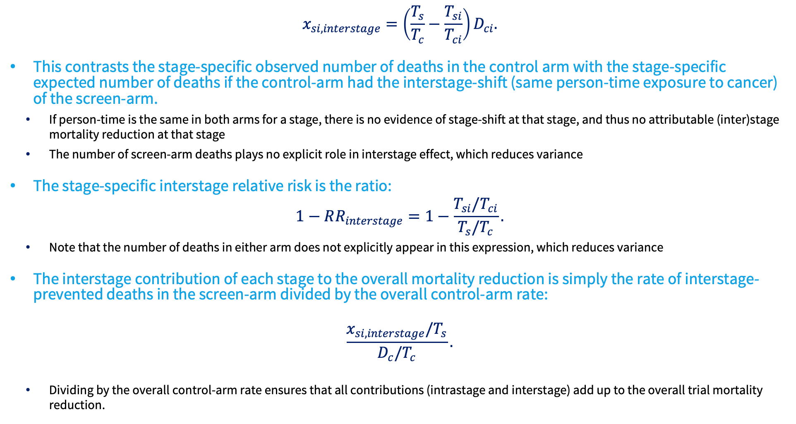
Number of (inter)stage-prevented deaths within stage
$$x_{si,interstage}=\left(\frac{T_{s}}{T_{c}}−\frac{T_{si}}{T_{ci}}\right)D_{ci}.$$
This contrasts the stage-specific observed number of deaths in the control arm with the stage-specific expected number of deaths if the control-arm had the interstage-shift (same person-time exposure to cancer) of the screen-arm.
    If person-time is the same in both arms for a stage, there is no evidence of stage-shift at that stage, and thus no attributable (inter)stage mortality reduction at that stage
    The number of screen-arm deaths plays no explicit role in interstage effect, which reduces variance
The stage-specific interstage relative risk is the ratio:
$$1−RR_{interstage}=1−\frac{T_{si}/T_{ci}}{T_{s}/T_{c}}.$$
    Note that the number of deaths in either arm does not explicitly appear in this expression, which reduces variance
The interstage contribution of each stage to the overall mortality reduction is simply the rate of interstage-prevented deaths in the screen-arm divided by the overall control-arm rate:
$$\frac{x_{si,interstage}/T_{s}}{D_{c}/T_{c}}.$$
    Dividing by the overall control-arm rate ensures that all contributions (intrastage and interstage) add up to the overall trial mortality reduction.

Slide 9
Stages 1A & 4 contributions to intrastage/interstage mortality and overall lung cancer mortality reduction
We show only stages 1A and 4 because effects are small at other stages.
1
Inputs
3
Intrastage contribution to lung cancer mortality reduction
4
Interstage contribution to lung cancer mortality reduction
Stage 1A
Stage 4
Overall
STAGE 1A
STAGE 4
STAGE 1A
STAGE 4
Control
person-years
1,051
1,443
143k
RR = 157 / 295 = 0.53
1 − RR = 47%
RR = 1,557 / 1,808 = 0.86
1 − RR = 14%
RR = 2,232 / 1,051 = 2.1
1 − RR = −111%
RR = 1,086 / 1,443 = 0.75
1 − RR = 25%
Screen
person-years
2,232
1,086
144k
Stage 1A mortality is 47% lower when stage 1A is CT-detected.
Stage 4 mortality is 14% lower when stage 4 is CT-detected.
Screening doubles exposure to stage 1A cancer, thereby adding deaths in stage 1A.
Screening reduces exposure to stage 4 cancer by 25%, thereby reducing deaths in stage 4.
Control deaths
31
261
442
Screen deaths
35
169
354
(295 − 157) / 10k × 2,232 = 31
(1,808 − 1,557) / 10k × 1,086 = 27
-111% × 31 = −35
25% × 261 = 66
Control rate
per 10,000 (10k)
295
1,808
30.9
31 fewer deaths
27 fewer deaths
35 excess deaths
66 fewer deaths
Screen rate
per 10,000 (10k)
157
1,557
24.6
31 / 442 = 6.9%
27 / 442 = 6.1%
−35 / 442 = −7.8%*
66 / 442 = 14.9%
2
Overall lung cancer mortality reduction
Mortality reduction due to stage 1A screen-detection
Mortality reduction due to stage 4 screen-detection
Mortality increase due to stage shift into stage 1A
Mortality reduction due to stage shift out of stage 4
1 − RR = 1 − (24.6 / 30.9)
p = 0.03
p = 0.08
p < 0.001
p < 0.001
20.4%
To simplify calculations, assumes same overall person-years in both arms
To simplify calculations, assumes same overall person-years in both arms
* -7.8% is the exact answer without simplifications so we substitute it here
5
Total lung cancer mortality reduction sums the intrastage and interstage contributions across all stages
INTRASTAGE MORTALITY REDUCTION
INTERSTAGE MORTALITY REDUCTION
OVERALL LUNG CANCER
MORTALITY REDUCTION
6.9% + 0.7% − 1.2% − 1.4% + 6.1% =
−7.8% − 0.4% + 0.1% + 2.4% + 14.9% =
11.2%
+
9.2%
=
20.4%
p = 0.045
p = 0.09
p = 0.001
Notes:
[Sources]
- User-provided modified slide image.
[/Sources]

Slide 10
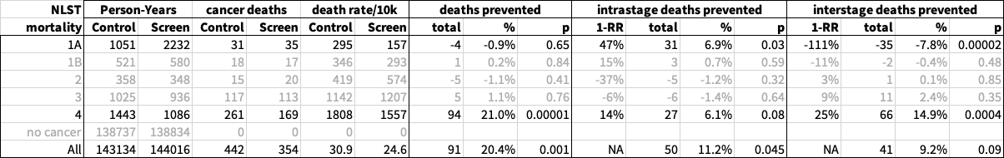
Total effect of intrastage-shift in NLST
Note that stages 1B/2/3 have small (if any) intrastage and interstage effects
    Perhaps this is due to in-flow and out-flow in these middle stages that cancels out to no stage-specific effects
NLST: CT is a high-sensitivity screen for lung cancer with strong interstage-shift
    Yet intrastage shift accounted for about half the mortality reduction
    CT-detected stage-1A lung cancer had superior survival, suggesting it might be an earlier form of stage-1A cancer
    CT-detected stage-4 lung cancer had slightly superior survival, but acted on high baseline mortality so may save substantial lives

Slide 11
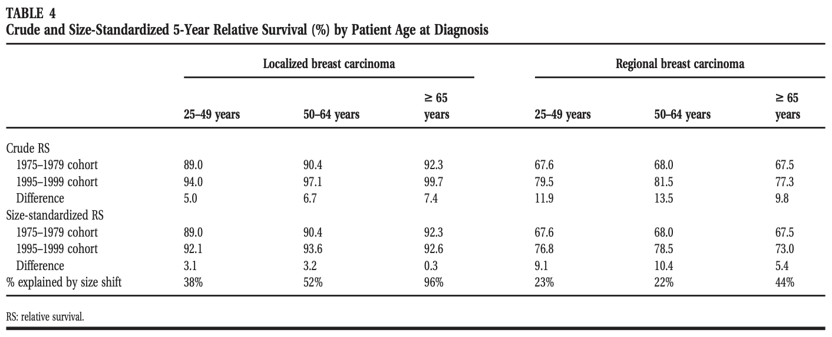
Tumor-size within stage: Breast cancer
Elkin et al noted that mammography finds smaller tumors within stage that might account for improved breast cancer survival within stage 1975-1999 (“size-migration within stage”)
    Size-migration accounts for some of the “intrastage effect”, residual is due to improvements in survival within stage and size
    Survival improvements are more due to size-migration for localized rather than regional breast cancer
Elkin et al, Cancer, 2005

Slide 12
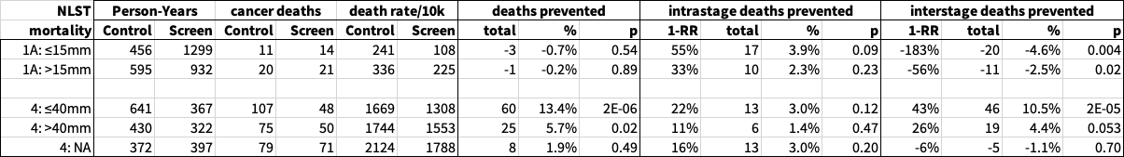
Does tumor-size explain intrastage mortality reductions at stage 1A?
Intrastage mortality reductions within stage-1A may occur simply because CT screening finds smaller tumors with lower mortality within each stage
    Indeed the mean stage-1A tumor size was slightly smaller for CT vs CXR detection (CT: 16.5mm vs. CXR: 18.6mm, p=0.006)
Above we dichotomize stage-1A at median tumor-size (15mm).
    Within stage-1A, there was greater interstage mortality increase for smaller stage-1A (≤15mm: -183% relative reduction, p=0.004 vs. >15mm: -56% relative-reduction, p=0.02), suggesting that the stage-shift was primarily to smaller stage-1A tumors.
    Despite that stage-shift to smaller stage-1A tumors, intrastage-1A mortality reduction did not disappear
      Strong intrastage-1A mortality reduction reduction may well remain:
        ≤15mm: 55% relative reduction, p=0.09
        >15mm: 33% relative reduction, p=0.23

Slide 13
Does tumor-size explain intrastage mortality reductions at stage 4?
Intrastage mortality reductions within stage-4 may occur simply because CT screening finds smaller tumors with lower mortality within each stage
    However, CT-detected stage-4 cancers were, if anything, larger (CT: 43.6mm vs. CXR: 40.5mm, p=0.49)
Above we dichotomize stage-4 at median tumor-size (40mm).
    Most of the interstage-4 mortality reduction was in smaller stage-4 tumors and none at all among those with missing tumor-size
      ≤40mm: 43% relative-reduction, p<0.001
      >40mm: 26% relative-reduction, p=0.053
      missing: -6% relative-reduction, p=0.70

Slide 14
Does tumor-size explain intrastage mortality reductions at stage 4?
Above we dichotomize stage-4 at median tumor-size (40mm).
    Intrastage mortality reductions may well remain for smaller stage-4 tumors:
      ≤40mm: 22% relative-reduction, p=0.12
      >40mm: 11% relative-reduction, p=0.47
      missing: 16% relative-reduction, p=0.20
Thus CT detecting smaller tumors does not explain the observed intrastage-mortality reductions for stage-1A and stage-4 tumors

Slide 15
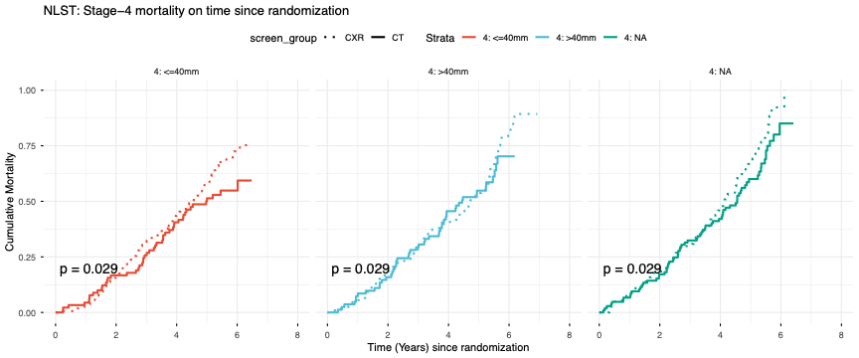
Does tumor-size explain intrastage mortality reductions at stage 4?
Stage-4 tumors (≤40mm) in the CT-arm might still have improved survival

Slide 16
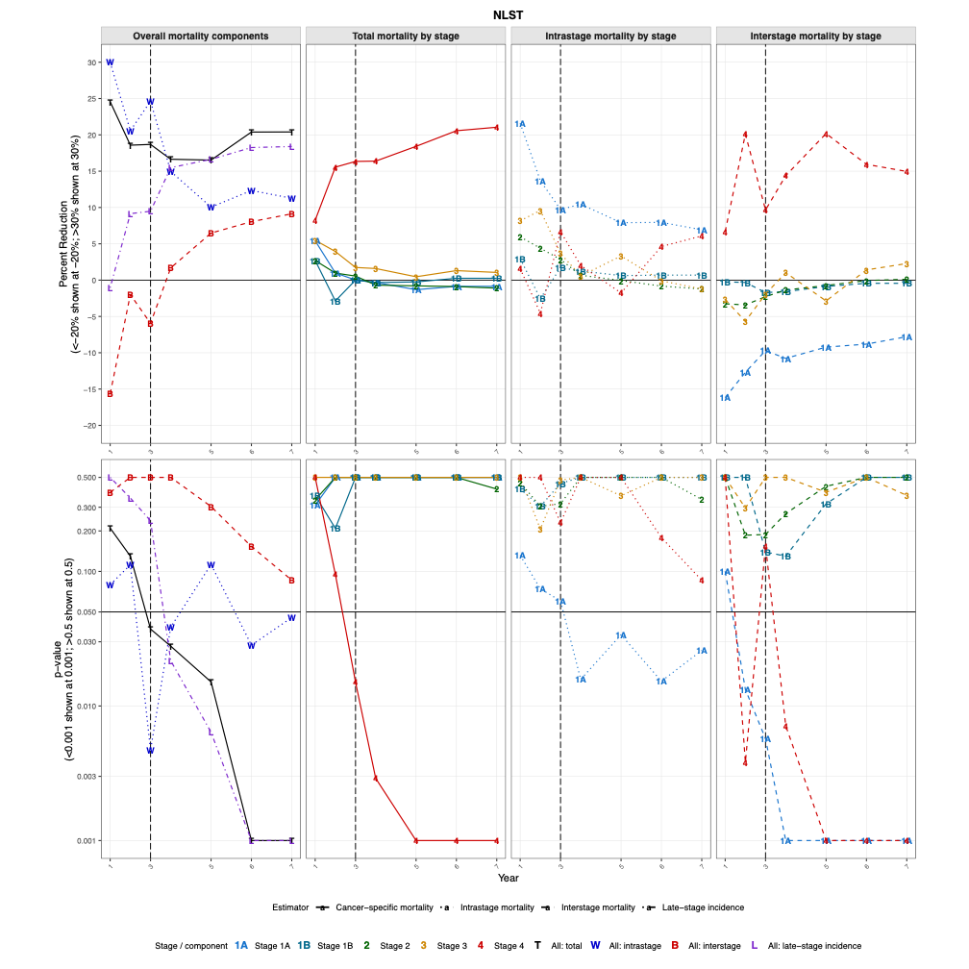
Mortality reductions over follow-up time in NLST: Surrogates
Intrastage mortality reduction (W) is greater than interstage mortality reduction (B) at all times
    It takes time to see mortality reductions due to (inter)stage-shift
    Intrastage mortality reductions are more earlier apparent
      Early prevented deaths are “just in time” and attributed to intrastage
    Converge after screening ends
Late-stage incidence (L) is problematic
    NLST Mortality-reduction (T) was statistically significant starting year-3 of follow-up (18.7%,p=0.037)
    Unlike stage-3/4-incidence reduction (9.5%,p=0.24), which was not significant until year-4 of follow-up (15.5%,p=0.017)
    Using stage-3/4 incidence would actually have delayed the time to a significant finding by one year
When intrastage-shift is substantial, this lessens the rationale for late-stage incidence as a surrogate

Slide 17
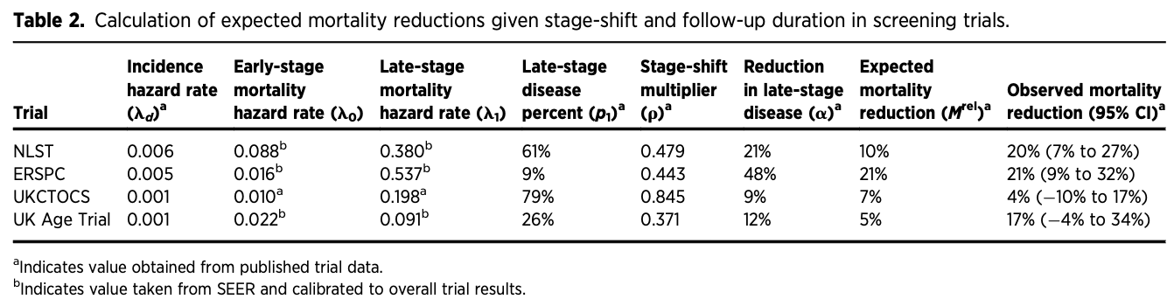
Relationship of late-stage incidence to mortality
Owens et al developed a mathematical model relating reduction in late-stage cancer incidence to expected reduction in mortality if cases diagnosed early via screening receive a corresponding shift in mortality
    They calculate the expected mortality reduction based on stage-shift alone
For NLST
    Stage-shift is projected to only account for 10% mortality reduction, which is close to our interstage mortality reduction (9.2%)
    Clearly the other 20-10=10% must come from another mechanism, we posit intrastage mortality reduction
Other trials
    UK Age Trial for breast cancer also shows a divergence (5% predicted, but 17% observed) suggesting intrastage effects
    ERSPC (prostate cancer) and UKCTOCS (ovarian cancer) findings suggest that (inter)stage-shift is sufficient to explain observed mortality reductions
Owens et al, CEBP, 2022

Slide 18
Mortality reductions over follow-up time by stage
Total stage-4 mortality is immediately reduced and p<0.05 by year-3
Other stages may be reduced during screening, but this dilutes
    In particular, stage-3
    However, combining stage-3 with stage-4 is a diluted stage-3/4 mortality effect
For the middle stages 1B/2/3, we have inflow balancing outflow
The story for stage-1A is different
    Intrastage mortality reductions balance (inter)stage mortality increases

Slide 19
Intrastage mortality reductions over follow-up time by stage
Intrastage-1A mortality is immediately reduced and p<0.05 by year-4
    This dilutes after screening ends presumably because stage-1A cancer is essentially asymptomatic and can only be screen-detected, but survival is long-lasting
Other stages may have intrastage reduction during screening, but this dilutes
    In particular, stages 2/3
Intrastage-4 bounces around during screening, does not become noteworthy until the end

Slide 20
Interstage mortality reductions over follow-up time by stage
Interstage-4 mortality is immediately reduced and p<0.05 by year-4
    Stage-shift out of stage-4 immediately saves lives and also in the longer-term
Interstage-1A is increased immediately and p<0.05 by year-3
    Stage-shift is into stage-1A and thus we have increased deaths from stage-1A cancer
Other stages 1B/2/3 may have slight interstage increases during screening, but this dilutes
    Little stage-shift in the middle stages because inflow counteracts outflow
Intrastage-4 bounces around during screening, does not become noteworthy until the end

Slide 21
Summary of findings
NLST: CT is a high-sensitivity screen for lung cancer with strong interstage-shift
    Yet intrastage shift accounted for about half the mortality reduction
      CT-detected stage-1A lung cancer had superior survival, suggesting it might be an earlier form of stage-1A cancer
      CT-detected stage-4 lung cancer had slightly superior survival, but acted on high baseline mortality so may save substantial lives
    Only small effects in middle stages 1B/2/3, possibly because inflow of cancers counteracts outflow of cancers
    Intrastage effects not explained by CT detecting smaller tumors because smaller tumors had substantial intrastage mortality reduction
Implications for choice of surrogate
    Stage-3/4 incidence was first significant at 3-years since randomization, but lung-cancer mortality was first significant at 4-years since randomization
      Late-stage incidence relies on dominance of stage-shift effects, and does not account for strong intrastage effects as in NLST
      Intrastage mortality reductions might be stronger early in screening
    Stage-3 had small (inter)stage and intrastage mortality reductions, perhaps due to inflow counteracting outflow
      Inclusion of stage-3 as “late-stage” further weakened late-stage incidence

Slide 22
Thank You

