Slide 1

Discovery and validation of novel blood-based biomarkers to improve the screening and early detection of breast cancer
Christopher I. Li, MD, PhD
Helen G. Edson Endowed Chair for Breast Cancer Research
Division of Public Health Sciences
Fred Hutchinson Cancer Center

Slide 2
Disclosure Information
I have the following relevant financial relationships to disclose:
Employed by: Fred Hutchison Cancer Center

Slide 3
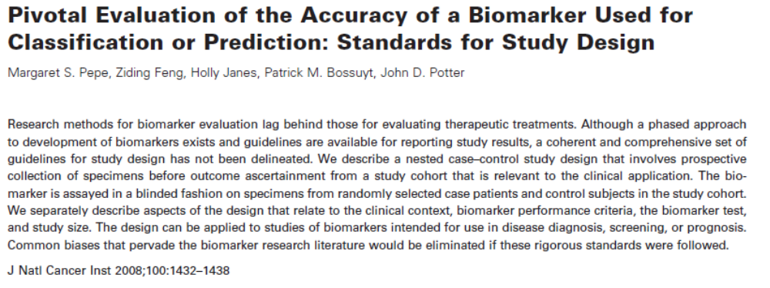
General Approach
PRoBE Design: Prospective-specimen-collection, Retrospective-Blinded-Evaluation
Clear potential clinical applications (target population, setting, outcome of interest) specifying necessary biomarker performance (sensitivity/specificity) for clinical utility
Prioritize use of sufficiently sized preclinical samples in discovery and validation sets relevant to potential clinical applications
Utilization of rigorous study designs with stringent study protocols for specimen collection, processing, and storage
Use of reproducible discovery and validation platforms with small sample requirements
Incorporate disease heterogeneity (biologically relevant cancer subtypes)

Slide 4
Workflow for Biomarker Discovery and Validation
Phase 1
Preclinical
Exploratory
Promising directions identified
Phase 2
Clinical Assay
and Validation
Assay detects established disease
Phase 3
Retrospective
Longitudinal
Biomarker detects preclinical disease
and a “screen positive” rule is defined
Phase 4
Phase 5
Prospective
Screening
Extent and characteristics of disease detected by the test and the false
referral rate are identified
Cancer
Control
Impact of screening on reducing burden
of disease in the population is quantified
Pepe MS, et al. JNCI 2001;93:1054-61

Slide 5
Workflow for Biomarker Discovery and Validation
Phase 1
Preclinical
Exploratory
Promising directions identified
Phase 2
Clinical Assay
and Validation
Assay detects established disease
Phase 3
Retrospective
Longitudinal
Biomarker detects preclinical disease
and a “screen positive” rule is defined
Phase 4
Phase 5
Prospective
Screening
Extent and characteristics of disease detected by the test and the false
referral rate are identified
Cancer
Control
Impact of screening on reducing burden
of disease in the population is quantified
Pepe MS, et al. JNCI 2001;93:1054-61

Slide 6
Background
Mammography reduces mortality by 30% among women 50-69 yrs of age
PPV is only 4.4% overall, with a 1.3% PPV among women age 40 and 9.8% PPV among women age 60
Breast cancer remains the leading cause of cancer mortality in women worldwide
Improvement in mammography’s performance is desired:
  It has a 10% recall rate with only 5 of every 100 women recalled diagnosed with cancer.
  ~20% of breast cancers are interval detected.
  There are a number of ongoing controversies including should healthy elderly women be screened and should subgroups of women be prioritized for screening.
Given that ~80% of breast cancers diagnosed among women 50-69 yrs of age are hormone receptor positive (HR+) we have focused our efforts on developing biomarkers specific for the early detection of HR+ cancers.

Slide 7
Intended Clinical Applications
Inform timing of a subsequent mammogram in women with a negative screening mammogram
(early vs. routine vs. late recall)
Inform continuation of mammographic screening among older women (beyond recommended age of screening)
Prioritize women who should be screened with mammography in areas with limited resources

Slide 8
Defining Minimally Acceptable Performance Characteristics
  Precision Screening: Biomarkers to inform timing of subsequent screening in women with a negative mammogram (early recall in 6 mos vs. regular screening vs. screening in >2 yrs):
  Among women 50-69 the annual breast cancer incidence rate among those with a negative mammogram is 0.3%.
  Assume half of these cancers are present but mammographically undetectable at baseline
  and become detectable 6 months later (0.15%).
  Based on this prevalence, a test with a 5% FPR and a 35% TPR (sensitivity) would detect 10.5 breast cancers from every 1000 repeat 6 month mammograms.
  Even if the TPR is only 20%, 6 cancers would be detected per 1000 mammograms.
  This compares favorably to the 3.5 cancers that are diagnosed per 1000 regular screening mammograms.
  Desired performance: High specificity (95%) but can tolerate low sensitivity (20-35%)

Slide 9


Sources of preclinical blood samples
  Women’s Health Initiative (WHI)
  Large prospective cohort of 161,808 women. The 93,676 women in the WHI
  Observational Study (OS) had blood collected at baseline and at Year 3 of follow-up.
  943 women in the WHI OS were diagnosed with breast cancer within 2 years of a
  study blood draw.
  Breast cancer outcomes were centrally adjudicated.
  Cardiovascular Health Study (CHS)
  Prospective cohort of 5,201 men and women >65 years of age.
  Blood collected at baseline and then every 2 years through 9 years of follow-up.
  Have access to serial samples for breast, colorectal, lung, and prostate cancer cases.
  65 breast cancer cases with blood drawn within 2 years of diagnosis.

Slide 10

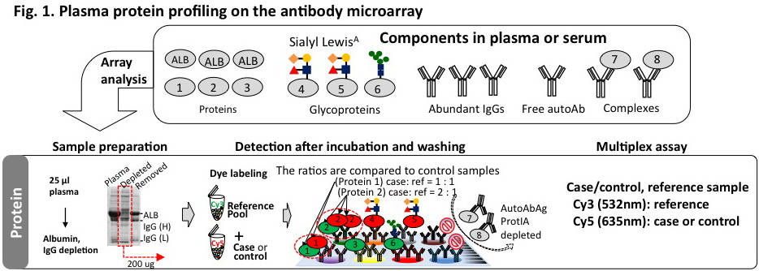
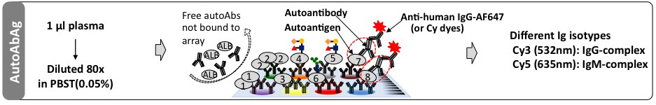
Biomarker discovery
Plasma protein profiling on an antibody microarray
Paul Lampe, PhD
Fred Hutch
Can evaluate ~3,000 markers on each array
Profiling antigen-antibody complexes on the antibody microarray

Slide 11
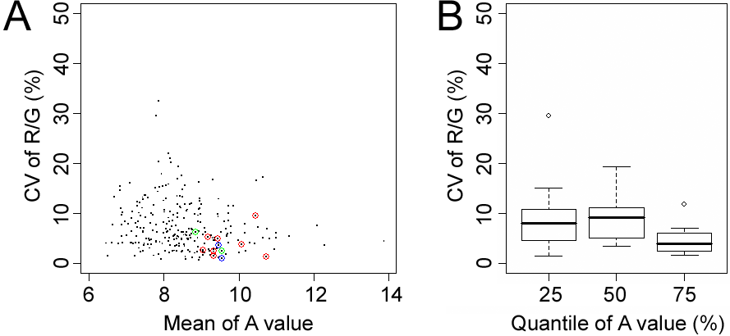
Coefficients of Variance (CV) for most antibodies is less than 10%

Slide 12
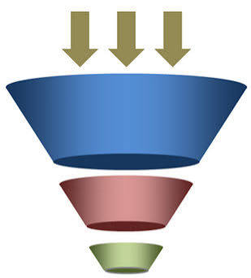
Path of biomarkers
Biomarker Discovery
Biomarker Confirmation
Biomarker Validation
Clinical Validation
Regulatory Approval
Proteomics
Cohort | Sample type | N | Discovery |  | Confirmation | Validation
WHI 1 | Pre-diagnostic | 242 (121 case/121 control) | ✓
WHI 2 | Pre-diagnostic | 180 (90 case/90 control) |  |  | ✓
EDRN Ref | Diagnostic | 271 (112 case/159 control) |  |  | ✓
CHS | Pre-diagnostic | 361 (65 case/296 control) |  |  |  | ✓
~3,000 markers
32 markers
Proteomics (for CHS testing)
# of Markers | Criteria
9 | Spec ≥80%/Sens ≥30%/p≤0.2
6 | Spec ≥80%/Sens <30%/p≤0.2
17 | A-list markers from WHI2 not validated in EDRN Ref
6/32 markers validated at p<0.05
10/32 markers validated at p<0.1

Slide 13
Path of biomarkers
Biomarker Discovery
Biomarker Confirmation
Biomarker Validation
Clinical Validation
Regulatory Approval
Autoantibody-Autoantigen
Cohort | Samples | N | Discovery |  | Confirmation | Validation
WHI 2 | Pre-diagnostic | 180 (90 case/90 control) | ✓
EDRN Ref | Diagnostic | 271 (112 case/159 control) |  |  | ✓
WHI 1 | Pre-diagnostic | 242 (121 case/121 control) |  |  | ✓
CHS | Pre-diagnostic | 361 (65 case/296 control) |  |  |  | ✓
~3,000 markers
12 markers
Autoantibody-Autoantigen (for CHS testing)
# of Markers | Criteria
12 | ↑cases/spec ≥80%/sens ≥30%
5/12 markers validated at p<0.05
7/12 markers validated at p<0.1

Slide 14
Validated Biomarkers in Preclinical Sets
Protein Markers
 | WHI 1 |  | WHI 2 |  | CHS
Protein Name | Sens @ 80% spec | p-value | Sens @ 80% spec | p-value | Sens @ 80% spec | p-value | Biological Relevance
REG4 | 40% | 0.001 | 33% | 0.040 | 42% | 0.010 | Upregulated in BC, promotes proliferation & metastasis
JAK2 | 34% | 0.017 | 40% | 0.001 | 34% | 0.024 | Drives BC progression, therapy resistance
Autoantibody Markers
 | WHI 1 |  | WHI 2 |  | CHS
Protein Name | Sens @ 80% spec | p-value | Sens @ 80% spec | p-value | Sens @ 80% spec | p-value | Biological Relevance
TLR2 | 31% | 0.04 | 38% | 0.04 | 46% | 0.0004 | BC development, can ↑ TLR2 signaling
MSLN | 30% | 0.05 | 32% | 0.10 | 38% | 0.02 | Promotes invasion and metastasis
CUX1 | 30% | 0.06 | 33% | 0.09 | 33% | 0.049 | Promotes tumor progression
UNPUBLISHED – DO NOT POST

Slide 15
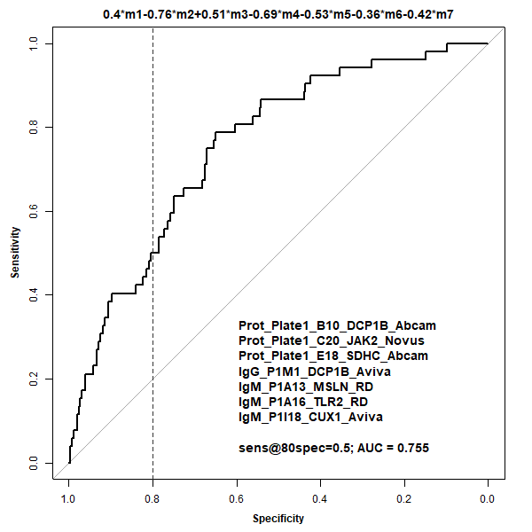
Biomarker Panel
(Max AUC)
Developed using Lasso selection considering our validated proteomic and autoantibody markers
Conducted 100 runs, 7 markers survived 100 runs
AUC=0.76
Sensitivity=15%
Specificity=95%
But AUC is not the appropriate measure to maximize in this setting as it does not directly pertain to the intended clinical application.
See: Pepe MS, Janes H, Li CI. JNCI 2014, PMID: 24681599.

Slide 16
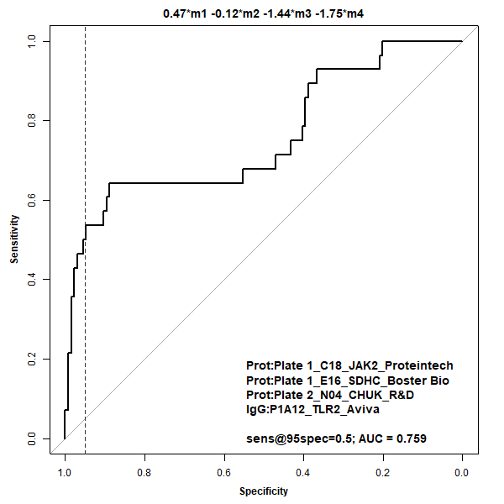
Biomarker Panel
(Max sens@95% spec)
Optimized 4 marker panel with specificity set at 95%
AUC=0.76
Sensitivity=50%
Specificity=95%

Slide 17




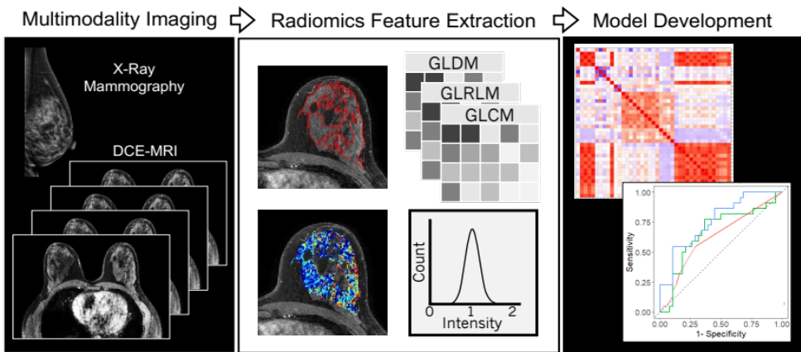
Planned Next Steps
Develop clinical grade assays: Working with Mesoscale
Diagnostics (MSD) to develop assays for our top 5 validated
markers. So far high reproducibility observed with the
completed REG4 assay (average CV of 1.7%).
Once all MSD assays are complete, we will test them on one of our original WHI preclinical sets to assess correlations with marker levels found using our original array-based platform.
Evaluate MSD assays in new WHI set (228 cases/455 controls) with two time points per patient. Data will be used to
refine a combination marker decision rule.
Test decision rule in the MD Anderson MERIT
cohort (~250 incident breast cancers to date)
Integration of multi-modal radiomic data
Savannah
Partridge (UW)
John Heine
(Moffitt)

Slide 18
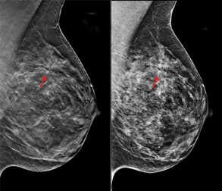
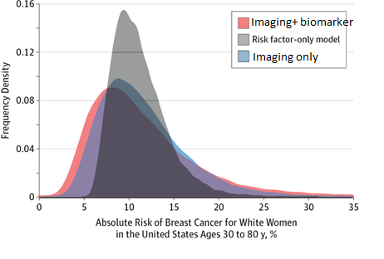


MERIT Study
Metabolomics and Proteomics
(small molecules, lipids, and proteins)
Imaging
Pipeline
Mammography
Early detection biomarkers
Risk assessment
Imaging
Technologies
Health Information
(diet, family history, exercise, etc)
Biobank
Questionnaires
Medical Record
Mammography
8,000+ subject enrollment since 2017
23,754 follow-up visits
N = 258 breast cancers diagnosed
N = 188 other invasive cancers diagnosed
Sam Hanash, MD, PhD
Improve Risk Stratification
and Early Detection

Slide 19
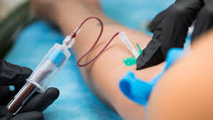

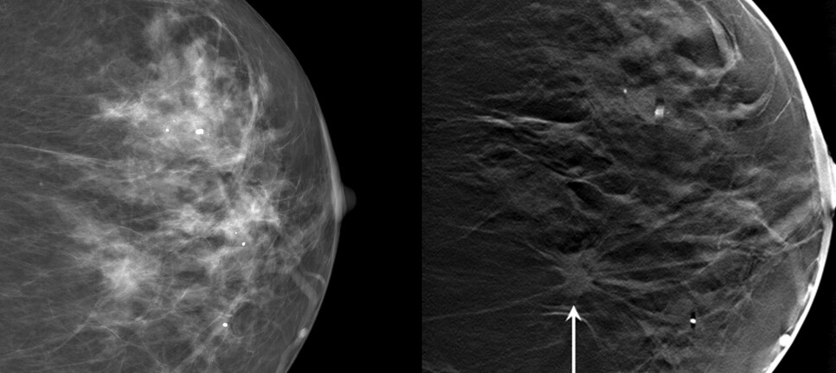

Clinical Goal: Improve Efficacy and Efficiency of Breast Cancer Screening
High Risk – Early Recall:
Repeat mammography in 6 months
Blood Biomarkers
Validated Risk Prediction Tool Incorporating Multiple Inputs
Average Risk:
Follow current guidelines
Women with a negative screening mammogram
Low Risk – Extended Recall: Repeat mammography in >2 years
Imaging Features
Medical Record Data

Slide 20


Acknowledgements
Lampe Lab:
Paul Lampe
Carly Garrison
Jon Ladd
Jung-Hyun Rho
Biostatistics:
Margaret Pepe
Ying Huang
Yuzheng Zhang
Tracey Marsh
Mei Tang
U01-CA152637
U01-CA152746
Sam Hanash
Johannes Fahrmann
Martin Stenglin
Anu Mathew
Mingyue Wang
WHI Coordinating Center & Study Participants
CHS Coordinating Center & Study Participants

