Slide 1
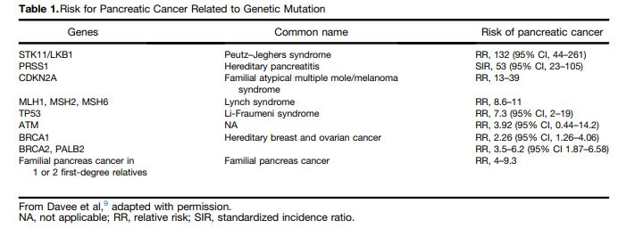

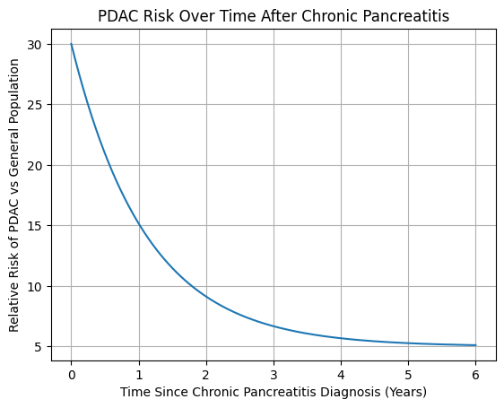


Biomarker Panels for the Early Detection of Pancreatic Adenocarcinoma Should be Tailored Based on the Indication for Surveillance
Lynette M. Smith, PhD; Brian Haab, PhD; Anna Lokshin, PhD; Maneesh Jain, PhD; Ben Staal, MS; Sushil Kumar, PhD; Gopal Natarajan, PhD; Ronit Gandhi, BS, Amer Zureikat, MD; Alessandro Paniccia, MD; Christine Worthington, BS; Surinder K. Batra, PhD; Randall Brand, MD
Hereditary Risk
New Onset Diabetes (NOD) Risk
DM Duration (years) | Ben et al. RR (95% CI) | Huxley et al. RR (95% CI)
<1 | 5.38 (3.49-8.30)
1-4 | 1.95 (1.65-2.31) | 2.05 (1.87-2.25)
5-9 | 1.49 (1.05-2.12) | 1.54 (1.31-1.81)
>10 | 1.47 (0.94-2.31) | 1.51 (1.16-1.96)
Mutations RR ~ 2.3-132
Familial history RR ~ 4-9.3
Ben et al. European J of Cancer 2011: 35 studies, 1966-2010
Huxley et al. Br J of Cancer 2005: 36 studies, 1966 to 2005
Aslanian et al. Gastro 2020
Chronic Pancreatitis (CP) Risk
Highest relative risk occurs in the first 2 years after diagnosis
• Overall standardized incidence ratio (SIR): ~10–20×
• First 0–2 years after diagnosis: RR~15–30×
• After 2 years: declines but remains elevated (~5–10×)
Adapted from Kirkegård J et al. Am J Gastro 2017; Munigala S et al. Clin Gastro Hepatol 2014.
Notes:
Evaluate the performance of biomarker panel(s) for surveillance of patients with a hereditary predisposition for PDAC development and for detecting PDAC in patients with new-onset diabetes and chronic pancreatitis, defined as within two years of initial diagnosis.

Slide 2
Methods
Hereditary cases (n=72) and controls (n=104) met criteria for familial PC or had a pathogenic variant in a PDAC susceptibility gene.
NOD cases (n=72) within 2 years of diagnosis, and diabetes controls + healthy controls >3 years follow-up (n=88)
CP cases (n=72) diagnosis dates were within 2 years, and controls (n=50) were self-reported or identified through chart review.
The labs submitted case/control calls on 9 biomarkers (CA19-9, CA19-9:sTRA, MUC5AC, CA125, CEA, CYFRA21-1, TSP2, TIPM1, TGM2) from the blinded validation set to an independent statistician.

Slide 3
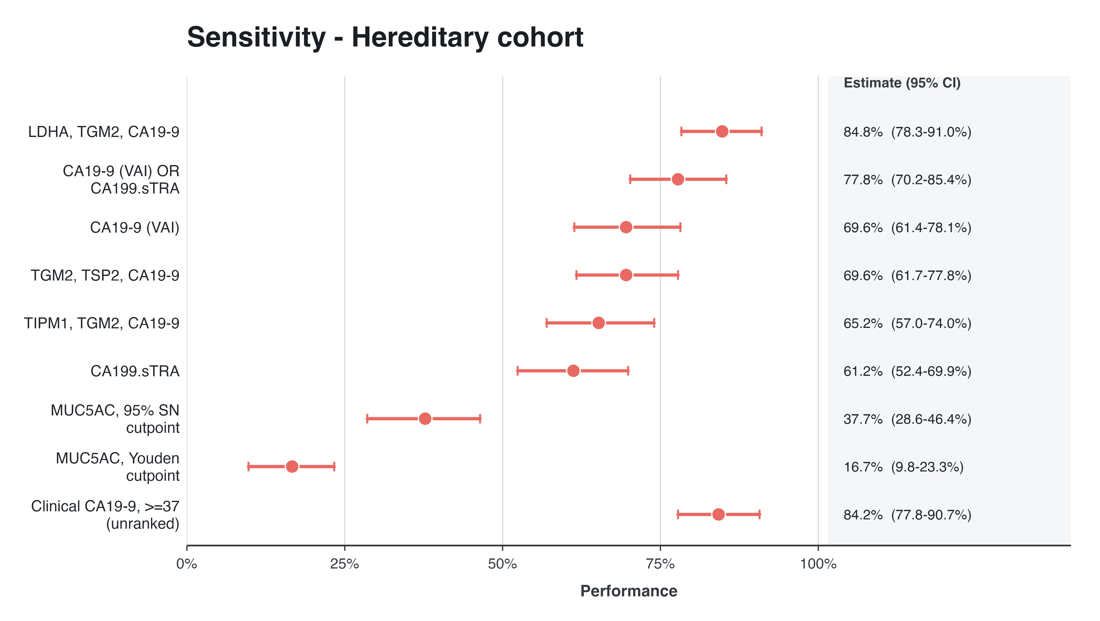
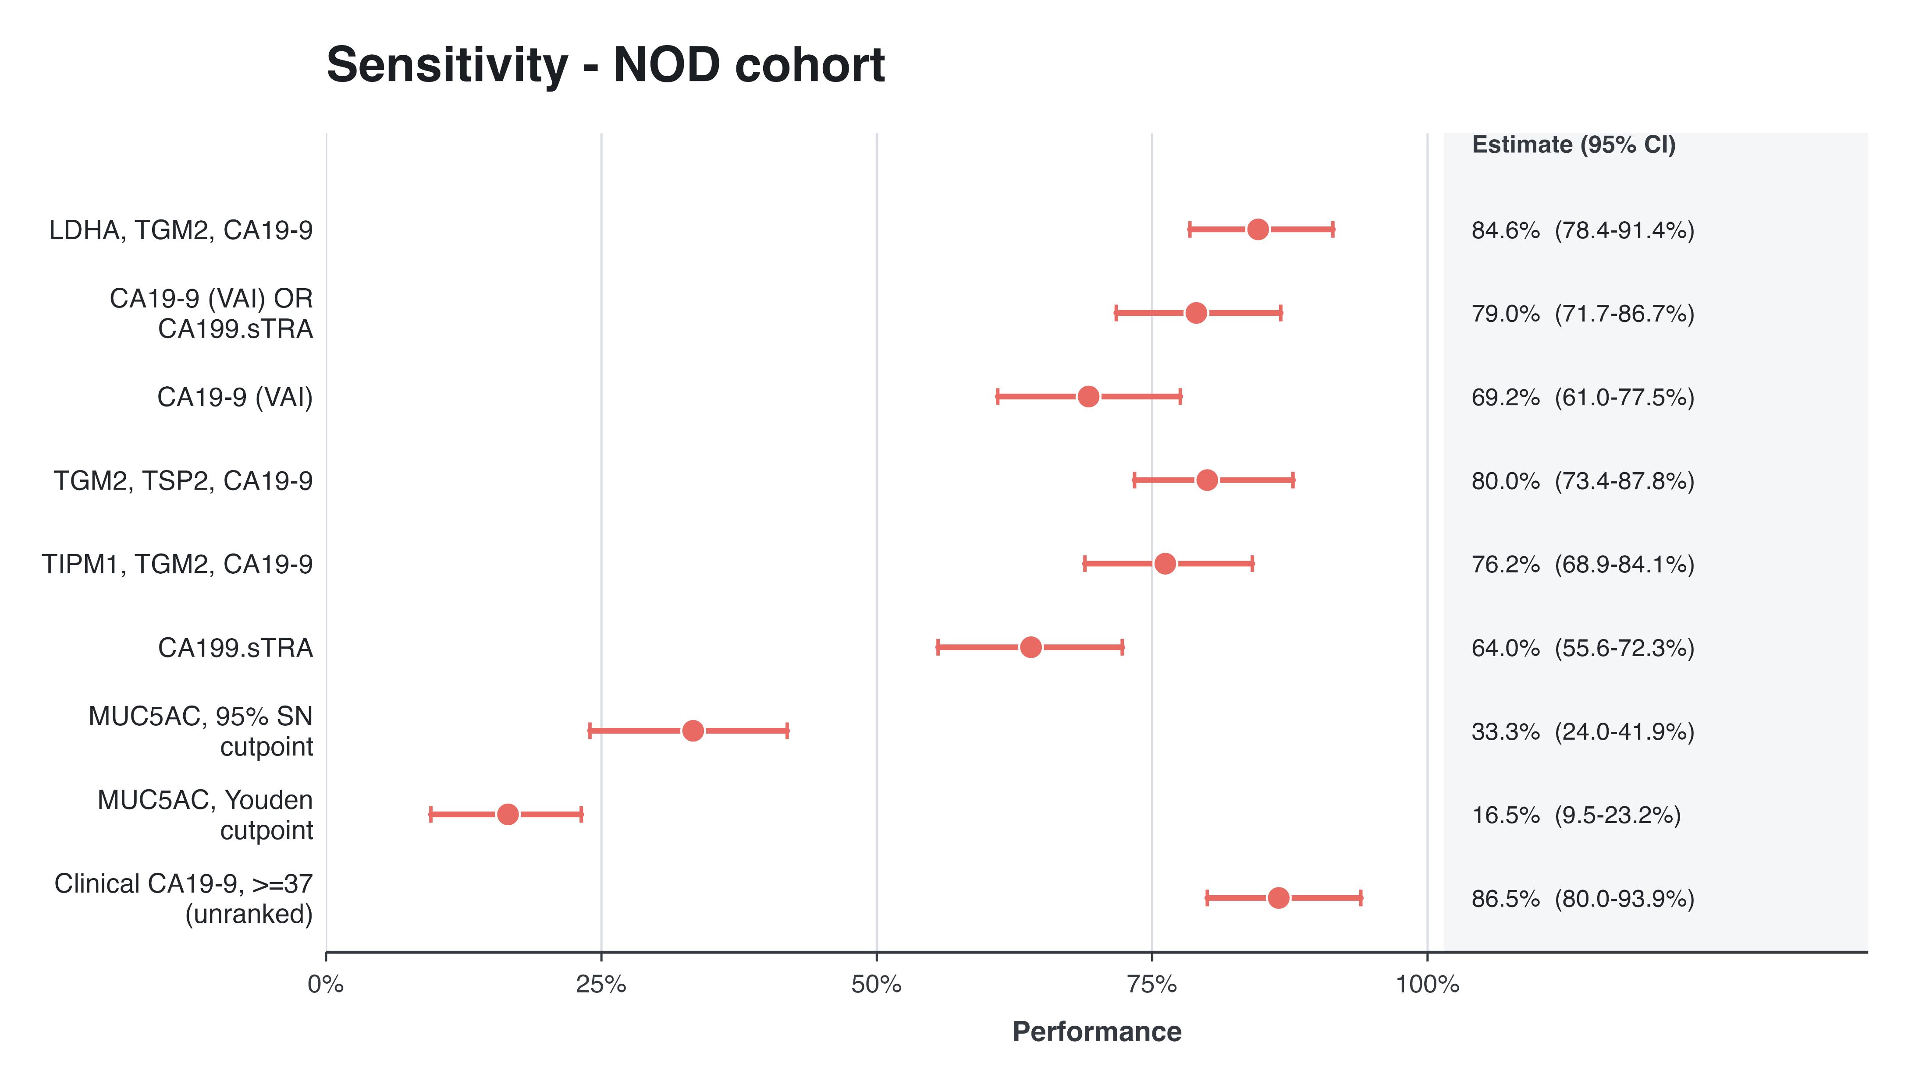
Biomarker panel performance in 2 cohorts
The best-performing biomarker panels differed by population.
These results reinforce the need to develop individualized biomarker panels based on the indication for PDAC surveillance.

