Slide 1

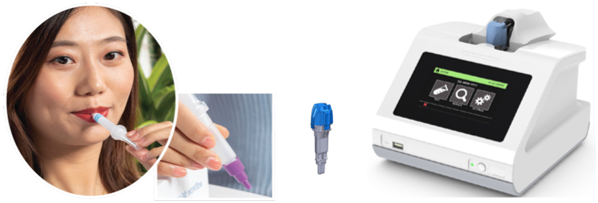
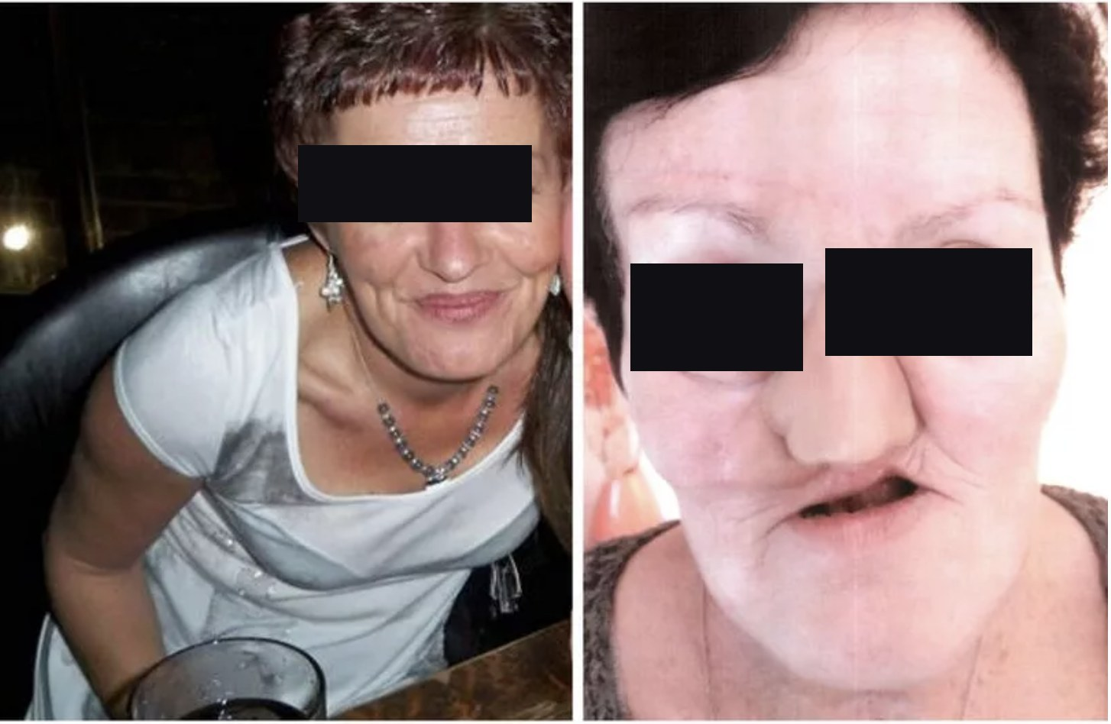
INNOTECH PRECISION MEDICINE · RECOGNIZE EARLY- TREAT EARLY™
Recognize ™: Integrated Detection Of Cancer Risk And Cancer Progression Markers, With AI Decision Support Built On The Patient's Risk Factors
No single marker, and no multiplex of a single class, is diagnostic. The diagnosis lives in combining orthogonal genotypic and phenotypic signals.
Multiomic layers: none sufficient alone
5
cancers have a screening or monitoring test today
Genomic, transcriptomic, proteomic, metabolomic, epigenetic: read on different technologies, none 100% accurate alone.
Genotypic · HPV DNA genotype: marks cancer risk, never cancer presence.
>80%
of cancers have no objective screening or triage pathway
Phenotypic · HPV E6/E7 expression: marks oncogene activity; transient or episomal infection can mimic it, and in blood it can come from four other HPV-driven cancers.
Head and neck cancer, diagnosed too late: the human cost of single-signal detection.
Phenotypic · p16: transformation signal; inflammatory disease can confound it.
Proprietary phenotypic panel: ML-identified host response markers, verified preclinically and in participant saliva.
Roya Khosravi-Far, PhD · Founder & CEO · roya@innotechprecisionmed.com · © 2026 InnoTech Precision Medicine
1
Notes:
Good morning. I am Roya Khosravi-Far, and I am here to introduce InnoTech Precision Medicine's Recognize platform for integrated detection of cancer risk and cancer progression markers, with AI decision support built on the patient's risk factors. Why did we build it? Thirty years in translational oncology, seventeen as Professor of Pathology at Harvard Medical School, and one question has followed me: why do patients still die of cancers we already know how to cure? We rarely fail to detect cancer; we detect it too late.
Screening has cut mortality in the five cancers that have a test; more than 80% of cancers have no objective screening or triage pathway. Head and neck cancer is the example in front of us: screening is observational and tactile, and saliva-based HPV testing alone is useless for cancer detection because of the biology. No single biomarker, and no multiplex of a single biomarker class, carries the diagnosis.
Cancer emerges across multiomic layers, genomic, transcriptomic, proteomic, metabolomic, epigenetic, read by different technologies, none 100% accurate. HPV DNA genotype marks who is at risk, never that cancer is present. E6/E7 expression marks oncogene activity, yet transient or episomal infection can mimic it, and in blood it can come from four other HPV-driven cancers. p16 marks transformation in IHC, yet inflammation can raise it falsely. Every marker has a failure mode; that is the reason to combine these orthogonal genotypic and phenotypic signals, plus our proprietary ML-identified markers, verified preclinically and in participant saliva. The patient on this slide is why the timing matters.

Slide 2
THE TECHNICAL ARGUMENT
Multi-omics in the Algorithm, Single-Modal at the Lab
Stitching together separate devices, workflows, and software after the fact. This fails in four ways no algorithm can fully correct.
Information
Biomarker levels
Time
Calibration
A model cannot recover what the measurement never captured.
Split the sample across devices and low-copy aliquots contain zero molecules; no AI can un-split a sample.
Different omics decay on different clocks; the diagnostic ratio drifts with handling, not biology.
No shared controls, no shared scale: fused models inherit batch artifacts and bias; fairness cannot be assured.
▼ Combine in the assay: one sample, one set of controls, one detection modality ▼
One saliva sample. Three signals detected simultaneously. One same-visit answer. Just 30 minutes.
Signal 1 · Cancer Risk
+
Signal 2 · Cancer Progression
+
Signal 3 · Patient Risk Factors
High-Risk HPV Genotype
Proprietary Host-Response Biomarker Panel
AI Decision Support
Recognize™: issued 2023 USPTO patent and pending applications.
Roya Khosravi-Far, PhD · Founder & CEO · roya@innotechprecisionmed.com · © 2026 InnoTech Precision Medicine
2
Notes:
Today the field makes multi-modal decisions by stitching separate tests together with AI after the fact: separate devices, workflows, detection technologies, and software, each with its own failure modes. That is multi-modal in the algorithm but single-modal at the lab, and it fails in four ways no algorithm can fully correct-yet. Information: a model cannot recover what the measurement never captured. Biomarker levels: split the sample and low-copy aliquots contain zero molecules; no AI can un-split a sample. Time: different omics decay on different clocks, so the diagnostic ratio drifts with handling, not biology. Calibration: without shared controls, fused models inherit batch artifacts and bias; fairness cannot be assured.
True multi-modal detection combines in the assay itself: one sample, one set of controls, one detection modality. That is what we built. Our patented one-pot chemistry and microfluidics read genotypic and phenotypic markers with a single detection strategy in one closed cartridge: one saliva sample, three signals simultaneously, one same-visit answer in thirty minutes.

Slide 3
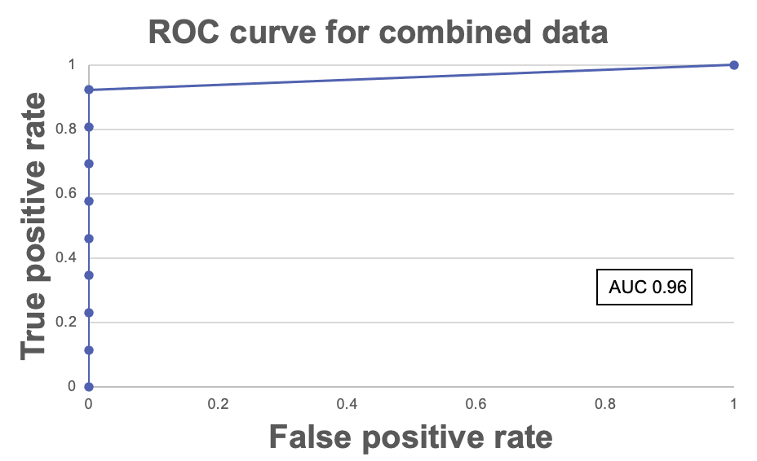
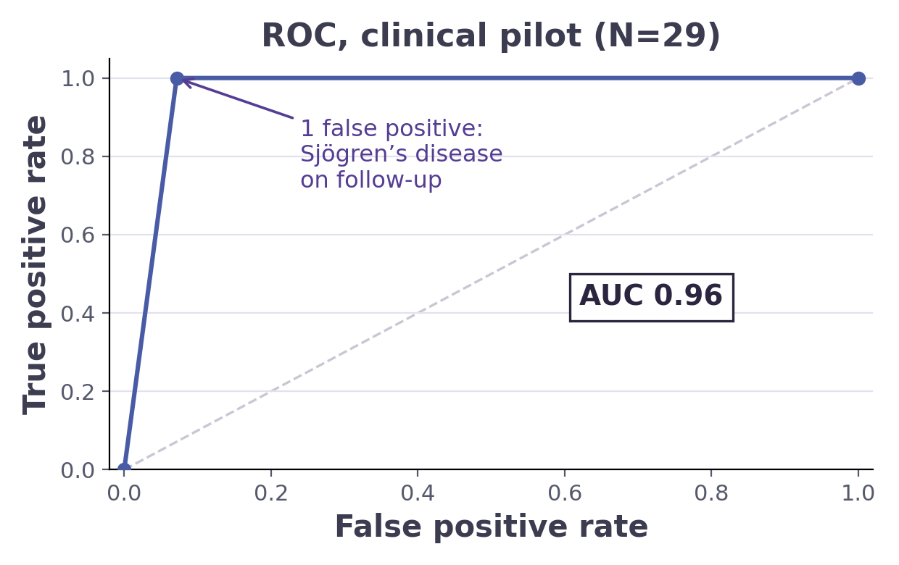

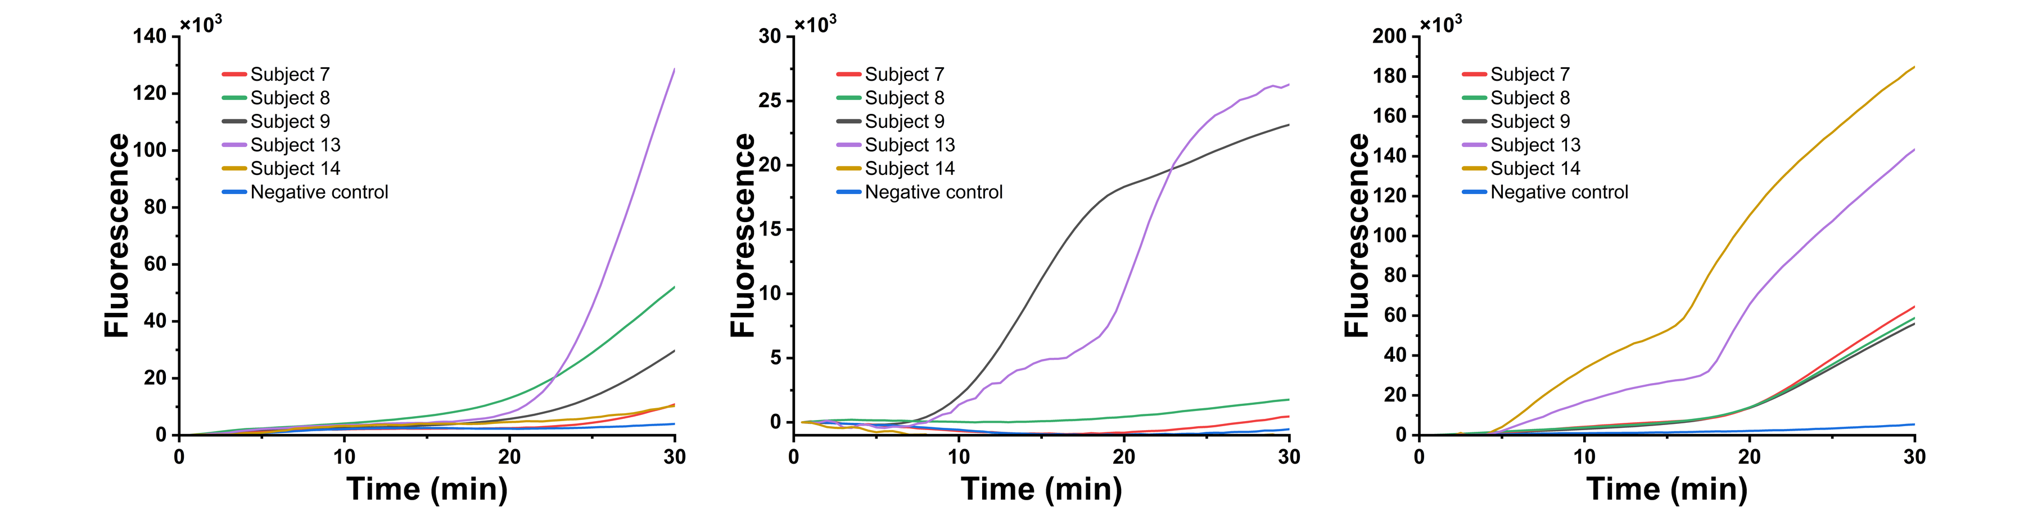
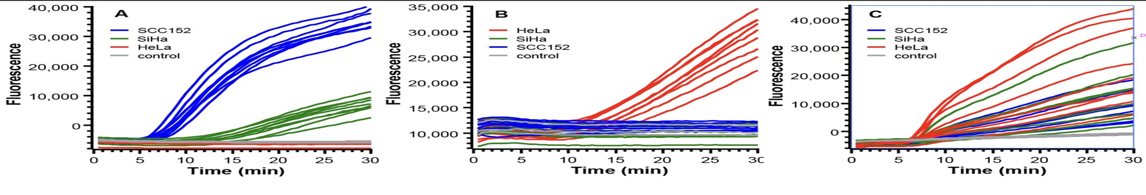







FIRST INDICATION
First Indication: Biopsy Triage in Head and Neck Cancer
Preclinical: randomized, blinded
Pilot: clinical, blinded
29 participants: 15 HPV+ OPSCC, 2 benign, 12 healthy. Sensitivity 15/15, specificity 13/14.
164 samples: 98% accuracy, 97% sensitivity, 100% specificity, AUC ≥0.98.
First blinded pilot site
3 clinical sites: BWH, WSDM, MCI (WCI), funded by NIDCR.
Preclinical, real-time curves
Clinical translation, 29 samples
Our ask: EDRN partners in multicenter validation, reference sets, and funding support.
Supported by
Roya Khosravi-Far, PhD · Founder & CEO · roya@innotechprecisionmed.com · © 2026 InnoTech Precision Medicine
3
Notes:
Now The data: our blinded, randomized preclinical study of 164 samples reached 98% accuracy, 97% sensitivity, and 100% specificity. The first clinical pilot, run blinded, twenty-nine participants, detected all fifteen HPV-positive cancers with one false positive, a healthy participant who proved on follow-up to have Sjogren's disease, consistent with a true host-response signal. We have added additional proprietary biomarkers discovered through ML to remove this error point. A funded, NIDCR- is supporting multicenter pilot at BWH, Miami Cancer Institute and HPU. This is the validation valley EDRN exists to cross; we would welcome this network's partners in multicenter validation and reference sets and of course Randy for financial support. Thank you.
Now the patient this was built for. A woman in her fifties notices a lump in her neck: referral, imaging, biopsy, pathology, fourteen to forty-two weeks to an answer, when roughly eighty percent of referred masses are benign. An ENT surgeon told our NSF I-Corps team: I know maybe twenty percent of these patients need a biopsy; I just cannot tell which twenty percent. Recognize gives that clinician a same-visit answer: one saliva sample, one integrated multiomic run, an AI risk score in thirty minutes; low risk monitored, high risk biopsied that day. The data: our blinded, randomized preclinical study of 164 samples reached 98% accuracy, 97% sensitivity, and 100% specificity. The first clinical pilot, run blinded at High Point University, twenty-nine participants, detected all fifteen HPV-positive cancers with one false positive, a healthy participant who proved on follow-up to have Sjogren's disease, consistent with a true host-response signal. AUC 0.96. A funded, NIDCR-supported multicenter pilot is underway at three clinical sites: BWH, WSDM, and MCI (WCI). This is the validation valley EDRN exists to cross; we would welcome this network's partners in multicenter validation and reference sets, and, of course, Randy, for financial support. Thank you.

Slide 4




FIRST INDICATION
First Indication: Biopsy Triage in Head and Neck Cancer
One saliva sample, non-invasive, collected chairside
14–42 wks
diagnostic delay for HPV-driven head and neck cancer today
Integrated multiomic run: HPV genotype and host response in one closed cartridge
~80%
of referred neck masses and oral lesions are benign; nearly all still face invasive biopsy
AI risk score in 30 minutes, molecular modalities fused with patient risk factors
>42M
Americans at risk of HPV-driven cancers
Same-visit decision: low risk, monitor; high risk, biopsy
Preclinical:
randomized, blinded
Pilot: clinical, blinded
29 participants: 15 HPV+ OPSCC, 2 benign, 12 healthy. Sensitivity 15/15, specificity 13/14.
164 samples: 98% accuracy, 97% sensitivity, 100% specificity, AUC ≥0.98.
Supported by
Roya Khosravi-Far, PhD · Founder & CEO · roya@innotechprecisionmed.com · © 2026 InnoTech Precision Medicine
3
Notes:
Now the patient this was built for. A woman in her fifties notices a lump in her neck: referral, imaging, biopsy, pathology, fourteen to forty-two weeks to an answer, when roughly eighty percent of referred masses are benign. An ENT surgeon told our NSF I-Corps team: I know maybe twenty percent of these patients need a biopsy; I just cannot tell which twenty percent. Recognize gives that clinician a same-visit answer: one saliva sample, one integrated multiomic run, an AI risk score in thirty minutes; low risk monitored, high risk biopsied that day. The data: our blinded, randomized preclinical study of 164 samples reached 98% accuracy, 97% sensitivity, and 100% specificity. The first clinical pilot, run blinded at High Point University, twenty-nine participants, detected all fifteen HPV-positive cancers with one false positive, a healthy participant who proved on follow-up to have Sjogren's disease, consistent with a true host-response signal. AUC 0.96. A funded, NIDCR-supported multicenter pilot is underway at three clinical sites: BWH, WSDM, and MCI (WCI). This is the validation valley EDRN exists to cross; we would welcome this network's partners in multicenter validation and reference sets, and, of course, Randy, for financial support. Thank you.

