Slide 1


Fred Hutchinson CVC: AI-Driven Near-term Breast Cancer Risk Prediction Using 3D MRI
Lucas J. Liu
Postdoctoral Fellow, Fred Hutch
on behalf of the UW–Fred Hutch–Microsoft collaboration
Sep 24th, 2026

Slide 2


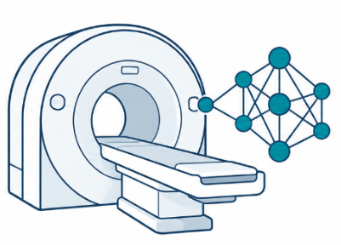
Why Predict Near-Term Breast Cancer Risk?
Breast cancer is the 2nd leading cause of cancer-related death among women in the US [1].
High-risk screening
Near-term Risk Gap
MRI + AI
Annual MRI + mammography
recommended for women at higher risk [2].
Risk remains heterogeneous
within the high-risk population
Traditional risk factors provide limited near-term stratification
MRI background parenchymal enhancement (BPE) and mammographic density are associated with breast cancer risk [3,4]
AI may help extract additional information from radiologic images
Questions: Can AI predict near-term breast cancer risk from 3D MRI?
[1] Siegel, R. L., Miller, K. D., Wagle, N. S., & Jemal, A. (2023). Cancer statistics, 2023. CA: a cancer journal for clinicians, 73(1).
[2] National Comprehensive Cancer Network. NCCN Clinical Practice Guidelines in Oncology: Breast Cancer Screening and Diagnosis. Version 1.2026. 2026.
[3] Jiang S, Bennett DL, Rosner BA, Colditz GA. Longitudinal Analysis of Change in Mammographic Density in Each Breast and Its Association With Breast Cancer Risk. JAMA Oncology. 2023;9(6):808–814. doi:10.1001/jamaoncol.2023.0434.
[4] Dontchos, B. N., Rahbar, H., Partridge, S. C., et al. (2015). Are qualitative assessments of background parenchymal enhancement, amount of fibroglandular tissue on MR images, and mammographic density associated with breast cancer risk?. Radiology, 276(2), 371-380.

Slide 3
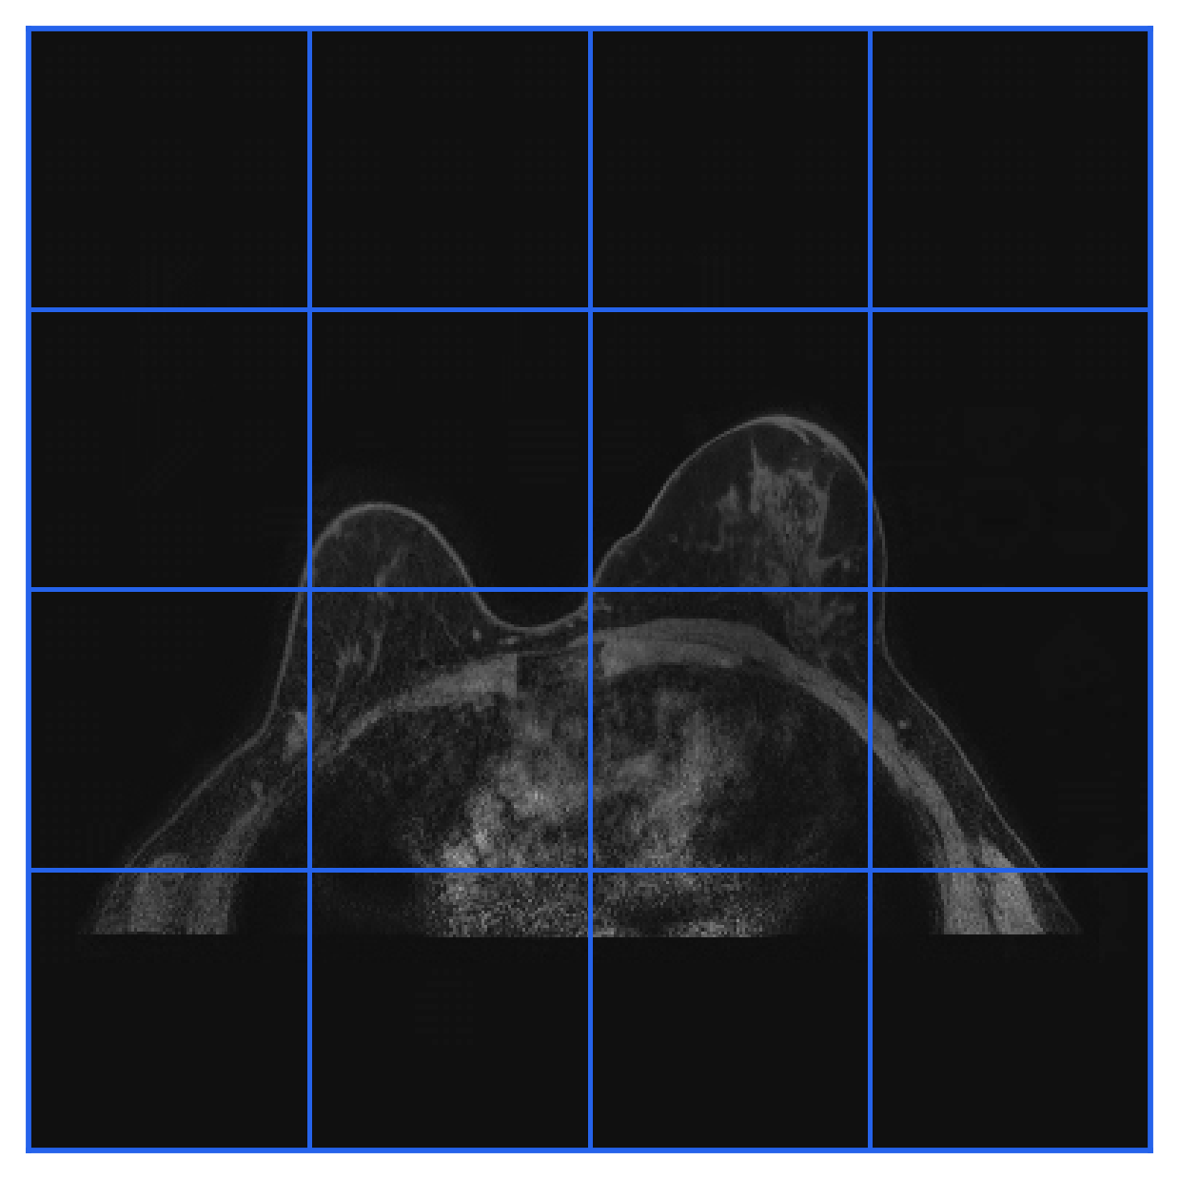
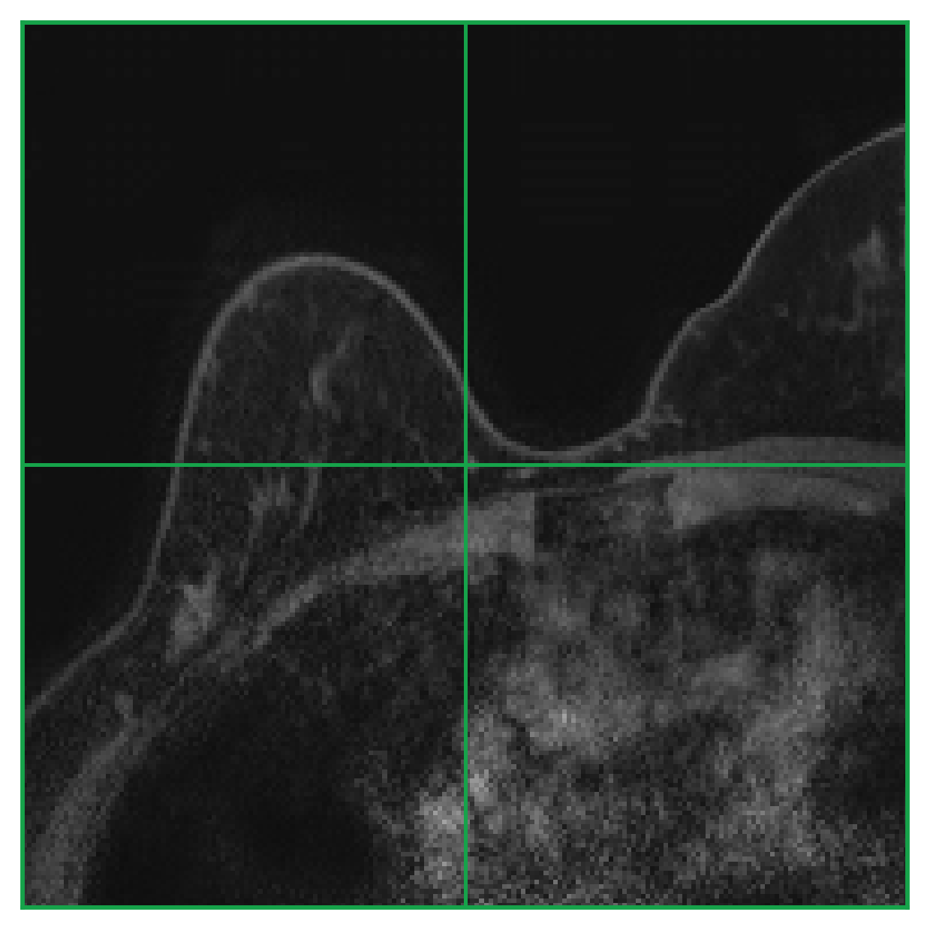
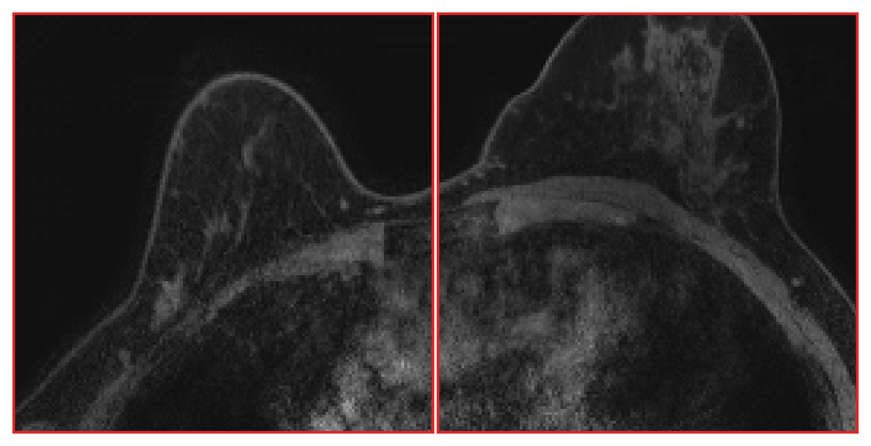
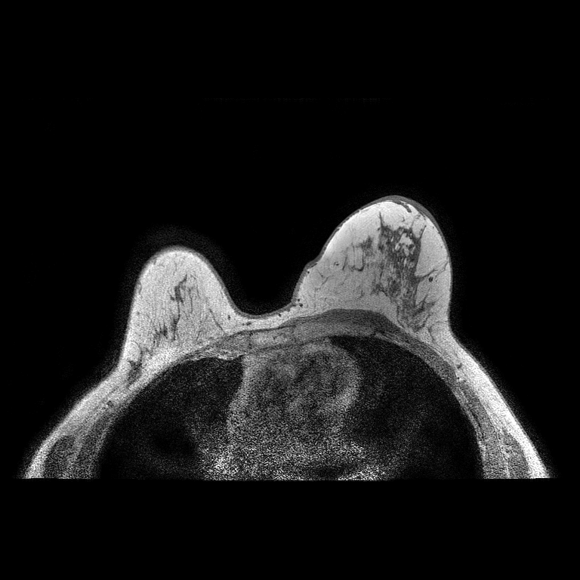
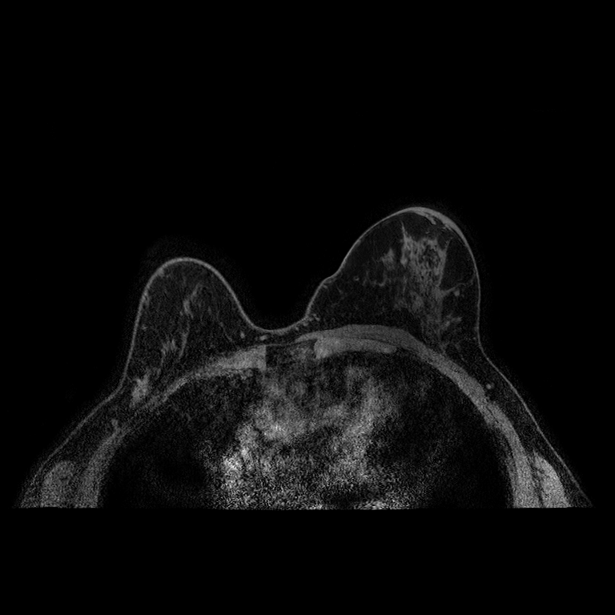
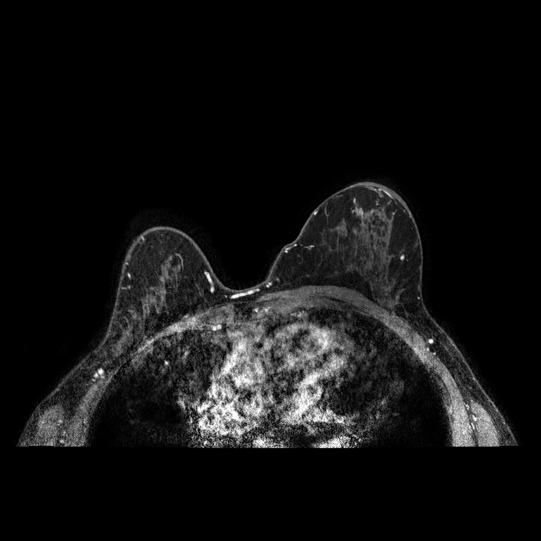
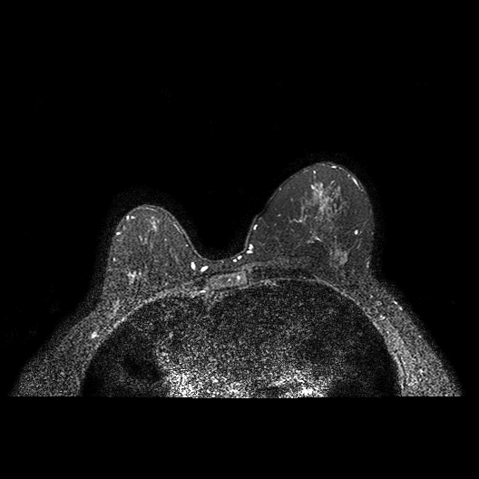
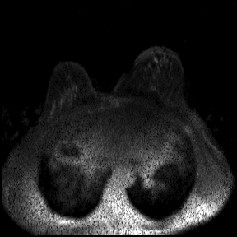
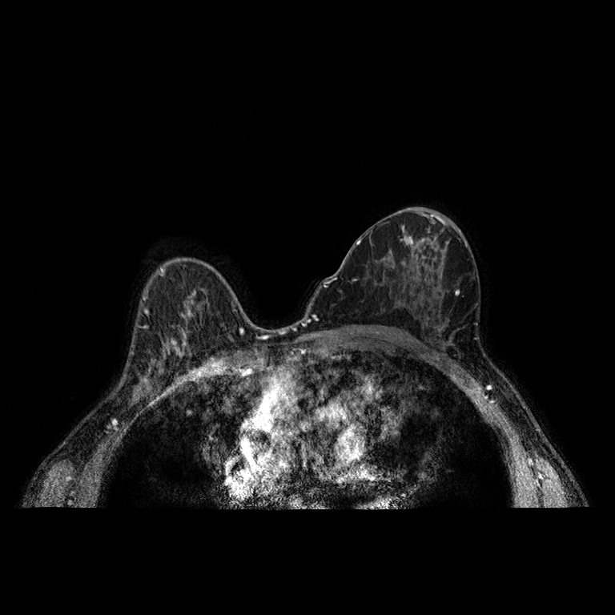
The Near-term Breast Cancer Risk Prediction Pipeline
Full-Protocol MRI
Multi-Scale Attention
BPE
Gadolinium contrast
LOC
T1W
DWI
T2W
DCE: Pre
DCE: Post1
DCE: Post2
DCE: Post3
Breast density
1:00
3:00
6:00
11:00
14:00
17:00
20:00
23:00
3D MRI volumes
(3 x 192 x 384 x 384)
Pillar-0 [1] encoder
Age
3-channel 3D MRI volumes
Scale 1
DCE:
Scale 2
Scale 3
T1W
(Dynamic
Contrast-Enhanced)
(T1-Weighted)
Multiscale
attention
Multiscale
attention
Multiscale
attention
Patchify3D
Pre
Embedding
(AI-Derived Feature)
Classifier
Prediction
LayerNorm
LayerNorm
LayerNorm
Stack
DWI
DCE:
(Diffusion-
Weighted Imaging)
Stage 1 (×2)
Stage 2 (×2)
Stage 3 (×8)
Post1
3-year
cancer risk
Pretrained and frozen
Ch 0
Pre-contrast DCE
Ch 1
T2W
Ch 2
First post-contrast DCE
T2W
DCE:
Ch 0
Pre-contrast DCE
(T2-Weighted)
Post2
1,152-d
Cancer-risk MLP
Ch 1
T2W
Ch 2
First post-contrast DCE
[1] Agrawal, K. K., Liu, L., Lian, L., et al. (2025). Pillar-0: A new frontier for radiology foundation models. arXiv preprint arXiv:2511.17803.

Slide 4
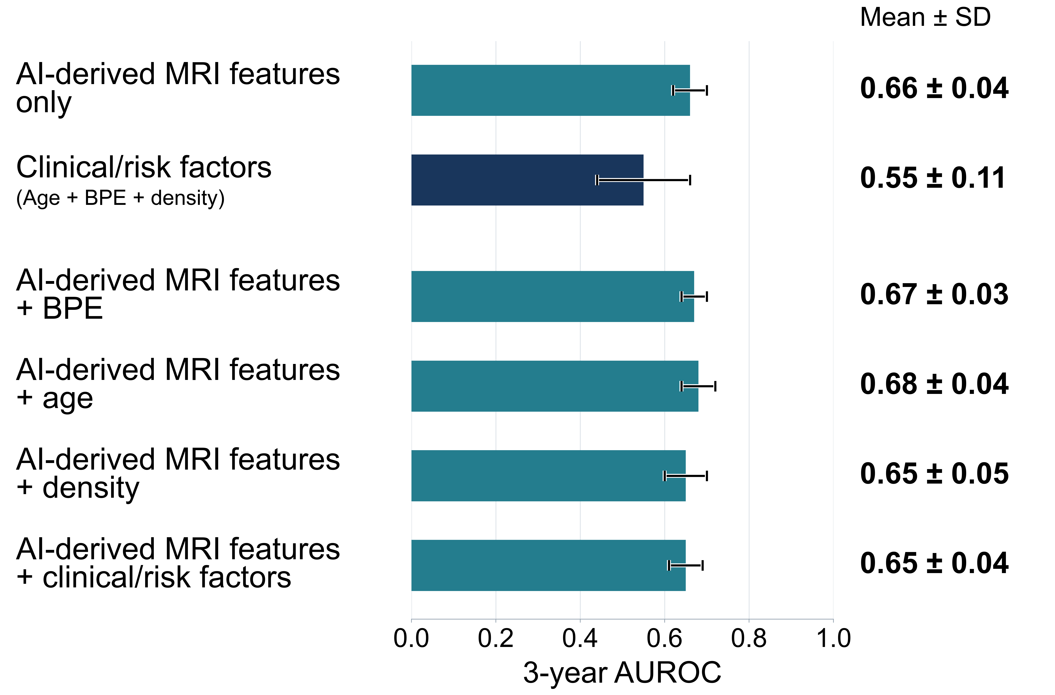
Results
Data:
Figure 1. Performance for 3-year breast cancer risk prediction.
Women undergoing high-risk screening breast MRI at the University of Washington from 2005 to 2022
Excluding:
  with prior breast cancer or contemporaneous cancer (diagnosed ≤12 months of imaging)
  non-index negatives
  1.5T magnetic fields strength or implants
  < 3 year of follow up
  missing T2W
1,300 women with 1,319 MRI exams
  Mean age: 44.9 ± 11.7 years
  46 women (3.5%) developed breast cancer
  Median time to cancer diagnosis 1.94 years, range 1.02 to 2.99 years
Next Steps: Using larger cohorts, incorporating additional clinical factors, independent validation

Slide 5


Thank you!
University of Washington - QBI Lab
Savannah C. Partridge
Yu-Tzu Kuo
Suleeporn Sujichantararat
Isabella Li
Anum S. Kazerouni
Daniel S. Hippe
Wesley Surento
Habib Rahbar
Fred Hutch Cancer Center – Etzioni Lab
Research support:
FHCC TDS IRC Pilot Award
NIH/NCI U01CA152637
R35 CA274442
Ruth Etzioni
Microsoft - AI For Good Lab
Felipe Oviedo
Come visit us at Poster #4!

