Slide 1
Utility of microRNAs from extracellular vesicle as blood-based biomarkers for lung cancer diagnosis
Jun-chieh J. Tsay, Geoffrey Cloud, Hua Zhou, Kendrew Wong, Fares Darawshy, Benjamin Kwok, Benjamin G. Wu, Imran Sulaiman, James Mattison, Yonghua Li, Rosemary Schluger, Destiny Collazo, Yaa Kyeremateng, Colin Mccormick, Alexander Duval, Qingsheng Li, Chandra Goparaju, Kenneth Tokoro, Edwin Ostrin, Daniel Sterman, Aristotelis Tsirigos, Harvey I. Pass, and Leopoldo N. Segal
September 24, 2026

Slide 2
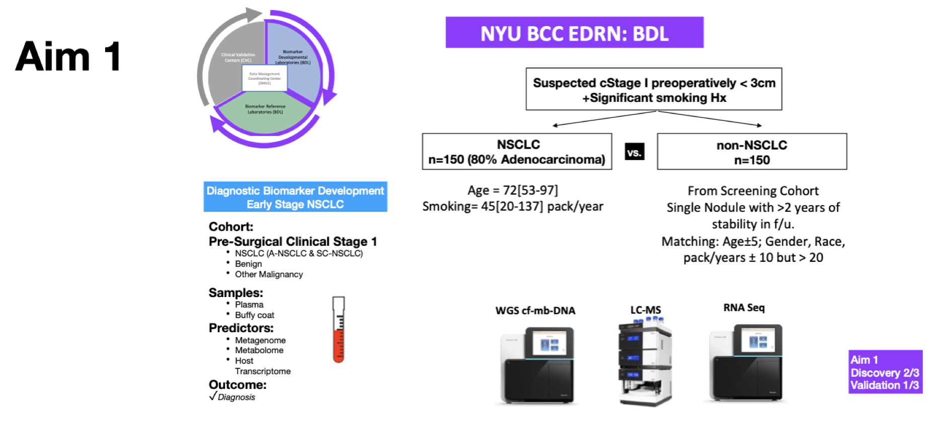
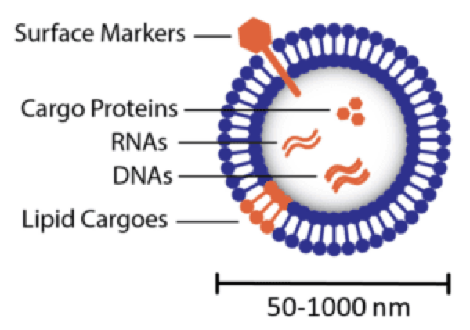
EDRN BDL Project: EV-miRNA biomarker for early lung cancer detection
Extracellular Vesicles (EVs) are lipid bilayer-enclosed particles secreted by diverse cell types.
Their exceptional structural stability protects molecular cargo, making them a breakthrough advancement for reliable biomarker discovery.

Slide 3
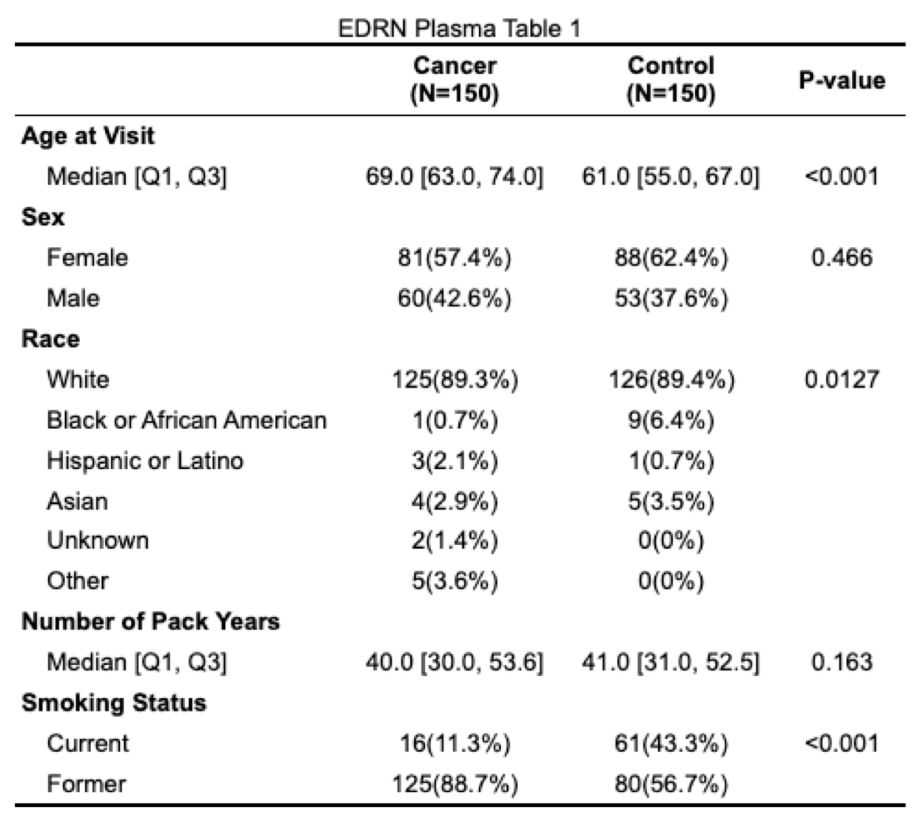
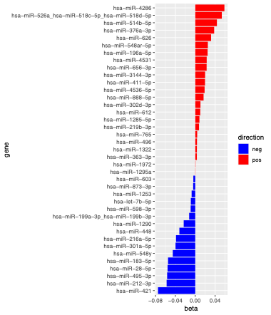
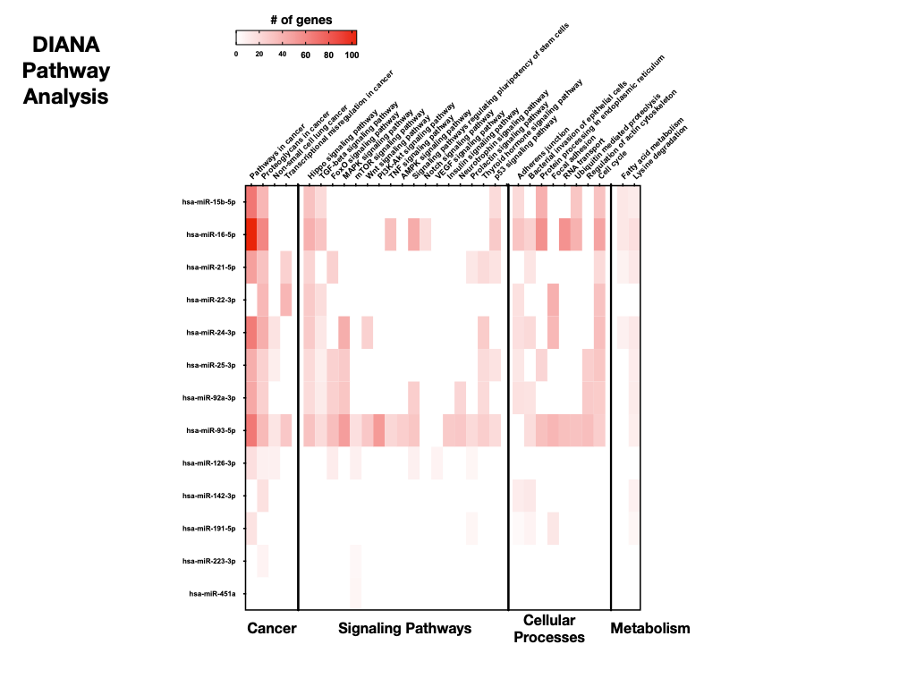
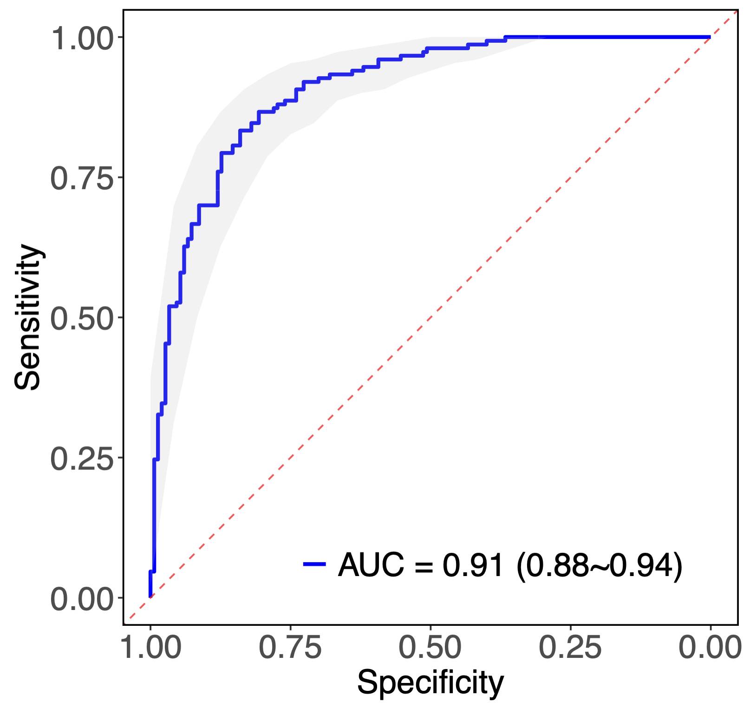
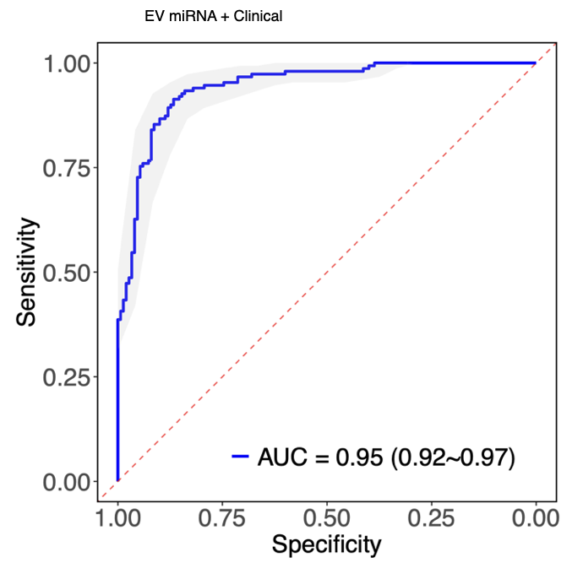
EV-miRNA: Discovery Cohort
Table 1
Top 50 miRNA
Pathway related to top miRNA
Positively associated:
miR-196a-5p, -626, -765, -4286
Cancer
Negatively associated:
miR-Let7b, -28, -212, -216a, -421, -603
Case
Top 50 miRNA
Top 50 miRNA +
Clinical features
Functional analysis reveals that the top 50 miRNAs correlate significantly with cancer development, cell signaling, metabolic functions, and core cellular processes
AUC= 0.91
AUC= 0.95

Slide 4
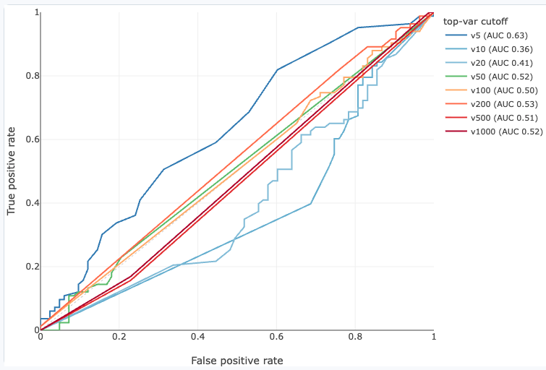
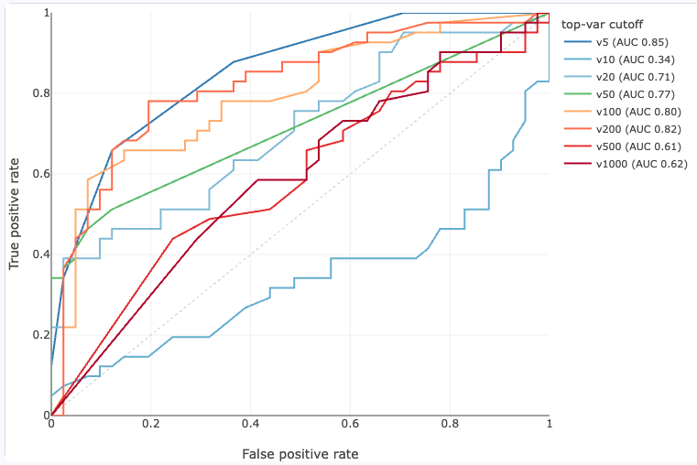
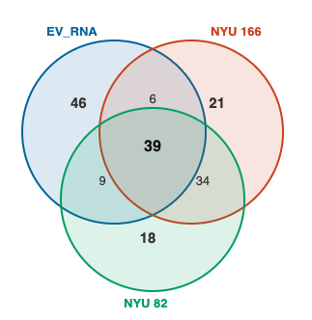
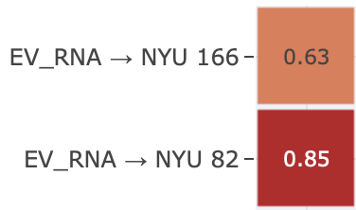
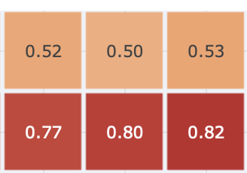

EV-miRNA: Validation Cohort
Top miRNA signatures:
miRNA- 1246
miRNA-1253
miRNA-1290
miRNA-4536-5p
miRNA-548ar-5p
miRNA-603
miRNA-873-3p
Surgical Cohort
(83 cases vs 83 control)
Screening Cohort
(41 cases vs 41 control)
Conclusion
EV-miRNA has potential as a biomarker for early lung cancer detection, specially within a screening cohort
Next step
Optimize EV isolation protocol
Refine biomarker modeling
Validate in an external cohort- Vanderbilt screening cohort
AUC = 0.41-0.63
AUC = 0.34-0.85
5
20
100
200
Top overlapping
miRNA features

Slide 5
contact information (jun-chieh.tsay@nyulangone.org)

