Slide 1

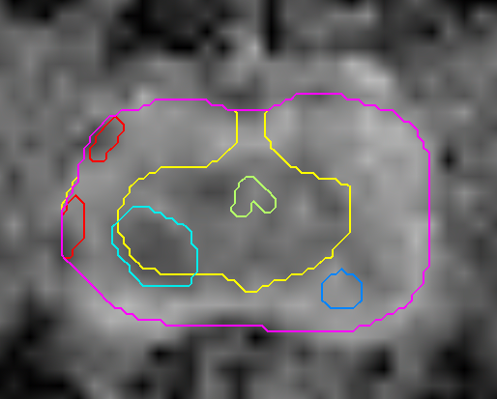
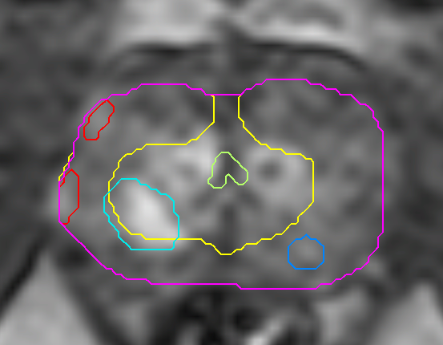
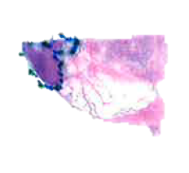
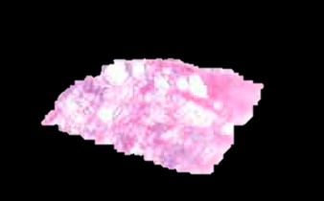
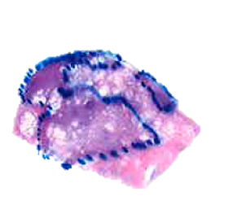
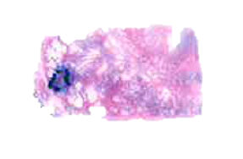
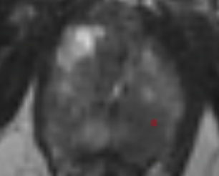
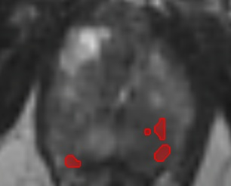
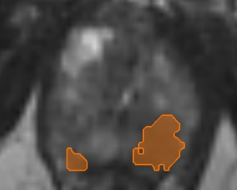
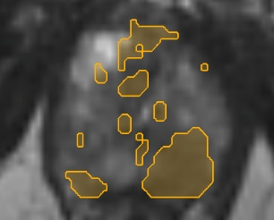
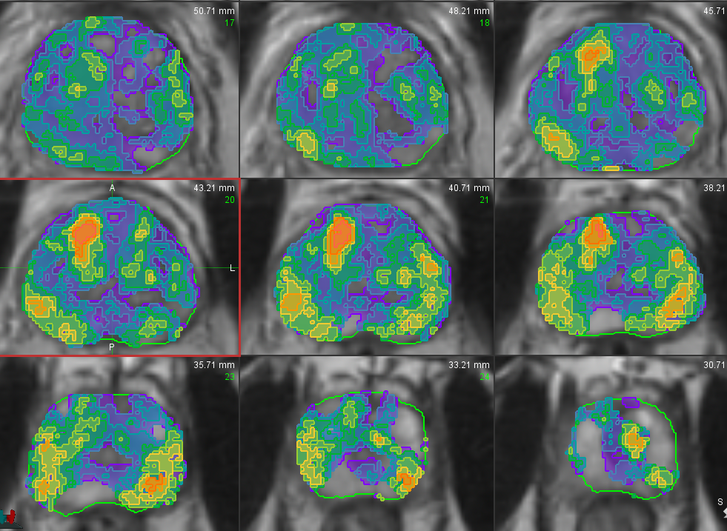
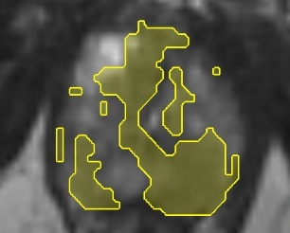
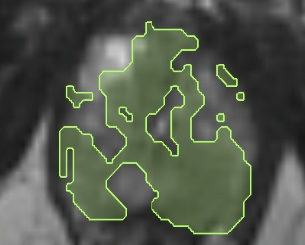
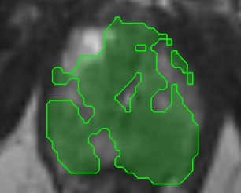
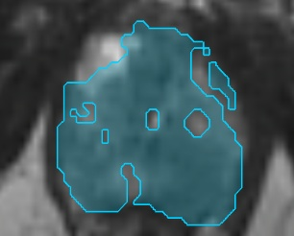
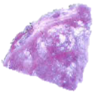
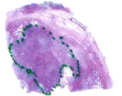
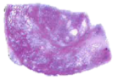
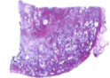
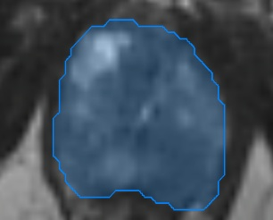
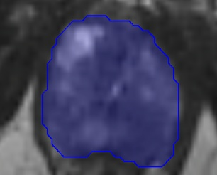
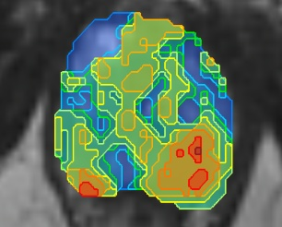
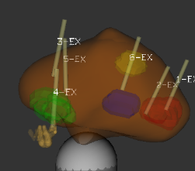
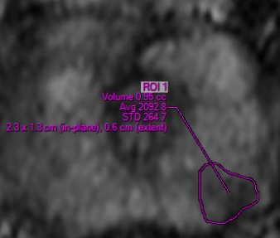
Prospective Validation of Automated Imaging Scoring System, Habitat Risk Score (HRS), for Prostate Cancer Detection
Prostatectomy
Diffusion
Perfusion
HRS10
HRS9
HRS8
HRS7
HRS6
HRS5
HRS4
HRS3
HRS2
HRS1
Prostate Imaging and Reporting Data System (PI-RADS)
Refined needle placement

Slide 2
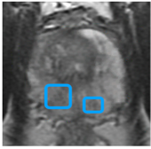
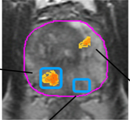
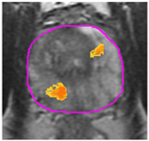
Marker Driven Selection of Patients for Prostate Biopsy and Management: MDSelect (PI: Sanoj Punnen)
Patients with possible indications for prostate cancer: PSA kinetics, elevated PSA, abnormal DRE
Between June 2020 and May 2025: N = 289 (245 evaluable)
 | PI-RADS | HRS | p-value
AUC | 0.52 | 0.62 | <0.001
Accuracy | 60 | 67 | 0.002
Sensitivity | 97 | 94 | 0.221
Specificity | 8 | 30 | < 0.001
PPV | 60 | 65 | < 0.001
NPV | 62 | 78 | 0.108
In the equivocal PI-RADS3 (N = 32) subgroup, NPV reached 100%.
Among 30 HRS-negative discordant cases, 25 (83%) had no or GG1 cancer, suggesting potential to reduce unnecessary biopsies.
Imaging data from 27 imaging centers acquired on magnets from the three major vendors
Planned multi-institutional trial for clinical HRS adoption
+ 12 cores systematic biopsies
NIH-NCI: U01CA239141 (MPI: Pollack/Stoyanova/Punnen): MRI Imaging and Biomarkers for Early Detection of Aggressive Prostate Cancer

Slide 3
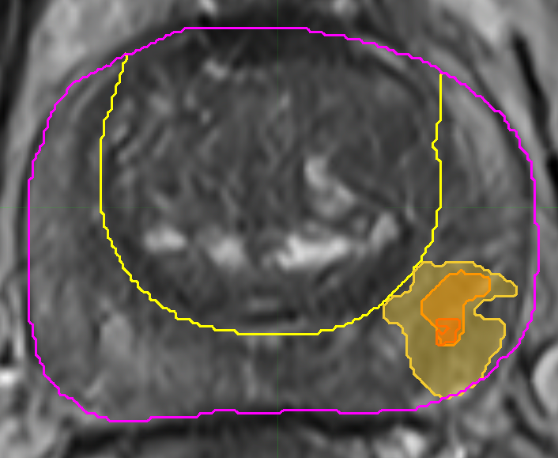
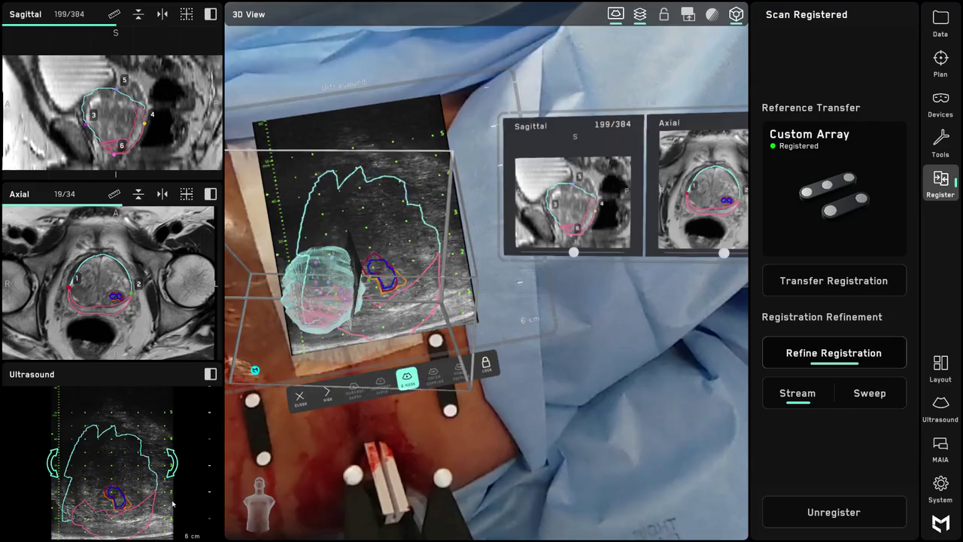

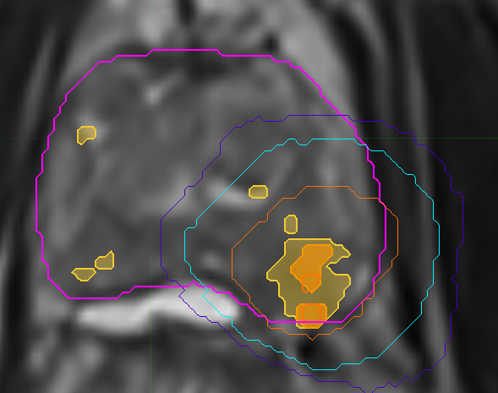
HRS in Clinical Trials @ University of Miami
UAdapt; PI Ben Spieler
HRS in AR; PI Archan Khandekar
No HRS
No PCa
No HRS
HRS 6
No PCa
GS 6
HRS 7
GS 6
HRS 8
GS 7
Post-RT
Veronica Wallaengen Ph.D., Adrian L. Breto M.S., Arpita Dutta Ph.D.,, Sandra M. Gaston Ph.D., Rosa P. Castillo Acosta M.D., Oleksandr N. Kryvenko M.D., Alan Pollack M.D., Ph.D., Sanoj Punnen M.D.

