Slide 1

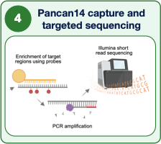
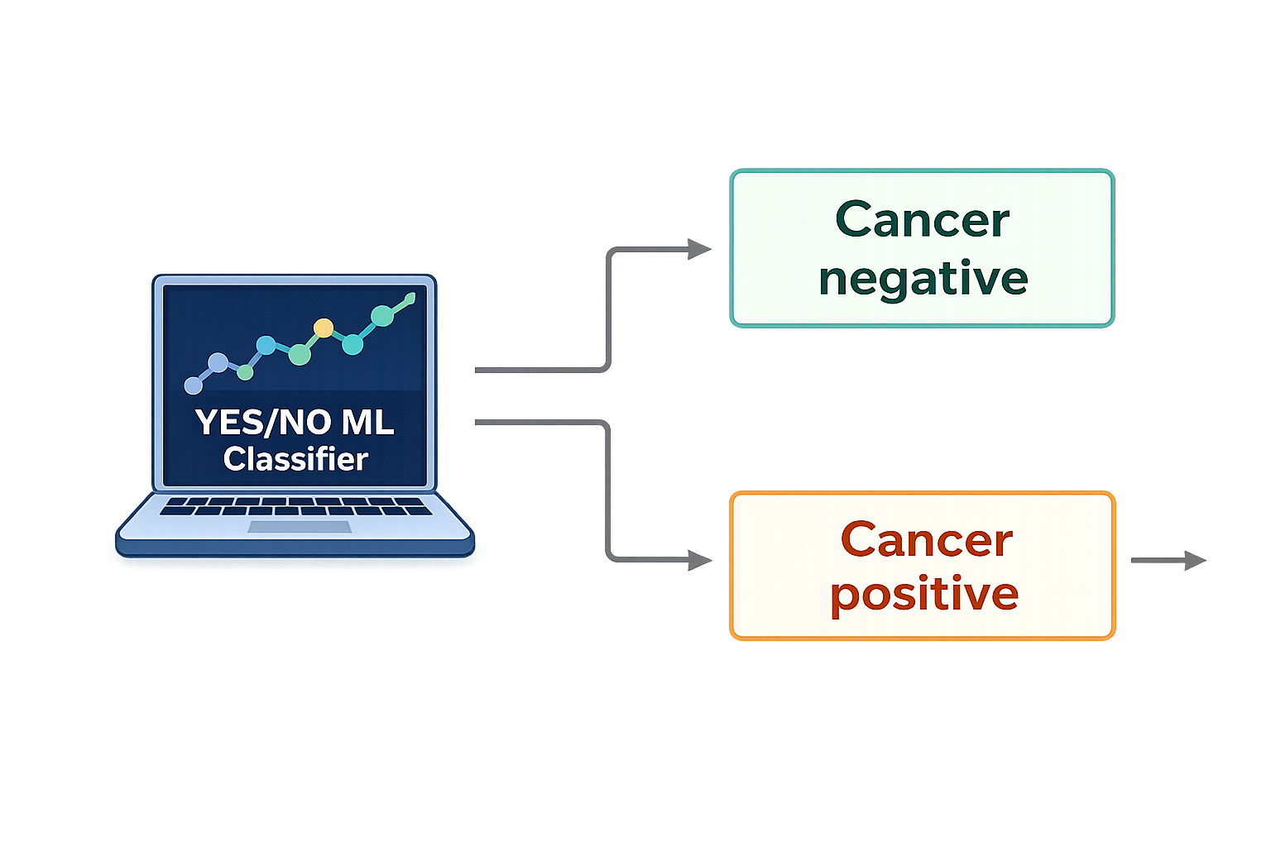
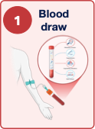
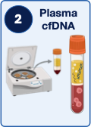
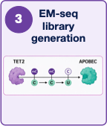
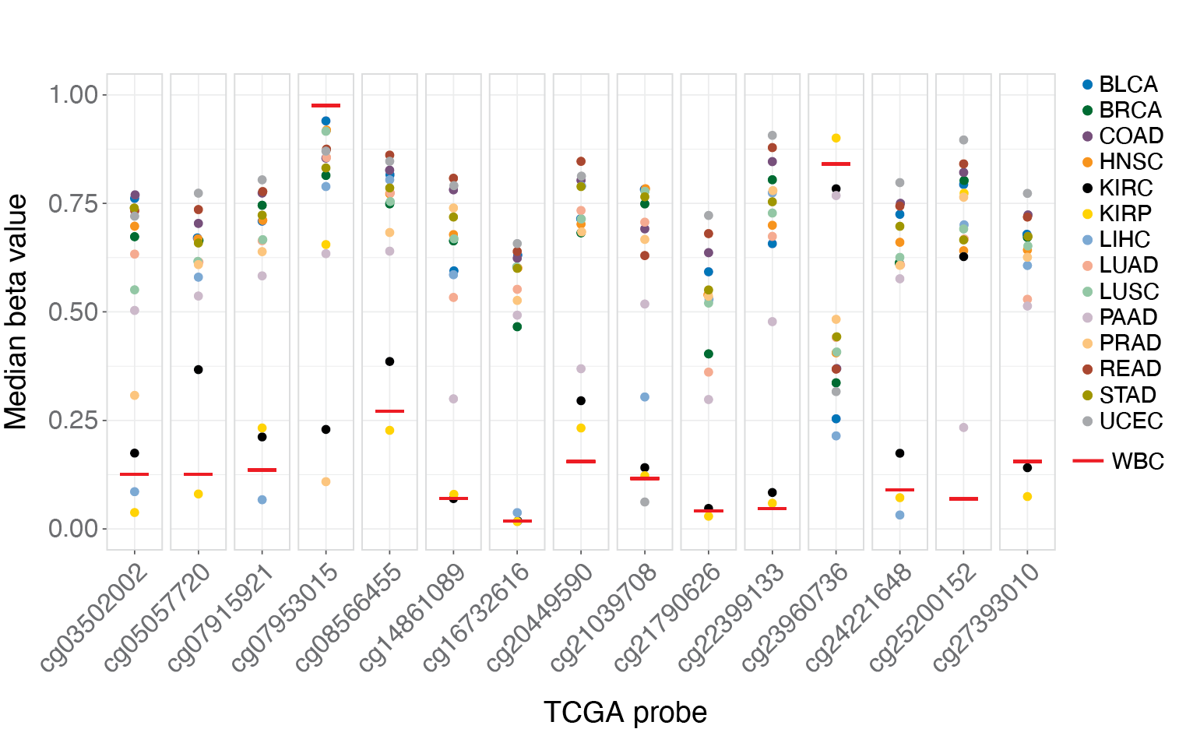
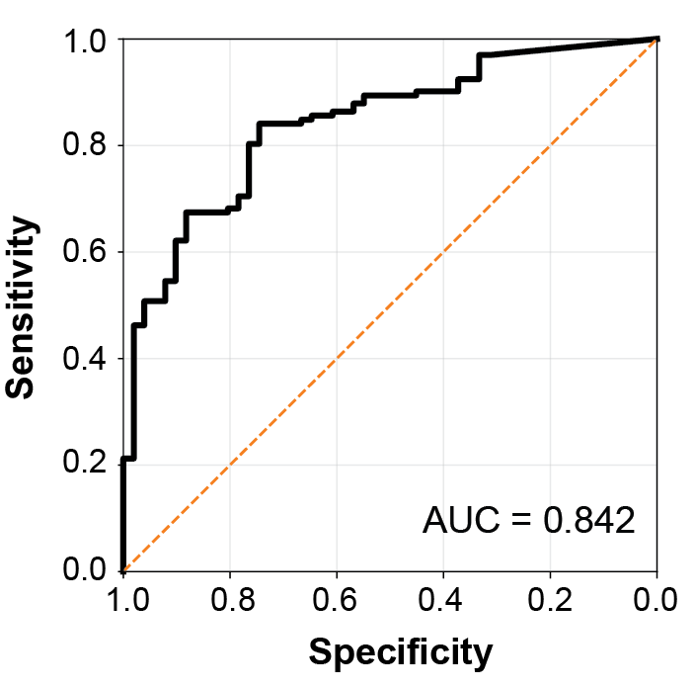


Building a staged cell-free DNA methylation and fragmentomics workflow for cancer screening and tumor tissue-of-origin prediction
Stage 1: targeted methylation detects cancer across multiple cohorts
S. Katie Farney
Elnitski Lab
Poster #14
Notes:
Liquid biopsy assays are often framed around detecting tumor signal in the blood. But for early detection, a positive result immediately raises a second question: where is that signal likely coming from?
Our project is built around a two-stage cfDNA workflow. The first stage uses a targeted methylation capture panel to detect cancer, and the second stage asks whether whole-genome EM-seq can recover additional methylome and fragmentomic signals to predict the cancer of origin.
We collected plasma samples from 48 healthy donors and 148 treatment-naive cancer patients.
We extracted the cfDNA and prepared libraries according to the Enzymatic Methyl-seq protocol.
Our lab previously identified 148 methylation biomarkers that distinguish tumor-derived cfDNA from blood-cell background. From these, 14 markers were selected for our Pancan14 panel because they showed broad cancer-associated methylation differences across multiple cancer types.
We built a classifier using these 14 targeted methylation regions to classify plasma samples as cancer negative or cancer positive. Across 6 different cancer cohorts, the model achieved an AUC of 0.84.

Slide 2
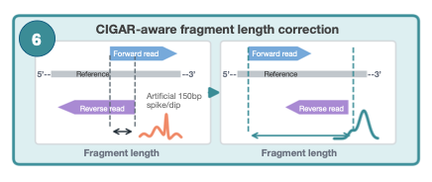
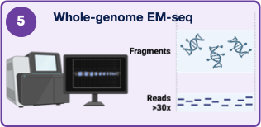
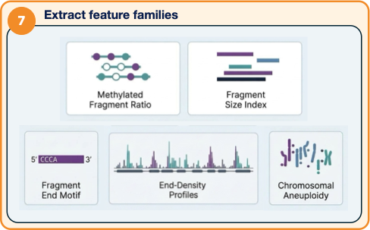
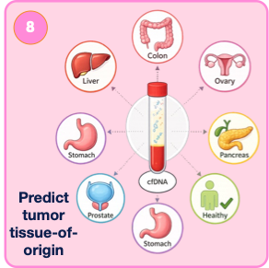
Stage 2: Whole-genome EM-seq enables multimodal cancer type prediction
*Adapted from Wang H, Mennea PD , Chan YKE et al. Genome Biology 2025
Notes:
For the samples that come back positive, we are able to go back to the cfDNA libraries we already prepared in step 3 and send the samples for WG EM-seq at 30X depth.
One important preprocessing step is cfDNA fragment-length correction. With paired-end 150bp short read sequencing, typical workflows can miscalculate read length.
Not properly aligning the forward and reverse strands to the reference loses the true, preserved 5’ end, miscalculates the read length, and distorts fragmentomic analyses.
So before feature extraction, we correct the fragment span from the paired-end alignments.
After preprocessing, we extract several feature families: CpG methylation features, fragment length summaries, 4 base pair fragment end motifs, end-density profiles, and copy-number features.
Our goal was not to rely on a single signal, but to ask whether these complementary features together can support tumor tissue-of-origin prediction.
--------
The hard part is that our cohorts include samples from different clinics and different collection tubes, so we have to make sure the model is learning cancer biology rather than technical artifacts from sample handling.

Slide 3
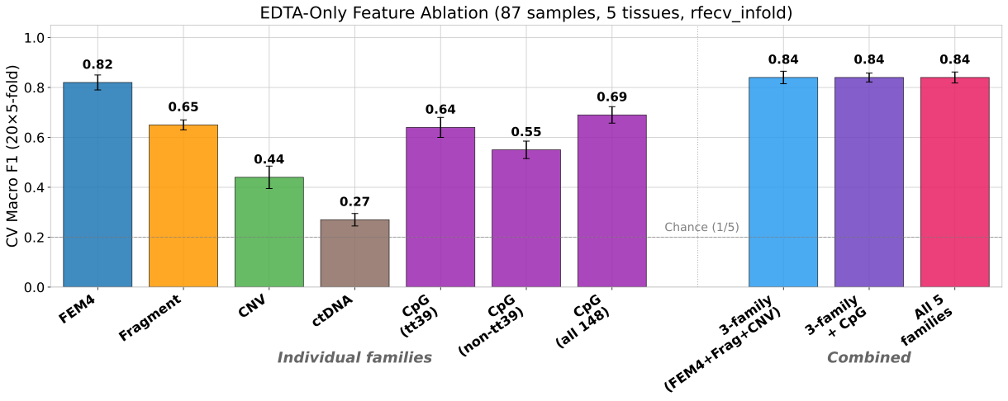
EDTA-Only Feature Ablation
87 samples, 5 cancer types, post-recursive feature elimination with cross validation
Notes:
Since our cancer cohorts include samples obtained from different clinics and samples that are stored in different collection tubes, we first wanted to make sure our model is learning cancer biology rather than technical artifacts from sample handling.
To control for batch effects, we initially separated samples by blood collection tube type and analyzed only samples that were stored in EDTA tubes. This consisted of 87 samples across five cancer types.
After recursive feature elimination with 20 repeats of 5-fold cross validation,
We have found that individual feature families do carry cancer signal. Fragment end motifs perform particularly well, with a macro F1 of 0.82. Fragment length and our 148 CpG methylation biomarker features also show signal, while CNV is weaker on it's own.
The main result is that combining feature families performs best. A three-family model combining fragment end motifs, fragment length, and CNV reaches a 0.84 macro F1, and adding CpG methylation or combining all five feature families gives similar performance. So far, the power seems to come from a multimodal assay where different feature families contribute complementary information.
Overall, this project is moving from cancer detection toward cancer interpretation: Stage 1 uses our custom designed targeted methylation capture panel to identify cancer-positive samples, and Stage 2 uses whole-genome EM-seq to ask where that signal is coming from. Our preliminary results suggest that no single feature tells the whole story, but combining methylation, fragmentomics, and copy-number signals may support tissue-of-origin prediction.
Our current efforts focus on reintegrating those samples from additional collection tube types while removing tube-associated signal; refining our methylation features, and processing additional plasma samples for further validation.
This is work in progress, so I welcome any feedback or suggestions, or offers of more samples to add to our cohort.
Thank you.

