Slide 1
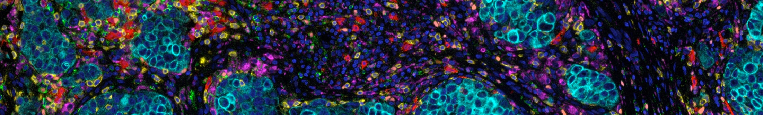

Spatial and liquid ecotyping of the
tumor microenvironment
Aaron M. Newman, Ph.D.
Associate Professor
Chan Zuckerberg Biohub Investigator
Department of Biomedical Data Science
Institute for Stem Cell Biology and Regenerative Medicine
Stanford Cancer Institute
Stanford University, Stanford CA
Notes:
Hi everyone – well thanks to the conference organizers for the kind invitation to speak today. I’d like to tell you about recently published data and technology for interrogating the TME. And while our work so far has mostly focused on later stage disease and understanding response to therapy, the technology itself is general and may have applications for early cancer detection and we are actively pursuing several collaborations to investigate this possibility.

Slide 2
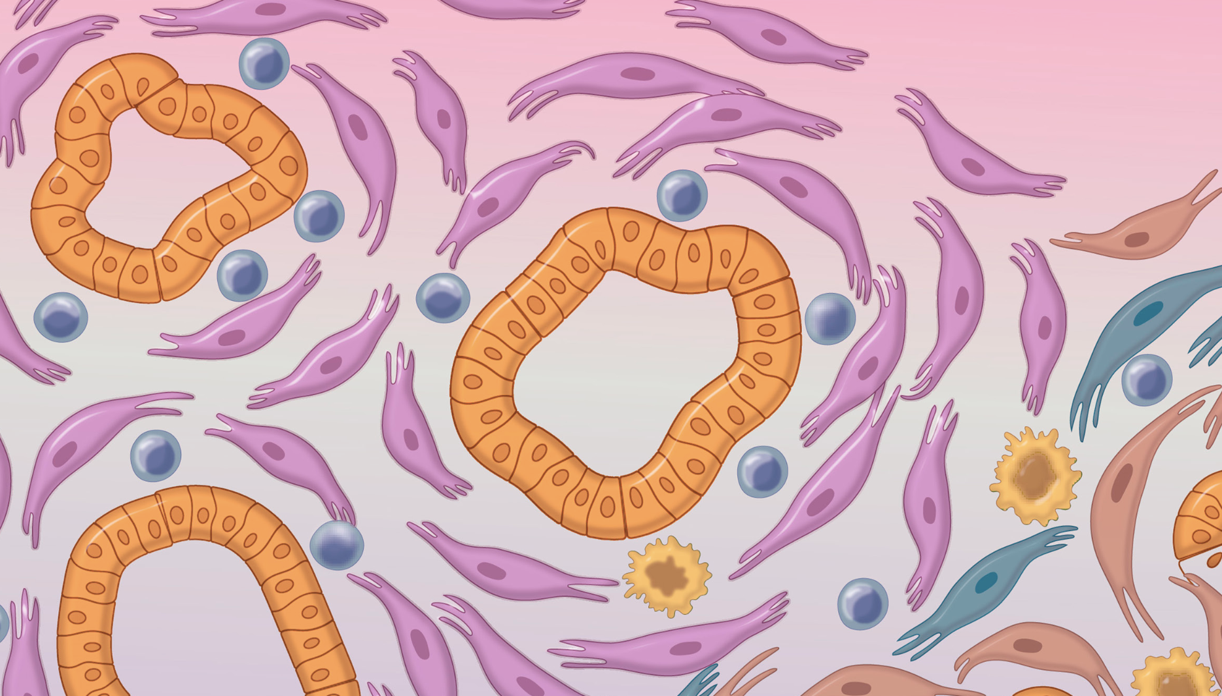
Cancer does not develop in isolation
Surrounding normal cells may block progression to malignancy
PanIN
Elhossiny et al., Cancer Discovery 2026
Notes:
So it’s now widely recognized that cancer does not arise purely from pre-cancerous cells. In an elegant recent study from Marina Pasca di Magliano [mahl-YAH-noh] and colleagues, the authors studied PanINs, which are precursor cells of pancreatic cancer. (pancreatic intraepithelial neoplasia). but rarely progress to it. Their findings described unique features of the surrounding normal cells that may be responsible for preventing these precursor lesions from progressing to malignancy. This suggests that mutations alone are not enough.

Slide 3
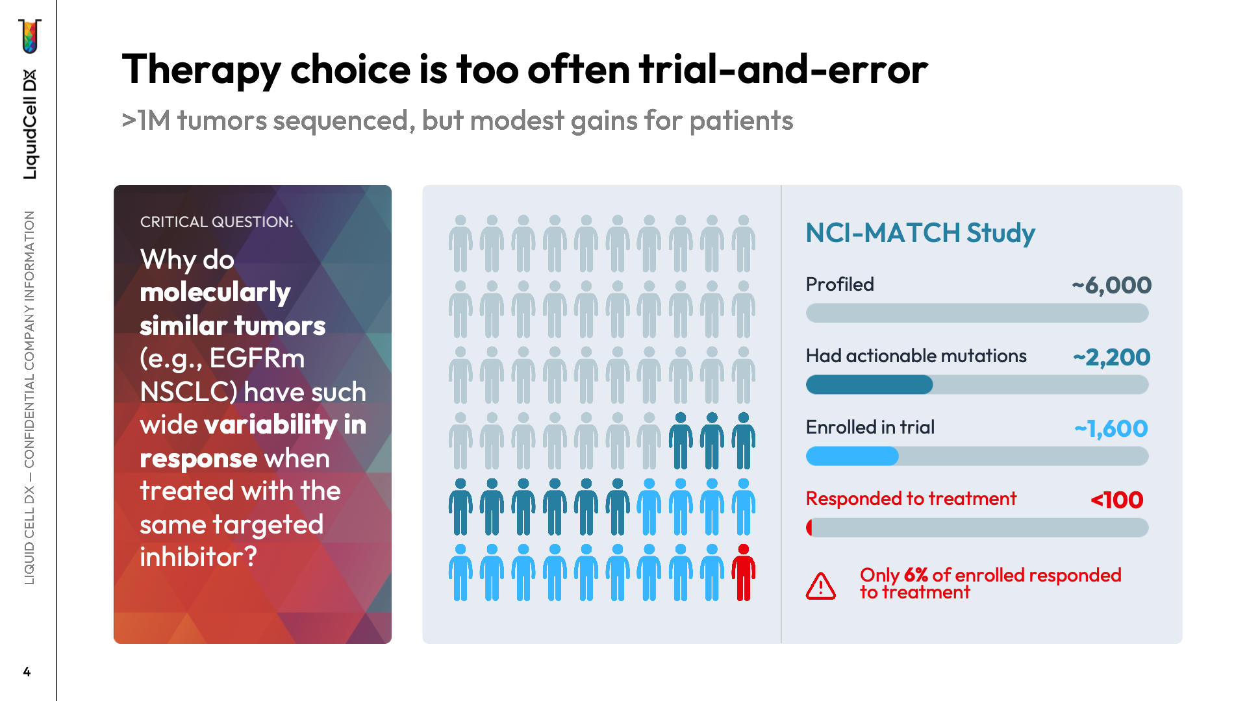
Notes:
Likewise, in later stage patients, therapy choice is often trial and error, as patients with the same targetable mutations can show dramatically different responses to the same targeted therapy. And this is despite millions of tumors sequenced to date, further demonstrating that mutations and molecular profiles of cancer cells are not enough to understand cancer behavior.

Slide 4
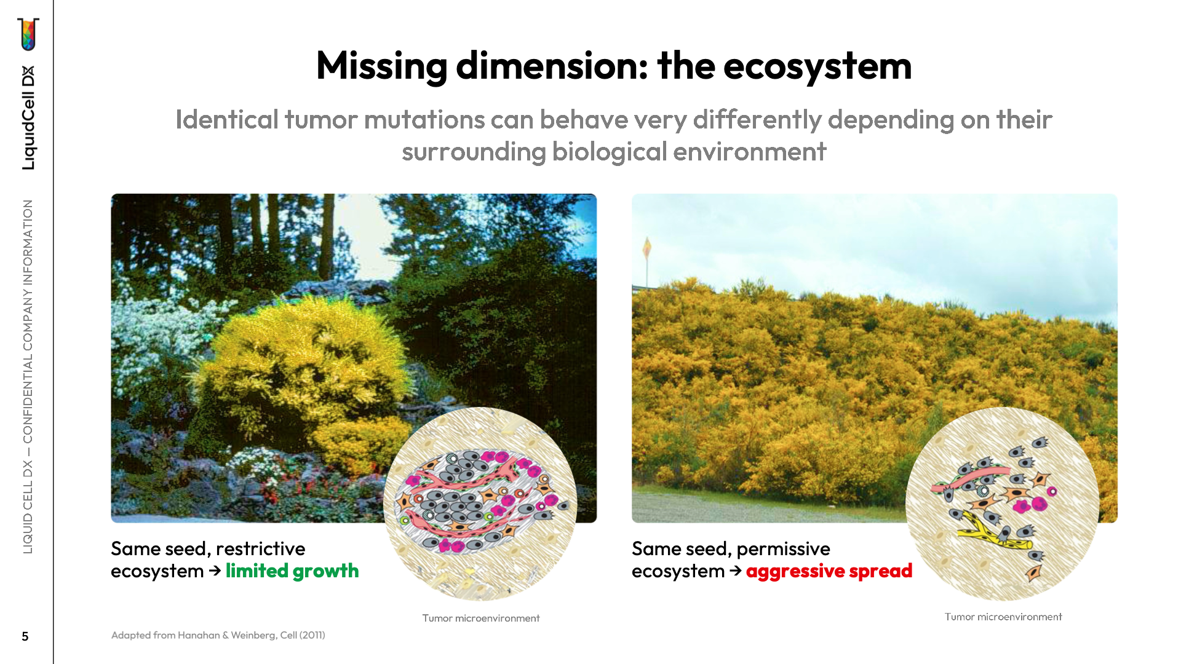
Notes:
So what’s the missing piece of this puzzle? The tumor microenvironment, or the ecosystem of genetically normal immune and stromal cells that surround precancerous and cancerous cells. As an analogy, the scotch broom is an invasive weed, but in some environments it shows restricted growth, and while in others it spreads like wildfire. The soil in which cancer cells live dictates whether they thrive, die, or respond to therapy.

Slide 5
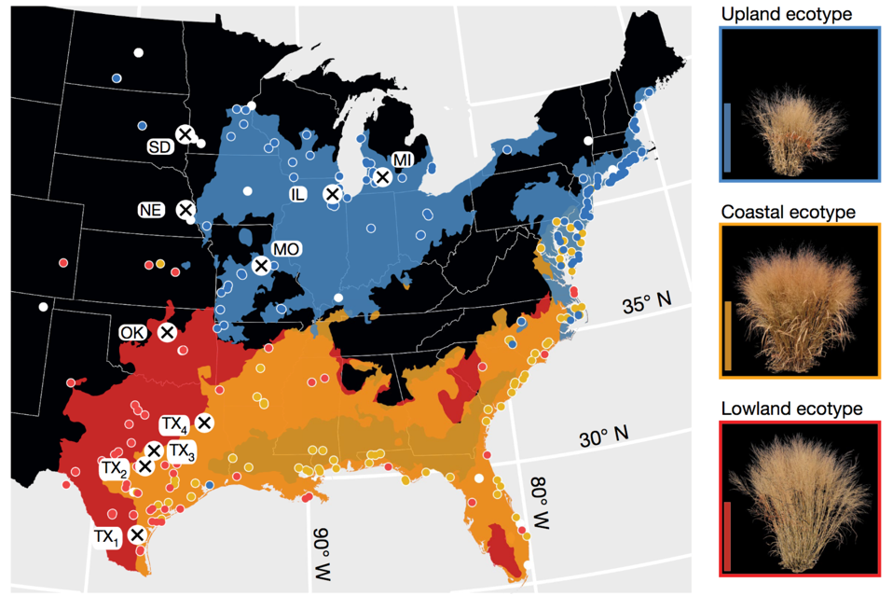

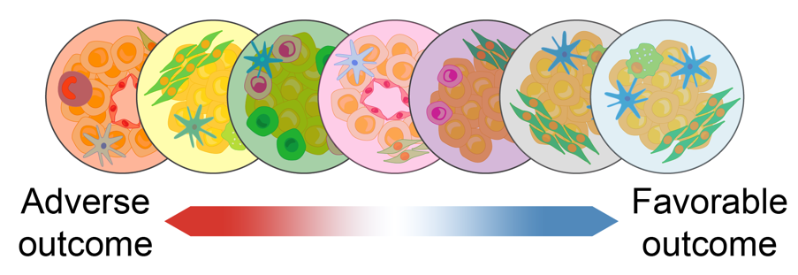
Ecosystem subtypes (ecotypes) in cancer
Adaptation to climate among switchgrass ecotypes
Cellular ecosystems in cancer
Tumor
ecotypes
Lovell et al., Nature (2021)
Steen et al., Blood (2019) [abstract]
Luca et al., Cancer Research (2020) [abstract]
Luca*, Steen* et al., Cell 2021
Steen*, Luca* et al., Cancer Cell 2021
Vahid*, Brown*, Steen* et al., Nature Biotechnology 2023
Gulati*, D’Silva* et al., Nature Reviews Mol Cell Biol 2025
Zhang*, Brown*, Usmani* et al., Nature 2026
Notes:
Now as a framework for understanding microenvironments in cancer, which vary as a function of context, we were inspired by the concept of ecotypes in ecology, where a given species changes its characteristics according to its local environment. With this in mind, we’ve recently proposed to call context-dependent cellular ecosystems in cancer “tumor ecotypes” and we devised computational methods to identify and measure them.

Slide 6
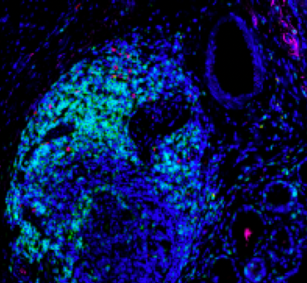
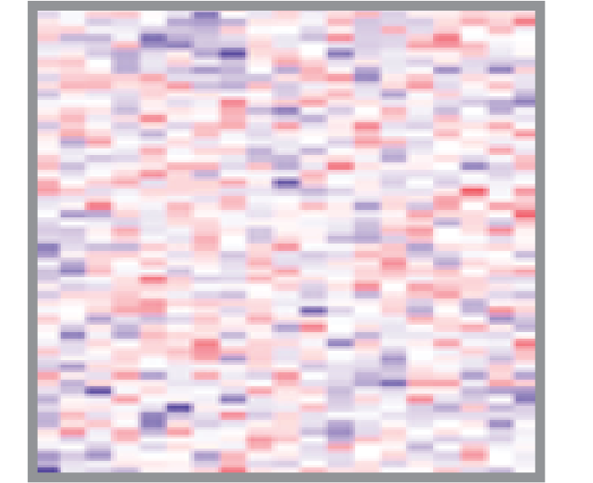
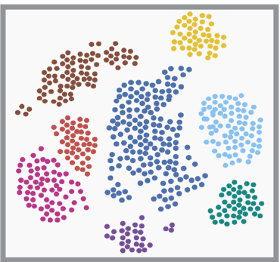
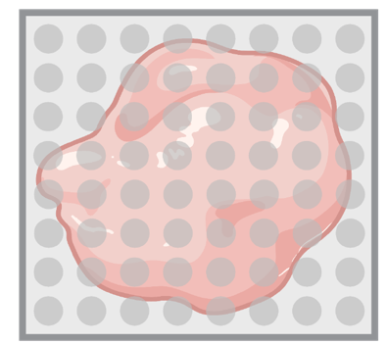
Barriers to profiling spatially-resolved tumor ecotypes at scale and without prior knowledge
Multiplexed protein imaging
Spatial
transcriptomics
Bulk transcriptomics
scRNA-seq
Single cell
Spatial
All genes
Practical cost
✓ | ✗ | ✓ | ✗ (Visium) ✓ (FISH)
✓ | ✗ | ✗ | ✓
✗ | ✓ | ✓ | ✓ (Visium) ✗* (FISH)
✓* | ✓ | ✗ | ✗
*Requires antibody optimization
*10x Atera covers 18k genes
Notes:
But before I tell you more about these methods, it’s important to understand the barriers of existing approaches for studying spatially-resolved tumor ecotypes, both at scale and without prior knowledge. Consider multiplexed protein imaging, which achieves single-cell spatial resolution. While it’s a powerful approach that can be reasonably economical after antibody optimization, the majority of assays are limited to at most a few dozen predefined markers. In contrast, bulk expression profiling can measure all genes for an increasingly practical cost but doesn’t achieve single-cell or spatial resolution. Single-cell RNA sequencing has become a popular technology for studying single-cell heterogeneity across all genes but lacks spatial information and is highly impractical for large cohorts. Finally, with the advent of spatial transcriptomics, it’s now possible to profile transcriptome-wide heterogeneity in spatial dimensions, but the most common commercially available assays are expensive and have serious tradeoffs, either in spatial resolution, such as the original 10x Visium, or in the number of genes recovered per cell when using FISH-based assays and others.

Slide 7
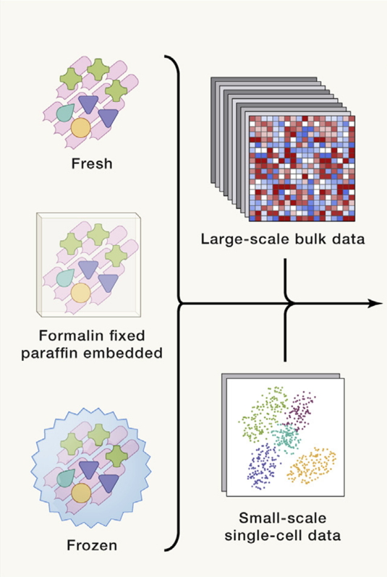
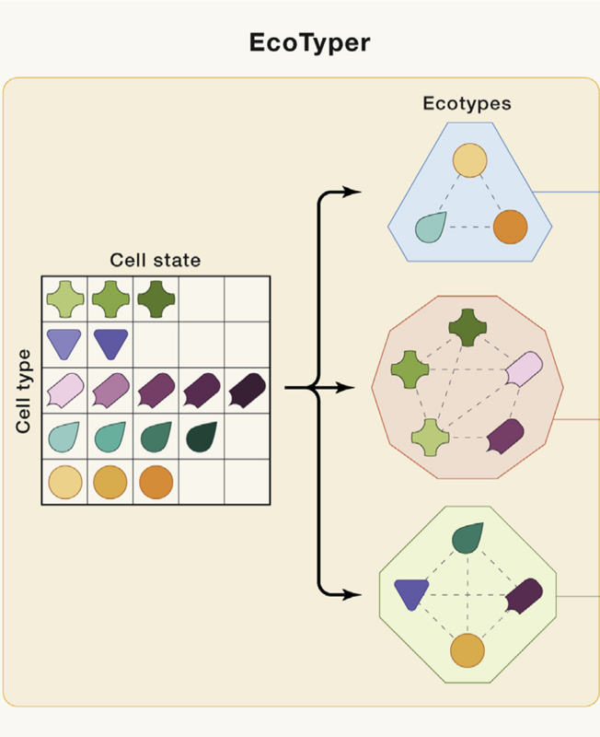
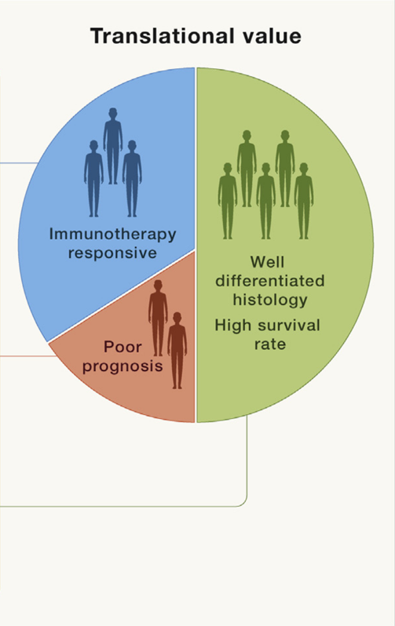

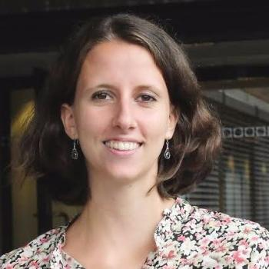
The EcoTyper framework
Tumor ecotype profiling with machine learning
Luca*, Steen* et al., Cell (2021)
Figure from Rolong et al., Cell (2021)
Bogdan Luca, PhD
Chloé Steen, PhD
Notes:
Multimodal profiling can overcome some of these limitations by combining different assays to marry the strengths of each assay while mitigating their individual weaknesses. For example, to exploit the scalability of bulk RNA-seq and the resolution of scRNA-seq, we introduced a machine learning framework called EcoTyper, which enables tumor ecotype profiling across bulk and single cell platforms. Starting from large-scale bulk data of fresh, frozen, or fixed clinical biospecimens, and scRNA-seq data from a smaller cohort, EcoTyper performs integrative analysis to identify and validate context-dependent cell states as well as their co-association patterns, or ecotypes. Once defined, cell states and ecotypes can be broadly explored for their biology as well as their potential translational value, such as for prognostic and predictive biomarkers in external datasets.

Slide 8
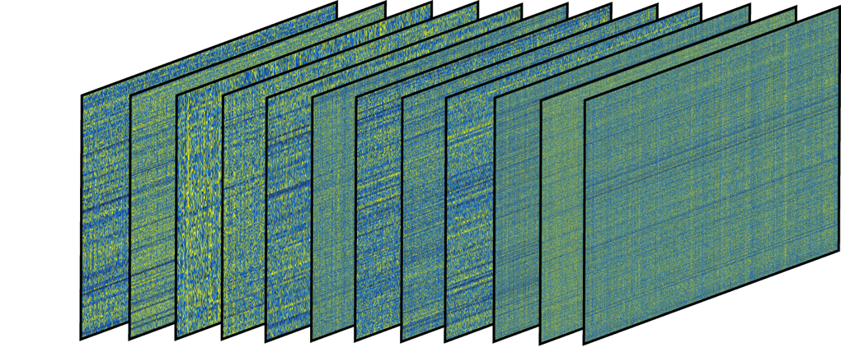
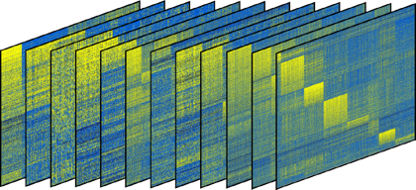
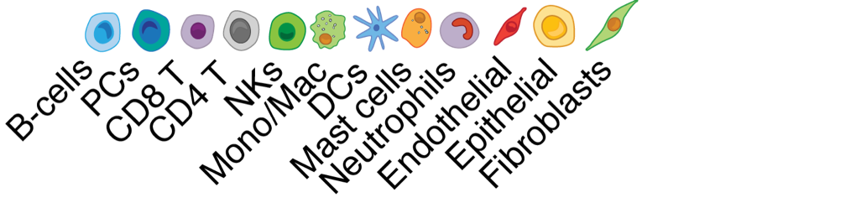
Cell state landscape in 16 carcinomas
6,475 bulk tumors and adjacent normal tissues
69 cell states
Luca*, Steen* et al., Cell (2021)
Notes:
To demonstrate the utility of this approach, I’d like to tell you about some key results from our paper where we studied 16 types of human carcinoma, a cancer type that is well represented in The Cancer Genome Atlas. After quality control, we identified nearly 6500 tumors and adjacent normal tissue samples from TCGA and we applied CIBERSORTx deconvolution to impute gene expression profiles of 12 cell types, spanning major lymphoid, myeloid, and stromal lineages, as well as epithelial cells. These matrices represent the output of CIBERSORTx. We then used EcoTyper to automatically identify cell states across these samples. We identified 69 total cell states, shown in the heatmaps on the left and in these UMAP embeddings on the right, where each point represents a tumor or an adjacent normal sample. We observed multiple context-dependencies, such as cell states that were preferentially associated with tumor or adjacent normal tissue, and remarkably, these states were nearly pervasive across the 16 cancer types.

Slide 9
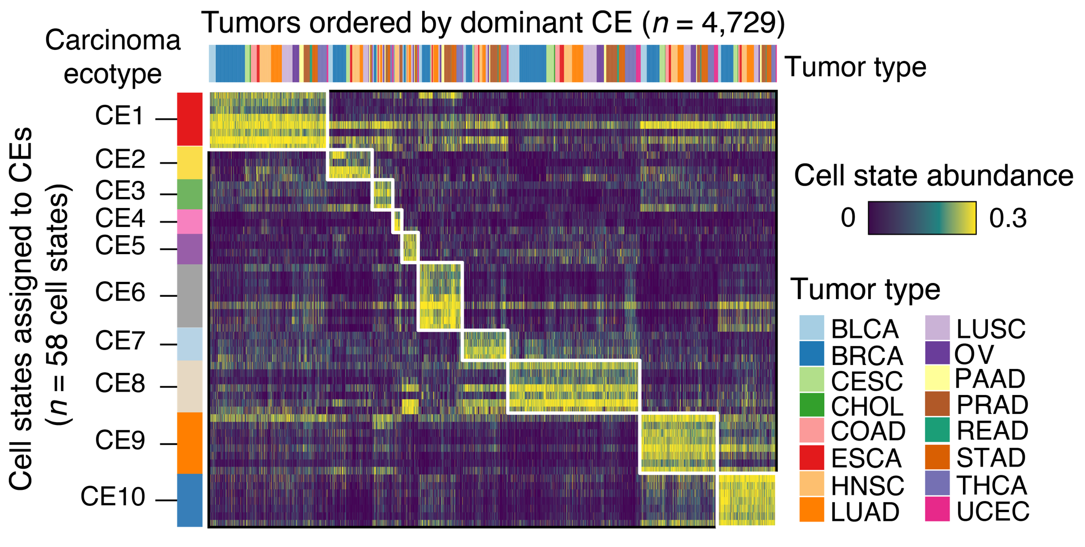
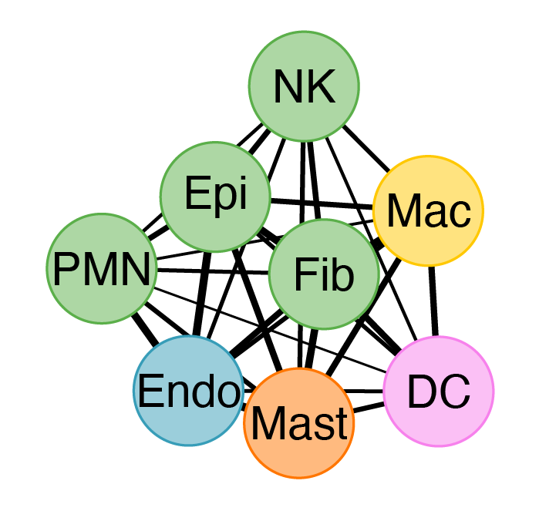
Large-scale reconstruction of carcinoma ecotypes (CEs)
C
Cell states
Luca*, Steen* et al., Cell (2021)
Notes:
Having identified cell states directly from nearly 6,000 tumor specimens, we identified statistically robust co-association patterns among these cell states, resulting in 10 dominant carcinoma ecotypes, abbreviated CEs. As we observed for cell states, these CEs were generally ubiquitous across tumor types. So what is a carcinoma ecotype? Let’s take a look at CE1. In the network diagram, nodes are distinct cell states of individual cell types, such as NK cells, macrophages, etc. And the lines or edges denote the strength of co-association patterns across samples.

Slide 10
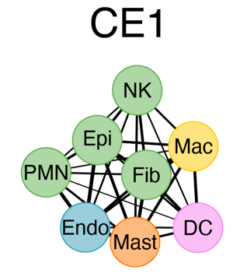
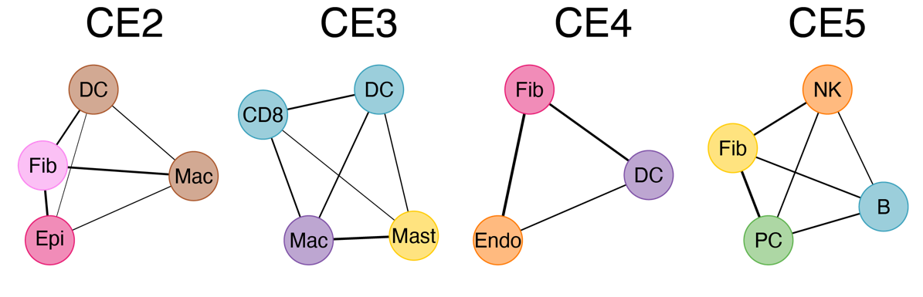
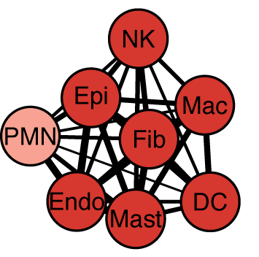
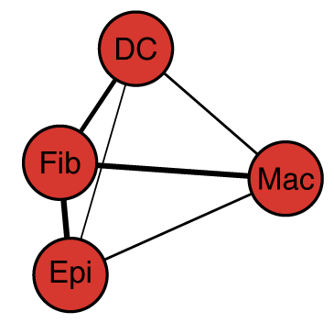
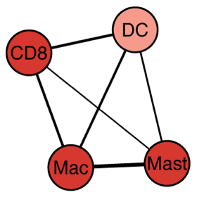
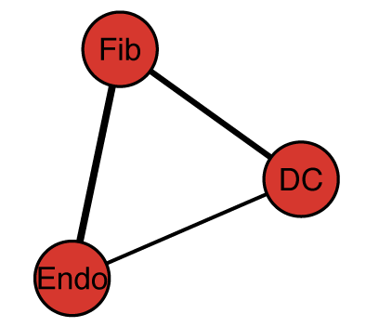
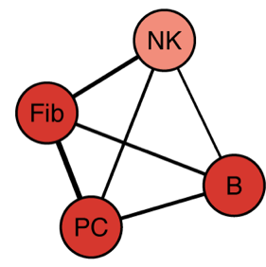
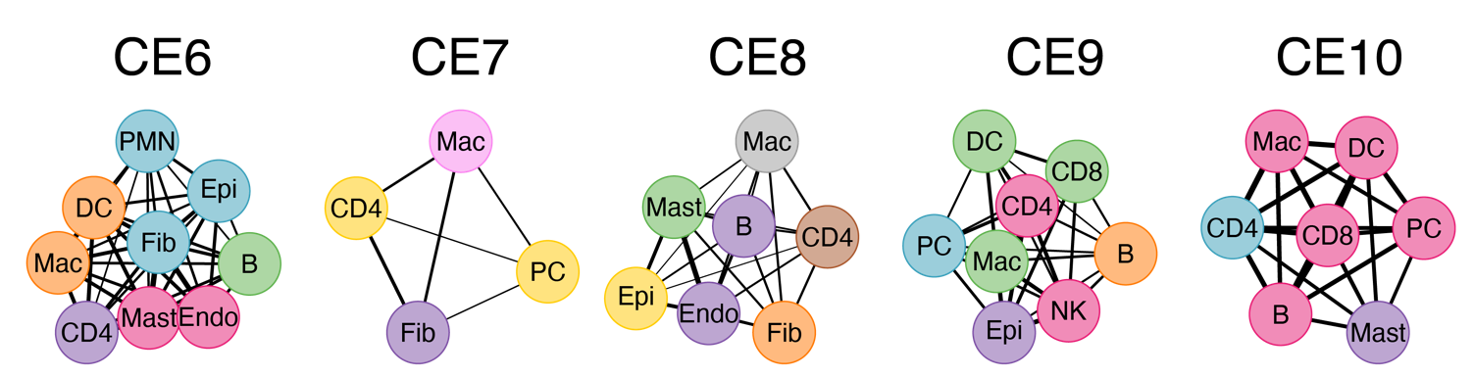
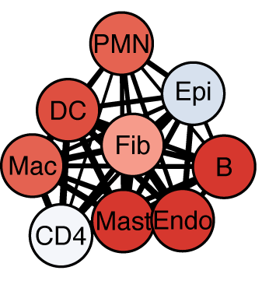
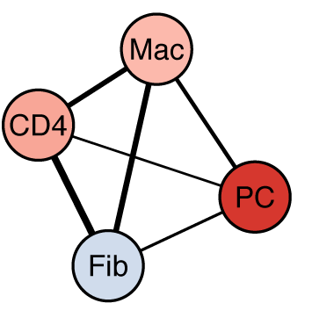
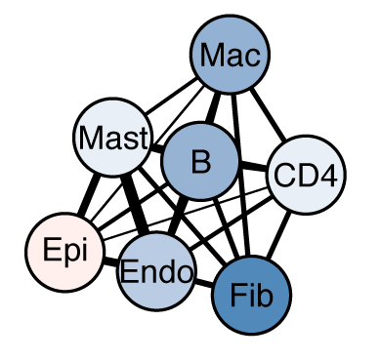
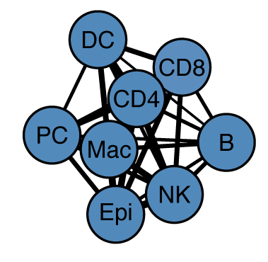
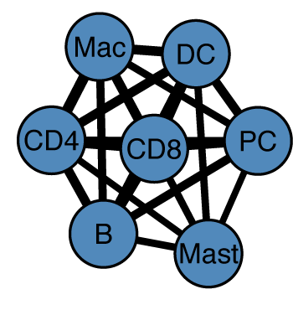
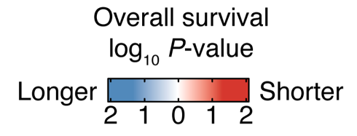
Carcinoma ecotypes are clinically relevant
Pan-carcinoma prognostic associations
Response to immune checkpoint inhibitors
Luca*, Steen* et al., Cell (2021)
Notes:
In the paper, we explored cellular, genomic, and clinical characteristics of each of these 10 ecotypes. Here, I’d like to highlight some of their clinical correlates. First, within each ecotype, we observed strikingly cohesive associations of cell states with overall survival, where blue states are associated with longer survival time and red states shorter survival time. Now, since each carcinoma ecotype integrates contributions from multiple cell states, we hypothesized that tumor ecotype profiling might have the potential to improve clinical outcome prediction. To test this, we compiled tumor expression data from 571 individuals with advanced metastatic disease prior to receiving immune checkpoint blockade with anti-PDL1 (urothelial carcinoma), anti-PD1 (melanoma), or anti-CTLA4 (melanoma) monotherapy. We included metastatic melanoma in this analysis as most non-epithelial cell states reliably generalized to this disease. We then compared CE profiling to 112 additional candidate predictive biomarkers, including 69 cell states identified by EcoTyper, 25 parental populations enumerated by CIBERSORTx, tumor mutational burden (TMB), and 2 published bulk signatures of ICI response. Remarkably, a single ecotype, CE9, outperformed all other measures for predicting ICI response. This suggested that by integrating multiple cell states into a single measure, ecotypes can capture biological signal with superior predictive value.

Slide 11
What if we could directly leverage spatial information in the definition of tumor ecotypes?
Notes:
With EcoTyper, cell type-specific states and their co-association patterns are learned and quantified without directly considering spatial information. But what if we could directly leverage spatial information in the definition of tumor ecotypes?

Slide 12
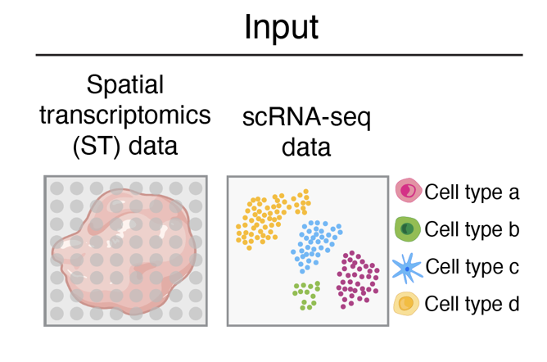

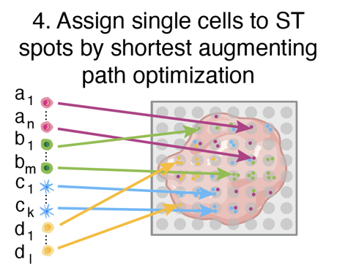

CytoSPACE: single-cell spatial mapping
Current spatial transcriptomics (ST) platforms are low spatial resolution or have low gene recovery
Single-cell to spatial spot mapping with guaranteed optimality
https://github.com/digitalcytometry/cytospace
Milad Vahid
Erin Brown
Chloé Steen
Vahid*, Brown*, Steen* et al., Nature Biotechnology 2023
Notes:
If we wanted to identify ecotypes directly from ST, it would be challenging as most spatial transcriptomics platforms are limited by low spatial resolution or low gene recovery. To tackle this problem, we developed CytoSPACE, an algorithm to optimally map individual cells from scRNA-seq data to their best matching spatial spots. This could be used to study spatially-resolved cell states not discernible from scRNA-seq data alone.

Slide 13
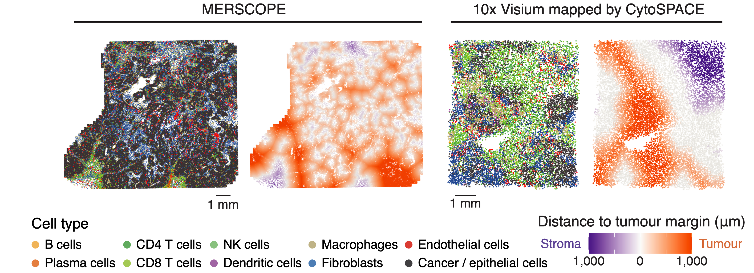
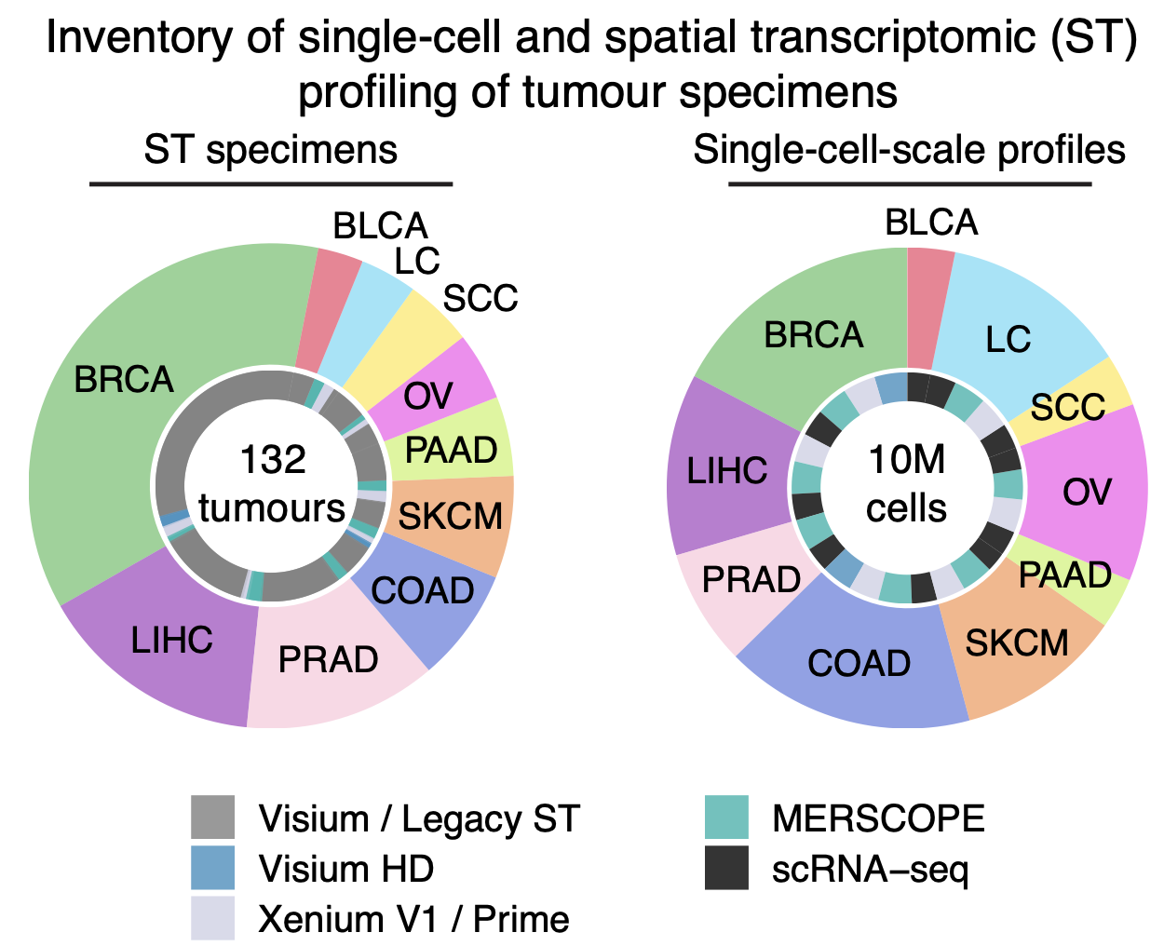
Inventory of single-cell spatial tumor maps
Zhang*, Brown*, Usmani* et al., Nature 2026
Notes:
So what have we done with CytoSPACE? While there are multiple platforms for ST, each with tradeoffs, they can be combined with tools like CytoSPACE for large-scale biological discovery of tumor ecotypes at single-cell spatial resolution across the entire transcriptome. To do this, Wubing Zhang in the group assembled tumor samples profiled by multiple ST platforms. Here are examples of this for a melanoma specimen profiled by MERSCOPE and a breast cancer specimen profiled by Visium, with the latter replaced by single cells using CytoSPACE. Both are annotated for major cell types and key geographic regions, such as tumor, stroma, and the margin between them.

Slide 14
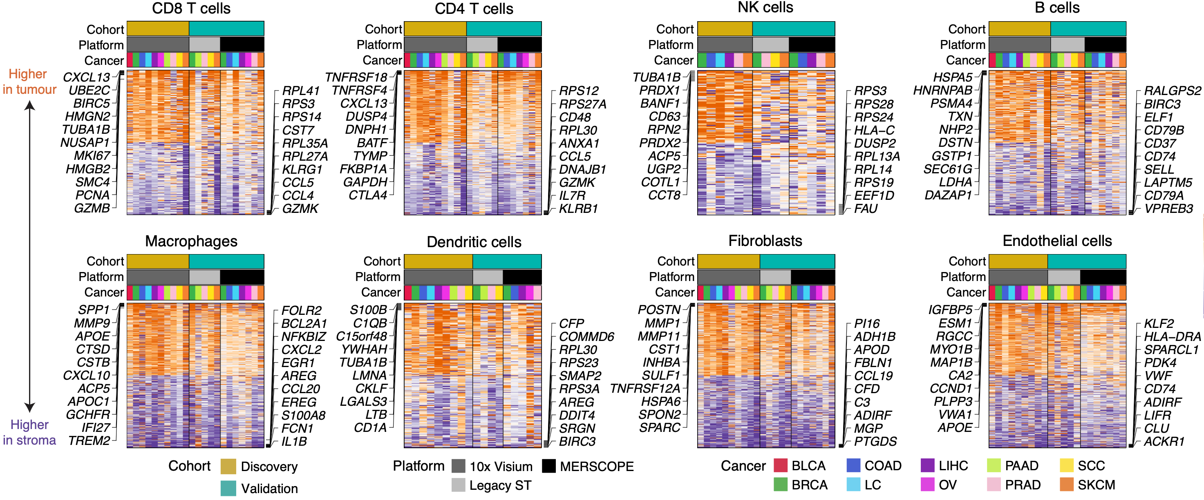
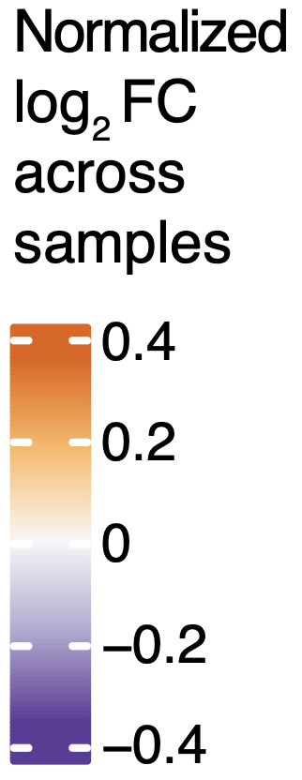
Tumor and adjacent stromal TME states in 10 cancer types
Zhang*, Brown*, Usmani* et al., Nature 2026
Notes:
In doing this, it was relatively straightforward to characterize conserved cell states across cancer types and platforms, here showing genes that are consistently upregulated within tumor regions in orange and genes upregulated in stromal regions in purple. Wubing did this for every major cell type in the TME, with al cell types showing extremely strong regional differences.

Slide 15
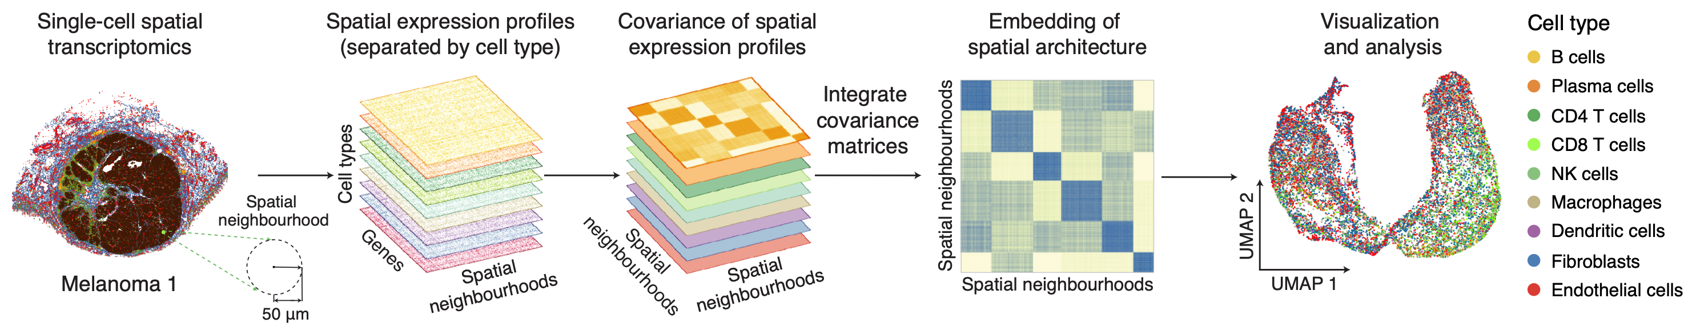


Integrative framework for spatial ecotype discovery
Wubing Zhang, PhD
Zhang*, Brown*, Usmani* et al., Nature 2026
Notes:
He then wanted to deeply characterize the relationship between transcriptional programs and spatial coordinates for all evaluated TME cell types simultaneously, both across malignancies and without the constraint of supervised analysis. To do that, he built a new computational method called Spatial EcoTyper to integrate spatially conserved cellular states into a common embedding reflecting the spatial architecture of multiple cell types and states simultaneously.

Slide 16
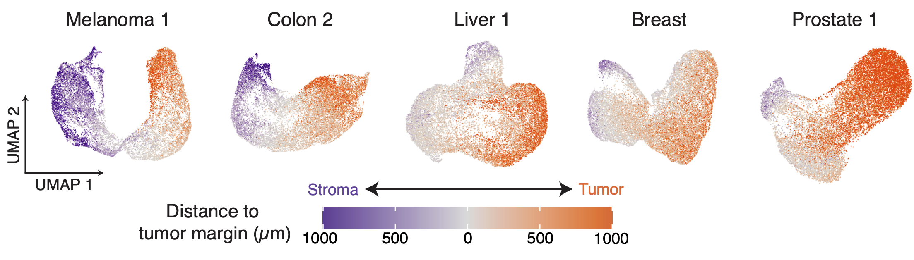
Spatially defined cell states form a gradient reflecting physical distance between tumor and stroma
Breast 1
Zhang*, Brown*, Usmani* et al., Nature 2026
Notes:
When examining these embeddings across multiple tumor samples, Wubing found that they naturally organize into a continuum that closely reflects the distance to the margin between the tumor and adjacent stroma. This smooth trajectory suggested that there is consider plasticity in transcriptional states based on spatial location.

Slide 17
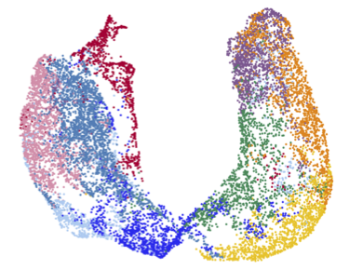
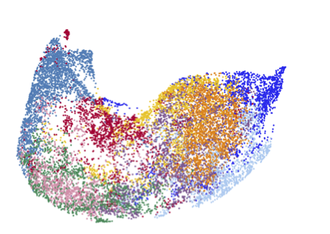
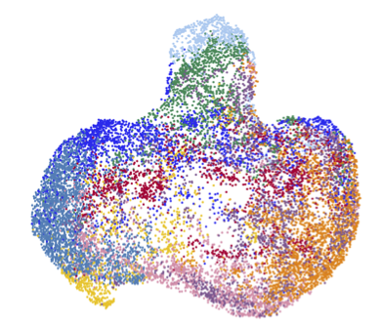
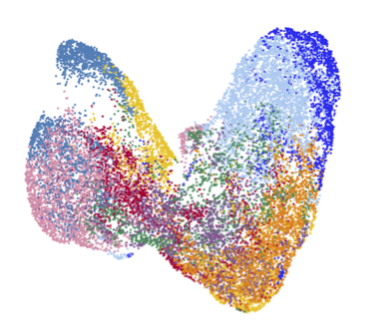
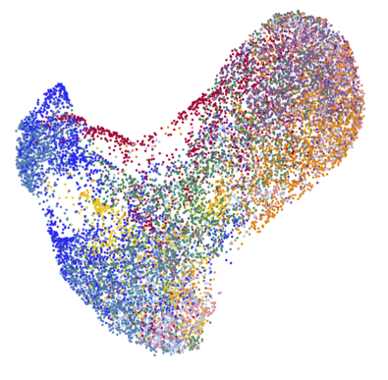
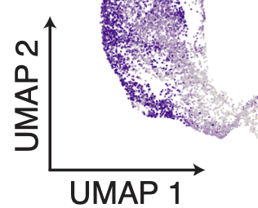
Spatial ecotypes (SEs) mark conserved cellular communities
Breast 1
Zhang*, Brown*, Usmani* et al., Nature 2026
Notes:
He then used Spatial EcoTyper to identify spatially conserved cellular states across multiple tumor samples and cluster them into spatial ecotypes or SEs, of which he identified 9 major classes in solid non-brain tumors. As can be seen, cancer types with different cells of origin such as melanoma and carcinomas share these entities.

Slide 18
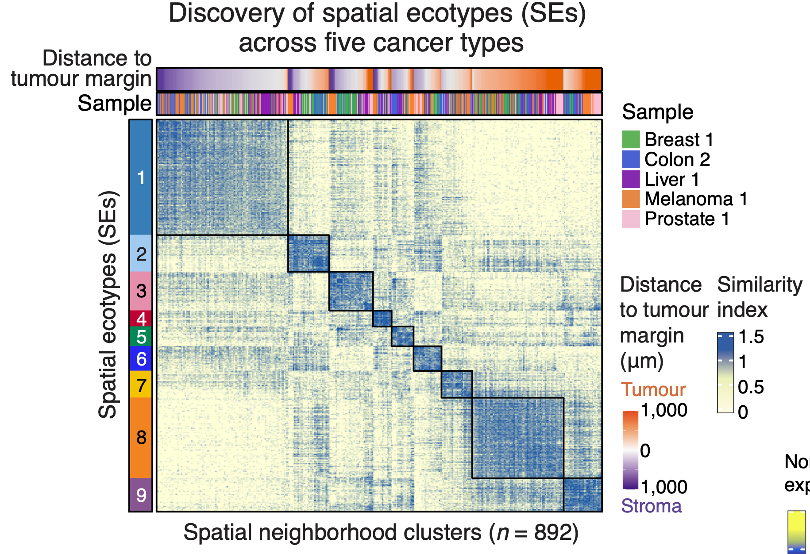
Spatial ecotypes (SEs) mark conserved cellular communities
Zhang*, Brown*, Usmani* et al., Nature 2026
Notes:
He then used Spatial EcoTyper to identify spatially conserved cellular states across multiple tumor samples and cluster them into spatial ecotypes or SEs, of which he identified 9 major classes in solid non-brain tumors. As can be seen, cancer types with different cells of origin such as melanoma and carcinomas share these entities.

Slide 19
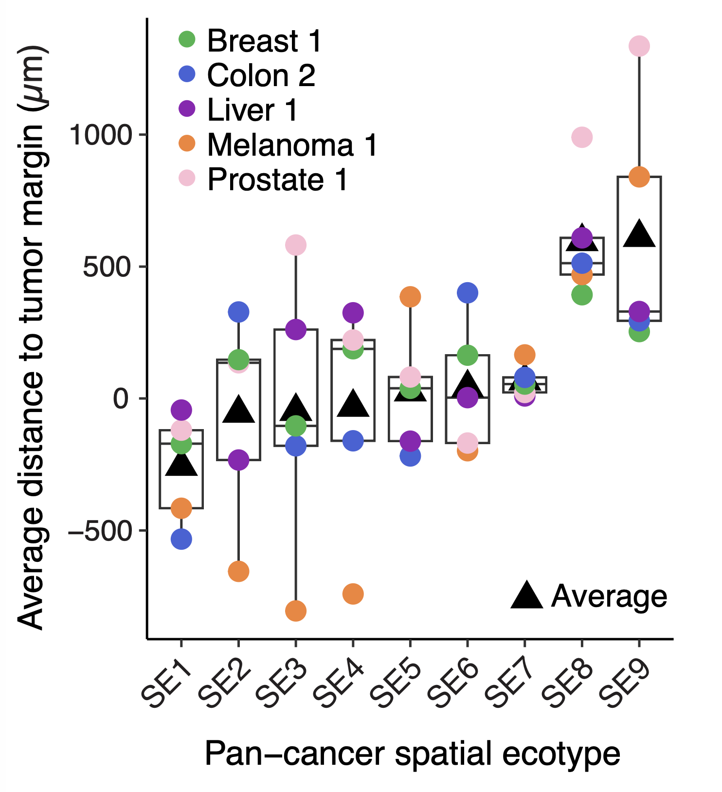
Spatial ecotypes have distinct geographic localization
Zhang*, Brown*, Usmani* et al., Nature 2026
Notes:
Wubing found that spatial ecotypes not only capture conserved multicellular communities across cancers, but also have conserved localization, as shown in this box plot organized by median distance of each SE to the tumor margin. While SE1 is highly stromal-enriched and SE8 and 9 are intra-tumoral, the majority of SEs localize within and around the tumor margin.

Slide 20
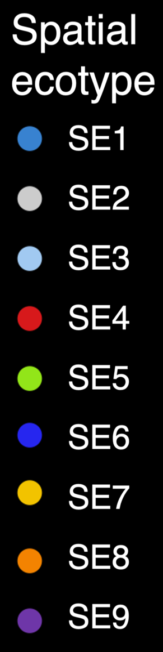








Spatial ecotypes mark conserved cellular communities
Melanoma 1
Melanoma 1
Melanoma 1
Distance to tumor margin
(μm)
Cell type
B cells
Cancer cells
CD4 T cells
CD8 T cells
Dendritic cells
Endothelial cells
Fibroblasts
Macrophages
NK cells
Plasma cells
Tumor
1500
1000
500
0
500
1000
1500
Breast 1
Breast 1
Breast 1
Stroma
2 mm
Zhang et al., Nature 2026
Notes:
For example, looking at a melanoma specimen on top and a breast cancer specimen on the bottom, we can see that SEs mark geospatial features in each specimen.

Slide 21




Spatial ecotypes mark conserved cellular communities
Melanoma 1
Melanoma 1
Melanoma 1
SEs
Stroma
Tumor
Breast 1
Breast 1
Breast 1
2 mm
Zhang et al., Nature 2026
Notes:
Zooming in, we can see distinct spatial ecotypes marking different geographic regions with conservation across tumor types.

Slide 22




SEs consist of spatially colocalized cell states
Zhang*, Brown*, Usmani* et al., Nature 2026
Notes:
Now importantly, each spatial ecotype is comprised of context-dependent spatially constrained cell states, shown here as a heat map, where cell states are rows and spatial ecotypes are columns. These states derive from all major immune and stromal linages in the tumor microenvironment. When shown as gene expression data across 10 cancer types profiled by scRNA-seq, you can see that each cell type has a range of spatial ecotype-specific gene expression programs.

Slide 23

SEs consist of spatially colocalized cell states
Zhang*, Brown*, Usmani* et al., Nature 2026
Notes:
Now importantly, each spatial ecotype is comprised of context-dependent spatially constrained cell states, shown here as a heat map, where cell states are rows and spatial ecotypes are columns. These states derive from all major immune and stromal linages in the tumor microenvironment. When shown as gene expression data across 10 cancer types profiled by scRNA-seq, you can see that each cell type has a range of spatial ecotype-specific gene expression programs.

Slide 24

Consensus programs and biological processes distinguish SEs
Zhang*, Brown*, Usmani* et al., Nature 2026
Notes:
Now importantly, each spatial ecotype is comprised of context-dependent spatially constrained cell states, shown here as a heat map, where cell states are rows and spatial ecotypes are columns. These states derive from all major immune and stromal linages in the tumor microenvironment. When shown as gene expression data across 10 cancer types profiled by scRNA-seq, you can see that each cell type has a range of spatial ecotype-specific gene expression programs.

Slide 25


Consensus programs are reproducible across platforms
Zhang*, Brown*, Usmani* et al., Nature 2026
Notes:
Now importantly, each spatial ecotype is comprised of context-dependent spatially constrained cell states, shown here as a heat map, where cell states are rows and spatial ecotypes are columns. These states derive from all major immune and stromal linages in the tumor microenvironment. When shown as gene expression data across 10 cancer types profiled by scRNA-seq, you can see that each cell type has a range of spatial ecotype-specific gene expression programs.

Slide 26



SEs consist of spatially colocalized cell states
Zhang*, Brown*, Usmani* et al., Nature 2026
Notes:
Now importantly, each spatial ecotype is comprised of context-dependent spatially constrained cell states, shown here as a heat map, where cell states are rows and spatial ecotypes are columns. These states derive from all major immune and stromal linages in the tumor microenvironment. When shown as gene expression data across 10 cancer types profiled by scRNA-seq, you can see that each cell type has a range of spatial ecotype-specific gene expression programs.

Slide 27

Spatial EcoTyper recovers SEs across spatial, single-cell, and bulk transcriptomic assays
Notes:
So getting back to the concept of multimodal profiling, we implemented Spatial EcoTyper to seamlessly recover spatial ecotypes across platforms and modalities, including spatial, single-cell, and bulk transcriptomic assays.

Slide 28
Are SEs quantifiable from single-cell RNA-seq?
Notes:
For the sake of time, I won’t be able to cover the many robustness and validation experiments that we did, but I’d like to highlight two of its most important capabilities. First, are SEs quantifiable from single-cell RNA-seq

Slide 29



SE-specific cell states show striking co-association patterns in scRNA-seq data
Zhang*, Brown*, Usmani* et al., Nature 2026
Notes:
To address this, we used Spatial EcoTyper to perform a reference-guided annotation of SE-specific cell states in scRNA-seq data from 10 cancer types and 135 tumors spanning carcinomas and melanomas. We then determined the fractional abundance of each cell state in each tumor and asked whether cell state abundance levels are more correlated within the expected spatial ecotype than between SEs. As can be seen by this heat map showing the strength of the co-association patterns, with cell states as rows and columns, our data strongly suggest that SEs are transferrable from single-cell spatial data to scRNA-seq data.

Slide 30




SE-specific cell states show striking co-association patterns in scRNA-seq data
Zhang*, Brown*, Usmani* et al., Nature 2026
Notes:
To address this, we used Spatial EcoTyper to perform a reference-guided annotation of SE-specific cell states in scRNA-seq data from 10 cancer types and 135 tumors spanning carcinomas and melanomas. We then determined the fractional abundance of each cell state in each tumor and asked whether cell state abundance levels are more correlated within the expected spatial ecotype than between SEs. As can be seen by this heat map showing the strength of the co-association patterns, with cell states as rows and columns, our data strongly suggest that SEs are transferrable from single-cell spatial data to scRNA-seq data.

Slide 31
Are SEs quantifiable from bulk RNA-seq?
Notes:
We then asked whether SEs are quantifiable from bulk RNA-seq data.

Slide 32






Spatial EcoTyper quantifies spatial cellular ecosystems from bulk RNA-seq data
SE4
High
Medium
Bulk RNA-seq SE levels
Low
Visium SE levels
Zhang*, Brown*, Usmani* et al., Nature 2026
Notes:
To do this, we performed a number of experiments. However, here I’d like to show the deconvolution performance of Spatial EcoTyper applied to 42 pairs of bulk RNA-seq and 10x Visium spatial transcriptomic data from paired tumor samples of five cancer types. As shown in this cross-correlation heat map, we observed strong linearity and specificity for SE levels determined from the two modalities. Looking at SE4, for example, we can see that high SE4 levels deconvolved from bulk RNA-seq correspond to high levels in the corresponding spatial transcriptomic sample, with the same being true for medium and low levels of SE4.

Slide 33




Spatial EcoTyper quantifies spatial cellular ecosystems from bulk RNA-seq data
SE7
High
Medium
Bulk RNA-seq SE levels
Low
Visium SE levels
Zhang*, Brown*, Usmani* et al., Nature 2026
Notes:
The same holds true for another ecotype, SE7, demonstrating consistent SE recovery.

Slide 34



Higher SE levels in pretreatment tumors strongly predict ICI response
Non-
spatial
CE9
tumor core
margin
SE7
SE8
Spatial
Tumor
margin
Tumor
core
Candidate biomarkers of ICI response
Benefit
margin
Zhang*, Brown*, Usmani* et al., Nature 2026
Notes:
Now getting back to our earlier question about the impact of using spatial information to define tumor ecotypes, we performed a greatly expanded meta-analysis of over 1200 bulk tumor RNA-seq profiles spanning four cancer types, all with known immunotherapy outcomes. We then enumerated spatial ecotypes as well as our previous carcinoma ecotypes defined without spatial information. We also analyzed a number of other potential immunotherapy response correlates. We first found that CE9 from our previous work continues to be strongly associated with immunotherapy benefit. However, further analysis of CE9 showed that it can be decomposed into two SEs from our new work, SE7 in the tumor margin and SE8 in the tumor core. SE8 far surpassed other measures for immunotherapy response prediction, with SE7 also predicting benefit and showing highest significance in melanoma. We further found that SE4, another tumor margin associated ecotype, was strongly associated with resistance.

Slide 35




Clinically available TME assays are inadequate
RESOLUTION & INFO RICHNESS
EASE OF CLINICAL ADOPTION
Research tools
Clinical tools
High resolution
Adopted in clinical practice
Too complex for routine use
Low resolution
Expensive
Limited predictive power
Require tissue biopsy
Require tissue biopsy
Notes:
Now as we all know, invasive tumor biopsies are not an ideal material for clinical applications owing to tumor geographic heterogeneity, sampling bias in metastatic disease, and the impracticality of acquiring serial tumor biopsies for longitudinal analysis.

Slide 36

Liquid biopsy as a noninvasive window in cancer
Gardner et al., Nature Reviews Clinical Oncology 2022

Slide 37






AI framework for quantifying SEs from plasma cell-free DNA methylation data (Liquid EcoTyper)
Liquid EcoTyper
Blood-based ecotype detection
=
cfDNA SE1
=
cfDNA SE2
...
=
cfDNA SE9
Validated against paired tissue SE levels in melanomas
Erin Brown
Zhang*, Brown*, Usmani* et al., Nature 2026
Notes:
We hypothesized that a liquid biopsy approach based on cfDNA methylation profiling may allow SE levels to be noninvasively resolved. The core engine of our approach is Liquid EcoTyper. This is a new deep learning architecture developed in my group for spatial ecotype profiling from CpG methylation data. It learns CpG methylation signatures that can be seamlessly extracted from the model so it’s not a black box and it’s been extensively validated against SE levels in paired tumors.

Slide 38


Spatial ecotype levels can be quantified from bulk tumor methylomes
Zhang*, Brown*, Usmani* et al., Nature 2026
Notes:
We first trained the model on paired tumor methylation data and RNA-seq data. The model showed good specificity and was able to significantly resolve spatial ecotypes from CpG methylation data, whether in melanomas or carcinomas.

Slide 39


Spatial ecotype levels can be quantified from plasma cell-free DNA (cfDNA) methylomes
Zhang*, Brown*, Usmani* et al., Nature 2026
Notes:
We then tested its ability to recover similar signal in paired tumor and plasma samples from melanoma patients. To do this we profiled plasma cfDNA by whole genome EM-seq and paired tumors by either Visium or Visium HD spatial RNA sequencing. In nearly all cases, SE levels significantly correlated between plasma and tumors, showing that similar signal was recoverable

Slide 40

Spatial ecotype levels in plasma are faithful to tissue
Zhang*, Brown*, Usmani* et al., Nature 2026
Notes:
As another example, we analyzed the difference in relative abundances between two SEs with significant but reciprocal associations with ICI response in melanoma—SE7 and SE4. Shown here are the patients organized by higher SE7 and lower SE4 in plasma on the left and vice versa on the right. When overlaid across compartments, we found that the delta between these two ecotypes in plasma was directly reflective of the delta in tumors, here showing the top 3 from either end of the spectrum, both in SE7 and SE4, with their relative tumor levels quantified below.

Slide 41


Spatial ecotype levels in plasma robustly correlate with tissue levels and are not a surrogate for circulating leukocytes
Zhang*, Brown*, Usmani* et al., Nature 2026
Notes:
We then tested its ability to recover similar signal in paired tumor and plasma samples from melanoma patients. To do this we profiled plasma cfDNA by whole genome EM-seq and paired tumors by either Visium or Visium HD spatial RNA sequencing. In nearly all cases, SE levels significantly correlated between plasma and tumors, showing that similar signal was recoverable.

Slide 42






Liquid SE profiling for ICI response assessment at baseline in melanoma (n = 78 patients)
Tumor
microenvironment
SE7/8 and SE4 are respectively most strongly associated with ICI benefit and resistance in bulk tumors
Zhang*, Brown*, Usmani* et al., Nature 2026
Notes:
To test this approach on melanomas with known immunotherapy response outcomes, we then applied methylation sequencing to a new cohort of 78 pretreatment plasma samples from patients with melanoma. Patients were annotated into those that achieved durable clinical benefit, shown in gold, and no durable clinical benefit, shown in navy blue. We then applied our approach to resolve spatial ecotypes. Both SE8 and SE7 were previously found to associate with benefit and SE4 with resistance in bulk RNA-seq data. By plasma cfDNA, we can see a very similar phenotype. As a control, we also performed circulating tumor DNA profiling. We found only modestly higher levels of ctDNA in non-responders, and compared to SEs, ctDNA was a weaker pre-tx surrogate of ICI response.

Slide 43



Liquid SE associations with ICI response are concordant with ICI response associations in bulk tumors
Melanoma patients stratified by SE4 levels in plasma cfDNA
Melanoma patients stratified by SE7 levels in plasma cfDNA
ICI benefit
Response association of liquid SEs (z-score)
(n = 78 melanoma patients)
ICI resistance
Response association of tissue SEs (z-score)
(n = 366 melanoma patients)
ICI resistance
ICI benefit
Zhang*, Brown*, Usmani* et al., Nature 2026
Notes:
Moreover, when we compared response associations across all spatial ecotypes enumerated in plasma, shown on the y-axis, they were surprisingly correlated with those measured in bulk tumors from independent cohorts. When viewed another way, we can see that SE7 is associated with greater overall survival whereas SE4 is associated with inferior OS.

Slide 44

Noninvasive profiling of SE7 at baseline forecasts ICI benefit
DCB, durable clinical benefit
NDB, no durable clinical benefit
Zhang*, Brown*, Usmani* et al., Nature 2026
Notes:
When assessed by immunotherapy type, this relationship held for SE7, where it predicted benefit to ICI from baseline plasma samples regardless of combination therapy or PD1 monotherapy.

Slide 45

Noninvasive profiling of SE4 at baseline forecasts ICI resistance
DCB, durable clinical benefit
NDB, no durable clinical benefit
Zhang*, Brown*, Usmani* et al., Nature 2026
Notes:
The same was true in reverse for SE4, where it predicted resistance to ICI from baseline plasma samples regardless of ICI therapy type.

Slide 46

We hypothesize that liquid biopsy of TME dynamics can improve early therapy response assessment
The TME underpins therapy response
The TME is challenging to measure clinically
The TME is not static
The impact of therapy on the TME is unclear
No clinical assay to measure TME dynamics
Notes:
Given these exciting preliminary data we hypothesized that liquid biopsy of the TME and its dynamics can improve early ICI response assessment. This hypothesis is grounded in several premises, including the TME underpins ICI response, it’s challenging to measure clinically, it’s not a static entity, the impact of ICI on the TME is unclear, and there is no clinical assay to measure TME dynamics.

Slide 47

TME dynamics as a real-time biomarker of ICI response
Unpublished data
Notes:
So our paper focused on pretreatment settings, however in pilot data for this proposal, we profiled serial blood samples from a patient with advanced melanoma treated with ICIs—one who initially showed progressive disease by imaging but ultimately responded.

Slide 48
TME dynamics as a real-time biomarker of ICI response
Plasma
SE4 level
(resistance)
Plasma
SE7 level
(response)
Unpublished data
Notes:
We hypothesized that noninvasive profiling of SE4, which is associated with resistance, and SE7, which is associated with benefit, might anticipate the patient’s ultimate outcome.

Slide 49
TME dynamics as a real-time biomarker of ICI response
Plasma
SE4 level
(resistance)
Plasma
SE7 level
(response)
Unpublished data
Notes:
Initially, SE4 rose faster than SE7, in line with progressive disease.

Slide 50
TME dynamics as a real-time biomarker of ICI response
Plasma
SE4 level
(resistance)
Plasma
SE7 level
(response)
Unpublished data
Notes:
However, during combination ICI, SE4 fell sharply while SE7 levels rose, suggesting favorable remodeling of the TME and outperforming imaging by over 2 months.

Slide 51






Spatial ecotype discovery
and AI-enabled liquid biopsy recovery
132 tumors
10 cancer types
6 ST modalities
Patient
blood draw
Plasma
cell-free DNA
Cancer patient
https://github.com/digitalcytometry/spatialecotyper https://spatialecotyper.stanford.edu
Notes:
So, to summarize, we performed a large-scale integrative analysis of single cell and spatial transcriptomic data across human cancers, revealing that tumors can be decomposed into spatial ecotypes. Spatial ecotypes are clinically distinct and can be recovered by liquid biopsy, where they can be used to forecast therapy response and profile longitudinal changes in the TME non invasively. Ongoing studies to assess utility of Liquid EcoTyper across cancer types and therapies will further illuminate the translational potential of this approach.

Slide 52
Could spatial and liquid ecotyping improve early cancer detection?
Notes:
We then asked whether SEs are quantifiable from bulk RNA-seq data.

Slide 53



Tumor ecotype dynamics predict early lung cancer evolution
Luca*, Steen* et al., Cell 2021

Slide 54

Liquid TME profiling has potential to boost signal detection
Liquid SE4 levels stratify ICI outcomes in melanoma patients with
circulating tumor DNA below the limit of detection (low shedding)
Data from supplement of Zhang*, Brown*, Usmani* et al., Nature 2026

Slide 55





Acknowledgments
Stanford
Wubing Zhang*
Erin Brown*
Minji Kang
Chloé Steen
Hyun Soo Jeon
Susanna Avagyan
Janella Schwab
Qingyuan Cai
Andrew Gentles
Yale
James Knight
Antonella Bacchiocchi
Mario Sznol
Ruth Halaban
WashU
Abul Usmani*
Noah Erland
Irfan Alahi
Nicholas Semenkovich
Chloe Sachs
Bilge Gungoren
Peter Harris
Jacqueline Mudd
Ryan Fields
David Chen
Mayo
Chibuzor Olelewe
Anushka Viswanathan
Pradeep Chauhan
Faridi Qaium
Peter Lucas
Rondell Graham
Kaushal Parikh
Aaron Mansfield
Aadel Chaudhuri*

Slide 56



Thank you
https://anlab.stanford.edu
amnewman@stanford.edu

Slide 57
Liquid ecotype profiling at baseline outperforms biological benchmarks for ICI response prediction
Zhang*, Brown*, Usmani* et al., Nature 2026

Slide 58

Spatial EcoTyper quantifies spatial cellular ecosystems from bulk RNA-seq data
Zhang et al., Nature 2026

Slide 59

Independent validation of association between CEs and immunotherapy response
Notes:
These findings were recently reproduced by a multi-institutional collaboration applying EcoTyper to the ORIEN Avatar ICI cohort containing 1610 real-world tumor samples

