Slide 1

Multi-dimensional cell-free DNA analysis for cancer detection, risk stratification and MRD
Aadel Chaudhuri, MD PhD
Professor and Vice Chair, Department of Radiation Oncology
Principal Investigator, Liquid Biopsy & Immunogenomics Laboratory
Enterprise Co-Leader, Cancer Precision Medicine Office
Mayo Clinic Comprehensive Cancer Center

Slide 2


Save the Date!
Early Cancer Detection & Precision Cancer Management 2027
April 23-24, 2027
The Westin Carlsbad Resort & Spa
Carlsbad, California
ce.mayo.edu/cancerintercept2027

Slide 3
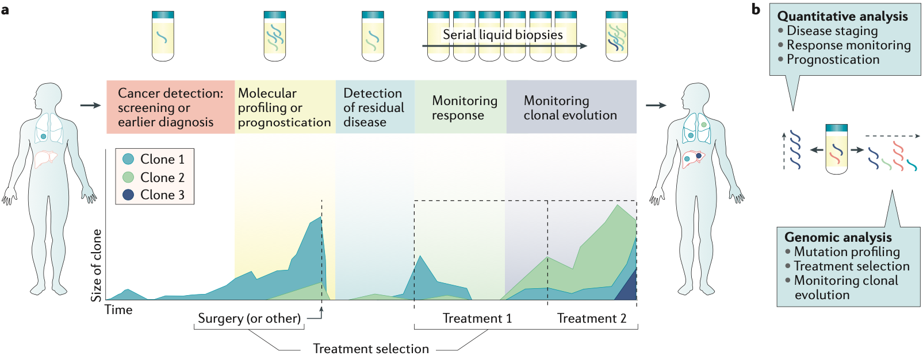
Wan et al. Nature Reviews Cancer, 2017

Slide 4
Early detection
Image from: Wan et al. Nature Reviews Cancer, 2017

Slide 5
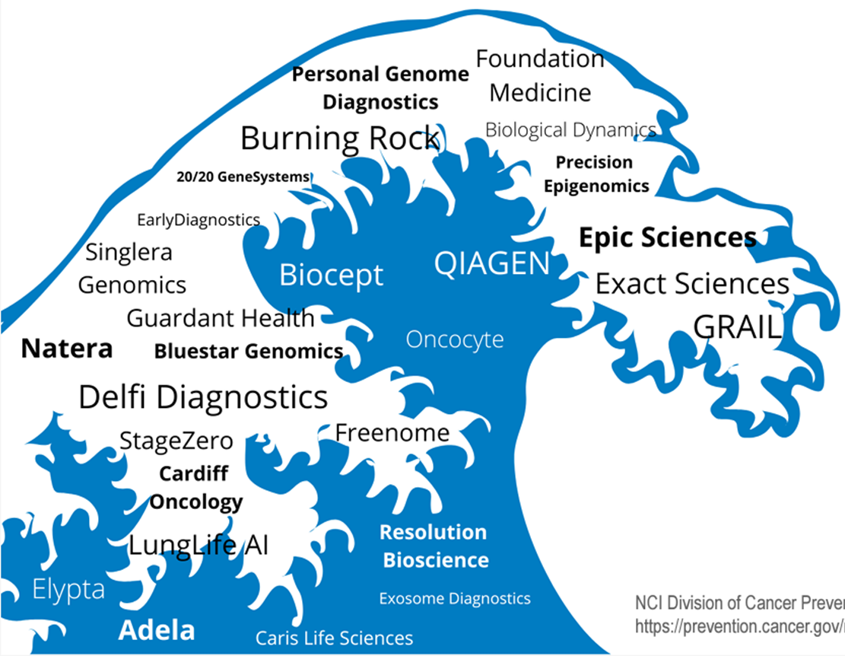
Companies in the MCD Liquid Biopsy Space

Slide 6

Mayo Clinic Provider Survey Outcome
Survey Statistics – Test Information
Testing
Infrastructure
Notes:
Strong support for idea that this will play a major role in population cancer screening, but high degree of concern about managing results inc. when insurance will not cover diagnostic testing and the nuances around PPV, Sensitivity and Specificity… esp unconfirmed positives.

Slide 7



Mayo Clinic Multi-Cancer Detection Clinic & Pragmatic Trial
MCD Positives Clinic
Develop a tri-site clinic for patients who receive a positive MCD test result at Mayo, or outside of Mayo. Previously, there was no ‘home’ for these patients. This clinic will exclusively serve cancer positive signal patients nationwide agnostic to vendor (not for ordering test).
Note competitors also launching such clinics: MSK, Dana-Farber, UCSF, Mercy and more coming.
MCD Positives Clinic
Pragmatic trial
Pragmatic trial
Launch a pragmatic Observational Cohort trial to follow patients who elect to have any MCD test regardless of the test company to follow and understand the journey, with survey and targeted biospecimen collection on those with positive results.
Testing infrastructure
Create test ordering infrastructure agnostic of vendor* for the three DMCs and Mayo Clinic Health System.
Plummer chart orderset and diagnostic algorithms for those with MCD positive signals approved by SMEs with iterative updates.
*Only tests that utilize cell-free DNA given superior PPV.
Testing infrastructure
Education
Education
Provider education completed including education regarding MCD ordering and consent. Patient education includes pre-test education materials including as video and brochures in multiple languages.
Notes:
Here to manage positive results, not order test. We’ve also done 3 site upskilling in ordering of Galleri with start-up deck.
Only those that include cell-free DNA methylation analysis, which has proven it’s value (note Cologuard as first to market with 2 DNA Methylation signals tested)
Will need iterative updating of ordersets, provider and patient education as new industry tests come on-line.

Slide 8
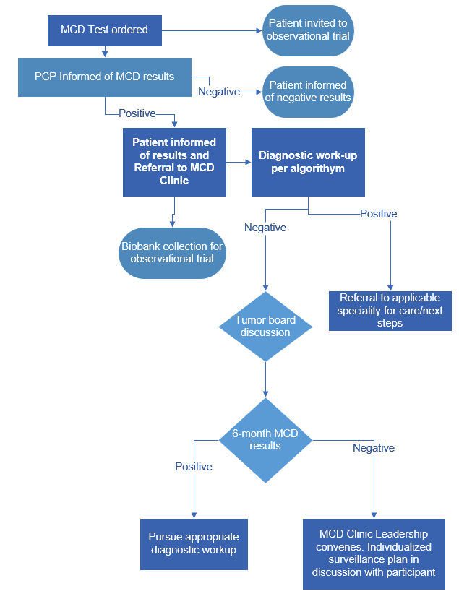
Mayo Clinic Multi-Cancer Detection Workflow
Notes:
Two parallel efforts here were felt necessary: 1. MCD Observational Cohort with invites to all who elect to have the test (and those who show up with a positive test done outside) AND
2. MCD Clinic to manage patients with positive results.
Re “6 month MCD results” – we may repeat in 6 months after Tumor Board/DG discussion or may apply additional or emerging diagnostics to help further risk stratify or diagnose. E.g. Pancreas signal, but normal MRCP. At risk patient, ?EUS as well?

Slide 9
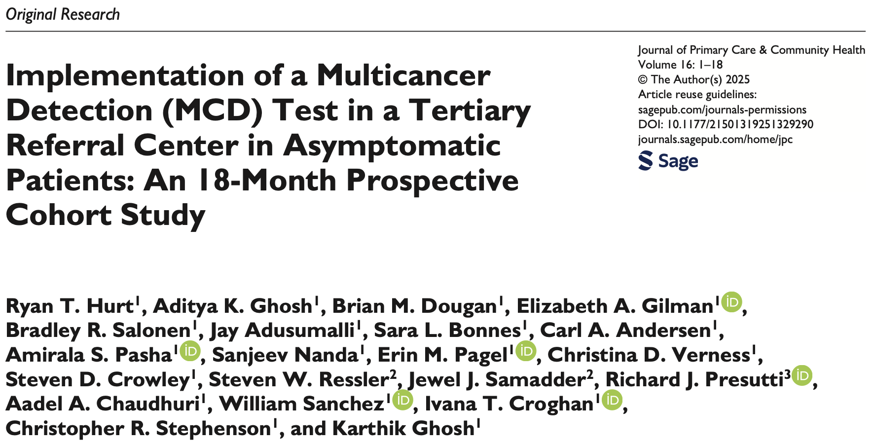
Results: Of the 2244 patients tested, 17 (0.76%) had positive results, and 15 underwent further diagnostic evaluation. Cancer was confirmed in 11 (73.3%) patients, including cases of breast, colon, esophageal, lymphoma, ovarian, and pancreatic cancers. Four patients had no identifiable malignancy despite comprehensive work-up.
Notes:
Exceeds confirmation of possible signal by 25 percentage points above anything published in the literature for population screening. In other words, bringing the strengths of a dedicated team to this is already showing promise.

Slide 10
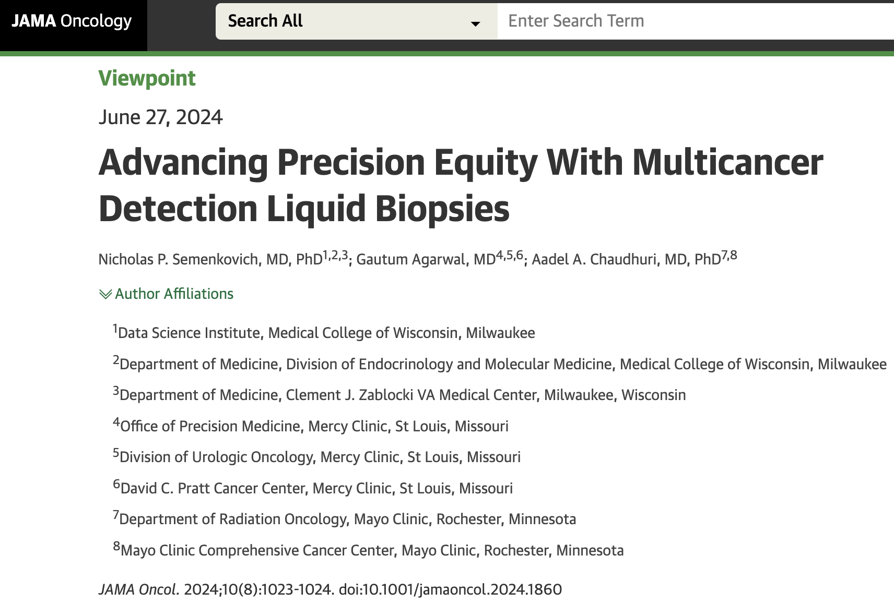

Slide 11
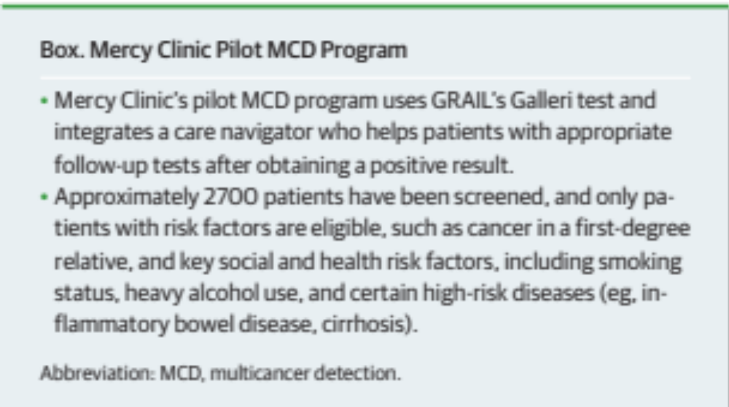
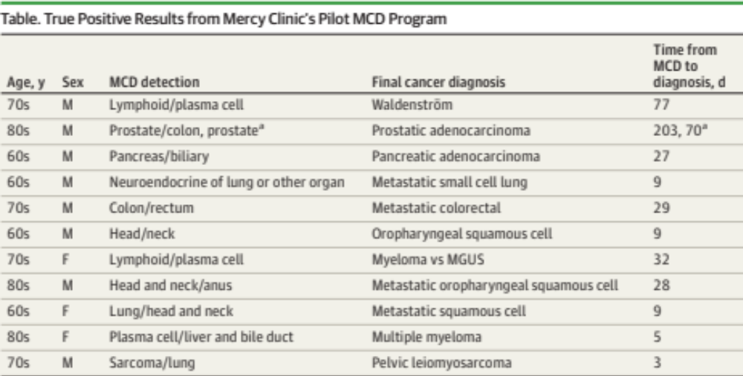
Semenkovich, Agarwal & Chaudhuri, JAMA Oncology, 2024

Slide 12
Pre/on-tx prognostication
Image from: Wan et al. Nature Reviews Cancer, 2017

Slide 13
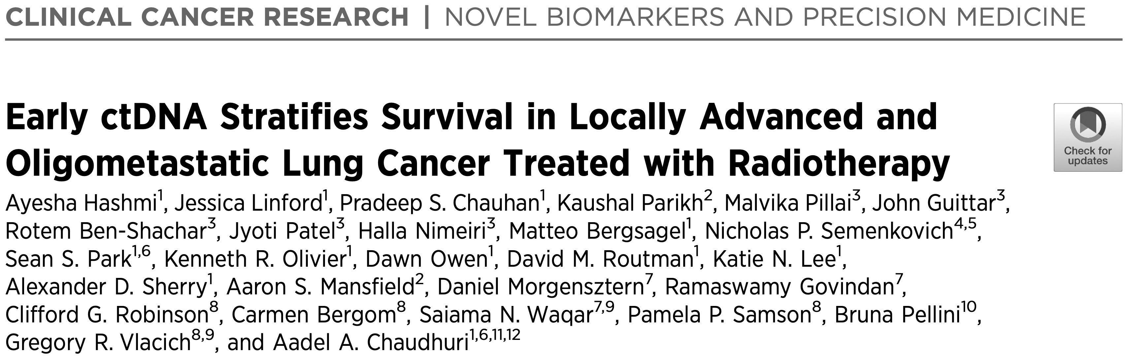
Hashmi et al. Clinical Cancer Research, 2026

Slide 14
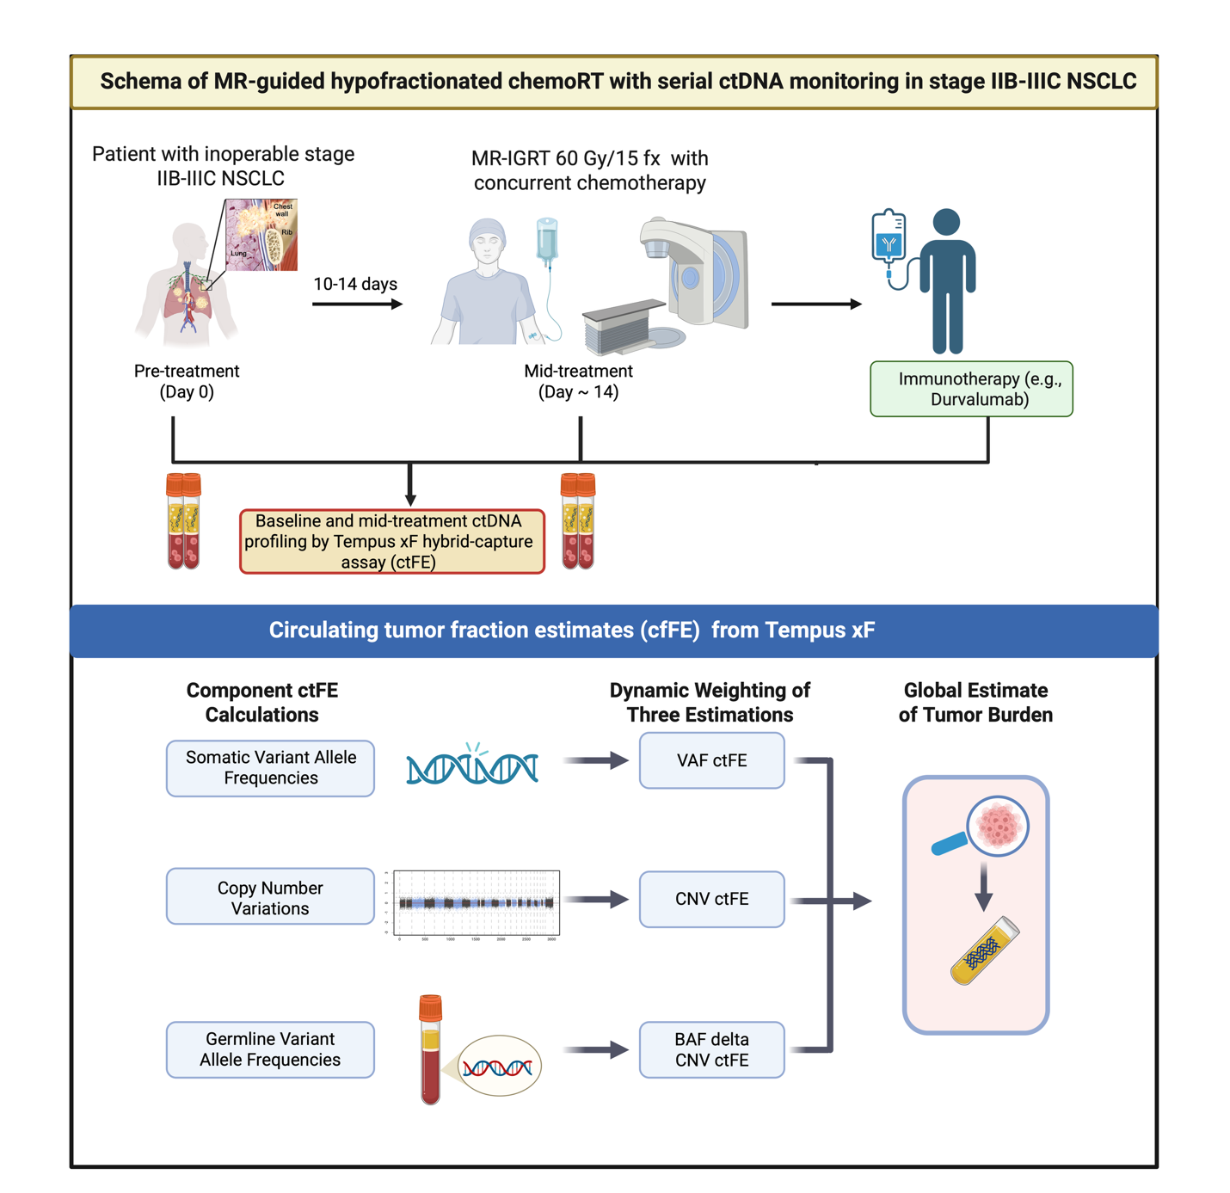
Hashmi et al. Clinical Cancer Research, 2026

Slide 15
Hashmi et al. Clinical Cancer Research, 2026

Slide 16
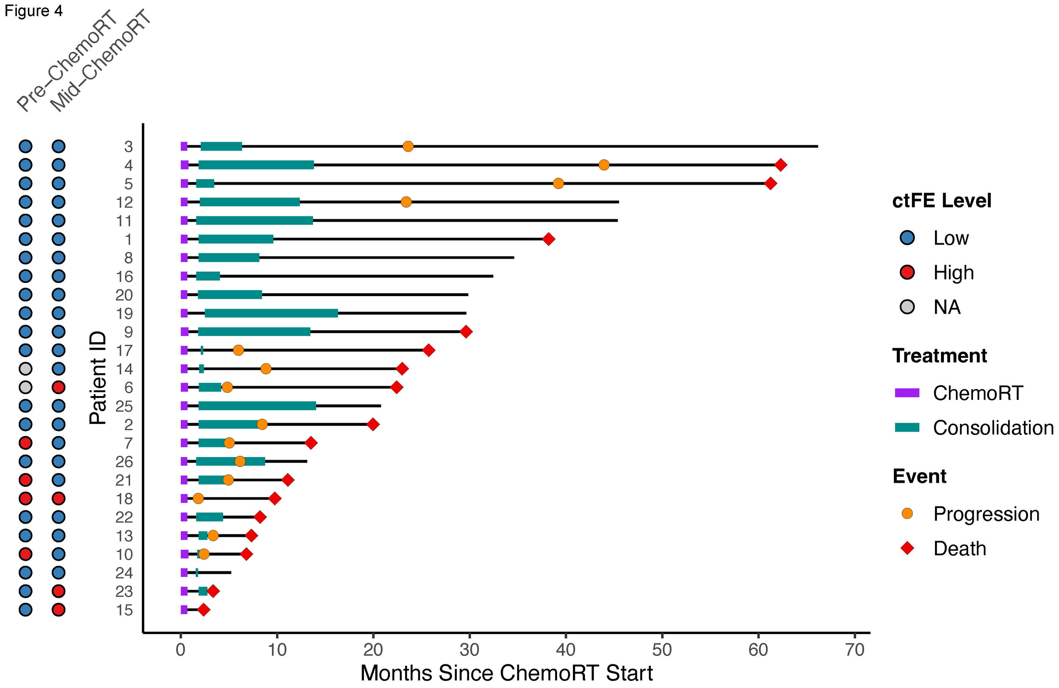
Hashmi et al. Clinical Cancer Research, 2026

Slide 17
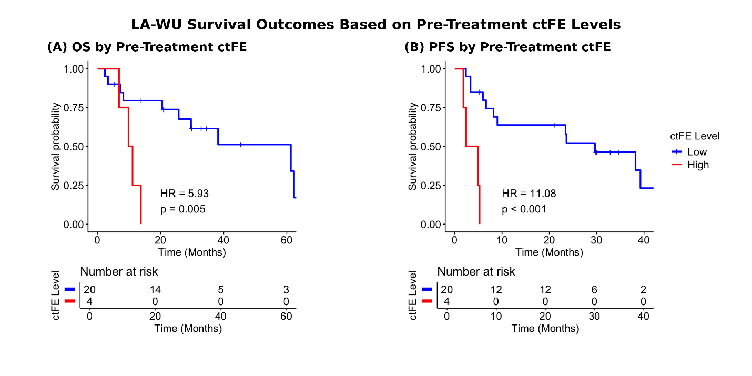
Hashmi et al. Clinical Cancer Research, 2026

Slide 18
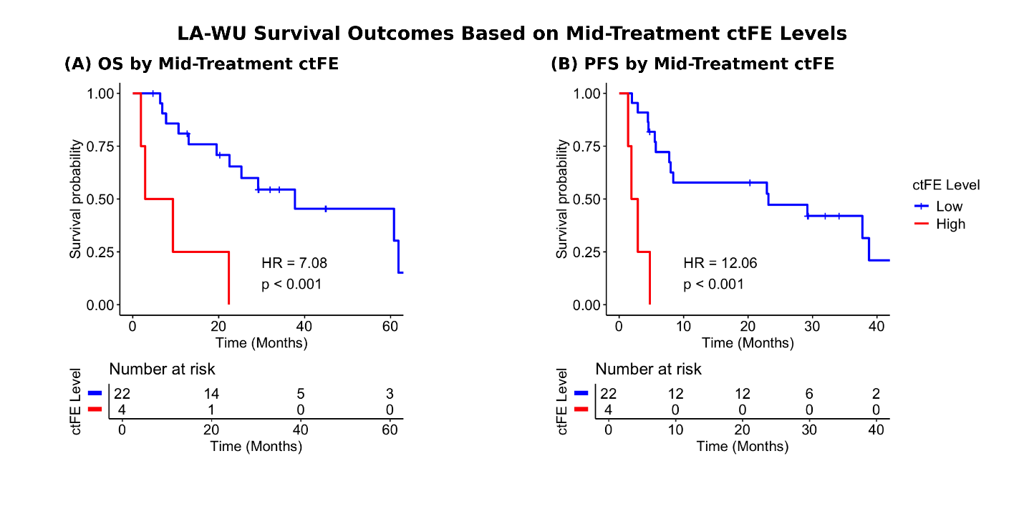
Hashmi et al. Clinical Cancer Research, 2026

Slide 19
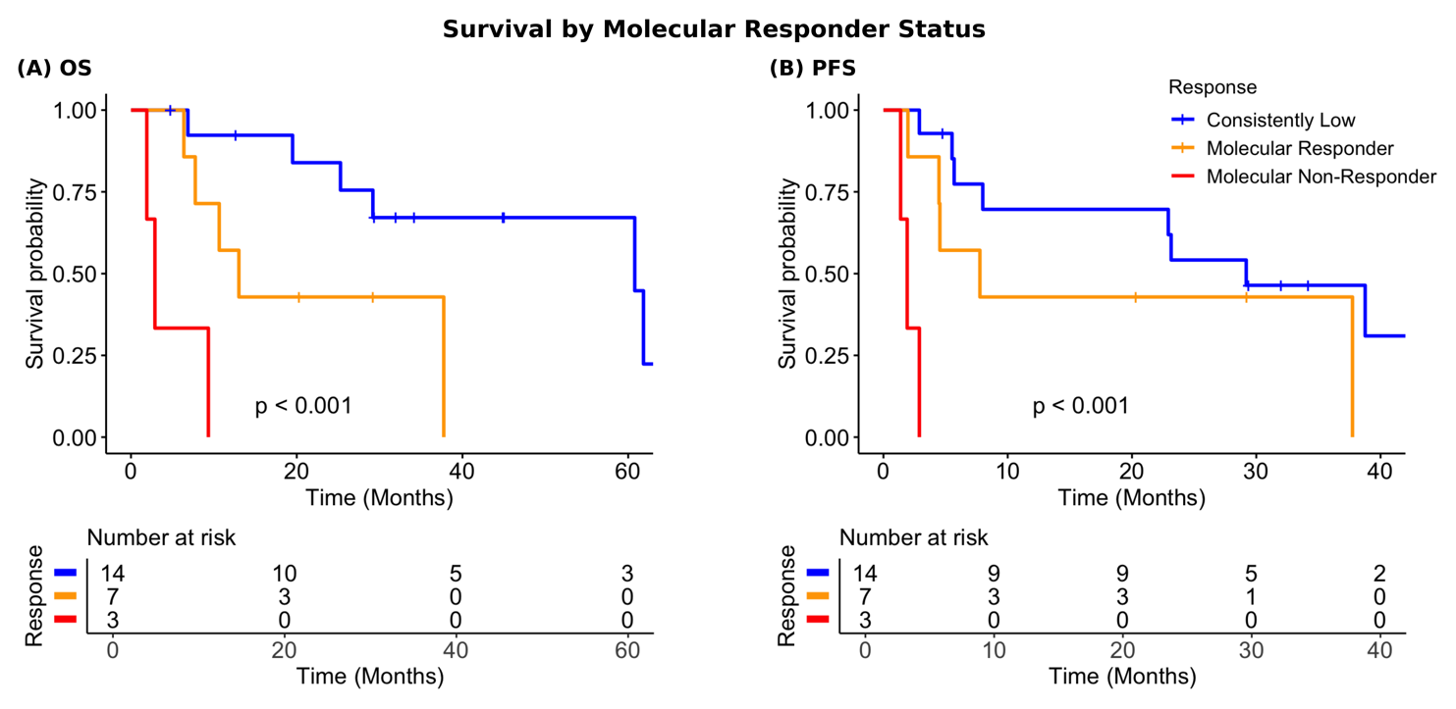
Hashmi et al. Clinical Cancer Research, 2026

Slide 20
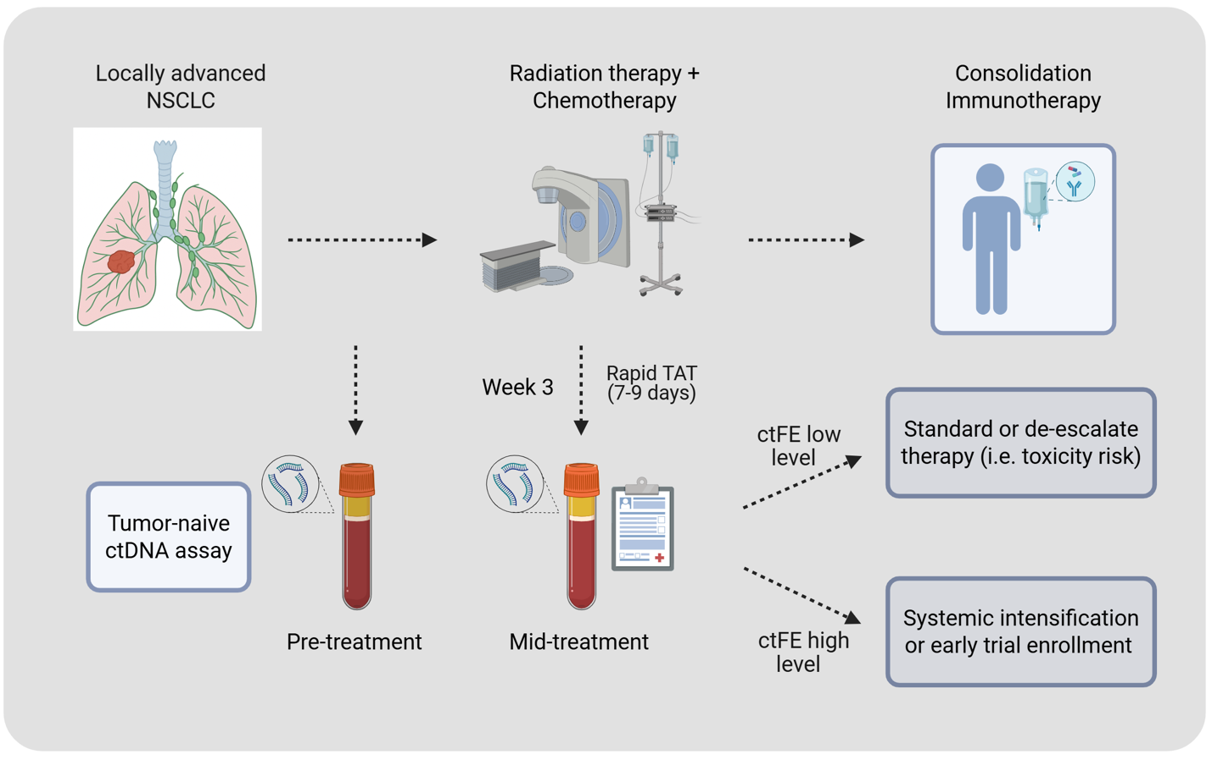
Future paradigm to adapt treatment for NSCLC based on early ctDNA dynamics
Hashmi et al. Clinical Cancer Research, 2026

Slide 21
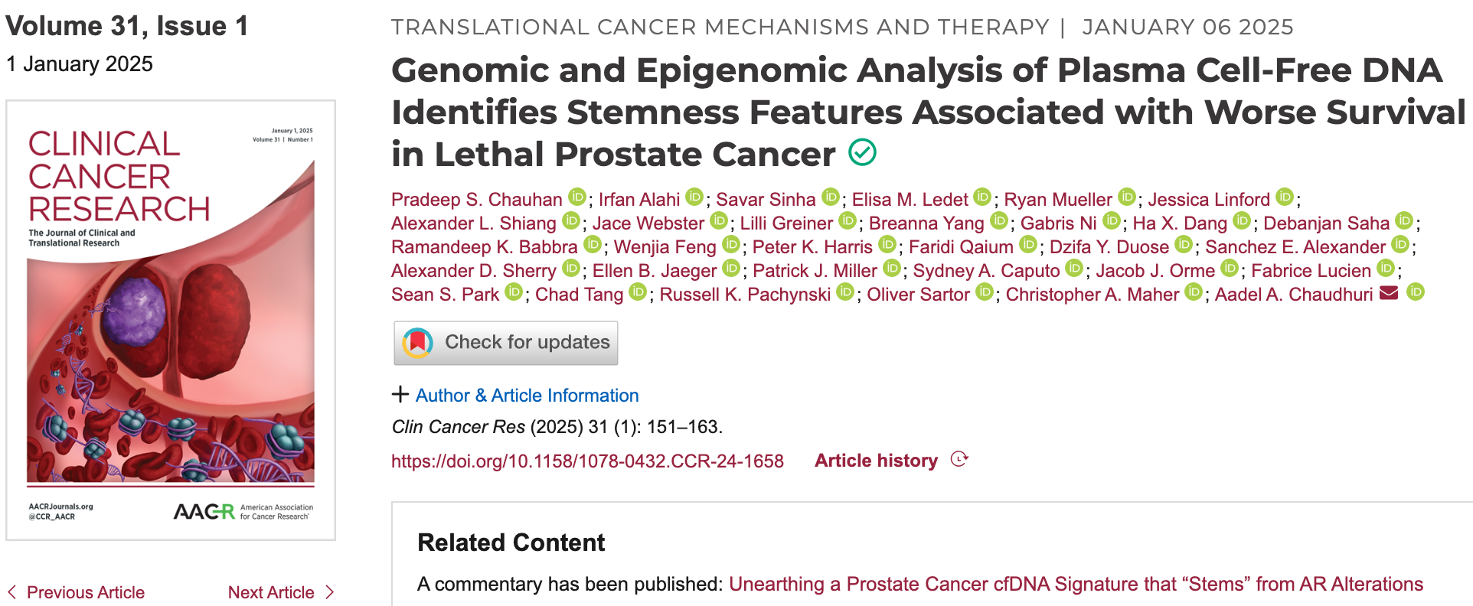

Slide 22
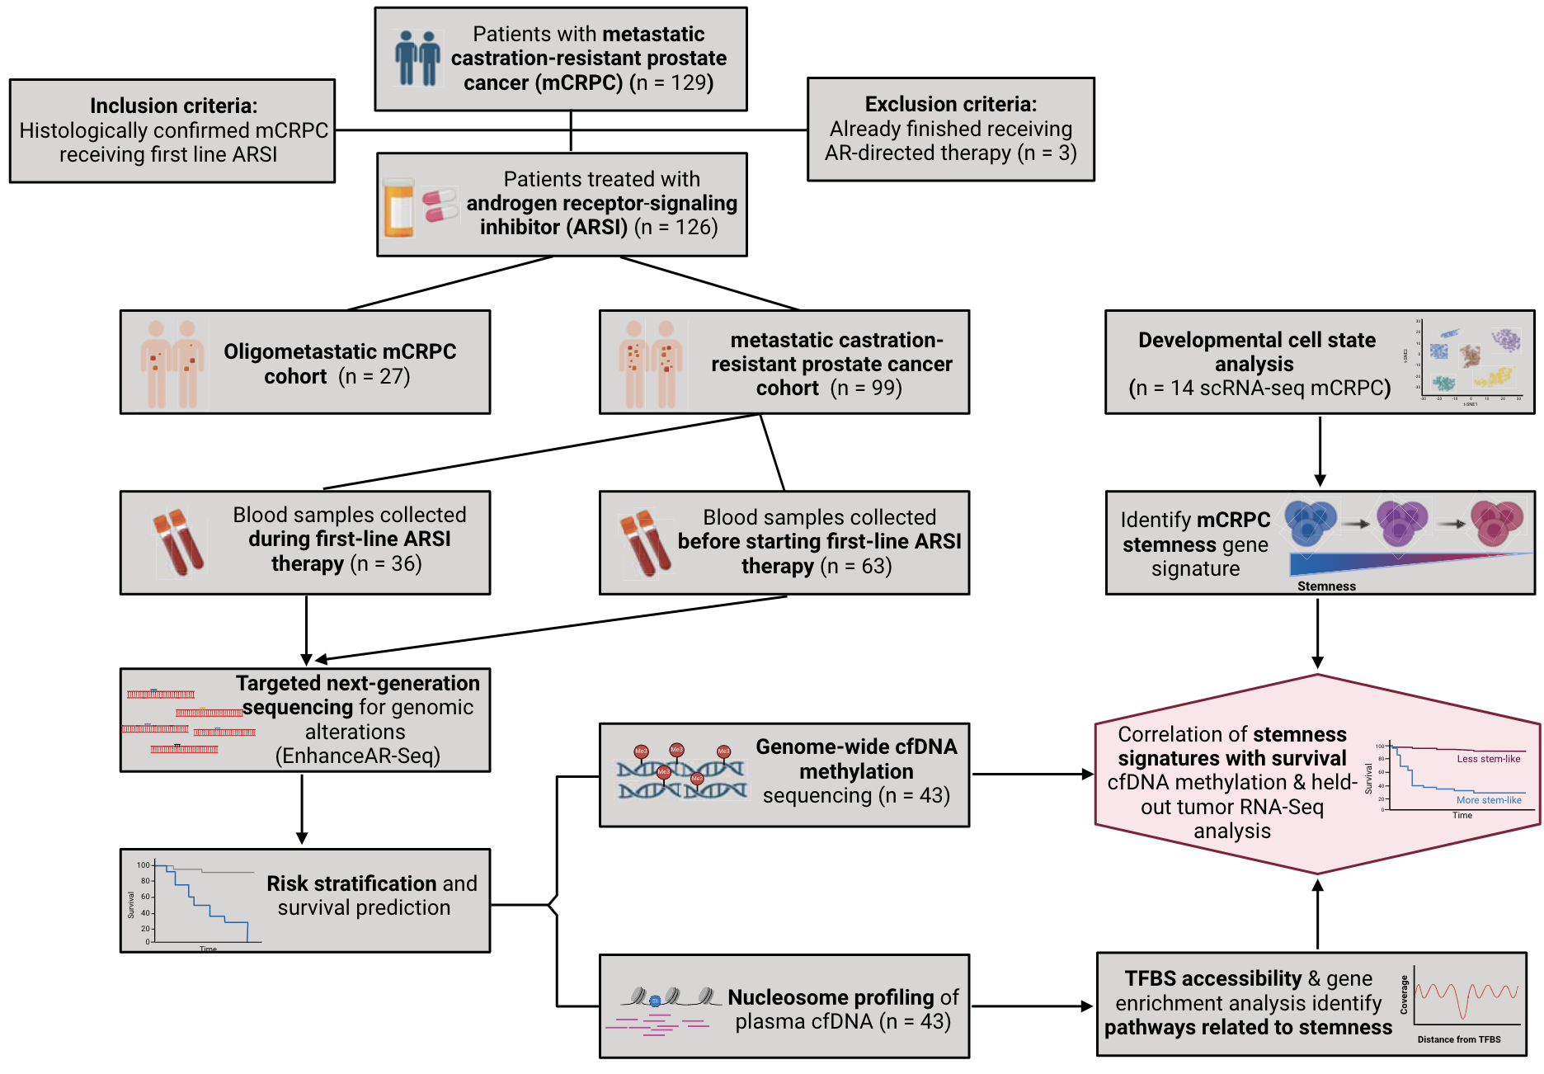
129 mCRPC patients enrolled from 3 institutions (n = 52 Tulane, n = 47 WashU, n = 27 MDACC)
Key Collaborators
Oliver Sartor, MD (Tulane)
Russell Pachynski, MD (WashU)
Christopher Maher, PhD (WashU)
Chad Tang (MD Anderson)
Chauhan et al. Clinical Cancer Research, 2025

Slide 23
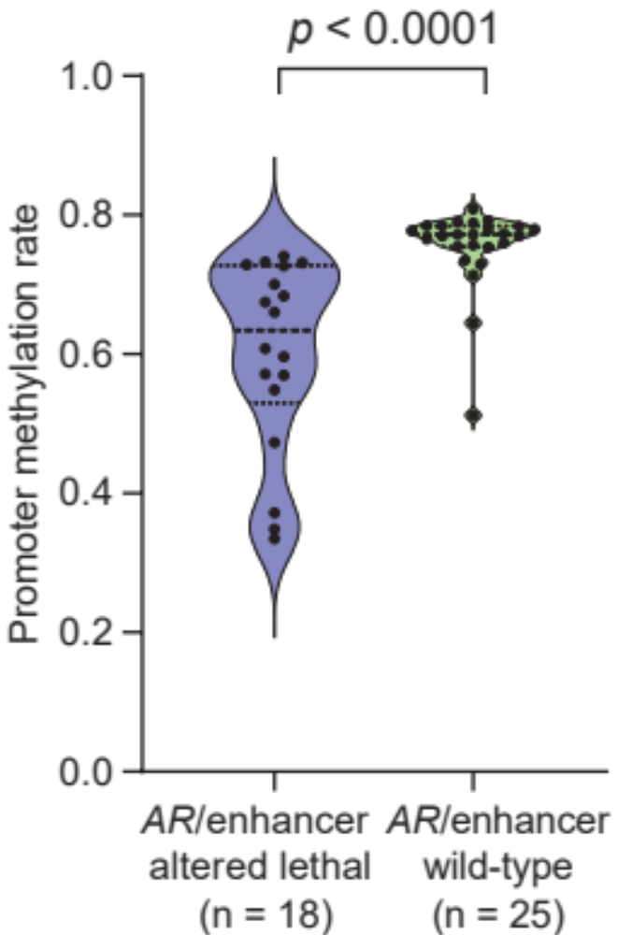
Global promoter-level hypomethylation in high-risk lethal mCRPC patients compared to lower risk
Chauhan et al.
Clinical Cancer Research, 2025

Slide 24
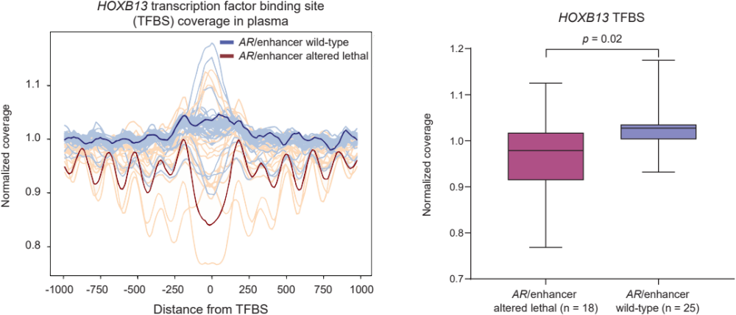
Nucleosome-positioning inference in AR/enhancer wild-type vs. altered lethal mCRPC patients
Chauhan et al. Clinical Cancer Research, 2025

Slide 25
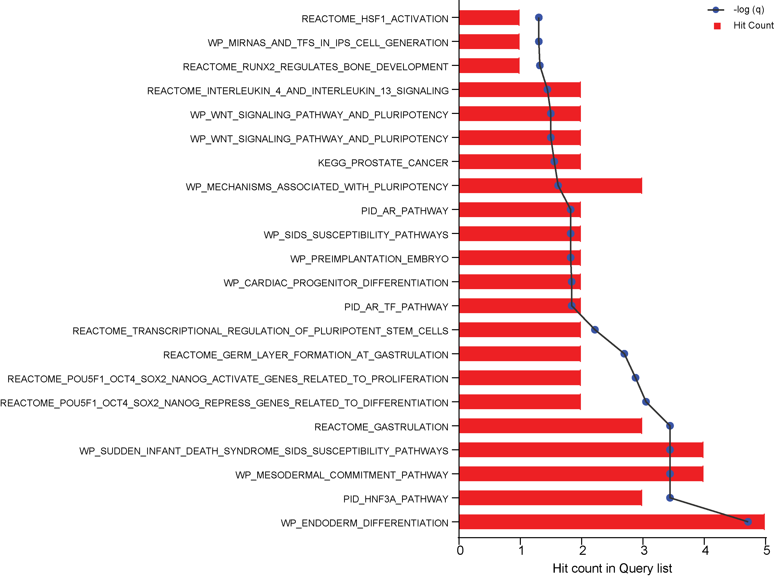
Gene set enrichment analysis of top 20 accessible transcription factors (based on cfDNA analysis) in AR-altered lethal mCRPC
Top 20 transcription factor more accessible in high-risk mCRPC
ZNF384
HOXB13
GRHL2
AR
ASCL2
FOXA1
GLIS3
NKX3-1
ERF
PRDM6
HMGA1
ZNF22
ZNF280A
SP1
RELB
SP4
NFKB2
HNF4G
HSF1
Pathways related to development immaturity / stemness
Chauhan et al. Clinical Cancer Research, 2025

Slide 26
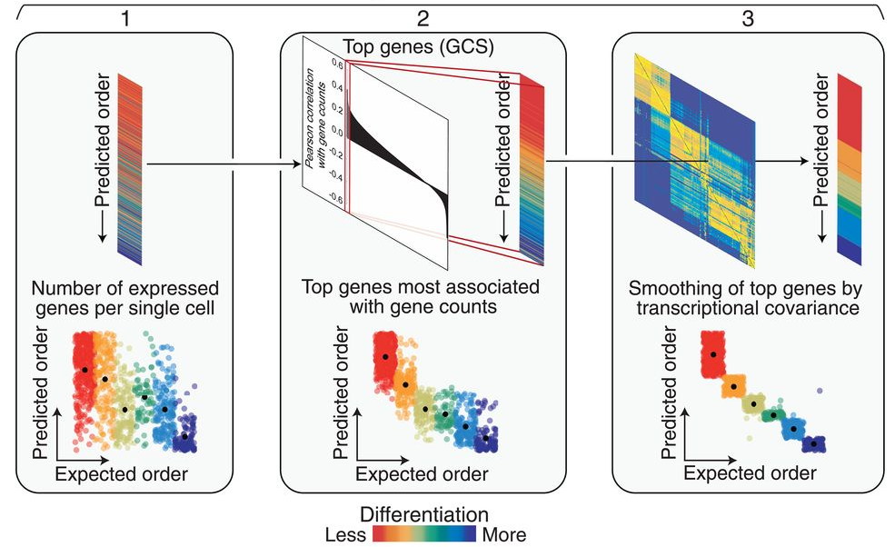
Inference of stemness using the CytoTRACE platform
CytoTRACE cell score
Each cell is given a stemness score
1: More stem-like
0: Less stem-like
CytoTRACE Gene score
Each cell state-specific gene is given a score
1: Genes correlated with more stem-like features
0: Genes correlated with less stem-like features
Gulati,…, Newman, Science, 2020

Slide 27
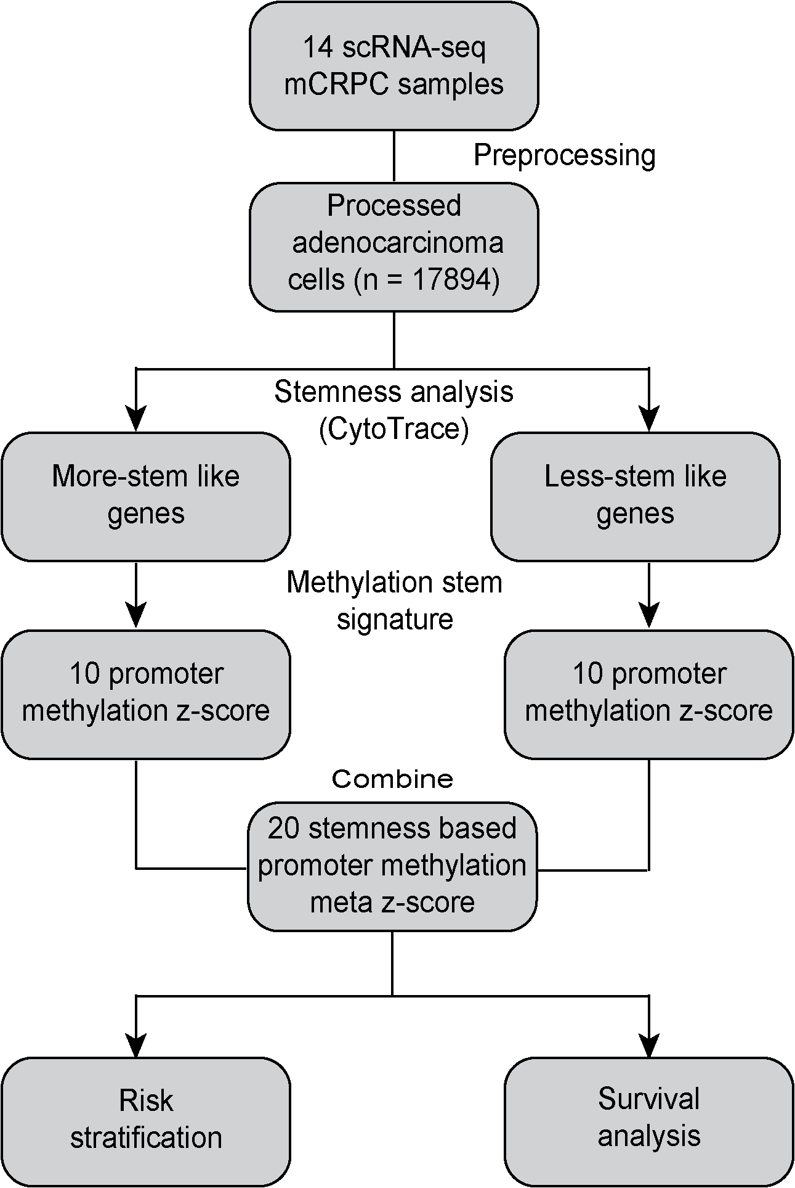
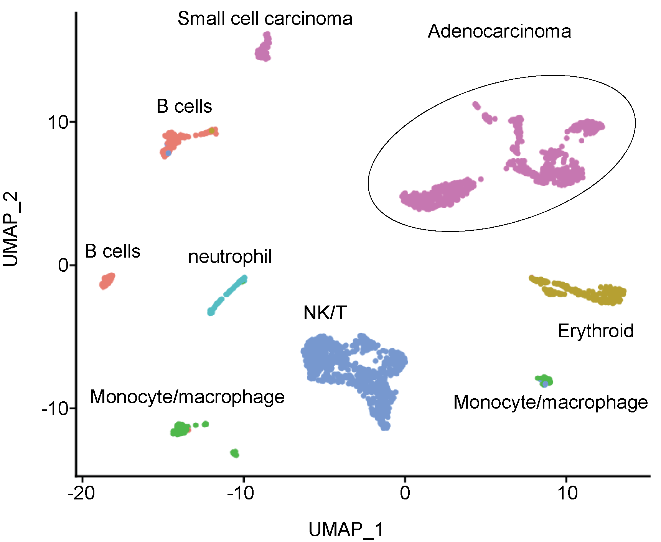
Adaptation of CytoTRACE to cell-free DNA to assess stemness signatures
Single-cell RNA-seq (mCRPC = 14)
He,…, Van Allen, Nature Medicine, 2021
Chauhan et al. Clinical Cancer Research, 2025

Slide 28
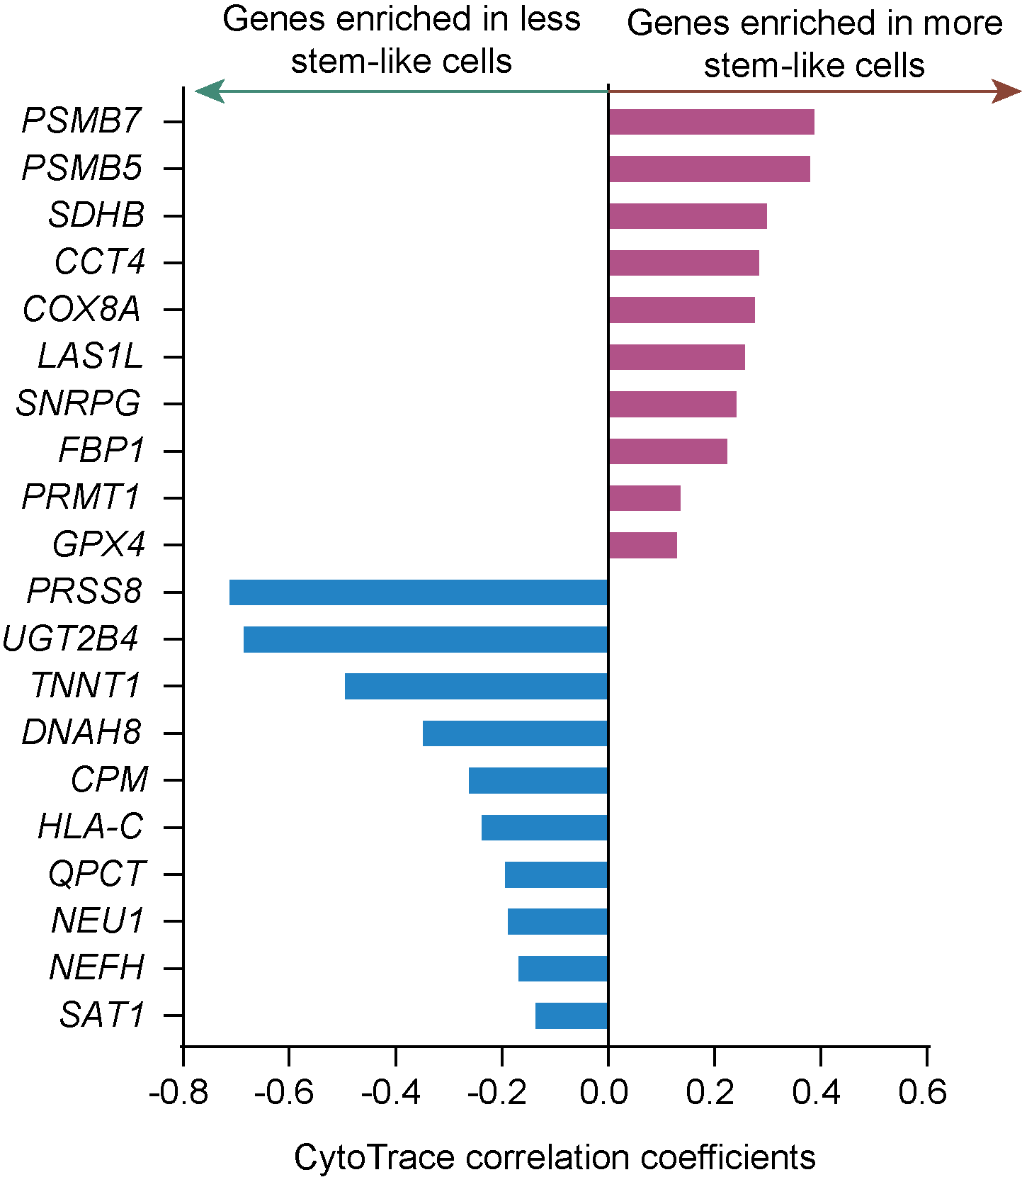
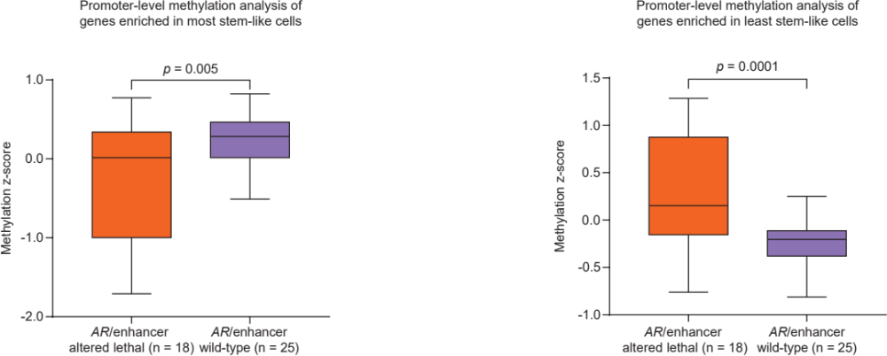
Stemness signature in AR/enhancer altered lethal patients
Most and least stem-like genes by scRNA-seq stemness analysis (CytoTRACE)
Promoter-level cfDNA methylation analysis
Chauhan et al. Clinical Cancer Research, 2025

Slide 29
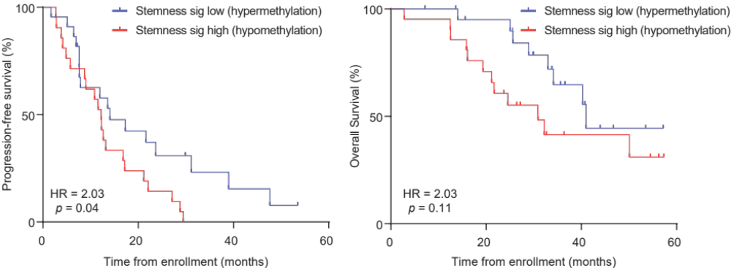
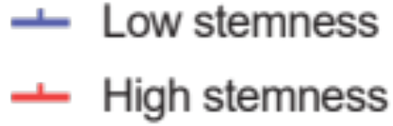
Epigenomic stemness signature in cfDNA pre-treatment correlates with worse survival outcomes in mCRPC patients
Chauhan et al. Clinical Cancer Research, 2025

Slide 30
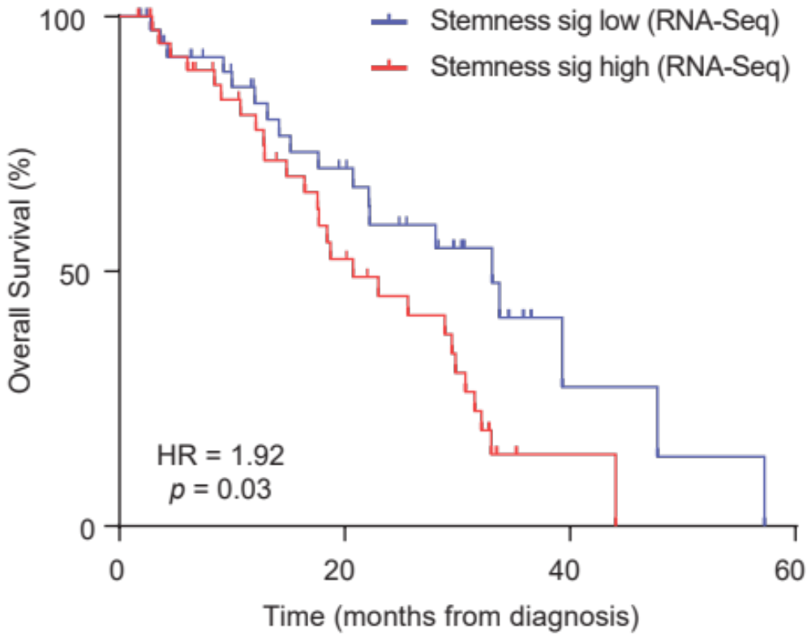
Stemness signature also predicts survival in bulk RNA-seq data (External cohort of 80 mCRPC patients from Abida et al. PNAS, 2019)
Chauhan et al. Clinical Cancer Research, 2025

Slide 31
MRD detection
Image from: Wan et al. Nature Reviews Cancer, 2017

Slide 32
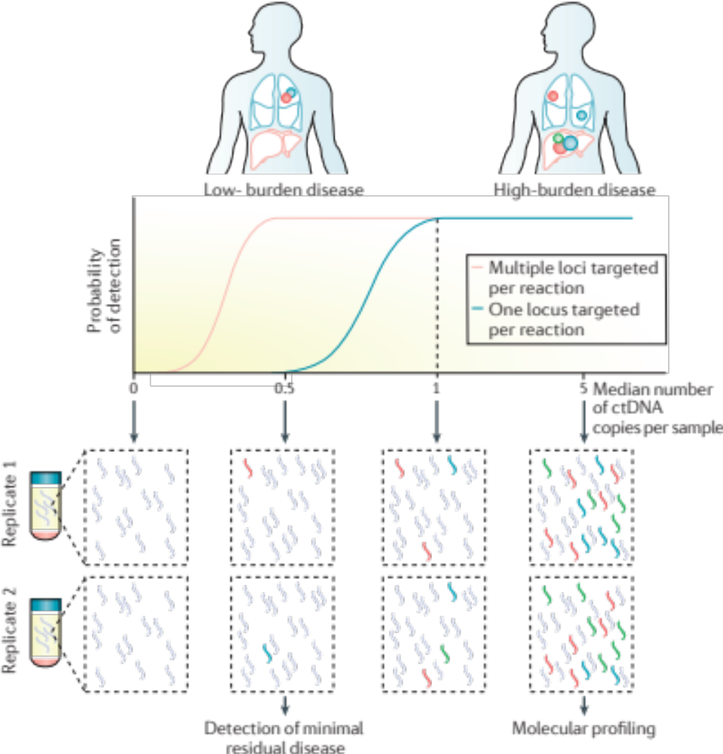
Highly Sensitive Methods are
Required for MRD detection
Wan et al. Nature Reviews Cancer, 2017

Slide 33
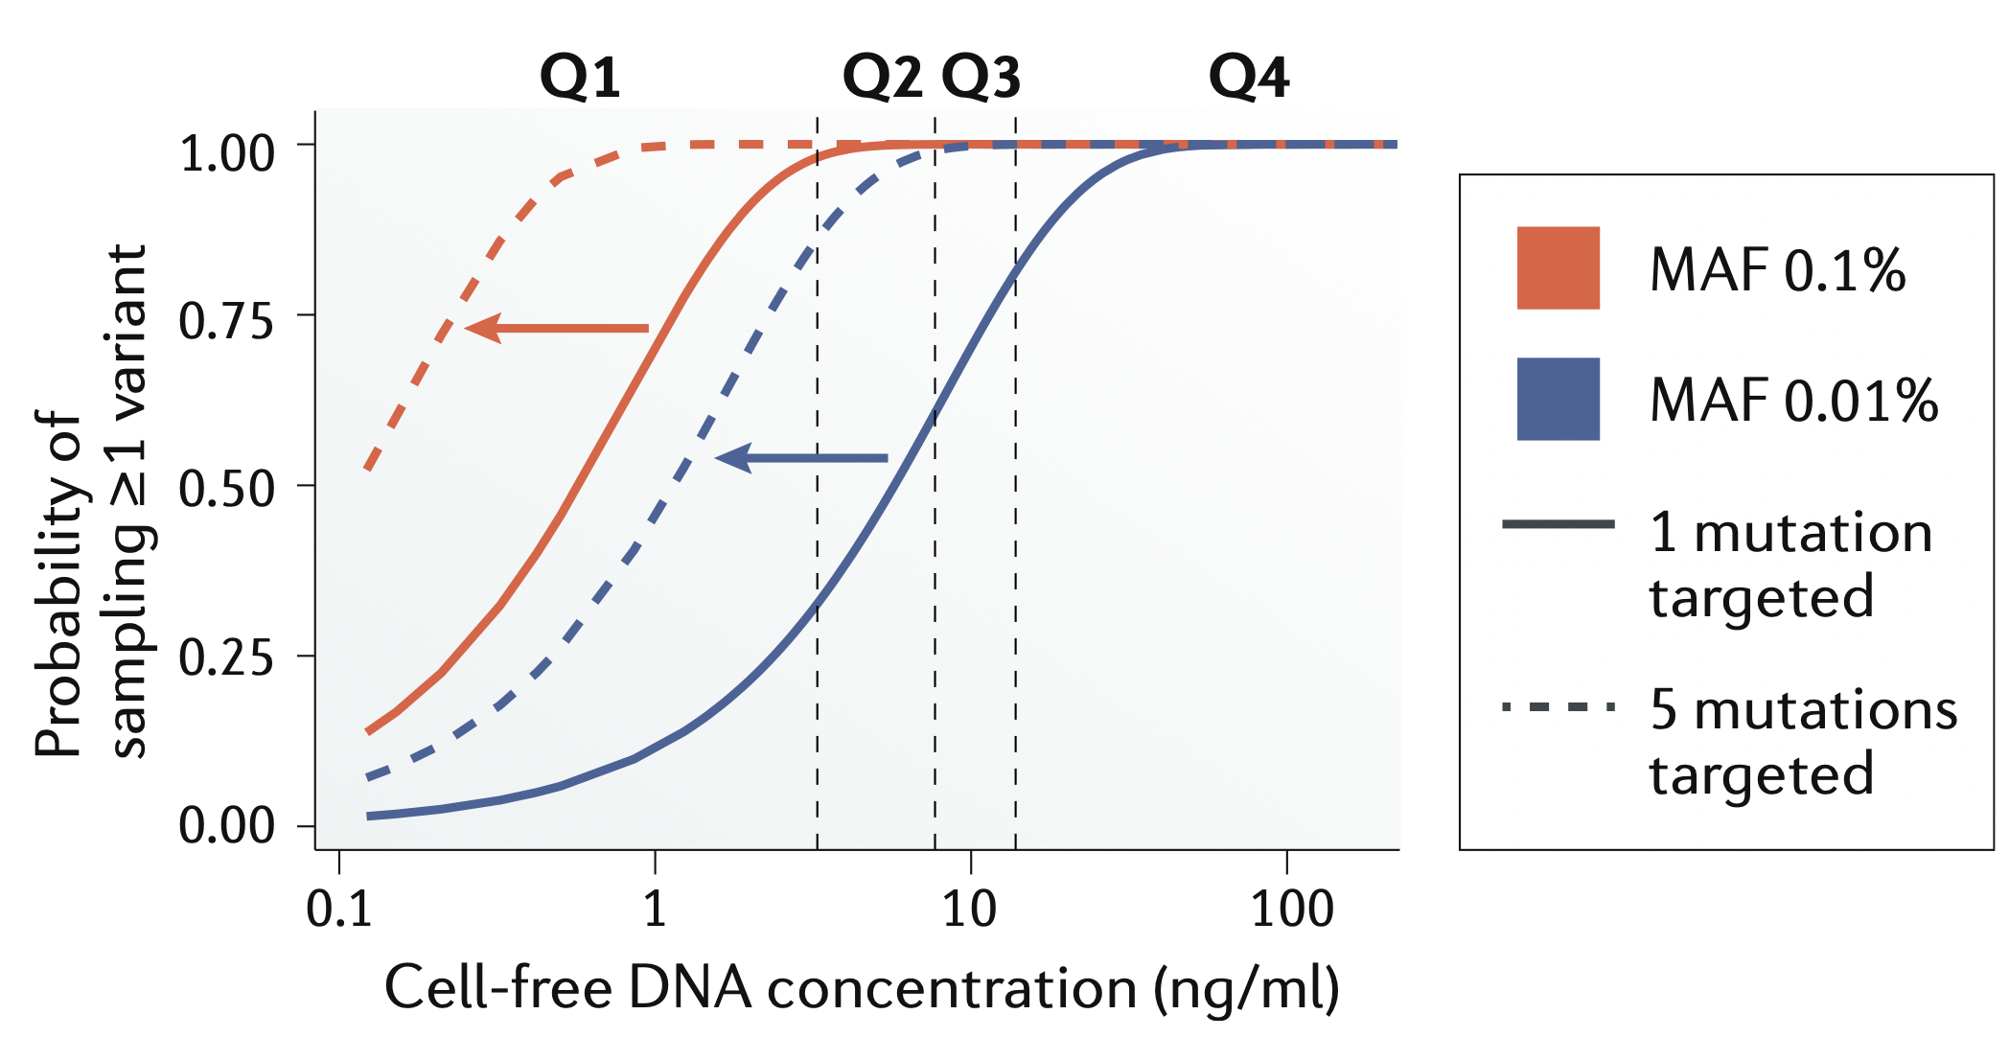
Multi-mutation tracking lowers the limit of detection
Abbosh, Birbak & Swanton, Nature Reviews Clinical Oncology, 2018

Slide 34
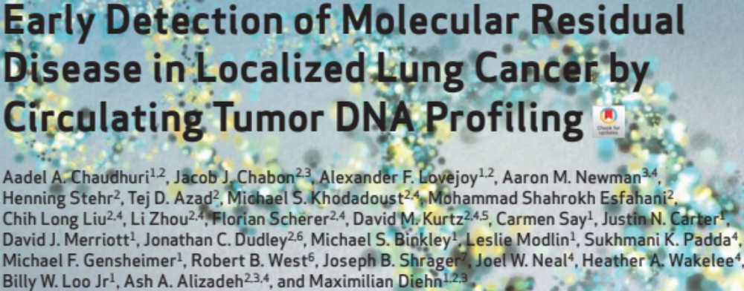
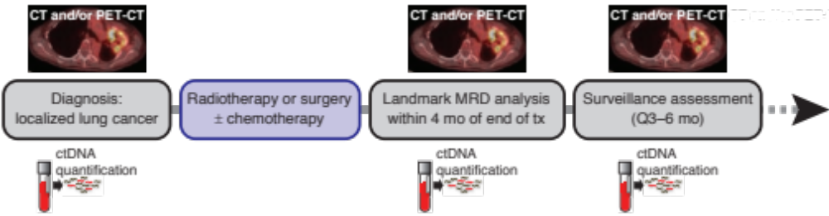

Chaudhuri et al. Cancer Discovery, 2017

Slide 35
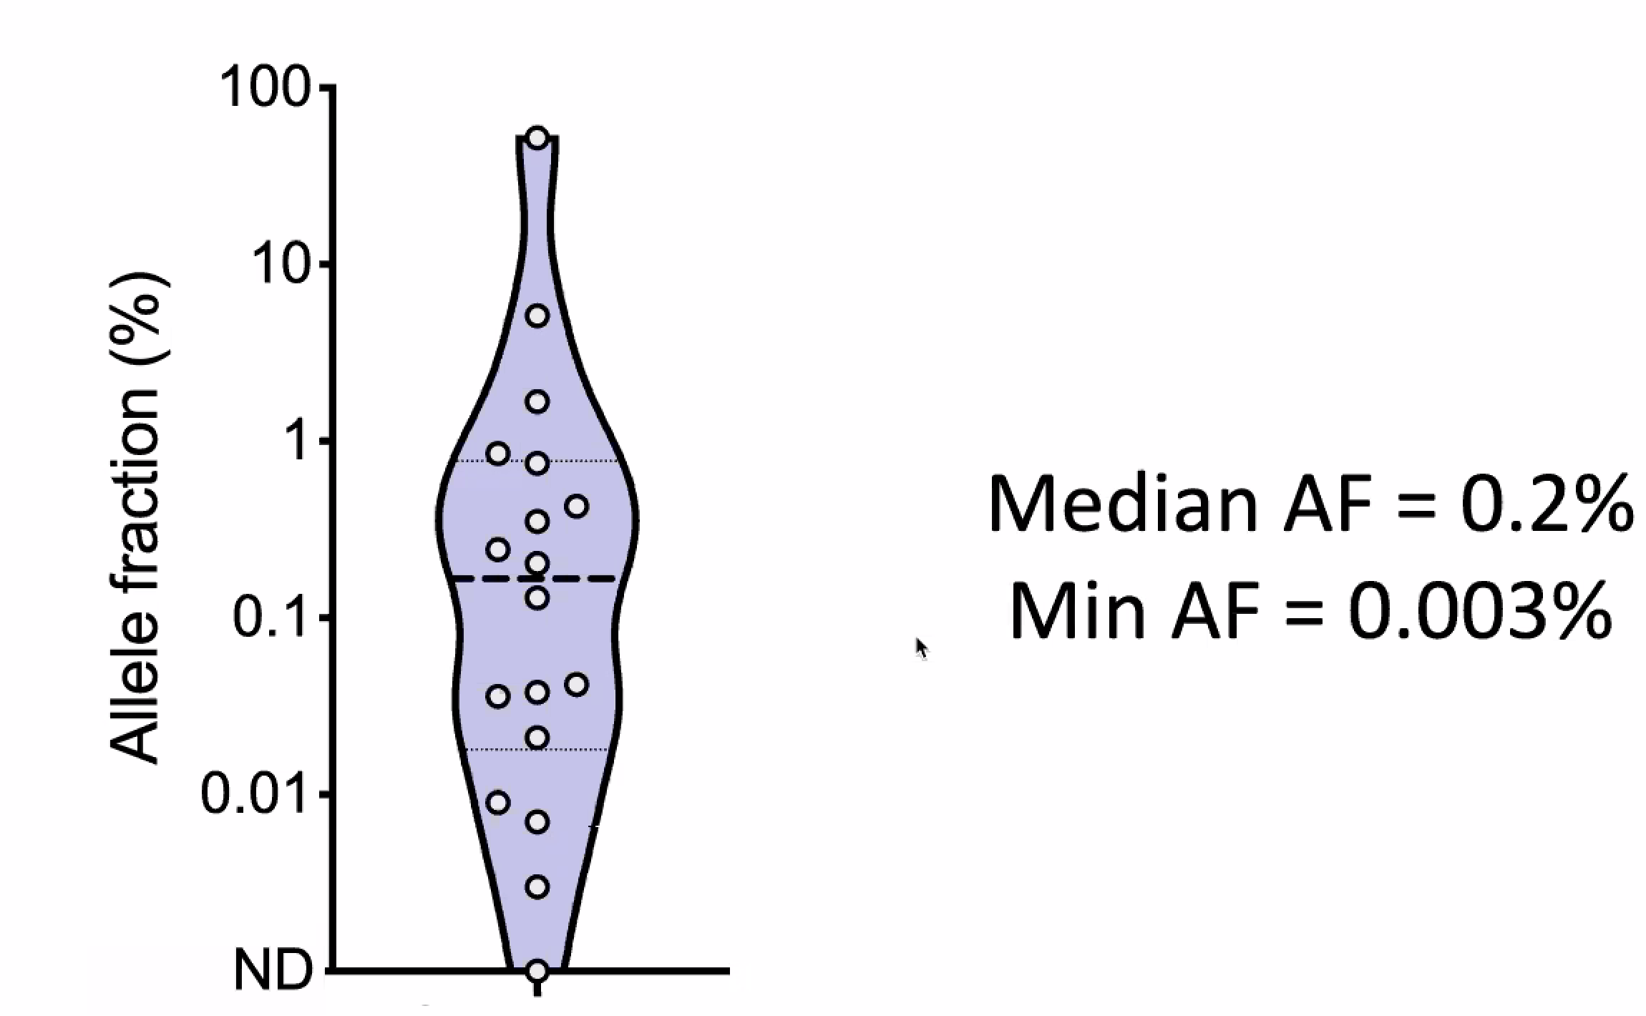
ctDNA MRD detection requires a low limit of detection
Chaudhuri et al. Cancer Discovery, 2017
Notes:
Using CAPP-Seq approach.

Slide 36
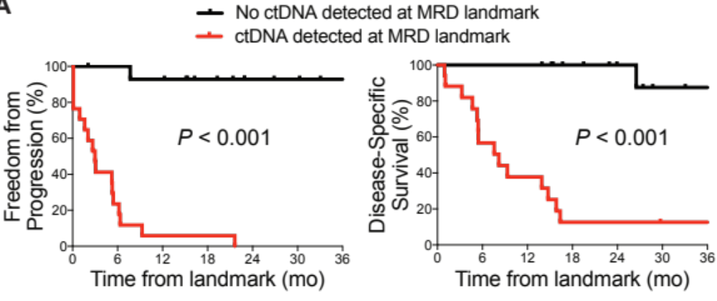
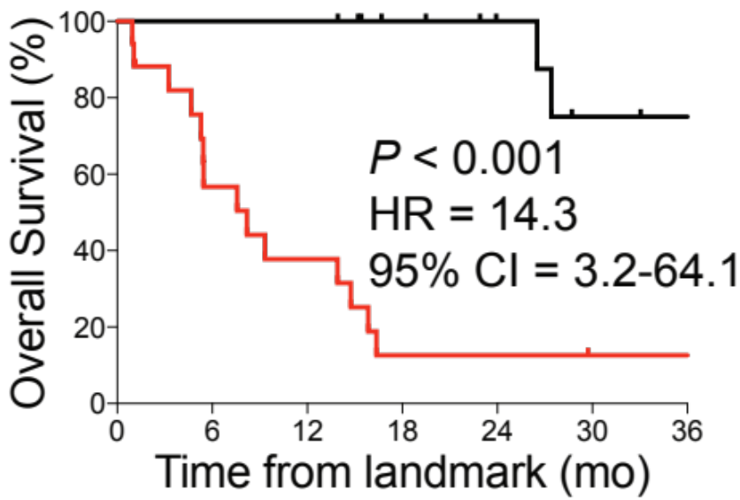
ctDNA MRD detection was highly prognostic after localized lung cancer XRT
CAPP-Seq targeted hybrid capture NGS approach
Chaudhuri et al. Cancer Discovery, 2017
Notes:
Using CAPP-Seq approach.

Slide 37
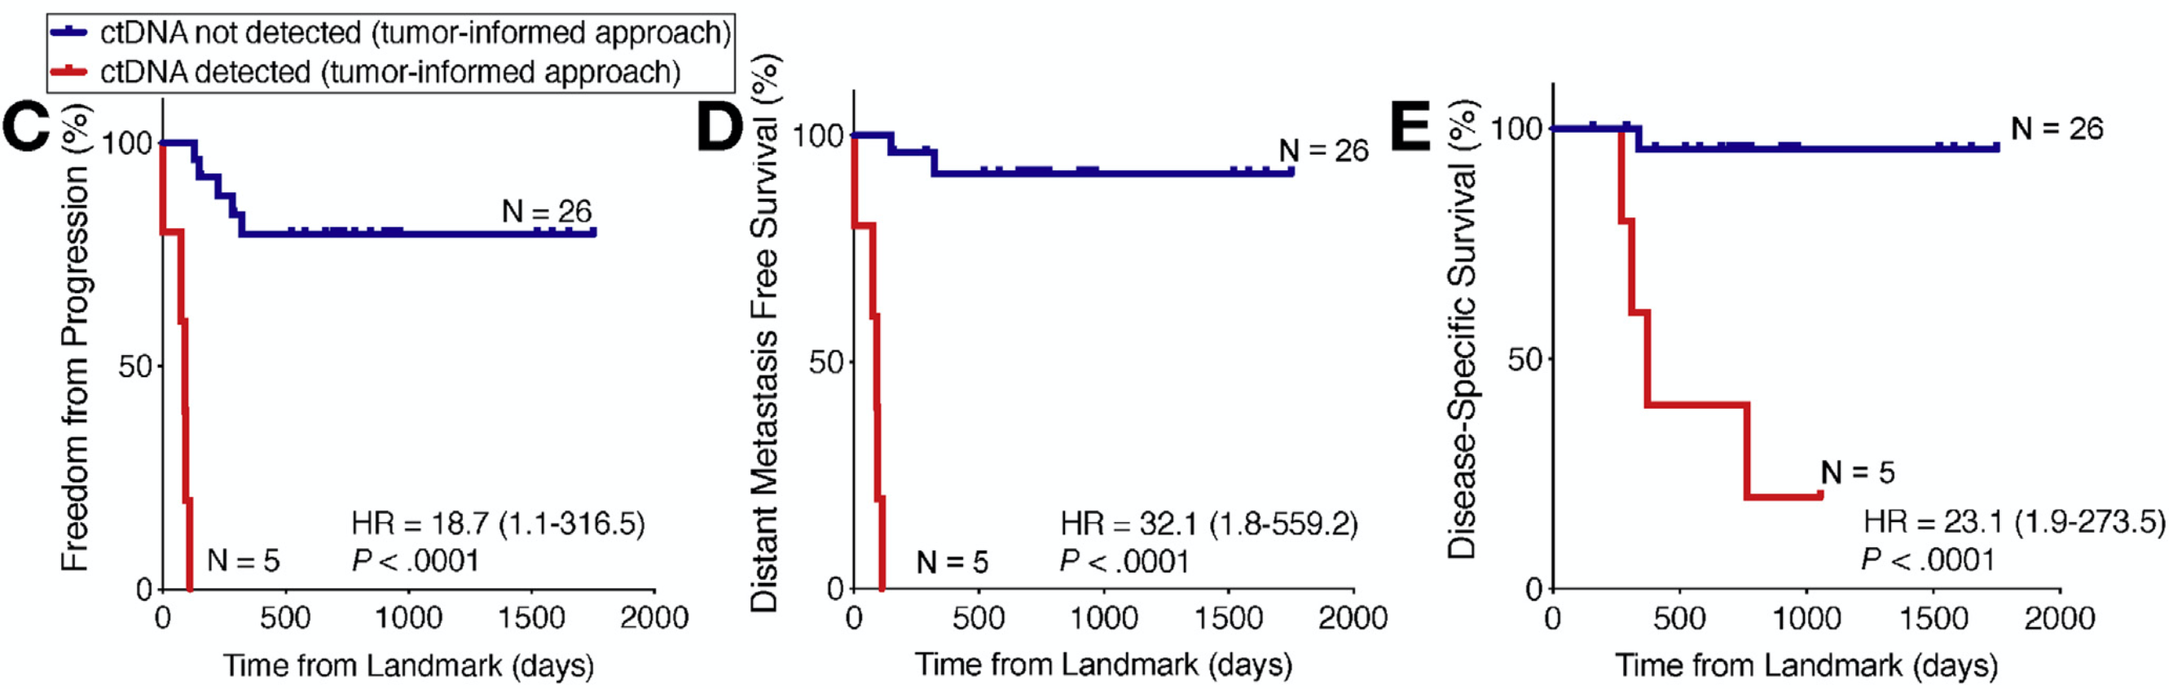
ctDNA MRD highly prognostic for locally advanced esophageal cancer after chemoRT
CAPP-Seq targeted hybrid capture NGS approach
Azad & Chaudhuri et al. Gastroenterology, 2020

Slide 38
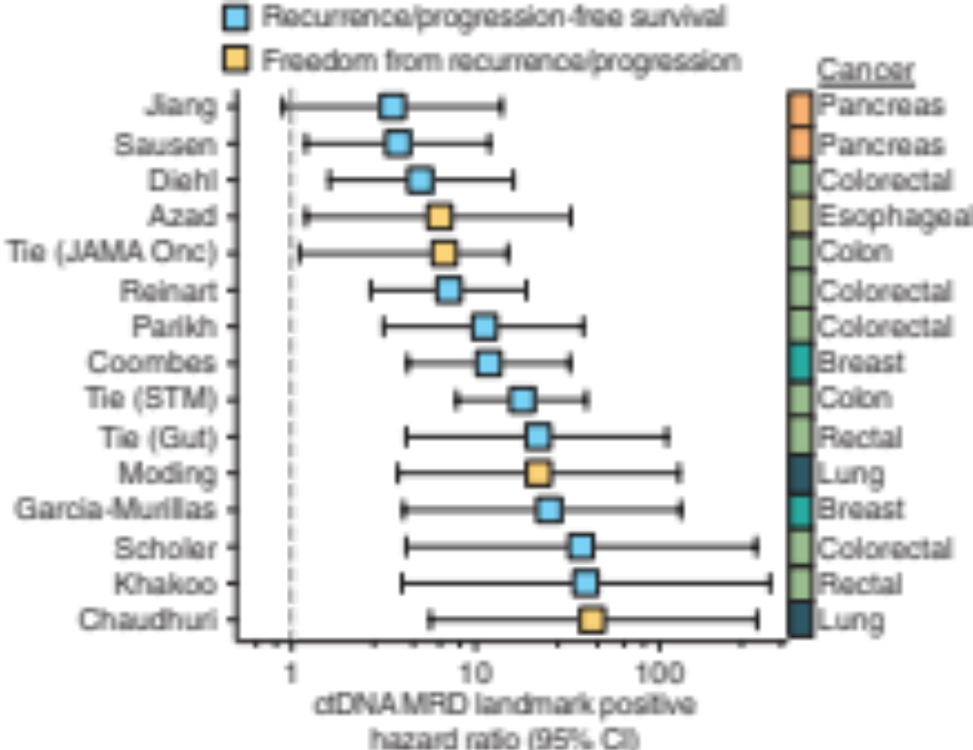
Moding et al. Cancer Discovery, 2021

Slide 39
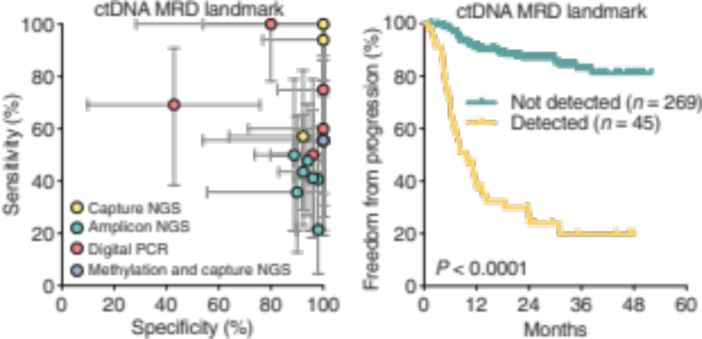
Moding et al. Cancer Discovery, 2021

Slide 40
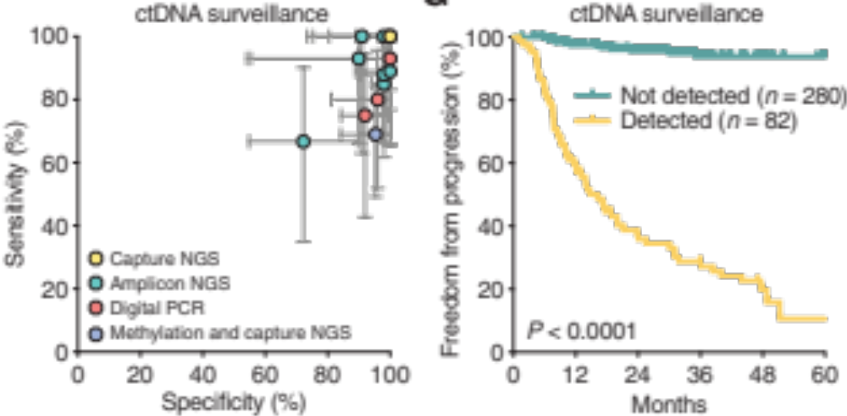
Moding et al. Cancer Discovery, 2021

Slide 41
2026 Update: Tumor-informed ctDNA MRD assay performance
ctDNA MRD technology | Example Assay | Estimated lower limit of detection
Limited panel with ~10 targets | CAPP-Seq (Stanford / Roche), SafeSeqS (Hopkins / Illumina) | 100 ppm
WES-based personalized with <25 mutational targets | Signatera (Natera) | 50 ppm
WES-based personalized with >25 mutational targets | RADAR (Neogenomics), OncoDetect (Exact), PCM (Invitae / Labcorp) | 10 ppm
Tumor-informed 30x WGS | MRDetect / MRDEdge (Cornell / Veracyte) | 10 ppm
WGS-based personalized with ≥1,000 mutational targets | NeXT Personal (Personalis) | 1 ppm
Tumor-informed 150x WGS | MRDetect / MRDEdge on Ultima Genomics sequencer (Cornell) | 1 ppm
Paired plus-minus duplex sequencing (300x WGS) | ppmSeq (Ultima Genomics) | <1 ppm
WGS-based personalized with phased variants | Clarity (Stanford / Foresight / Natera) | <1 ppm
WGS-based personalized with mutational enrichment | MAESTRO (Broad / Exact) | <1 ppm

Slide 42
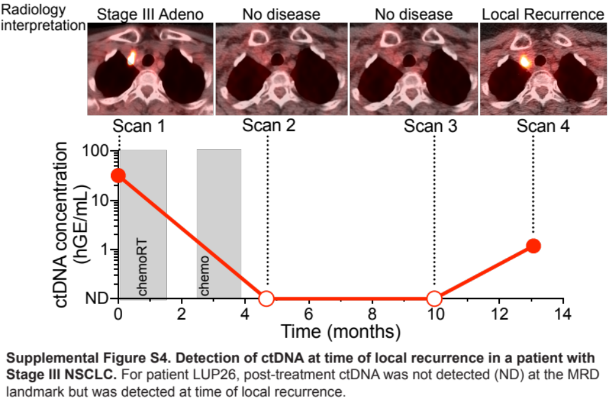
Patient with locoregional-only recurrence: ctDNA MRD detection very challenging in this setting
Chaudhuri et al. Cancer Discovery, 2017

Slide 43
Can we improve the sensitivity of locoregional ctDNA MRD detection by sampling more proximally than blood?

Slide 44
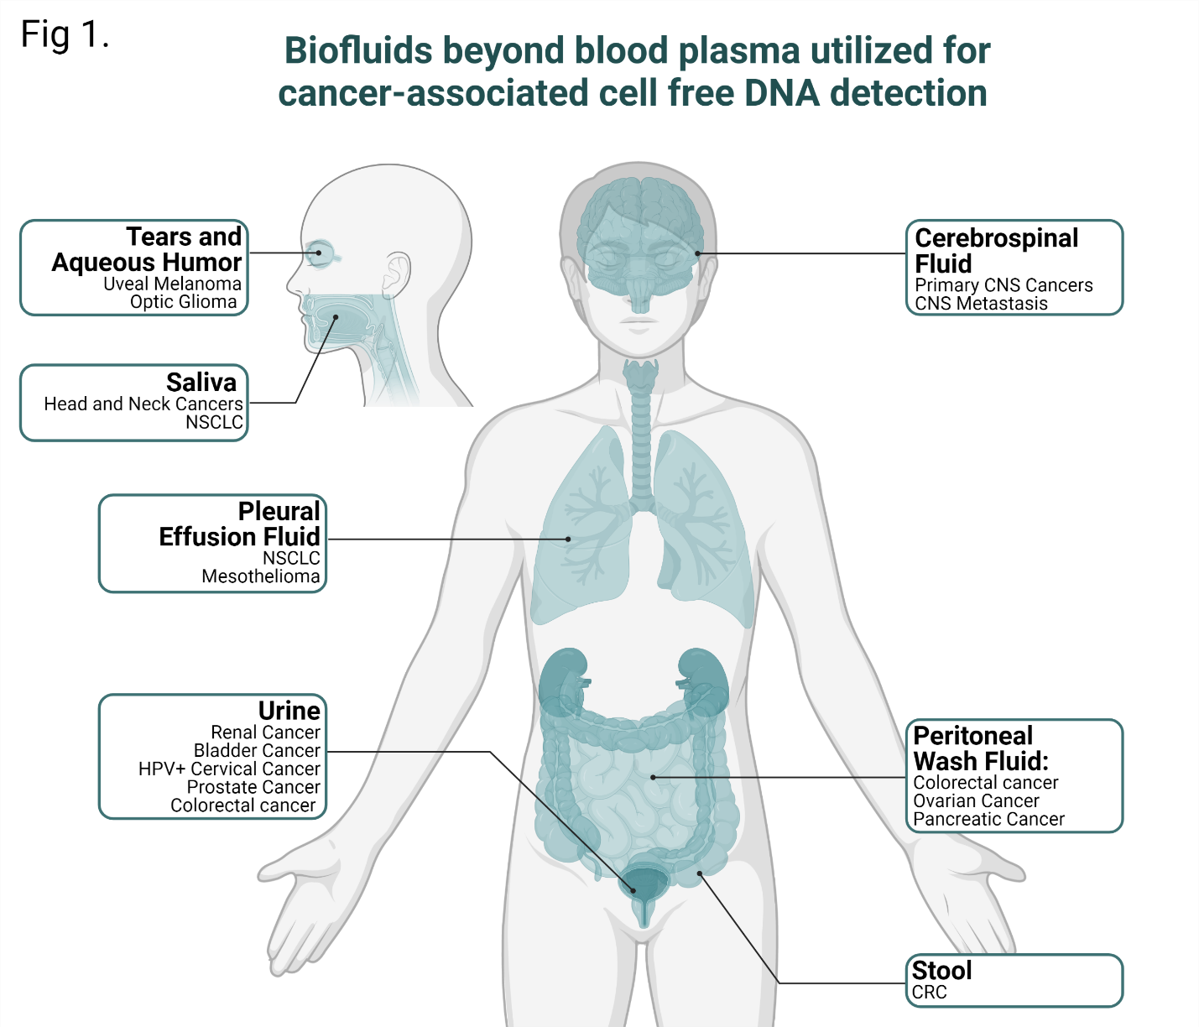

Lymph?
Semenkovich,..,Chaudhuri, JITC, 2023

Slide 45
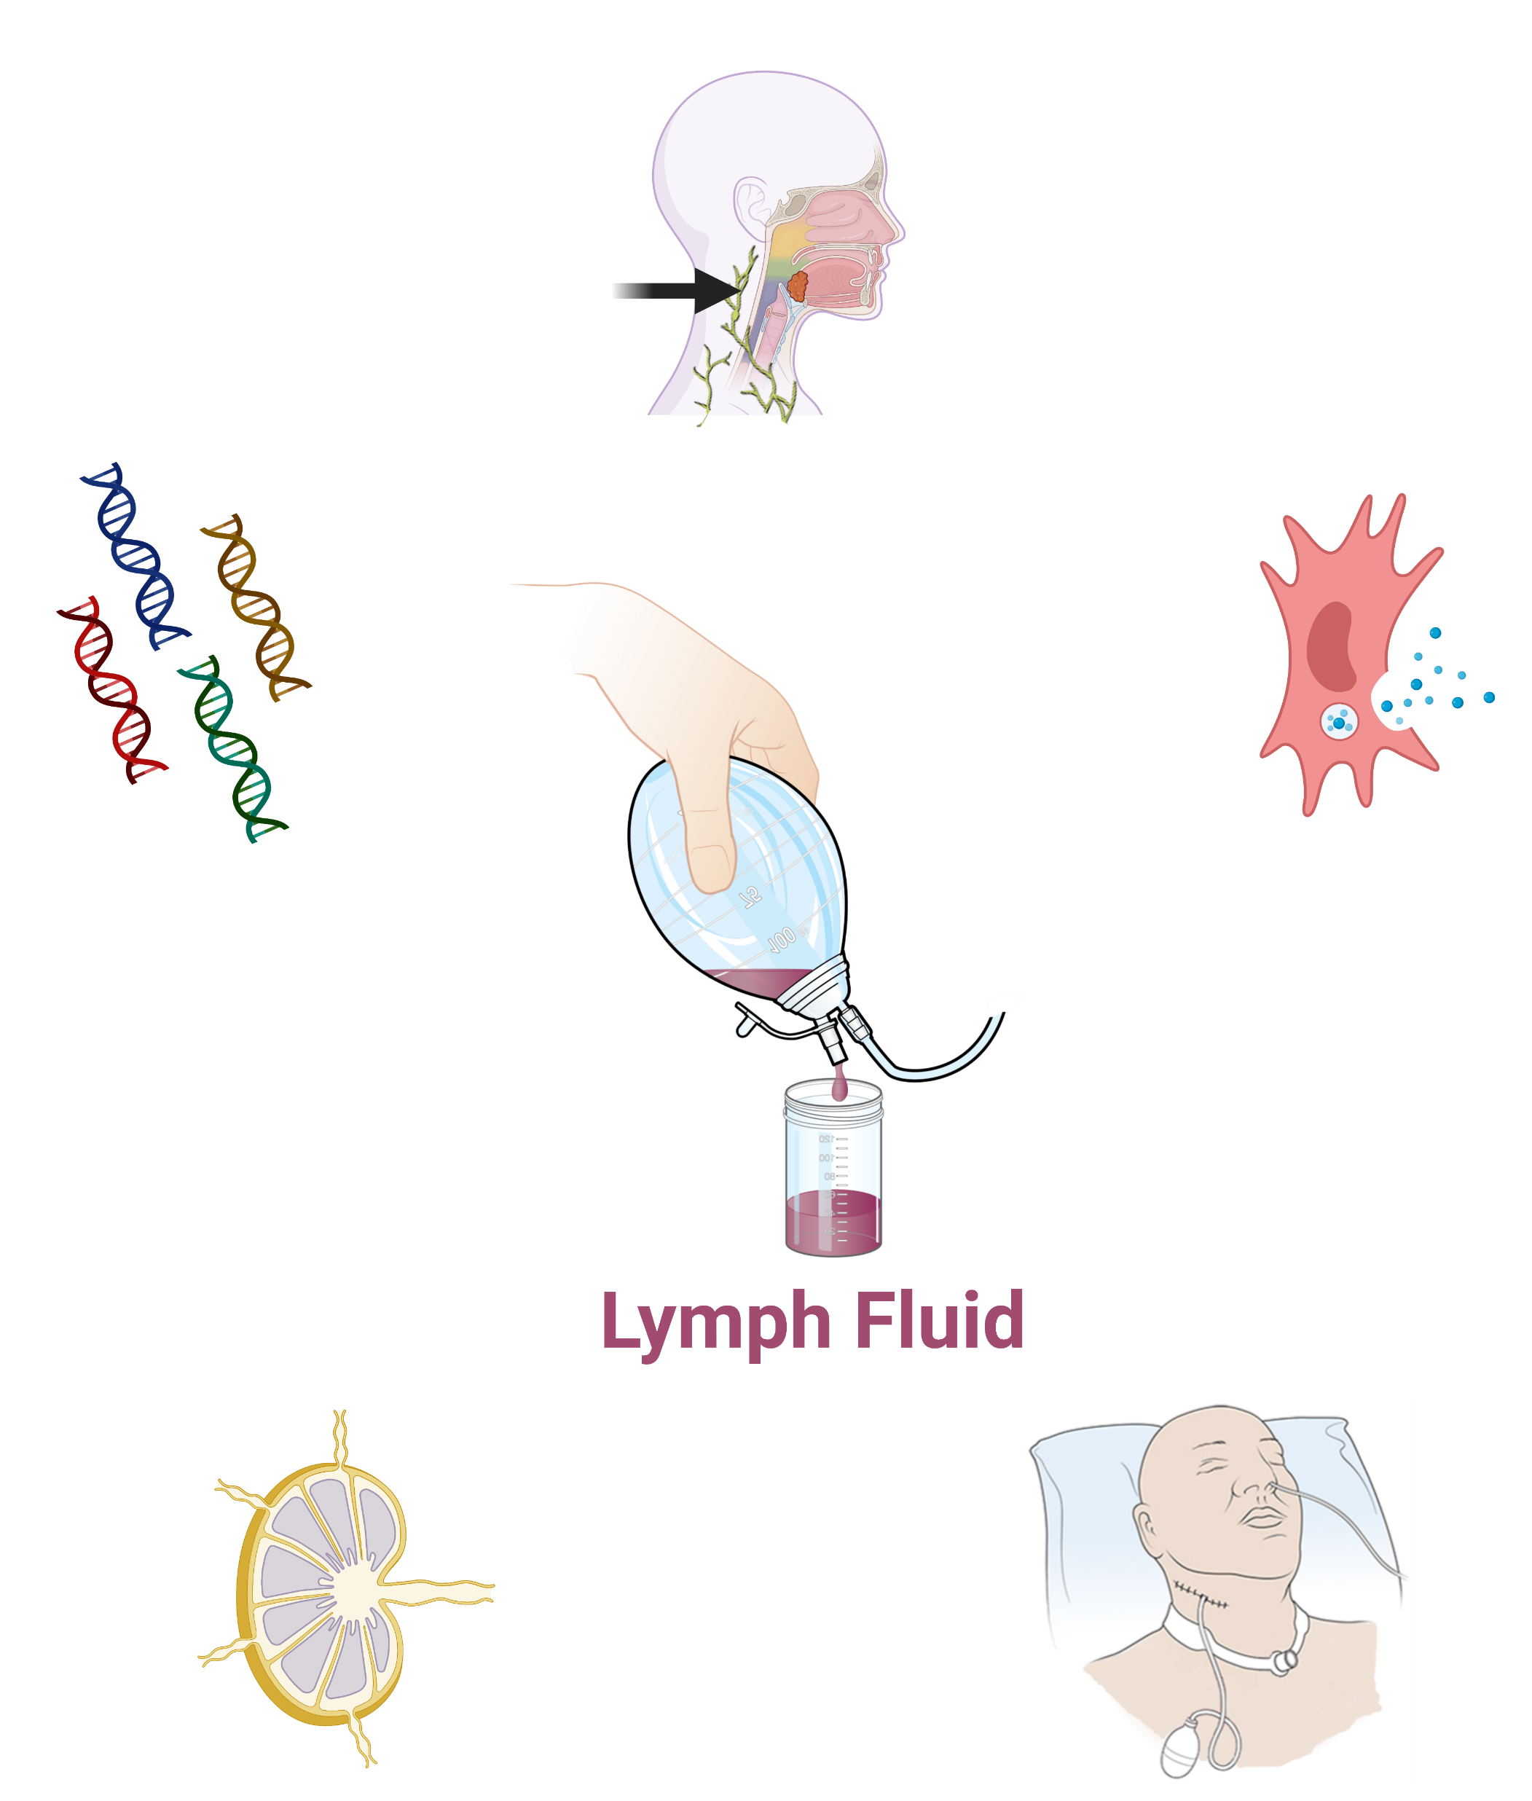

Surgical drain fluid – A lymph-enriched proximal biofluid
Proximal to disease
A proximal biofluid that is enriched for lymph
Likely enriched with biomarkers
Abundant in quantity after surgery
Proximal to locoregional LNs
Standard-of-care post-surgical biofluid

Slide 46
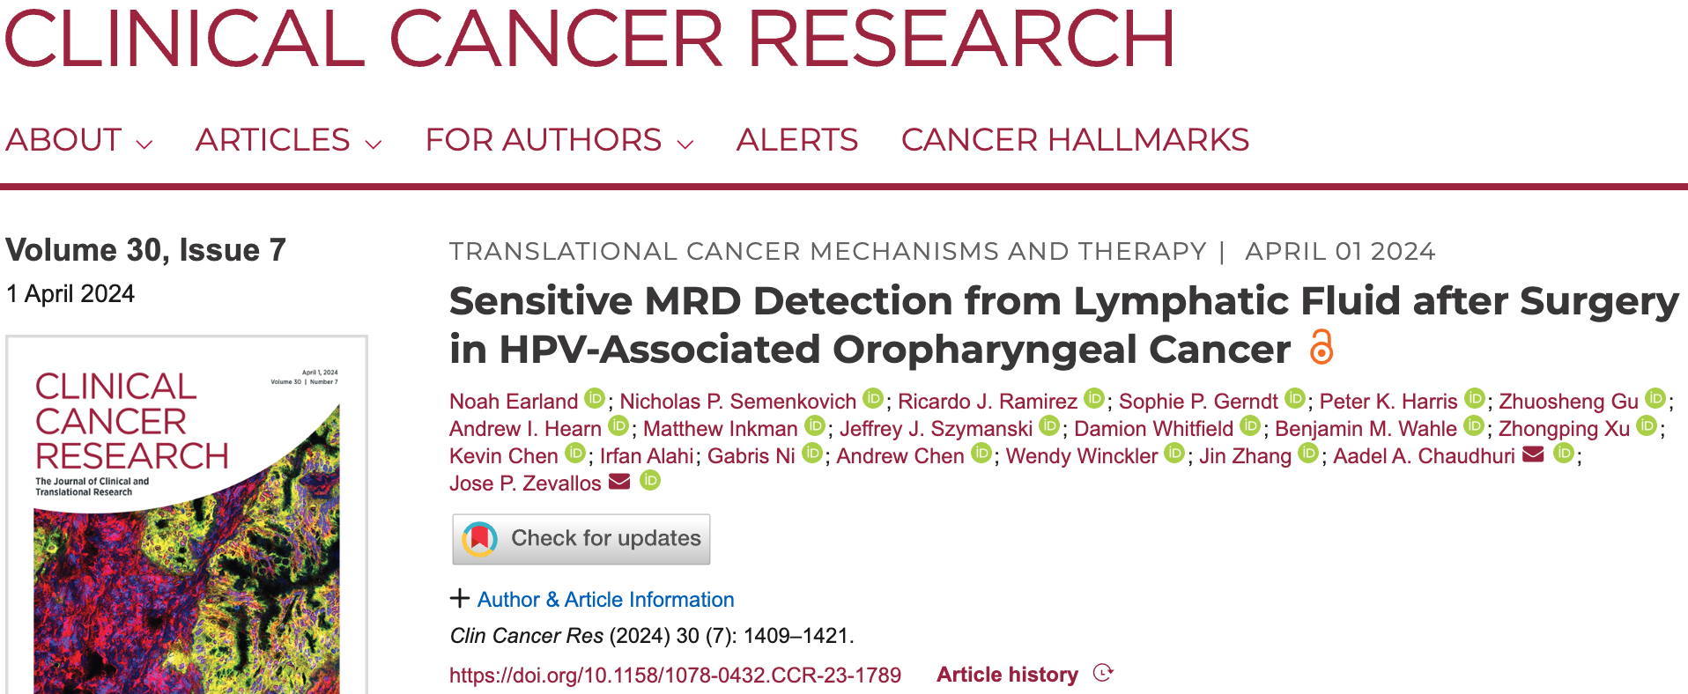

Slide 47
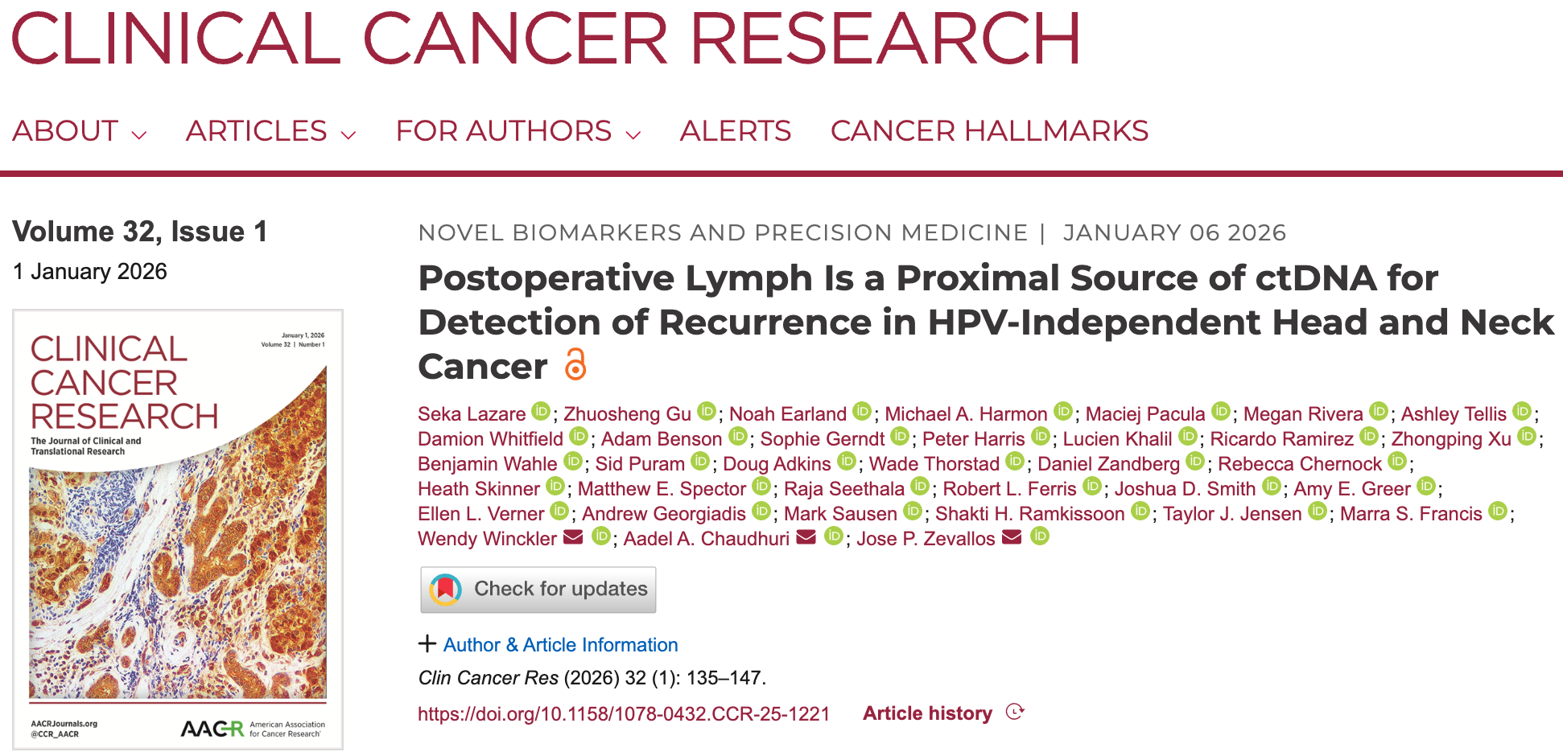

Slide 48
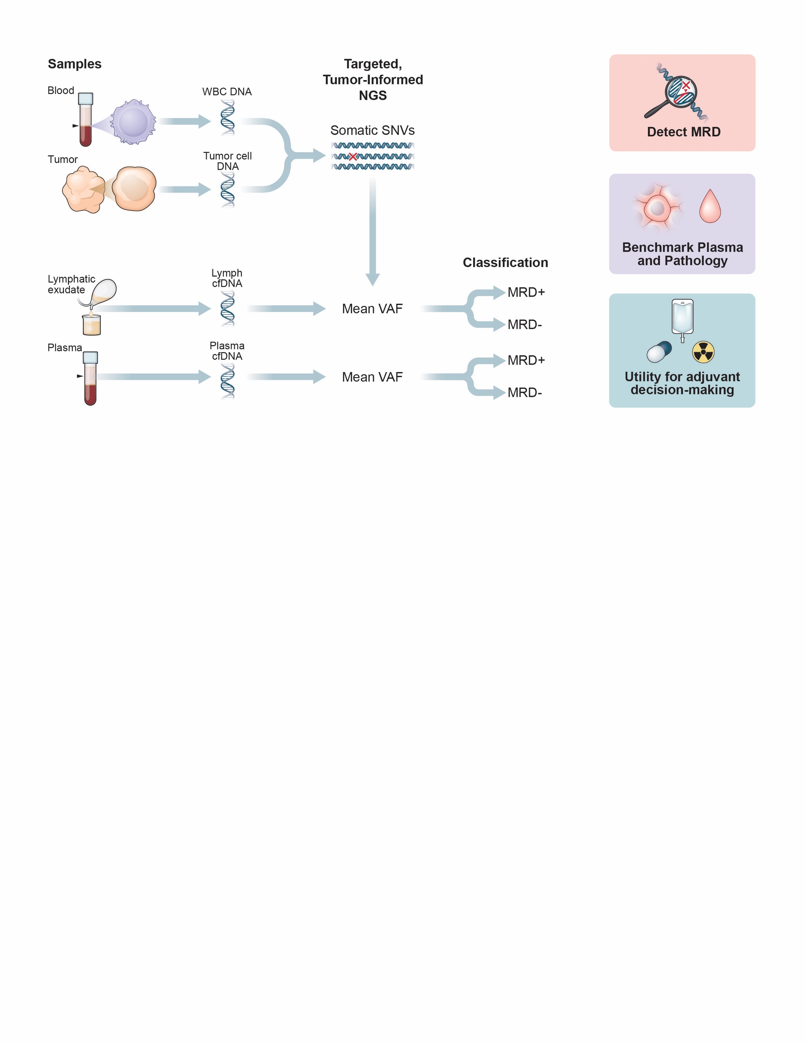

Slide 49
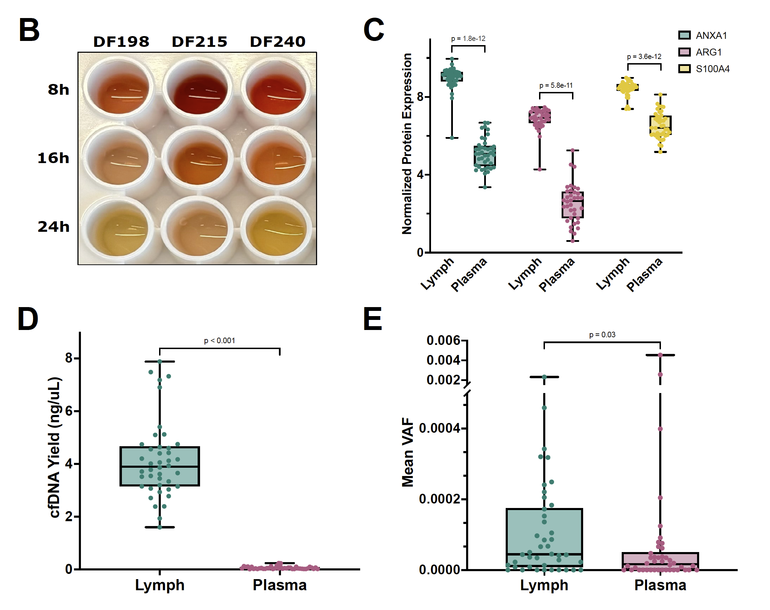
Lymph-associated proteins
24h postoperative lymph is distinct from blood and enriched in ctDNA
Lazare et al. Clinical Cancer Research, 2026

Slide 50
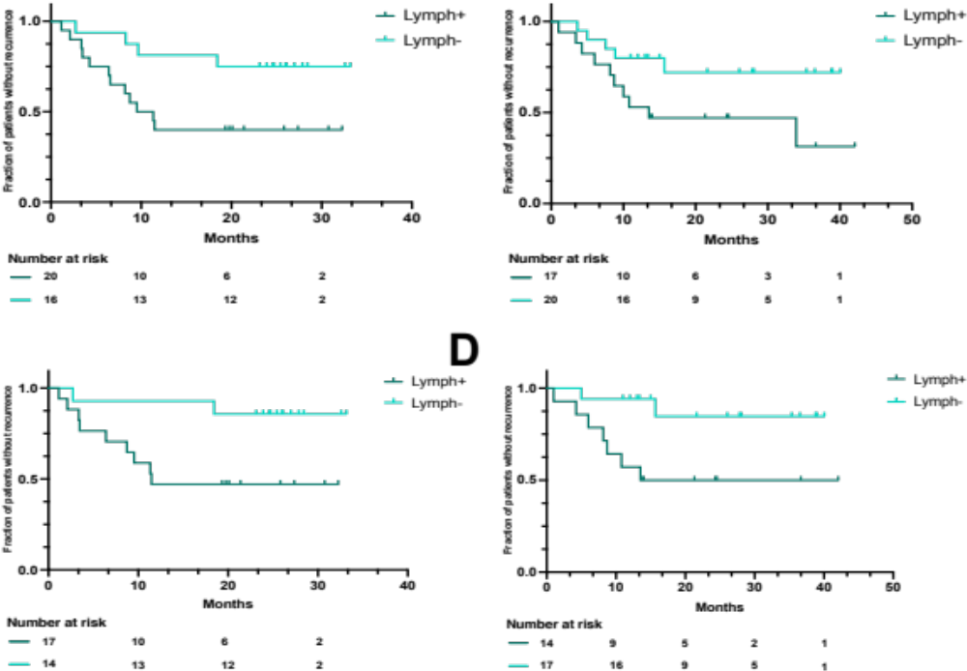
Lymph ctDNA MRD is associated with worse PFS and locoregional PFS
Progression-free Survival
Locoregional Progression-free Survival
P = 0.03
HR = 3.3
P = 0.025
HR = 4.9
Lazare et al. Clinical Cancer Research, 2026

Slide 51
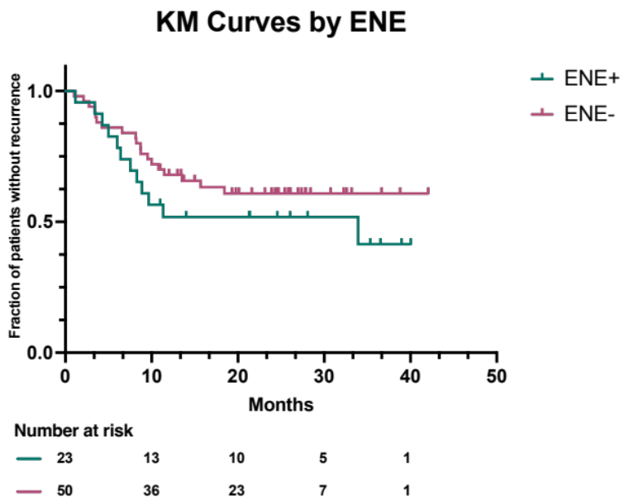
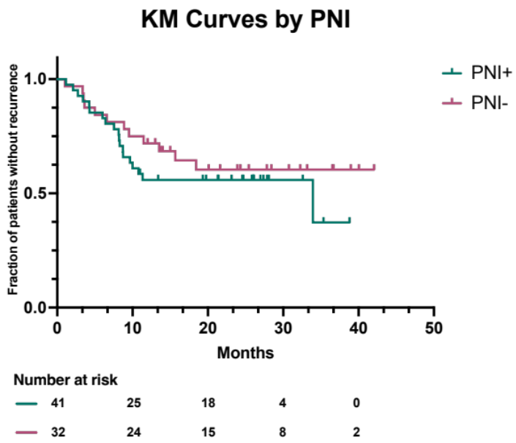
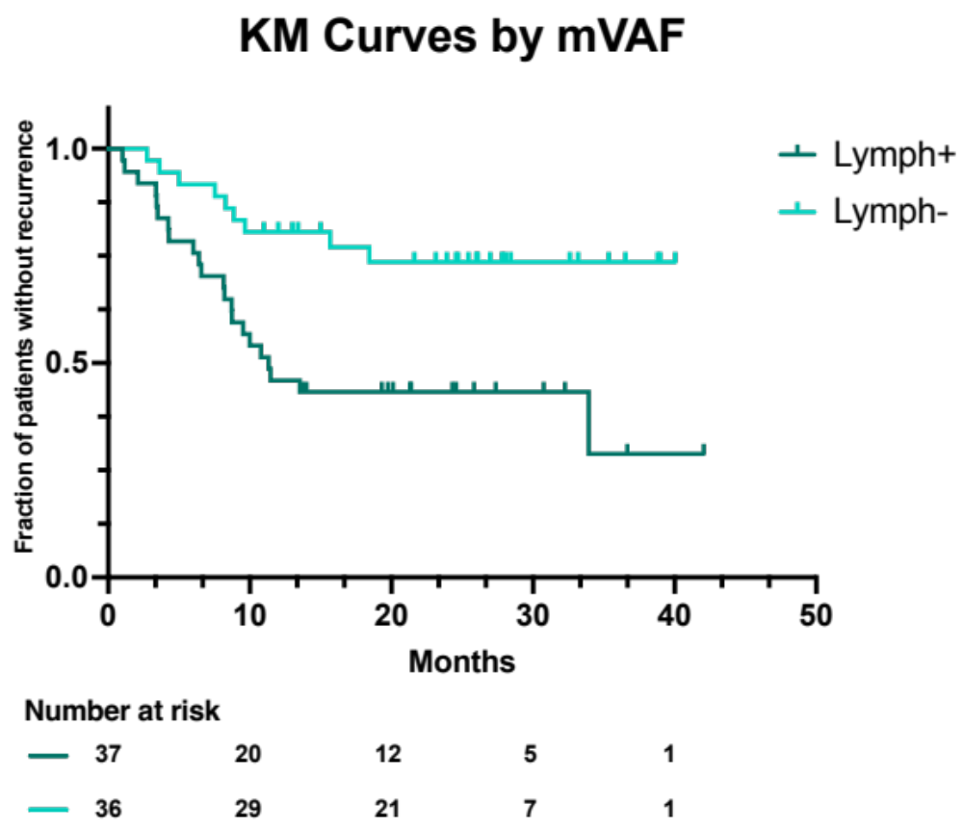
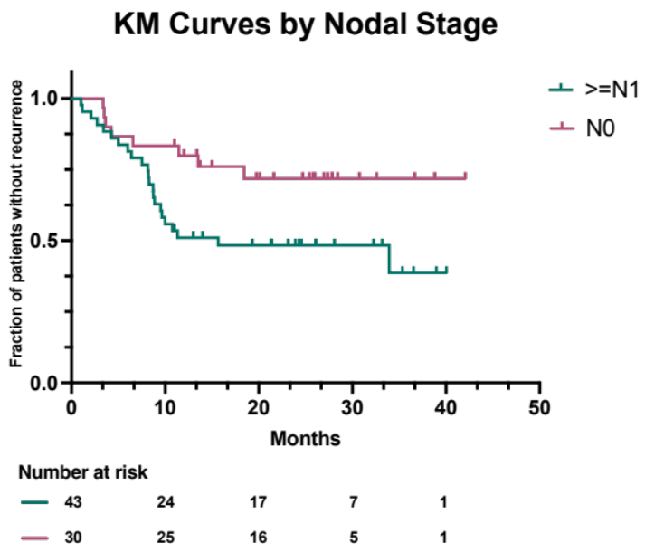

Lymph ctDNA outperforms individual pathology features
P = 0.3
HR = 1.5
P = 0.38
HR = 1.4
Lymph ctDNA
P = 0.003
HR = 3.1
P = 0.03
HR = 2.4
P = 0.02
HR = 2.2
Lazare et al. Clinical Cancer Research, 2026

Slide 52


Lymph ctDNA MRD remains prognostic in patients with low- or intermediate-risk pathology features
PFS in N0 patients (n = 27)
PFS in N(+) ENE(-) patients (n = 50)
P = 0.11
HR = 3.4
P = 0.003
HR = 4.6
Lazare et al. Clinical Cancer Research, 2026

Slide 53

Lymph ctDNA 24h after surgery significantly stratifies PFS while plasma ctDNA does not
Lymph ctDNA
Plasma ctDNA
P = 0.025
HR = 3.2
P = 0.8
HR = 1.1
Lazare et al. Clinical Cancer Research, 2026

Slide 54

Urine-based biomarkers
Bullet three
Chaudhuri et al. JCO Precision Oncology (2020)

Slide 55

PLOS Medicine, 2021

Slide 56

utDNA MRD (-) → pCR
utDNA MRD (+) → no pCR
Chauhan et al. PLOS Medicine, 2021

Slide 57

npj Precision Oncology, 2023

Slide 58

Urine outperforms plasma for bladder cancer MRD detection
Chauhan et al. npj Precision Oncology, 2023

Slide 59

Chauhan et al. npj Precision Oncology, 2023

Slide 60

Canonical genomic positions are copy number altered in urine cell-free DNA in no PCR patients
Chauhan et al.
npj Precision Oncology, 2023

Slide 61

Chauhan et al. npj Precision Oncology, 2023

Slide 62

Chauhan et al. npj Precision Oncology, 2023

Slide 63
Oligometastatic risk stratification
Image from: Wan et al. Nature Reviews Cancer, 2017

Slide 64

The conundrum of oligometastatic disease management.

Slide 65
Oligometastatic dz: From Anatomy to Biology
Oligometastasis is clinically defined, but biologically heterogeneous
Radiographic burden (lesion count) doesn’t equal systemic risk
  Precision biomarkers may be required to accurately capture micrometastatic disease burden
Immunotherapy use in modern studies could be diluting the benefit of consolidative RT in certain patients, further highlighting the importance of biological selection

Slide 66
Radiation for extracranial oligo-metastasis/progression:
Key randomized phase II clinical trials
Result | Study | Clinical setting | Key outcome with local therapy
Positive | SABR-COMET Palma 2019/2020 • n=99 | Multiple cancer types 1–5 metastases | PFS: 5-year Not Reached vs 17.3% (P = 0.001) OS: 5-year 42.3% vs 17.7% (P = 0.006)
Positive | Gomez 2016/2019 • n=49 | NSCLC • ≤3 metastases No progression after induction chemo | PFS: Median 14.2 vs 4.4 mo (P = 0.022) OS: Median 41.2 vs 17.0 mo (P = 0.017)
Positive | Iyengar / UTSW 2018 • n=29 | NSCLC • primary + ≤5 metastatic sites No progression after induction chemo | Improved PFS; Not powered for OS PFS: Median 9.7 vs 3.5 mo (P = 0.01)
Positive | CURB Tsai 2024 • n=59 | NSCLC ≤5 oligoprogressive lesions | Improved PFS PFS: Median 10.0 vs 2.2 mo (P = 0.0039)
Negative | CURB Tsai 2024 • n=47 | Breast cancer ≤5 oligoprogressive lesions | No PFS benefit PFS: Median 4.4 vs 4.2 mo (P = 0.43)
Negative | NRG-LU002 Iyengar 2024 • n=215 | NSCLC • primary + ≤3 metastatic sites No progression after induction chemo | No PFS benefit: HR 0.93 (P = 0.66) No OS benefit: HR 1.05 (95% CI 0.70–1.56)
Negative | NRG-BR002 Chmura 2022 • n=125 eligible | Breast cancer • ≤4 metastases No progression on 1st-line systemic tx | No PFS benefit: Median 19.5 vs 23.0 mo (P = 0.36) No OS benefit: 3-year 68.9% vs 71.8% (P = 0.54)
Palma, JCO 2020; Gomez, JCO 2019; Iyengar, JAMA Oncol 2018; Tsai, Lancet 2024; Iyengar, ASCO 2024; Chmura, ASCO 2022
Variable benefit motivates testing biological selection beyond lesion count

Slide 67

npj Precision Oncology, 2023

Slide 68

Semenkovich et al. npj Precision Oncology, 2023
Question: Can ctDNA detection before XRT stratify survival outcomes in oligometastatic NSCLC patients?
If so, ctDNA could represent a precision biomarker to determine which oligometastatic patients should be prioritized for consolidation XRT.

Slide 69

Semenkovich et al. npj Precision Oncology, 2023
ctDNA detection pre-XRT portends PFS
n = 309 patients
P = 0.004
HR = 1.57

Slide 70
Semenkovich et al. npj Precision Oncology, 2023
ctDNA detection pre-XRT portends OS
P = 0.030
HR = 1.65
n = 309 patients

Slide 71

Semenkovich et al. npj Precision Oncology, 2023
ctDNA levels pre-XRT portend PFS
n = 309 patients
P = 0.008

Slide 72
Semenkovich et al. npj Precision Oncology, 2023
ctDNA levels pre-XRT portend OS
P = 0.007
n = 309 patients

Slide 73

Semenkovich et al. npj Precision Oncology, 2023
Multivariable Cox regression for PFS

Slide 74

Semenkovich et al. npj Precision Oncology, 2023

Slide 75

Semenkovich et al. npj Precision Oncology, 2023
Multivariable Cox regression for OS
These real-world data suggest that pre-treatment ctDNA could be a biomarker for oligometastatic NSCLC treated with XRT

Slide 76

Hashmi et al. Clinical Cancer Research, 2026

Slide 77
Immunotherapy response prediction
Image from: Wan et al. Nature Reviews Cancer, 2017

Slide 78

Exome-wide Tumor Mutational Burden (TMB)
TMB is a biomarker for immunotherapy response
FDA approved pembrolizumab for adults and children with TMB-high solid tumors
Yarchoan et al. NEJM, 2017

Slide 79


TMB inference from plasma cell-free DNA
TCGA - Training
Stanford - Validation
CAPP-Seq Panel in Tumor (#mt)
CAPP-Seq in cfDNA (#mt)
Whole Exome (#mt)
Whole Exome (#mt)
Chaudhuri et al. Cancer Discovery, 2017

Slide 80

TMB inference from urine cell-free DNA
Chauhan et al. PLOS Medicine, 2021

Slide 81


IO benefit may or may not increase with higher bTMB
PFS
OS
Prospective BFAST Phase III trial
Peters et al. Nature Medicine, 2022

Slide 82
Can we profile the tumor microenvironment from liquid biopsy to predict IO response?

Slide 83

Spatial Ecotype discovery and Liquid Biopsy translation
Melanoma
immunotherapy cohort
Cancer patient
Zhang*, Brown*, Usmani* et al. Nature, 2026

Slide 84
Testing Liquid EcoTyper in a novel NSCLC cohort
 | MD Anderson (n = 15) | Princess Margaret (n = 13) | Mayo Clinic (n = 11) | All (n = 39)
Median age (range) | 63 (47-81) | 75 (55-82) | 63 (51-73) | 65 (47-82)
Women / ECOG 0–1 | 6 / 14 | 5 / 11 | 7 / 11 | 18 / 36
LUAD / LUSC / NOS | 12 / 2 / 1 | 10 / 2 / 1 | 9 / 2 / 0 | 31 / 6 / 2
Stage at dx I / II / III / IV | 3 / 0 / 1 / 11 | 0 / 0 / 0 / 10 (3 n.r.) | 1 / 1 / 4 / 5 | 4 / 1 / 5 / 26 (3 n.r.)
Chemo-ICI / adjuvant ICI | 15 / 0 | 13 / 0 | 9 / 2 | 37 / 2
Pembrolizumab-based | 11 | 11 (2 n.r.) | 8 | 30
PD-L1 (≥ 50%) / TMB available | 13 (2) / 0 | 13 (7) / 0 | 11 (3) / 9 | 37 (12) / 9
Durable clinical benefit | 6 (40%) | 6 (46%) | 4 (36%) | 16 (41%)
PFS events / deaths | 12 / 10 | 10 / 10 | 10 / 8 | 32 / 28
Ayesha Hashmi (Mayo Clinic) / Erin Brown (Stanford)

Slide 85


Prediction of IO / chemoIO durable clinical benefit
Ayesha Hashmi (Mayo Clinic) / Erin Brown (Stanford)

Slide 86

Liquid spatial ecotypes stratify ICI response in PD-L1-low patients
Ayesha Hashmi (Mayo Clinic) / Erin Brown (Stanford)

Slide 87

Liquid spatial ecotypes stratify survival outcomes
Ayesha Hashmi (Mayo Clinic) / Erin Brown (Stanford)
Notes:
n = 39, with 32 progression events and 28 deaths
Two-sided log-rank P; HRs come from Cox models with the same binary splits with Efron method for ties

Slide 88


Slide 89


Acknowledgements
Chaudhuri Lab
Ayesha Hashmi, MBBS
Pradeep Chauhan, PhD
Nicholas Semenkovich, MD PhD
Irfan Alahi, MS PhD
Jessica Linford, MS
Faridi Qaium, MS
Kaushal Parikh, MBBS
Minna Goldberg, BS
Jeffrey Szymanski, MD PhD
Chibuzor Olelewe, PhD
Matteo Bergsagel, MS
Lilli Greiner, BS
Taylor Weiskittel, MD PhD
Enmar Harfoush, BS
Axel Hidalgo, MS
Peter Rosen, BS
Gigi Espinoza, BS
Emiliano Maldonado, BS
Ibrahim Janjua, BS
Stanford
Aaron Newman
Erin Brown
Wubing Zhang
Minji Kang
Mayo Clinic
Aaron Mansfield
Eric Edell
Wash U
Chris Maher
Russell Pachynski
Abul Usmani
U of Pittsburgh
Jose Zevallos
Zhongping Xu
MD Anderson
Chad Tang
Tulane
Oliver Sartor
Elisa Ledet
Funding Sources
NIH/NIGMS R35 GM142710
NIH/NCI R01 CA286127
NIH/NCI R01 CA283317
NIH/NCI R01 CA278197
NIH/NCI R01 CA276174
NIH/NCI U01 CA299909
NIH/NCI R01 CA317358
NIH/NCI U01 CA301249
NIH/NCI R01 CA300454
U.S. Department of Defense
Prostate Cancer Foundation
Melanoma Research Alliance
Children’s Tumor Foundation
Patients & their families
Mayo Clinic Business Development
Mayo Clinic Advanced Diagnostics Lab
Mayo Clinic Dept of Radiation Oncology
Mayo Clinic Comprehensive Cancer Center

Slide 90
Save the Date!
Early Cancer Detection & Precision Cancer Management 2027
April 23-24, 2027
The Westin Carlsbad Resort & Spa
Carlsbad, California
ce.mayo.edu/cancerintercept2027

