Slide 1
Novel Strategies for the Early Detection of Hepatocellular Carcinoma
Jorge A. Marrero, M.D., M.S. (CRDSA), M.S.H.C.M.
T. Grier Miller Professor of Medicine
Chief, Division of Gastroenterology and Hepatology

Slide 2
Topics in Early Detection of HCC
Current Standard
New strategies

Slide 3
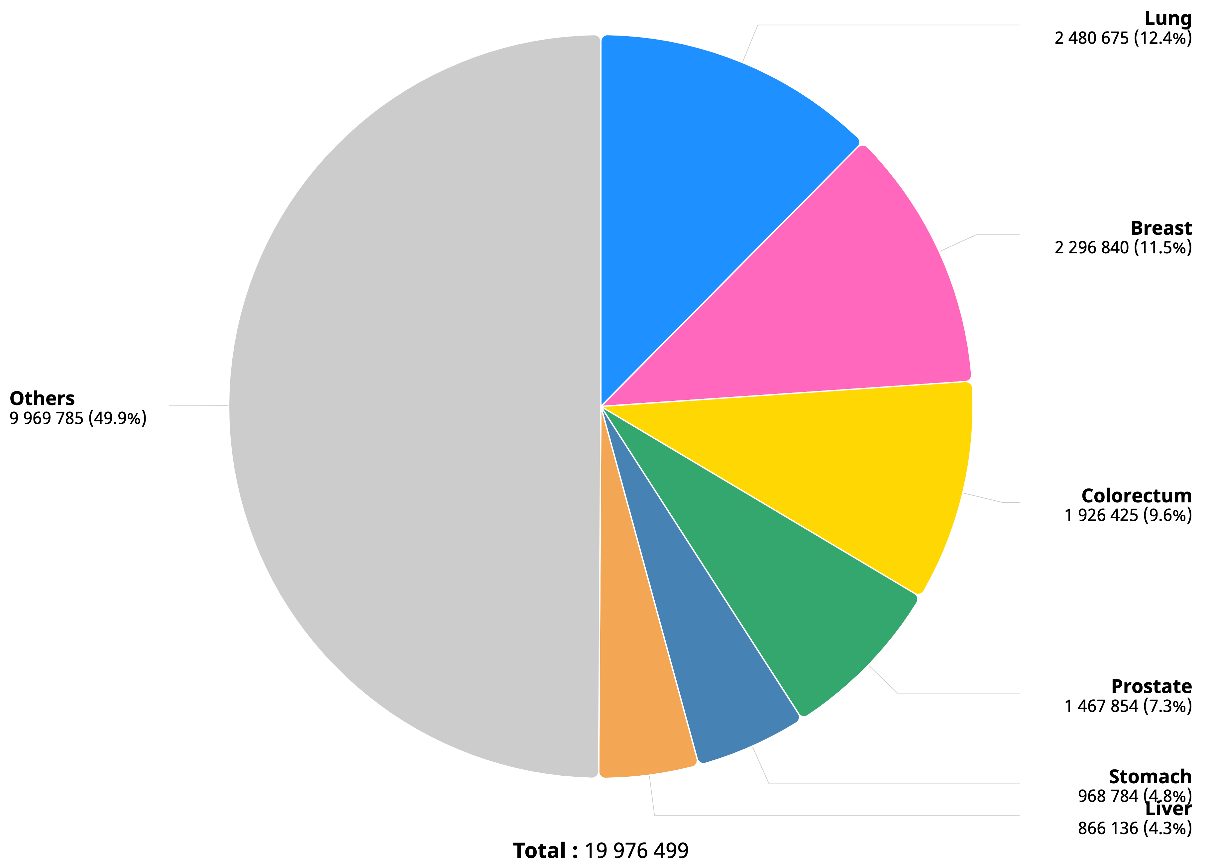
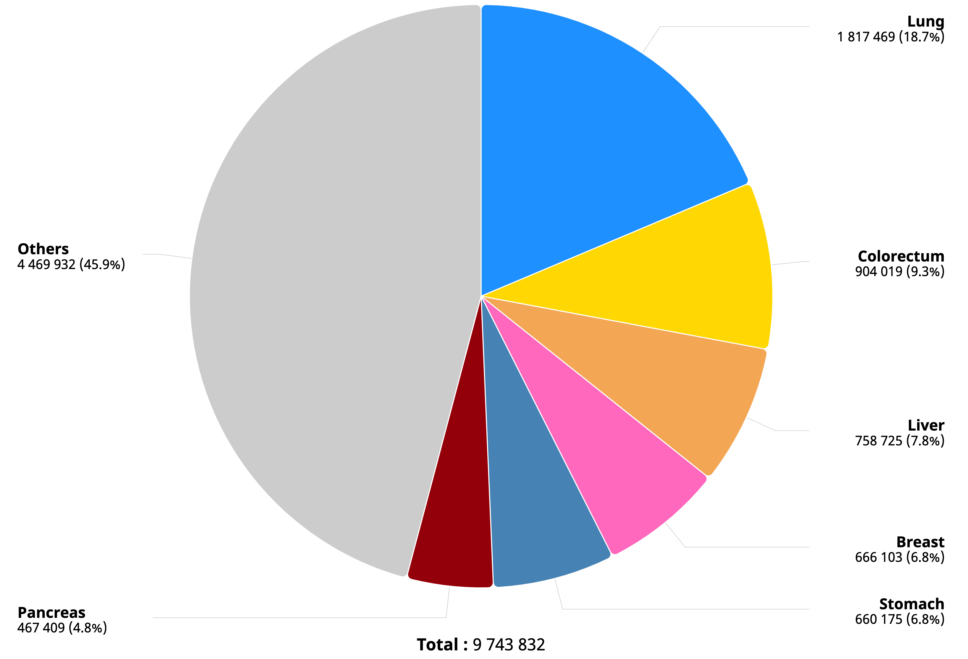
HCC Worldwide Epidemiology
Incidence
Mortality
GLOBOCAN 2022

Slide 4
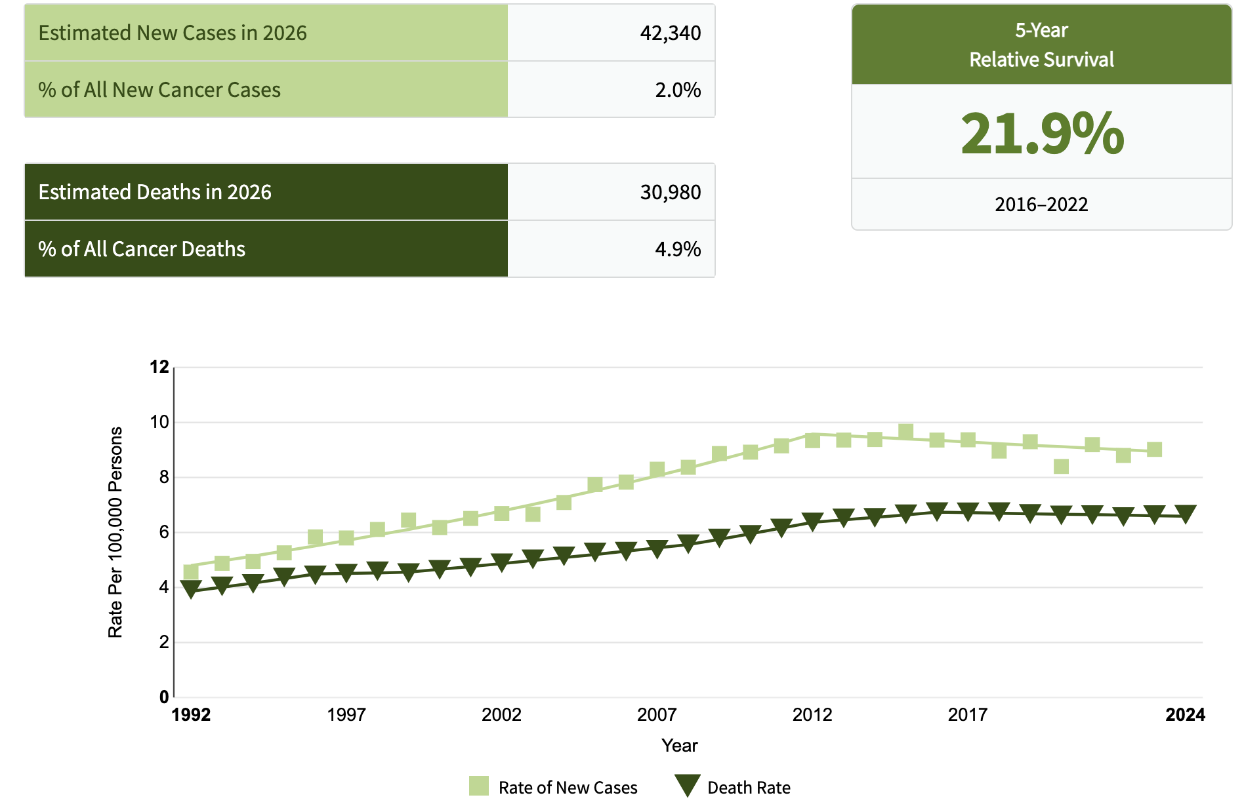
Incidence and Mortality of HCC in USA
https://seer.cancer.gov/statfacts/html/livibd.html

Slide 5
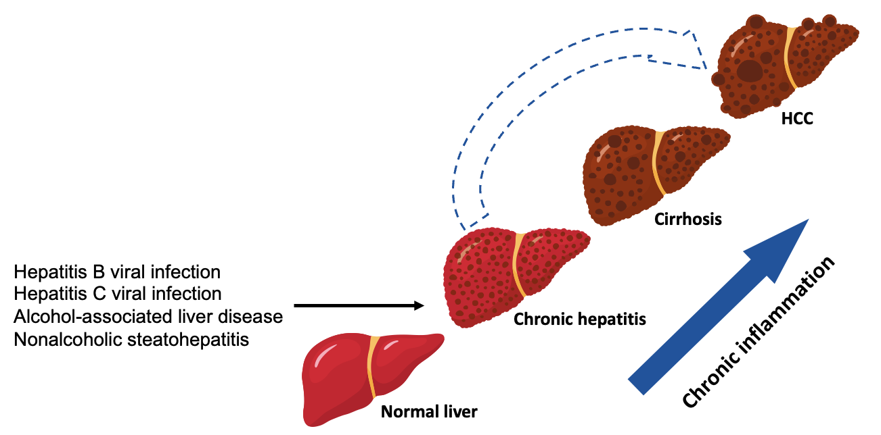
Who is the target population for HCC Surveillance?
< 0.2%/year
~1.5%/year
Metabolic Associate Steatotic LD
Alcohol related Liver Disease
Other

Slide 6
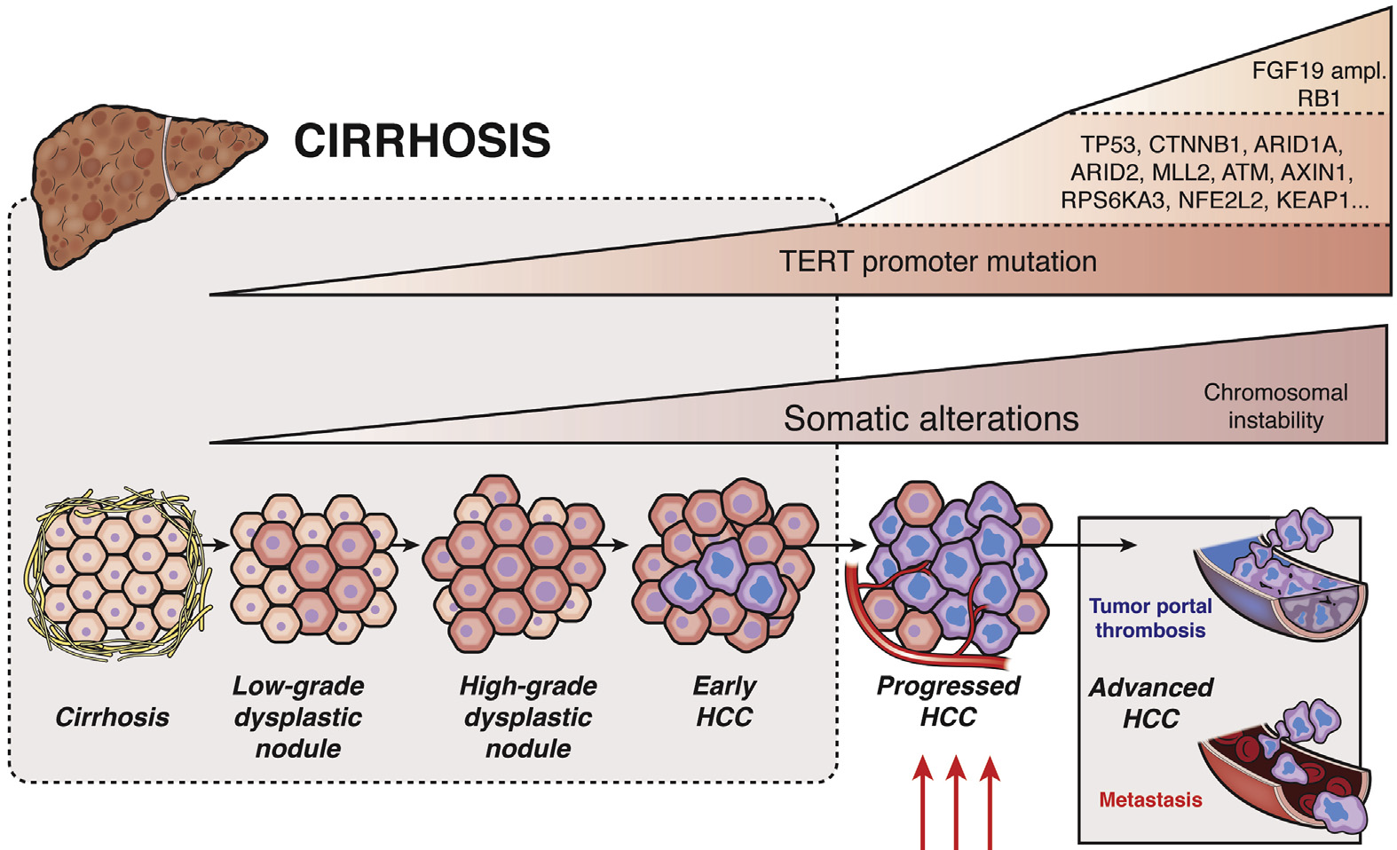
HCC Pathogenesis
Llovet JM, et al. Cell 2026
Notes:
Through a process of necrosis and regeneration, oxidative stress, and blockage of apoptosis, the hepatocytes acquire molecular aberrations, especially in the context of an immunosuppressive tissue environment and fibrosis.¹⁷ Telomerase reverse transcriptase (TERT)-activating mutations, chromosomal gains (1q, 8q) and losses (8p, 22p), and epigenetic changes (APC, SOCS1, TSPYL5) are reported gatekeepers in 30%–50% of dysplastic nodules.
To date, none of these recurrent alterations are actionable with selectively approved therapies (as opposed to multikinase inhibitors), underscoring why HCC has yet to benefit broadly from precision oncology.

Slide 7
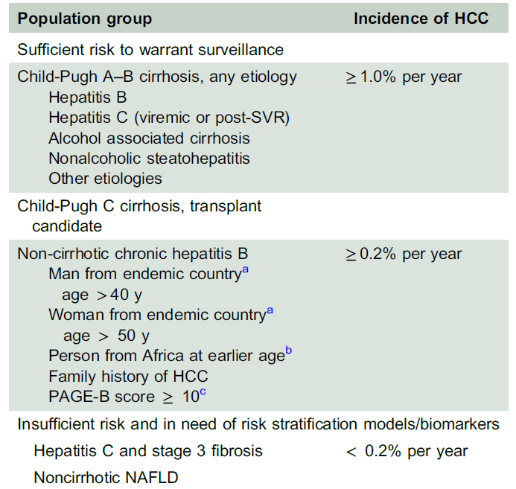
At-risk Population for HCC Surveillance
Non-cirrhotic Hepatitis B
Man from endemic country
age > 40 y
Singal AG, et al. Hepatol 2023

Slide 8
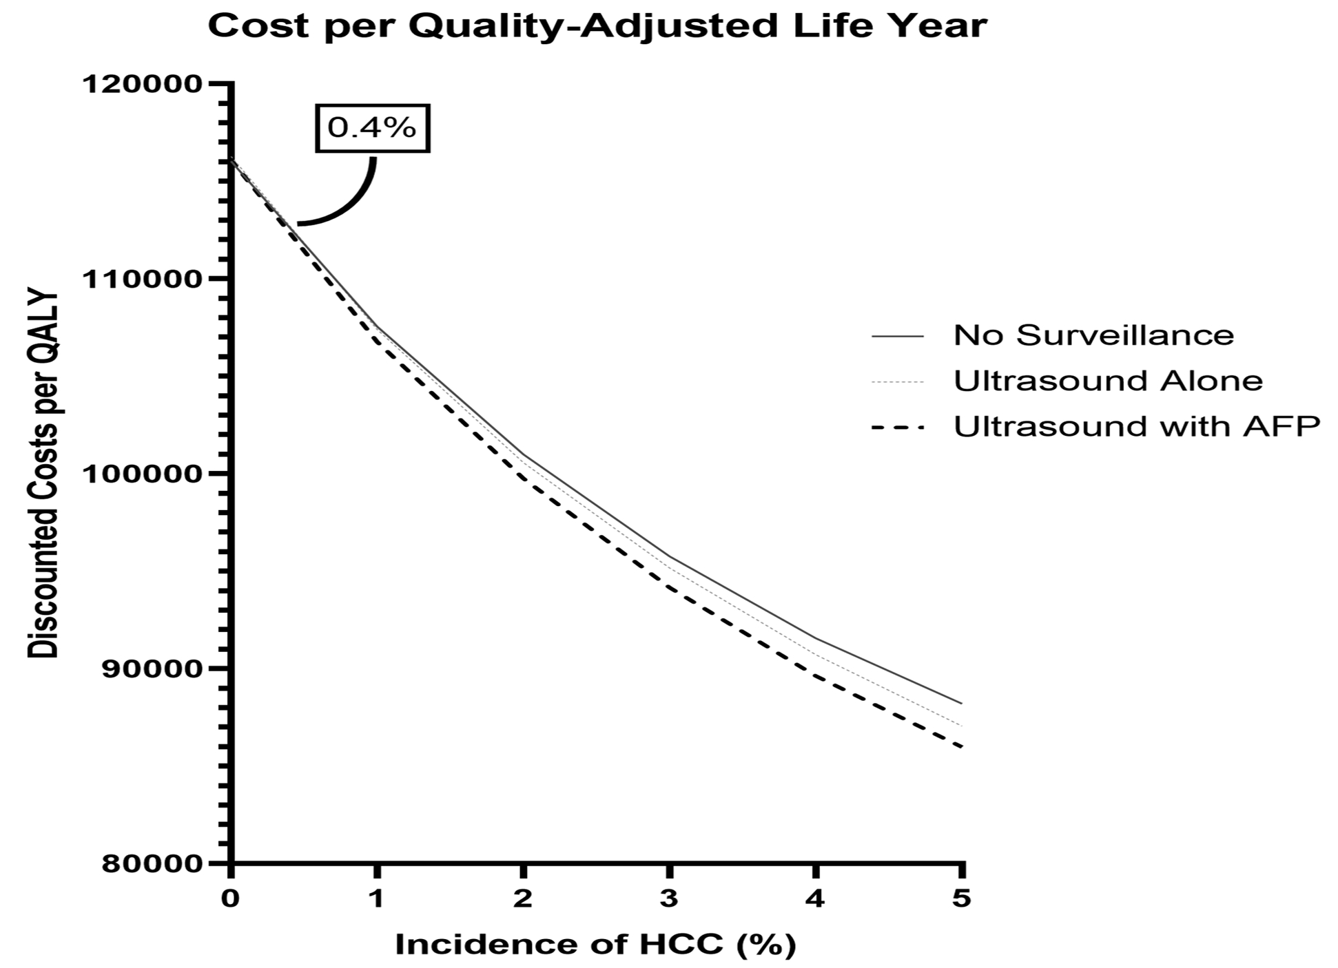
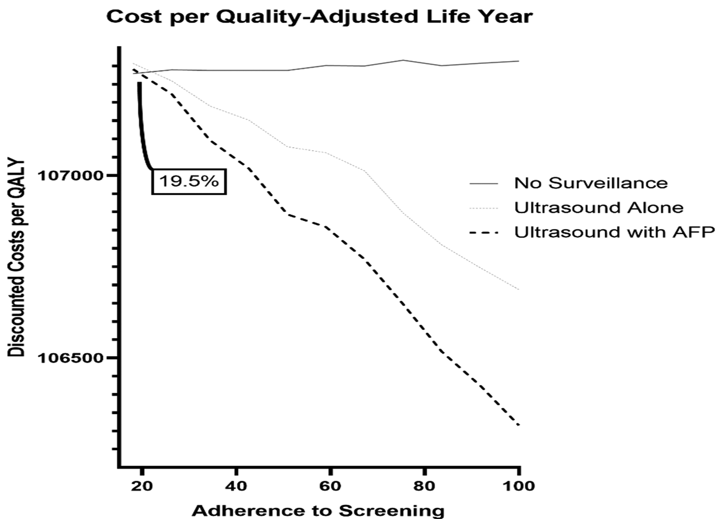
Cost-Effectiveness of Hepatocellular Carcinoma Surveillance: An Assessment of Benefits and Harms
Parikh ND, et al. Am J Gastro 2020 PMID:32530829

Slide 9
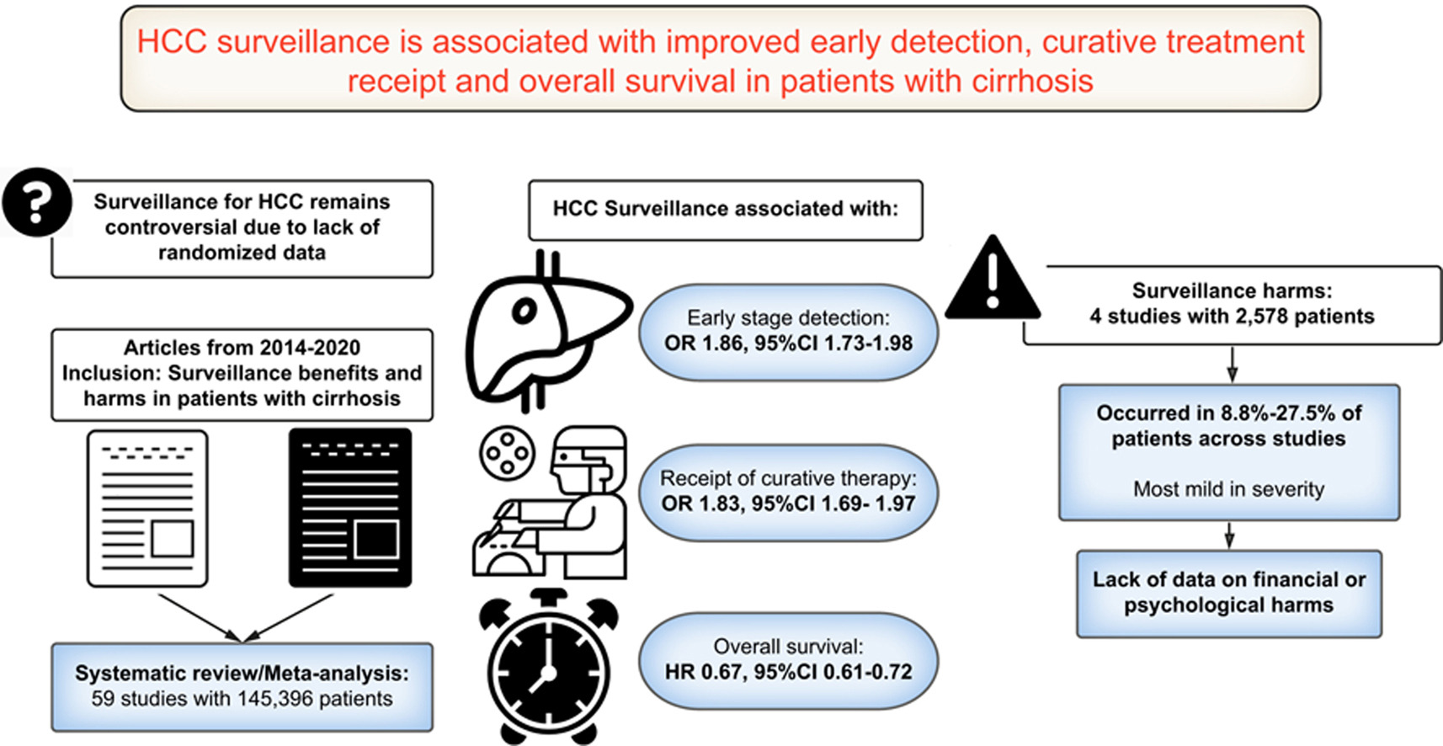
HCC Surveillance in Cirrhosis Improves Survival
Singal AS, et al. J Hepatology 2022;77:128.

Slide 10
Ultrasound and AFP Surveillance in Early HCC: Systematic Review
Tzarzeva K, et al. Gastroenterology 2018

Slide 11
Patients report barriers to HCC surveillance
N=541 patients
Receipt of HCC surveillance was significantly lower in patients reporting barriers to surveillance (54% vs. 71%; OR 0.42, 95%CI 0.25 – 0.70)
Farvardin et al. Hepatology 2017

Slide 12
US Quality in Surveillance of HCC
Definitely Adequate Likely Adequate Likely Inadequate Definitely Inadequate
Simmons O, et al. Aliment Pharmacol Ther 2017 Jan;45(1):169

Slide 13
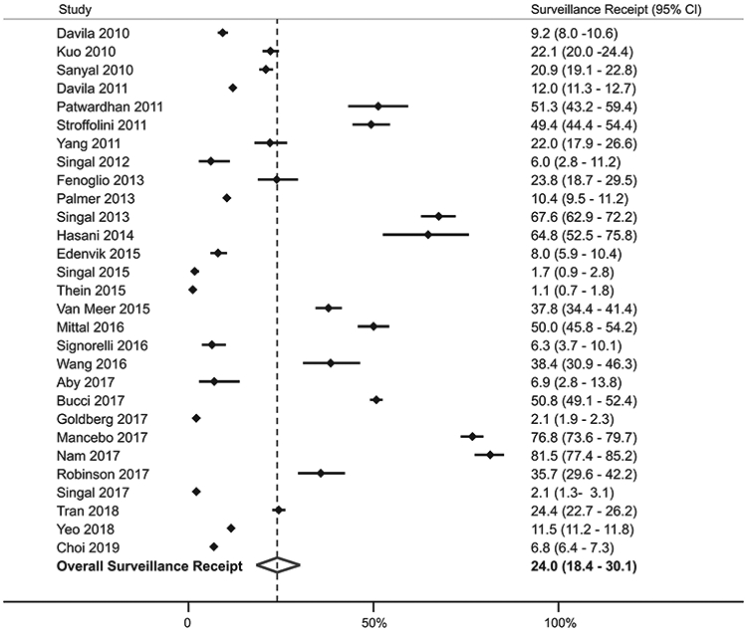
Utilization of Surveillance for HCC is Low
Huang DQ, et al. Nat Rev Gastroenterol Hepatol 2023

Slide 14
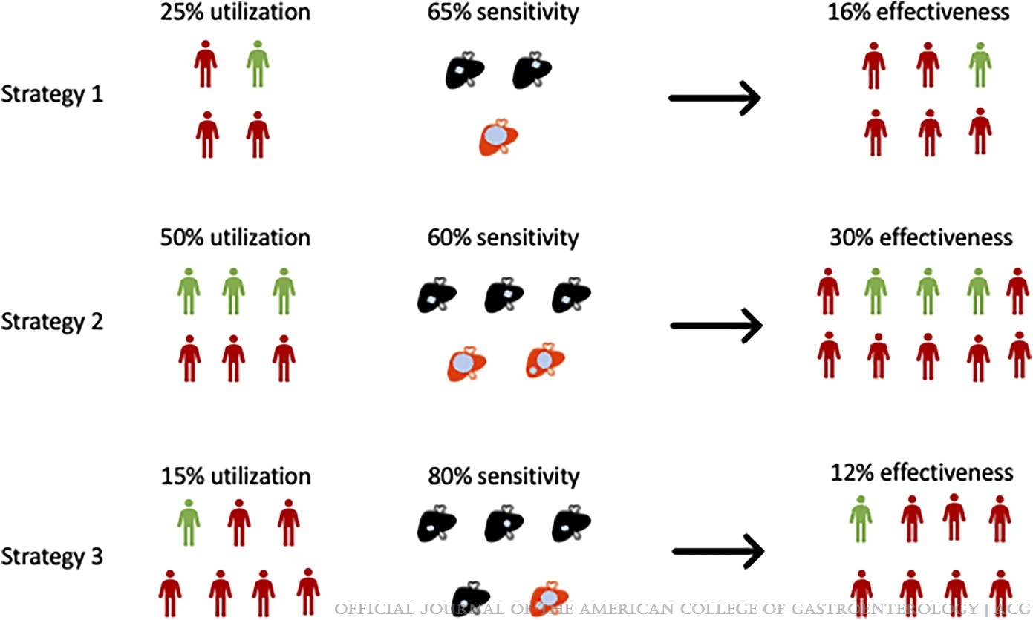
Adherence Improves the Effectiveness of Screening
Singal AG, et al. Am J Gastroenterol 2022;117:1948

Slide 15
Topics in Early Detection of HCC
Current Standard
New strategies

Slide 16
Phase 2 of AFP, AFP-L3 and DCP in Early Stage HCC in Cirrhosis
 | Cutpoint (95%CI) | Sensitivity (%) | Specificity (%)
DCP mAU/mL | 202 (61-331) | 56 | 77
AFP-L3 % | 0.6 (0.6-1.9) | 37 | 93
Total AFP ng/mL | 10.9 (5.7-18.4) | 66 | 82
Marrero JA, et al. Gastroenterology 2009

Slide 17
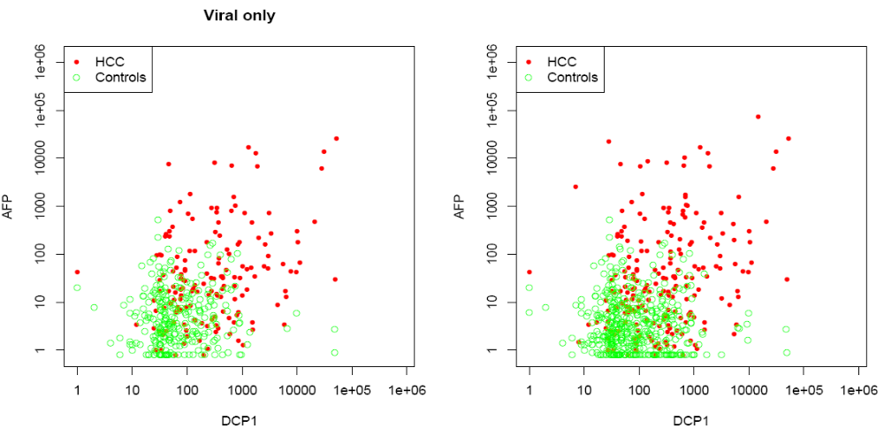
AFP and DCP are Complementary in Early-Stage HCC
Marrero JA, et al. Gastroenterology 2009

Slide 18

GALAD for the detection of Early Stage HCC in Cirrhosis
Johnson PJ, et al. Cancer Epidemiol Biomarkers Prev 2013;23:144

Slide 19
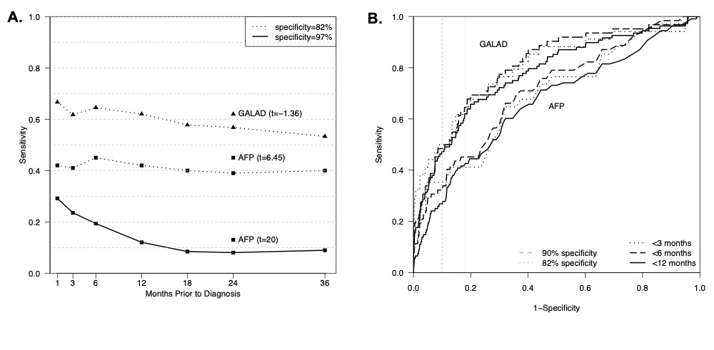
Phase 3 validation of GALAD in HCC: HEDS Study
Marsh T, et al. Gastroenterology 2025 PMID: 39293548

Slide 20
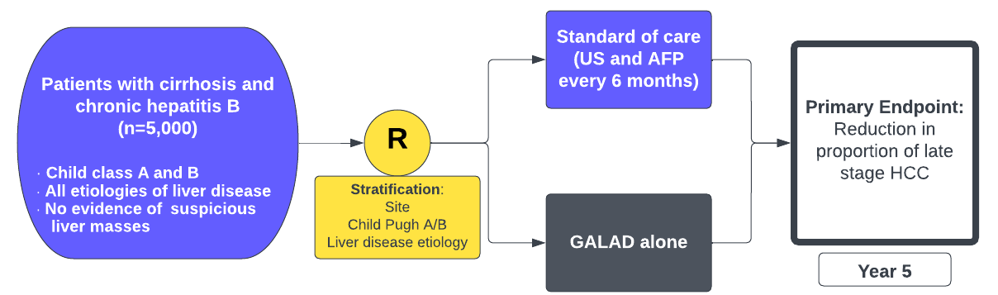
National Liver Cancer Screening Trial (TRACER)

Slide 21
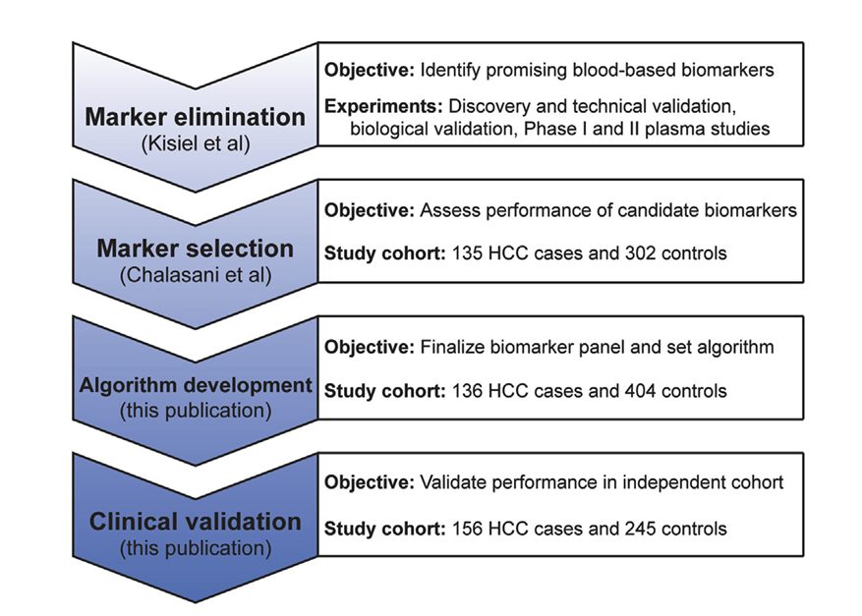
Multitarget Blood Test Biomarker for Hepatocellular Carcinoma
The mt-HBT combines information from 3 DNA methylation markers (HOXA1, TSPYL5, and reference marker B3GALT6).
AFP
Sex
Chalasani N, et al. Clinical Gastroenterology and Hepatology 2022;20:173–182

Slide 22
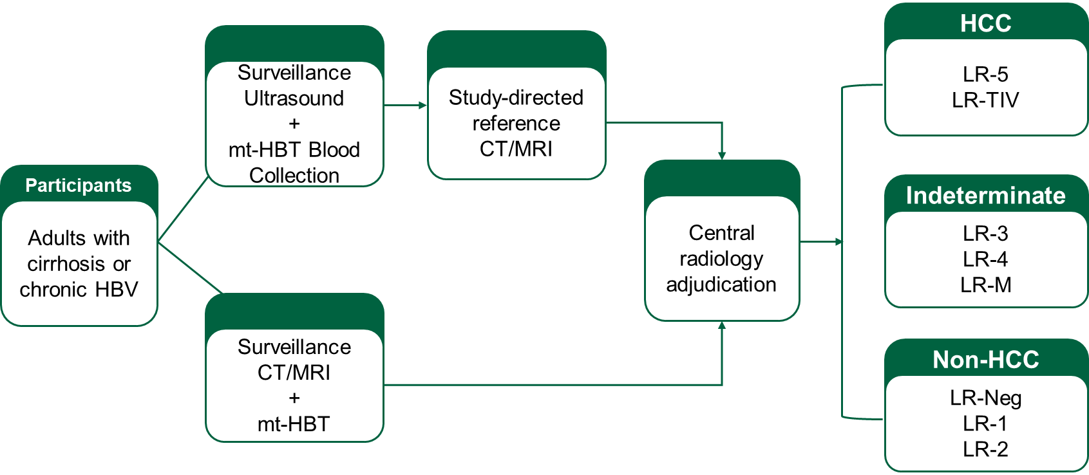
Multi-Target Blood Test Versus Ultrasound in Detecting Hepatocellular Carcinoma: Results from the ALTUS Prospective Study

Slide 23
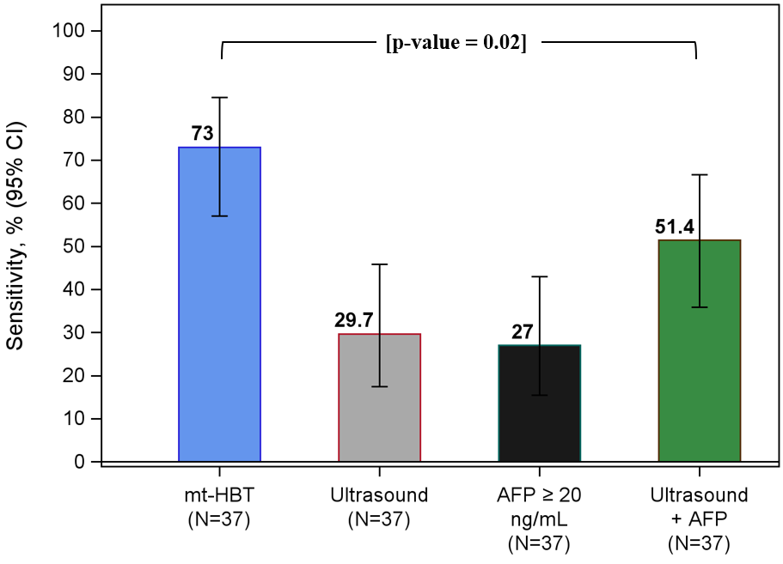
ALTUS: Overall (any Stage) HCC Sensitivity
2,467 patients enrolled; 40 incident HCC
mt-HBT demonstrated the highest overall HCC sensitivity (73.0%), outperforming ultrasound (29.7%), AFP (27.0%), and ultrasound plus AFP (51.4%).
All HCCs that had a paired mt-HBT and Ultrasound were included.
AFP, alpha-fetoprotein; HCC, hepatocellular carcinoma; mt-HBT, multi-target HCC blood test

Slide 24
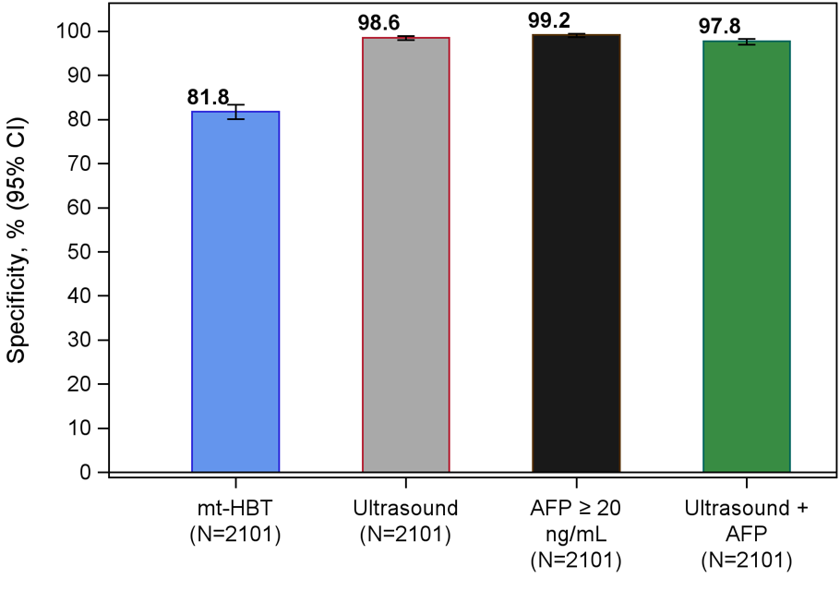
ALTUS Study: Specificity
mt-HBT specificity was 81.8% (95% CI, 80.1-83.4) and exceeded a Delphi panel consensus recommendation of 80% for emerging HCC surveillance tests.¹
1. Singal AG, et al. Hepatology. 2025;82(3):794-809.
All non-HCCs that had a paired mt-HBT and Ultrasound were included.
The mt-HBT specificity in the overall effectiveness population was 81.9% (95% CI 80.3-83.4).
AFP, alpha-fetoprotein; HCC, hepatocellular carcinoma; mt-HBT, multi-target HCC blood test

Slide 25
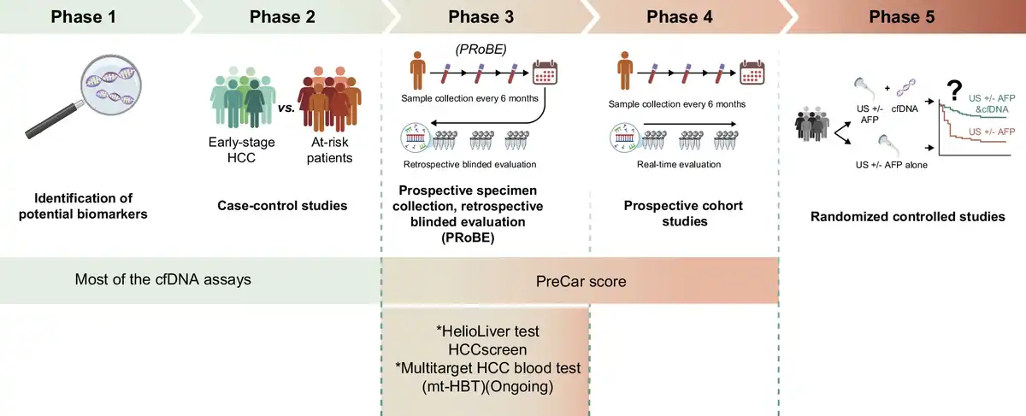
Validation phases of cell-free DNA as an early detection biomarker for HCC
Wang, J. J., et al. Hepatology 2026;84(4):1096–1120.

Slide 26
HCC Surveillance Tests Undergoing Validation
Test | Level of Evidence
GALAD | Phase 4/5 validation
PEB Longitudinal GALAD and AFP | Phase 3
Methylation DNA algorithm | Phase 3 validation
Glycoproteomic biomarker panel | Phase 1-2 validation
Cell-free DNA | Phase 2 validation
mSEPT9 | Phase 2 validation
Multicenter platform | Phase 2 validation

Slide 27
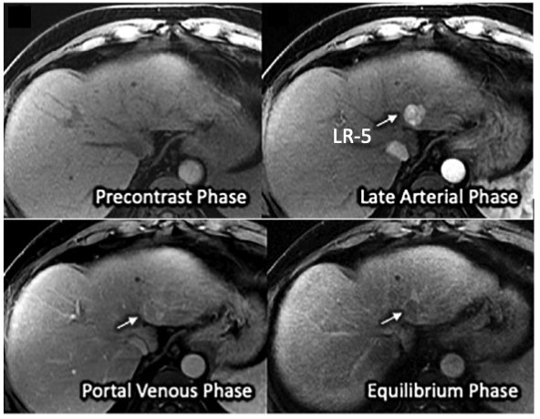
Multicenter Validation of Abbreviated MRI for Early Stage HCC
Retrospective study in 161 patients with cirrhosis who underwent MRI followed by resection or transplant for early stage HCC. 138 controls without HCC
Dynamic abbreviated MRI had a sensitivity of 88% and specificity of 89% for early stage HCC
54 (33%) had HCC between 1-1.9 cm
Patient-level sensitivity was lower in Child-Pugh B or C cirrhosis than class A
Issues with cost, capacity, patient preference
Yokoo T, et al. Radiology 2023;307:e220917

Slide 28
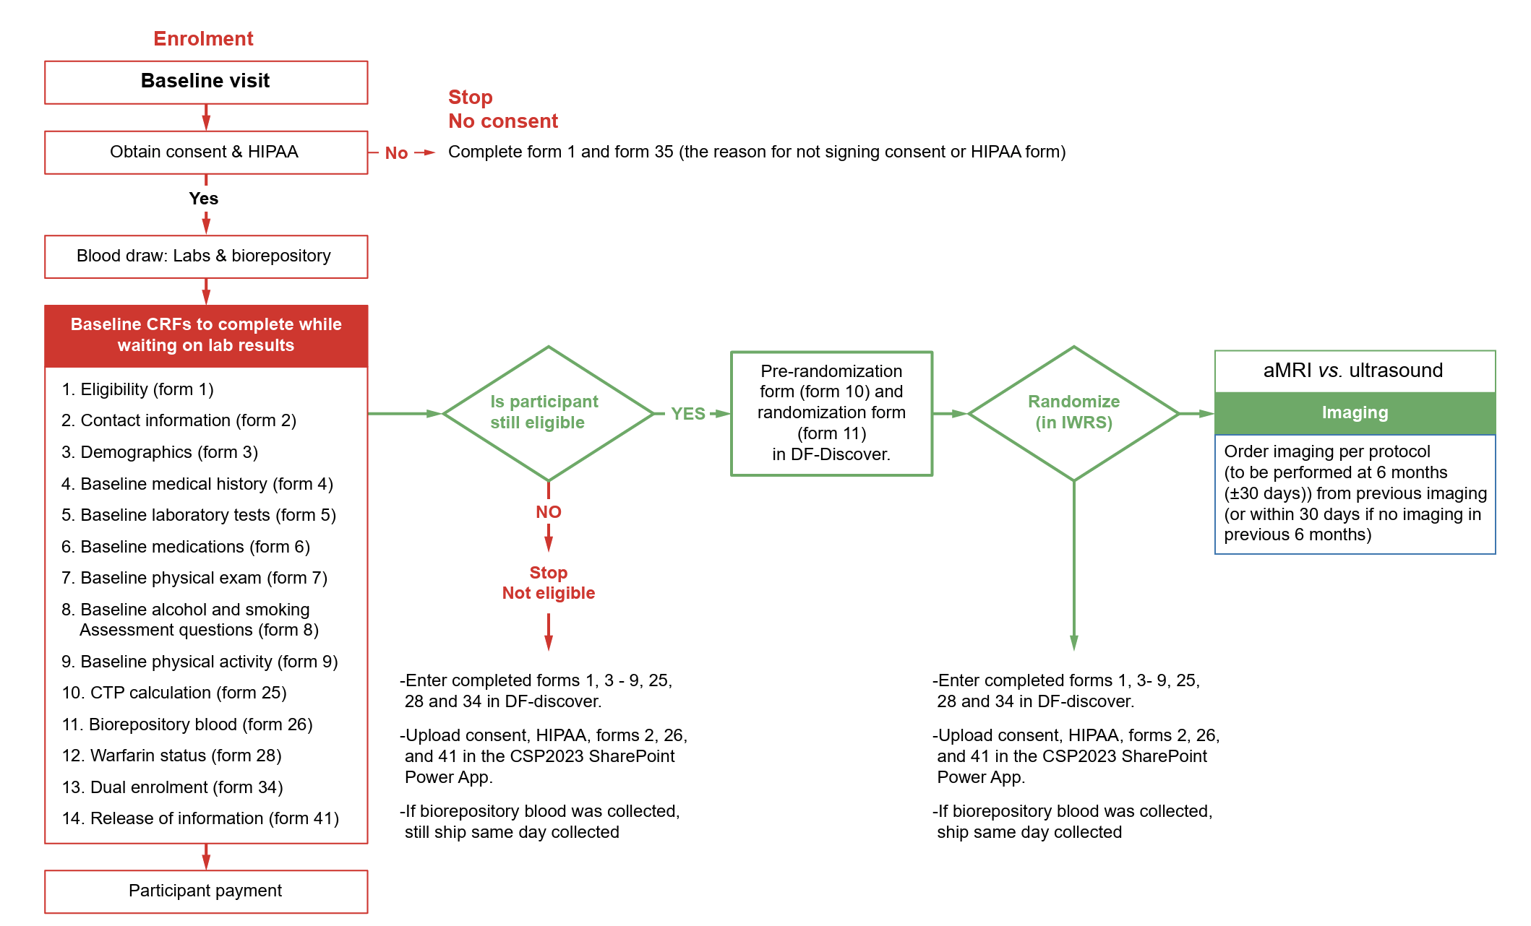
Abbreviated MRI plus AFP vs. US plus AFP for HCC in cirrhosis (PREMIUM study)
Ioannou GN, et al. HEP Reports 2026

Slide 29
Summary
Patients with cirrhosis and non-cirrhosis HBV (PAGE-B> 10) are at the highest risk and should undergo surveillance.
Ultrasound and AFP are the best surveillance tests at the moment.
Increasing utilization and adherence are critical to further improve outcomes.
Blood-based biomarker approaches may improve the effectiveness of surveillance for HCC.
GALAD and multi-target HCC blood test may be better than the current strategy.
Liquid biopsy and aMRI hold promise as other strategies.

