Slide 1
Advances in Blood-Based
Cancer Screening: from
CRC to Multicancer Detection
Minetta C. Liu, MD
CMO, Oncology and Early Cancer Detection
Natera, Inc

Slide 2
Financial Disclosures
Natera: Employment and stock

Slide 3
Basic Tenets for Development of a Cancer Screening Test
ctDNA shed rates
Molecular heterogeneity of the cancer(s) of interest
The target intended use population
  Healthy vs at-risk vs high-risk populations
  Symptomatic patients
  Patients with indeterminate physical or radiographic findings
Need for new clinical workflows
  Interpret a screen detected result
  Guide evaluation of a screen detected result to diagnostic resolution
  Monitor patients with a screen detected result but no cancer diagnosis

Slide 4

Early Cancer Detection at Natera
Unparalleled sample access enables deep discovery
1
Biological depth
>250,000 CRC exomes sequenced across all stages enables deep biological understanding of the disease
Novel platform developed over 2 years
Deep and broad methylation discovery with cancers, premalignant lesions, and other conditions
2
Discovery
3
Algorithm
Development specific to advanced adenoma targets and samples
4
Methylation technology refinement reduces the noise floor
Technology

Slide 5
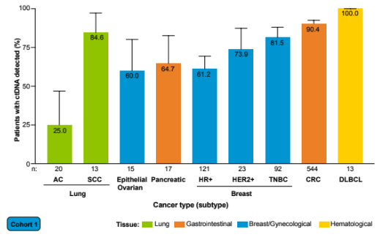
Detection rates vary by cancer type, stage, and subtype
Pretreatment ctDNA detection by Signatera in stage I/II disease
Nakamura et al. 2025. Presented at ESMO..
Not for reproduction or further distribution.

Slide 6
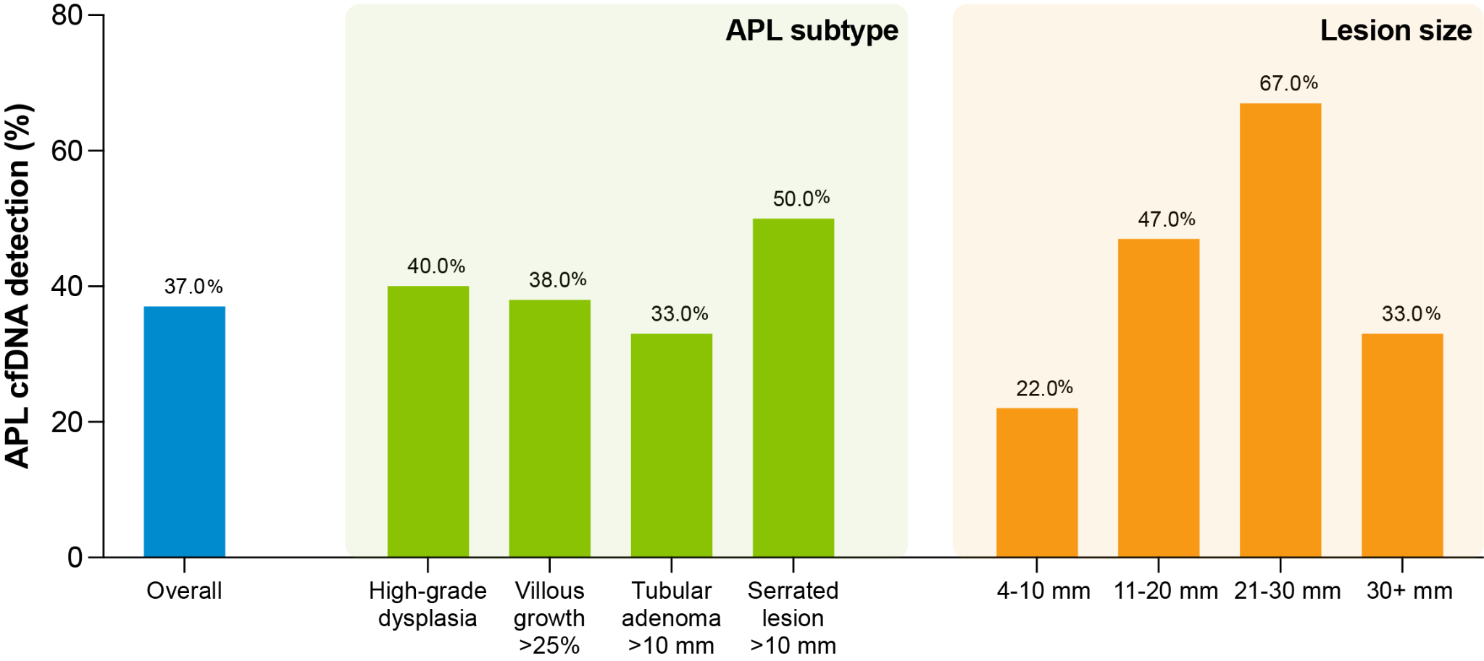
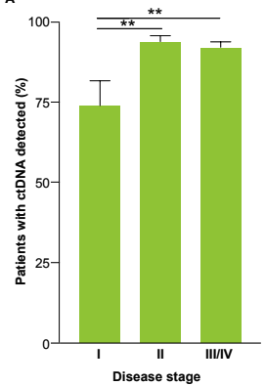
mPCR-NGS workflow for SNVs detects both advanced precancerous lesions (APLs) and colorectal cancer (CRC)
APL performance (FF samples) ¹
CRC performance²
¹Lu et al. 2026. Presented at AACR. ²Nakamura et al. 2025. Presented at ESMO..
Not for reproduction or further distribution.
Notes:
Advanced precancerous lesions (APLs) have a high probability of developing into colorectal cancer (CRC) and include lesions that are greater than 10 mm in size or have advanced histology such as villous architecture or high-grade dysplasia.1 While colonoscopy can effectively detect APLs, adherence to colonoscopy screening remains low.
Minimally invasive, blood-based tests for the detection CRC and APLs have emerged as a screening tool to aid in the early detection of cancer. Cell-free (cf)DNA detection of CRC has demonstrated high sensitivity and specificity. However, sensitivity of APL detection has ranged from 12.5% to 22.5% with differences across APL subtypes.
WGS data from APL tissue and matched normal blood samples were used to design custom, research-use only, personalized, mPCR-NGS-based ctDNA assays. Plasma samples collected at the same time as tissue and whole blood collection were evaluated for the presence of circulating APL biomarkers.

Slide 7
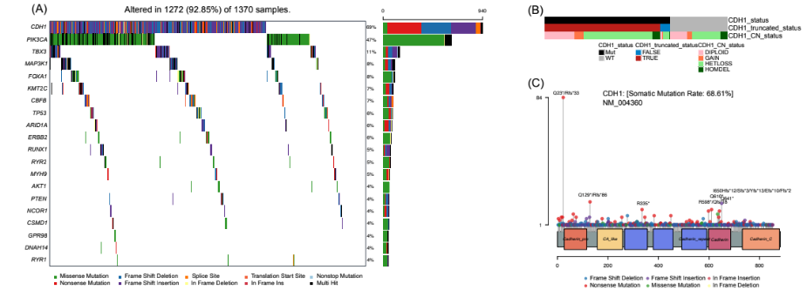
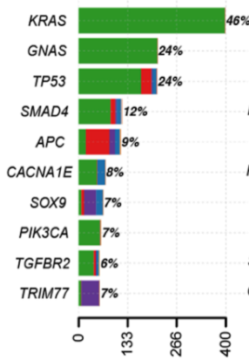
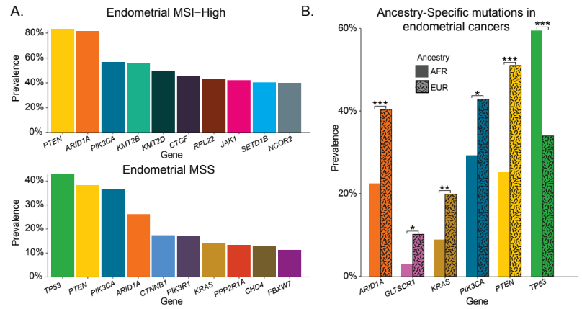
Diversity of molecular landscapes in other indications
Utilizing findings from other studies to inform MCD assay design
Invasive Lobular Carcinoma¹
Appendiceal Adenocarcinoma³
Endometrial Cancer²
¹Oesterreich S, et al. SABCS 2025, San Antonio, Texas. December 9-12, 2025. ²Aushev VN, et al. AACR 2025, Chicago, IL. April 25-30, 2025. ³White M, et al. ESMO, Madrid, Spain, October 20-24, 2023.
Not for reproduction or further distribution.

Slide 8
Why select methylation for cancer detection?
Technical Characteristics
Clinical Benefit
Sensitivity and Detection
• Detects tumor fraction down to ~0.01% (10⁻⁴)
• Superior performance compared to fixed mutation-based panels
Clinical Utility
• Earlier cancer detection and relapse identification
• Expands treatment selection
Comprehensive Insight
• Broader profiling vs tissue alone
• Tissue-of-origin specific patterns
Abundance of Signal
Genome-wide methylation: 100,000s of CpG sites vs few mutations
5-25 CpG sites in single ctDNA fragment vs ~1 mutation
Epigenetic changes occur early in tumorigenesis
More Robust & Consistent Biology
Stable patterns across patients and tumor regions
Less impacted by tumor heterogeneity
Cleaner Signal vs Mutation Noise
Avoids interference from clonal hematopoiesis (CH)
Not dependent on rare mutation sampling

Slide 9







PROCEED (NCT06620627)
Prospective Collection of Samples to Enable the Development of Natera Screening Assay for Early Cancer Detection
Average risk population >40
Multiple Recruitment Methods to Connect with Diverse Participants
Social Media
Pharmacy
Patient Advocacy
Prescreening
Study consent
Mobile phlebotomy
SOC colonoscopy & medical records
Sites
Not for reproduction or further distribution.

Slide 10
PROCEED (NCT06620627)
Prospective Collection of Samples to Enable the Development of Natera Screening Assay for Early Cancer Detection
Average risk, pre-colonoscopy cohort
Blood draw matched to standard-of-care colonoscopy
Set high goals for participant enrichment
Explore novel recruitment strategies to enroll a diverse participant cohort
Engage communities
Key study
design
Not for reproduction or further distribution.

Slide 11
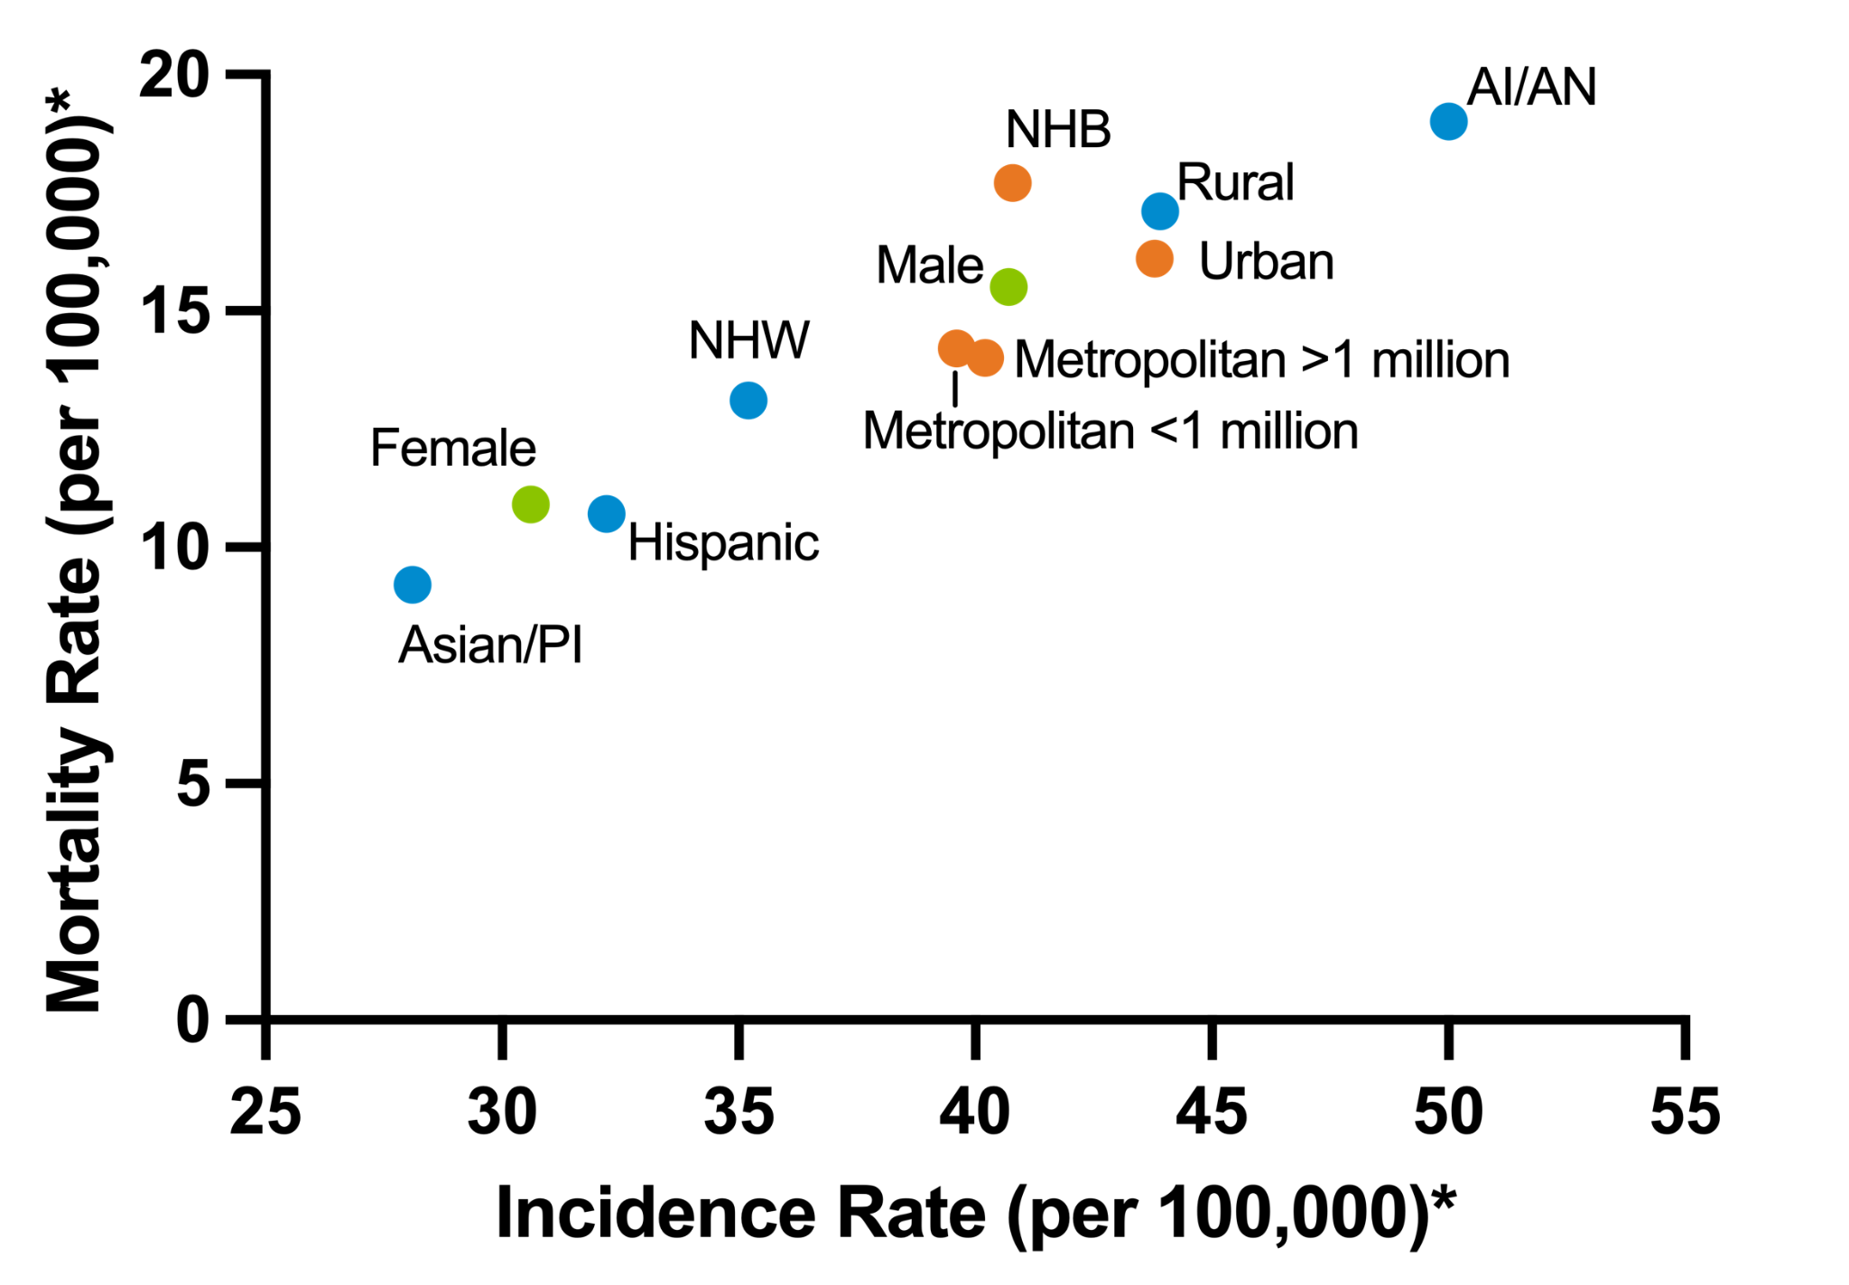
PROCEED (NCT06620627)
Variability in CRC incidence and outcomes across demographic features
An ECD assay should be reflective of the intended use population.
Race and ethnicity¹
Sex¹
Geography²
*Age-adjusted to the 2000 US standard population
Abbreviations: AI/AN, American Indian/Alaska Native; PI, Pacific Islander.
¹Adapted from: American Cancer Society, Cancer Statistics Center, Analysis Tool. Accessed: July 9, 2024. ²Henley et al. MMWR. 2017;66(14):1-13.
Not for reproduction or further distribution.

Slide 12
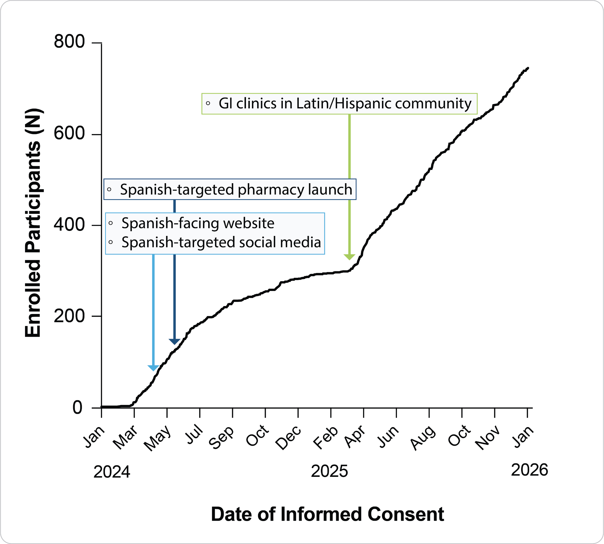
PROCEED (NCT06620627)
Implementation of recruitment channels over time
Case example:
Hispanic and Latino participants
Addition of unique channels changes enrollment rates, with each having a different level of impact
Dayger et al. 2026. Presented at Advancing Cancer Research for Latinos and All Population.
Not for reproduction or further distribution.

Slide 13
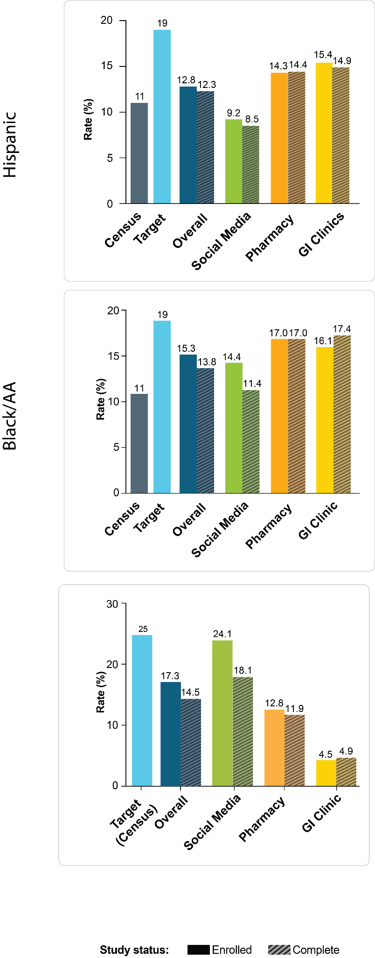
PROCEED (NCT06620627)
Different recruitment channels engage different participant populations
Low Income¹
Black/African American¹
Hispanic/Latino²
1Gary et al. 2026. Presenteed at American Society of Preventive Oncology. 2Dayger et al. 2026. Presented at Advancing Cancer Research for Latinos and All Population.
Not for reproduction or further distribution.

Slide 14
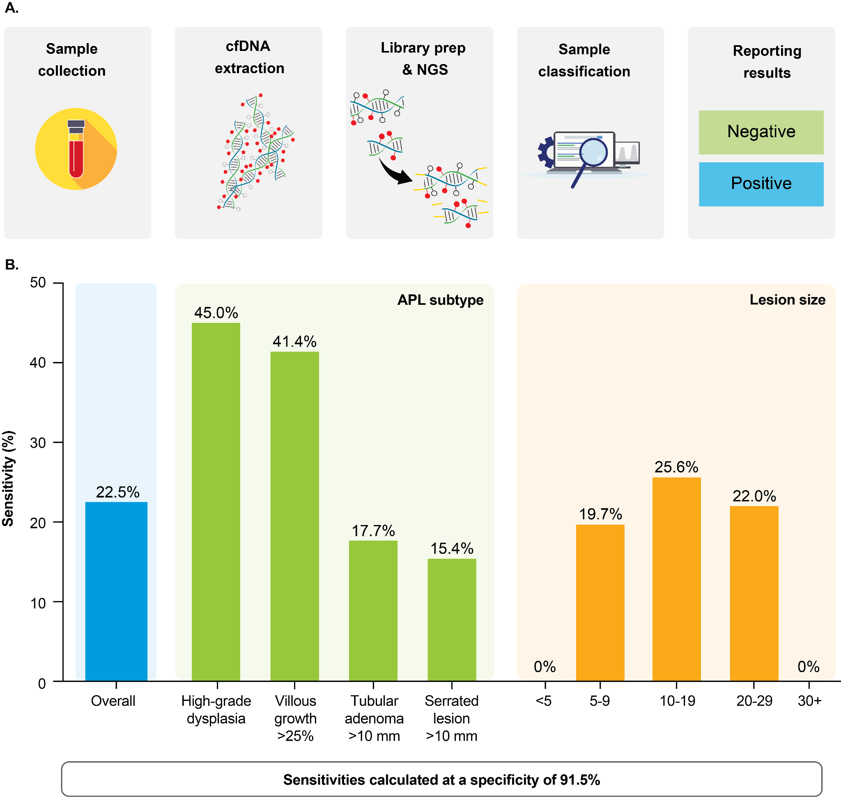
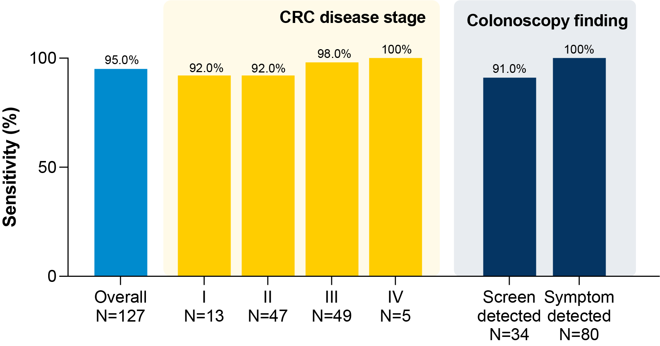
Sensitivity of Methylation-based Detection of Advanced Precancerous Lesions and CRC
APL performance¹
CRC performance²
¹Natarajan et al. 2026. Presented at AACR. ²Nakamura et al. 2025. Presented at ESMO..
Not for reproduction or further distribution.
Notes:
This study included participants enrolled in the ongoing, prospective, PROCEED-CRC clinical study (NCT06620627), designed for the collection of clinically annotated biospecimens from participants ≥40 years old who underwent asymptomatic colonoscopy screening. Plasma samples from 92 sequentially collected participants with APL and a representative cohort of 366 healthy individuals were included in this analysis. These participants were drawn from the first 1400 cases from the clinical study.
At a specificity of 91.5% (CI: 88.2%-94%), mean sensitivity across all APLs was 22.5% (CI: 15.4%-32.4%). Overall performance was further calculated based on the prevalence observed in the screening population. Subtype adjusted sensitivities based on published pivotal trials were 22.4% and 23.7%. At a specificity of 91.5%, sensitivity was highest in APLs classified as high-grade dysplasia (45.0%) and villous growth (41.4%). Sensitivity of APL at 5-9 mm was 19.7% and sensitivity increased with increasing lesion size. Notably, we did not observe deterioration of specificity with increasing age (p-value n.s., p > 0.05).

Slide 15
FIND-CRC (NCT07046585)
FDA enabling pivotal study for blood-based CRC screening test
Average risk population >40
Multiple Recruitment Methods to Connect with Diverse Participants
Social Media
Pharmacy
Patient Advocacy
Prescreening
Study consent
Mobile phlebotomy
SOC colonoscopy & medical records
Sites
Key Study Features
Enrollment targeting 70 CRC cases
Decentralized and site based enrollment strategies
Not for reproduction or further distribution.

Slide 16

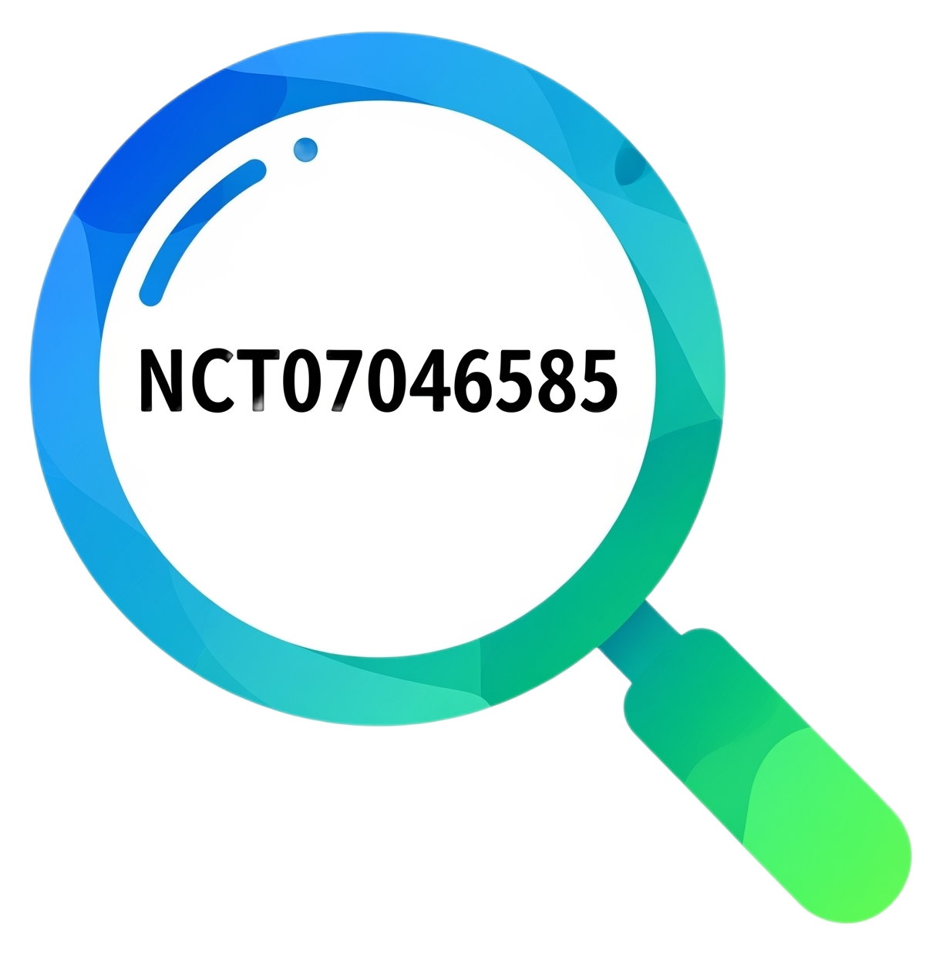

FIND-CRC (NCT07046585)
Launch informed by validated PROCEED-CRC recruitment channels
Screenshots from https://www.thefindstudy.com/. Accessed August 5, 2025.
Not for reproduction or further distribution.

Slide 17
Early Cancer Detection at Natera
Unparalleled sample access enables deep discovery
1
Biological depth
>250,000 CRC Exomes sequenced across all stages enables deep biological understanding of the disease
Novel platform developed over 2 years
Deep and Broad methylation discovery with cancers, premalignant lesions and other conditions
2
Discovery
3
Algorithm
Development specific to Advanced Adenoma targets and samples
4
Methylation technology refinement reduces the noise floor
Technology

Slide 18
Conclusions
Baseline detection rates can inform expectations for assay performance.
Patient characteristics, such as genetic ancestry, are associated with the molecular landscape of cancer. These should be considered for assay development.
Enrolling a study population that emulates the intended use population is critical.
Not all subgroups will engage with clinical studies in the same way.
  Identify recruitment methods that will meet participants where they are
  Implement enrollment approaches that maintain high completion rates
The intended use population may differ across each cancer in an MCD test.

Slide 19

THANK YOU!
MLIU@NATERA.COM

