Slide 1
Plasma Proteomic Characterization of the EDRN Prostate Cancer Cohort for Aggressive Prostate Cancer Biomarker Discovery
T. Mamie Lih, PhD
PI: Hui Zhang

Slide 2
Introduction
Most prostate cancers are indolent at diagnosis.
Aggressive disease is associated with progression and increased mortality.
Blood provides a minimally invasive source for aggressive prostate cancer biomarker discovery.
Magnetic-COF enrichment enables high-throughput and reproducible blood proteomic analysis.
Y Huang et al., Anal. Chem. (2026) 98 (15): 11261–1127

Slide 3
Magnetic-COF-based blood enrichment platform
Y Huang et al., Anal. Chem. (2026) 98 (15): 11261–1127
Automation offers high-throughput, consistent handling, reduced human error, and better reproducibility
Capture diverse blood proteins, particularly those in the low-abundance range

Slide 4
Magnetic-COF enrichment provides consistent proteome coverage and captures disease-associated proteins
Performance across blood sample types
Application to clinical PDAC samples
Plasma yielded the greatest proteome coverage, followed by whole blood and serum.
The workflow identified proteins associated with PDAC
Y Huang et al., Anal. Chem. (2026) 98 (15): 11261–1127

Slide 5
Overview of the EDRN discovery plasma cohort (n = 596)
Basic clinical information of the plasma sample cohort
 | BxN | GG 1 | GG 2 | GG 3 | GG 4 | GG 5
Number of samples | 341 | 116 | 64 | 31 | 16 | 28
Mean Age | 60 | 62 | 65 | 61 | 64 | 68
Mean serum PSA, ng/mL | 4.4 | 4.35 | 5.04 | 5.3 | 8.95 | 8.6

Slide 6
Higher Gleason Grade Groups in localized prostate cancer are associated with increased risk of prostate cancer-specific death
Gleason Grade Groups | Gleason score | 10-Year Survival Rate
GG1 | 3+3=6 | 98%
GG2 | 3+4=7 | 92%
GG3 | 4+3=7 | 77%
GG4 | 4+4=8 | 70%
GG5 | 4+5, 5+4, 5+5 =9-10
The Gleason grade (or Gleason score) is the standard grading system to evaluate the aggressiveness of prostate cancer

Slide 7
Consistent QC performance and deep proteome coverage across the EDRN cohort
Clinical samples were processed in 7 batches, with 4 QC samples included per batch.
Median correlation among QC samples = 0.88
>5,000 proteins identified across 596 EDRN plasma samples

Slide 8
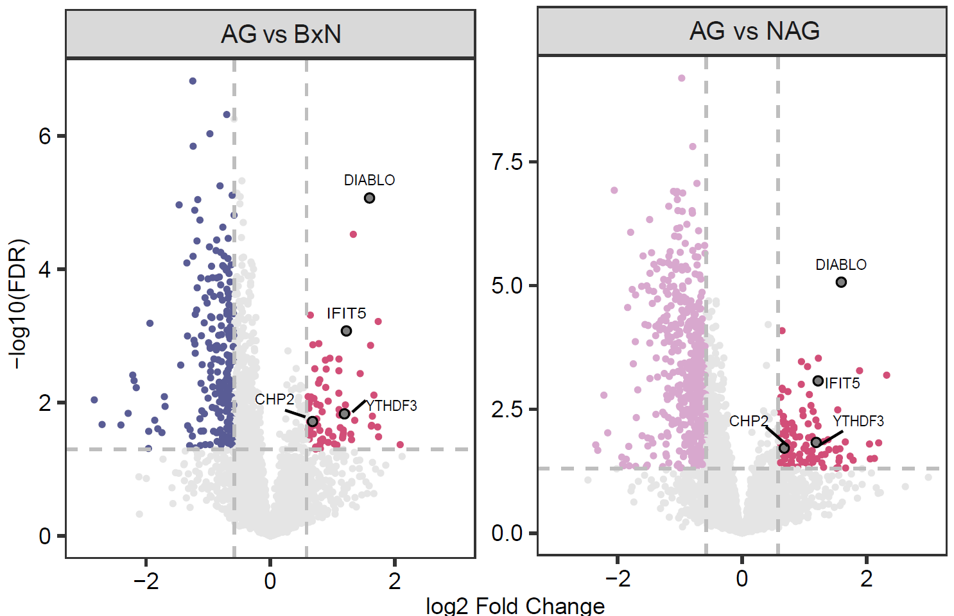
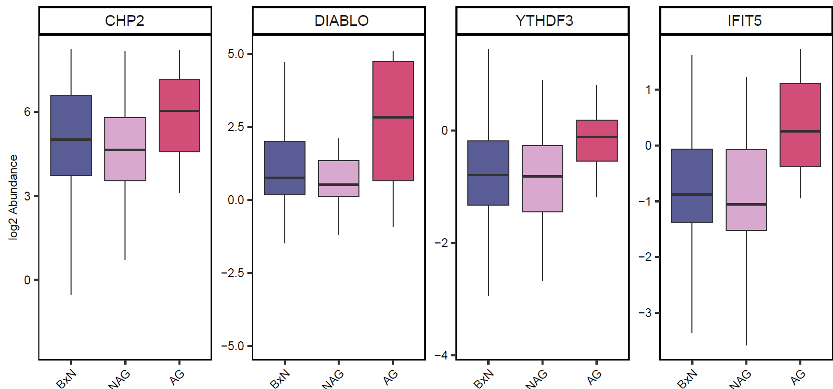
Several plasma proteins are elevated in aggressive prostate cancer compared with BxN and NAG

Slide 9
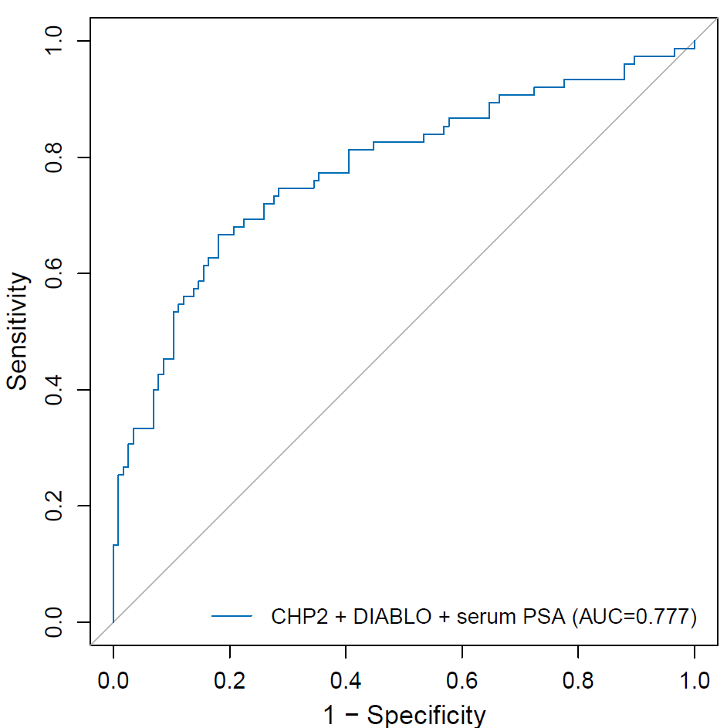
Combining CHP2 and DIABLO with serum PSA improves discrimination of AG prostate cancer from BxN and NAG prostate cancer

Slide 10
High-throughput plasma proteomics enables discovery of candidate markers for aggressive prostate cancer
High-throughput and reproducible workflow: Magnetic-COF enrichment enables efficient, automated processing of large numbers of blood samples with consistent performance across batches.
Deep plasma proteome coverage: More than 5,000-7,500 proteins can be identified, providing broad coverage for biomarker discovery.
Aggressive disease–associated proteins identified: Differential analysis revealed plasma proteins associated with aggressive prostate cancer.
Candidate marker development is ongoing: Individual and multi-protein markers are being evaluated for distinguishing AG from BxN and NAG, including combinations with serum PSA that can improve discriminatory performance.
Targeted assay development: Final candidate markers will be transitioned to targeted MS assays for validation in independent cohort.

Slide 11


Acknowledgments
Hui Zhang
Daniel W. Chan
Lori J. Sokoll
Zhen Zhang
Yuanyu Huang
Zhenyu Sun
Liyuan Jiao
Yingwei Hu
Lijun Chen
Yuefan Wang
Bay Xu
All members in the CBDT

