Slide 1


Statistical modeling of genome-wide cfDNA methylation
for early cancer detection
EDRN 2026 Scientific Workshop
September 24th, 2026
Daniel E. Schwartz, PhD
with Steven Skates, Zoe Guan, & Abhijit Patel
Notes:
Very much ongoing work
My goal is to highlight and raise awareness about some of the statistical considerations & issues in biomarker development here.
These points are important pragmatically for developing accurate detection algorithms, but also raise interesting questions about the cancer biology.

Slide 2
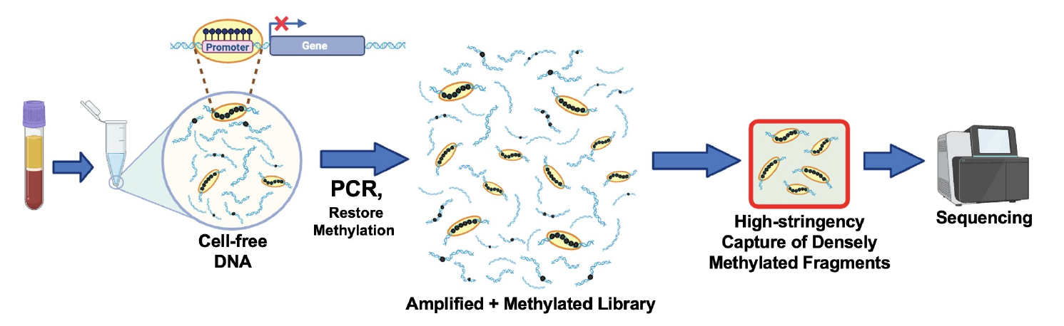
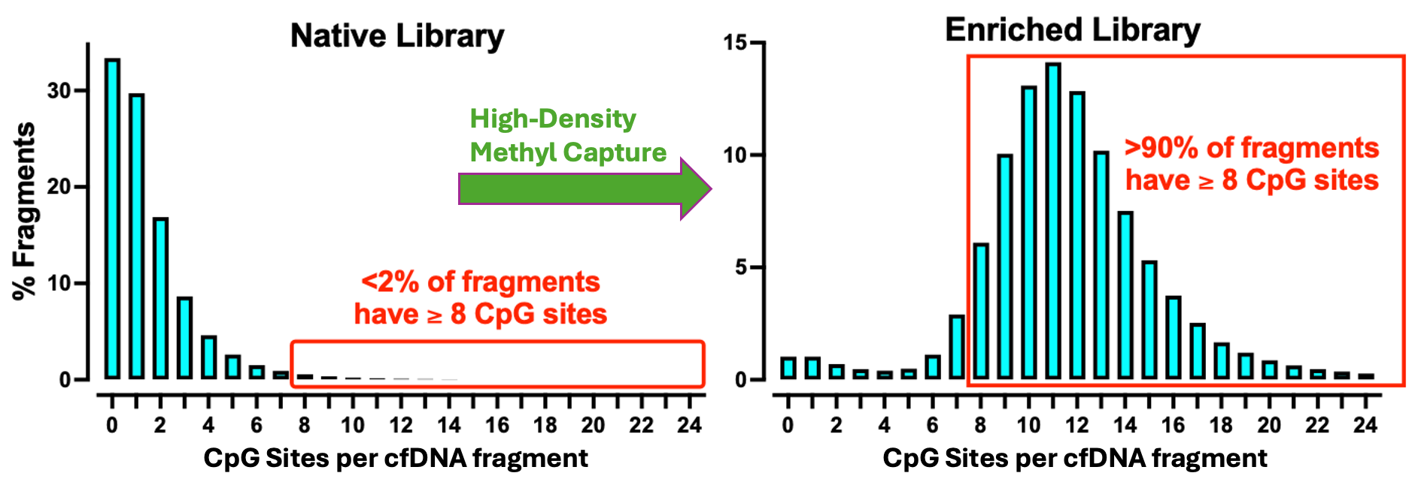
High-density methyl-seq captures highly methylated DNA genome-wide
Seq. depth reflects both
technical variation & cancer signal
More captured fragments may reflect methylation enrichment, but also library yield, conversion, and sequencing variation.
Statistical consequence
Modeling + normalization need to preserve biological signal.
Credit: Abhijit Patel

Slide 3
Island-level methylation breadth
Basic Method Idea
For each sample and CpG island:
# CpG sites in the island methylated on ≥1 fragment
Methylation breadth =
# CpG sites in the island covered on ≥1 fragment
For each island, model differences in methylation breadth b/w controls, early cases, and late cases…
Then combine signal genome-wide.
Project State
Statistical prototyping w/ initial data (n ≈ 100)
Processing more samples for training + internal validation
External validation on locked algorithm

Slide 4
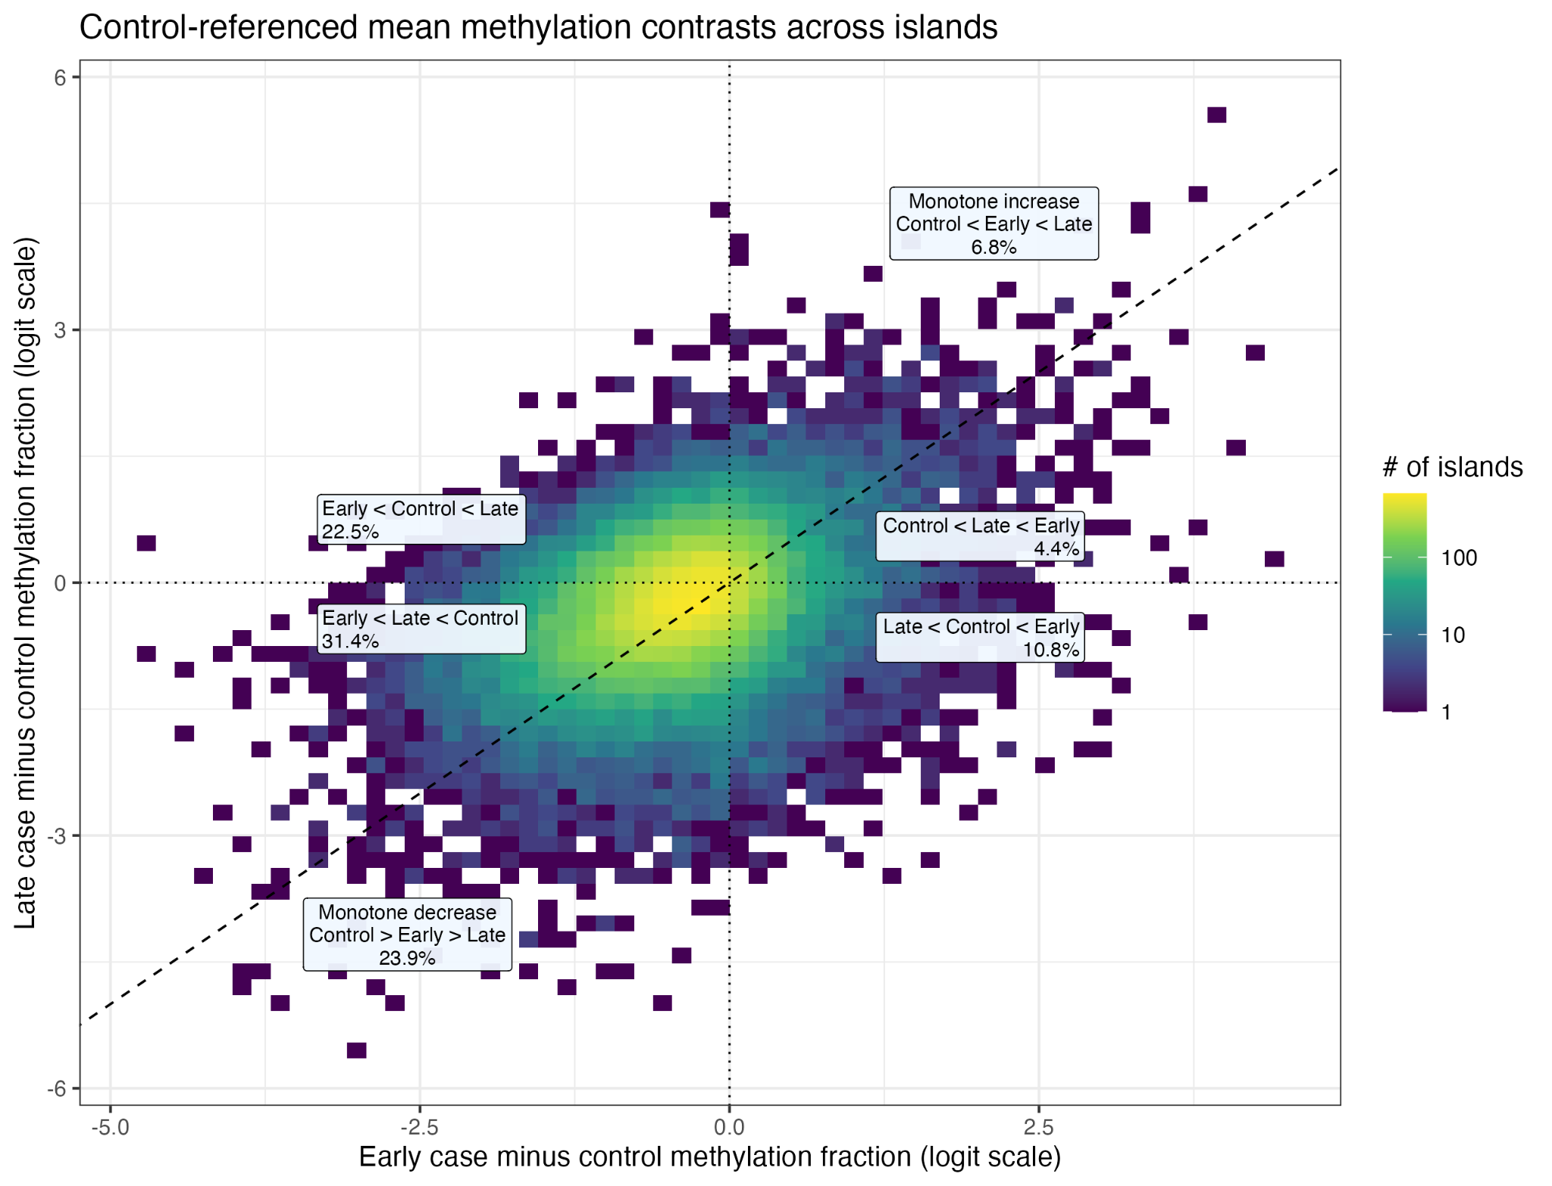
Early and late cases have qualitatively different methylation signals
Opposite shifts
At some islands, early and late cases fall on opposite sides of controls.
Biological questions
Due to tumor shedding, cell mixture, tumor progression, etc.?
Implications for detection
An algorithm learned from late-stage disease may miss early-stage patterns.
Need to model stage-specific patterns.
Notes:
Figure: exploratory control-referenced island methylation contrasts, Script 17. The figure describes observed patterns and does not identify their mechanism.

Slide 5
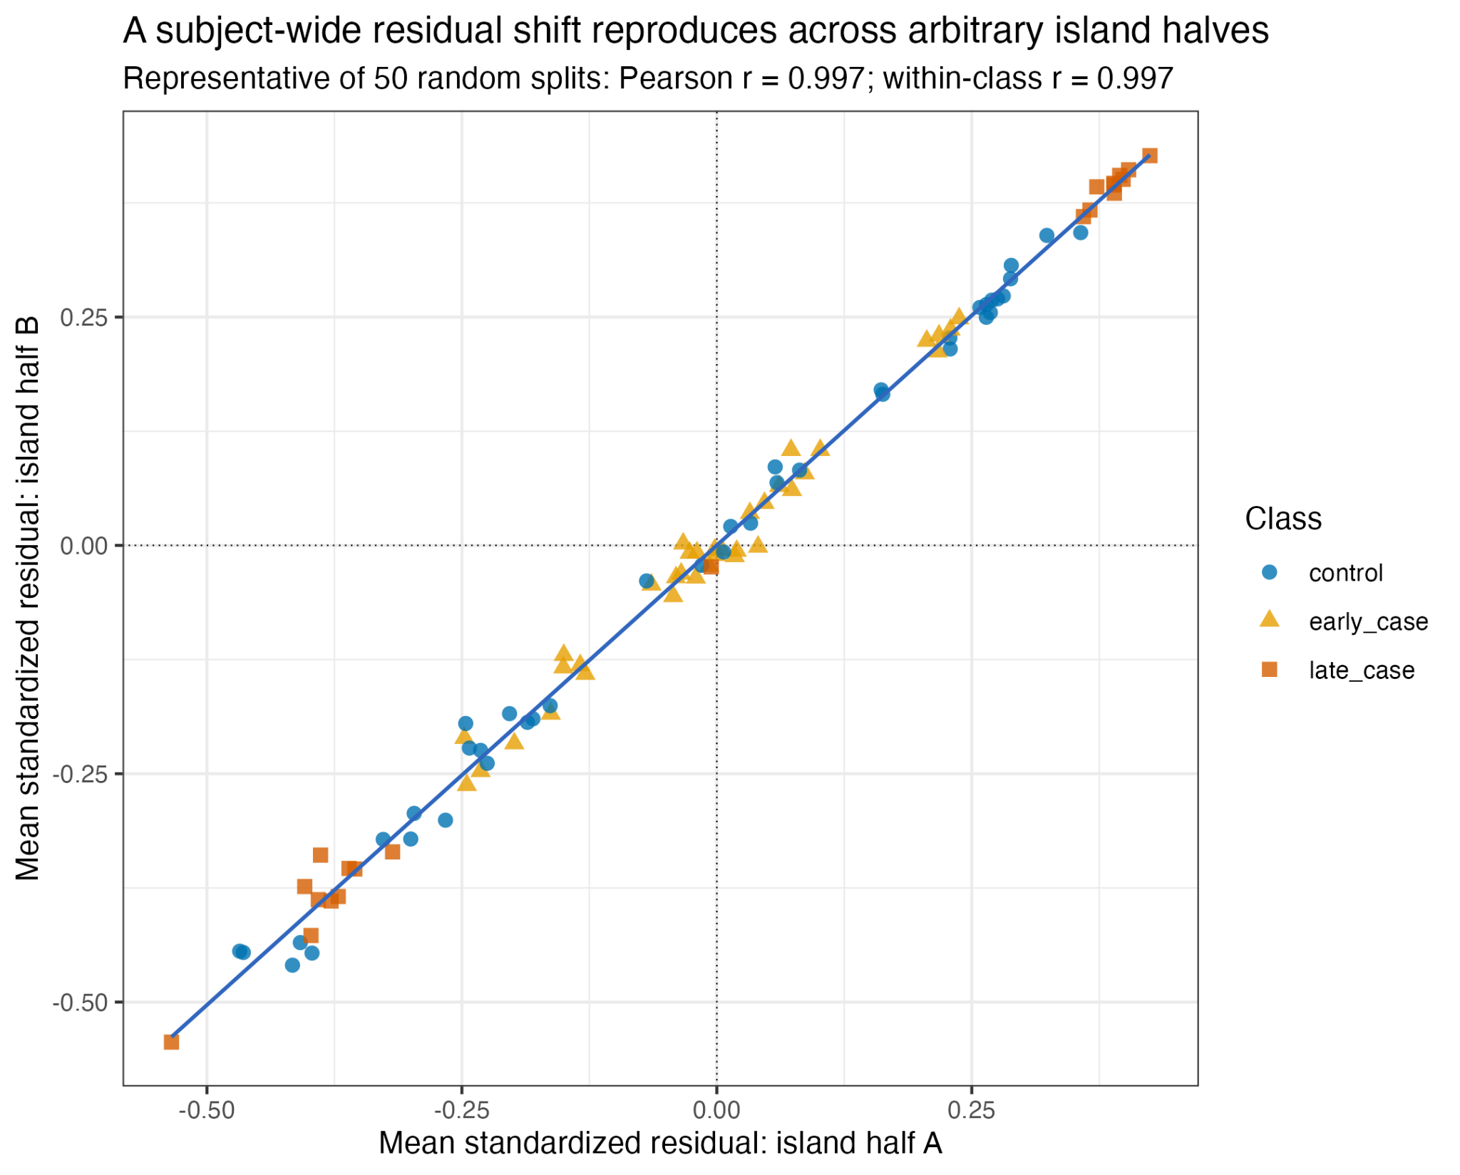
Large genome-wide differences between people & samples
Why model dependence?
Treating thousands of islands as independent overstates the amount of independent evidence.
Modeling dependence improves fit + calibration
Subject-level models and factor models improve model fit and uncertainty calibration (reduce overconfidence).
… but not classification accuracy
Better modeling of the same island summaries made smaller gains in early classification (AUCs in 0.75-0.80).
Notes:
Figure: Script 17 residual split-half diagnostic. A representative split of 50 has Pearson r=0.997, including within-class r=0.997. Better dependence models improve data fit and calibration, while early discrimination has improved less.

Slide 6
Cancer signal may be stronger in certain assay summaries
Island-level
methylation breadth
Island-level
fragment abundance
Island-level
targeted fragment abundance
Site-level
methylation patterns
# methylated CpGs /
# covered CpGs
# methylated fragments /
sample depth
# unusually highly methylated fragments / sample depth
CpG sites + patterns
within fragments
Simple summary, but no fragment multiplicity or healthy-reference context.
Incorporates multiplicity, but normalization could remove technical variation and sample-level signal.
Filter to loci unmethylated in healthy reference data; normalize by # normally high-methylated fragments.
Richer information/signal but complex dependence?

Slide 7
What’s next?
Leverage biological info about likely location of cancer signal
Richer models of assay data
Larger/broader training and validation
Selective island sets
Biologically targeted fragments
Healthy-reference methylation
Internal count normalization
CpG-site observations
Within-fragment patterns
Count models that respect depth
More lung training samples
Independent lung validation
Ovarian plasma
Ovarian uterine lavage
Take-homes
Early and late disease can have very disparate methylation patterns.
Higher detection accuracy may require leveraging richer biology
to target the most informative methylation patterns.
Notes:
Three next-step groups: biologically motivated feature selection and normalization; site and fragment models; more lung training data and independent lung validation followed by ovarian plasma and uterine lavage.

Slide 8


Questions?

