Slide 1
From Postdoc to Site PI:
Building research capacity through collaboration with AHEAD and the EDRN
Brittney L. Dickey, PhD, MPH
Department of Epidemiology
Notes:
1. How EDRN created opportunities for your career transition
2. How a multicenter biomarker study was successfully expanded to a new institution
3. Why implementation and collaboration are essential for biomarker science to have impact

Slide 2




My EDRN/AHEAD Journey
A five-year path from postdoctoral fellow to Site Principal Investigator
2020
Postdoctoral Fellow
Cancer Epidemiology, Moffitt
2023
Assistant Professor
Epidemiology, UNMC
2025
Site Principal Investigator
EDRN · AHEAD Network, UNMC

Slide 3
Why this mattered
AHEAD: more than a group of studies
Addresses early detection in Head & Neck cancers
Provided a framework to develop collaborations
Connected investigators across disciplines
Created opportunities for ESIs
Notes:
Addresses the head and neck cancer burden with a focus on earlier detection and better biomarkers
Multicenter collaboration is essential

Slide 4


BASH-OPC (U01 DE033329)
Goal
To validate a non-invasive diagnostic biomarker panel to detect OPC early.
Objective
To distinguish early OPC cases from cancer-free individuals using biomarkers related to HPV and host epigenetic alterations.
“
In other words…. we're identifying tumors that can be effectively and safely treated with a single modality, where survival is highest and treatment sequelae are lowest.
Notes:
OPC Background:
Until recently oropharyngeal carcinoma (OPC) was a rare cancer, therefore screening was not considered a practical approach to cancer control.
However, OPC incidence is on the rise in the U.S. and is the sixth most common cancer worldwide.
In the US, OPC incidence in men 50-69 years has exceeded incidence of cervical cancer among women ages 40-44 years, the age group with the highest incidence of this disease.
Over the past two decades, there has been a shift in the primary cause of OPC, from tobacco to human papillomavirus (HPV).
A screening approach to prevent the morbidity and mortality associated with treatment of this cancer is now necessary.

Slide 5
Building Capacity at UNMC: Challenges, Opportunities, Outcomes

Slide 6

Establishing a New Study Site
CHALLENGES:
New Faculty position
Minimal to no observational trials conducted through CTO
  Can we establish a new site?
  Can we recruit necessary collaborators and patients?
  Can we navigate institutional processes?

Slide 7
Establishing a New Study Site
Opportunities
Implement infrastructure for more observational trials
Add UNMC as a site to BASH-OPC and part of EDRN/AHEAD
Assemble an interdisciplinary team

Slide 8
Building Blocks to Success
Feasibility Assessment
Institutional Support
Clinical Collaboration
Case counts
Lab Space
FPBCC Buy-in
Personnel Onboarding
Recruiting clinic
Clinical Partner

Slide 9
OUTCOMES: Collaborative Team
Clinicians
  Dr. Elizabeth Bradford Bell (Head & Neck Surgical Oncology); Dr. Apar Ganti (Medical Oncology) and Dr. Omar Abughanimeh (Medical Oncology)
Clinical Trials Office
  Institutional support for trial start-up and regulatory processes
Research Coordinator
  Non-interventional Trial Research Coordinator
Lab
  Institutional Biospecimen Bank

Slide 10
OUTCOMES: Enrollment
24
Participants Enrolled to Date
Across all case/control categories at the UNMC BASH-OPC site
SEX
10
CONTROLs
19 male · 5 female
RACE
7
EARLY CASEs
23 White · 1 Black
7
LATE CASEs
AGE
Mean 60.96 yrs
Range 40–82

Slide 11
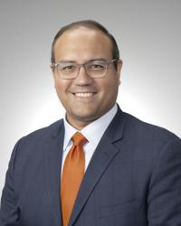
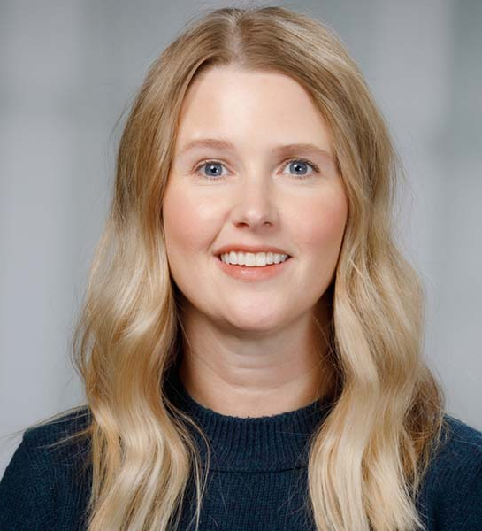
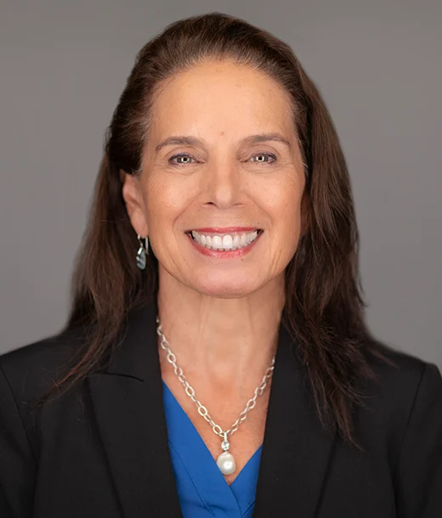
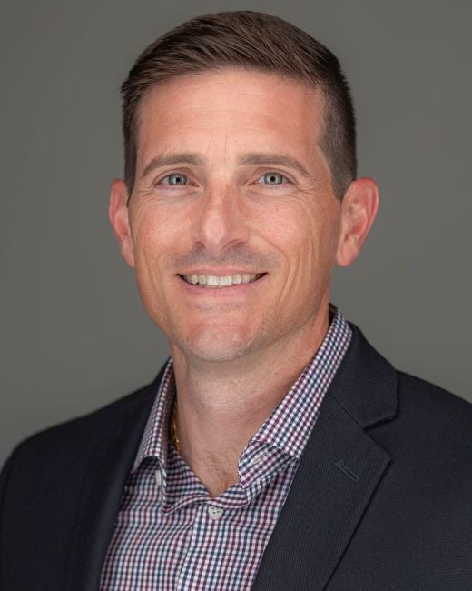
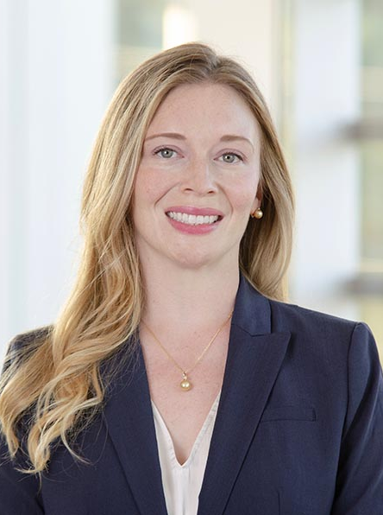
2022
Jose Zevallos, MD, MPH
Professor and Chair, Department of Otolaryngology-Head & Neck Surgery
Deputy Director, UPMC Hillman Cancer Center
2020
Brittney L. Dickey, PhD, MPH
Post-doc
Cancer Epidemiology
2023
Brittney L. Dickey, PhD, MPH
Assistant Professor
Epidemiology
2025
UNMC added as Site
UNMC FPBCC
University of Pittsburgh Hillman Cancer Center
Moffitt Cancer Center
Before 2019
Anna Giuliano, PhD
Director, Center for Immunization and Infection Research in Cancer
Senior Member,
Cancer Epidemiology
2022
Tony Amelio, PhD
Vice Chair for Research, Head & Neck Oncology
Associate Member, Tumor Microenvironment & Metastasis
2024
Elizabeth Bradford-Bell, MD
Assistant Professor
Otolaryngology—Head and Neck Surgery
2023
U01 FUNDED
Notes:
An example of growing networks and interdisciplinary science

Slide 12
Lessons Learned

Slide 13
Beyond Research Aims
What the BASH-OPC site at UNMC made possible beyond its original scope
New collaborations across the cancer center
Awareness of head and neck biomarker cancer research
New patient recruitment strategies
Foundation for future studies

Slide 14



Things they don’t teach you in school
Lesson 1: Infrastructure matters
Lesson 2: Relationships accelerate research
Lesson 3: Observational studies exist & need support
Notes:
Lesson 1
Infrastructure matters.
Great science requires systems that allow the science to happen.
Lesson 2
Relationships accelerate research.
Early conversations with clinical and operational partners prevented months of delays.
Lesson 3
Observational studies create platforms.
The value extends beyond a single project by building future research opportunities.
This slide will probably be the most memorable.

Slide 15


Early Career Investigators & EDRN
What EDRN gives ECIs
· National collaborations · Exposure to new research · Access to resources
Early-Career
Investigators
EDRN
What ECIs give back
· New institutional connections · Energy for implementation · Future leadership of multicenter studies
Notes:
As early-career investigators, we often think our role is to contribute to the science. What I've learned through AHEAD and EDRN is that we also contribute by building connections, creating opportunities, and expanding the reach of research. Those investments may ultimately be just as important as any single dataset.

Slide 16
Acknowledgments
EDRN & AHEAD
UNMC CTO & IIT
  Jordyn Rockwell
  Jackson Schiefelbien
  Stephanie Parker
UNMC Institutional Biospecimen Bank
FPBCC Leadership
Moffitt Collaborators
  Dr. Anna Giuliano
  Dr. Toni Amelio
  Julie Rathwell
  Kim Isaacs-Soriano
Pittsburgh Team

