Slide 1
Early Detection: FDA Perspective
15th EDRN Workshop
Reimagining Early Detection in the Era of Multimodal Science
September 25, 2026
Courtney H. Lias, Ph.D.
Director
OHT7: Office of In Vitro Diagnostics
Office of Product Evaluation and Quality
CDRH | Food and Drug Administration

Slide 2


Slide 3
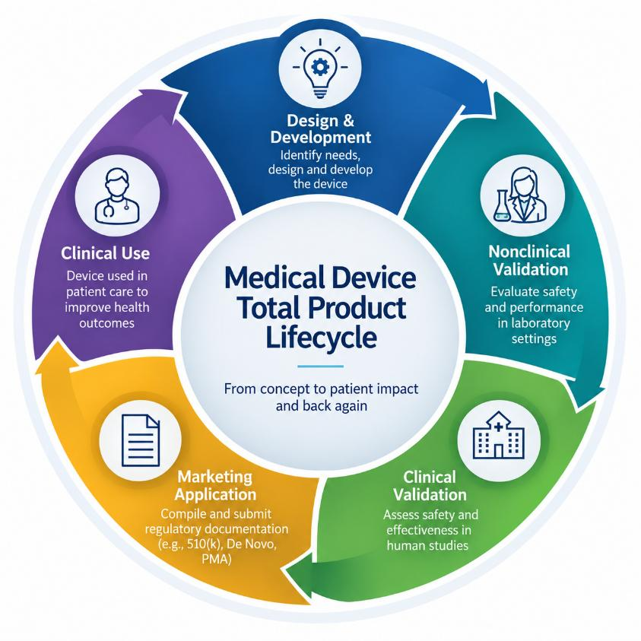

Slide 4
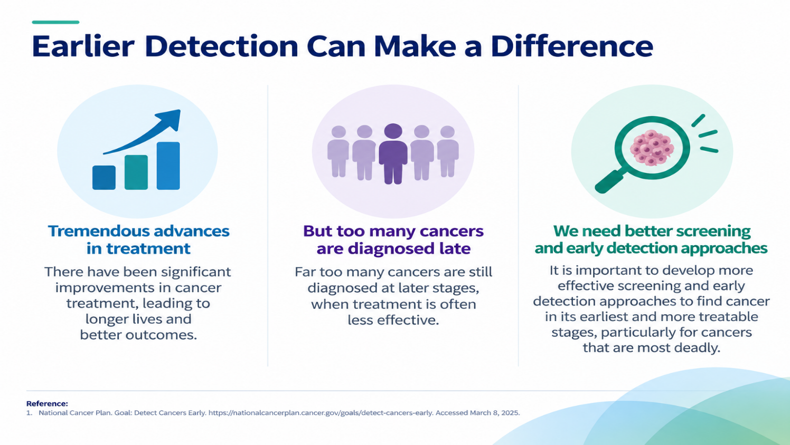

Slide 5
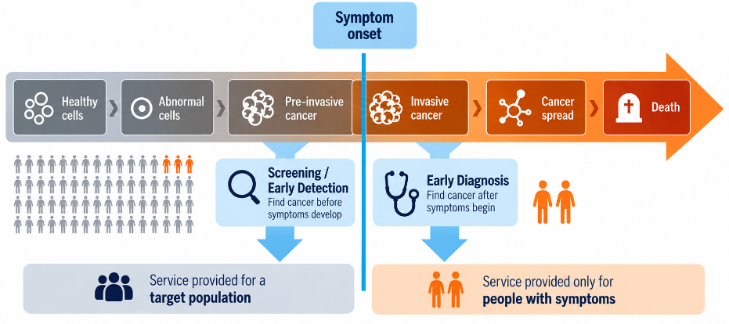
Screening vs. Early Diagnosis
1
Screening²:
Checking for cancer (or abnormal cells that may become cancer) in people who have no symptoms.
Early Detection³:
Detecting a disease at an earlier stage than would usually occur in standard practice, at which point the patient has no clinical complaint (no symptoms or signs).
Early Diagnosis¹:
Detecting symptomatic patients as early as possible so they have the best chance for successful treatment.
Guide to cancer early diagnosis. Geneva: World Health Organization; 2017.
https://www.cancer.gov/about-cancer/screening
Gordis L (2004) Epidemiology. Elsevier Saunders, Philadelphia.

Slide 6
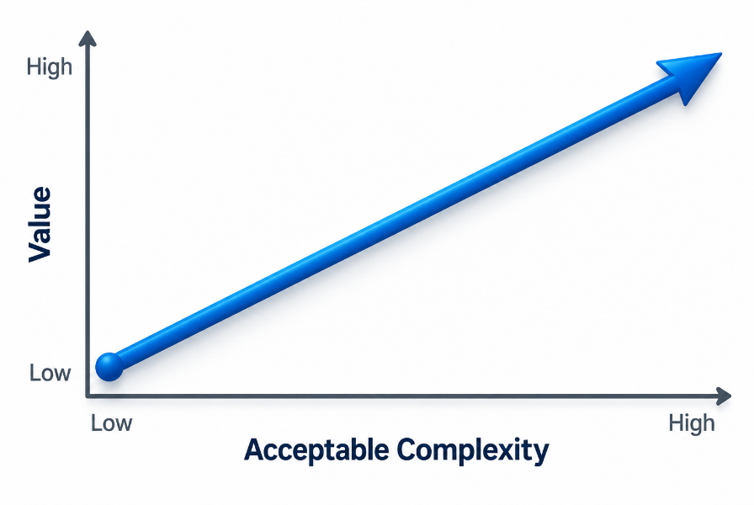
Screening/ED – Test Design
Complexity:
Invasive procedure
Specimen type
Timing
Frequency
Follow up
Etc….

Slide 7
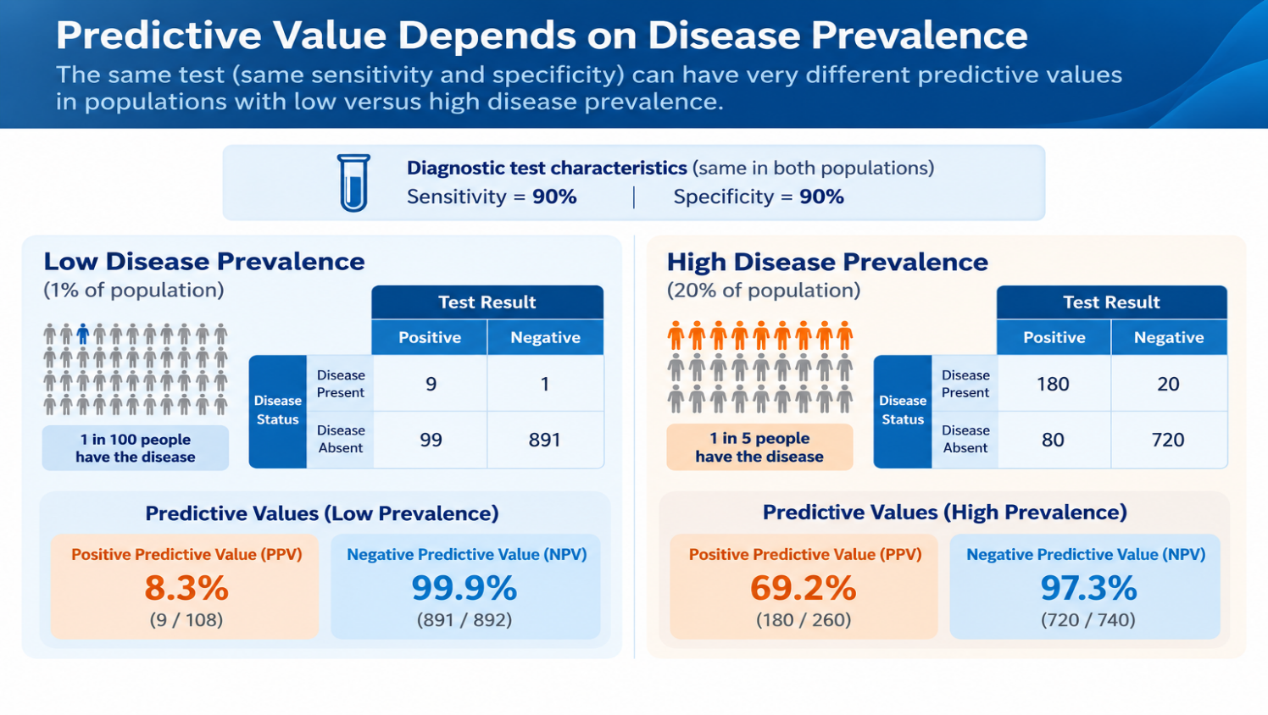

Slide 8
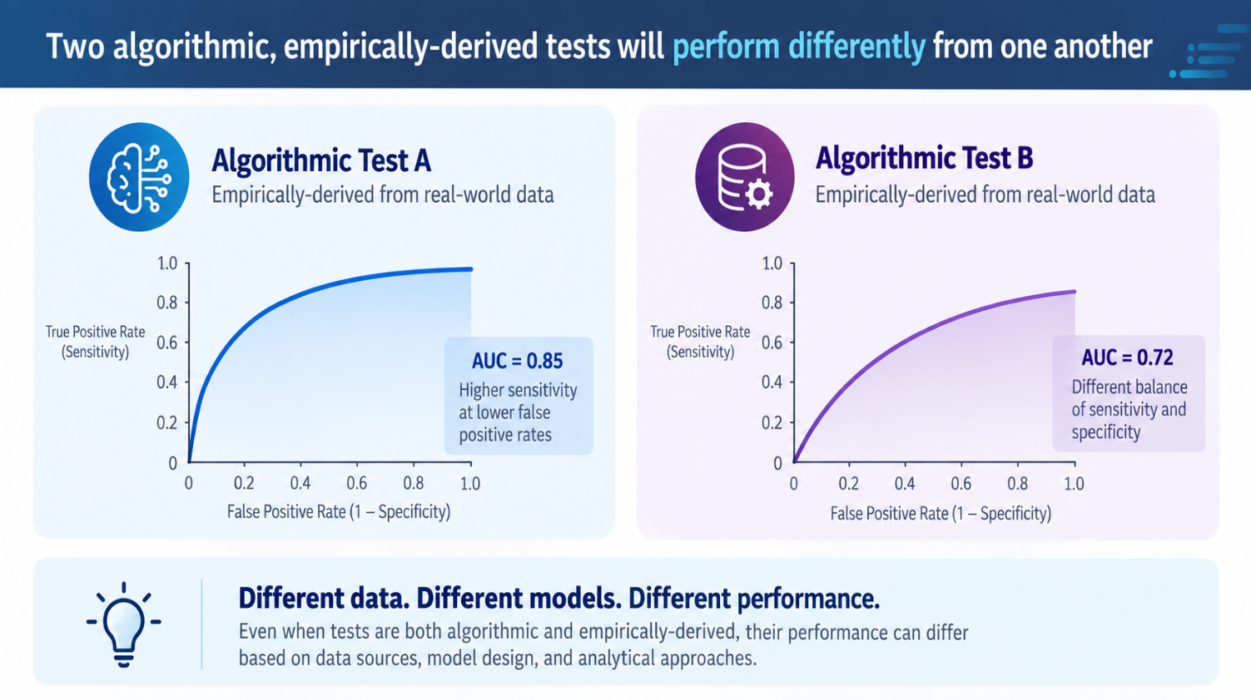

Slide 9
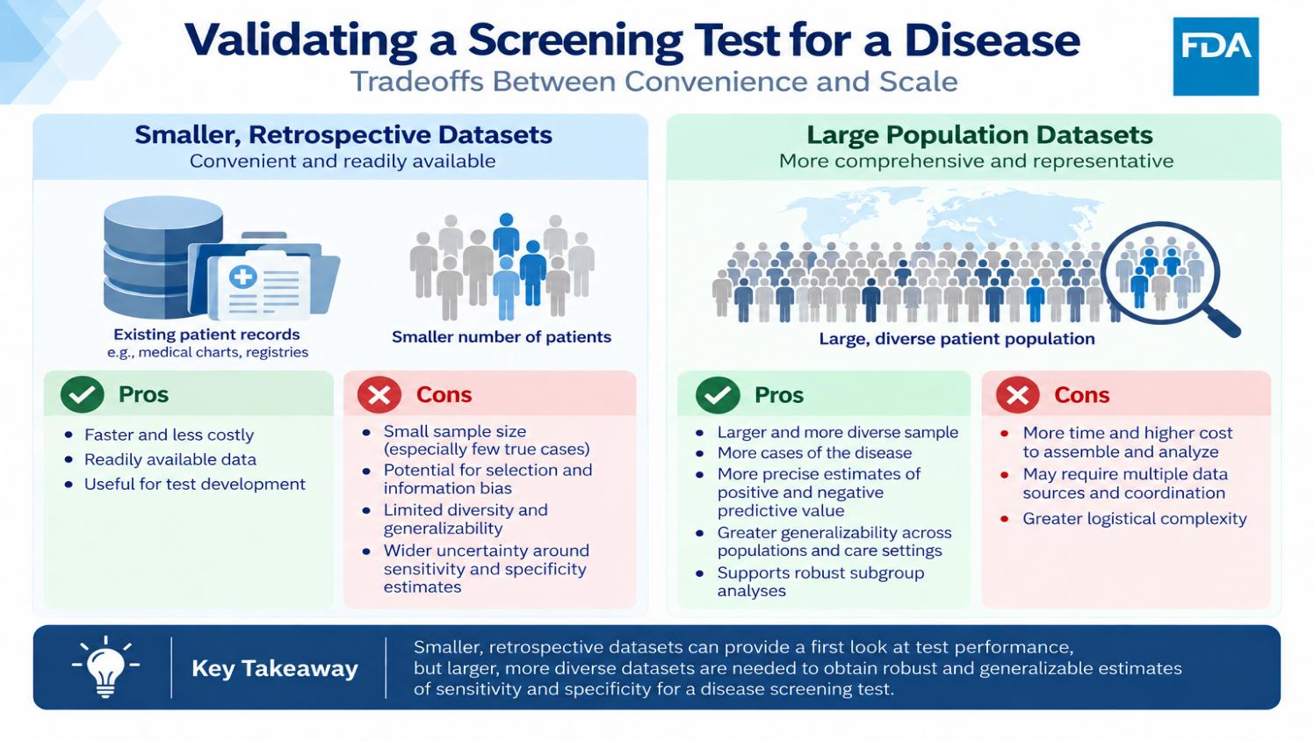

Slide 10
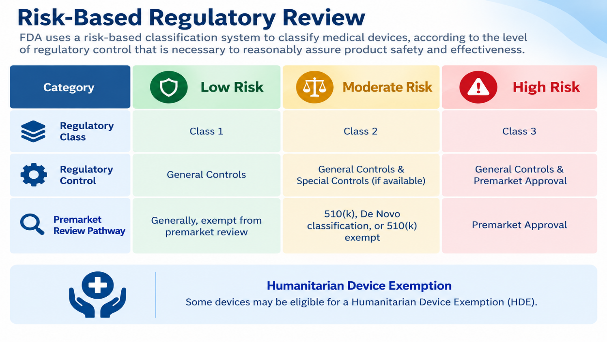

Slide 11
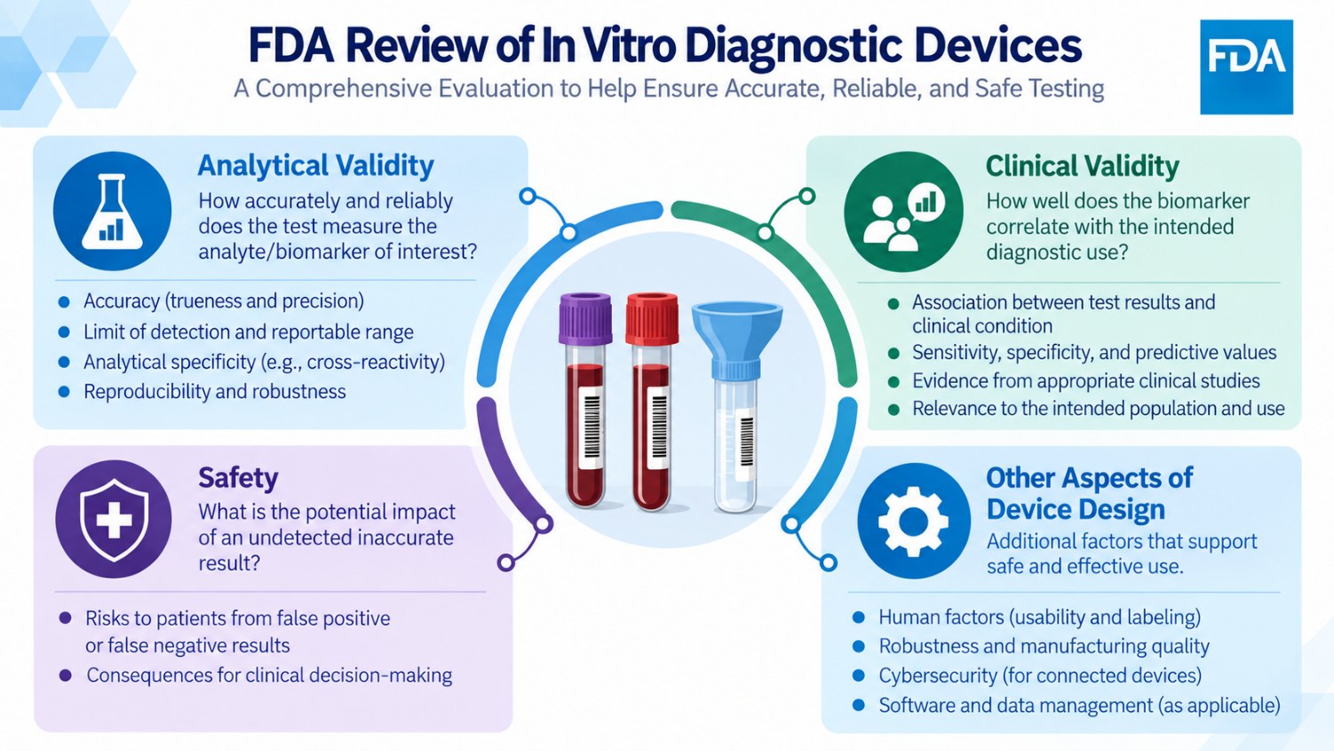

Slide 12
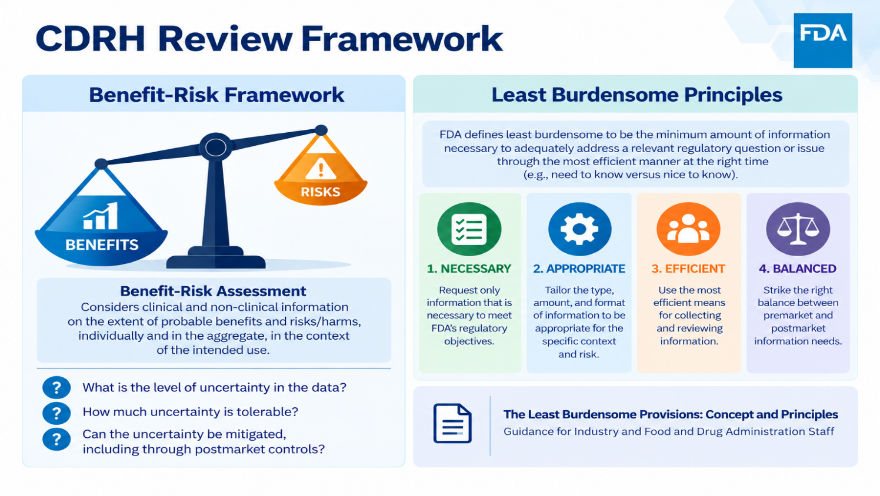

Slide 13
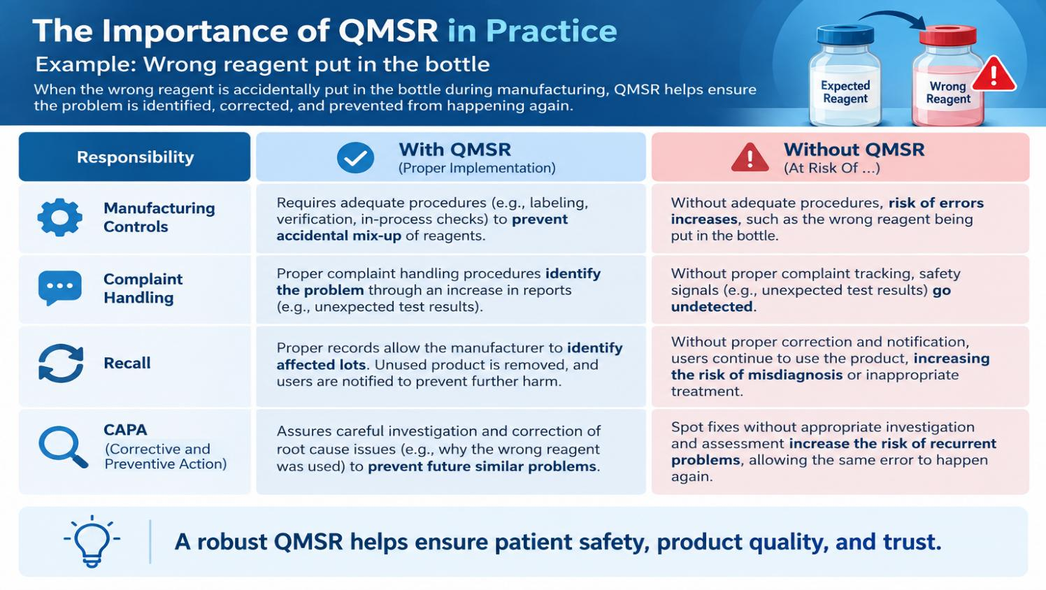

Slide 14
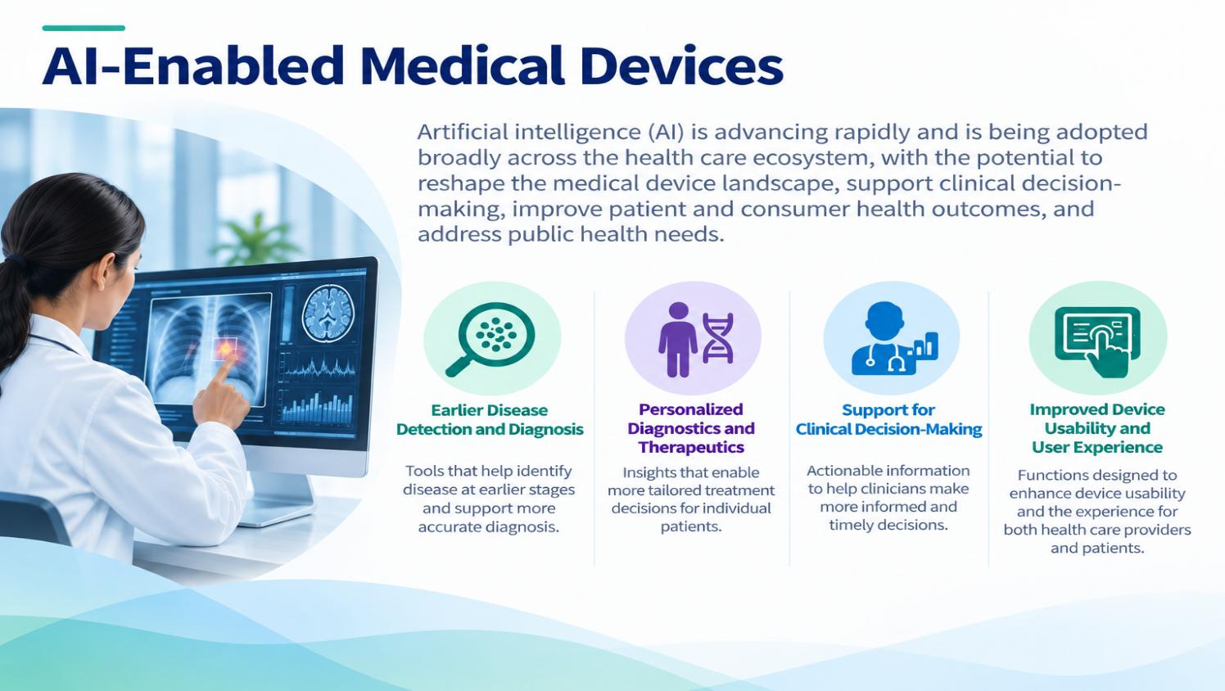

Slide 15
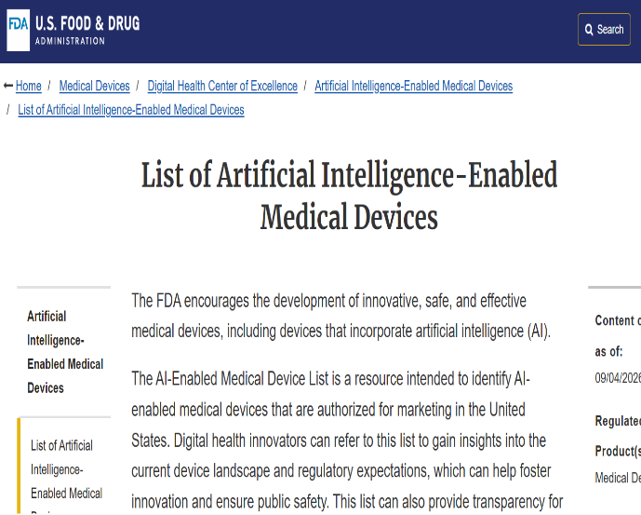
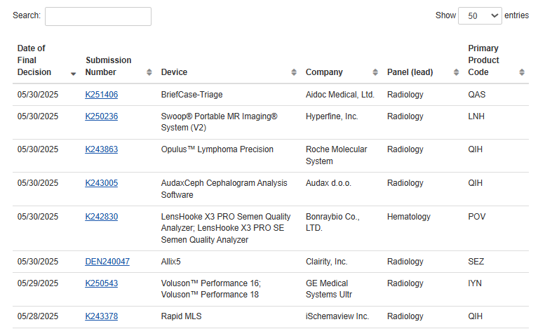
AI-Enabled Medical Devices
Over 1,600 AI-enabled devices have been authorized by FDA

Slide 16
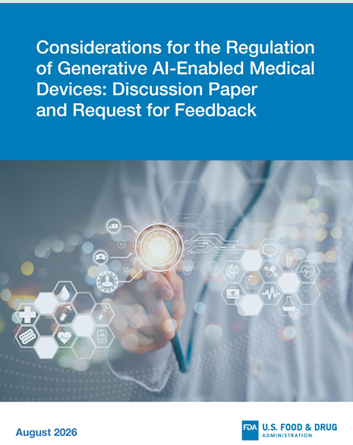
Discussion paper intended to engage stakeholders on GenAI-enabled medical devices to advance regulatory approaches for these devices.
Covers:
  considerations for the assessment of risk
  considerations for premarket evaluation
  postmarket monitoring, and
  other topics relevant to the regulation of GenAI-enabled medical devices.
  Open for comment until October 19, 2026
Considerations for the Regulation of Generative AI-Enabled Medical Devices: Discussion Paper and Request for Feedback | FDA

Slide 17
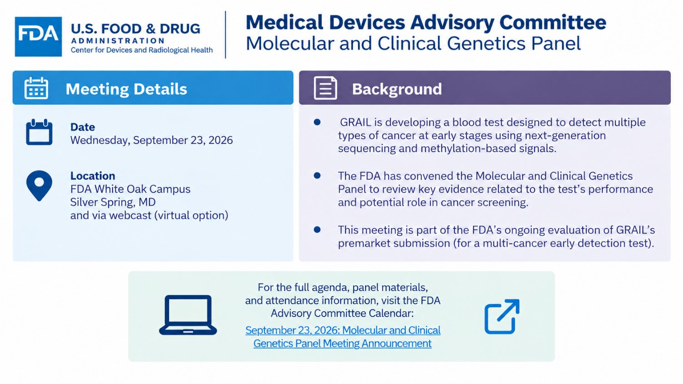

Slide 18

Panel consensus that clinical significance of Galleri greatest for cancers without guideline-recommended screening
Panel called for clear labeling to help with informed shared decision making between HCPs and patients
Questions about whether the test detects cancers “early”
Desire for ongoing data collection to refine understanding, including of clinical outcomes
The Panel voted on safety (10 Y, 0 N), effectiveness (6 Y, 4 N), and whether the benefits outweigh the risks (7 Y, 2, N, 1 Abs.)

Slide 19
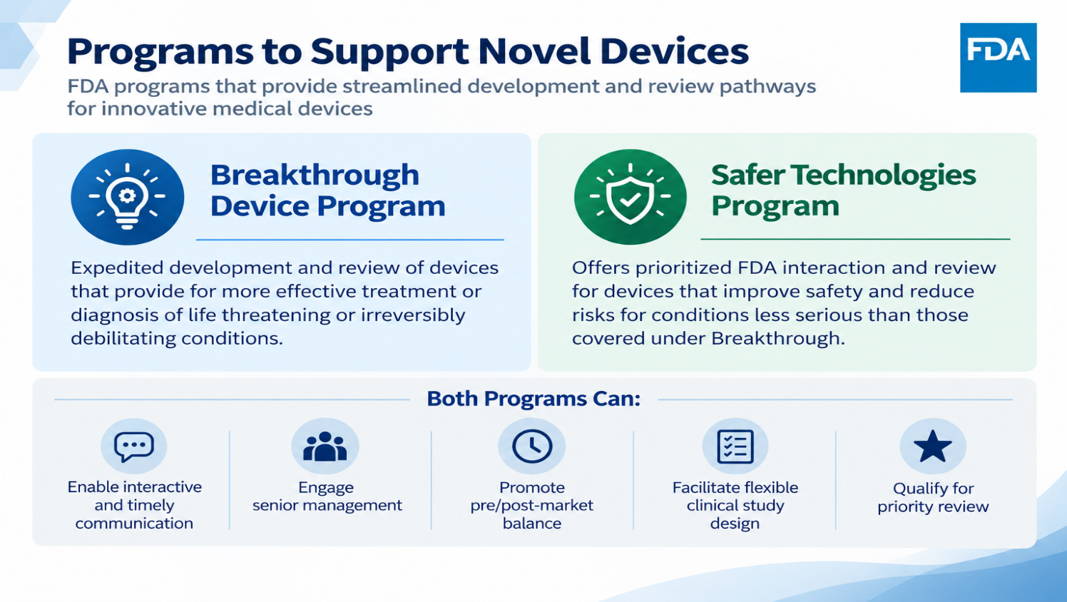

Slide 20
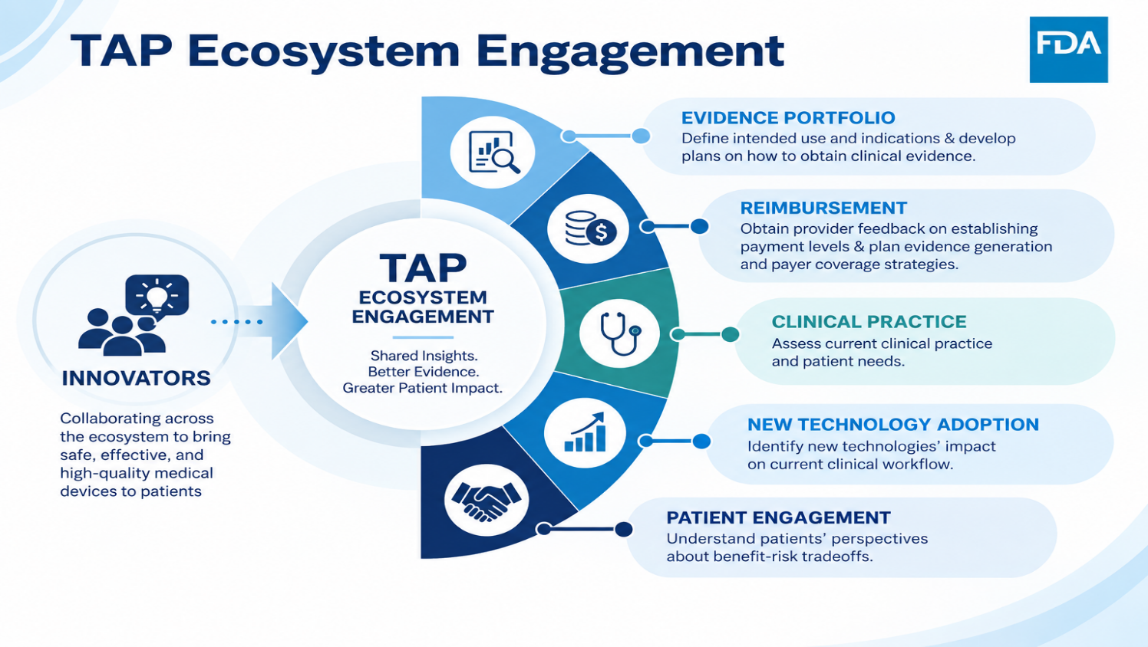

Slide 21
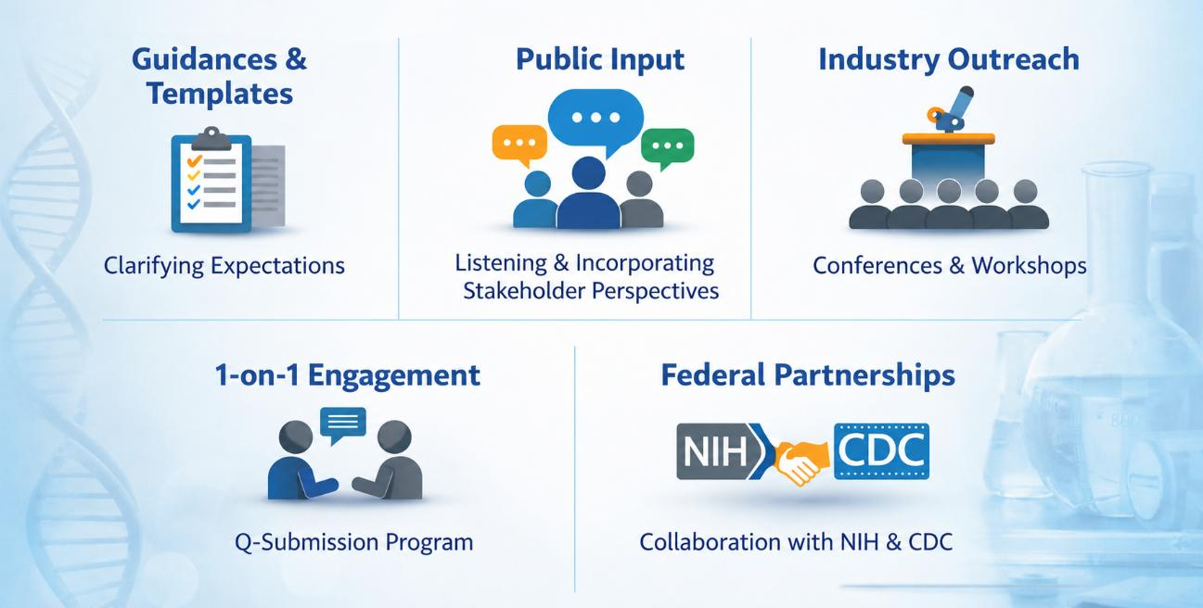

Innovation

