Slide 1
Simulation Modeling for Evaluation of New Screening Paradigms
Kathryn Lowry, MD
Associate Professor of Radiology
University of Washington School of Medicine
Fred Hutchinson Cancer Center, Seattle WA

Slide 2
Disclosures
Research Funding
  American Cancer Society
  NIH/NCI
  Screenpoint Medical, Inc.

Slide 3
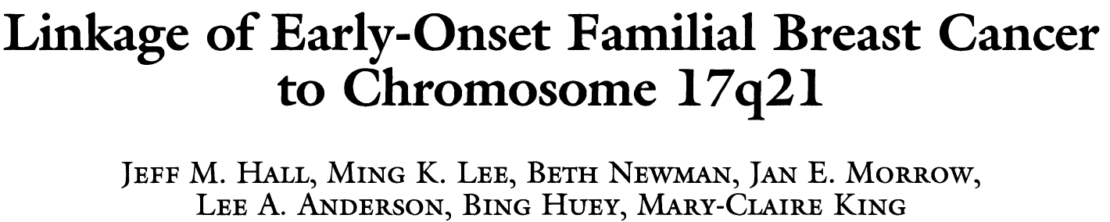
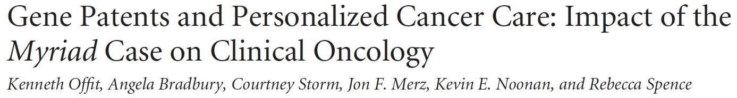
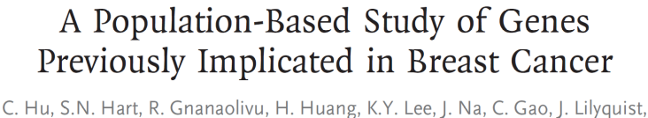
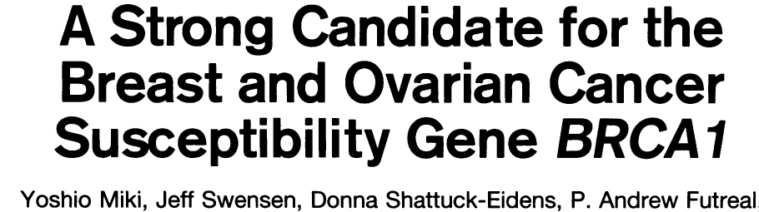
Advances in Early Detection of Breast Cancer
BRCA Identification
AMP vs. Myriad Genetics
Multigene Panel Testing
1980s
1990s
2000s
2010s
2020s
Film Mammo
Ultrasound
Film Mammo
Ultrasound
MRI
Digital Mammo
Ultrasound
MRI
Digital Mammo
Ultrasound
Better MRI
Tomosynthesis
Digital Mammo
Ultrasound
Better MRI
Tomosynthesis
CEM
AI

Slide 4
Estimating the Impact of Earlier Detection
Simulation Modeling
RCTs with Mortality Endpoints
Accuracy Studies

Slide 5
Estimating the Impact of Earlier Detection
Simulation Modeling
RCTs with Mortality Endpoints
Accuracy Studies
PROS:
Quick Provides estimates of diagnostic performance (Sensitivity, specificity, AUC) Can be performed across settings
CONS:
Do not assess intermediate or long-term outcomes (Cancer stage, mortality)

Slide 6
Estimating the Impact of Earlier Detection
Simulation Modeling
RCTs with Mortality Endpoints
Accuracy Studies
PROS:
Randomization (infer causality) Assess intermediate/long-term outcomes
CONS:
Mortality endpoints require long follow-up Costly Technology evolves Participant cross-over

Slide 7
Estimating the Impact of Earlier Detection
Simulation Modeling
RCTs with Mortality Endpoints
Accuracy Studies
PROS:
Allow for rapid assessments of new technology Can compare numerous strategies to vary screening ages, intervals Can be adapted to different populations
CONS:
Estimates rely on quality of available data Simplified assumptions of complex biology

Slide 8
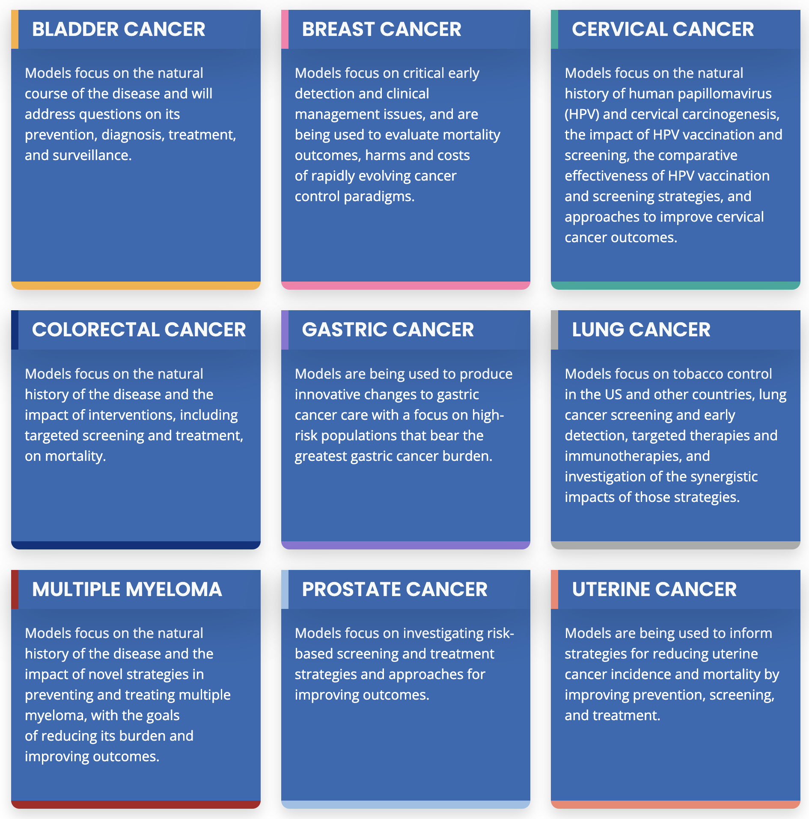

Translating Discovery to Screening Policy
Cancer Intervention and Surveillance Modeling Network
NCI-funded consortium continuously funded since 2000
Currently 9 Working Groups
Collaborative Modeling approach to answer cancer-related policy questions

Slide 9
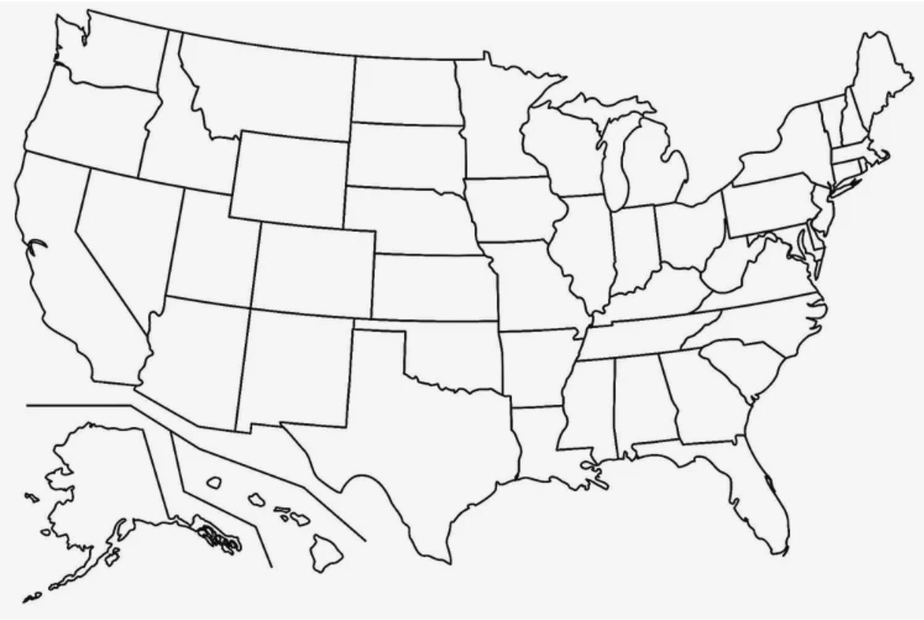
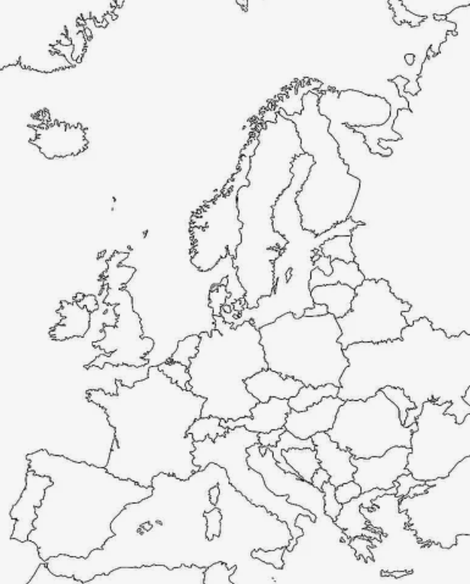
CISNET Breast Working Group
6* independent modeling groups
Vary in model structure and assumptions about breast cancer natural history
Collaborate to choose some common data elements

Slide 10

Simulation of Breast Cancer Screening
Cancer Risk
Screening Performance
Competing Risks
Treatment Efficacy
Cancer Progression Rates
Quality-of-Life Effects
Mathematical models
Screens
Recalls
Procedures
Mortality
Life Years
QOL
Disparities
Simulate Screening Scenarios

Slide 11
Data (Not) Used by Models
Data | Included in Models?
Breast Cancer Risk Factors | Yes
Breast Density | Yes
Birth Cohort Effects | Yes
Breast Cancer Subtypes (ER/HER2) | Yes
Screening Sensitivity* | Sort of
Cancer Stage Distribution* | Sort of
Cancer Recurrence | No
Mortality Benefit from Screening | No
*Calibrated outputs (not direct inputs)

Slide 12
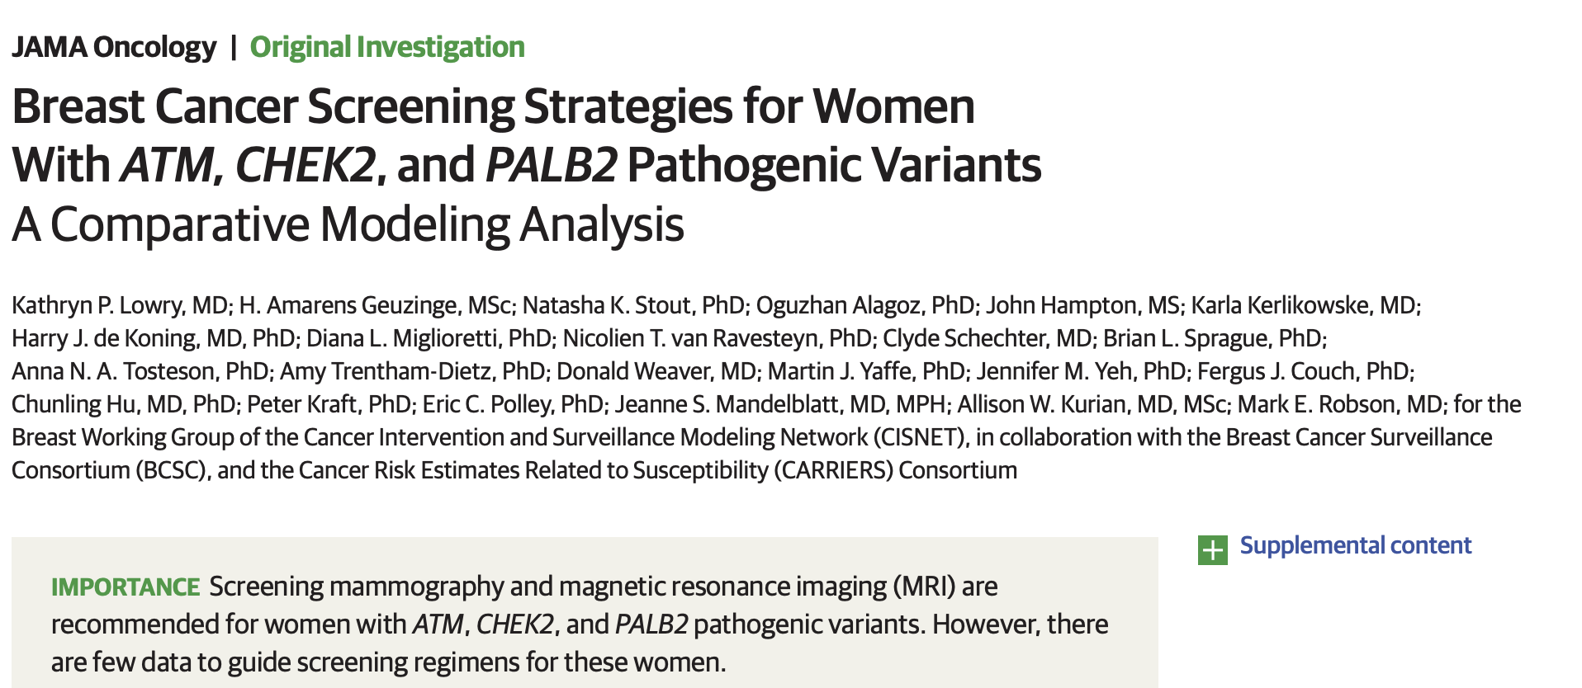


Translating Genetic Risk Information to Screening Policy
CARRIERS

Slide 13
Breast Cancer Screening Guidelines in ATM, CHEK2, and PALB2
“Intermediate” risk of breast cancer (RR 2-5x)
Screening with mammography and MRI recommended by ASCO, ACS, and NCCN
 | Prior NCCN Recommendation
ATM | Mammography + MRI at age 40
CHEK2 | Mammography + MRI at age 40
PALB2 | Mammography + MRI at age 30
No screening trials for ATM, CHEK2, and PALB2 PVs have been performed.
Lowry et al, JAMA Oncol 2022

Slide 14
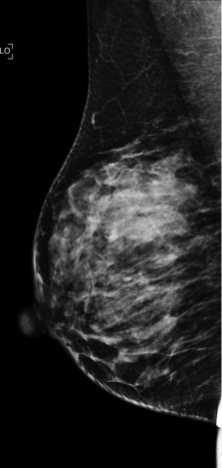
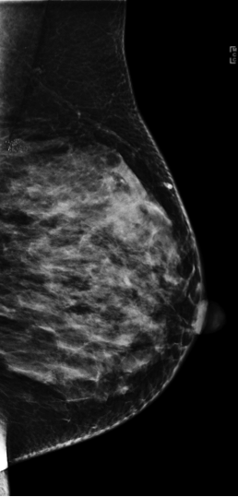
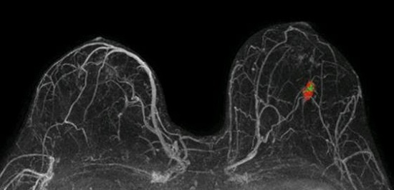
Screening Strategies
Primary Analysis:
    Annual mammography at age 40
      +Annual MRI at 40
      +Annual MRI at 35
      +Annual MRI at 30
      +Annual MRI at 25
  Secondary analysis:
  MRI at 30, mammography at 35, 30
Screening continued until age 74
Lowry et al, JAMA Oncol 2022

Slide 15
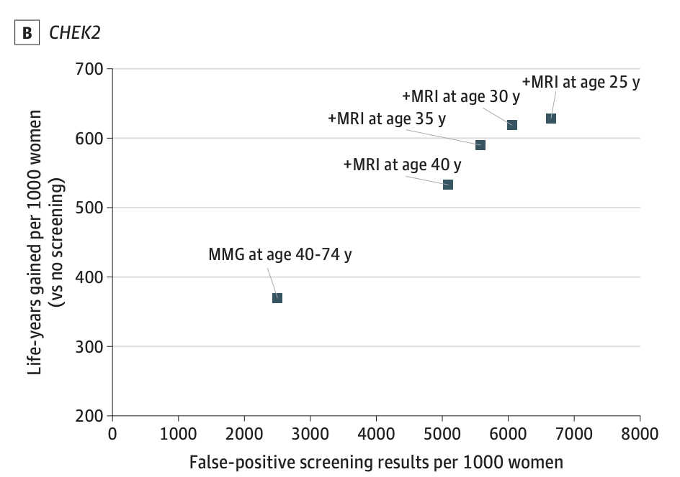
False Positives versus Life Years Gained
 | FP Screens per LYG* | Benign BX per LYG*
MMG alone | 3-8 | 0.5-1
+MRI at 40 | 7-18 | 3-7
+MRI at 35 | 7-15 | 3-6
+MRI at 30 | 13-15 | 5-6
+MRI at 25 | 47-58 | 18-22
*Model averages per 1000 women
Lowry et al, JAMA Oncol 2022

Slide 16
False Positives versus Life Years Gained
 | FP Screens per LYG* | Benign BX per LYG*
MMG alone | 3-8 | 0.5-1
+MRI at 40 | 7-18 | 3-7
+MRI at 35 | 7-15 | 3-6
+MRI at 30 | 13-15 | 5-6
+MRI at 25 | 47-58 | 18-22
*Model averages per 1000 women
Starting MRI at age 30-35 has better trade-offs of benefits and harms
Lowry et al, JAMA Oncol 2022

Slide 17
Impact of Earlier Mammography
 | BC Mortality Reduction | FP Screens/ 1000 Women | Benign BX/ 1000 Women
MRI at 30, Mammography at 40 | 55-60% | 5,075-5,415 | 1,439-1,528
Mammography at 35 vs 40 | ↑0.1-0.2% | ↑338-339 | ↑37-38
Mammography at 30 vs 40 | ↑0.1-0.3% | ↑649-650 | ↑58-59
Starting mammography at 35 or 30 had minimal impact on mortality
But increased FP screens and biopsies
Lowry et al, JAMA Oncol 2022

Slide 18


Impacts on Policy (2023)
For women with PALB2, CHEK2, or ATM pathogenic variants
Age of eligibility for MRI lowered to 30 (NCCN)
Mammography delayed until 40 if patient receiving MRI (ACR)
National Comprehensive Cancer Network. NCCN Clinical Practice Guidelines in Oncology. V3.2023.
Monticciolo et al. J Am Coll Radiol 2023 Sep;20(9):902-914.

Slide 19

What about “Non-Genetic” Risk?
Women with elevated breast cancer risk due to multiple moderate risk factors
Familial Risk
Estrogen exposures
Prior breast biopsies
BMI

Slide 20
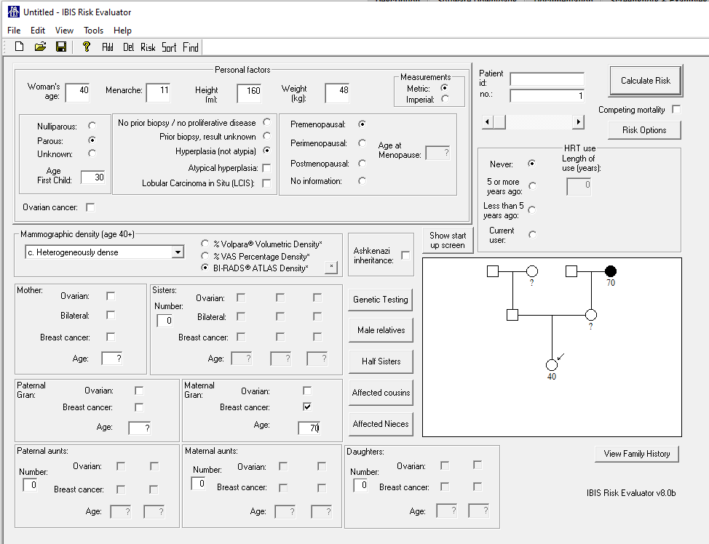
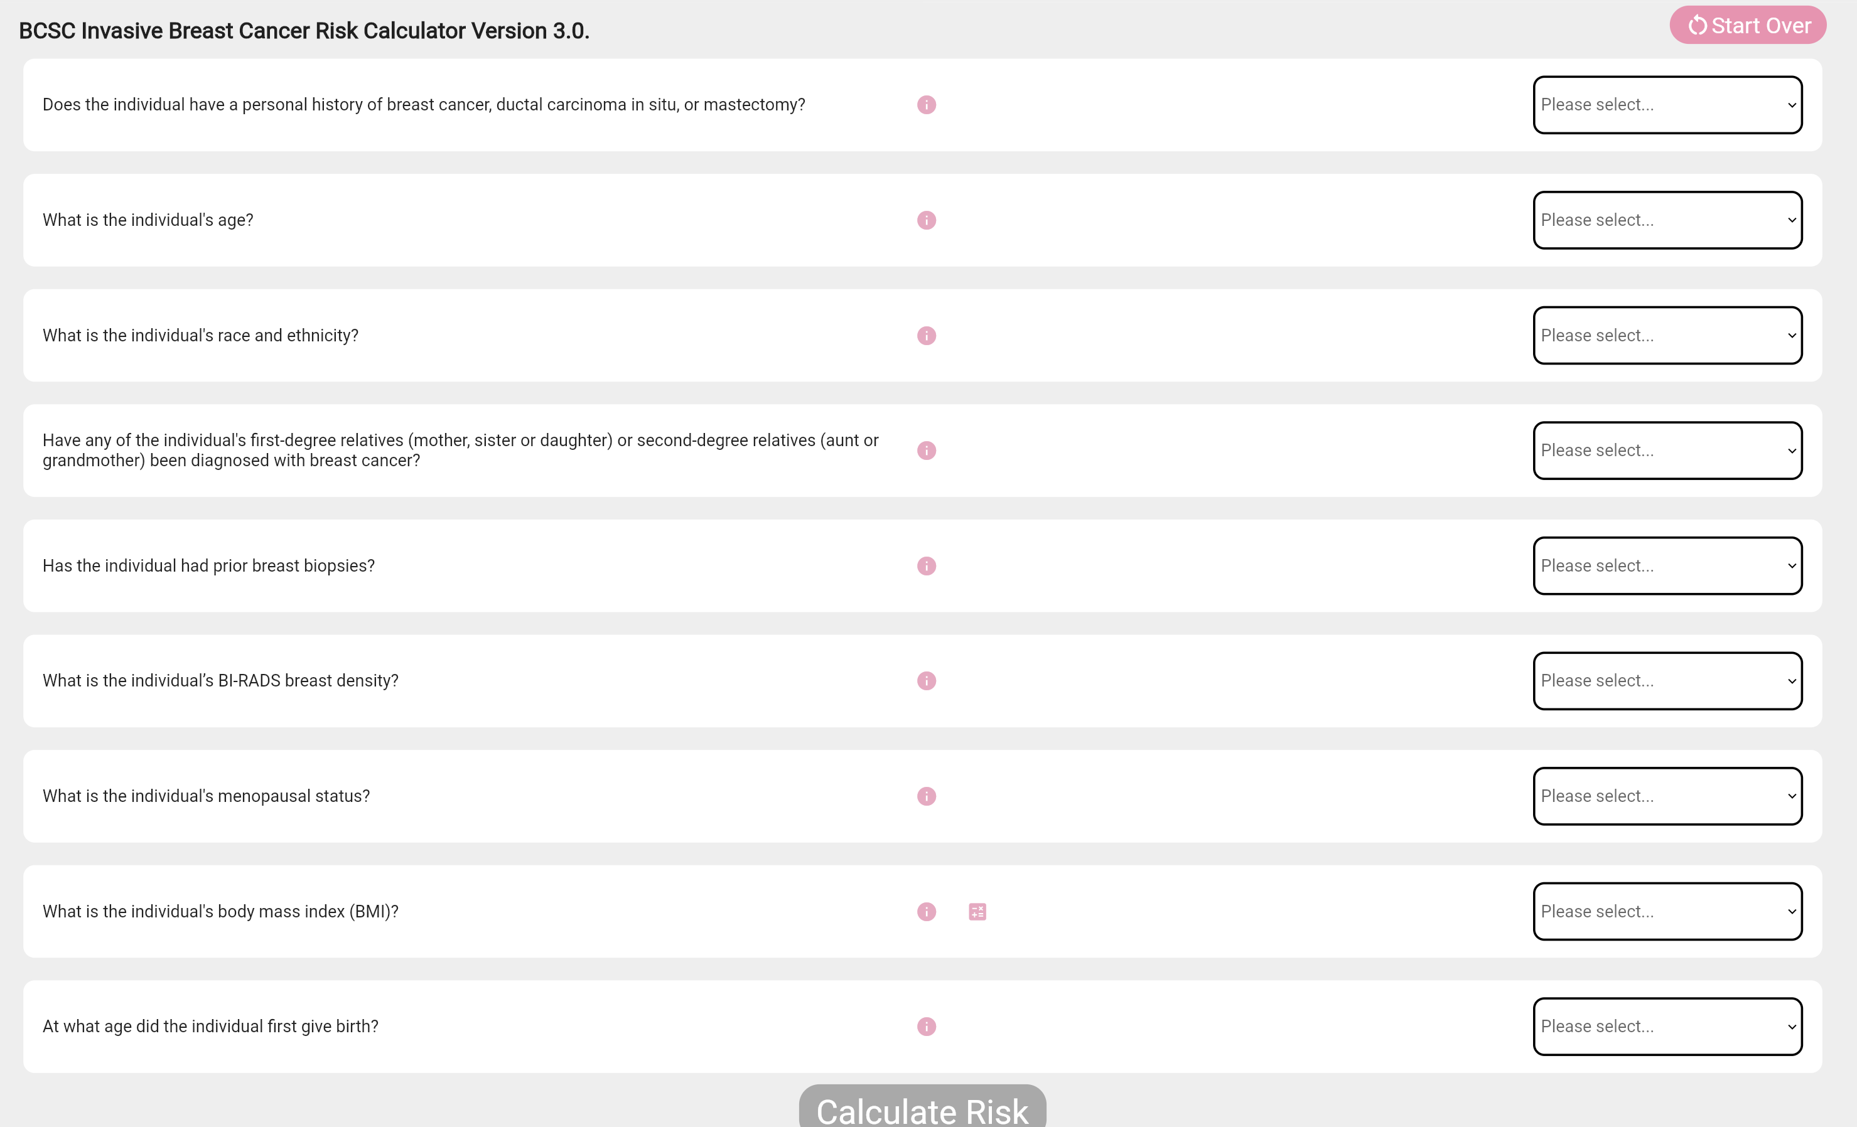
Tyrer-Cuzick v8
BCSC v3
https://tools.bcsc-scc.org/BC5yearRisk/calculator.htm
https://ems-trials.org/riskevaluator/

Slide 21
Age-Based versus “Risk-Based” Screening
Recommendations for routine screening do not take these factors into account
Could screening be tailored to risk factors beyond age?
Lives Saved
Years of Life
Quality of Life
False Positives
Biopsies
Overdiagnosis
Lives Saved
Years of Life
Quality of Life
False Positives
Biopsies
Overdiagnosis

Slide 22
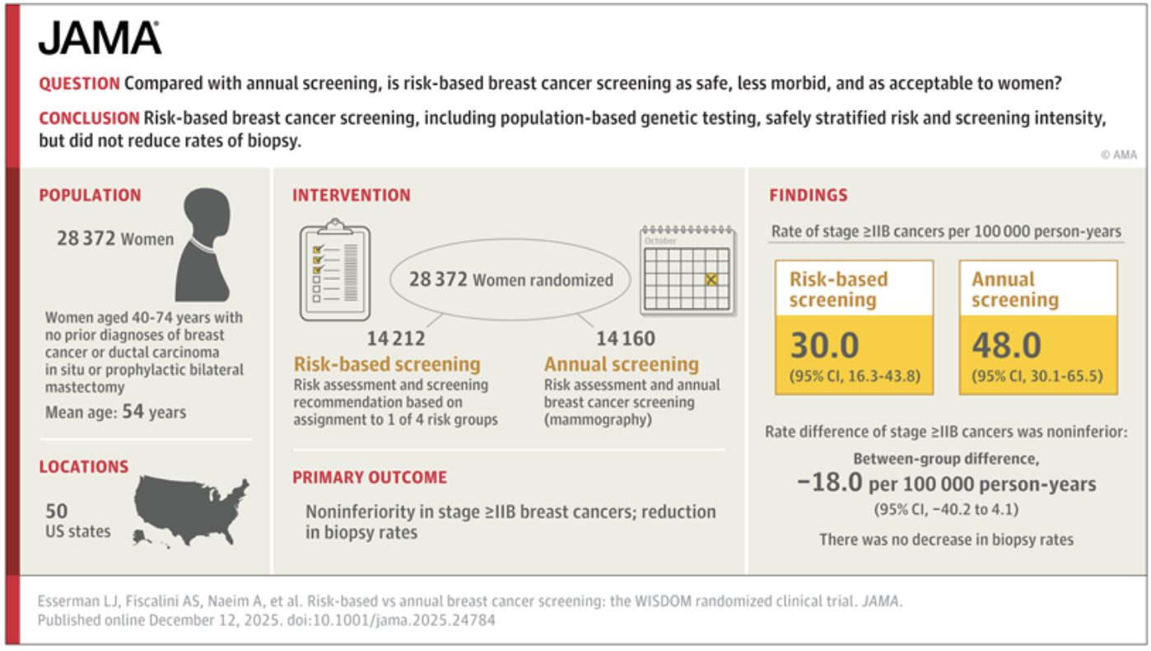
WISDOM TRIAL
LIMITATIONS
Only 20-30% of participants adhered to study arm over study period
Small differences in screening utilization between arms may mask differences in outcomes
Screening counseling performed by study team rather than PCPs
Baxter & Phillips, JAMA 2026.

Slide 23
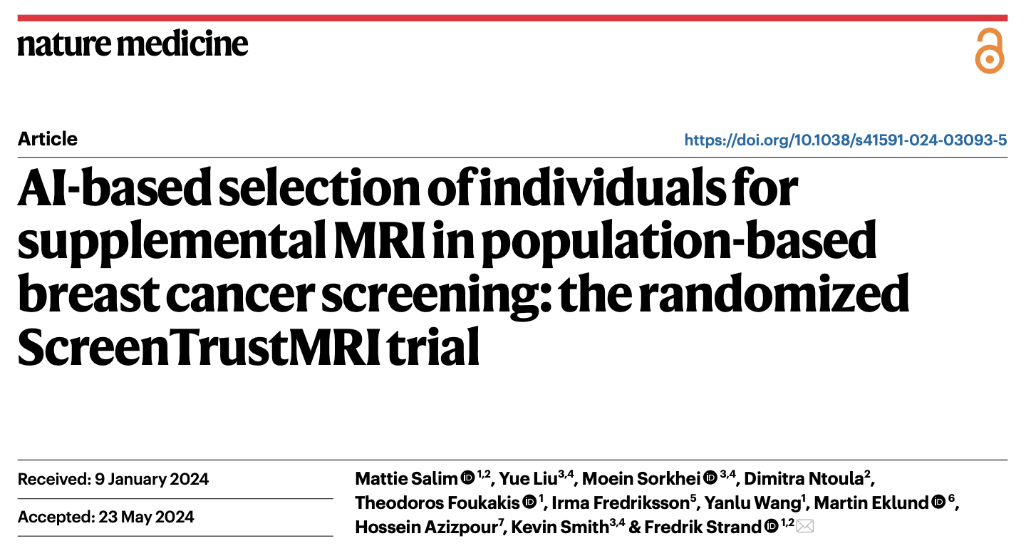
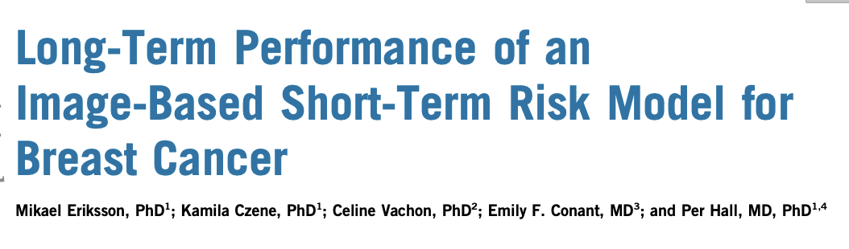
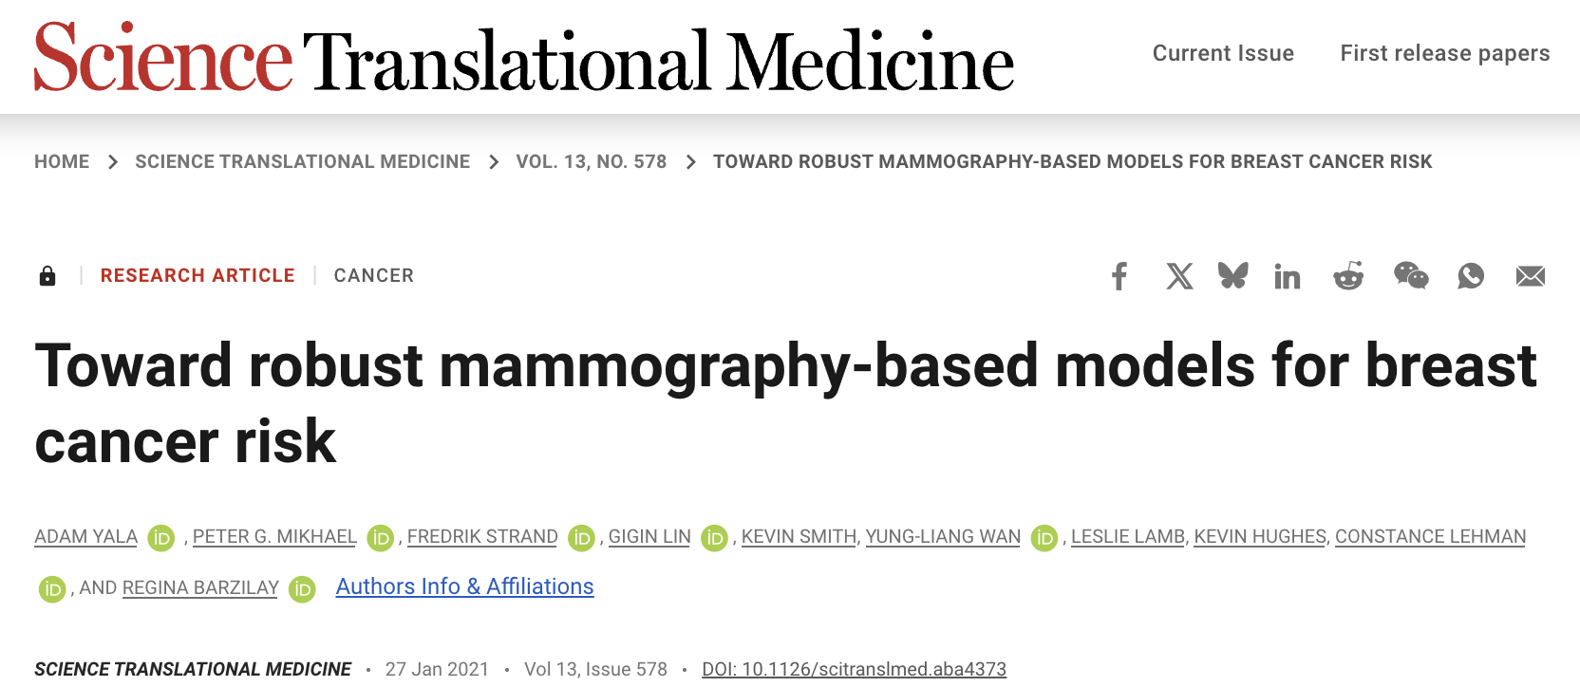
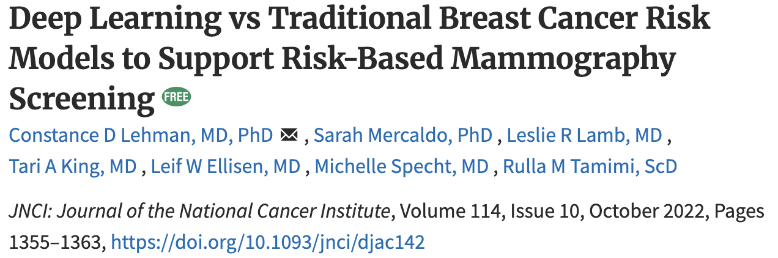
The “AI Boom”

Slide 24
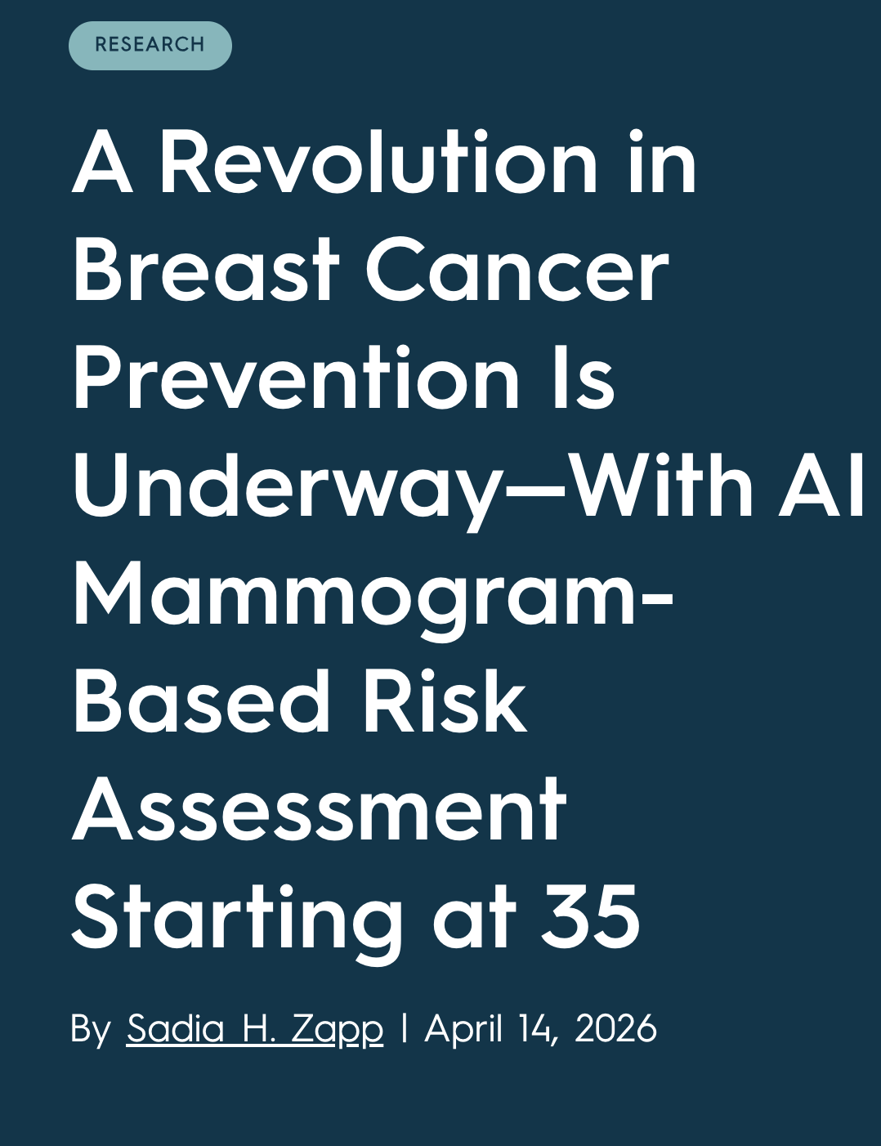
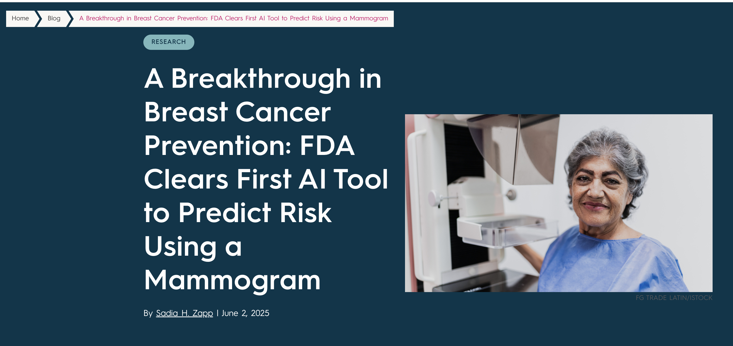
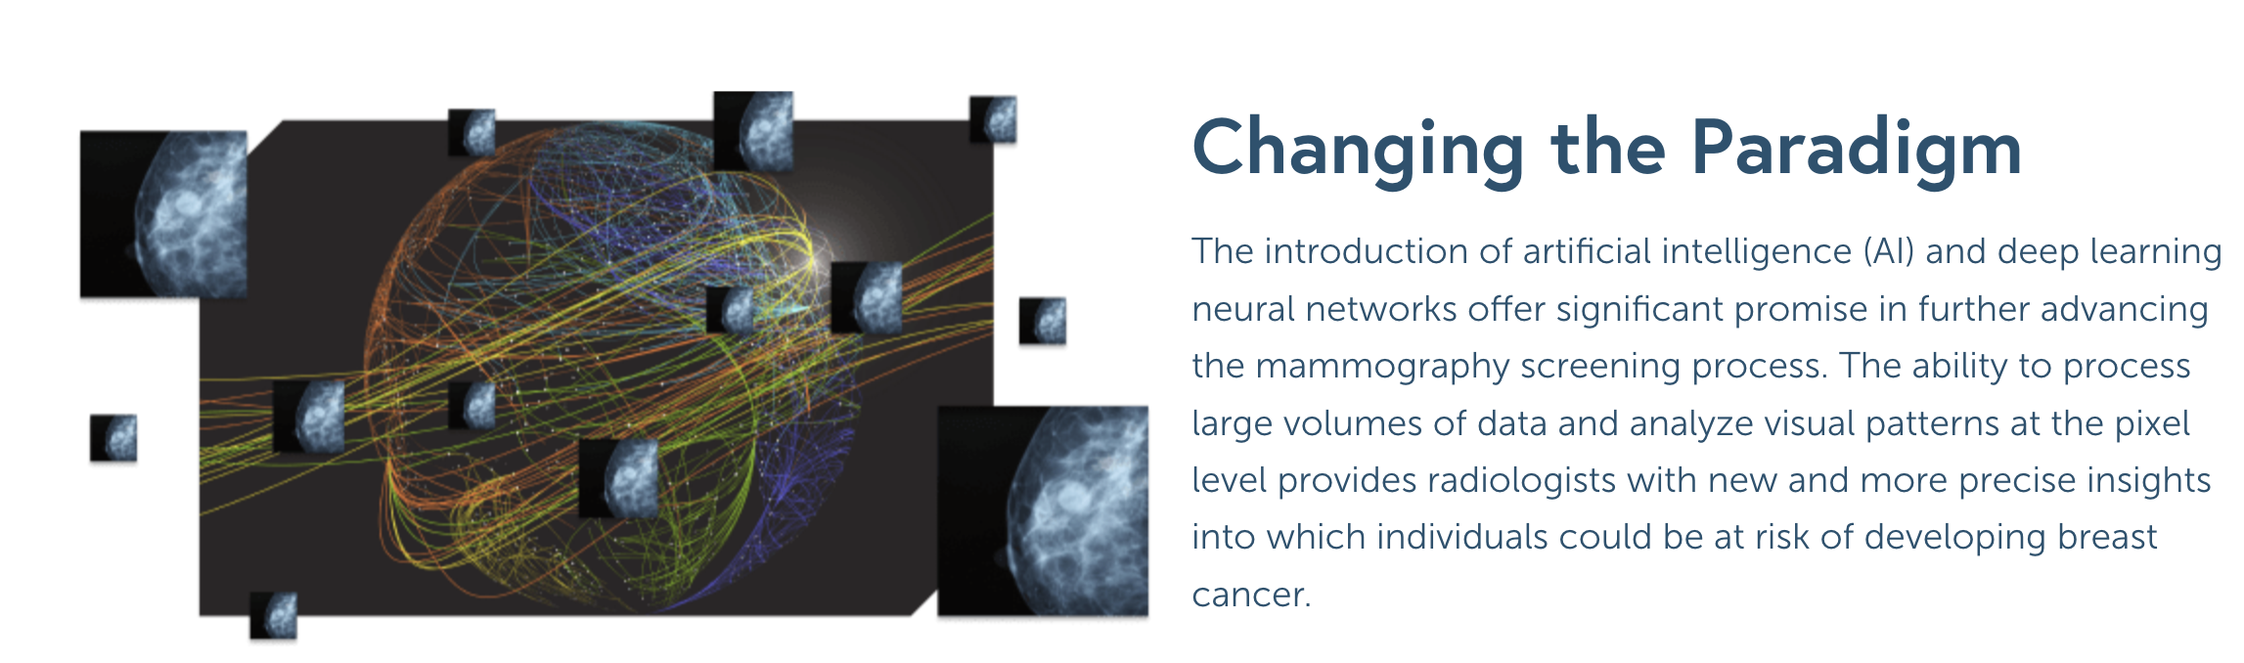
The Changing Paradigm

Slide 25
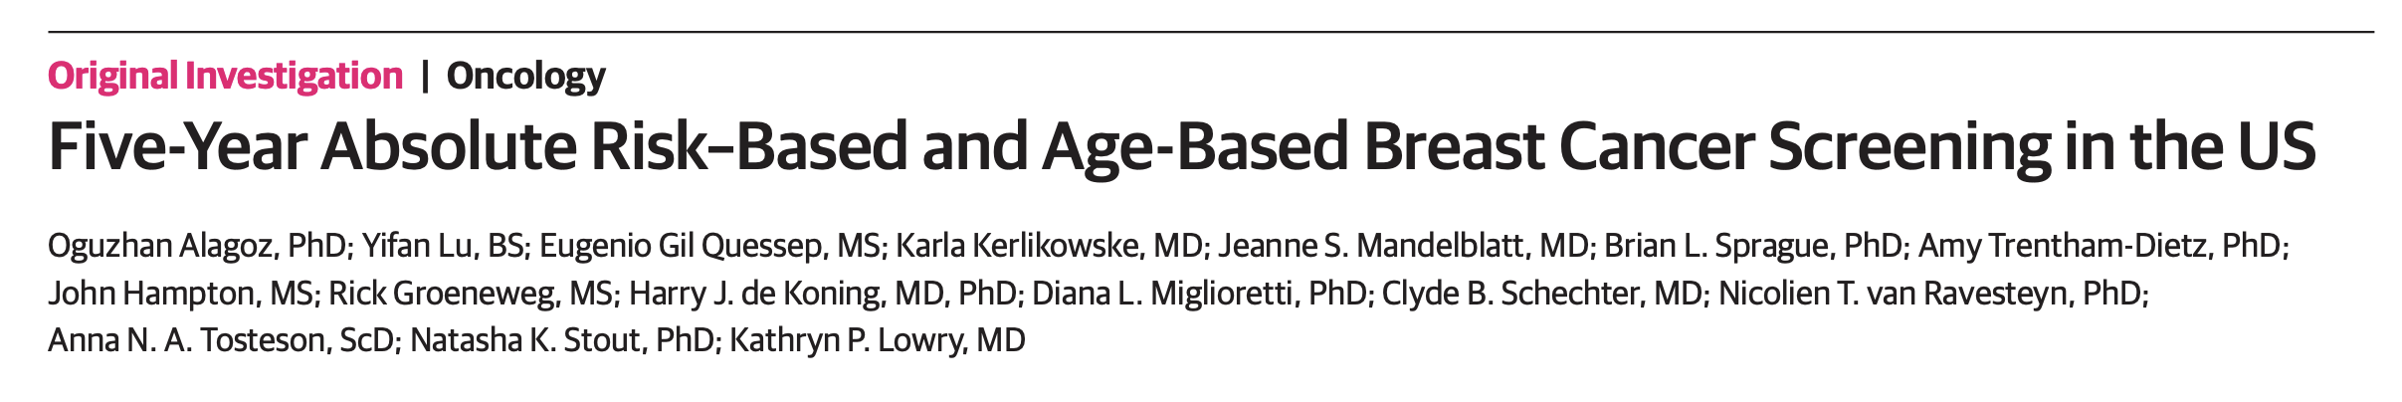
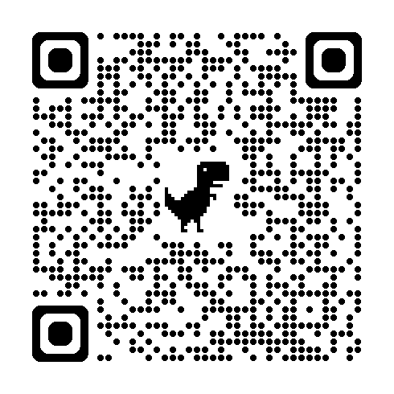
Simulating Risk-Based Mammography Screening
2 CISNET Models used to compare screening paradigms using 5-year breast cancer risk to assign mammography screening interval (annual, biennial, triennial)
  Wisconsin-Harvard Model and Erasmus Model
Compared age-based screening (40 or 50, annual or biennial) to 50 screening strategies using 2 methods of assigning risk: age-specific percentiles and absolute risks

Slide 26
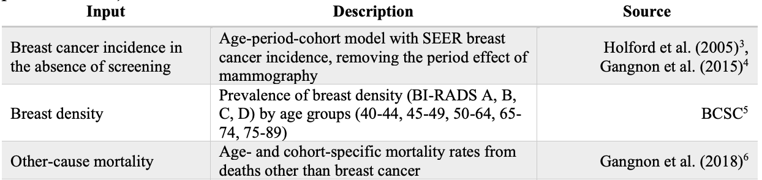
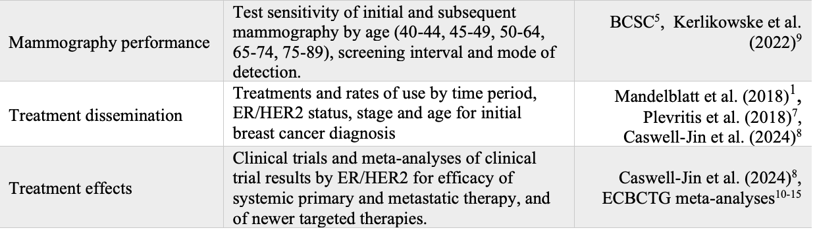
Inputs and Assumptions
Alagoz et al JAMA Netw Open 2026

Slide 27
Inputs and Assumptions
5-year risk assigned to simulated individuals based on age and density-specific risk distributions observed in the BCSC screening population
Risk only applied to cancer onset
No changes to cancer subtypes, progression, or post-treatment survival
100% Screening Adherence
Alagoz et al JAMA Netw Open 2026

Slide 28
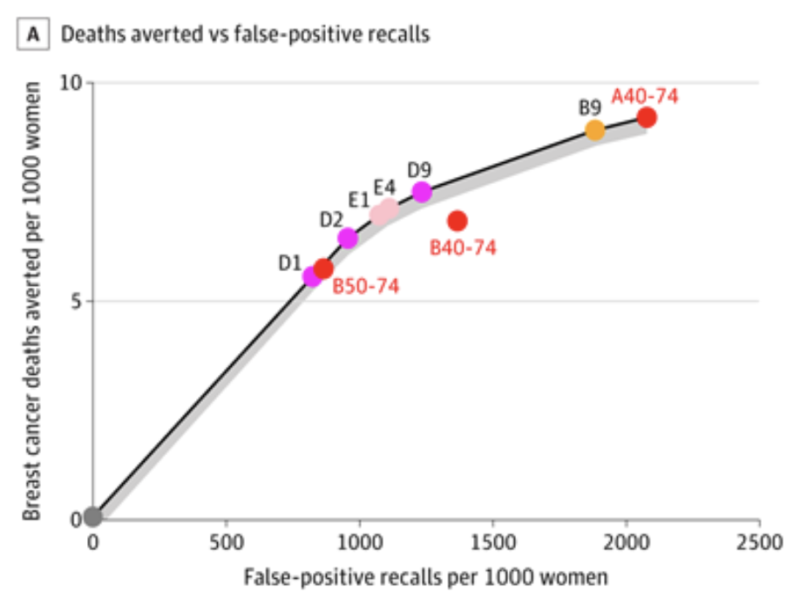
Outcomes
 | Biennial Ages 40-74 (USPSTF) | Risk-Based Low=Biennial Avg/High=Annual
No. of MMGs | 15,960 | 20,224
FP Recalls | 1,365 | 1,232
BC Deaths Averted | 6.8 | 7.5
Life Years Gained | 127 | 126
Outcomes were similar or slightly improved with risk-based mammography screening

Slide 29
Limitations and Future Directions
Only considered mammography
  More intensive screening and/or risk-reducing medication can be offered for those at highest risk
Did not incorporate other markers of risk (AI, PRS, multi-gene panel testing)
To be addressed in future work

Slide 30
Take-Aways
Simulation modeling offers complementary data to support decision-making and policy-making for cancer screening
Can be used to project outcomes while clinical trials are underway
Can consider alternative screening paradigms not included in original trials
If interested in collaborating, please reach out!

Slide 31
Thank You
Model D: Sandra LEE
Model E: harold de koenig, nicolien van ravesteyn
MODEL GE: clyde schechter, Jeanne mandelblatt, christina chapman
Model M: don berry, xuelin li
Model S: sylvia plevritis, Jennifer caswell-jin, allison kurian
Model W (CC): Amy trentham—dietz, oguz alagoz
NCI: tasha stout, eric feurer, brandy heckman-stodderd
kplowry@uw.edu

