Slide 1
Progress and Challenges in oral Cancer Chemoprevention
Frank G. Ondrey, MD, PhD, FACS
Professor, Otolaryngology Department
Co-leader Carcinogenesis and Prevention Program
Masonic Cancer Center
NCI Early Detection Resource Network
September 25, 2026 Gaithersburg, MD

Slide 2
What is Oral/Oropharyngeal Cancer
Squamous tumors of the lining tissues of the lips, mouth (oral cavity), throat (pharynx) and voice box (larynx)
Tobacco, Alcohol, HPV, Chronic inflammation
Form years after exposure, but sometimes grow rapidly
Field cancerization precludes lesion removel

Slide 3
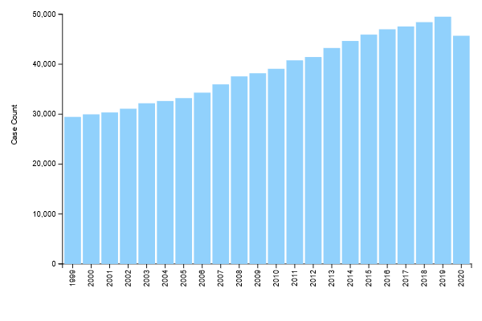
United States, Oral Cavity and Pharynx, Male and Female, All Races and Ethnicities
Annual Number of New Cancers, 1999-2020
Source - U.S. Cancer Statistics Working Group. U.S. Cancer Statistics Data Visualizations Tool, based on 2022 submission data (1999-2020): U.S. Department of Health and Human Services, Centers for Disease Control and Prevention and National Cancer Institute; https://www.cdc.gov/cancer/dataviz, released in November 2023.

Slide 4
United States, Oral Cavity and Pharynx, Male and Female, All Races and Ethnicities
Annual Number of New Cancers, 1999-2020
Emergence of HPV
Source - U.S. Cancer Statistics Working Group. U.S. Cancer Statistics Data Visualizations Tool, based on 2022 submission data (1999-2020): U.S. Department of Health and Human Services, Centers for Disease Control and Prevention and National Cancer Institute; https://www.cdc.gov/cancer/dataviz, released in November 2023.

Slide 5
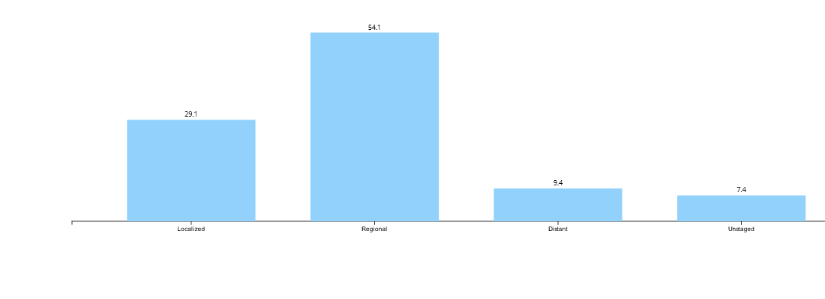
Stage Distribution (%) of New Cancer Cases, Oral Cavity and Pharynx, United States, 2016-2020
Source - U.S. Cancer Statistics Working Group. U.S. Cancer Statistics Data Visualizations Tool, based on 2022 submission data (1999-2020): U.S. Department of Health and Human Services, Centers for Disease Control and Prevention and National Cancer Institute; https://www.cdc.gov/cancer/dataviz, released in November 2023.

Slide 6
Stage Distribution (%) of New Cancer Cases, Oral Cavity and Pharynx, United States, 2016-2020
~80+ % Survival
Source - U.S. Cancer Statistics Working Group. U.S. Cancer Statistics Data Visualizations Tool, based on 2022 submission data (1999-2020): U.S. Department of Health and Human Services, Centers for Disease Control and Prevention and National Cancer Institute; https://www.cdc.gov/cancer/dataviz, released in November 2023.

Slide 7
Stage Distribution (%) of New Cancer Cases, Oral Cavity and Pharynx, United States, 2016-2020
~40-80 % Survival
~80+ % Survival
Source - U.S. Cancer Statistics Working Group. U.S. Cancer Statistics Data Visualizations Tool, based on 2022 submission data (1999-2020): U.S. Department of Health and Human Services, Centers for Disease Control and Prevention and National Cancer Institute; https://www.cdc.gov/cancer/dataviz, released in November 2023.

Slide 8
Challenge 1- Trial Accrual
Accrual to many clinical trials slow
Even pre existing cohorts sometimes cannot supply necessary patients
Require agents with minimal contraindications

Slide 9
UMN Active Surveillance
Oral Potentially Malignant Disorders (OPMD)
  4-5 % of the population harbors a risk for oral cancer
    Leukoplakia variations
    Transplantation
    GVHD
    Fanconi Anemia/dyskeratosis congenita
    Inflammatory/autoimmune disease (lichenoid conditions, lupus, pemphigus)
    Submucous fibrosis
    Proliferative verrucous conditions
    Glossitis variations

Slide 10
U of MN Active Surveillance Clinic
ENT/Dental clinics, HP, HCMC, VAMC
Dental/M Health Clinic/HP Clinic
  > 6000 suspicious lesion referrals since
Multiple IRB approved protocols for biospecimens (saliva, blood, biopsy tissue)
NIH and Industry support for protocols for 25 years

Slide 11
Clinical Trial Accrual/Cohorts
First trial 1 per 140 patients screened accrued. Current trial 1 accrual per 1.5 screened individuals.
Screening database (M Health only) increased from approximately 100 patients to 1500+
Only program in multiple NCI-CP/NET U grants
PI/Co I for approximately 70 % of Oral preneoplasia trials in oral cancer in the CP-NET

Slide 12
Catchment analysis
Automated Database Extraction R01CA254270
QA analysis to analysis appropriate catchment involvement in trials
Examined ~30 ICD 9/10 of an estimated 125 potential conditions
Analyzed service to Catchment
Analyzed cancer conversion
Mortensen et al. Oral Oncol. 2026 Apr, Palatnik et al, The Laryngoscope. 2025 October; 136(4):1755-1761.

Slide 13
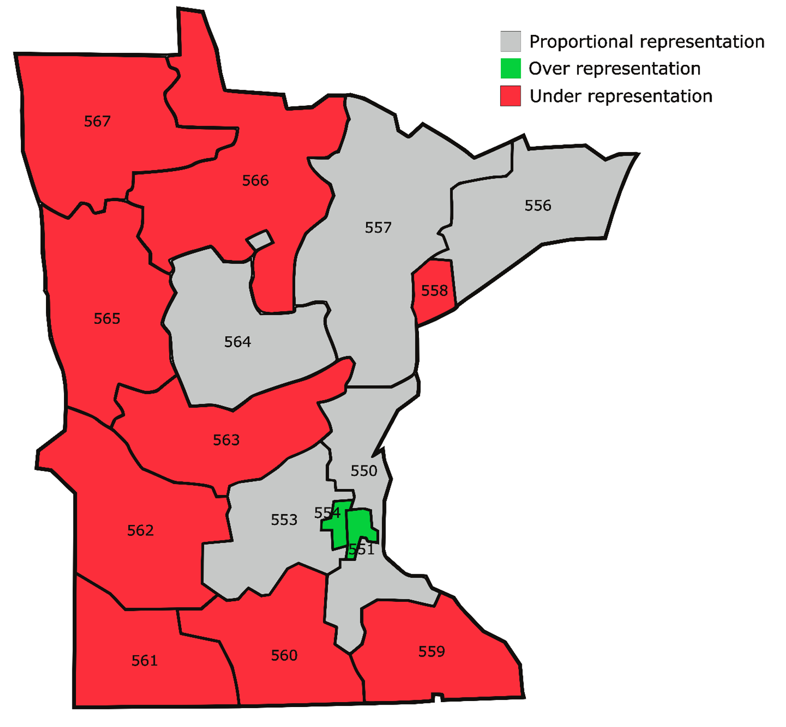
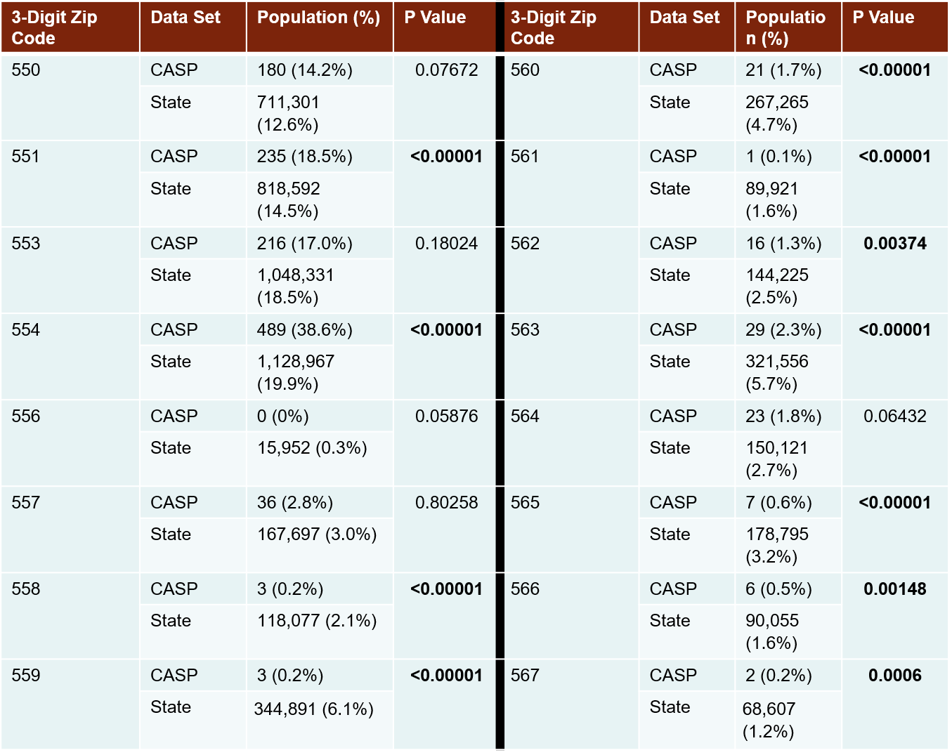
Screening analysis for MN

Slide 14
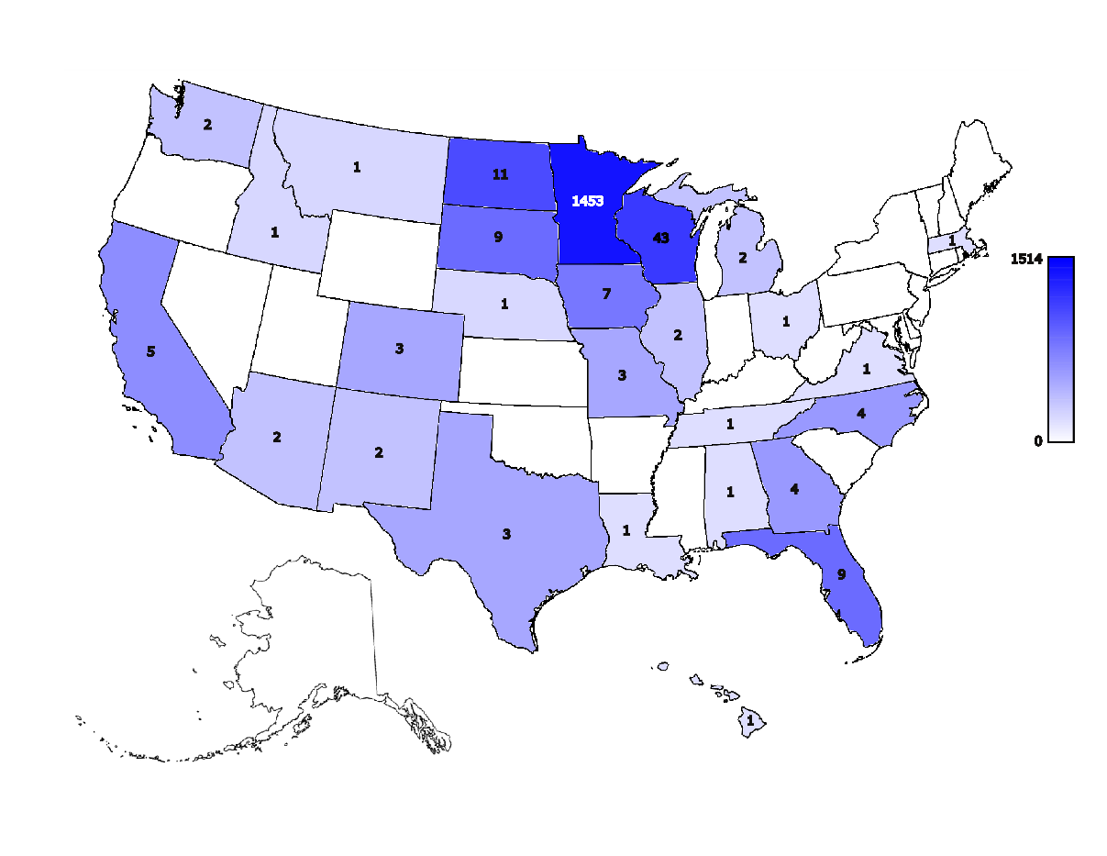
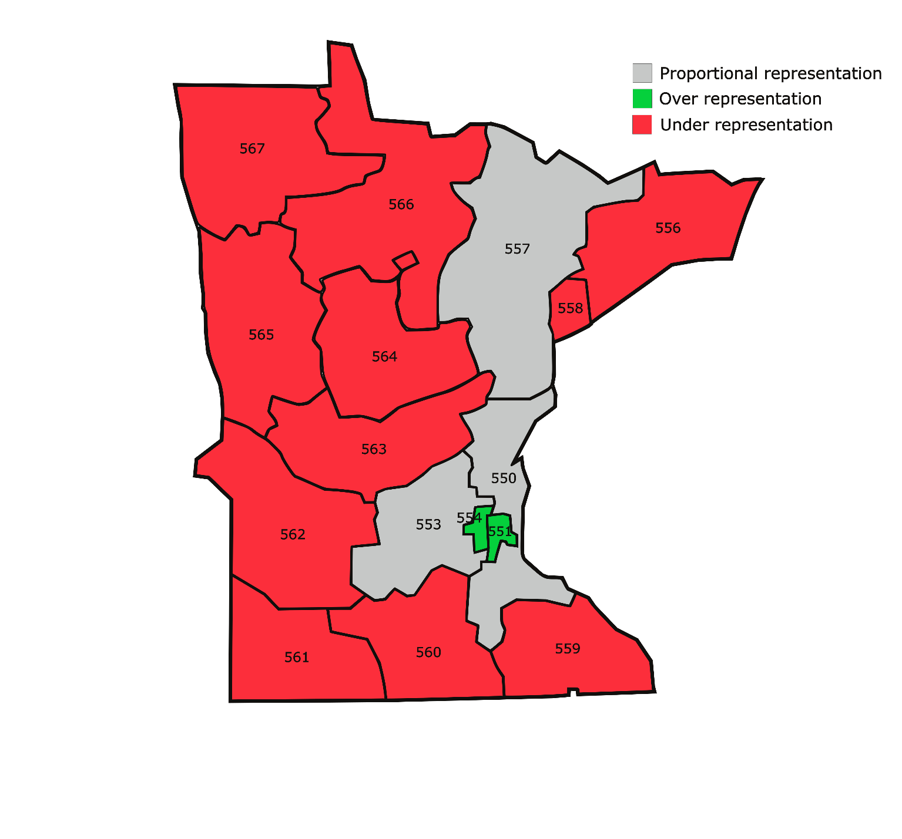
Catchment findings
NCI R01s awarded – 14, $3.7M direct
NIH R01s awarded – 4, $954K direct
NCI P01 (Hecht) – 4 projects, $1.8M direct
U2C Exposure Assessment Hub (Peterson/Hecht)
NIDA Exposure U01 (Stepanov)
NCI Research Scientist (Villalta)
5 new recruits during last funding period:
  Silvia Balbo, PhD
  Britt Erickson, MD
  Laurie Parker, PhD
  Michael Smanski, PhD
  Robert Turesky, PhD
24 research members in 6 schools/colleges
Research Funding: 57 awards, $7.9 million cancer-related direct funding
2017 Research Papers: 108 total publications
Utilization of MCC Shared Resources by Program Members
Category | Awards | Direct ($)
NCI Funding | 33 | $5,349,000
Other NIH Funding | 14 | $2,023,927
Other Peer-Reviewed | 2 | $202,551
Total Peer Reviewed Funding | 49 | $7,575,478
Total Non-Peer Reviewed | 8 | $294,267
Total Research Funding | 57 | $7,869,745
Publication Collaborations | Subtotal | % of Total
Inter-programmatic publications | 19 | 18
Intra-programmatic publications | 30 | 28
External collaboration publications | 80 | 74
High impact journal publications (score of 10 or greater) | 2 | 2
Resource | AB | Biostats | CGSR | CISR | ClPh | CPSR | FCSR | TTSR
FY2017 Users | 13 | 3 | 7 | 1 | 2 | 7 | 9 | 1
HN TRWG
Notes:
Intermediate data update thru 12/31/17 (update from 9/30/17 in the grant). Actual site visit data in slides will be as of 3/31/18.
For comparison - CC Research Funding from CCSG Grant:
NCI, 32 projects, $7.4M
NIH, 14 projects, $5.1M
Other PR, 3 projects, $230K
Non-PR, 13 projects, $465K
Total: 62 projects, $7.85M
Updated grant data IN SLIDE as of 12/31/17.
Publication data now shows full 2017 snapshot (CCSG grant provided 9-month partial 2017 snapshot). New papers will need to be reviewed for cancer relevance. (this will cause denominator of collaboration papers to go down; % to go up.)
Shared resource utilization data from grant.

Slide 15
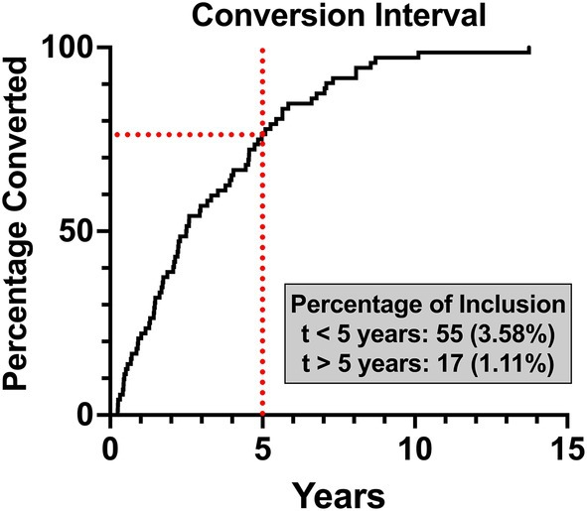
Time to Malignancy conversion

Slide 16
Time to Malignancy conversion
72/1535 conversions

Slide 17
Challenge 2- Multi institutional SOP
Templated clinical trial
Techniques standardized across Otolaryngology, Oral surgery, Periodontics
Standard lesion, collection of lesion/normal
Maximum use of small specimens
  3-4 mm punches
  Fluids, brushes, etc
Digital pathology/central pathology

Slide 18
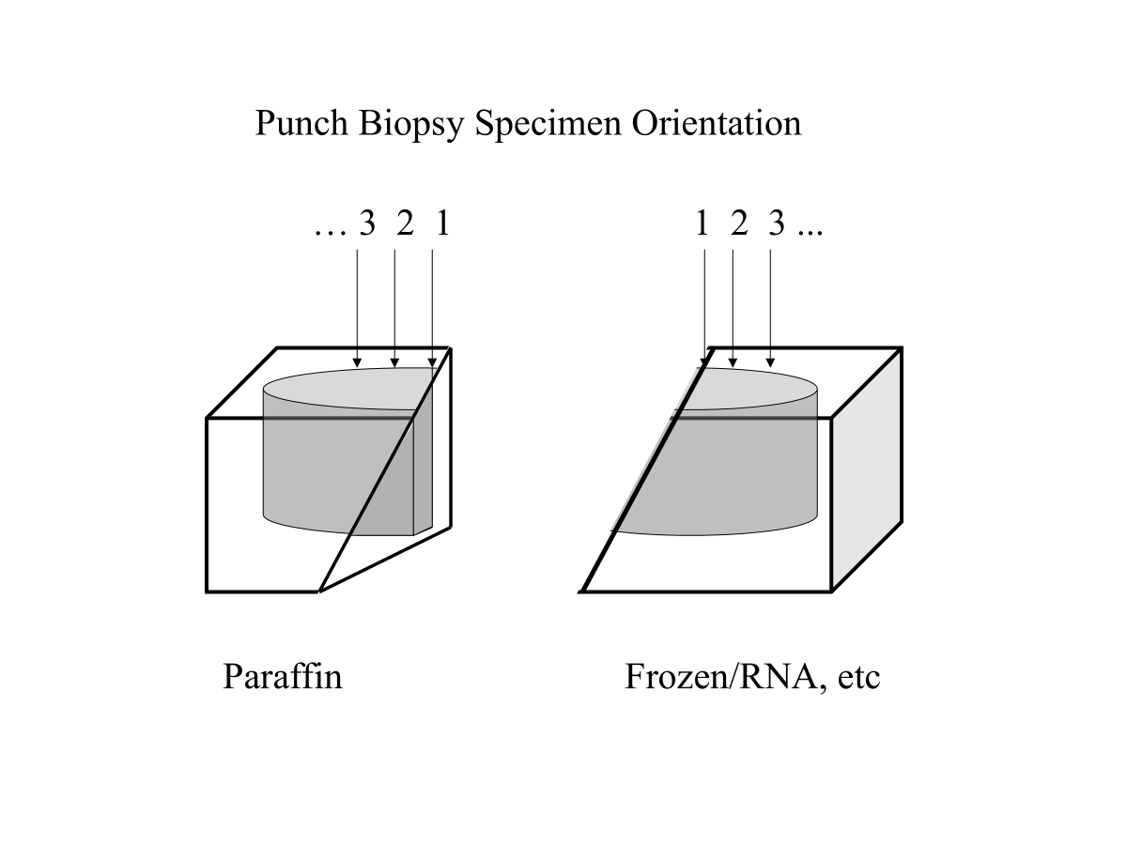
Standard Techniques
12-24 week intervention
Biopsy of leukoplakia and 1 cm margin
Pre/post biopsies
Other exploratory biomarkers

Slide 19
Definitions
Primary Chemoprevention
  Don’t smoke or drink
Secondary Chemoprevention
  Reverse a premalignancy state (DCIS, Oral leukoplakia, PIN, AK)
Tertiary Chemoprevention
  Delay the development of malignancy

Slide 20
Target/Surrogate Evolution
Oral Leukoplakia
  standard surrogate lesion for 40 years
Changes in Histology are often incorporated
  (Normal,Mild, Moderate, Severe dysplasia) WHO 2017/2022
Delay malignancy in ultra high risk individuals
  3p19/9p21 loss (EPOC Trial)
  Fanconi Anemia
Reverse Other surrogates
  Ki 67, RNA SEQ gene panels

Slide 21
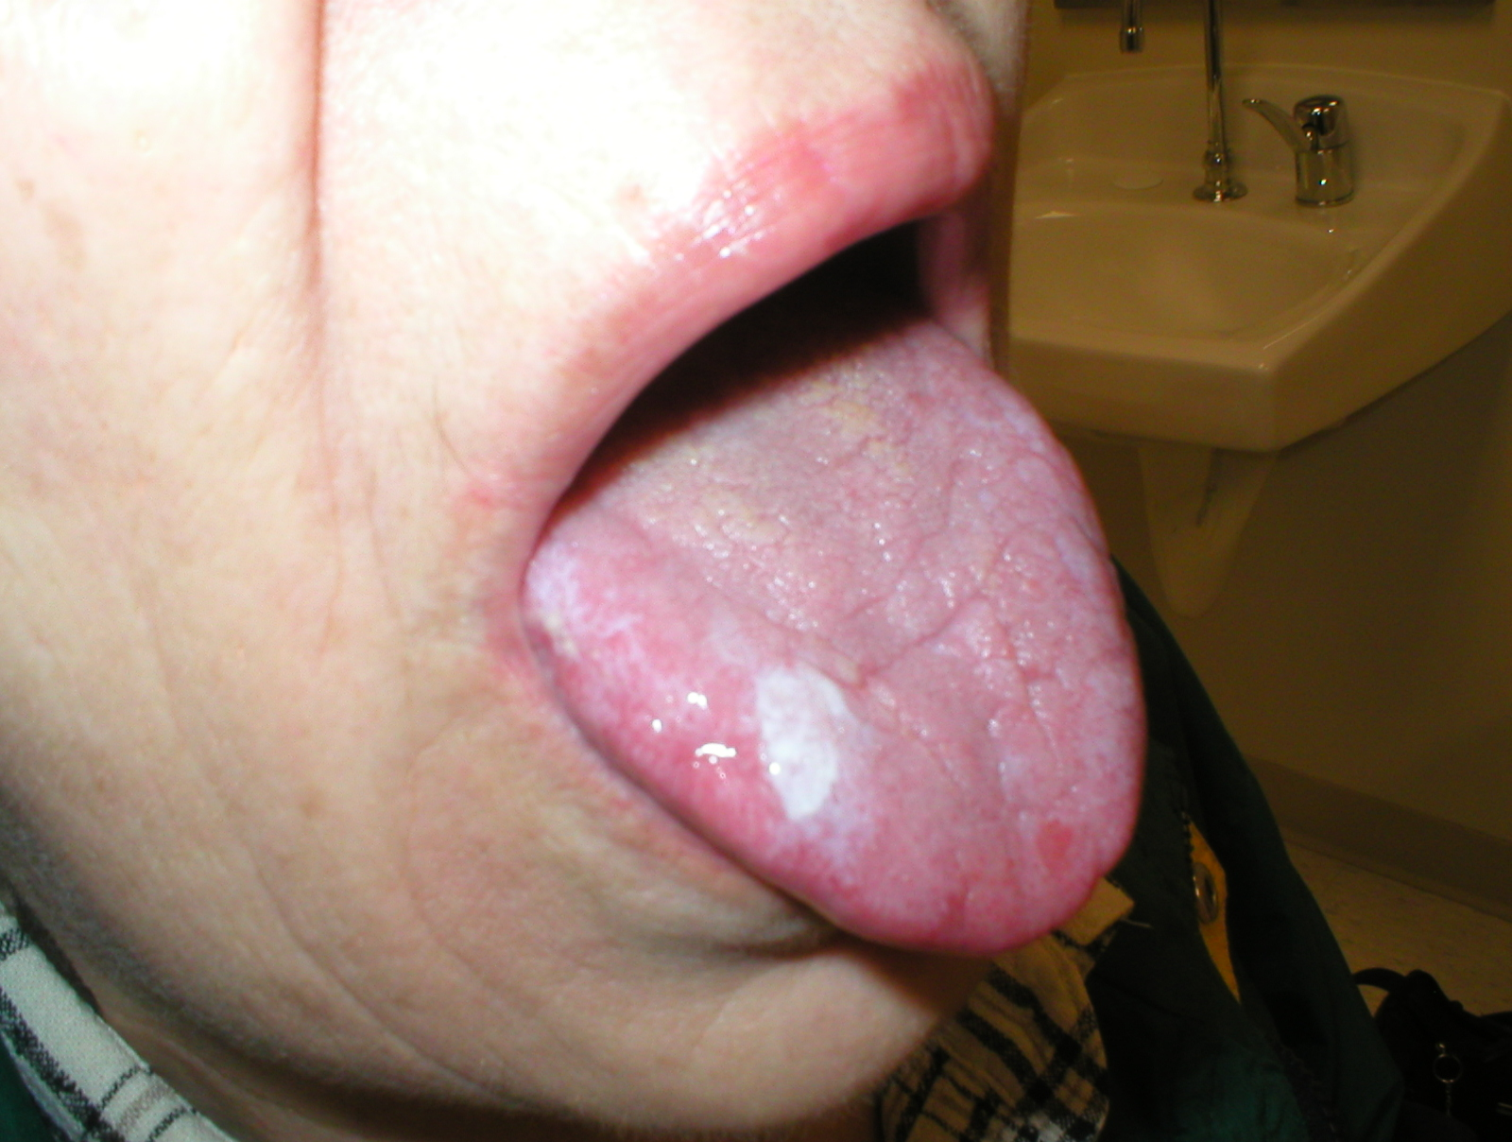
Oral leukoplakia lesion
5% conversion risk

Slide 22
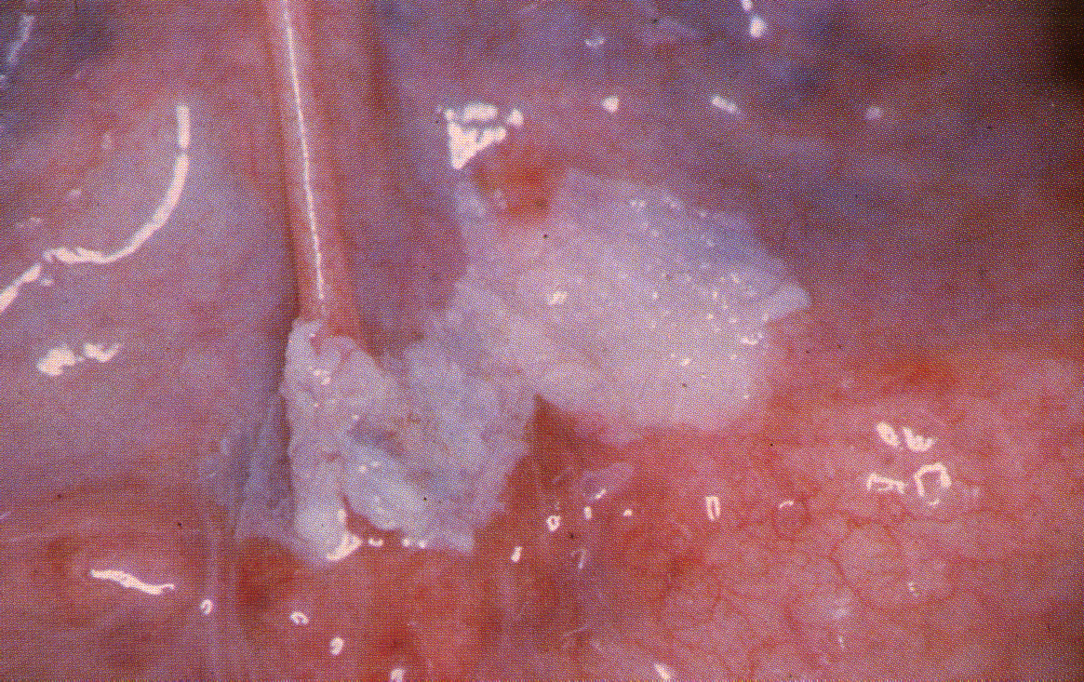
Leukoplakia of Floor of Mouth

Slide 23
Challenge 3- Agent (s), Dose, Schedule, Route,
Safe and tolerated
  CTCAE Grade 2 is maximum Toxicity
What is Effective dose?
What Administration route
  Pill, Mouthwash, Aerosol, Ablation
Duration
  12 weeks, 6 months, 18 months, lifelong?

Slide 24
Interventional Clinical trial refinement
Retinoids (1980s-1990s)
Celecoxib (Searle) (1999)
Ketorolac Mouthwash, Raspberry gels (2000s)
Bowman-Birk Inhibitor
Phase IIa- Pioglitazone: 70% response rate
Phase IIb- Pioglitazone Multi institutional 45% response rate
Phase IIa- Metformin (UCSD)- responses enhanced in smokers
Phase II- Actoplus Met XR Window trial- Ki67 suggestive of biomarker
Phase IIb- Metformin in smokers (2024)
Phase IIa- Pio/Met trial- (2024)

Slide 25
Challenge 4- evolution of Biomarkers
Clinical + Histologic response
Development of Invasive Cancer
RAR Beta (isotetrinoin)
Ki 67, P16ink 4a
Salivary CRP
Multiplexed IHC
RNA Seq

Slide 26
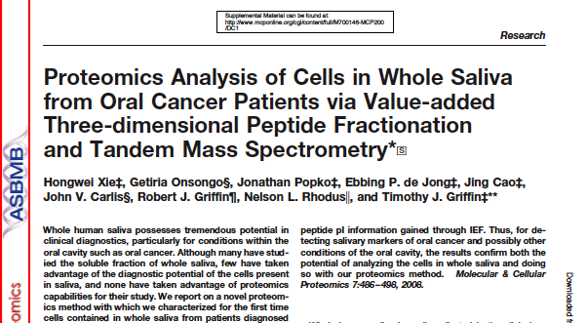

Slide 27
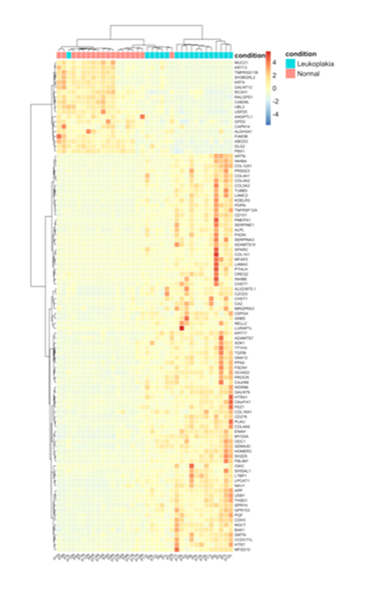
Pioglitazone-Metformin Combination Treatment for High Risk Oral Preneoplasia 5R01CA254270
High risk leukoplakia
12 week intervention
Lesion size measurements and dysplasia grading pre/post
Ki 67
Bulk RNA seq
N=25

Slide 28
Overall Summary
Built large OPMD recall population over 25 years
  Bur accrual not trivial
Preclinical cell and animal models with all potential interventions
Overall innovations in specimen collection and storage

Slide 29
Challenges
Improving oral cancer surveillance
Find Randomized Phase II success in Oral chemoprevention
Non invasive biomarkers

Slide 30
Acknowledgments
20+ Years of NCI, NIDCR, Industry & foundation support (Lions 5M, Shaver foundation, Fanconi Anemia foundation)
25 years of Masonic Cancer Center and M Health support
Collaborators: Wattenberg, Rhodus, Griffin, Jagtap, Gaffney, Rohrer, Wuertz, Gopalakrishnan, Unger, Szabo DCP

