Slide 1
From Bench to Benefit: The Hidden Work of Bringing a New Category of Cancer Screening Test to Market
EDRN SCIENTIFIC SUMMIT
SEPTEMBER 22, 2026

Slide 2
Disclosures
Employment: Mercy BioAnalytics
Stock / Equity Ownership: Mercy BioAnalytics, Quanterix

Slide 3

Our Mission
Relieve suffering and save lives through the early detection of cancer
By focusing on rigorous science, we are pioneering globally accessible and accurate diagnostic tests to identify cancer at its earliest stages when it can be most successfully treated. This will advance the diagnostic paradigm and offer better health outcomes for more people.

Slide 4


Our Technology Measures Extracellular Vesicles
A Better Test Needs a Better Biomarker
Tumor Cell
Tumor Markers
High Stage I & II SENSITIVITY
Ultra-High
SPECIFICITY
Lipid Bilayer
Salem et al., JMD, 2024

Slide 5
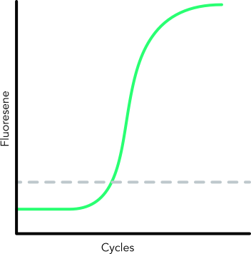



Our First-Generation Platform: Mercy Halo
EV-based blood tests: simple workflow, low sample volume requirement
Tumor-derived EV
Healthy cell-derived EV
Detection Abs with complementary oligonucleotides
Immunoaffinity Capture
qPCR Detection

Slide 6
EDRN PRoBE Study Design Framework
PROBE DESIGN ELEMENT^{1,2}
Prospective Collection
Biospecimens are gathered from a relevant clinical cohort before clinical status is ascertained.
Identical Collection
Identical Conditions
Cases and controls are enrolled under the exact same criteria.
Standardized Processing
Standardized Processing
Samples are collected, processed, and stored identically to prevent pre-analytical technical bias.
Blinded Evaluation
Laboratory assays are performed on the stored samples while technicians remain blinded to the patient's clinical outcome.
Blinded Evaluation
¹Pepe, JNCI 2008
²Ransohoff, JNCI, 2008

Slide 7


Mercy Bio’s Longitudinal, PRoBE-Aligned Cohorts
UKCTOCS
200,000 Subjects
enrolled in a randomized controlled screening trial for ovarian cancer
PLCO
78,000 Subjects
enrolled in a randomized controlled screening trial for ovarian cancer
NLST
50,000 Subjects
enrolled in a randomized controlled screening trial for lung cancer
Blood sample collected
at enrollment/longitudinal
7-11 years of annual screening
Comparative evaluation of Mercy’s Evident Test, CA125, ROCA, & TVUS
Blood samples
collected longitudinally
4-6 years of annual screening
Comparative evaluation of Mercy Test vs CA125 & TVUS
Blood samples
collected longitudinally
3 years of annual screening
Comparative evaluation of Mercy Test vs LDCT

Slide 8

Ovarian Cancer is Deadly…
40%
Diagnosed only after an Emergency Room visit¹
80%
Ovarian cancer cases diagnosed at Stage III or IV²
30%
Five-year survival when diagnosed at Stage IV²
60M+
Postmenopausal women suitable for screening³
¹Zachou et al., BMJ Oncology, 2026
²seer.cancer.gov
³census.gov
…but it doesn’t have to be
Confidential and Proprietary. Copyright © 2026 by Mercy BioAnalytics, Inc. All Rights Reserved.

Slide 9



The Long Journey to Patient Impact
Test Development
Clinical Validation
FDA Approval
Guidelines Inclusion
Payer Coverage
5-10 YRS
1-2 YRS
5+ YRS
1-2 YRS

Slide 10
The Long Journey to Patient Impact Starts Here
Test Development
Clinical Validation
FDA Approval
Guidelines Inclusion
Payer Coverage
5-10 YRS
1-2 YRS
5+ YRS
1-2 YRS

Slide 11
Evident Ovarian Cancer Population Screening Test
Now Available | Modular PMA review in progress
UKCTOCS
200,000 Subjects
enrolled in a randomized controlled screening trial for ovarian cancer
Screening Average Risk Postmenopausal Women
89% stage I/II sensitivity at 98% specificity for detecting prevalent round high grade serous ovarian cancer in a well-powered blinded evaluation in the intended use population¹
Significantly superior performance compared to CA125 & TVUS¹
Blood sample collected
at enrollment/longitudinal
7-11 years of annual screening
Comparative evaluation of Mercy’s Evident Test, CA125, ROCA, & TVUS
Cancer detection nearly two years earlier than CA125¹
Modular PMA submission initiated under FDA Breakthrough Device Designation; 1st PMA Module reviewed & accepted; IDE approved
Testing in our certified CAP/CLIA lab happening now
¹Manning et al., Gyn Oncology, 2025

Slide 12

Evident Test: PRoBE-Aligned Clinical Validation
200,000
women
UKCTOCS Trial
enrolled in a randomized controlled screening trial for ovarian cancer
UKCTOCS
~200,000 post-menopausal women
randomization
NO SCREENING
~100,000
ANNUAL TVUS
~50,000
ANNUAL CA125
~50,000
up to 4 longitudinal samples
Blood sample collected
at enrollment
20 years of follow-up
~1600 samples tested with Mercy Halo and CA125
Clinical Validation Study
Longitudinal Clinical Validation Study
200 cases; 148 HGSC, ~10X controls
Enriched for under-
represented minorities
Endpoints: sensitivity & specificity
89% early-stage sensitivity
98% specificity
Superior vs CA125 and TVUS
Longitudinal Clinical Validation Study Is Complete

Slide 13
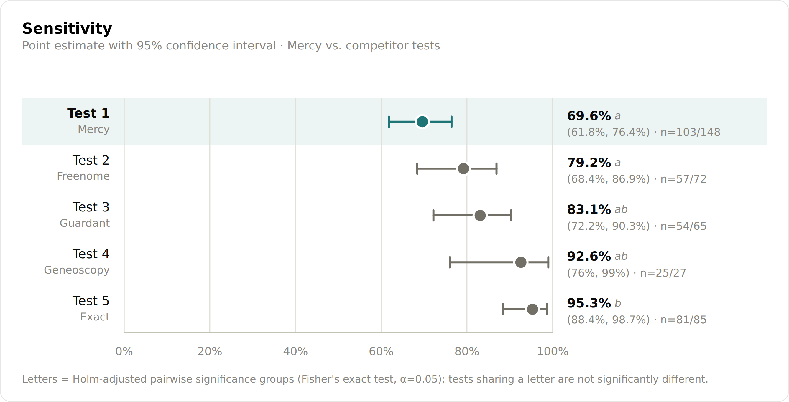
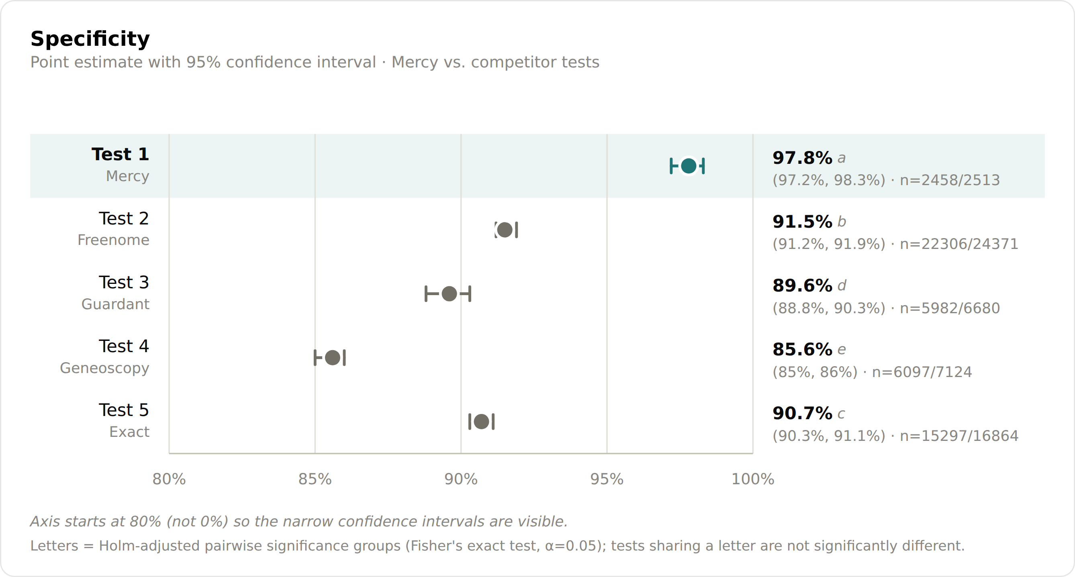

PRoBE Cohorts Can Enable Similar or Better Statistical Power vs Prospective Studies
Sensitivity
Specificity
Test #1
Test #2
FDA approved non-invasive CRC screening tests
Test #3
Test #4
Assessment of sensitivity and specificity with tight confidence intervals

Slide 14
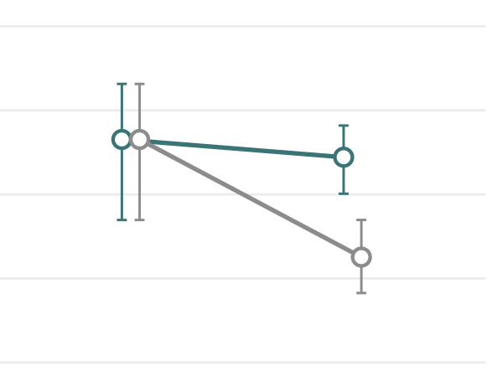
Mercy’s Study Also Reports Screening Program Sensitivity
All Other Studies Report Prevalent Sensitivity Only
Sensitivity
~80% incident cancers
Test #1
Test #2
100% prevalent cancers
FDA approved non-invasive CRC screening tests
CA125
Test #3
Test #4
Prevalent Round
n = 26
Incident Rounds
n = 122
Prevalent round-only studies can over-estimate sensitivity

Slide 15
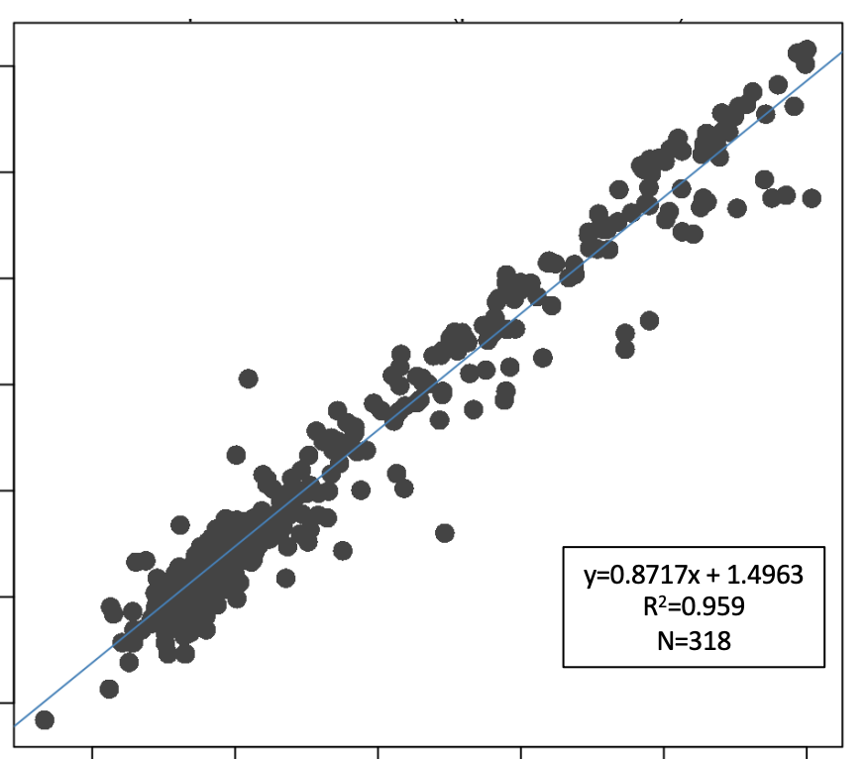
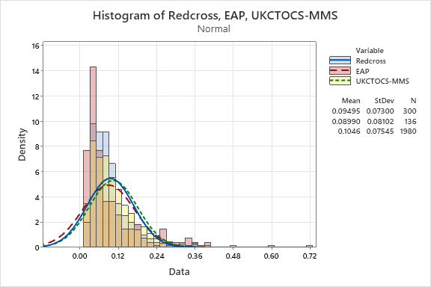
The UKCTOCS Cohort: An Oldie but a Goodie
Data suggests similar test performance in banked vs freshly collected samples
The Samples Are Stable
Concordant CA125 results on matched samples generated 20+ years apart¹
Old Samples Behave Like New Samples
Similar signal distributions in freshly collected samples vs UKCTOCS samples
12
16
R² = 0.959
n = 318
UKCTOCS
14
10
Red Cross
12
Mercy CLIA Testing
8
10
6
Density
Mercy-Generated CA125 (log2)
8
4
6
2
4
2
0
0
2
4
6
8
10
12
0.00
0.12
0.24
0.36
0.48
0.64
0.72
Original CA125 (log2) from UCL
Evident Test Score
¹Winn-Deen et al., JMD, 2024

Slide 16
PRoBE Studies Do Have Important Limitations
Key Limitation: Safety
Sources of Bias¹ | Risk | Mitigation
Spectrum Bias |  | All Available Cases Tested
Pathological Spectrum | LOW | Stage distribution reasonably aligned to SEER statistics
Clinical Spectrum | LOW | Presence of non-specific symptoms was not an exclusion criteria in the trial
Co-Morbidities Spectrum | LOW | Co-morbidities were not an exclusion criteria in the trial
Demographic Spectrum | MOD | Enrich cohort for under-represented minorities; post-stratification adjustment to match US age distribution
Work Up Bias |  | Blinded Evaluation
Diagnostic Review Bias | LOW | Evident test was compared against definitive truth, and was not used to catalyze workup
Test Review Bias | LOW | All diagnoses were confirmed and adjudicated by an independent Outcomes Review Committee
Incorporation Bias | LOW | The Evident Test result was generated on a blinded basis; analysis only after all results were reported
Limitation: PRoBE study designs can’t address test safety associated with downstream workup of false positive results
Mitigation: Mercy is running a prospective interventional study to evaluate test safety
Primary endpoint: # women screened per false positive surgery
Regulatory: IDE was approved by FDA on Sept. 18
Enrollment: Starting in Q4 ‘26
¹Ransohoff & Feinstein, NEJM, 1978

Slide 17
The Long Journey to Patient Impact is Just Getting Started
Test Development
Clinical Validation
FDA Approval
Guidelines Inclusion
Payer Coverage
5-10 YRS
1-2 YRS
5+ YRS
1-2 YRS

Slide 18

Medicare Coverage Requires One of Two Events to Occur
Pathway #1: Act of Congress
Pathway #2: USPSTF
Congress can pass a law amending the Social Security Act of 1935 to add a new Medicare benefit category
Under the Affordable Care Act, CMS can cover cancer screening if the test receives an A or B rating from the USPSTF
Breast, CRC, cervical, prostate, and now multi-cancer screening tests are covered this way
Lung cancer screening is covered this way
18
Confidential and Proprietary. Copyright © 2024 by Mercy BioAnalytics Inc. All Rights Reserved.
18

Slide 19
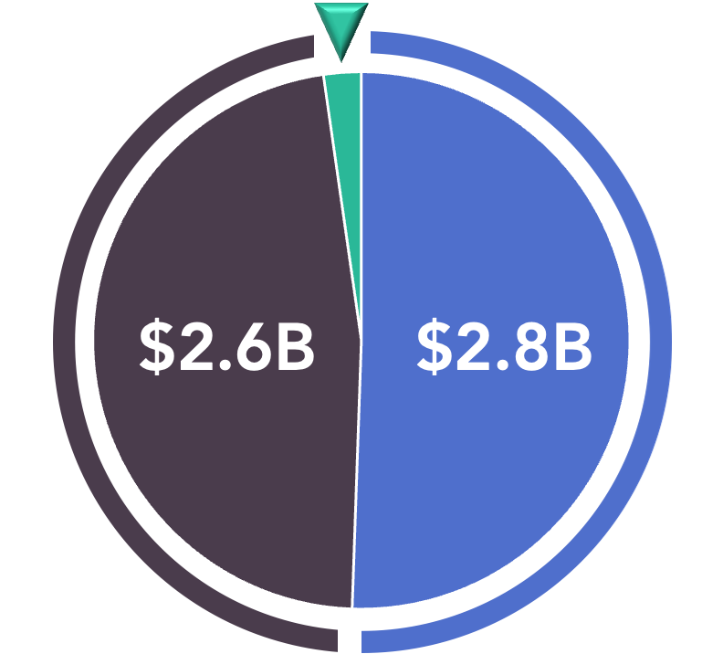
This System Creates a Powerful Disincentive for Investment in New Screening Tests
All Other Categories Combined | $0.1B
New Medicare benefit category established through legislation
Established Medicare benefit category or USPSTF recommended predicate
MCED | 3 companies
Colorectal & Lung | 6 companies
Data: Venture capital invested in currently operating companies during their pre-IPO phase. Category assignments made based on primary area of focus at the time of venture investment.

Slide 20
A New Paradigm is Needed
OLD PARADIGM
NEW PARADIGM
Safety & Effectiveness
A single large prospective prevalent-round trial to demonstrate performance at a single screening encounter
Totality of evidence across longitudinal PRoBE & prospective trials to demonstrate performance in a screening program
Benefits & Harms
100,000+ subject, 10+ year randomized controlled trial to demonstrate mortality benefit
Alternative endpoints including stage-shift & natural history modeling studies to impute mortality benefit
Reasonable & Necessary
Act of Congress or USPSTF A/B rating to enable Medicare coverage with no cost sharing
Provisional Medicare coverage with cost sharing for tests approved under FDA’s Breakthrough Device Program

Slide 21

“
If you want to go fast, go alone; if you want to go far, go together.
“
Please join us on our mission to relieve suffering and save lives through the early detection of cancer.

