Slide 1

Update on Capacity/Resource Building Projects for Pancreatic Cancer Supported by CORE Funds
Randall Brand, MD
University of Pittsburgh Medical Center (UPMC)
Brian Haab, PhD
Van Andel Research Institute (VARI)

Slide 2
Overview
Background on Pancreatic Cancer
Review of core projects
Pancreatic Cancer Reference Set
Pancreatic Cyst Reference Set
Highlight use of the Cancer Reference Set

Slide 3
Pancreatic Cancer: Background
US in 2017: 53,670 new diagnoses
43, 090 deaths
3% of all cancers and 7% cancer deaths in US
- 3rd cause of cancer related mortality in the US
Five-year survival rate of 8%
- Local disease(9%) with 5-yr survival rate of 29%
Average life-time risk of PC is 1.5% (1 in 65)
> 90% of tumors are adenocarcinomas
American Cancer Society Cancer Statistics 2017

Slide 4
Pancreatic Adenocarcinoma: Precursor lesions
Pancreatic Intraepithelial Neoplasias (PanINs)
Mucinous cystic neoplasms
Intraductal Papillary Mucinous Neoplasms (IPMNs)

Slide 5
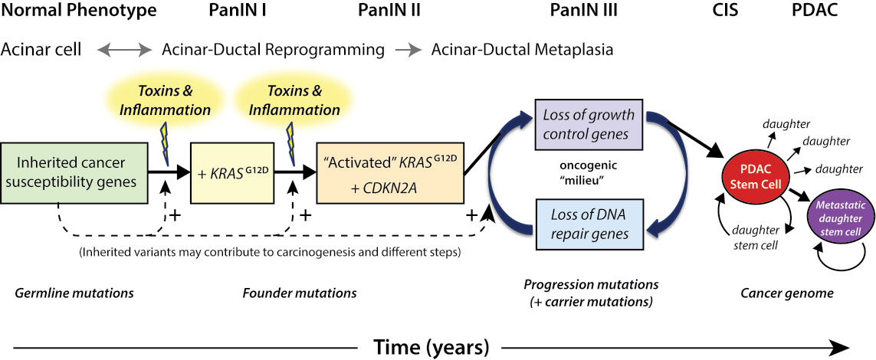
Pathogenesis of PDAC (model)
Whitcomb DC, Shelton C, Brand RE. Genetics and Genetic Testing in Pancreatic Cancer. Gastroenterology. 2015. PMID: 26255042

Slide 6
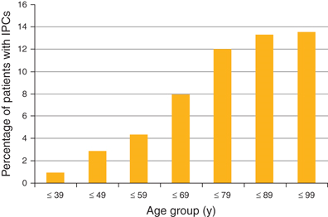
Pancreatic Cyst Epidemiology
Autopsy data suggests 25% pancreata contain a cyst
Prevalence of incidental pancreatic cysts in the adult population on MR imaging (Lee et al. Amer J Gastro 2010)

Slide 7
Calculation of pancreatic cyst prevalence in the US population in adults between age 40 and 84 (Gardner et al. Oct 2013 American Journal of Gastro)
 | US populationª | Cyst prevalence rate (%) ^{b} | Total number of cysts
Total population | 137,154,960 | 2.5 | 3,428,874
40–49-year-olds | 43,599,555 | 1.35 | 588,594
50–59-year-olds | 41,962,930 | 2.05 | 860,240
60–69-year-olds | 29,253,187 | 3.25 | 950,729
70–79-year-olds | 16,595,961 | 7.3 | 1,211,505
80–84-year-olds | 5,743,327 | 8.7 | 499,669
ª US population determined from 2010 United States census information
^{b} The cyst prevalence rate was determined by combining the mean cyst rate of the two most scientifically rigorous cross-sectional imaging studies on cyst prevalence

Slide 8
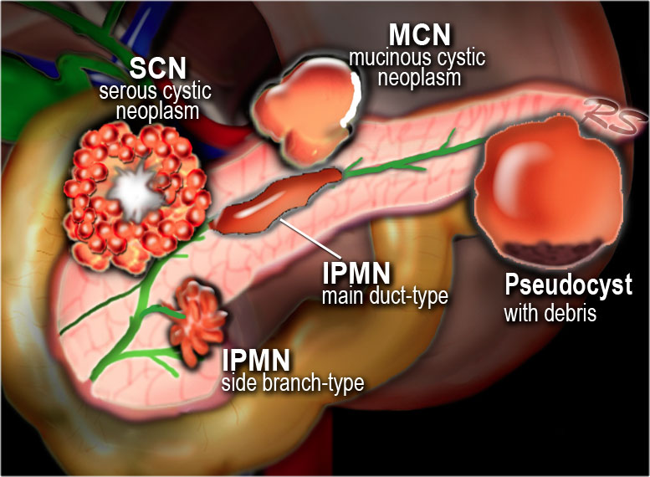

Slide 9
Ideal Diagnostic Goals for PC Biomarkers
Short-term
Finding a tumor at an early stage
“Localized” tumor, node negative (Stage I or 2A)
Identify long-term survivors ( > 5 years)
Goal of PanCan to double 5-year survival rate (~10%)
Distinguish cysts with lethal potential vs. cystic lesions with no malignant potential
Long-term
Identification of advanced precursor lesions
PanIN-3 lesion
Cystic lesions that have or will progress in a short period of time to an invasive carcinoma

Slide 10

Why did we develop pancreatic cancer and pancreatic cyst reference sets?

Slide 11
Pancreatic Cancer: An Agenda for Action Report of the Pancreatic Cancer Progress Review Group: February 2001 Kern, Tempero, Conley
Research priority # 2 from Risk, Prevention, Screening, and Diagnosis section
Develop specimen banks for all types of biomaterials—blood, serum, pancreatic juice, stool, tumors, other body fluids—to redress the paucity of specimens available for analysis.

Slide 12
EDRN PC Reference Set Participants
University of Pittsburgh
University of Nebraska Medical Center
NorthShore University Health Systems (formerly known as Evanston Northwestern Healthcare)
University of Michigan
Memorial Sloan Kettering Cancer Center

Slide 13
EDRN Pancreatic Cancer Validation Set
63 Chronic pancreatitis patient
31 Benign Biliary Obstruction
61 Healthy Controls
100 Pancreatic cancer cases
IA: 8
IB: 7
IIA: 42
IIB: 43

Slide 14
Final Set
Each sample
Complete data at DMCC (Data transfer)
Four ml of serum, 2 ml of plasma at NCI Frederick
All samples have been shipped
Ready for use

Slide 15
Scientific Framework for Pancreatic Adenocarcinoma (PDAC) February 2014
“The Recalcitrant Cancer Research Act of 2012 (Public Law 112-239, §1083) calls upon the National Cancer Institute (NCI) to “develop scientific frameworks” that will assist in making “progress against recalcitrant or deadly cancers.” PDAC is a recalcitrant cancer as defined by its five-year relative survival rate of less than 5 percent that translates into the loss of almost 40,000 lives per year. Consensus within the scientific community regarding the limited early diagnostic or therapeutic approaches for patients with PDAC has provided a stimulus for the evaluation of new and missed opportunities that could now be applied to the existing portfolio of PDAC research in order to make more substantial progress. “

Slide 16
Biomarkers for Early Detection of PDAC and Its Precursors
Recommendations for next steps: For further progress in the development of early detection biomarkers, it will be essential to optimize screening protocols, to improve enrollment of high risk populations in screening studies, and, crucially, to demonstrate that screening can improve the outcome of patients. A potentially useful approach to enhancing screening research is to prospectively harvest and analyze tissue from patients with PanIN-2 and -3 lesions during resection, and from cyst fluid from those undergoing endoscopic ultrasound and fine needle aspiration.

Slide 17
EDRN Cyst Reference Set Participants
University of Pittsburgh (Brand)
University of Michigan (Kwon)
Memorial Sloan Kettering Cancer Center (Allen)
Thomas Jefferson University (Winter)
Stanford University (Park)
Vanderbilt University (Merchant)
Mt Sinai Medical Center (DiMaio)
Moffitt Cancer Center (Vignesh)
University of Nebraska Medical Center (Singh)
Johns Hopkins University (Lennon)
Georgetown University (Smith)
St. Michael’s Hospital (Marcon)
UCSF (Kirkwood)
Ohio State University (Conwell)
MD Anderson CVC (Maitra)

Slide 18
Biospecimen and Data Collection
Total enrollment of 301 patients
166 surgical resections
120 Low malignant potential or benign
46 high malignant potential
133 EUS only
2 being clarified

Slide 19
Studies Using the Reference Set
CA19-9 analysis
Two EDRN lab-based assays and Abbot Architect
run by Ivan Blasutig, U. Toronto
Distributions
Dr. Ann Killary, MD Anderson Cancer Center
Dear1
Dr. Surinder Batra, U. Nebraska Medical Center
MUC5AC
Dr. Brian Haab, Van Andel Research Institute
3-marker glycan panel
Dr. Kazufumi Honda, National Cancer Center Research Institute, Tokyo
Apolipoprotein-A2 isoforms

Slide 20
CA19-9 Analysis

Slide 21
Similar to published studies for resectable pancreatic cancer
Biliary obstruction is the greatest confounder
At optimal threshold, specificity higher than sensitivity

Slide 22
Some discordance between assays, but similar overall performance

Slide 23

Assessment of MUC5AC

Slide 24
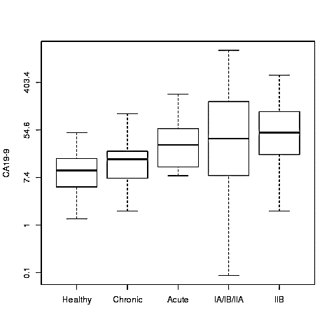
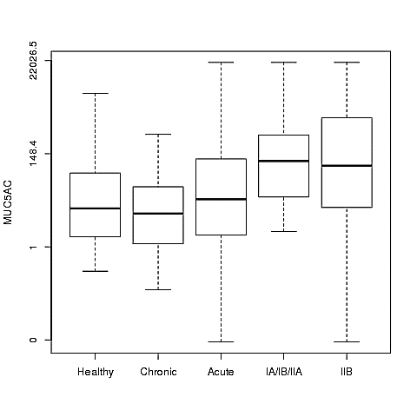
CA19.9 AND MUC5AC LEVELS
Elevated levels of both MUC5AC and CA19.9 were observed in PC early stages in comparison to various control groups
Similar trend was observed after age, diabetes adjustment
Elevated levels of CA19.9 were observed in acute biliary obstruction cases while MUC5AC showed varying trend in this group

Slide 25
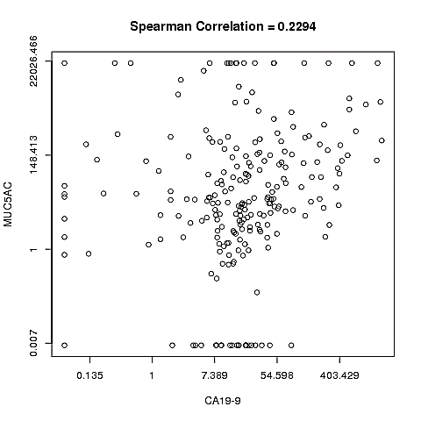
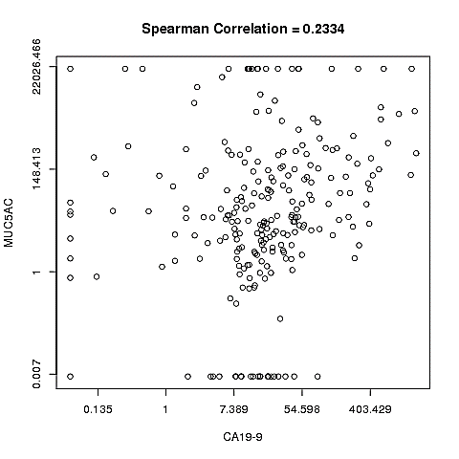
CORRELATION BETWEEN MUC5AC AND CA19.9
Age and Diabetes Adjustment
Unadjusted
No significant correlation was observed between MUC5AC and CA19.9

Slide 26
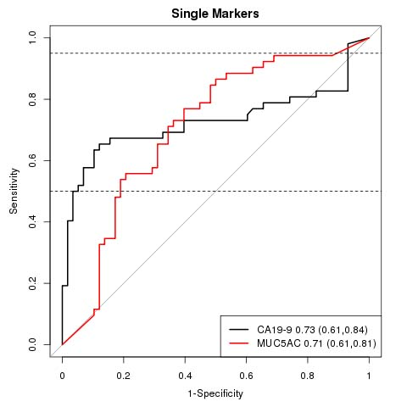
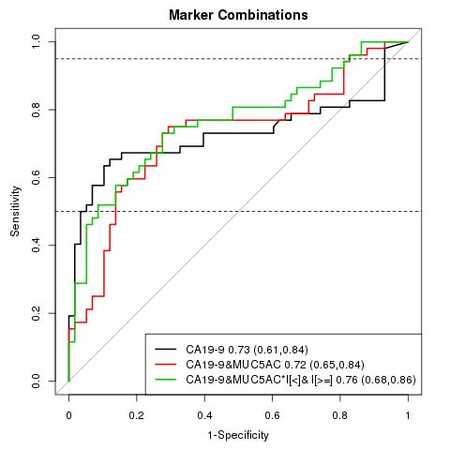
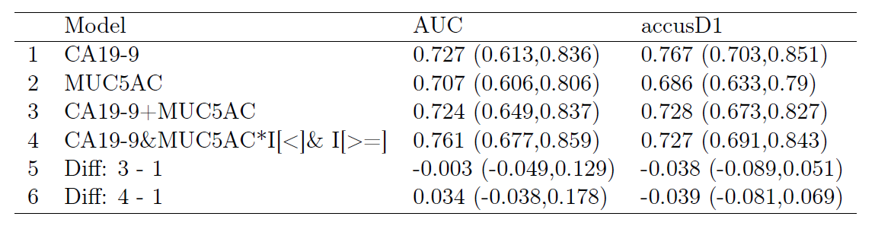
STAGE IA/IB/IIA FROM HEALTHY CONTROL GROUPS
0.73 TO 0.76
MUC5AC marginally improved the diagnostic efficacy of CA19.9 for differentiating HC from stage 1A/1B/IIA
Notes:
Because MUC5AC was measured with an upper limit, an additional model, labelelled CA19-19 +
MUC5AC I[MUC5AC < 20; 000] + I[MUC5AC 20; 000] was analysed and reported. It is based
on using values of MUC5AC for observations in which the value was below the upper limit and a
simple indicator for observations with value above the measurement threshold. The two coefficients
(for the continuous measured term and the indicator) are referred to as mkrLow and mkrHigh,
respectively.
In all models, the biomarkers are included on the log-scale. Any included adjustment covariates
are left on their natural scale (not log-transformed). For example, a model including one biomarker,
BMKR1, and adjusting for age would have linear predictor: 0 + 1 (log(BMKR1)) + 2 AGE.
For brevity, labels for models and coefficients do not reflect the log transformation.

Slide 27
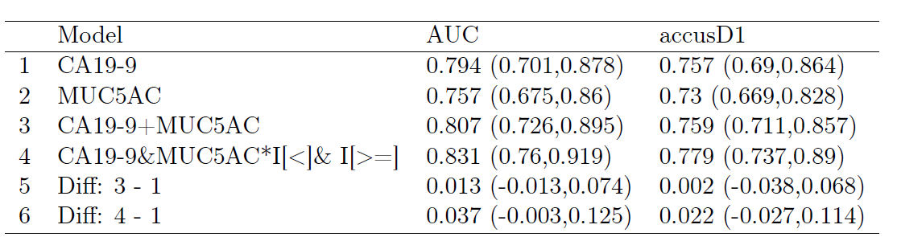
STAGE IA/IB/IIA FROM HEALTHY CONTROL AGE/DIABETES ADJUSTMENT
0.79 TO 0.83
SIMILAR TREND WAS OBSERVED AFTER AGE AND DIABETES ADJUSTMENT

Slide 28
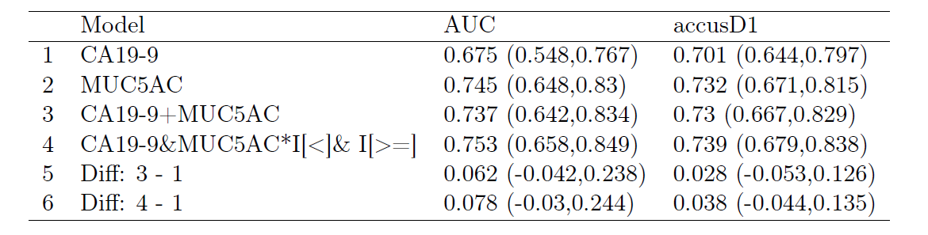
STAGE IA/IB/IIA VS CHRONIC PANCREATITIS
0.67 TO 0.75
MUC5AC PERFORMED BETTER THAN CA19.9 IN DIFFERENTATING CHRONIC PANCREATITIS CASES FROM CA19.9 THAT WAS USED AT ITS OPTIMAL CUT-OFF

Slide 29
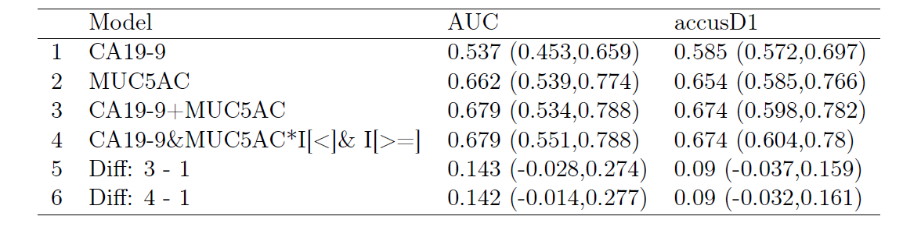
STAGE IA/IB/IIA VS ACUTE BILIARY OBSTRUCTIONS
0.54 TO 0.68
MUC5AC HAS HIGH DIAGNOSTIC POTENTIAL IN ACUTE BILIARY OBSTRUCTION CASES AND COMBINATION PERFORMED MUCH BETTER THAN CA19.9 ALONE
Notes:
DIFFERENCES DID NOT REACH SIGNIFICANCE DUE TOLOW SAMPLE NUMBER

Slide 30
Reference Set Usage Summary
The reference set has been used in multiple biomarker studies
Provides rigorous evaluation and comparison of diverse biomarkers
Improvements upon CA19-9 were achieved in some cases; further work is necessary
Future plans include the development of a panel to improve performance characteristics over any single biomarker alone

