Slide 1
ROMA – Overview and FDA Lessons
Clinical Situation:
A woman with a pelvic mass
Background:
  Patients with ovarian cancer have significantly improved survival if operated on by a gynecologic oncologist than by other surgeons.
  A woman with a pelvic mass has 20% chance of having a malignancy
  50% of US patients with ovarian cancer are operated on by a gynecologic oncologist – 50% are NOT
  CA125 and HE4 are two ovarian cancer related biomarkers

Slide 2
ROMA – Overview and FDA Lessons
Challenge:
Can a diagnostic test identify which women with a pelvic mass have a high risk for malignancy?
Benefit:
Women with pelvic masses with high risk of malignancy referred immediately to a tertiary care center with a gynecologic oncology department

Slide 3
ROMA - Derived from Retrospective Study
Postmenopausal PI = -12 + 2.38*LN(HE4) + 0.0626*LN(CA 125)
Premenopausal PI = -8.09 +1.04*LN(HE4) + 0.732*LN(CA 125)
PI = Predictive Index
ROMA score (%) = exp(PI)/(1+exp(PI)) * 100
Cut-points:
Pre: 13%
Post: 28%

Slide 4
ROMA – Overview and FDA Lessons
Intended Use:
The risk of malignancy algorithm (ROMA) identifies patients with a high risk of malignancy in women with a pelvic mass
Benefit:
Women with pelvic masses with high risk of malignancy referred immediately to a tertiary care center with a gynecologic oncology department
Reduces risk of two surgeries (generalist, then specialist)

Slide 5
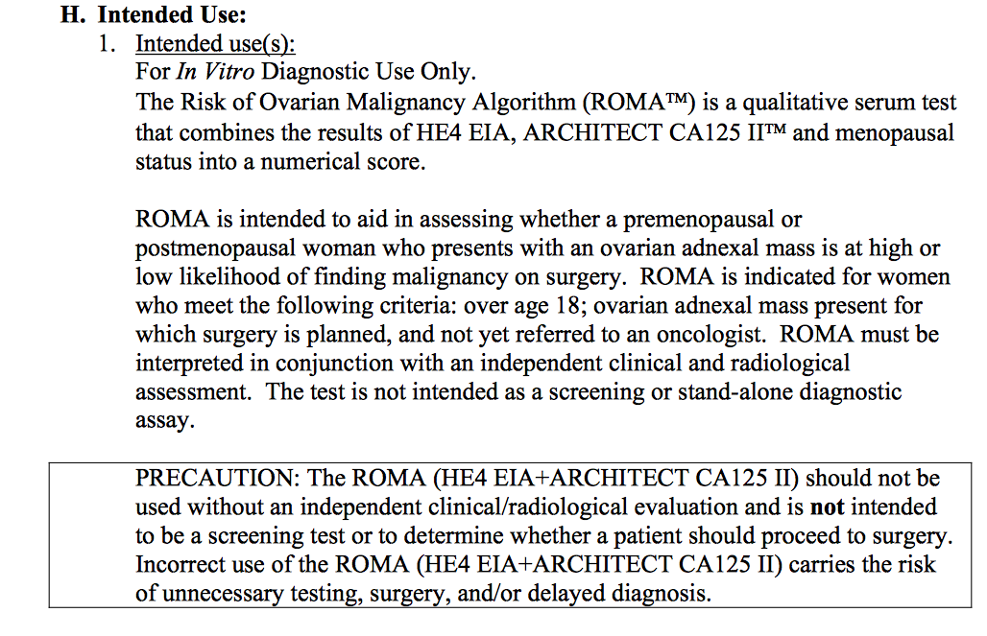
Detailed Intended Use – FDA approved

Slide 6
FDA Experience
A gynecologic oncologist assembled a group of colleagues to conduct a prospective diagnostic trial of women with a pelvic mass.
500 women with pelvic masses were enrolled
Pre-specified criteria of > 80% sensitivity (for malignancy) at 75% specificity
Results: postmenopausal: 92% sensitivity at 76% specificity
premenopausal: 100% sensitivity at 75% specificity
FDA submission – sent to panel
Panel rejected study
Why?

Slide 7
FDA Experience
A gynecologic oncologist assembled a group of colleagues to conduct a prospective diagnostic trial of women with a pelvic mass.
500 women with pelvic masses were enrolled
Pre-specified criteria of > 80% sensitivity (for malignancy) at 75% specificity
Results: postmenopausal: 92% sensitivity at 76% specificity
premenopausal: 100% sensitivity at 75% specificity
Panel said that samples were not from relevant population
Patients were from gynecologic oncology practices
Patients need to be from general care (e.g. gynecologist, general internist practices)
FDA required new study – 2 year delay

Slide 8
ROMA Study II
Enrolled 472 evaluable patients – 89 malignant, 383 benign
  The study included premenopausal and postmenopausal women 18 years of age or older presenting to a generalist (defined as a general gynecologist, internist, family practitioner gastroenterologist, or general surgeon) with an ovarian cyst or an adnexal mass and subsequently scheduled to undergo surgery.
Postmenopausal: Sensitivity 92% at 76% specificity
Premenopausal: Sensitivity 100% at 74% specificity
Essentially results the same as first ROMA study
Moore et. al. Obstetrics and Gynecology 2011

Slide 9
ROMA Study – FDA Lessons
Intended Use AND Study Design must ALIGN
Intended Use needs careful attention to detail
Study Design needs similar level of attention
Input from FDA at DESIGN stage can save years

