Slide 1
AFP-L3 and DCP Biomarkers for Liver Cancer
March 7, 2017
Hiro Yamada
Wako Diagnostics

Slide 2
Outline
Part 1
Introduction of Wako Hepatocellular Carcinoma
(HCC) biomarkers
Part 2
Experiences with approaching the FDA for the HCC
biomarkers
Part 3
Current clinical study data
Notes:
My name is Hiro Yamada, Senior Clinical Affairs Manager of Wako Life Sciences. Wako is an international company based in Osaka Japan, and its American head office in Mountain View, California.
Today I will present to you our HCC biomarkers, AFP, AFP-L3 and DCP on Wako’s immunoassay systems and some clinical study data on early detection of hepatocellular carcinoma (HCC).

Slide 3
AFP-L3 (Lectin reactive alpha-fetoprotein)
Fucose
Carbohydrate chain
AFP-L1
AFP-L3
AFP-L3
Sia
Gal
GlcNac
Man
LCA ； Lens culinaris agglutinin
AFP-L3% = AFP-L3 / (AFP-L1+AFP-L3) x 100
Notes:
This is one of our HCC biomarkers, Lectin reactive alpha-fetoprotein, which is called “AFP-L3”. AFP-L3 has the structure in which fucose is attached to the carbohydrate chain in AFP-L1. Based on the differences of their structures, AFP-L1 and AFP-L3 are detected separately and the percentage of AFP-L3 / AFP is calculated.

Slide 4
DCP (des-gamma-carboxy prothrombin)
1
NH₂
10
30
20
37- 579
Glutamic acid or γ-carboxyglutamic acid
Amino acid
Notes:
This is another HCC biomarker, des-gamma-carboxy prothrobin, which is called “DCP”. DCP is abnormal prothrombin which has different structure including glutamic acid or gamma-carboxyglutamic acid shown as symbols of red triangle. (This is also called as “PIVKA-II”).

Slide 5
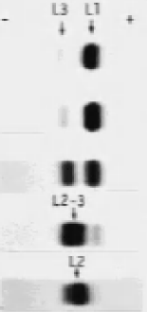
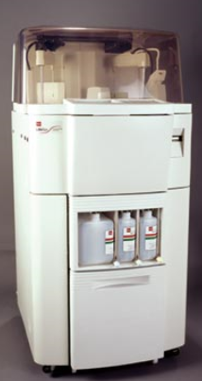
Immunoassay Systems for HCC Biomarkers
Lectin Affinity Electrophoresis
Electrophoresis. 1989 Aug-Sep;10(8-9):562-7
2nd Generation: LiBASys
AFP-L3: May 2005
DCP : Jan. 2007
In the US market
3rd Generation:
μTASWako i30
AFP-L3 / DCP:
Feb. 2011

Slide 6
Outline
Part 1
Introduction of Wako Hepatocellular Carcinoma
(HCC) biomarkers
Part 2
Experiences with approaching the FDA for the HCC
biomarkers
Part 3
Current clinical study data

Slide 7
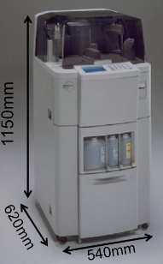
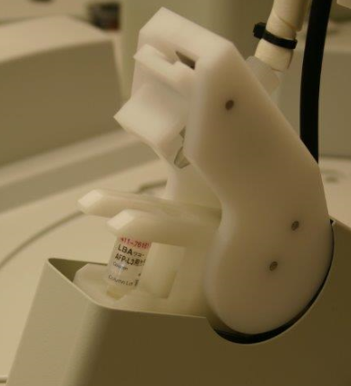
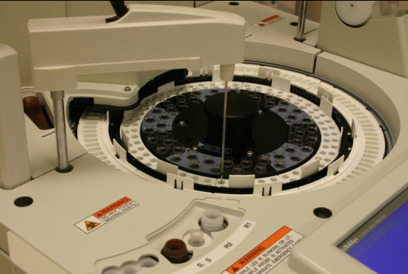
Commercialization Steps of LiBASys
Analyzer
Column
Cuvettes

Slide 8
Commercialization Steps of LiBASys
C
C

Slide 9
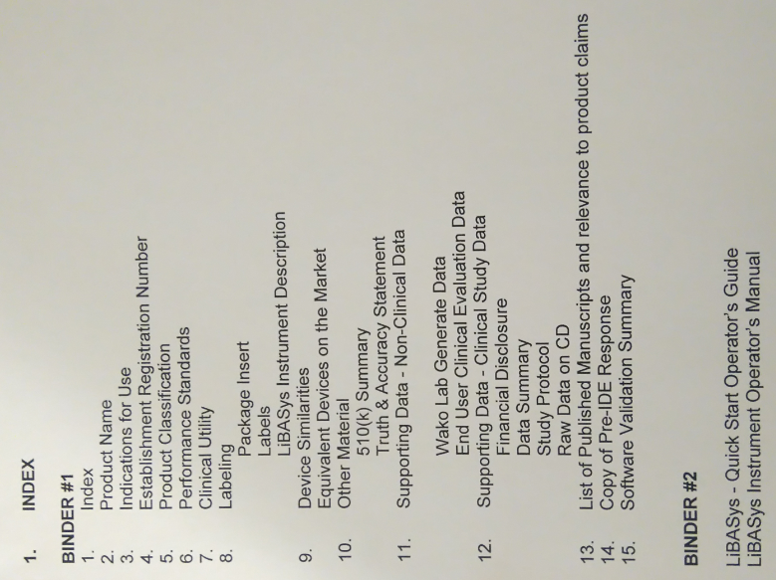
Submission of AFP-L3 on LiBASys
2004 July
Wako LBA AFP-L3 Test Kit
Wako AFP-L3 Calibrator set and Control Set
Wako LiBASys Analyzer and accessories
Submission type: 510(k) De Novo
Substantial Equivalence: No predicate

Slide 10
Non-Clinical Data
Data Summary
Non-clinical Data
Sensitivity (LOD)
Within-run precision
Total precision
Accuracy
Linearity
Specificity (Interference studies)
Stability
Long term stability
Stability after reconstitution
Open vial stability

Slide 11
Clinical Study Data
Multi-center
Prospective
Surveillance Study
HCC | HCC DX | Non-HCC | Suspicious | Total
HCC →HCC | CH/LC →HCC | CH/LC →CH/LC | CH/LC →Suspious
54 | 39 | 273 | 71 | 437
Lahey
VCU
Miami
Mt. Sinai
Toronto
UCSF
UPenn
Cut-Off Value
Sensitivity
Specificity
Positive period before diagnosis
Clinical course
Relative risk

Slide 12
Submission of AFP-L3 on LiBASys
Continued to communicate with FDA
Q&A with FDA
2005 May
Cleared by FDA as Class II
Intended for use: AFP-L3 is intended for in vitro diagnostic use as aid in the risk assessment of patients with chronic liver disease for development of hepatocellular carcinoma in conjunction with other laboratory findings, imaging studies and clinical assessment.

Slide 13
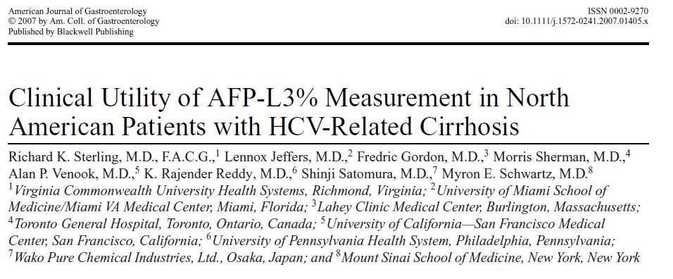
Publication of AFP-L3 on LiBASys

Slide 14
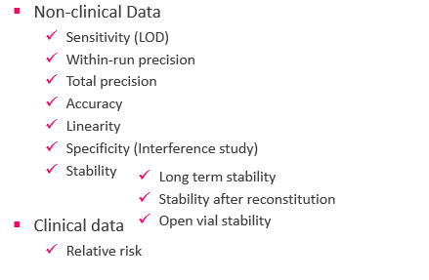
Submission of DCP on LiBASys
2006 August
Wako LBA DCP Test Kit, Calibrator set and Control Set
Submission type: Traditional 510(k), K062368
Substantial Equivalence: Wako LBA AFP-L3
Q&A with FDA
2007 January
Cleared by FDA as Class II
Intended for use: DCP is intended for in vitro diagnostic use as aid in the risk assessment of patients with chronic liver disease for development of hepatocellular carcinoma in conjunction ……

Slide 15
μTASWako i30 system
Analyzer
Microfluidic chip
50 mm
17 mm

Slide 16

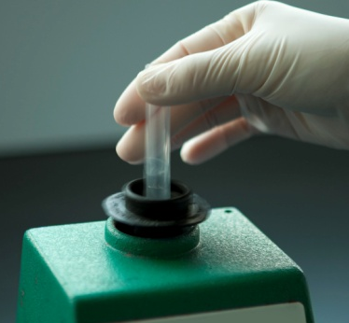
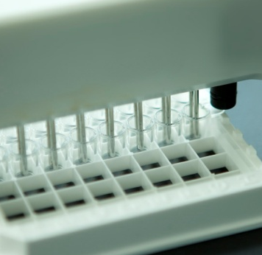
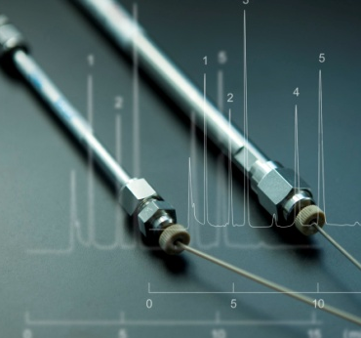
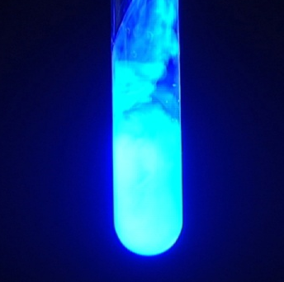
Integrated Immunoassay with Microfluidic Chip
Dispensing Mixing Washing Separation Detection
High speed, high precision
and high sensitivity
9 min for first results ,
2 min per subsequent results
25 test per hour
Notes:
The i30 platform integrates all steps of immunoassay including dispensing, mixing, washing, separation, and detection, being carried out on chip. The i30 analytical microfluidics systems couples isotachophoresis and lectin affinity capillary electrophoresis on a single fully automated platform.

Slide 17
Submission of μTASWako i30 system
2010 February
Submitted devices:
Submission type: Traditional 510(k)
510(k) number: K100464
Predicate device:
μTASWako AFP-L3, Calibrator Set, Control L and H
μTASWako DCP, Calibrator Set, Control L and H
μTASWako i30 system
AFP-L3 test system including calibrators and controls was previously cleared as LBA AFP-L3 on LiBASys
DCP test system including calibrators and controls was previously cleared as LBA DCP on LiBASys

Slide 18
Submission of μTASWako i30 system
Q&A with FDA
2011 February
Cleared by FDA as Class II
Intended for use: In DCP is intended for in vitro diagnostic use as aid in the risk assessment of patients with chronic liver disease for development of hepatocellular carcinoma in conjunction ……

Slide 19
Outline
Part 1
Introduction of Wako Hepatocellular Carcinoma
(HCC) biomarkers
Part 2
Experiences with approaching the FDA for the HCC
biomarkers
Part 3
Current clinical study data

Slide 20

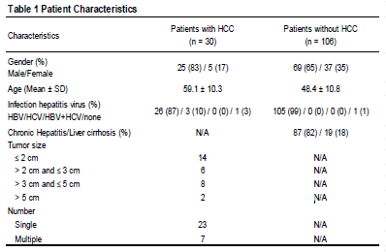
Inclusion of AFP-L3 & DCP Improves Detection of Early HCC

Slide 21
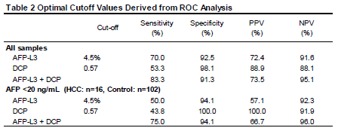
Inclusion of AFP-L3 & DCP Improves Detection of Early HCC

Slide 22
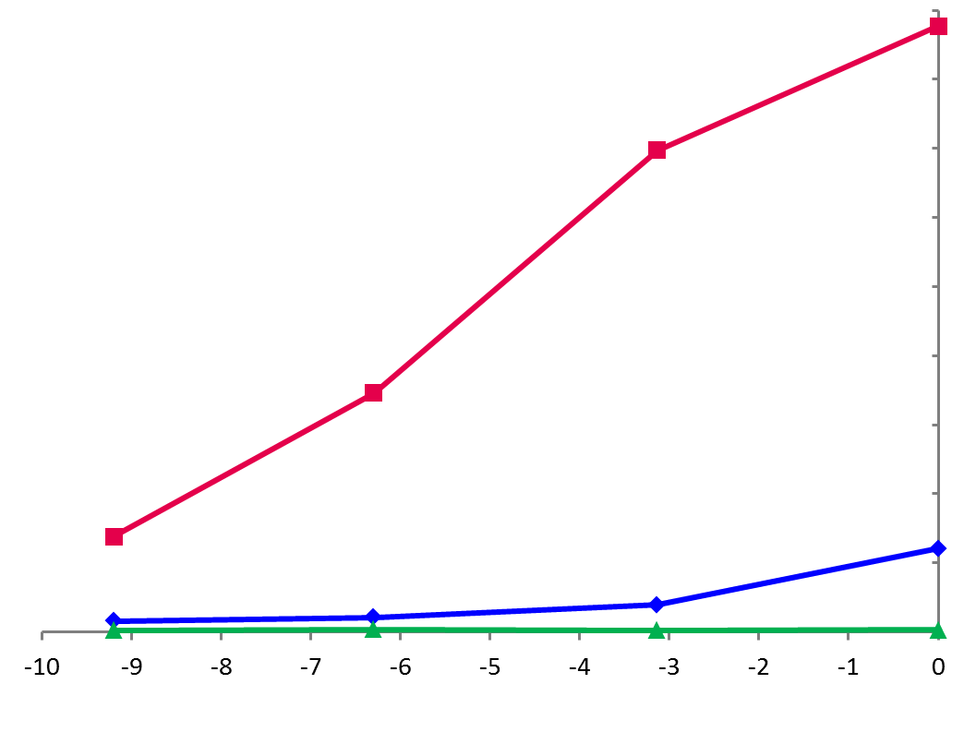
Case 1 – Risk assessment of HCC development by AFP-L3
Only AFP-L3 increased before HCC diagnosis by MRI.
------------------------------------- Elevation of AFP-L3 indicates higher risk of developing HCC and can be a trigger to do CT/MRI for early detection.
87.7%
MRI dx of HCC
69.7%
34.6%
Level of Biomarker
AFP-L3
Normal: <10 %
13.8%
AFP
Normal: <20 ng/mL
Cut-off
Level
DCP
Normal: <7.5 ng/mL
Months Before Diagnosis by imaging
Hann HW, et al. J Med Microb Diagn 2014; 3: 130.

Slide 23
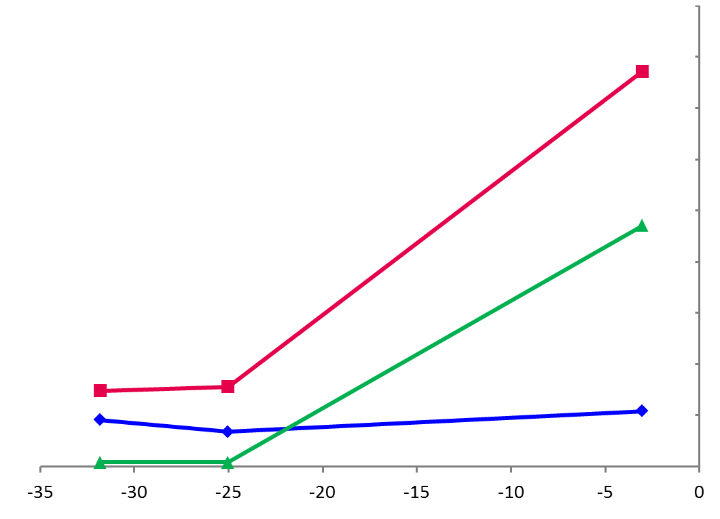
Case 2 – Risk Assessment Using AFP-L3 and DCP Elevation
AFP-L3 and DCP were increased before HCC detection in some patients who had a low (normal) AFP level.
-----------------------------------------------------Adding AFP-L3 and DCP as risk markers to conventional surveillance tools such as AFP and ultrasound can increase chances of early detection of HCC.
MRI dx of HCC
38.6%
17.65 ng/mL
Level of Biomarker
AFP-L3
Normal: <10 %
7.4%
7.8%
Cut-off
Level
AFP
Normal: <20 ng/mL
0.30 ng/mL
0.32 ng/mL
DCP
Normal: <7.5 ng/mL
Months Before Diagnosis by imaging
Hann HW, et al. J Med Microb Diagn 2014; 3: 130.

Slide 24
Combined Biomarker Testing
If HCC biomarkers are used prior to imaging:
In this study of 74 patients, the use of AFP alone would have detected 45 HCC cases and missed 29 cases of HCC
AFP-L3 Positive
15 (20.3%)
All Negative
7
(9.5%)
4
(5.4%)
15
(20.3%)
15
(20.3%)
 | Cut off | Positive
AFP | ≥ 20 ng/mL | 45 (60.8%)
AFP-L3 | ≥ 10% | 49 (66.2%)
DCP | ≥ 7.5 ng/mL | 29 (39.2%)
All combined | Same as above | 67 (905%)
DCP Positive
3 (4.1%)
AFP Positive
8 (10.8%)
7
(9.5%)
Data collected for FDA submission

Slide 25
HCC Biomarker Models
GALAD Score for Diagnosis of HCC
= Gender, Age, AFP-L3, AFP, and DCP
Z = -10.08 + 1.67 x [Gender] + 0.09 x [Age] + 0.04 x [AFP-L3]
+ 2.34 x log[AFP] + 1.33 x log[DCP]

Slide 26
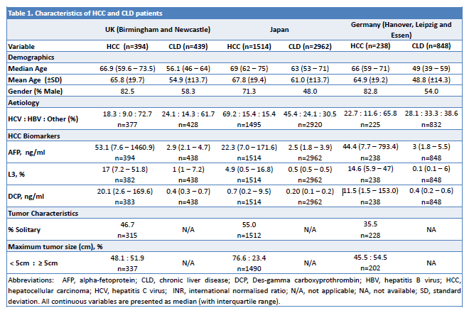
International Validation of GALAD

Slide 27
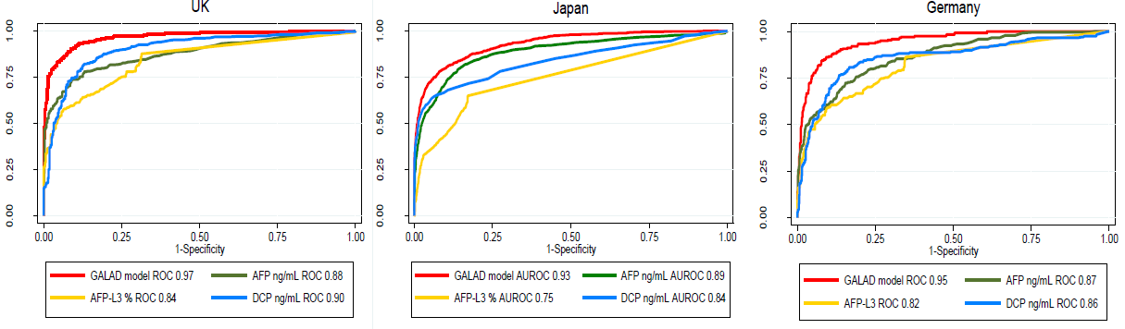
International Validation of GALAD

Slide 28
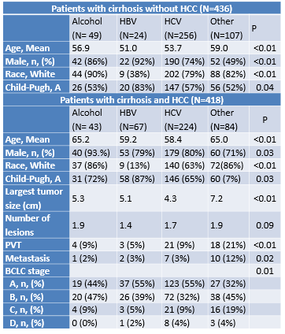
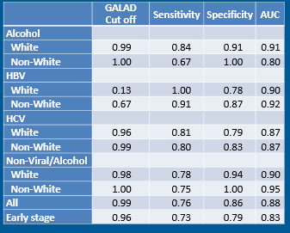
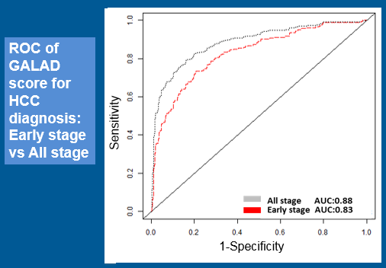
GALAD Evaluation using EDRN Phase 2 Cohort

Slide 29
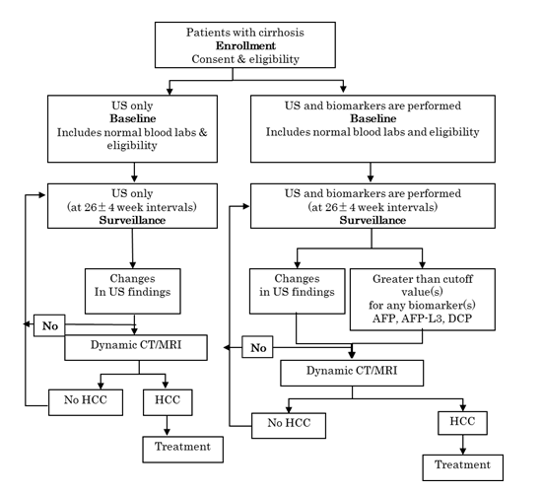
Canadian RCT
This study expects to demonstrate that addition of biomarkers
will increase the detection rate by at least 10%.

Slide 30
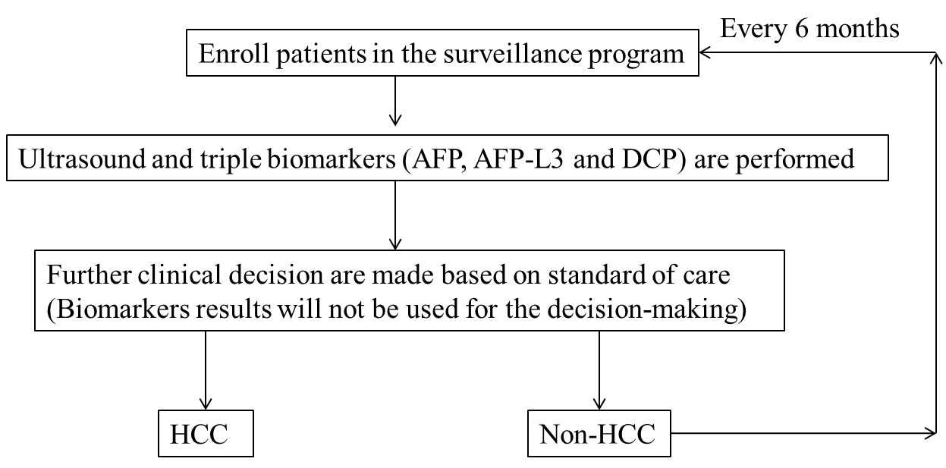
VA Houston Prospective Study

Slide 31
Thank you for your attention!

