Slide 1
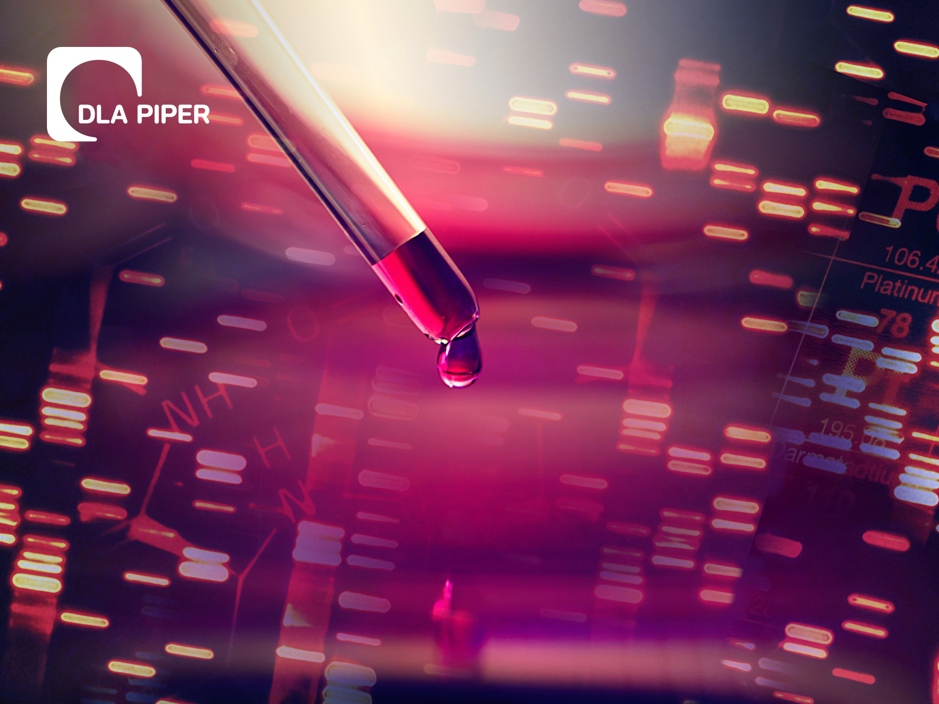
DIAGNOSTIC AND BIOMARKER PATENT AND LICENSING STRATEGIES
Lisa A. Haile, J.D., Ph.D.
EDRN Meeting 7 March 2017

Slide 2
Patent Strategy: Where and When to File
Patent rights are territorial
U.S. patents provide NO rights outside the U.S.
*May provide a bar to imports
Can file directly in other jurisdictions within 1 year of a priority filing
A Patent Cooperation Treaty (PCT) application can be filed to provide a foundation for later filings in many other countries
Individual filings in specific countries and regions are ultimately required
Patent filings are costly $$$

Slide 3
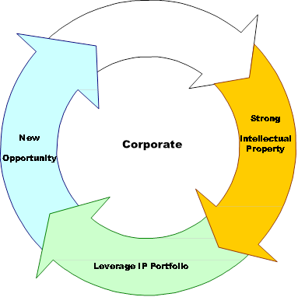
Patent Strategy: Business Context
Goals of portfolio management
Protect current and future product developments
Maintain competitively-sized portfolio with attention to patent expiration dates (attract investment and partnering)
Evaluate competitive IP landscape and protect areas that will likely be valuable to the industry as a whole
Manage Costs - $$$

Slide 4
Patent Eligible Subject Matter
Whoever invents or discovers any new and useful process, machine, manufacture, or composition of matter, or any new and useful improvement thereof, may obtain a patent therefor, subject to the conditions and requirements of this title.
35 U.S.C. §101

Slide 5
Personalized Medicine, Diagnostics and Gene Patents-Recent U.S. Cases
Significant Cases in the U.S. 2012-2016:
Supreme Court:
Mayo Collaborative Services et al. v. Prometheus Laboratories Inc. (Supreme Court, 2012)
ACLU et al. v. USPTO and Myriad Genetics (Supreme Court, 2013)
Alice Corp. Pty. Ltd. v. CLS Bank International (Supreme Court, June 2014)
Federal Circuit:
Univ. of Utah Res. Foundation et al. v. Ambry Genetics Corp. (Fed. Cir., Dec 2014)
Ariosa Diagnostics v. Sequenom (Fed. Circ., June 2015)
Genetic Technologies Ltd. v. Merial LLC (Fed. Circ., April, 2016)
Rapid Litigation Management Ltd. v. Cellzdirect, Inc. (Fed. Circ., July, 2016)

Slide 6
Personalized Medicine-Legal and Strategic Considerations-Mayo/Prometheus
“To transform an unpatentable law of nature into a patent eligible application of such a law, a patent must do more than simply state the law of nature while adding the words ‘apply it’…we conclude that the patent claims at issue here effectively claim the underlying laws of nature themselves. The claims are consequently invalid.“
Patent claims for methods of diagnosing diseases that merely provide “routine” steps and observations of “natural phenomena” (e.g., look at levels of a metabolite before and after administration of a drug) are no longer valid or enforceable.
Is the method of measuring the level of the marker novel or are the reagents used in the diagnostic method novel?

Slide 7
ACLU et al. v. USPTO and Myriad Genetics (Supreme Court, 2013)
"A naturally occurring DNA segment is a product of nature and not patent eligible merely because it has been isolated”
However, the Court also held that manipulation of a gene to create something not found in nature—such as a strand of synthetically-produced complementary DNA (cDNA)--could still be eligible for patent protection.
What was the effect on patents after Myriad? How far reaching is the case?
Following Myriad, the USPTO applied the case beyond DNA sequences to include naturally occurring proteins, stem cells, etc. however, claims to fragments of DNA (probes/primers) or proteins were still being issued at that time.
Patent Strategies-EDRN

Slide 8
How to Claim DNA/Proteins Post-Myriad
Non-naturally occurring, e.g., add labels, fusion proteins, vectors, heterologous sequences
An isolated nucleic acid sequence as in SEQ ID NO:1 and encoding a protein having amylase activity, operably linked to a heterologous promoter.
An isolated nucleic acid sequence of SEQ ID NO:1 in a viral vector.
Gene/protein profiles or panels, e.g., novel combinations not occurring in nature

Slide 9
Alice v. CLS Bank 2014
Alice is a Supreme Court Case (June 2014) that sets forth the eligibility test under Section 101 for patent claims that involve abstract ideas.
Alice confirms that the two-part test from Mayo v. Prometheus Labs (Supreme Court 2012) is applicable to abstract ideas:
Are claims at issue directed to one of the patent-ineligible concepts (e.g. law of nature, natural phenomenon or abstract idea)?
If yes, is there an “inventive concept”? Do the claims include an element or combination of elements such that the claim amounts to significantly more than a claim to the ineligible concept (abstract idea) itself.

Slide 10
Patent Strategies - Univ. of Utah Res. Foundation et al. v. Ambry Genetics Corp. (Fed. Cir., Dec 2014)
When Alice was applied in a life sciences patent case:
Comparison of a sequence in the genome to a reference sequence is considered “abstract mental steps necessary to compare two nucleotide sequences”
Here, the claims merely set forth “well-understood, routine and conventional activity” engaged in by scientists at the time of the Myriad applications (e.g., ELISA, PCR)
The scope of patent eligible subject matter for certain method claims was significantly narrowed following this decision.
Composition claims to primers and probes were now held to be invalid, leading to an inference that protein fragments such as epitopes would also be patent-ineligible
Is there enough in the claims to provide sufficient inventive concept (“significantly more”) to render the claims patent eligible?

Slide 11
Ariosa Diagnostics v. Sequenom, (Fed. Circ., June 2015)
“First, one must determine whether the claims at issue are directed to a patent-ineligible concept, and if the answer is yes, then it must be determined whether additional claim elements transform the nature of the claim into patent-eligible subject matter.”
On Pre-emption: “Sequenom’s attempt to limit the breadth of the claims by showing alternative uses of cffDNA outside of the scope of the claims does not change the conclusion that the claims are directed to patent ineligible subject matter”.
The district court agreed with Ariosa’s argument that the claims of the patent were directed to the natural phenomenon of paternally inherited cffDNA and that the claims did not add enough to the natural phenomenon to make the claims patent eligible under §101.

Slide 12
Screening of Genetic Markers-New Guidelines May 4, 2016
A screening method claim based on “comparing” sequences does not satisfy § 101 when the comparison is recited at a high level of generality such that it could read on a mental process (Alice)
A screening method claim satisfies § 101 if the claim recites the use of a technique that is not “well-understood, routine and conventional”

Slide 13
Diagnosis and Treatment of Diseases-New Guidelines May 4, 2016
A method of diagnosing a disease by detecting a newly identified protein marker does not satisfy § 101 when the detection steps are recited at a high level of generality, i.e., adding a “diagnosing …” step to a patent-eligible method of detecting claim will render the claim ineligible
A method of diagnosing a disease by detecting a newly identified protein marker satisfies § 101 if the claim recites the use of agents (e.g., porcine antibodies) that are novel or at least are not “well-understood, routine and conventional”
A personalized medicine method of diagnosing and treating a disease that involves detecting a newly identified protein marker satisfies § 101 even if the detection method is recited at a high level of generality and the recited treatment is a conventional treatment for the condition
A method of treating a disease satisfies § 101

Slide 14
Genetic Tech v. Merial (Fed. Circ. 2016)
Methods of detecting a coding region allele by amplifying and analyzing any linked non-coding regions
Based on Mayo/Alice-Step 1-claims are invalid as directed to a law of nature (relationship between non-coding and coding sequences in linkage disequilibrium) without “significantly more”
Pre-emption: the claims cover any comparison for any purpose of any non-coding region sequence known to be linked with a coding region allele at a multi-allelic locus (not limited to any particular allele or non-coding sequence
Standard techniques are used therefore step 2 of the test not met either (“significantly more”)

Slide 15
Rapid Litigation v. Cellzdirect (Fed. Circ. 2016)
Invention/claims-cryopreservation techniques to preserve hepatocytes for later use (freeze/thaw/density gradient fractionation)
District court-claims ineligible as directed to a natural law (freeze/thaw)
Fed Circuit-significant improvement and finding that repeated freeze/thaw resulted in a viable fraction of cells

Slide 16
Rapid Litigation v. Cellzdirect (Fed. Circ. 2016)
1. A method of producing a desired preparation of multi-cryopreserved hepatocytes, said hepatocytes, being capable of being frozen and thawed at least two times, and in which greater than 70% of the hepatocytes of said preparation are viable after the final thaw, said method comprising: (A) subjecting hepatocytes that have been frozen and thawed to density gradient fractionation to separate viable hepatocytes from non-viable hepatocytes, (B) recovering the separated viable hepatocytes, and (C) cryopreserving the recovered viable hepatocytes to thereby form said desired preparation of hepatocytes without requiring a density gradient step after thawing the hepatocytes for the second time, wherein the hepatocytes are not plated between the first and second cryopreservations, and wherein greater than 70% of the hepatocytes of said preparation are viable after the final thaw.

Slide 17
Legal and Strategic Considerations Post-Myriad
What is the effect of US not allowing gene/natural product patents?
More difficult for a genomics/Dx company to get funded in the absence of patents
How far reaching is this line of cases re: products? Does it extend to naturally occurring proteins, e.g., antibodies, proteins, stem cells?
Is it possible to patent diagnostic claims?
Take another look at FTO opinions.
Assess validity of your own patent claims before assertion

Slide 18
DIAGNOSTIC AND BIOMARKER PATENT AND LICENSING STRATEGIES
Lisa A. Haile, J.D., Ph.D.
EDRN Meeting 7 March 2017

