Slide 1
Bioinformatics Resources for EDRN
CPDR-PICB-NCI collaboration in data sharing and data analysis
31st EDRN Steering Committee Meeting
Biomarkers at the Crossroads
March 7-9, 2017
Tempe Mission Palms Hotel & Conference Center
Yixue Li and Guoping Zhao
CAS-MPG Partner Institute for Computational Biology (PICB) Shanghai Institutes for Biological Sciences, CAS
March 7, 2017
Notes:
Barnett Kramer, M.D., M.P.H., Director, Division of Cancer Prevention, National Cancer Institute
Sudhir Srivastava, Ph.D., M.P.H., National Cancer Institute
Dear Dr. Kramer
Dear Dr. Srivastava
Dear colleagues and friends:
It is my great honor to be invited to give a talk on behalf of our group from the Chinese Academy of Science - Max-Planck-Gesellschaft (Society) Partner Institute for Computational Biology (PICB) to report to this meeting about our collaboration wiht the NCI organized EDRN project with close collaboration with CPDR.
Next slide

Slide 2
Milestones of the collaboration:
  1. Beginning of discussions for collaboration
  May 2012 when the cancer workshop was held in Beijing China
  2. Memorandum of Understanding (MOU) :
  Meeting on May 29, 2014 (Drs. Zhao, Srivastava, Wang)
    Plans and action items
    MOU: Dr. Varmus - Dr. Zhao and Dr. Li
    Possible specific collaboration projects
3. Meetings/Conference Calls for preparing the plans and action items
  Second Forum Discussion on Collaborations, (Dec. 15-16, 2014)
  Third Discussion Forum to Promote Collaborations (October 13, 2015)
  4. Plans and action items
  Forth Discussion Forum to Promote Collaborations (January 14- 15, 2016)
  Research Agreement (RA) Finalized
  Ethics and Human Subject Protection Training Certificates for Chinese participants
  Received all required certificates from SIBS and NCI (sent to CPDR-USUHS)
  Data disk was received by PICB on June 8, 2016 (Contact: Albert, Hong, and Wendy)
  ERG Antibody was received by PICB on Feb 8, 2017 (provided by Biocare Medicine)
  Test results of ERG IHC was discussed on Feb 22, 2017
  (Yuan Ji from ZhongShan Hospital)
Notes:
This collaboration was initiated in 2012 via a personal discussion between Dr. Srivastava and me at a workshop held in Beijing. After two years of communication and preparation, the MOU was signed on May 29, 2014. Then after further joined efforts in planning and regulatory processing, we finally sign the research agreement and the CPDR data was sent to the PICB, which clearly marked the kick off of the project.
Next slide

Slide 3
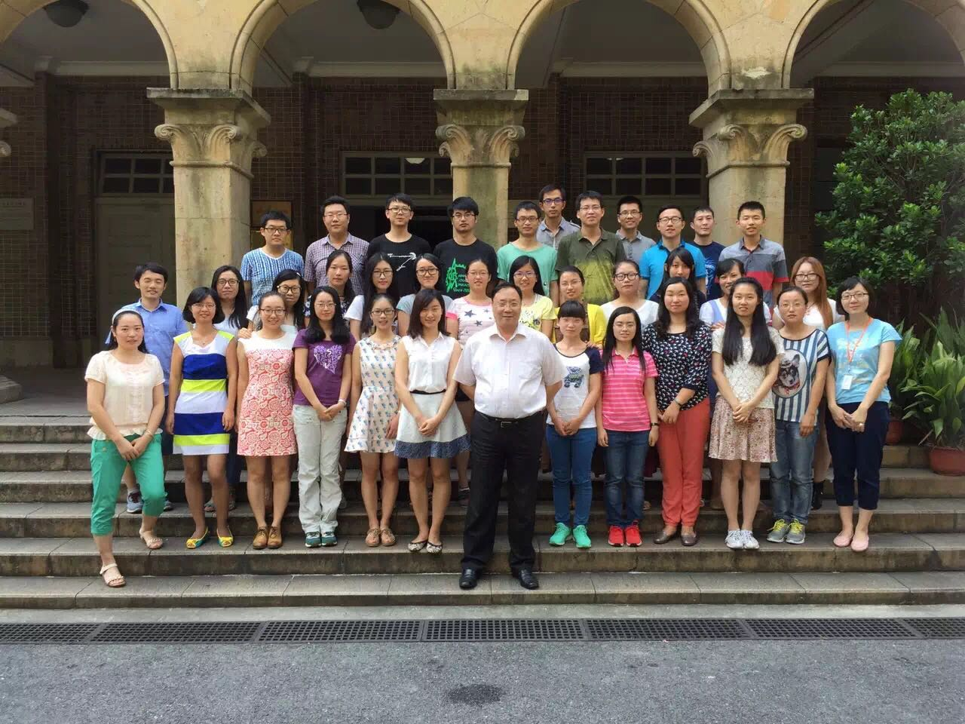
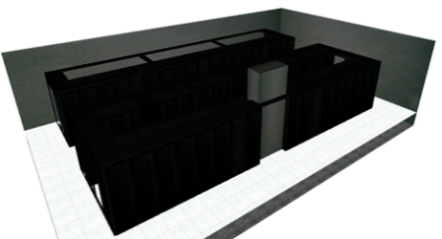
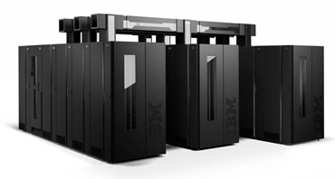





Resources: CAS-MPG Partner Institute for Computational Biology (PICB)
Bio-Med Big Data Center
Research Scientists; Students; Analytical Engineer; Omics Core Facility; I.T. Facility.
Hard infrastructure
1200 core, including large memory sets (>128GB);
high-performance network storage;
Data storage capacity: 10 PB ;
Computing power: 30 trillion (TFLOPS) / sec ;
Network bandwidth: 500 Mb ;
Collaborative research in cancer biology
Prostate cancer | Racial difference; Driver gene and molecular subtype; Microbiome
Lung cancer | Biomarker for immunotherapy; ctDNA for monitoring tumor progress
Liver cancer | PDX models; Pharmacogenomics; Tumor metastasis
Colorectal cancer | Evolution from adenomas to carcinoma
Pancreas cancer | PDX models; Pharmacogenomics;

Slide 4
Resources: specimens of prostate cancer
Collaborative Partner
Zhongshan Hospital, China
100 FFPE samples (for ERG IHC)
All of the cases were resected without any hormone treatment before operation.
The radical resected prostate were fixed in 10% Formalin for 12-24 hours, then the whole organ was sectioned into several slices, 3mm thickness. After dehydration, embedding in paraffin, we cut our sections into 4um sections on polarized slides.
100 Fresh Frozen samples (for omics experiments)
Some of samples are obtained after hormone treatment.
Most of samples have complete follow up information.

Slide 5
CPDR-PICB-NCI (originally, SIBS-NCI-CPDR) collaboration project
CPDR-PICB-NCI collaboration project
Qingyu Xiao, Yidi Sun, Hong Li
Yixue Li, Guoping Zhao
March 7, 2017
Notes:
In this following part of the talk, I shall report our current work progress on analyzing the prostate cancer data. The whole project has been led and organized by Prof. Yixue LI, who is also the Director of the BigData Center of PICB. The research group is led by Dr. Hong LI and two of her graduate students, Qingyu XIAO and Yidi SUN are directly involved in this project.
Next slide

Slide 6
Project overview
Analyses—multi-“omics” approach
Aims
Questions/Hypothesis
Validation of the ERG driver genes in new (mainly Chinese) samples
Frequency of ERG mutations and expressions in CaP of
CA, AA and Asians
Mutation
CNV
Fusion
PRAD Data
CPDR data:
(7 AA + 7 CA)
WGS RNA-Seq
Public Chinese data: (14 Chinese)
RNA-Seq
TCGA PRAD data:
(497 patients; level 3)
RNA-Seq CNV Methylation
Genomic level
Identification of other potential drivers
Find other drivers for ERG-fusion negative samples/populations?
Transcrip-tome
level
mRNA
methylation
MicroRNA
Identification of regulatory targets of drivers
How drivers regulate the cancer cell gene expression?
Identification of bacterial species (profiles) in cancer as potential biomarkers/targets
Microbiome level
What kind of bacteria species are specifically increased or decreased in prostate cancer?
Microbiome
Resource
Early Detection Markers for Screening, Diagnosis, Treatment and Prognosis
Notes:
This slide gives us an overview of our project. The PRAD data used in this study: (1) The CPDR dataset containes 7 AA and 7 CA prostate cancer samples, with both WGS and RNA-Seq data. (2) The RNA-seq data of 14 Chinese prostate cancer samples from ENA (European Nucleotide Archive); (3) TCGA level 3 prostate cancer data include RNA-seq and CNV data. Because RNA-seq data are available in all of the 3 datasets, interrogatively analysis and comparison of the prostate cancer transcriptome is performed. We have other two major Aims, one is the genomic markers, initially focused on ERG (ERG fusion) and the another is trying to analyze the microorganisms paralyzed on the prostate cancer tissues. Overall, taking the advantage of integrated data and a multi-”omics” analysis approach, we would like toanswer the question of Early Detection of Prostate Cancer in Caucasian American (CA), African American (AA) and Chinese/Asians.
Next slide

Slide 7
Project 1
Analyses—multi-“omics” approach
Aims
Questions/Hypothesis
Validation of the ERG driver genes in new (mainly Chinese) samples
Frequency of ERG mutations and expressions in CaP of
CA, AA and Asians
Mutation
CNV
Fusion
PRAD Data
CPDR data:
(7 AA + 7 CA)
WGS RNA-Seq
Public Chinese data: (14 Chinese)
RNA-Seq
TCGA PRAD data:
(497 patients; level 3)
RNA-Seq CNV Methylation
Genomic level
Identification of other potential drivers
Find other drivers for ERG-fusion negative samples/populations?
Transcrip-tome
level
mRNA
methylation
MicroRNA
Identification of regulatory targets of drivers
How drivers regulate the cancer cell gene expression?
Identification of bacterial species (profiles) in cancer as potential biomarkers/targets
Microbiome level
What kind of bacteria species are specifically increased or decreased in prostate cancer?
Microbiome
Resource
Early Detection Markers for Screening, Diagnosis, Treatment and Prognosis
Notes:
This slide gives us an overview of our project. The PRAD data used in this study: (1) The CPDR dataset containes 7 AA and 7 CA prostate cancer samples, with both WGS and RNA-Seq data. (2) The RNA-seq data of 14 Chinese prostate cancer samples from ENA (European Nucleotide Archive); (3) TCGA level 3 prostate cancer data include RNA-seq and CNV data. Because RNA-seq data are available in all of the 3 datasets, interrogatively analysis and comparison of the prostate cancer transcriptome is performed. We have other two major Aims, one is the genomic markers, initially focused on ERG (ERG fusion) and the another is trying to analyze the microorganisms paralyzed on the prostate cancer tissues. Overall, taking the advantage of integrated data and a multi-”omics” analysis approach, we would like toanswer the question of Early Detection of Prostate Cancer in Caucasian American (CA), African American (AA) and Chinese/Asians.
Next slide

Slide 8
Comparing the fusions of different populations (using RNA-Seq)
Samples with fusion data: TCGA (14AA+105CA), CPDR (7AA+7CA), Public data (14 Chinese)
Common fusions (Total 4, detected in at least 2 races)
TMPRSS2-ERG (ERG) is a causal gene alteration in CaP with biomarker potential in diagnosis, prognosis and in targeted therapy.
ERG-MAb distinguishes tumor foci from benign glands with 99.9% specificity (N=1,200+)
[A good reagent for future large scale screen]
Fusion | Chinese | AA | CA
HLA-C:HLA-B | 0 | 2 | 1
PDE4D:DEPDC1B | 0 | 1 | 1
TMPRSS2:ERG | 4 (28.57%) | 5 (23.81%) | 41 (36.61%)
TTC6:MIPOL1 | 0 | 2 | 1
Total samples | 14 | 21 | 112
**Notice： Sample sizes are too small to detect any statistical significant differences.
Race-specific fusions:
 | Chinese specific | AA specific | CA specific
Fusion counts | 642 | 44 | 347
Notes:
Only 4 common fusions were detected in at least 2 races apparently due to the small sample sizes, particularly for Chinese. TMPRSS2:ERG was the only fusion detected in all 3 populations (red square emphasized), which again inferred the important driver function of this fusion even in the population of Chinese. This result again supported the necessity of performing “large population” screen of ERG fusion in Chinese prostate cancer patients employing the monoclonal antibody from CPDR. We also count the number of race-specific fusions in Chinese, AA and CA respectively.
Next slide

Slide 9
ERG overexpression in samples with or w/o fusion
Population | Frequency of ERG overexpression in ERG-Fusion samples | Frequency of ERG overexpression in samples without ERG-Fusion | Total samples
African American (CPDR+TCGA) | 100% (7/7) | 7.1% (1/14) | 21
Caucasian American (CPDR+TCGA) | 97.7% (42/43) | 27.5% (19/69) | 112
Chinese (SMMU) | 100% (4/4) | 0 (0/10) | 14
ERG fusion frequencies in ERG overexpression samples
Population | ERG-fusion Frequency in ERG overexpression samples
African American | 87.5% (7/8=7+1)
Caucasian American | 68.9% (42/61=42+19)
Chinese | 100% (4/4=4+0)
Overexpression cutoff：lfc > 2, comparing to the expression change of the corresponding genes in normal samples
Notes:
We compared the frequencies of ERG overexpression in samples with or without ERG-fusion in AA, CA and Chinese respectively. It is clear that in ERG high expression samples, the frequency (percentile) of ERG-fusion tumors are much higher than that of ERG-fusion negative tumors, cross all the races (need more data for Asians/Chinese in particular).
Not all ERG over expression samples were also detected with ERG fusion, indicating high expression of ERG may be caused by other alterations other than ERG-fusion.
Next slide

Slide 10
Frequency of ERG fusion in Asians
Journal | Population | Samples | Method | TMPRSS2:ERG
J Mol Diagn. (2010) 12(5):718-24. | Southern Chinese (中山大学附属第三医院) | FFPE | FISH | 78% (39/50)
Asian Pacific J Cancer Prev, (2012) 13(10): 4935-4938 | Northern Chinese (北京同仁医院) | specimens were obtained from patients during prostate biopsy or radical surgery | FISH | 46% (46/100)
Asian Pac J Cancer Prev. (2014) 15(7): 3099-103. | Eastern Chinese (华东医院) | 91 FFPE needle biopsies | FISH | 14.3%(13/91)
 |  | 18 FFPE gained from radical prostatectomy | FISH | 11.1% （2/18)
Tumour Biol. (2016) 37(9):12397-12402. | Chinese (长海医院) | FFPE or fresh frozen | immunohistochemistry & RT-PCR | 14.9% (26/174, immunostaining); 11.1% (15/135, RT-PCR)
Modern Pathology (2010) 23:1492–1498 | Japanese | FFPE obtained by radical prostatectomy | RT–PCR | 28% (54/194)
Prostate. (2011) 71(5):489-97. | Japanese | FFPE | tissue microarray | 15.9% (7/44)
Urology. (2010) 76(5):1268.e7-13. | Korean | FFPE | FISH | 20.9% (53/254)
Notes:
FISH （fluorescenceinsituhybridization)、IHC（immunohistochemistry)、
RT-PCR （reverse transcriptase-polymerase chain reaction)

Slide 11
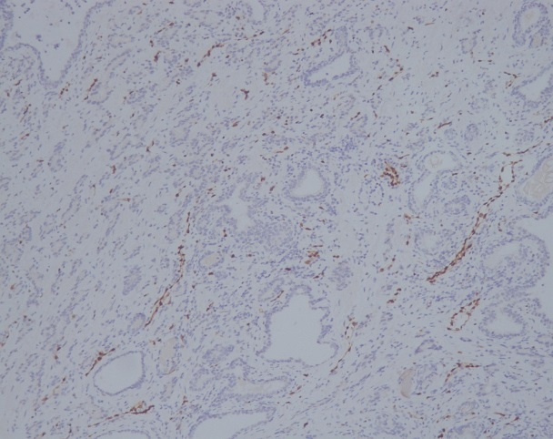
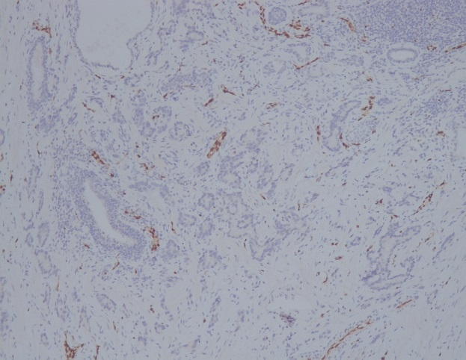
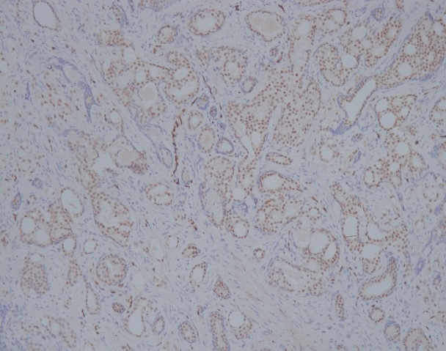
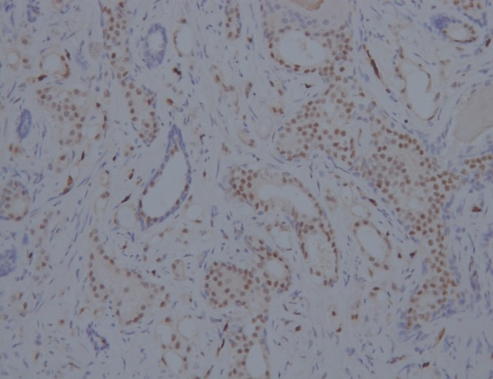
Test results of ERG IHC
Control experiment will be conducted:
Employing control slides from CPDR to make sure the results from American and Chinese patients are comparable
ERG negative
(only nuclear staining on endothelial cells)
ERG positive
(positive for ERG on prostate carcinoma cells, while negative on basal cells)
Chinese prostate cancer patients; ERG antiby 9FY; Images provided by Zhongshan hospital
Notes:
我怎么看都看不出positive和negative的差别，当然，右下角的那一张是明显positive的。

Slide 12
Conclusion and Future Work
Conclusion
Frequency of ERG fusion: CA > AA ≈ Chinese
ERG fusion is associated with ERG over-expression
Reported frequency of ERG fusion ranged from11.1% to 78% in Asian patients.
Future Work
ERG immunohistochemistry in 100 Chinese samples
Compare ERG over-expression frequencies in CA, AA, Chinese

Slide 13
Project 2
Analyses—multi-“omics” approach
Aims
Questions/Hypothesis
Validation of the ERG driver genes in new (mainly Chinese) samples
Frequency of ERG mutations and expressions in CaP of
CA, AA and Asians
Mutation
CNV
Fusion
PRAD Data
CPDR data:
(7 AA + 7 CA)
WGS RNA-Seq
Public Chinese data: (14 Chinese)
RNA-Seq
TCGA PRAD data:
(497 patients; level 3)
RNA-Seq CNV Methylation
Genomic level
Identification of other potential drivers
Find other drivers for ERG-fusion negative samples/populations?
Transcrip-tome
level
mRNA
methylation
MicroRNA
Identification of regulatory targets of drivers
How drivers regulate the cancer cell gene expression?
Identification of bacterial species (profiles) in cancer as potential biomarkers/targets
Microbiome level
What kind of bacteria species are specifically increased or decreased in prostate cancer?
Microbiome
Resource
Early Detection Markers for Screening, Diagnosis, Treatment and Prognosis
Notes:
This slide gives us an overview of our project. The PRAD data used in this study: (1) The CPDR dataset containes 7 AA and 7 CA prostate cancer samples, with both WGS and RNA-Seq data. (2) The RNA-seq data of 14 Chinese prostate cancer samples from ENA (European Nucleotide Archive); (3) TCGA level 3 prostate cancer data include RNA-seq and CNV data. Because RNA-seq data are available in all of the 3 datasets, interrogatively analysis and comparison of the prostate cancer transcriptome is performed. We have other two major Aims, one is the genomic markers, initially focused on ERG (ERG fusion) and the another is trying to analyze the microorganisms paralyzed on the prostate cancer tissues. Overall, taking the advantage of integrated data and a multi-”omics” analysis approach, we would like toanswer the question of Early Detection of Prostate Cancer in Caucasian American (CA), African American (AA) and Chinese/Asians.
Next slide

Slide 14
Method: identify drivers by integrating multi-omics data
TCGA samples
Candidate regulators
(significantly CNV alteration (SCNA);
or differentially methylated genes;
or differentially expressed miRNAs)
CNV/methylation/miRNA data
Expression data
(diff-expressed genes)
Single modulator
CONEXIC
Module network
(learn regulatory program iteratively)
We applied two methods to find race-specific drivers:
All samples were used together to find driver genes, then the frequency of each candidate driver gene was compared between AA and CA.
AA and CA samples were separately used for driver detection.
bootstrap 100 times
drivers (detected >60 times)
* Cell. 2015 Nov 5;163(4):1011-25. doi: 10.1016/j.cell.2015.10.025.
Notes:
The overview of identifying CNV regulators. (1) Cell用的是什么数据？如何filter的？ (2) 这里称为30 drivers，到后面，马上就变成30 CNV regulators?? 不仅名称（driver vs regulator）不同；definition也不同，这里是综合了三种数据（CNV仅仅是其中一种），而后面一张，只剩下了CNV。太随便了！(3) most robust regulators后面加了1.e., 也就是表明detected>60 times就是most robust的“标准”，是吗？
【（1）这篇cell就是TCGA发的paper。文章中给出了20个amplification和35个deletion区域（q value < 0.25, GISTIC 2.0）。我们直接用了这篇文章给出的区域，然后filter掉了一些microRNA和不标准的基因名，得到这些区域内的3145个基因。
（2）确实有这个问题，我们把名称统一了，挑选后的基因都称为“driver”。使用CNV+表达谱筛选出的drivers，称为CNV drivers； 后面也尝试了甲基化+表达谱筛选driver，称为methylation drivers。
（3）是的，被检测到>60次我们就认为它是“most robust”的。这个阈值是参考了别人的文献中的阈值。】

Slide 15
30 potential CNV drivers (detected >60 times)
Gene | CNV | Altered in AA (N = 40) | Altered in CA (N = 279) | Bootstrap frequency
ERG | Del | 4 | 64 | 100
CTHRC1 | Amp | 7 | 38 | 100
DDR2 | Amp | 0 | 8 | 95
DCST2 | Amp | 0 | 12 | 94
DUOX1 | Del | 2 | 5 | 94
TRIM29 | Del | 2 | 8 | 91
MEIS2 | Del | 2 | 6 | 90
JAZF1 | Amp | 4 | 15 | 85
CACHD1 | Del | 1 | 17 | 84
ATP1A2 | Del | 2 | 7 | 83
CHRNA2 | Del | 14 | 82 | 80
GSTP1 | Amp | 0 | 6 | 80
GTSE1 | Del | 0 | 8 | 80
C5orf4 | - | - | - | 77
KCNMB1 | Del | 1 | 3 | 77
Gene | CNV | Altered in AA (N = 40) | Altered in CA (N = 279) | Bootstrap frequency
MXD3 | Amp | 2 | 3 | 77
TP63 | Amp | 2 | 8 | 75
ANKRD35 | - | - | - | 71
NRG2 | Amp | 2 | 3 | 70
ARHGAP20 | Del | 2 | 6 | 67
S100A6 | Del | 2 | 6 | 67
TGFBR3 | Del | 1 | 7 | 66
F5 | Del | 1 | 7 | 65
KIRREL | Del | 2 | 6 | 65
FAT4 | Del | 4 | 10 | 64
FAT2 | Del | 1 | 4 | 64
NPFF | Amp | 0 | 4 | 63
GPR124 | Del | 9 | 56 | 62
GCNT4 | Del | 4 | 19 | 61
IL6ST | Del | 5 | 28 | 60
Conclusion (1):
30 CNV drivers were identified based on TCGA CNV & expression data;
12 of these 30 CNV drivers were reported to be associated with cancer in literatures, indicating our method was effective;
18 new drivers may provide insights on further studies.
GO/KEGG enrichment analysis on these 30 drivers shows no significant GO terms or pathways.
Notes:
30 CNV drivers (with CNV frequency in CA/AA) was shown in the table. The frequency was calculated using TCGA level 3 data.
The reason why the frequency was slightly different from other studies:
For ERG gene, fusion may caused by deletion or translocation. As a result, the CNV frequency would be lower than fusion frequency.
Different cutoff of AMP/DEL. (Here we use: AMP: > log(1.25), DEL: < log(0.75))
The frequency will be slightly different on different sample subset (we used 279 CA + 40 AA)

Slide 16
10 CNV drivers: reported to be associated with PCa in literatures
Driver genes | Alteration | Function
ERG | fusion; deletion | ETS-family; fused to AR-sensitive genes (eg. TMPRSS2)
GSTP1 | epigenetic silencing | GSTs family; detoxification & cell cycle regulation
TRIM29 | downregulated in cancer | TRIM protein family; increases AR transcriptional activity; regulate the stability or transcriptional activity of p53
DDR2 | Abnormal expression | Discoidin Domain Receptor Tyrosine Kinase 2 (RTKs), regulation of cell growth, differentiation, and metabolism; associated with the aggressive progression of prostate cancer patients
MEIS2 | Decreased in prostate cancer | Highly conserved transcription regulators. function as tumor suppressor genes
CACHD1 | Abnormal expression | May regulate voltage-dependent calcium channels; may associate with prostate cancer metastatic
CHRNA2 | Abnormal expression | ligand-gated ion channels. Significantly altered in prostate cancer
C5orf4 (FAXDC2) | epigenetically silenced | Cholesterol synthesis; epigenetically silenced in almost all tumors (>85%)
KCNMB1 | Amplification | Potassium Calcium-Activated Channel Subfamily M Regulatory Beta Subunit 1; associated with tumor cell proliferation
TP63 | Abnormal expression | transcription factors. Acts as a sequence specific DNA binding transcriptional activator or repressor.
Notes:
This table shows 10 CNV drivers reported to be associated with prostate cancer in previous studies. 注意，这里有“previous studies”，定义是明白的；与前面的定义（不明确的）一致吗？
【此处为前人的研究，与第6张slides (content页)中的定义不同。您的理解是正确的。把这里的“previous studies”改成了 “literatures”】

Slide 17
2 CNV drivers: reported to be associated with other cancers in literatures
Reported in other cancer (but not in PCa):
Driver genes | Alteration | Function
CTHRC1 | highly expressed | Related pathways: Wnt; tissue repair process. Aberrant expression of CTHRC1 is widely present in human solid cancers and seems to be associated with cancer tissue invasion and metastasis.
GTSE1 | Silencing | cell cycle; May be involved in p53-induced cell cycle arrest; associate with gastric cancer and HCC
Notes:
This table shows 2 CNV drivers reported to be associated with other cancers in previous studies. 于是，12个CNV regulator （potential）是过去报道的（我猜，就是那篇cell paper. 而18个是过去没有报道的？他们都与COG没有significant的关系，那么结论是什么？ 后面的80个被ERG regulate的基因，与这个结论是矛盾的吗？
【这12个是曾被报道过的，不仅仅来自于那篇cell paper，是从多个文章中整理得到的。
30个CNV driver中，18个是没有报道的，可以认为是我们新找到的driver，不过还需进一步确认。
每个CNV driver都会调控一些基因。比如：ERG是30个CNV driver中的1个，ERG调控了80个其它的基因。
这部分工作中没有出现COG？】

Slide 18
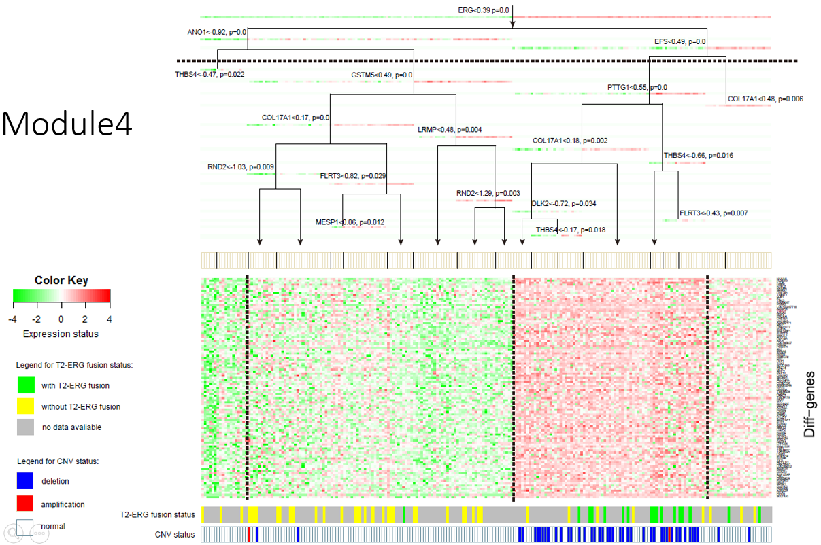
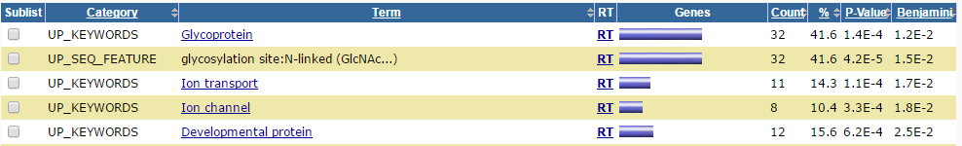
Functional analysis of genes regulated by ERG
80 genes are regulated by ERG; 5 of them are known ERG targets: FZD8, TWIST1, TDRD1, EN2, TBX1
These 80 genes are significantly associated with glycoprotein, ion transport and developmental protein
Notes:
We found 80 most robust genes (>60 times in 100 bootstrap) regulated by ERG. Among these genes, 5 are known ERG targets. The functional enrichment results show that these 80 genes are significantly associated with glycoprotein, ion transport and developmental protein.
上面写出的5个，与下面表里面的5个，是什么关系？
【上面的5个基因：80个基因中，有5个是已知的ERG下游基因。下面的5个：80个基因富集的GO词条，每一个条目是一组基因的集合。两者是从不同的角度看被ERG调控的基因的功能。】
Next slide
known ERG targets: http://www.nature.com/onc/journal/v30/n17/full/onc2010582a.html

Slide 19
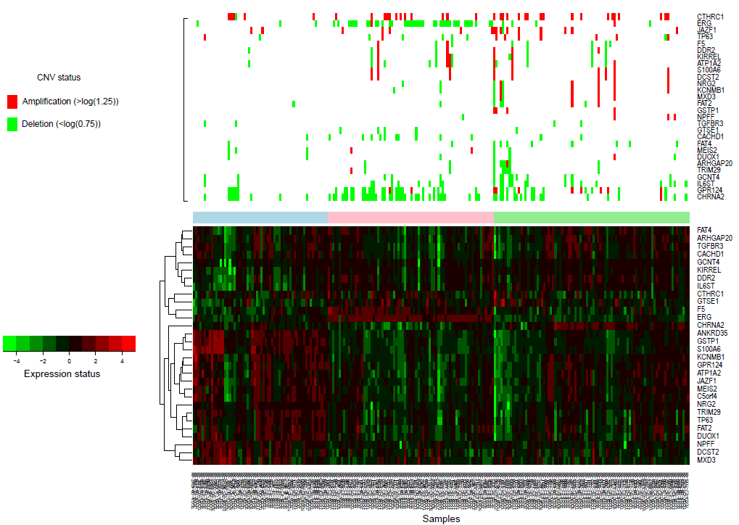
Conclusion(2) Three subtypes were identified based on the expression of 30 CNV drivers
ERG高表达
CTHRC1扩增
Subtype 2 shows high expression of ERG
Important genes for each of the 3 subtypes:
Subtype | Metagenes
1 | DCST2, DUOX1, TRIM29, MEIS2, JAZF1, ATP1A2, GSTP1, C5orf4, KCNMB1, MXD3, TP63, ANKRD35, NRG2, S100A6, FAT2, NPFF
2 | ERG, F5
3 | CTHRC1, DDR2, CACHD1, CHRNA2, GTSE1, ARHGAP20, TGFBR3, KIRREL, FAT4, GPR124, GCNT4, IL6ST
NMF clusters
Notes:
We identified 3 clusters using NMF method based on the expression profiles of 30 CNV drivers.
结论（2）：根据这些CNV drivers的表达谱数据，可以将样本分为3个不同的亚型。其中一个亚型显示ERG高表达。
NMF: Nonnegative Matrix Factorization, an algorithm of clustering.

Slide 20
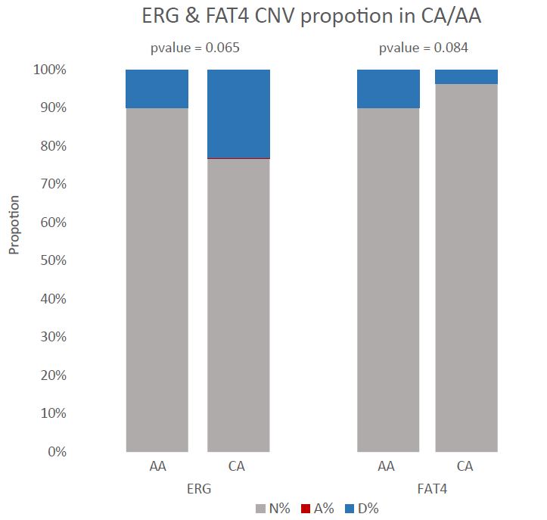
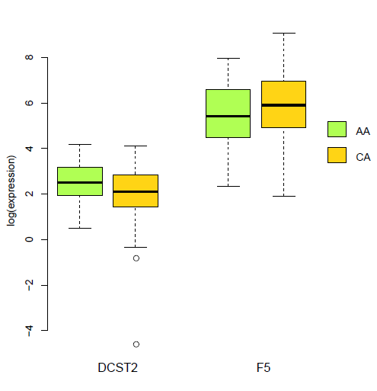
CNV frequency & expression differences of 30 drivers in AA/CA
p = 0.14
p = 0.17
None of these drivers show significant differences in frequency of CNV alterations b/w AA and CA
None of these drivers diff-expressed b/w AA and CA
AA sample: 40
CA sample: 279
Fisher.test, p < 0.1
Notes:
We want to see whether these identified drivers show significant difference in CNV frequency between different populations.

Slide 21
Identify CNV drivers using CA and AA, respectively
only use 279 CA samples
only use 40 AA samples
Gene | Altered in CA (N = 279) | Bootstrap Frequency | Gene | Altered in CA (N = 279) | Bootstrap Frequency
TRIM29 | 8 (2.87%,Del) | 100 | RPS14 | 2 (0.72%,Amp) | 79
NDUFS8 | 6 (2.15%,Amp) | 100 | GPR124 | 56 (20.07%,Del) | 78
ERG | 64 (22.94%,Del) | 98 | SLC30A4 | 5 (1.79%,Del) | 78
RAB27A | 7 (2.51%,Del) | 95 | ATP11B | 10 (3.58%,Amp) | 77
ARL6IP4 | 7 (2.51%,Amp) | 93 | S100A6 | 12 (4.30%,Amp) | 74
SH3GLB2 | 9 (3.23%,Amp) | 93 | WNK2 | 6 (2.15%,Amp) | 70
MED13 | 2 (0.72%,Amp) | 91 | CCS | 7 (2.51%,Amp) | 70
DUSP1 | 4 (1.43%,Amp) | 91 | IL6ST | 28 (10.04%,Del) | 69
NDUFA2 | 4 (1.43%,Del) | 88 | EPHX2 | 82 (29.39%,Del) | 69
TMED9 | 3 (1.08%,Amp) | 88 | CHRNA2 | 82 (29.39%,Del) | 69
NR4A3 | 7 (2.51%,Amp) | 88 | PRELID1 | 3 (1.08%,Amp) | 68
ADAM10 | 7 (2.51%,Del) | 87 | CLU | 80 (28.67%,Del) | 66
GNB2L1 | - | 87 | CLTB | 3 (1.08%,Amp) | 66
LMAN2 | 3 (1.08%,Amp) | 86 | SYNPO2 | 11 (3.94%,Del) | 64
ASH1L | 10 (3.58%,Amp) | 86 | NHP2 | 3 (1.08%,Amp) | 64
ATP1A2 | 7 (2.51%,Del) | 86 | GBP2 | 6 (2.15%,Del) | 63
PDIA3P | - | 86 | PSMC3 | 3 (1.08%,Del) | 63
GSTP1 | 6 (2.15%,Amp) | 84 | PRRC1 | 8 (2.87%,Del) | 62
NDUFS3 | 4 (1.43%,Del) | 83 | LEPREL1 | 9 (3.23%,Amp) | 61
ANKRD17 | 3 (1.08%,Amp) | 80
Gene | Altered in AA (N = 40) | Bootstrap Frequency
NHP2 | 2 (5.00%, Amp) | 39
HSPA9 | 2 (5.00%, Amp) | 29
TAGLN2 | 2 (5.00%, Del) | 27
KIAA0368 | 4 (10.00%, Amp) | 25
NDUFS8 | 0 (0.00%) | 24
PTGES2 | 4 (10.00%, Amp) | 22
CLTB | 2 (5.00%, Amp) | 22
COQ4 | 4 (10.00%, Amp) | 20
GSTP1 | 0 (0.00%) | 20
Notes:
With the purpose of identifying race-specific drivers, we run CONEXIC based on AA and CA respectively.
Sample (TCGA)：CA = 279, AA = 40.
CA drivers: selected as regulators > 60 times in 100 times bootstrap;
AA drivers: the highest frequency was 39, (too small sample size to get robust drivers). The frequency of ERG in AA population was 4 (out of 100 times bootstrap procedure).
ARL6IP4: diff-expressed in CA/AA (significantly higher in CA, logFC = -1.12, p.adj = 0.01); It’s CNV alteration frequency in CA/AA is not significantly differentp-value = 0.6023, fisher.test.

Slide 22
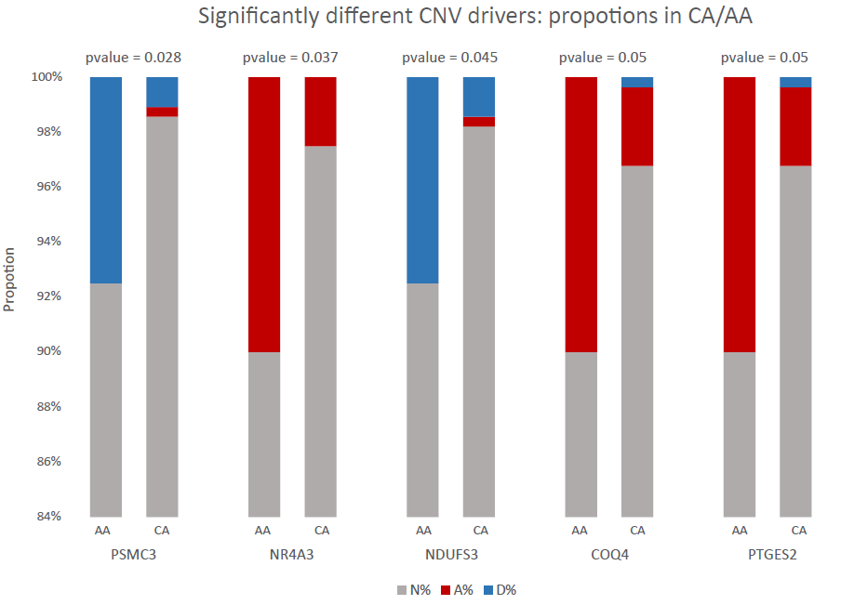
Potential race specific CNV drivers
Compare 39 drivers (identified from 279 CA) and 9 drivers (identified from 40 AA)
Gene | CNV | Altered in AA (N = 40) | Altered in CA (N = 279) | p-value
PSMC3 | Del | 3 | 3 | 0.03
NR4A3 | Amp | 4 | 7 | 0.04
NDUFS3 | Del | 3 | 4 | 0.04
PTGES2 | Amp | 4 | 8 | 0.05
COQ4 | Amp | 4 | 8 | 0.05
ERG | Del | 4 | 64 | 0.07
SH3GLB2 | Amp | 4 | 9 | 0.07
KIAA0368 | Amp | 4 | 9 | 0.07
NDUFA2 | Amp | 2 | 2 | 0.08
RPS14 | Amp | 2 | 2 | 0.08
PRRC1 | Amp | 2 | 2 | 0.08
HSPA9 | Amp | 2 | 2 | 0.08
WNK2 | Amp | 3 | 6 | 0.09
Conclusion (3):
5 genes have significantly differential CNV frequencies between CA/AA.
Some frequently altered genes (e.g: ERG) are not significantly differential between CA/AA; More AA samples are needed for further studies.
AA sample: 40; CA sample: 279; fisher.test, p < 0.1
Notes:
5 significant genes: alteration frequency: AA > CA； 前面表里面好像也有过。
【有一些是重复的。再次列出来是为了对比这些race specific 的CNV drivers，分别在AA/CA中altered的频率。看得更清晰。】

Slide 23
Potential race specific CNV drivers (description & function)
Genes | Description | Function
PSMC3 | Proteasome 26S Subunit, ATPase 3 | regulate the interaction between the viral protein and the transcription complex
NR4A3 | Nuclear Receptor Subfamily 4 Group A Member 3 | tumor suppressor; Epigenetic silencing; may act as a transcriptional activator; may involved in transcriptional misregulation in cancer.
NDUFS3 | NADH:Ubiquinone Oxidoreductase Core Subunit S3 | electron carrier activity and oxidoreductase activity, acting on NAD(P)H. down-regulates in some cancers (breast, kidney and ovarian).
PTGES2 | Prostaglandin E Synthase 2 | Overexpressed in colorectal cancer and endometrial adenocarcinomas
COQ4 | Coenzyme Q4 | coenzyme Q biosynthesis pathway. mutated in cancers such as lung/breast cancer.
Notes:
Refs: doi:10.1038/srep31690

Slide 24
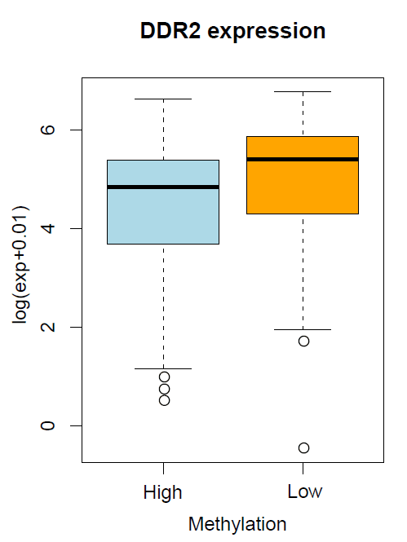
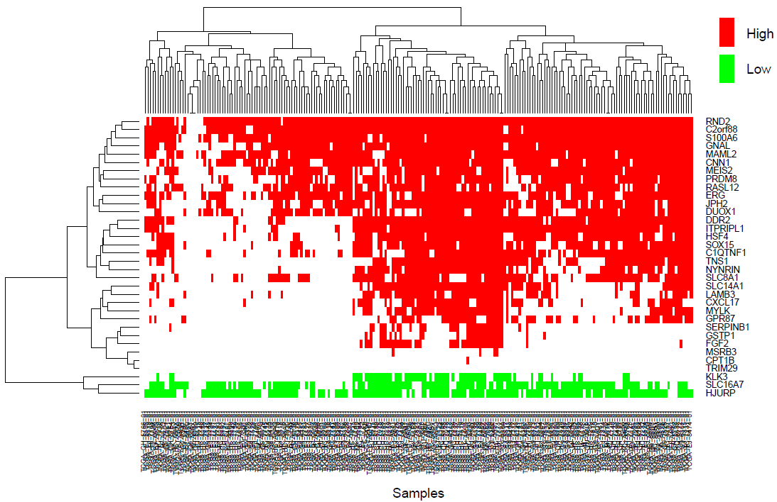
34 potential methylation drivers
Gene | Frequency | Gene | Frequency
GSTP1 | 100 | KLK3 | 72
HJURP | 100 | SOX15 | 71
DDR2 | 100 | C2orf88 | 71
ERG | 99 | SERPINB1 | 69
NYNRIN | 99 | MYLK | 68
CPT1B | 98 | HSF4 | 68
TNS1 | 97 | RND2 | 68
TRIM29 | 96 | SLC8A1 | 67
PRDM8 | 92 | SLC14A1 | 66
CNN1 | 91 | S100A6 | 65
JPH2 | 88 | RASL12 | 63
ITPRIPL1 | 88 | C1QTNF1 | 62
DUOX1 | 81 | CXCL17 | 61
FGF2 | 77 | MSRB3 | 60
MAML2 | 77 | GPR87 | 60
GNAL | 73 | MEIS2 | 60
LAMB3 | 72 | SLC16A7 | 60
DDR2 is not high methylated.
GSTP1 high methylation
Methylation
Conclusion (4):
34 methylation drivers were identified based on TCGA methylation & expression data;
Three subtypes were identified based on the methylation of 34 methylation drivers.
GO/KEGG enrichment analysis on the 34 drivers shows no significant GO terms or pathways.
Notes:
We combined the CNV and methylation drivers (union: 57 genes). However, GO/KEGG enrichment analysis on these 57 drivers shows no significant GO terms or pathways either.
目的 探讨盘状结构域受体2 (DDR2 )蛋白在前列腺癌组织标本中的表达 ,分析其与其临床病理特征的关系 ,初步明确DDR2在前列腺中的作用 ,为探寻新的治疗靶点提供基础.方法 采用免疫组化检测46例前列腺癌和18例良性前列腺增生组织标本中DDR2的表达情况.结果 前列腺癌组织的DDR2阳性表达率(82 .61% )明显高于良性前列腺增生组织的DDR2的阳性表达率(11 .11% ,P<0 .05).Gleason 5~7分组和8~10分组前列腺癌组织的DDR2阳性表达率明显高于Gleason 2~4分组前列腺癌组织DDR2阳性表达率 (P<0 .05).DDR2蛋白阳性表达与 TNM 分期比较 ,TNM分期越晚 ,DDR2阳性表达率越高(P<0 .05).血清PSA水平≤20 μg/L组前列腺癌组织的DDR2阳性表达率明显低于 PSA>20 μg/L组(P<0 .05).而DDR2阳性表达率与患者的年龄因素无关(P>0 .05).结论 DDR2在前列腺癌中高表达 ,提示其在前列腺癌的发生发展中可能起重要作用.
PRDM8 is a novel histone H3-specific methyltransferase and selectively transferred methyl groups to H3K9

Slide 25
Future work
TCGA data
Use similar methods to discover miRNA drivers.
Identify drivers in ERG-fusion negative samples.
Analyze the association between molecular subtypes and clinical characteristics
Multi-omics characteristics of Chinese prostate cancer patients
New drivers in Chinese patients
Racial difference among CA, AA and Chinese
Experiment | Tissue sample (fresh frozen, microdissection)
RNA-Seq | 50 tumor, 10 adjacent normal
WGS | 10 matched tumor and normal pairs
Target-Seq (~770 genes) | 45 matched tumor and normal pairs
Notes:
结论（4）：相似地，如果再加入DNA甲基化和miRNA，可以找到其它组学的driver基因，对样本进行分型，可能有更好的分型结果。再研究亚型与临床特征的相关性，解释不同亚型的肿瘤的特点。

Slide 26
Project 3
Analyses—multi-“omics” approach
Aims
Questions/Hypothesis
Validation of the ERG driver genes in new (mainly Chinese) samples
Frequency of ERG mutations and expressions in CaP of
CA, AA and Asians
Mutation
CNV
Fusion
PRAD Data
CPDR data:
(7 AA + 7 CA)
WGS RNA-Seq
Public Chinese data: (14 Chinese)
RNA-Seq
TCGA PRAD data:
(497 patients; level 3)
RNA-Seq CNV Methylation
Genomic level
Identification of other potential drivers
Find other drivers for ERG-fusion negative samples/populations?
Transcrip-tome
level
mRNA
methylation
MicroRNA
Identification of regulatory targets of drivers
How drivers regulate the cancer cell gene expression?
Identification of bacterial species (profiles) in cancer as potential biomarkers/targets
Microbiome level
What kind of bacteria species are specifically increased or decreased in prostate cancer?
Microbiome
Resource
Early Detection Markers for Screening, Diagnosis, Treatment and Prognosis
Notes:
This slide gives us an overview of our project. The PRAD data used in this study: (1) The CPDR dataset containes 7 AA and 7 CA prostate cancer samples, with both WGS and RNA-Seq data. (2) The RNA-seq data of 14 Chinese prostate cancer samples from ENA (European Nucleotide Archive); (3) TCGA level 3 prostate cancer data include RNA-seq and CNV data. Because RNA-seq data are available in all of the 3 datasets, interrogatively analysis and comparison of the prostate cancer transcriptome is performed. We have other two major Aims, one is the genomic markers, initially focused on ERG (ERG fusion) and the another is trying to analyze the microorganisms paralyzed on the prostate cancer tissues. Overall, taking the advantage of integrated data and a multi-”omics” analysis approach, we would like toanswer the question of Early Detection of Prostate Cancer in Caucasian American (CA), African American (AA) and Chinese/Asians.
Next slide

Slide 27
Content
Previous Work
Development of the workflow to identify microbes from WGS data of prostate cancer samples – Actually, only the data of control blood sample were analyzed
Improve the procedures of microbes identification workflow
Compare the distribution of microbes in prostate cancer tissues and blood
1)
2)
Current Work
3)
Notes:
The initial work was to develop a workflow to identify microbes from WGS data. Next, we make improvements with our procedures for identifying microbes as much as possible. The third part mainly includes comparing the microbial profiles between prostate cancer tissues and blood.
Next slide

Slide 28
Method: remove human sequences
Sequencing Reads (WGS)
(14 tumor-blood pairs; 7 CA, 7 AA)
Mapping to human reference genome (hg19 and additional assembled human genome) (BWA)
Reads not mapped to human genome
Filtering Repeats and Low Complexity DNA sequences (RepeatMasker)
Qualified Reads
Mapping to human reference database (MegaBlast)
Remaining Reads
Mapping to human reference database (Blastn)
Reads free of human DNA
Clean Reads for microbiome detection
Notes:
The first step of our working flow was to remove human sequences. The low-quality and duplicate reads are removed from the complete read set, and then the reads are filtered by mapping to the human genome.

Slide 29
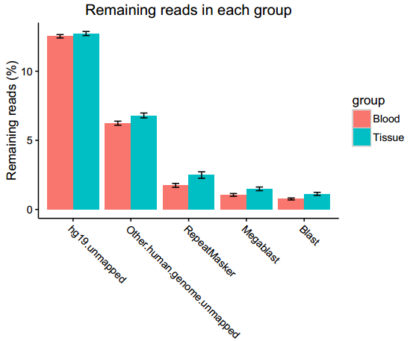
Remaining reads after each filtering step
* P < 0.05
*
*
*
The number of non-human reads is more in tumor tissues compared to the matched blood
Notes:
The plot on the left showed the remaining reads in each sample after the filtering steps. Barplot on the right demonstrated there are more non-human reads in tumor tissues compared with the matched blood. The y-axis depicts the mapping ratio (which is calculated: remaining non-human reads / all sequencing reads)

Slide 30
Method: map non-human reads to microbes
Sequencing Reads from WGS
(14 tumor-blood pairs; 7 CA, 7 AA)
Bacteria (2,647 genomes)
Non-human Reads
1) NCBI Reference genomes
Archaea (30,800 genomes)
Remaining Reads
Viral (7,807 genomes)
2) HMP assembly sequences (134, 120 contigs)
Fungi (74,345 genomes)
4) De-novo assembly and gene prediction
3) IGC Gene Catalog
(3 million genes)
Unmapped Reads
Non-redundant gene catalogs
Blast with non-redundant protein databases for gene annotation
Notes:
The filtered non-human reads were then mapped to the microbial reference sequences in a step-by-step method. NCBI reference genomes are widely used with the highest confidence,
Assembly sequences from the human microbiome project, integrated reference catalog and de-novo assembly were used for the purpose of identifying more microbes as much as possible.
NCBI reference genomes
Bacteria, archaea, fungi and viral genomes were from the NCBI Refseq website
(ftp://ftp.ncbi.nih.gov/refseq/release)
HMP (Human Microbiome Project) assembled sequences
Reference genomes from major body sites, including 131 archaeal strains over 97 species,
326 lower eukaryotes over 326 species, 3,683 viral strains over 1,420 species and 1,751
bacterial strains over 1,253 species (http://www.hmpdacc.org/HMREFG/)
IGC (Integrated reference catalog) gene catalogs
A high-quality reference gene catalog established from 1267 fecal samples and 1070 people
around the world, including Danish, Spanish, Chinese and Americans.
(http://meta.genomics.cn/meta/)
这一点是进步了！在这一件事上，要与张国庆的微生物组数据库紧密配合，有可能会有比较好的突破。

Slide 31
Mapped reads for different databases
Tumor vs Blood: 9.97 x 10⁻⁸
(Two-sided Wilcox Rank Sum test)
Blood
Tumor
Conclusion (1):
Reads mapped to microbiome sequences are significantly higher in tumor tissues compared with paired blood samples
Notes:
The barplot shows the mapping ratio of each sample after mapping different databases. The mapping ratio denotes mapped reads / non-human reads
总体看，blood 样本是比较“一致”的，而tissue样本之间的差别非常大，这是有道理的。其实，我很希望看到“绝对量”，从开始到现在，都没有看到“绝对量”！

Slide 32
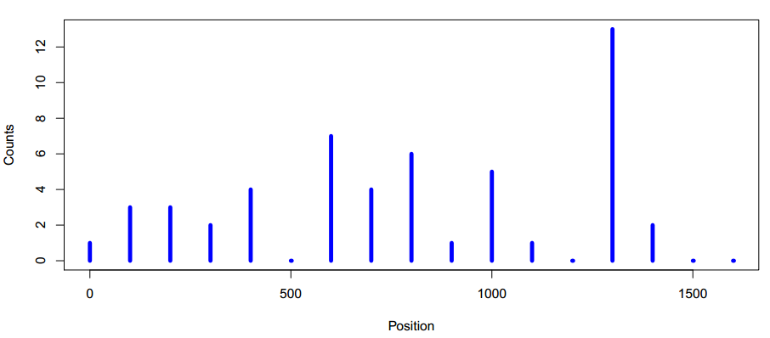
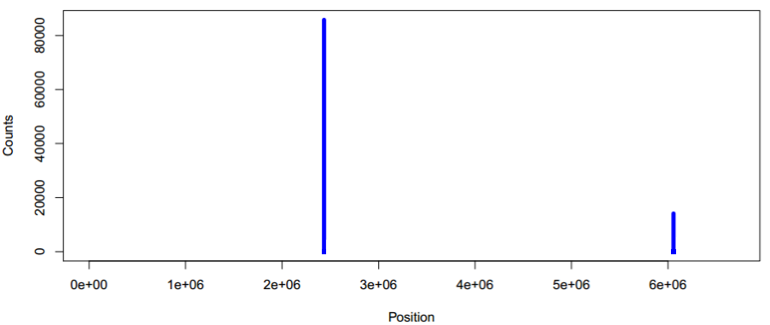
Method: Identification criteria
Coverage = bins covered by reads /total bins
Bins = genome length / 100
Criteria : Total reads > 10 and coverage > = 0.1
(Used for NCBI and HMP results)
Example of positive result
Example of negative result
Sulfolobus ATCC 33909
Achromobacter xylosoxidans
Notes:
The next two slides show the microbial genome identification criteria used in our workflow. If there are more than 10 reads perfectly mapped to one genome and the coverage was more than 0.1, this genome was considered as positive existence. The two plots below were two examples of negative identification, The X-axis depicts the genome length and the Y-axis depicts counts/100bp. The genome on the left had only 5 reads mapped. On the right, there were more than 50,000 reads mapped to achromobacter, while the coverage was far less than 10%, suggesting it’s not likely to be present in the sample.

Slide 33
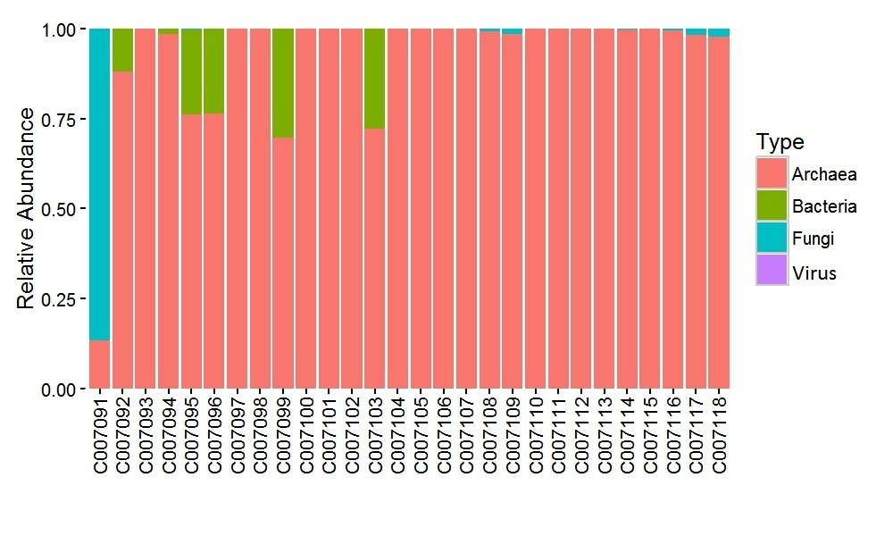
1) Detected microbes --- NCBI
Tissue vs Blood :
The abundance of Archaea: P-value=0.002
The abundance of Bacteria: P-value=0.04
The abundance of Fungi: P-value=0.40
The abundance of Viral: P-value=0.74
*
*
Blood
Tissue
Conclusion (2):
Archaea was the most abundant type of microbes in our samples, and significantly more in tumor tissues compared with the matched blood, while bacteria demonstrated the opposite result.
(red star, P value<=0.05,
Student t’s test )
Notes:
We calculate the read counts of each genome for each sample and normalize them by genome length, after that, normalized genome abundances were transformed by dividing them with the sum of normalized genome abundances for a given sample. The resulting set of genome frequencies, termed as relative abundance of a genome for the sample, was used for further analysis.
### This picture denotes the relative abundance of each type of microbe in each sample by mapping to the NCBI genomes.
In the next two slides, we normalized the relative abundance value of each genus (species) among samples, which aims to mark the differential abundant genus(species) between prostate cancer and blood. In the next slide, Sulfolobus is still the most abundant genus in our samples, but the color in the heatmap denotes whether it is higher or lower in prostate cancer than in blood samples.
几个病人的血中有细菌，而组织中几乎没有。
GPZ: 正因为你们不喜欢用“绝对值”，所以，这样的结果，就无法在图表上表现出来！
当然，你们觉得绝对量没有办法做normalization，所以，就没有办法比较了。这里有两层意义。首先，normalization是可以做的，就是我们要加入所检测的样本的体积（或者质量）。问题当然是，一不一定有这样的数据，二即便有这样的数据，量的多少是由多种原因造成的，如何排除其中的技术原因呢？这一点我很难回答，但是，我可以暂时假设技术原因不是主要的。这就到了第二层意义了，也就是说，哪怕我们连这样粗糙的normalization都不做，就看到了你们说的“几个病人的血中有细菌，而组织中几乎没有”，这也是有意义的。因为你们如此“精细”分析的数据，得到的结论，无非就是：（1）微生物的含量，血液中与tumer中差别很大（哪个方向不确定？）；（2）微生物的种类，血液中与tumer中差别很大；而且这个差别大，是可以落实到一些具体的类群上的；（3）就血液和tumer分别考虑，血液中微生物的状况，比较uniform（无论是量，还是类），而tumer中的，差别就很大。是这样吗？请你们再总结一下！我估计，如果你们同时做绝对量，即便没有统计分析，结论也差不多。当然，我不是否认要统计分析；可是，绝对量会很快给我们一些非常直观的“现象”（当然，不一定有“统计意义”，甚至不是基于“准确的实验”），帮助我们从中找出“问题”，有助于我们后面做“有意义”的工作。现在的分析，都是为了以后能做出“统计上显著的差别”，这样的设计，是有一些问题的。
至于生物学意义，这是你们一直关心的，也是应该关心的。但是，有两个问题，一是现在数据的可靠性及其在“统计上”的意义都不清楚，搞太多的生物学意义没有太大的作用（已经做的是不错的）。二是文献不是真理的终结，而是追求真理的新起点。文献上没有的，只要我们实实在在做出来而且经科学评估是对的，就要坚持。当然，又回到了统计上是否是有意义了。
所以，现在方法问题很重要。以前人们做的都是肠胃道，那里菌多，也容易做。现在做的prostate，那里原来应该是没有菌的，所以就难做。要把肺癌作为一个很重要的切入点，那里的菌会比prostate多，但是，比肠胃道少。是一个很好的中间状态。要有一个好的质控。

Slide 34
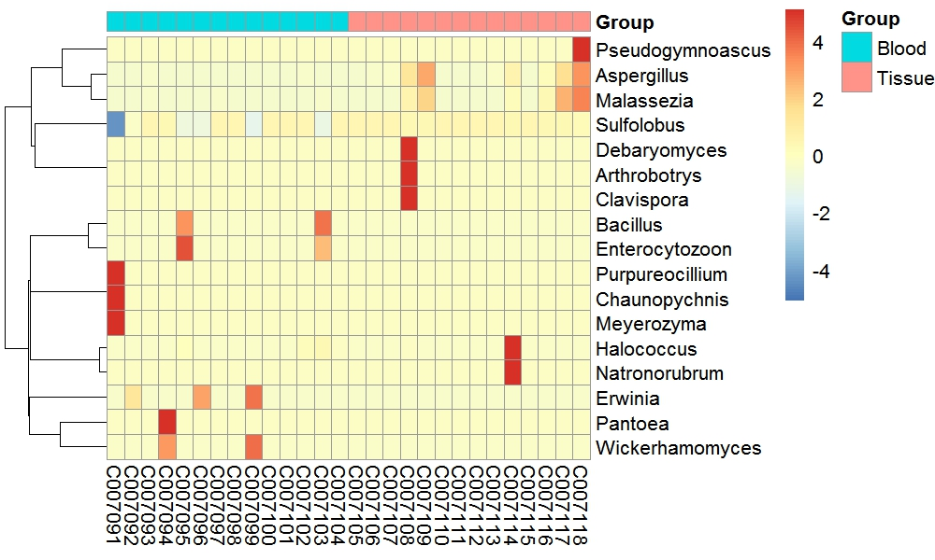
Detected microbes --- NCBI, genus level
Differential abundant genus (red star, P value<=0.05, Student t’s test )
*
*
Aspergillus (Fungi):
A genus of conidial fungi, members of the genus are also sources of natural products that can be used in the development of medications to treat human disease ^{[1]}
Malassezia (Fungi):
Naturally found on the skin surfaces of many animals, including humans.
Sulfolobus (Archaea):
A genus of microorganism in the family Sulfolobaceae, archaea. Volcano species.
*
[1]. FEMS Microbiol Lett. 2011 Aug;321(2):141-9. doi: 10.1111/j.1574-6968.2011.02322.x. Epub 2011 Jun 23
Notes:
This plot shows the microbes in the genus level. Aspergillus, malassezia and sulfolobus are significantly more abundant in the tumor samples

Slide 35
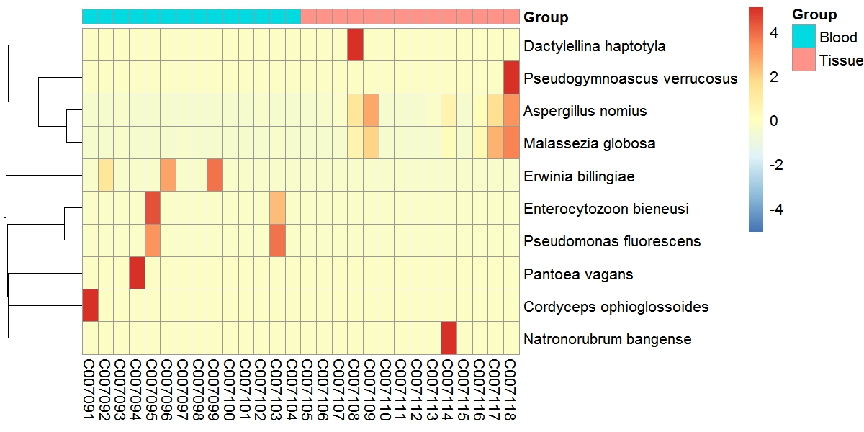
Detected microbes --- NCBI, species level
Conclusion (3):
Most of the species detected were reported to be associated with diseases
*
Aspergillus nomius (Fungi):
Incidence of Aspergillus infections among cancer patients has increased over the last 30 years [7][8].
Malassezia globosa (Fungi):
Malassezia infections in immunocompromised patients. Malassezia colonization implied a role in the induction of this type of cancer. [9].
Pseudomonas fluorescens (Bacteria):
It was found in the blood of four oncology patients [3].
Delayed refrigeration of blood affects the growth of Pseudomonas fluorescens [4].
*
Enterocytozoon Bieneusi (Bacteria):
Enterocytozoon bieneusi and Encephalitozoon intestinalis are most commonly associated with chronic diarrhea.[6]
Pantoea vagans (Bacteria):
Pantoea agglomerans: a Plant Pathogen Causing Human Disease. [5]
(red star, P value<=0.05,
Student t’s test )
[1]. BMC Genomics. 2015 Jul 28;16:551
[2]. J Investig Dermatol Symp Proc. 2007 Dec;12(2):15-9
[3]. J Clin Microbiol. 1998 Oct; 36(10): 2914–2917.
[4] J Clin Pathol. 1995 Aug; 48(8): 717–718.
[5]：Pantoea aggloJ. Clin. Microbiol. June 2007 vol. 45 no. 6
[6]: J Clin Microbiol. 2005 Feb; 43(2): 610–614.
[7]: http://www.cancernetwork.com/review-article/invasive-aspergillosis-cancer-patients-1.
[8]: Mycoses. 2002 Nov;45(9-10):358-63.
[9] Clin Microbiol Rev. 2012 Jan; 25(1): 106–141.
Aspergillus nomius ： An pathogen and one of the three most important producers of aflatoxins in section Flavi ^{[1]}
Are lipid-dependent and demonstrate adaptation allowing them to exploit a narrow niche on sebum-rich skin, associated with Dandruff and seborrheic dermatitis ^{[2]}
Notes:
As to the species level, aspergillus nomius and malassezia globosa may contribute to the tumorigenesis of prostate cancer considering their enrichment in tumor tissues. While, no research has reported their roles in prostate cancer, more samples and experiments are needed to validate these findings.
肿瘤病人的血里发现了几种细菌，有些细菌以前在其他类型病人的血中被发现过。血中细菌的出现，也可能与病人免疫力低有关。
Sulfolobus在Genus水平显著，但在species水平几乎没有显著的。.
Lineage (full): root; cellular organisms; Eukaryota; Opisthokonta; Fungi; Dikarya; Ascomycota; saccharomyceta; Pezizomycotina; Orbiliomycetes; Orbiliales; Orbiliaceae; Dactylellina
Lineage( full )cellular organisms; Eukaryota; Opisthokonta; Fungi; Dikarya; Ascomycota; saccharomyceta; Pezizomycotina; leotiomyceta; sordariomyceta; Leotiomycetes; Leotiomycetes incertae sedis; Pseudeurotiaceae; Pseudogymnoascus
Lineage (full): root; cellular organisms; Bacteria; Proteobacteria; Gammaproteobacteria; Enterobacterales; Erwiniaceae; Erwinia
Lineage (full): root; cellular organisms; Eukaryota; Opisthokonta; Fungi; Microsporidia; Apansporoblastina; Enterocytozoonidae; enterocytozoon bieneusi.
Lineage (full): root; cellular organisms; Bacteria; Proteobacteria; Gammaproteobacteria; Pseudomonadales; Pseudomonadaceae; Pseudomonas; Pseudomonas fluorescens group
Lineage (full): root; cellular organisms; Bacteria; Proteobacteria; Gammaproteobacteria; Enterobacterales; Erwiniaceae; Pantoea
Lineage (full): root; cellular organisms; Eukaryota; Opisthokonta; Fungi; Dikarya; Ascomycota; saccharomyceta; Pezizomycotina; leotiomyceta; sordariomyceta; Sordariomycetes; Hypocreomycetidae; Hypocreales; Ophiocordycipitaceae; Tolypocladium； Cordyceps ophioglossoides 冬虫草？
Lineage (full): root; cellular organisms; Archaea; Euryarchaeota; Halobacteria; Natrialbales; Natrialbaceae; Natronorubrum； Natronorubrum bangense

Slide 36
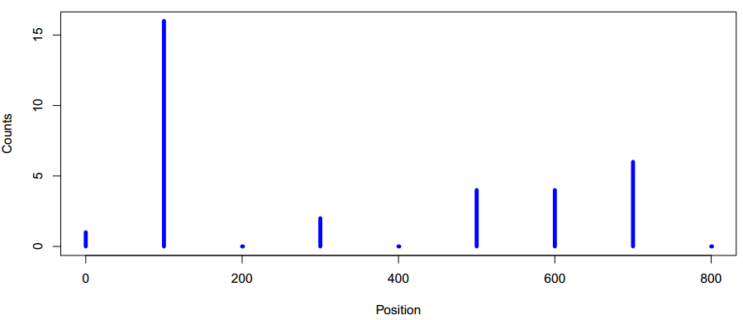
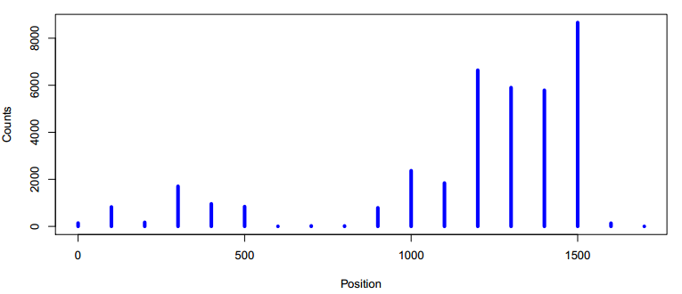
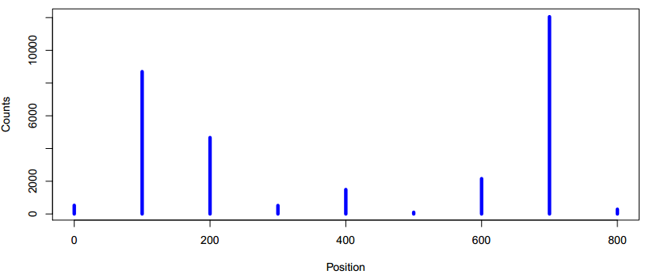
Example result: Higher abundance in tumor compared to blood
Sulfolobus ATCC 33909
Malassezia globosa CBS 7966
C007091, blood
C007104, blood
C007105, tumor (C007091 is the paired blood)
C007118 , tumor (C007104 is the paired blood)
Notes:
The above plots show some cases of positive identification with sulfolobus and malassezia globosa, which meet our criteria perfectly.
Lineage (full): root; cellular organisms; Archaea; TACK group; Crenarchaeota; Thermoprotei; Sulfolobales; Sulfolobaceae; Sulfolobus; Sulfolobus acidocaldarius ; Sulfolobus ATCC 33909

Slide 37
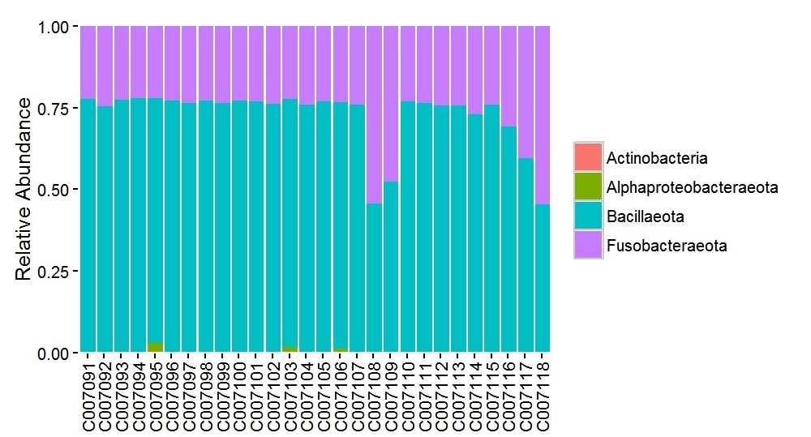
Detected microbes --- HMP
Phylum composition (all are bacteria)
)
Bacillaeota and fusobacteraeota were prevalent in our samples, Bacillaeota was significantly enriched in the tumor tissues, while the abundance of fusobacteria decreased in the prostate cancer
*
*
Tissue vs Blood :
The abundance of Actinobacteria:
P-value=0.34
The abundance of Alphaproteobacteraeota:
P-value=0.35
The abundance of Bacillaeota:
P-value=0.02
The abundance of Fusobacteraeota:
P-value=0.02
Blood
Tissue
(red star, P value<=0.05, Student t’s test )
Notes:
By mapping the NCBI-remaining reads to the reference sequences from the human microbial projects, we found bacillaeota and fusobacteraeota are prevalent in our samples, bacillaeota was significantly enriched in the tumor tissues, while the abundance of fusobacteria decreased in the prostate cancer.

Slide 38
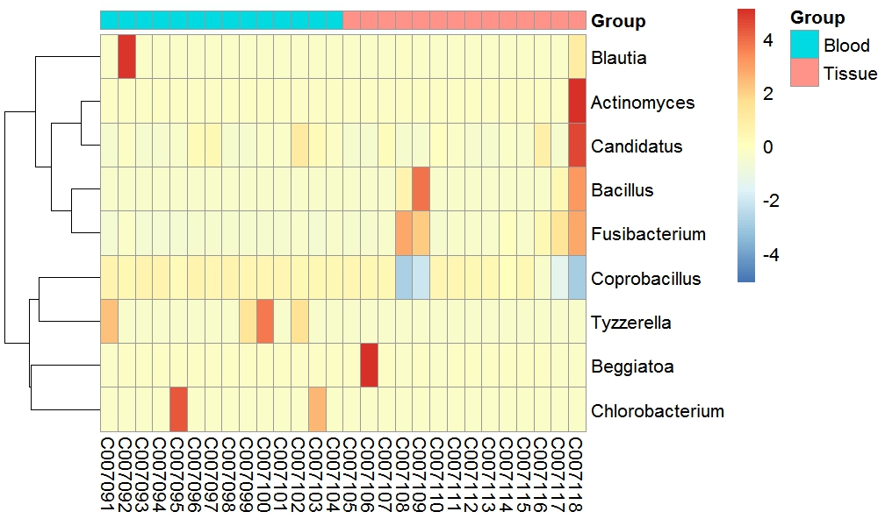
Detected microbes --- HMP, genus level
Differential abundant genus (red star, P value<=0.05, Student t’s test )
Coprobacillus (Bacillaeota):
A Gram-positive, obligate anaerobic and non-motile genus from the family of Erysipelotrichidae
Fusibacterium (Fusobacteraeota):
A genus of anaerobic, Gram-negative, non-sporeforming, bacteria, similar to Bacteroides, Fusobacterium flourishes in colon cancer cells, and is often also associated with ulcerative colitis ^{[1]}
*
*
[1]. Alice Park (18 October 2011). A Surprising Link Between Bacteria and Colon Cancer. Time.com. Retrieved 18 October 2011
Notes:
This slide shows the detected microbes in the genus level by mapping to HMP references. Coprobacillus and fusibacterium have differential abundance between tumor tissues and the matched blood samples. Fusibacterium was once reported to be enriched in colon cancer cells.

Slide 39
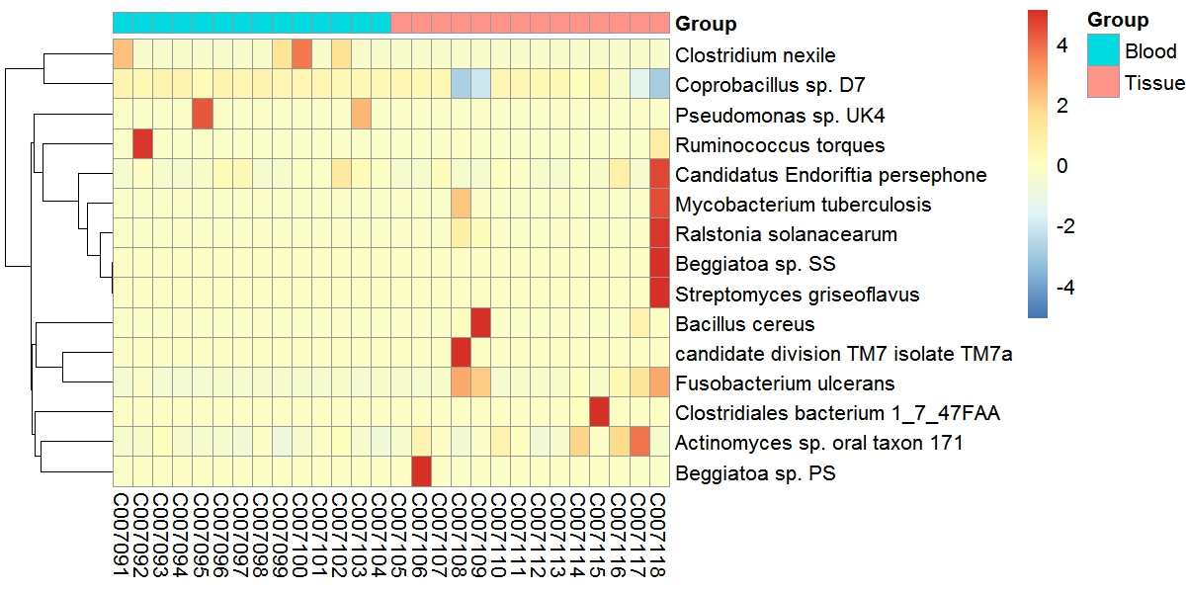
Detected microbes --- HMP, species level
(red star, P value<=0.05, Student t’s test )
*
Actinomyces sp. oral taxon 171 (Actinobacteria):
A species of actinomyces genus
Coprobacillus sp. D7 (Bacillaeota):
Isolated from an intestinal biopsy specimen taken from the transverse colon of a patient with active Crohn's disease.
Fusobacterium ulcerans (Fusobacteraeota):
Anaerobic Gram-negative, non-spore-forming rod that has been isolated from tropical ulcers ^{[1]}
*
*
Conclusion (4):
Fusobacterium ulcerans and Actinomyces were enriched in tumor tissues, while the abundance of coprobacillus sp.D7 was significantly decreased.
[1]. B. Adriaans, H. Shah. Fusobacterium ulcerans sp.nov. from tropical ulcers. Int J Syst Bacteriol, 38 (1988), pp. 447–448
Notes:
The next slide shows the HMP microbes in the species level. For the three species with differential abundance between the two groups, fusobacterium ulcerans was reported to be isolated from tropical ulcers.

Slide 40
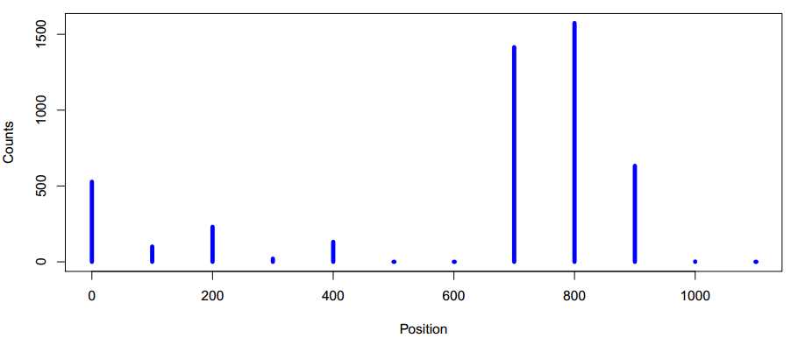
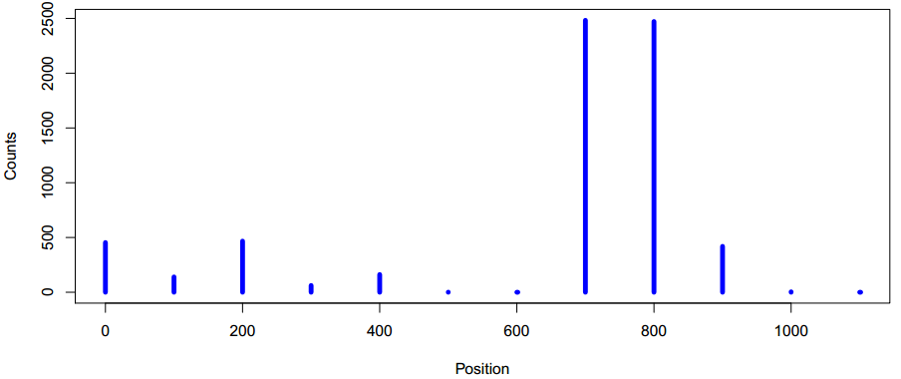
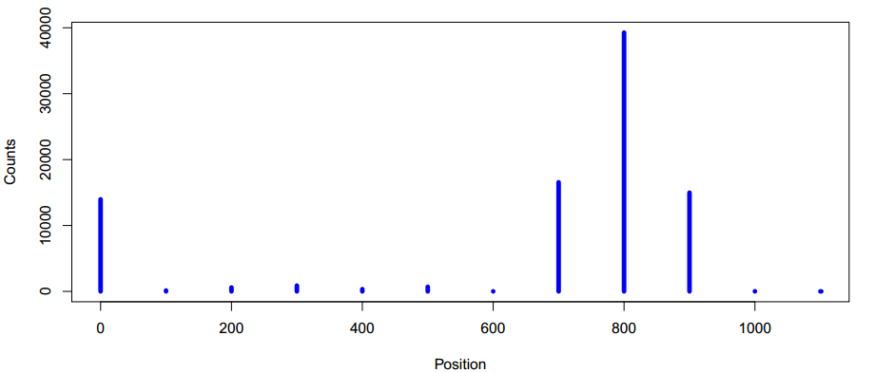
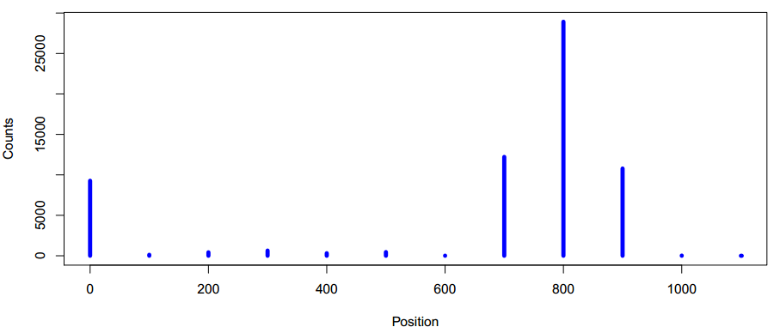
Example of detected microbe --- Fusobacterium ulcerans
C007095
C007105
C007108
C007118
Notes:
These plots shows the distribution of mapped reads on the fusobacterium ulcerans genome, suggesting the identification of this bacterium is of high confidence.

Slide 41
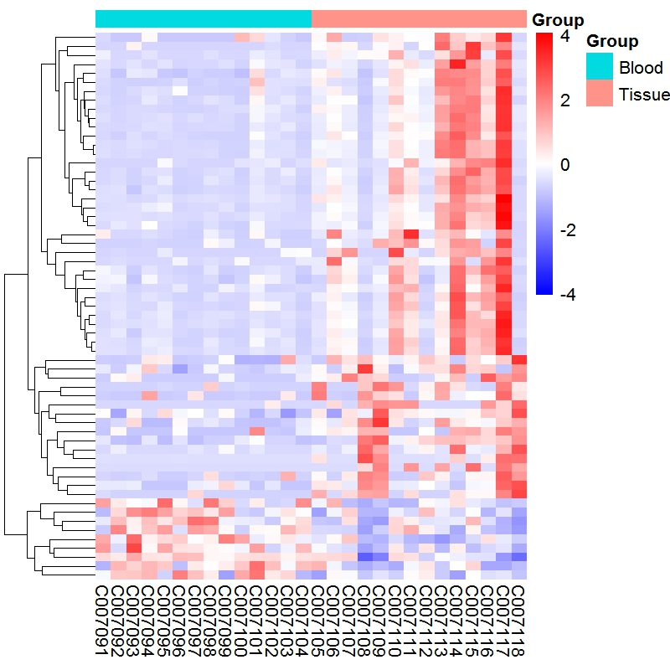
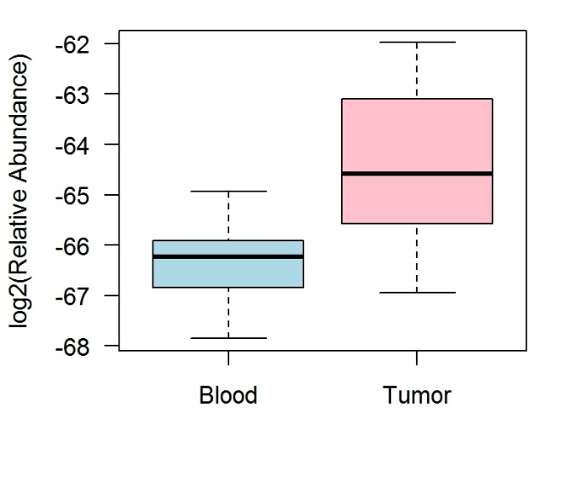
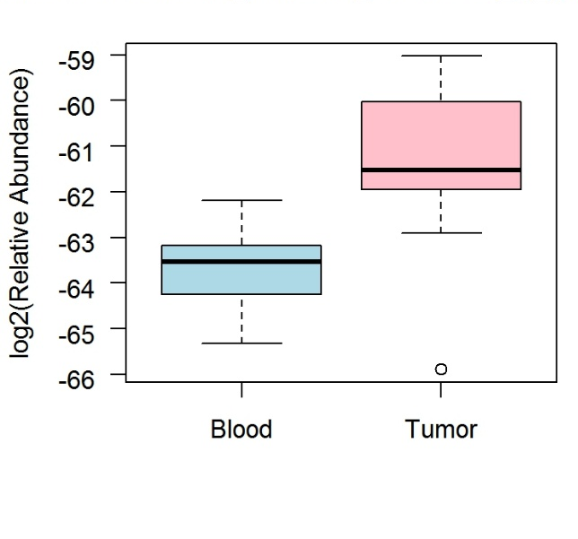
Detected genes --- IGC, gene level
Example of two genes with differential abundance involved in Lipid metabolism
63678604-stool2_revised_C1012054_1_gene45085
764669880-stool2_revised_C301794_1_gene68495
Conclusion (5):
61 genes were significantly different between the tissue and blood samples, the abundance of 2 genes involved in the Lipid Metabolism pathway were showed in the boxplot.
Differentially abundant genes with P value<=0.01 (Student t’s test)
Notes:
Totally we detected 61 genes with differential abundance between the tissue and blood samples. The heatmap on the left shows the relative abundance of each gene in the samples, the boxplot on the right are two examples of differential abundant genes involved in the lipid metabolism pathway.

Slide 42
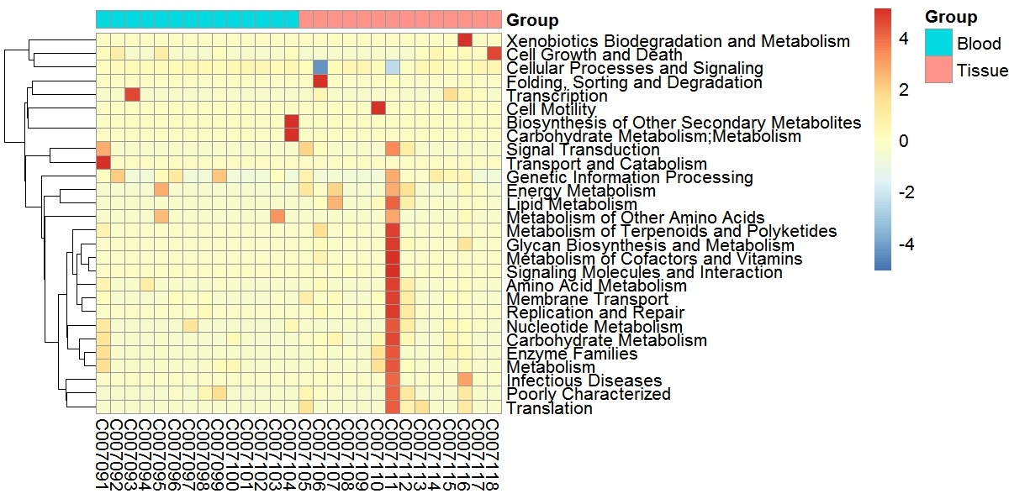
Detected genes --- IGC, KEGG level
Red star, P value<=0.05, (Student t’s test )
*
Genes involved in the Lipid metabolism were significantly more abundant in tumor tissue than the blood samples
Notes:
Reads could not be mapped to neither NCBI or HMP were then aligned to the IGC gene catologs. By aggregating the mapped genes to KEGG pathways, we found lipid metabolism was significantly enriched in the tumor tissues, the next plot shows the lipid metabolism pathway

Slide 43
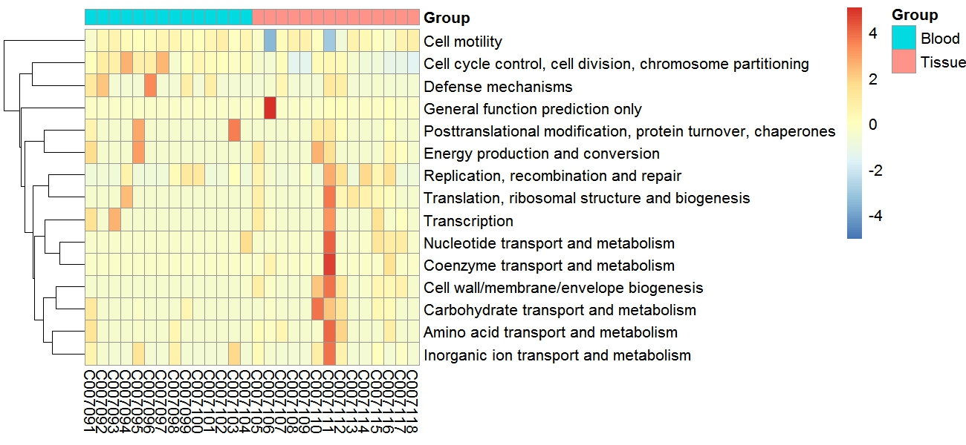
Detected genes --- IGC, eggNOG level
Red star, P value<=0.05, (Student t’s test )
*
Genes involved in the Cell cycle control and cell wall biogenesis had significantly different abundance in tumor tissue compared with the blood samples
*
Notes:
We also aggregate detected genes in the eggNOG (evolutionary genealogy of genes: Non-supervised Orthologous Groups) terms, the abundance of genes involved in the cell cycle control significantly decreased in the tumor tissues, while the function of cell wall biogenesis was enhanced.

Slide 44
De novo assembly and predicted genes
Non-redundant assembly gene catalogs: 79,716 genes (Length: 200 - 9,424bp)
Blood | unmapped reads | contigs |  |  | Predicted genes | Tissue | unmapped reads | contigs |  |  | Predicted genes
 |  | Total length (bp) | Range (bp) | N50 |  |  |  | Total length (bp) | Range(bp) | N50
C007091 | 8,100,559 | 751,563 | 202-9,424 | 805 | 1,882 | C007105 | 12,100,475 | 581,006 | 201-7,297 | 786 | 1,398
C007092 | 9,597,704 | 542,919 | 200-8,087 | 804 | 1,236 | C007106 | 8,677,008 | 611,059 | 200-6,959 | 865 | 1,374
C007093 | 8,482,176 | 588,670 | 200-9,424 | 805 | 1,382 | C007107 | 8,942,648 | 591,495 | 201-6,458 | 765 | 1,410
C007094 | 7,198,132 | 536,132 | 203-6,386 | 813 | 1,248 | C007108 | 15,440,460 | 2,391,338 | 200-6,870 | 431 | 18,110
C007095 | 7,706,127 | 1,064,931 | 201-6,453 | 434 | 4,336 | C007109 | 13,304,043 | 932,892 | 200-6,281 | 485 | 4,984
C007096 | 7,686,782 | 574,115 | 201-6,870 | 820 | 1,296 | C007110 | 10,160,513 | 575,432 | 201-6,410 | 863 | 1,232
C007097 | 5,491,692 | 558,463 | 202-6,955 | 819 | 1,256 | C007111 | 9,124,508 | 558,897 | 200-6,274 | 849 | 1,240
C007098 | 8,092,936 | 513,083 | 205-6,305 | 814 | 1,194 | C007112 | 12,309,868 | 536,285 | 200-6,941 | 826 | 1,264
C007099 | 17,794,387 | 893,735 | 200-5,165 | 453 | 3,550 | C007113 | 14,541,702 | 493,376 | 200-6,357 | 805 | 1,134
C007100 | 8,701,188 | 473,640 | 201-6,983 | 761 | 1,148 | C007114 | 13,762,510 | 478,803 | 200-5,414 | 767 | 1,140
C007101 | 13,118,721 | 480,496 | 201-6,263 | 796 | 1,132 | C007115 | 20,570,511 | 505,972 | 202-7,293 | 780 | 1,214
C007102 | 12,340,046 | 484,032 | 201-6,973 | 869 | 1,136 | C007116 | 14,438,577 | 530,847 | 201-9,088 | 792 | 1,338
C007103 | 7,486,105 | 540,330 | 200-9,095 | 750 | 1,412 | C007117 | 16,637,564 | 668,279 | 200-6,274 | 578 | 2,700
C007104 | 10,399,546 | 495,365 | 201-6,296 | 803 | 1,234 | C007118 | 16,086,108 | 2,313,538 | 200-5,996 | 438 | 17,736
Conclusion (6):
De novo assembly may reveal some new microbial genes.
Notes:
This table shows the de-novo assembly results of each sample, we finally assembled a non-redundant gene catalog of ~80 thousand genes, with gene lengths from 200bp to more than 9 thousand. We will blast the IGC and assembly genes with NCBI non-redundant protein databases for taxonomy annotation and combine our analysis results

Slide 45
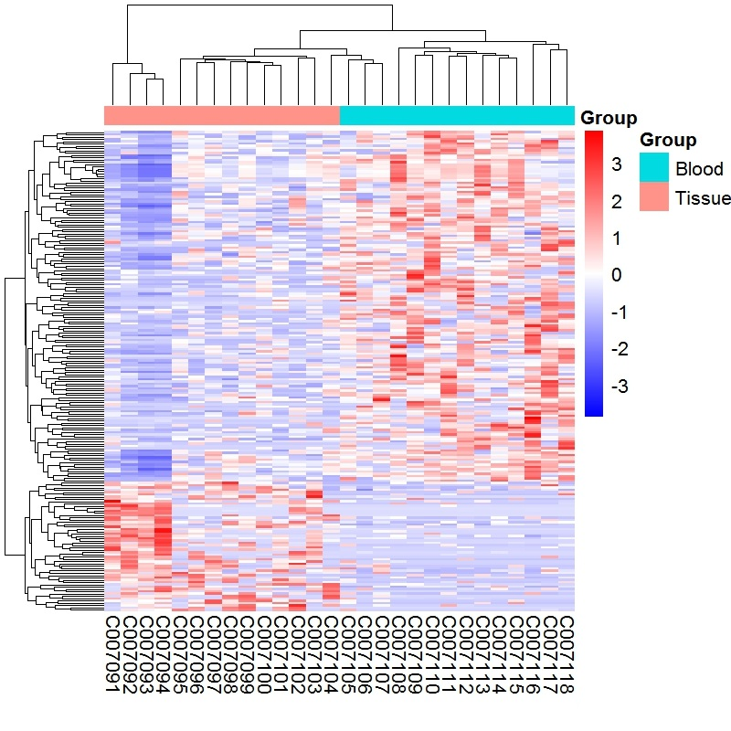
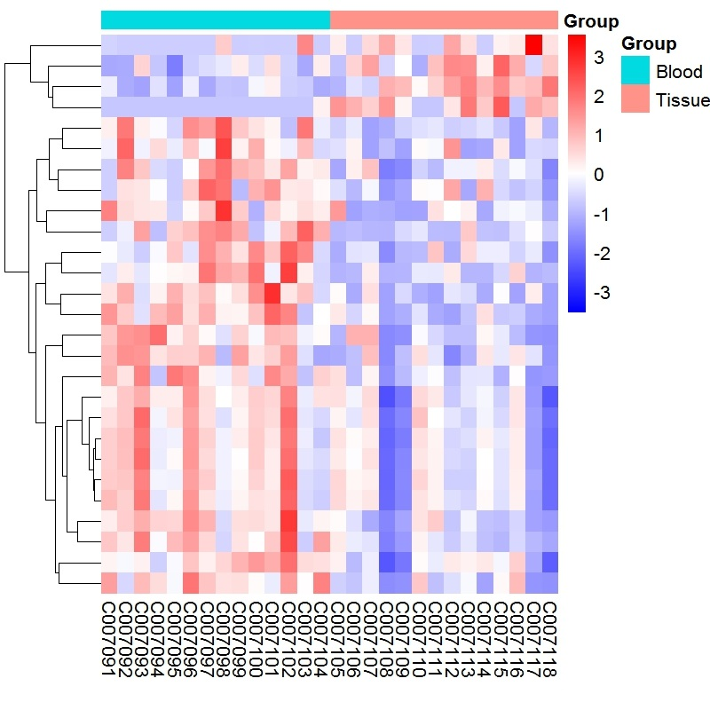
Detected genes --- de novo assembly
27 differentially abundant genes with FDR <=0.05
218 differentially abundant genes with P value<=0.01 (Student t’s test)
Notes:
By aligning the reads not mapped to any of the 3 known databases to the assembly gene catalog, we found 218 genes with significantly differential abundance between the two groups, and 27 out of them are identified with FDR <= 0.05.

Slide 46
Conclusion
The number of non-human reads is more in tumor tissues compared to the matched blood
Reads mapped to microbiome sequences are significantly higher in tumor tissues compared with paired blood samples
Archaea was the most abundant type of microbes in our samples, and significantly more in tumor tissues compared with the matched blood, while bacteria demonstrated the opposite result
The microbial species detected in our samples were mostly reported to be associated with human diseases, which validates the accuracy and biological significance of our method
We also found differentially abundant genes associated specific functions between tumor tissues and the matched blood

Slide 47
Future Work
CPDR WGS data
Blast the IGC and assembly genes with NCBI non-redundant protein databases for taxonomy annotation
Combine the results from multiple databases
Improve the procedures of microbes identification workflow
Microbiome of more prostate cancer samples
Microbiome profile in Chinese prostate cancer patients
Compare target sequencing with WGS
Experiment | Tissue sample
WGS | 10 matched tumor and normal pairs
Target sequencing (design specific sequences for microbes) | 100 tumors
Notes:
We found differential abundant genes in the last two databases, but we had no idea which microbe they belong. So the next step was to blast the genes with the NCBI non-redundant protein catalog for taxonomy annotation（这个工作要与张国庆好好合作）. Next, we will find a way to combine the results from multiple databases. In-depth analysis were needed to explain the results of species or genes with differential abundance （这里的abundance，既有相对的，又有绝对的） between tumor and normal tissues. We will also compare the microbial profiles between different populations（要找到profile的规律，需要比较多的样本量，以及很好的背景信息）. And more WGS samples are needed to validate our procedures.

Slide 48
Thanks for your attention!

