Slide 1
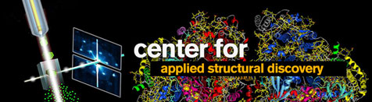
Compact Source of Intense X-rays for Biomedical Applications
W.S. Graves
Arizona State University

Slide 2
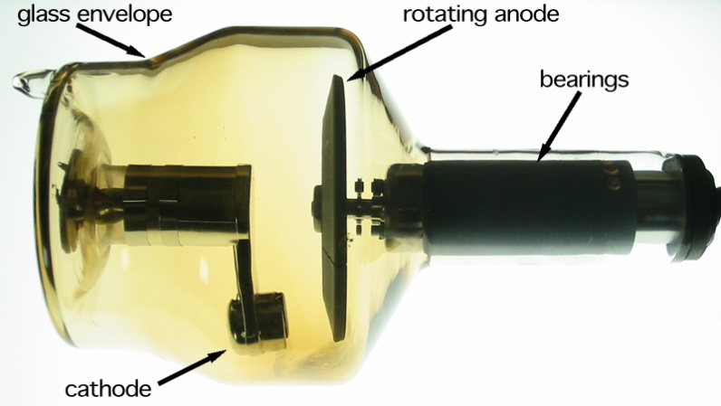
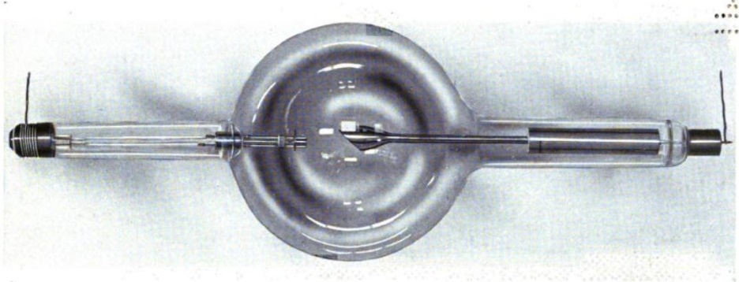
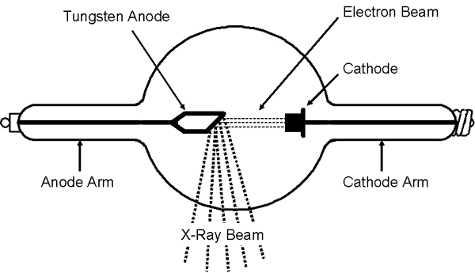
From Rontgen’s tube to today’s best laboratory-scale sources
X-ray tube from 1917
X-ray tube today
Tubes are primitive low energy (0.1 MeV) electron accelerators
Flux of 5 X 10⁹ photons/sec
Brilliance* of 10⁹
Factor of ~100 better than 100 years ago
*Brilliance is in units
photons/(sec mm² mrad² 0.1%)
X-ray flux of 10⁷ photons/sec from source of few mm² and large opening angle

Slide 3
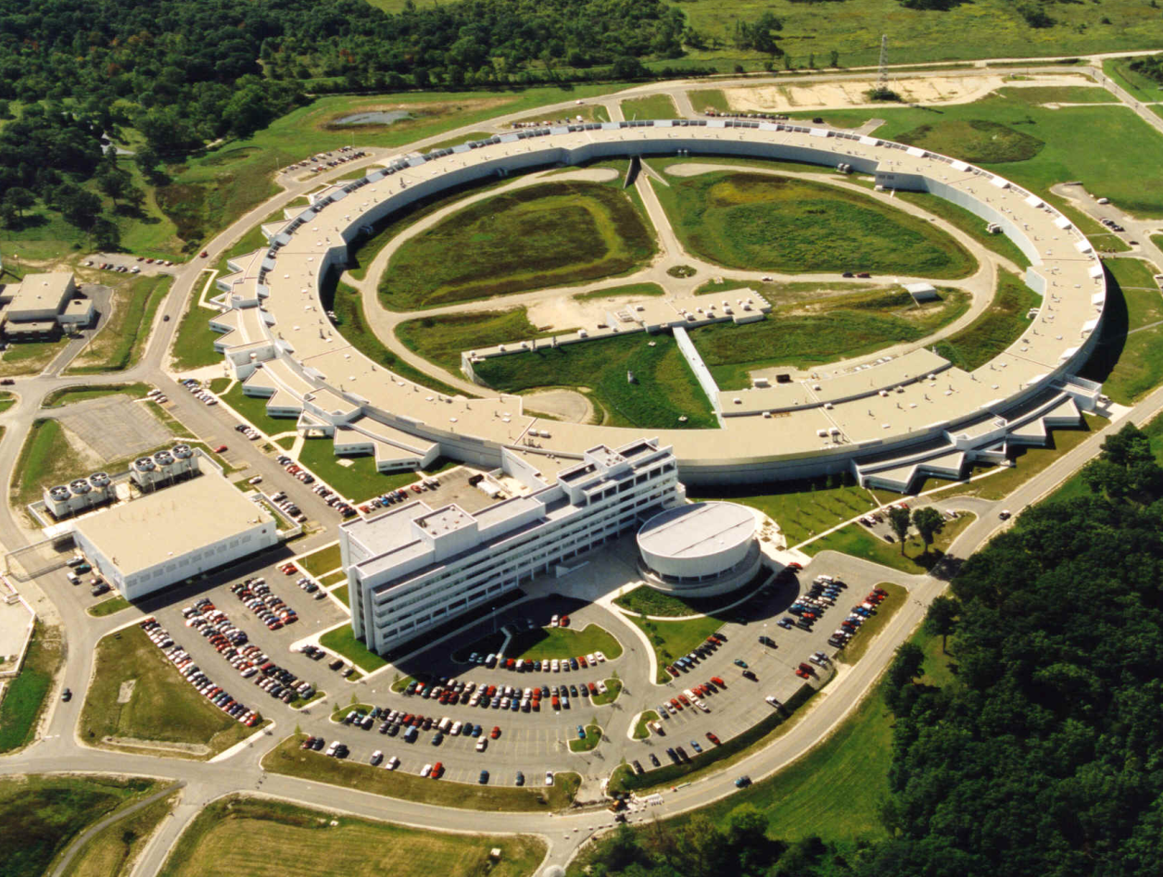
Particle accelerators in the 20th century
Synchrotron radiation from relativistic beams first developed around 1960 and is now mature 50 years later
X-ray flux of 10¹⁵ photons/sec into a 50 X 50 micron spot
X-ray brilliance of 10²¹ photons/(sec mm² mrad² 0.1%)
Roughly a trillion times brighter than a laboratory source!
kilometers in size
$1 billion in cost
7,000 MeV electron energy
1000’s of users
Advanced Photon Source (APS) at Argonne Nat’l Lab

Slide 4
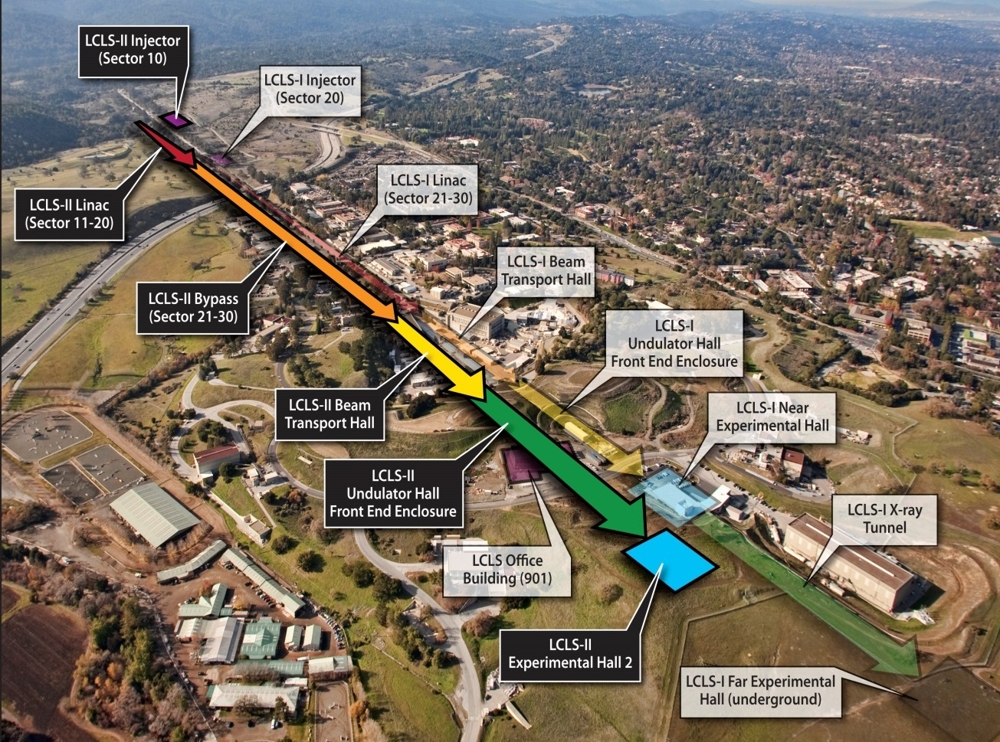
X-ray Free Electron Laser (XFEL)
Linac Coherent Light Source (LCLS) at Stanford
X-ray bursts of 10¹² photons in 100 fs
Peak x-ray brilliance of 10³³ photons/(sec mm² mrad² 0.1%)
Transverse coherence (not yet temporally coherent)
kilometers in size
$1 billion in cost
14,000 MeV electron energy
100’s of users

Slide 5
Radiation from an undulator
Source size
Δx, Δy
Source Divergence
Δθ_{x} , Δθ_{y}

Slide 6
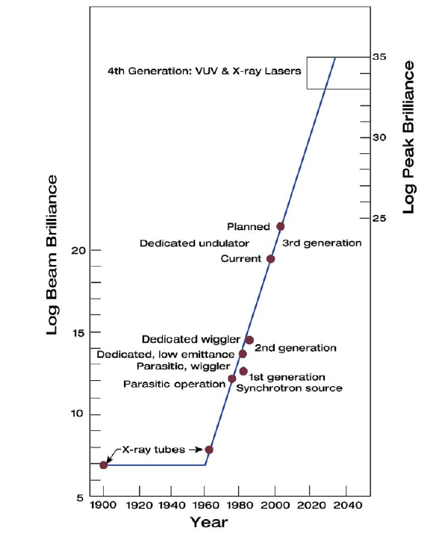
Generational advances in beam brilliance
XFELs
Coherent
Emission
CXFEL
Synchrotron Radiation
CXLS
Relativity
X-ray Tubes

Slide 7
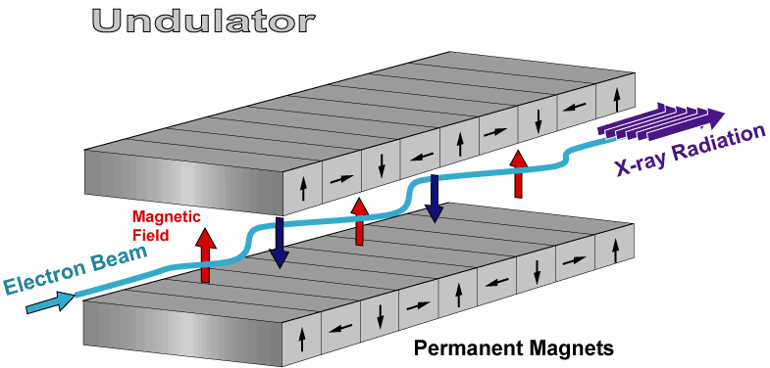
How to make a compact source?
Undulator Radiation
Laser wavelength is 10,000X shorter than undulator period
Electron energy is 100X lower for same x-rays
Facility size and cost is 100X lower ($1B -> $10M)
Inverse Compton Scattering
Laser field
X-ray radiation
Electron beam

Slide 8
Basic Layout for ICS
Laser amplifier
Detector
RF gun
Quads
1 meter long linac
ICS
Dipole
Sample
X-ray optic
Laser cavity
Electron dump
~4 m

Slide 9
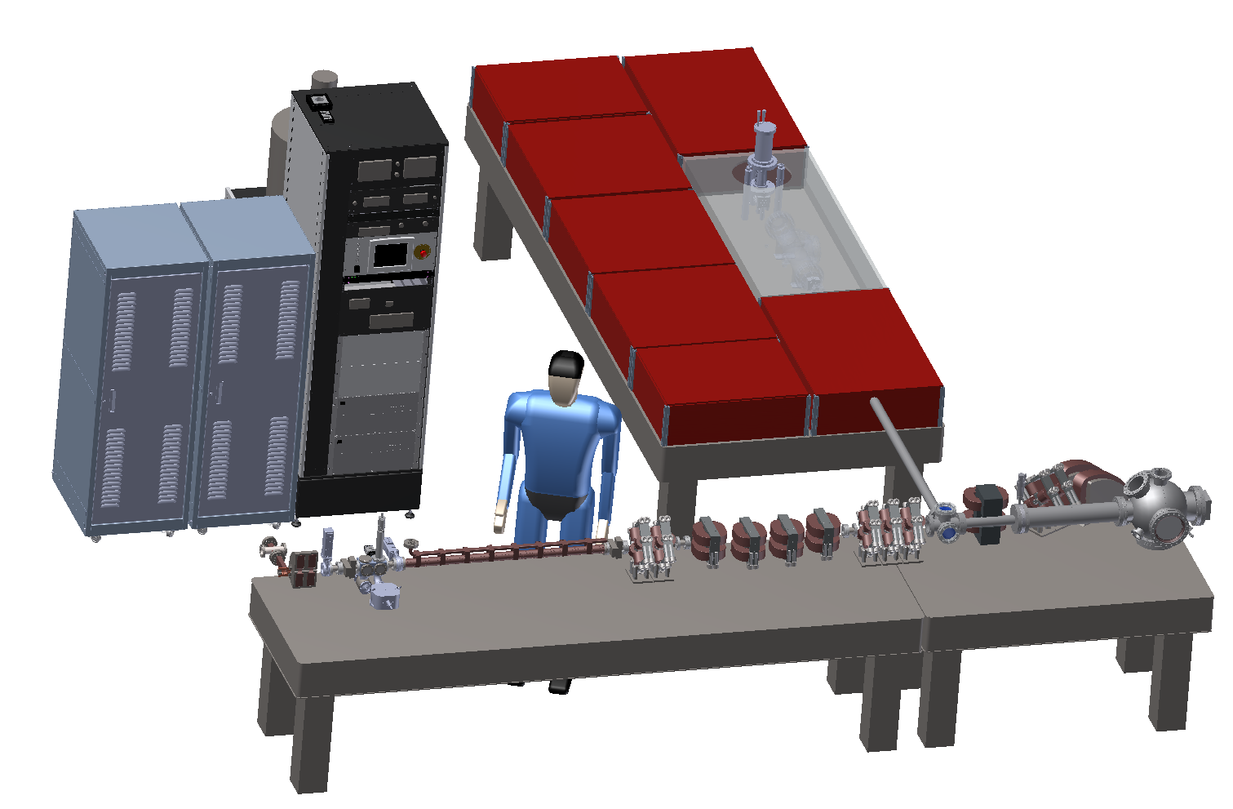
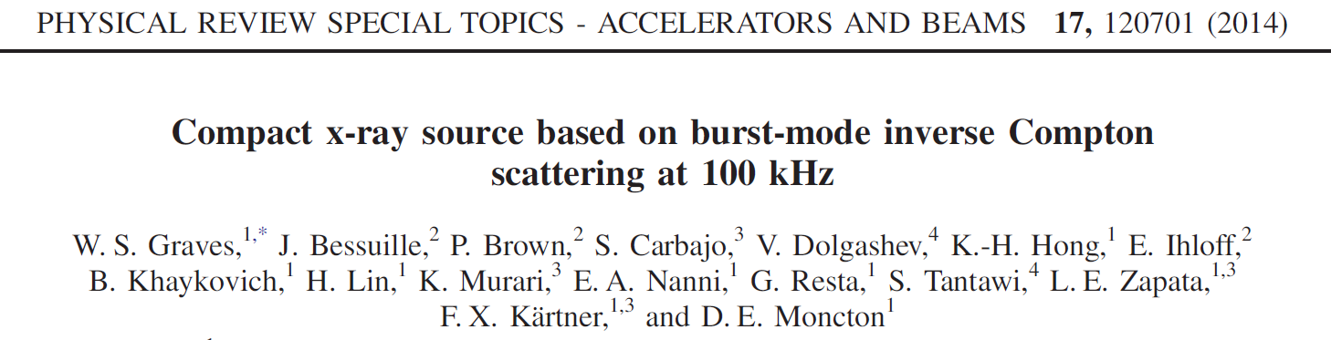
Compact X-ray Light Source (CXLS)
Oscillator
Yb:YAG regen
Yb:KYW amp #1
Yb:KYW amp #2
Cryo Yb:YAG
Yb:KYW compressor
Yb:YAG compressor
UV for cathode
Power supplies for magnets, UHV equipment, lasers
RF transmitter
Beam dump
Interaction area for ICS
X-ray experiments
Linac
Chicane
RF gun

Slide 10
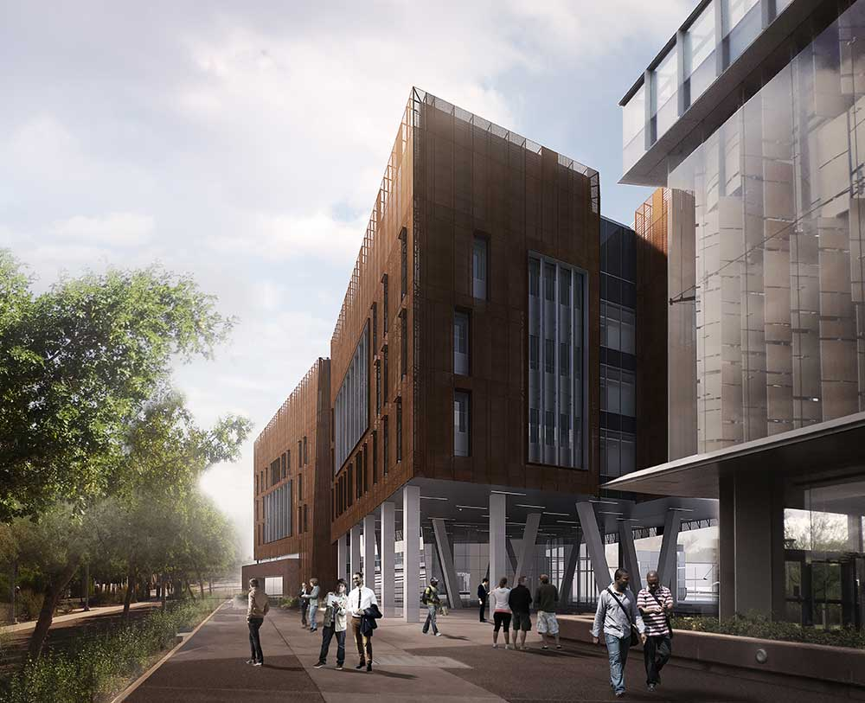
Biodesign C Project Schedule
Now – Q2 2018 Biodesign C construction
Now – Q3 2017 Equipment assembly at MIT
Q4 2017 Demonstration x-ray experiments
Q2 2018 X-ray program at ASU

Slide 11
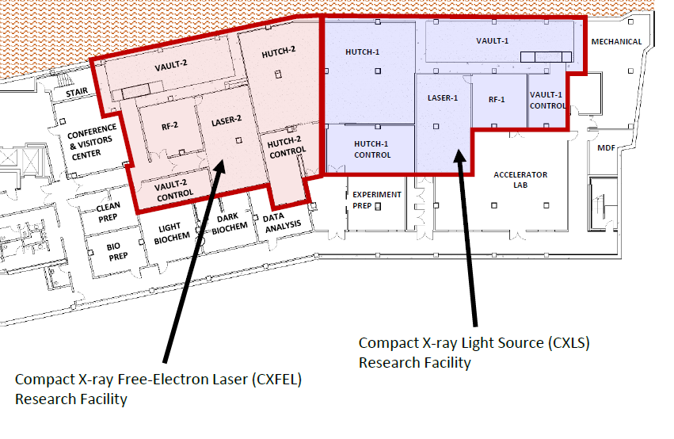
CXLS/CXFEL Laboratories
Biodesign C Building Basement

Slide 12
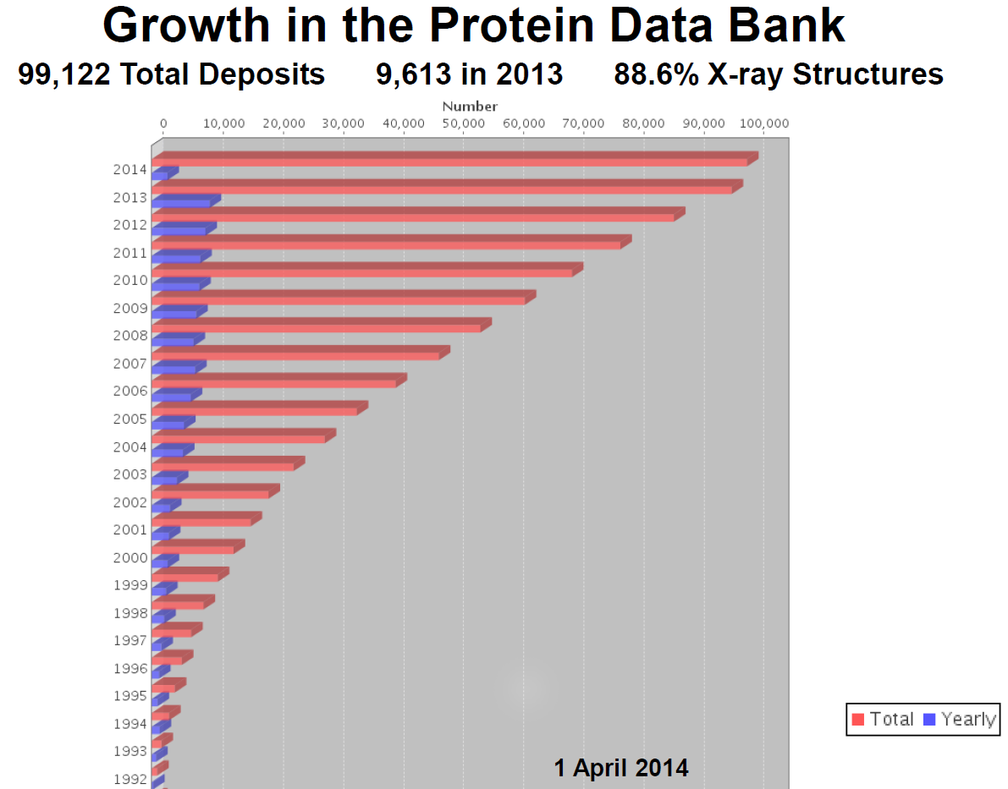
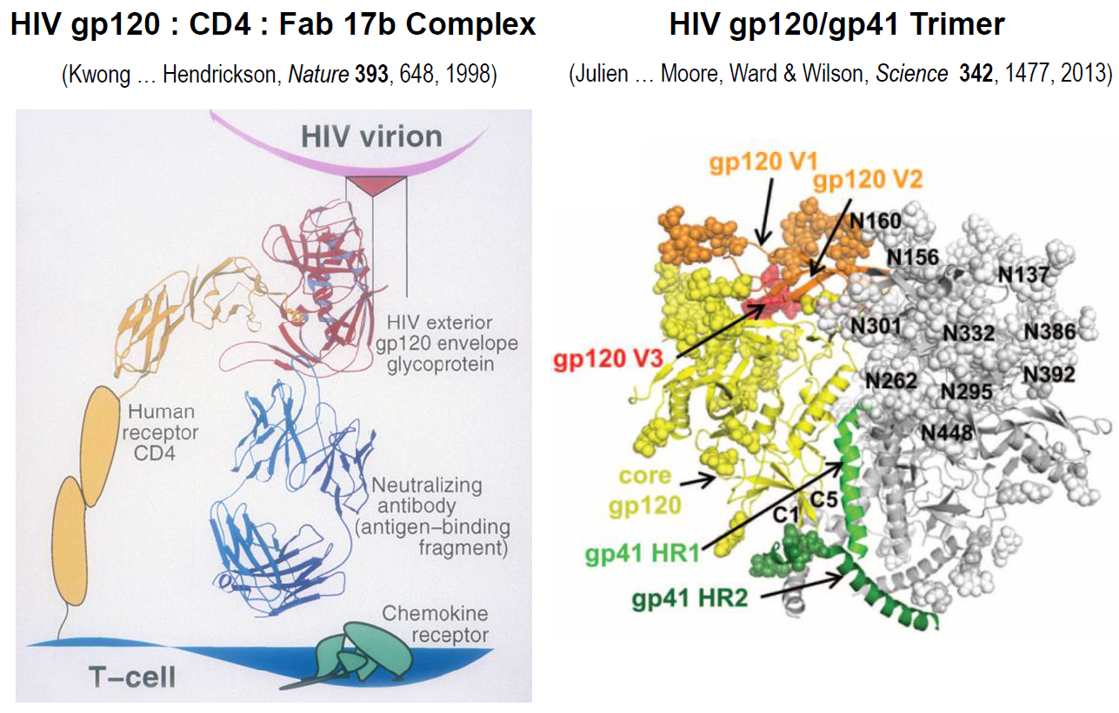
High brilliance is needed for modern x-ray science
Complex structures and small crystals require high brilliance x-rays
Modern methods require tunable, monochromatic radiation
Courtesy of W. Hendrickson, Columbia U.

Slide 13
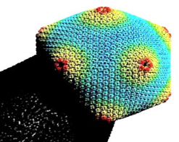
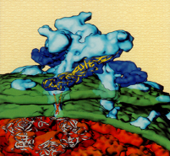
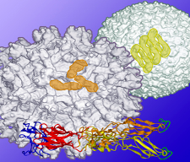
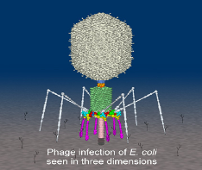

Structure of Pathogens
Virus Protein Science at the MIT STC
-M. Rossmann, Biological Sciences
Conduct structure determinations of proteins associated with viruses, and viral complexes with antibodies and antiviral agents. Extend current research efforts into
bacteriophages
animal RNA viruses
large ds DNA viruses
virus-membrane interactions
Virus Protein Science at Purdue
- Michael Rossman
ds viruses
Alpha viruses
Flaviviruses
Bacteriophages
Notes:
13
Fonts
Font used in Title is Helvetica Bold 100 pt.
Font used on Presenters is Helvetica 54 pt.
Font Sizes for body text should be no smaller than 14 pt. And no larger than 24
Secondary Tiles should be sized larger than body text by at least 10 pts.
Note:
Not all computers have the same fonts. When designing your poster please keep this in mind. Common fonts that are easily found on the majority of machines will be
Helvetica
Times
Times Roman
Arial
Verdana
Symbol
Georgia
Impact
Courier
Book Antiqua
Using one of these fonts will save you time and headaches down the road.
2. When working with text from Word. Do not simply drag the text from Word into Powerpoint creating a “Text Box”. It makes it to hard to adjust the size and position in your poster. Also numerous errors such as spacing between words, character switching and formating errors can occur. When ever possible create the text using the Powerpoint text tool. This will eliminate many of the text problems occurring in printing. One other way would be to select the text in word, copy, then “paste it into Powerpoint.
3. Accenting Text can be bone with color, It is best to keep the title in black.
Graphics
Note:
1. For printing purposes images should be no smaller than 250dpi. Do Not use images that you have taken off the web! These images are 72 dpi and are absolutely no use for printing. Tif files seem to work the best. Images can be converted through Photoshop and various other programs. If creating images in a scientific application make sure you can export the file as a Tif. Excel files can also be used in Powerpoint
2. Colored Backgrounds are nice but are not needed. Plain white is best for presenting your material. Colored Backgrounds waste too much of the ink on the printer, and if it is a complicated color can cause banding or streaking . Color should be used in graphs, charts, images, and text.
3. In the lower right corner is the Purdue Logo. This is the official logo of the University. And Should be displayed accordingly with the co-branding identity of the Department of Biological Sciences underneath.
The co-branded school or department name appears no taller than one-half the height of the small caps in the word “Purdue” and no shorter than the font size in
the word “university” in the Purdue signature. Co-branded school or department name aligns right or left with the Purdue signature.
( officially Frutiger is the font suppose to be used as the dept. name however it is not that common on all computers if you do have this Font you can use it instead of Verdana which is found in this Template.)
4. Try putting a lined border around graphs and images to keep them from appearing like they are floating. The line tool has many options and widths. Keep it simple, the single lines work the best.
5. There is a black line bordering the poster area. For poster printing purposes all material should be set within this border.
If you do not wish to have a border around the edge when the poster is printed, simply select and delete after you have the final layout complete.
Layout
Notes:
There are many different ways to lay out your material. One suggested method is to separate information into different columns. Columns shouldn’t be much wider than 8.5 inches. Wider columns tend to be harder to read when presenting a lot of material. At 8.5 inches wide per column 4 columns across would give you nice spacing between each one and make it easy to read. Whatever your column width, try to keep it consistent through out the poster

Slide 14
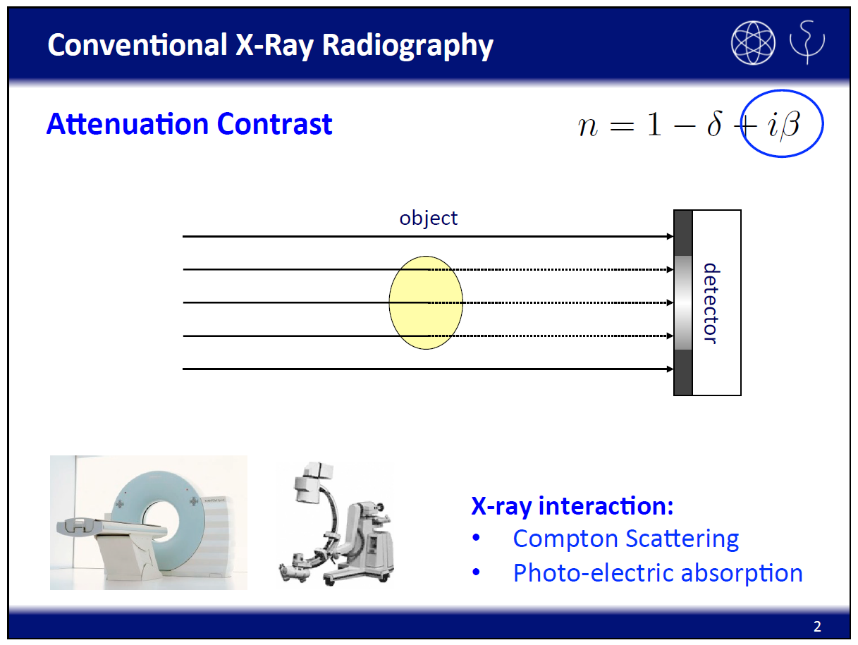
Courtesy of F. Pfeiffer, TU-Munich

Slide 15
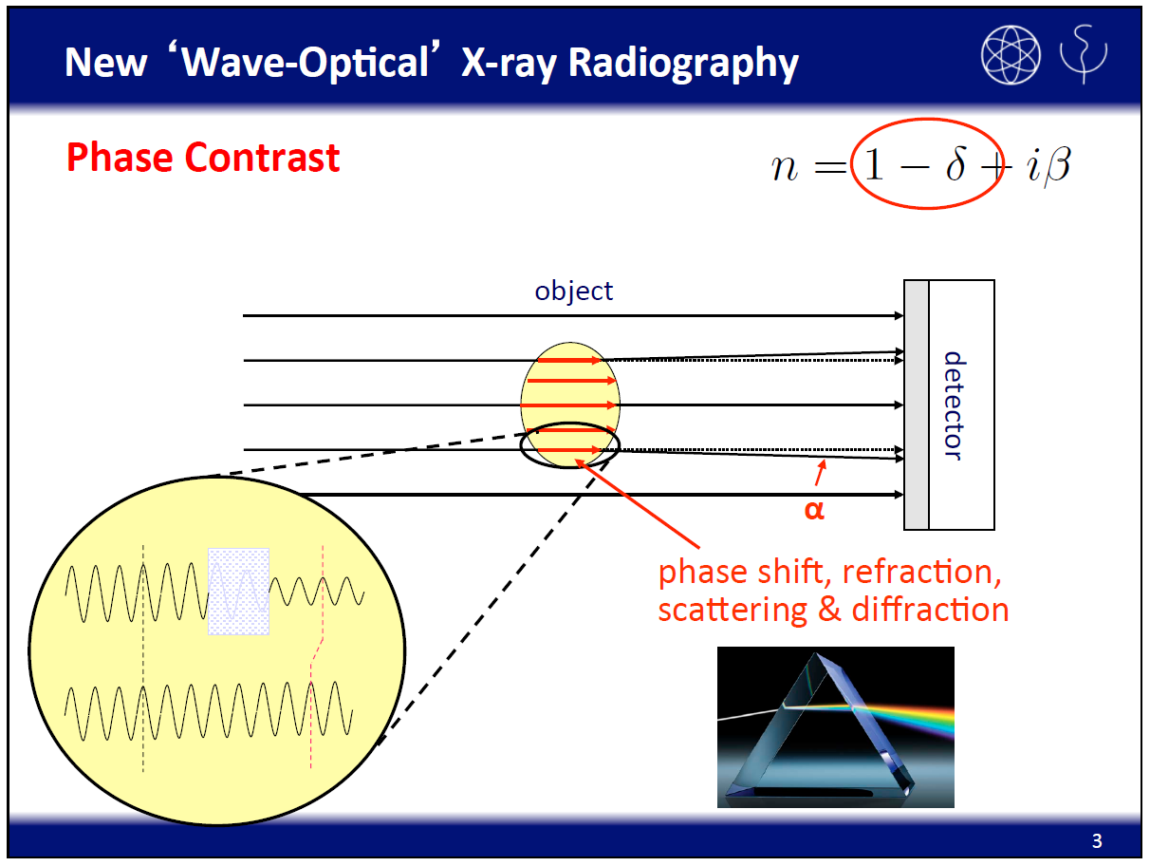
Courtesy of F. Pfeiffer, TU-Munich

Slide 16
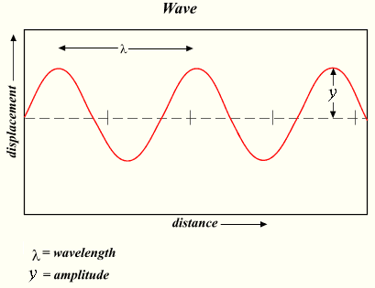
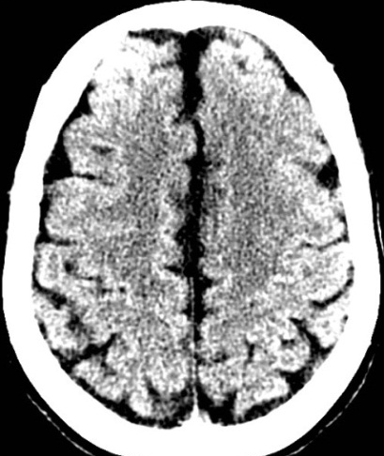
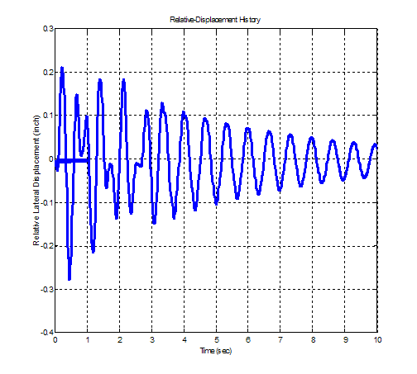
What is Phase Contrast Imaging?
Object
X-rays Wave: Amplitude, frequency, and phase

Slide 17
Contrast Mechanisms
Complex refractive index:
η = 1 − δ + iβ
Attenuation:
Depends on β
Path length
Photoelectric effect
Compton scattering
Depends on Z
Phase change:
Depends on δ
Path length
Depends on Electron Density

Slide 18
Magnitude of Attenuation and Phase Contrasts
Material | µ (cm⁻¹) at 60keV | Φ (cm⁻¹) at 60keV | Ratio
H2O | 0.2061 | 195.5 | 949
dH2O | 0.2267 | 215.1 | 949
Ethenol | 0.1582 | 156.6 | 990
Glycerin | 0.2477 | 140.7 | 568
Fat | 0.1793 | 180.7 | 1008
Liver | 0.2174 | 205.2 | 944
Sources:
ICRP (1975)
Woodard and White (1986)

Slide 19
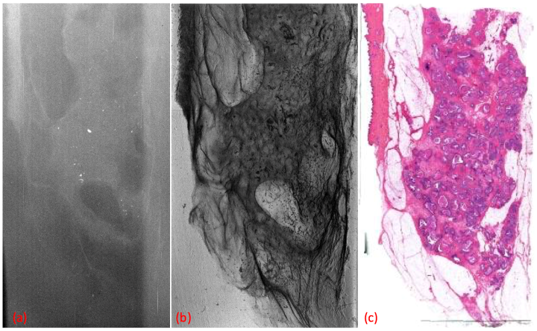
Ductal Carcinoma in-situ
Attenuation Contrast
Phase Contrast
Histology
The phase image not only improves contrast, it also shows the localized nature of the cancer which is amenable to surgical resection
Courtesy of C. McCollough, Mayo Clinic

Slide 20
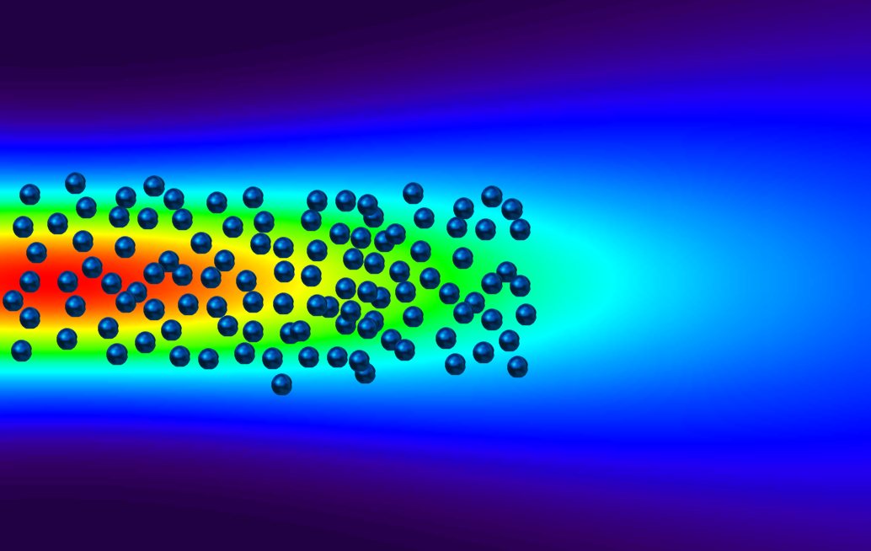
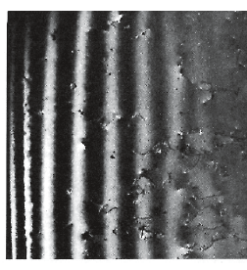
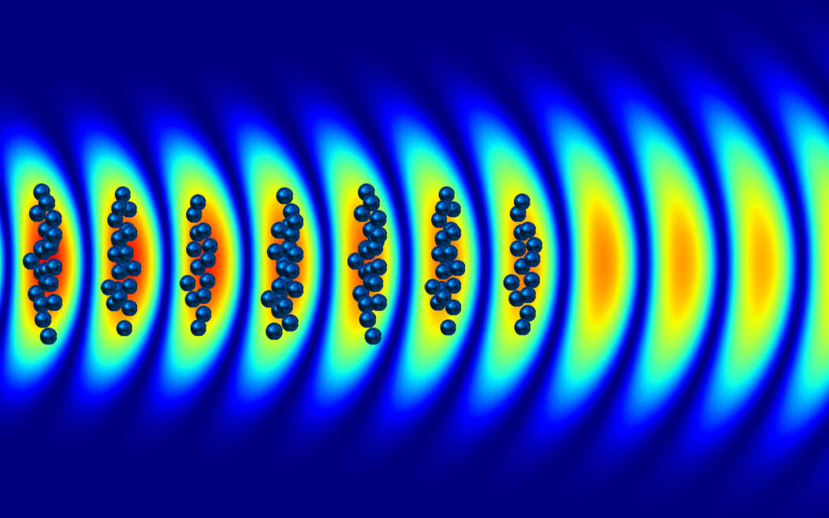
Coherent x-rays require coherent electron bunching
λ_{x}
Random electron positioning for
Undulator radiation with GeV electrons or
Inverse Compton Scattering with MeV electrons
βc
Pendellosung fringes: electron diffraction varies periodically with wedge thickness
λ_{x}
Coherently bunched electrons for
XFEL radiation (GeV electrons) or
Coherent ICS, compact CXFEL (MeV electrons)

Slide 21
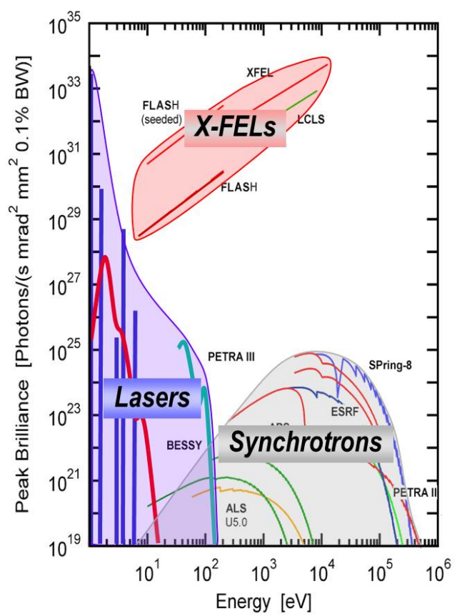
Brilliance of Light Sources
ASU CXFEL

Slide 22
Summary
ASU is building an intense x-ray source on campus in the basement of the new Biodesign C
Experiments start within 1 year
Synchrotron-like beam properties enable major advances in x-ray imaging using phase contrast methods
Plans are underway to upgrade the source to an x-ray laser
The new x-ray source enables a wide range of scientific and medical applications currently only possible at giant national lab facilities

