Slide 1
Ex Vivo Protein Oxidation as a Metric of Plasma/Serum Integrity
Chad R. Borges
Assistant Professor
School of Molecular Sciences
The Biodesign Institute – Center for Personalized Diagnostics

Slide 2
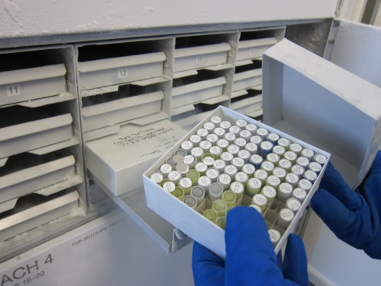
Quality Control in Biomarker Development
Background
The risk involved in biomarker discovery is often considered too high to justify opening a clinical study to collect new specimens just for “discovery” work
How can “biomarker discovery” researchers be certain that their “discoveries” represent real biology and don’t arise from pre-analytical variables?
Clinical biospecimens are precious and often archived indefinitely
Archived specimens are commonly used for “discovery” studies
Pre-analytical variables can dramatically impact nature and quantity of biomolecules
freezerworks.com
Notes:
4. Define PAVS
5. BP4 Raises the question… “How can…?”

Slide 3
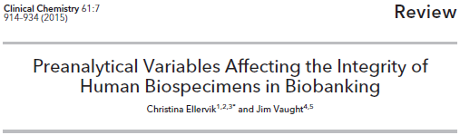
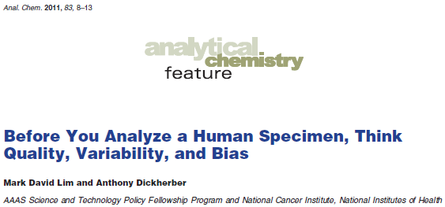
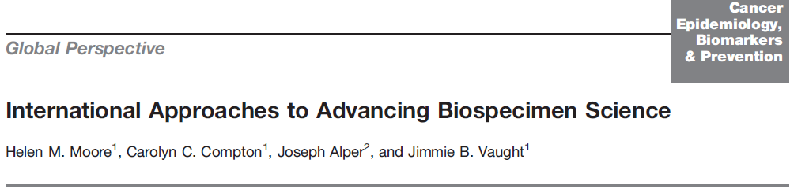
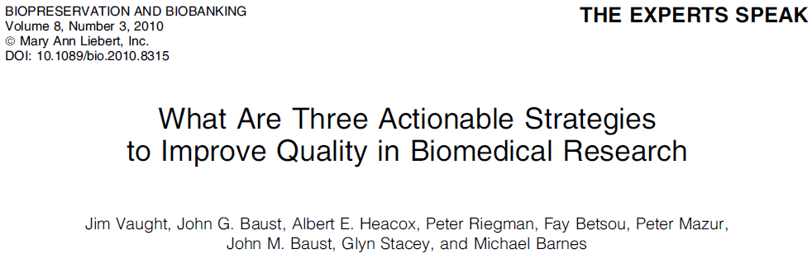
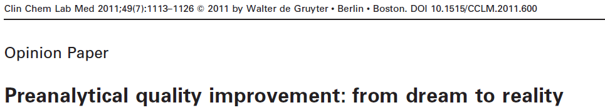
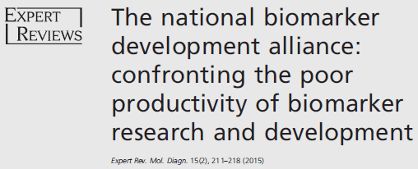
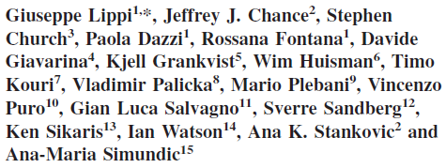
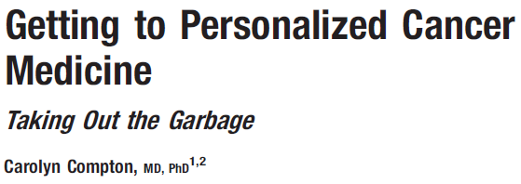

Quality Control in Biomarker Development
Flashy Science? No… Important? Absolutely!...
… Because Garbage In = Garbage Out

Slide 4
Quality Control in Biomarker Development
Journals that Now Require Documentation of Biospecimen Handling Conditions in Manuscript Submissions
Clinical Chemistry
Clinical Chemistry & Laboratory Medicine
Transfusion
American Journal of Hematology
Annals of Clinical Biochemisty
Clinica Chimica Acta
Clinical Biochemistry

Slide 5
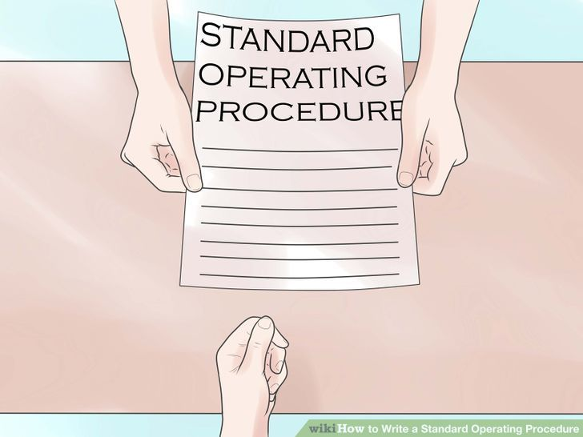
Quality Control in Biomarker Development
NIH-Sponsored Research
In 2014, of 455 NCI-sponsored grants, 287 relied on the use of pre-existing biospecimens ¹
No empirical, objective QA criteria/thresholds exist for establishing the integrity of pre-existing samples employed in NCI-sponsored research.
Best Practice: Use samples collected under good SOPs and by experienced PIs…
… Is that good enough?!
1. Carrick DM, et al. Biopreserv Biobank 2014, 12(4):240-245.
Notes:
St: How is this problem handled in the context of NIH-sponsored research?

Slide 6
What Can Go Wrong Prior to Analysis?
Pre-Analytical Variables (PAVs) for Blood Plasma/Serum
Type of blood collection tube
Extravascular hemolysis resulting from poor phlebotomy technique(s)
Improper tube filling
Improper number of tube inversions post-fill
Pre-centrifugation delay
Post-centrifugation delay
Improper storage temperature (> -30 °C)
But -20 °C lab freezers are common
Plasma/serum appears frozen at -20 °C
Freeze-thaw cycles
Exposure to the thawed state (> -30 °C ) for any reason
Collection at a site that lacks a -80 °C freezer or liquid nitrogen storage
-80 °C freezer failure
Delays in shipment & loss of dry ice
Need to re-aliquot samples
Most difficult PAV to control & track over the life of a specimen
Notes:
E1: Doctor’s office or other community site
E4: At the site of analysis or to squeeze in unplanned analyses

Slide 7
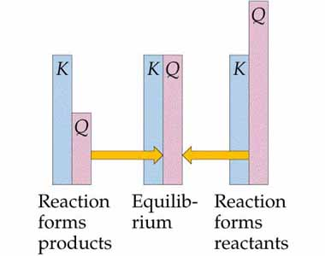
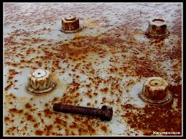
What Happens to Plasma/Serum (P/S) in the Thawed State?
In vivo, many chemical systems within P/S are not at chemical equilibrium
Ex vivo, P/S [O_{2 (aq)}] ≈ 0.25 mM. (In vivo, [O_{2 (aq)}] in P/S is negligible.)
Added enzyme inhibitors & heat-denaturation cannot stop ex vivo oxidation
wps.prenhall.com
deviantart.com
Notes:
E. Is eliminating O2 an option…. Probably not

Slide 8
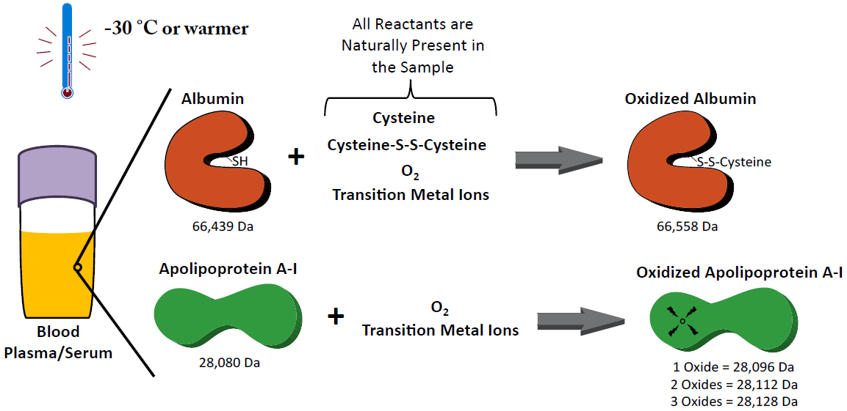
Ex Vivo Protein Oxidation of Two Highly Abundant Plasma/Serum Proteins
Borges CR, Rehder DS, Jensen S, Schaab MR, Sherma ND, Yassine H, Nikolova B, Breburda C: Elevated Plasma Albumin and Apolipoprotein A-I Oxidation under Suboptimal Specimen Storage Conditions. Molecular & cellular proteomics, 13(7):1890-1899, 2014.
Notes:
St. So how does Ex Vivo oxidation impact the biomolecules in P/S samples?... Probably many 1000s of still-undocumented ways, but I can tell you that when we take 0.5 uL of P/S & dil 1000x and inject it onto an LC/MS the TWO proteins that we most readily observe exhibit susceptibility to ex vivo oxidation.

Slide 9
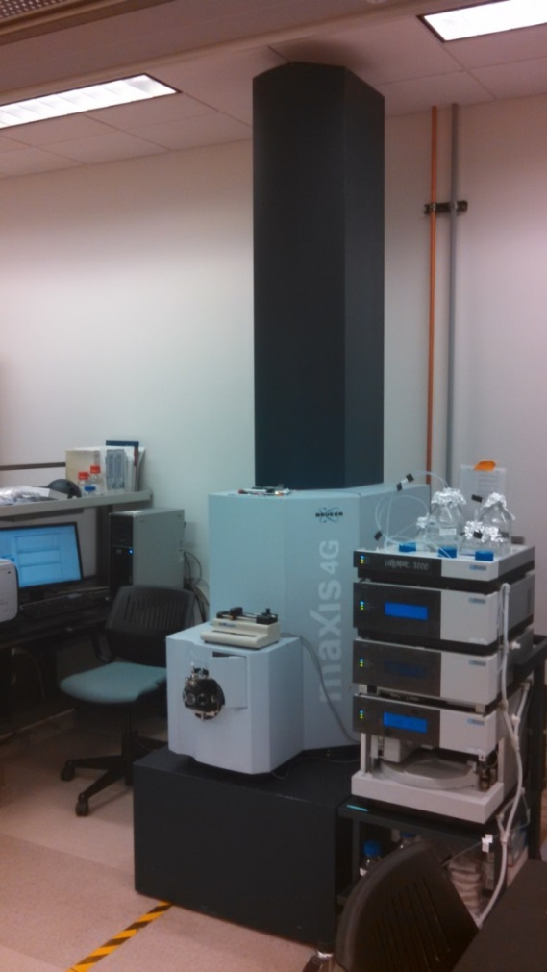

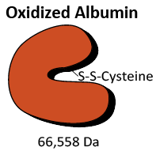
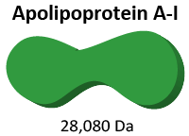
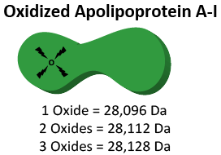
Method for Measuring Protein Oxidation
Dilute 0.5 µL whole plasma/serum 1000x in 0.1% TFA
Inject onto a Trap-and-Elute LC-MS System with Electrospray Ionization (ESI) and Time-of-Flight (TOF) Mass Analysis
Notes:
E. Proteins are analyzed intact by LC-ESI-MS; there are some technical reasons why we use ESI rather than MALDI here but I can explain later…

Slide 10
‘Dilute & Shoot’ Raw ESI Mass Spectra
Averaged Spectra from 4.84-5.89 min
Averaged Spectra from 5.89-6.30 min
Apolipoprotein A-I
Albumin
Albumin
Intens.
Intens.
x10
4
5000
1.5
4000
1.0
3000
2000
0.5
1000
0.0
1000
1250
1500
1750
2000
2250
m/z
0
800
1000
1200
1400
1600
1800
2000
m/z
+65
+30
+38
+27
Increasing Charge State
Increasing Charge State
Apply charge deconvolution signal processing algorithm
Apply charge deconvolution signal processing algorithm
Notes:
Both spectra from LTS Time 0_1-f,1_03_4407.d

Slide 11
After charge deconvolution signal processing algorithm
After charge deconvolution signal processing algorithm
Albumin
Apolipoprotein A-I
100
66439 (Unmodified)
28080
(Unmodified)
Relative Abundance
Relative Abundance
- D from N-terminus
66558 (S-Cysteinylated)
- DA from N-terminus
Glycated
66200
66400
66600
66800
Da
28000
28025
28050
28075
28100
28125
28150
28175
Da

Slide 12
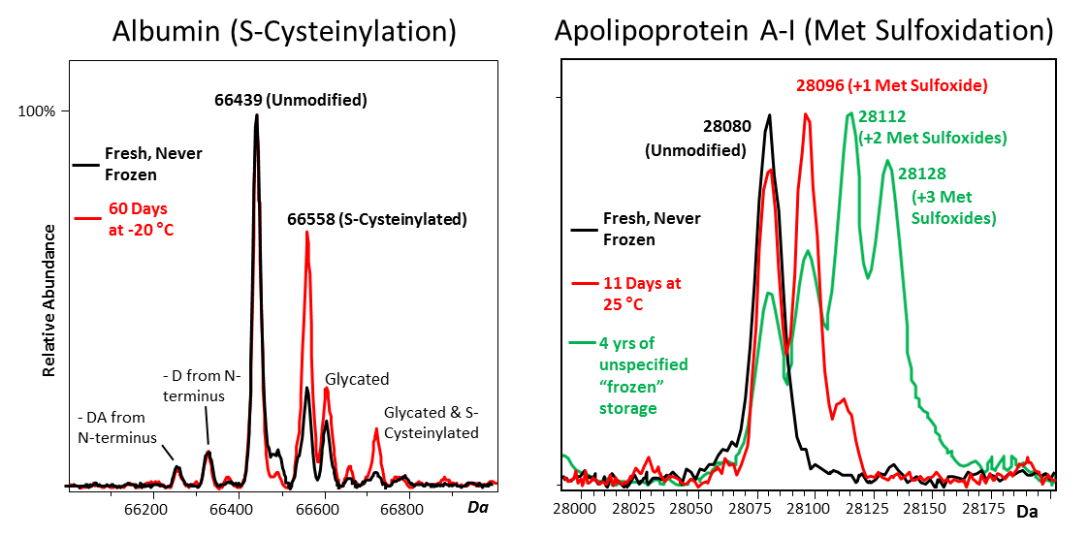
Artifactual ex vivo Protein Oxidation
Δ oxidized form
Blood Plasma Does Not Actually Freeze Until -30 ºC.
Samples Only Appear Frozen at -20 ºC.
Notes:
St. So how does albumin in P/S behave ex vivo? (Example)
-ApoAI also oxidizes ex vivo, but in a different way and in multiple forms…
-NOT due to corona discharge and artifactual oxidation in the ESI source

Slide 13
Ex Vivo Albumin Oxidation Over Time
Healthy, 25 ºC
Both Donors, -20 ºC
pcT2D = Poorly controlled type 2 diabetic
Healthy, -80 ºC
Borges CR, Rehder DS, Jensen S, Schaab MR, Sherma ND, Yassine H, Nikolova B, Breburda C: Molecular & cellular proteomics, 13(7):1890-1899, 2014.

Slide 14
Ex Vivo ApoA-I Oxidation Over Time
Healthy, 25 ºC
Both Donors, -20 ºC
pcT2D = Poorly controlled type 2 diabetic
Healthy, -80 ºC
Borges CR, Rehder DS, Jensen S, Schaab MR, Sherma ND, Yassine H, Nikolova B, Breburda C: Molecular & cellular proteomics, 13(7):1890-1899, 2014.

Slide 15
Additional Results from Ex Vivo Protein Oxidation Studies
Vial headspace / degree of sealing did not affect oxidation rates
Freeze-thaw cycles ALONE have negligible impact on protein oxidation
Neither gender or blood collection type (serum vs. EDTA plasma) impacted initial oxidation state
Specimen surface area-to-volume ratio impacted apoA-I oxidation rate, but not that of albumin
24 patients experiencing myocardial infarction lacked detectable apoA-I oxidation
24 patients with Stage II prostate cancer lacked detectable apoA-I oxidation
Borges CR, Rehder DS, Jensen S, Schaab MR, Sherma ND, Yassine H, Nikolova B, Breburda C: Molecular & cellular proteomics, 13(7):1890-1899, 2014.
Notes:
2) Total time-temperature integral was more important
5-6) Samples were collected fresh, but not under our direct control or for the express purposes of this study. There some albumin oxidation in some of the samples, but it requires further investigation to determine if this occurred in vivo or ex vivo.

Slide 16
Conclusions of Initial Ex Vivo Protein Oxidation Study
Albumin and apoA-I oxidation inevitably occurs in plasma/serum at storage temperatures above the freezing point of −30 °C.
Implication: Other “clinically important” proteins are also susceptible to ex vivo oxidation—which can lead to erroneous results in molecular-interaction based assays without any indication of assay failure.
Oxidized albumin and apoA-I are candidate “canaries in the coalmine” for P/S sample integrity due to their ease of analysis and apparent minimal in vivo oxidation.
Notes:
1. So what? “Who cares about HSA and apoAI… no one cares about these proteins anyway.”
First, not true, both have CPT codes AND people have mistaken oxidation of these two proteins as biomarkers of CVD, intrauterine growth restriction, and other disorders that involve oxidative stress.
2. Example of 50% of 100ng/mL protein oxidized giving a reading of 50 ng/mL
3. Because albumin and apoAI are easily accessible, they are ideal ‘canaries in the coalmine’ of poor sample integrity / history of improper sample handling and/or storage.
3. There are a few other low-abundance candidate markers of poor sample handling out there that “disappear” according to molecular interaction based assays, but I think these markers are rather appealing (to the analytical chemist in all of us) because they are based on direct measurement of the molecular damage that occurs due to improper sample storage. They are NOT based on an “apparent” loss of a protein as measure by ELISA or similar assay where you really don’t know what exactly happened to the target protein.

Slide 17
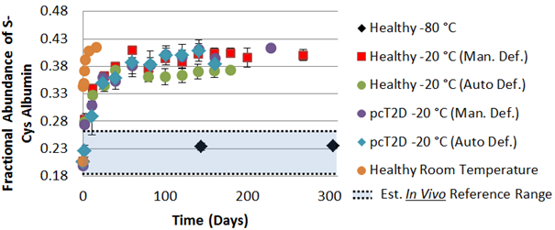
Implementation Problem for S-Cys Albumin
Unknown In Vivo Reference Range
Plateau: All Free Cysteine/Cystine Consumed
Notes:
Problem: The population reference range for our “early damage” marker, ox-albumin is unknown… So we don’t know for sure where to draw the “cut-off” on the y-axis that indicates true sample mistreatment (vs. natural in vivo state).
Initial estimates based on a limited number of samples for which we’ve absolutely know for sure the entire history of each sample, put 95% of the human population within the blue shaded region… but this is from a limited number of samples and we’d need 100s to determine this range with certainty. … “Too risky”
We can be more confident of apoA-I because we’ve analyzed hundreds of samples from patients with and without disease that have essentially no apoAI oxidation… So OxApoAI is useful as a severe-damage indicator;… but we’d like to have a marker that is sensitive to more subtle mistreatment.
We could set out to determine the pop. Ref range for albumin, but it would be rather expensive to do so and it could be a high-risk proposition if the range is too wide…

Slide 18
Further Developments
Population reference ranges for albumin, cysteine, and cystine are known:
Albumin: 650 µM (± 60 SD)
Cysteine: 11 µM (± 1 SD)
Cystine (Cys-S-S-Cys): 70 µM (± 10 SD)

Slide 19
Further Developments
ΔS-Cys Albumin Concept
CHANGE in S-Cys-Albumin that occurs if samples are intentionally driven from in vivo state to their maximum ex vivo plateau:
95% of the population will experience an ex vivo INCREASE in S-Cys-Albumin of 14-36% if the sample is driven from its natural in vivo value to its max. ex vivo plateau
I.e., No matter what the in vivo value of S-Cys-Albumin actually is, it will always be possible to INCREASE its fractional abundance by 14-36%
No change in S-Cys-Alb indicates a damaged sample
Notes:
1. This means that if we look at the CHANGE…

Slide 20
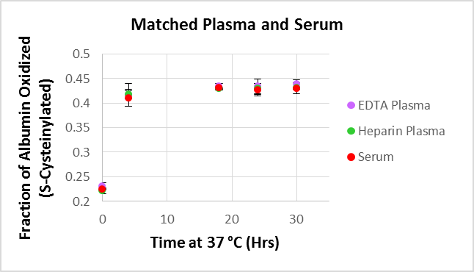
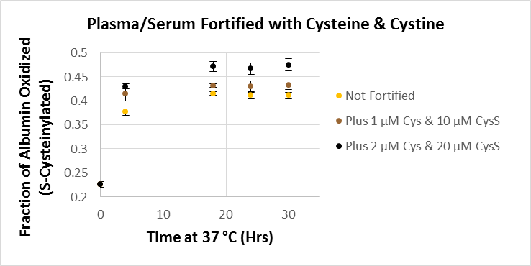
Development of ΔS-Cys Albumin
ΔS-Cys Albumin
An 18-hour (overnight) incubation of plasma or serum at 37 ˚C drives the albumin S-cysteinylation reaction to completion

Slide 21
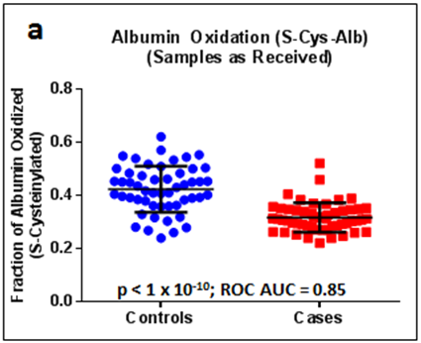
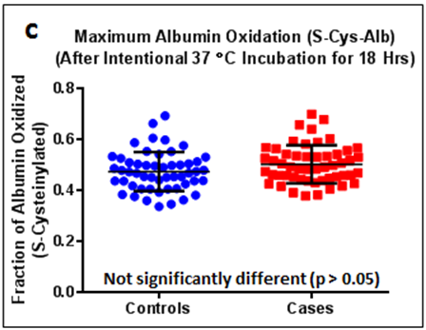
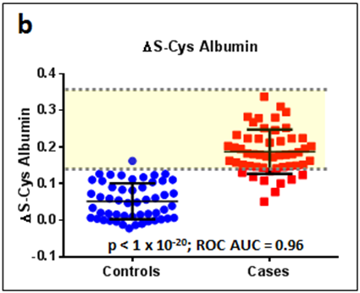
ΔS-Cys Albumin Applied to a Set of Cancer Patient Serum Samples
Under R33CA191110 (Borges, PI) *Employs pre-existing serum*
Collecting clinical scientists
Excellent reputations in cancer biomarker research
Long histories of NIH funding
Same SOP for all samples
Cancer Cases vs. Controls
Yellow shaded area represents theoretical population reference range for ΔS-Cys Albumin (14-36%) for “pristine” samples
Notes:
St. Not long after putting this assay together we had occasion to apply it to a set of nominally pristine samples that we had but in which we suspected an integrity problem…
…Part of R33 (Yes one of the NCI grants that employs previously exisiting P/S samples)—but not just any willy-nilly samples…
PreAnim: We got some “better-than-expected” data in our validation study, so I got suspicious and decided to apply the ΔS-Cys-Alb assay to the cases vs. the controls… [Anim]
E. Think about the potential to draw false conclusions if we just happened to be doing some form of proteomics and measuring many randomly selected proteins in these two sets of samples and we got results for one particular protein that looked like this!
EE. If you don’t know your samples intimately well, you cannot make any biological conclusions with certainty!

Slide 22
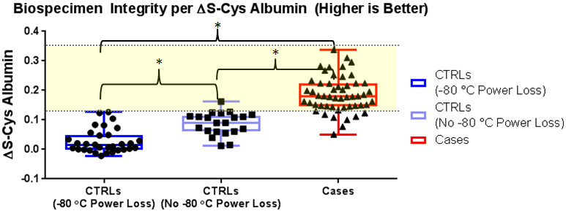
Initial Application of ΔS-Cys Albumin
Revealed to clinical scientists who provided samples
-80 ˚C freezer power outage during a recent natural disaster was revealed
Yellow shaded areas represent theoretical population reference range for ΔS-Cys Albumin (14-36%) for “pristine” samples.
n = 31
n = 21
n = 52
* p < 0.05 for Dunn’s multiple comparison test following non-parametric ANOVA. ROC AUC for -80 ˚C Power Loss vs. No -80 ˚C Power Loss CTRLs = 0.85
Notes:
-NIH IMAT R33 Biospecimen Science grant pending to fully validate Delta-S-Cys Alb…
-US Nationalized PCT application filed on oxidized albumin and apoAI as well as Delta-S-Cys-Alb as marker of biospecimen integrity.

Slide 23
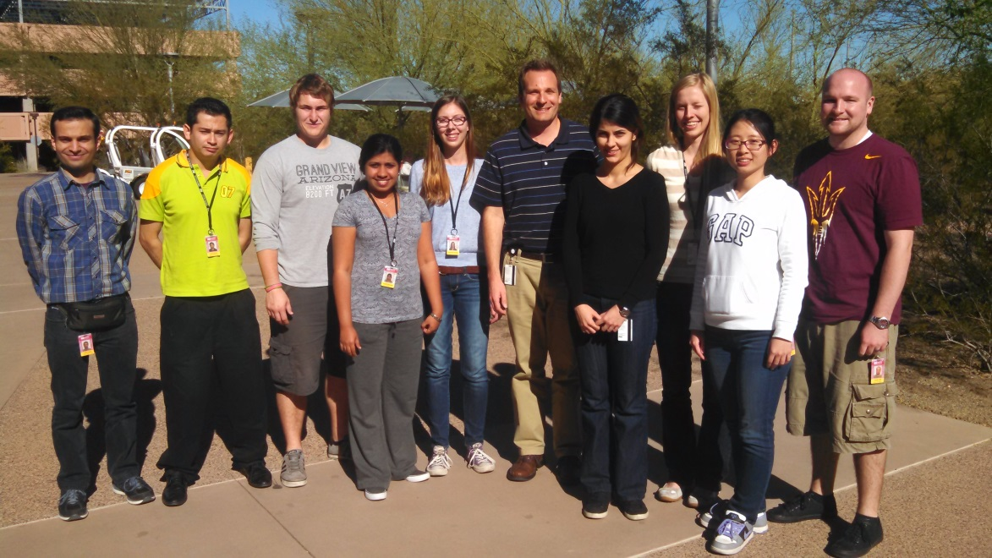





Acknowledgments
Borges Lab Group
Funding
R33CA191110
Grant No. 1977
Project Contributors
Other Members
Former Members
Joshua Jeffs
Shadi Ferdosi
Yueming Hu
Erandi Kapuruge
Stephanie Thibert
Jesús Aguilar
Douglas Rehder
Sally Jensen
Sahba Zaare
James Geiger
Start-up Funding

Slide 24
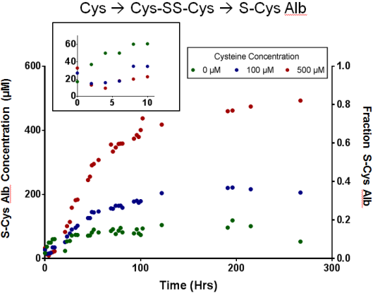
In Vitro Oxidation of Albumin in pH 7.4 Buffer in the Presence of Cysteine
Blood plasma/serum typically contains:
600 µM Albumin, 10 µM Cysteine and 70 µM Cys-SS-Cys
Notes:
-Albumin is the most abundant protein in P/S, but it is also redox sensitive. Given the native constituents of P/S, the form of ox. to which it is most readily susceptible is disulfide bond formation
-To demonstrate the inexorable nature of albumin oxidation we pre-reduced it (to ~3-5% from ~ 20%), then added even more reducing agent (Cys), then watched it over time by intact MS.

Slide 25
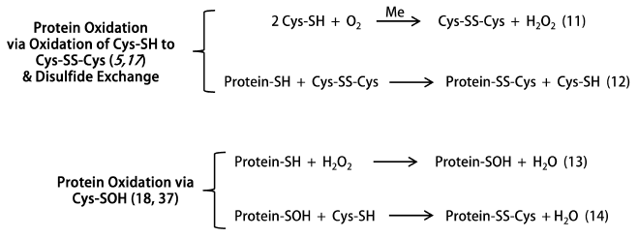
In Vitro Oxidation of Fully Reduced Albumin in pH 7.4 Buffer in the Presence of Cysteine
What’s Happening
Borges, C.R., Jeffs J.W., Kapuruge E.P.: Impact of Artifactual, Ex Vivo Oxidation on Biochemical Research. In: Oxidative Stress: Diagnostics and Therapy Volume 2. Edited by Hepel M, Andreescu S. Washington, DC: American Chemical Society; Chapter 16, pp. 375-413; 2015.
Notes:
It’s inevitable in the presence of air (and trace quantities of transition metals)

Slide 26
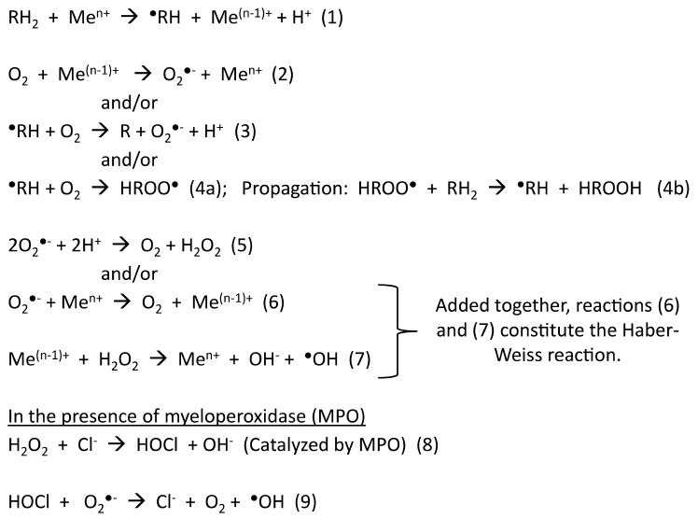
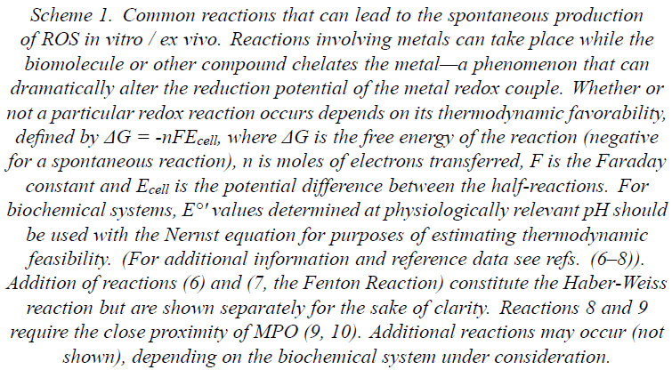
Extras
Borges, C.R., Jeffs J.W., Kapuruge E.P.: Impact of Artifactual, Ex Vivo Oxidation on Biochemical Research. In: Oxidative Stress: Diagnostics and Therapy Volume 2. Edited by Hepel M, Andreescu S. Washington, DC: American Chemical Society; Chapter 16, pp. 375-413; 2015.

Slide 27
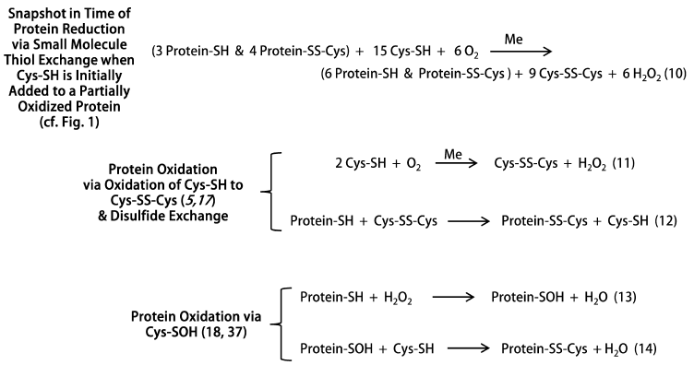
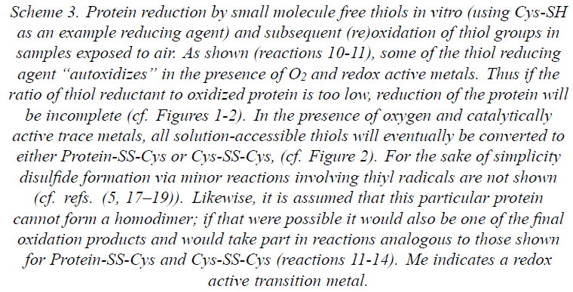
Extras
Borges, C.R., Jeffs J.W., Kapuruge E.P.: Impact of Artifactual, Ex Vivo Oxidation on Biochemical Research. In: Oxidative Stress: Diagnostics and Therapy Volume 2. Edited by Hepel M, Andreescu S. Washington, DC: American Chemical Society; Chapter 16, pp. 375-413; 2015.

Slide 28
Extras
Clinically Relevant Protein-Protein Interactions Disrupted by Mild Oxidation (Met Sulfoxide)
A sampling of the literature available on the topic reveals that methionine oxidation has been documented to disrupt a large variety of biomolecular interactions including methionine oxidized (MetOx) IgG antibody binding to protein A/G and Fc receptors ⁴⁻⁶, MetOx calmodulin binding to its receptor ^{7,8}, the activity of MetOx parathyroid hormone ⁹⁻¹², MetOx antigenic peptide binding to the MHC and subsequent recognition by the T cell receptor ¹³, the binding of a MetOx C-type natriuretic peptide analog to its receptor ¹⁴, and the binding of the MetOx prion protein (PrP) to antibodies against its Helix-3 region ¹⁵. Thus it is evident that protein oxidation in improperly handled clinical samples should not be dismissed as an unimportant event that has no possible bearing on the outcome of clinical assays that rely on protein-protein interactions.
Notes:
4. Gaza-Bulseco G, Faldu S, Hurkmans K, Chumsae C, Liu H. Effect of methionine oxidation of a recombinant monoclonal antibody on the binding affinity to protein A and protein G. J Chromatogr B Analyt Technol Biomed Life Sci 2008;870:55-62.
5. Bertolotti-Ciarlet A, Wang WR, Lownes R, et al. Impact of methionine oxidation on the binding of human IgG1 to FcRn and Fc gamma receptors. Molecular immunology 2009;46:1878-82.
6. Pan H, Chen K, Chu L, Kinderman F, Apostol I, Huang G. Methionine oxidation in human IgG2 Fc decreases binding affinities to protein A and FcRn. Protein Sci 2009;18:424-33.
7. Yao Y, Yin D, Jas GS, et al. Oxidative modification of a carboxyl-terminal vicinal methionine in calmodulin by hydrogen peroxide inhibits calmodulin-dependent activation of the plasma membrane Ca-ATPase. Biochemistry-Us 1996;35:2767-87.
8. Gao J, Yao Y, Squier TC. Oxidatively modified calmodulin binds to the plasma membrane Ca-ATPase in a nonproductive and conformationally disordered complex. Biophysical journal 2001;80:1791-801.
9. Galceran T, Lewis-Finch J, Martin KJ, Slatopolsky E. Absence of biological effects of oxidized parathyroid hormone-(1-34) in dogs and rats. Endocrinology 1984;115:2375-8.
10. Horiuchi N. Effects of oxidation of human parathyroid hormone on its biological activity in continuously infused, thyroparathyroidectomized rats. J Bone Miner Res 1988;3:353-8.
11. Nabuchi Y, Fujiwara E, Ueno K, Kuboniwa H, Asoh Y, Ushio H. Oxidation of recombinant human parathyroid hormone: effect of oxidized position on the biological activity. Pharm Res 1995;12:2049-52.
12. Hocher B, Oberthur D, Slowinski T, et al. Modeling of oxidized PTH (oxPTH) and non-oxidized PTH (n-oxPTH) receptor binding and relationship of oxidized to non-oxidized PTH in children with chronic renal failure, adult patients on hemodialysis and kidney transplant recipients. Kidney & blood pressure research 2013;37:240-51.
13. Weiskopf D, Schwanninger A, Weinberger B, et al. Oxidative stress can alter the antigenicity of immunodominant peptides. J Leukoc Biol 2010;87:165-72.
14. Thibault G, Grove KL, Deschepper CF. Reduced affinity of iodinated forms of Tyr0 C-type natriuretic peptide for rat natriuretic peptide receptor B. Mol Pharmacol 1995;48:1046-53.
15. Canello T, Frid K, Gabizon R, et al. Oxidation of Helix-3 Methionines Precedes the Formation of PK Resistant PrPSc. Plos Pathog 2010;6.

