Slide 1
Activities in the EDRN lung collaborative group Cohorts
Pierre P. Massion, MD
March 7, 2017 Tempe FL
March 2017

Slide 2
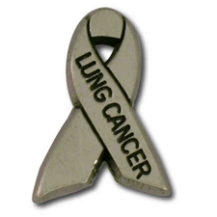
Lung Collaborative Group
Biomarker Development Laboratories
Avi Spira, Steve Dubinett, Marc Lenburg, Deni Aberle | BU, UCLA and Lahey Clinic
Louise Showe, Qihong Huang | Wistar Institute
Jim Herman, Jeff Wang, David Wilson, Brenda Hoegaarde | U of Pittsburgh, Hopkins
Harvey Pass, Haining Yang | NYU
Biomarker Reference Laboratory
Sanford Stass, Feng Jiang | University of Maryland
Clinical Validation Centers
Pierre Massion, Kim Sandler | Vanderilt
Bob Gillies, Matt Schabath | Moffitt CC
DMCC
Margaret Pepe, Jackie Dahlgren | Fred Hutchinson CC
Program Officers
Lynn Sorbara | NCI DCP
Karl Krueger | NCI DCP
Notes:
8 institutions, 6 BDLs, 2 CVCs, 2 BRLs.

Slide 3
5 pearls for Team Science
Relevant clinical questions, group decision
Careful design and power, support from DMCC
Shared biospecimens, clinical, imaging, biological with MTAs, IRBs, Databases VSIMS
Shared Data, publication policy
Collaboration with outside investigators via set-aside funds and associate memberships

Slide 4
EDRN Lung collaborative group
Biomarker of risk
high risk individuals
CVC
DECAMP
Diagnostic biomarker for IPNs Molecular & Imaging
NCI
LTP2
DECAMP
Risk
Early
Diagnosis
Diagnosis
Progression
Biomarker of risk for
never smokers, early onset
disease and strong family history
Biomarker of Risk of
post-surgical progression
LTP3
Biomarker-based clinical trial

Slide 5
Indeterminate pulmonary nodules 3 cohorts

Slide 6
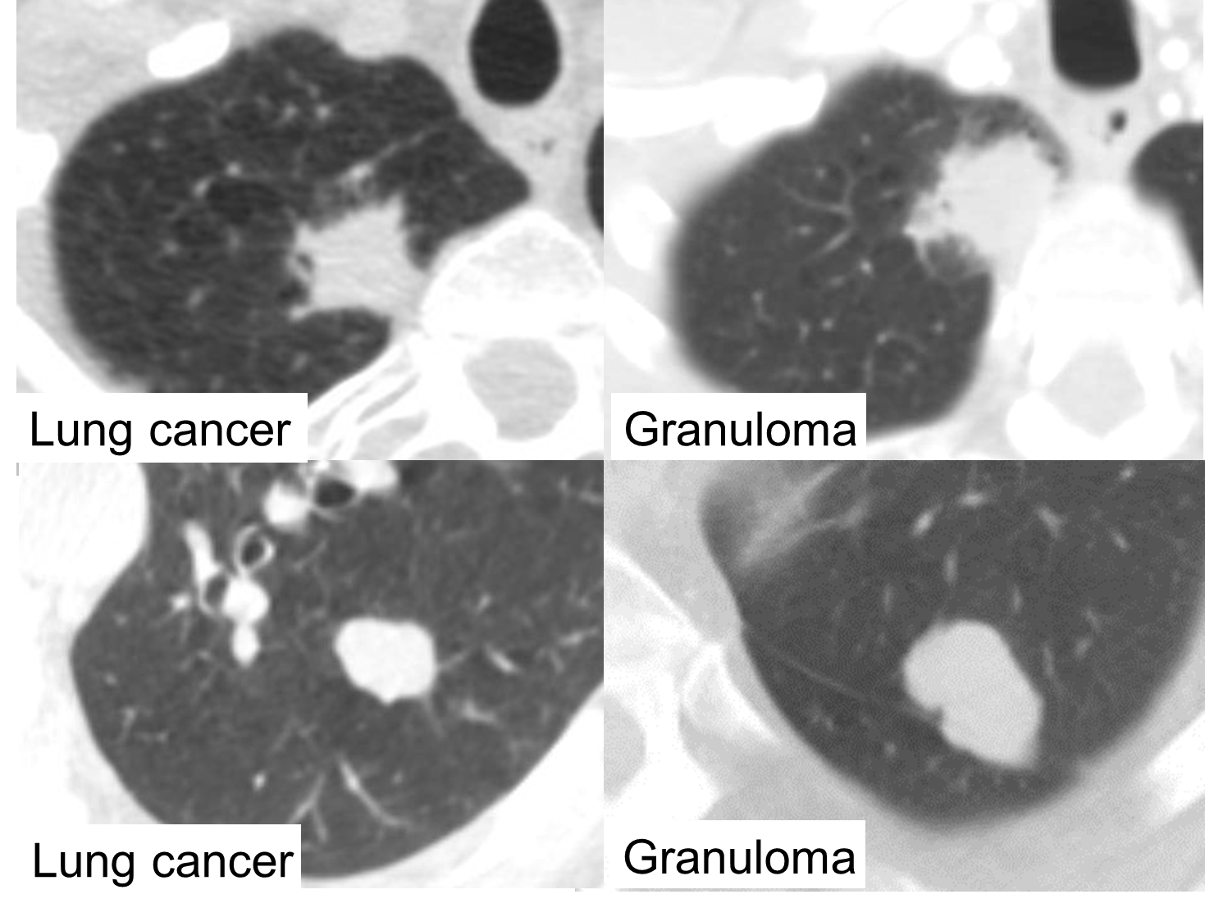
Clinical problem: Indeterminate pulmonary nodules
Courtesy
Dr. Ron Walker

Slide 7
Existing repositories Lung Cancer: Blood archives at Frederick
 | Set A | Set B | Set C
Collection | Prospective |  | Prospective
SOP | No or not unique SOP |  | Unique SOP
Date | 2000-2005 |  | 2006-on
Clinical setting | Diagnosis | Screening | Diagnosis
Cases | 180 | 170 | 180
Controls | 180 | 250 | 180
Other ca | 75 |  | 75

Slide 8
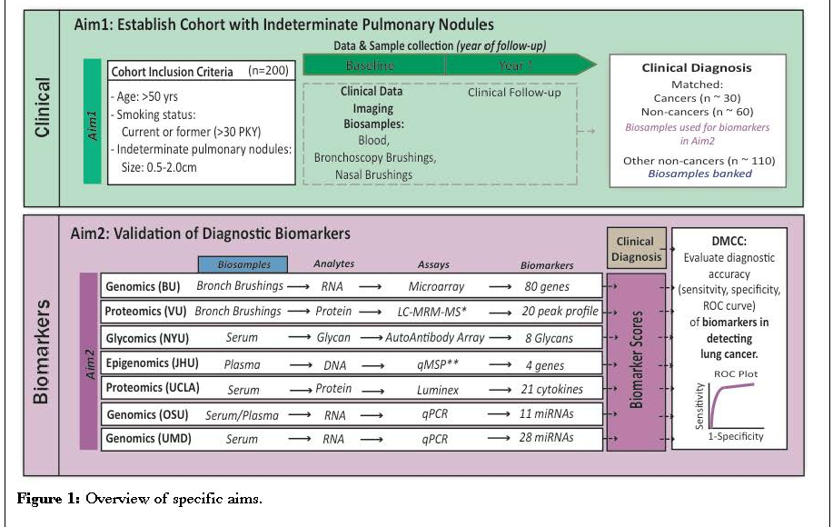
Lung collaborative project - LTP2

Slide 9
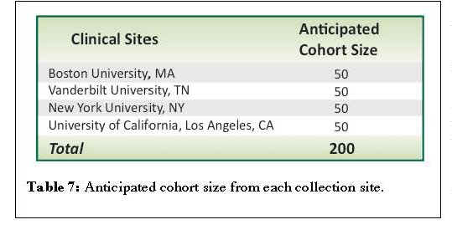
Participating collection sites

Slide 10
Existing repositories: LTP2- IPNs n=132/200
Risk Factors Among LTP2 Participants
LC Dx
Other
(n=62)
(n=70)
Smoker:
Yes
62
70
Age:
mean
67.6
66.7
sd
8.7
8.4
Diameter mm:
mean
17.4
13.6
sd
5.4
4.5
Years Since Quitting:
mean
6.1
7.7
sd
10.9
11.7

Slide 11
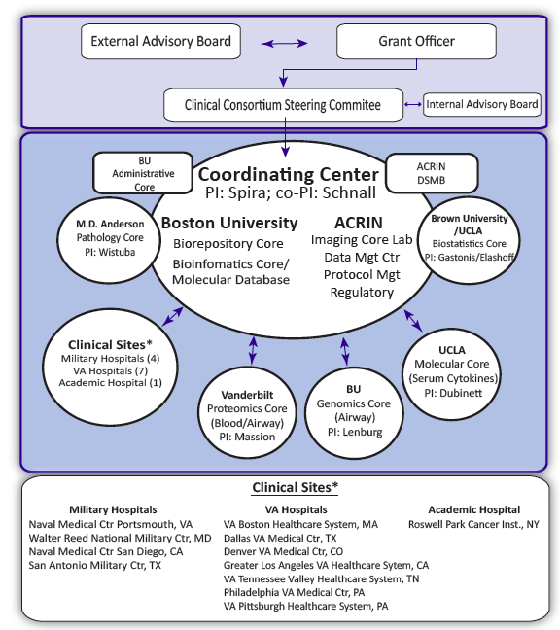
The Detection of Early Lung Cancer Among Military Personnel (DECAMP)
Imaging Core:
Denise Aberle
George Washko
Sequencing Core
Matt Wilkerson

Slide 12
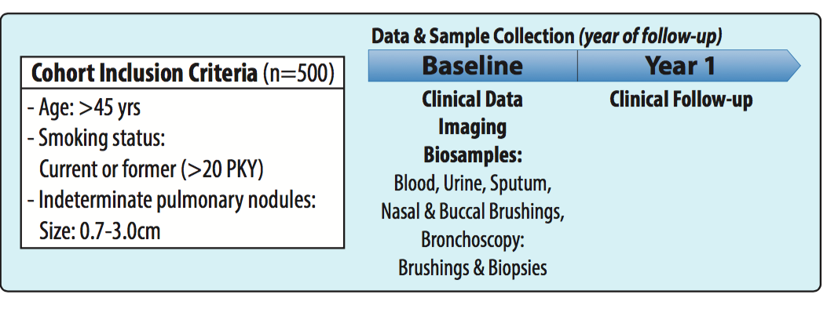
DECAMP1 (nodule) study design
Exclusions: prior history of lung cancer, pure GGO
Notes:
Considering the enrollment trend, we project subject recruitment will be completed by early 2017.

Slide 13
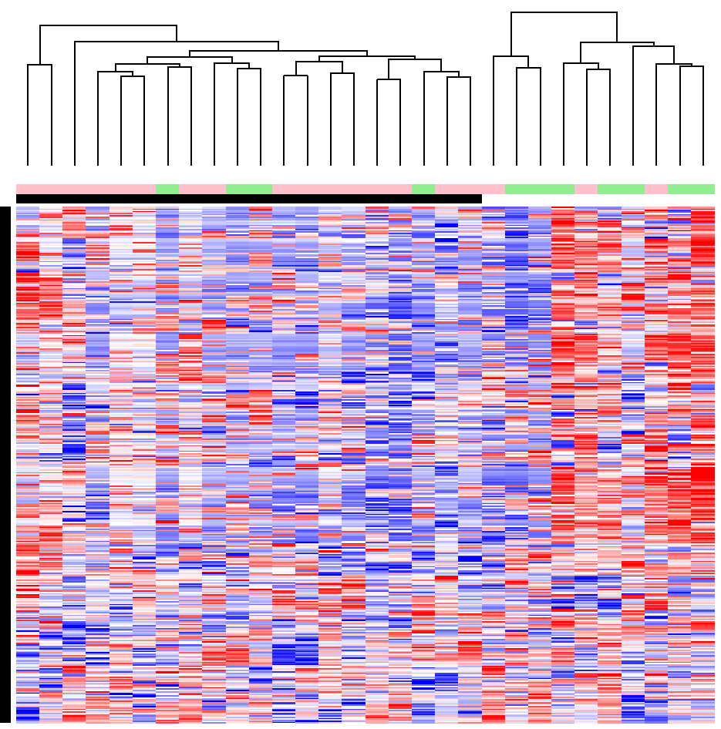
An Immune-Related Gene Set is downregulated in bronchial airway wall of smokers with lung cancer in DECAMP-1
Lung cancer
Benign disease
Genes associated with immune activation, inflammatory response, chemotaxis, cytokine production

Slide 14
Indolent vs aggressive lung cancer 1 cohort

Slide 15
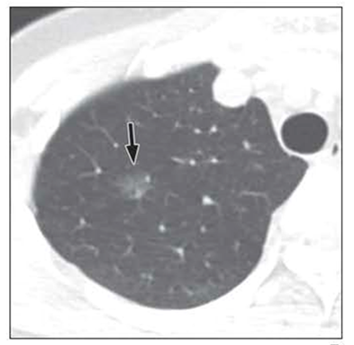
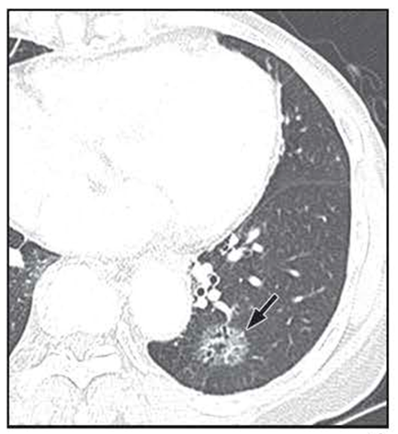
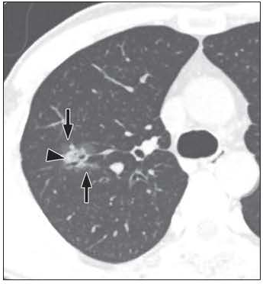
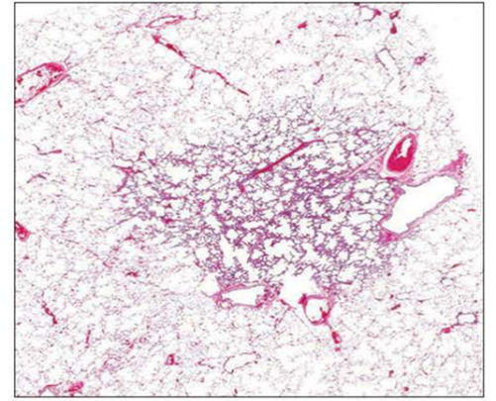
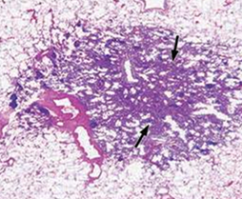
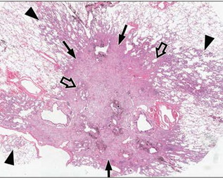
Clinical problem: Indolent vs Aggressive LC
A
C
E
B
D
F
AIS
MIA
ADC
Lee AJR 2014
Weichert COPM 2014

Slide 16
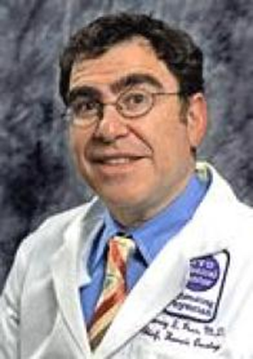
Existing repositories LTP3- Early LCs, n=180
Harvey Pass
All with plasma
178 with snap frozen matching lung from the same lobe

Slide 17
High Risk Cohorts 2 cohorts

Slide 18
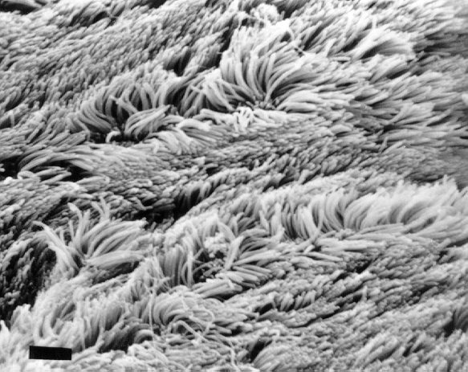
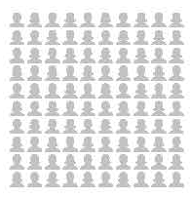
High risk population
Scanning microscopy of the airway epithelium
Life time risk of cancer among smokers?
15%

Slide 19
Existing repositories CVC Screening 235/480
Age: 55-74
Smoking status:
Current > 25 years, 10 cig/day
Former >20 PKY, quit <20 years ago
COPD/Emphysema or family hx of lung cancer
480 participants
Baseline
Year 1
Year 2
Year 3
Year 4
Year 5
450 no cancer
30 cancers
Consent
Blood
Urine
Sputum
Spirometry
CT scan
Bronchoscopy
Blood
Urine
Sputum
CT scan
Blood
Urine
Sputum
CT scan
Bronchoscopy
Blood
Urine
Sputum
Blood
Urine
Sputum
Blood
Urine
Sputum
CT Scan
Bronchoscopy
Clinical Diagnosis
Molecular
Biomarkers
Molecular
Biomarkers
Molecular
Biomarkers
Molecular
Biomarkers
Molecular
Biomarkers
Molecular
Biomarkers

Slide 20
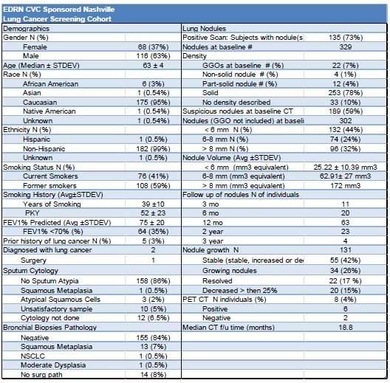
Existing repositories CVC Screening 235

Slide 21
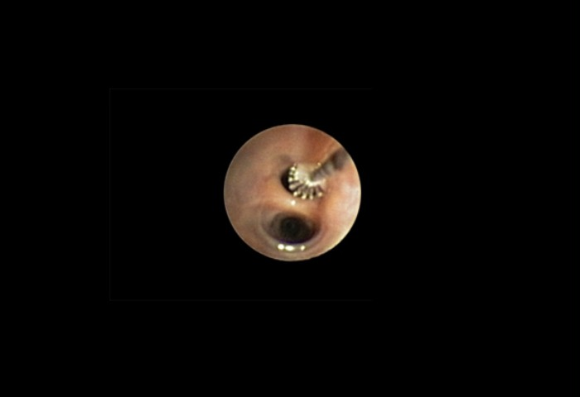
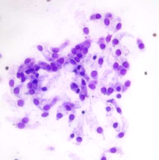
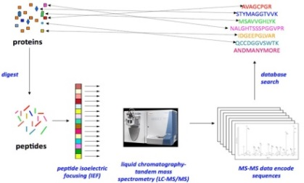
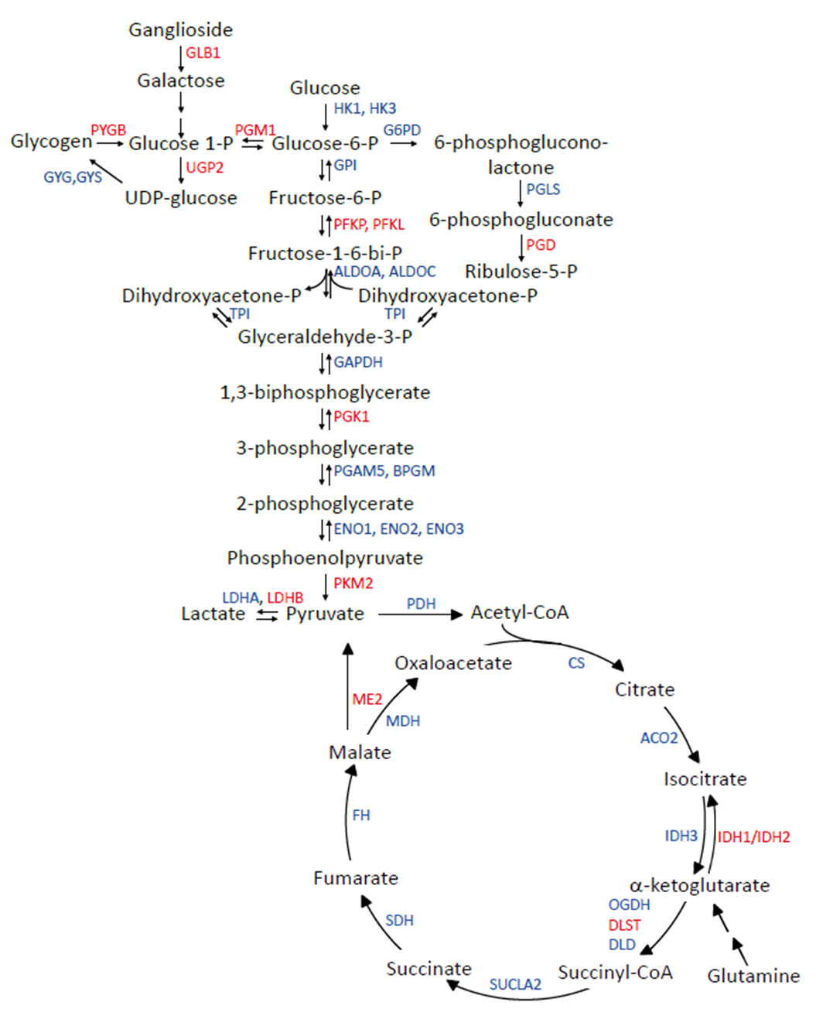
Proteomic analysis of bronchial epithelium in high risk individuals
In the high risk epithelium:
Carbohydrate metabolism reprogramming
Lipid metabolism reprogramming
Looking to test a Link between reprogramming and cancer dvpt
Shotgun proteomics
Rahman et al. JCI Insight. 2016
Funding
R01 CA 102353, EDRN CA152662
DoD W81XWH-11-2-0161

Slide 22
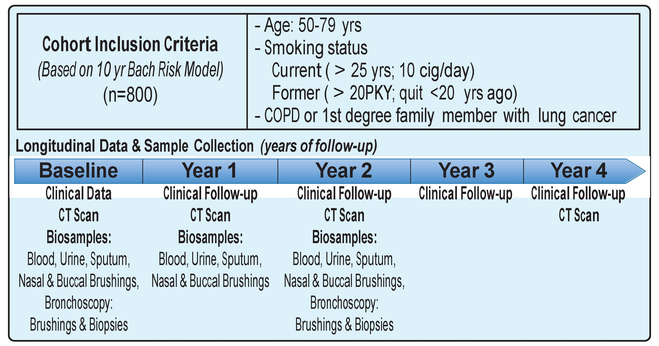
DECAMP2 (screening) study design

Slide 23
Overview of Biomarker validation progress
Biomarker Committee: guidelines established for evaluating candidate biomarkers
Plasma Protein Biomarker (Vanderbilt)
Validation of C4C, CRP and CYFRA on first set of DECAMP1 patients with final diagnosis as of May 2016 (n=91; 60 cancers +30 no cancers)
Bronchial Airway Gene Expression Biomarker (BU)
- 23 gene biomarker validated in AEGIS trials (Silvestri et la. NEJM 2015)
Validation of this biomarker on first set of DECAMP1 patients with final diagnosis as of May 2016 (n=91)
Plasma Exosomal microRNA Biomarker (UCLA)
Validation on ~100 patients with final diagnosis as of Dec 2016

Slide 24
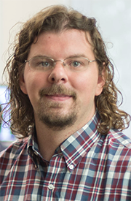
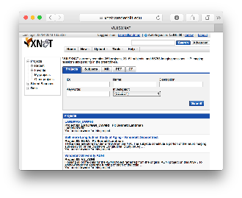
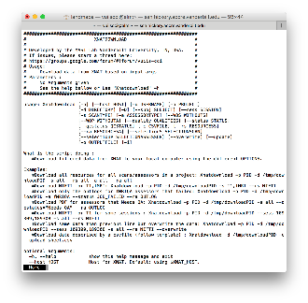
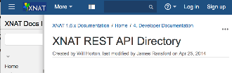

Vanderbilt Lung Imaging Repository Medical image Analysis and Statistical Interpretation lab Bennett Landman, PhD
Contributing Sites
Repository Users
External Programs
External Web Browser / Computer
External File System
External PACS
External XNAT
Web portal
Vanderbilt Lung Repository
Q/A and
De-identification
DAX/XNAT
Command line tools
DAX: Neuroimage. 2016 Jan 1;124(Pt B):1097-101. doi: 10.1016/j.neuroimage.2015.05.021.
XNAT: Neuroimage. 2016 Jan 1;124(Pt B):1093-6. doi: 10.1016/j.neuroimage.2015.06.076.
Software API
Image Processing
PACS or XNAT
Notes:
Vandy, Moffitt, Stanford, U Pen,

Slide 25
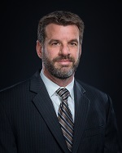
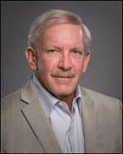
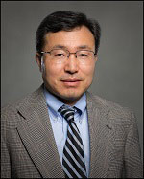
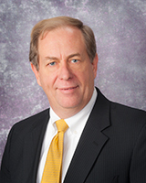
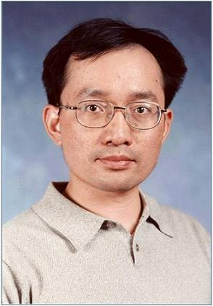
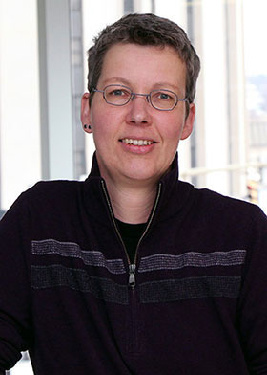
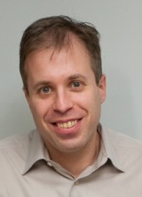
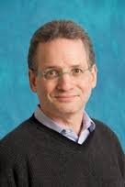
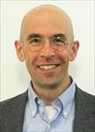
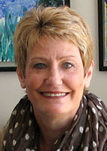

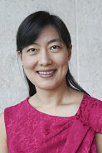
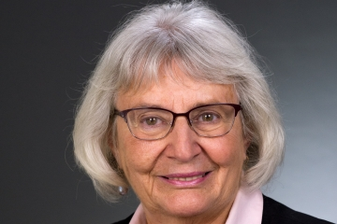
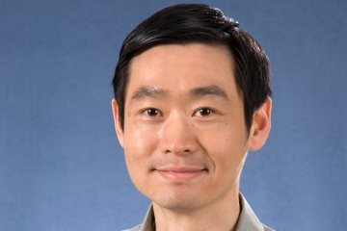
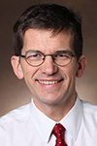
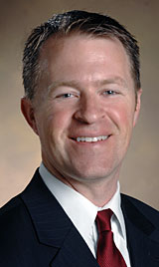
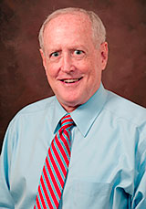
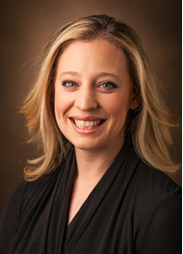
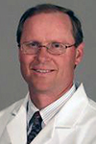
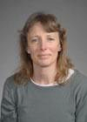
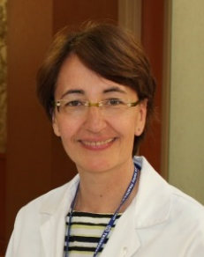
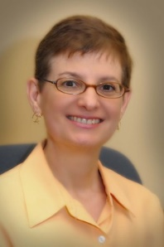
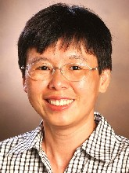
Matt Schabath, PhD
Bob Gillies, PhD
Jae Lee, PhD
Jim Herman,
MD
Jeff Wang, PhD
Brenda Diergaarde,
PhD
Avi Spira MD
Steve Dubinett, MD
Marc Lenburg, PhD
Deni Aberle, MD
Harvey Pass, MD
Haining Yang, MD, PhD
Louise Showe, PhD
Qihong Huang, MD, PhD
Pierre Massion
Eric Grogan
Ron Walker
Kim Sandler
Gary Smith
Margaret Pepe, PhD
Sanja Antic
Rosana Eisenberg
Heidi Chen
Bennett Landman

