Slide 1


Development and Implementation of Mi-Prostate Score (MiPS)
Scott A. Tomlins M.D., Ph.D.
Assistant Professor of Pathology and Urology
Michigan Center for Translational Pathology Department of Pathology
University of Michigan Medical School
March 7, 2017

Slide 2
Disclosure Information
I have the following financial relationships to disclose:
The University of Michigan has been issued a patent on ETS gene fusions on which I am a co-inventor.
The diagnostic field of use has been licensed to Hologic/Gen-Probe, Inc., which has sublicensed rights to Roche/Ventana Medical Systems
Consultant for and honoraria from Roche/Ventana Medical Systems, Almac Diagnpostics, Jansenn, AbbVie, Astellas/Medivation and Sanofi
Sponsored research agreement with, and travel support from, Compendia Biosciences/Life Technologies/ThermoFisher Scientific
Sponsored research agreement with Astellas and GenomeDX
Co-founder, consultant for and equity holder in Strata Oncology

Slide 3
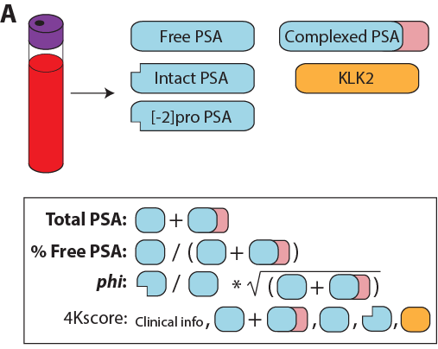
Can we use the prostate cancer genome to improve early detection?
~70% of benign glands show ≥ weak staining for -2 proPSA
(Chan et al. Urology 2003)

Slide 4
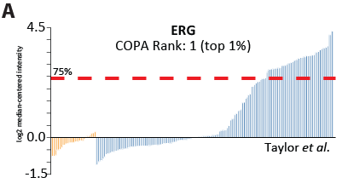
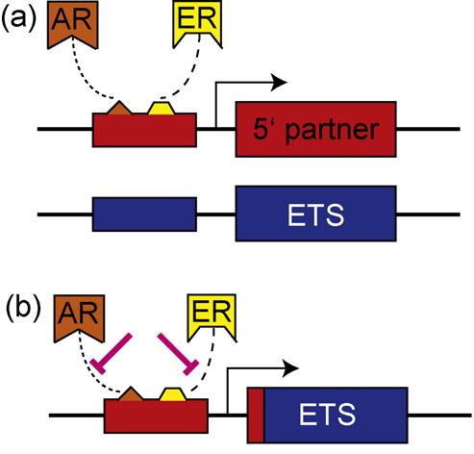
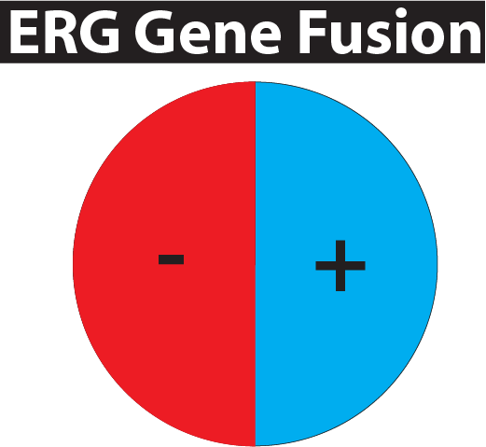
TMPRSS2:ERG gene fusions
A.
B.
C.
(Tomlins et al. Science 2005)
D.
IHC >99.99% specific
47%
(Young et al. AJCP 2012)
(Furusato et al. PCPD 2010)
(Tomlins et al. APLM 2012)
Resolves 28% of atypical cases
~10,000 tumors
(Shah et al. Human Pathol 2013)
(Pettersson et al. Cancer Epid Bio Prev, 2012)
Notes:
T2:ERG fusions are the most prostate cancer specific biomarker yet reported. Tissue expression, using antibodies directed against ERG, is used diagnostically and has specificity for cancer >99.99% by immunohistochemistry across multiple studies using different antibodies.
~50% of prostate cancer foci harbor T2:ERG fusions. However, ~80% of men at prostatectomy have at least 1 T2:ERG positive focus, given that most men with prostate cancer have multifocal disease.

Slide 5
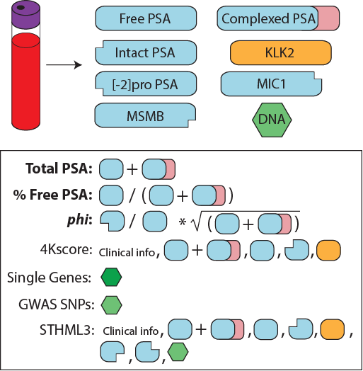
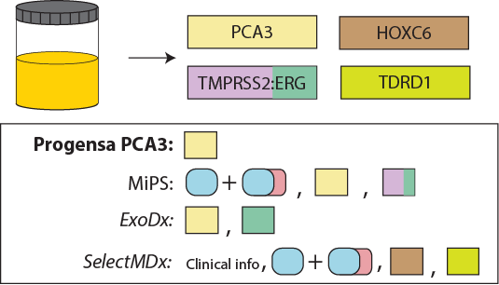
Can we use the prostate cancer genome to improve early detection?
mpMRI

Slide 6
T2:ERG quantification in urine
Collaborated with Hologic/Gen-Probe to develop a TMA assay for T2:ERG quantification in urine
Using early generation assays, we assessed 1,312 prospectively collected urine samples from multiple institutions
T2:ERG+PCA3 improved upon serum PSA (or the PCPT risk calculator) for predicting PCa on biopsy
Tomlins et al. Sci Transl Med. 2011
Notes:
Previous development work

Slide 7
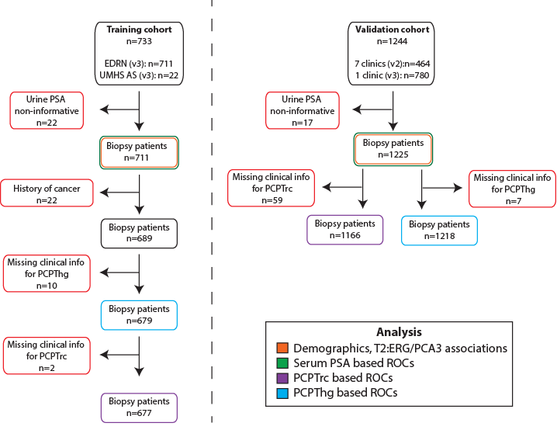
Sample Flow
n=1225
n=711
Tomlins et al., European Urology, 2015

Slide 8
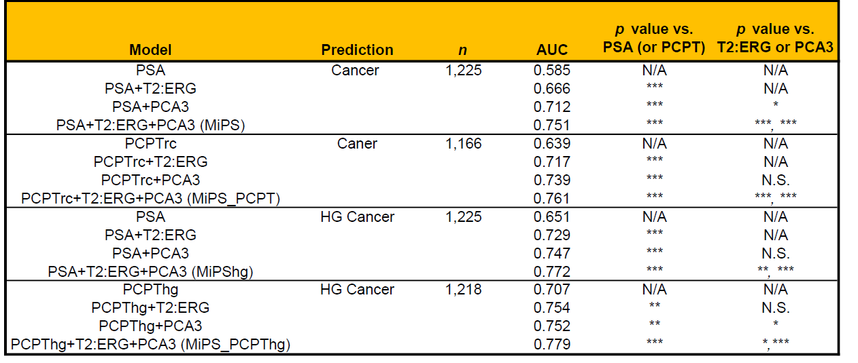
Performance of MiPS in validation cohort
Comparison of serum PSA, PCPT and MiPS based models for predicting PCa and
High-Grade PCa
Notes:
Among 1225 informative validation cohort patients, AUCs for PSA, PSA plus T2:ERG score, PSA plus PCA3 score, and Mi-Prostate Score (MiPS) were 0.585, 0.693, 0.726, and 0.751, respectively
all MiPS models showed significantly greater AUC than singlebiomarker (PSA or PCPT) or two-biomarker (PSA or PCPT plus T2:ERG or PCA3) models

Slide 9
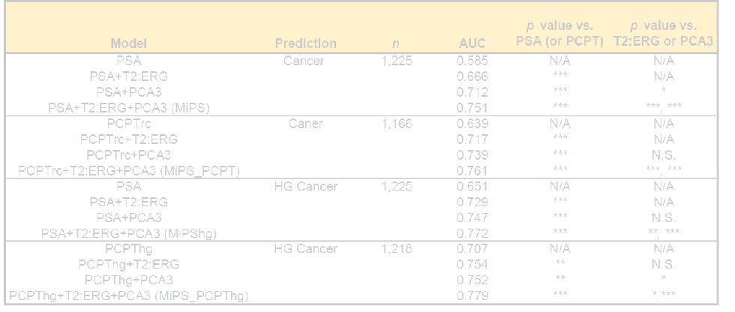
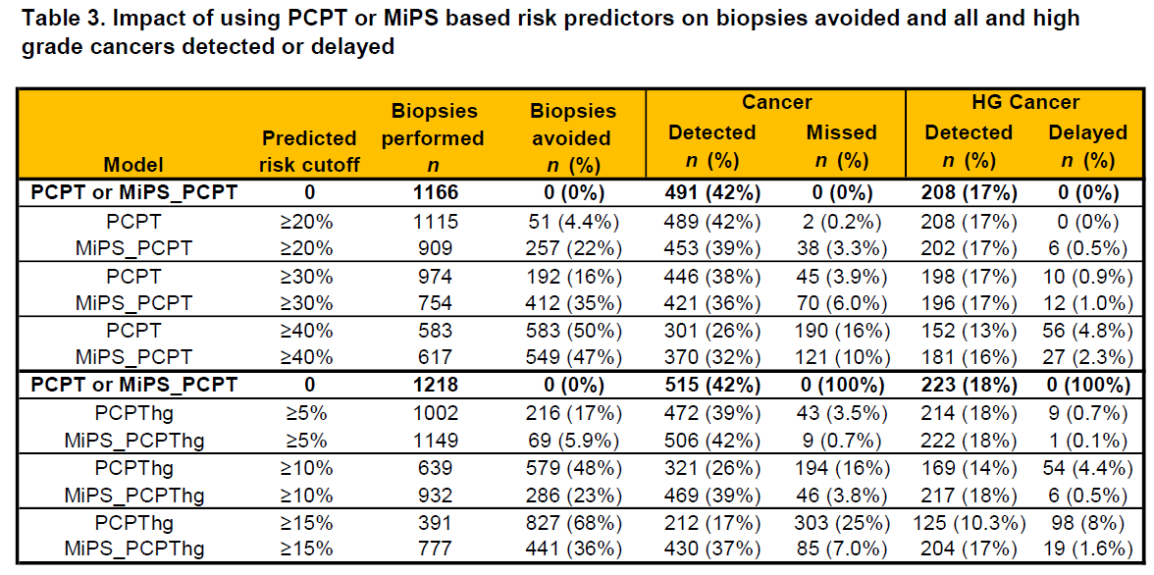
Performance of MiPS in validation cohort
Notes:
This table shows the Clinical consequences of using a 30% or higher cut-offs of the MiPS and PCPT–based model risk predictions (compared with the strategy of biopsying all patients), including the number and % of biopsies that could have been avoided and the number of high-grade cancer diagnoses that would have been delayed. The apper has a more detailed table using varying cutoffs

Slide 10
MiPS_PCPT(hg) shows net clinical benefit over PCPT alone
Notes:
Decision curve analysis is a method used to show clinical utility (net benefit) across thresholds of risk as patient/provider preference may influence individual decision making. For both predicting prostate cancer or high grade cancer on biopsy, the MIPS models (biomarkers + PCPT risk calculator) outperform the PCPT risk calculator alone. E and F present these results in the % of biopsies that can be avoided without missing any cancers (E) or high grade cancers (F).

Slide 11
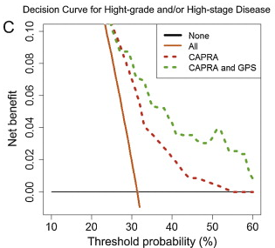
Context of clinical improvement
“The addition of GPS to CAPRA improved the AUC for favorable pathology to 0.67 from 0.63 with CAPRA alone.”
Klein et al. Euro Urol 2014

Slide 12
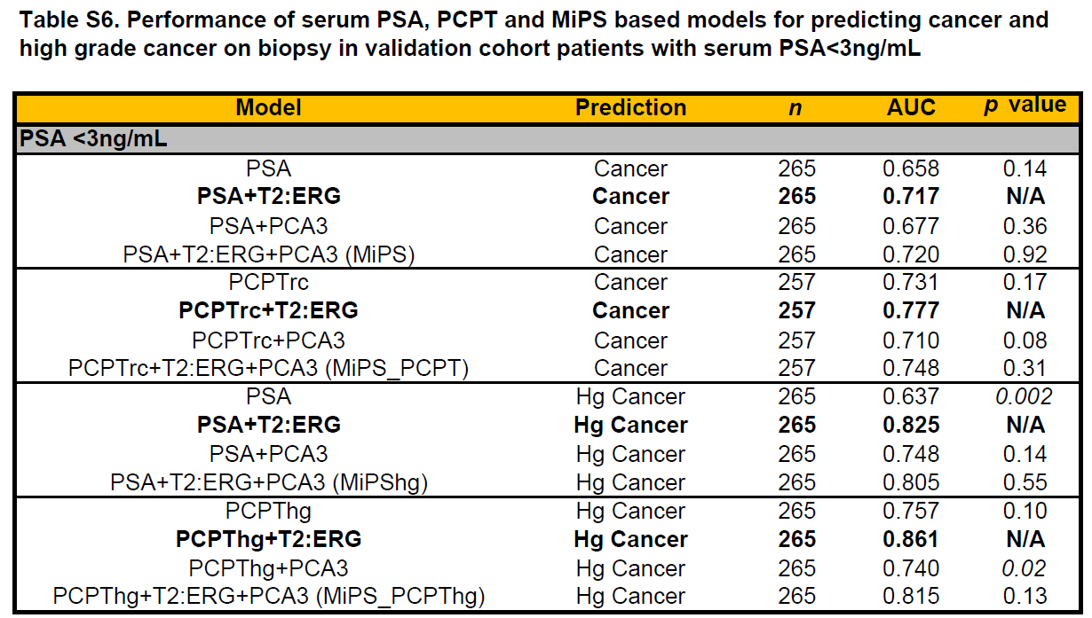
Reflects known biology

Slide 13
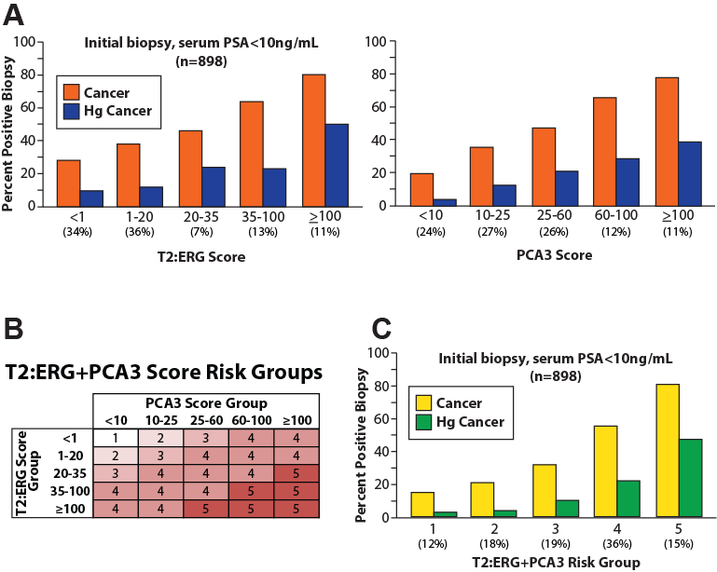
EDRN Validation study (PSA or T2:ERG or PCA3) in press at JAMA Oncology
(Sanda et al.)
Notes:
Advantage to quantitative T2:ERG score vs. +/- assays

Slide 14
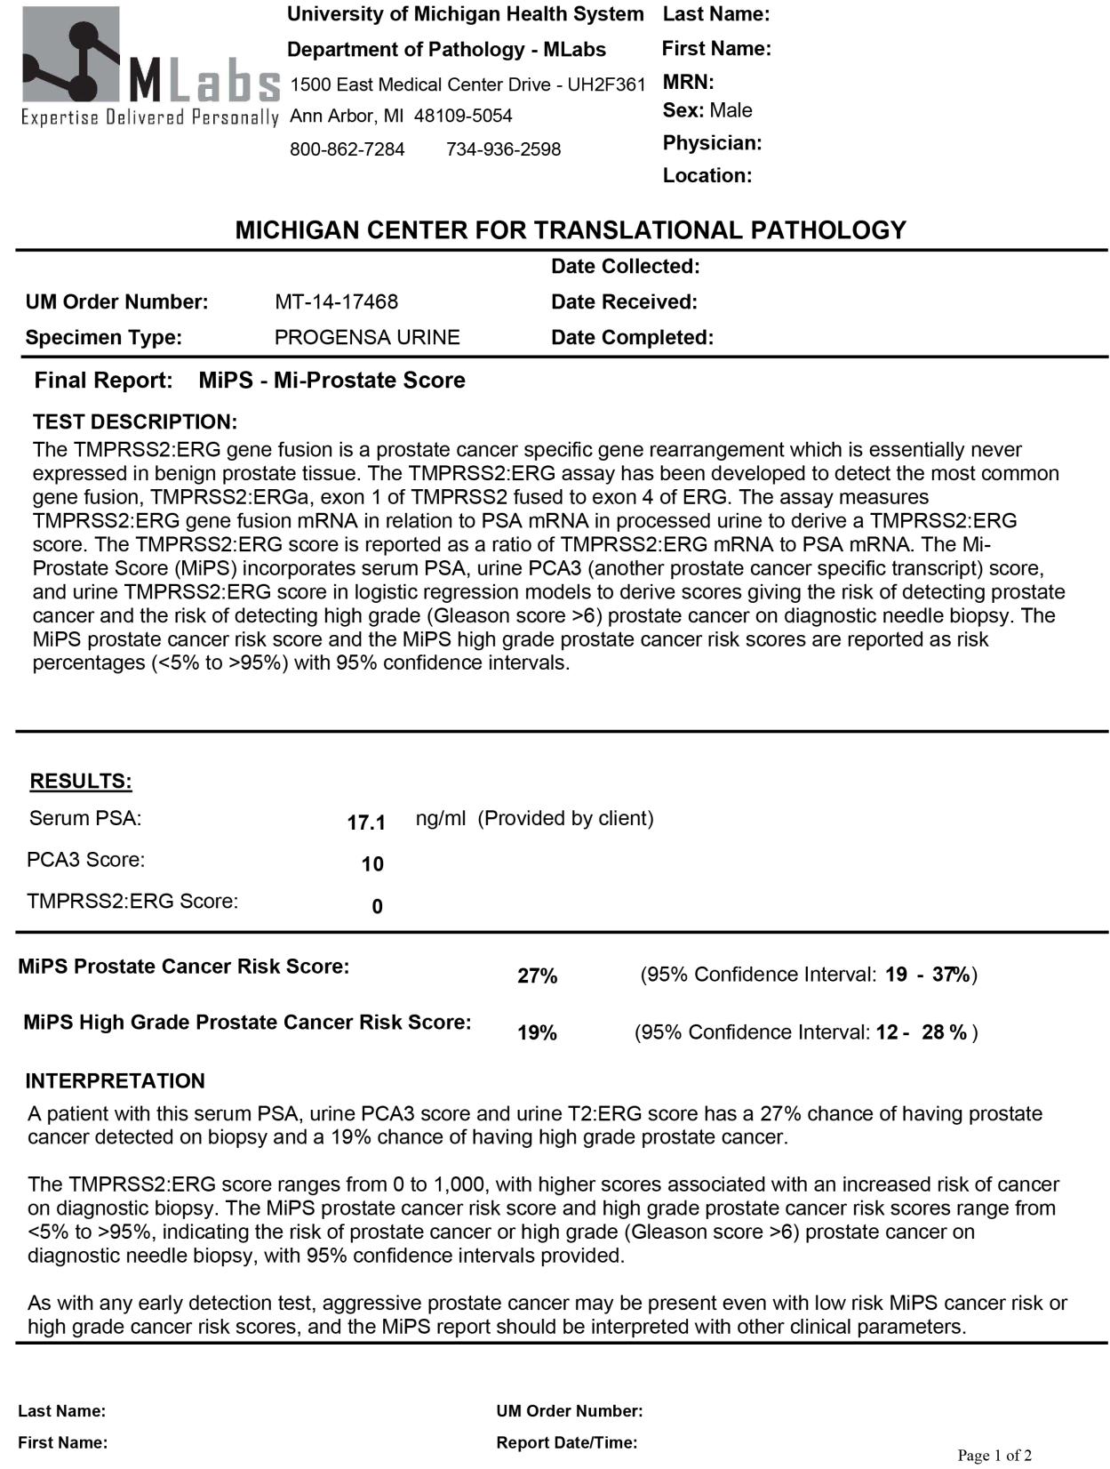
Mi Prostate Score
(MiPS)
Using trained/tested models
Incorporates: Serum PSA
PCA3 Score
T2:ERG Score
17.1 ng/ML
27% risk
Reports: Risk of cancer on bx
Reports: Risk of Gleason > 6 on bx
Notes:
An example score report is shown. This shows a patient who has a very high risk of prostate cancer by serum PSA, but low values of PCA3 and T2:ERG. The MIPS cancer and high grade cancer risk scores are shown, which are much lower than expected given serum PSA. The MIPS score incorporates serum PSA, PCA3 and T2:ERG

Slide 15
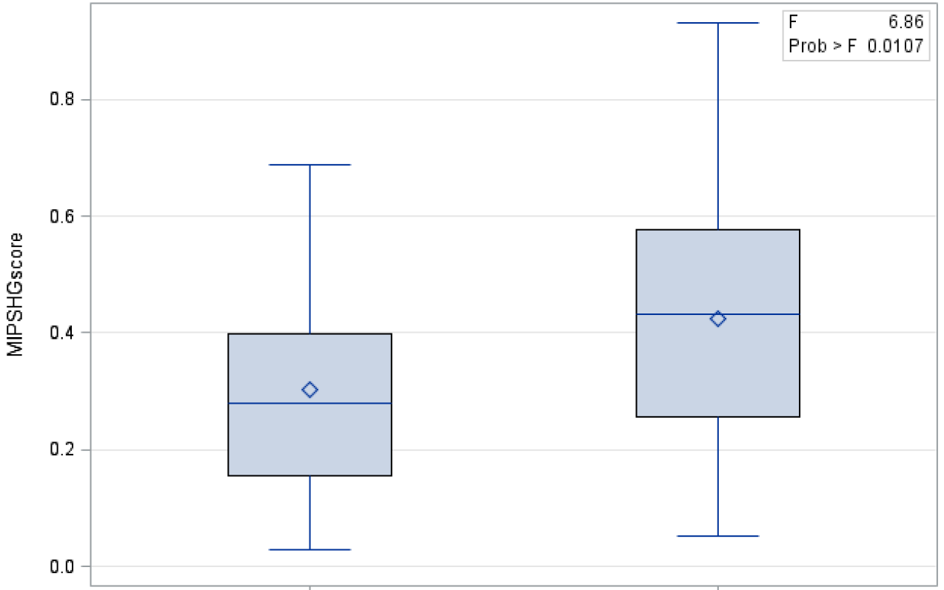
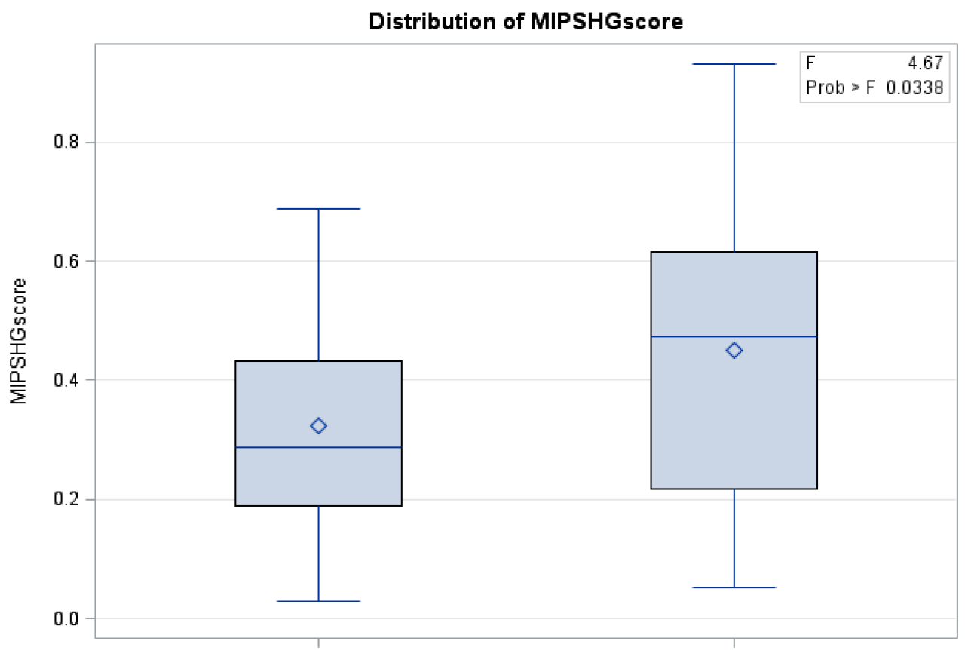
How does MiPS work in the real world?
149 UMHS patients undergoing MiPS since 8/13
9.2 months follow up
MiPShg vs. bx decision
MiPShg vs. HG PCa on bx
NO YES
n=76
n=73
NO YES
T2: ERG significantly higher in HG PCa
(179 vs 44, p<0.05)
Helfand et al, AUA 2015
Notes:
Prospectively followed UM patients tested by MIPS. Left shows that MiPShg risk score impacts decision to make a biopsy (MIPShg score distributions are plotted, patients not biopsied on left vs. those biopsied on the right).
Right shows whether high grade (Gleason score >6) was found on biopsy in patients who underwent biopsy. Those with high grade cancer on biopsy (right) had higher mipshg scores than those without (left).

Slide 16
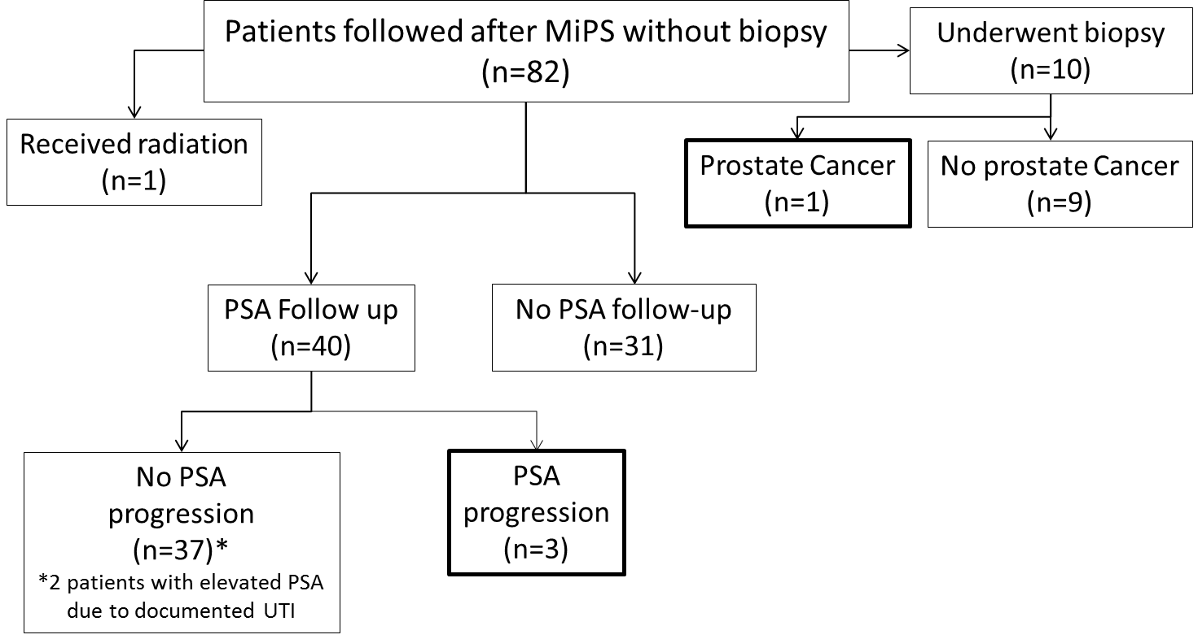
Follow-up of MiPS tested patients who did not undergo biopsy
JT Wei , Updated info, July 2015
Notes:
Of the 82 patients who had MiPS tests but did not undergo immediate biopsy, we tracked “missed” disease by whether they had PSA progression or subsequent biopsy pathology. Of the 40 patients with PSA follow-up, only 3 showed PSA progression (biopsy results were not available at censoring). Of 10 patients who underwent subsequent biopsy, only 1 had prostate cancer.

Slide 17

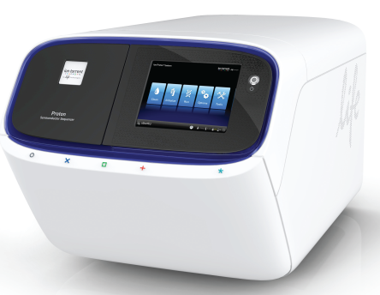
Where are we going?
Ampliseq RNA
(RT, multiplex PCR,
Ligate adaptors/barcode)
Isolate RNA
(and DNA)
NGS
Potential advantages
<1-10ng FFPE or urine RNA vs. >>10ng qRT-PCR for many targets
Multiplexing is easier by sequencing than most qRT-PCR
Digital data (sequence information)
Combinatorial priming for gene fusions/splice variants

Slide 18
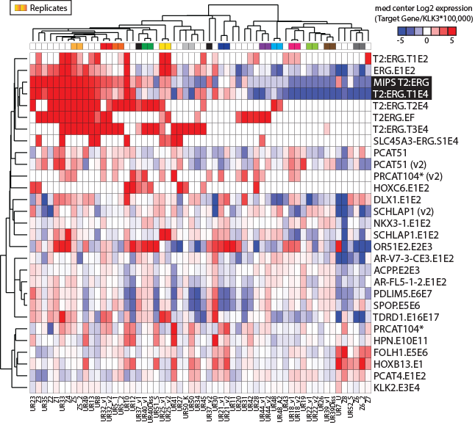

Slide 19
Summary
Inclusion of T2:ERG and PCA3 improves upon serum PSA (or PCPTrc) for predicting prostate cancer and high grade cancer on biopsy
MiPS models provide individualized risk estimates and are clinically available
Results reflect known biology and are impacting treatment practice
EDRN validation study in press (EDRN: Sanda and Feng)
Potential utility of targeted RNAseq approach

Slide 20
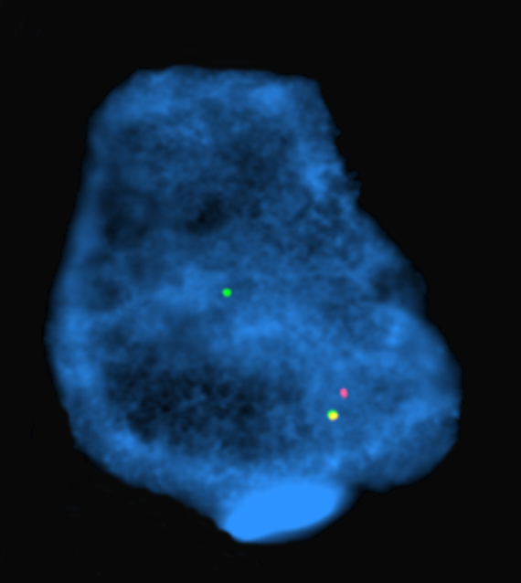






Acknowledgements
UMHS
WCMC
Arul Chinnaiyan
John Wei
Mark Rubin
BIDMC/Emory
Javed Siddiqui
Nallasivam Palanisamy
L. Priya Kunju
Allison Young
Laurie Sefton-Miller
David Wood
Brent Hollenbeck
Bharathi Laxman
Rohit Mehra
Kenneth J. Pienta
Daniel Hovelson
Andi Cani
Sumin Han
Komal Kunder
Marty Sanda
Jack Groskopf
Harry Rittenhouse
Sheila M. J. Aubin
John R. Day
Amy Blase
Siobhan Miick
Sarah Williamsen
Gen-Probe/Hologic
University of Washington
Pete Nelson

Slide 21
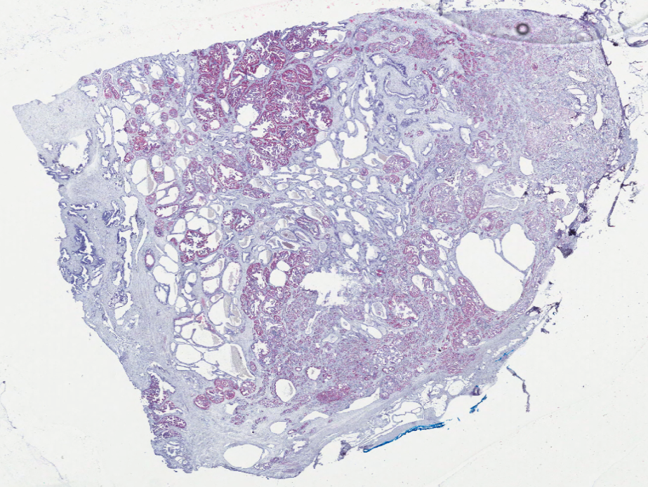
Urine/Tissue ERG and PCA3
41 whole mount prostatectomies, 159 cancer foci, assessed for ERG and PCA3
ERG 99.99% spec. for cancer
49% of foci ERG+
80% of men with at least one ERG⁺ focus
PCA3 >90% spec. for cancer & PIN
56% of foci PCA3+
71% of HGPIN foci PCA3+
Total tumor vs. urine T2:ERG
r_{s}=0.24 (P=0.13)
Total tumor vs. urine PCA3
r_{s}=0.26 (P=0.10)
ERG+ tumor vs. urine T2:ERG
r_{s}=0.68 (P<0.0001)
PCA+ tumor vs. urine PCA3
r_{s}=0.09 (P=0.56
Young et al. AJCP. 2012
Warrick et al. Mod Path. 2013
Notes:
Urine T2:ERG and tissue ERG expression is strongly correlated. Hence, high urine T2:ERG is correlated with large tumor burden. PCA3 tissue expression is less correlated with urine PCA3 levels.

