Slide 1
EDRN Prostate Cancer Detection Center Sites
Site | EDRN Center Type | Expertise/Interest
CPDR | BDL | Tissue, Urine Transcriptome
Emory-Harvard-Univ Washington | CVC | Urine Transcriptome, phi, Clinical Validation
Eastern Virginia MS-Toronto | BDL | Urine, tissue proteomics
Johns Hopkins | BDL and BRL | Urine, tissue glycomics; Reference Laboratory (phi)
University of Michigan | BDL | Tissue, Urine Transcriptome
Pacific Northwest Natl Lab | BRL | Reference Laboratory
Univ Texas-San Antonio | CVC | Clinical validation

Slide 2


Emory-Harvard-University of Washington Prostate Cancer Biomarker Center NCI Early Detection Research Network U01-CA113913-11 (2016-2020)
EMORY
University
Winship
Cancer Center
AIM 1: Combine serum phi with urine PCA3/T2Erg
HYPOTHESIS: early detection targeting aggressive prostate cancer will enhance survival benefit of treating lethal disease while reducing over-treatment of indolent Pca
AIMS:
Combine serum phi with urine PCA3 and T2Erg to detect aggressive prostate cancer (Pca)
Validate multiplex RNA signatures discerning aggressive from indolent PCa (see next slide)
FACBC-PET imaging to detect occult metastatic in high risk primary prostate cancer
Provide urine, blood, tissue for NIH-funded & other peer-reviewed collaborative projects/PI’s
Distributed 9,361 urine, blood, or tissue samples/aliquots from 4,680 patients to 16 PI’s/projects across the US, in Canada, Ireland, and the United Kingdom in the prior funding cycles (2011-2016)
INVESTIGATORS: Emory: Sanda (PI), Moreno, Schuster, Goodman, Alemozaffar, Petros Harvard School of Public Health: L Mucci University of Washington, Fred Hutch CCC: D Lin
Notes:
PCA3 has limited use as a stand-alone marker
We began our studies by optimizing the conditions required for RNA isolation from urine

Slide 3

FDA-approved, Commercially Available Assays: combining serum phi and urine PCA3
Biomarkers | Cutpoints | Sensitivity | Specificity
PCA3 | 7.6 | 95 | 17
phi | 23 | 95 | 27
PCA3 or phi | phi > 31 OR PCA3 > 29 | 97 [95]# | 35 [35]
First phi then PCA3 | phi>31 OR phi>16 AND PCA3>29 | 97 [95] | 38 [37]
♯ numbers in brackets were based on 10-fold cross validation

Slide 4
Aim 1. Combining Serum Prostate Health Index with post-DRE Urine PCA3 and T2Erg Clinical Assays to Predict Aggressive Prostate Ca
Serum Prostate Health Index (y axis), post-DRE Urine PCA3 (x axis), and T2Erg (z axis) clinical assay results stratified by aggressive Gleason 7+ prostate cancer (red) vs benign or indolent (blue)
Biospecimen Substrate | Biomarker Combination | Sensitivity | Specificity
Blood (serum) | Prostate Health Index (phi) | 95 | 27
Urine (post-DRE) | PCA3 + T2Erg | 92 | 36
Blood and Urine | phi + PCA3 + T2erg | 97 | 41
1st Blood, then Urine | phi > PCA3 + T2erg | 97 | 45
1st Urine, then Blood | PCA3 + T2erg > phi | 96 | 46
Notes:
PCA3 has limited use as a stand-alone marker
We began our studies by optimizing the conditions required for RNA isolation from urine

Slide 5
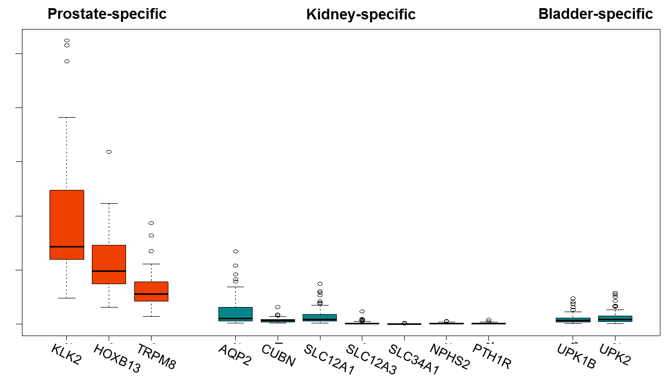
Aim 2: Targeted Sequencing of Prostate Ca-Associated RNAs in Exosomes From Post-DRE Urine (U01-CA113913-11)
EMORY
University
Winship
Cancer Center
A. Post-DRE Urine Extracellular Vesicles Enriched for Prostate RNA
C. RNAseq of Urine EV’s Clusters GS7+Pca (>2-fold change in 178/340 candidate RNA’s)
B. Targeted RNA Seq Discerns Expected PCa-associated RNA’s
Notes:
PCA3 has limited use as a stand-alone marker
We began our studies by optimizing the conditions required for RNA isolation from urine

Slide 6
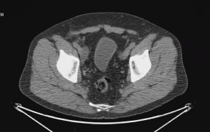
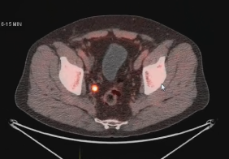



Aim 3: FACBC (Axumin) The 1st FDA-Approved PET Diagnostic Imaging Test for Prostate Ca M Goodman, Dept of Radiology & Chemistry; D Schuster, Dept of Radiology, et al
EMORY
University
Winship
Cancer Center
FACBC fluciclovine (Axumin):
A non-natural alicyclic amino acid analogue PET radiotracer
Detection of lymph node metastasis (not visible on standard CT) by FACBC-PET-CT in patient with rising PSA post-prostatectomy
1996-2000:
Dr. Mark Goodman et al invent FACBC at Emory University
2007-2013: Emory University 115 patient clinical trial in recurrent prostate cancer
R01 CA 129356
2014:
BED Ltd formed (Oxford, UK); Syncona Partners invests; Licenses rights from GE
2003:
NMP licenses FACBC from Emory University
2008:
GE licenses rights
2015: BED Inc. (Boston, USA) submits NDA/ MAA for PET imaging in BCR Prostate cancer based on 700 pt trials in the US, Italy, Norway
2016: FDA Approves AxuminTM (flucivlovine F 18) Imaging Agent for Use in Biochemically Recurrent Prostate Cancer
Notes:
PCA3 has limited use as a stand-alone marker
We began our studies by optimizing the conditions required for RNA isolation from urine

Slide 7
EDRN Prostate Cancer Collaborative Proposals
Topic | Biospecimen | Endpoint | Site(s) | Level
Blood+urine (Phi-PCA3+/-Terg) | Serum, post- DRE urine | Biopsy Gl 7 | Emory, PCA3 Trial, Michigan | Validation
Proteoglycomics | Post-DRE Urine, Tissue | Mixed | Hopkins, CPDR, PNNL, EVMS-Toronto | Discovery/prevalidation
Transcriptome | Post-DRE urine | RP Upgrading | UTHSCSA, Michigan, CPDR, Emory | Training/prevalidation
Imaging | (combine) | Mixed | Moffit, Emory, MI, UTHSCSA | Discovery/prevalidation

